Slide 1
Performance of the PS Hybrid Pixel beam gas ionization monitor
BI Day 2018
On behalf of the CERN BGI team:
Hampus Sandberg (University of Manchester UK, CERN)
http://bgi-web.web.cern.ch

Slide 2
CERN PS Beam Gas Ionization (PS-BGI) profile monitor
Purpose:
Measure the transverse beam profile to improve the quality of the beam used for the LHC
Integrated non-destructive beam profile throughout the cycle @ 1 kHz
Basic principle of operation:
Transport ionization electrons with E-field and B-field
Image 10 keV ionization electrons using hybrid pixel detectors
Operating environment:
Ultra-high vacuum: outgassing ≤ 1·10-7 mbar·l·s-1
Radiation: 10 kGy/year at beam pipe, 1 kGy/year at 40 cm
Presence of beam with losses and electro-magnetic interference

Slide 3
Hybrid pixel detectors - Timepix3
We are using 4 detectors: each has an array of 256x256 pixels = 64 kiloPixel
Cartoon here only shows 2 pixels
Steps:
A charged particle (q₁) hits the sensor made of silicon
Electron-hole pairs will be created in the silicon proportional to the energy of the particle
An electric field (bias) causes the holes to drift down
The holes will be collected by the Timepix3 readout chip
If the number of holes is above a set threshold a digital event is created
Each event contains:
Time with 1.5625 ns resolution
Position with 55 um resolution
Energy of the particle as time-over-threshold

Slide 4
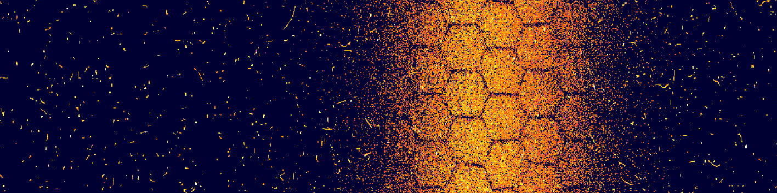
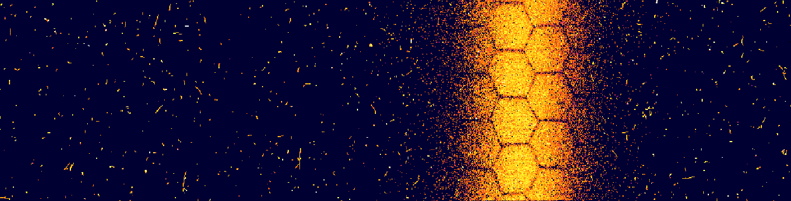
Two examples of recorded image - 10 ms
Example 1
Pixel detector 1
Pixel detector 2
Pixel detector 3
Pixel detector 4
Example 2
Background particles
(beam loss, cosmic, etc)
Ionization electrons (beam direction)

Slide 5
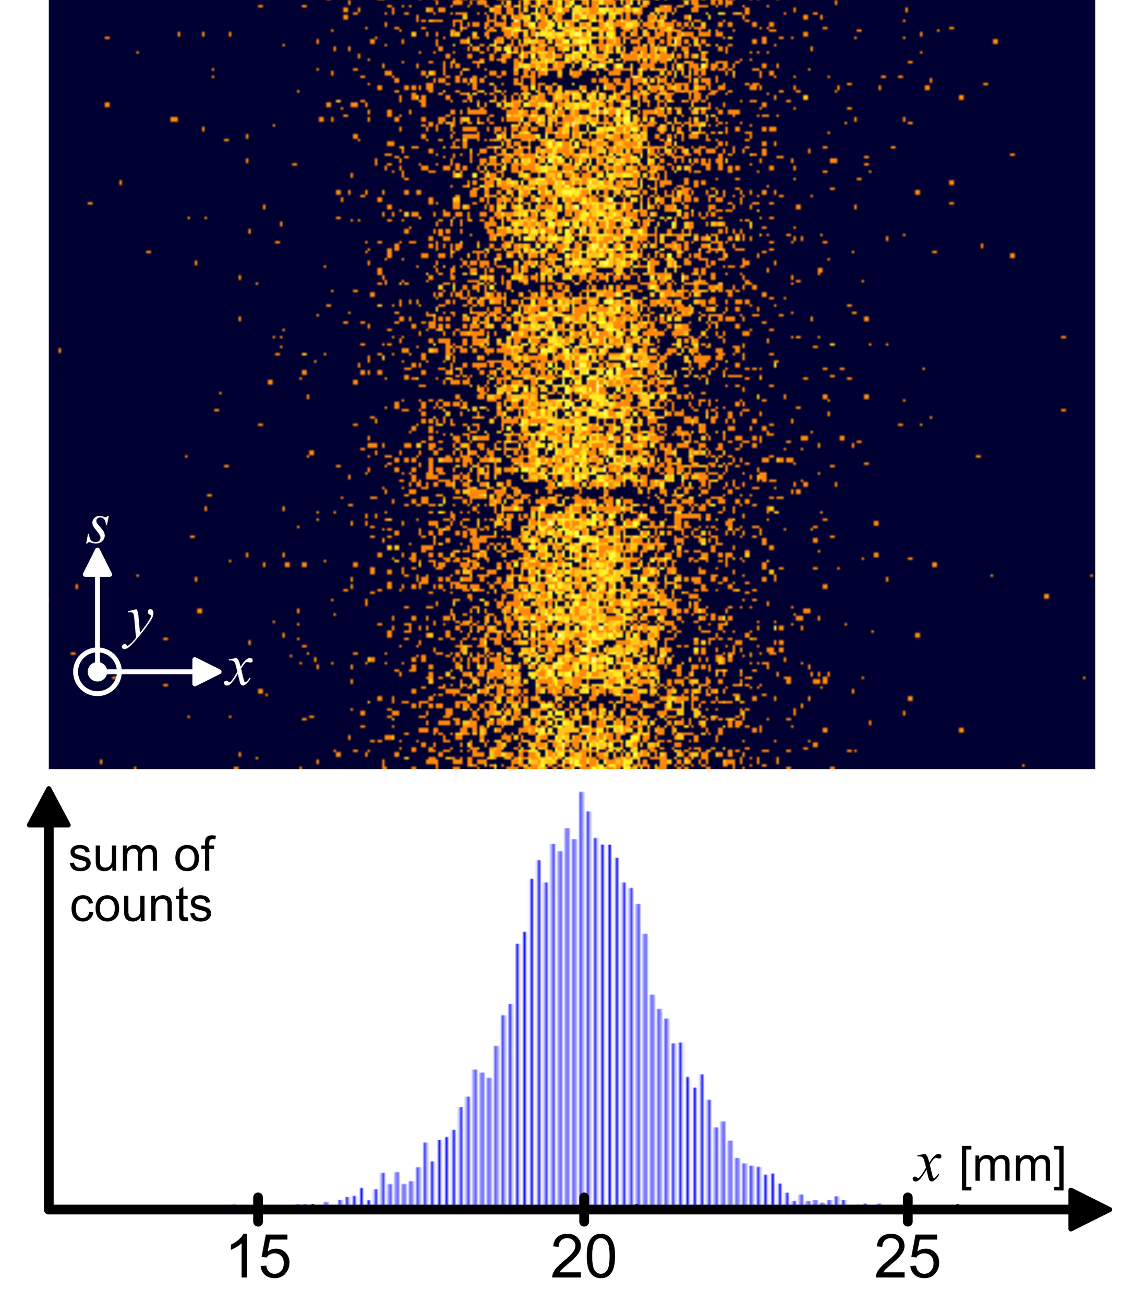
From pixel image to beam profile
Beam width (profile)
Procedure:
Sum all the events in one column
Assign to specific bin in histogram
Move to the next column
Repeat
Corrections:
Space between the four detectors
Honeycomb shadow
Assumption:
All the events are ionization electrons
  Sometimes require filtering
  next slide ->
Beam direction

Slide 6
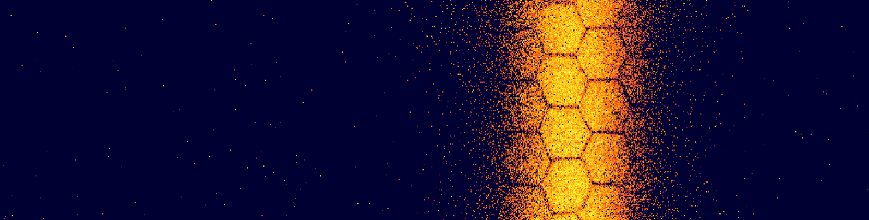
Pixel image filtering
Before filtering
After filtering
Ionization electrons are usually single-pixel events with low energy
Background tracks and clusters are multi-pixel events close in time with higher energy
Timepix3 Time-over-Threshold (energy) information is essential for this
Work in progress to filter data in real-time
The data we filter out could be used for a beam-loss monitor

Slide 7

Video of a complete cycle - injection to extraction
Timepix3 data-driven readout enables "live" display of the beam throughout the cycle
1.5 seconds in real time: slowed down here for viewing purpose
Each frame is 10 ms of data
Not filtered: background particles are interesting to look at!
The beam shrinks in size during acceleration because of adiabatic damping
LHC INDIV beam
http://bgi-web.web.cern.ch/bgi-web/images/iworid-2018-video.gif

Slide 8




Frames from the video
Injection momentum:
2.1 GeV/c
Extraction momentum:
26.3 GeV/c

Slide 9
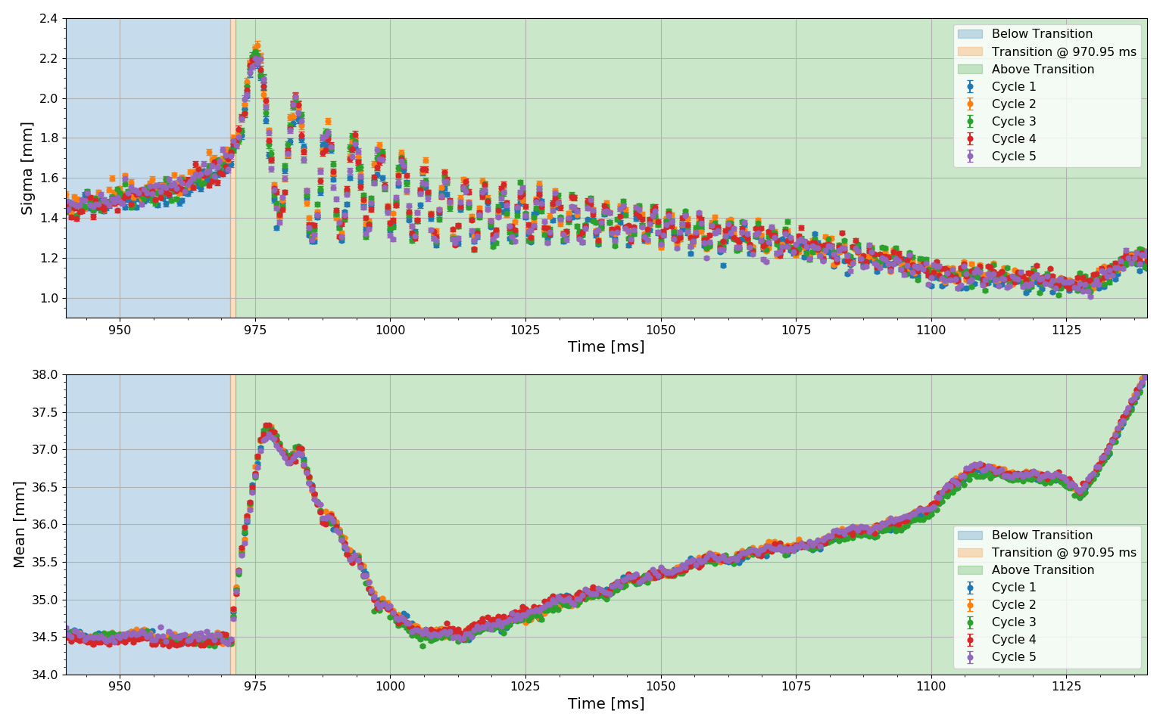
Practical use case for beam diagnostics - transition crossing
Sigma = width of the beam
Mean = position of the beam center
Beam sigma/mean measured continuously at 2 kHz
Evolution of the beam within a single cycle
ILHC100#4b beam

Slide 10
Time resolution - resolving individual bunches
Turn 1
Turn 2
Turn 3
Turn 4
Bunch 1
Bunch 2
Bunch 3
Bunch 4
Bunch 5
Bunch 6
LHC25#72b beam

Slide 11
Time resolution - resolving individual bunches
Turn 1
Turn 2
Turn 3
Turn 4
Turn 5
Turn 6
Turn 7
Turn 8
Turn 9
Turn 10
2.3 μs
180 ns
Observed revolution period (2.3 μs)
Observed longitudinal bunch length (180 ns)
Consistent with expectation
Single bunch BCMS beam

Slide 12
Time resolution - resolving individual bunches
Turn 1
Turn 2
Turn 3
Turn 4
Turn 5
Turn 6
Turn 7
Turn 8
Turn 9
Turn 10
Turn 1
Turn 2
Turn 3
Transverse
Histograms
.......
Single bunch BCMS beam

Slide 13
Surprise use case
Graph shows the mean value of the histograms from the previous slide

Slide 14
Surprise use case - fractional tune measurement
The sine fit to our data below gives: 0.217 ± 0.001 oscillations/turn
Fractional tune in the PS at injection should be between 0.210 and 0.220

Slide 15
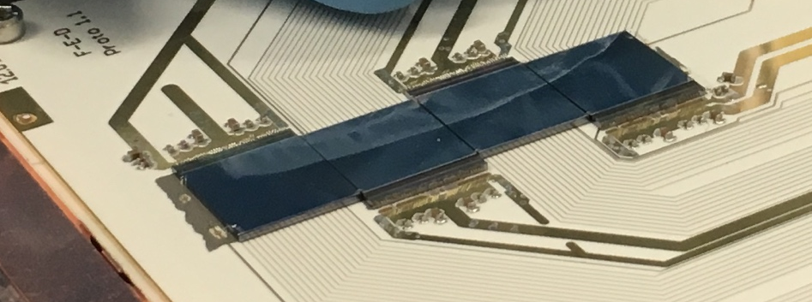
Summary
A beam profile instrument using hybrid pixel detectors has been implemented
Meets the operational requirements:
  Ultra-high vacuum: outgassing ≤ 1·10-7 mbar·l·s-1
  Radiation: 10 kGy/year at beam pipe, 1 kGy/year at 40 cm
  Presence of beam with losses and electro-magnetic interference
Prototype in use since beginning of 2017
BGI profile monitors based on pixel detectors show great promise
Continuous non-destructive measurements at > 2 kHz (traditional BGIs ≈ 10 Hz)
Direct detection of ionization electrons (no MCP needed)
Time resolving of bunches with the available time resolution
Good spatial resolution
Energy information useful for filtering of data
Potential use in other beam instrumentation applications
Radiation hardened readout system enables use of pixel detectors at accelerators
  e.g. bunch-by-bunch beam loss monitoring
Can give new insights for beam diagnostics

Slide 16
Thank you for your attention!

