Slide 1

Software for the new BPM systems in LEIR
Luisa Sanchez Avivar
BI-SW

Slide 2
LEIR
The Orbit System
Ring Orbit
Challenge
Solution
Results
MXBPM Expert GUI
Injection Line
Challenge
Solution
Bpmli Expert GUI

Slide 3
LEIR
The Orbit System
Ring Orbit
Challenge
Solution
Results
MXBPM Expert GUI
Injection Line
Challenge
Solution
Bpmli Expert GUI
▷

Slide 4
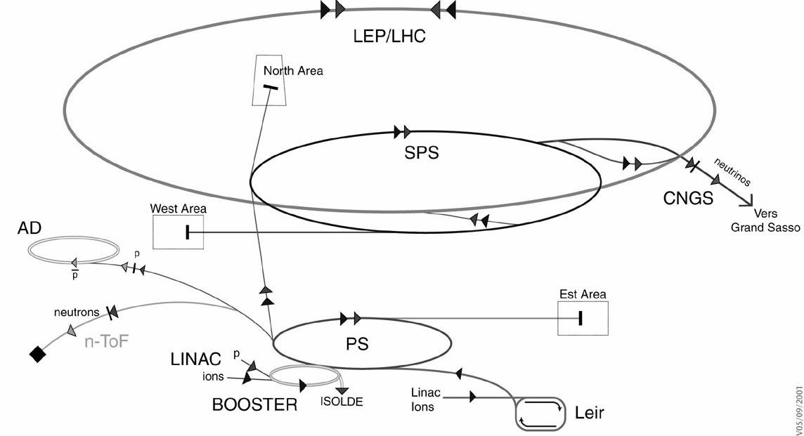
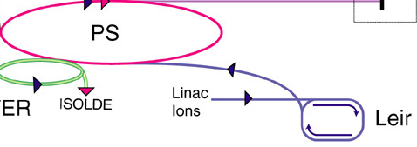

LEIR
Low Energy Ion Ring
4

Slide 5
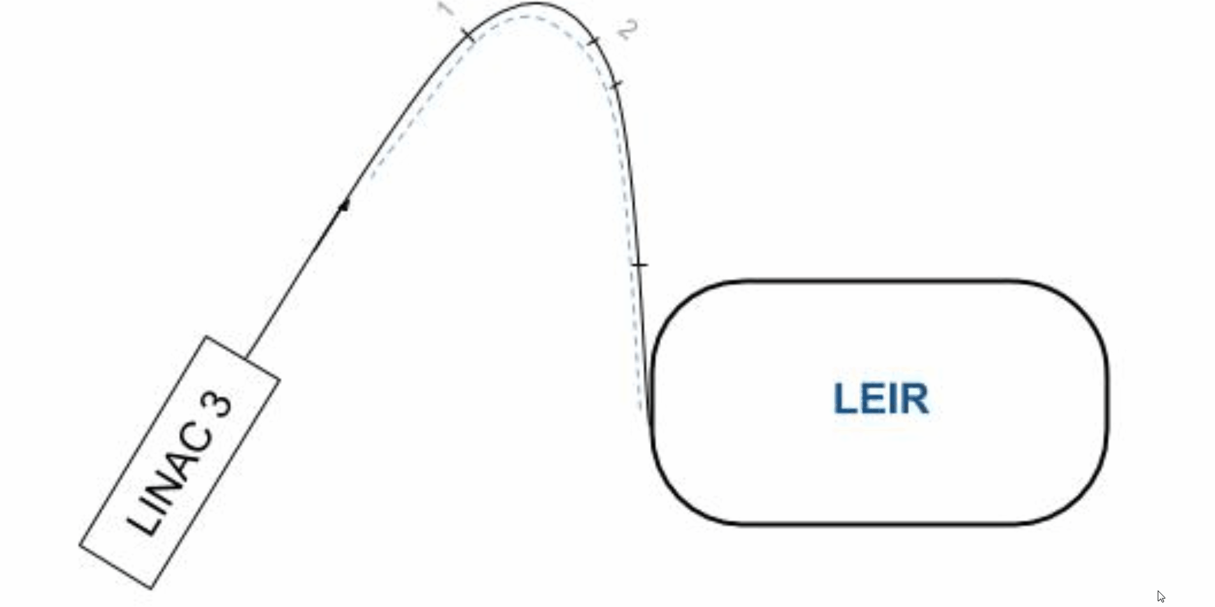

LEIR
Mainly heavy ions PB53+, at an energy of 4.2MeV/u
LEIR Ring
Pulses of up to 30uA, 200us
Accelerated to 72MeV/u
Injection Line
5

Slide 6
LEIR
The Orbit System
Ring Orbit
Challenge
Solution
Results
MXBPM Expert GUI
Injection Line
Challenge
Solution
Bpmli Expert GUI
▷

Slide 7
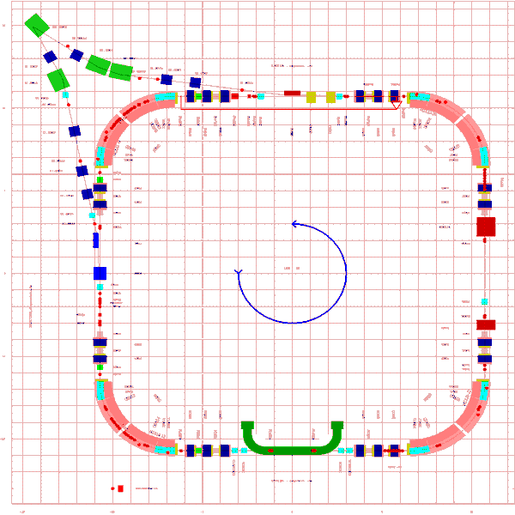
The Orbit System
UEHV42
UEHV41
UEHV34
System installed for ion accelerations at LEIR’s
UEHV43
UEHV32
UEHV11
UEHV33
Allows position measurement of the bunched beam
UEHV44
UEHV12
UEHV21
UEHV22
UEHV31
UEHV13
UEHV24
UEHV14
UEHV23
7

Slide 8
LEIR
The Orbit System
Ring Orbit
Challenge
Solution
Results
MXBPM Expert GUI
Injection Line
Challenge
Solution
Bpmli Expert GUI
▷

Slide 9
Ring Orbit What was the challenge?
LEIR orbit upgrade due to a change of electronics
1. Old System
It was not precise enough (OP requested precision of 0.1mm)
2. Add trajectory feature
The current software and calibration programs were obsolete and had to be replaced
9

Slide 10
Ring Orbit What did we do?
New digital acquisition system DSP-based was installed by Ole Marqversen and other staff from BE-BI-PI
BPMADLNA class development
The existing common class for AD and ELENA was reused and adapted
Driver upgrade was needed for trajectory feature
Re-Commissioning of orbit feature after the driver upgrade
10

Slide 11
LEIR
The Orbit System
Ring Orbit
Challenge
Solution
Results
MXBPM Expert GUI
Injection Line
Challenge
Solution
Bpmli Expert GUI
▷

Slide 12
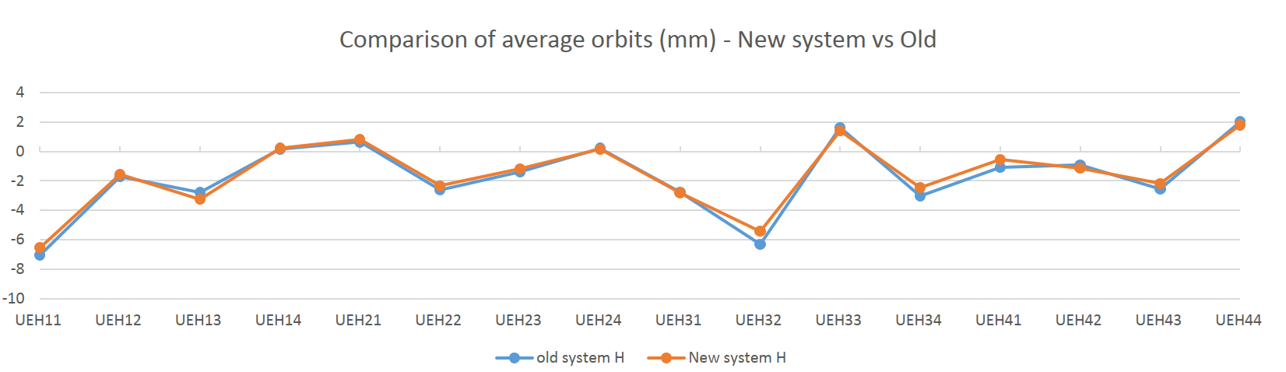
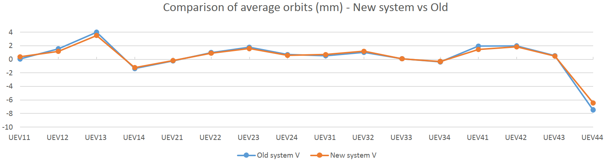
Results Orbit comparison
HORIZONTAL
How was the data taken?
Statistics for 40 different cycles with both system in parallel
What are we showing?
The accuracy is the same as the old system
VERTICAL
12

Slide 13
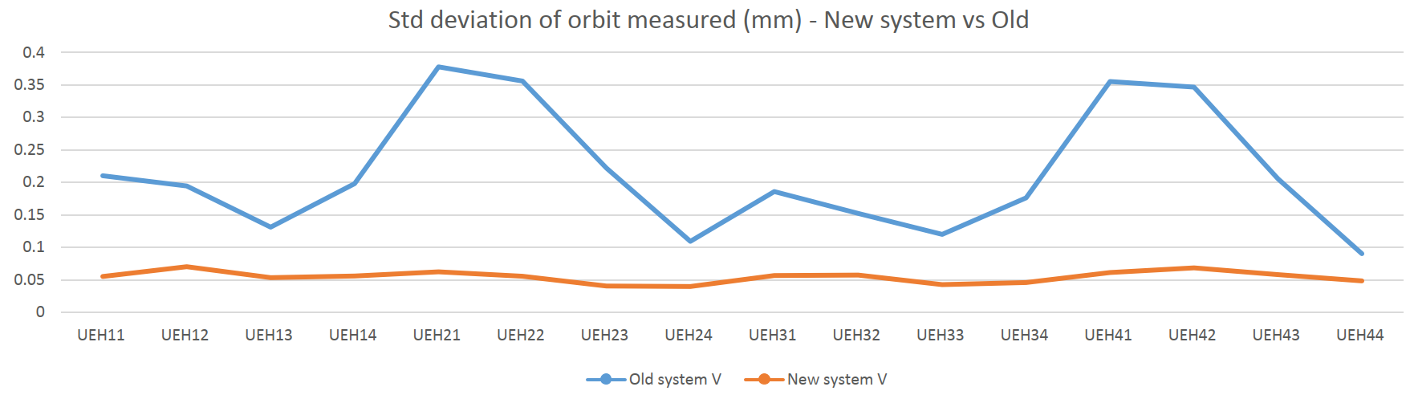
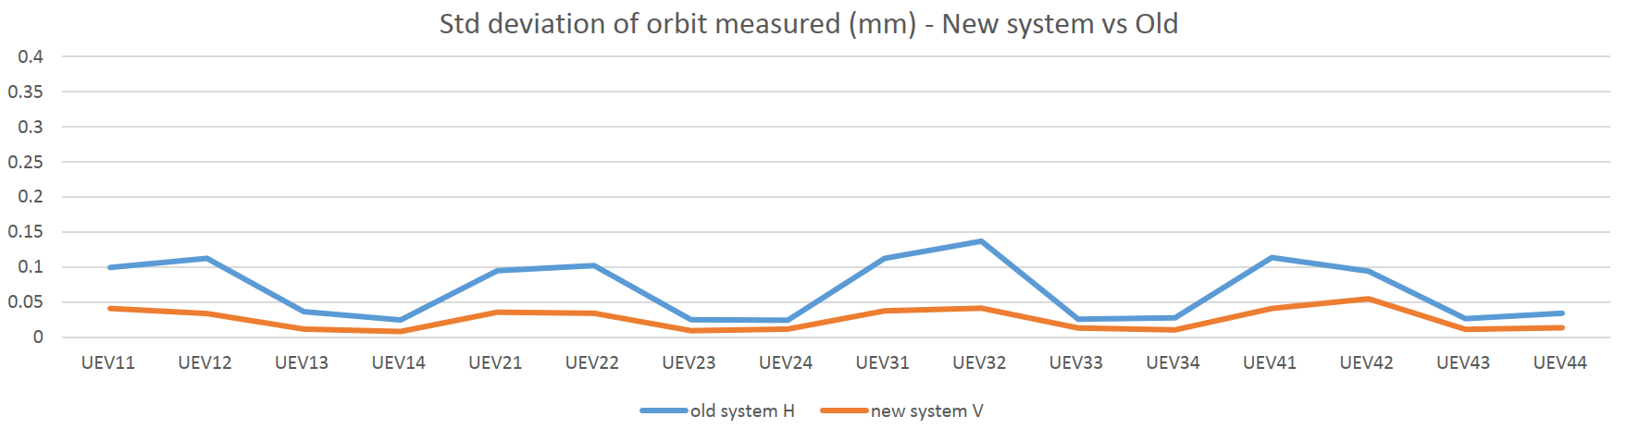
Results Standard Deviation comparison
HORIZONTAL
How was the data taken?
Statistics for 40 different cycles with both system in parallel
What are we showing?
The precision is better, within the specifications (0.1mm RMS)
VERTICAL
13

Slide 14
LEIR
The Orbit System
Ring Orbit
Motivation
Solution
Results
MXBPM GUI Expert
Injection Line
Motivation
Solution
Bpmli Expert GUI
▷

Slide 15
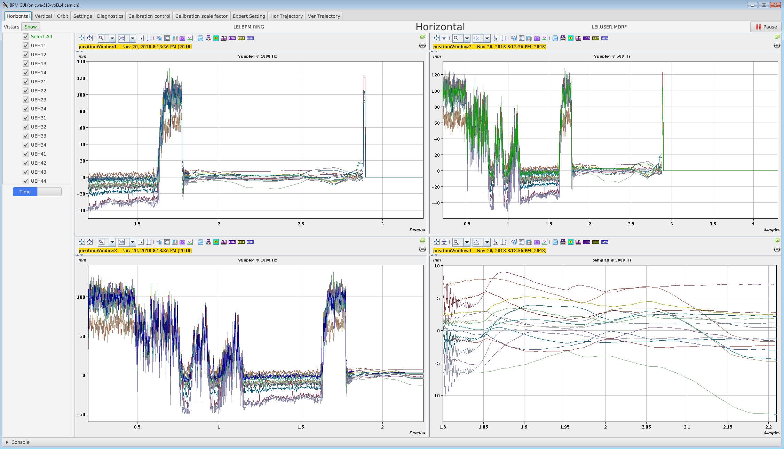
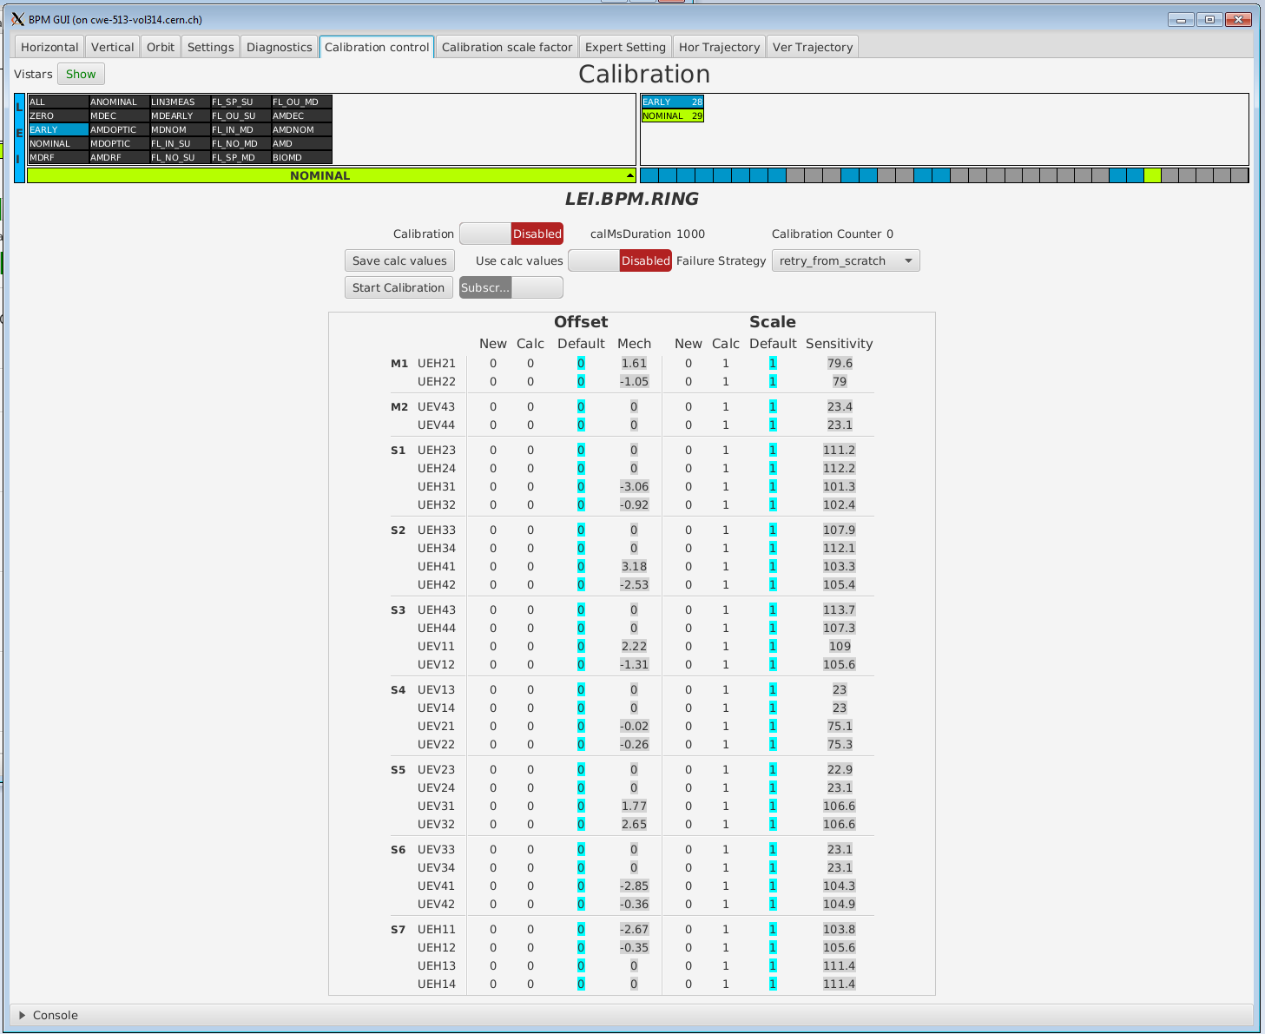
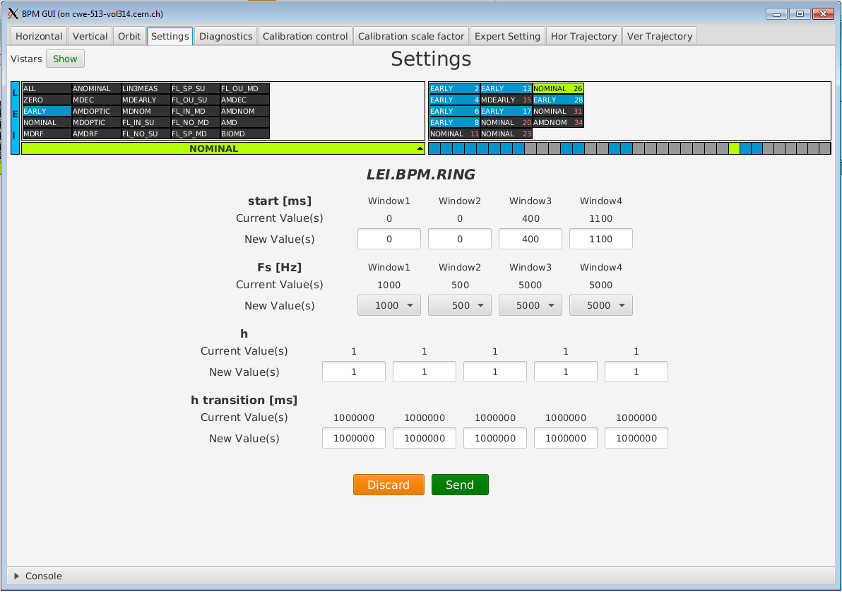
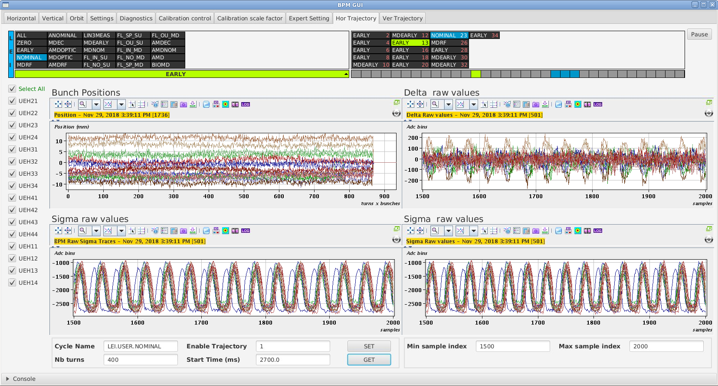
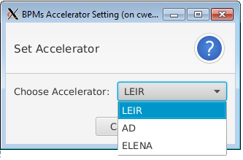
MXBPM Expert GUI Overview
Position traces for all the BPMs.
Orbit for Vertical and Horizontal planes at once.
Calibration and Expert Settings.
Trajectory measurement.
Common class for AD and ELENA accelerators adapted to LEIR
15

Slide 16
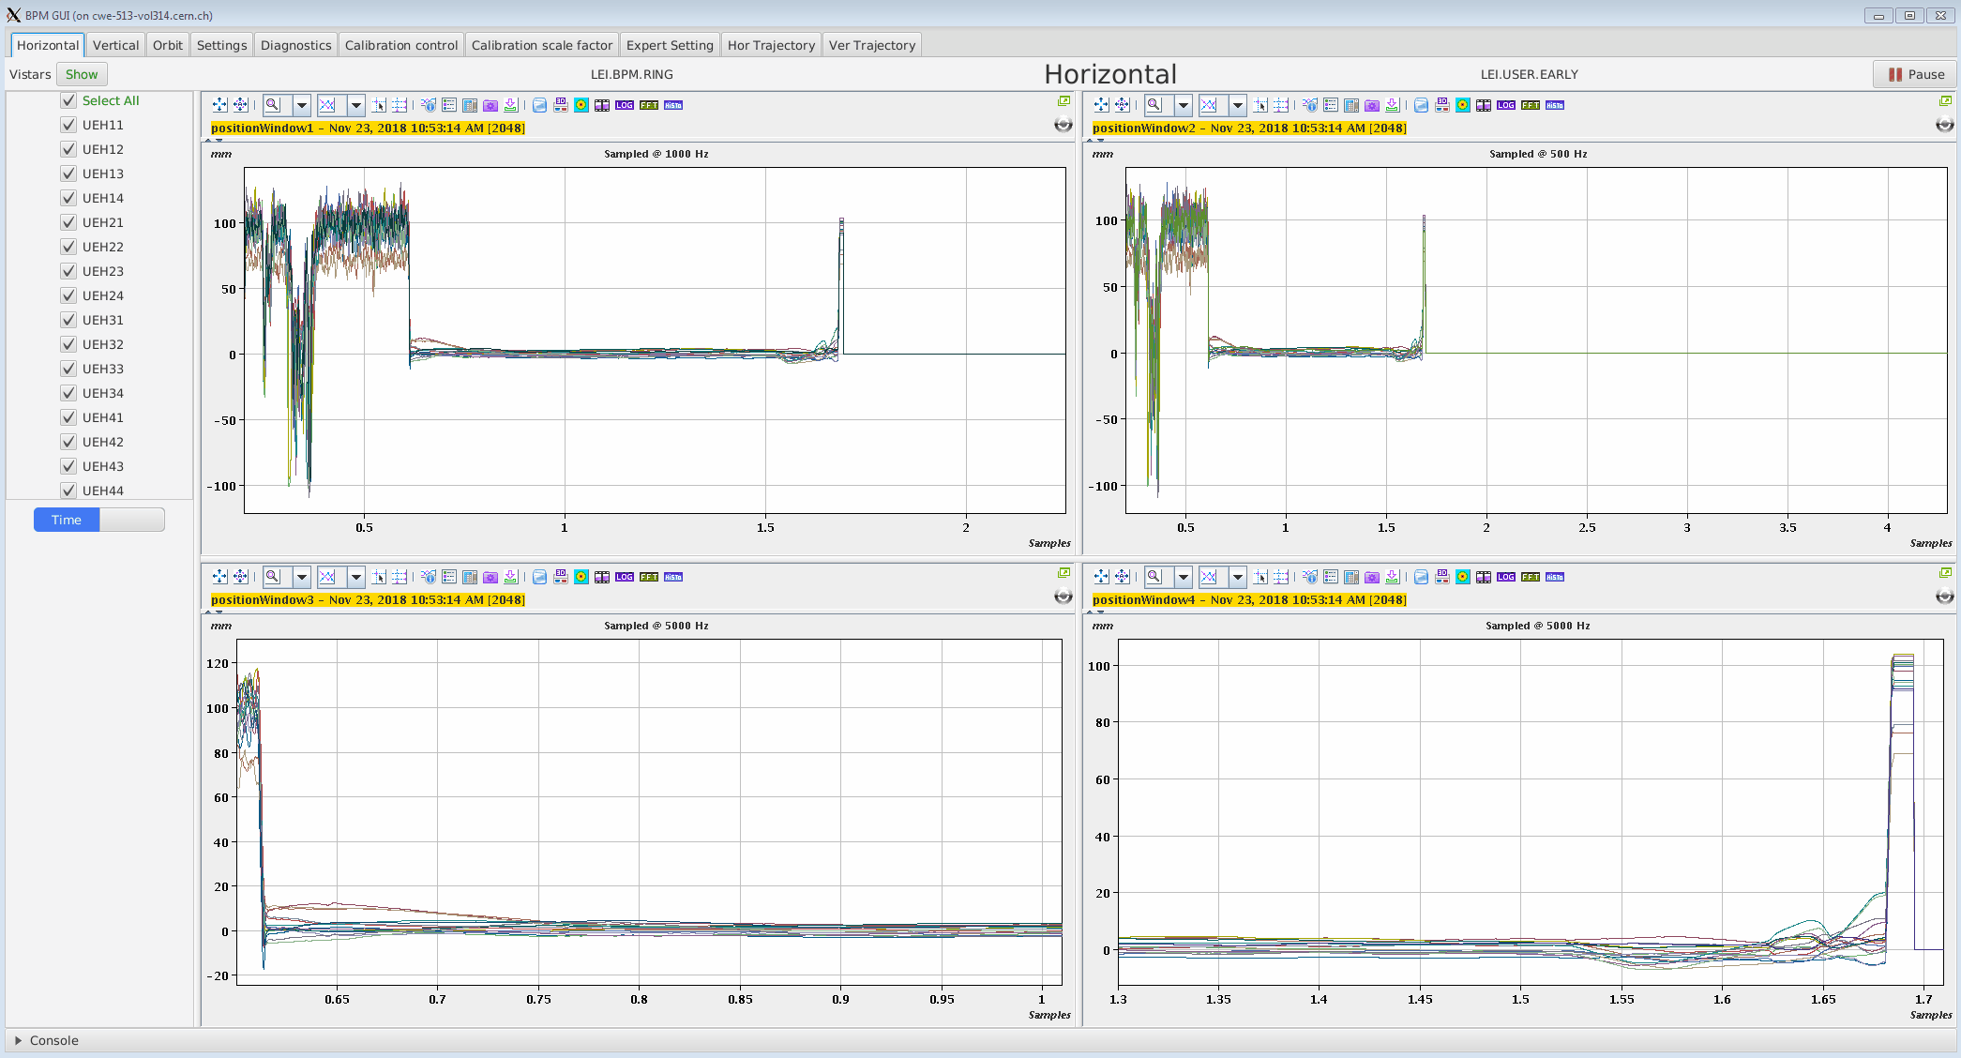
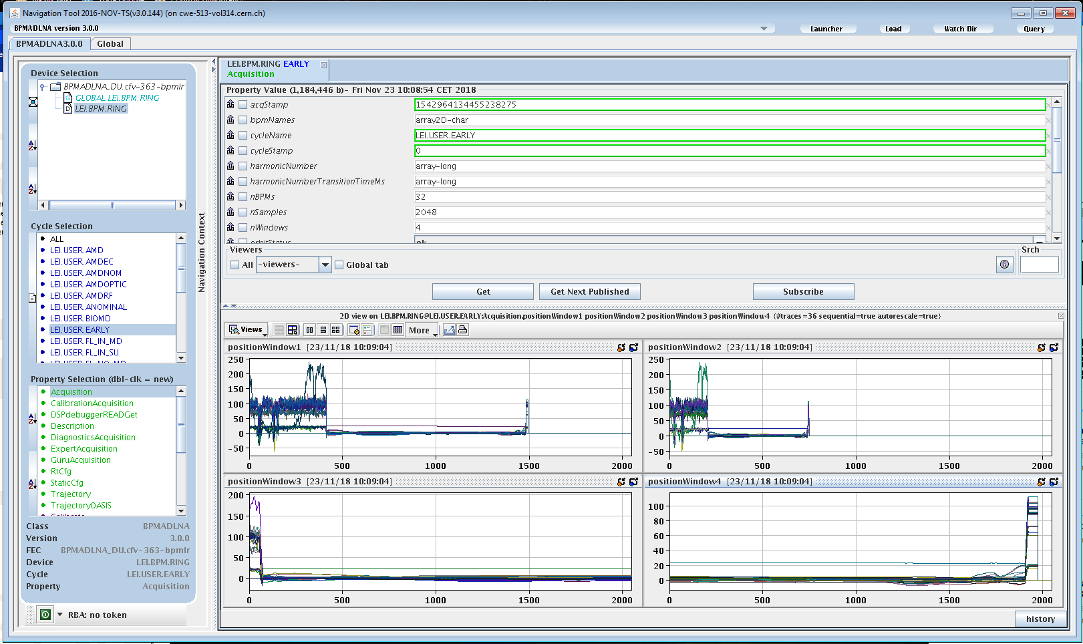
MXBPM Expert GUI Acquisition
Measures the beam positions for the 4 different timestamps
User can easily select which BPMs traces to display
position Window 1
position Window 2
Acquisition
position Window 3
position Window 4
16

Slide 17
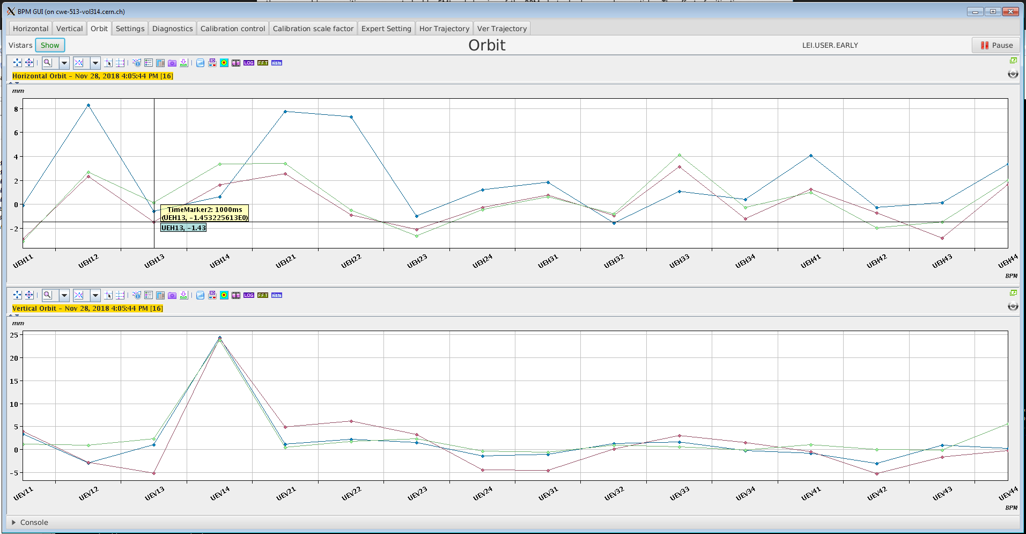
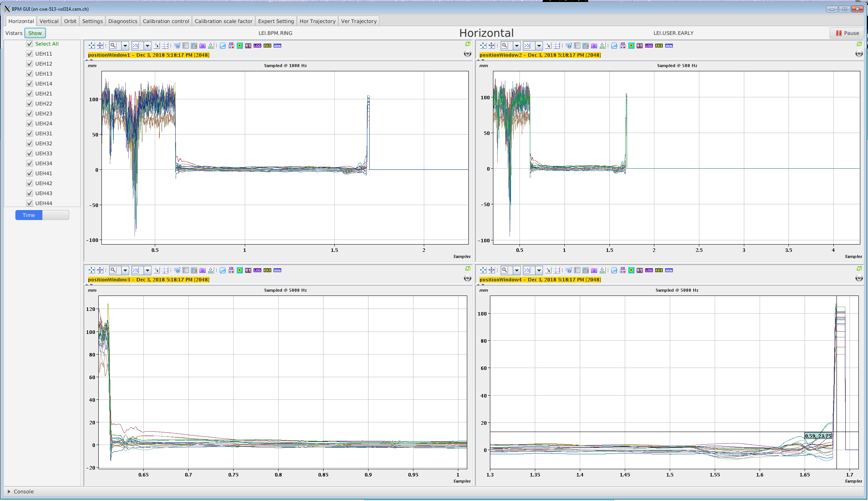
MXBPM Expert GUI Orbit
Orbit
One point per timestamp and per BPM as the evolution of the orbit can be seen easily
1500 ms
700 ms
1000 ms
1.5 s
0.7 s
1 s
17

Slide 18
MXBPM Expert GUI Calibration and Expert Settings
Settings
Defines the timestamp and the sampling rate
Sets the harmonic (number of circulating bunches)
18

Slide 19
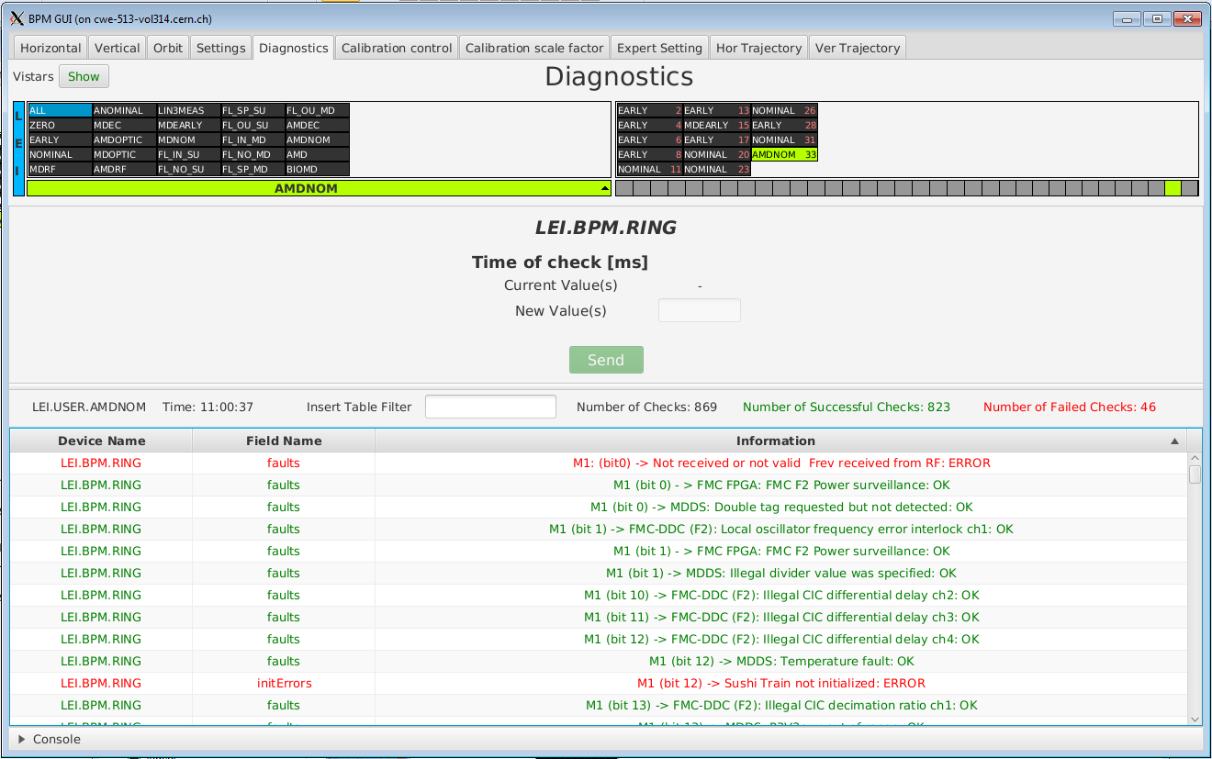
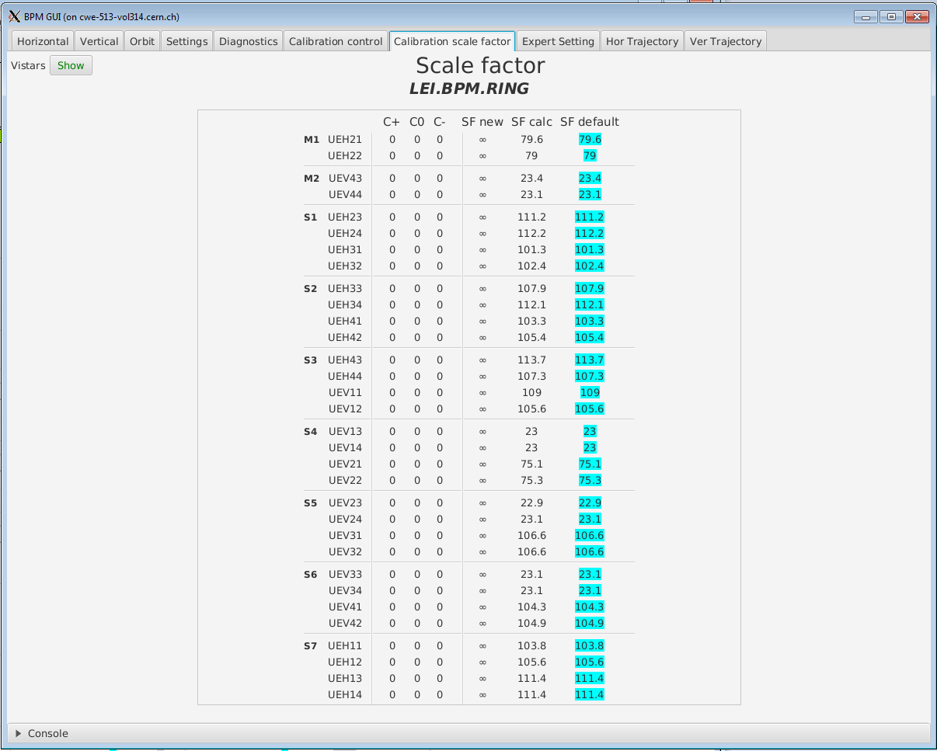
MXBPM Expert GUI Calibration and Expert Settings
Scale Factor
Diagnostic
Calibration
19

Slide 20
MXBPM Expert GUI Trajectory
Trajectory
BPMs names
Bunch turn by turn positions
Trajectory OASIS
Delta traces
Sigma traces
will be replaced by trajectory traces
19

Slide 21
MXBPM Expert GUI
Future improvements
Showing the trajectory traces, reorganizing data to follow the BPM order
Conclusions
New orbit system is used operationally by BI and OP for orbit and trajectory
The old system will be removed during LS2
That software is useful for debugging new features for the first turn positions
Common FESA class and Expert GUI for the
LEIR, AD and ELENA
20

Slide 22
LEIR
The Orbit System
Ring Orbit
Challenges
Solution
Results
MXBPM Expert GUI
Injection Line
Challenges
Solution
Bpmli Expert GUI
▷

Slide 23
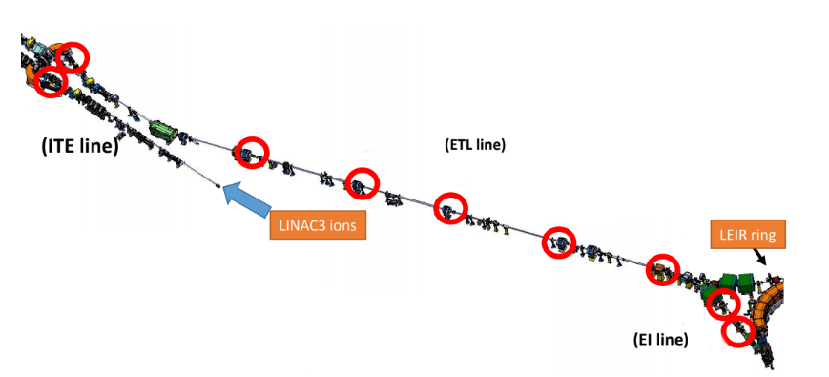
Injection Line What was the challenge?
Optimization the injection efficiency
Need to optimize and measure the trajectory of the low intensity ion beams coming from LINAC3
2
Nine new electrostatic BPMs were installed into LEIR’s injection line
1
3
4
5
New Reception amplifiers and PS were installed
6
7
The low noise charge amplifier was mounted directly on the BPM
8
9
22

Slide 24
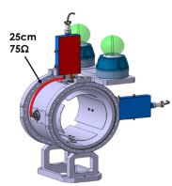
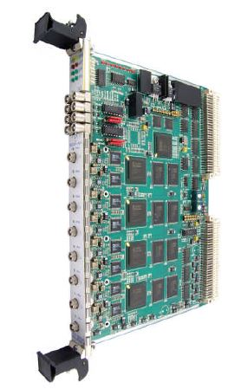

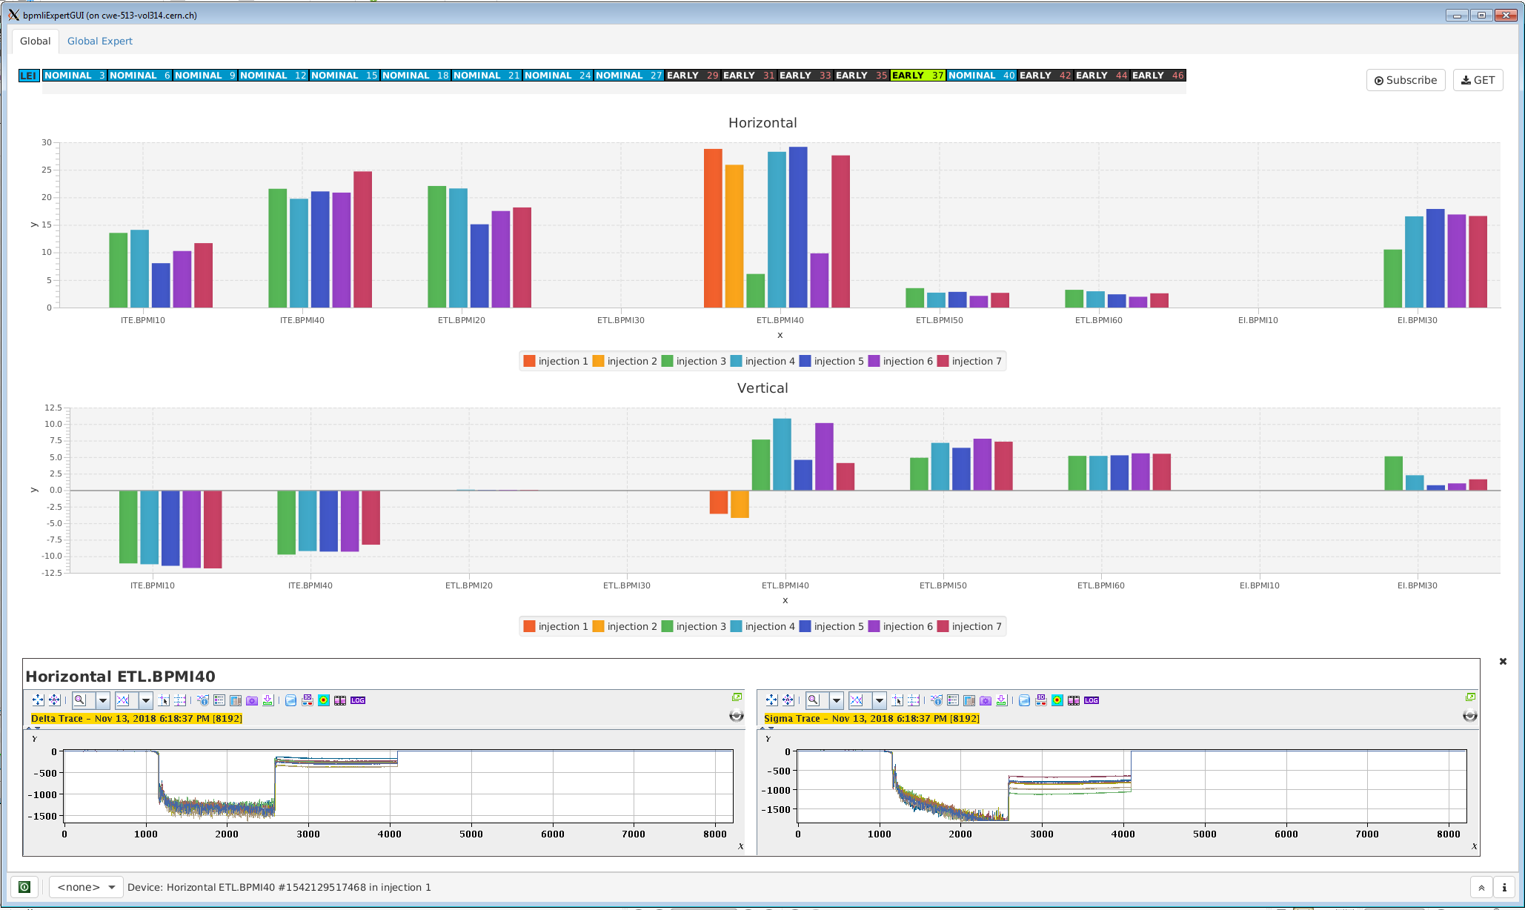
Injection Line What did we do?
BPMLI new FESA class
A new acquisition system was installed in the injection line which required the development of a new FESA class
Calibration
Beam Position Monitor
SIS 3300 card
FESA
Expert GUI
23

Slide 25
LEIR
The Orbit System
Ring Orbit
Challenges
Solution
Results
MXBPM Expert GUI
Injection Line
Challenges
Solution
Bpmli Expert GUI
▷

Slide 26
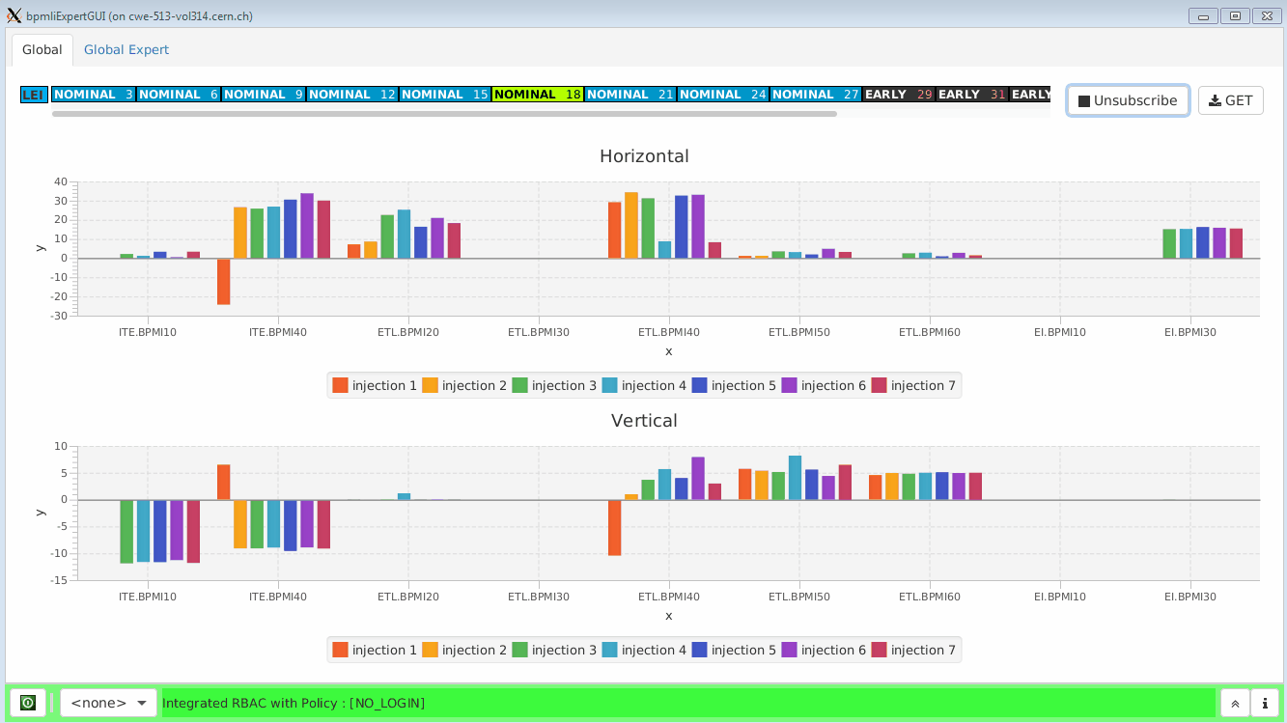
Bpmli Expert GUI Global Overview
25

Slide 27
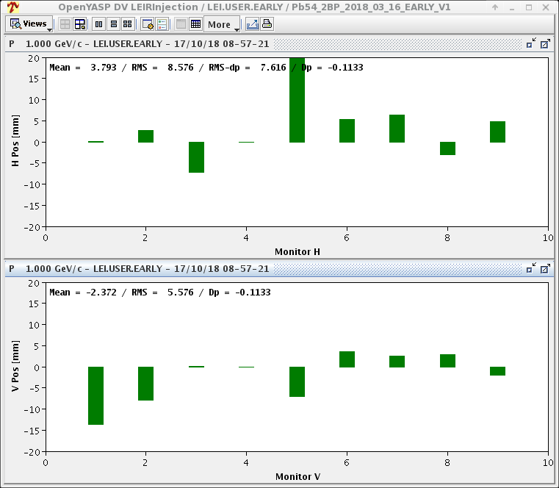
Bpmli Expert GUI Global Overview
YASP
Bpmli GUI Expert
Displays one injection for each BPM
Displays all 7 injections per BPM
It allows operators to monitor all injections at once
26

Slide 28
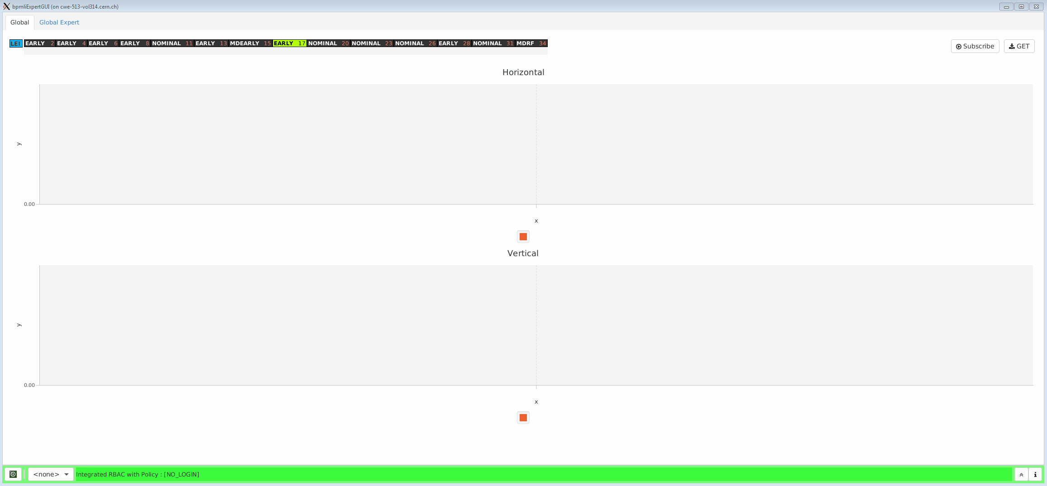
Bpmli Expert GUI Global Overview
Sigma and delta traces for ETL.BPMI.40 (Horizontal), NOMINAL cycle
Sigma and Delta traces are useful to detect problems in the measurements
27

Slide 29
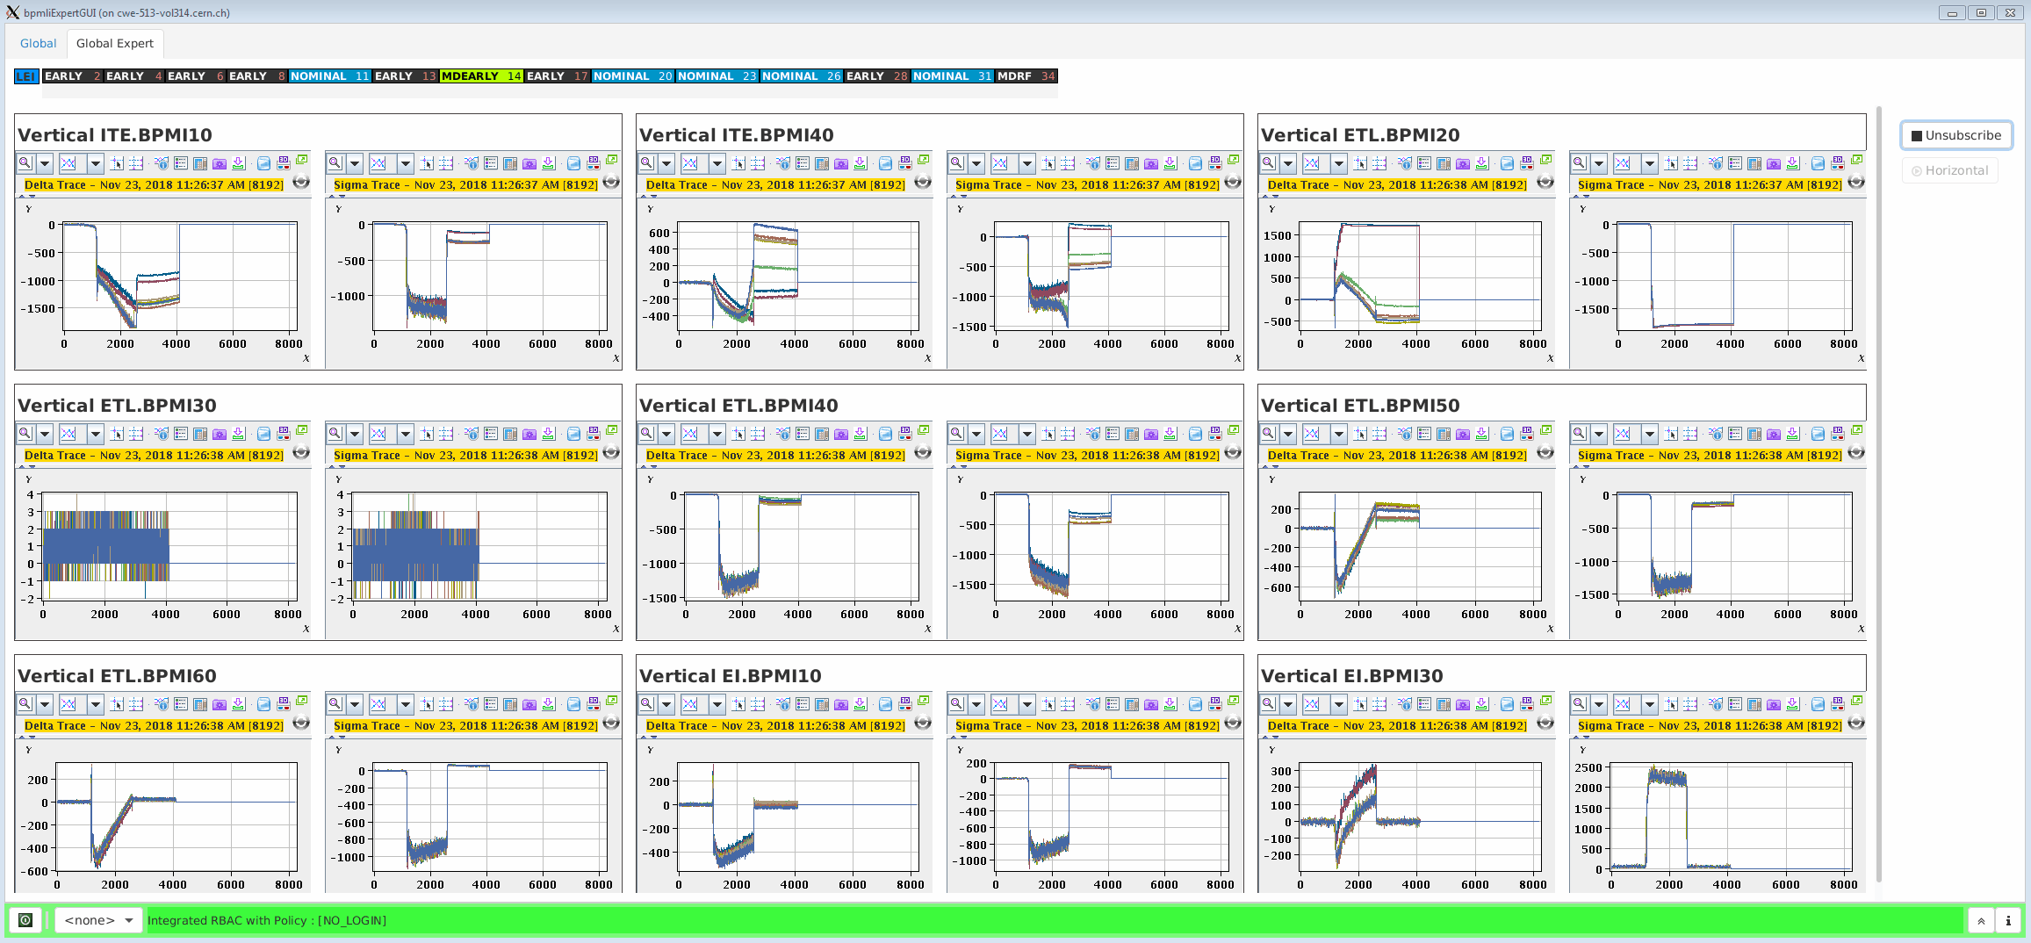
Bpmli Expert GUI Global Expert Overview
Sigma and delta traces for all BPMs along the injection line for Vertical, in NOMINAL
28

Slide 30
Bpmli Expert GUI
Future and improvements
Switch between the raw traces and the position traces for a global overview of all BPMs (Global Expert tab)
Conclusions
This Expert GUI is helping to debug the new system
It is used operationally by BI and OP
Easy to maintain and take over by others (code is using the standard software pattern)
29

Slide 31

Questions
Thank you

