Slide 1
Quadrupolar pick-up measurements in the LHC
M. Gasior, T. Lefevre, J. Olexa, A. Sounas, M. Wendt
Presenter: D. Alves
BI day Quadrupolar pick-up measurements in the LHC Archamps, 04/12/2018

Slide 2
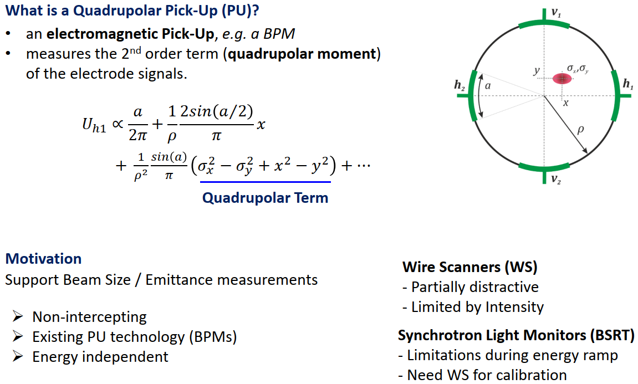

c₀
c₁
$$\frac{U_{h1}}{i_{b}}$$
beam size information
c₂
(more) position information
Invasive
Intensity & energy restrictions
Non-invasive
- Non-invasive
Notes:
A quadrupolar pick-up is an electromagnetic pick-up optimized for measuring the quadrupolar moment
This can be for example a BPM, as shown in the figure (beam pipe, beam - represented here off center and with finite size and the 4 electrodes)
For a circular BPM the intensity normalized electrode signal can be expressed in this form. Where we can see the pure intensity term, the typical position dependent term and also the quadrupolar term
The weight of each term depends on the geometry
The motivation for quadrupolar measurements is to extract information about the beam size

Slide 3
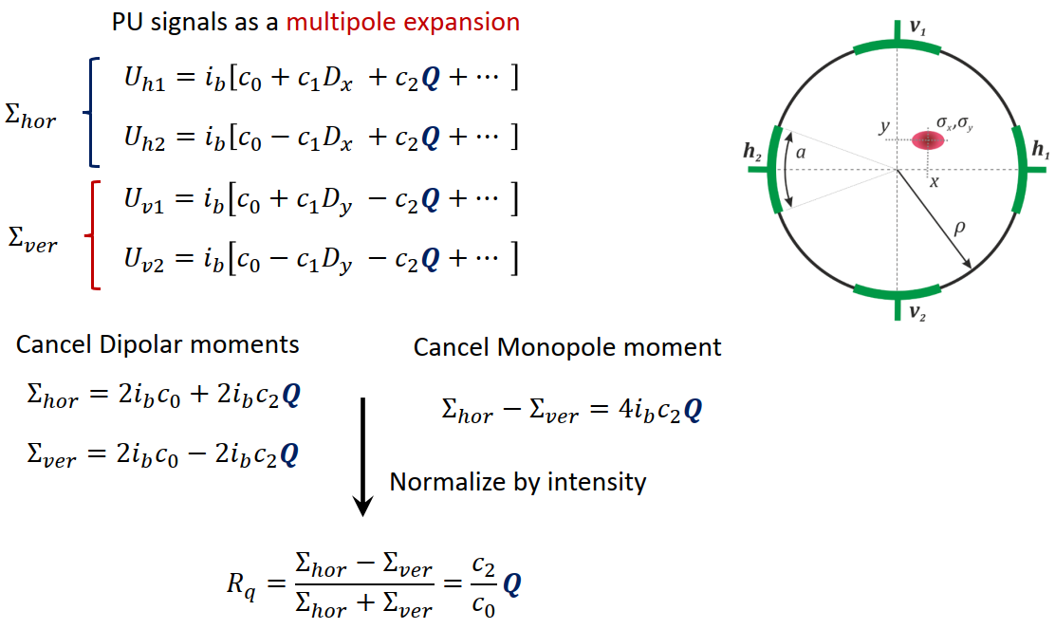
Notes:
There is a standard and straightforward way of calculating the quadrupolar moment Q using the signals of all 4 electrodes
By taking the sum of 2 opposite electrodes, the dipole moment (linear position dependency) is cancelled
By taking the difference of the 2 sums, the monopole moment is cancelled

Slide 4
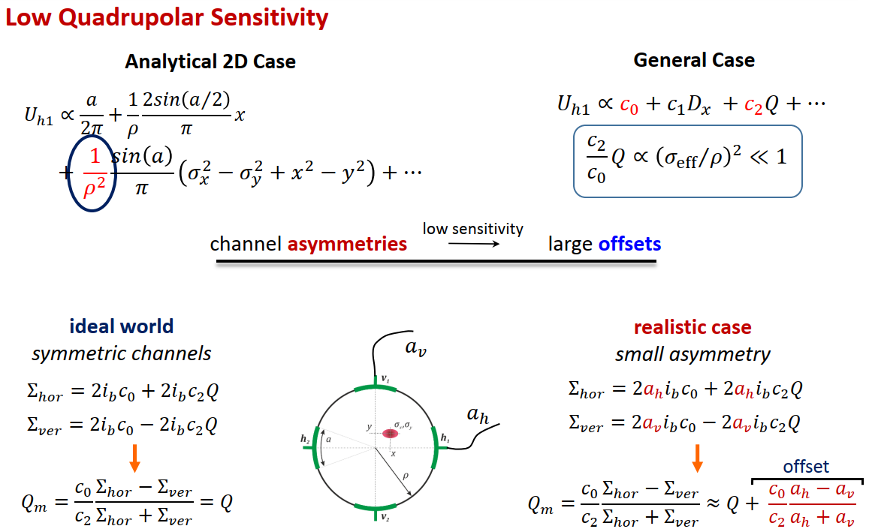

$$\frac{c_{2}}{c_{0}}≈{10}^{−3}$$
Notes:
For typical LHC BPMs the sensitivity of this measurement is of the order of 1e-3
The low sensitivity to the Quadrupolar moment, combined with inevitable electrode channel asymmetries leads to potentially large offsets

Slide 5
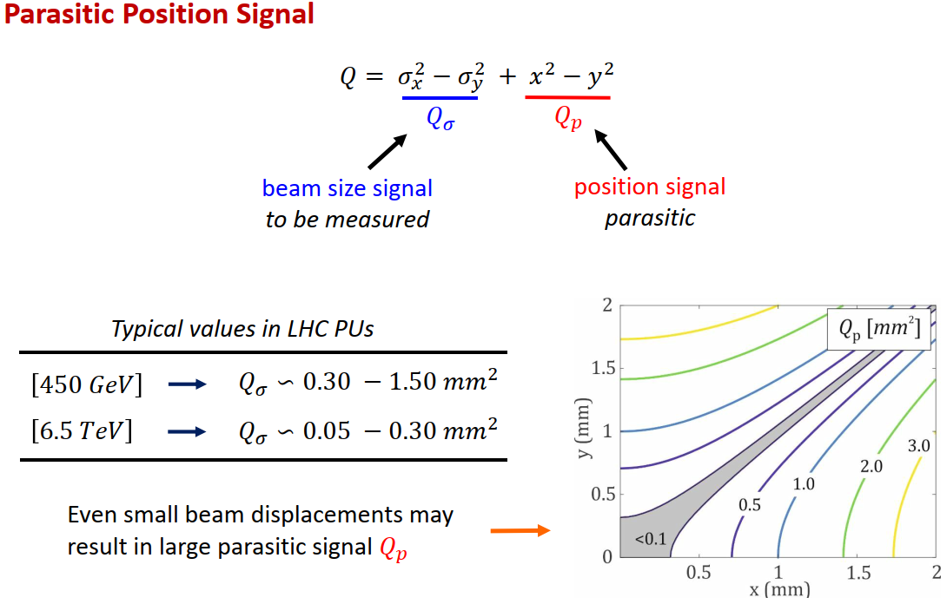
Notes:
- Furthermore, even if one succeeds in estimating the Quadrupolar moment accurately enough, in order to extract beam size information, one still has to subtract the position dependence

Slide 6
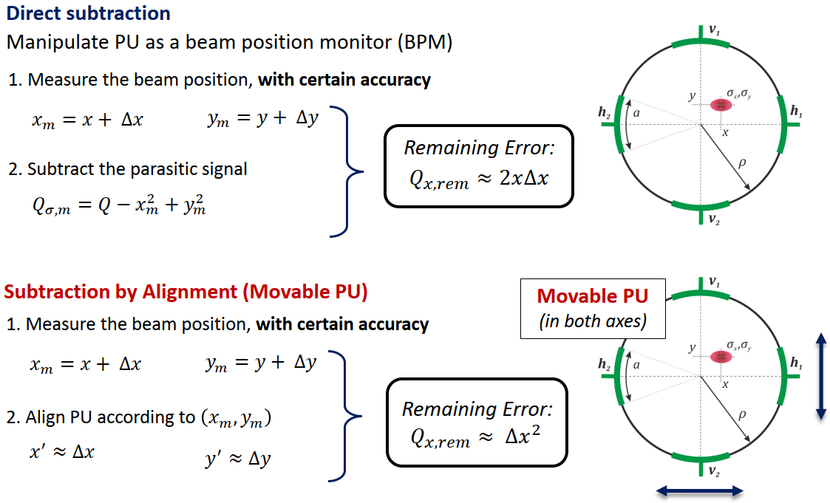
Notes:
Let us now consider 2 scenarios
In the first scenario we subtract the position dependence of the Q by using the measured beam position – trouble is that the error is proportional to the position times the error
In the second case we assume that we have movable pick-ups that can center the beam – the error now becomes proportional to the square of the error

Slide 7
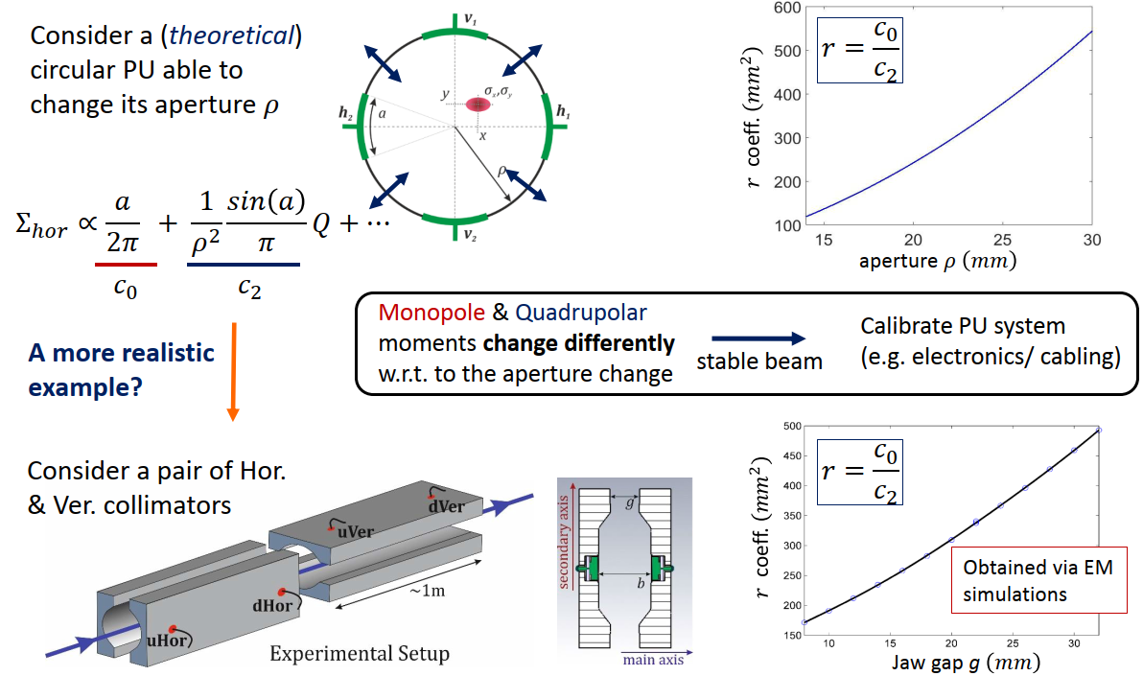
BPMs with DOROS electronics installed in LHC collimators
Notes:
Assuming an ideal circular PU of variable aperture one can see how the geometrical coefficients change as a function of the aperture
In reality, the collimator BPMs in the LHC can be used as movable PUs
Typically a 1m H collimator is followed by a V one. Each collimator carries 2 pairs of BPM electrodes, a pair upstream and a pair downstream
For these BPM types, EM simulations were performed to calculate the geometrical coefficients as a function of the variable aperture

Slide 8
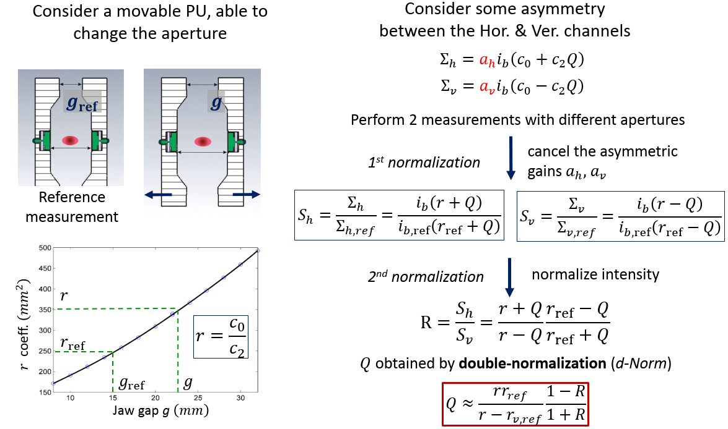
Notes:
So now we have movable pick-ups which hopefully will help by allowing for a more precise removal of the position contribution to the Q
Could they also be useful for removing the channel asymmetries? Yes, for example, using the following technique
Taking 2 measurements with different apertures, the asymmetric circuit gains can be canceled out
Then, by taking the ratio of the relative horizontal and vertical sums, the intensity contribution can also be cancelled
The use of aperture scans can in principle provide absolute measurements of the Q

Slide 9
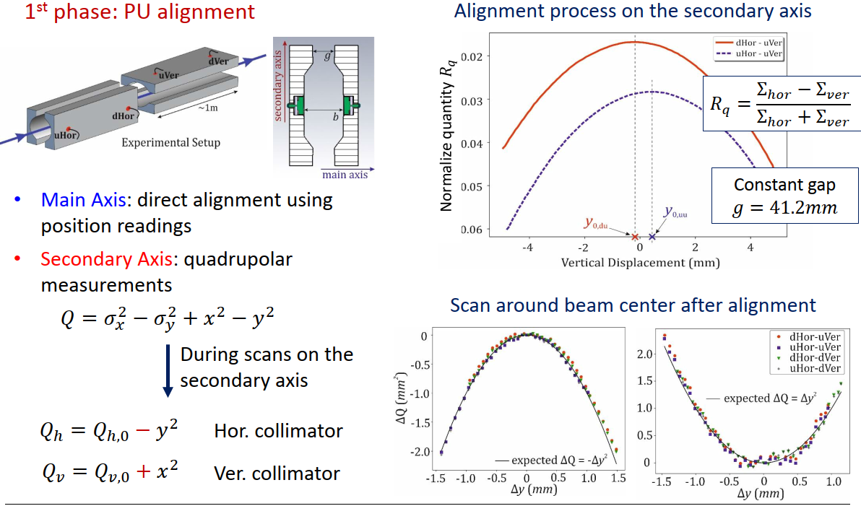
Notes:
1st phase: alignment
Main axis alignment using position readings
Secondary axis alignment by maximizing Q readings

Slide 10
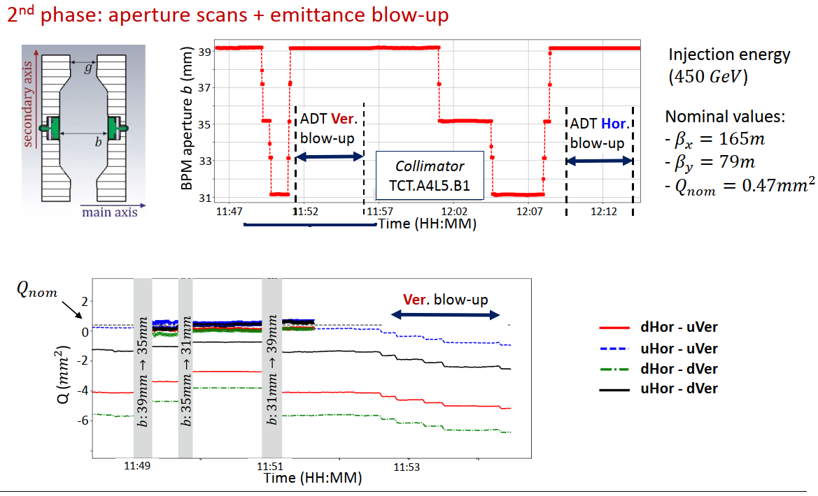
Notes:
2nd phase: aperture scan using the d-Norm technique to cancel circuit asymmetries
Here we see a sequence of aperture scans and emittance blow-up performed during an MD
The nominal value of Qsigma estimated from WS measurements was ~0.47mm^2
In the plot below we can see the absolute value of Q calculated from the various possible combinations of electrode signals
The difference between the standard method and the d-Norm method is obvious

Slide 11
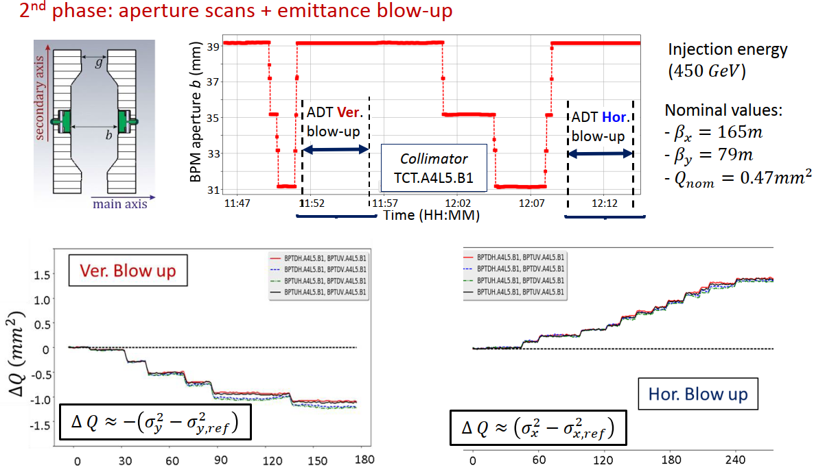
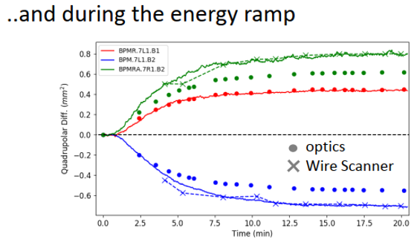

$$→ε∝{\left(γβ\right)}^{−1}$$
Notes:
Example of differential measurements
Note the difference in beta function, desirable for not having same transverse beam sizes in x and y at the location of the BPM
As expected, changes in transverse beam size have opposite signs

Slide 12
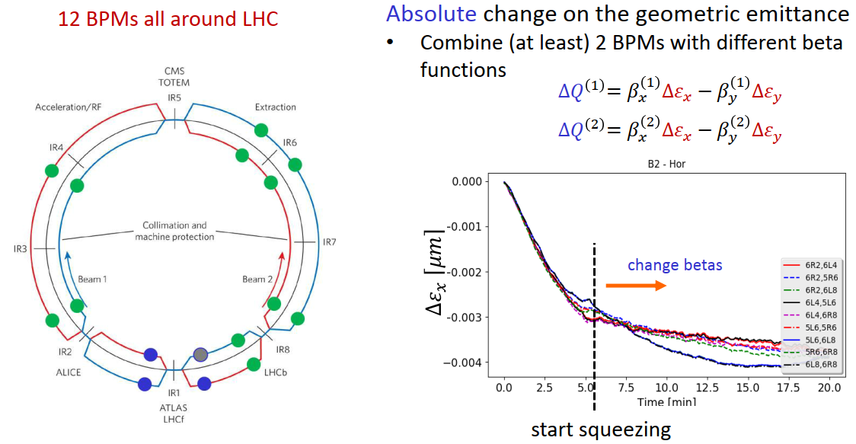
Estimating change of geometrical emittance during the ramp
Notes:
Assuming negligible changes in beam position
Assuming stationary and known beta functions

Slide 13
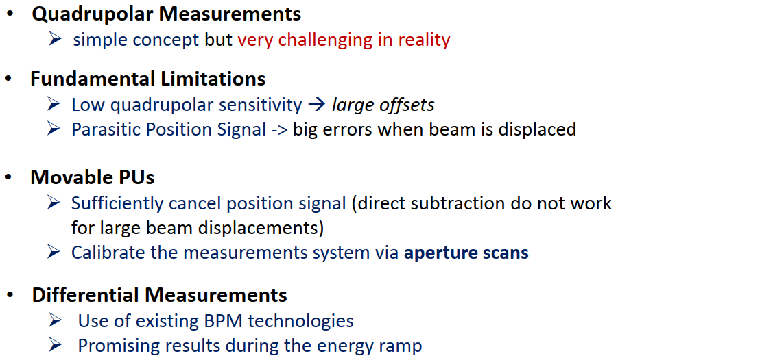
Conclusions

Slide 14
Thank you for your attention

Slide 16
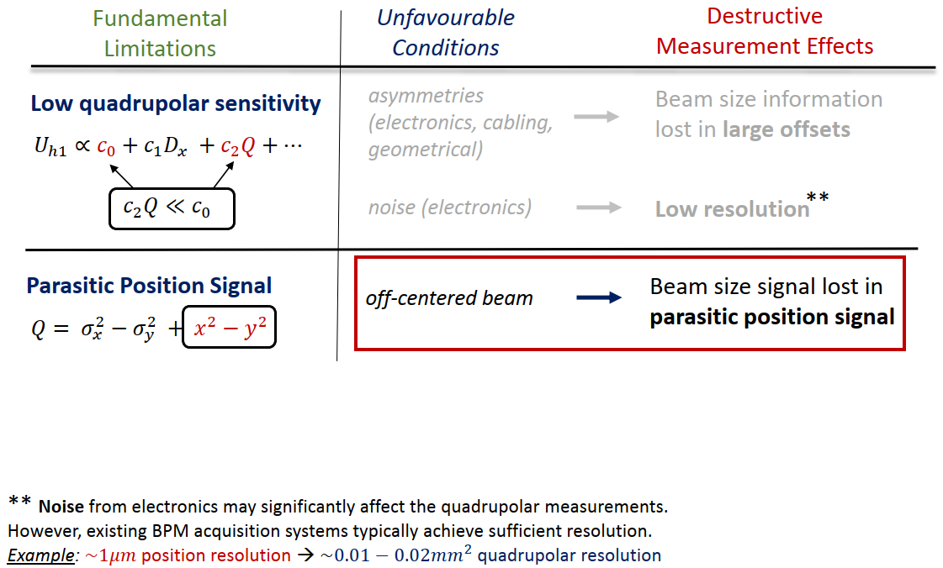

Slide 17
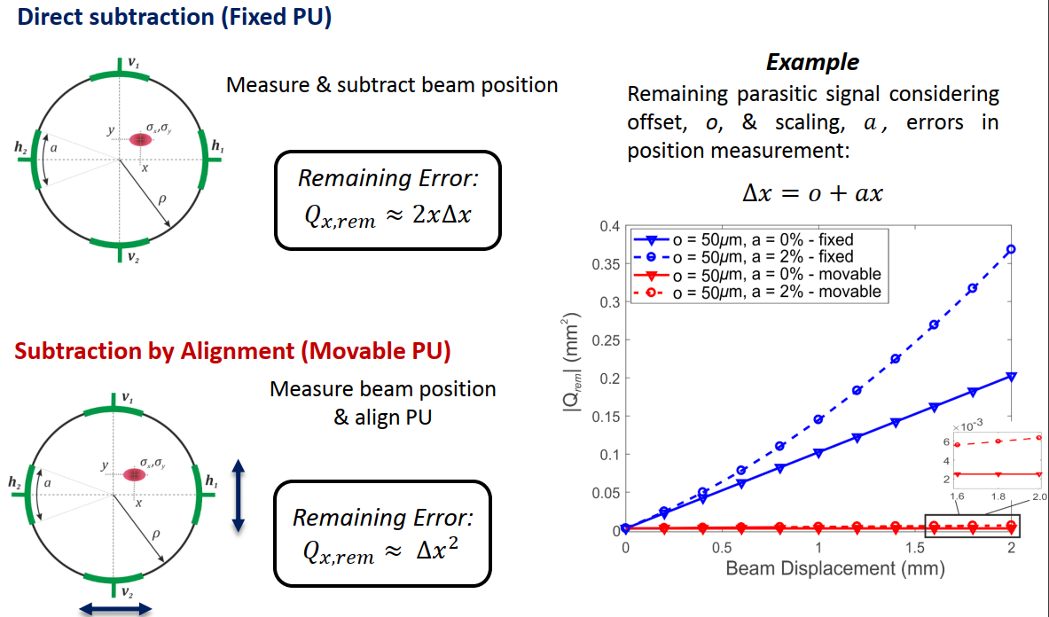

Slide 18
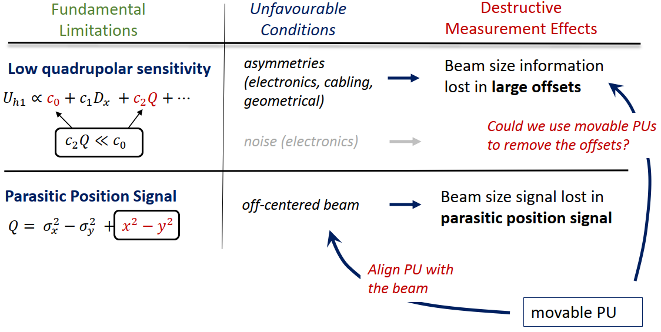
Notes:
So now we have movable pick-ups which hopefully will help by allowing for a more precise removal of the position contribution to the Q

Slide 19
