Slide 1
Reminder of SPS interlocks from BI with new requests
Kevin Li, Francesco Velotti
15. November 2018

Slide 2
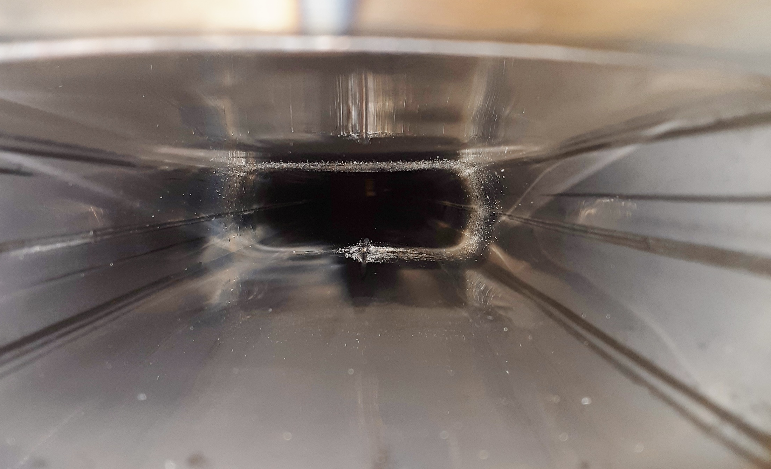
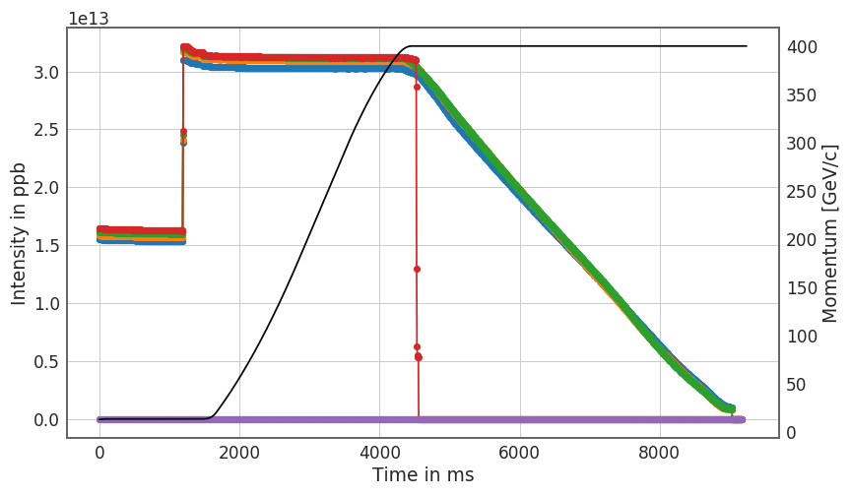
Why?

Slide 3
Current limitation and proposed schemes
Only diagnostics for general fast failures in the ring are our ring BLMs. These have a very low response time of 20 ms.
For extraction, we also have the extraction BPMs. There is the 30 mm interlock, but not sure whether this is actually still working.
Additional protection and possible upgrades include:
  dI/dt interlock
  BLM software upgrades
  BPM ALPS upgrade
Specification document (SPS-B-ES-0005-00-10) has been drafted and is now circulating; this is what we now are iterating on.

Slide 4
dI/dt interlock
Spot fast changes in intensity – could use the BCT(?)
Response time of 1ms.
Dedicated input to the BIS and maskable at this level.
Fire when threshold levels are crossed; simultaneously latch the SIS.
Problematic with programmed dumps or fast extraction can be handled by implementing additional logic on the SIS (interlock is fine but prevent latching).
Integration time | Total loss threshold | Average loss rate | Comments
1 ms | 3e11 p+ | 3e11 p+/ms | ppm
10 ms | 1e12 p+ | 1e11 p+/ms | ppm

Slide 5
BLM software upgrade
Reduce response time of BLMs to become practical; implementation of running sums to narrow down thresholds.
Response time of 2ms is highly desirable as clearly indicated by the use cases that occurred during this year.
One veto ppm per running sum and per device → would effectively add a factor 4 to today’s number of veto fields.
One channel input into the BIS which will be maskable (signals combined in OR configuration; a veto from any running sum on any device will trigger an interlock)
Integration time | Adjustable threshold | Veto | Enable/disable
1 tick | Yes (ppm) | 1 per device (ppm) | ppm
5 ticks | Yes (ppm) | 1 per device (ppm) | ppm
200 ticks | Yes (ppm) | 1 per device (ppm) | ppm
500 ticks | Yes (ppm) | 1 per device (ppm) | ppm
Full cycle | Yes (ppm) | 1 per device (ppm) | ppm

Slide 6
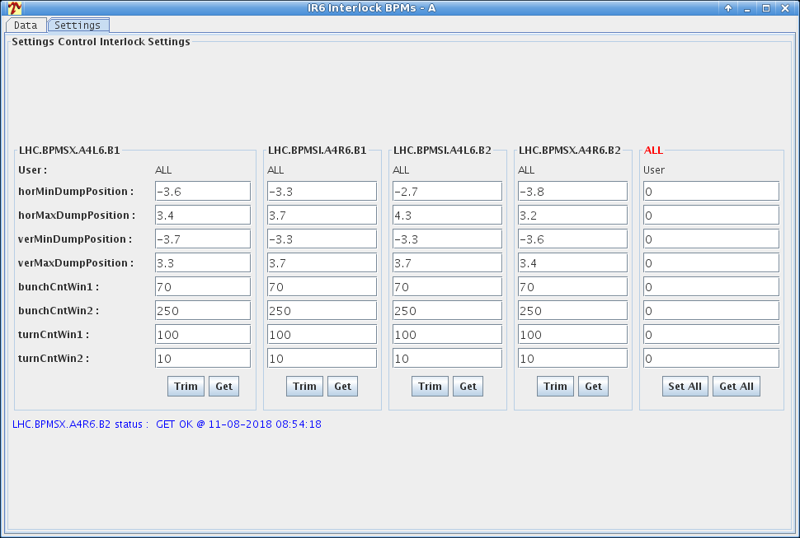
ALPS interlocks
Spot excessive excursions from orbit – very fast response time at the level of turns.
Currently for the extraction interlock BPMs, we allow a 0.5 mm RMS window. The extraction beam permit must be given no later than 15 ms before extraction takes place.
We normally give a time when to measure in the cycle (delay from some event) and the number of turns to measure (typically between 220 and 440 turns). It would be more practical to have this in ms before extraction or in ms after injection. Total measurement time can be up to 20ms.
For the future system to be effective, a reaction time of the order of 1-2 SPS turns is required. The system should directly dump the beam by providing an input to the SPS Ring Beam Interlock loop. To avoid issues with injection, the position interlock must not be active in a window of a few ms around each SPS injection.
It must be possible to define the maximum amplitude for the interlock and a simple filter on the data (even if at the expense of the reaction speed).
The exact BPMs to be equipped are being identified. For the moment we have is one BIC channel in BA1.

Slide 7
ALPS interlocks
Spot excessive excursions from orbit – very fast response time at the level of turns.
Recent proposition – strategy:
Pick 4 BPMs per plane to protect against large coherent oscillations
Main potential sources of coherent oscillations:
  Dampers
  Kickers (MKE, MKQ)
    MKP not considered as not charged after flat bottom
Try to find BPMs with about 90 deg phase advance from these elements for both FT and Q20 optics
  Tolerance chosen +/- 20 deg
Currently for the extraction interlock BPMs, we allow a 0.5 mm RMS window. The extraction beam permit must be given no later than 15 ms before extraction takes place.
We normally give a time when to measure in the cycle (delay from some event) and the number of turns to measure (typically between 220 and 440 turns). It would be more practical to have this in ms before extraction or in ms after injection. Total measurement time can be up to 20ms.
For the future system to be effective, a reaction time of the order of 1-2 SPS turns is required. The system should directly dump the beam by providing an input to the SPS Ring Beam Interlock loop. To avoid issues with injection, the position interlock must not be active in a window of a few ms around each SPS injection.
It must be possible to define the maximum amplitude for the interlock and a simple filter on the data (even if at the expense of the reaction speed).
The exact BPMs to be equipped are being identified. For the moment we have is one BIC channel in BA1.

Slide 8
ALPS interlocks
Spot excessive excursions from orbit – very fast response time at the level of turns.
Possible BPMs to interlock:
Damper H:
  "BPH.60208”
Damper V:
  "BPV.60708" and "BPV.32908"
MKQH:
  "BPH.11408”
MKQV:
  "BPV.10308" and "BPV.13508"
MKE4:
  "BPH.43008”
MKE6
  "BPH.30408”
Currently for the extraction interlock BPMs, we allow a 0.5 mm RMS window. The extraction beam permit must be given no later than 15 ms before extraction takes place.
We normally give a time when to measure in the cycle (delay from some event) and the number of turns to measure (typically between 220 and 440 turns). It would be more practical to have this in ms before extraction or in ms after injection. Total measurement time can be up to 20ms.
For the future system to be effective, a reaction time of the order of 1-2 SPS turns is required. The system should directly dump the beam by providing an input to the SPS Ring Beam Interlock loop. To avoid issues with injection, the position interlock must not be active in a window of a few ms around each SPS injection.
It must be possible to define the maximum amplitude for the interlock and a simple filter on the data (even if at the expense of the reaction speed).
The exact BPMs to be equipped are being identified. For the moment we have is one BIC channel in BA1.

Slide 10
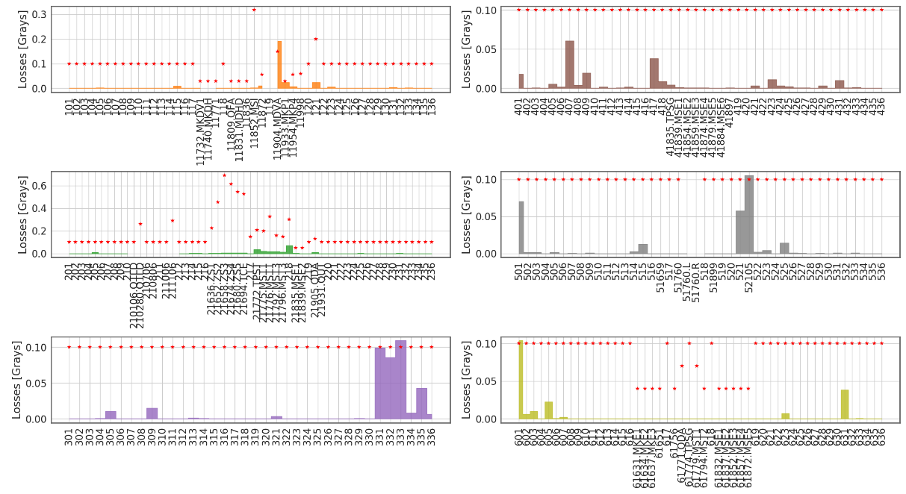
Loss profiles from half-integer

Slide 11
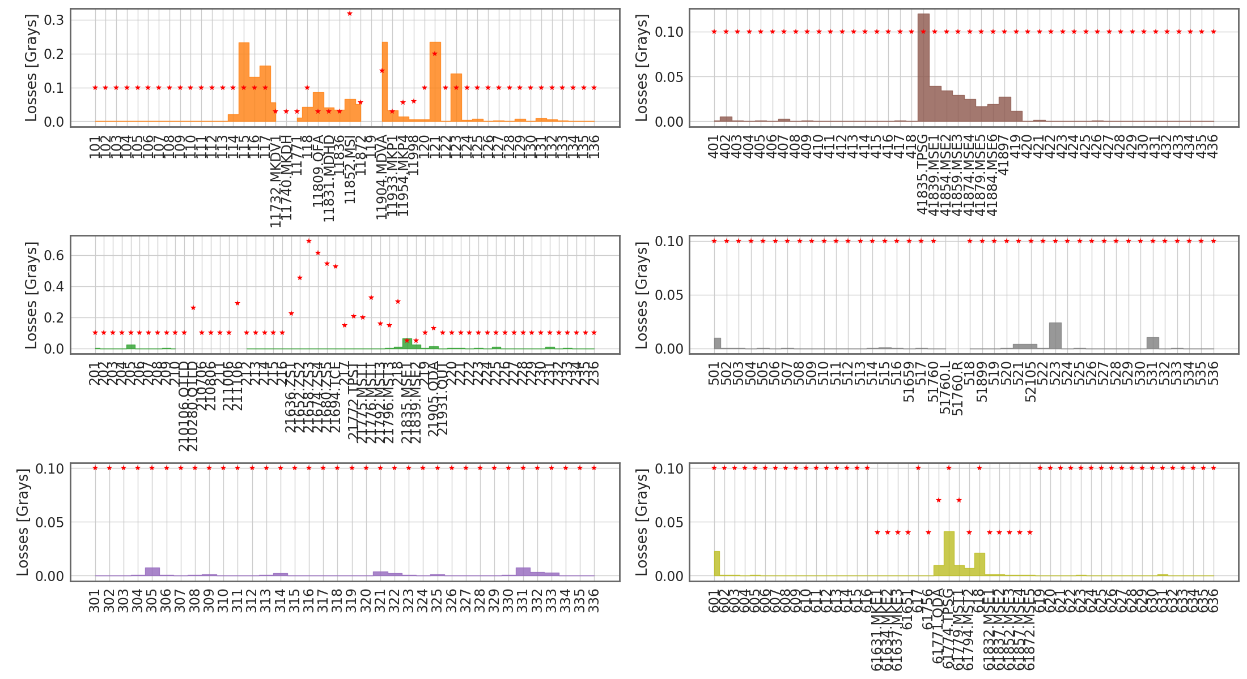
Loss profiles from damper trip

