Slide 1
Beam loss monitoring in SPS
- plans for LS2
Notes:
Good morning.
For those of you who don’t know me yet, my name is Steen Jensen and I work in the BI software sections since a bit more than a year.
I will tell you about the LS2 changes foreseen for the SPS beam-loss interlocking

Slide 2


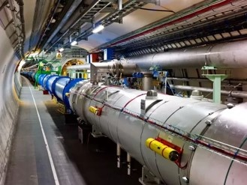
Overview
SIS
PostMortem
SPS
Reset integrator
BLRSPS
ch0
Integrator gain
En-/disable dump channels
BIS
BLM
Reset dump (general)
Set dump
En-/disable dump
Channel selection
Start conversion
ADC values per channel
(raw beam loss values)
Reset dump (channels)
Reset watchdog timer
BLM
ch1
Amplifier gain
DAC thresholds 1-16
BLM
ch2
Disassemled BLM ionization chamber
https://cds.cern.ch/record/930275/files/ab-2006-009.pdf
BLM
ch3
BLM
ch4
ADC
BLM
ch5
Amplifier
…
BLM
ch6
Multiplexer
DAC1
DAC8
/8
…
ch7
…
/8
BLM
Analogue integrated values
Comparators
OR
CIBU
Integrators
BI_BLMADC #0
…
BLM
power
supply
DAC1
DAC8
/8
…
…
/8
Comparators
Steen Jensen, BE-BI-SW
BI_BLMDMP #1
BLM
ch32
New version (v1) only
From BI_BLMDMP card in upstream FEC
BLM
ch33
BLM
ch34
BLM
ch35
ch36
ADC
ch37
Multiplexer
Amplifier
Maximum 36 BLM channels per FEC
ch38
ch39
Analogue integrated values
Ch36 = Voltage of BLM power supply
Ch37 = Current of BLM power supply
Ch38 = Unused
Ch39 = Unused
Integrators
BI_BLMADC #N, N <=4
BLM ionization chambers in LHC
FEC
Notes:
Here is an overview of the current beam-loss system in SPS.
The measuring device used for monitoring beam losses is an ionization chamber which gives an analogue output proportional to the radiation it receives.
This output is fed to the input of a VME hardware module which integrates and digitizes the signal so it can be read from the FESA class.
Another VME module – the BLMDMP - is connected to the BIS system and it allows us to dump the beam, either from the FESA class or in certain cases purely by hardware.

Slide 3
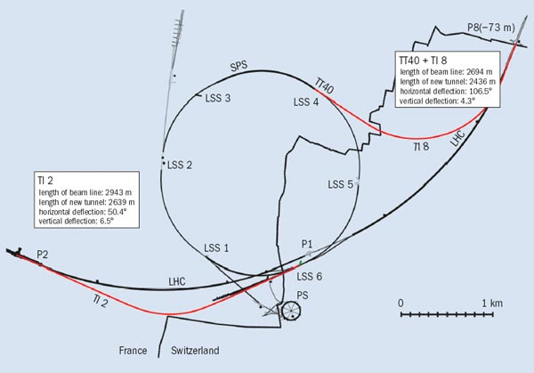
Deployment
Transfer lines: LHC(TI2, TI8), AWAKE(TT40, TT41)
Active only on fast extractions
Single-shot => beam dump makes no sense
=> Prevents beam permit on following cycles,
to be reset by operator.
Long Straight Sections (LSS)
Monitoring throughout cycle
Hardware based beam-dump in < 1ms
Arcs – the sections between LSS’s
Monitoring throughout cycle
Software based beam-dump in < 20ms
Software improvements possible
SPS overview, from https://cerncourier.com/protons-on-the-doorstep-of-the-lhc/
Notes:
The BLM system is deployed in three different configurations:
…
In the following I focus on the configuration deployed in the Arcs

Slide 4
Current Principle for Arc installations
Response time up to 20ms
Only monitors integrated loss since cycle start
Integration time, Δt_{tick} = 20ms
Start Acquisition
Measure @ tick
Stop Acquisition
CYCLE A
Cycle-losses
CYCLE B
Cycle-losses
time
Steen Jensen, BE-BI-SW
@Start acquisition:
for ( all channels ) {
Reset & re-start hw integrator
}
@Measure:
for ( all channels ) {
Acquire and store loss-value
if (loss-value > threshold) {
dump beam
}
}
@Stop acquisition:
for ( all channels ) {
Publish loss-values
}
Notes:
The Arc installations work as follows:
Every 20ms the FESA class acquires the BLM value for each channel and determines if that value exceeds a predefined threshold.
If so, the beam is dumped.
Hence we are currently monitoring the integrated losses per cycle with a response time up to 20ms

Slide 5
New functionalities for Arc (and LSS) installations
OP requests for the SPS BLM system:
Request: Reduce the integration time
  Solution: 5ms instead of 20ms (hardware access time reduced from ~12ms to ~2ms)
Request: Improve detection of fast losses
  Solution: 4 new interlocking running-sums:
    Veto-able per channel
    Adjustable threshold per channel
    Adjustable width per running-sum
    Sub-sets published every BP for visualization
    Timestamped max-values published end-cycle for diagnostic and trimming purposes
Additional functionality for RP (not interlocking)
  Ambient losses
    Measured from ejection to injection
  Fast extraction losses
    Measures losses in smallest possible time window covering the extraction
Notes:
Op has requested an increase in mo

Slide 6
New vs. Current Principles
Post-LS2 principle
Current principle
Start Acquisition
Measure @ tick
Fast extraction start
Fast extraction end
Stop Acquisition
Start Acquisition
Measure @ tick
Stop Acquisition
CYCLE A
Cycle-losses
CYCLE A
Cycle-losses
CYCLE B
CYCLE B
Δt_{tick} = 5ms
Ambient-losses
Cycle-losses
Δt_{tick} = 20ms
Cycle-losses
time
time
running-sum
Steen Jensen, BE-BI-SW
Steen Jensen, BE-BI-SW
@Start acquisition:
for ( all channels ) {
Reset & re-start hw integrator
}
@Measure:
for ( all channels ) {
Acquire and store loss-value
if (loss-value > threshold) {
dump beam
}
}
@Stop acquisition:
for ( all channels ) {
Publish loss-values
}
@Start acquisition:
for ( all channels ) {
Acquire & publish ambient loss
Reset & re-start hw integrator
}
@Measure:
For ( all channels ) {
Acquire and store loss-value
Process running-sum-1
Process running-sum-2
Process running-sum-3
Process running-sum-4
Process Cycle-running-sum
}
@Stop acquisition:
For ( all channels ) {
Publish max running-sums
Publish fast-extraction loss
Reset & re-start hw integrator
}
“Process” means:
Calculate difference from loss X ticks ago
Compare difference to threshold
Dump beam if difference > threshold
Thresholds to be set by OP
Channels can be vetoed so they do not cause beam dumps
@Fast extraction start:
for ( all channels ) {
Register latest loss measurement as
fast-extraction-start
}
@Fast extraction end:
for ( all channels ) {
Register latest loss measurement
Calculate/record difference from fast-extraction-start
}

Slide 7
Additional slides

Slide 8
Deployment
Arcs
BLRSPS_BA1: 36 channels
BLRSPS_BA2 : 36 channels
BLRSPS_BA3 : 36 channels
BLRSPS_BA4 : 36 channels
BLRSPS_BA5 : 36 channels
BLRSPS_BA6 : 36 channels
BLRSPS_BA80 : 11 channels
297 channels
x
24 users
x
5 running-sums
=>
297 channels
=>
=>
35.640 thresholds
LSS’s
BLRSPS_LSS: 12 channels
BLRSPS_LSS: 32 channels
BLRSPS_LSS: 8 channels
BLRSPS_LSS: 4 channels
BLRSPS_LSS: 14 channels

