Slide 1
SPS DCCT and dI/dt

Slide 2
SPS DCCT summary
Device | FS [charges] | Technology of the monitor | Nb of dynamic ranges | Analog signal BW | FESA aqn | Noise Pic-pic value with 10 kHz BW [charges] | Users
BCTDC 31832 | 1.6 E14 | Bergoz | 1 | > 20 kHz | 16 bit 5 ms/S Data published at the end of the cycle | 3.6 E11 | Vistar Operational displays SMP (setup beam + probe beam flags) BIS RF cage Dump
BCTDC 41435 | 7.2 E11 | Bergoz | 1 | > 20kHz |  | NA | Vistar Operational displays SMP (setup beam + probe beam flags) BIS RF cage
BCTDC 51895 (BCTDC 514xx after LS2) | 1 E14 | CERN | 4 | 15kHz |  | 2.5 E11 | SMP (setup beam + probe beam flags) North Area Primary Ions Interlock
BCTDC 51897 (BCTDC 514xx after LS2) | 1 E14 | CERN | 4 | 15kHz |  | 2.5 E11 | North Area Primary Ions Interlock

Slide 3
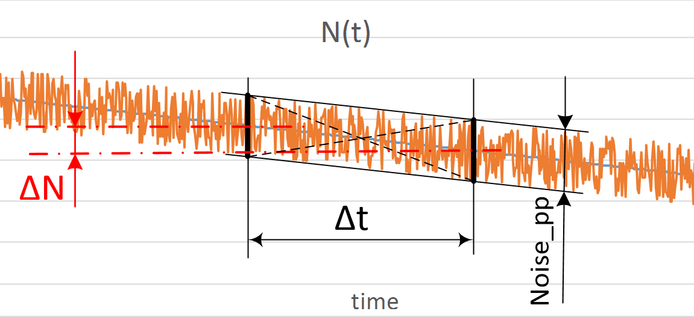


DCCTs and dI/dt
Current FESA acquisition does not fulfil the requirements
  5ms not quick enough
  data published only at the end of cycles
DCCTs BW enough to resolve 1ms
Either BCTDC3 or BCTDC5 noise level too high for the 1ms integration time threshold (3E11 ch)
Should be OK for the 10ms integration time threshold (1E12 ch)
New acquisition needed
$$ΔN_{min}=2∗Noise_pp$$
$$Δt_{min}=\frac{ΔN_{min}}{dI/dt}$$
$$num.(BA5): ΔN_{min}=2∗2.5E11$$
$$Δt_{min}=\frac{5E11 ch}{3E11 ch/ms}=1.7ms$$

