Slide 1
SPS DIDT acquisition
T. Levens

Slide 2
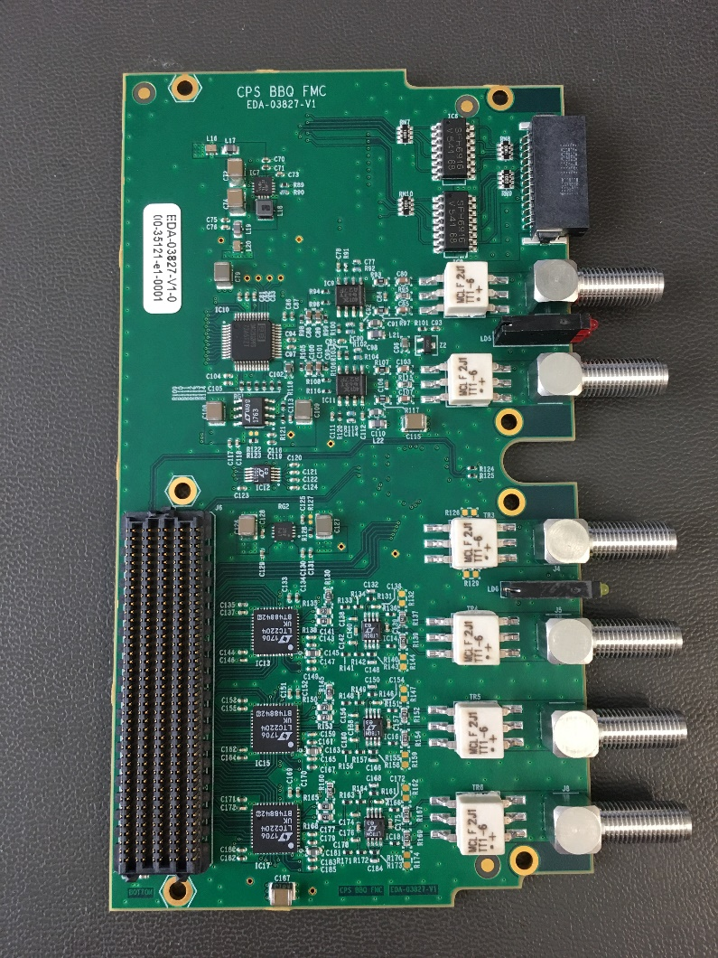
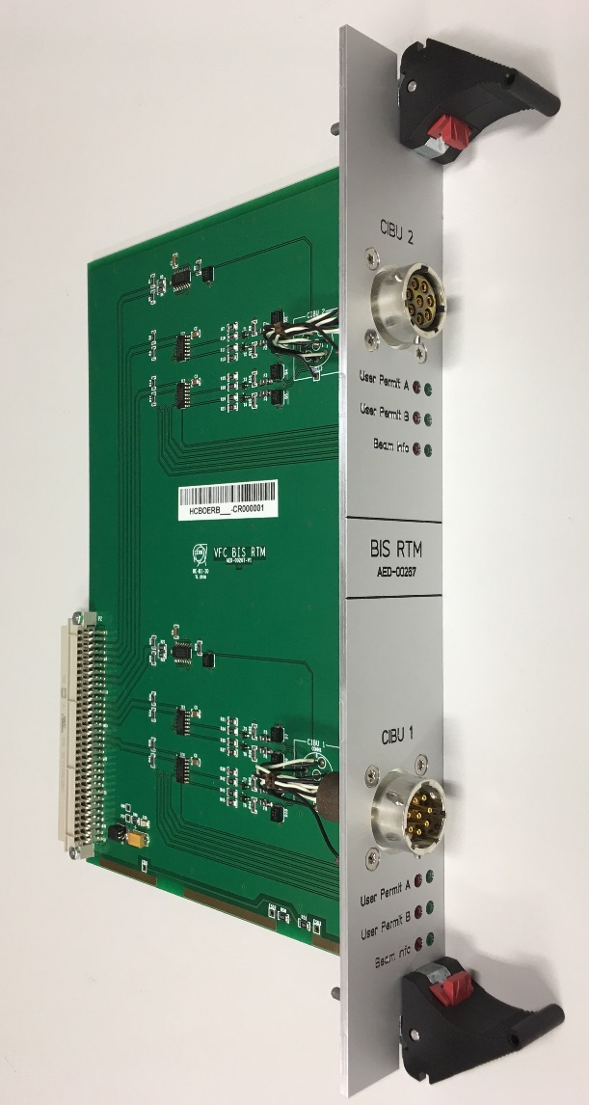
(New) LHC DIDT
Based on VFC-HD
40 MSPS 16-bit ADC
  Designed for injector BBQ systems
  Modified for DC coupling
  3 ADC channels
  +/- 1.125V FS input
RTM providing direct BIS interface
  Note, design available for other projects if needed!

Slide 3
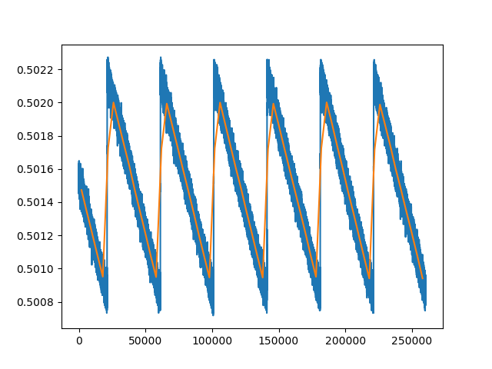
ADC Performance
3 mV (3e11) modulation at 1 kHz
40 MSPS:
  0.9 mVpp noise level
  i.e. 9e10 (for 1e14 full scale)
10 kSPS (averaged):
  60 uVpp noise level
  i.e. 6e9 (for 1e14 full scale)
The ADC performance does not seem to be a limitation to achieve requested 3e11/ms

Slide 4
LHC DIDT HW in SPS
Could reuse existing hardware
  Require budget for VFC(s) + ADC(s): 1.2k VFC, ~1k ADC
  Compatible with existing DCBCT VME crates in BA5
New firmware development required
  Although some parts could be reused from LHC DIDT
New FESA development required
  Needs definition of what parameters OP would like for logging, etc
Require cabling for CIBU channel
  Should be requested ASAP

