Slide 1
Fesa Web | CERN
BE-BI-SW
Jordi Ustrell Garrigos

Slide 2
Context
Need for a super lightweight FESA device data interface requested,
Accessible from both the CERN TN and GPN,
Display real-time data from different FESA devices,
The display is made of different nodes containing data from FESA property fields,
All nodes standardized with same basic functionalities (ex: maximize, close, export option…).

Slide 3




How does it work?
Clients
Web server
FESA Servers
HTML5, CSS3, Bootstrap4, JavaScript, JQuery, Flot chart library and homemade components…
Java, Japc, SQL, Tomcat Apache
Subscription request
CERN NETWORK
Request
Data
Data
WebSocket
BE-CO JAPC
Setting
GUI
* Browser compatible + Android + iOS
(Except IE & Edge)
Java
Settings Info.
(Json File)

Slide 4
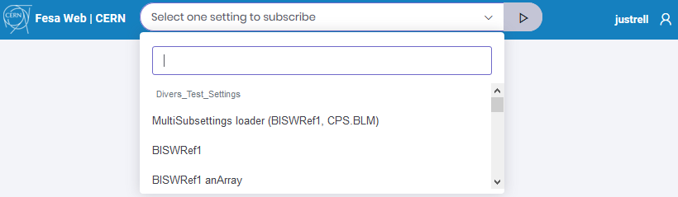
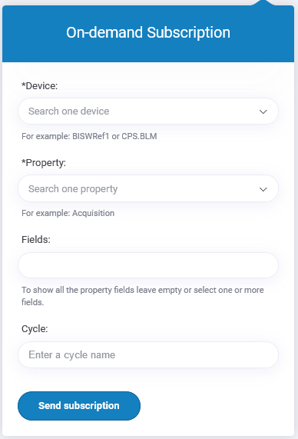
Types of subscriptions
1. Subscription pre-defined by setting
Pre-defined user subscription setting including multiple options (FESA fields, timing, chart options…).
2. On-demand subscription
Specific panel to make on-demand request using the FESA device, the property, the field name and if necessary the cycle.

Slide 5
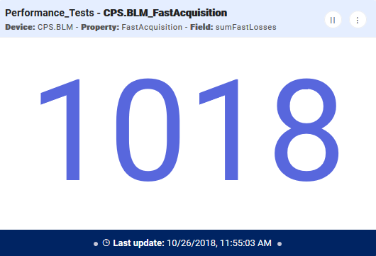
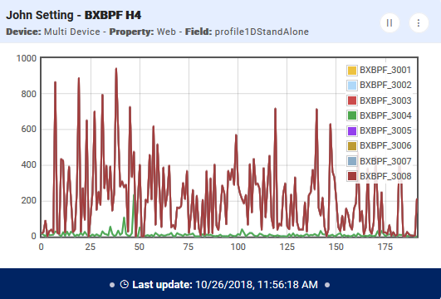
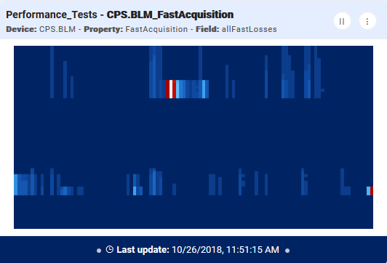
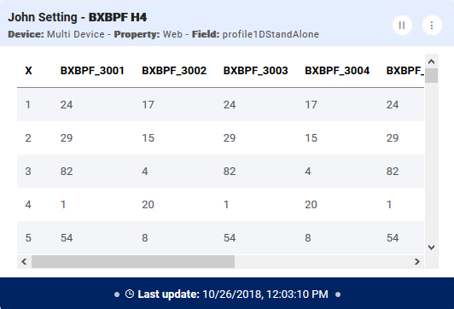
Types of fields
Accept strings and numerical values.
Data can be received as:
  Scalar (single value),
  1D Array,
  2D Arrays.
Display per type of field:
Single value (label)
Chart
Image
Table

Slide 6
Users test
10 people: BI-EA, BI-SW, CO, EN-EA-LE and users
To replace number of Java GUIs for CERN Neutrino Platform (Dune)
Feedback from the users :
The main improvements over the Java programs were:
The speed of loading a web page compared to starting a Java program.
Ability to run on GPN computers.
The speed which at data fields could be added and removed from the display during the commissioning of new equipment.
What is missing?
Security access but solution found (sso),
Custom data range (chart scale),
Selection of chart type (lines, points, bars…)

Slide 7
Performance and Test
N clients share a single subscription per device/property,
Data compression for arrays > 5000 points,
Chart refreshing rate up to 10Hz,
Multiple charts tested with more than 100,000 points,
Test with 30 different clients connected at the same time,
Mobile display running smoothly,
Direct access to subscriptions by URL.
Where to find it?
http://fesaweb

