Slide 1

Cost and system performance modelling in WLCG and HSF: an update
Andrea P. Sciabà
on behalf of the HSF/WLCG Systems performance and cost modelling WG
HEPiX Spring 2019 Workshop
La Jolla, 25-29 March 2019

Slide 2
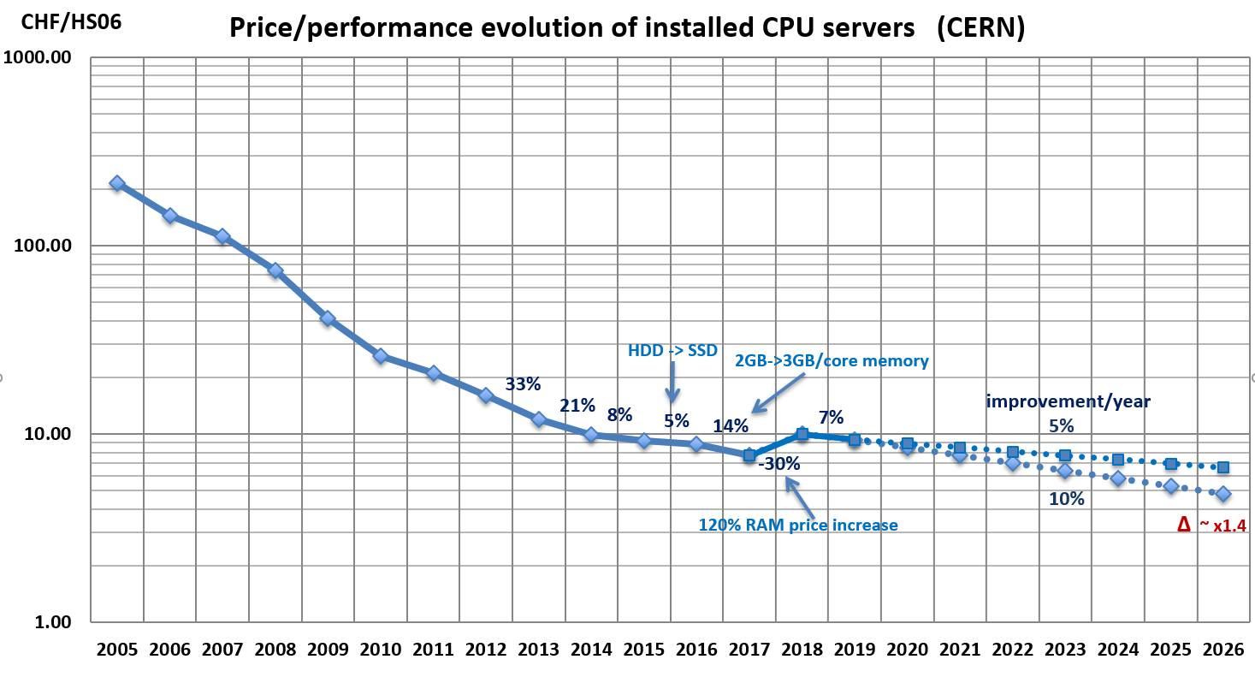
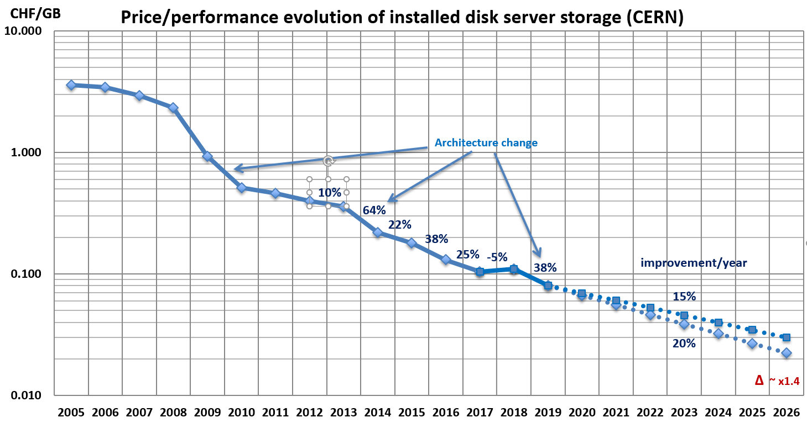
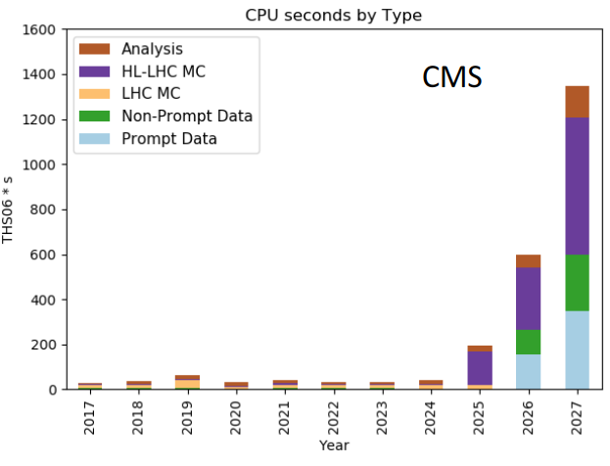
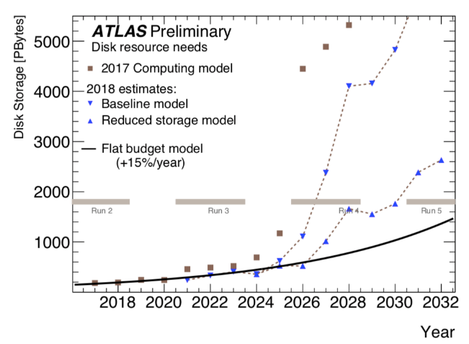
The High Luminosity challenge
There is still a significant gap between the estimations of needed and available resources
  10x increase in trigger rates, 5x increase in pile-up, NLO & NNLO, …
  Price/performance advances slowing down, 10-15%/year at best
CPU and disk short by a factor ≈ 2
  Even if the gap is reducing!
Strong need to quantitatively understand our efficiency and how we can optimize performance
Source: B. Panzer-Steindel
Source: D. Costanzo
Source: D. Lange

Slide 3
The Working Group
Main motivation is to help WLCG to fit into the available resources for Run3 and Run4
  Develop a deep understanding of current workloads, resource utilisation, and site costs
  Explore future scenarios, estimate possible improvements in efficiency
  Develop tools and methods for the above
The group was created in November 2017
  Already presented status reports at HEPiX
  Conveners: J. Flix, M. Schulz, A. Sciabà
  ~35 active members from LHC experiments, sites and including software experts
  By-weekly meetings
    https://indico.cern.ch/category/9733/
Dedicated session at the HOW workshop last week

Slide 4
Current areas of work
Some of the current areas of work and goals
  Identify representative experiment workloads
  Define which metrics best characterise such workloads
  Understand how to estimate resource needs
  Define a process to evaluate the TCO of an infrastructure
  Measure the impact of new storage configurations
  Identify potential areas for savings

Slide 5
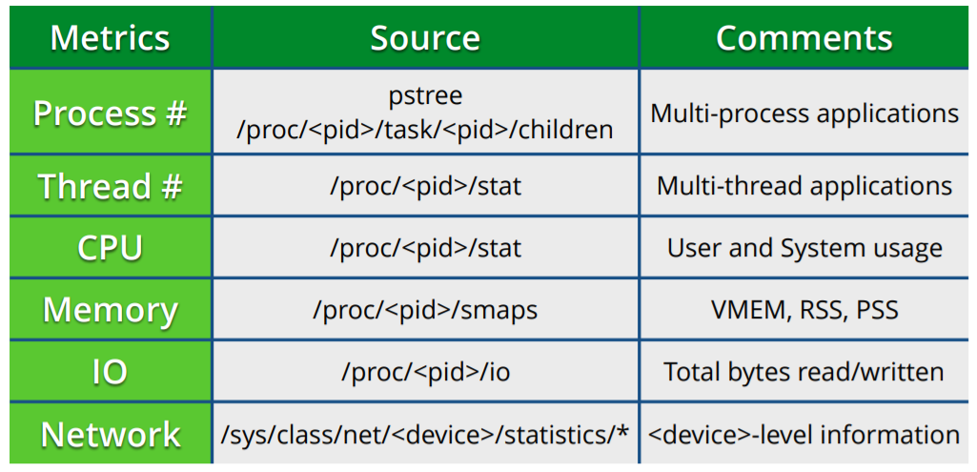
Metrics and workload characterization
Identify the metrics that best characterize the resource usages of HEP workloads
  To quantify the impact of changes in the workload implementations → software experts
  To quantify the impact of changes in the infrastructure → site administrators
  Ultimately, to guide design decisions towards improved efficiencies
Basic metrics
  CPU (i.e. how much do I use?)
  Memory (i.e. do I swap a lot?)
  Disk I/O (i.e. how much do I read/write?)
  Network (i.e. what are the access patterns?)
Can use procFS for the above → PrMon (GitHub)
Hardware counters for deeper analysis → Trident

Slide 6
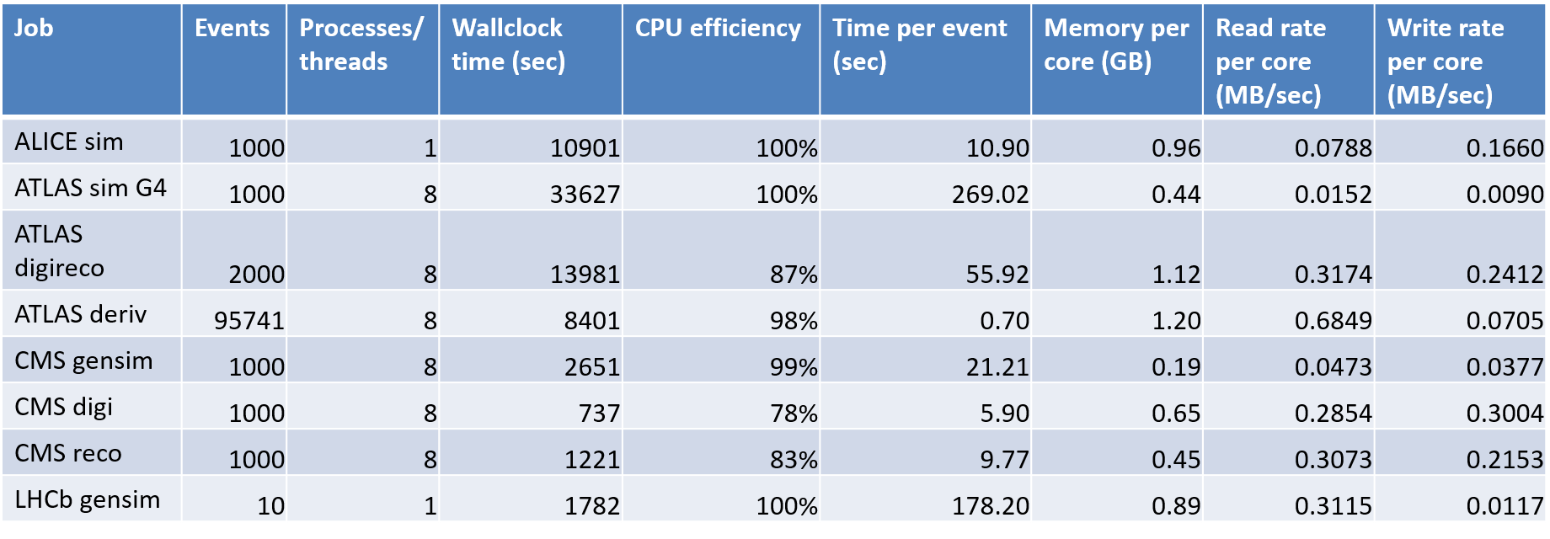
Reference workloads
ALICE (link) (GitLab)
  A simple p-p simulation job using Geant3
ATLAS (link)
  A ttbar simulation job using Geant4 (GitLab)
  A digitization + reconstruction job
  A DxAOD derivation job
CMS (link)
  Generation + simulation of ttbar events (GitLab)
  Digitization and trigger simulation with premixed pile-up
  Reconstruction job producing AODSIM and MINIAODSIM
LHCb (link)
  Generation + simulation using Geant4 of D*(→π(D⁰→K π)) π π π events (GitLab)

Slide 7
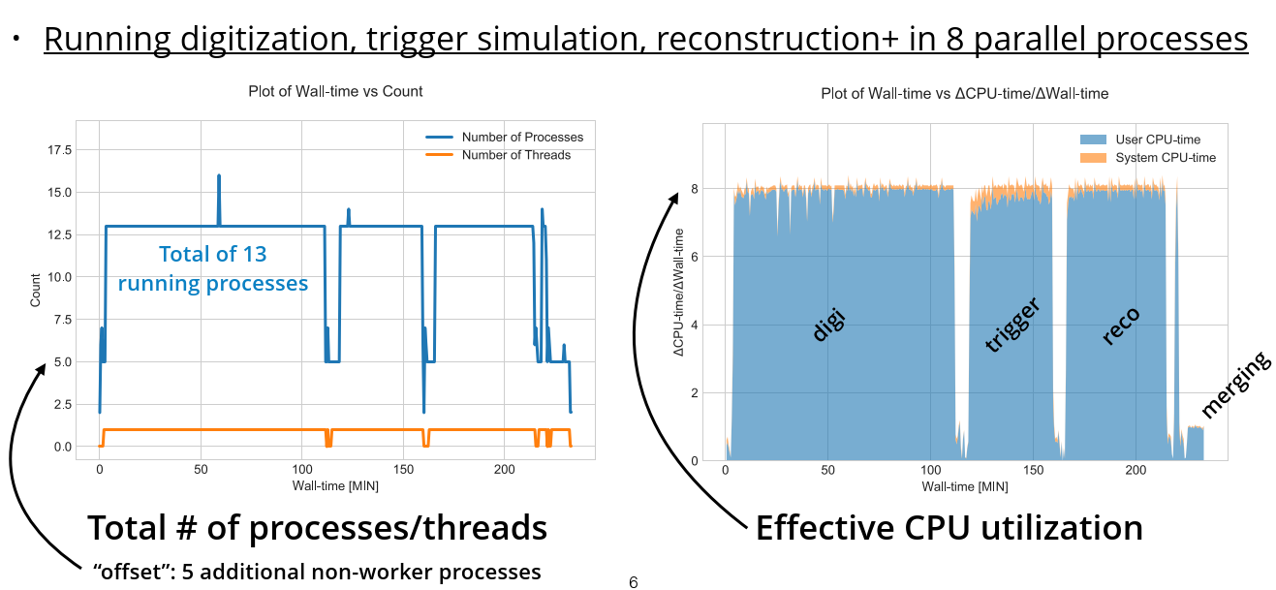
PrMon example: ATLAS digi-reco (1/2)
Source: Serhan Mete

Slide 8
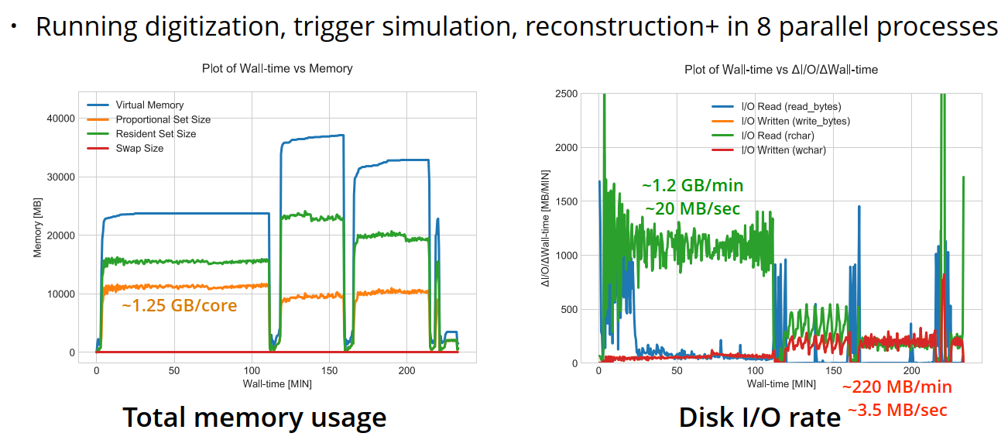
PrMon example: ATLAS digi-reco (2/2)
Source: Serhan Mete

Slide 9
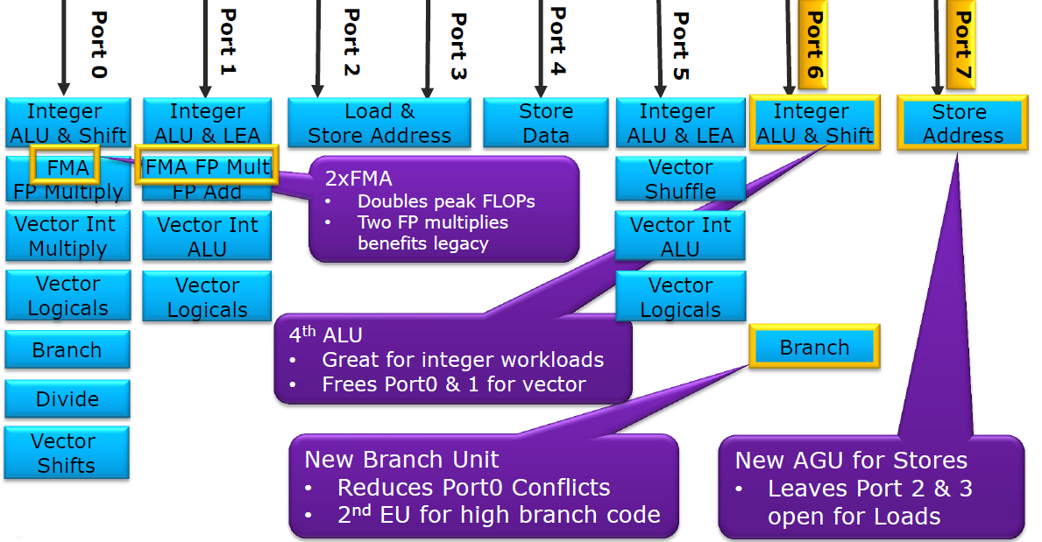
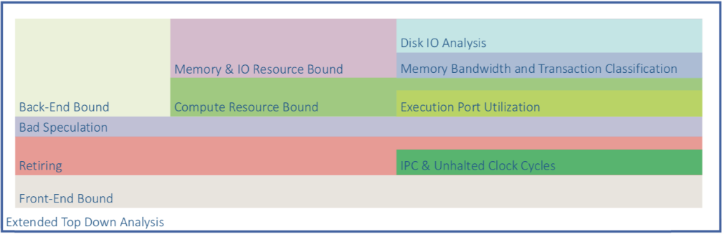
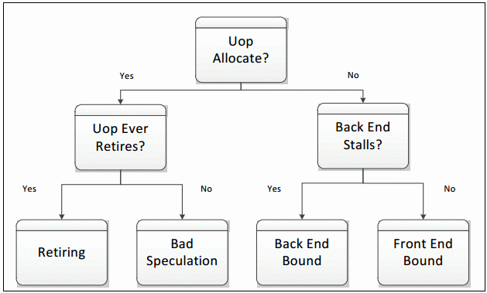
Measuring performance with Trident
Measures CPU, IO and memory utilization based on hardware counters, memory and IO information, e.g. to identify bottlenecks
Several metrics calculated
  CPU: IPC, total cycles, top-down analysis (front-end bound, back-end bound, retiring, bad speculation)
  Core backend utilization: compute (ports 0,1,5,6) vs memory (ports 2,3,4,7)
  Memory: bandwidth usage, transaction classification (page-hit, page-empty, page-miss)
Can be used to see how workloads differ (or resemble) the benchmarks we use (e.g. HS06)
CPU counters are a powerful (but complex) tool and Trident makes them accessible
Full exploration of CPU utilization
Source: Intel

Slide 10
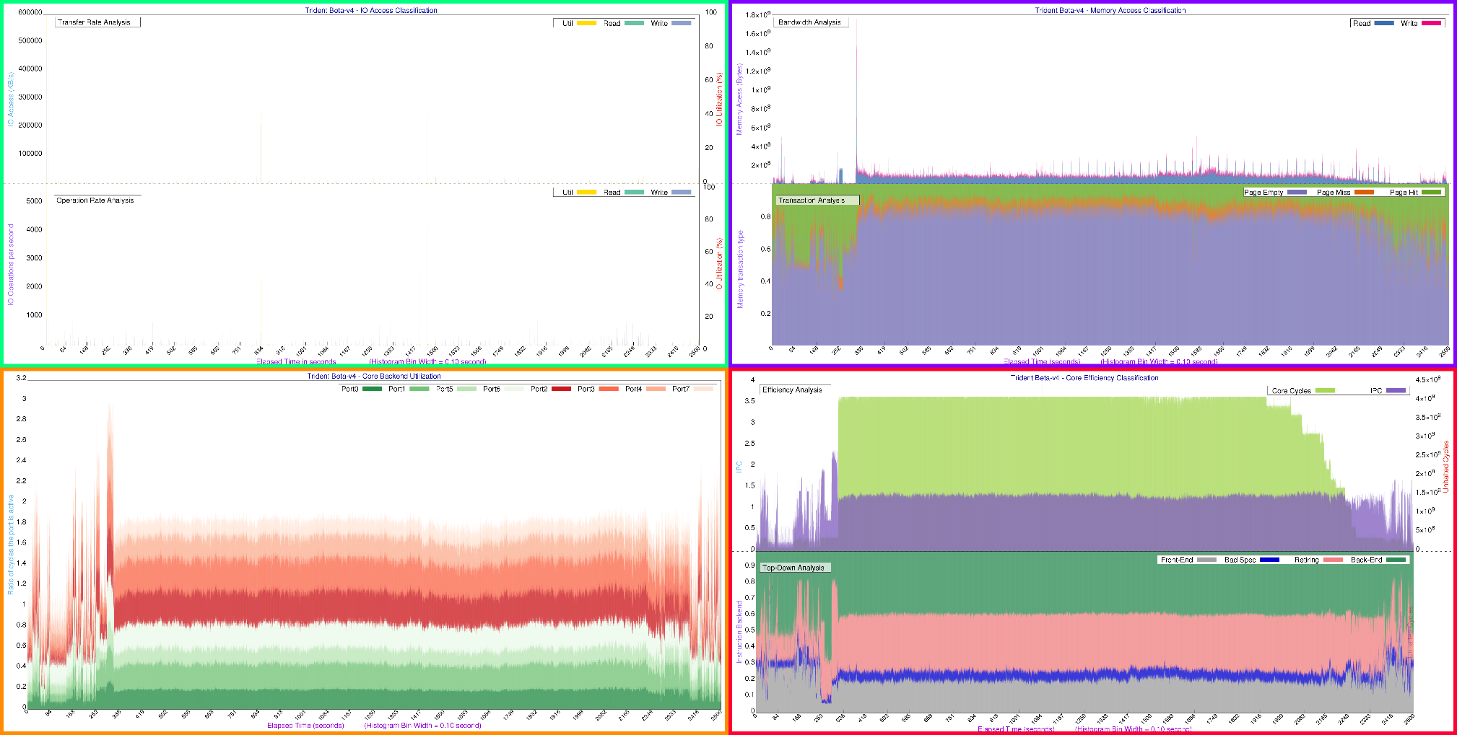
Trident plots: ATLAS Geant4
Little IO
Inefficient memory access
Low IPC (vectorization not much used)
~50% time on compute ops
Reasonably well balanced
More on top-down analysis here
Source: Servesh Muralidharan

Slide 11
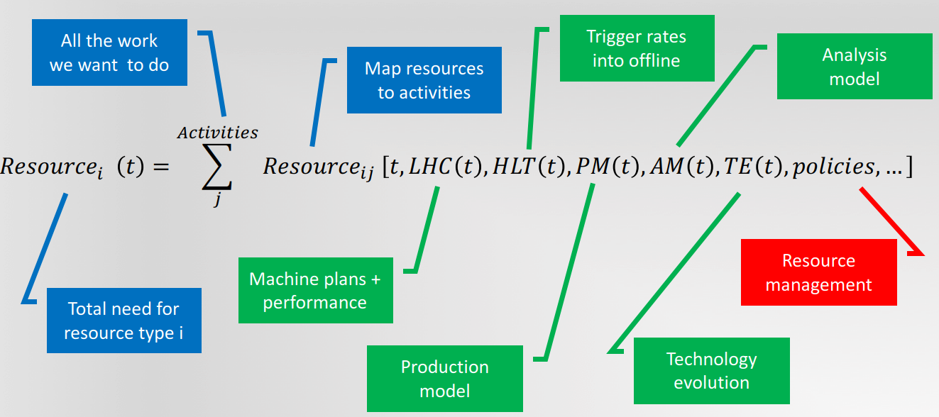
Resource estimation
The initial goal was to define a common framework for modelling the computing requirements of the LHC experiments
  Models as collection of parameters and generic calculations
  Using as input the characteristics of the workflows
  Allow to play with different scenarios
However, now it seems that difference among experiments are large enough to make such tool either very complex or not realistic enough
  Still, lot of progress came from sharing ideas and code
Source: D. Lange

Slide 12
General observations from resource estimation
Models address CPU, disk and tape
  But not network (not OK), and no GPUs (still OK)
Yearly granularity in estimates is sufficient
  Easy to fill the resources at all times
Effect of R&D or big changes in computing models difficult to anticipate
  Better to use the model to set targets given the constraints
Experiments are talking to each other more than ever (also thanks to the working group)
Discussion if still important to separate T0/1/2s in the context of HL-LHC
Tape I/O as an extremely important metric at HL-LHC
  RAW data will increase by 50x (CMS)
  Expect bursts in tape I/O, need to have good estimates

Slide 13
Site cost estimation models
The goal is to develop a method to calculate the cost of providing the needed resources
  At first, several site people in the WG went through a cost estimation exercise starting from an “example” workload
    Significant differences due to different metrics, methodologies, understanding of metrics
A model should rely on
  Common metrics
  Common measurement methods
  Common framework for computing costs
First implementation as a spreadsheet using as input prices and trends to calculate required budgets

Slide 14
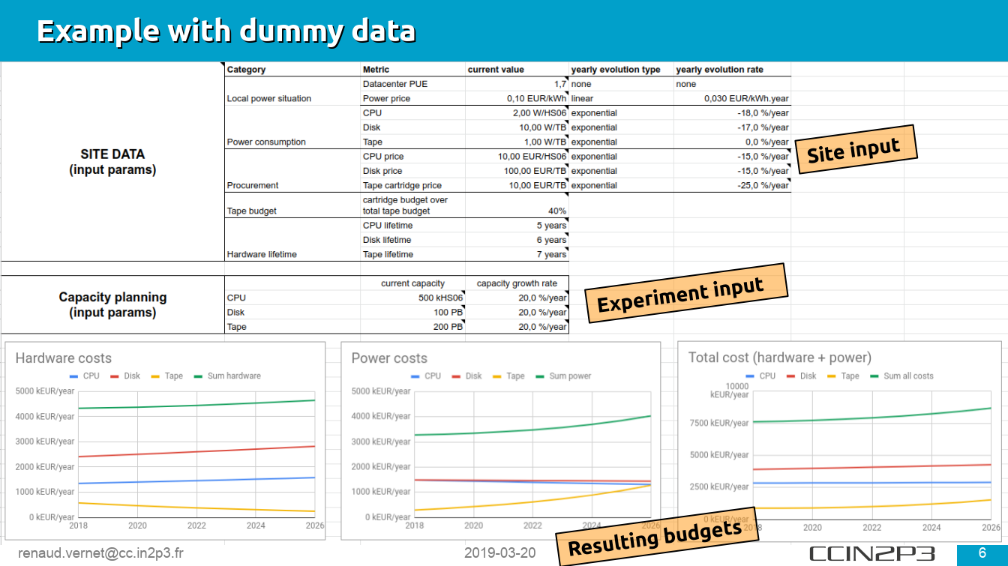
Cost evolution model

Slide 15
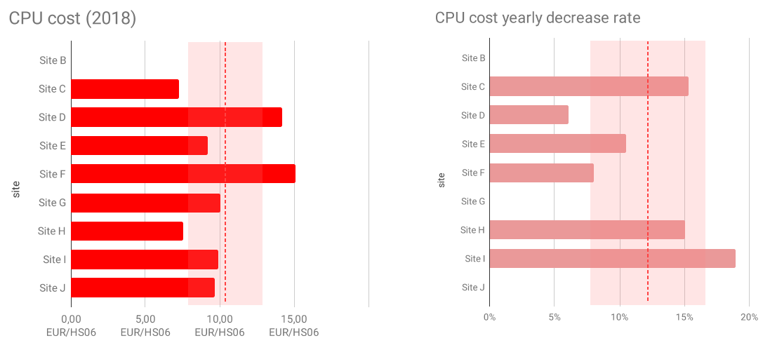
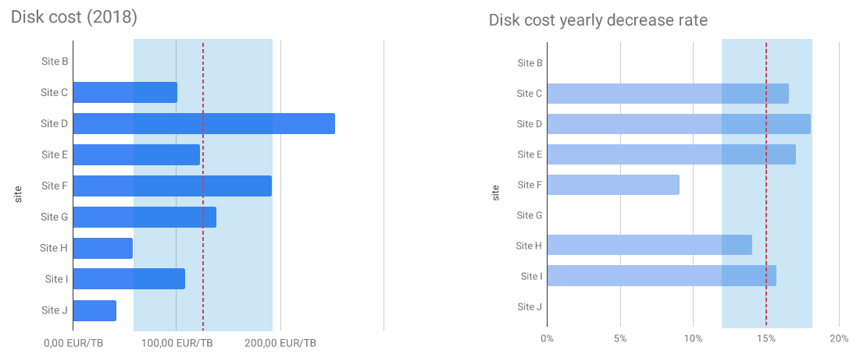
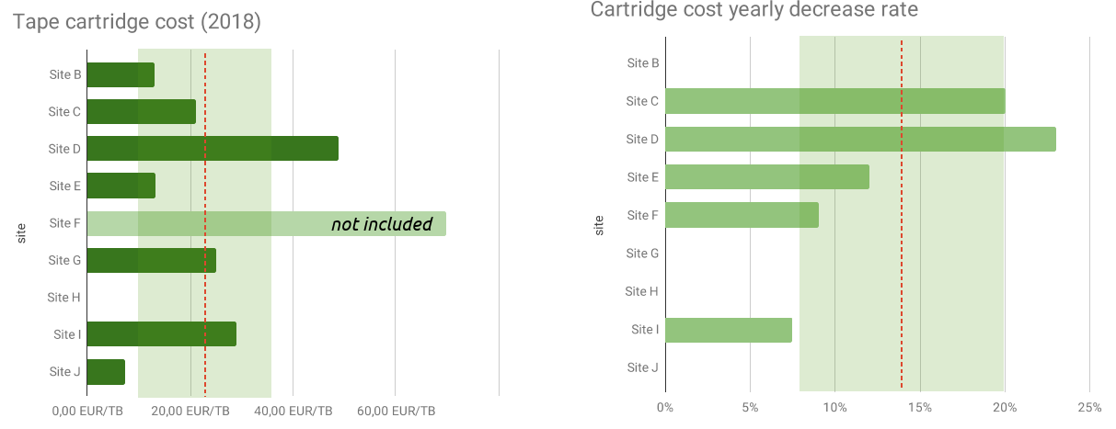
Site cost Tier-1 survey
Launched in September a survey among Tier-1 sites (and open to Tier-2s) to understand their costs for CPU, disk and tape
  Questionnaire available here
  Eight Tier-1s and one Tier-2 answered
Average costs
  CPU: €10.3/HS06, -12%/y
  Disk: €126/TB, -15%/y
  Tape: €22/TB, -14%/y
20-50% spread among sites
Source: R. Vernet

Slide 16
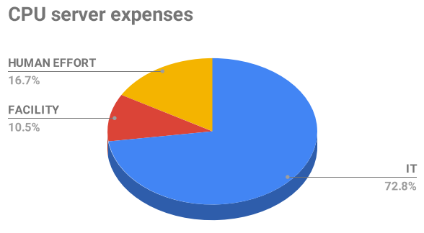
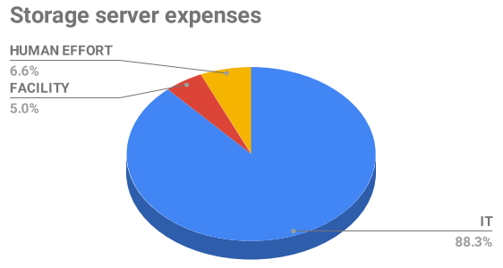
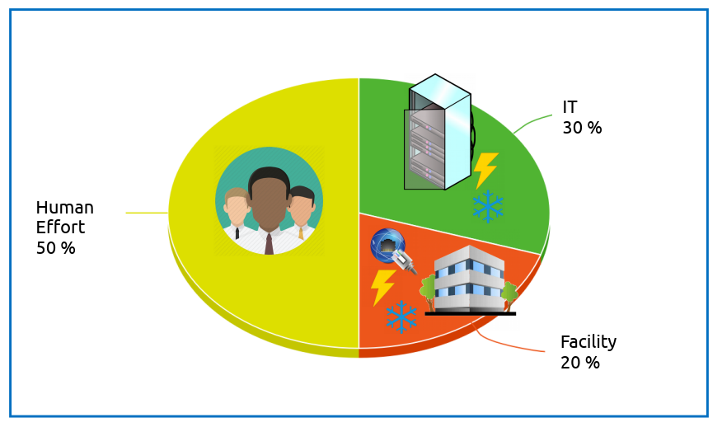
Total cost of ownership
Two approaches being considered
“Atomic” approach
  Cost of hardware, power, network equipment, building, electricity, PUE, FTEs included
  Implemented as a self-documented spreadsheet
“Holistic” approach
  Take the complete budget of the datacenter
  Remove tertiary expenses
  Categorize per sector
  Deduce TCO per unit of resource capacity
Networking expenses not yet modelled
The goal is to come up with a unified approach usable by all WLCG sites
  Discussions are still ongoing
CC-IN2P3
https://goo.gl/ctiMkE
CC-IN2P3
Source : R. Vernet

Slide 17
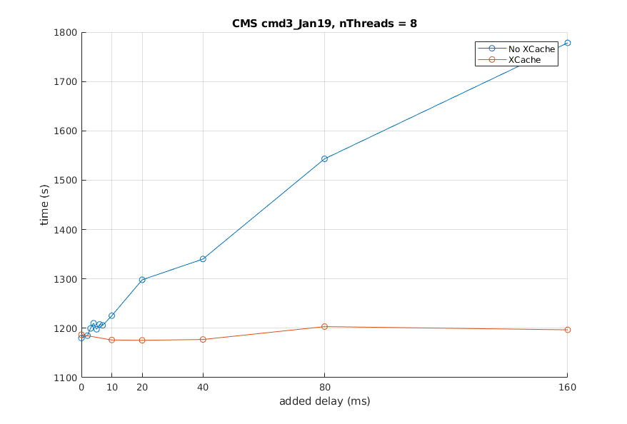
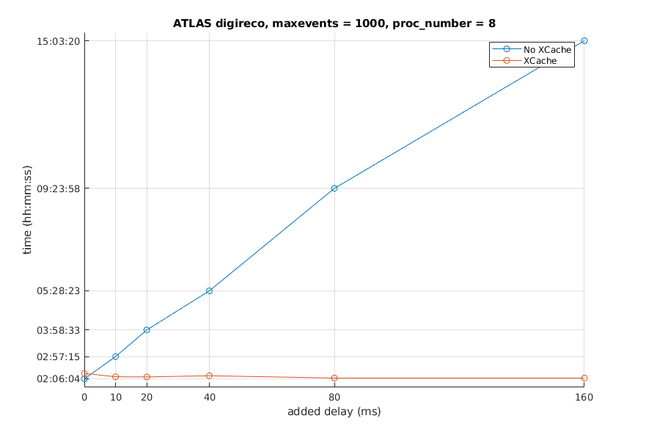
Storage modeling and popularity studies
Investigated the feasibility of storage caches and the impact of network latency
  Work is now converging into the DOMA (Data Organization Management Access) working group in WLCG
  Studies with a focus on cost will stay in this WG
Examples
  Investigating the effect of data losses on non-redundant storage (spreadsheet)
  Effect on reference workloads of an artificial latency, with and without a cache
CMS DIGI job

Slide 18
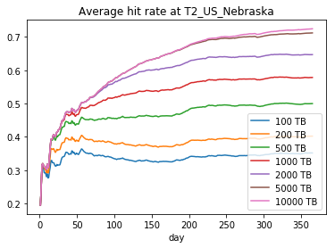
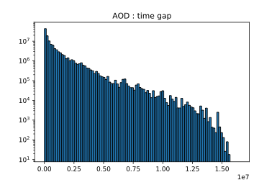
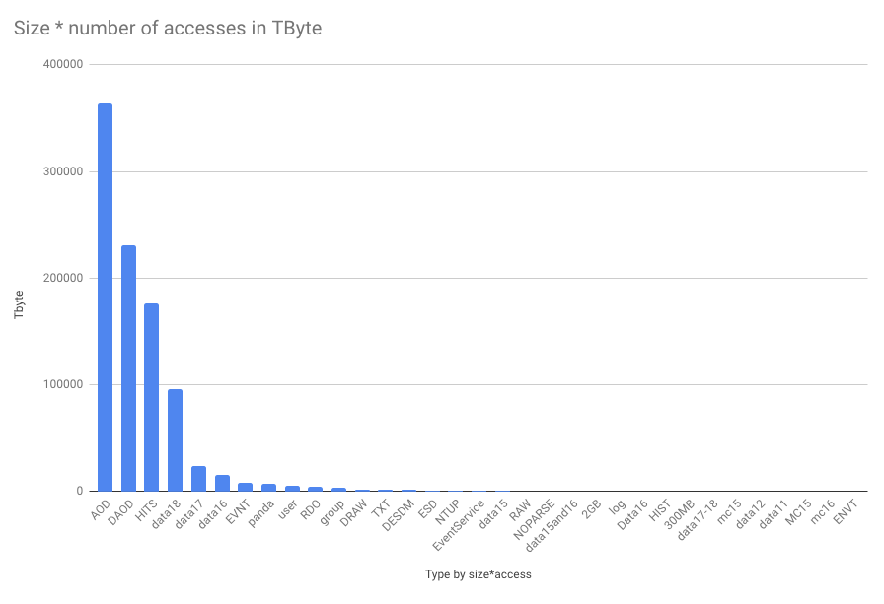
Storage modeling and popularity studies
Examples (cont’d)
  Simulating a cache using CMS popularity data
    Hit rates vs. cache size
  Studying data access patterns in ATLAS
    Using Rucio logs
    Looked at “impact”(file size * no. of accesses) vs. file type, time between accesses, etc.
Studies are all preliminary
  The point here is to give a taste of what is going on
Log scale !!
Time between access on same site
sec ( 1bin ~ 1.5 days)

Slide 19
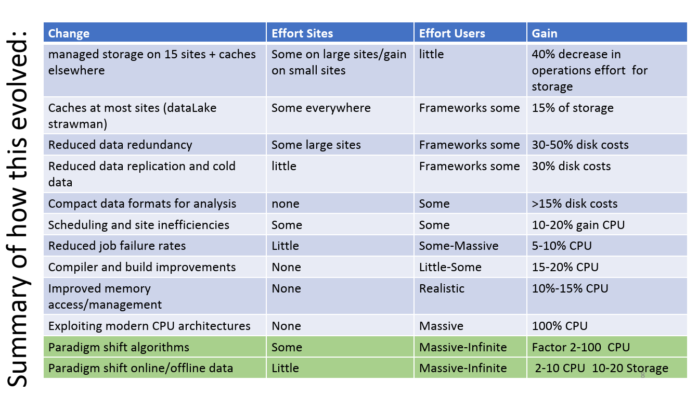
Other areas of potential savings
Many “small” improvements can stack to provide significant gains
  Some of these estimates got more precise as a result of recent studies (data popularity, TCO estimates, effect of data loss, …)
Source: M. Schulz

Slide 20
Next steps
After 1.5 years of activity it’s time to re-examine the roadmap and the goals
Some preliminary ideas
  Archive the results of all current and future studies
  Set clear priorities for studies
    So far much of the work was done in a “spontaneous” way, leading to interesting results but without a long-term goal in mind
  Harmonize studies performed on data from different experiments
    Typically popularity data
  Make sure that such studies are well coordinated with DOMA
  Consolidate the tools to calculate TCO and cost trends
    Very important to allow experiments to plan for the future
  Improve the understanding of tape costs relative to disk
    Including complexities like Oracle dropping out of tape business
  Consider running PrMon for all jobs
    Negligible overhead, may lead to a much better understanding of resource usage (currently experiments record averages, or max of metrics, not time series)

Slide 21
Conclusions
This working group was established to improve our understanding of the performance and the cost of computing for LHC (and HEP) and its evolution
  HL-LHC requires us to squeeze all the performance we can get at all levels
The WG is active in many areas, is already achieving important results and these activities are much more mature now
Independent work also started (e.g. at KIT to model a datacenter), we should try to benefit from it
Right time to re-evaluate priorities
Better coordination with DOMA
Work is still in progress but the time scale is long…

Slide 22
Membership
Alaettin Serhan Mete, Alessandra Forti, Alessandro Di Girolamo, Andrea Sartirana, Andrea Sciabà, Andrea Valassi, Andrew Sansum, Andrey Kirianov, Antonio Pérez-Calero, Bernd Panzer-Steindel, Carlos Perez Dengra, Catherine Biscarat, Concezio Bozzi, Costin Grigoras, Daniele Bonacorsi, David Lange, David Smith, Davide Costanzo, Dirk Duellmann, Domenico Giordano, Duncan Rand, Eric Fede, Erik Mattias Wadenstein, Frank Wuerthwein, Gareth Roy, Graeme A Stewart, Helge Meinhard, Jan Iven, Johannes Elmsheuser, José Flix, Markus Schulz, Martin Gasthuber, Michel Jouvin, Michele Michelotto, Oxana Smirnova, Paul Millar, Raul Cardoso Lopes, Renaud Vernet, Servesh Muralidharan, Tommaso Boccali, Torre Wenaus, Xavier Espinal Curull, Xiaomei Zhang, Yves Kemp

Slide 23
Further reading
Indico category
  https://indico.cern.ch/category/9733/

Slide 24
Backup slides
Backup slides

Slide 25
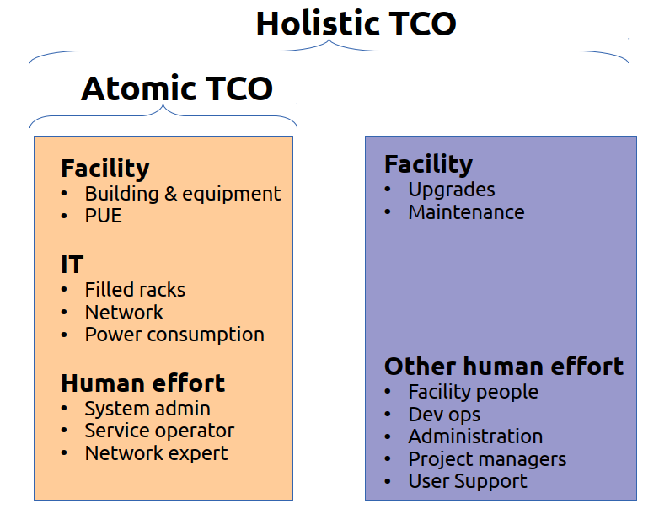
Differences in TCO

