Slide 1
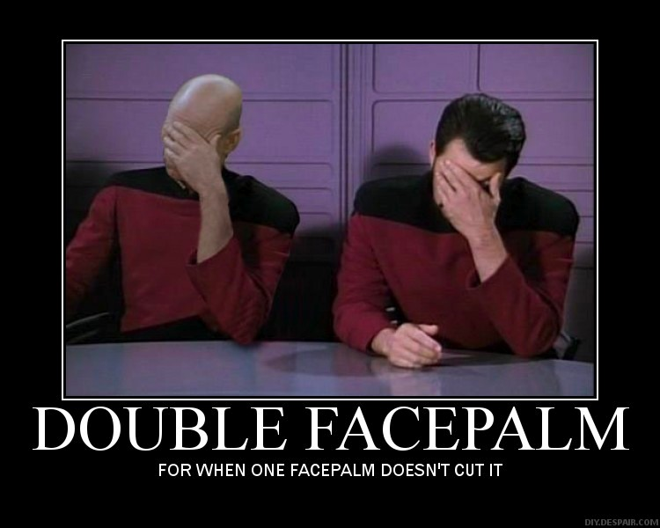
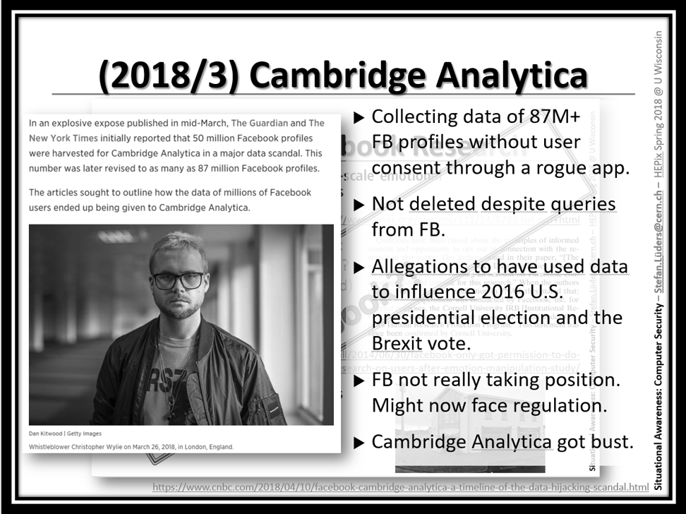
Situational Awareness: Computer Security
Same surprises as before…
Hence, a resurrection of my slides from HEPix Spring 2018:
https://indico.cern.ch/event/676324/contributions/2953745/attachments/1646858/2637234/Situational_Awareness__HEPix_2018.pdf
Dr. Stefan.Lüders@cern.ch for the CERN Computer Security Team
HEPix Spring 2019 @ SDSC, March 25-29 2019
Notes:
Timing: 20 mins

Slide 2
Preamble
“Freedom, security, convenience ---
choose two” (Dan Geer)
Consequently:
“Security will always be exactly
as bad as it can possibly be
while allowing everything to still function.”
(Nat Howard)

Slide 3
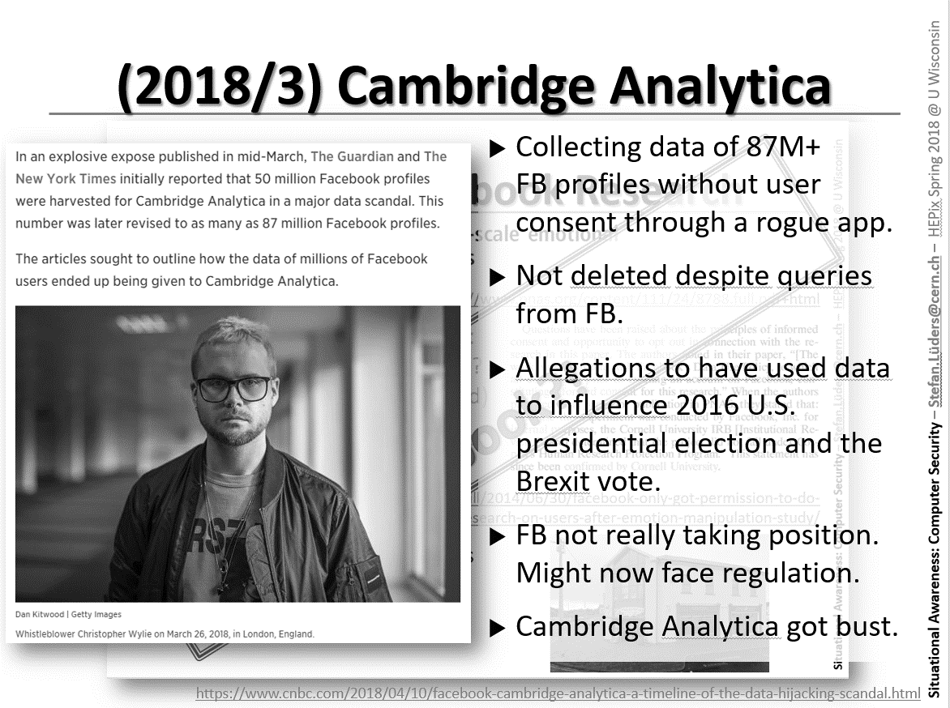
(2018/9) Facebook, again…

Slide 4
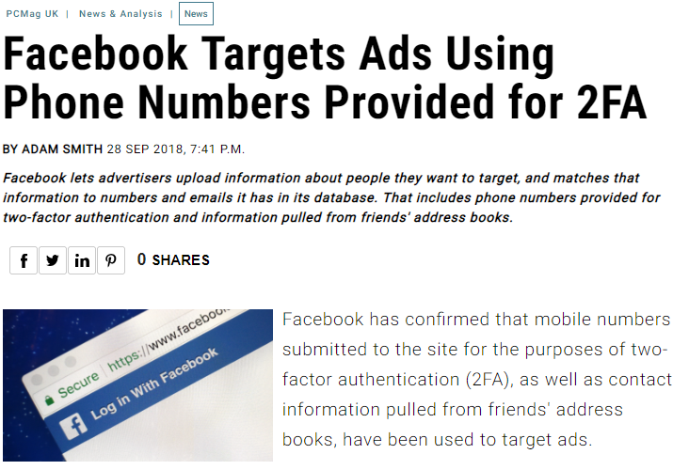
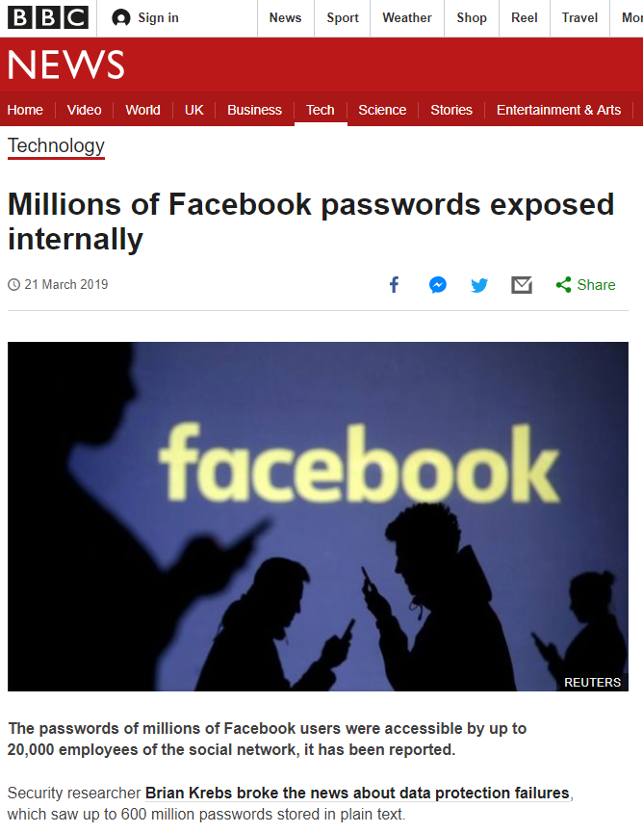
(2018/9) Facebook, again…

Slide 5
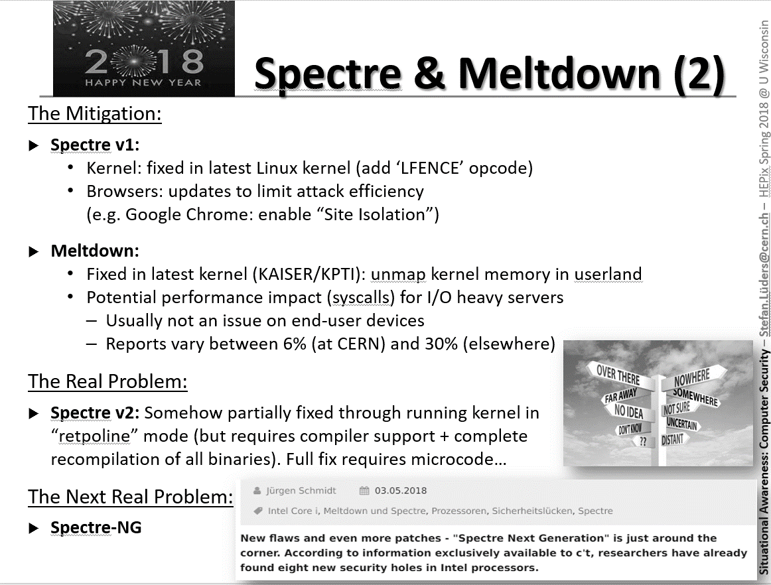

Slide 6
(2018/10) PortSmash
(2019/3) SPOILER
PortSmash: Exposes small amounts of data from legitimate processes to any malicious process running in parallel “thanks” to Intel's “SMT” capabilities
The Mitigation: Toggle simultaneous multi-threading (SMT) OFF ꟷ with a performance penalty on heavily used CPUs
SPOILER: Abuses speculative execution by leaking secrets from another area of Intel chips: its ”Memory Order Buffer” (tightly coupled with the cache)
The Mitigation: None, yet. And most likely, none to be expected
The Bigger Problem:
No serious exploits out in the wild yet. Nor for Spectre/Meltdown/L1TF.
Can we rely on the fact that never nothing will not happen?
Or: How much risk appetite do you fancy?
Mitigation:
Prompt & agile patching…
..and keeping fingers crossed.
https://www.zdnet.com/google-amp/article/intel-cpus-impacted-by-new-portsmash-side-channel-vulnerability
https://www.zdnet.com/article/all-intel-chips-open-to-new-spoiler-non-spectre-attack-dont-expect-a-quick-fix/

Slide 7
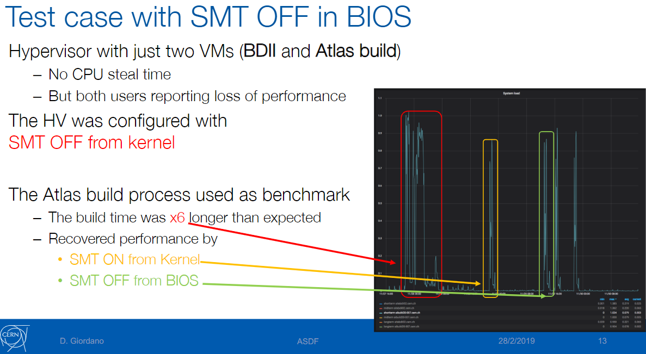
Hold on! SMT OFF?
Disabling SMT:
Via BIOS: (Initially thought to) Requires too much manual intervention
Via Kernel modules vis sysfs: Flexible as done by S/W. However:
: 20/40-cores i.e. virtual CPUs
Courtesy: D. Giordano (CERN)
Notes:
Interpretation: Due to a design flaw of Intel processors related to Machine Check Exceptions the non primary siblings have to be brought up at least partially and are then shut down again (https://www.kernel.org/doc/html/latest/admin-guide/l1tf.html)
-> CPU scheduler still considers the sibling for queueing (but rejects) and this causes delays to re-assign the primary thread.
Tests going on.

Slide 8
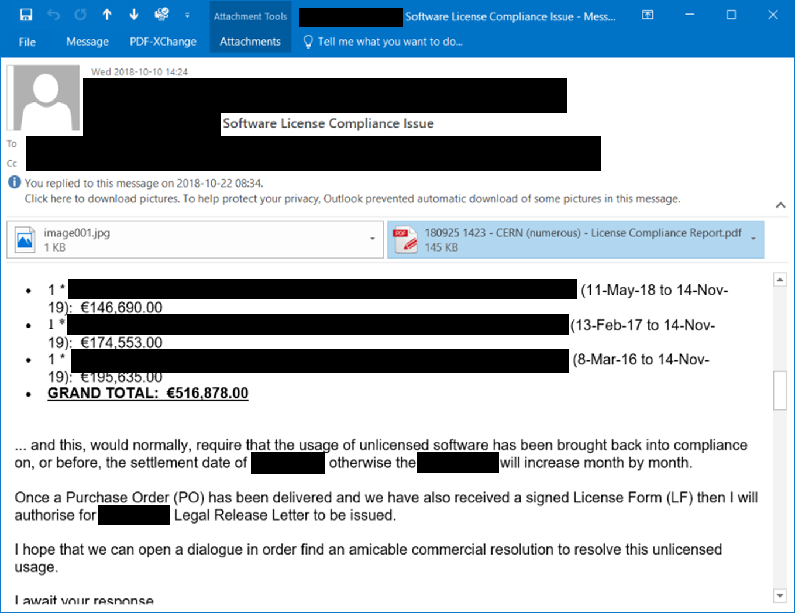
(2018/11) Software Licenses

Slide 9
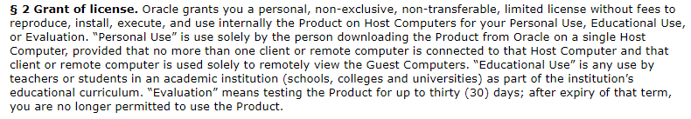
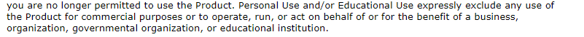

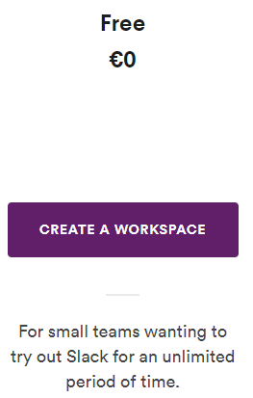

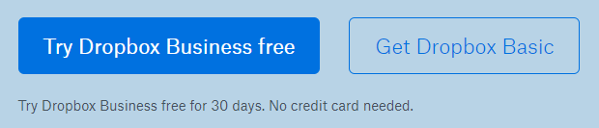
Software Licenses: More General
Oracle VM Virtual Box license scheme changed around 11/2017:
Still allowed to be used by our community?
…and there are more:
Mitigation:
Need for a Compliance Officer?
https://https://www.virtualbox.org/wiki/VirtualBox_PUEL

Slide 10
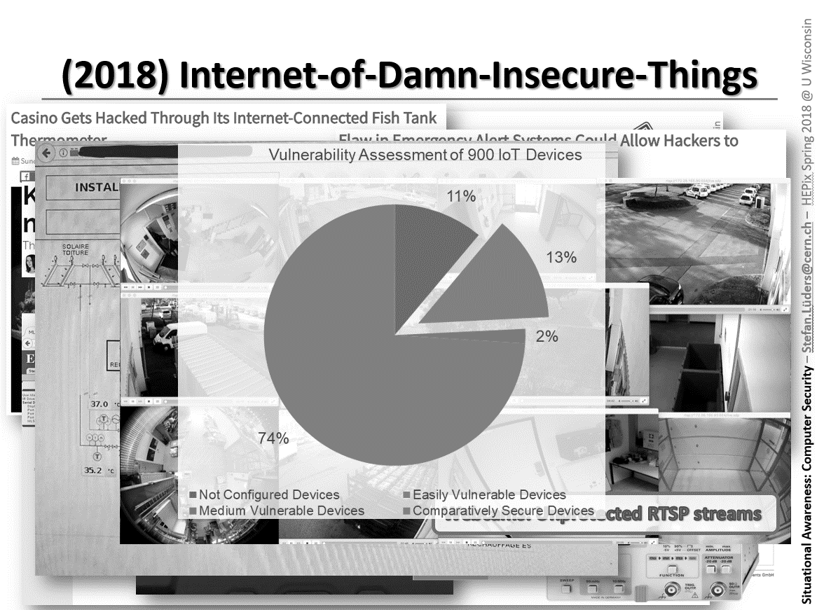

Slide 11
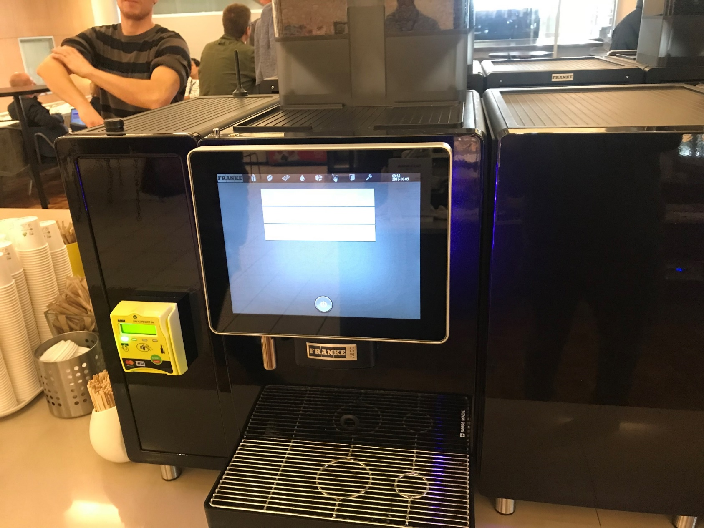
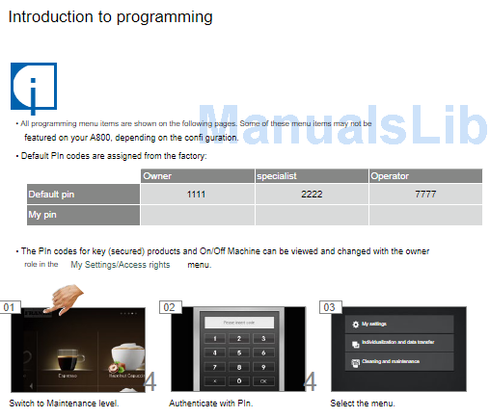
(2018/12) The Internet-of- hopelessly-Insecure-Things
Mitigation: Change defaults; kill unused services; add network segregation.

Slide 12
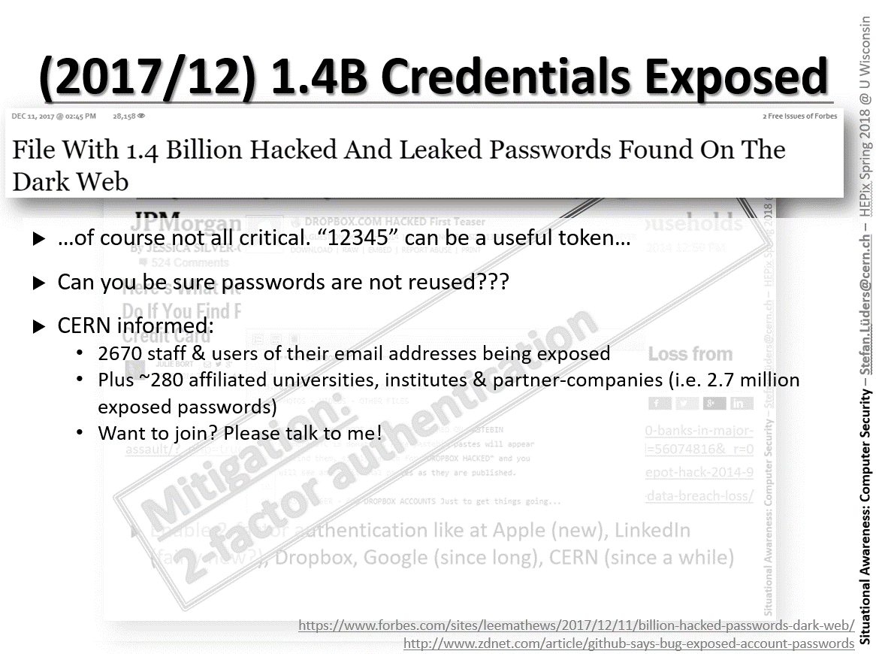

Slide 13
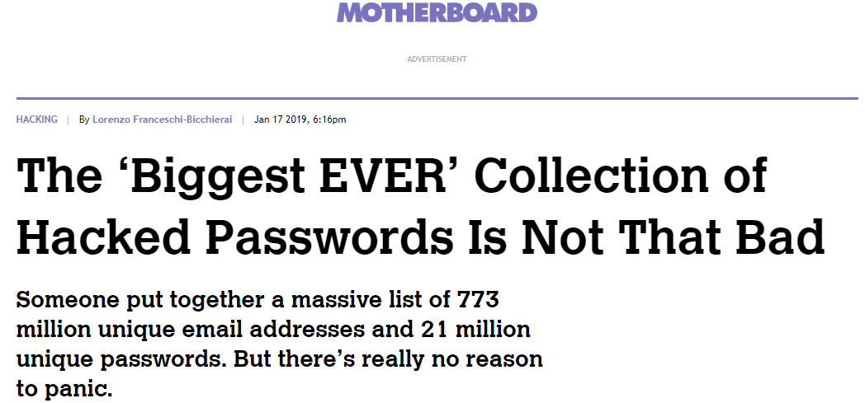
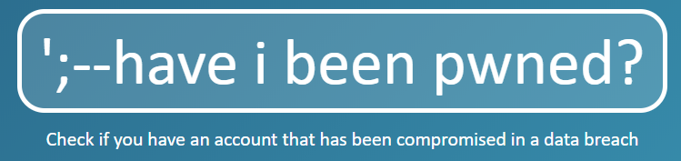
(2019/1) BigDB & Collection #1-5
https://haveibeenpwned.com/
Mitigation:
Subscribe to:
Most recent dump-of-dumps with lots of juicy stuff
…of course not all critical. “12345” can be a useful token…
Can you be sure passwords are not reused???
CERN informed:
    2751 staff & users of their CERN or external email addresses being exposed
    Plus 236 affiliated universities, institutes & partner-companies
    Want to join? Please talk to me!
https://motherboard.vice.com/en_us/article/evegxw/collection-one-data-breach-password-hack-what-to-do

Slide 14
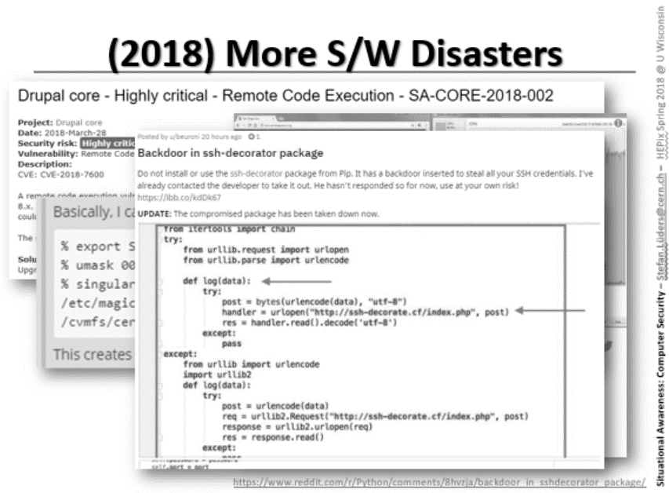

Slide 15
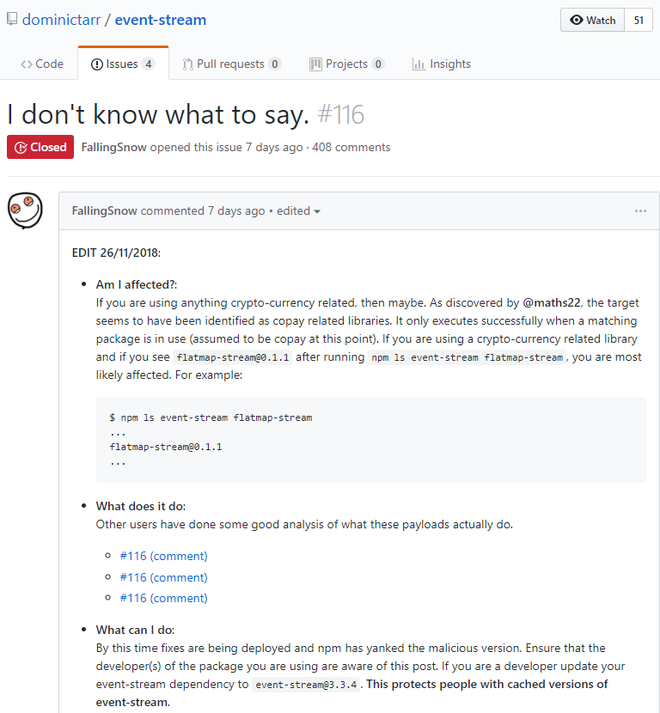
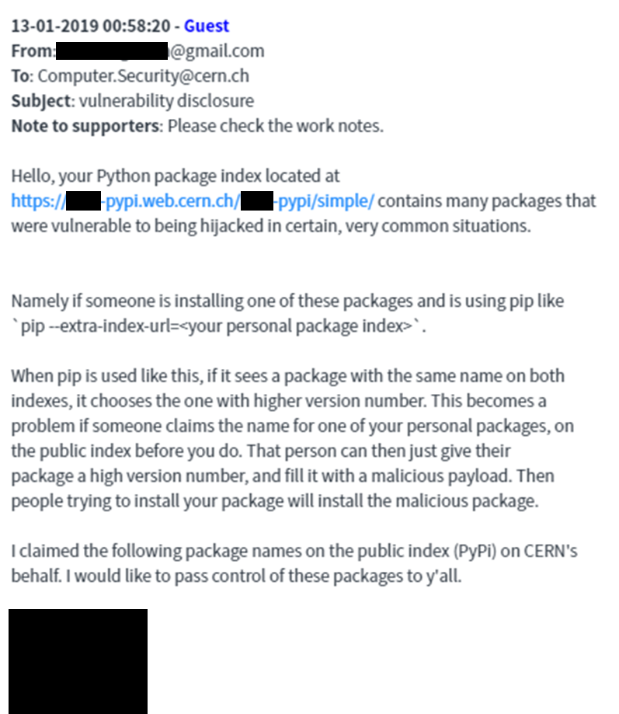
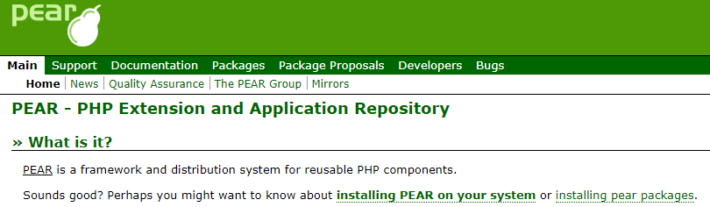
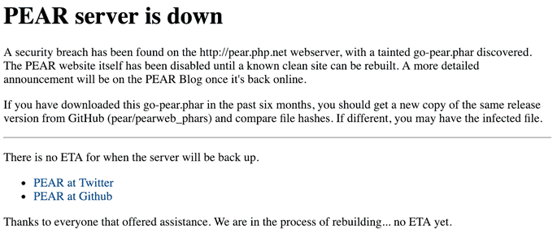
(2019/1) S/W Dependencies
With more and more agile development, external S/W dependencies pose an increased security risk
In particular, when dependencies are imported in an automatic fashion from untrusted/unverified origins (PiP/PyPI, NPM, …)
Mitigation: Run a centralized repo mirror like Nexus.

Slide 16
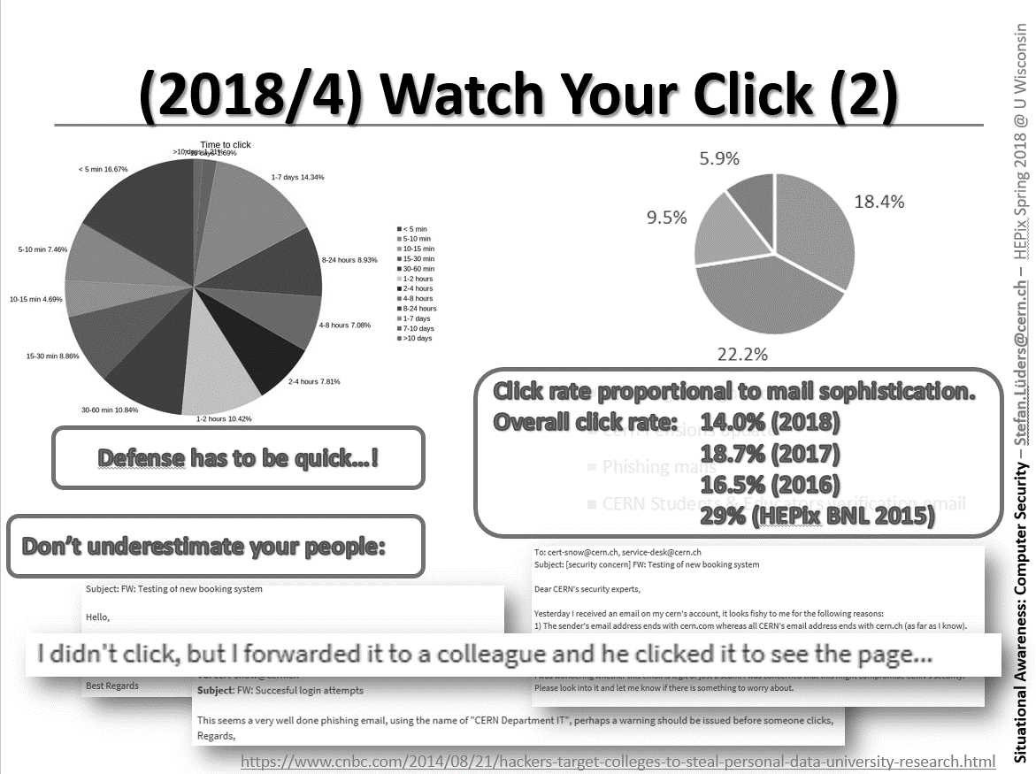

Slide 17
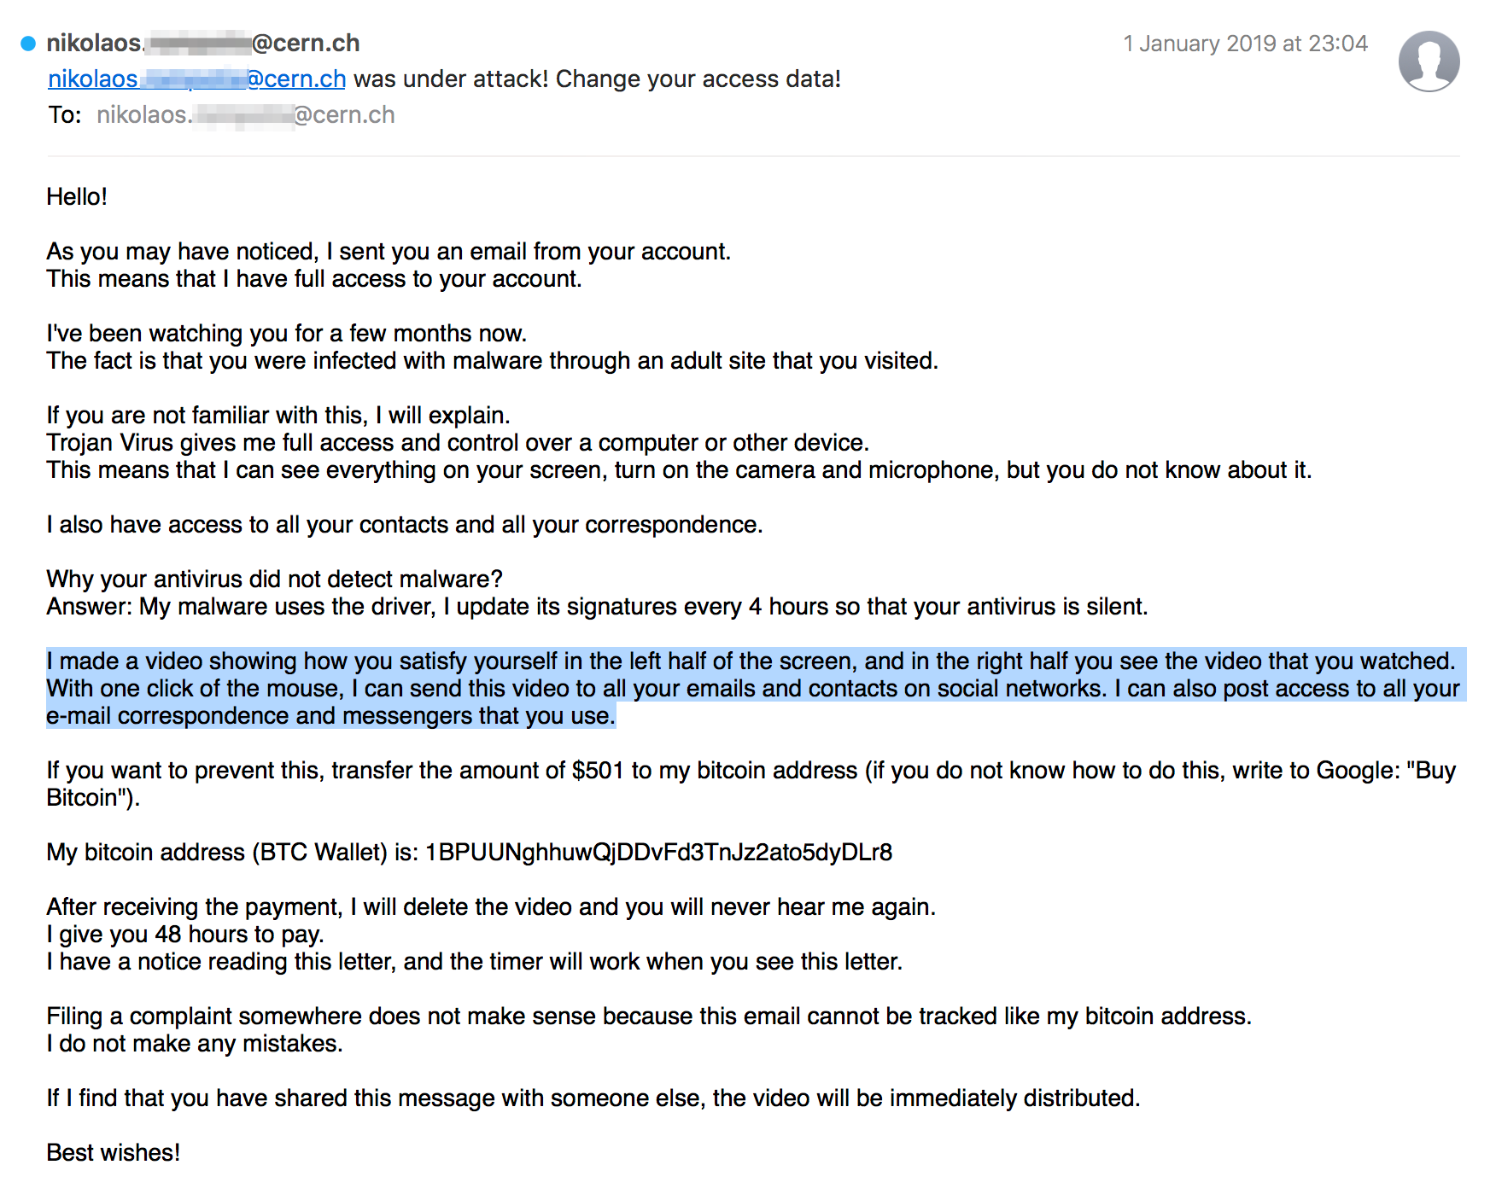
(2019/2) Money Extortion Scams

Slide 18
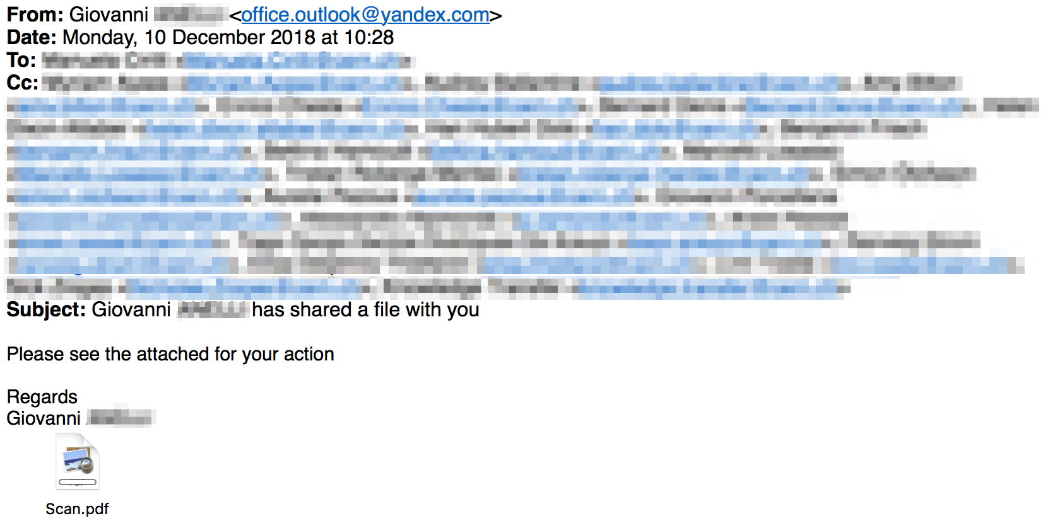
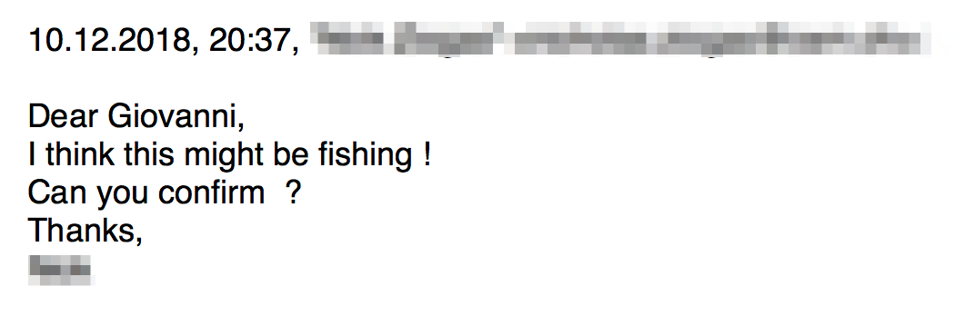
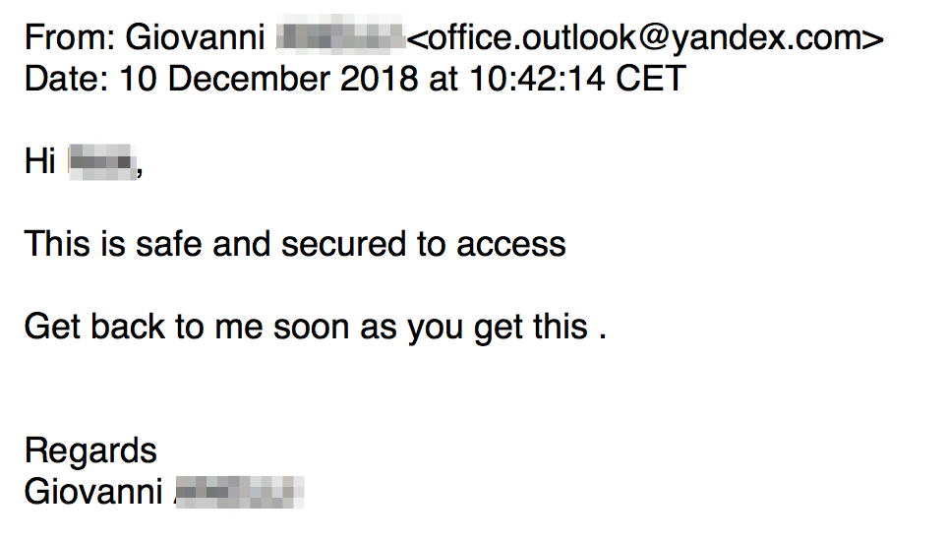
Increased Sophistication
Mitigation: Host hardening & eMail detonation chambers

Slide 19
Counting on your Click

Slide 20
Azure or not: https://*.*.web.core.windows.net
Mitigation: Host hardening & eMail detonation chambers
Email with embedded malicious HTTPS link: Hard to analyse on IDS level
Valid genuine SSL certificate and hosted on “Windows.net”
…allocated to Azure customers, here malicious ones!
https://azure.microsoft.com/en-us/

Slide 21
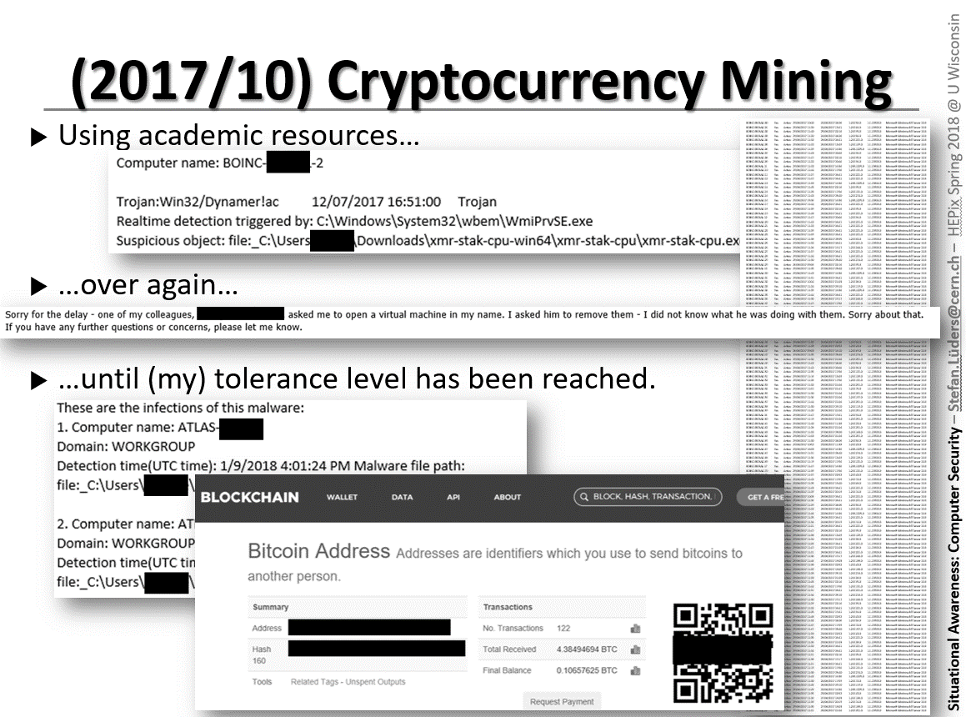

Slide 22
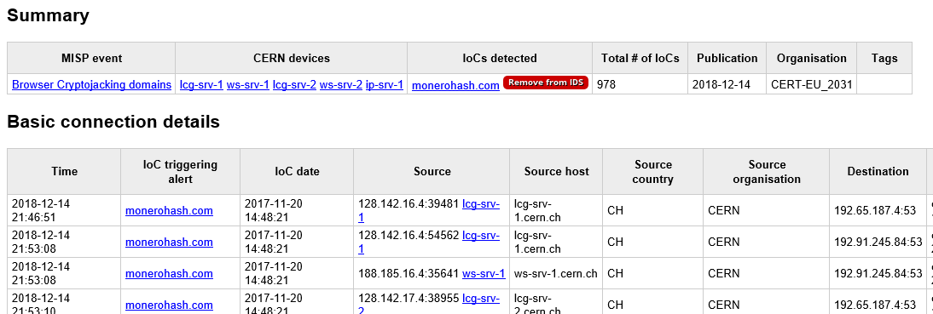
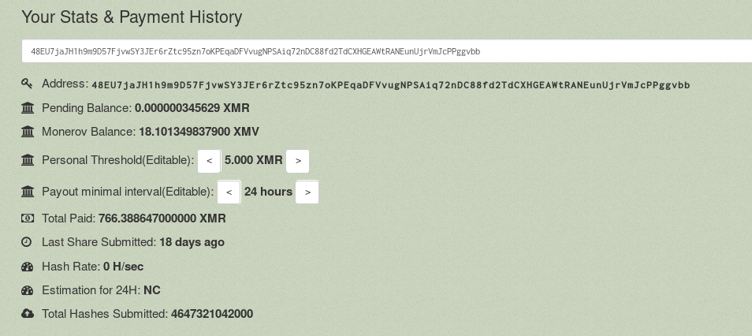
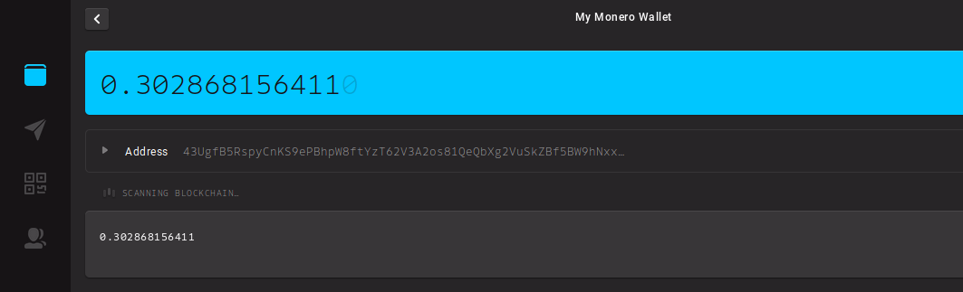
(2019/3) Cryptocurrency Mining
Mitigation: Tight monitoring of
computing cluster activities
Monero I:
$40000 in XMR mined
2500 CPU-years used
$110.000 damage
Monero II:
$15 in XMR mined
1353 CPU-years used
$60.000 damage
What about you?

Slide 23
Random Tour of Vuln’s (1)
Disabling Jenkins security model to compromise instances (CVE-2018-1999001, https://jenkins.io/security/advisory/2018-07-18/)
Remote code execution on Drupal (PSA-2019-02-1, https://www.drupal.org/psa-2019-02-19; SA-CORE-2019-003, https://www.drupal.org/sa-core-2019-003)
Privilege escalation through a local user on Apache Spark (CVE-2018-11760 & more; https://spark.apache.org/security.html)
Arbitrary code execution and privilege escalation by unauthenticated thirds affecting Intel Server Boards, Intel Server Systems and Intel Compute Modules firmware versions before 00.01.0014 (CVE-2018-12173; https://www.intel.com/content/www/us/en/security-center/advisory/intel-sa-00179.html)

Slide 24
Random Tour of Vuln’s (2)
Exploiting “mount-suid“ on Singularity 2.4.0 to 2.6.0. Delete those binaries: “/usr/libexec/singularity/bin/start-suid” and “/usr/libexec/singularity/mount-suid”
Privilege escalation in Kubernetes providing access to secrets, pods, environment variables, running pod/container processes, and persistent volumes, including access to sensitive information (https://github.com/kubernetes/kubernetes/issues/71411)
Code execution through hosted containers by remote, anonymous users in order to steal cluster authentication tokens on Kubernetes (https://labs.mwrinfosecurity.com/blog/attacking-kubernetes-through-kubelet). Disable anonymous authentication for the “kubelet” service by setting “anonymous-auth” (/etc/kubernetes/kubelet) to FALSE and restart kubelet
Mitigation: Prompt & agile patching… and digest security notifications.

Slide 25
Conclusions
If we want to win/keep up with this marathon, we should/must(!)
More often choose “security” instead of “convenience”
More often consider “privacy” instead of “freedom”;
Have deep direct ties with the community to learn quickly about the malicious evil (and where they affect/attack us);
Have good traceability & logging in place to figure out whether/where(!) we are attacked/affected;
Have good configuration management for prompt and agile patching (office computing, data center and control systems!);
Accept that we do not and cannot control the full phase-space. Protection is often difficult/impossible, and ꟷ for sure ꟷ costly.

Slide 26
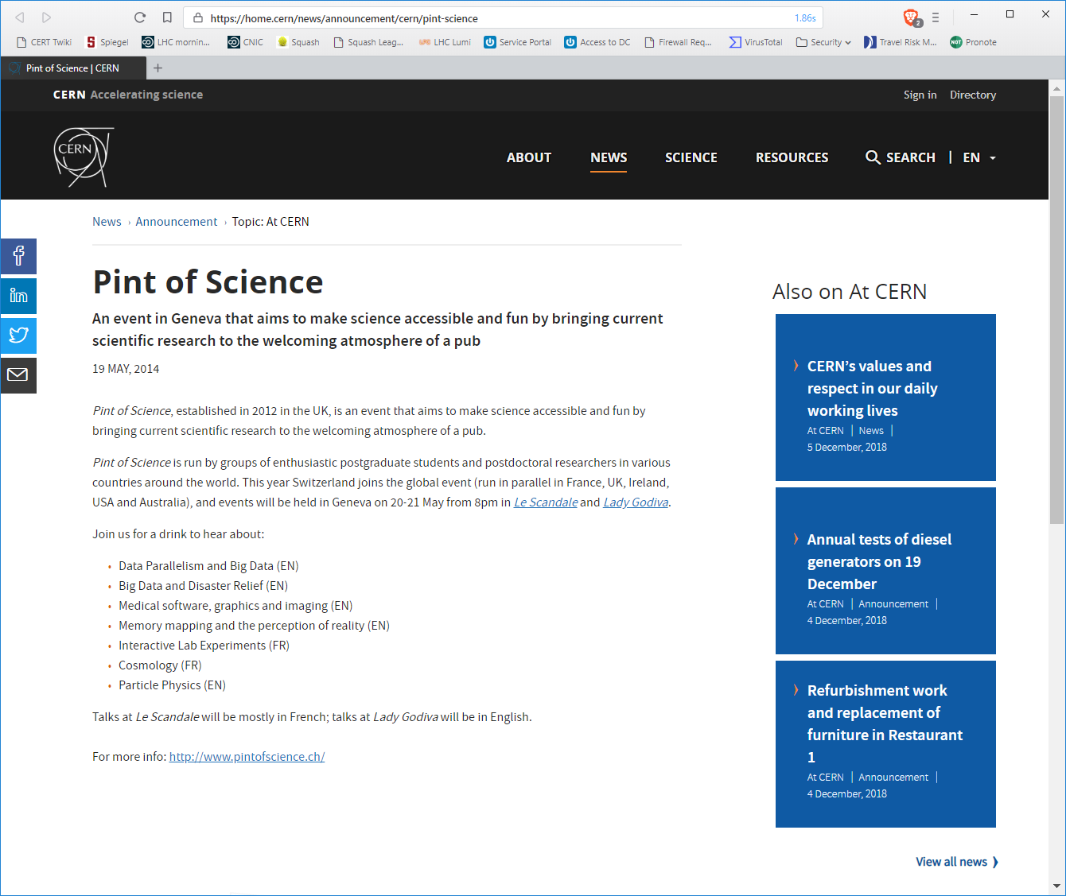

Legacy Web Sites: Reputational Risks
Thank you!
Questions?

