Slide 1

IPv6 & WLCG – an update from the HEPiX IPv6 working group
David Kelsey (STFC UKRI), Andrea Sciabà (CERN)
HEPiX, UCSD, 26 Mar 2019

Slide 2
On behalf of all colleagues in the HEPiX IPv6 working group
Active in HEPiX IPv6 Working Group – last 6 months
M Babik (CERN), M Bly (RAL), T Chown (Jisc), J Chudoba (Prague),
C Condurache (RAL), T Finnern (DESY), C Grigoras (CERN/ALICE),
B Hoeft (KIT), D P Kelsey (RAL), F López Muñoz (PIC), E Martelli (CERN), A Manzi (CERN), R Nandakumar (RAL/LHCb), K Ohrenberg (DESY), F Prelz (INFN), D Rand (Imperial), A Sciabà (CERN/CMS)
Many more in the past, and others join from time to time
and thanks also to WLCG operations, WLCG sites, LHC experiments, networking teams, monitoring groups, storage developers…

Slide 3
Outline
Since HEPiX in Barcelona (8-12 Oct 2018)
  Finalised our CHEP2018 paper – “IPv6 in production: its deployment and usage in WLCG”
  One F2F meeting at CERN (24/25 Jan 2019)
  3 meetings by Vidyo
WLCG dual-stack service endpoint tracking
Tier-0/Tier-1/LHCOPN/LHCONE status
Tier-2 status
FTS transfers
Monitoring
Work in progress
Summary

Slide 4
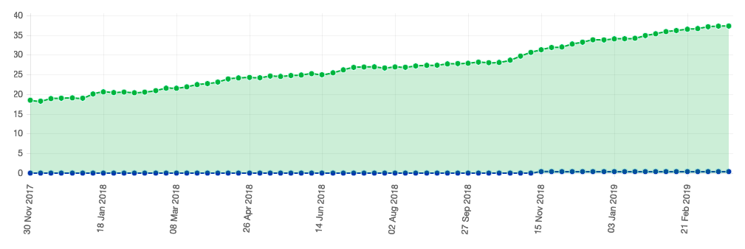
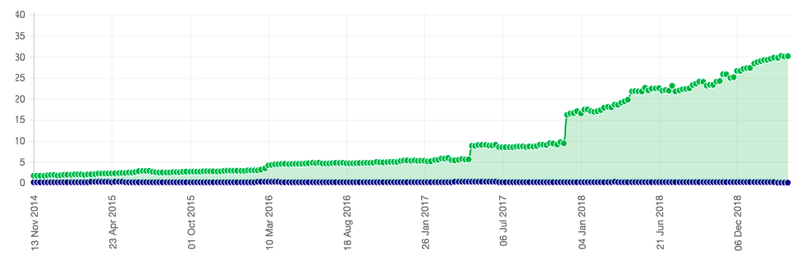
WLCG services status (dual-stack)
results from the LHC Expts VO feeds (http://orsone.mi.infn.it/~prelz/ipv6_vofeed/) (~37%)
Fraction of endpoints listed in the CERN central BDII (lcg-bdii.cern.ch) where the DNS returns a dual-stack IPv6-IPv4 (A+AAAA) resolution (green line) or an IPv6-only resolution (blue line). (http://orsone.mi.infn.it/~prelz/ipv6_bdii/).

Slide 5
Tier-0/Tier-1/LHCOPN/LHCONE status
(Bruno Hoeft)

Slide 6
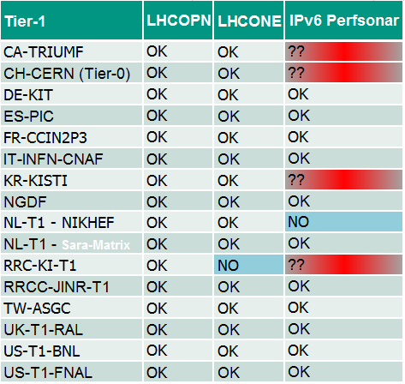
Network and pS at Tier-1’s
All sites connected to LHCONE except RRC-KI
TRIUMF, CERN, KISTI and RRC-KI still have some problem with IPv6 on pS

Slide 7
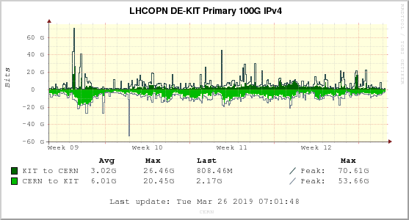
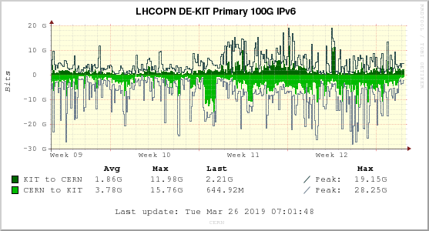
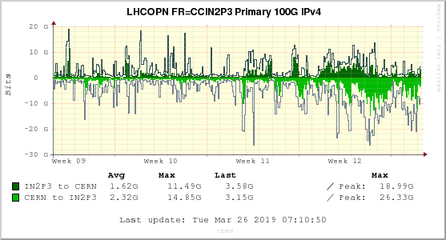
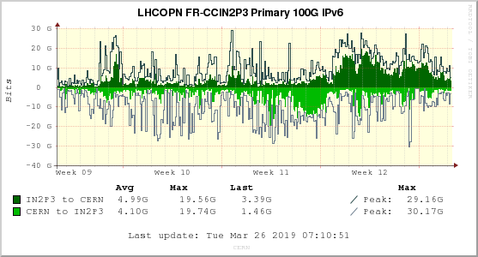
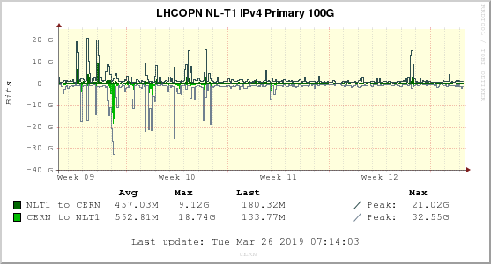
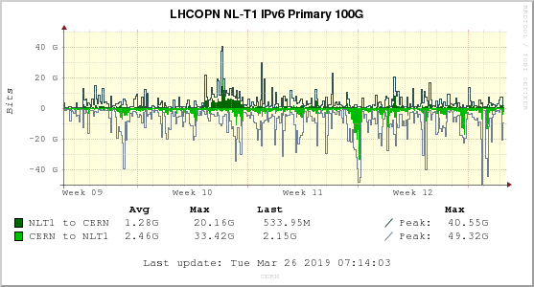
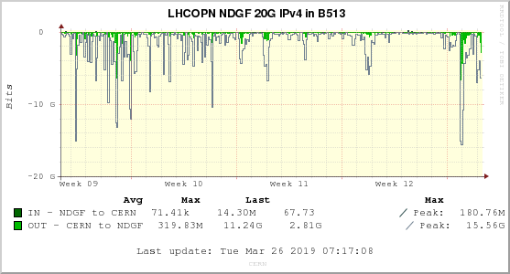
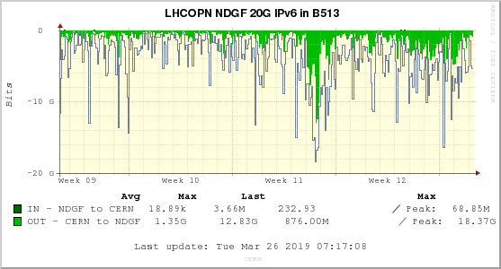
IPv6 traffic to selected T1’s
Link | IPv4 | IPv6
KIT→CERN | 62% | 38%
CERN→KIT | 61% | 39%
IN2P3→CERN | 25% | 75%
CERN→IN2P3 | 36% | 64%
NL-T1→CERN | 26% | 74%
CERN→NL-T1 | 19% | 81%
NDGF→CERN | 79% | 21%
CERN→NDGF | 19% | 81%

Slide 8
IPv6 on FTS and at Tier-1’s
FTS servers at BNL, CERN and RAL work in dual stack, while at FNAL they use IPv4 only
GridFTP transfers happen also via IPv6 at
  IN2P3, JINR, NDGF, RAL, SARA-MATRIX, NIKHEF, CNAF, ASGC, PIC, TRIUMF, KIT
IPv6 transfers do not happen at
  FNAL, RRC-KI
Fraction of disk storage on IPv6:
  ALICE: 73%
  ATLAS: 96%
  CMS: 71%
  LHCb: 94%
  All VOs: 86%

Slide 9
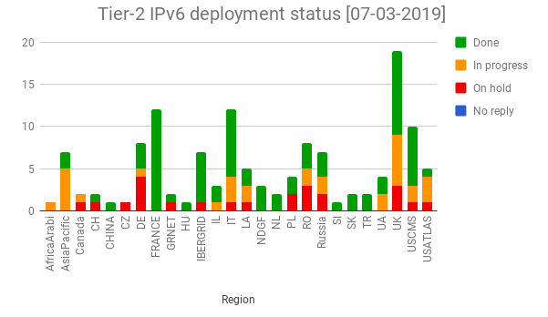
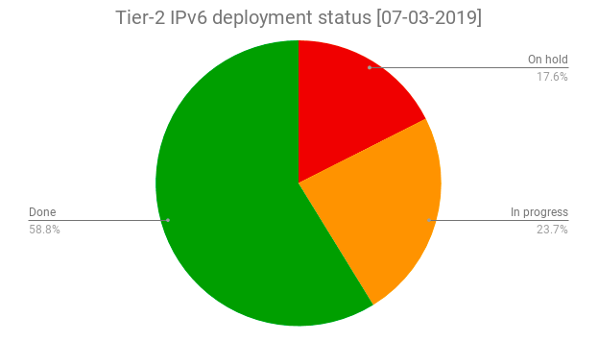
Tier-2s: GGUS tickets to all Tier-2 sites
WLCG set a target for end 2018 for deploying IPv6 on storage systems (and perfSONAR)
The deployment campaign was launched in November 2017
  GGUS tickets sent to all non-US sites
  US sites are tracked via the experiments
  Sites made aware of the WLCG plans and asked to report plans and give updates
Steady progress (status)
  About 59% of T2 sites have storage on dual stack

Slide 10
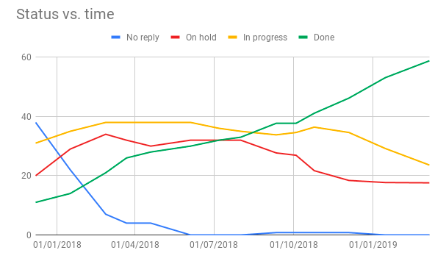
Tier 2 status (cont’d)
Experiment | Fraction of T2 storage accessible via IPv6
ALICE | 64%
ATLAS | 46%
CMS | 83%
LHCb | 63%
Overall | 62%

Slide 11
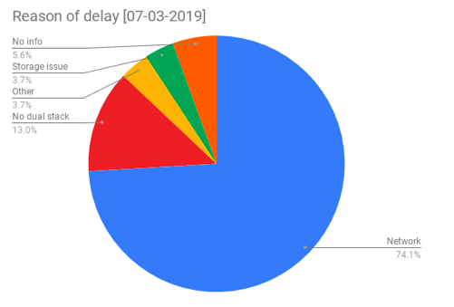
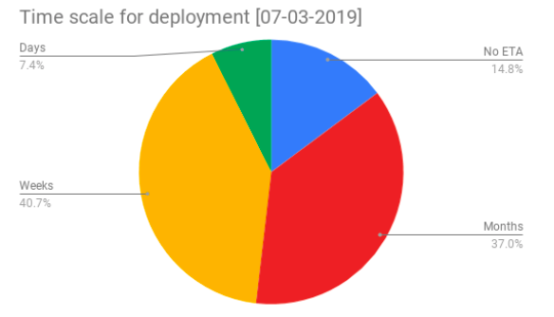
Tier-2 status: reasons for delays
Checked why sites are late in their IPv6 deployment and the expected ETA
  Network: waiting for interventions on the site infrastructure or network issues to be fixed
  No dual stack: infrastructure network is fine but IPv6 needs enabling on storage or perfSONAR
  pS/storage issues: encountered problems that need fixing
  Other: other types of problems (e.g. the site needs relocating)
  No info: no meaningful information given by the site on their plans

Slide 12
T2 deployment observations
Tentative extrapolation to the future
  Within days: 62%
  Within weeks: 79%
  Within months: 94%
Most sites are responsive and provide detailed information
  For some however regular pinging is a must…
Several sites must wait for their campus infrastructure to become IPv6-ready
It is evident that IPv6 is being deployed or will soon be deployed at the vast majority of the remaining sites and that the WLCG request is taken seriously

Slide 13
FTS – transfers over IPv6
(xRootD transfers not yet instrumented
to track IPv6 vs IPv4)

Slide 14
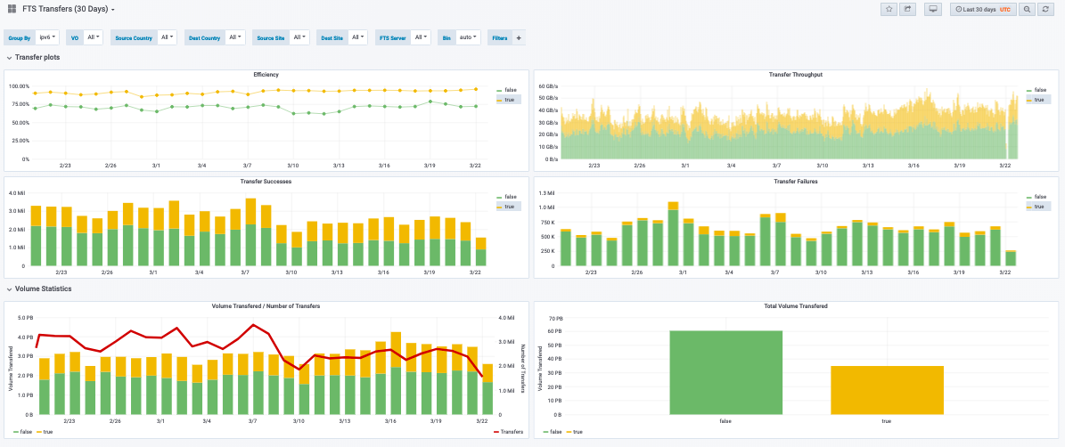
FTS transfer monitoring
Approximately 37% of data transferred via FTS in the last 30 days went over IPv6
https://monit-grafana.cern.ch/

Slide 15
Monitoring
(Marian Babik)

Slide 16
ETF News
Experiments instances ready
  CMS and LHCb IPv6 instances ready, currently dual-stack
  ATLAS has an IPv6-only instance, CMS and LHCb will soon follow
Other news
  protoDUNE plans to use ETF to monitor its infrastructure
  CMS/DODAS project and FNAL HEPCloud also being discussed; CMS/DODAS is working in QA (it’s VAC-model; no remote API; jobs are pulled from ETF HTCondor pool)
  ETF is being migrated to Docker and Kubernetes

Slide 17
perfSONAR news
Marian Babik & Duncan Rand
Campaign to update all perfSONARs to CC7 and 4.1 ongoing
  Contacting sites directly (will issue tickets if necessary)
  SL6 unsupported since Q4 2018
CERN new perfSONAR servers
  2 servers with 40 Gbps/100 Gbps
Good progress with maddash
  Solved most pS problems at Tier-1s
  Found some bugs, already fixed by developers
IRIS-HEP started
  Has tasks/objectives related to perfSONAR

Slide 18
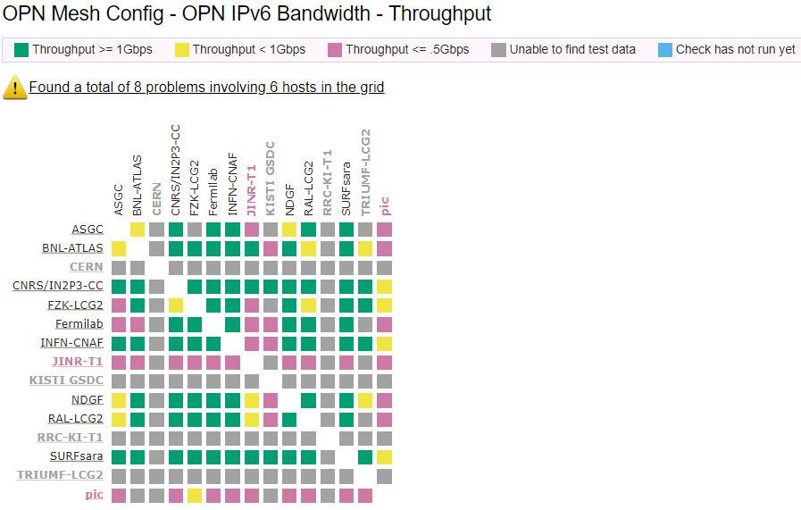
perfSONAR IPv6 Mesh
Re-configured as was agreed
  IPv6 pS tests now included in all meshes
  Throughput and traceroute tests always for both IPv4 and IPv6, latency tests for either depending on what’s available on both ends
Dual-stack mesh retired
New monitoring is in place which reports test “efficiency” wrt IPv4 and IPv6
  Efficiency =number of working destinations / total destinations
  For each perfSONAR node and each mesh, reports missing results in the perfSONAR’s local measurement archive (link)

Slide 19
Work in progress
PIC and FTS team – investigating why transfers made over IPv4 when both ends are IPv6?
  Lots of places where the IPv6 versus IPv4 preference is configured
ATLAS and CMS are testing IPv6-only worker nodes
  ATLAS: SiGNET (Slovenia) – production work on IPv6-only WN – works well
  CMS: Nebraska T2 – See Garhan’s talk

Slide 20
IPv6 deployment on WLCG - Summary
WLCG to support use of IPv6-only CPU resources
Good steady progress towards this goal!
Tier-1s should already have production storage accessible over IPv6
  > 85% of data is available via IPv6
Tier-2s 59% sites done
  62% of Tier-2 storage is dual-stack
37% of FTS transfers today over IPv6
  No monitoring yet for xRootD
>50% perfSONAR hosts now reporting IPv6-enabled
There are still some issues to fix and/or understand

Slide 21
Questions?

Slide 22
Backup slides

Slide 23
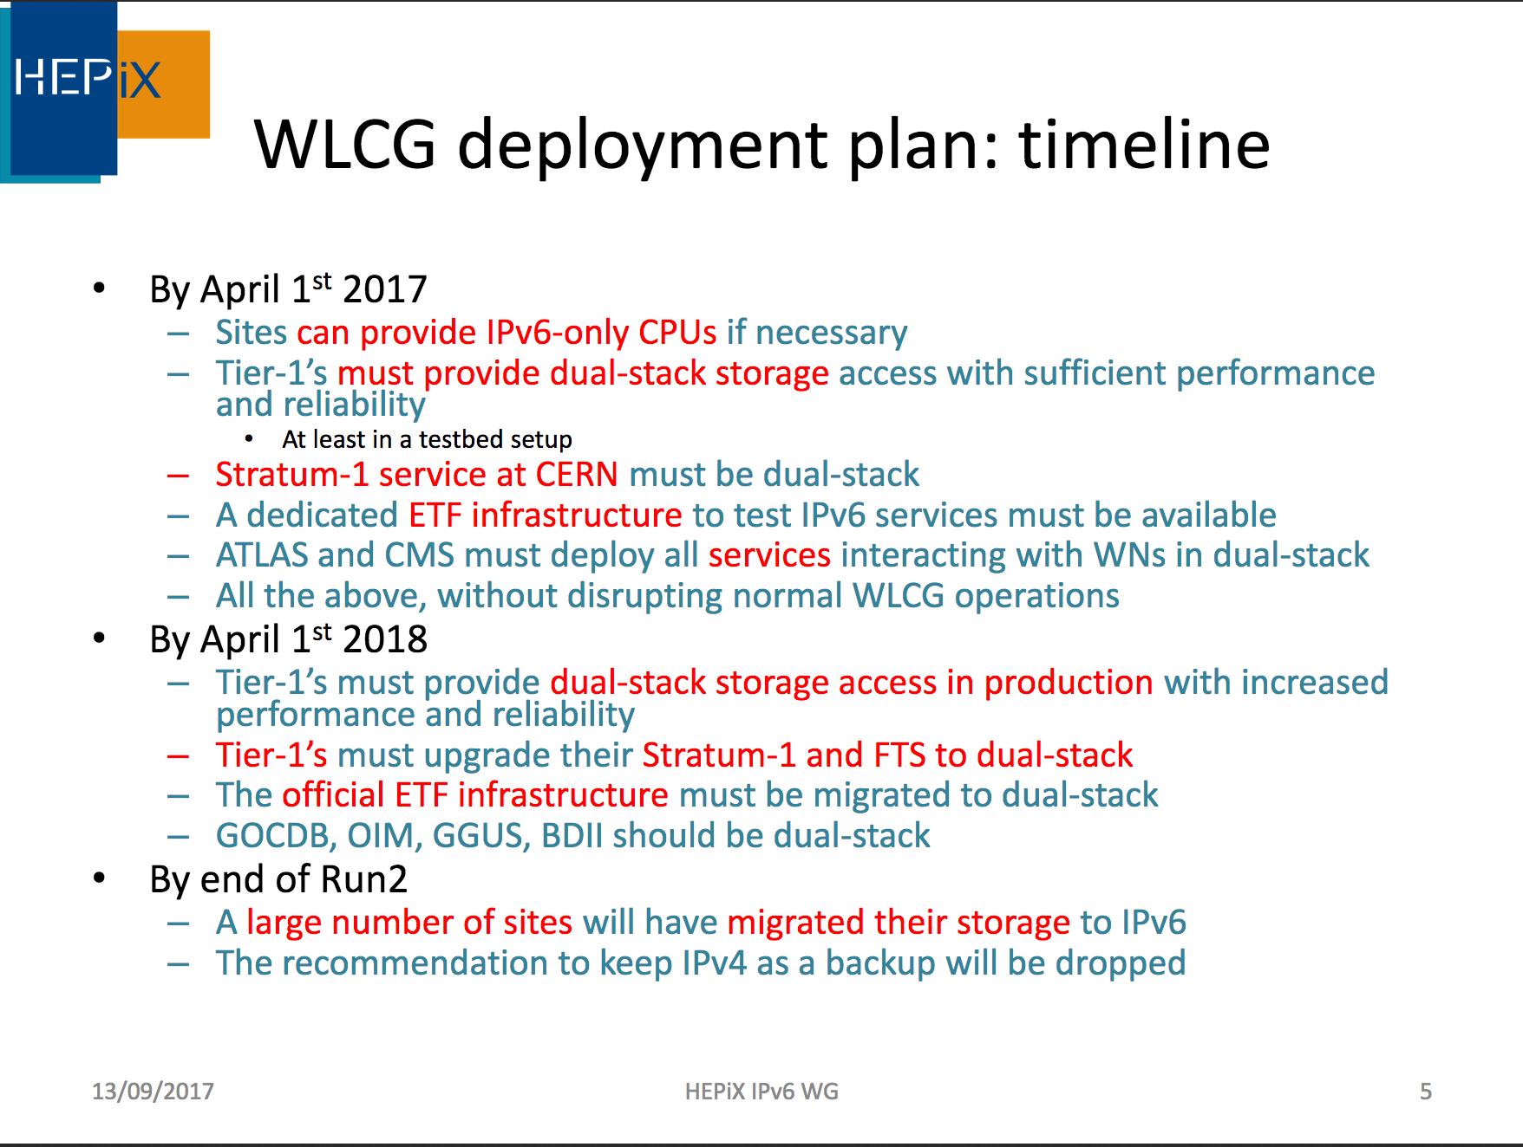

Slide 24
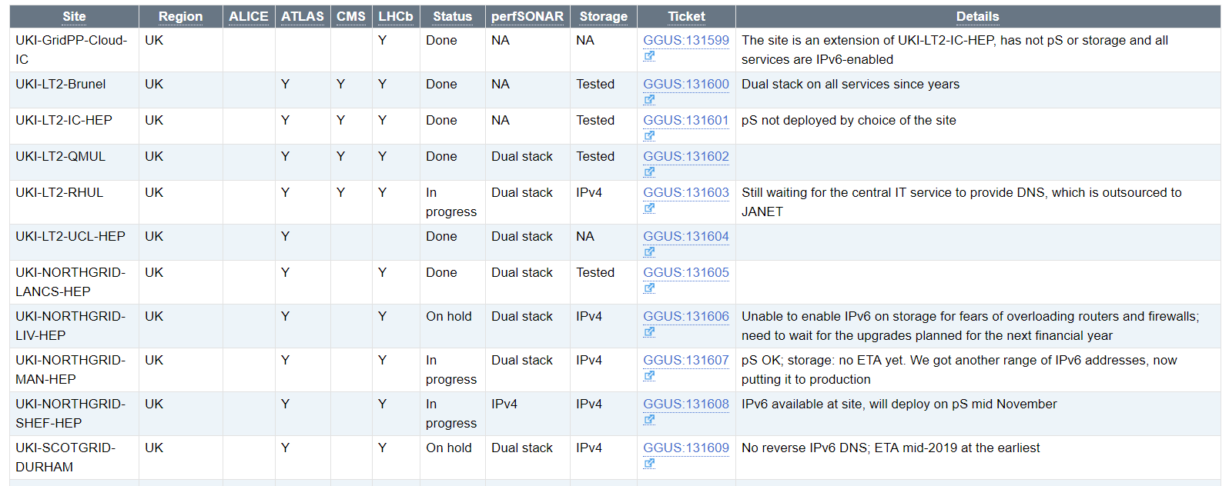
T2 tracking page
https://twiki.cern.ch/twiki/bin/view/LCG/WlcgIpv6

Slide 25
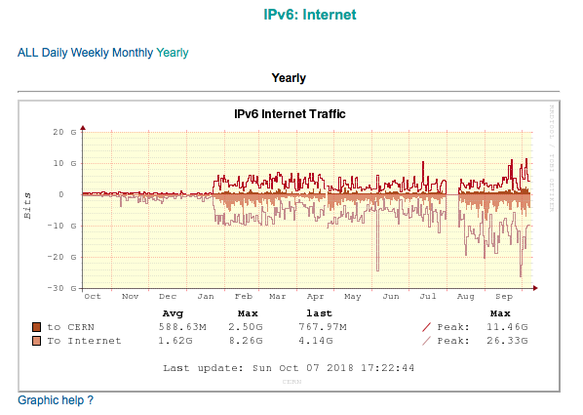
CERN Non-LHCOPN traffic – showing dual-stack EOS turn-on in Jan 2018
https://netstat.cern.ch/monitoring/network-statistics/ext/?q=IPv6&p=EXT&mn=Internet&t=Yearly

Slide 26
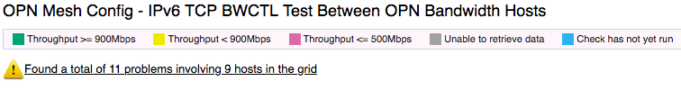

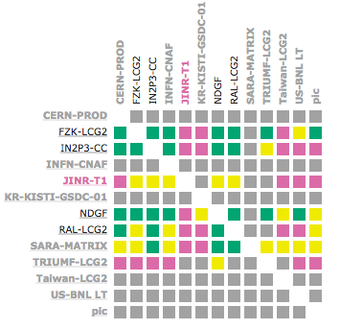
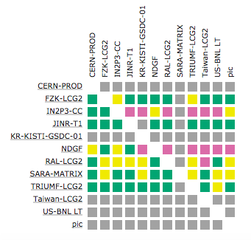
perfSONAR
http://psmad.grid.iu.edu/maddash-webui/index.cgi?dashboard=OPN%20Mesh%20Config

