Slide 1

Status of reference workloads, packaging and benchmarking
Manfred Alef (KIT)
Domenico Giordano (CERN)
Michele Michelotto (INFN)
On behalf of HEPiX Benchmarking Working Group
HEPiX Spring 2019

Slide 2
HS06 obsolescence
M. Alef (KIT)
Still using HS06 32bit since a decade even if scaling with “real” LHC applications is poor
Experiments run at 64 bit but this a +10-20% effect
Some experiments have some kind of magic boost on intel cpu after Haswell
DB12 proposed at some point, but found to be inadequate
  Dominated by front-end calls and branch prediction units
  Ok as a rough fast estimate of HS06 at runtime

Slide 3
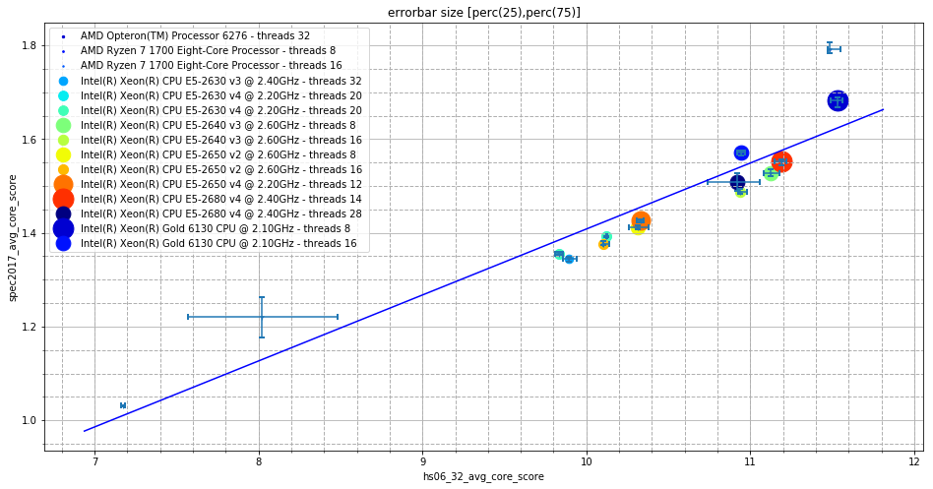
SPEC CPU2017 vs HS06
SPEC CPU2017:
geometric mean of benchmark scores (subset 508, 510, 511, 520, 523, 526, 531, 541)
optimizing flags: -O3 -fPIC -pthread
parallel benchmark runs (like HS06
SPEC CPU2017 (64bit) very similar to official HS06 (32bit) with current x86 architectures
Slope 0.14, correlation 0.935

Slide 4
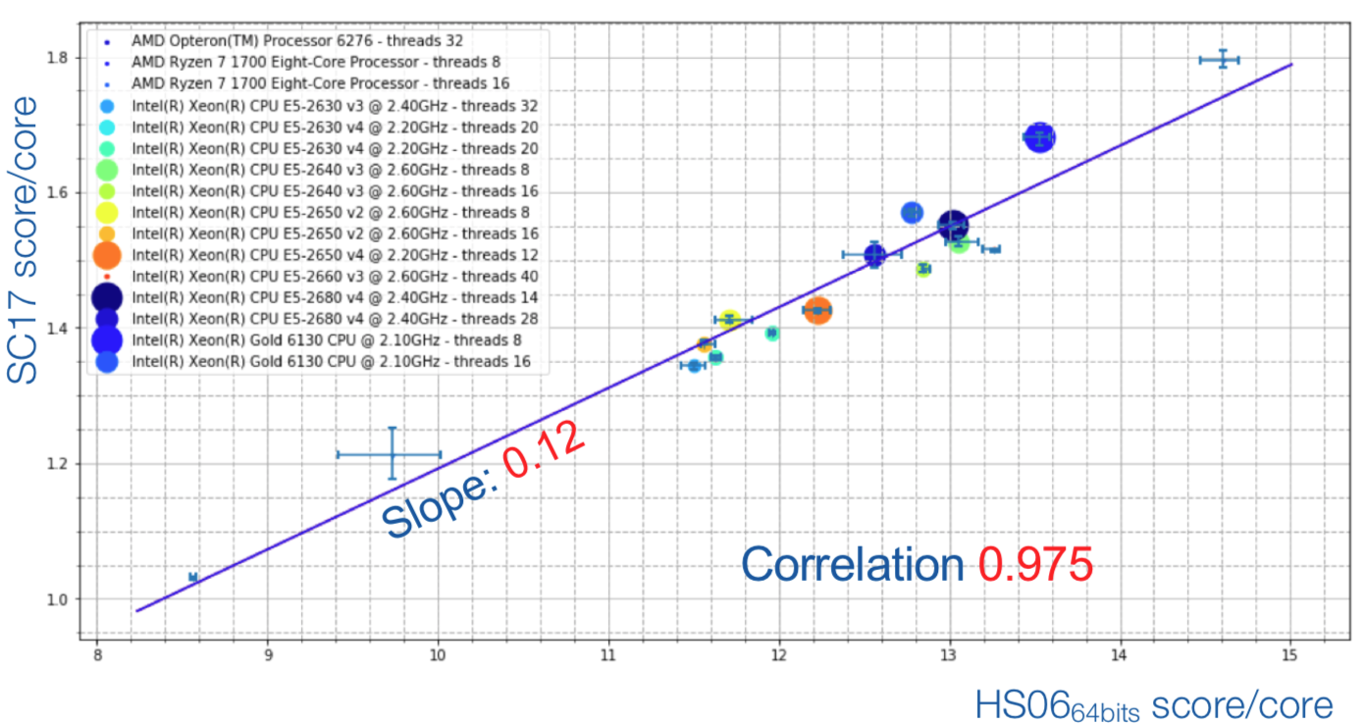
SPEC CPU2017 vs HS06 (64bit)n WLCG
SPEC CPU2017 (64bit) very similar also to HS06 (64bit) with current x86 architectures
Correlation with HS06 r=0.975

Slide 5
Workloads provided by experiments
ALICE
  A p-p simulation job using Geant3
ATLAS
  A ttbar simulation job using Geant4
  A digitization + reconstruction job
  A DxAOD derivation job
CMS
  Generation + simulation of ttbar events
  Digitization and trigger simulation with premixed pile-up
  Reconstruction job producing AODSIM and MINIAODSIM
LHCb
  Generation + simulation using Geant4 of D*(→π(D⁰→K π)) π π π events
Thanks to Andrea Sciabà for all the slides on workload

Slide 6
Summary of performance metrics
Job | Events | Processes/threads | Wallclock time (sec) | CPU efficiency | Time per event (sec) | Memory per core (GB) | Read rate per core (MB/sec) | Write rate per core (MB/sec)
ALICE sim | 1000 | 1 | 10901 | 100% | 10.90 | 0.96 | 0.0788 | 0.1660
ATLAS sim G4 | 1000 | 8 | 33627 | 100% | 269.02 | 0.44 | 0.0152 | 0.0090
ATLAS digireco | 2000 | 8 | 13981 | 87% | 55.92 | 1.12 | 0.3174 | 0.2412
ATLAS deriv | 95741 | 8 | 8401 | 98% | 0.70 | 1.20 | 0.6849 | 0.0705
CMS gensim | 1000 | 8 | 2651 | 99% | 21.21 | 0.19 | 0.0473 | 0.0377
CMS digi | 1000 | 8 | 737 | 78% | 5.90 | 0.65 | 0.2854 | 0.3004
CMS reco | 1000 | 8 | 1221 | 83% | 9.77 | 0.45 | 0.3073 | 0.2153
LHCb gensim | 10 | 1 | 1782 | 100% | 178.20 | 0.89 | 0.3115 | 0.0117
https://cernbox.cern.ch/index.php/apps/files/?dir=/__myprojects/wlcg-cost-model/Workloads/sciaba&
Thanks to Andrea Sciabà for all the slides on workload

Slide 7
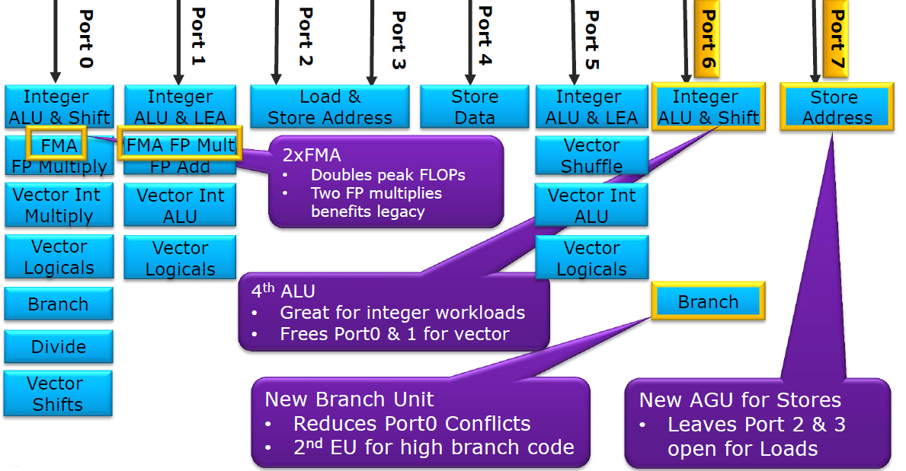
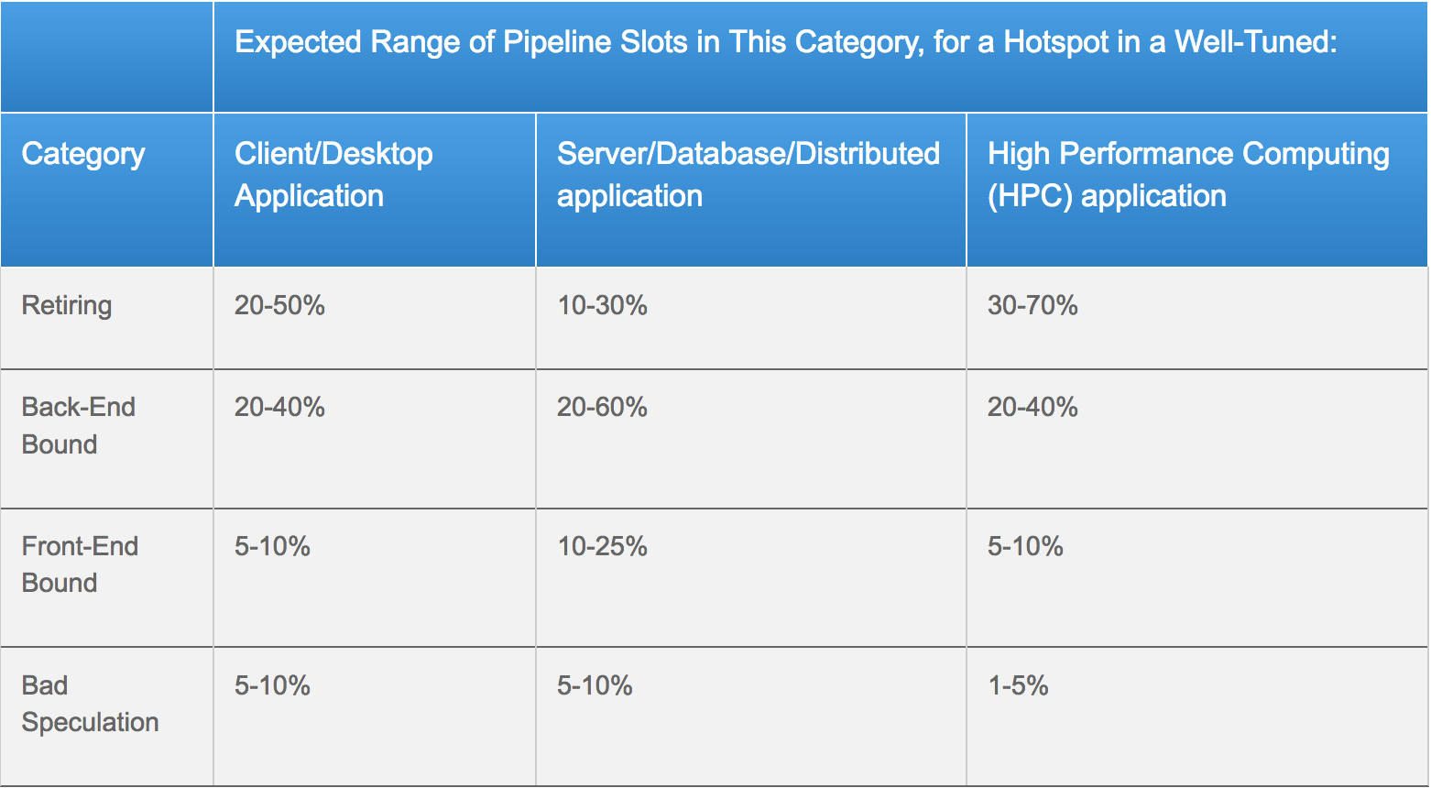
Trident - Core Performance Analysis
Intel Haswell EP
Instruction Per Cycle (IPC)
  Denotes ratio of parallel instructions executed
  Modern processors like Intel Haswell EP can do 4 IPC
Top down characterization
  Identifies the resources dominated by workload
  Front-End – fetch and decode program code
  Back-End – monitor and execution of uOP once the dependent data operands availability
  Retiring – Completion of the uOP
  Bad speculation – uOPs that are cancelled before retirement due to branch misprediction
Execution Unit Port Utilization
  Determines how many cycles the port was busy
  Identifies broadly the pressure from different types of uOPs
  INT & FP operations, address calculation, etc.,
Source: https://arstechnica.com/gadgets/2013/05/a-look-at-haswell/2/
Thanks to Servesh Muralidharan for all the slides on Trident
Source: https://software.intel.com/en-us/vtune-amplifier-help-tuning-applications-using-a-top-down-microarchitecture-analysis-method

Slide 8
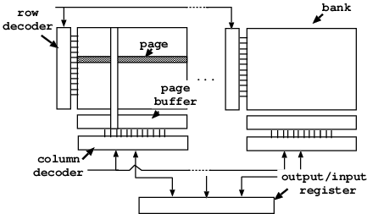
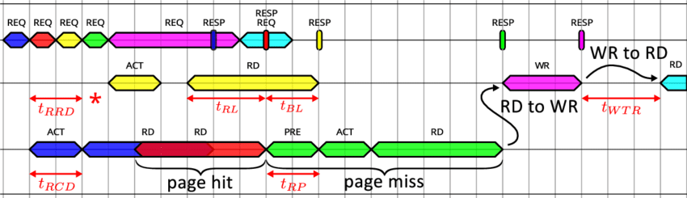
Trident - Memory Performance Analysis
Memory bandwidth usage
  Amount of data read and written to main memory
Memory transaction classification
  Memory transaction occurs through pages from memory bank
  Page-Hit
    Memory bank in open state
    Lowest access latency (Open)
    Sequential memory access usually have high page hits
  Page-Empty
    Memory bank is idle and needs to be activated
    Moderate access latency (Usually 2x of page hit)
    Random memory access usually have high page empty counts
  Page-Miss
    Memory to be accessed requires closing of a page in the same bank
    Worst access latency (Usually 3x of page hit)
Source: https://www.researchgate.net/figure/Multi-banked-SDRAM-architecture_fig1_221341164
Source: https://www.researchgate.net/figure/Example-of-a-typical-TLM-trace-with-DRAM-related-phases_fig4_282806593
Further info: https://www.anandtech.com/show/3851/everything-you-always-wanted-to-know-about-sdram-memory-but-were-afraid-to-ask/5

Slide 9
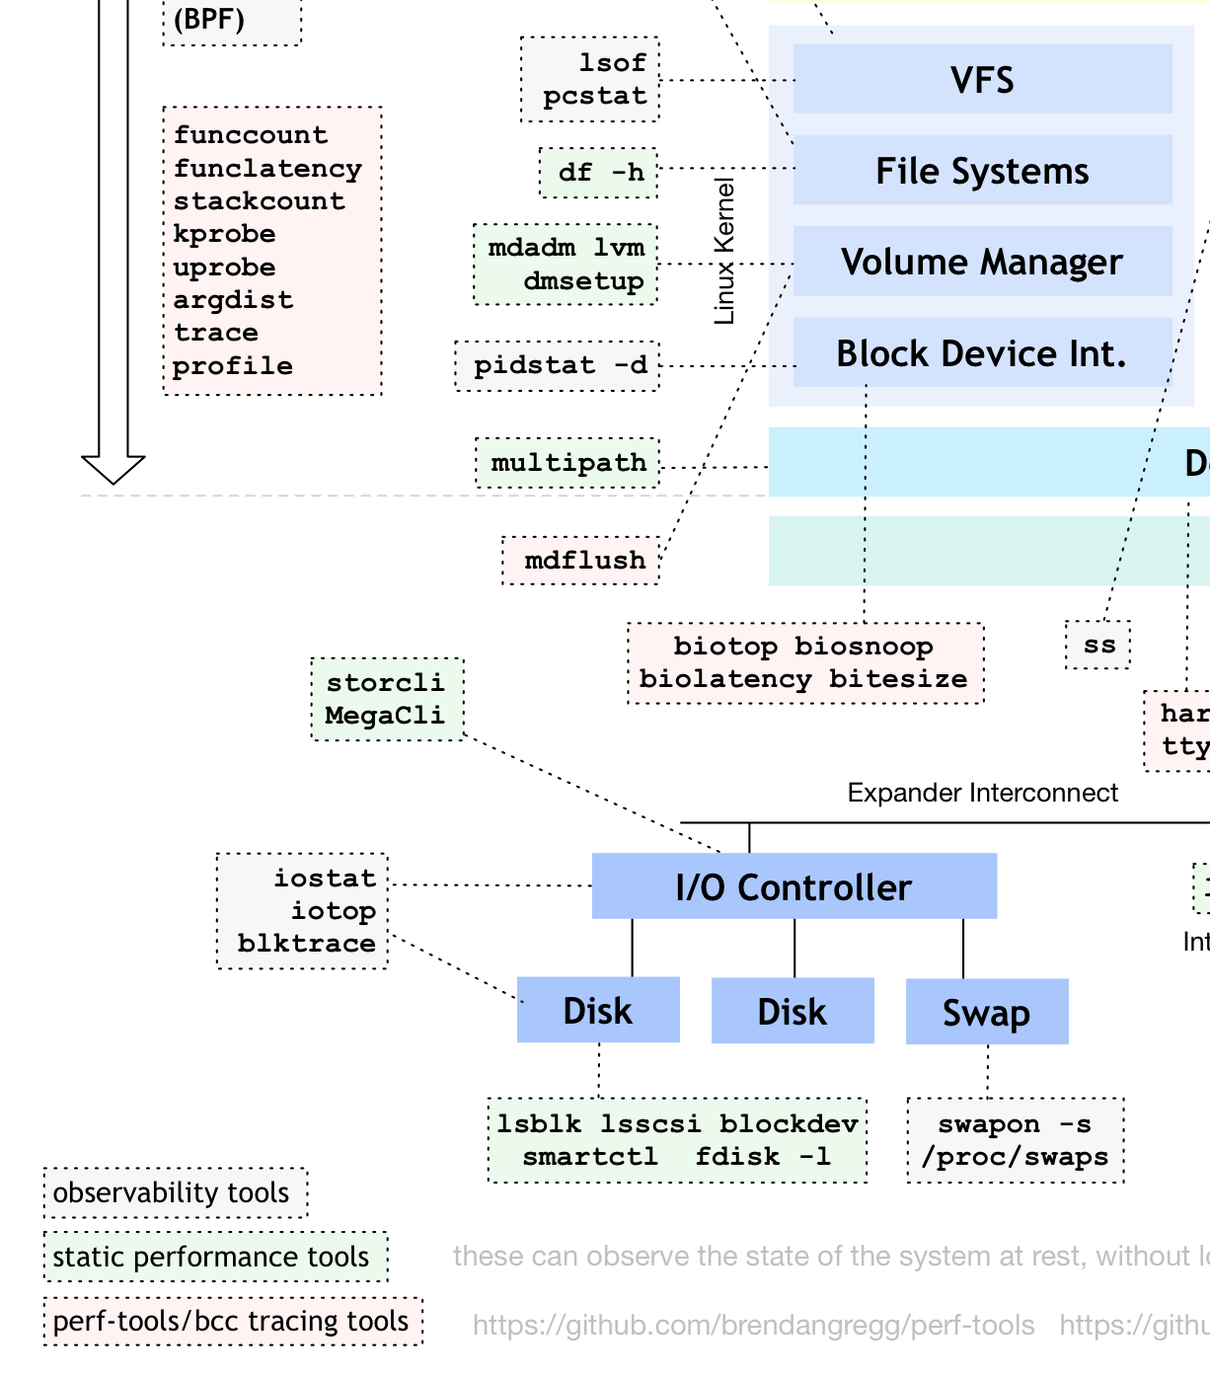
Trident - IO Performance Analysis
Data recorded form ProcFS
Transfer Rate Analysis
  Amount of data read and written to storage
  Limited by interface and type of memory
  Sustained Vs Bursts
Operation Rate Analysis
  Amount of operations performed
  Limited by controller for fast memory
  Limited by disk head for HDDs
  Random Vs Sequential accesses

Slide 10
Experiment setup
Test System
  2x Intel(R) Xeon(R) E5-2630 v3@2.40GHz /
  64GB DDR4-2133 RAM
  Centos 7 (3.10.0-957.5.1.el7.x86_64)
  Non-HT, 8 physical cores per socket
Workloads
  Standard Benchmarks – Repeated five times
    Extracted from Domenico Giordano’s Cloud Benchmark Suite
    HEPSPEC06 Benchmark Suite
      450.soplex,471.omnetpp,447.dealII,473.astar,444.namd,453.povray,483.xalancbmk
    SPEC CPU2017 Benchmark Suite
      508.namd_r,510.parset_r,511.povray_r,520.omnetpp_r,523.xalancbmk_r,526.blender_r,531.deepsjeng_r,541.leela_r
  HEP Workload Based Benchmarks - Pre & Post wait time of 60 seconds
    ATLAS – MC Simulation, MC Digitization & Reco, Derivation production
    CMS – Gen+Sim, Digi+Trigger+PileupSimulation, Reco+Analysis data creation – Streaming Inputs
    LHCb – Generation + Simulation (DG Cloud Benchmark Suite)
    ALICE – Generation + Simulation (DG Cloud Benchmark Suite)

Slide 11
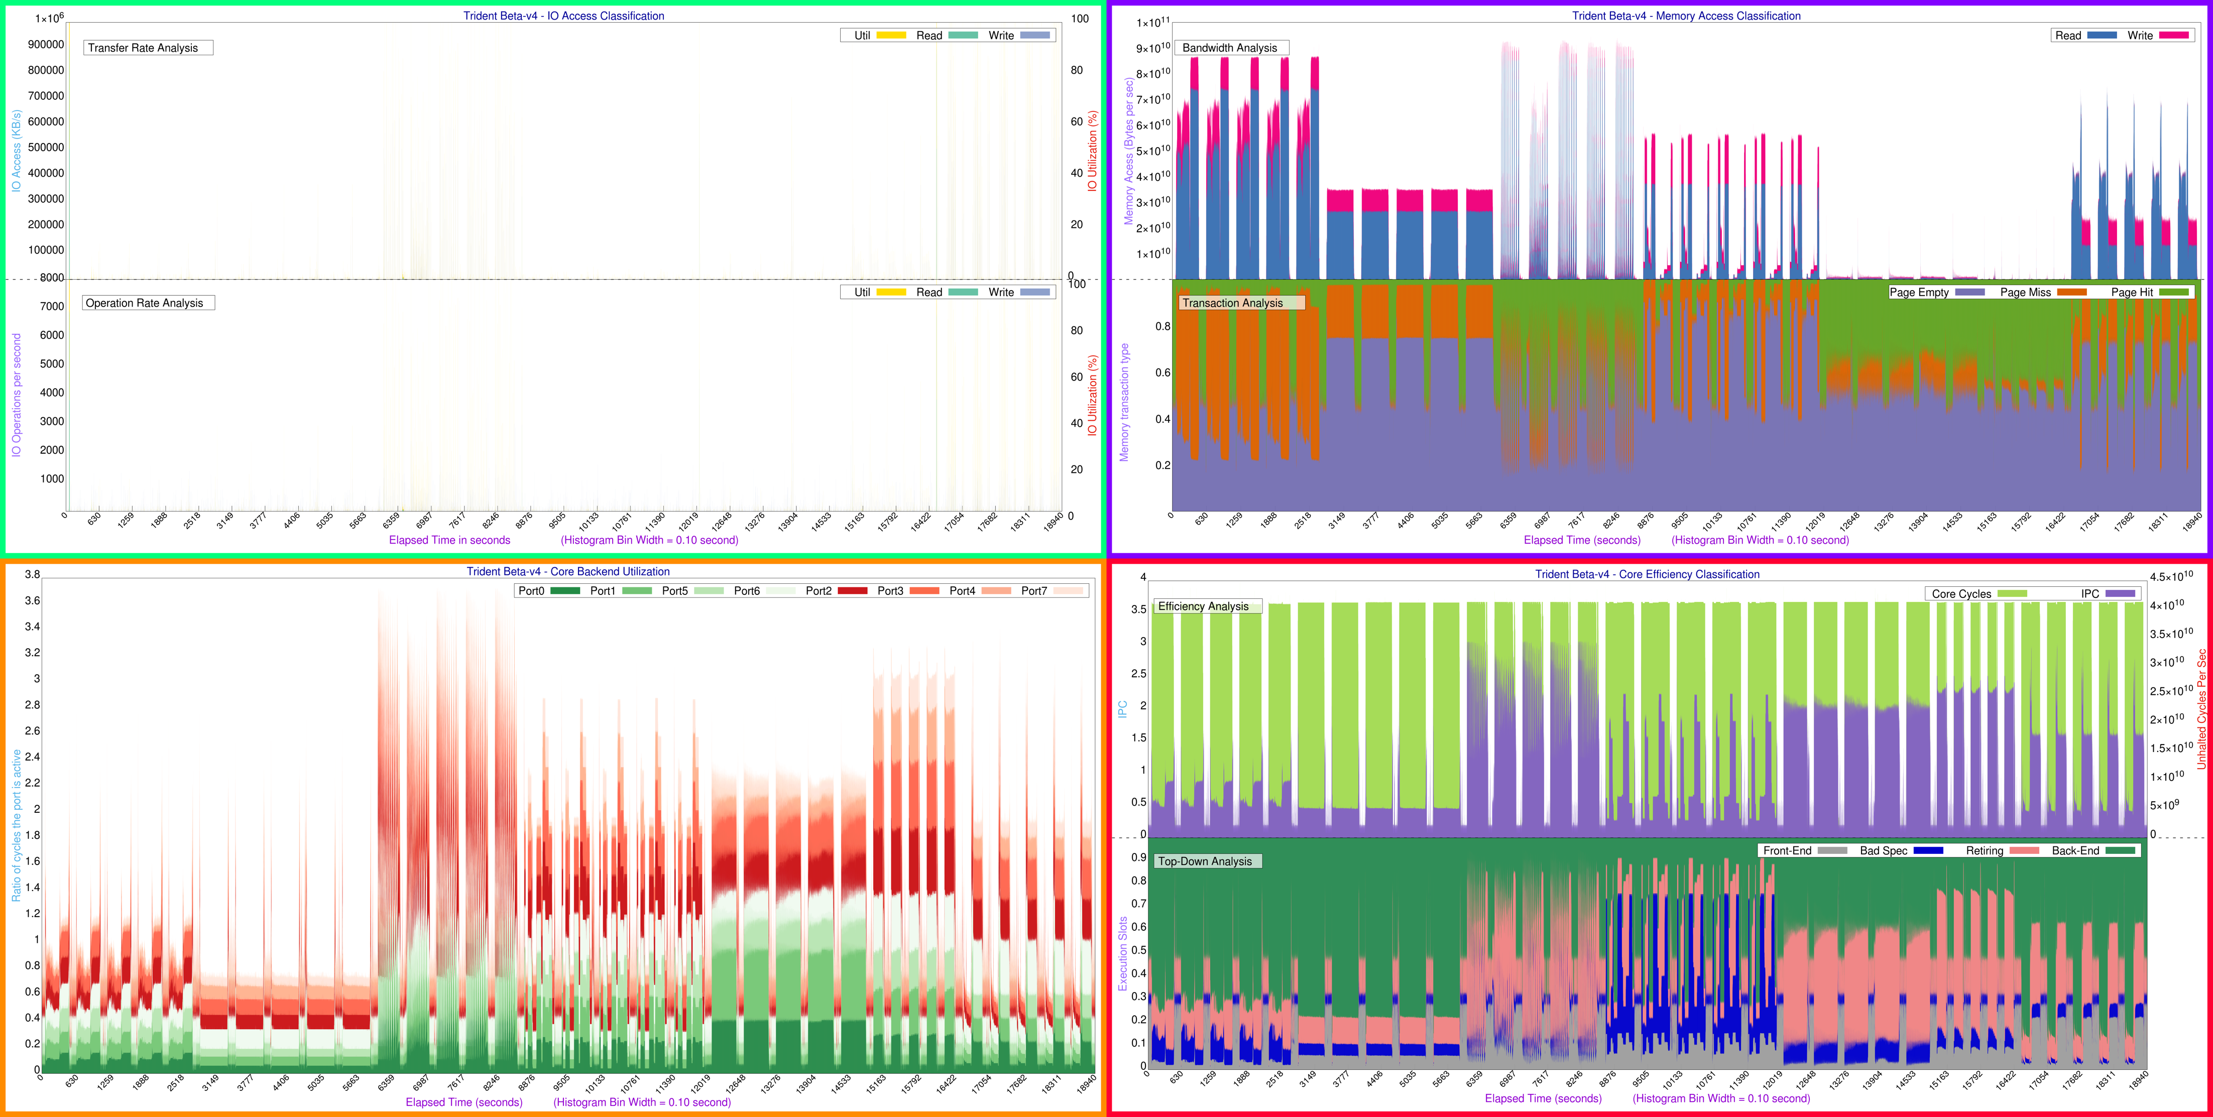
HS06

Slide 12
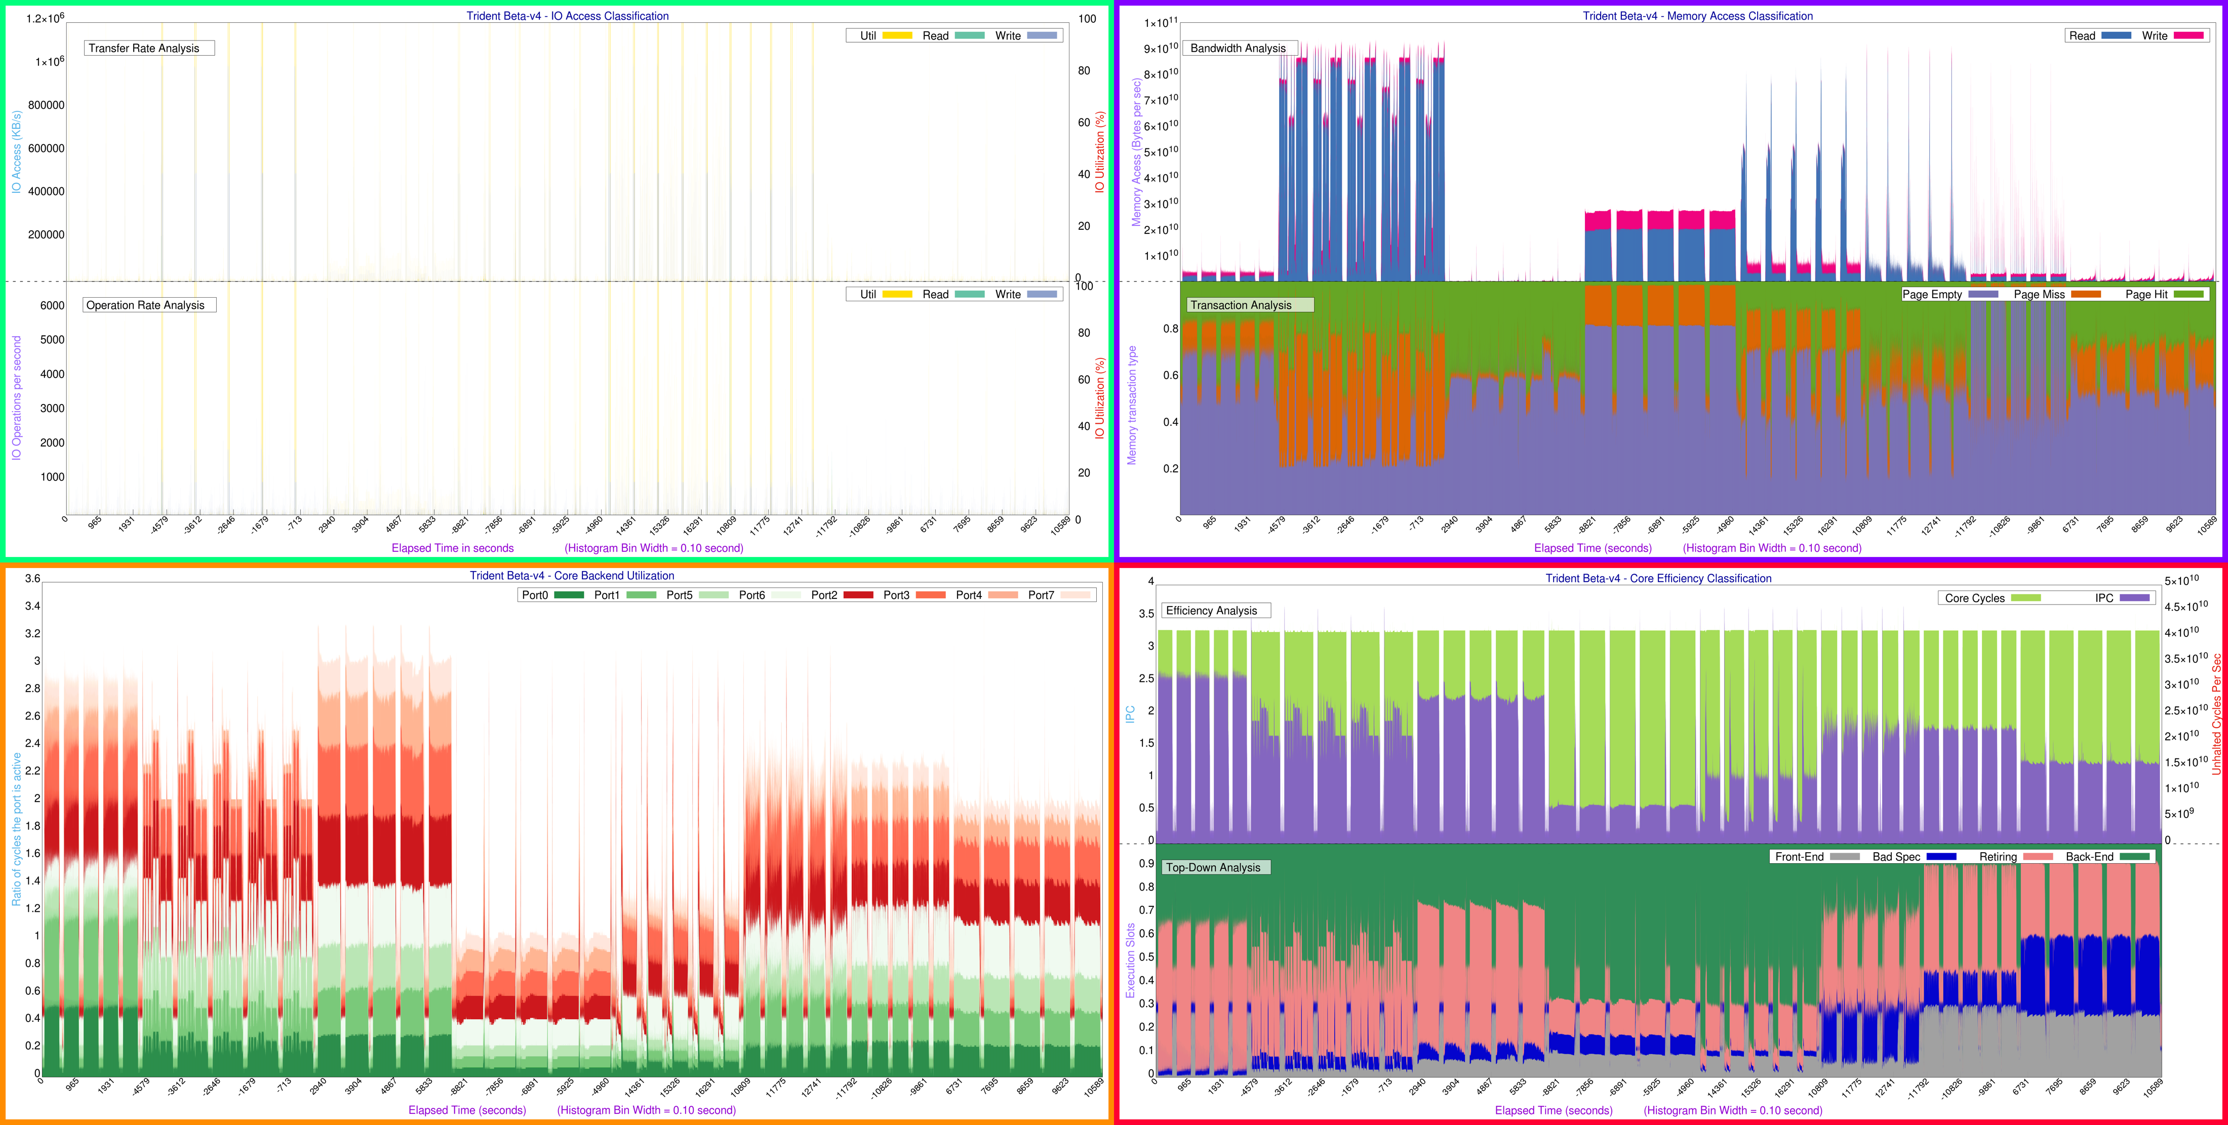
SPEC CPU2017

Slide 13
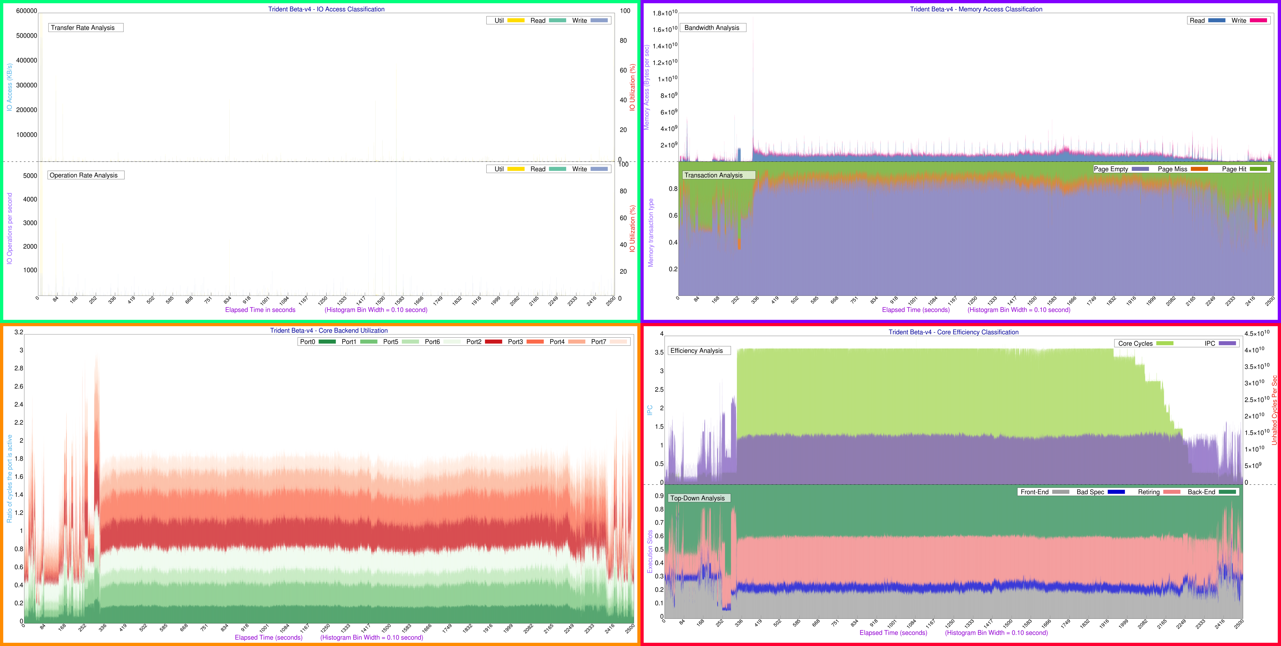
ATLAS – MC Simulation

Slide 14
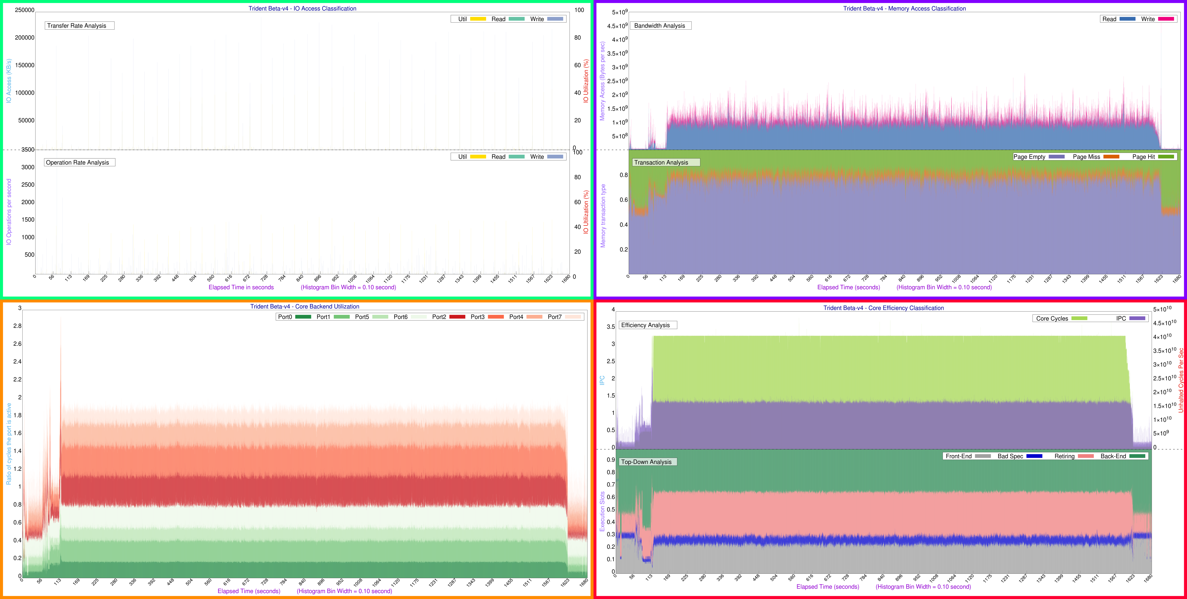
CMS – Generation + Simulation

Slide 15
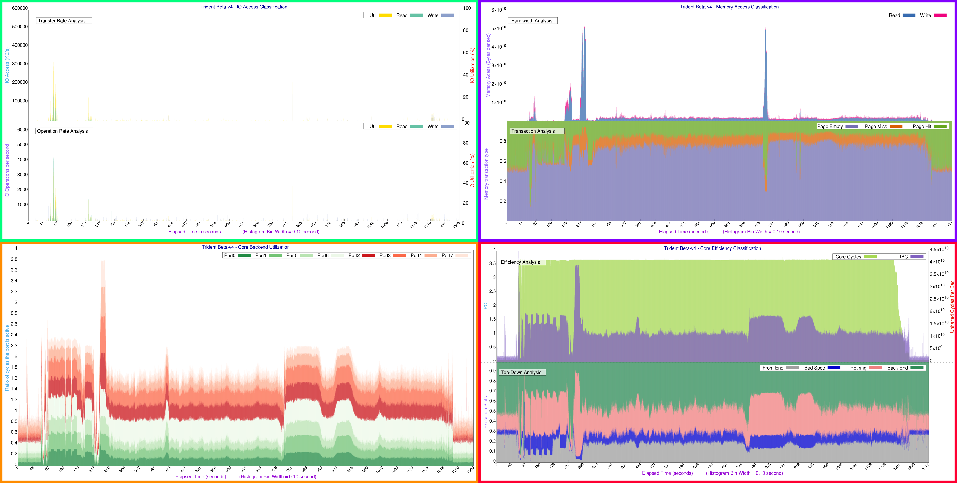
LHCb – Gen+Sim

Slide 16
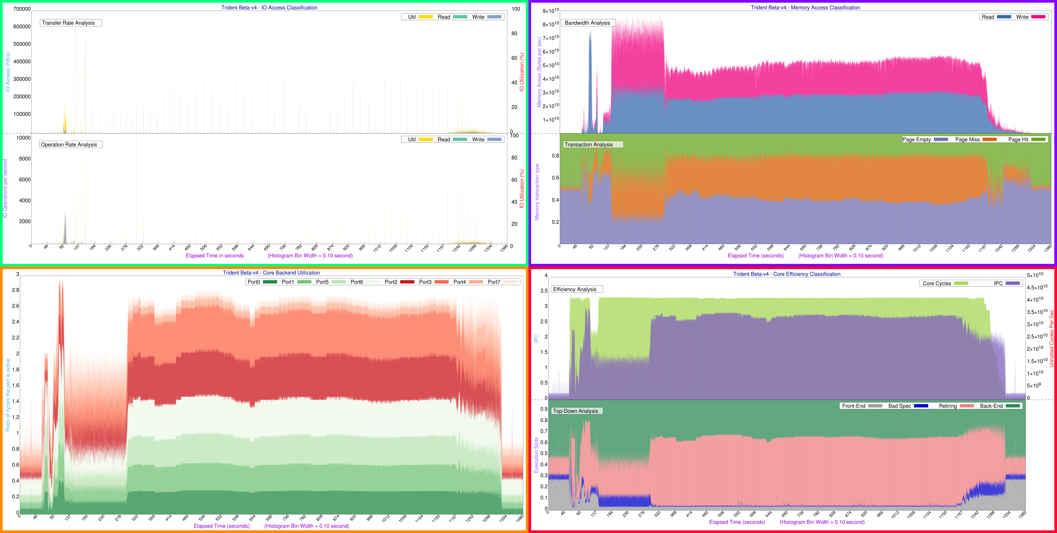
ALICE – Gen+Sim

Slide 17
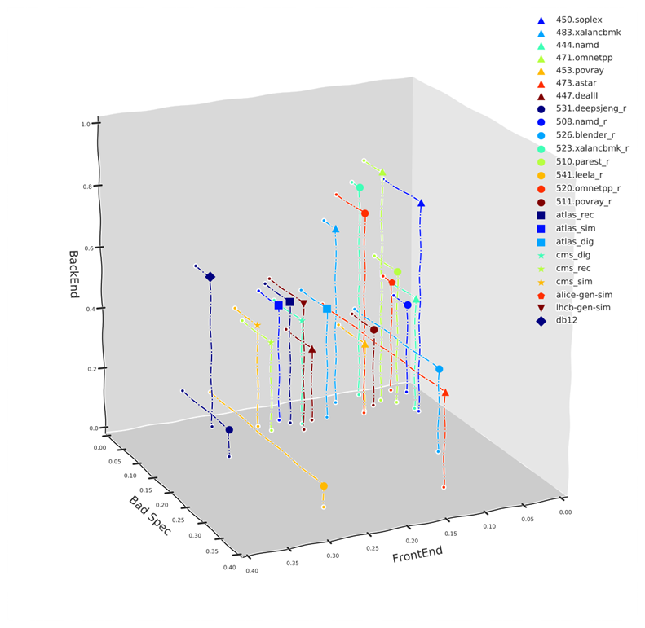
Quantitative comparison
Used Trident to quantitatively compare how the CPU is used by LHC applications vs. synthetic benchmarks
  Percentage of time spent in front-end, vs back-end, vs bad speculation
    Used as coordinates
    Retired not appearing since it is complement to 1 of the other 3 coordinates
    Measured “distance” in 3D space

Slide 18
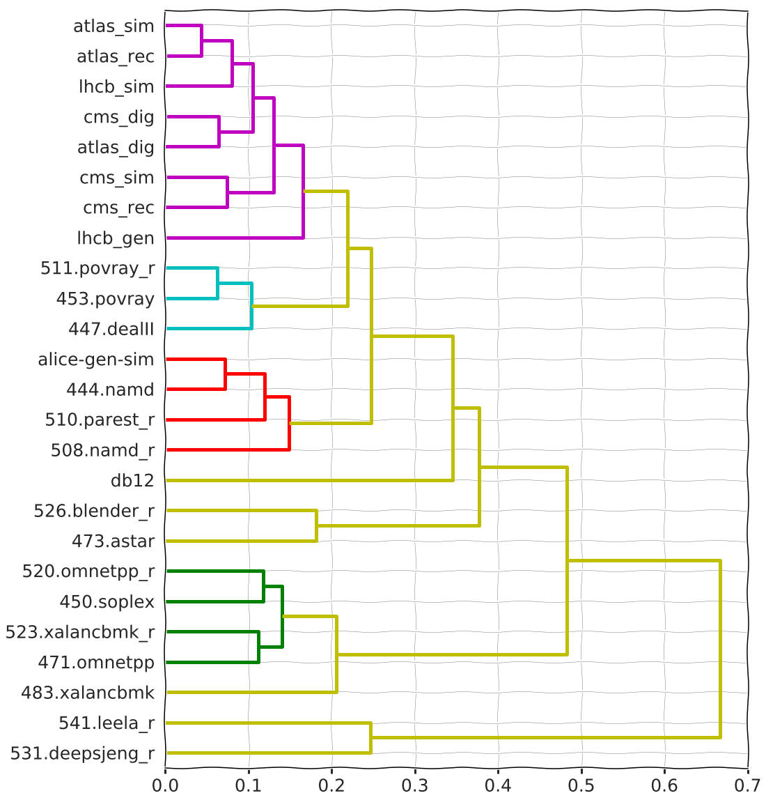
Hierarchical clustering
All LHC applications clustered together (apart from ALICE gen-sim, due to Geant3 ? )
Rather far from clusters consisting in HS06 (4xx) or SPEC CPU 2017 (5xx) benchmarks
Strong argument in favour of building an LHC benchmark using LHC applications

Slide 19
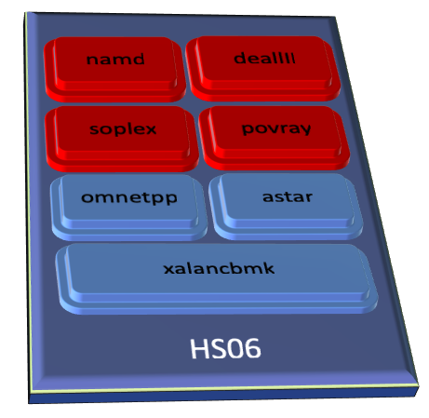
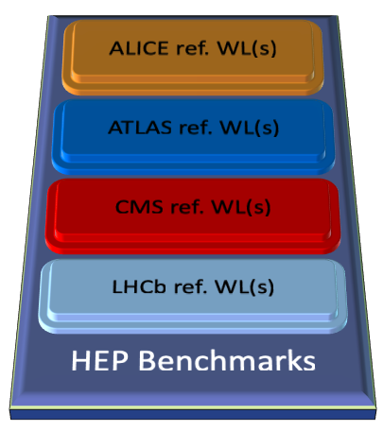
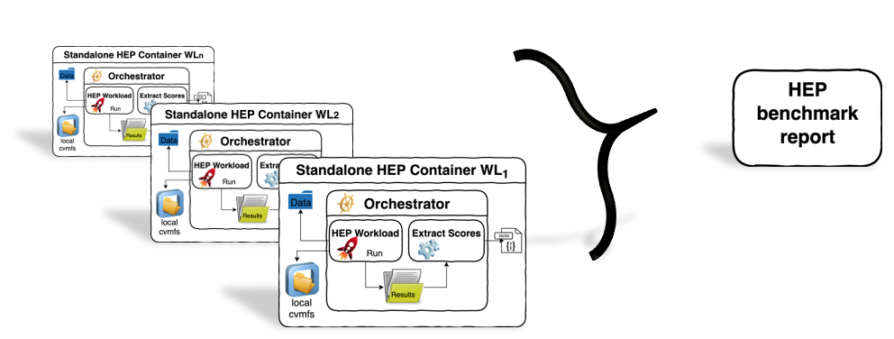
Benchmark requirements
Requirements
  No need for network connectivity
  Not too large package
  Easy to use
  Reproducible results
Ingredients
  SW repository (CVMFS)
  Input data (ROOT files and conditions DB dumps)
  An orchestrator script per workload
    Sets the environment
    Runs the application
    Parses the output
Packaging
  Decided to go for Docker containers
    Also work with Singularity – thanks to Chris Hollowell
    Very easy to use
  Containing also the needed SW from CVMFS and input data

Slide 20
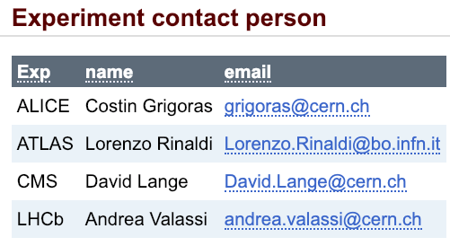
Current status of benchmark
All (GEN-)SIM workloads available as containers
  https://gitlab.cern.ch/hep-benchmarks/hep-workloads
  https://twiki.cern.ch/twiki/bin/view/HEPIX/HEP-Workloads
Working now on DIGI and RECO
  Will also include a ROOT analysis job
    Useful to select hardware for analysis workloads
Support from experiment experts
  On containerizing the workloads
  On how to best extract a score
  Debugging the workload

Slide 21
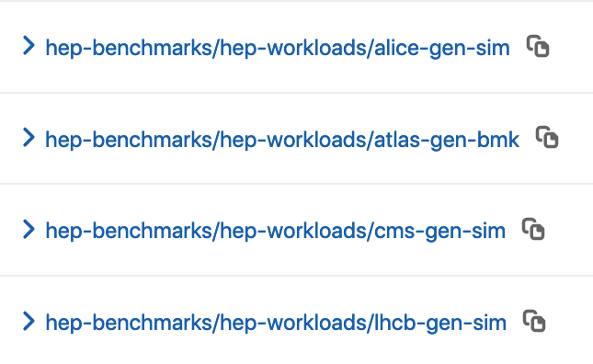
Advantage of standalone containers
Usability:
  Simple instructions: Insert disk, run shell script, wait, and read and report score
    docker run --rm -v /tmp/results:/results $IMAGE [args]
    singularity run -B /tmp/results:/results docker:://$IMAGE [args]
Accessibility:
  No need for remote data access
    With containers the benchmark can be distributed as full tarball in a drive
Free License:
  Follow the experiment code license
Long term support
  Containers are versioned (tagged), reference software is also tagged in cvmfs and/or git
https://gitlab.cern.ch/hep-benchmarks/hep-workloads/container_registry

Slide 22
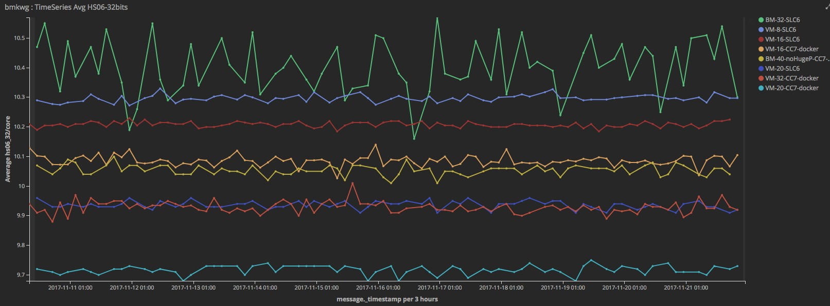
Debugging and validation
Benchmark results must be reproducible
  They should not vary more that 1-2%
  Performing benchmark validation (repeated ≥ 20 times per workload, 1 task per each logical processor in parallel)
  Sometimes we notice a spread not related to the number of events
  Experiments experts and site admins are working on improvements
    Twiki: https://twiki.cern.ch/twiki/bin/view/HEPIX/HEPWorkloadReproducibility

Slide 23
Status of the activity
Very good progress since the last report
  Improvement in the gitlab-ci infrastructure
    it takes care of the automation of the container builder
    it eases the validation of changes via gitlab CI pipelines
    A. Valassi is heavily contributing here!
  Increased participation of experiment experts
    Contact persons, field experts, beta testers, …

Slide 24
Bring the experiments know-how in the WG
We have asked 1 expert per experiment to work on 2 areas
  Containerisation of the remaining experiment workloads
  Definition/validation of the metrics extracted from the experiment job, and used to build a score
The active participation of experiment experts contributed to the integration of all the workloads and their validation
  Example: the need to remove Frontier from the jobs of CMS and ATLAS and replace sqlite files.
  Those problems have been solved recently
  Now the situation is progressing much better than few months ago

Slide 25
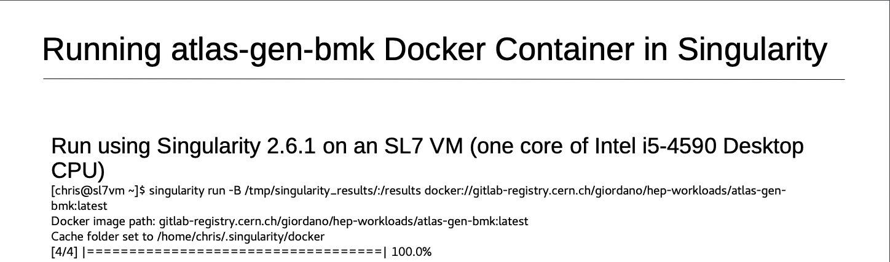

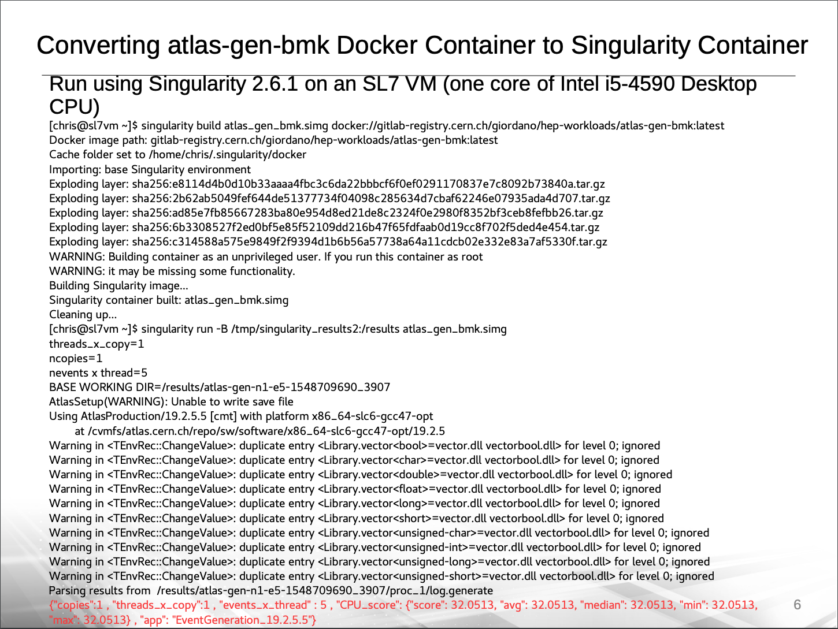
Not only the docker container
The approach is not bound to a single “container” technology
  Decouple the benchmark workload from the packaging and distribution
Successfully tested adoption of Singularity containers
  Same performance score obtained as with Docker containers
    When the Singularity image is generated and used score is ~2% higher

Slide 26
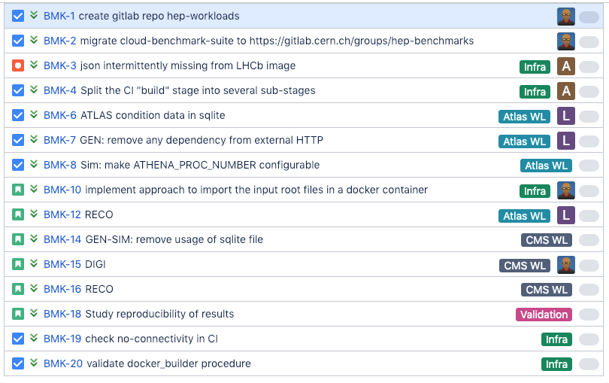
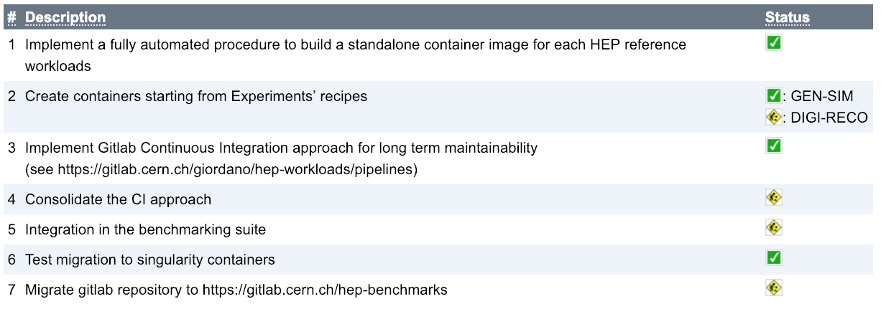
Consolidating the project management
Dedicated Jira project
New Gitlab group hep-benchmarks
  Hosting the benchmarking related projects
    hep-workloads
    benchmarking suite
      Toolkit to run all available benchmarks
      and simply collect, track and share results.
  Migration from previous repos completed
HEPiX Bmk WG twiki to summarise
the status

Slide 27
Reference
All LHC experiments provided and maintain instructions to manually submit jobs representative of the main workloads
  Simulation, digitisation, reconstruction, …
  But analysis still missing
The initial goal was to have fixed references to be used for performance studies
  They became natural candidates for a HEP benchmark
Instructions are currently in the gitlab repo in the orchestrator scripts such as:
  https://gitlab.cern.ch/hep-benchmarks/hep-workloads/blob/qa/alice/gen-sim/alice-dpgsim-bmk/alice-dpgsim-bmk.sh
  https://gitlab.cern.ch/hep-benchmarks/hep-workloads/blob/qa/atlas/sim/atlas-sim/atlas-sim-bmk.sh
  https://gitlab.cern.ch/hep-benchmarks/hep-workloads/blob/qa/cms/gen-sim/cms-gen-sim/cms-gen-sim.sh
  https://gitlab.cern.ch/hep-benchmarks/hep-workloads/blob/qa/lhcb/gen-sim/lhcb-bmk/lhcb-bmk.sh

Slide 28
Open Access
The experiments must provide data files to be inserted in the containers
  E.g. Snapshot of the conditions database to run GEN and SIM
  Minimum bias event in the DIGI benchmark
These files should be OPEN ACCESS if we need to distribute the benchmark outside HEPiX/WLCG
  E.g. to the vendors that want to participate to a tender for the procurements of future worker nodes
This is a political issue, not a technical one

Slide 29
Next Steps
Finalize debugging and validation
Add remaining workloads
Finalize the score calculations
Start using for real-world benchmarking
Agree on a (single) total performance score (e.g. a weighted average of the individual workload scores)
Include GPU workloads (reconstruction algorithms and machine learning algorithms)
  There are already contacts with experiments
Integrate all those benchmark in the bmk suite that automate the running and collection

Slide 30
Conclusions
Common effort between performance modelling and cost model working group, and the HEPiX benchmarking working group
From simple performance studies to a working and already usable LHC benchmarking suite
We welcome new participants with new ideas or new processor to benchmark

Slide 31
BAC
BACKUP SLIDES

Slide 32
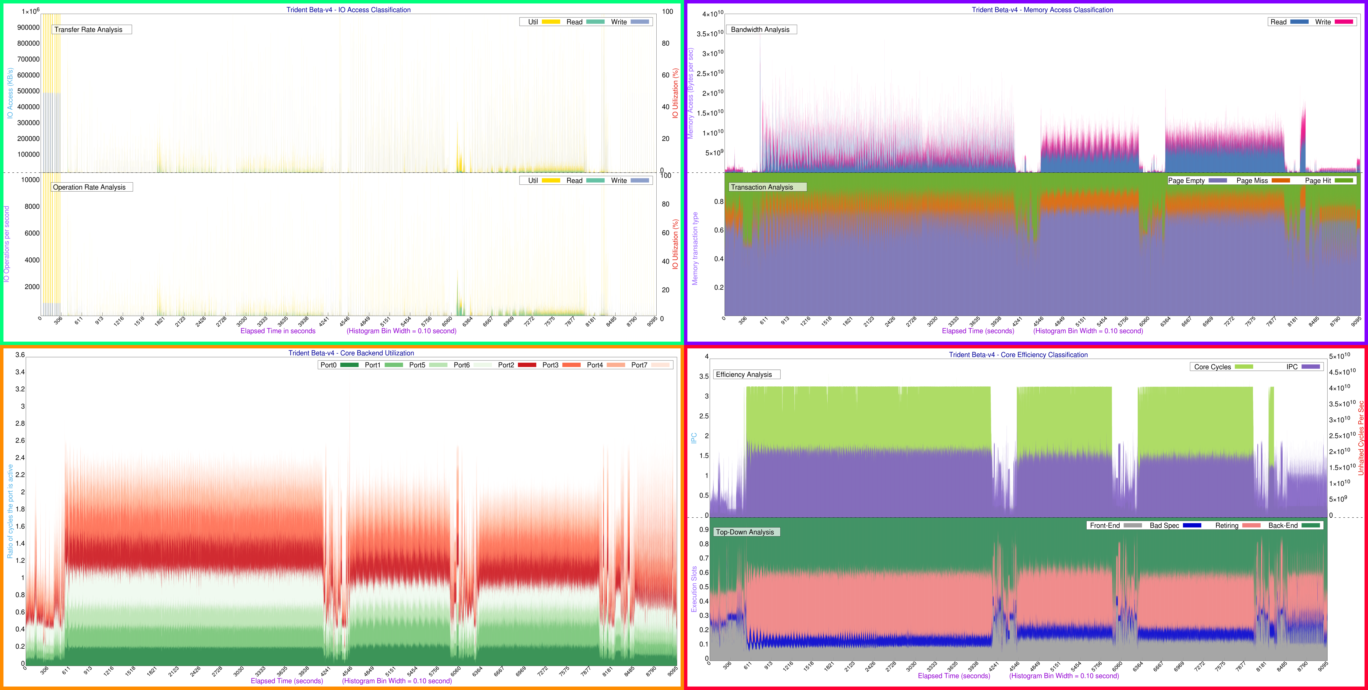
ATLAS – MC Digi + Reco

Slide 33
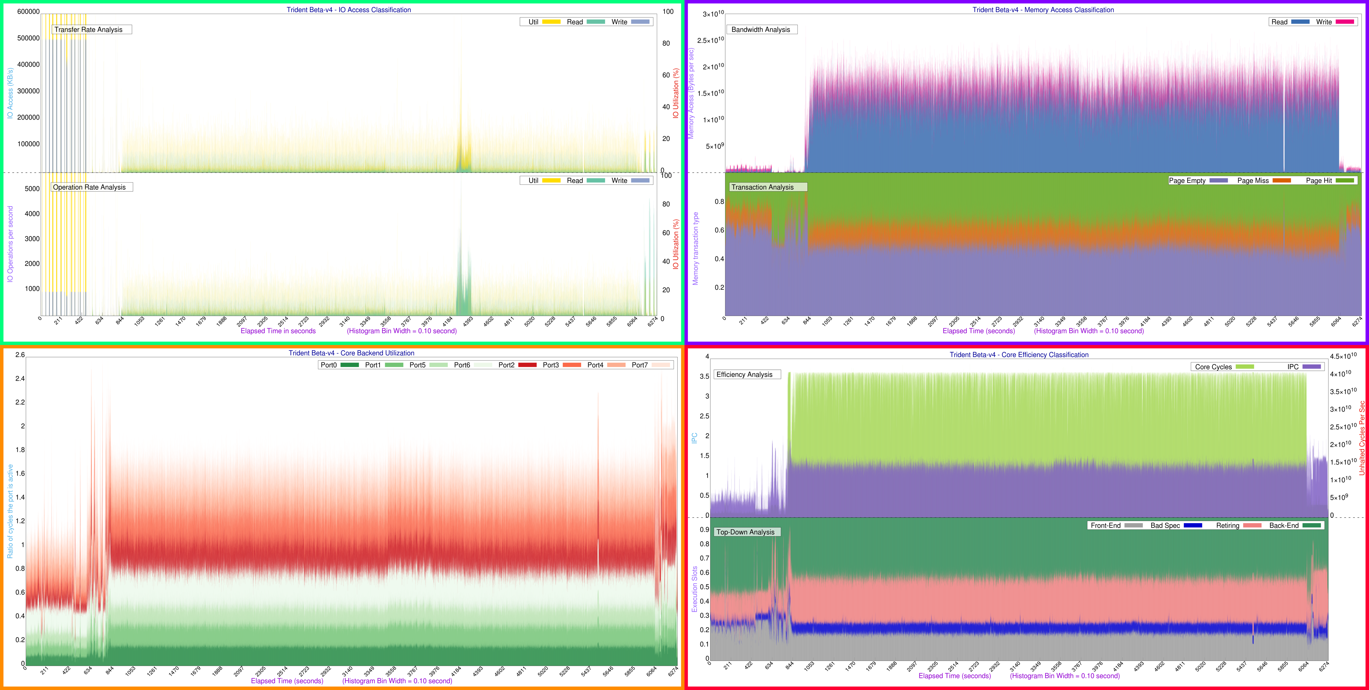
ATLAS – Derivation Production

Slide 34
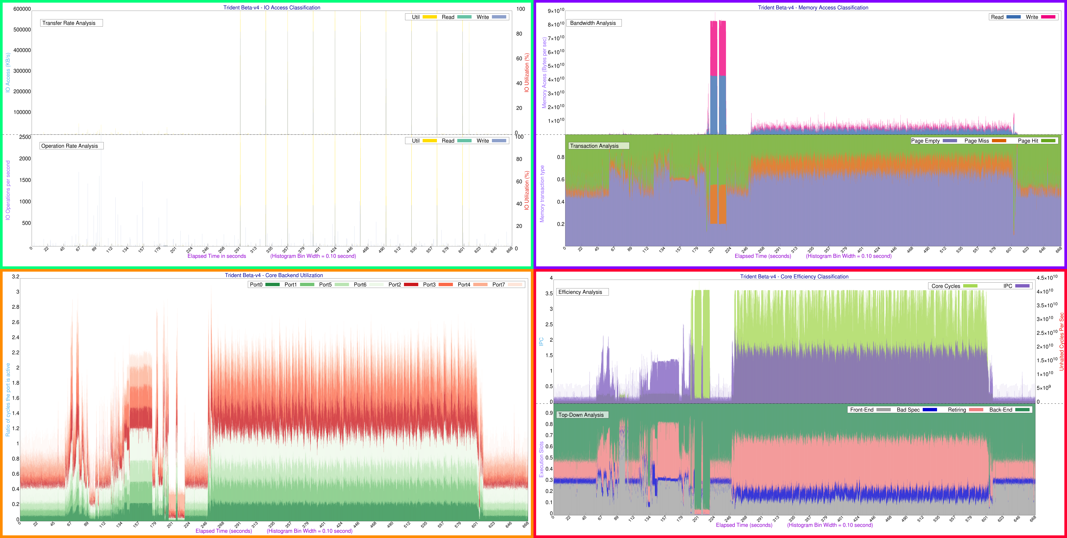
CMS – Digitization + Trigger + Pileup Simulation

Slide 35
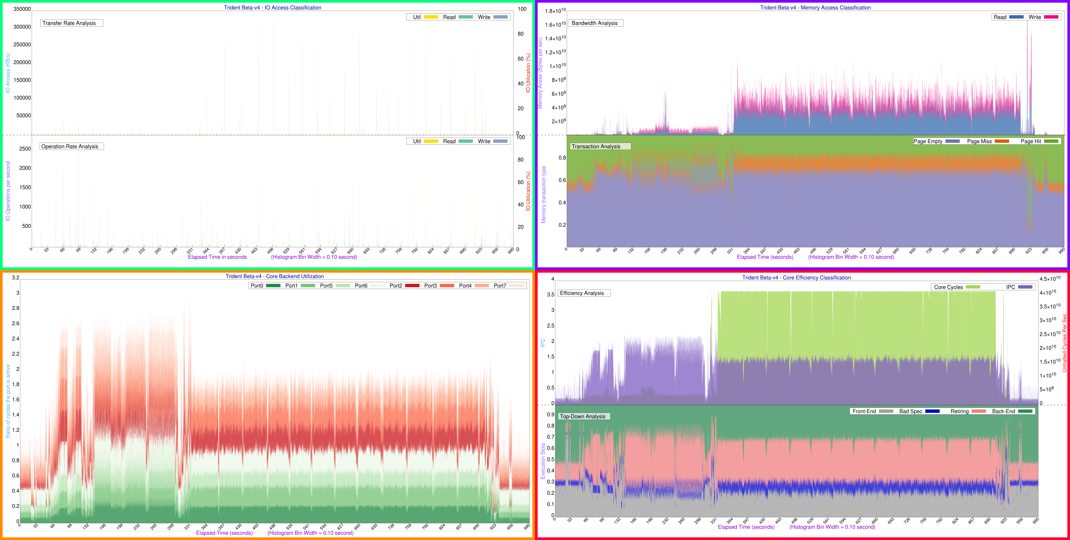
CMS – Reconstruction + Analysis Data Creation

