Slide 2



Storage Services at CERN
Enrico Bocchi
On behalf of CERN IT – Storage Group
HEPiX, San Diego, March 2019

Slide 3
Outline
Storage for physics data – LHC and non-LHC experiments
  EOS
  CASTOR
  CTA
General Purpose Storage
  AFS
  CERNBox
Special Purpose Storage
  Ceph, CephFS, S3
  CVMFS
  NFS Filers

Slide 4


1
Storage for Physics Data
EOS
CASTOR

Slide 5
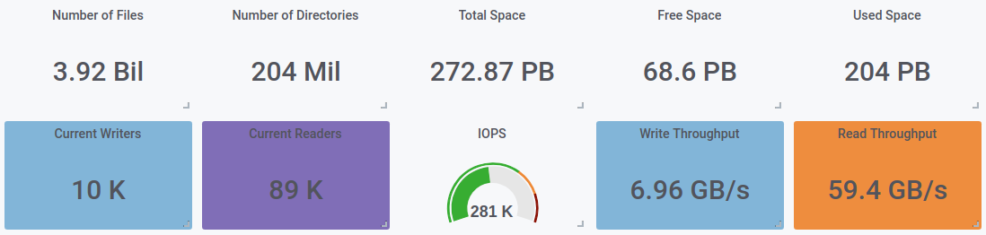
EOS at CERN
+51% in 1y
(was 2.6 B)
+14% in 1y
(was 178 PB)
EOS Instances
5 for LHC experiments
EOSPUBLIC: non-LHC experiments
7 for CERNBox (including EOSBACKUP)
2 for Project Spaces (work-in-progress)
EOSMEDIA: photo/video archival
EOSUp2U: Pilot for Education and Outreach

Slide 6
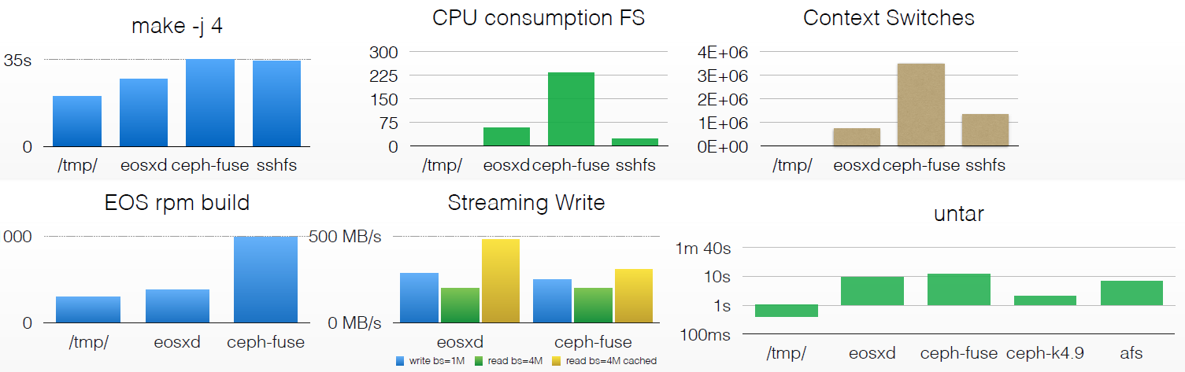
EOS: New FuseX
EOS client rewrite: eosd → eosxd
  Started Q4 2016, ~2.5 years now
  Better POSIXness, rich ACL, local caching
  Acceptable performance, low resource usage
Further Details:
Extended FUSE Access Daemon
1000

Slide 7


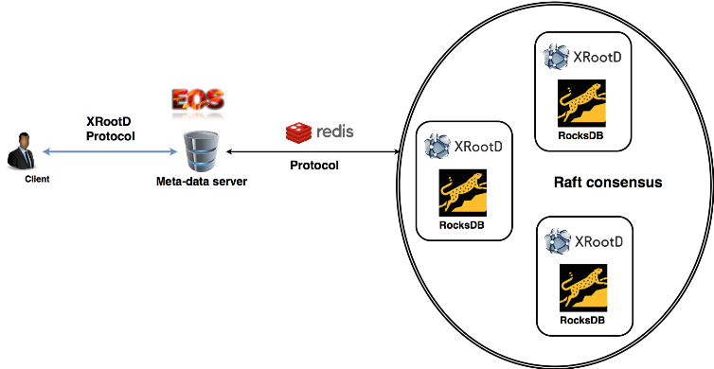
EOS: New Namespace
Old: Entire namespace in memory
  Requires a lot of RAM, slow to boot
New: Namspace in QuarkDB
  RocksDB as storage backend
  Raft Consensus
  algorithm for HA
  Redis protocol for communication
Further Details:
New Namespace in Production

Slide 8
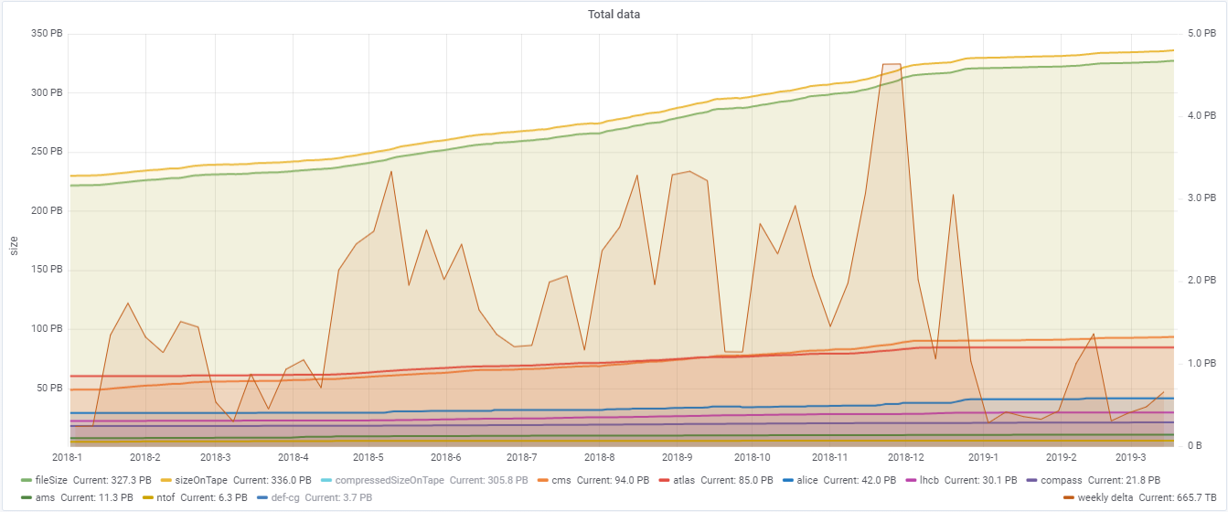
CASTOR
Heavy Ion Run 2018
Closing Run 2 at 4+ PB/week
  327 PB data (336 PB on tape), ~800 PB capacity
  Record rates, matching the record LHC luminosity

Slide 9
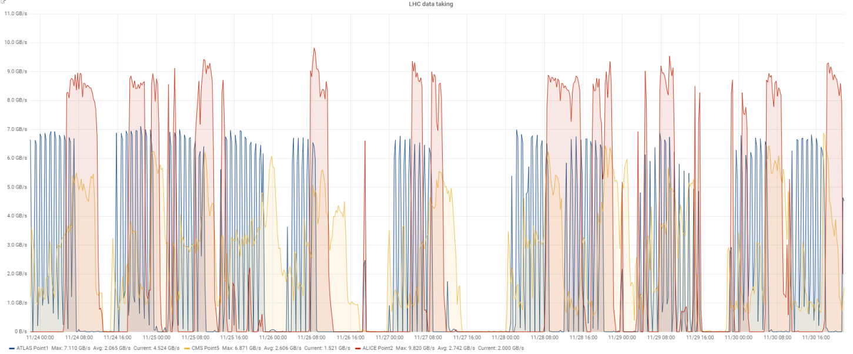
Heavy-Ion Run 2018
Typical model: DAQ → EOS → CASTOR
  ALICE got a dedicated EOS instance for this
24-day run, all but LHCb anticipated rates 2x to 5x higher than proton-proton
Real peak rates a bit lower:
  ALICE ~9 GB/s
  CMS ~6 GB/s
  ATLAS ~3.5 GB/s
Overall,
smooth data-taking
LHC Data Taking
10GB/s
9GB/s
5GB/s
Summary available at:
https://cds.cern.ch/record/2668300

Slide 10


General Purpose Storage
2
AFS
CERNBox

Slide 11
AFS: Phase-Out Update
Seriously delayed, but now restarting
  EOS FuseX + new QuarkDB namespace available
Still aiming to have AFS off before RUN3
Need major progress on AFS phaseout in 2019
  E.g., /afs/cern.ch/sw/lcg inaccessible (use CVMFS)
  Major cleanups, e.g., by LHCB, CMS
  Will auto-archive “dormant" project areas
See coordination meeting 2019-01-25:
https://indico.cern.ch/event/788039/

Slide 12
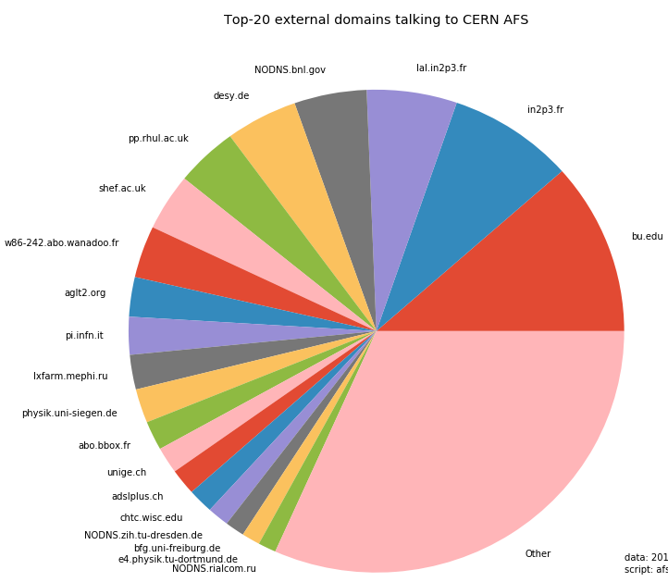
AFS: 2nd External Disconnection Test
FYI - Might affect other HEPiX sites
Test: No access to CERN AFS service
from non-CERN networks
  Affects eternal use of all AFS areas
  (homedirs, workspace, project space)
  Goals: Flush unknown AFS dependencies
Start: Wed April 3rd 2019 09:00 CET
Duration: 1 week
Announce on CERN IT - Service Status Board:
OTG0048585

Slide 13




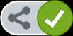






CERNBox
Available for all CERN user: 1 TB, 1 M files
Ubiquitous file access: Web, mobile, sync to your laptop
Not only physicists: engineers, administration, …
More than 80k shares across all departments
XROOTD
WebDAV
Sync
Mobile
POSIX
Filesystem
 | Jan 2016 | Jan 2017 | Jan 2018 | Jan 2019
Users | 4074 | 8411 | 12686 | 16000 | +26%
Files | 55 Million | 176 Million | 470 Million | 1.1 Billion | +134%
Dirs | 7.2 Million | 19 Million | 34 Million | 53 Million | +56%
Raw Space Used | 208 TB | 806 TB | 2.5 PB | 3.4 PB | +36%
Share
Web
Hierarchical
Views
ACLs
Physical Storage

Slide 14





CERNBox: Migration to EOSHOME
Architectural review, new deployments, data migration
  Build 5 new EOS instances with QuarkDB namespace: EOSHOME
  Migrate users’ data gradually from old EOSUSER instance
OLD
EOSUSER
Migrate Users
Copy data over
Migrated?
CERNBox
redirector
EOSHOME{0..4}
Sync Client
NEW
Transparent migration | Support for system expansion (or reduction)
No visible downtime | Better load control over time

Slide 15
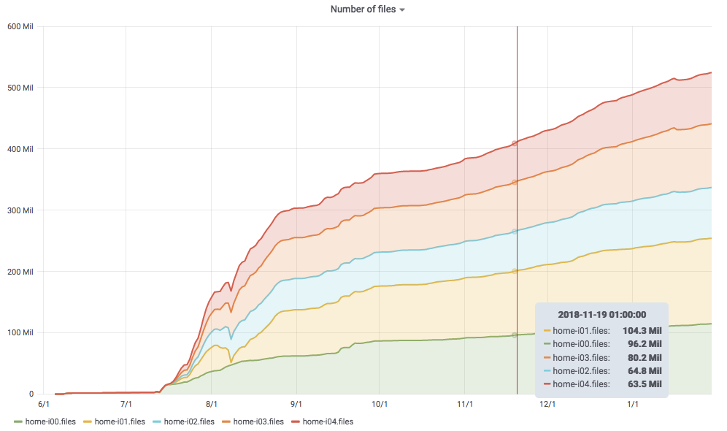
CERNBox: Migration to EOSHOME
5 Dec 2018
670 users left
15 Jan 2019
~200 users left
home-i01
wiped
Number of Files
home-i00
is born

Slide 16









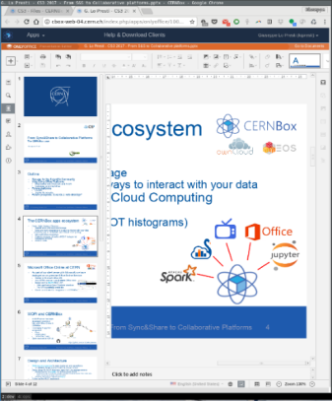
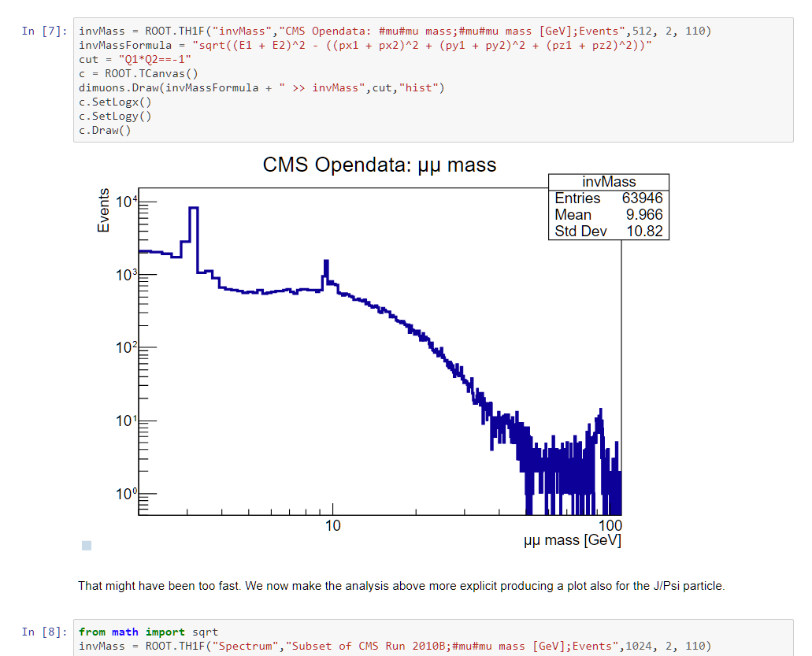

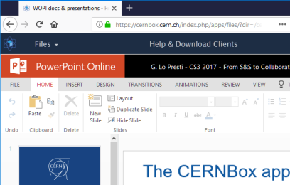
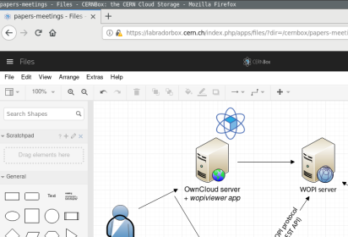
CERNBox as the App Hub
CERNBox Web frontend is the entry point for:
  Jupyter Notebooks (SWAN, Spark)
  Specialized ROOT histogram viewer
  Office Suites: MS Office 365, OnlyOffice, Draw.io
  More to come: DHTMLX Gantt Chart, …
SWAN, powered by

Slide 17

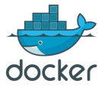








SWAN in a Nutshell
Turn-key data analysis platform
  Accessible from everywhere via a web browser
  Support for ROOT/C++, Python, R, Octave
Fully integrated in CERN ecosystem
  Storage on EOS, Sharing with CERNBox
  Software provided by CVMFS
  Massive computations on SPARK
Infrastructure
Storage
Software
– More this afternoon at 2:50 –
Piotr Mrowczynski
Evolution of interactive data analysis for HEP at CERN:
SWAN, Kubernetes, Apache Spark and RDataFrame
Compute

Slide 18
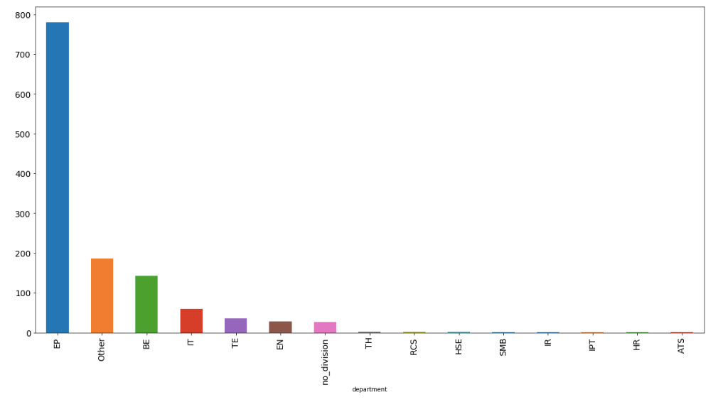
SWAN usage at CERN
Experimental Physics Dept.
1300 unique users in 6 months
Beams Dept.
LHC logging + Spark
Department

Slide 19
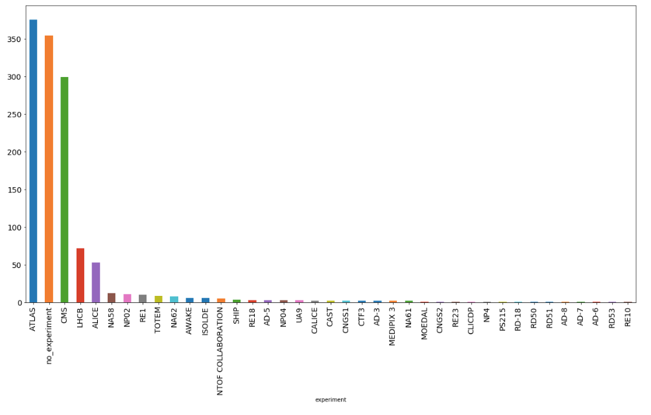





SWAN usage at CERN
Experiment

Slide 20



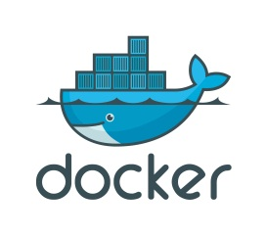
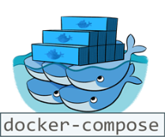




Science Box
Self-contained, Docker-based package with:
+
+
+
One-Click Demo Deployment
Production-oriented Deployment
Single-box installation via docker-compose
No configuration required
Download and run services in 15 minutes
https://github.com/cernbox/uboxed
Container orchestration with Kubernetes
Scale-out storage and computing
Tolerant to node failure for high-availability
https://github.com/cernbox/kuboxed

Slide 21
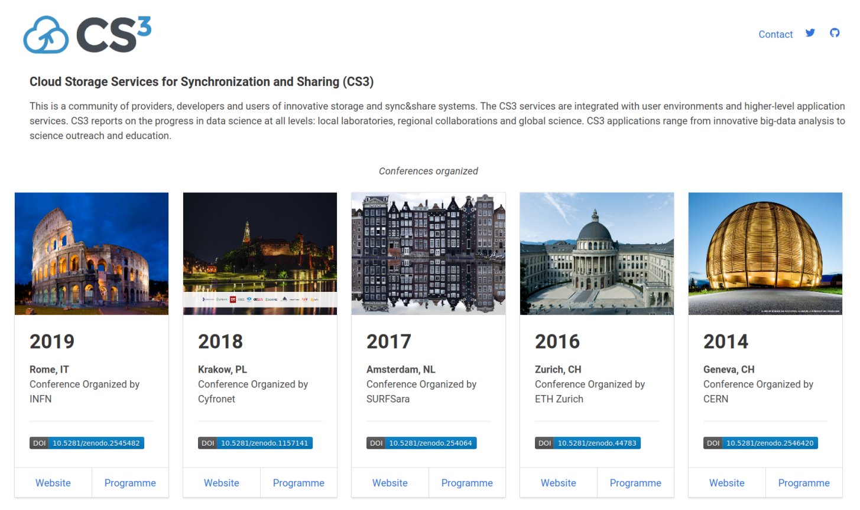
CS³ Workshop
  5 editions since 2014
Last edition – Rome:
http://cs3.infn.it/
55 contributions
147 participants
70 institutions
25 countries
Industry participation:
  Start-Ups: Cubbit, pydio, …
  SMEs: OnlyOffice, ownCloud
  Big: AWS, Dropbox, …
Community website:
http://www.cs3community.org/

Slide 22

Ceph, CephFS, S3
3
It all began as storage for OpenStack

Slide 23

Ceph Clusters at CERN
Usage |  |  | Size | Version
OpenStack Cinder/Glance |  | Production | 6.4 PB | luminous
Remote (1000km) |  |  | 1.6 PB | luminous
Hyperconverged |  |  | 245 TB | mimic
CephFS (HPC+Manila) |  | Production | 786 TB | luminous
Preproduction |  |  | 164 TB | luminous
Hyperconverged |  |  | 356 TB | luminous
CASTOR |  | Public Instance | 4.9 PB | luminous
S3+SWIFT | Production (4+2 EC) | Production 4+2 | 2.07 PB | luminous
Notes:
16.5 PB total

Slide 24
Block Storage
Used for OpenStack Cinder volumes + Glance images
  Boot from volume available, Nova "boot from glance" not enabled (but we should!)
  No Kernel RBD clients at CERN (lack of use-cases)
Three zones
  CERN main data-center, Geneva → 883 TB x3 used
  Diesel UPS room, Geneva → 197 TB x3 used
  Wigner data-centre, Budapest → 151 TB x3 used
    Decommissioning end 2019
Each zone has two QoS types
  Standard: 100r + 100w IOPS
  IO1: 500r + 500w IOPS

Slide 25
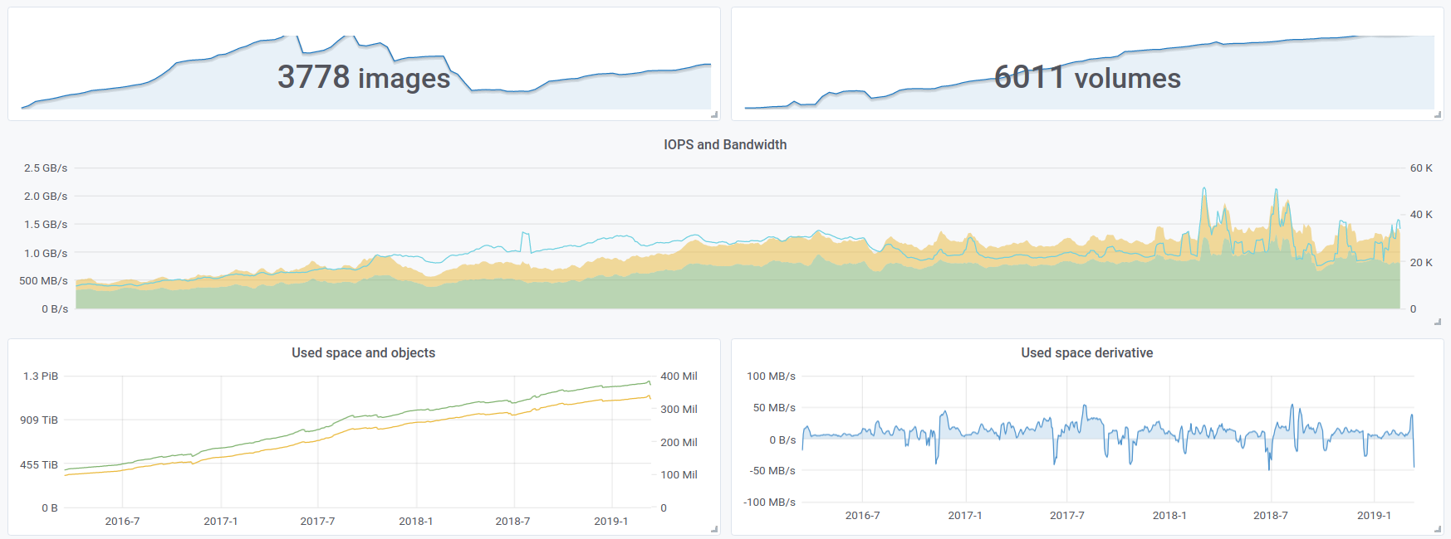
RBD for OpenStack
Last 3 years
IOPS
Reads
Writes
Bytes used
Objects

Slide 26
CephFS
In production for 2+ years as HPC scratch & HPC home
  Using ceph-fuse mounts, only accessible within HPC cluster
  Ceph uses 10 GbE (not Infiniband)
OpenStack Manila (backed by CephFS) in production since Q2 2018
  Currently 134 TB x3 used, around 160M files
Moving users from NFS Filers to CephFS
  ceph-fuse small file performance (fixed with kernel client in CentOS 7.6)
  Backup non-trivial
    Working on a solution with restic
    TSM would be an option (but we try to avoid it)

Slide 27
S3
Production service since 2018: s3.cern.ch
  Originally used by ATLAS event service for ~3 years: up to 250TB used
Single region radosgw cluster
  Load-balanced across 20 VMs with Traefik/RGW
  4+2 erasure coding for data, 3x replication for bucket indexes
  Now integrated with OpenStack Keystone for general service usage
Future plans
  Instantiation of a 2nd region: HW from Wigner + New HDDs
  Demands for disk-only backup and disaster recovery are increasing
  E.g. EOS Home/CERNBox backup, Oracle databases backup

Slide 28
CVMFS
4
Software distribution for the WLCG
Notes:
Operating Stratum 0, CERN Stratum 1, and CERN's Squid hierarchy

Slide 29


CVMFS: Stratum 0 Updates
S3 default storage backend since Q4 2018
  4 production repositories, 2 test repositories for nightly releases
Moving repos out of block volumes
  Opportunity to get rid of garbage
  Blocker1: Sustain 1000 req/s on S3
  Blocker2: Build 2nd S3 region for backup
  and high availability
Repository Owner
ssh
S3 Bucket
Ceph @CERN
AWS
…
Release Manager
Stateless
Dedicated for one
(or more) repo
To HTTP CDN

Slide 30


CVMFS: Stratum 0 Updates
CVMFS Gateway service
  Allow for multiple concurrent
  Release Manager (RM) access
Repository
Owner
Release Managers
CI Slave
Gateway
API for publishing
Regulates access
to S3 storage
Issues time-limited
leases for sub-paths
S3
Bucket
To HTTP CDN

Slide 31

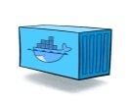

CVMFS: Stratum 0 Updates
CVMFS Gateway service
  Allow for multiple concurrent
  Release Manager (RM) access
Next step:
Disposable Release Managers
  Queue service by RabbitMQ
  State is kept by the Gateway
  E.g., Active leases, access keys
  RMs started on-demand
  (Much) Better usage of resources
Queue
Service
Disposable
Release Managers
Repository
Owner
CI Slave
Gateway
Keep state
Lease management
Receive from RMs
Commit changes
to storage
S3
Bucket
To HTTP CDN

Slide 32



CVMFS: Squid Caches Updates
Two visible incidents due to squids overloaded:
  11th July: “lxbatch cvmfs cache was misconfigured by a factor of 10x too small”
  Mid-Nov: Atypical reconstruction jobs (heavily) fetching dormant files
Deployment of dedicated squids
  Reduce interference causing (potential) cache trashing
  Improve cache utilization and hit ratio
Clients
any-repo
repo1
Dedicated
squids
Generic squids

Slide 33
Thank you!

Slide 35
Backup Slides

Slide 36
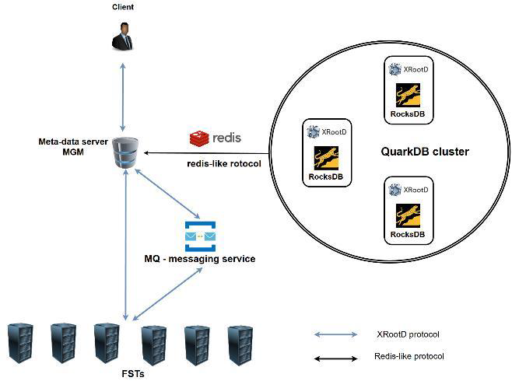
EOS QuarkDB Architecture
Raft
consensus

Slide 37
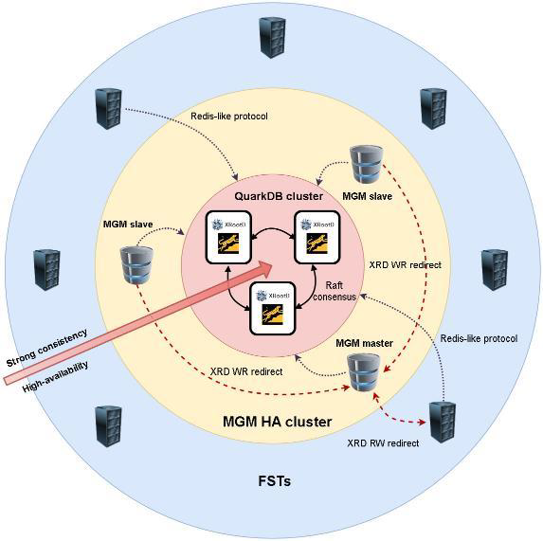
EOS QuarkDB Architecture

Slide 38
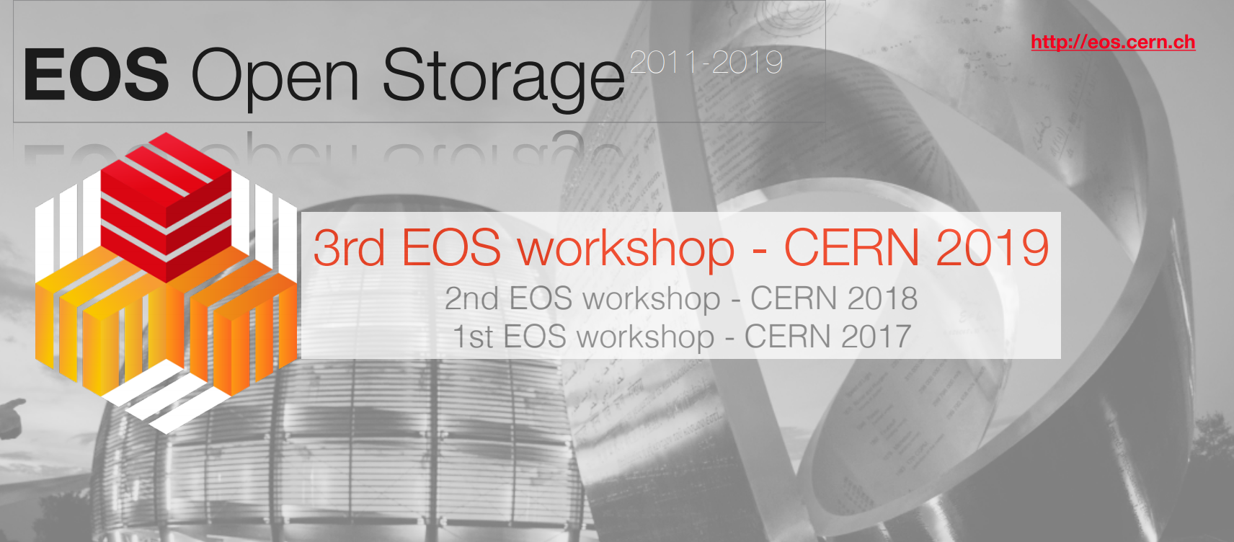
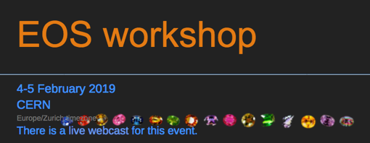
EOS Workshop
Last edition: CERN, 4-5 February 2019
32 contributions
80 participants
25 institutions
https://indico.cern.ch/event/775181/

Slide 40
CERNBox
Available for all CERN Users
  1 TB, 1 Million files quota
  Data stored in CERN data-centre
Ubiquitous file access
  All major platforms supported
Convenient sharing with peers
and external users (via link)
Integrated with ext. applications
  Web-based data analysis service
  Office productivity tools
XROOTD
WebDAV
POSIX
Filesystem
Sync
Share
Mobile
Web
Hierarchical
Views
ACLs
Physical Storage

Slide 41
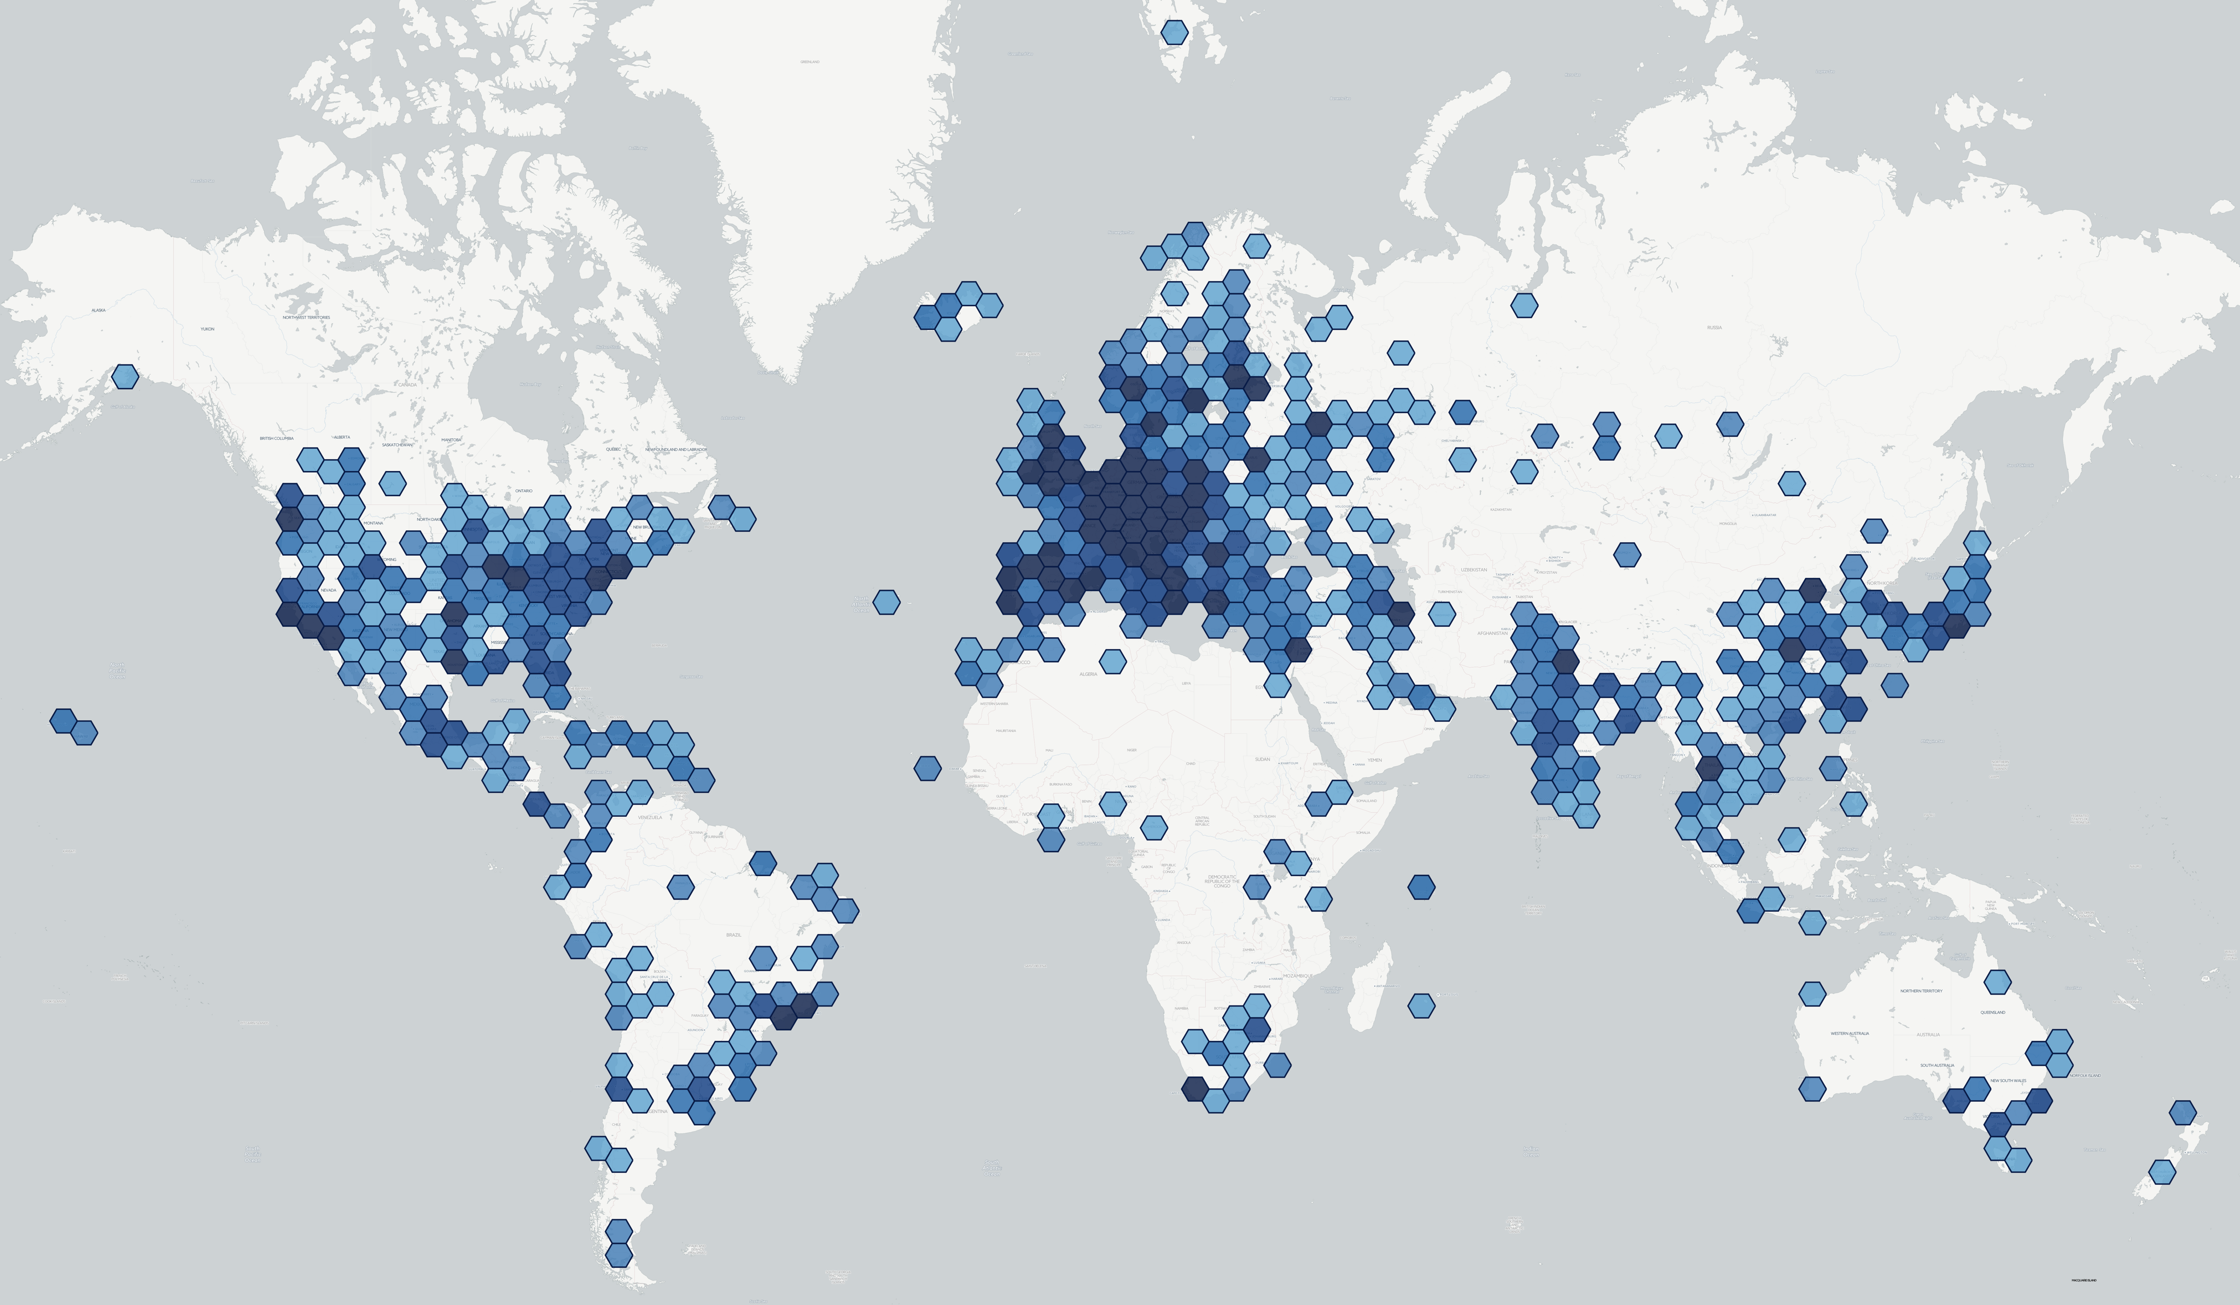
CERNBox: User Uptake
 | Jan 2016 | Jan 2017 | Jan 2018 | Jan 2019
Users | 4074 | 8411 | 12686 | 16000 | +26%
Files | 55 Million | 176 Million | 470 Million | 1.1 Billion | +134%
Dirs | 7.2 Million | 19 Million | 34 Million | 53 Million | +56%
Raw Space Used | 208 TB | 806 TB | 2.5 PB | 3.4 PB | +36%
Raw Space Deployed | 1.3 PB | 3.2 PB | 5.7 PB | 6.8 PB | +19%
Available for all CERN user: 1 TB, 1 M files
~3.5k unique users per day worldwide
Not only physicists: engineers, administration, …
More than 80k shares across all departments

Slide 42
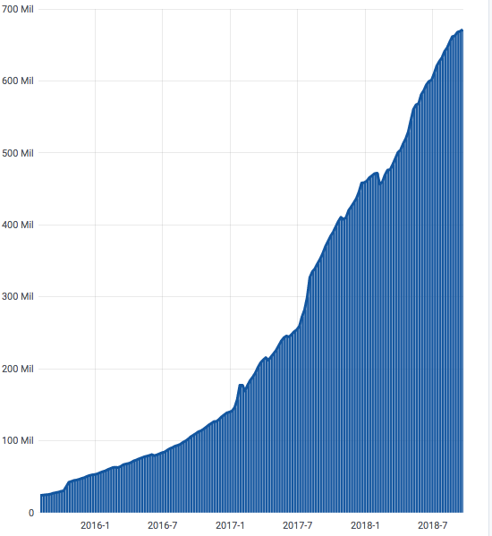
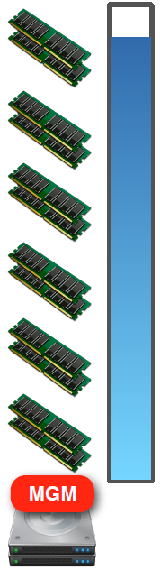
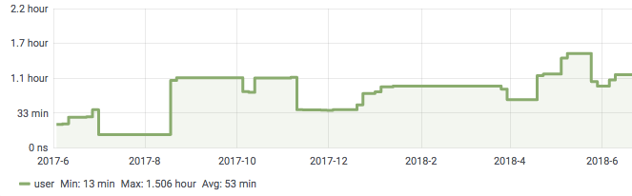
EOS Namespace Challenge
1 TB
Number of files impacts
  Memory consumption
  Namespace boot time
Change of paradigm:
Scale-out the namespace
Number of Files
Namespace boot time

Slide 43

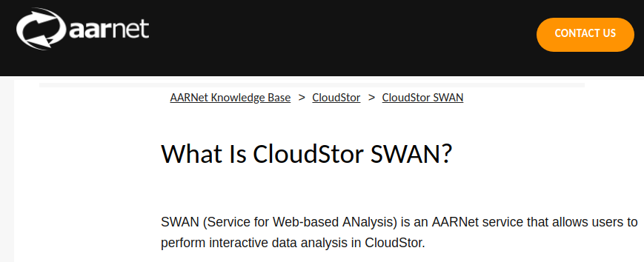








Science Box Use Cases
EU Project Up to University
Simplified try-out and deployment for peers
  Australia's Academic and
  Research Network (AARNET)
  Joint Research Centre (JRC), Italy
  Academia Sinica Grid Computing Centre (ASGC), Taiwan
Runs on any infrastructure
  Amazon Web Services
  Helix Nebula Cloud (IBM, RHEA, T-Systems)
  OpenStack Clouds
  Your own laptop! (CentOS, Ubuntu)

Slide 44
CS³ Workshop
  5 editions since 2014
  Focus on:
  Sharing and
  Collaborative Platforms
  Data Science & Education
  Storage abstraction
  and protocols
  Scalable Storage Backends
  for Cloud, HPC and Science
Last edition:
http://cs3.infn.it/
Community website:
http://www.cs3community.org/

Slide 45
CS³ Workshop
HEP & Physics
NRENs
Last edition: Rome
28-30 January 2019
  55 contributions
  147 participants
  70 institutions
  25 countries
Industry participation
  Start-Ups: Cubbit, pydio, …
  SMEs: OnlyOffice, ownCloud
  Big: AWS, Dropbox, …
Universities
Companies

Slide 47
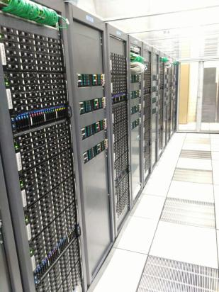
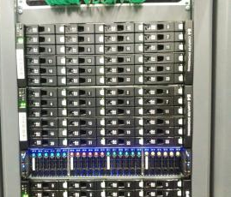
Ceph Clusters at CERN
Typical Ceph node
  16-core Xeon / 64-128GB RAM
  24x 6TB HDDs
  4x 240GB SSDs (journal/rocksdb)

Slide 48
MON+MDS Hardware
ceph-mon on main RBD cluster:
  5x physical machines with SSD rocksdb
  (moving to 3x physical soon – btw, Openstack persists the mon IPs, so changing is difficult)
ceph-mon elsewhere:
  3x VMs with SSD rocksdb and 32GB RAM
ceph-mds machines:
  Mostly 32GB VMs, but a few 64GB physical nodes (ideally these should be close to the OSDs)

Slide 49
OSD Hardware
"Classic" option for block storage, cephfs, s3:
  6TB HDD FileStore with 20GB SSD journal
  24xHDDs + 4x240GB SSDs
All new clusters use same hardware with bluestore:
  >30GB block.db per OSD is critical
  osd memory target = 1.2GB
Some 48xHDD, 64GB RAM nodes:
  Use lvm raid0 pairs to make 24 OSDs
Some flash-only clusters: osd memory target = 3GB

Slide 50
Block Storage
Small Hyperconverged OpenStack+Ceph cell
  20 servers, each with 16x1 TB SSDs (2 for system, 14 for Ceph)
  Goal would be to offer 10,000 IOPS low latency volumes for databases, etc.
Main room cluster expansion
  Added ~15% more capacity in January 2019
  Hardware is 3+ years old, time for a refresh this year
Balancing is an ongoing process
  Using newest upmap balancer code
  Also have a PG split from 4096 to 8192 ongoing
  Constant balancing triggers a luminous issue with osdmap leakage (disk+ram usage)

Slide 51


CephFS for HPC
HEP is high throughput, embarrassingly parallel
Several HPC corners do exist at CERN
  Beam/plasma simulations, accelerator physics, QCD, ASIC design, …
CERN approach is to build HPC clusters with commodity hardware
  Typical HPC storage not attractive: missing expertise + budget constraints
  Computing solved with HTCondor/SLURM
~1 PB CephFS (RAW)
~500 client nodes
HPC Worker nodes
CephFS on BlueStore
Intel Xeon E5 2630 v3
128 GB Memory 1600 Mhz
RAID 10 SATA HDDs
Low-latency 10 GbE
3x replication
Per-host replication
MDS as close as possible
Hyperconvergence

Slide 52
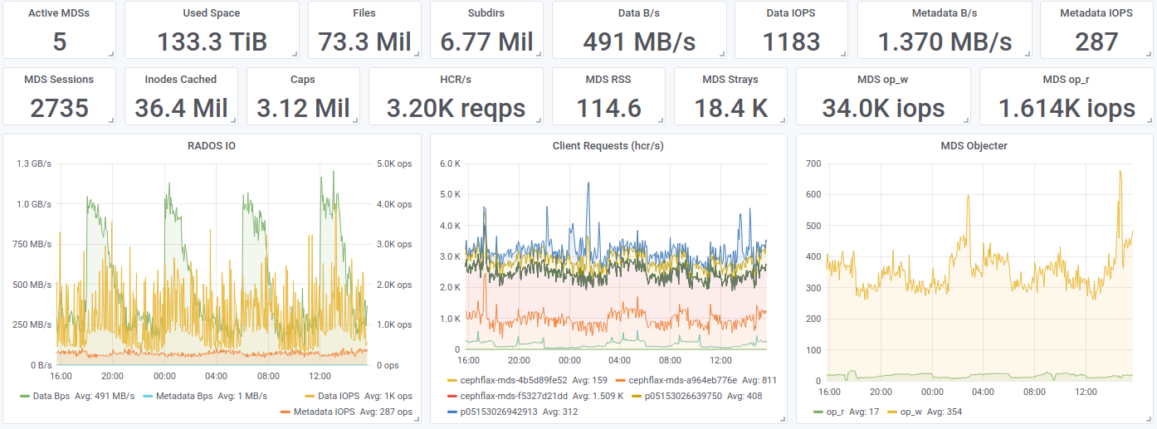
CephFS
One day on CephFS

Slide 53
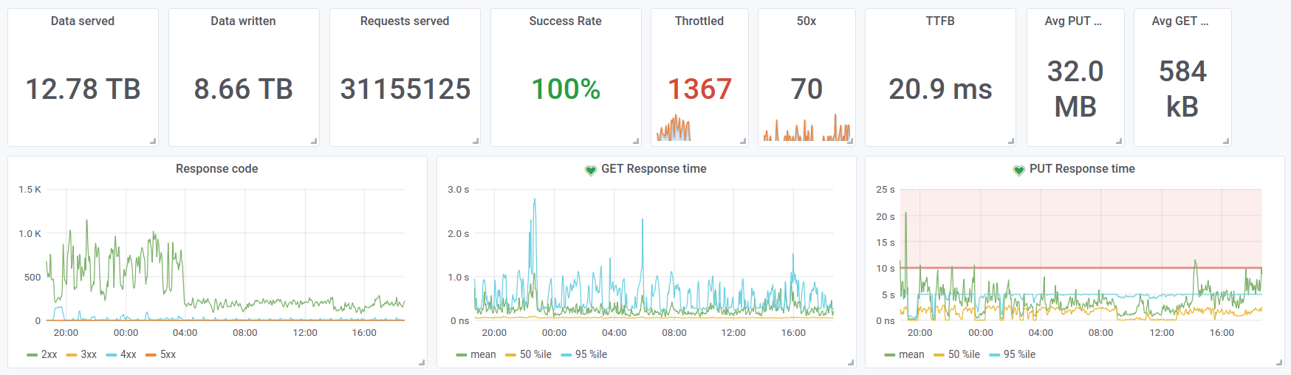
S3
One day on S3

