Slide 1

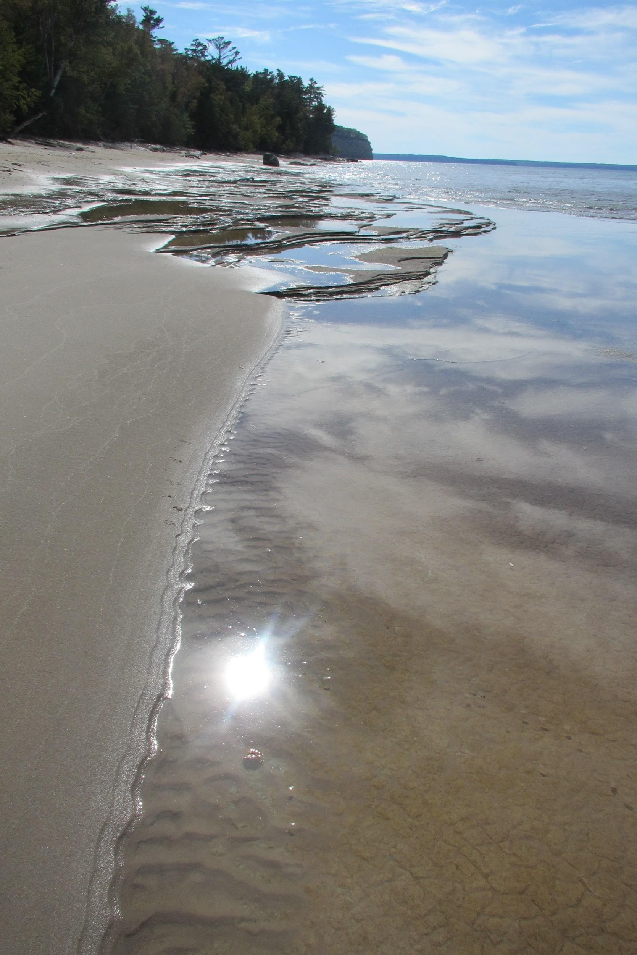

AGLT2 Site Report
Wenjing Wu/University of Michigan
Shawn Mckee, Chip Brock, Philippe Laurens, Mike Nila
HEPiX Spring 2019 / San Diego

Slide 2
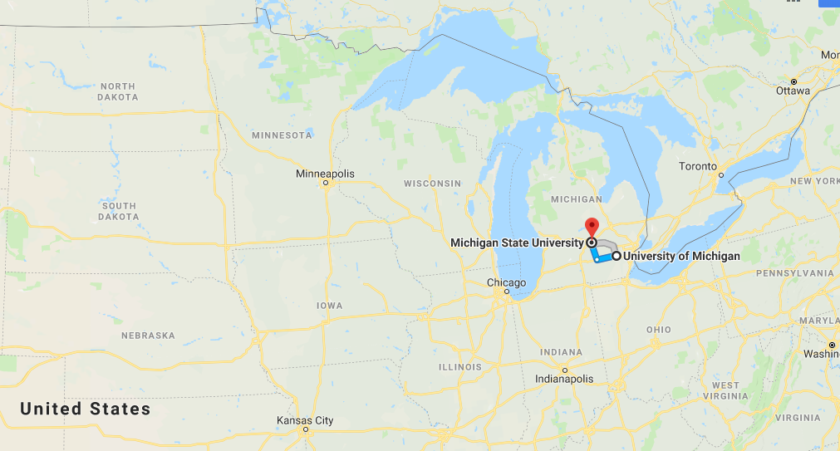
AGLT2 Overview
AGLT2(ATLAS Great Lake Tier-2) is a distributed LHC Tier-2 for ATLAS spanning between UM(University of Michigan)and MSU(Michigan State University).
What VO(s) we serve?
  ATLAS Tier2/Tier3
  OSG (ligo, uscms, glow etc.)
Resource contribution:
  UM Tier3: 10%
  UM Tier2: 45%
  MSU Tier2: 45%
  MSU Tier3 is not part of AGLT2
Resource Usage:
  Over 98% are constantly used by ATLAS Tier2 jobs

Slide 3
AGLT2 Network
internal ports
  10Gb (lots of), 40Gb x 20, 100G/40G x 32 or 50G/20G x 64
Bond (LACP) for all nodes, storage nodes have dual stack links.
Different Vlans for management (IDRAC), private IP, public IP etc.
VMware Server
Work Nodes
AGLT2 MSU
10G
WAN (Chicago)
10G
100G or 40G
40G
Switches
100G
2 x 10G or
2 x 25G
2 x 50G or
2 x 100G
40G
40G
AGLT2 UM
Low Capacity
Storage Nodes
High Capacity
Storage Nodes
Detroit
UM Tier3
Part of AGLT2
40G
40G

Slide 4
AGLT2 Storage
dCache (serve ATLAS Tier2)
  Version 5.05
  Total capacity 6.95PB
  2 head nodes (@UM, each has postgresql database), with another 2 slave nodes for postgresql hot standby (all postgresql are on ZFS)
  6 door nodes (3@UM, 3@MSU)
  25 pool nodes (14 @MSU, 11 @UM)
  Bonded Ethernet for pool nodes with links varying in 20Gbps, 50Gbps, 100Gbps depending on the storage capacity
Lustre (serve UM ATLAS Tier3, mounted to all the UM cluster nodes)
  Version: Server 2.10.4, Client 2.10.6(to work with the new kernel in SLC7.6)
  Total capacity 1.5PB
  ZFS 0.7.11 on the OSS, ldiskfs on MGS/MGT
  20Gbps bonded Ethernet on each OSS
  Hardware is old, frequent hard disk replacements.

Slide 5
AGLT2 Cluster
HTCondor (8.6.13 for head nodes , 8.4.11-1 for work nodes)
  412 Physical nodes, with cores range in (8,16,24,32,56), RAM per core ranges in (2, 3,5,6)GB
  Average 10.69 HS06/core
  Total of 127 kHS06
  11935 logical cores, 37TB RAM, Avg. 3.2GB RAM/Core
    144 nodes with older hardware(<=16 cores/node) providing 1962 Static job slots (1952x1core, 10x8 Cores). (Historical reasons, to give certain user groups quick access to job slots. We see low utilization on the static job slots, will convert them soon)
    268 nodes with newer hardware(>=24 cores/node) providing dynamical partitionable job slots(either 1 core or 8 cores according to the requirements of the incoming jobs)
    936 cores are provided by Tier3, but shared by both Tier2 and Tier3.

Slide 6
Cluster optimization (1)
We identified low utilization problems on the cluster, mainly due to
  17% cores are 1-core static job slots, most of the incoming jobs(ATLAS production) require multi core, so we often see around 5% unclaimed cores
  HTCondor configuration issues on some low memory work nodes, some cores are not claimable by condor because they are not being configured with enough memory to match the job requirements.
  More generally speaking
    Site has scheduled downtime for maintenance
    Site is not always saturated with jobs..
    Jobs have various CPU Efficiency (ATLAS job CPU Efficiency varies from low 40% to high 90%), so there are always CPU cycles not being exploited even all the cores are 100% occupied by jobs.

Slide 7
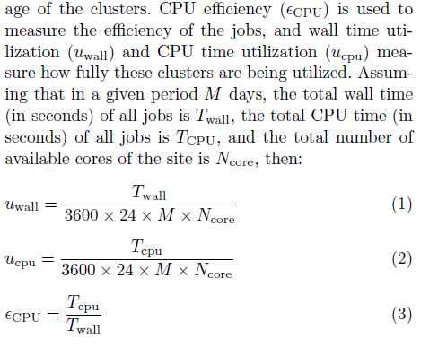
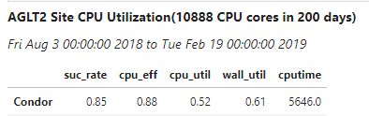
Cluster optimization (2)
We use ATLAS job archive and analytic platform to analyze the utilization of our cluster in a 200 day period, to minimize the impact of downtime, problematic hardware.
The Avg. number of cores constantly can be used by ATLAS jobs is around 10888,excluding hardware issues.
This looks bad… Why ATLAS only uses 61% of its available capacity in wall time and 52% in CPU time(5646 CPU time in days)?
M = 200
Ncore = 10888

Slide 8
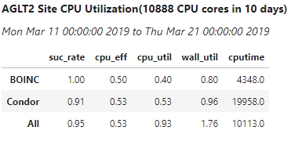
Cluster optimization (3)
We did a few things:
  Reconfigure low memory nodes, making all the cores being claimable by Condor
  Most importantly, we use the ATLAS@home (BOINC) jobs to backfill the cluster
  Condor and BOINC clients are both running on the work nodes to process their own jobs(from different PanDA Queues). BOINC jobs are niced with low priority, so they only use the CPU cycles which are not being used by the Condor jobs(during I/O).
We see a big improvement in CPU utilization of the cluster (0.5->0.93), Avg. daily CPU time in days is 10113
Very low impact on the CPU utilization(0.52 ->0.53) of Condor jobs
No impact on Condor job success rate. (0.85->0.91)
Drawbacks: The CPU Efficiency for Condor jobs seem to drop a lot (0.84-> 0.53)
But since they are both ATLAS jobs, the drawback is acceptable to achieve a high CPU utilization of the cluster which means more CPU time being exploited
Still need to convert the static job slots to dynamical

Slide 9
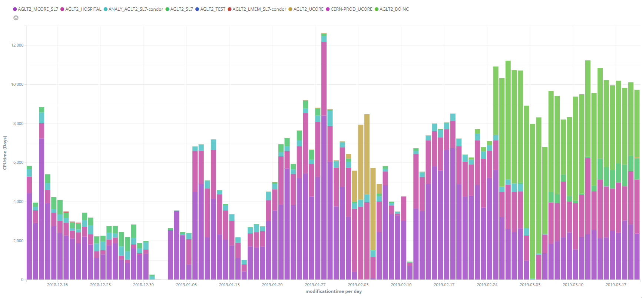
Cluster Optimization(4)
daily CPU time converted to day(s)
After Backfilling
Total Capacity is 10888 CPU cores
CPU time from BOINC jobs
site downtime
The total CPU time of ATLAS jobs has significantly increased after applying the backfilling jobs. (Avg daily CPU time 5646->10113 CPU days out from 10888 Cores)
Data is from ATLAS job Archive and Analytic platform

Slide 10
Software Updates
Work node OS: Scientific Linux release 7.6 (3.10.0-957.1.3.el7.x86_64 )
dCache: 5.05
  Postgresql 9.5-> 11.2, zfs 0.7.13
Lustre
  Server: 2.10.4, Client: 2.10.6, ZFS: 0.7.9
HTCondor
  Head nodes/gatekeepers (Master, Schedd, collector, procd) 8.6.13
  Work nodes (Master, Startd) 8.4.11
OSG CE updated to 3.4.5
VMware update : 5.5->6.7
Monitoring updates: OMD/check_mk : 1.5.0p12
Various firmware updates applied to switches/servers/work nodes

Slide 11
New Hardware
Finished the purchases for FY18
  16 Dell C6420 nodes( 9 @UM, 7@MSU, each node with 56 HT cores and 192GB RAM)
  Tape Library and Server (User home backup and critical services backups)
  New VMWare Servers (3 Dell R740)

Slide 12
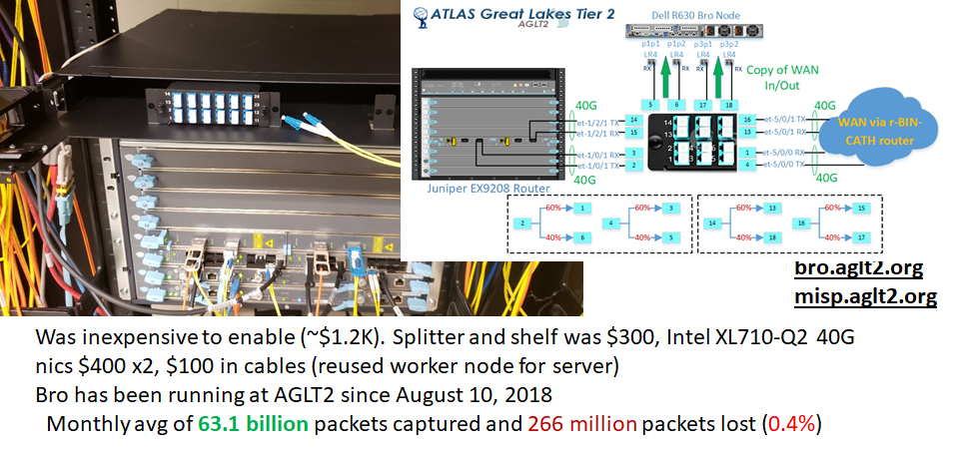
Networking Updates: Optical Splitter

Slide 13
ELK at AGLT2
AGLT2 has been using ElasticSearch, Logstash and Kibana for a few years, primarily to host a central syslogging service
Currently we have a 3 node (all VM) cluster running Elasticsearch 6.6.1.
  The VMs are hosted on VMware
  The primary node has 16GB of RAM and 8 cores and runs Logstash and Kibana (avg load 0.66)
  The secondary nodes are only running Elasticsearch and have 12 GB of RAM and 4 cores
  Total space available is 3.1 TB (73% in use)
ElasticSearch 712 indices, 2.5 billion documents and 2750 primary and 3400 replica shards
The main data sources are 1) syslogging from all our devices, 2) dCache logs and 3) Netflow/Sflow, 4) Bro/Zeek logs and 5) will add HTCondor soon

Slide 14
Summary
Conclusion
Updates of OS, software, firmware and security patches are applied in a timely way to keep AGLT2 current
We have done a lot of work to improve the utilization of the cluster, and it has worked!
FUTURE: dCache over Ceph, Accounting in ELK, more improvement work of HTCondor system
Questions ?

Slide 15
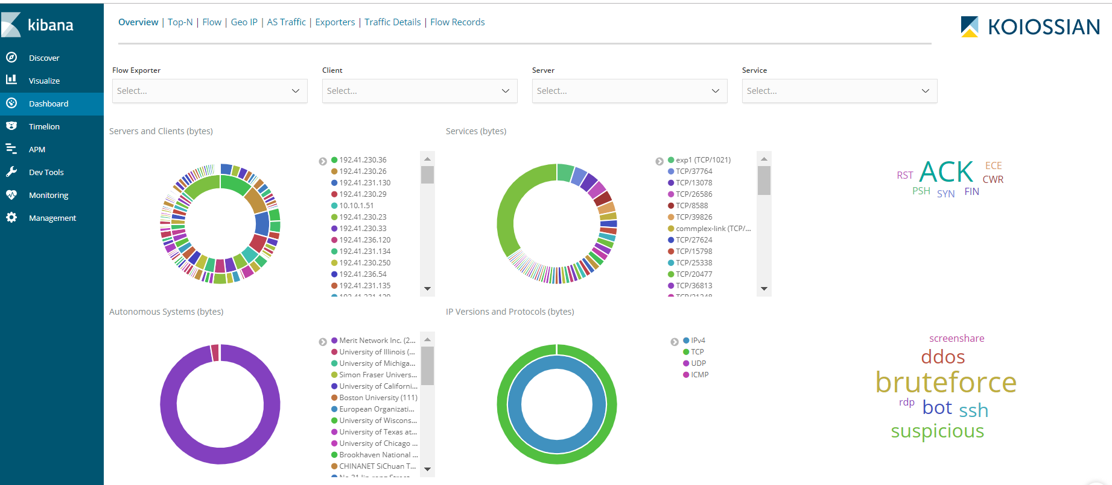
ElastiFlow @ AGLT2 Examples (1)

Slide 16
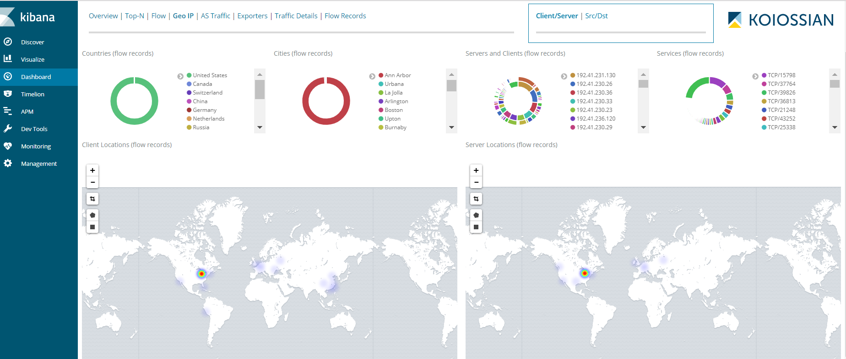
ElastiFlow @ AGLT2 Examples (2)

Slide 17
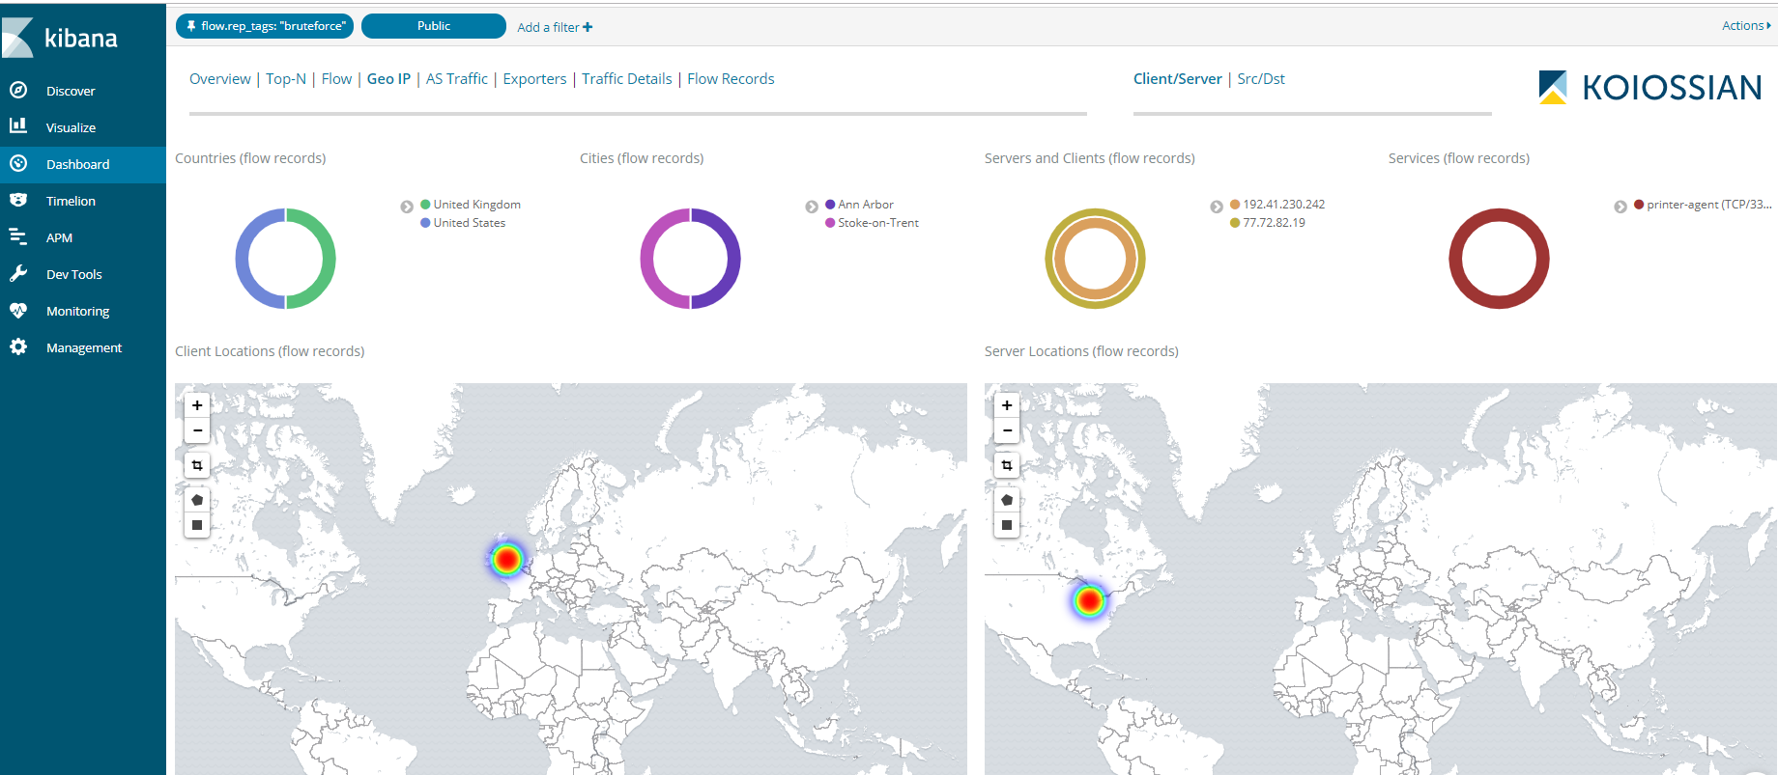
ElastiFlow @ AGLT2 Examples (3)

Slide 18
Near Term Plans
Will begin testing dCache on Ceph using AGLT2 and OSiRIS
Continue to work on the optimization of the cluster
Work with Farso OS to test its performance in processing the ATLAS jobs.
Import more accounting information (dCache, HTCondor, BOINC) to AGLT2 ELK

Slide 19
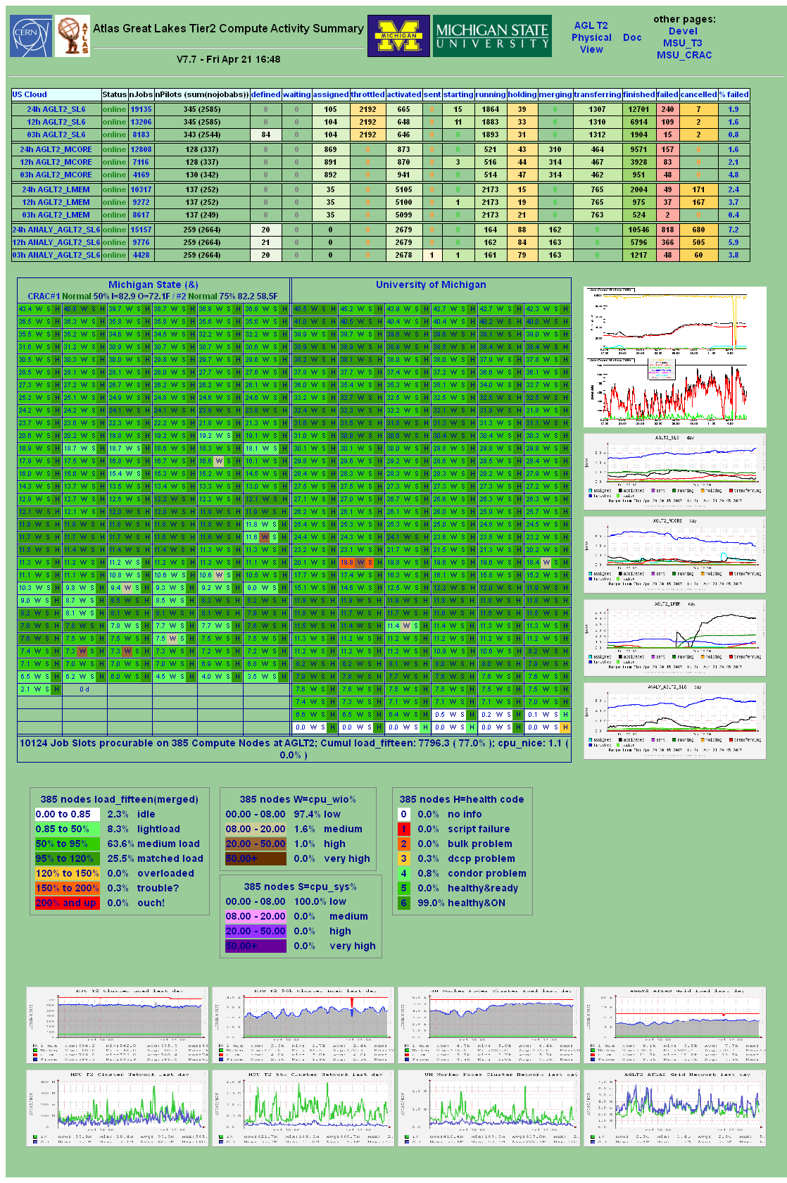
AGLT2 Monitoring
AGLT2 has a number of monitoring components in use
As shown before we have:
Customized “summary” page ------->
OMD (Open Monitoring Distribution) at both UM/MSU
Ganglia
Central syslog via ELK: Elasticsearch, Logstash, Kibana
SRMwatch to track dCache SRM status
GLPI to track tickets (with FusionInventory)
We find this set of tools indispensable for proactively finding problems and diagnosing issues.

Slide 20
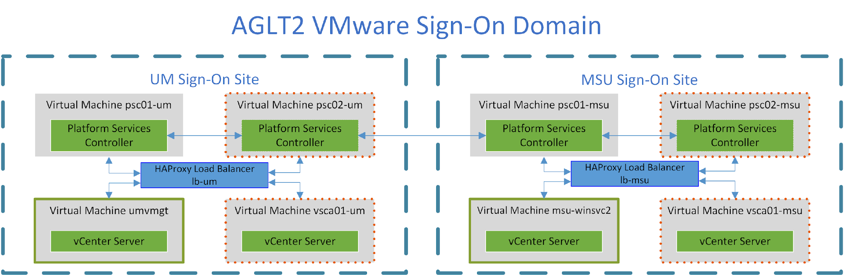
VMware Update

