Slide 1
HEPIX Spring 2019 Summary
Tony Wong
BNL

Slide 2
Meeting Statistics
88 participants
  31 from North America
  39 from Europe
  4 from Asia and elsewhere
  14 from corporate sponsors
64 accepted abstracts
  Site Reports (19)
  Storage & Filesystems (10)
  Grids, Clouds & Virtualization (8)
  Networking & Security (7)
  Computing & Batch Systems (7)
  IT Facilities & Business Continuity (7)
  End User IT Services & OS (3)
  Basic IT Services (2)
  Other (1)
Webcasting most presentations—recordings to be made available
Notes:
re

Slide 3
SDSC/UCSD
Brief introduction by Mike Norman on SDSC history, usage and current developments
  35+ years of operational history
  99% of jobs use single rack and ~10% use single node (16 cores)
  Support for HTC and OSG computing
  Support for bursting out to cloud computing

Slide 4
Site Reports
NERSC turning off PDSF in April and Edison in May 2019, migrating workload to Cori
Migration to FreeIPA to BNL—federation and SSO on-going
Canada’s Tier1 services migrating from TRIUMF to SFU—support continuity provided by TRIUMPF staff
Optimization of computing resources at AGLT2 with HTCondor to increase cpu utilization rate
UW-Tier2 – opportunistic usage of CHTC (average of ~1.5k cores for CMS production)
Nebraska Tier2 reported extending useful lifetime of equipment to stretch resource availability –general push to use Leadership Class Facilities HPC resources
KEK reported on ramp-up in resource utilization due to Belle-II and J-PARC physics data
Tokyo Tier2 completed migration to new cpu and disk hardware in January (total downtime was 34 hours)

Slide 5
Site Reports
UW’s CEMPA description of bringing up a re-purposed NERSC cluster for usage
Jlab reported on a new GPU cluster for LQCD and providing support for cloud computing
IHEP presented remotely—expand services in HPC activities and plans to leverage remote, heterogeneous clusters to augment resources
CERN’s decommissioning of the Wigner remote site—equipment to go into containers while 2nd data center plans are being discussed
Infrastructure work still on-going at INFN as part of plan to address previous data center flooding
RAL’s SCD Cloud delivers dynamic compute resources across STFC and externally (including LSST and Diamond)
DESY’s developments regarding future AFS and Windows upgrades

Slide 6
Site Reports
Increasing deployment of EPYC-based servers (Nikhef, FZU, GSI)—reported variable gains in price/performance based on historical data
Diamond leverages services at STFC RAL and described existing resources available to Photon Science community
FNAL updates on current and future HEP experimental activities, storage updates, HEPCloud, InCommon, etc

Slide 7
End-User IT Services & OS
SDSC presentation on ML algorithm to classify user tickets and possibly automate response to common questions
CERN presentation on user end-point management—survey available on Indico page for the San Diego meeting
NERSC’s project to consolidate cluster management & provisioning—simplify staff effort and present consistent experience to users

Slide 8
Networking & Security
CERN has plans to modernize support code for DNS and DHCP services
Security presentation by Stefan Lueders—freedom, security, convenience, choose two
BNL presentation on migration to FreeIPA to support SSO and federated access
Nikhef presentation on performance and scaling tests on selected network equipment
Shawn gave an update on OSG/WLCG Networking activities
Andrea presented the status of IPv6 readiness across sites (T1, T2, etc)—progress, but still ways to go
Shawn reviewed status of activities in the Network Functions Virtualization WG—white paper coming soon

Slide 9
Storage & Filesystems
OpenAFS description of latest developments (releases, bug fixes, security updates, etc) and contributions by user community
VU presentation on a HDFS-LS integration project to optimize processing performance of large volume of small data files
RAL presented status of migration to ECHO (Ceph-based disk storage) and tape services (currently based on CASTOR but in discussions about the future)
Update on Dynafed by Marcus—redirector for a dynamic data federation
Presentation on OSIRIS and mechanism for federated access with CoManage and usual IDP’s (InCommon, EduGain, etc)
KIT’s presentation on oVirt/RHV-based virtualized online storage cluster activities
FZU described activities related to upgrade of legacy grid storage system to DPM Dome

Slide 10
Storage & Filesystems
CERN update on status of storage services (EOS, Castor, AFS, Swan, CERNBox, Ceph, CVMFS, etc)
plans to phase out AFS has been delayed but still on target for completion before run 3—disconnection test for one week beginning April 3rd dddd
BNL activities on large-scale storage hardware management
WekaIO presented a GPU-optimized storage filesystem that significantly outperforms other popular filesystems
BoF session on storage with contribution from AuriStor

Slide 11
Computing & Batch Systems
Michele provide a status report on the Benchmarking WG
  HS06 obsolete, evalaluating CPU Spec2017
  Experiment-based benchmarks promising—use LHC workloads but other contributions welcome
Fair(?)-share mechanism at IN2P3—proposals to address and fine-tune batch policy
CERN’s presentation about on-demand provisioning and elastic scaling to large compute pools with Spark on Kubernetes and SWAN
Will presented for BNL a MFA-enabled Jupyter cluster available on HTC and HPC resources
DESY’s presentation on Photon Sciences computing practices—very different from HEPN community!
  Small teams with little (no?) computing expertise
  Challenges with detector and accelerator improvements
  The necessity of data reduction techniques

Slide 12
Computing & Batch Systems
CSCS report on activities at the Swiss SuperComputing Center
  ATLAS/CMS workloads on HPC environment
  Potentially leveraging HPC technologies (ie, gpu’s) for Tier2 facility usage
IN2P3’s presentation on deep learning in containers
  Address needs (ie, simulations) in HEP
  Potentially leverage GPU’s for HL era

Slide 13
IT Facilities & Business Continuity
Andrea’s presentation on WLCG/HSF on cost performance modeling
  Gap between requirement and affordability is narrowing but still factor of ~2
  Future work includes refining requirement estimates, understand TCO of infrastructure and identify areas of savings
BNL’s description of new data center and migration plan without service interruption
Superfacility project at NERSC to coordinate, manage and integrate various aspects needed for scientific computing workflow (computing, storage, network, software and infrastructure)

Slide 14
Technology Watch WG summary
Track evolution of IT technologies market trends
  Current focus on HEP and LHC, but open to contributions from other fields
Andrea presented a comprehensive summary of recent market developments for cpu, gpu, fpga, memory, etc
  AMD return to the data center
Martin highlighted a few trends in storage
  Shrinking market for HDD, increasing usage of SSD
  Concern with shrinking competition in tape storage market
Michele showed some highlights in server trends
  Rising market for x86 servers
  Concern about power usage and transition to liquid-cooled racks
Network highlights presented by Rolf
  5G will contribute to rising network traffic (3x higher in 2022 when compared to 2017)
  100 Gbps becoming commodity and 400 Gpbs is available
  Several network evolution areas discussed

Slide 15
Basic IT Services
centralized configuration and deployment at KIT for data-intensive computing
SLAC presentation on the need to upgrade its token renewal service—many choices out there to cope with contemporary computing environments

Slide 16
Grids, Clouds & Virtualization
Boyd Wilson (Omnibond) described two projects
  AWS cloud cluster (scale up 1.1M cores in 2 hours)
  Use traffic video data with AI algorithms for congestion analytics and improve traffic flow
UV’s on-going work on CloudScheduler v2, an upgrade of v1 originally released in 2009
  Used by ATLAS and to be extended to Belle-II
  Report on scaling tests
  Support for AWS soon
GlideinWMS recent developments
  Management system for dynamic HTCondor pools
  Re-engineered front-end for FNAL’s HEPCloud project
  New features/improvements, such as whole-node allocation, singularity support
KEK described activities and challenges to support grid computing needs , in particular in support of Belle-II requirements

Slide 17
Grids, Clouds & Virtualization
Igor described activities in provisioning an opportunistic OSG site within California’s Pacific Regional Platform (PRP) cluster
Entonos ‘ experiences with HTC at public clouds—adjustments to computing models to maximize throughput/cost ratio
A description of the evolution of cloud services at CERN over last 6 years—from 0 to 300k cores
SLATE project (distributed service orchestration platform) for management of edge services remotely—stimulate creation of multi-institution research platforms
Major OSG re-organization in Spring 2018—a summary of resulting changes and updates in services

Slide 18
HEPIX Board meeting summary
Edgar Fajardo Hernandez has accepted an invitation to join the HEPIX Board
HEPIX Fall 2019 (Oct. 14-18) will be organized by Nikhef in Amsterdam
  HEPIX last held in Amsterdam in 2003
  Local organizational effort led by Dennis Van Dok
  General announcement (and meeting webpage coming soon
On-going discussions on future meetings in 2020 and beyond—more details to be announced soon
Presentations by working groups in San Diego
  IPv6
  Network Functions Virtualization
  Benchmarking
  Technology Watch
A complete list of working groups can be found on www.hepix.org. HEPIX encourages you to join and contribute. Please contact the WG coordinator (see website) for more information

Slide 19
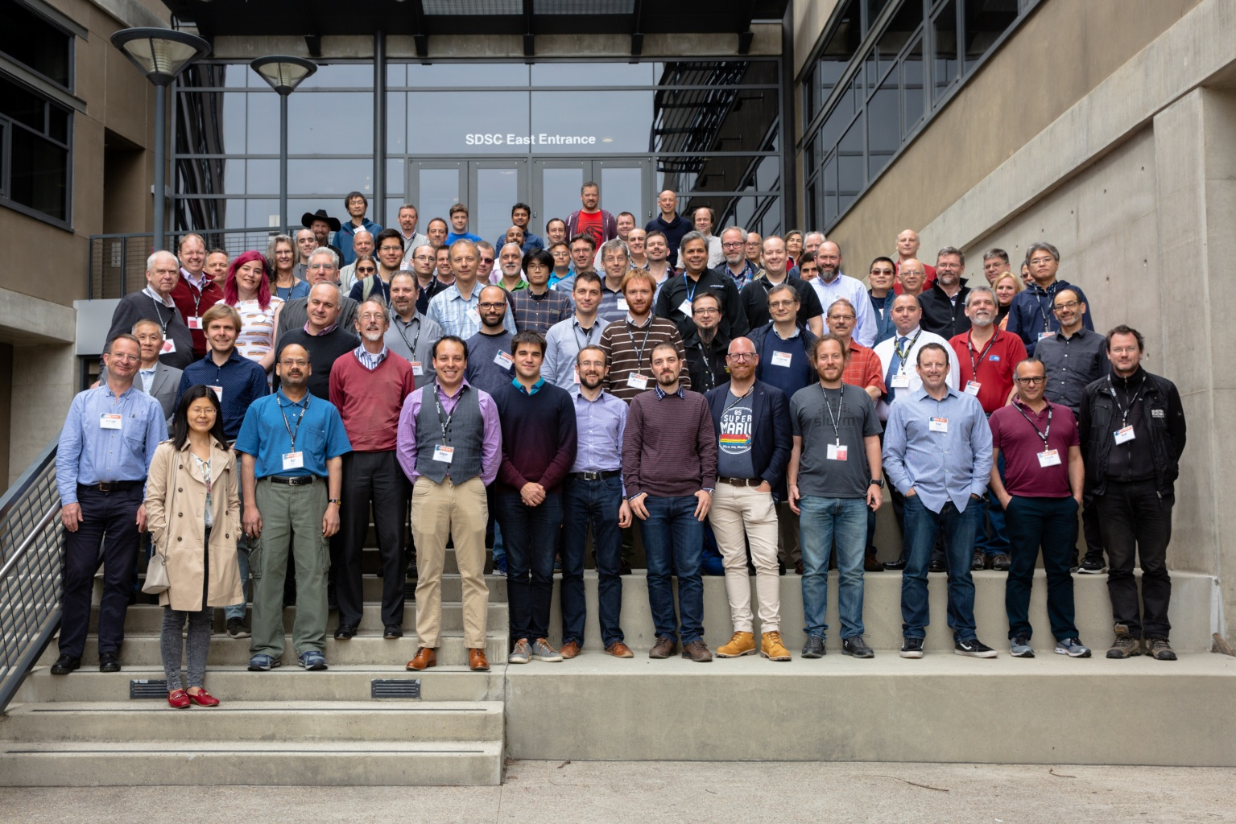
Acknowledgements
Congratulations to Edgar, Frank, Cindy, Susan and the entire local organizing team for a well-run meeting and social events!
Thanks to all sponsors (AuriStor, Weka.IO,Teradactyl, Spectra Logic, Entonos)
Of course, thanks to all of you for making this an interesting meeting!

Slide 20

See you in Amsterdam!

