Slide 1

Patrimony and site Information during Opendays 2013

Slide 2
Localisation of networks
- where to connect: electricity, water
- where to set up tents : If anchored in the ground caution has to be made to burried networks
Patrimony and site Information
during Opendays 2013
Localisation of field plots and owners
- for additionnal car Parks

Slide 3
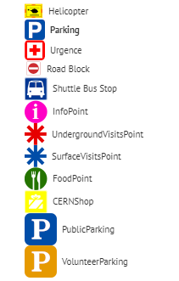


Patrimony and site Information during Opendays 2013
Use of GIS as a sharing plateforme:
  - One person had the responsability to enter and keep up to date the information
64 tentes
36 barrières
20 itinéraires
248 points d’intérêt
Annotations diverses
https://gisdev.cern.ch/?share=88dfc693-9197-4041-b5a4-5e6afcb2ce02

