Slide 1

Open Days 2019
Service Management / Service Desk
Orchestrate support activies

Slide 2
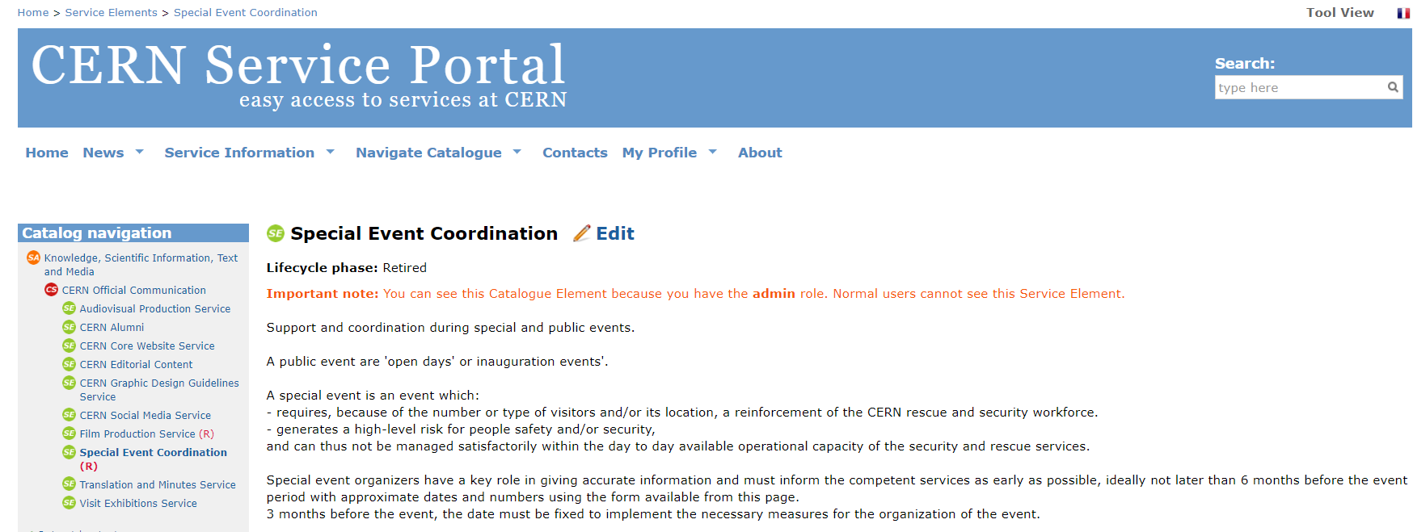

Slide 3
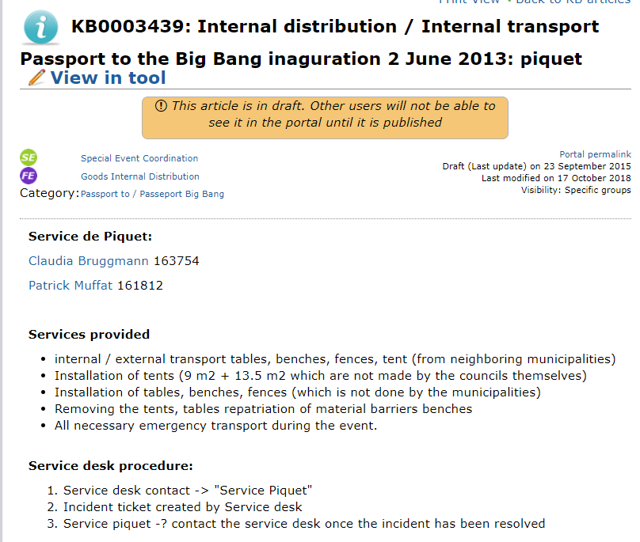
Centralise, coordinate, follow it up general issues
List of services involved includes contacts and different procedure when applicable
By service:
  Identify service piquet
  Service offering
  Procedure

Slide 4
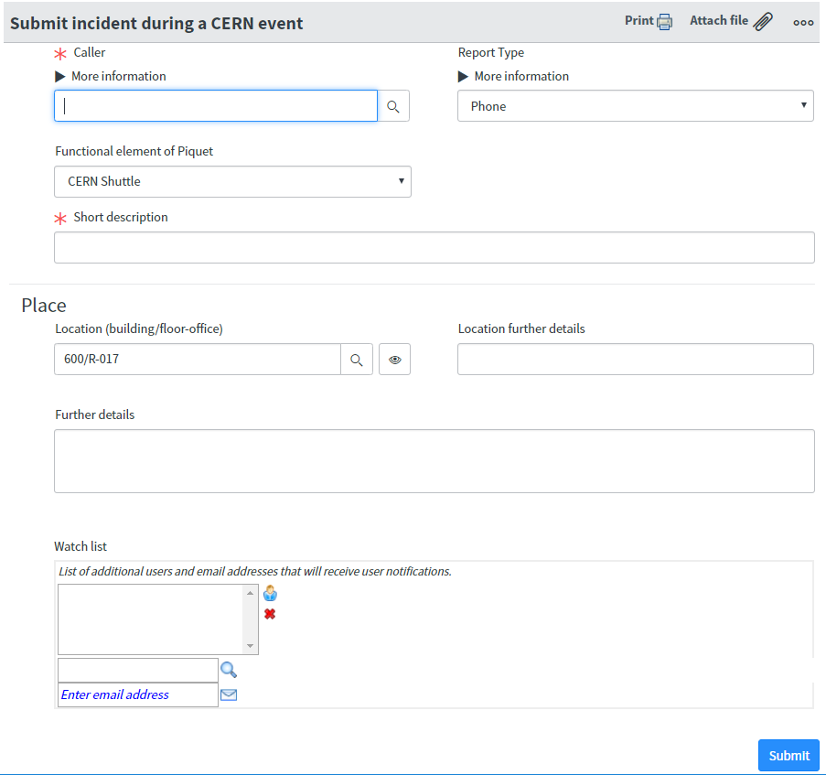
Centralise, coordinate, follow it up general issues
Service desk contact the «Service piquet»
  Service piquet gives information about delay, etc…
Register the issue
Service piquet called back service desk once solved
Caller is informed

Slide 5
Centralise, coordinate, follow it up general issues
Dashboard to follow the issues:
  HeatMap with all the open tickets on the map
  Open Days Dashboard with open tickets

Slide 6
Safety / Security /Access
To define special procedure for security, safety and access issues

Slide 7
Service Desk -General information
General information on the Event: What is going on?
Contacts in the Operation Center (blg 160)
The organization chart of the Core Team with the names of the project managers.
The telephone numbers of the information points where the volunteers are
Cleaning, transport and waste collection services schedules / interventions

Slide 8
Service Desk - Event application
CERN Open Days Flow Monitor
  Train Service desk

