Slide 1
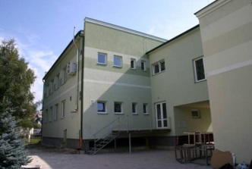
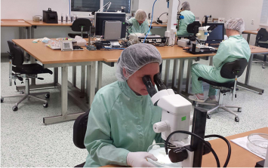
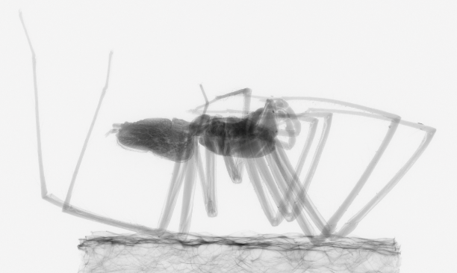
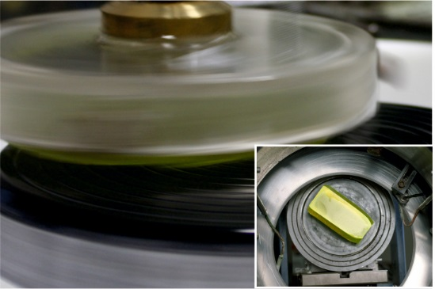
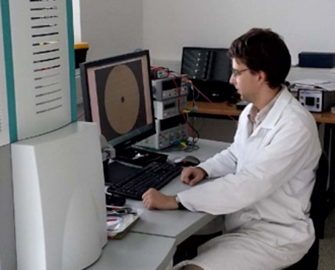
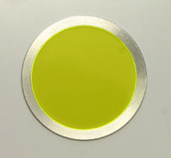
Production and use of inorganic scintillators
Krakow
April 1, 2019
Jiri Parizek
Technology application specialist
parizek@crytur.cz
Notes:
1

Slide 2
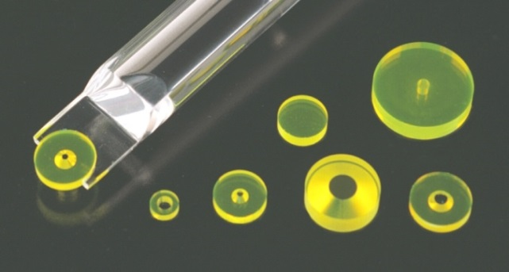
Contents
CRYTUR History
Company portfolio
Crystal growing
Materials and processing
Company portfolio
Imaging systems and scintillation screens
Ionizing radiation detection units
Summary

Slide 3
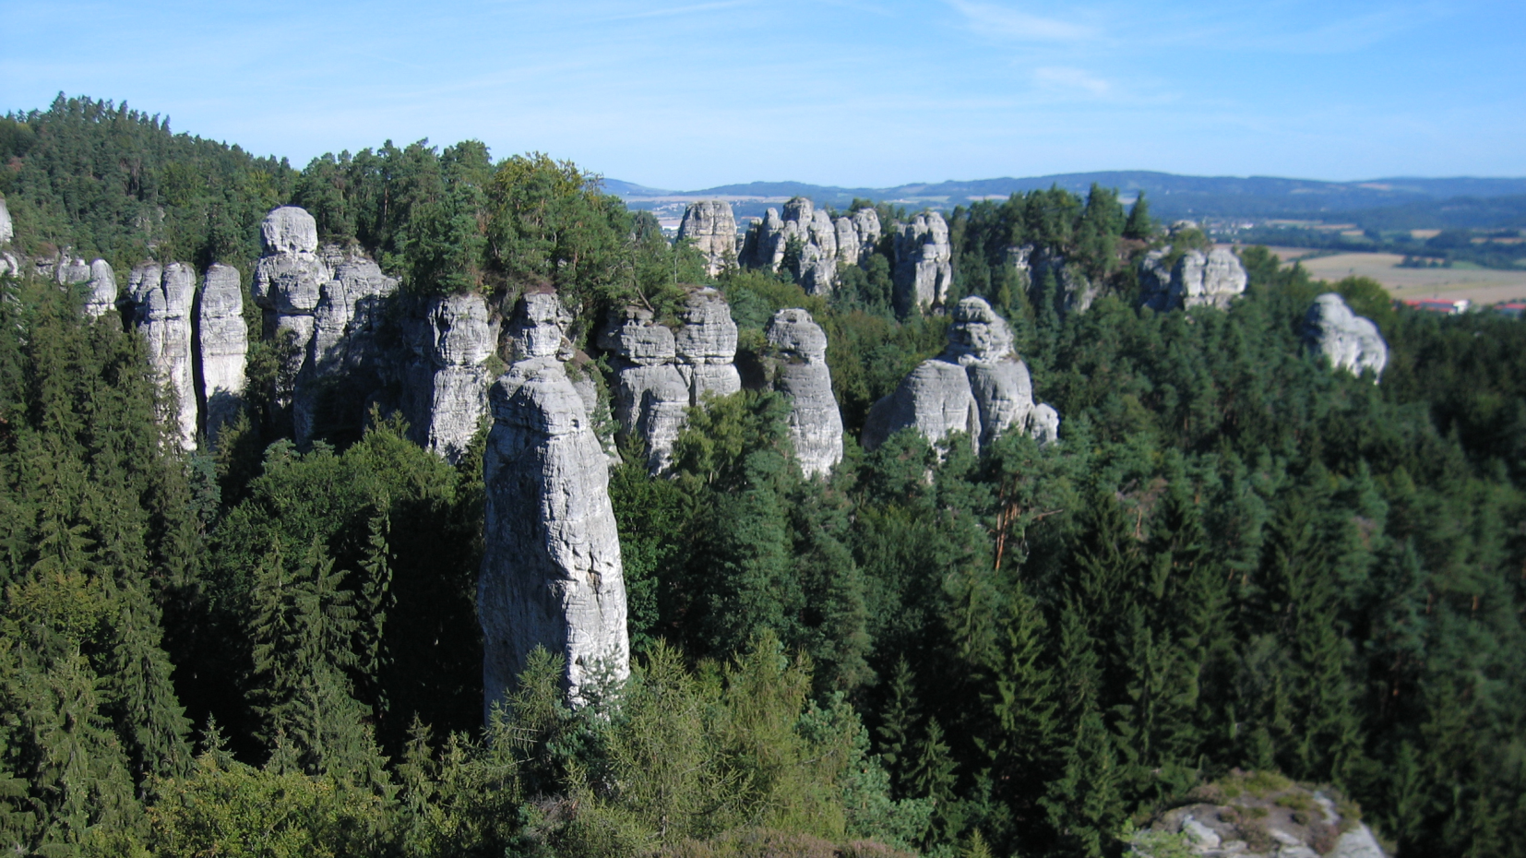
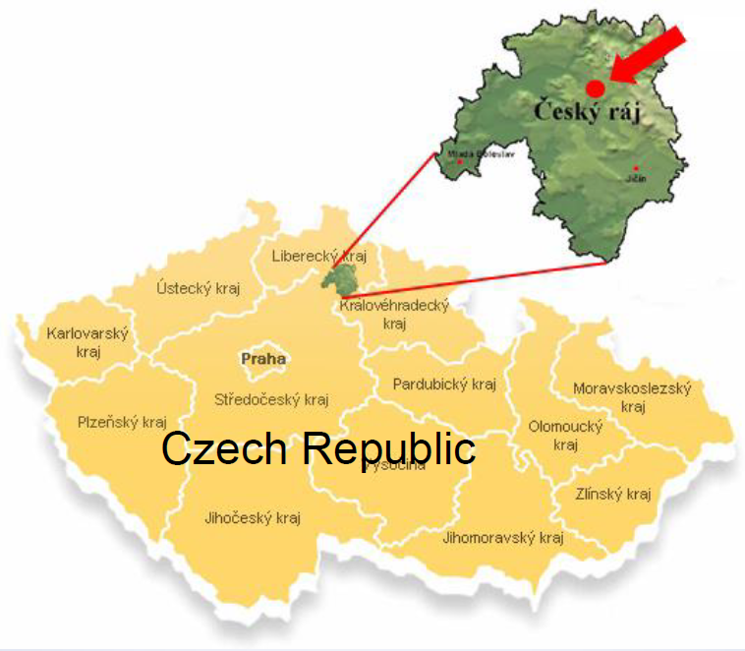
CRYTUR, spol s r.o.
Notes:
3
3

Slide 4






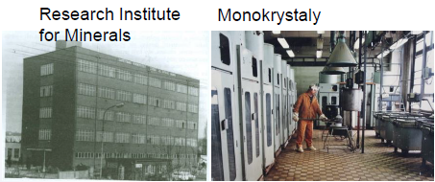
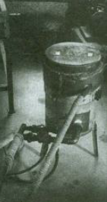

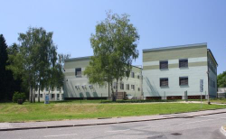
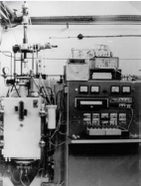
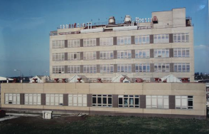
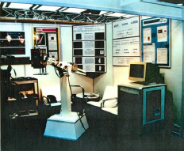
Tradition in crystal growing and processing
1943-1952
1952-1966
1966-1992
1992-1995
1995-1998
1998-
Notes:
4
4

Slide 5
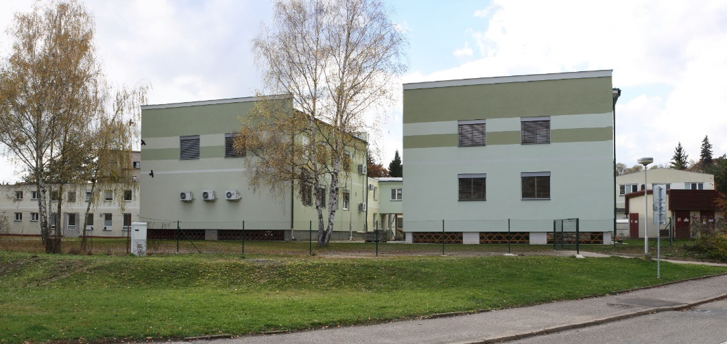
CRYTUR
Experience & quality
200 employees
SME status
11 mil. EUR turnover
ISO 9001 certified
Advanced customer audit
Our own unique material processed in several advanced steps to complex product with the support of our strong R&D team, with the quality assurance over the complete supply chain.
Notes:
5
5

Slide 6
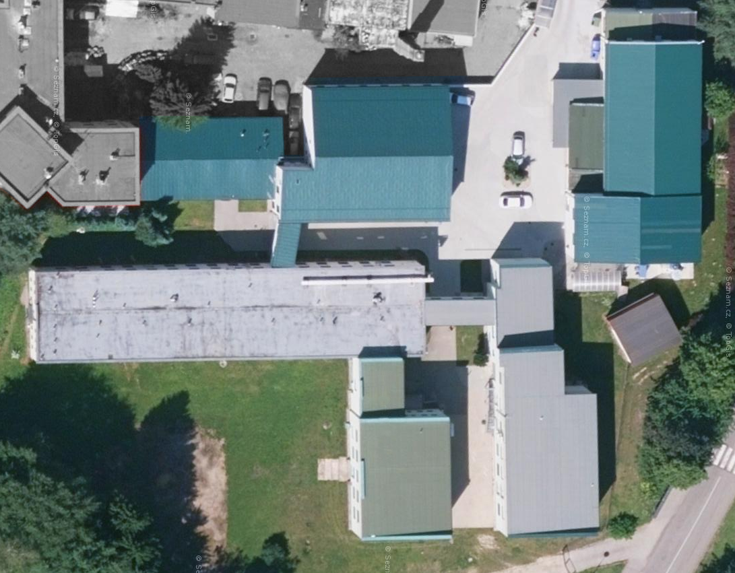
CRYTUR
Experience & quality
Modern production facility - Na Lukách
CRYSTAL
GROWING
ADMIN
+
CNC MACHINING
EXTENSION 2015
MACHINING
+
QUALITY CONTROL
2017
CLEAN ROOM
+
MACHINING
+
ADMIN
RESEARCH
CENTER
02/2013
CLEAN ROOM
+
COATING

Slide 7
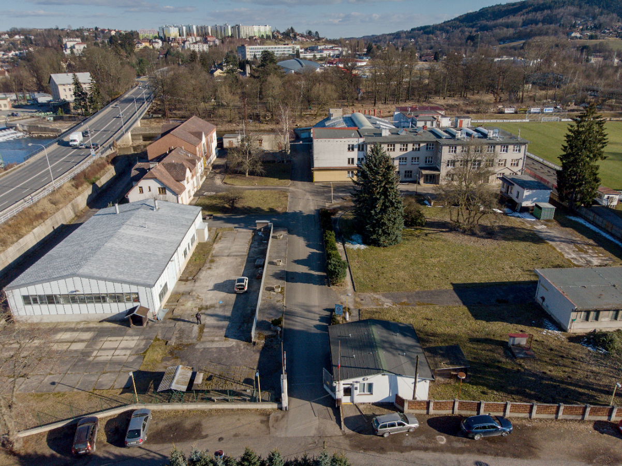
CRYTUR
Experience & quality
New production facility - Koškova
Currently:
PbWO4 project
Induction growing
Precision optics
Plan:
Crystal growing
CNC machining

Slide 8
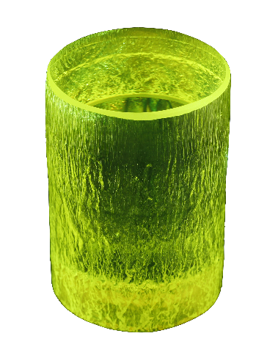
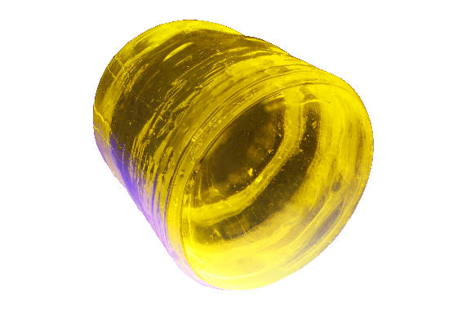
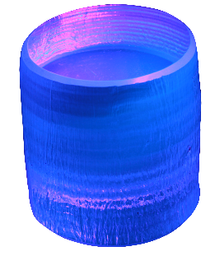
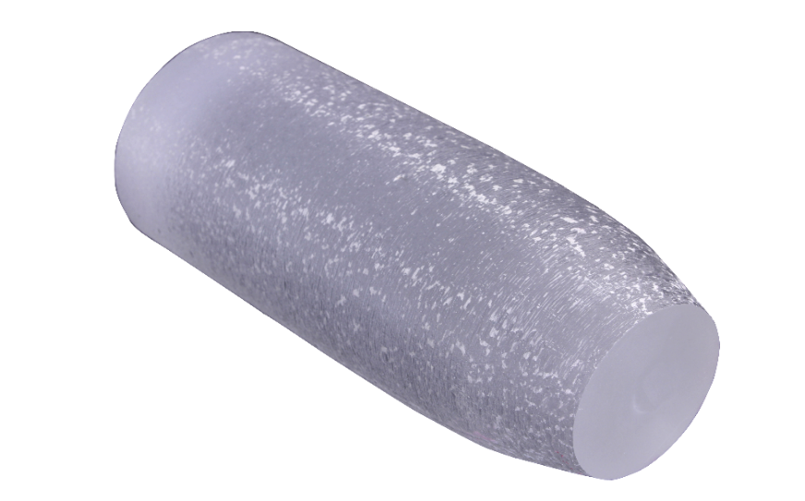
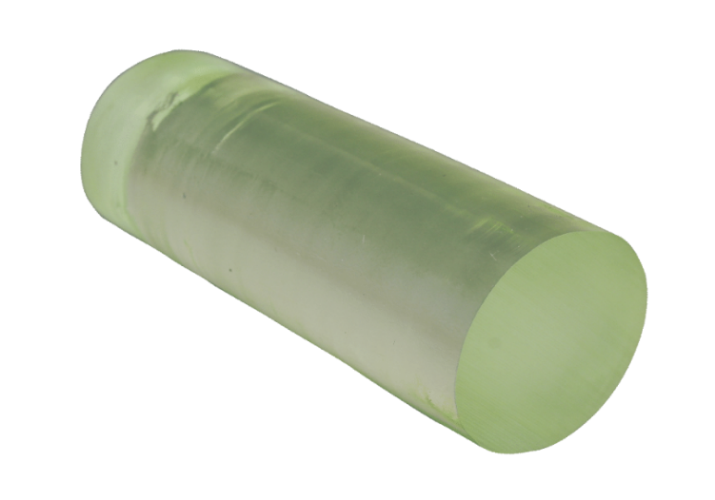
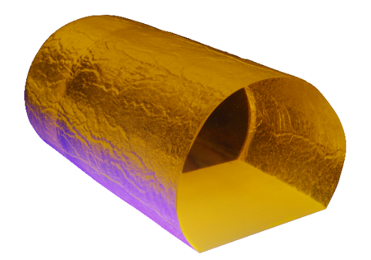
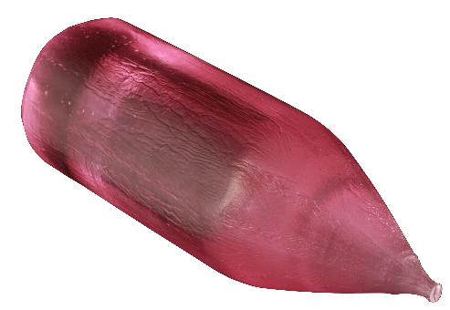
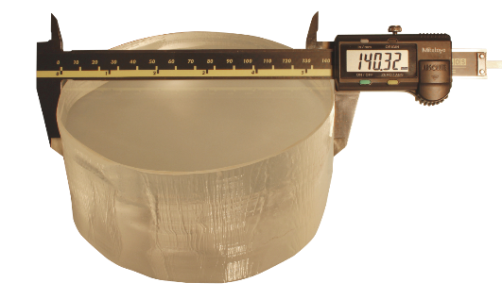
MATERIALS
(grown as single-crystals)
Garnets YAG and LuAG
Perovskites YAP
Silicates, Tungstates (PWO)
Dopants: Ce, Nd, Tm, V, Yb, Pr, Er, Cr
Notes:
8
8

Slide 9
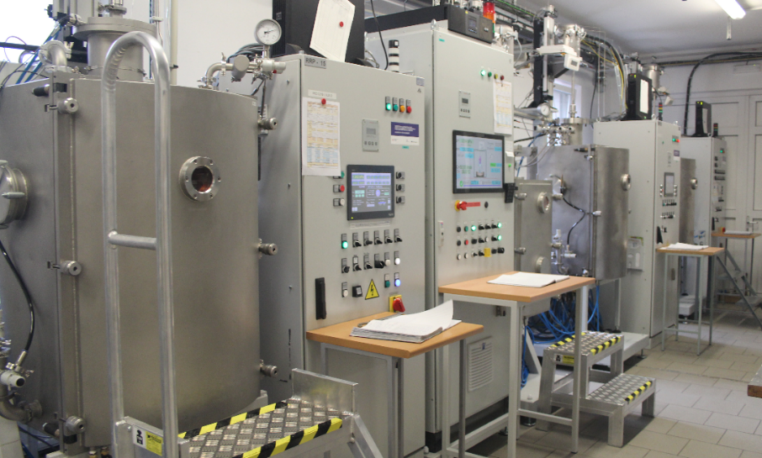
TECHNOLOGIES
– Crystal Growth
CRIG (Crystal Improved Growth)
Based on Czochralski method
Patent EP 2675944
  6 l crucibles
  Tungsten crucible
  H₂ atmosphere
  Special inside configuration
Strictly controlled process
Homogenous crystal ingots
Melting of oxide material
Introducing seed to the melt
Beginning of the crystal growth
Crystal pulling
Crystal boule cooling

Slide 10
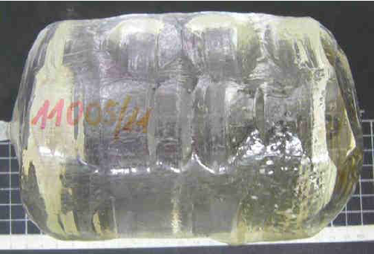
TECHNOLOGIES
– Crystal Growing
„World largest YAG stress-free crystals“
Diameter up to 6 inch
Weight up to 14 kg
Stress-free core

Slide 11
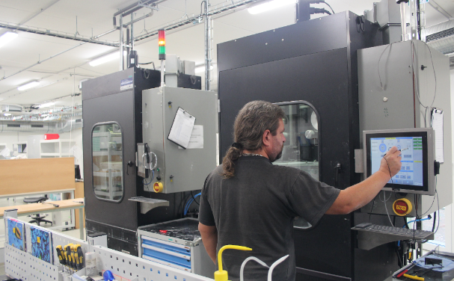
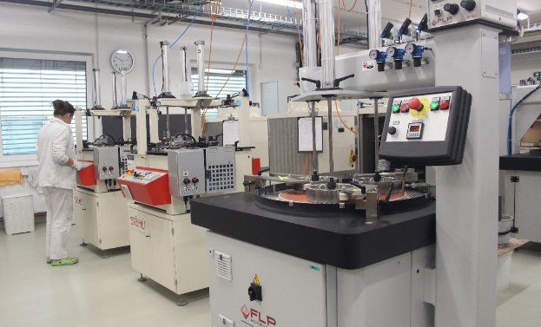
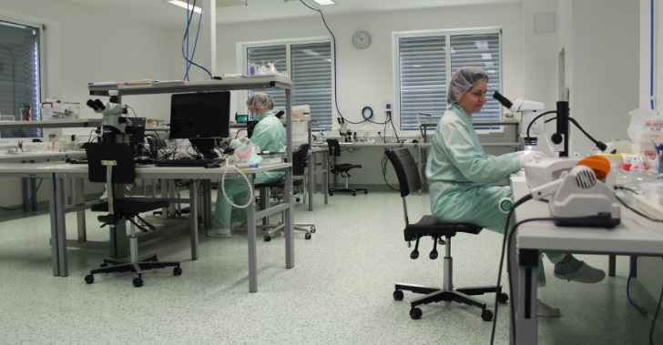
Process diagram
Manufacturing
Cutting (OD, ID, single and multi-wire)
Characterization (QC)
Grinding, Lapping, Polishing, CNC machining
Assembly and packing
Quality check (QC)
ISO 7 – ISO 5 grade

Slide 12
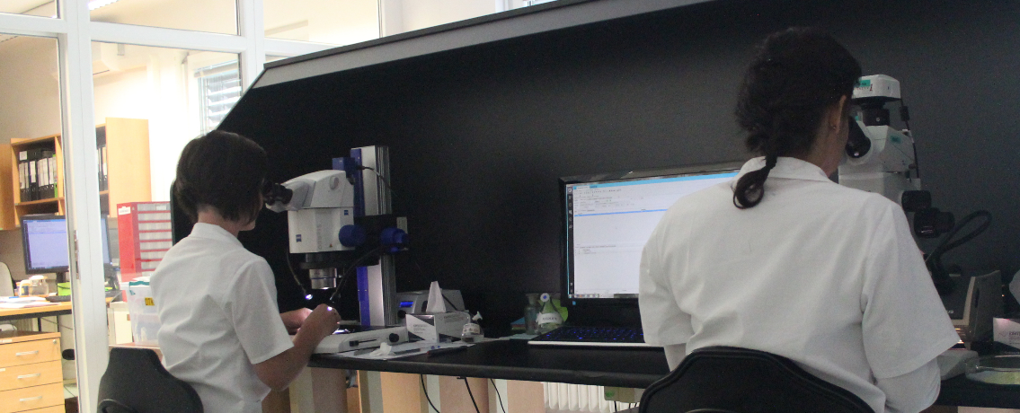
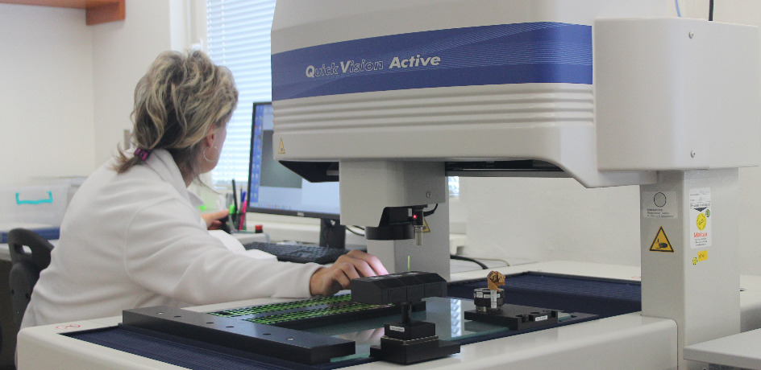
Quality check
El. microscope, interferometers, spectrometers 0.2-5 μm,
XRD, 3D structural analysis, X-ray fluorescence etc.
back-up characterization techniques at university groups

Slide 13

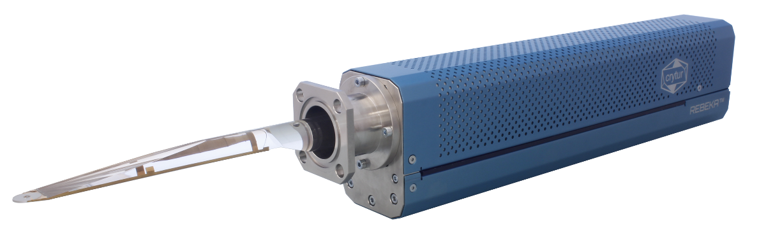
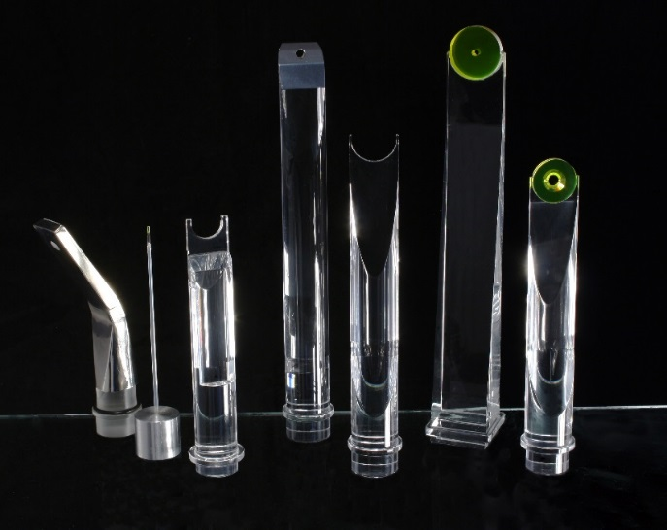
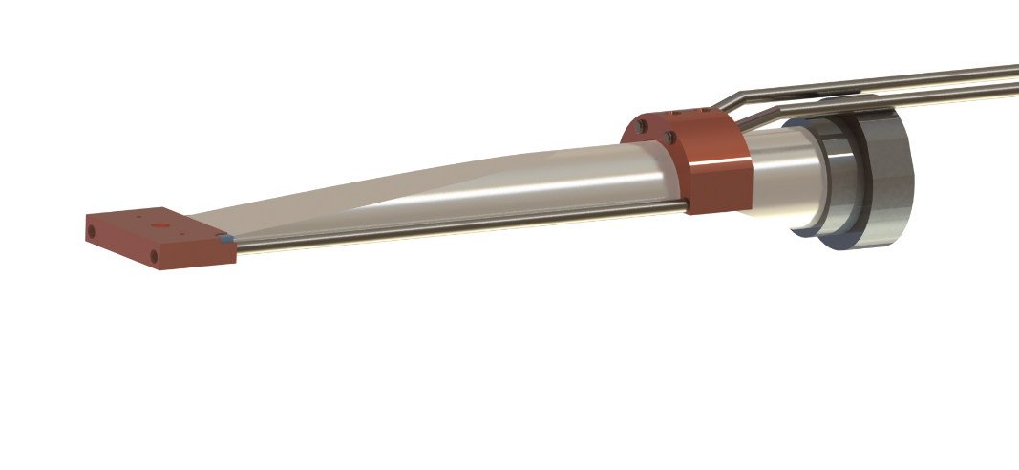
Product line
ELECTRON MICROSCOPY
BSE detection in electron microscopy – global market majority
Complete detection systems
Rebeka
Karmen
Notes:
13
13

Slide 14

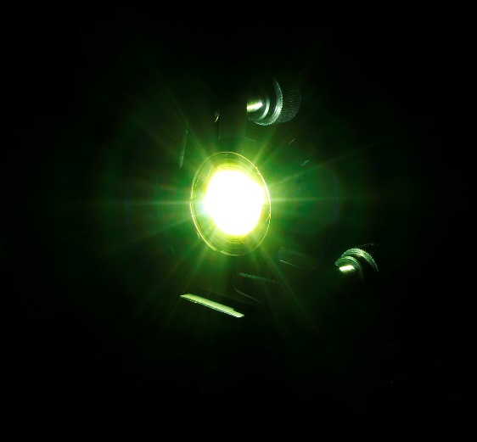
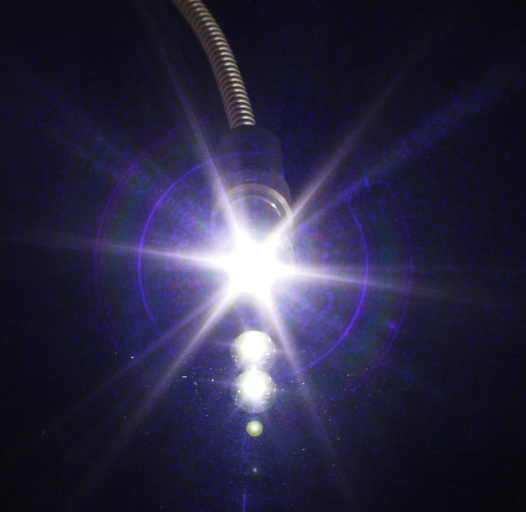
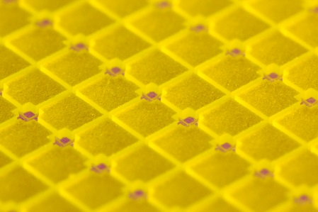
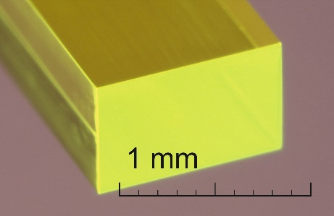
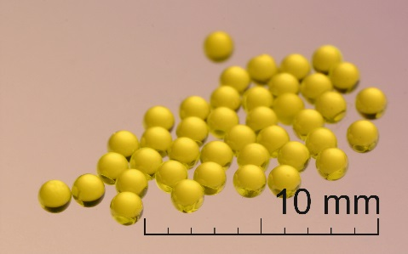
Product line
LUMINOPHORES
Light conversion elements for LEDs
and laser diodes
White-LED conversion
Full light conversion elements
Optical elements
Remote laser excitation
14
Notes:
14
14

Slide 15
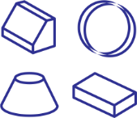

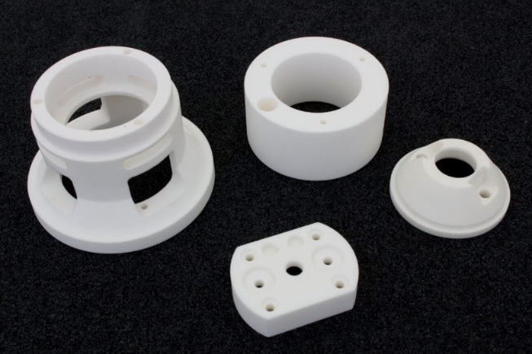
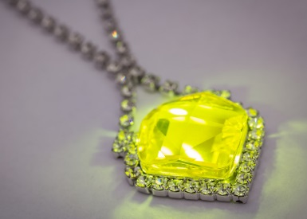
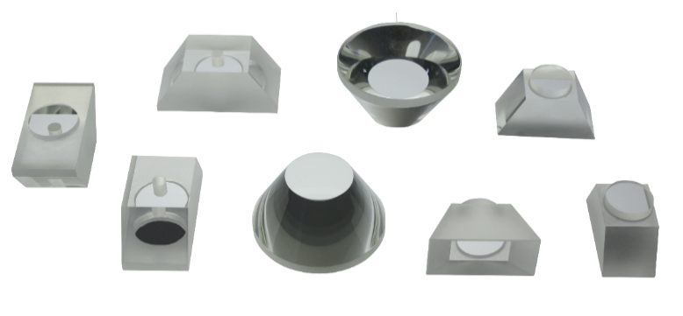
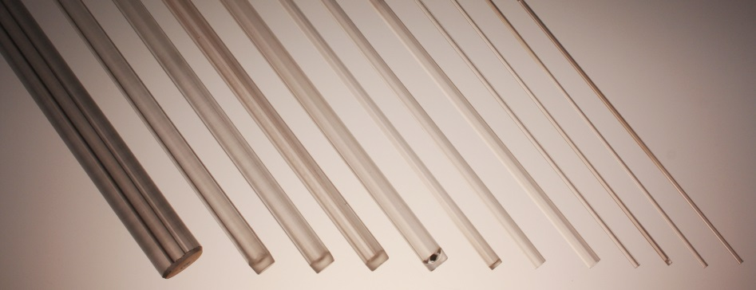
Product line
SAPPHIRE AND
PRECISSION OPTICS
High precision crystal optics (sapphire, garnet)
Sapphire tubes and rods (Temperature measurement probes, ultra-high pressure probes, lightguides, laboratory equipment)
High precision ceramics
UV-light gemstone
Complex shapes,
high precision,
perfect surfaces
Notes:
15
15

Slide 16

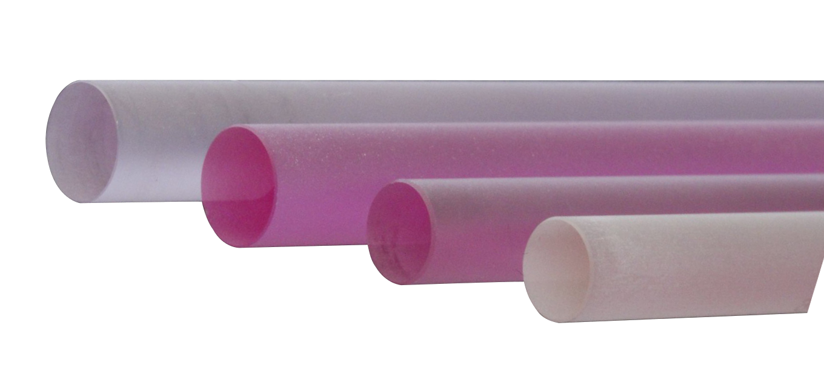
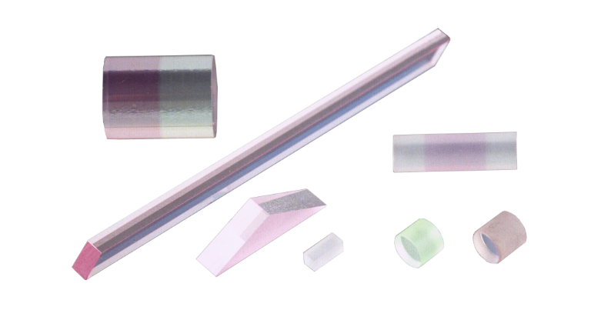
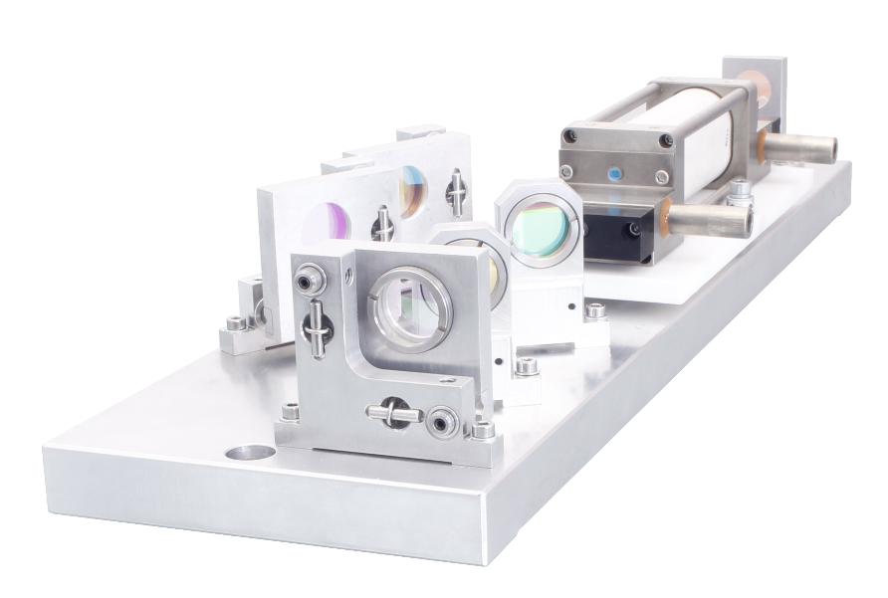
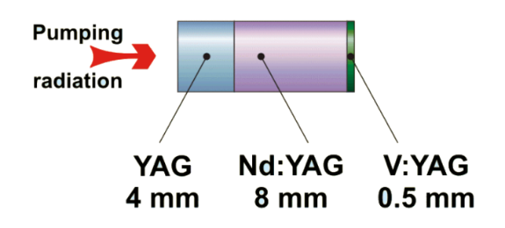
Product line
LASERS
Laser rods primarily for medical and defence industries
Specialty materials – YAP, YAG, LuAG with Nd, Tm, V, Yb, Pr, Er, Cr, BaWO₄...
Bonding, angles
Notes:
16
16

Slide 17







Scintillators & Detectors
X-ray imaging
X-ray / γ-ray
Single photon counting
Integrated solutions
Multipixel detector
Electron detector
Fiber detectors
neutron
Notes:
17
17

Slide 18



Imaging screens
Optical inhomogeneity <5 %
Optical quality (S/D 0/0)
High light output
Excellent Radiation Hardness*
Long life-time
Chemical & Mechanical stability
Coatings & lithography patterns
Free-Standing
In Frames
On Substrates
*M. T. Lucchini et al. "Radiation Tolerance of LuAG:Ce and YAG:Ce Crystals Under High Levels of Gamma- and Proton-Irradiation," in IEEE Transactions on Nuclear Science, vol. 63, no. 2, pp. 586-590, April 2016.

Slide 19

Imaging screens

Slide 20
Scintillation Materials
Imaging screen standards
Scintillator | Emission wavelength [nm] | Density [g.cm⁻³] | Cleavage/ Hygroscopic | Photon Yield [ph/keV] | Decay [ns]
YAG:Ce | 550 | 4.55 | No/No | 35 | 70
LuAG:Ce | 535 | 6.73 | No/No | 25 | 70
LuAG:Pr | 315 | 6.73 | No/No | 19 | 20
CRY19 | 420 | 7.1 | Yes/No | 32 | 41
YAP:Ce | 370 | 5.37 | No/No | 25 | 25
CRY18 | 425 | 4.5 | Yes/No | 32 | 45
CsI:Tl | 565 | 4.51 | No/Yes | 45 | 900
GOS:Tb | 544 | 7.34 | -/No | 60 | 106
CWO | 475 | 7.9 | Yes/No | 12-15 | 5000
BGO | 480 | 7.13 | No/No | 8-10 | 300
CRYTUR
~35 ph/keV
YAG:Ce
Literature ~8 - 12 ph/keV
Theoretical value ~41 ph/keV

Slide 21

Imaging screens
Non-proportional response
LY Temperature Dependence
*Khodyuk, Hass, Dorenbos „Nonportional response between 0.1-100 keV energy by means of highly monochromatic synchroton X-rays," in IEEE Transactions on Nuclear Science, vol. 57, .No. 3, June 2010.

Slide 22


Imaging screens
LY temperature depence
The scintillating single-crystals YAG:Ce an YAP:Ce exhibit very stable light output at wide range of temperatures and high radiation dose.
LY Temperature Dependence

Slide 23

YAG:Ce proton irradiation
Measurement performed at CERN
*M. T. Lucchini et al. "Radiation Tolerance of LuAG:Ce and YAG:Ce Crystals Under High Levels of Gamma- and Proton-Irradiation," in IEEE Transactions on Nuclear Science, vol. 63, no. 2, pp. 586-590, April 2016.

Slide 24

YAG:Ce gamma irradiation
Measurement performed at CERN
*M. T. Lucchini et al. "Radiation Tolerance of LuAG:Ce and YAG:Ce Crystals Under High Levels of Gamma- and Proton-Irradiation," in IEEE Transactions on Nuclear Science, vol. 63, no. 2, pp. 586-590, April 2016.

Slide 25

Scintillation Materials
New materials R&D
GAAG+
High density: 6.6 g/cm³
Light yield => lum. decay
Max. diameter 50 mm
Target: up to 70 mm
Optimization
in progress

Slide 26


Scintillation Materials
New materials R&D
CRY060
~0.5 µm active layer on substrate
Emission: 410 nm
Fast ~ns
High photon LY
Applications
Imaging screen (EUV, X-rays)
Electron detection
TOF detectors
Mass spectrometry

Slide 27






Single crystal vs powder
Single crystal
LuAG:Ce screen
20 um
8 um
100 um
Powder screen
P43 (GOS)
20 um (2um grain)

Slide 28


Imaging Systems
Imaging systems - CRYCAM
Features
  Macro vs Micro system
  Perfect contrast (single crystal screens)
  Outstanding intrinsic resolution (1 µm)
  Highly customized (FOV up to 35 x 35 mm)
  Multiple imaging options
  OEM or end-user solution
Micro system
Application
  X-ray radiography
  X-ray tomography
  X-ray topography
  Beam viewer
Macro system

Slide 29
X-ray radiography
Object
Enlarged projection
Point-like
X-ray source
Imaging
X-ray detector

Slide 30

Imaging Systems
CRYCAM examples
Wasp on foam pedestal

Slide 31

Imaging Systems
CRYCAM examples
Sting - detail

Slide 32


Imaging Systems
CRYCAM examples
Poppy head
Carbon fiber reinforced polymer

Slide 33

Imaging Systems
CRYCAM examples
Carbon Fibers, 7 µm
Phase contrast!
  Microfocus X-ray source
  1 µm spot
  Small focus to
  object distance

Slide 34



Imaging Systems
CRYCAM examples
Cotton Stick – 3D tomography

Slide 35

Imaging Systems
New design – FOP based cameras
Features
  Medium resolution down to 15-20 µm
  Improved light collection efficiency
  High speed acquisition
  Perfect contrast (single crystal screens)
  FOV 16 x 14 mm / 32 x 28 mm
  Multiple scintillator accessories
  OEM or end-user solution
FOT based system example
Related services
  Bonding to CCD (CCD/fiber optics/scintillator)
  Custom design

Slide 36


Imaging Systems
FOP based camera example
  Cu target, 40kV, 2 W
LuAG screen
CsI:Tl – HR version

Slide 37



Imaging Systems
Scintillators & Detectors
Matrix detectors example – special solutions
Tungsten shielded array of inorganic fibers
  Tailored solution
  Dimension: 13 x 13 x 100 mm³
  6 x 6 array of 1 x 1 mm² fibers
  High resistence to radiation damage
  Very good light yield
Fiber materials
  YAG:Ce, LuAG:Ce
  New: LuAP:Ce (faster than LYSO:Ce)
Applications
  Medical applications (PET)
  Calorimeters

Slide 38



X-ray / γ-ray detector family
X-ray detector
(counting / spectroscopy)
HT – X-ray detector for
high temperature environment
LGD – γ-ray detector

Slide 39
X-ray detector
  Features
  Innovative YAP:Ce technology => Non-toxic substances (e.g. Be)
  Counting and spectroscopy
  Properties
  Energy range of 5 keV to 150 keV (50 % absorption)
  High count rate up to 10⁶ pulses/s
  Detection area: Ø 37 mm (Ø 1.45 inch)
  Magnetic shielding: Mu-metal
  Application
  X-ray diffraction
  X-ray fluorescence
  DXA (double-energy X-ray analysis)

Slide 40

LGD – γ-ray detector
  Features
  Scintillation detector based on YAP:Ce scintillation crystal
  Energy resolution (FWHM) ≤ 5.5 % … ¹³⁷Cs@662 keV
  Energy resolution (FWHM) ≤ 18% … ²⁴¹Am@59.9 keV
  No intrinsic background
  Fast detector for high count rate applications
  Minimal energy non-proportionality (max. 3 %)
  Properties
  Energy range of 20 keV to 800 keV (@50 % absorption)
  Detection area: Ø 44 mm (Ø 1.45 inch )
  Typical voltage 700 V
  Magnetic shielding: Mu-metal
  Application
  Spectroscopy with high resolution

Slide 41
X-ray detector for HT
  Features
  High temperature resistivity up to 175 °C
  Ruggedized detector for harsh operating conditions
  Fast response
  All parts of the unit adapted for HT
  Application
  Densitometry at high temperatures
  Geology
  Level gauges

Slide 42
Summary
CRYTUR = reliable partner in scintillators and integrated solution
Niche application with single crystals and precise technologies
Long-term collaboration with international institutes
New opportunities welcome
Notes:
42
42

Slide 43
Thank you for your attention!
Contacts:
CRYTUR, spol. s r.o.
Na Lukách 2283
511 01 Turnov
Czech Republic
crytur@crytur.cz
Jiri Parizek
Technology application specialist
parizek@crytur.cz
Notes:
43

