Slide 1

Overview for RHIC complex:
Screens for electrons, protons and ions
Workshop on
Scintillation Screens and Optical technologies for transverse Profile Measurements
Krakow, Poland April 1 – 3, 2019
Toby Miller
Notes:
Version 7 compressed photos.

Slide 2
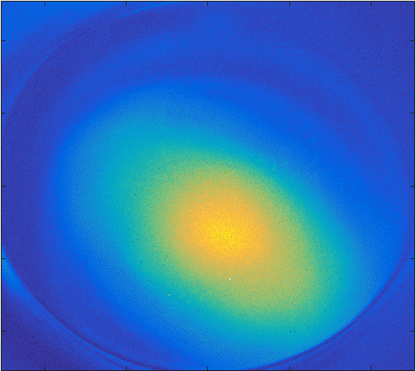
Outline
Overview of Collider-Accelerator Facility Machines
Facility Layout of Accelerators
Overview of Collider-Accelerator Facility Profile Monitor Screens
Profile Monitor Screen Details
  Chromox (Al₂O₃ Cr₂O₃)
  Radlin (aka PFG, P20)
  Gadolinium (P43)
  YAG:Ce Crystalline Screens
    Uses, Illumination, Resolution
    YAG Damage Incident
    Destructive YAG Test
  Crystalline CsI(Tl)
  BNNT “Bucky Paper”
Camera Network & Controls
  Legacy Analog Video Management Server
  GigE Cameras
  GigE Video Network
Conclusion

Slide 3
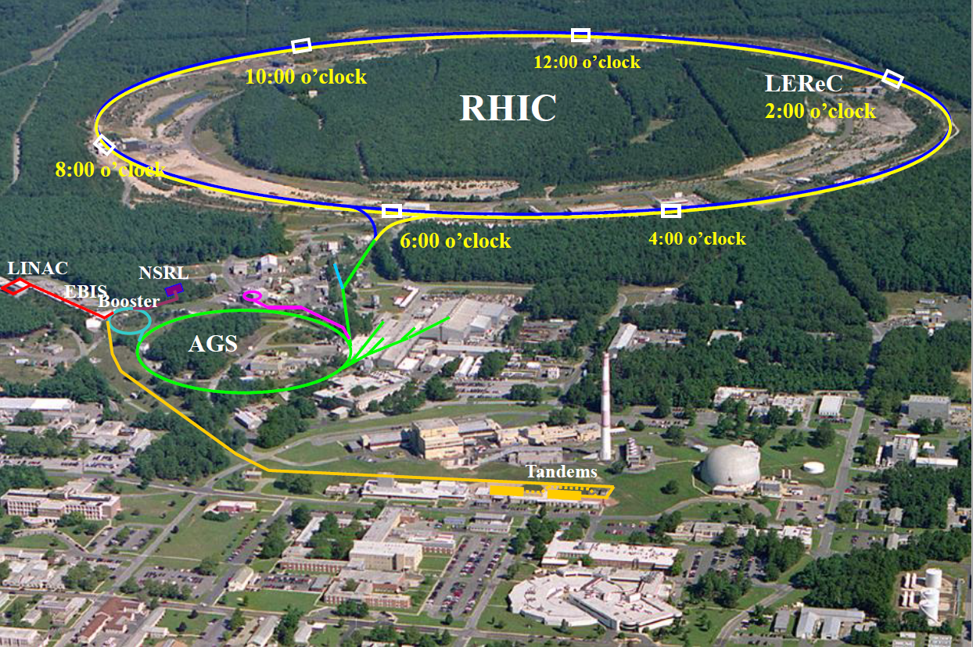
Overview of Collider-Accelerator Facility Machines
RHIC (3.85 to 255 GeV; protons, heavy ions)
Low Energy RHIC electron Cooling (LEReC,1.6 to 2.7 MeV electrons)
Coherent electron Cooling (CeC,18 MeV electrons)
Electron-Lens (5 KeV electrons)
AGS (up to 28 GeV; protons, heavy ions)
EBIS (range of 14 – 25 KeV ions)
Linac (200 MeV protons)
Booster (up to 3 GeV; protons, heavy ions)
NASA Space Radiation Laboratory (NSRL)
Tandem Van de Graaff
(up to 28 MeV/AMU; protons, heavy ions)

Slide 4
Overview of Collider Accelerator Facility Profile Monitor Screens
Tandem Van de Graaff Accelerator
  Chromox screens – 1.5 mm thick ceramic
  AF995R Chromium doped Alumina Ceramic Fluorescent Screen
Electron Beam Ion Source
  CsI (Tl) scintillator screen, rectangular 80 mm by 30 mm
Booster & NSRL
  4 Chromox screens 1.5 mm thick ceramic, located at Booster extraction and in the transfer line to AGS
  NSRL has 7 screens: (2) Chromox, (4) Gadolinium and (1) Radlin
AGS
  Chromox and Radlin screens used to monitor slow and fast extracted beams.
RHIC
  AGS-to-RHIC transport beam line
  12 Gd₂O₂S:Tb Plunging Profile Monitor Screens.
  Electron-Lens [1, 2]
  YAG:Ce monolithic 100 microns x 30mm diameter, Crytur
  LEReC [3] & CeC [4]
  YAG:Ce monolithic 100um x 30 – 60mm diameter, Crytur
  OTR on 250um thick metalized silicon wafer (15 x 25mm)
  BNNT “Bucky Paper” 50um x 60mm, density of 2.5 mg/cm^2 for 50 micron thickness

Slide 5
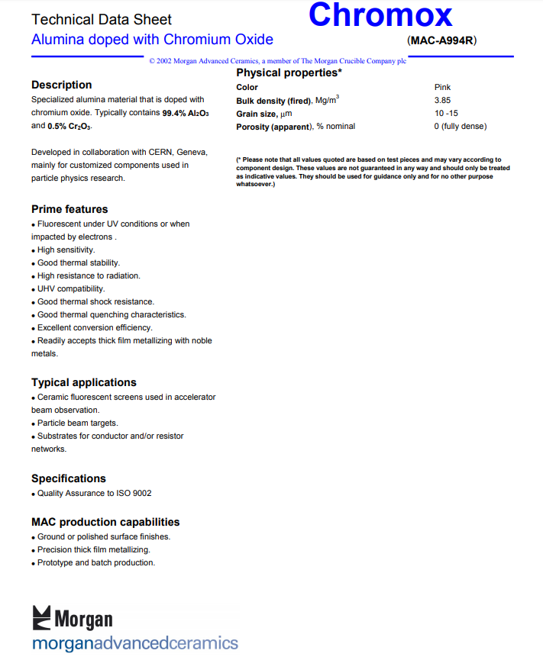
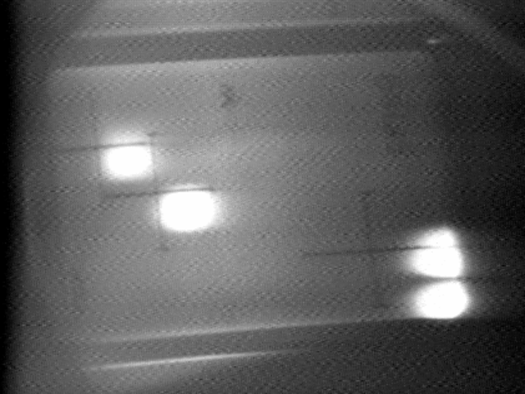
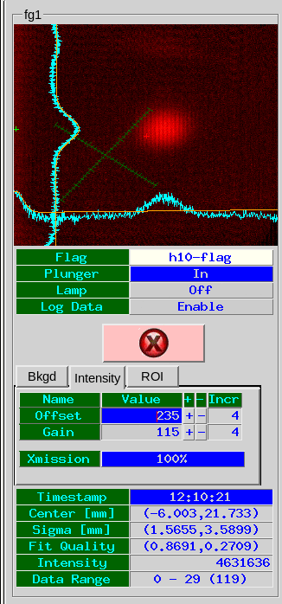
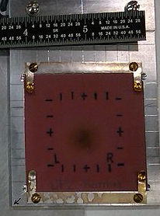
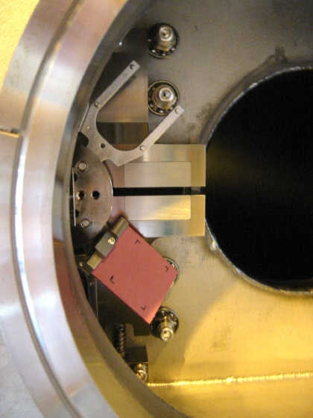
Chromox
(Al₂O₃ 99.4% + Cr₂O₃ O.5%), average grain size 10-15 microns. Morgan Advanced Ceramics
Use for many years at the AGS fix target experiments
Used inside Booster vacuum (10⁻¹¹ torr), baked 200C..
Resilient to high intensity beams
AGS 28 GeV proton beam, slow extraction over 1 sec, split 4 ways to separate fixed targets. Chromox screen 100’ from extraction septum. FY96
CF100
Chromox screen removed from
AtR, showing burn mark from
28 GeV proton beams.
Chromox screen in Booster,
on rotary stage, near extraction collimator vertical jaws
3.85 GeV Au beam on Chromox screen AGS extraction to RHIC
Notes:
Which element is the Chromox screen in the above photo in the Booster?
AGS extraction beam image shows lines… Is this due to a rastering image tube?
What beam current/charge is applied to these screens?

Slide 6
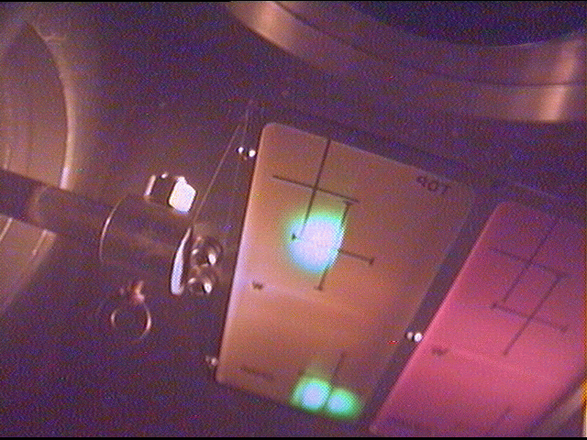
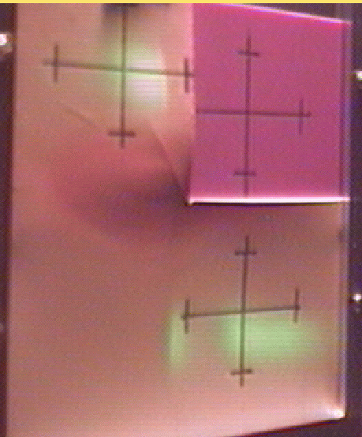
Radlin (aka PFG, P20)
ZnCdS:Ag Zinc cadmium sulfide, 40% Cadmium Sulfide, 60% Zinc Sulfide, <0.1% Silver, by weight. Manufactured by MCI Optonix
Decay time: 4ms 90-10%, 55ms 10-1%
Booster NSRL Target Station
“Digital Beam Imager”
History:
Use for many years at AGS and Booster extraction at fix target experiments.
High sensitivity for low intensity beams.
Not UHV compatible, or as resilient at Chromox
AGS slow spill extraction, 11.68 GeV/c/n Au beam split into 3, FY97
Maximum dose: 70x10¹² protons/1s spill
40x40 cm² Radlin screen and a pair of mirrors guide light to a Hamamatsu CCD camera
Reference: Overview of the NASA space radiation laboratory,
C. La Tessa. BNL-113465-2017-JA
Figure bottom right shows a rectangular beam image of dimensions 20 cm² x 20 cm²
CF100
CF255
Multi-position profile monitor screen plunger
Radlin screen on left for low intensity Au
Chromox screen (pink) on right for high intensity protons
Courtesy K. Brown.
Notes:
Photo above – what are fiducials made of? Radlin is not Vacuum compatible, but these look like they are installed in vacuum.
NSRL:
Was it an octupole magnet used to produce the square beam pattern? Is the original beam round to start? -> YES
Hamamatsu deep cooled camera with motorized lens, with microscopy software from Hamamatsu
16” 3mm glass mirror, 8” square target area.
Braag peeks visible with Ca+ and Ne+ beams through copper wedge; where ions are decelerated enough by copper to find their stopping point in the fluorescent screen.
Typical ion does rates are 10^11 portons per spill and 10^9 Fe+ per spill. This is 40,000 Fe+ ions/cm^2 per spill on the screen, 2,000 Ta+ ions/cm^2 per spill. Spill is over 300msec.
Camera uses Tedlar plastic light blocking film upstream and downstream of film and mirror.

Slide 7
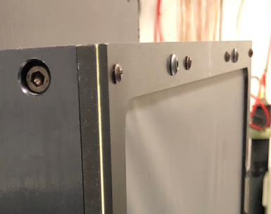
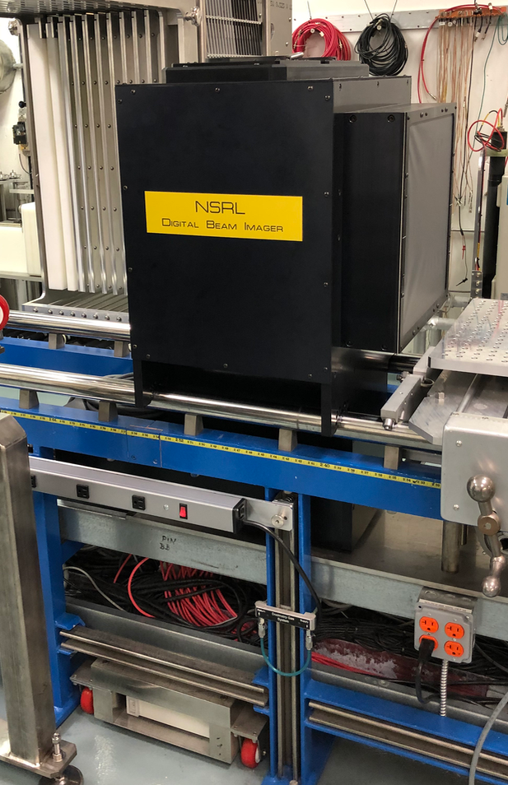
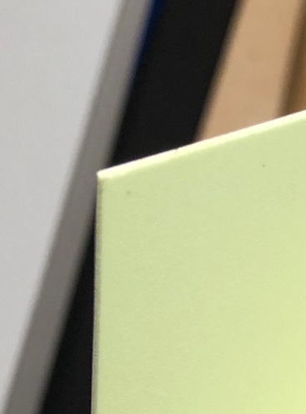
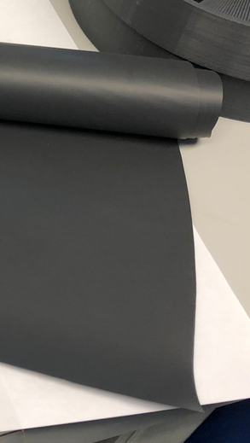
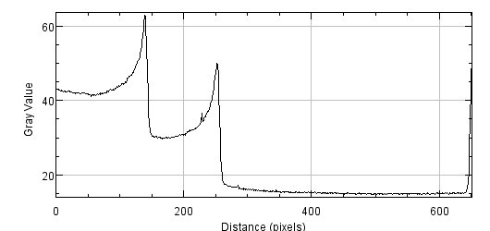
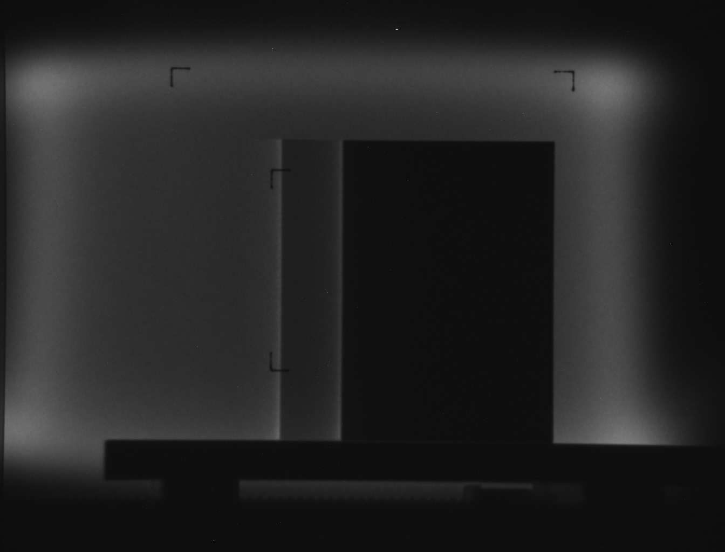
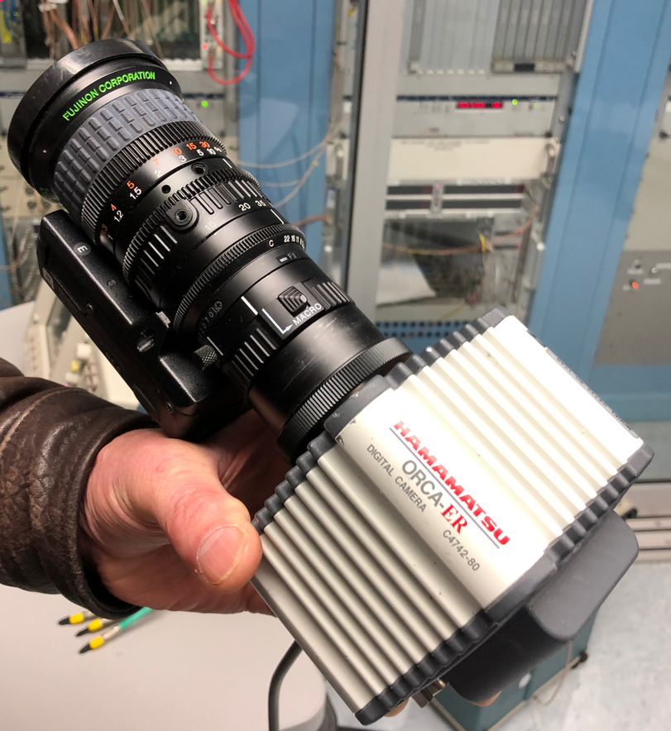
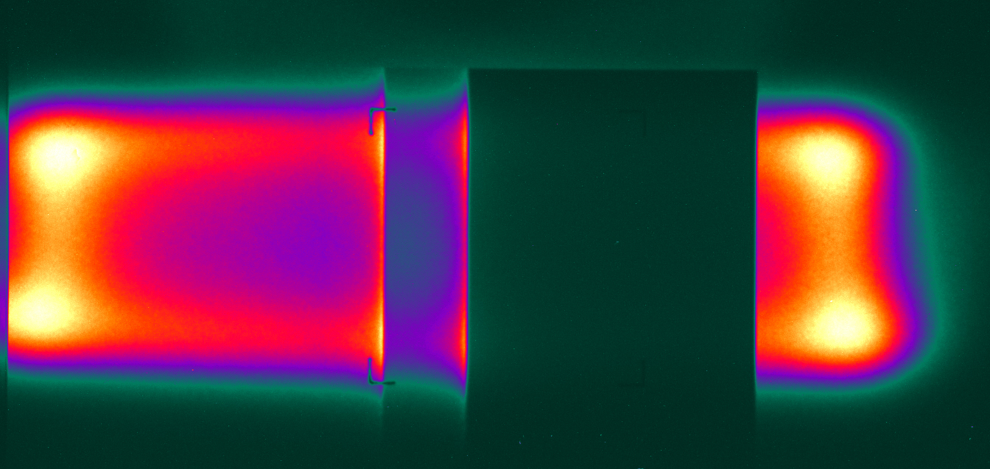
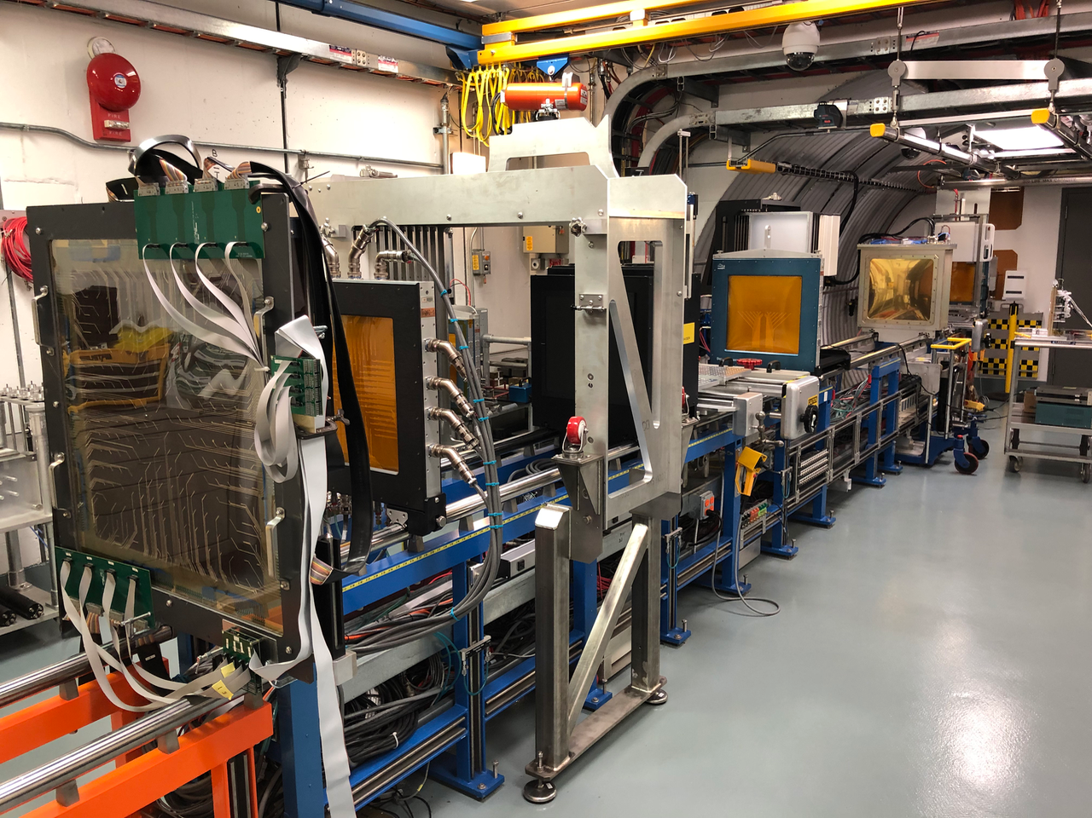
NSRL Target Station
- Camera & images
Screen & mirror assy
(camera below)
Bragg Peaks of Ca⁺ and Ne⁺ beam on Radlin Target through copper wedge.
Hamamatsu deep cooled camera with motorized lens, with microscopy software
40 cm square target area
Radlin
coating on
0.75mm vinyl
Tedlar film
(PVF)
Intensity plot shows Bragg Peaks of Ca⁺ & Ne⁺
Color & BW images of beam
through copper wedge
Courtesy of Adam Rusek, NSRL, BNL
Hamamatsu ORCA-ER deep cooled CCD camera with motorized lens and microscopy software
Camera & Detector layout along beam line

Slide 8
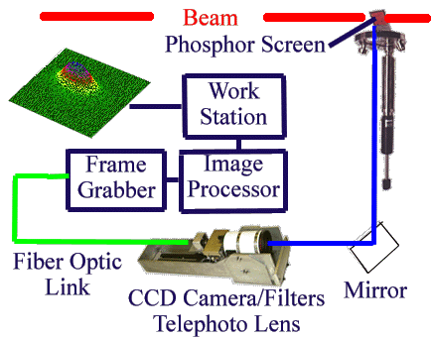
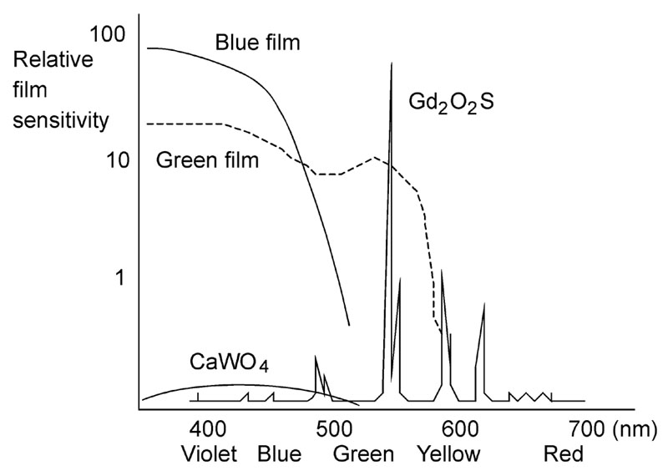
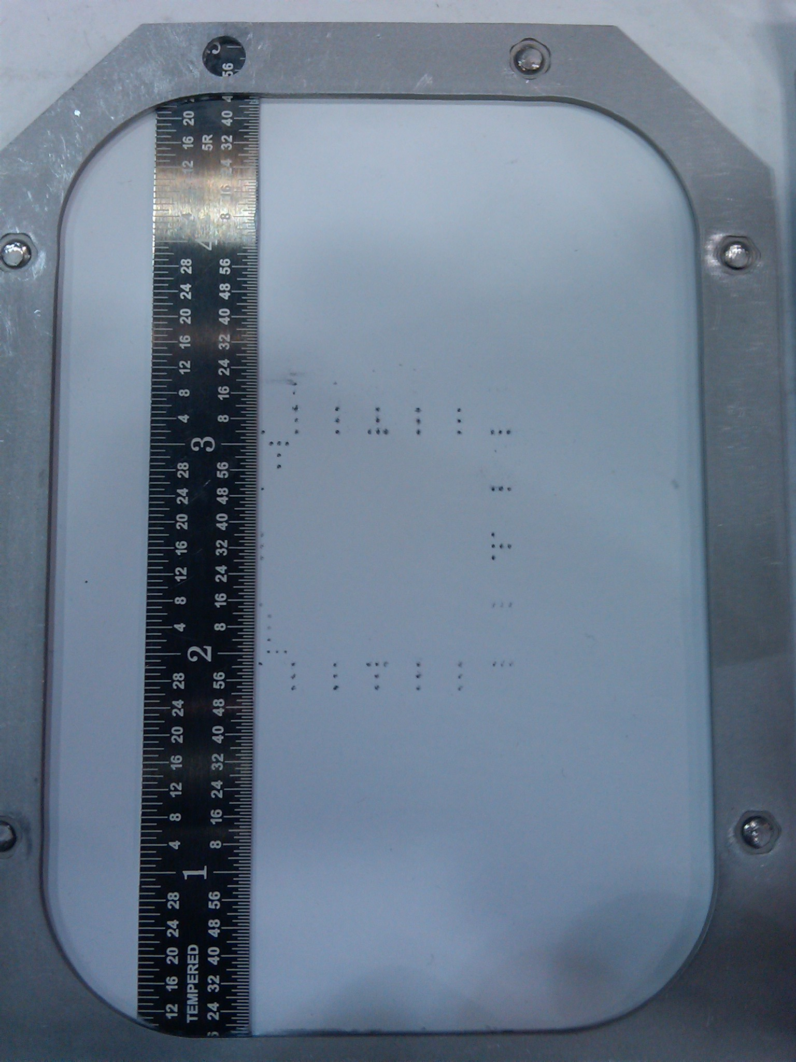
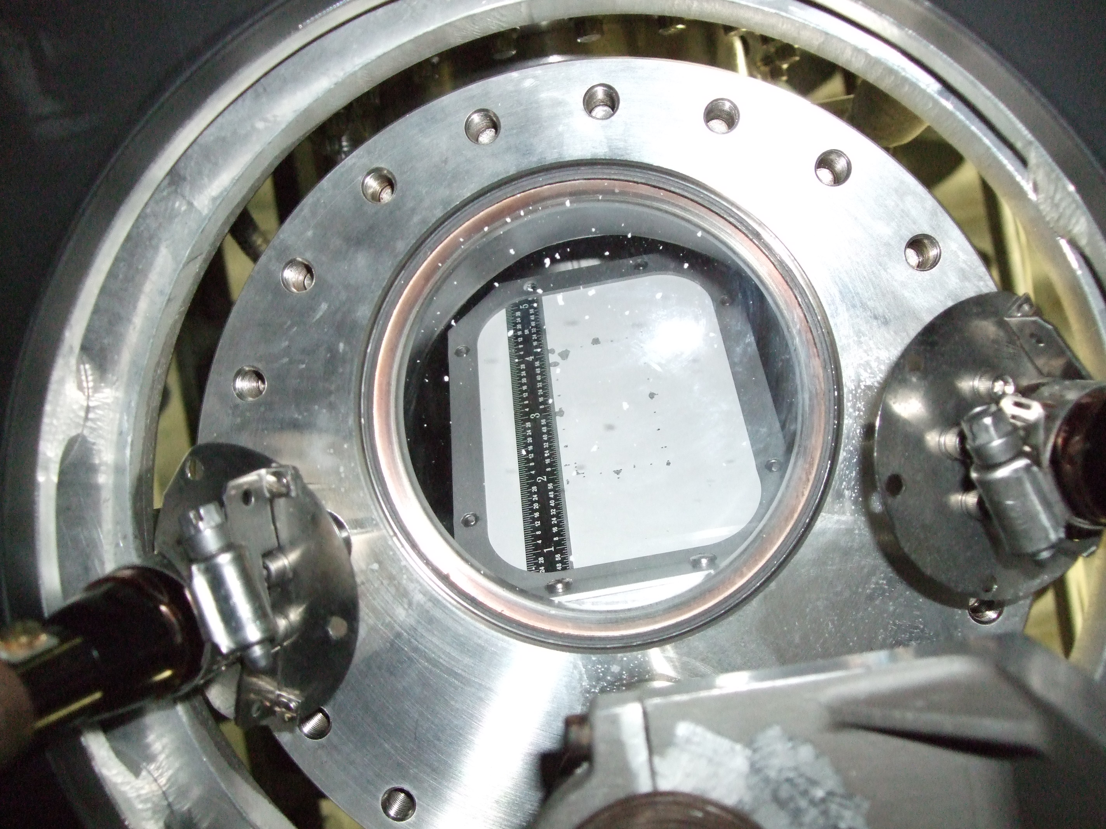
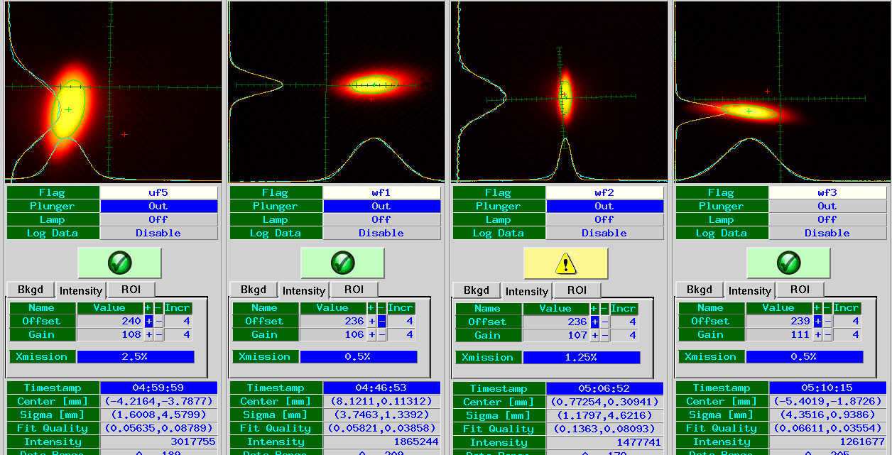
Gadolinium (P43)
Gadolinium oxy-sulfide doped with terbium (Gd₂O₂S:Tb)
The screen consists of a 0.002“ thick coating of (Gd₂O₂S:Tb) phosphor on a 0.001" aluminum foil substrate with a potassium silicate binder. (courtesy R. Witkover)
The best resolution measured was ~150 microns over a 3 m optical path.
Used at:
  12 screens AGS-to-RHIC transport
  4 Screens NSRL
High sensitivity, fast response (few ms’s)
UHV compatible, not bake-able.
Emission spectrum
(primary peak at 545nm).
Source: http://www.e-radiography.net/radtech/s/specsense.htm
AGS-to-RHIC Profile Monitor
system block diagram
Au beam profiles in the AGS-to-RHIC transport
AGS-to-RHIC PM screen with ruler
for resolution measurements
Notes:
Odd that the colors in the profiles don’t look gaussian as the line profile does…
Description of the chemical process / application process?
What beam current/charge is applied to these screens?

Slide 9
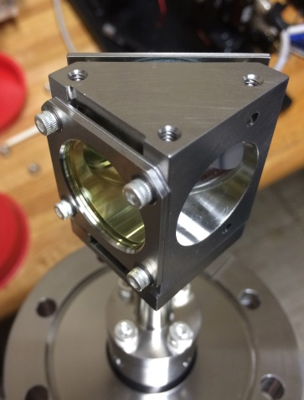
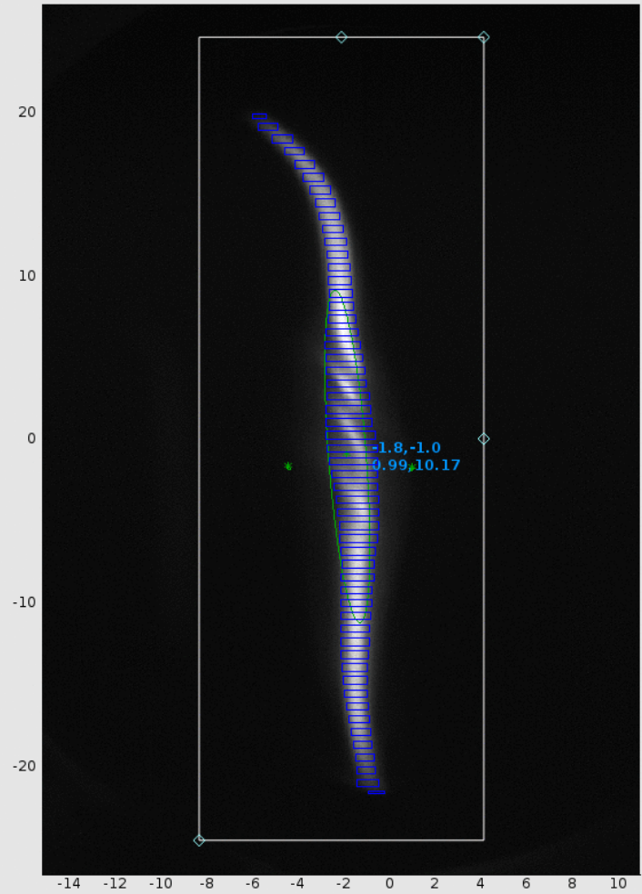
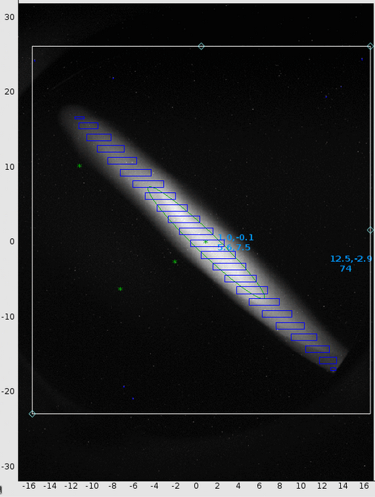
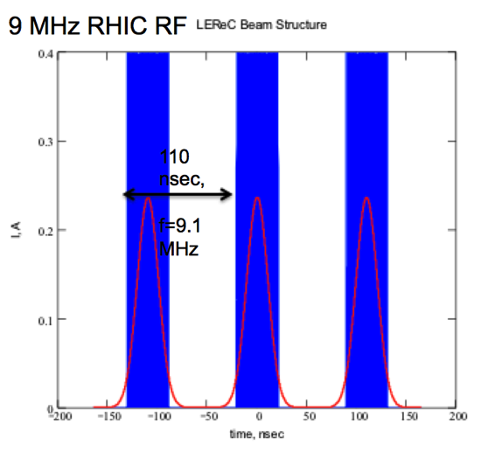
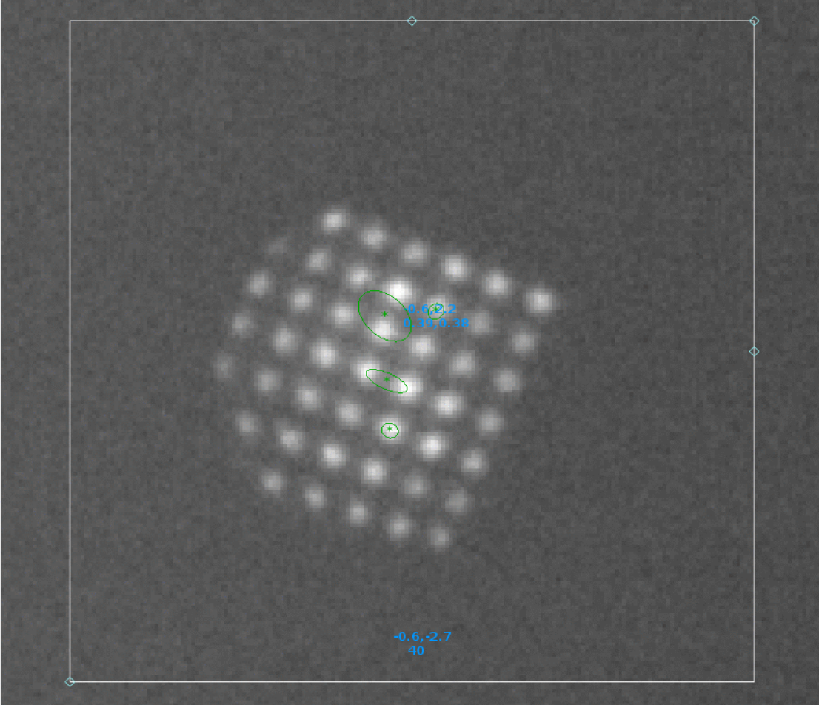
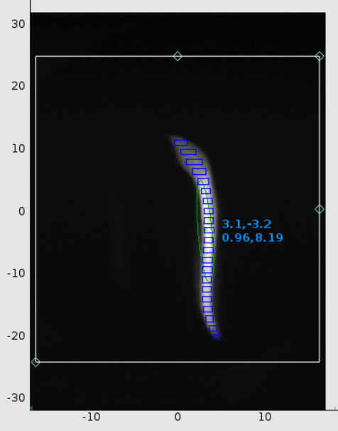
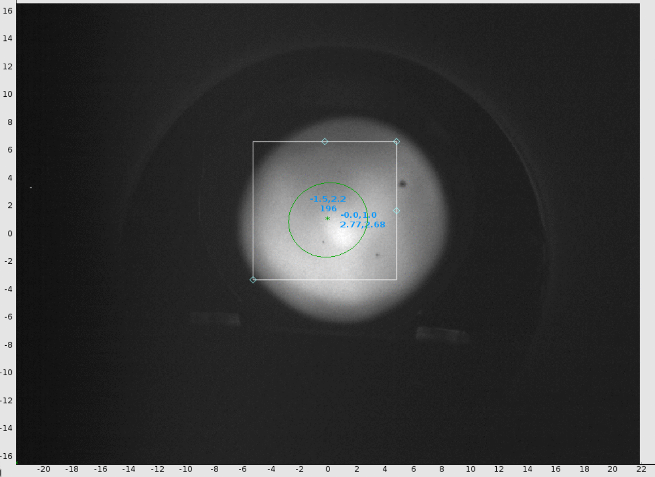
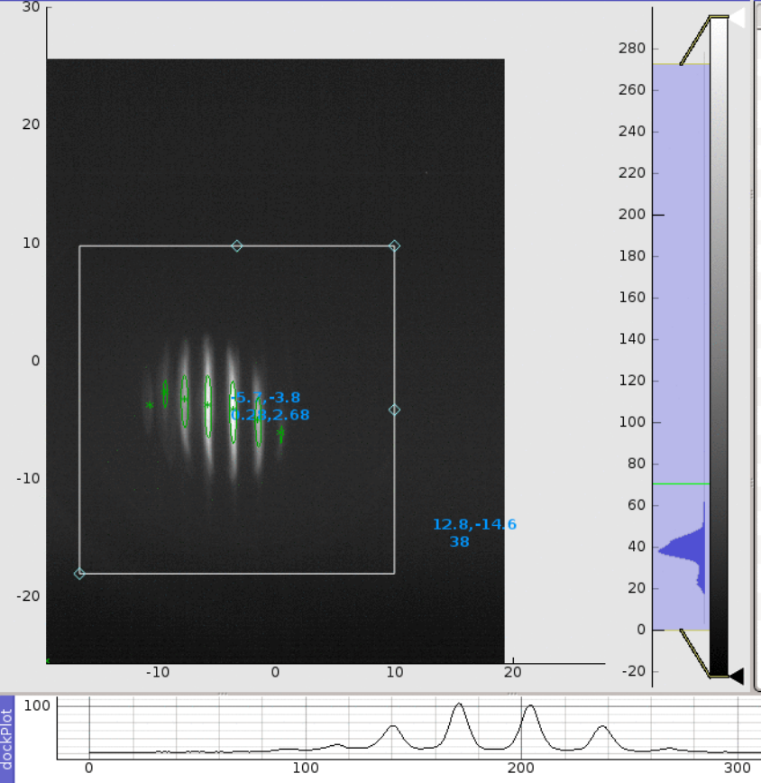
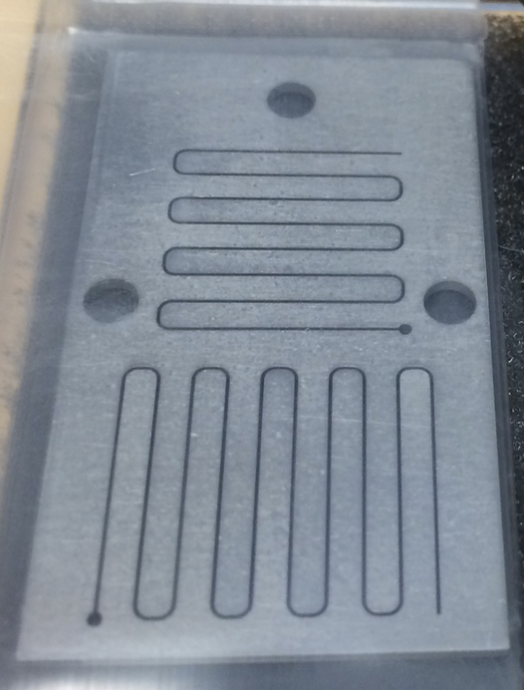
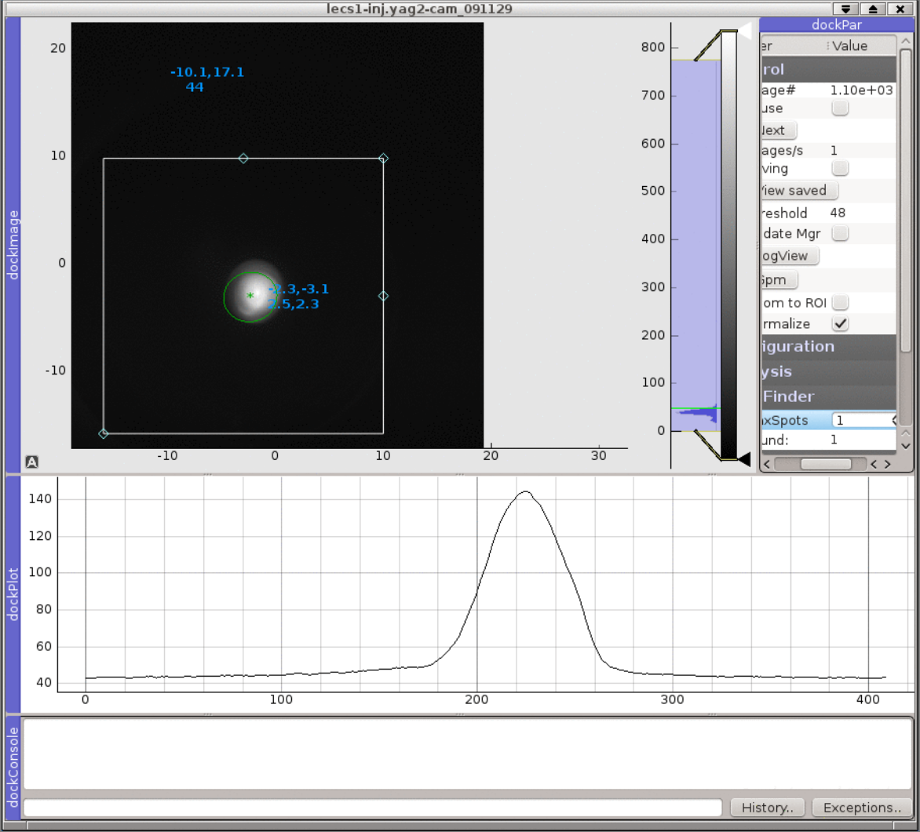
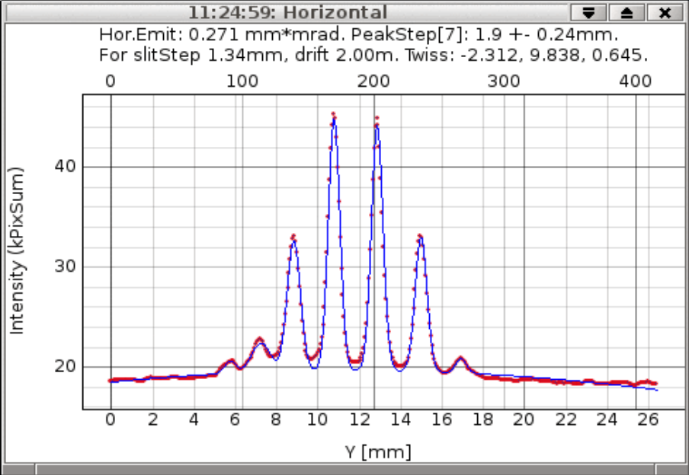
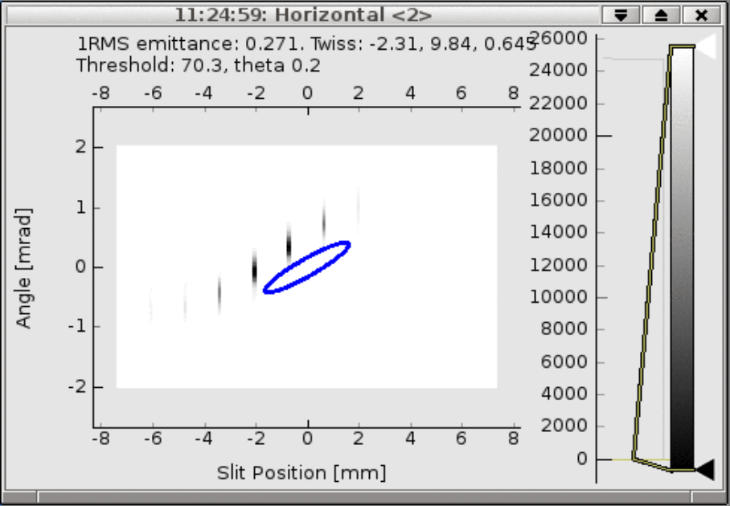
YAG:Ce Crystalline Screens
Monochrystalline YAG, Cerium doped (Crytur)
  Sizes: ⍉20, 30, 50, 60mm & 20 x 30mm sq
  100 μm thick
  100 nm Aluminum coating to drain charge
  Some with fiducial markings
Used in electron machines:
Orientation
  Crystal normal to beam
  Rear 45º polished metal mirror
Applications
  Beam profile
  Emittance with slit masks
  Longitudinal Phase Monitor
    Deflecting cavity with Profile Monitor
    Measure e-energy spread, goal 10⁻⁴
LEReC Beam Pulse Structure [1]
YAG Holder with rear 45º polished metal mirror
Machine | Q (pC) | I (mA) | E (MeV) | Pulse | Period
eLens |  | 500 dc | 5 keV | 12 μs | 1 s
CeC | 500 |  | 1.5 15 | 200 - 400 ps 10 ps | 1 s 1 s
LEReC [6] | 3,900 | 93 pk 38 pk | 1.6 – 2.6 | 42 ns 250 μs | 1 s 10 s
The electron beam has a nested pulse structure [5], where 80 ps bunches at 704 MHz are grouped in macro bunches and positioned to overlap with the 9.1 MHz RHIC ion beam.
Longitudinal Energy Scan with Deflecting Cavity
  eLens: 500 mAdc @ 5keV over 12 μs
  LEReC: 30 pulse MacroBunch [1] @ 1.6 – 2.6 MeV
    Ops: up to 3.9 nC over 42ns [2]
    Max: up to 3.9 nC / MB @ 9.8 MHz over up to 250 μs (up to 10s delay) [3]
  CeC: ½ nC single pulse
    over 200-400ps @ 1.5MeV
    over 10ps @ 15MeV
Beam Transverse Profiles
Emittance with upstream slit masks

Slide 10
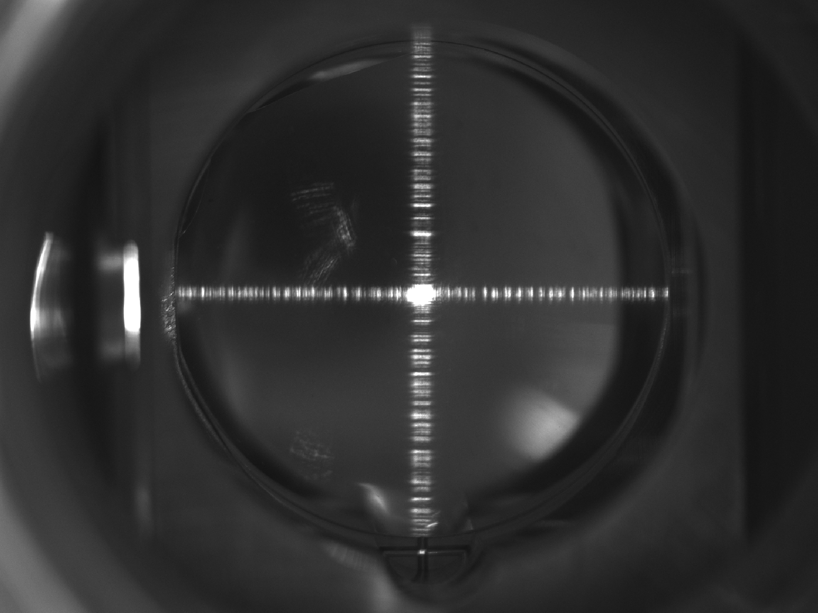
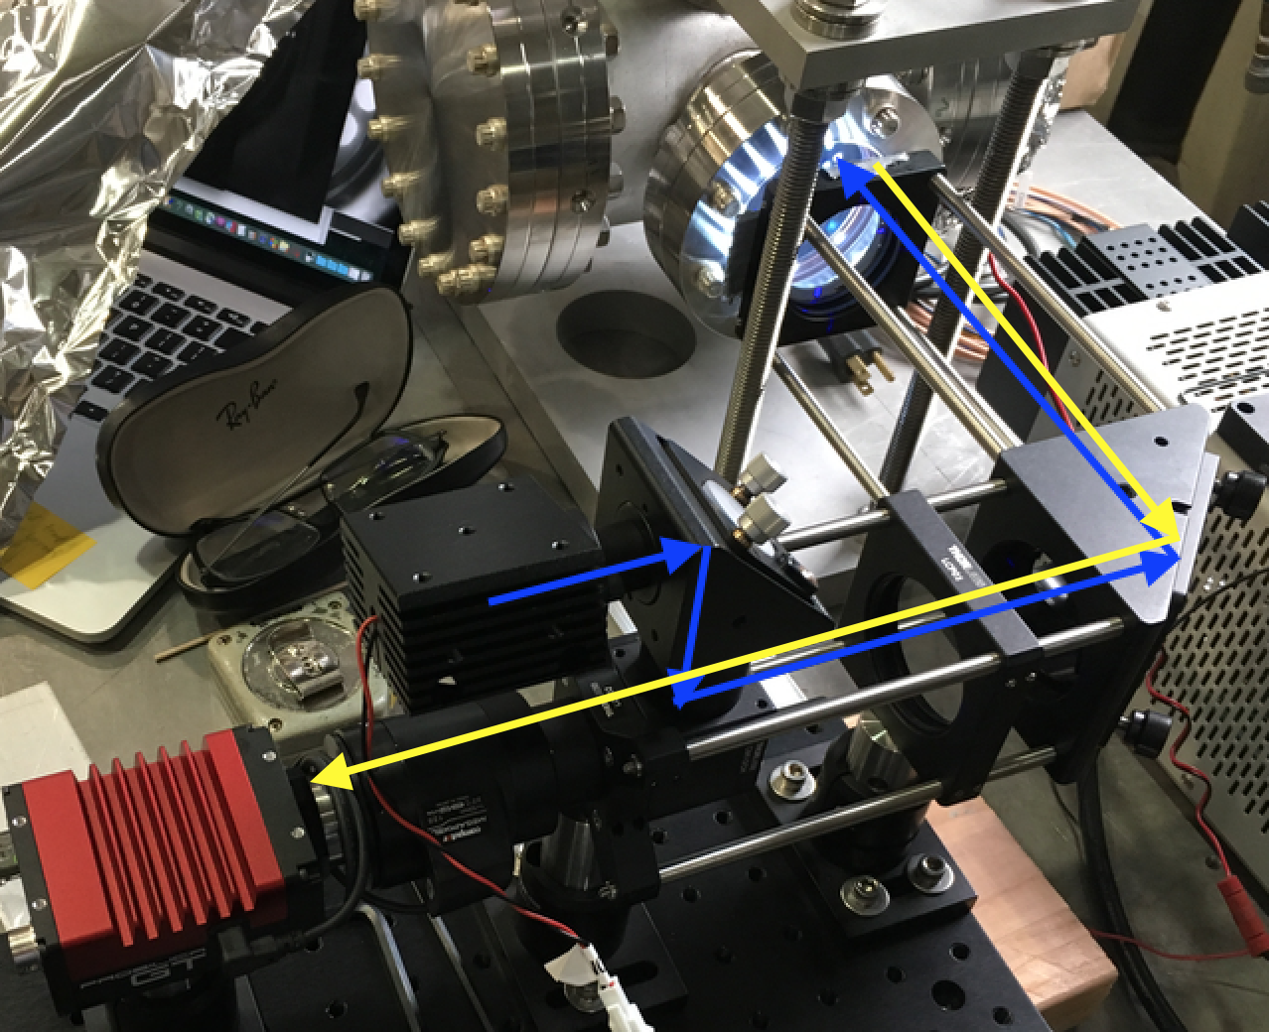
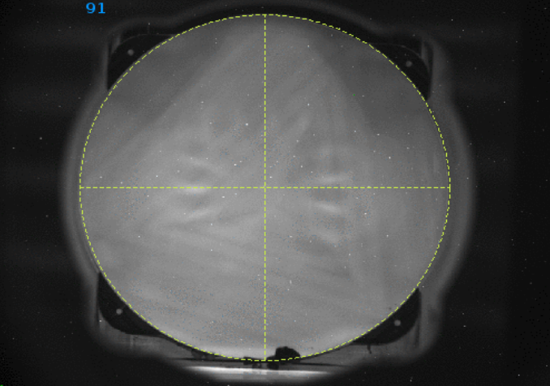
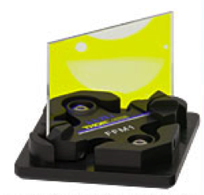
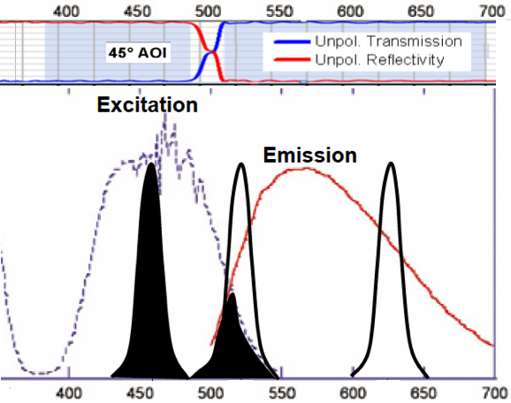
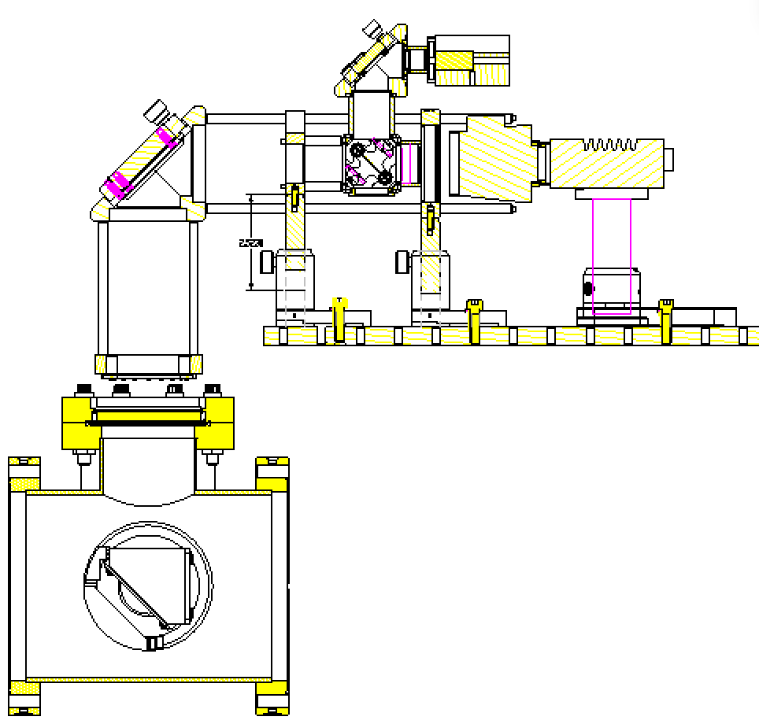
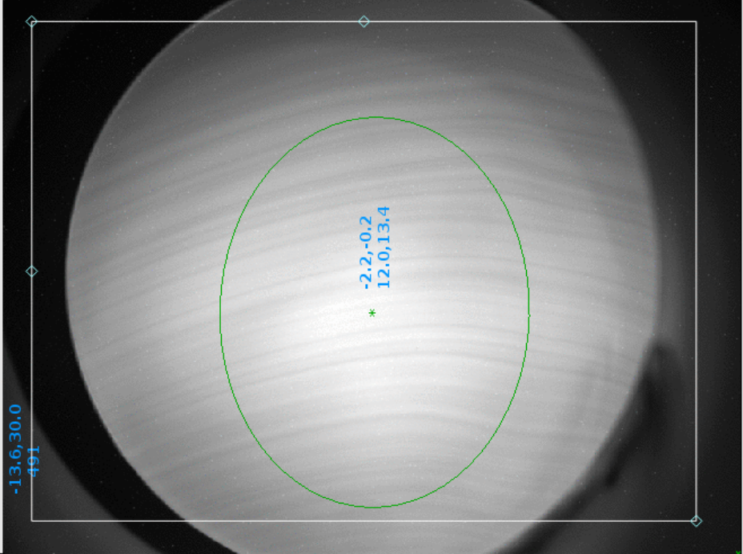
YAG:Ce Crystalline Screen Illumination
Normal & Fluorescent Illumination with RGB LED ring around lens
  Normal: Red + Green LEDs
  Fluorescent: Blue LED (~450nm)
  500nm low pass filter in camera
Project fluorescent cross on YAG
  Inject 450nm laser with Diffractive Optical Element [8]
    Dichroic beam splitter reflects Blue / Passes YAG emission
Blue laser through Diffractive Optical Element from Holoeye Photonics
Illumination laser light path
Dichroic Beam Splitter
450nm Laser
P-Iris
Lens
GigE Camera
(Top & Bottom) 50mm YAG with Fluorescing under
450nm Blue illumination.
Reference circle show above.
RGB LED Ring
Pneumatically actuated
horizontally
Y. Zhu, et al, “…Optical Properties of YAG:Ce…”
e⁻ beam
Copper Mirror

Slide 11
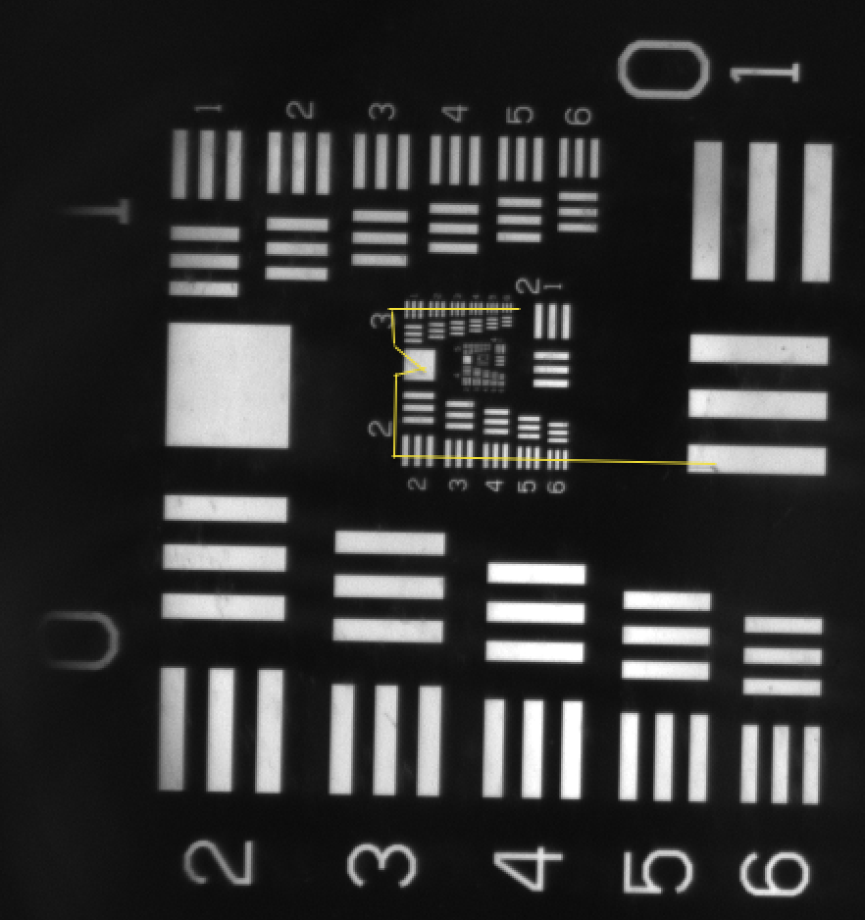
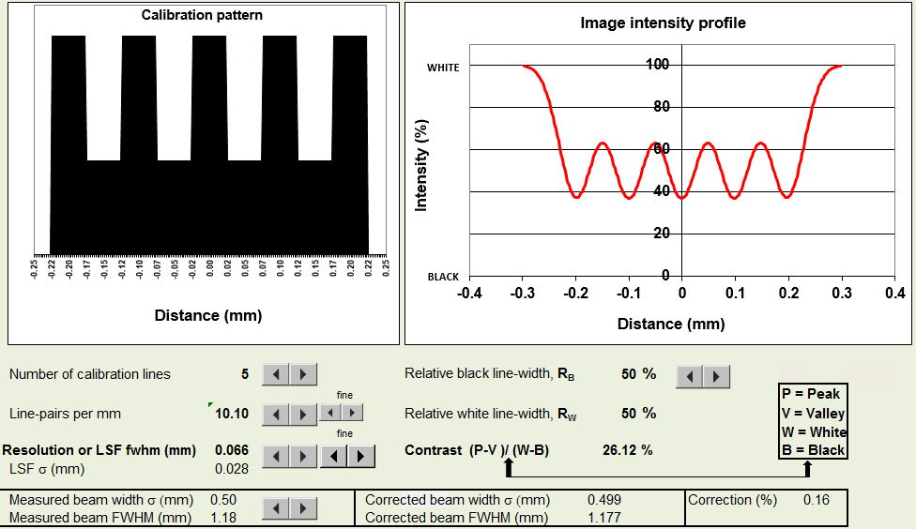
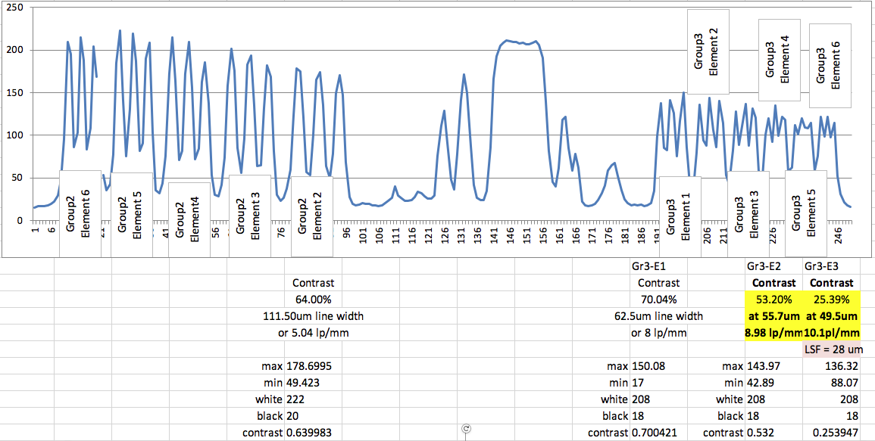
YAG:Ce Screen Resolution Tests
Measured “contrast” or Modulation Transfer Function (MTF) with standard resolution target.
MTF simulator uses pattern dimensions to find FWHM resolution corresponding to measured MTF
MTF = 27% on 49.5μm target
  Resolution => 66%_{FWHM} (>100μm Required)
YAG resolution limit due to secondary emissions was found by others [9] to be 30μm in 100μm YAG @ 1.5 – 2 MeV
USAF 1951 Target with line through Group 2 Elements
Modulation Transfer Function simulator from resolution of pattern line widths.
Line profile through Group 2 Elements
49.5um (10.1 line-pairs/mm) in Group 2-Element 3
Resolution simulation from MTF
courtesy of Peter Thieberger, BNL
Notes:
Is resolution expressed in FWHM or sigma

Slide 12
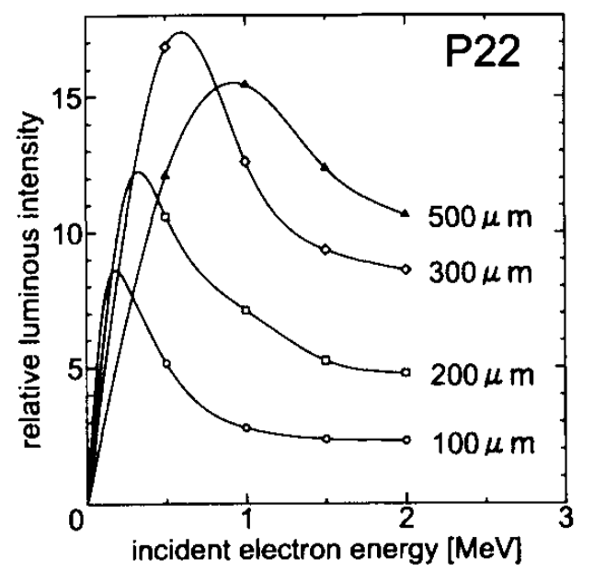
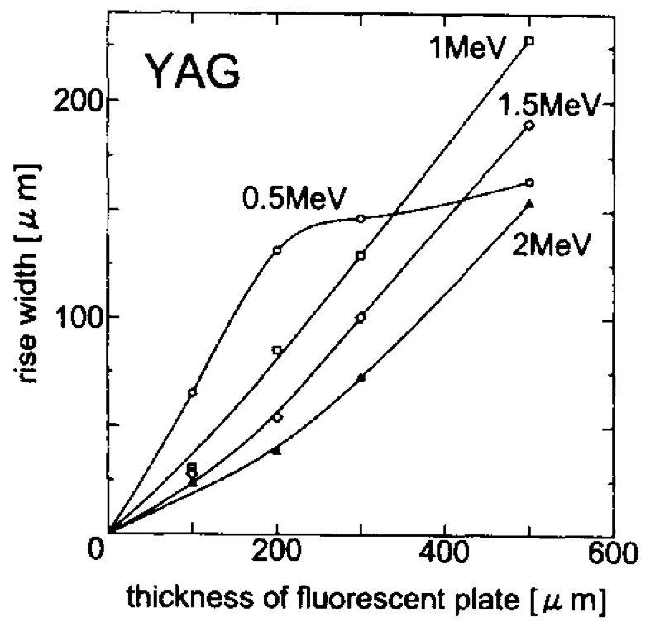
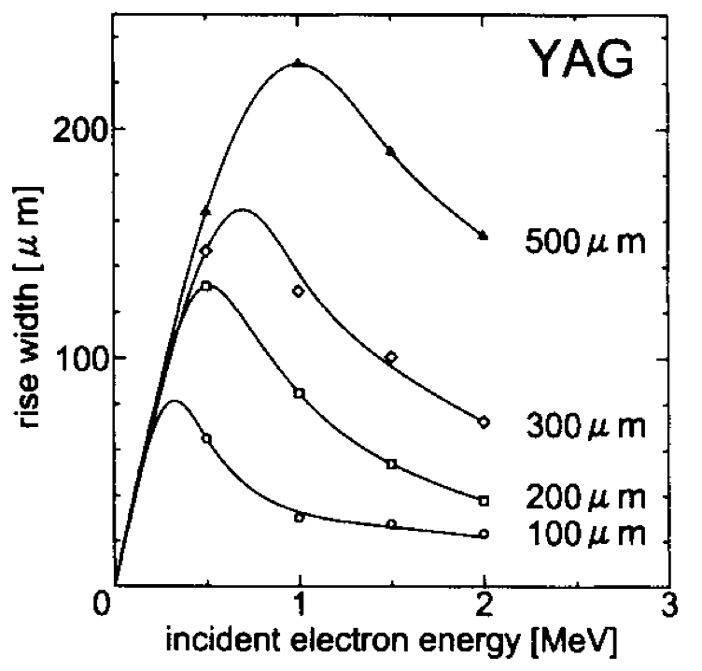
YAG:Ce Screen Resolution Limit
YAG resolution limit due to secondary emissions was found by others [9] to be 30μm in 100μm thick YAG @ 1.5 – 2 MeV
  From a study of electron energy dependence of fluorescence in electron microscopes (1996)
Reference data [9] courtesy of Vladimir Litvinenko, BNL

Slide 13
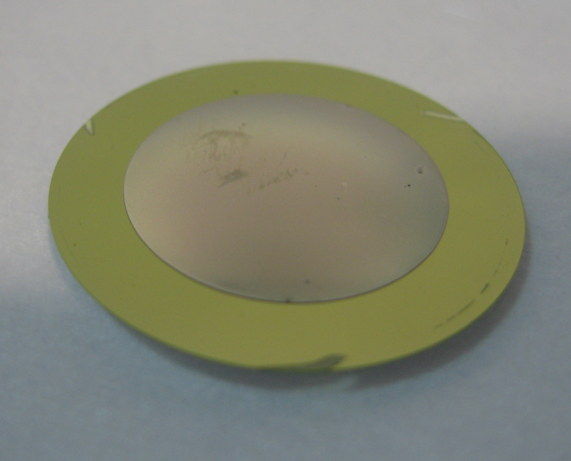
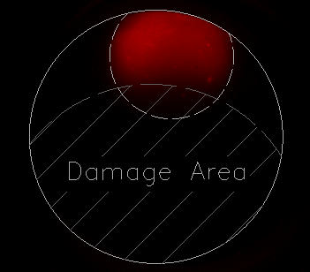


YAG Damage Incident
- Electron Lens Test Bench 2012
  3 shots of 80μs pulse of 400~500mA beam, 5keV electron beam
  Carbon coated YAG crystal
  Result :
    ➔ Thermal damage to the crystal
    Partially still fluorescent during bench inspection
    Color photo from Blue LED shows blue reflecting area (damaged) and yellow fluorescent area
    aluminum holder shielded 5mm ring around crystal
Undamaged area masked by holder
Damaged YAG removed from aluminum holder
Part of YAG still sensitive to beam – dead lower center
Photo of damaged YAG in vacuum – white illumination
455nm illuminated YAG after removal

Slide 14





YAG Damage Analysis
  Beam struck carbon coated side but damaged the back side.
  Color: white opaque
  Surface: still smooth
  Micro damage points seen under microscope
  Metal evaporated on nearby insulators
Showing carbon coated side hit by the beam.
Damaged YAG in aluminum holder (downstream side)

Slide 15



Destructive YAG Test
  Before replacing YAG, the damaging beam pulses were repeated & documented
    660mA pulses, 80μs long, 1Hz repetition rate
    YAG heated so much that deflection was visible after each shot – without fracture
    Couldn’t reproduce the same permanent surface damage…
Reflection of in polished surface of YAG
See this video on line at: http://www.youtube.com/watch?v=TOrgEd4AAAI
note: camera trigger was not properly synchronized and doesn’t show every shot.

Slide 16


YAG Crystal Test of Thermal Limits
Using Electron-Lens Test Bench (2012) – 5keV beam
Nondestructive Test of Linearity – highest exposure before distortion due to thermal limit
  800μs @ 100mA
  Q_{total} = 80k nC, P = 400mW (500W_{pk})
  Estimated single-shot Temperature = 310ºC (based on work in [7])
  40μS @ ~500mA
  Q_{total} = 2k nC, P = 100mW (2,500W_{pk})
Temporary Thermal Saturation
  1.2ms @ 100mA – profile distortion (gaussian peak flattening)
Permanent Thermal Damage (incident)
  80μs @ 400 – 500mA (3 shots in < 3s) – surface damage
Destructive Test of Maximum Power
  80μs @ 660mA – visible flexure of the crystal without fracture
  1.2ms @ 100mA (3 shots in < 3s) – fracture
Gaussian beam
profile starts to saturate

Slide 17
YAG Exposure Limit Simulation
The YAG screen for Longitudinal Phase Monitor required a 250us long electron beam pulse train, 2 MeV, 35mA.
Based on recommended maximum operating temperature of 200ºC, a steady state temperature was found [7].
  one pulse train => +35.5ºC in the YAG
  Assuming black body radiant cooling & 100% emissivity, steady state Temperature < 200ºC is reached with 40-50s with pulse interval of about 5 sec.

Slide 18






YAG:Ce Screens Casualties
  2012 eLens Test Bench
    #1 dc beam due to loss of gun control
  2017 LEReC
    #2 dc beam due to laser leakage
  2018 CeC
    #3 gun dark current
    #4 Crack (cause unknown)
    #5 Coating damage (cause unknown)
    #6 apparent scratches (nature unknown)
eLens: Sept 2012
DC beam
CeC: 1/14/19 – Damaged Coating
(gc2.mod.yag)
CeC: 8/18 – Crack
(ca2-acc.yag)
CeC: 5/14/18 – Dark Current
(ca2-inj.yag1)
CeC: 2017 – scratches
(ca2-dlg.yag)
LEReC: 6/17 – Laser Leakage
(lecs1-inj.yag1-fc)

Slide 19


Crystalline CsI(Tl) Screen
Thallium-doped Crystalline Cesium Iodide
A profile monitor with a CsI(Tl) scintillator screen was used [10] to help separate/select Xenon isotopes for the purpose of generating isotopically pure beams of singly charged ions with modest intensity, which can be used at NSRL and also accumulated by RHIC.
A CsI (Tl) screen has been successfully used to optimize mass resolution of the separator.
Details
  CsI(TI) screen vendor was Marketech International
  No coating, just optically transparent CsI(Tl) crystal
  Size – 80 x 40 x 3 mm
  We used fine grounded mesh on the front crystal surface to prevent charge build-up
  It has two decay components – fast (100 ns) and slow (1 us). We used single pulse mode.
  We didn’t study threshold energy. It was pretty impressive to have recordable signal for 14 keV energy and 100 nA/ms intensity.
¹³⁶Xe⁺ selected
Reference: “Isotope separator for external ion injection into EBIS” S. Kondrashev et al, 2018, AIP Conf Proceedings

Slide 20



BNNT “Bucky Paper”
R&D Screen for High Power Profile Monitor
Boron Nitride NanoTube (BNNT) pressed 50um “paper” screen
  2.6 mg/cm² density
  Thermally conductive
  Hi melting point at 2,973ºC
Application: Possibly only solution for direct imaging of high power low energy beam transverse profiles.
  Critical for LEReC – reconcile discrepancies between single MacroBunch (MB) and CW beam conditions.
  Must confirm match of e-beam to ion-beam profiles with 38mA CW e-beam
Tests:
  High energy low power test at JLAB - Done
  Low energy low power test at BNL - Done
  Low energy high power test at BNL- planned
Sheets of BNNT Paper
at various stages of processing
Photos & data courtesy of
Kevin Jordan, BNNT, LLC
Beam Test at JLAB
11GeV, 10nA
Hi power BNNT screen
profile monitor development
60mm BNNT screen installed in LEReC
60mm BNNT screen prepared for BNL

Slide 21





Analog & IP camera Video system
https://ipvideocorp.com
Video Management Server (by IPVideo Corp)
  Receives video from 4-ch analog to IP converters (Axis 7404)
  Private network feeds all converters to server
  Continuous loop recording (MPG) for 1 week
  Published video streams accessible via web browsers
Pulnix TN7
Analog CCD
Axis 7404
VMS
Private Switch
Dage
VIDICON
Linuac Axis 213 PTZ
Camera with Integrated Web Server

Slide 22



Camera & Lens Choice and Experience
Allied Vision Technology
GT series, GigE
GigE cameras for Profile Monitors
  AVT Prosilica GT1600 – 1/1.8” ICX274 CCD sensor
    12 bit, 4.4um pixel, 26dB gain, 2MP, 8.8e⁻ Dark Noise, 4,900e⁻ Saturation
    Manual Iris control through camera parameters (stepper controlled)
  Edmund Optics HD P-Iris lens - 50mm, f/2.0
    5 MegaPIxel Imaging
    P-Iris stepper motor control: f/2.0 – inf / 42 steps
  Camera Failures
GigE cameras for Low Light for Beam Induced Fluorescence (BIF) Monitor:
  Prosilica GT1930 – 1/1.2” IMX174 CCD sensor
    12 bit, 5.8um pixel, 40dB gain, 2.35MP, 3.3e⁻ Dark Noise, 32,810e⁻ Saturation
    Manual Iris control through camera parameters (stepper controlled)
  Image Intensifier from Photonis – 18mm MCP, Hi-QE Green photocathode, Glass input window, P43 output phosphor on Fiber-optic plate
    Photocathode response: 30% @ 380 - 480 nm
    Photon Gain @ 440 nm: 9,000 - 11,000
    Resolution: 64 linepairs/mm
Controls
  In-house developed driver using Aravis open source library
  External hardware-triggered acquisition
  Not using power of Ethernet… need control of power cycle to reset cameras
Edmund Optics
HD P-Iris Lens
Qty | Failure Type | Repair Type | Possible Cause | Location
3 | Iris control failures | warranty repairs | High Dose Area | Merger line
1 | imaging failure (warranty repairs) | warranty repairs | High Dose Area | Merger line
1 | total camera failure | paid repair @ 50% cost of camera | Unknown | Near Gun
GigE Camera
Intensifier
Iris
Servo
Motor
50mm f/0.95 lens
Camera + Intensifier
for BIF Monitor

Slide 23
Camera Network & Controls
Linux server runs camera managers
  Dual NIC – 1) camera switch, 2) publishing to outside network
  Manager software developed with open source Aravis Library
Private network for cameras
Hardware trigger (fan-out to all cameras) – Trigger Rate = 1 Hz
Managed power supply chassis for individual camera power cycle
Mutually Exclusive Cameras (Profile Monitors)
Only 1 allowed
Simultaneous Cameras (Laser Monitors)
Any 3 allowed
Managed Private Network Switch
…
…
Cam1
Cam2
Cam1
Cam2
Linux Server
Cam3
To Network
*
*
*
Cam3
Linux Server
*
*
*
Cam16
Cam6

Slide 24

Camera Image Data & Viewer
Image Viewer User Application
  Images from cameras continuously analyzed and logged
  Logged Image Data
    Spot position (X, Y)
    Spot size (Ellipse: W, H)
    Fitted Sigma
    Fitted position (X,Y)

Slide 25
Conclusion
A variety of scintillator screens have been used at the RHIC Facility over the years in the proton & ion beam lines that remain in service.
The new additions of integral electron machines has moved shifted focus to new monolithic YAG for pulsed beams with good results.
We continue to search to fill the need for continuous profile measurement of low energy, high power CW electron beams during operations.
Thank you for your attention
Special thanks to Kevin Jordan at BNNT,LLC and to the members of the C-AD Beam Components & Instrumentation Group at BNL.

Slide 26
References
[1] T. Miller et al., “Electron-Lens Test Stand Instrumentation Progress”, proceedings from IBIC 2012, Tsukuba, Japan, THCB01
[2] T. Miller et al., “RHIC Electron-Lens Beam Profile Monitoring”, proceedings from BIW2012, Newport News, VA TUPG039
[3] T. Miller et al., “Multifunction Instrument Designs with Low Impedance Structures for Profile, Energy, and Emittance Measurements for LEReC at NBL”, proceedings from IBIC 2015, Melbourne, Australia, TUPB007
[4] T. Miller et al., “Overview of Beam Instrumentation and Commissioning Results from the Coherent Electron Cooling Experiment at BNL”, proceedings from IBIC 2018, Shanghai CHINA, MOPA09
[5] A. Fedotov et al., “Bunched Beam Electron Cooler for Low-Energy RHIC Operation”, in Proc. NA- PAC’13, Pasadena, CA, USA, Sept. 2013, paper TUOAA1
[6] S. Seletskiy, et al., “Conceptual Design of LEReC Fast Machine Protection System”, presented at the IBIC’16, Barcelona, Spain, Sept. 2016, paper WEPG19
[7] S. Seletskiy, P. Thieberger and T. Miller, “Study of YAG Exposure Time for LEReC RF Diagnostic Beamline” presented at the IBIC’16, Barcelona, Spain, Sept. 2016, paper MOPG69
[8] Holoeye Photonics, https://holoeye.com/diffractive- optics/
[9] R. Nishi, et al., “Electron energy dependence of characteristics of fluorescent plates for ultrahigh-voltage electron microscopes”, Ultramicroscopy 62 (1996) 271-275
[10] S. Kondrashev et al., “Isotope separator for external ion injection into EBIS”, AIP Conf Proceedings, 2018

