Slide 1

Experience with Scintillator Screens at ALBA
U. Iriso and A. Nosych
ALBA – CELLS
Joint ARIES – ADA Workshop on
“Scintillation Screens and Optical Technology for Transverse Profile Measurements”
Krakow (Poland) – April 2019

Slide 2
Contents
Introduction
YAG – OTR systems @ Linac
In-Air X-ray Detectors
Pinhole Camera
Conclusions

Slide 3
Screen Monitors @ALBA
Up to 24 screen monitors at ALBA that use scintillator material
The most used scintillator @ALBA is YAG:Ce (or simply, YAG)
YAG:Ce → Yttrium Aluminum Garnet activated by Cerium (Crytur)
Location | Screen Type | # units
Linac | YAG | 3
Linac-to-Booster | YAG & OTR | 4
Booster | YAG & OTR | 4
Booster to Storage Ring | YAG & OTR | 3
Storage Ring | YAG | 6
Pinhole (SR) | YAG | 1
In-air X-ray Detector (SR) | Prelude / CRY19 | 3

Slide 4
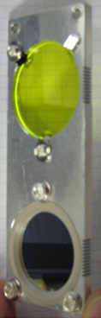
FSOTR @ALBA
Two screens (FS and OTR) held in the same support.
Can be insterted with 2 positions using pneumatic piston:
FS (YAG:Ce)
OTR (Al-foil)
YAG Screens:
0.1 - 0.5mm thick
Depending on beam charge density, light emission produced by YAG screens can saturate
Used with low charge beams
OTR - Optical Transition Radiation
100nm thick (in a 0.3mm Si substrate)
Produces little light, but linear response
Used with high intensity beams

Slide 5
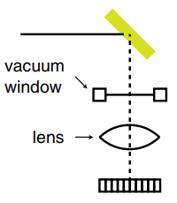
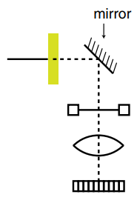
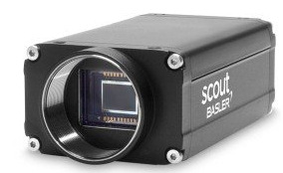
Optical Layouts
Optical Layout at FSOTR
Optical Layout at Pinhole
CCD in all cases:
OTR
Basler scA1300-32gm
Sony ICX445, 1/3”
3.75um pixel
GigE Interface
12bits
Remote trigger
C-mount
YAG
YAG/OTR at Vertical plane
Lens/CCD at Horizontal plane
→ Both screens on focus
Tested YAGs 0.1 & 0.5mm
Tested YAG:Ce screens: 0.1 & 0.2mm

Slide 6
Introduction
YAG – OTR @ Linac
In-Air X-ray Detectors
Pinhole Camera
Conclusions

Slide 7
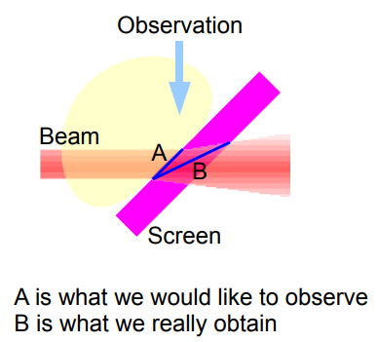
Comparison YAG vs OTR @Linac
YAG Pros & Cons
PROS: lots of light
CONS: Beam size increase due to YAG thickness*
Significantly affected when beam size ~ YAG thickness
Larger in the YAG tilt direction (horizontal @ALBA)
*E. Bravin, Transverse Profiles, CAS Diagnostics (2008)
**Experience with YAG and OTR screens at ALBA, U. Iriso et al, DIPAC 2009

Slide 8
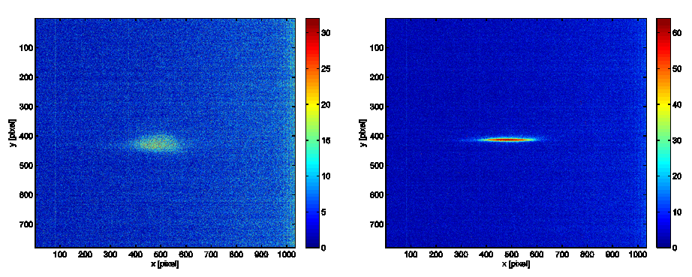

Comparison YAG vs OTR @Linac
OTR Pros & Cons
PROS: linear and directional light emission
CONS: low photon flux for low charge beams → image analysis difficult
emission angle: ±1/γ
e- beam
OTR foil
1nC ; σ_{y} ~ 0.3mm
1nC ; σ_{y} ~ 0.1mm
@ALBA, Nph ~0.02 ph/e

Slide 9
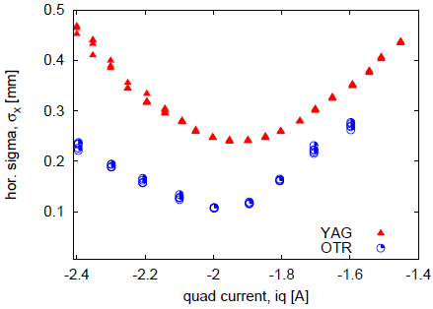
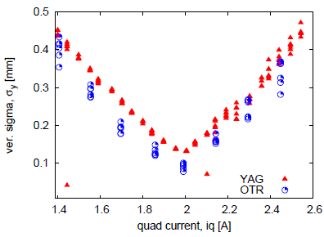
Comparison YAG vs OTR @Linac
Results from Quadrupole Scans*
YAG, 0.5mm thickness
Q = 2nC
Hor: factor ~2 larger
Ver: “only” 50%
Most critical at beam waist
HOR
VER
YAG screens @Linac were exchanged from 0.5mm to 0.1mm in ~2013
*Experience with YAG and OTR screens at ALBA, U. Iriso et al, DIPAC 2009

Slide 10
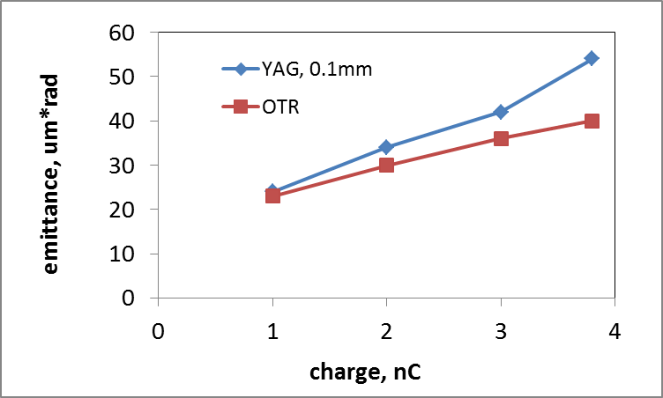
Comparison YAG vs OTR @Linac
Emittance Measurements with 0.1mm YAG
YAG and OTR emit measurements coincide for 1nC beams
For larger beam charges, YAG still produces an apparent beam size broadening
At ALBA, Linac charges in operation are ~[0.1 - 1nC], so we typically use YAG screens of 0.1mm thickness for the Linac emittance measurement
Results agree with theoretical predictions
The rest of screen monitors are still 0.5mm

Slide 11
Introduction
YAG – OTR systems @ Linac
In-Air X-ray Detectors
Pinhole Camera
Conclusions

Slide 12
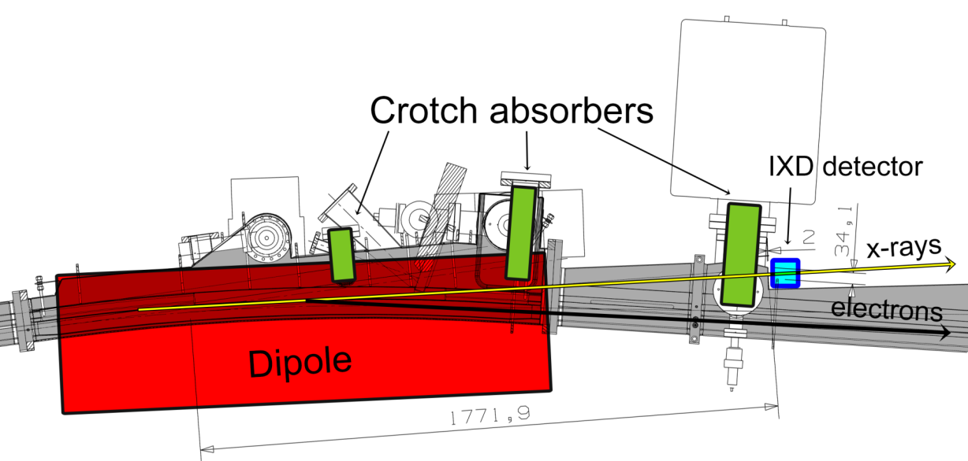
In-air X-ray Detectors (iXD)
Based on the projection of the very hard x-rays from synchrotron radiation traversing the dipole absorbers*
MOTIVATION: alternative emittance measurement
PROS: cheap and easy, iXD are located outside vacuum
CONS: Only vertical beam size is inferred
*K.Scheidt, Proc. Of DIPAC’05; A.Muller, Proc. Of EPAC’06

Slide 13
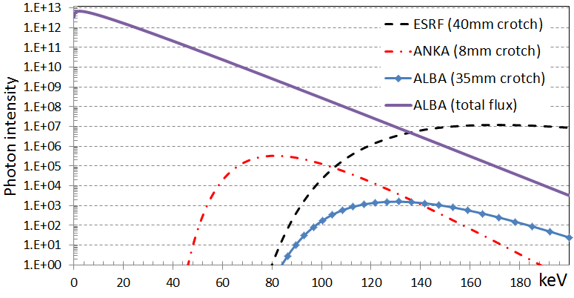
In-air X-ray Detectors (iXD)
Previous tests at ESRF and ANKA due to favourable conditions
Tests at ALBA required further work on the scintillator to improve light emission
 | ANKA | ESRF | ALBA
E, GeV | 2.5 | 6 | 3
Absorber thickness | 8mm | 40mm | 35mm
~1E4 flux reduction
wrt to ESRF or ANKA

Slide 14

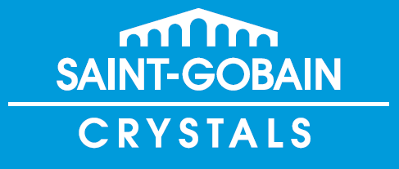
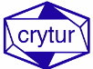
In-air X-ray Detectors (iXD)
Chemical composition: Lu_{1.8}Y0_{.2}SiO₅:Ce
Light yield: 32 photons/keV
Decay time: 41 ns
Scintillation emission wavelength: 420 nm
Thickness for tests: 1 and 2 mm
CRY19 a silicate single crystal for X-ray detectors.
Chemical composition: unknown
Light yield: 28 @300K [10³Ph/MeV]
Decay time: 41 ns
Scintillation emission wavelength: 420 nm
Thickness for tests: 1 mm

Slide 15
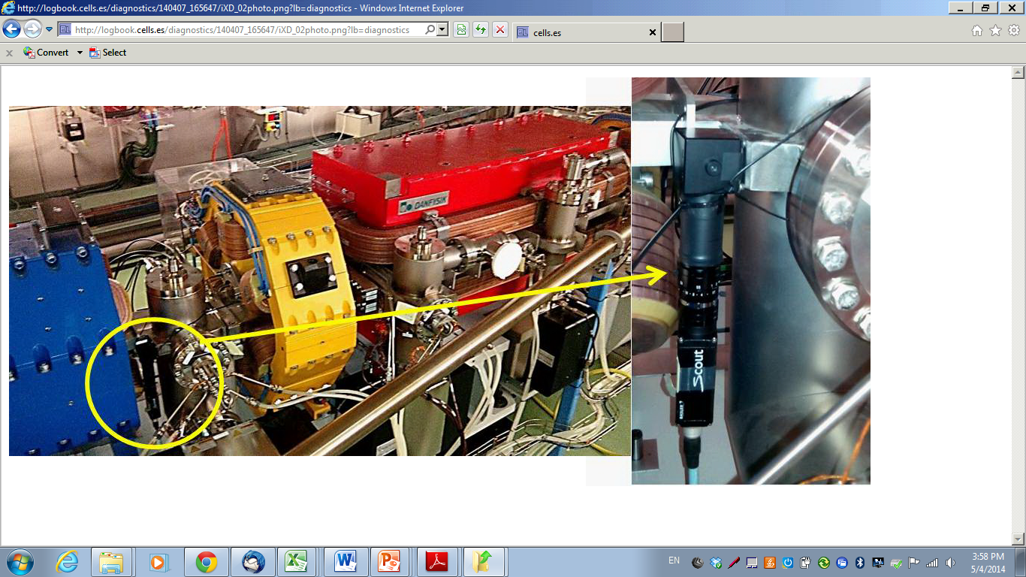
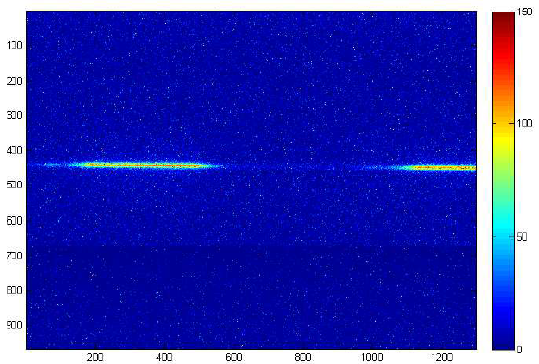
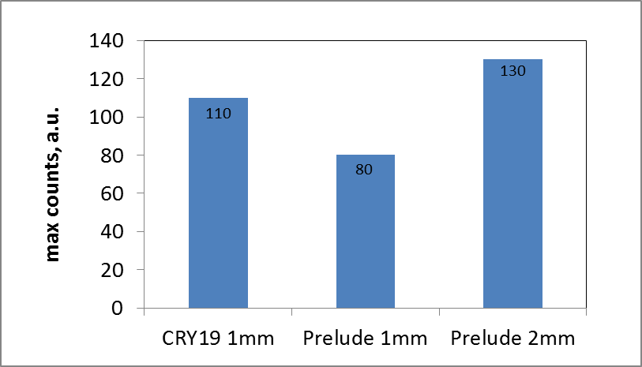
In-air X-ray Detectors (iXD)
Thicker part of absober
Thinner part of absober
Tests to characterize light emission:
Tests performed going in/out of the tunnel to change scintillator material to avoid changing experimental conditions
Evaluate the max counts at CCD

Slide 16
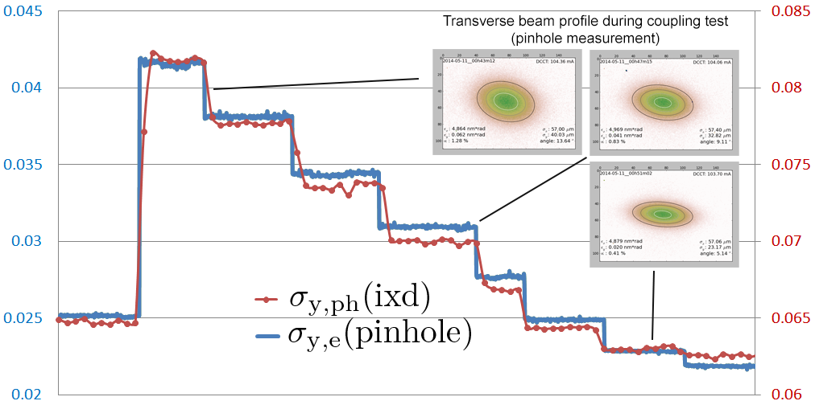
In-air X-ray Detectors (iXD)
Beam size limited by photon divergence and distance between source point and iXD location
Coupling scans to change beam size at source point
A linear relation exist along the whole range, but iXD shows an offset which is not understood
*A. Nosych and U. Iriso, A compact in-air x-ray detector for beam size measurements at ALBA, Proc. of IBIC14

Slide 17
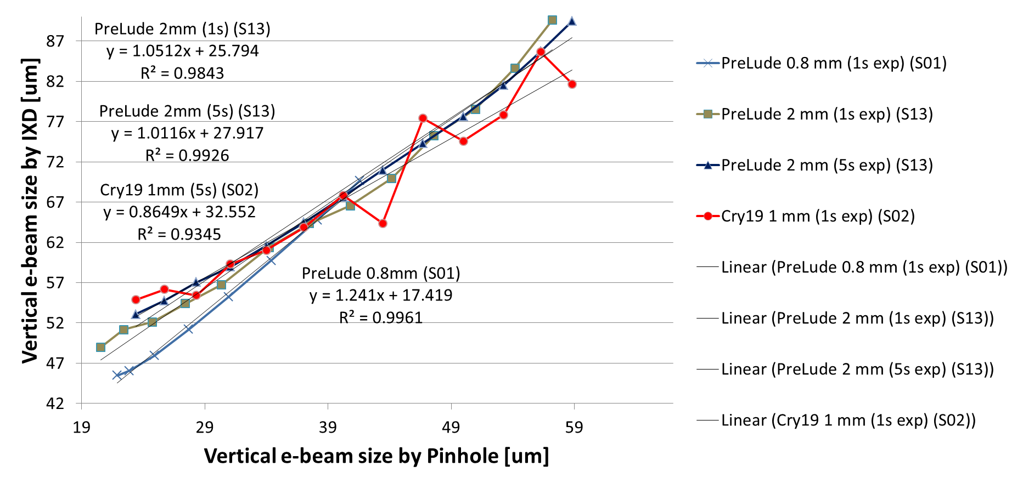
In-air X-ray Detectors (iXD)
All screens (Prelude & CRY19) are currently in use (but at different locations)
A linear relation exists with all materials, but experimental conditions cannot be compared
All tested materials provide an almost perfect 1:1 linear relation wrt pinhole beamsize
Disagreement still to be understood

Slide 18
Introduction
YAG – OTR systems @ Linac
In-Air X-ray Detectors
Pinhole Camera
Conclusions

Slide 19
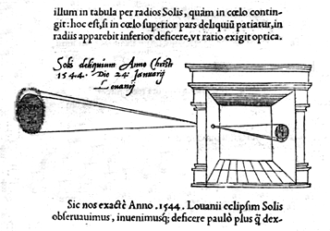
X-ray Pinhole Camera
Pinhole, or camera obscura, a “camera without lens”, has been used since SXVI to image solar eclipses
Light going through a small hole, image keeps source properties
Image is magnified by factor L2/L1 , which is very valuable asset to picture the small electron beams
Object
O
L₂
First used in synchrotrons by P. Elleaume (ESRF) in 1995
Widely used around the world: ESRF, ALBA, APS, Diamond, Soleil, Elettra, NSLS…
L₁
Image
I
Pinhole Aperture
σ_{i} = L₂/L₁ σ_{o}

Slide 20
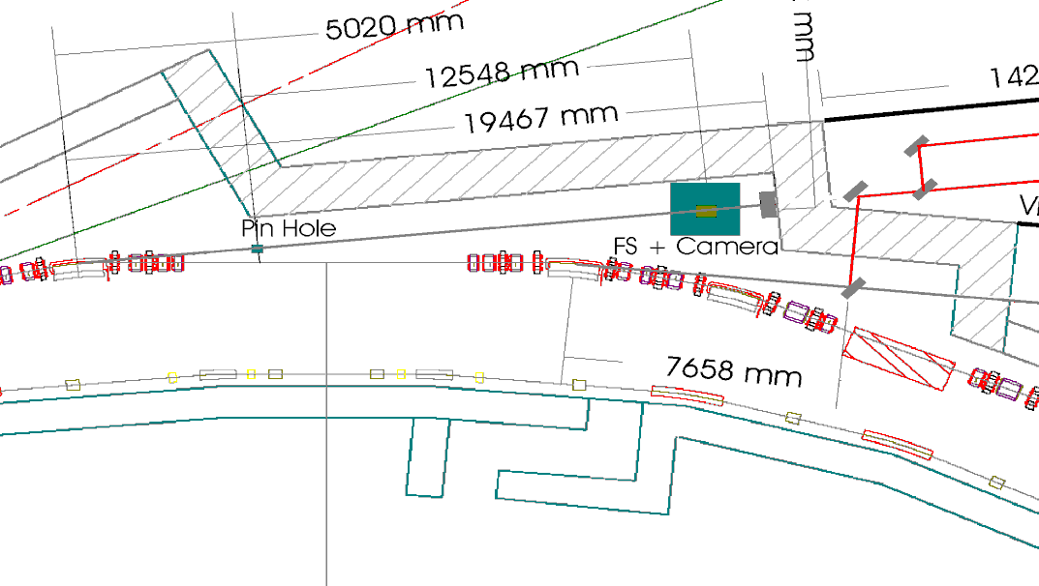
X-ray Pinhole Camera @ALBA
Pinhole: array of Tungsten bars → size: 10x10 um
L1 = 5.98m ; L2 = 13.6 → Magnification L₂/L₁ = 2.275
Al vacuum window + Cu material to filter x-rays → Spectrum ~[10 - 50] keV
X-rays passed to vis. light using scintillators → YAG:Ce screen, 0.1mm
screen
+ Optics +
CCD camera
Source point (dipole)
pinhole

Slide 21
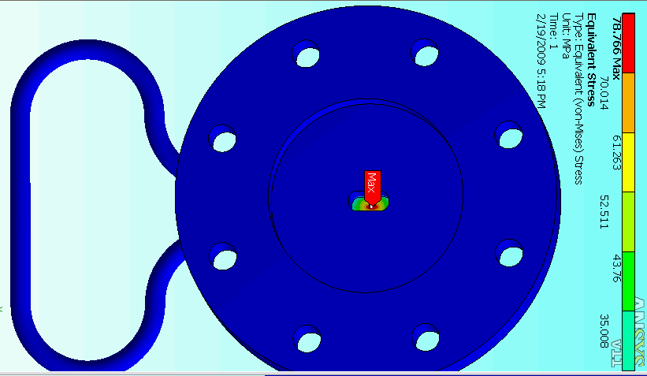
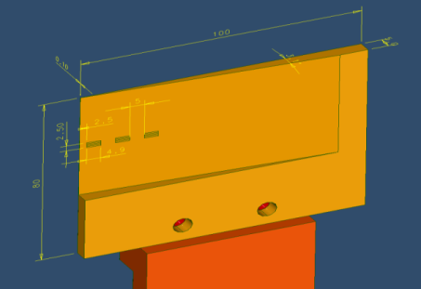
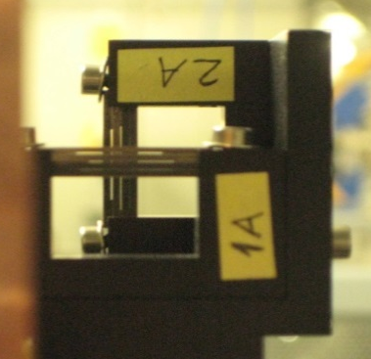
X-ray Pinhole Camera @ALBA
Pinhole: array of Tungsten bars → size: 10x10 um
L1 = 5.98m ; L2 = 13.6 → Magnification L₂/L₁ = 2.275
Al vacuum window + Cu material to filter x-rays → Spectrum ~[10 - 50] keV
X-rays passed to vis. light using scintillators → YAG:Ce screen, 0.1mm
Al Window:
1mm thickness, water cooled
Cu filter:
Thickness 0.1 – 5mm
Pinhole array:
Hole of 10x10 um in operation

Slide 22
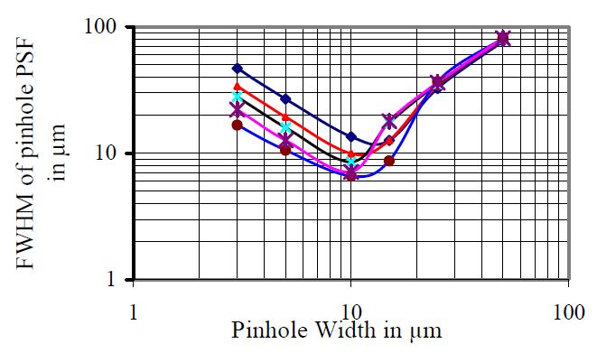
X-ray Pinhole Resolution
Beam size at YAG is given by the magnification factor and the optics limiting effects
Mainly, diffraction and blurring (Finite Aperture effect):
Minimize PSF → optimize pinhole aperture w at design stage
The optimization can be done analytically, or more in detail with simulations
σ_{YAG}² = [(L2/L1) σ_{e} ] ² + σ_{dif}² + σ_{blur}² ]
PSF²
Analytical Solution @ALBA
SRW Simulations @Soleil*
*M.A. Tordeaux, et al, “Ultimate Resolution of Soelil Pinhole Cameras”, DIPAC’07

Slide 23
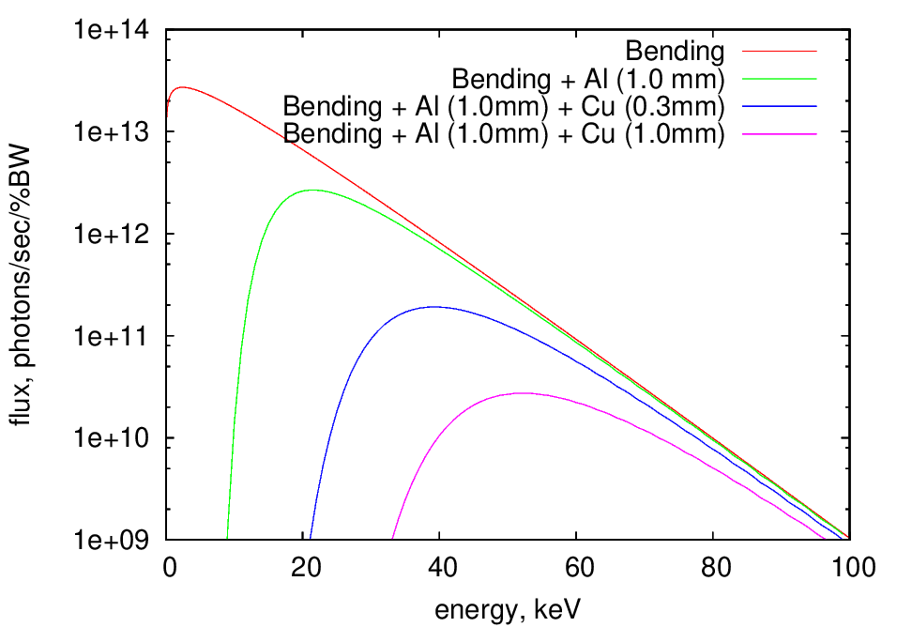
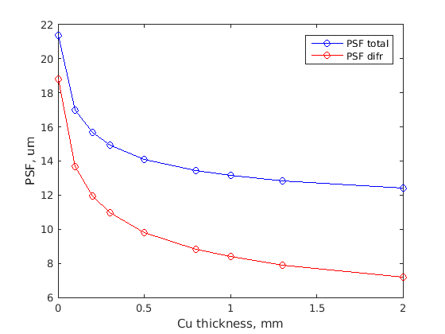
X-ray Pinhole Resolution
Usual set-ups in electron machines allow to change Cu filter thickness from ~[0.1 – 3] mm with two main purposes:
Produces both a flux attenuation and harden x-rays spectra
Decrease pinhole PSF
PSF dominated by diffraction
PSF dominated by blurring

Slide 24
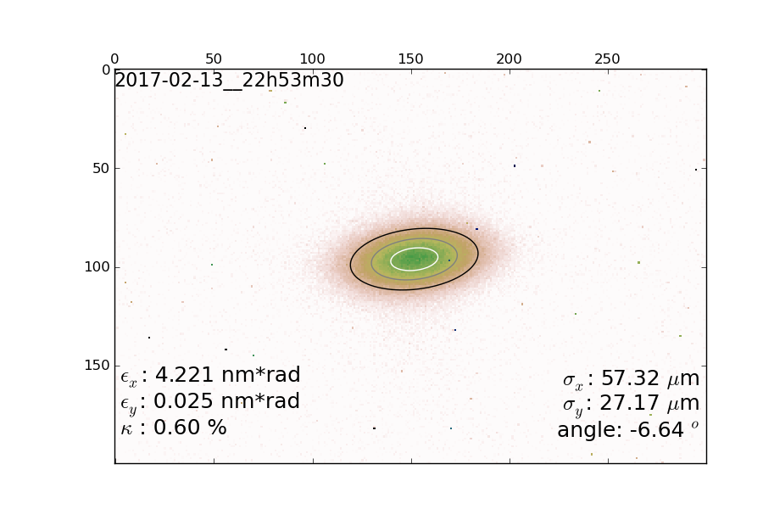
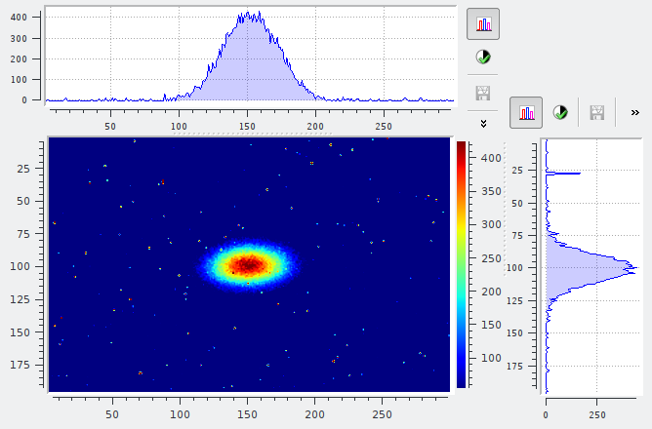
X-ray Pinhole Precision – Image Analysis
Usual recipe:
Select a Region Of Interest (ROI)
Add pixels in columns (rows)
Gaussian Fit for hor (ver) profiles
If tilted beam:
Select a Region Of Interest (ROI)
2d-Gaussian Fit
New ROI using AutoROI at +/-3σ_{x,y}
Back to step 2 until convergence

Slide 25
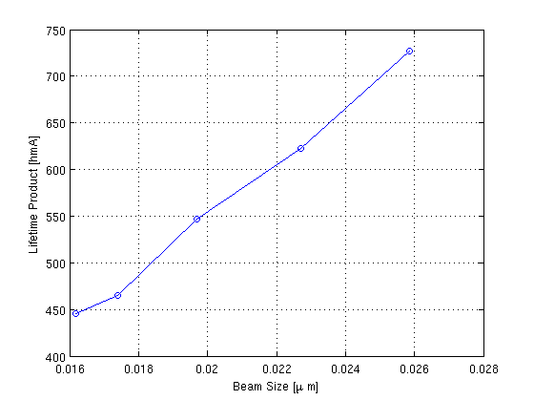
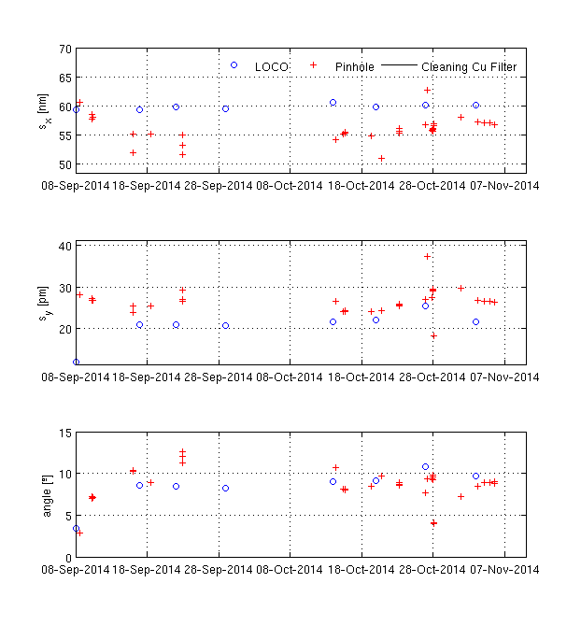
X-ray Pinhole Results
Good agreement is typically found for relative beam size evolution
Good agreement between beam lifetime and beam size during coupling scans
Small differences of beam size and tilt angle wrt LOCO
Pinhole
Loco
Loco
Pinhole
How precise can we determine the absolute values?

Slide 26
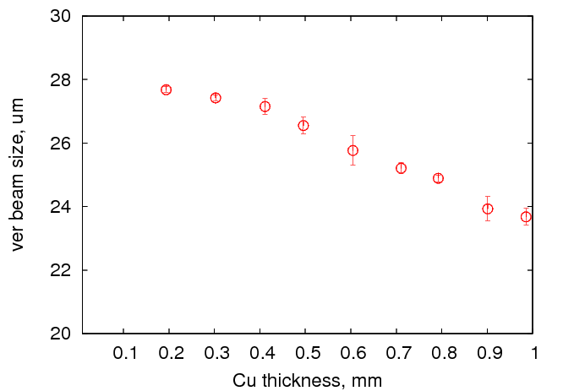
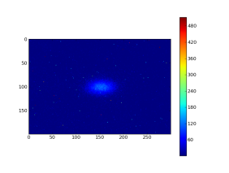
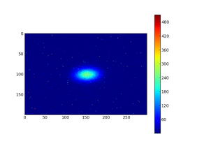

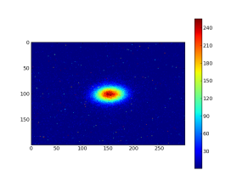




X-ray Pinhole: Absolute Precision?
The absolute beam size value depends on the acquisition parameters
Criteria to use a given set of acquisition parameters?
Cu Thickness Influence
Color scale prop. thickness
Fixed Color Scale
0.8mm
0.6mm
0.8mm
0.6mm
0.4mm
0.2mm
0.4mm
0.2mm
~25% difference!
(PSF already taken into account!)

Slide 27
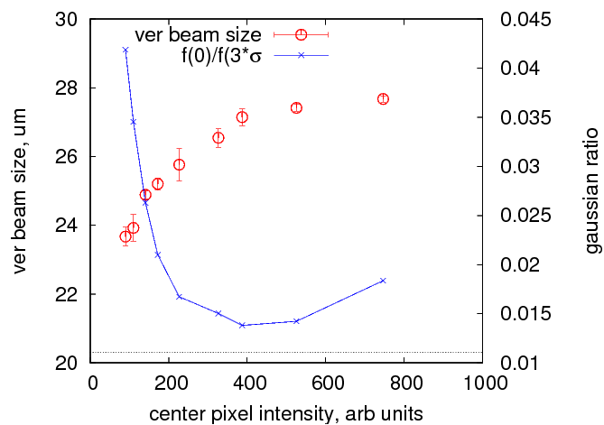

X-ray Pinhole: Absolute Precision?
Criteria: compare images of equal “Gaussian” Dynamic Range
1. Perform AutoRoi +/-3*σ_{x,y}
2. Ratio f(3σ_{x}, 3σ_{y})/f(0,0) = exp(-9/2) (closest to ideal Gaussian distribution)
Increasing illumination image (via CCD Exposure Time or Cu filter), the beam size increases up to a certain plateau
We stay at the beginning of this plateau
Increasing this illumination increases background level as well, but not necessarily the dynamic range and tails start to appear in the beam image
Not fully using 12bits of the CCD!!
exp(-9/2)

Slide 28
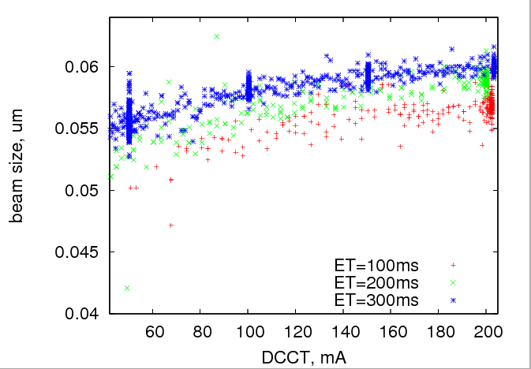
X-ray Pinhole: Absolute Precision?
This also is affects precise Machine Physics experiments
σ_{x} evolution with beam current
Emmittance growth with current:
If acquisition parameters are not changed, we have ~10% emittance growth, non-consisten with expectations
An automatic “feedback” system to keep max illumination constant is being prepared

Slide 29
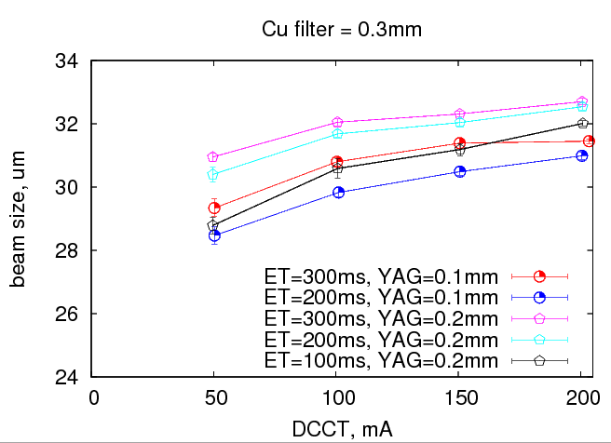
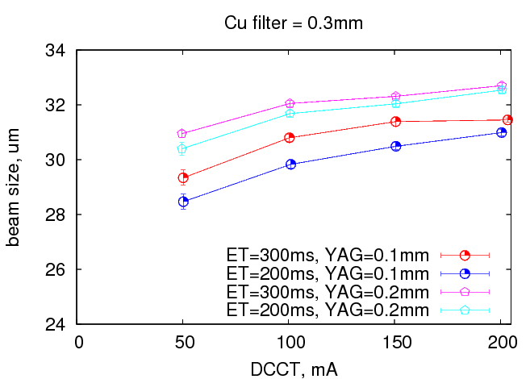
X-ray Pinhole: comparison YAG:Ce thickness
YAG:Ce thickness – 0.1mm vs 0.2mm
Thicker scintillator screens enlarge beam size measurement
But can be compensated with acquisition parameters (i.e. CCD Exposure Time)
YAG 0.2mm
YAG - 0.2mm behaves similar to YAG - 0.1mm if ET=100ms
So, how should we properly compare the two screens?
YAG 0.1mm
Notes:
For the same acquisition parameters and beam conditions, thicker YAG produce larger beam sizes.
Can actually this situations be compared? How can we know the “absolute” beam size value?

Slide 30
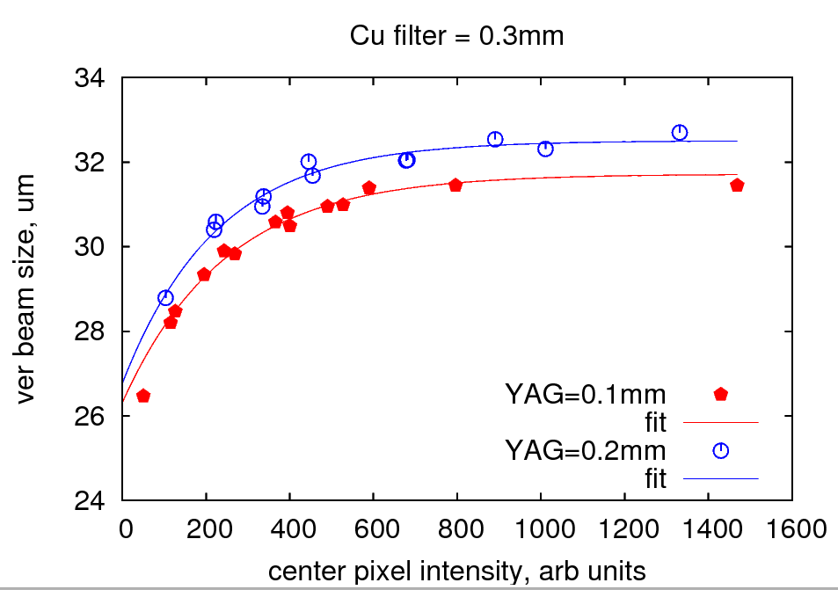
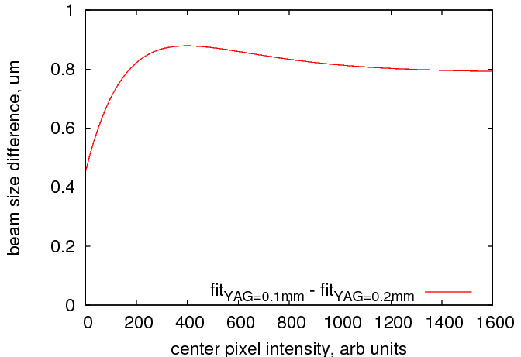
X-ray Pinhole: comparison YAG:Ce thickness
YAG:Ce thickness – 0.1mm vs 0.2mm
No matter if we scan DCCT, CCD Exposure Time, or Cu filter, the beam size lays on a curve which depends on the max illumination
In this situation, enlargement produced by screens of 0.1 vs 0.2 mm is <1um for 30um beams (~3%)

Slide 31
Introduction
YAG – OTR systems @ Linac
In-Air X-ray Detectors
Pinhole Camera
Conclusions

Slide 32
CONCLUSIONS
YAG & OTR @Linac:
Beam size enlargement due to scintillator thickness limited emittance measurements during quadrupole scans when beam size < scintillator thickness
Changed from 0.5mm to 0.1mm YAG:Ce thickness. Now emittance measurements agree with OTR if charge smaller than ~2nC
Scintillators for In-air X-ray Detectors
Tested CRY19 (1mm) and Prelude (1 and 2mm)
For the 1mm screens, photon flux by CRY19 is ~30% larger than Prelude
(Although beam size enlargement produced by this IXD is not understood)

Slide 33
CONCLUSIONS
Scintillator for X-ray Pinhole:
When looking at um precision level, image analysis and acquisition parameters play an important role , and we find more accurate to compare pinhole images based on similar CCD illumination
For ALBA parameters, going from YAG screens of 0.1 to 0.2mm produces a beam size enlargement of <1um in the vertical plane
Currently, a “feedback” system to keep similar CCD illumination is being implemented

Slide 34
Thanks
To ALBA Mechanical engineers, Operation & Linac Groups, Crytur

Slide 35
Extra slides

Slide 36
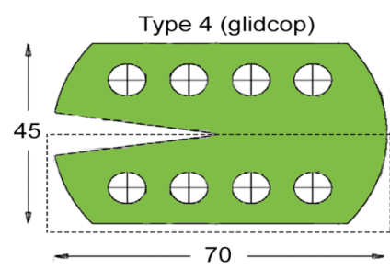
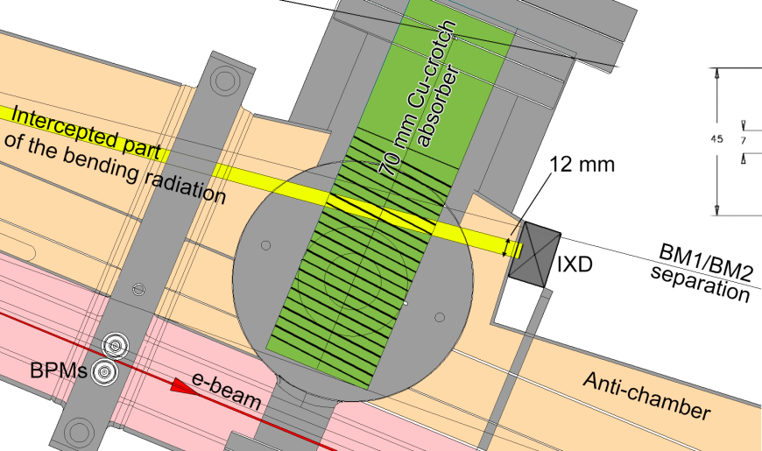
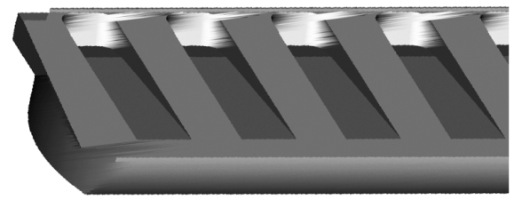
Crotch absorbers
Cross-section
bottom jaw
Tooth width: 6 mm
Teeth inclination angle: 8.8º
1700 mm
to source
35 mm of Cu
2 mm of steel
Ray tracing shows that radiation from previous dipole does NOT pass by the IXD, so we are looking at a single photon source

Slide 37
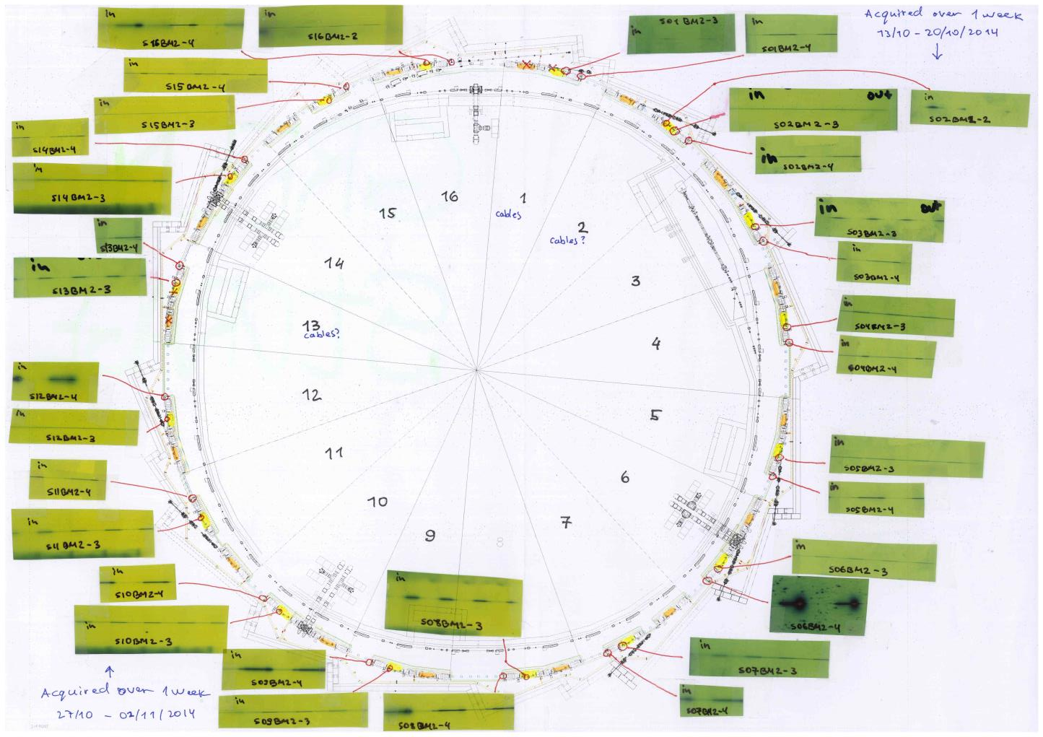

Slide 38
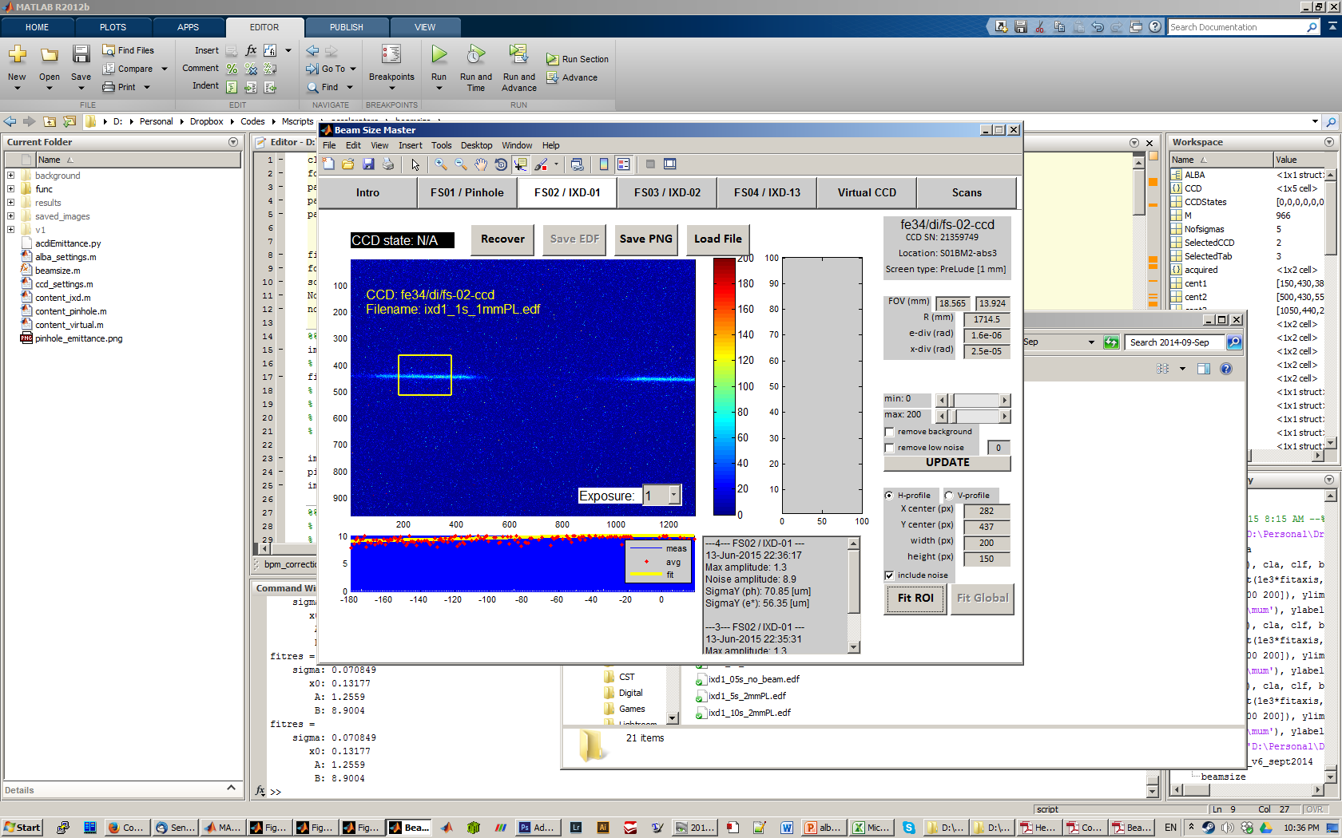
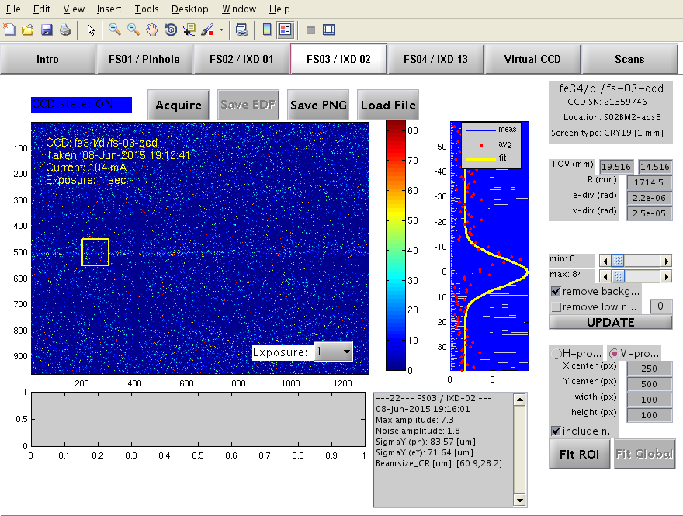
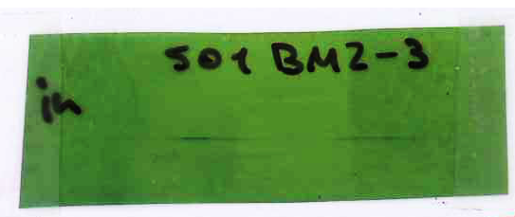
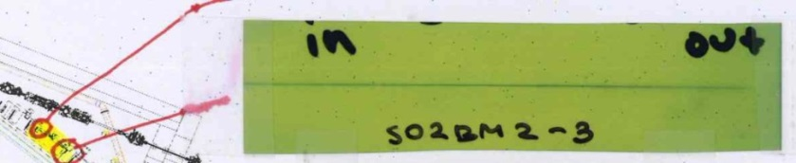
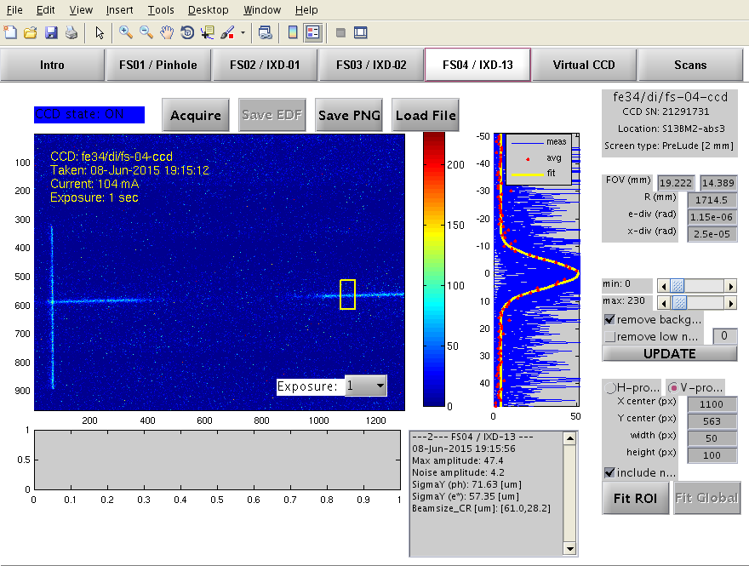
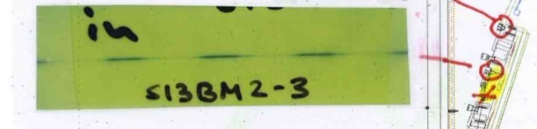
σy = 56 um
Cry19
1 mm
PreLude 1 mm
σy = 71 um
PreLude 2 mm
σy = 57 um

Slide 39

X-Ray Pinhole Camera
Light from an object (beam) goes through a single aperture (pinhole) and projects an inverted image of the source
Image is magnified by a factor L2/L1
ALBA magnification factor 2.27 (18m length system)
Use x-rays: Al-window and Cu-filter (~45keV)

Slide 40


X-Ray Pinhole Results
Example: correlation between beam lifetime and beam size while reducing koupling.
Example at 0.5% koupling
Minimum koupling = 0.1%

Slide 41


In-air X-ray Detector Limitations
PSF is limited by distance between source-point to iXD location and photon divergence
$σ_{sc}2=$ $σ_{b}2$ + (L·α)²
For this first case, PSF is quite large:
E~130keV; α=0.025mrad; L=1.7m
PSF = (L·α) ~ 42um!
At ALBA, need to look for a closer location, and/or use still harder x-rays

