Slide 1

MD4203 - intensity scan with trains of 12b at 450 GeV
Eric, Galina, Gianni, Giovanni, Kostas, Chiara, Slawosz, Guy, Michaela, David, Matteo, Helga, Jani, Daniel, Francesco, Belen and Ron.
This MD would not have been possible without a big effort on the injectors side.
Many thanks!!!!!
(in particular to Francesco, Giulia, Fabio, Oleg, Oscar, Yannick, Luci, Hannes, Kevin, Verena, Elena, Heiko)
https://op-webtools.web.cern.ch/elogbook/index.php?shiftID=1104479&lgbk[]=60

Slide 2
MD4203 - intensity scan with trains of 12b at 450 GeV
The goal of the MD was to collect heat load data with different bunch intensities with trains of 12b.
Used filling scheme with 1020b, injections of 4x12b
We started with the highest available from the injectors i.e. 1.9e11 p/bunch.
For a few hours at the beginning, we had problems in getting the beam injected, also due to the fact that the extraction from the SPS cycle could not be tested beforehand. Careful longitudinal adjustments had to be performed in the SPS before the beam could be sent do the LHC. → Measurements could only start after ~5h of setting up and optimization
Still, in order to inject 1.9e11 p/bunch, due to high longitudinal losses we needed to pulse the MKI without beam before each injection (thanks to Michaela, Fabio and Luci who did not miss a single shot!).
Lower intensities were significantly easier. → We performed four fills with ~1.9e11, ~1.5e11, ~1.2e11, 0.8e11 p/bunch.
The dependence on the heat load on the bunch intensity could be clearly measured

Slide 3
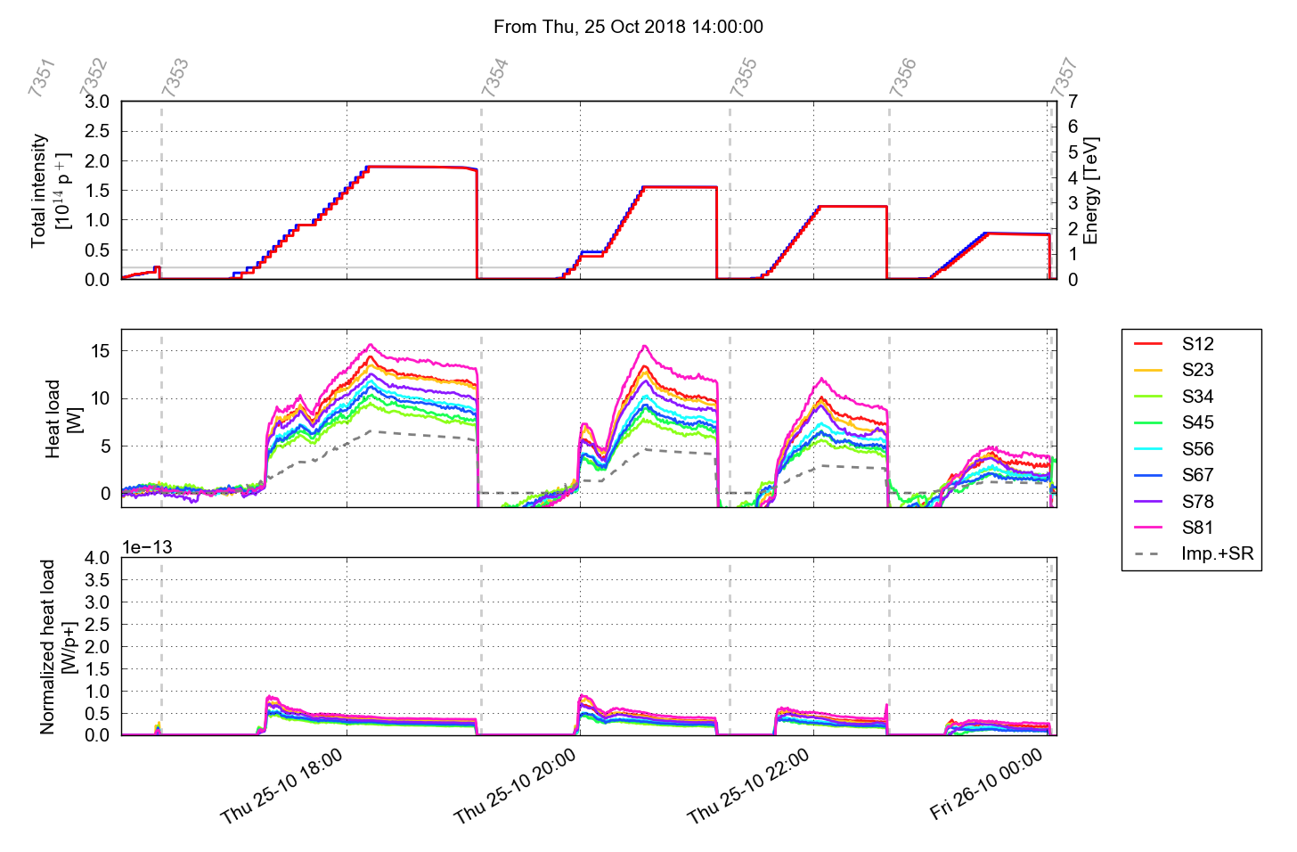
MD4203 - intensity scan with trains of 12b at 450 GeV
1.9e11 p/b
1.5e11 p/b
1.2e11 p/b
0.8e11 p/b

Slide 4
MD4203 - intensity scan with trains of 12b at 450 GeV
We measure the expected behavior for high bunch intensities ☺
Component from beam screen impedance is subtracted

Slide 5
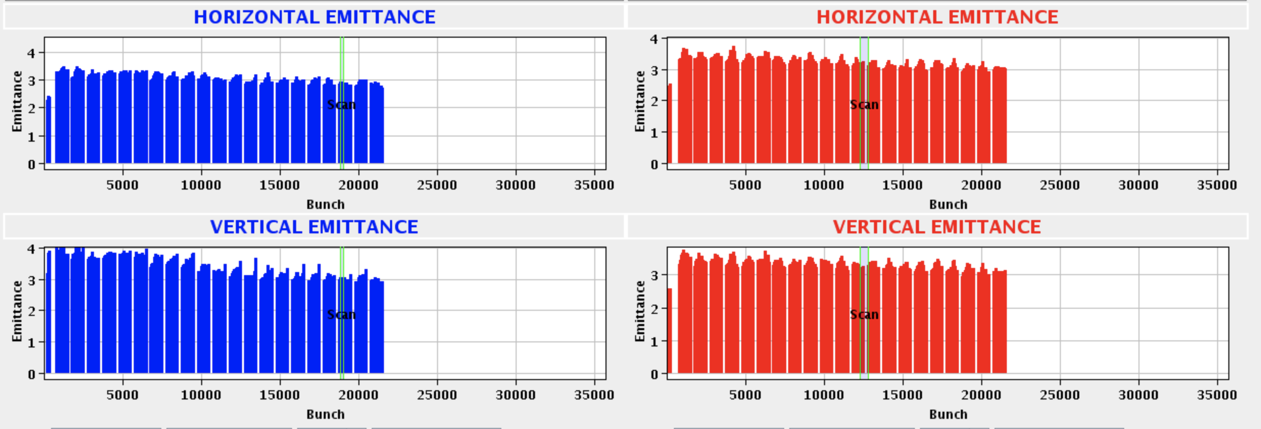
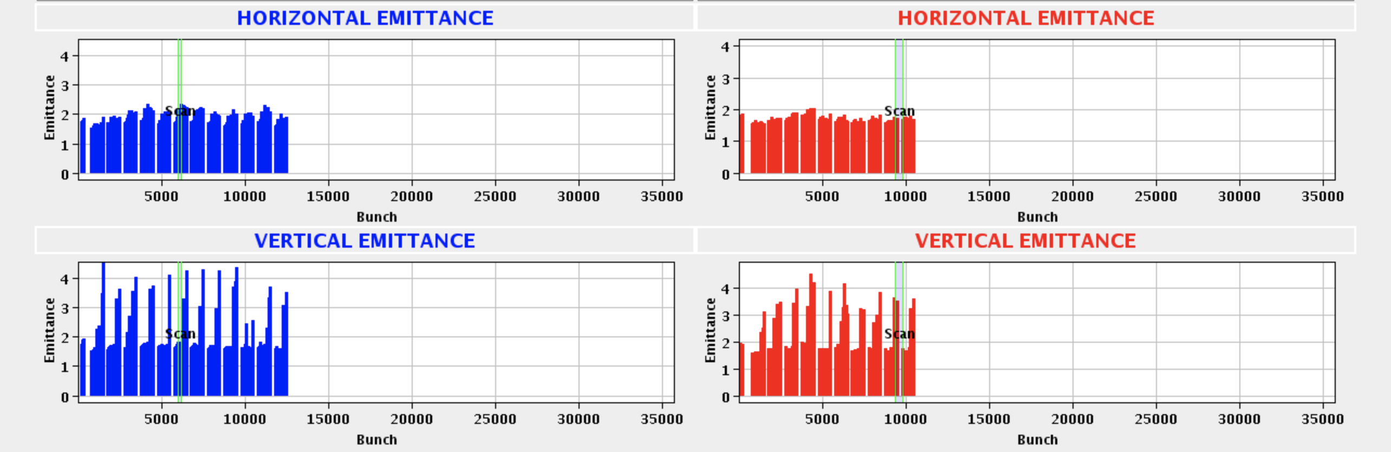
MD4203 - intensity scan with trains of 12b at 450 GeV
1.9e11 p/bunch → stable with no octupoles!
0.8e11 p/bunch → unstable in V with I_{oct} = 52 A

Slide 6
MD2484 - high intensity 8b+4e
Bjorn, Daniel, David^2, Francesco^2, Kostas, Galina, Gianni, Giovanni,
Guy, Michaela, Slawosz.
Many thanks to the injectors team for the preparation of this challenging beam!

Slide 7
MD2484 - high intensity 8b+4e
The intensity from the injectors was ~1.6e11 p/bunch.
The start of the MD was significantly delayed due to RF problems in the SPS. As experienced this afternoon, the beam was dumped a few times on losses at injection for B1 (probably showers from TCDI). This could be mitigated by increasing the transverse scraping in the SPS and optimizing the trajectory by centering the beam in the TCDI region.
Fill 7365: In these conditions (still with quite large losses) we could inject 852b and accelerate to 6.5TeV using the cycle with the large telescope. At flat-top the beams were kept separated at beta* = 65 cm for 30 mins for heat load measurements. Then collisions and a quick lifetime study as a function of the crossing angle.
Towards the end of the ramp the lifetime dropped below 10h and losses at the primary collimators reached 70% of the dump threshold on the long running sums. → Decided to switch to the nominal hypercycle for the next fill.
Fill 7366: At the beginning of the fill the trajectory in TI2 was further optimized. This allowed to fully mitigate the losses at injection. Filling with trains of 96b with 8b+4e scheme was very smooth. The beams were accelerated to 6.5 TeV and kept at flat-top for 30 mins for heat load measurements. Then the rest of the operational cycle was performed bringing the beams into collision. The beams were kept there for 30 mins to collect bunch-by-bunch lifetime data.
The beams were then separated for studies by the UFO team. For this purpose a transverse excitation was applied on 600b in order to blow-up the emittance. Unfortunately this generated too large losses which dumped the beams.

Slide 8
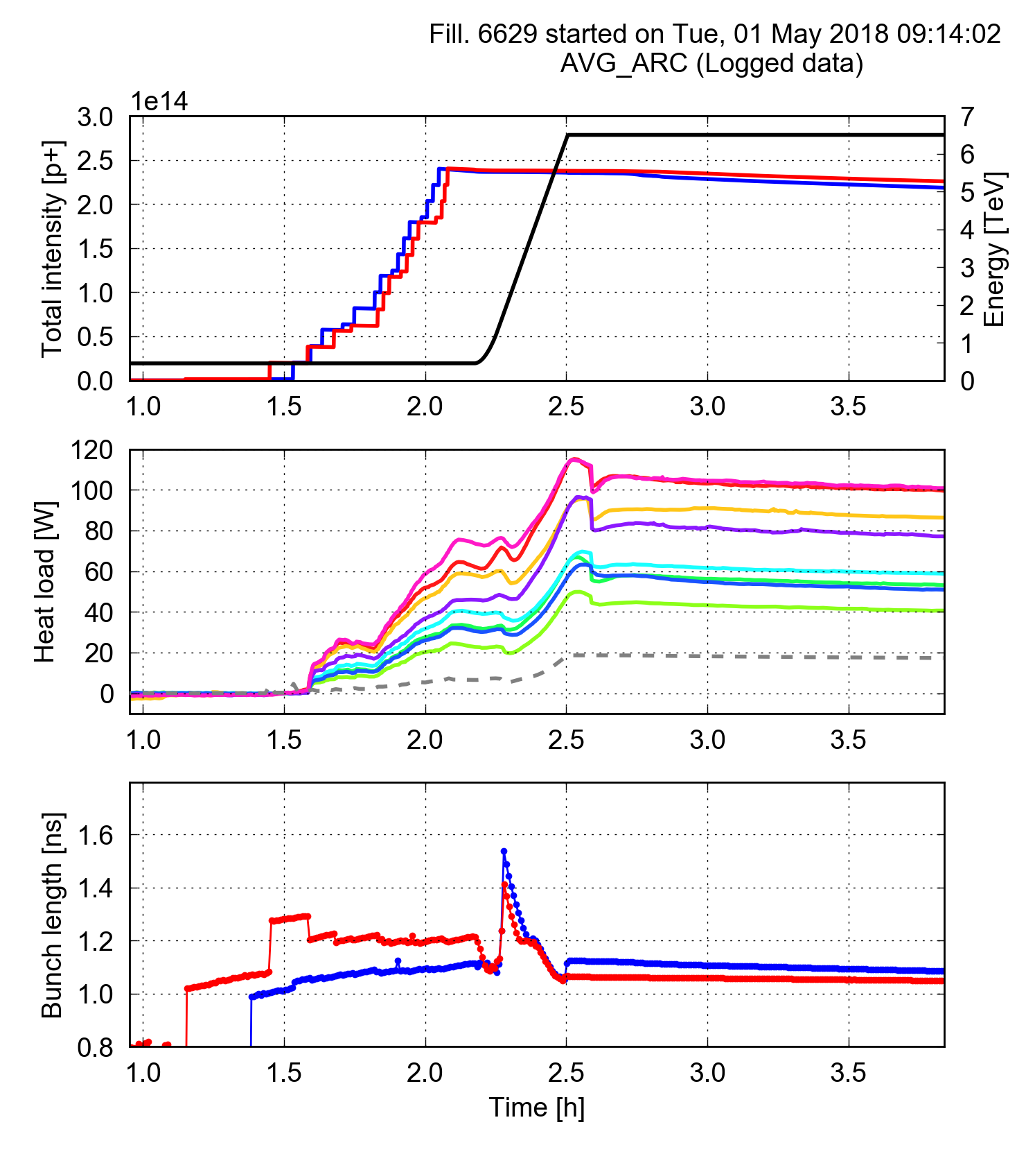
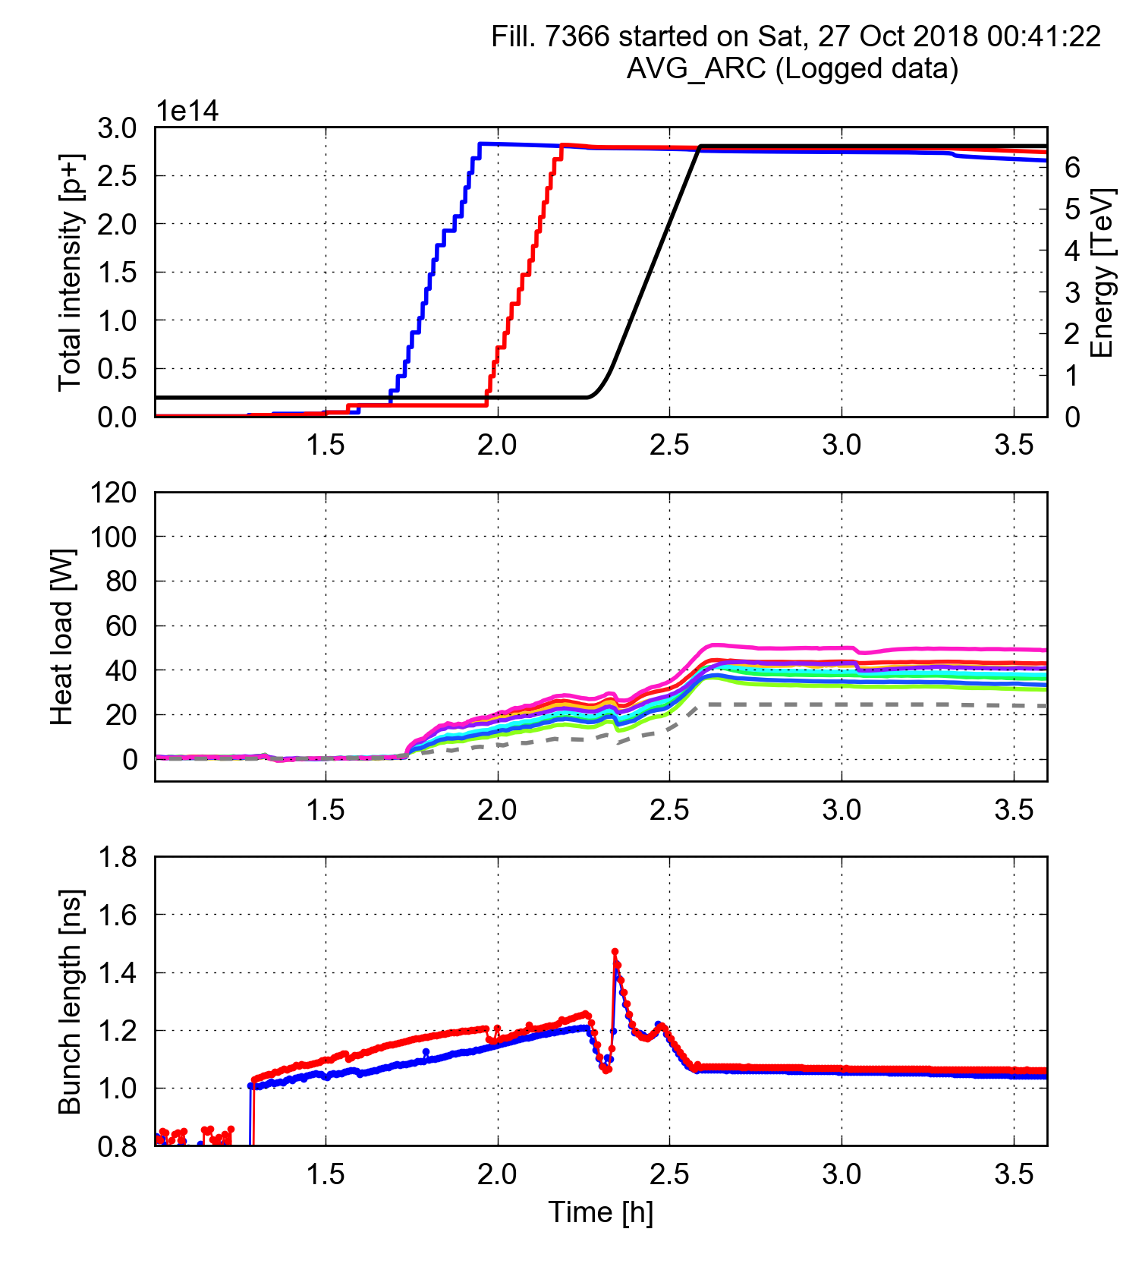
MD2484 - high intensity 8b+4e
Also for higher bunch intensity the 8b+4e beam generate much smaller heat load w.r.t. the standard 25 ns beam
25 ns, 1887b, 1.25e11 p/bunch
8b+4e, 1852b, 1.5e11 p/bunch

