Slide 2
Simulation studies of the bunch length dependence on e-cloud build-up in circular drift tubes
Eric Wulff

Slide 3
Outline
Goal
e-cloud simulation setup
SEY threshold
Heat load and current vs bunch length
Summary

Slide 4
Outline
Goal
e-cloud simulation setup
SEY threshold
Heat load and current vs bunch length
Summary

Slide 5
Goal
To study the dependence of bunch length on the heat load and current deposited on a circular drift tube of radius 40 mm

Slide 6
Outline
Goal
e-cloud simulation setup
SEY threshold
Heat load and current vs bunch length
Summary

Slide 7
e-cloud simulation setup
450 GeV beam energy
1.1 ×10¹¹ p/bunch beam intensity
Standard 25 ns beam
No magnetic field
Uniform initial electron density
SEY scan: 1.0 - 1.8
Bunch length scan: 0.7 - 1.8 ns
Circular chamber with radius of 40mm

Slide 8
Outline
Goal
e-cloud simulation setup
SEY threshold
Heat load and current vs bunch length
Summary

Slide 9
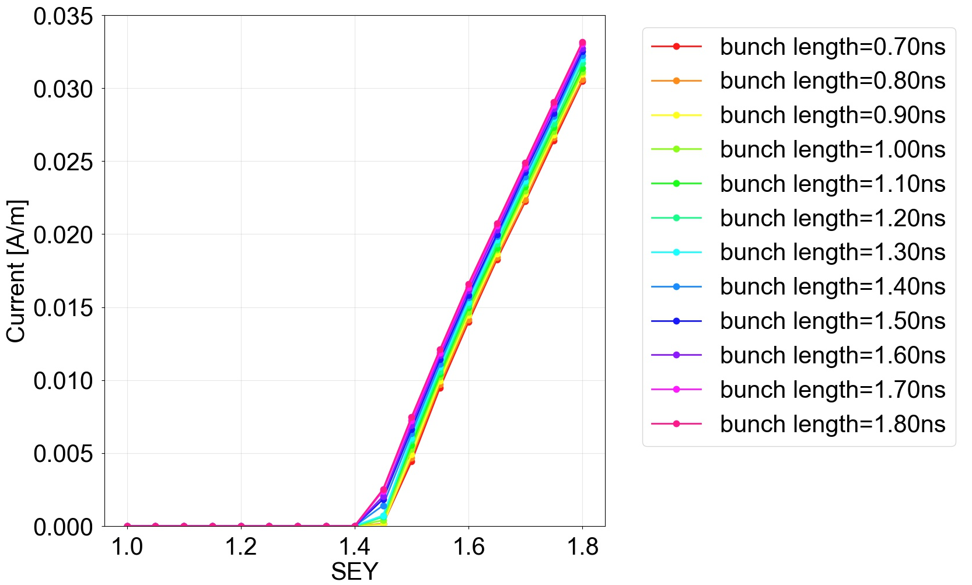
SEY threshold
The SEY threshold is 1.4 for all simulated bunch lengths

Slide 10
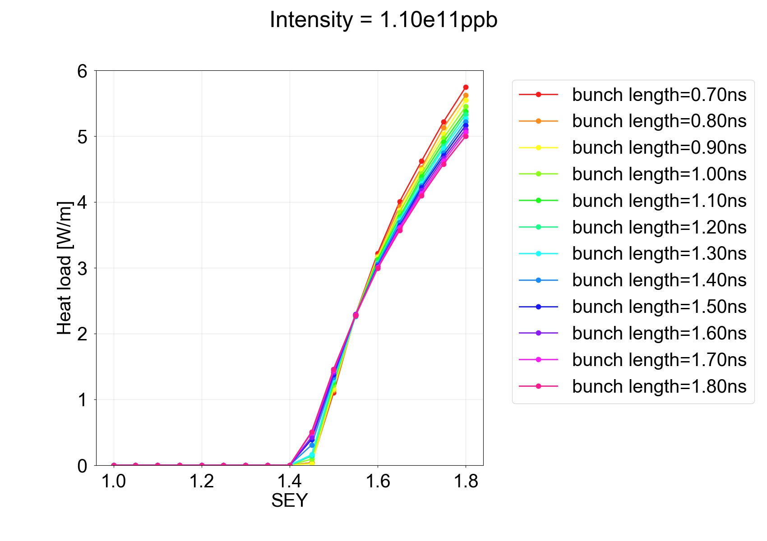
SEY threshold
The SEY threshold is 1.4 no matter which bunch length is used

Slide 11
Outline
Goal
e-cloud simulation setup
SEY threshold
Heat load and current vs bunch length
Summary

Slide 12
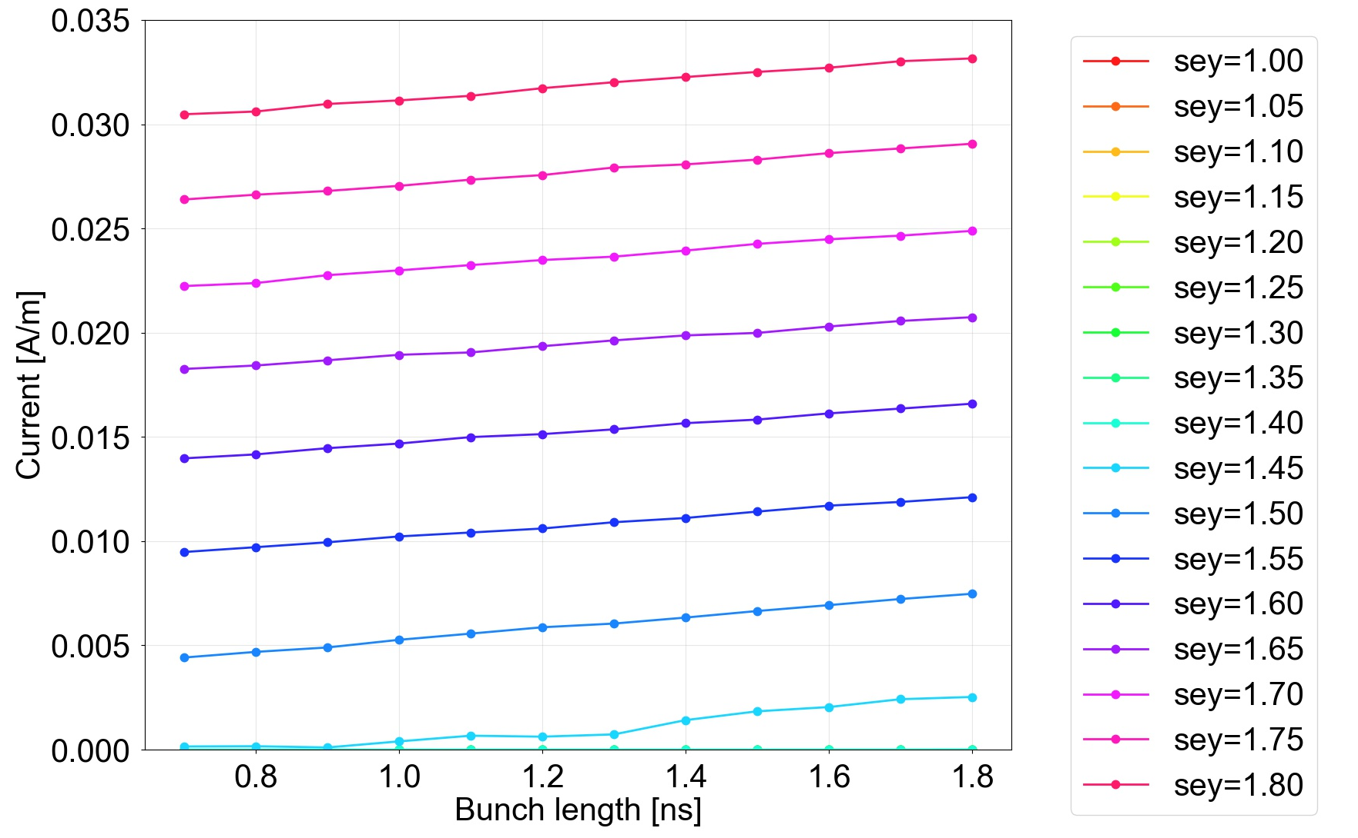
Current vs bunch length
The current is increasing linearly with the bunch length

Slide 13
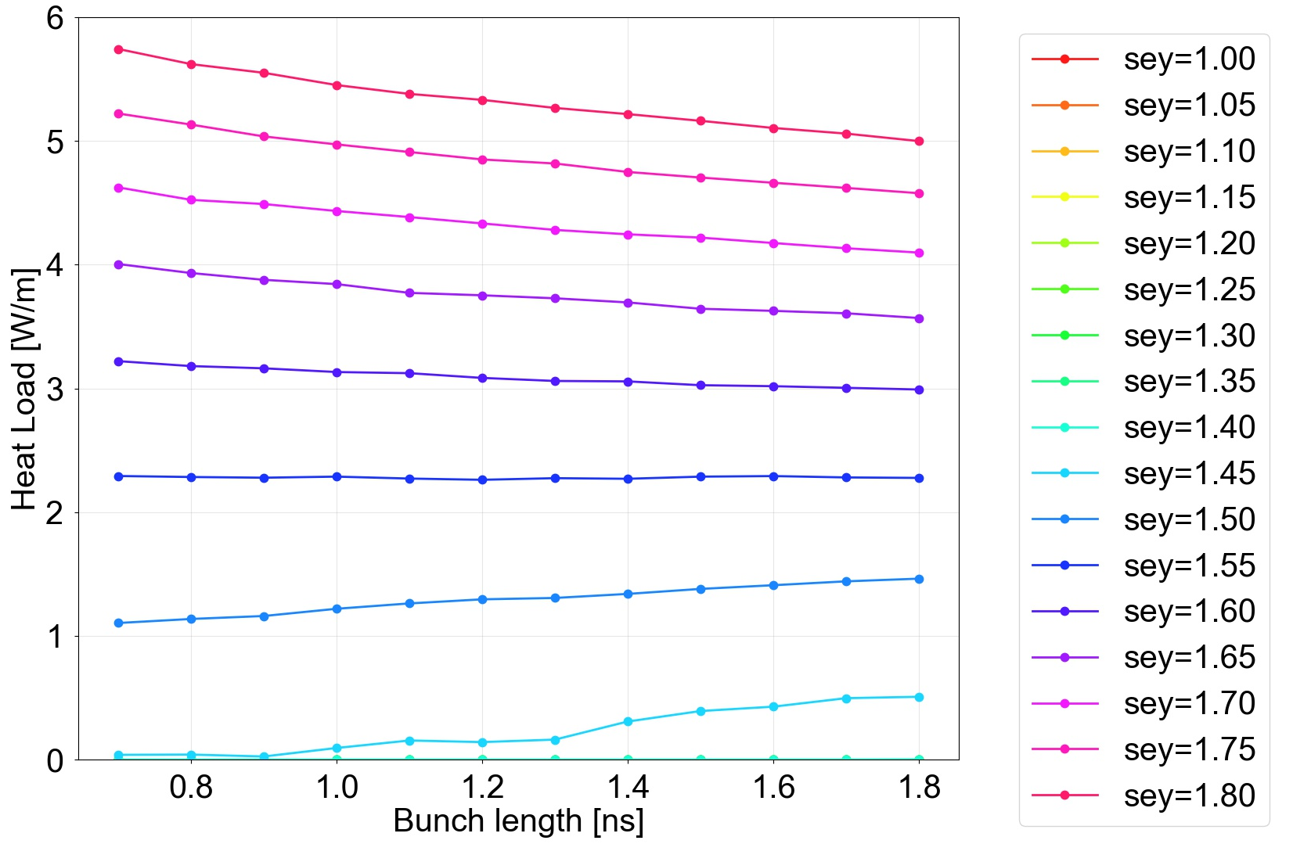
Heat load vs bunch length
For low SEYs the HL increases with growing bunch lengths
For high SEYs it decreases instead

Slide 14
Outline
Goal
e-cloud simulation setup
SEY threshold
Heat load and current vs bunch length
Summary

Slide 15
Summary
The SEY threshold is 1.4 for all bunch lengths in the range 0.7-1.8 ns according to simulations
The current is increasing linearly with the bunch length
For low SEYs the heat load increases with increasing bunch length
For high SEYs it decreases instead

