Slide 1
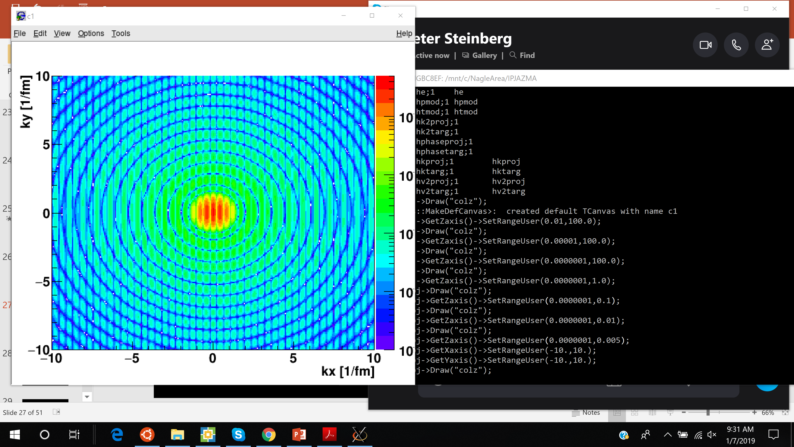
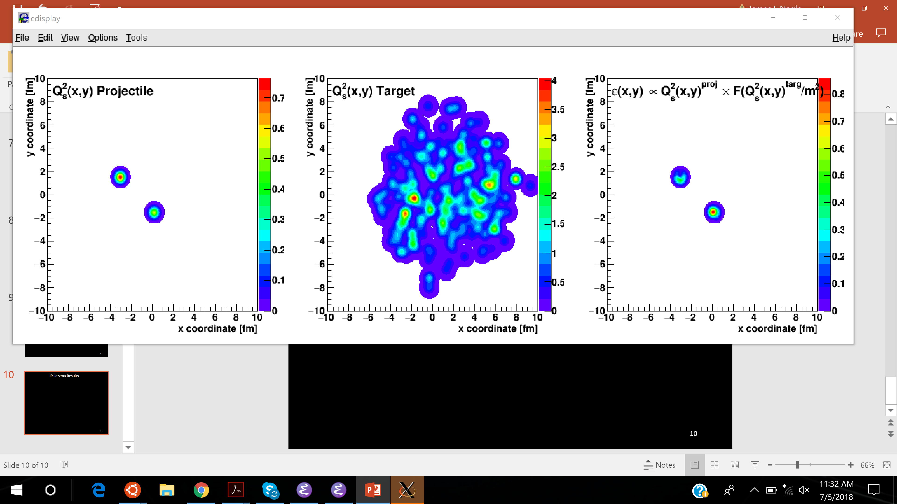
Ab Initio or
Non Pertinent
Jamie Nagle
University of Colorado Boulder
Winter Workshop on Nuclear Dynamics, Beaver Creek, Colorado 2019

Slide 2
Ab Initio Effective Theory
gluons, gluons, gluons
Gluon packing fraction K ~ 1 sets a new scale Q_{s}
Effective theory at high gluon occupation such that α_{s} << 1 (weak)

Slide 3
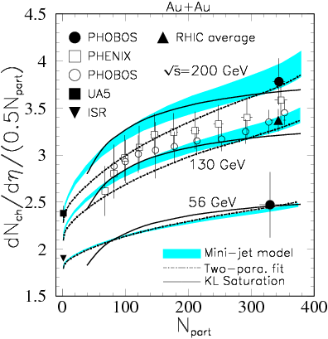
Early Days at RHIC
Particle Production increases per participant pair and
then levels off
Saturation physics
naturally explains via
However, like many things, the obvious was right in front of us…
All nucleon participants are not struck the same (i.e. impact parameter)

Slide 4
PHENIX Scaling Results
Nucleon Scaling
Quark Scaling
Simple geometry of nucleon overlap explains data at all energies
versus

Slide 5
No real evidence for 3 quark cloud configuration!
Anything with an impact parameter dependence
(3,4,5 substructures; Glauber-Gribov; MPI; etc.)

Slide 6
Simple geometry provides compact explanation
In 2019 we should not see any more two-component model results for particle production
Saturation may still play a role, but no strong evidence
Saturation calculations have gluon <p_{T}> ~ 1 – 1.4 GeV/c
Thus caution about comparing gluon v₂ with hadron v₂
_{That really means}
_{just don’t do it.}

Slide 7
Jump forward 10 years …

Slide 8
IP-Glasma
How often is this shown as an indication of
sub-nucleonic quantum fluctuations?

Slide 9
IP-Glasma
1. MC Glauber to obtain nucleon x,y positions in each event
Use IP-Sat (impact parameter saturation model) to calculate the Q_{s}² distribution on an x,y lattice
Just a uniform Gaussian with σ = 0.32 fm at RHIC and slightly
narrower (0.29) at the LHC
3. Simple linear sum Q_{s}² (projectile) and Q_{s}² (target)
4. Then calculate the resulting energy density in the interaction

Slide 10
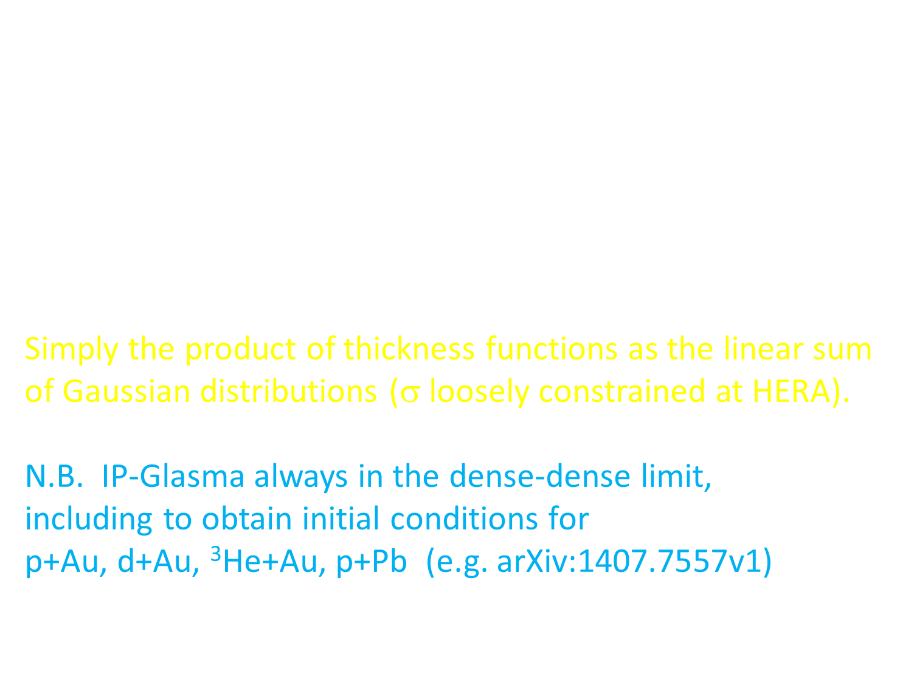
Romatschke & Romatschke (arXiv:1712.05815) found that
IP-Glasma yields:
T_{A}(x,y) = Σ Q_{s}²(x,y) [proj] and T_{B}(x,y) = Σ Q_{s}² (x,y) [targ]
ε $∝$ g² T_{A}(x,y) x T_{B}(x,y) (dense-dense limit)
Simply the product of thickness functions as the linear sum of Gaussian distributions (σ loosely constrained at HERA).
N.B. IP-Glasma always in the dense-dense limit,
including to obtain initial conditions for
p+Au, d+Au, ³He+Au, p+Pb (e.g. arXiv:1407.7557v1)

Slide 11
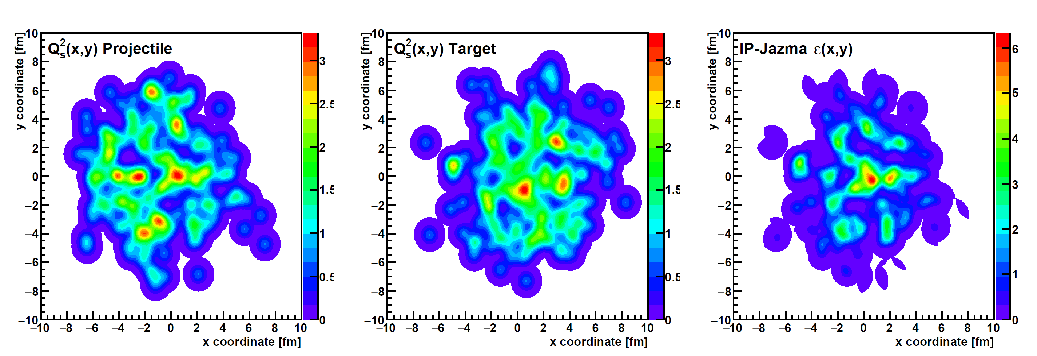
IP-Jazma Framework
https://arxiv.org/abs/1808.01276
https://github.com/jamienagle/IPJazma
T_{A}(x,y) = Σ Q_{s}²(x,y) [proj] T_{B}(x,y) = Σ Q_{s}² (x,y) [targ] ε $∝$ g² T_{A}(x,y) x T_{B}(x,y)

Slide 12
Au+Au @ 200 GeV Geometry
ε₂
ε₃
ε₄
IP-Jazma
IP-Glasma
ε₅
ε₆
Initial geometry totally dominated by simple nucleon overlaps
No evident effect of lattice artifacts or saturation effects

Slide 13
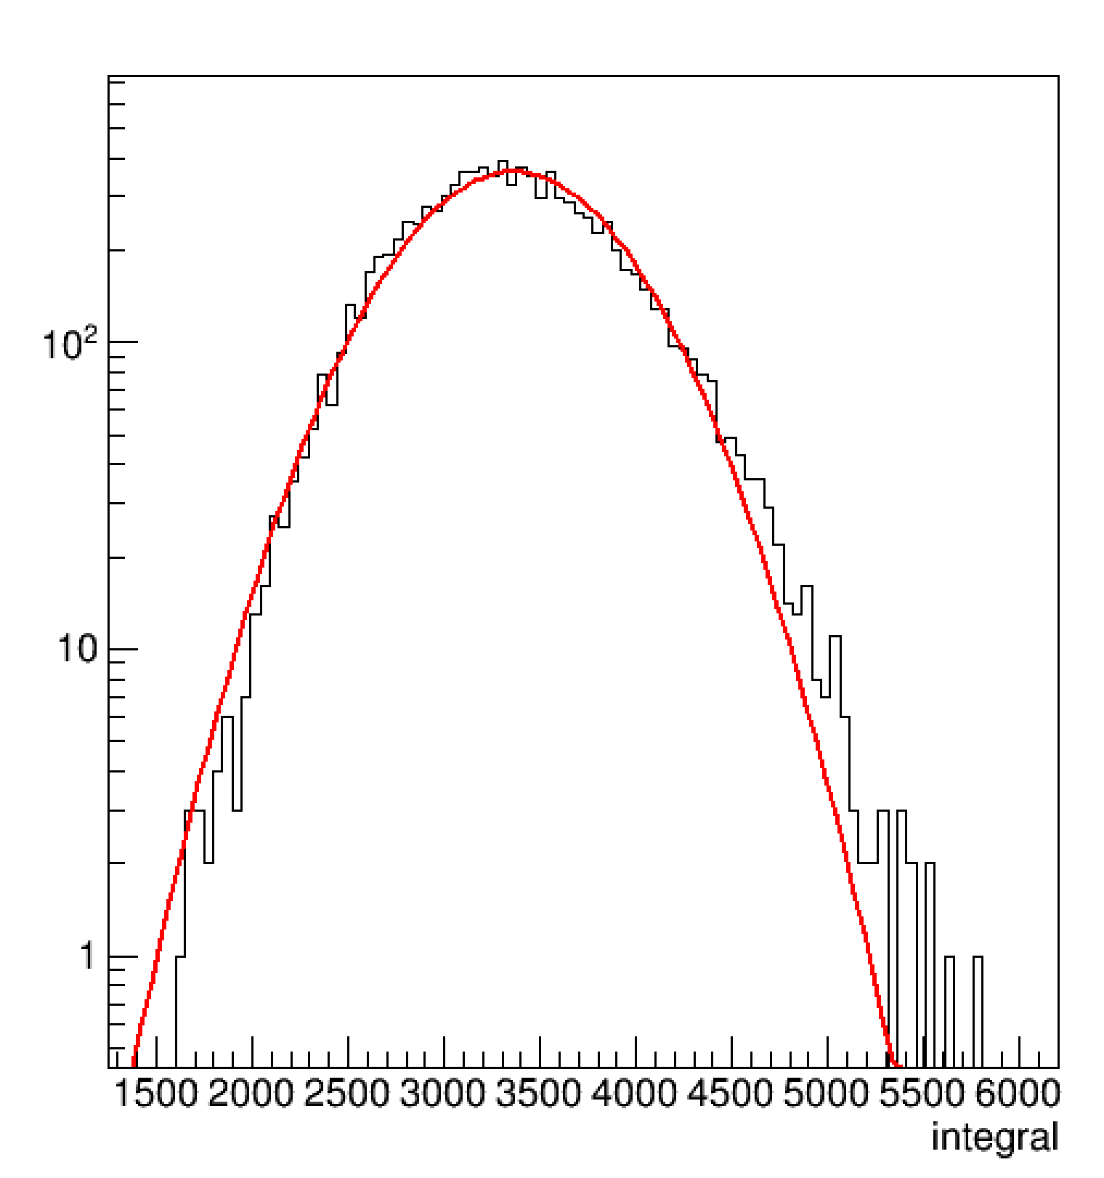
Test All Claims Or → Mistaken Attribution
IP-Glasma
https://arxiv.org/abs/1202.6646v2
IP-Jazma distribution is also
not Gaussian (red line)
and has a high side skew (Γ distribution)
Nothing to do with Glasma flux tubes.
IP-Jazma
dET/dy (a.u.)

Slide 14
Jump forward a few more years …

Slide 15
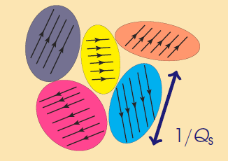
Color Domains
Theory has color domains…
Size scale ~ 0.2-0.4 fm
Gluons scattering from these domains if they have the right color get a kick (anti) aligned with field.
Correlation is suppressed by a factor 1 / ( S_{T} Q_{s}² N_{c}² )
# Domains = S_{T} Q_{s}²
Thus predicting v₂ (dAu) < v₂(pAu) which is opposite to the data

Slide 16
PHENIX Data Published in Nature Physics
Mace et al. [MSTV], https://arxiv.org/abs/1805.09342
Correlation Model Postdictions (MSTV)
Color domain result has very poor p-value.
At the same time, how does it have the right order v₂(dAu) > v₂(pAu)?

Slide 17
Mace et al. [MSTV], https://arxiv.org/abs/1805.09342
Individual domains not resolved up to pT ~ 2.5 GeV!
If 1/Q_{s} [projectile] > 1/k_{T} then individual domains are not resolved
Hence uncertainty principle blurs domain resolution
d+Au results are even higher because “higher color charge density” than in p+Au
Do these explanations make sense?

Slide 18
Uncertainty Principle
Incoming target gluon with k_{T}
uncertainty principle blurs the gluon with radius
r [fm] = hbar/k_{T} = 0.2 / k_{T}[GeV]
If k_{T} = 1 GeV, r = 0.2 fm
Target gluon wave
Projectile (proton) radius ~ 0.9 fm
If Q_{s} = 2 GeV, r_{domain} = 0.1 fm.
Note that this is x5 larger than value at x = 0.01.
Then target gluon sees
(Q_{s}/k_{T})² ~ 4 domains at once,
but still not the size of a deuteron!
Proton
Domains
Size ~ 1/Q_{s}
The “finger physics” numbers seem off by a factor of 5-10

Slide 19
Q_{s} Fluctuations
MSTV includes nucleon-by-nucleon fluctuations in Q_{s,0} ²
(the amplitude of the IP-Sat Gaussian). Thus, each nucleon is still a perfect Gaussian, just different amplitudes.
Implemented with variance 0.5 on log(Q_{s}²) – i.e. high side tail.
Non-perturbative on many scales
Not part of the standard CGC framework
Ad hoc not ab initio

Slide 20

Dilute-Dense Framework
MSTV utilize the dilute-dense framework
(hep-ph/0402256, hep-ph/0402257, arXiv:0711.3039)
The dilute-dense limit implies that Q_{s}(proj) < k_{T} < Q_{s}(targ) and one obtains on average:
N_{gluon} $∝$ g² Q_{s}²(proj) x F( Q_{s}(targ)/ m ) (dilute-dense limit)
where m is the infrared cutoff (= 0.3 GeV in MSTV).
Once you hit a thick enough part of the target,
you free all the projectile gluons and no more.

Slide 21
IP-Jazma Results
At this point, none of these fluctuations are ab initio.
All MC Glauber and “put-in-by-hand” Q_{s,0} ² fluctuations.

Slide 22
IP-Jazma: 5% p+Au has Q_{s,0}² 2.2x larger, 5% d+Au has Q_{s,0}² 1.7x larger
Essentially perfect agreement of d+Au multiplicity with MSTV
Distribution dominated by ad hoc Q_{s,0}² fluctuations;
other color fluctuations not in evidence!

Slide 23
MSTV: larger correlation in d+Au because of
larger color charge density
IP-Jazma: Not true.
Central d+Au collisions do not have a higher gluon density,
but rather a larger overlap area.
Then why do they find v₂(dAu) > v₂ (pAu)?

Slide 24
Bias to closer deuteron configurations
IP-Jazma published result for bias in overlap (rather small)
It would be great to compare with the MSTV result!

Slide 25
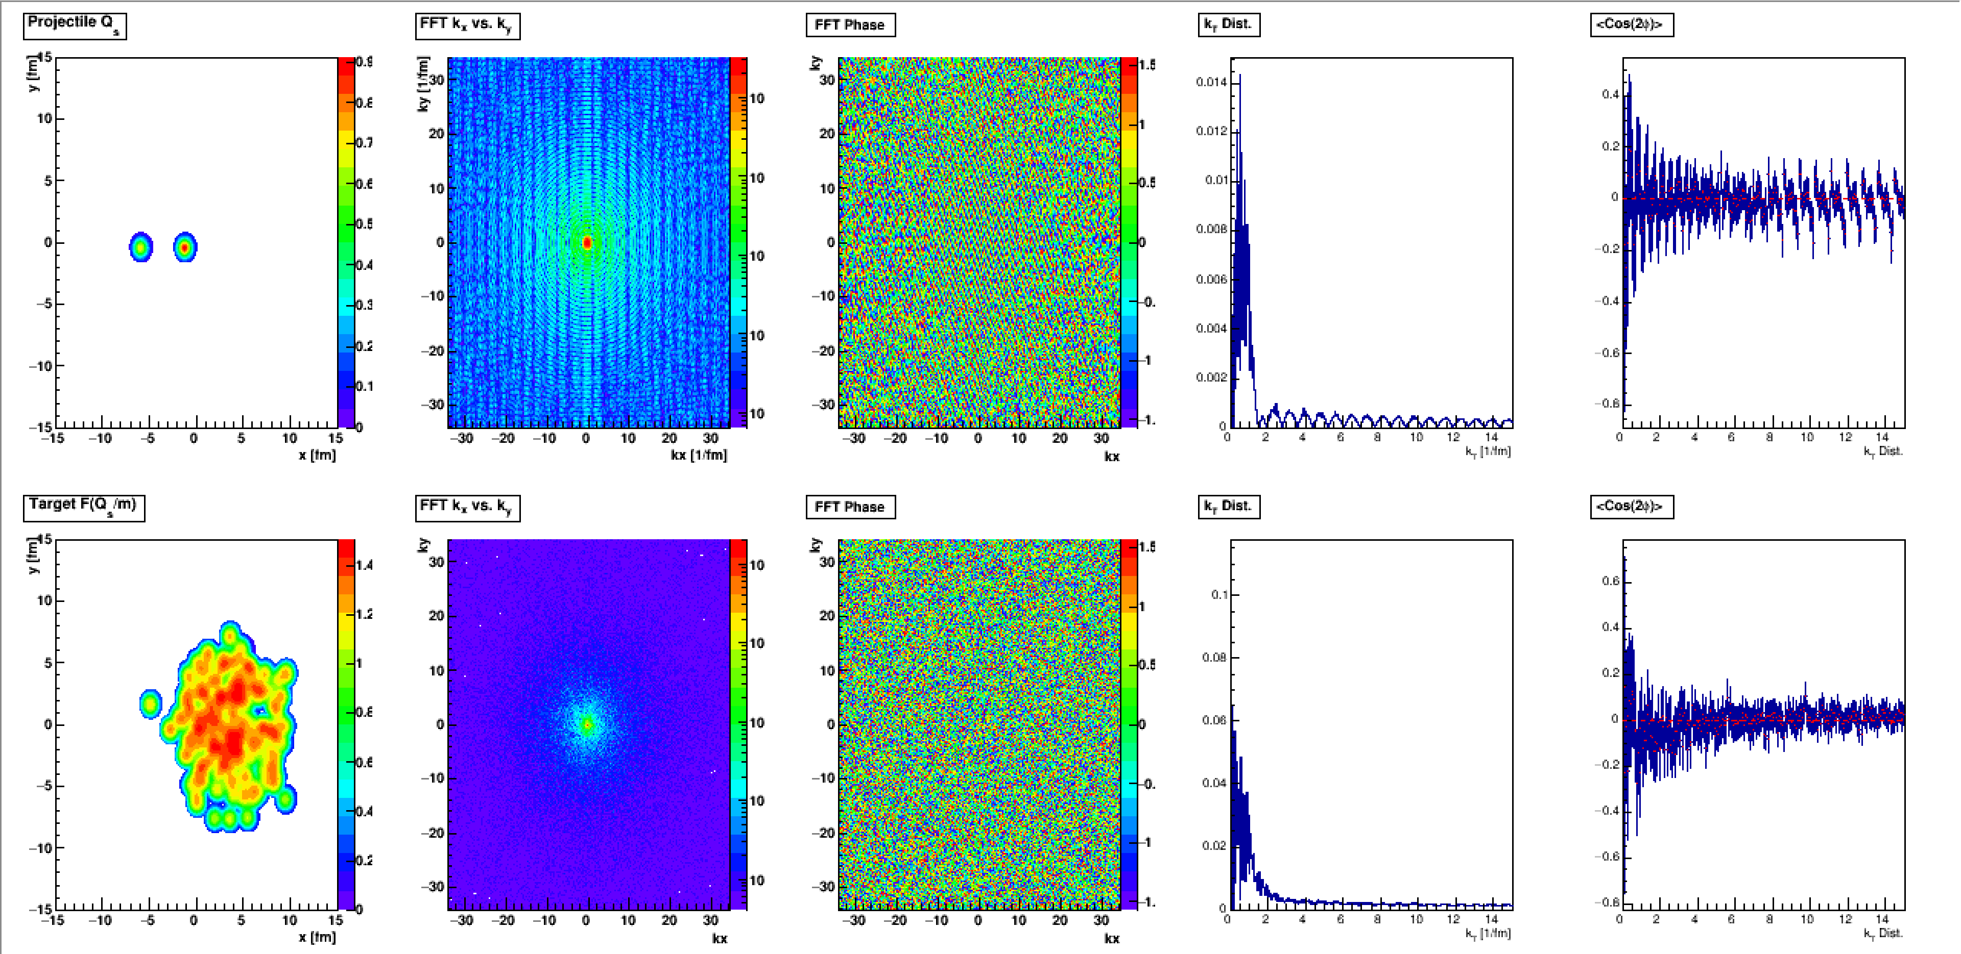
Momentum Space Calculation (FFT)
The k_{T} kicks from the projectile comes from the Fourier Transform.
Maybe it is just geometry after all.
Simple test – calculate v₂ with respect to the deuteron axis.

Slide 26
Concluding Question
One should consider whether there are any
non-trivial features that can be ascribed to saturation physics in heavy ion collisions.
Does this consideration help inform a future program of saturation physics at the
Electron Ion Collider?

Slide 27
Extras

Slide 28
Trento Initial Condition Comment
Trento p=0 yields similar geometry to IP-Glasma
However, there is a difference of the SQRT and thus Gaussian widths cannot be compared directly.
Trento p=0
IP-Jazma
IP-Glasma

Slide 29
Ab initio or non pertinet
Q_{s,0}² (gluon) = 0.67 GeV²
for x = 0.01 at the very center of the proton,
and averaged over
r = 0.67 fm the value would be
Q_{s}² (gluon) = 0.28 GeV²

Slide 30
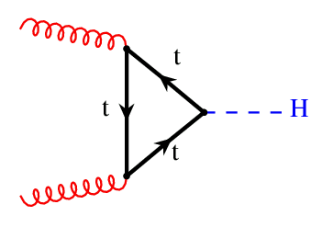
Essential physics
Think of a gluon with k_{T} from the target and its interaction with domains in the projectile…
Proton color domains
Deuteron color domains
Uncertainty principle blurring of gluon allows it to interact with multiple domains.

Slide 31
Explored by McLerran (arXiv:1508.03292v2) to explain high multiplicity tail of LHC p+p N_{ch} distributions.
Q_{s,0}² fluctuates to 5-6 times average value to
explain the high N_{ch} tail.

Slide 32
MSTV scaling of N_{ch} with Q_{s}²(proj) leads them to predict “that v_{2,3}(p_{T}) for high multiplicity events across
small systems should be identical for the same N_{ch}.”
Hydrodynamics matches
the splitting
Turns out this prediction is actually yet another postdiction
Existing PHENIX measurement already rules this out!

Slide 33
Proton-Neutron Separation
Deuteron is a
loosely bound system
d+Au
Sometimes the neutron
misses
http://journals.aps.org/prc/abstract/10.1103/PhysRevC.90.034902

Slide 34
Romatschke & Romatschke (https://arxiv.org/abs/1712.05815)
At RHIC energies, resulting Gaussian in Q_{s}² has σ = 0.32 fm. Note that this corresponds to a Gaussian in Q_{s} with σ = 0.45 fm.
Of course this depends on your choice of B_{G}, translating into R in the equation below.
In dense-dense limit, just sum Q_{s}² values for each nucleus.
Then energy density proportional to T_{A1A2} scaling

