Slide 1

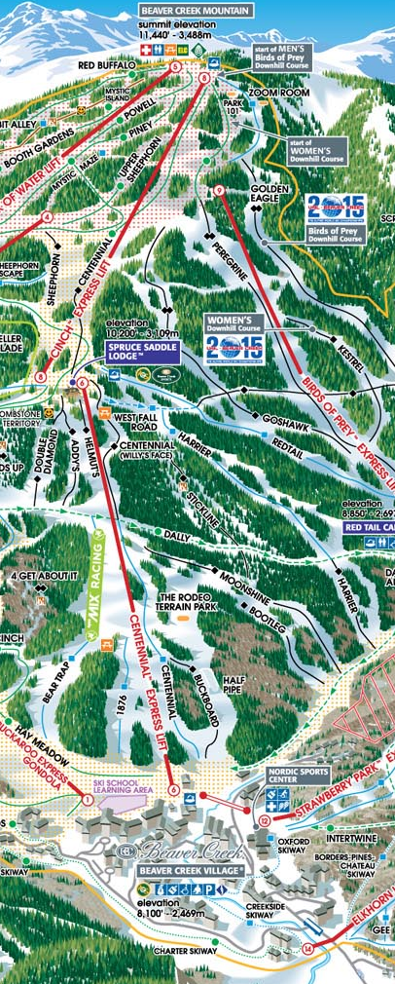


New Results from exact solutions of relativistic hydrodynamics
Máté Csanád (Eötvös U) @ WWNd 2019, Beaver Creek, Colorado
+T. Csörgő, G. Kasza, Z. Jiang, B. Boldizsár, B. Kurgyis, M. Nagy

Slide 2
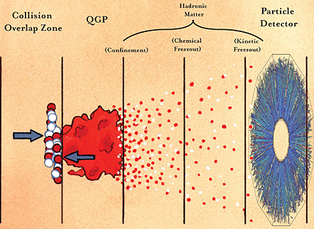
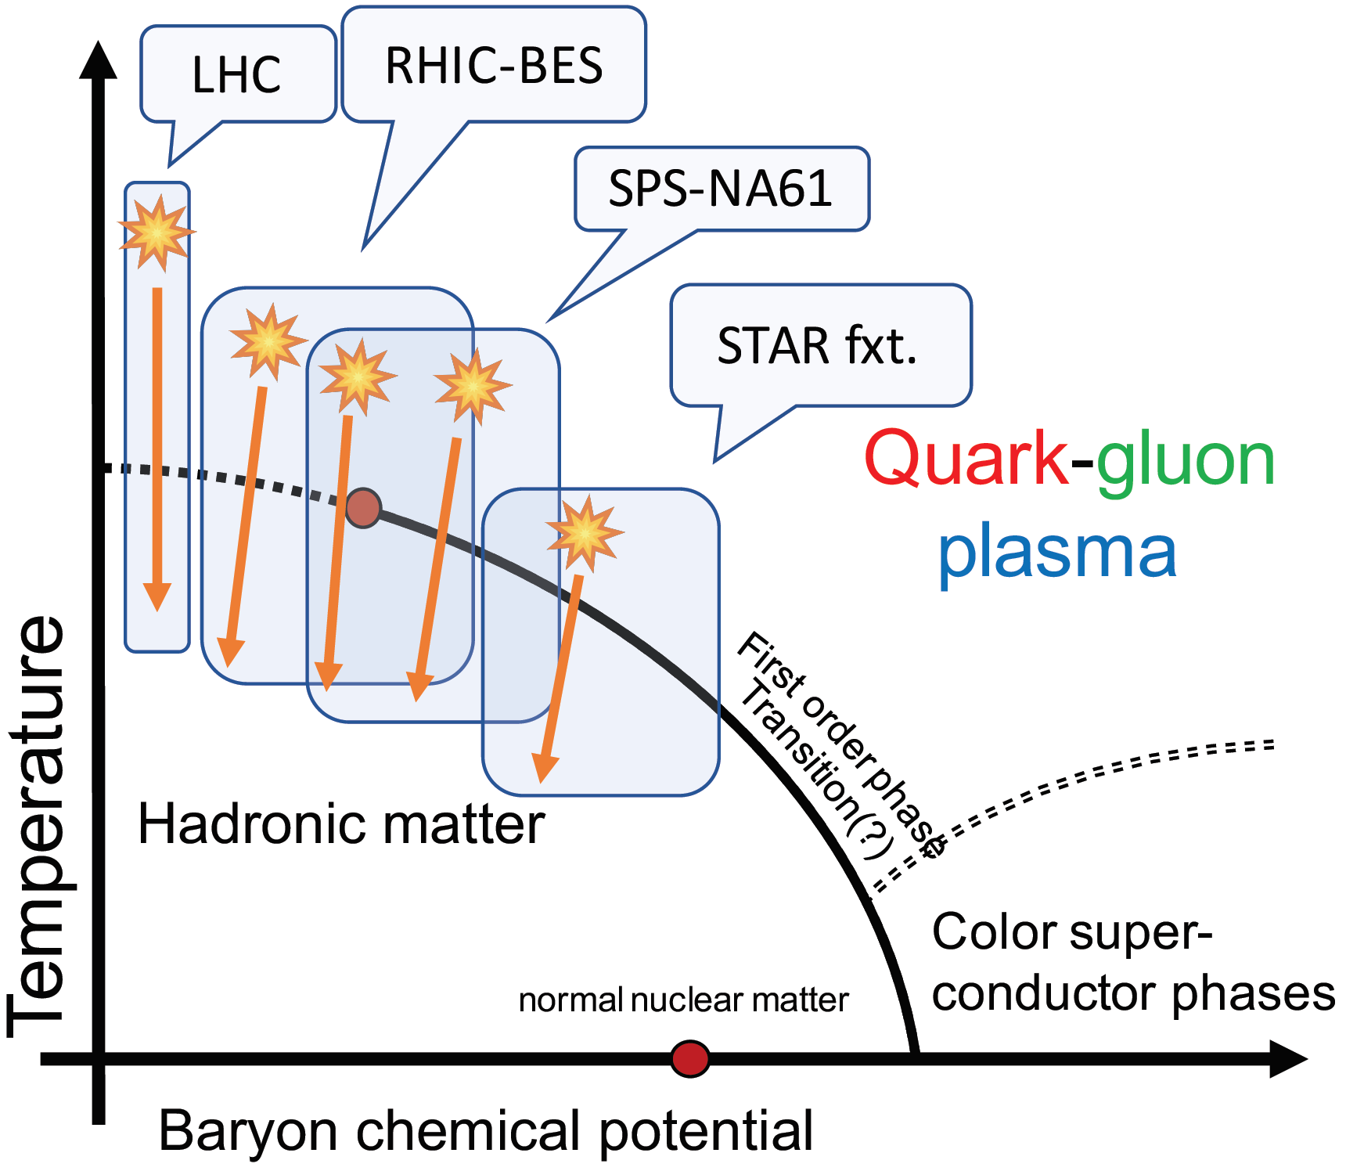
Phases of Quark Matter
An evolution throughout many phases
Modeling possible with hydrodynamics
ENERGY DENSITY NEW SOLUTIONS VISCOSITY PERTURBATIONS VORTICITY

Slide 3
Exact hydro solutions: History & basics
Relativistic hydrodynamics: established by Landau (for p+p!)
Exact, analytic solutions important: connect initial and final state, help in analytic understanding
Famous solutions by Landau&Khalatnikov and Hwa&Bjorken
  L. D. Landau, Izv. Akad. Nauk Ser. Fiz. 17, 51 (1953)
  I.M. Khalatnikov, Zhur. Eksp. Teor. Fiz. 27, 529 (1954)
  R. C. Hwa, Phys. Rev. D 10, 2260 (1974)
  J. D. Bjorken, Phys. Rev. D 27, 140 (1983)
Discovery of sQGP: many new solutions
  See e.g. the review of de Souza, Koide, Kodama, Prog. Part. Nucl. Phys. 86, 35 (2016)
Even simple analytic solutions capture many features of data
  MCs, Vargyas, Eur. Phys. J. A 44, 473 (2010)
  MCs, Szabo, Phys. Rev. C 90, 054911 (2014)
Still lacking: non-spherical 3D, accelerating, realistic and relativistic solutions
Linearized hydro: perturbations
  Shi, Liao and Zhuang, Phys.Rev. C90 (2014) no.6, 064912
  Kurgyis, MCs, Universe 3 (2017) no.4, 84
ENERGY DENSITY NEW SOLUTIONS VISCOSITY PERTURBATIONS VORTICITY

Slide 4
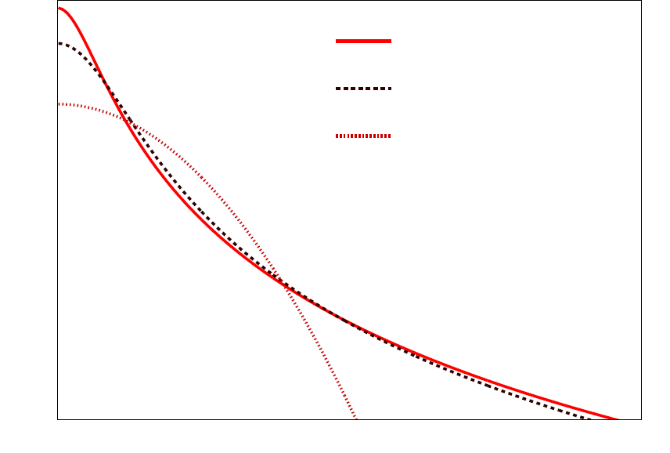
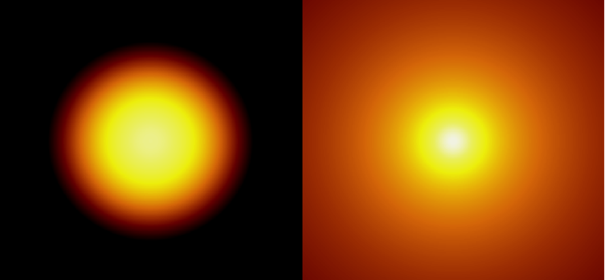
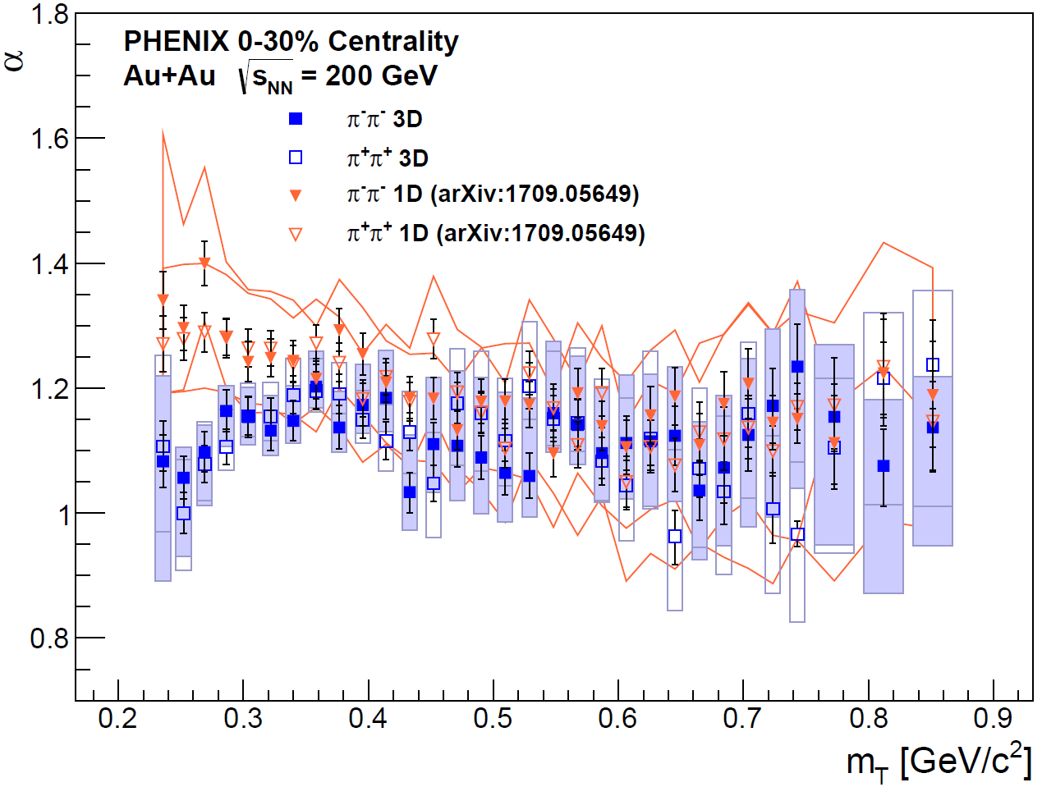

Sidenote: one of the new challenges
Cauchy
Lévy (α=1.2)
Gauss
Many (SPS, RHIC, LHC) observing Lévy sources:
$ℒ\left(α,R;r\right)=\frac{1}{{\left(2π\right)}^{3}}\int{d^{3}qe^{iqr}e^{−\frac{1}{2}{\left|qR\right|}^{α}}}$
Shape parameter: Gauss if $α=2$, power-law tail if $α<2$
How to reconcile with hydro?
  Exponential cutoff $\exp\left(−p^{μ}u_{μ}/T\right)$ in Boltzmann-Jüttner?
  Rescattering? Fluctuations?
Log source density
power-law tail
Gauss (α=2.0)
Lévy (α=1.2)
Distance
PHENIX, PRC97
+prelim@ WPFC2018
ENERGY DENSITY NEW SOLUTIONS VISCOSITY PERTURBATIONS VORTICITY

Slide 5
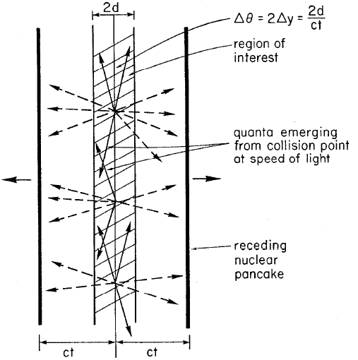


The Bjorken-estimate
The original idea: energy density based on dE/dy
QGP critical $ε_{c} \sim 1$ GeV/fm³ (from $εc=(6−8)T_{c}^{4}$)
Result (~2000x cited)
Boost invariant flow
Phys.Rev. D27 (1983)
Needs correction!
$$E=N\frac{dE}{dy}Δy=N\frac{dE}{dy}\frac{1}{2}\frac{2d}{t}=εAd$$
$$ε_{Bj}=\frac{1}{R^{2}πτ_{0}}\frac{dE}{dη}=\frac{\left\langle E\right\rangle }{R^{2}πτ_{0}}\frac{dN}{dη}$$
ENERGY DENSITY NEW SOLUTIONS VISCOSITY PERTURBATIONS VORTICITY

Slide 6
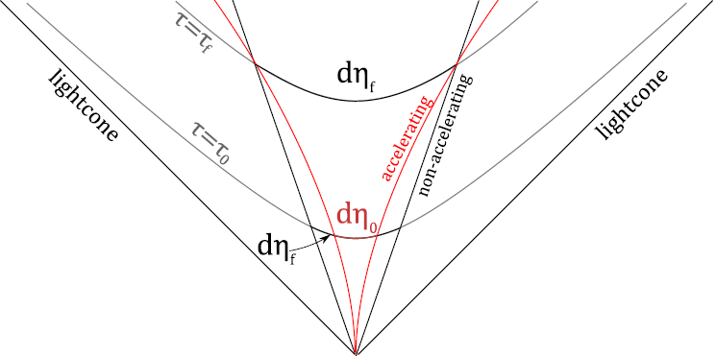
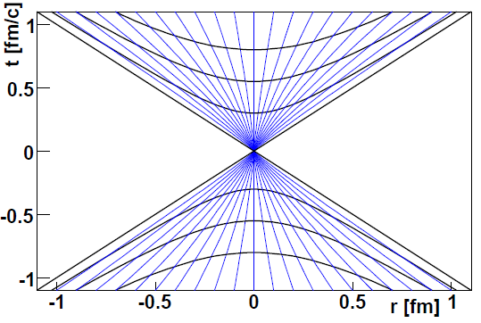

An Advanced Energy density estimate
Fact: $dN/dy$ not flat
Finiteness & acceleration
Corrections needed:
  $yη$ & $ηfinal ηinitial$
  Work done by pressure
Described by CNC solution with acceleration parameter λ
Csörgő, Nagy, MCs, Phys.Lett. B663 (2008) 306-311
Nagy, Csörgő, MCs, Phys.Rev. C77 (2008) 024908
Corrected estimate for EoS of $κ=1$
$ε=ε_{Bj}\left(2λ−1\right){\left(\frac{τ_{f}}{τ_{i}}\right)}^{λ−1}$, $τ=λτ_{Bj}=λ\sqrt{\frac{m_{T}}{T_{f}}}R_{long}$
Björken estimate: only for $κ=∞$ (dust EoS)
Will come back to this soon
ENERGY DENSITY NEW SOLUTIONS VISCOSITY PERTURBATIONS VORTICITY

Slide 7
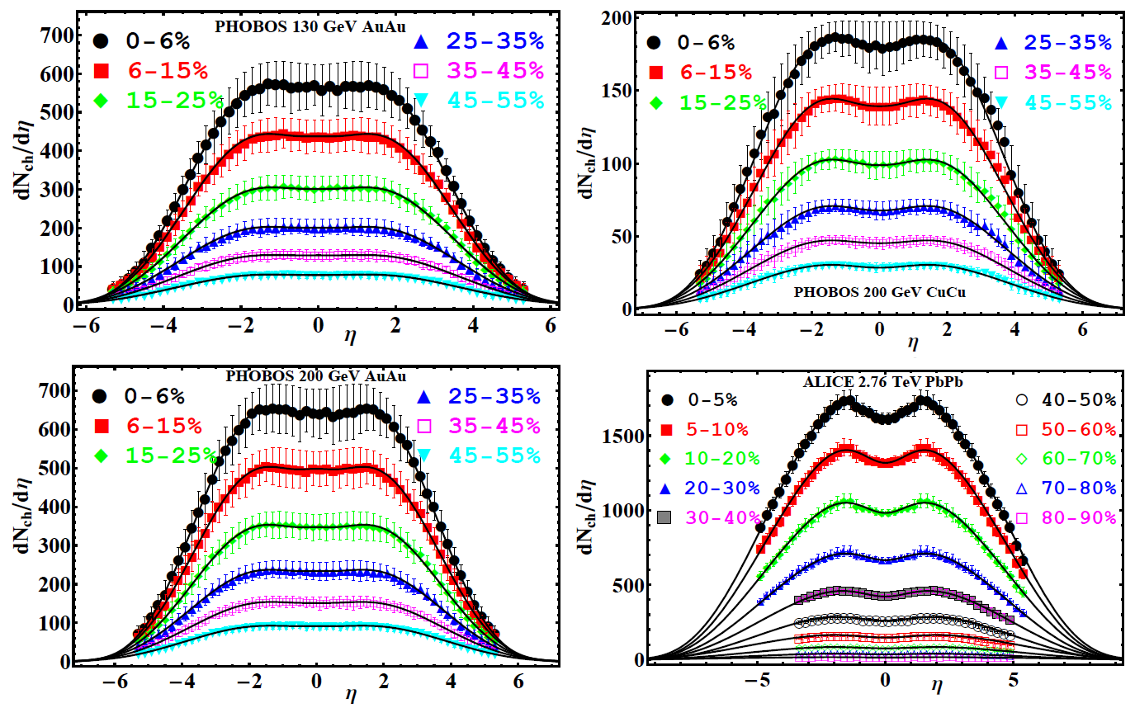
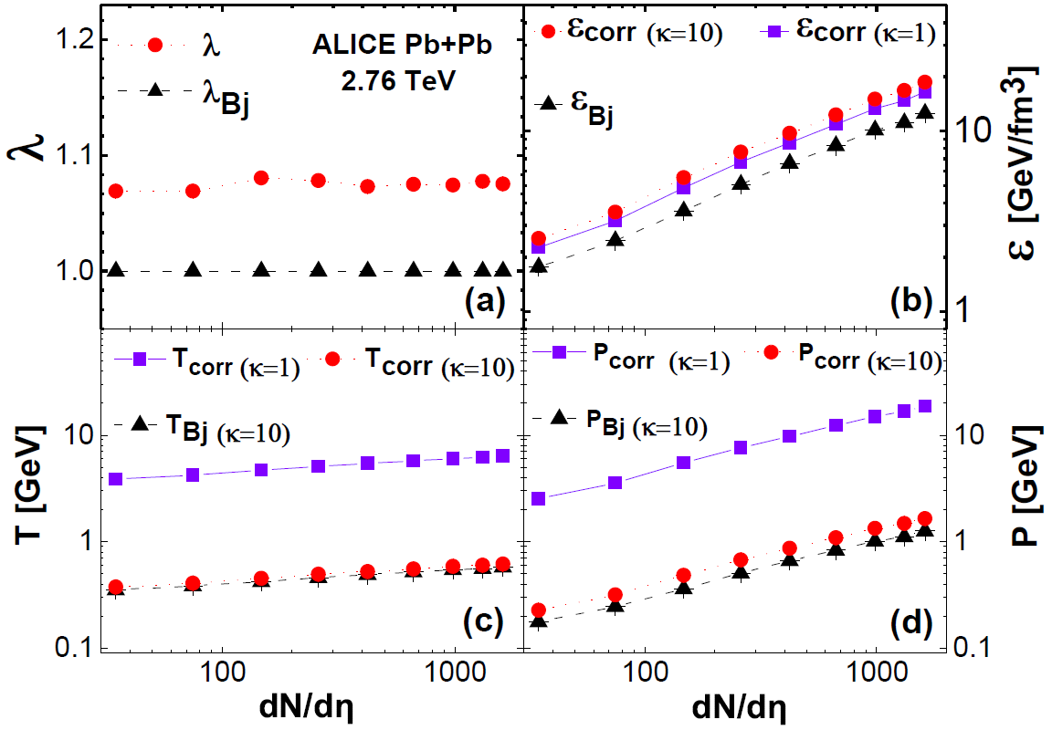
Energy densities in AA, RHIC to LHC
Results well described from RHIC to LHC
Effect of acceleration and conjectured effect of Equation of State studied
Jiang, Yang, MCs, Csörgő, Phys. Rev. C 97, 064906, 2018
Effect of EoS: important to understand analytically! Will come back to that in a few slides…
What about p+p?
ENERGY DENSITY NEW SOLUTIONS VISCOSITY PERTURBATIONS VORTICITY

Slide 8
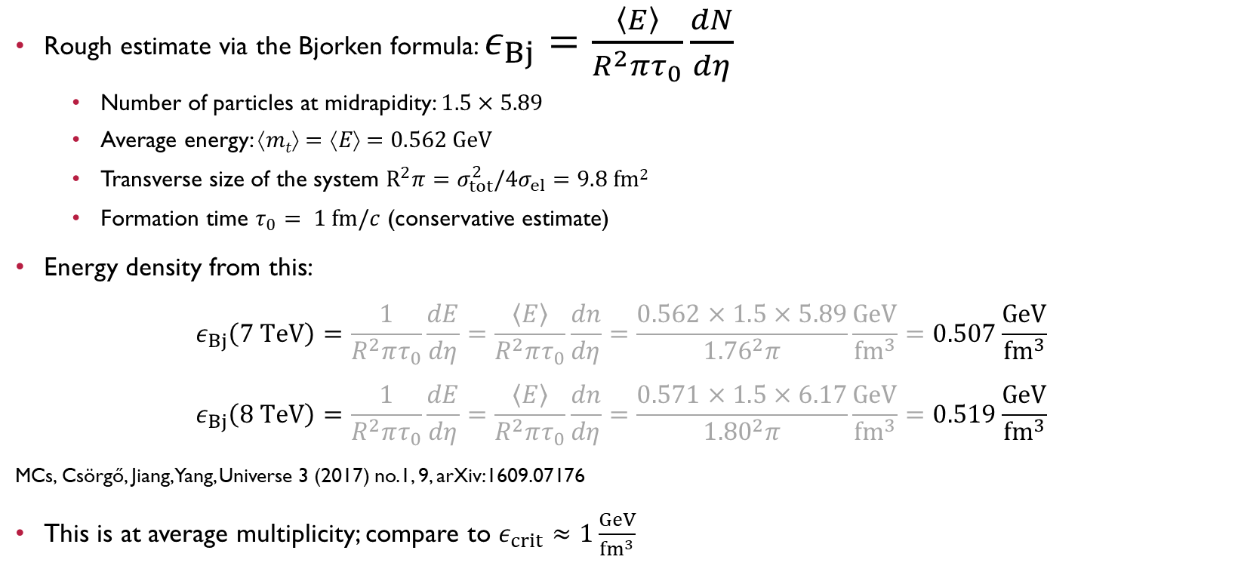
Bjorken energy density estimate in pp
Rough estimate via the Bjorken formula: $ε_{Bj}=\frac{\left\langle E\right\rangle }{R^{2}πτ_{0}}\frac{dN}{dη}$
  Number of particles at midrapidity: $1.5×5.89$
  Average energy: $↑mt=↑E=0.562 GeV$
  Transverse size of the system $R^{2}π=σ_{tot}^{2}/4σ_{el}=9.8 fm2$
  Formation time $τ_{0}= 1 fm/c$ (conservative estimate)
Energy density from this:
$$ε_{Bj}\left(7 TeV\right)=\frac{1}{R^{2}πτ_{0}}\frac{dE}{dη}=\frac{\left\langle E\right\rangle }{R^{2}πτ_{0}}\frac{dn}{dη}=\frac{0.562×1.5×5.89}{{1.76}^{2}π}\frac{GeV}{fm^{3}}=0.507\frac{GeV}{fm^{3}}$$
$$ε_{Bj}\left(8 TeV\right)=\frac{1}{R^{2}πτ_{0}}\frac{dE}{dη}=\frac{\left\langle E\right\rangle }{R^{2}πτ_{0}}\frac{dn}{dη}=\frac{0.571×1.5×6.17}{{1.80}^{2}π}\frac{GeV}{fm^{3}}=0.519\frac{GeV}{fm^{3}}$$
MCs, Csörgő, Jiang, Yang, Universe 3 (2017) no.1, 9, arXiv:1609.07176
This is at average multiplicity; compare to $ε_{crit}≈1\frac{GeV}{{fm}^{3}}$
ENERGY DENSITY NEW SOLUTIONS VISCOSITY PERTURBATIONS VORTICITY

Slide 9
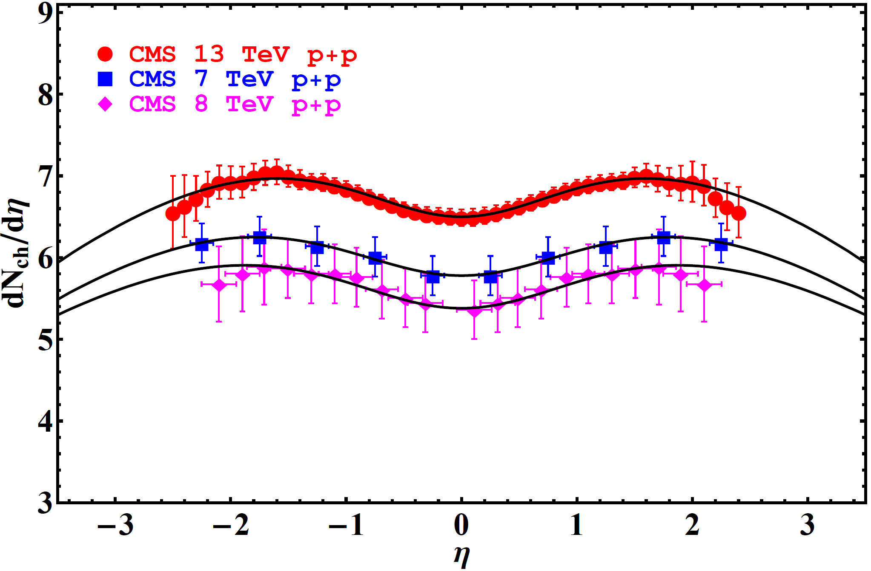
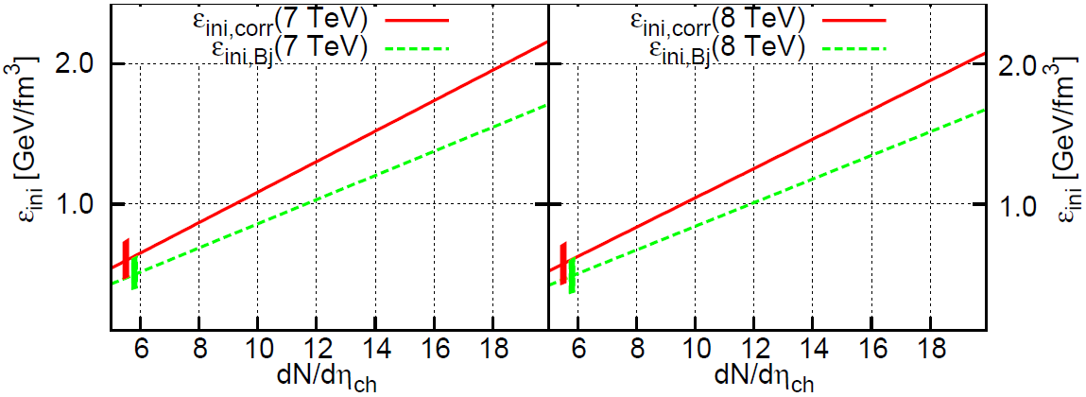

energy density in p+p
Data from p+p well described
  7 TeV: $λ=1.073$, $ε_{corr}=0.645\frac{GeV}{{fm}^{3}}$
  8 TeV: $λ=1.067$, $ε_{corr}=0.641\frac{GeV}{{fm}^{3}}$
  13 TeV: $λ=1.065$, $ε_{corr}=0.692\frac{GeV}{{fm}^{3}}$
Multiplicity dependence:
Energy density above 1 GeV/fm³ for multiplicities above ~10! EoS dependence?
MCs, Csörgő, Jiang, Yang, Universe 3 (2017) no.1, 9, arXiv:1609.07176 + Jiang, MCs, Kasza, Yang, Csörgő, Acta Phys. Pol. B Proc. Supp (WPCF 2018)
ENERGY DENSITY NEW SOLUTIONS VISCOSITY PERTURBATIONS VORTICITY

Slide 10
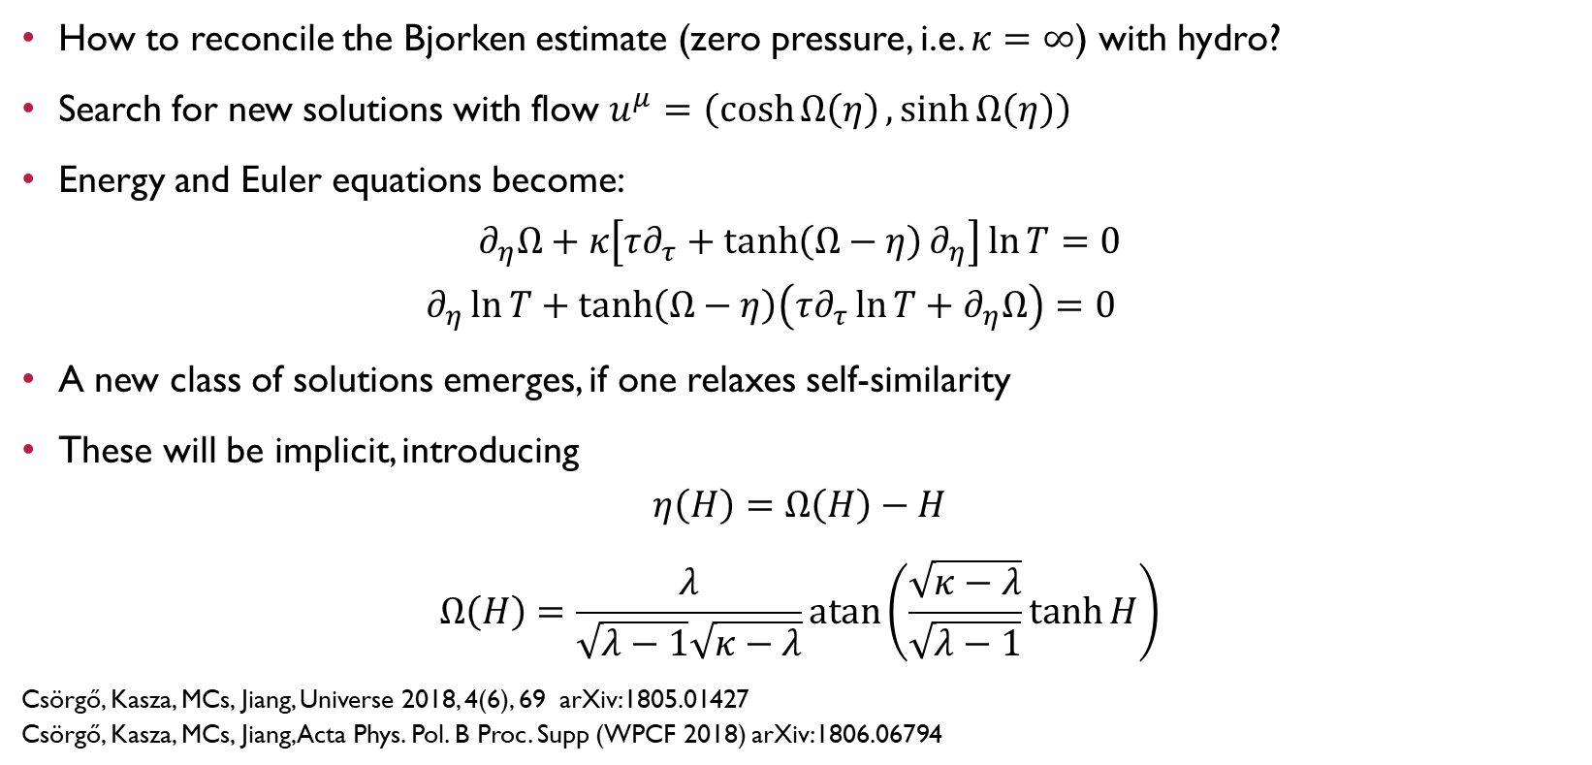
A new class of exact solutions
How to reconcile the Bjorken estimate (zero pressure, i.e. $κ=∞$) with hydro?
Search for new solutions with flow $u^{μ}=\left(\cosh{Ω\left(η\right)},\sinh{Ω\left(η\right)}\right)$
Energy and Euler equations become:
$$∂_{η}Ω+κ\left[τ∂_{τ}+\tanh\left(Ω−η\right)∂_{η}\right]\ln{T}=0$$
$$∂_{η}\ln{T}+\tanh\left(Ω−η\right)\left(τ∂_{τ}\ln{T}+∂_{η}Ω\right)=0$$
A new class of solutions emerges, if one relaxes self-similarity
These will be implicit, introducing
$$η\left(H\right)=Ω\left(H\right)−H$$
$$Ω\left(H\right)=\frac{λ}{\sqrt{λ−1}\sqrt{κ−λ}}\operatorname{atan}\left(\frac{\sqrt{κ−λ}}{\sqrt{λ−1}}\tanh{H}\right)$$
Csörgő, Kasza, MCs, Jiang, Universe 2018, 4(6), 69 arXiv:1805.01427
Csörgő, Kasza, MCs, Jiang, Acta Phys. Pol. B Proc. Supp (WPCF 2018) arXiv:1806.06794
ENERGY DENSITY NEW SOLUTIONS VISCOSITY PERTURBATIONS VORTICITY

Slide 11
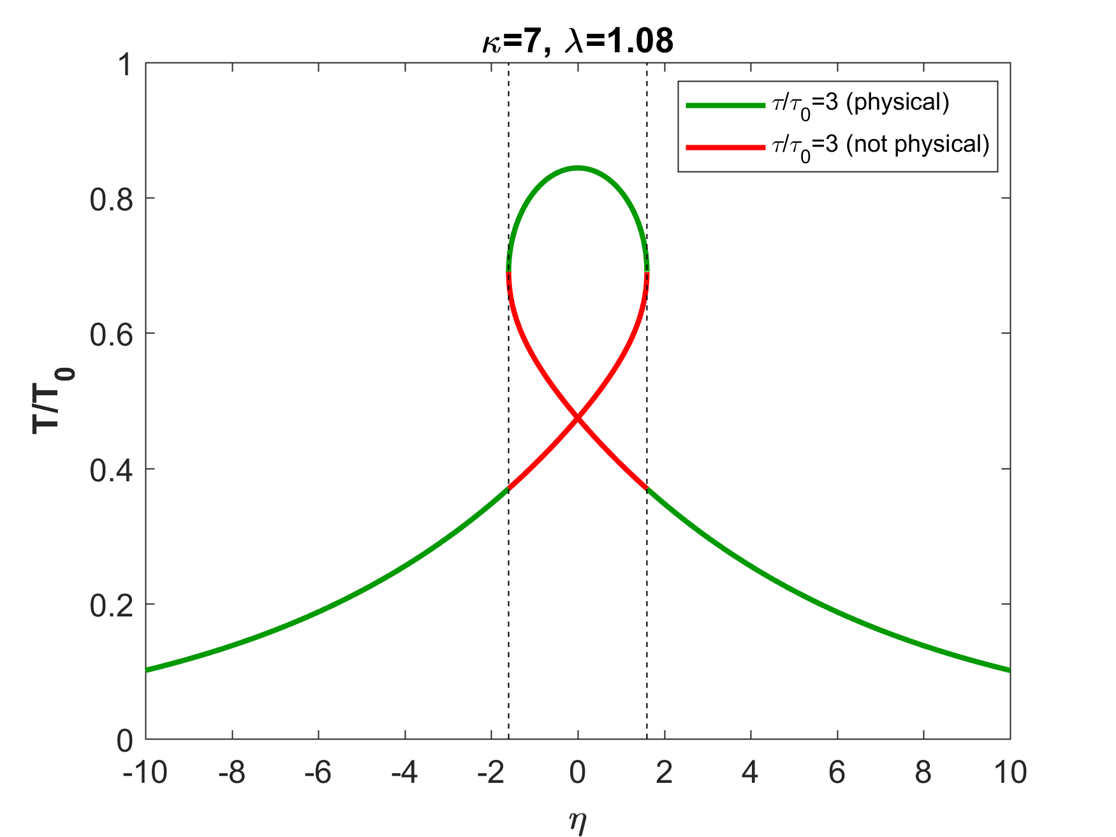
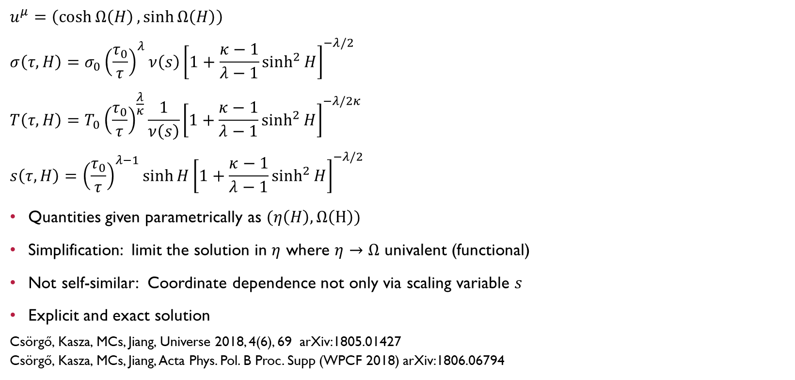
The new class of solutions
$$u^{μ}=\left(\cosh{Ω\left(H\right)},\sinh{Ω\left(H\right)}\right)$$
$$σ\left(τ,H\right)=σ_{0}{\left(\frac{τ_{0}}{τ}\right)}^{λ}ν\left(s\right){\left[1+\frac{κ−1}{λ−1}\sinh^{2}{H}\right]}^{−λ/2}$$
$$T\left(τ,H\right)=T_{0}{\left(\frac{τ_{0}}{τ}\right)}^{\frac{λ}{κ}}\frac{1}{ν\left(s\right)}{\left[1+\frac{κ−1}{λ−1}\sinh^{2}{H}\right]}^{−λ/2κ}$$
$$s\left(τ,H\right)={\left(\frac{τ_{0}}{τ}\right)}^{λ−1}\sinh{H}{\left[1+\frac{κ−1}{λ−1}\sinh^{2}{H}\right]}^{−λ/2}$$
Quantities given parametrically as $(η\left(H\right),Ω\left(H\right))$
Simplification: limit the solution in $η$ where $η→Ω$ univalent (functional)
Not self-similar: Coordinate dependence not only via scaling variable $s$
Explicit and exact solution
Csörgő, Kasza, MCs, Jiang, Universe 2018, 4(6), 69 arXiv:1805.01427
Csörgő, Kasza, MCs, Jiang, Acta Phys. Pol. B Proc. Supp (WPCF 2018) arXiv:1806.06794
ENERGY DENSITY NEW SOLUTIONS VISCOSITY PERTURBATIONS VORTICITY

Slide 12
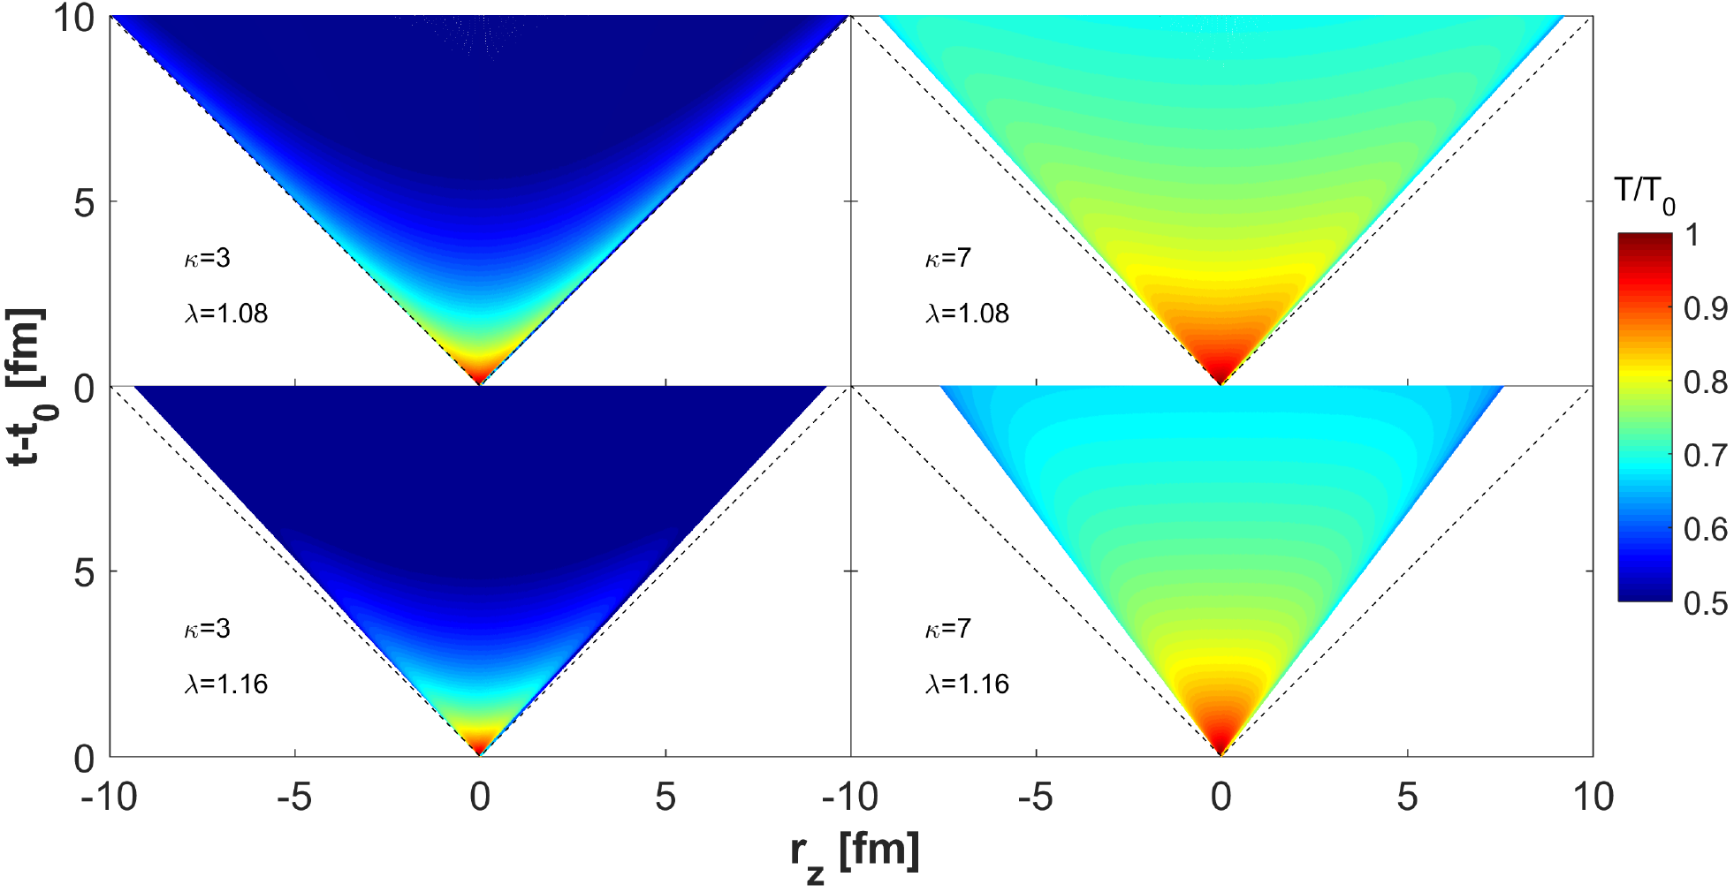

Temperature evolution
Recall: limited domain in $η$, where $(η\left(H\right),Ω\left(H\right))$ relation functional (shock-waves on boundary)
Strong dependence on EoS, analytic understanding of time evolution
Csörgő, Kasza, MCs, Jiang, Universe 2018, 4(6), 69 arXiv:1805.01427
Csörgő, Kasza, MCs, Jiang, Acta Phys. Pol. B Proc. Supp (WPCF 2018) arXiv:1806.06794
ENERGY DENSITY NEW SOLUTIONS VISCOSITY PERTURBATIONS VORTICITY

Slide 13
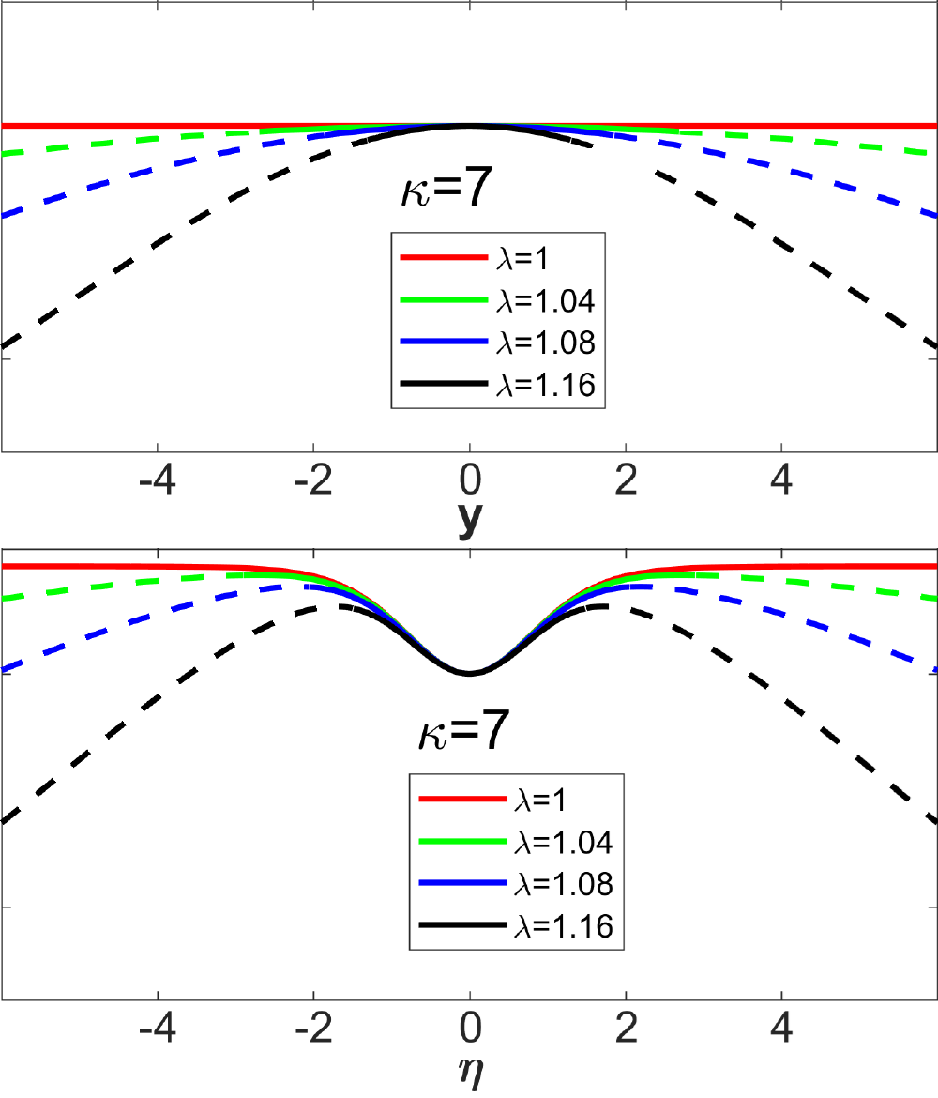



observables
Rapidity density calculable in saddle-point approximation
$$\frac{dN}{dy}≅N_{0}\cosh^{−\frac{α(κ)}{2}−1}\left(\frac{y}{α(1)}\right)\exp\left[−\frac{m}{T_{f}}\left(\cosh^{α\left(κ\right)}{\frac{y}{α\left(1\right)}}−1\right)\right]$$
where $α\left(κ\right)=\frac{2λ−κ}{λ−κ}$ was introduced
Normalization:
$$N_{0}=\frac{R^{2}πτ_{f}}{{\left(2πℏ\right)}^{3}}\sqrt{\frac{{\left(2πT_{f}m\right)}^{3}}{λ(2λ−1)}}\exp\left(−\frac{m}{T_{f}}\right)$$
Pseudorapidity density as
parametric $η\left(y\right)→\frac{dN}{dη}\left(y\right)$curve
Using Jacobian: $\frac{dy}{dη}=\frac{\left\langle p_{t}\left(y\right)\right\rangle \cosh{η\left(y\right)}}{\sqrt{m^{2}+{\left\langle p_{t}\left(y\right)\right\rangle }^{2}\cosh^{2}{η\left(y\right)}}}$
and $\left\langle p_{t}\left(y\right)\right\rangle =\frac{\sqrt{T_{f}^{2}+2mT_{f}}}{1+\frac{α\left(κ\right)}{2α\left(1\right)} \frac{T_{f}+m}{T_{f}+2m}y^{2}}$
$$\frac{dN}{dy}$$
$$\frac{dN}{dη}$$
Csörgő, Kasza, MCs, Jiang, Universe 2018, 4(6), 69 arXiv:1805.01427
Csörgő, Kasza, MCs, Jiang, Acta Phys. Pol. B Proc. Supp (WPCF 2018) arXiv:1806.06794
ENERGY DENSITY NEW SOLUTIONS VISCOSITY PERTURBATIONS VORTICITY

Slide 14
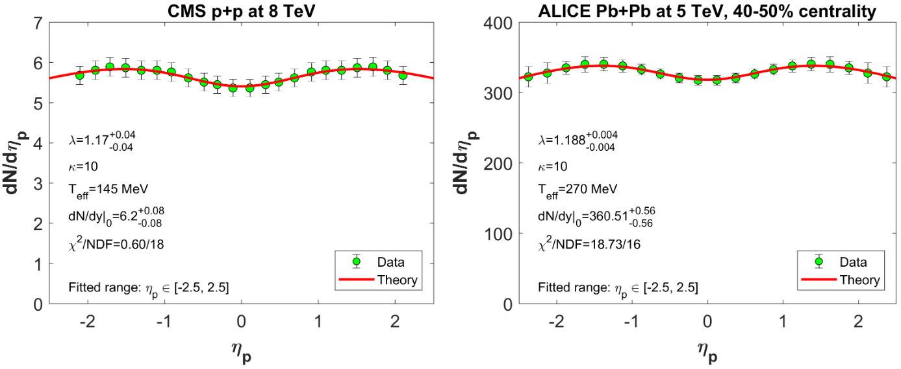

Comparison to Data
Description valid in limited $η$ interval only
Result very close to CNC solution
Csörgő, Kasza, MCs, Jiang, Universe 2018, 4(6), 69 arXiv:1805.01427, Csörgő, Kasza, MCs, Jiang, Acta Phys. Pol. B Proc. Supp (WPCF 2018) arXiv:1806.06794
ENERGY DENSITY NEW SOLUTIONS VISCOSITY PERTURBATIONS VORTICITY

Slide 15
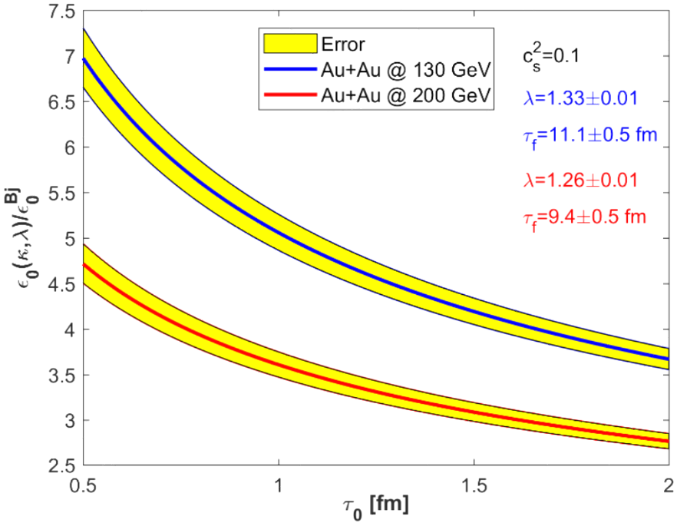
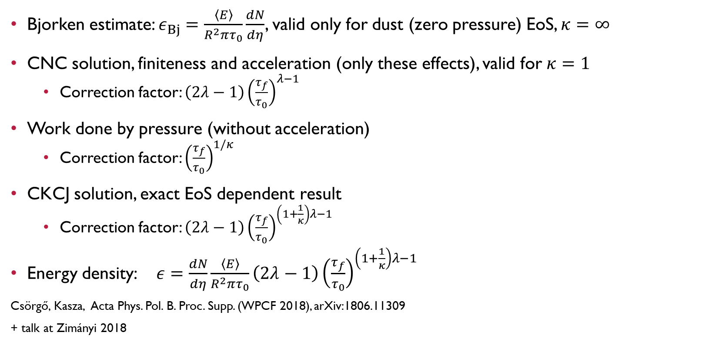
What about the energy density?
Bjorken estimate: $ε_{Bj}=\frac{\left\langle E\right\rangle }{R^{2}πτ_{0}}\frac{dN}{dη}$, valid only for dust (zero pressure) EoS, $κ=∞$
CNC solution, finiteness and acceleration (only these effects), valid for $κ=1$
  Correction factor: $\left(2λ−1\right){\left(\frac{τ_{f}}{τ_{0}}\right)}^{λ−1}$
Work done by pressure (without acceleration)
  Correction factor: ${\left(\frac{τ_{f}}{τ_{0}}\right)}^{1/κ}$
CKCJ solution, exact EoS dependent result
  Correction factor: $\left(2λ−1\right){\left(\frac{τ_{f}}{τ_{0}}\right)}^{\left(1+\frac{1}{κ}\right)λ−1}$
Energy density: $ε=\frac{dN}{dη}\frac{\left\langle E\right\rangle }{R^{2}πτ_{0}}\left(2λ−1\right){\left(\frac{τ_{f}}{τ_{0}}\right)}^{\left(1+\frac{1}{κ}\right)λ−1}$
Csörgő, Kasza, Acta Phys. Pol. B. Proc. Supp. (WPCF 2018), arXiv:1806.11309
+ talk at Zimányi 2018
Correction factor
ENERGY DENSITY NEW SOLUTIONS VISCOSITY PERTURBATIONS VORTICITY

Slide 16
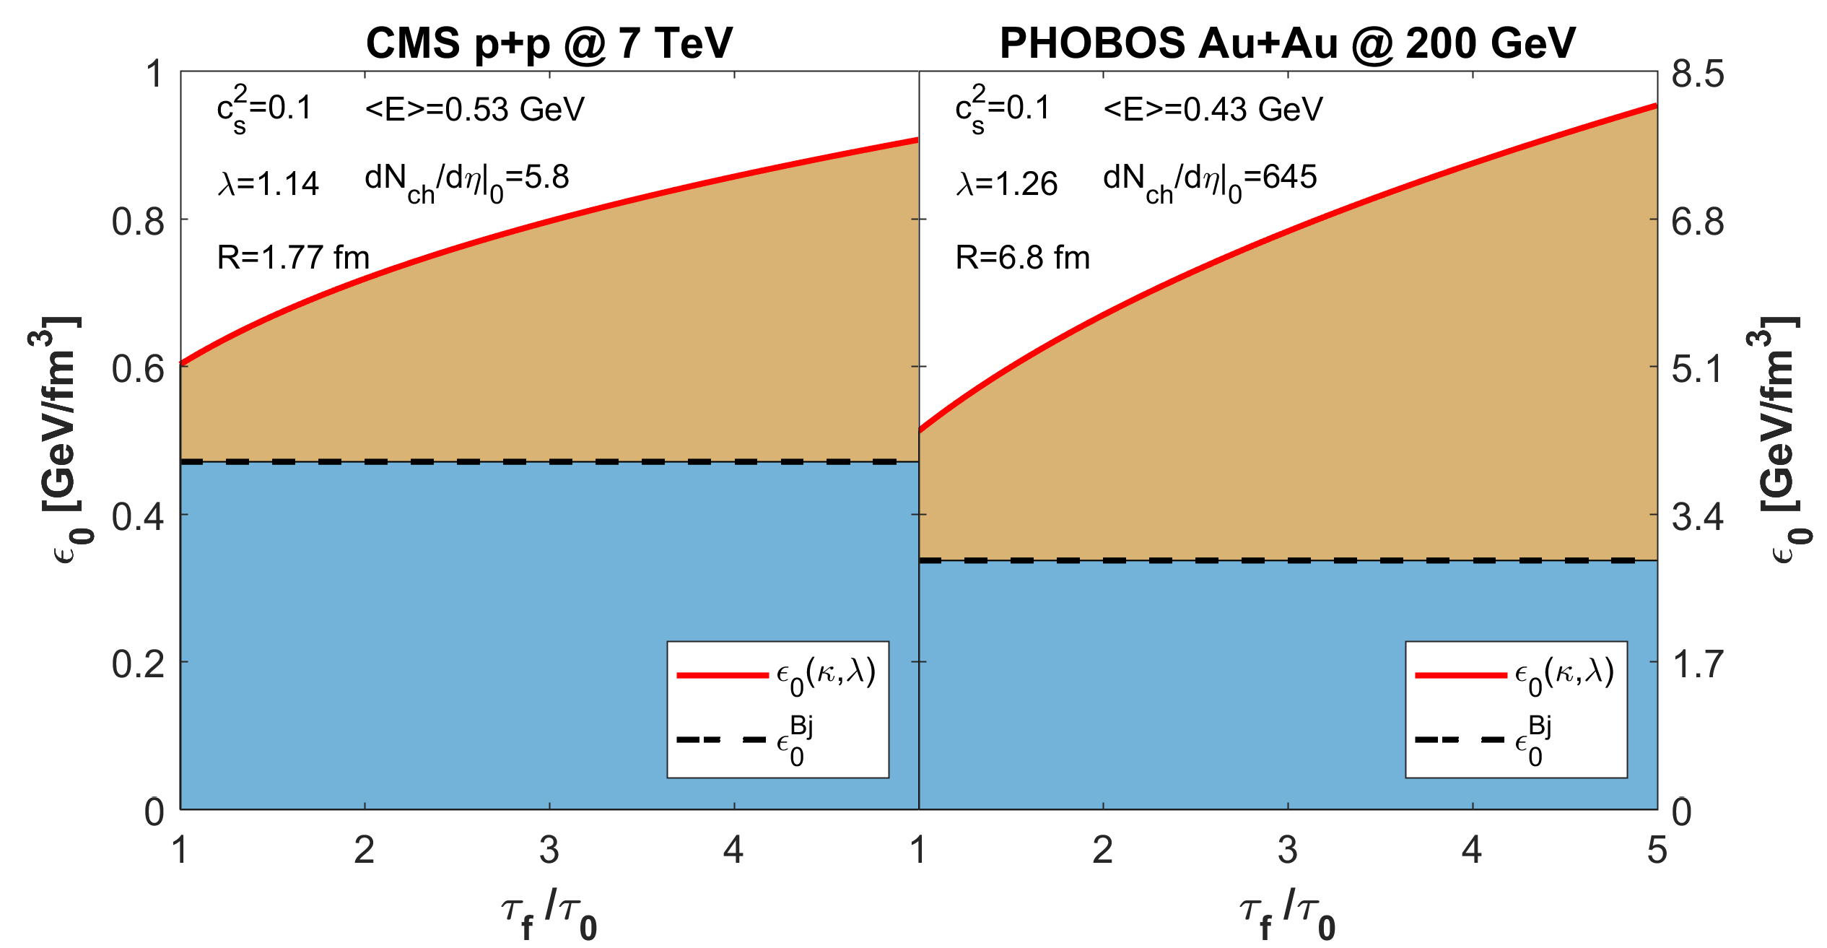
Determining the initial state
Dependence on EoS: from direct photons and/or lattice QCD
Dependence on multiplicity: plug in measured value
Dependence on final/initial time: largest source of uncertainty
What about the effect of viscosity?
Csörgő, Kasza, Acta Phys. Pol. B. Proc. Supp. (WPCF 2018), arXiv:1806.11309
ENERGY DENSITY NEW SOLUTIONS VISCOSITY PERTURBATIONS VORTICITY

Slide 17
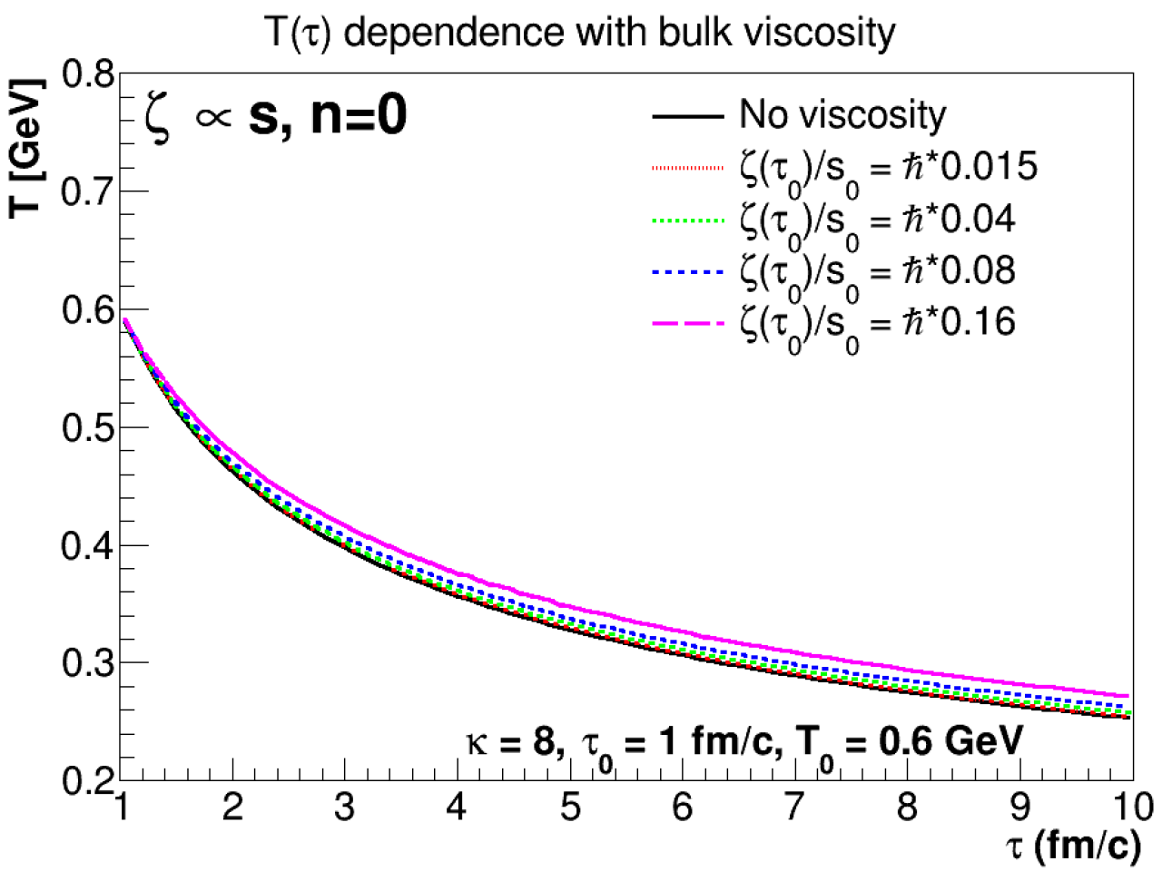
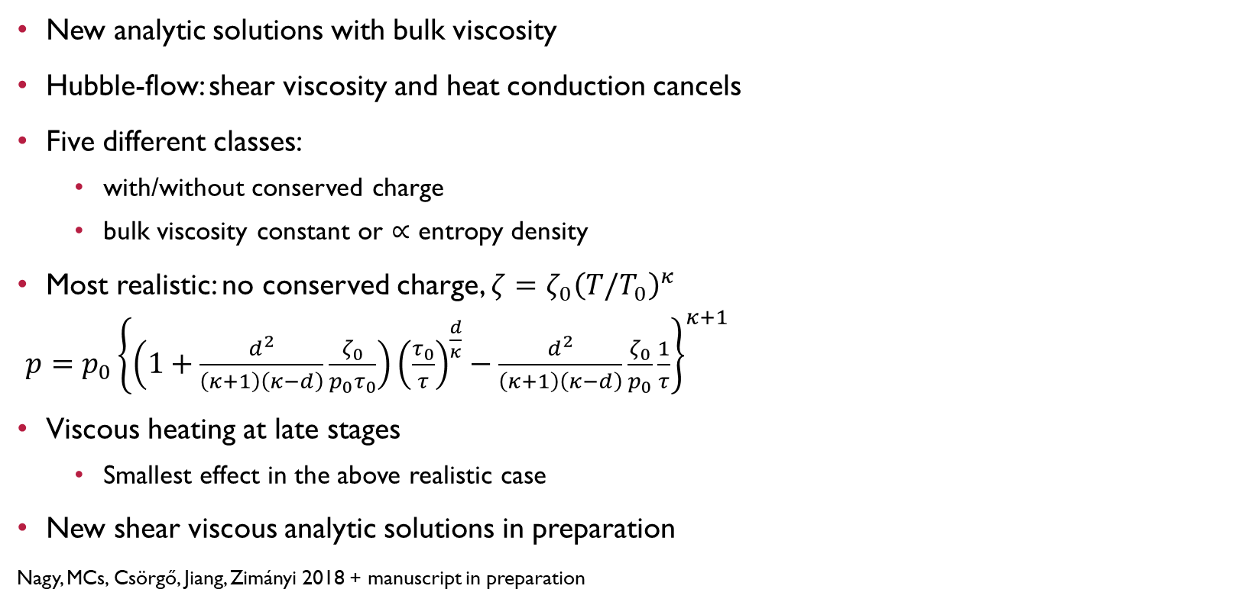
A new viscous solution
New analytic solutions with bulk viscosity
Hubble-flow: shear viscosity and heat conduction cancels
Five different classes:
  with/without conserved charge
  bulk viscosity constant or $∝$ entropy density
Most realistic: no conserved charge, $ζ=ζ_{0}{\left(T/T_{0}\right)}^{κ}$
$p=p_{0}{\left\{\left(1+\frac{d^{2}}{\left(κ+1\right)\left(κ−d\right)}\frac{ζ_{0}}{p_{0}τ_{0}}\right){\left(\frac{τ_{0}}{τ}\right)}^{\frac{d}{κ}}−\frac{d^{2}}{\left(κ+1\right)\left(κ−d\right)}\frac{ζ_{0}}{p_{0}}\frac{1}{τ}\right\}}^{κ+1}$
Viscous heating at late stages
  Smallest effect in the above realistic case
New shear viscous analytic solutions in preparation
Nagy, MCs, Csörgő, Jiang, Zimányi 2018 + manuscript in preparation
ENERGY DENSITY NEW SOLUTIONS VISCOSITY PERTURBATIONS VORTICITY

Slide 18
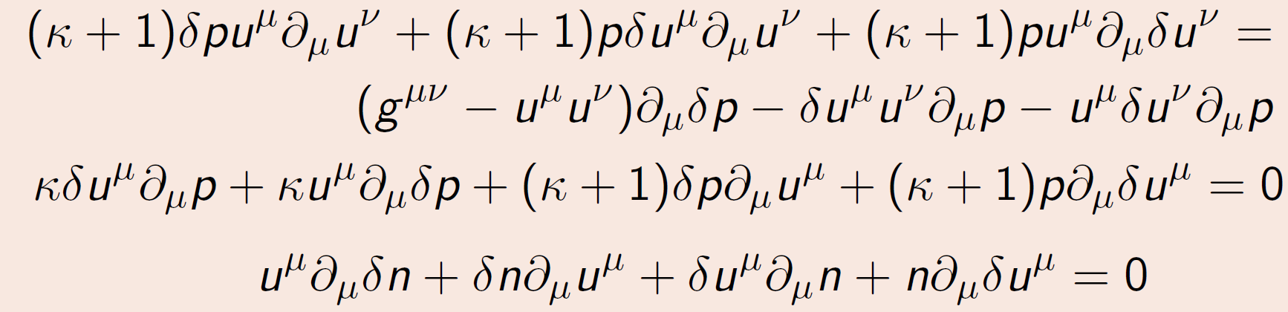
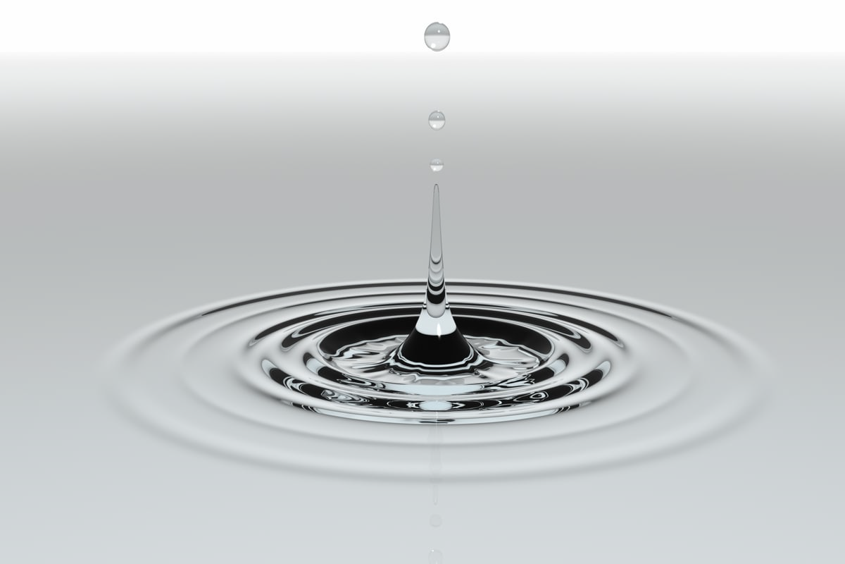

Perturbative solutions
Perturbed equations for a known solution
Linearized hydro equations: →
Need a specific “base” solution
Example: standing fluid, constant pressure/density
$$κ∂_{0}δp+\left(κ+1\right)p∂_{μ}δu^{μ}=0$$
$$\left(κ+1\right)p∂_{0}δu^{μ}−Q^{μν}∂_{μ}δp=0$$
with $Q^{μν}=δ^{μ1}δ^{ν1}−g^{μν}$
Result: waves
$$∂_{0}^{2}δp=c_{s}^{2}Δp$$
Method similar to Shi, Liao and Zhuang
Phys.Rev. C90 (2014) 064912 [arXiv:1405.4546]
ENERGY DENSITY NEW SOLUTIONS VISCOSITY PERTURBATIONS VORTICITY

Slide 19
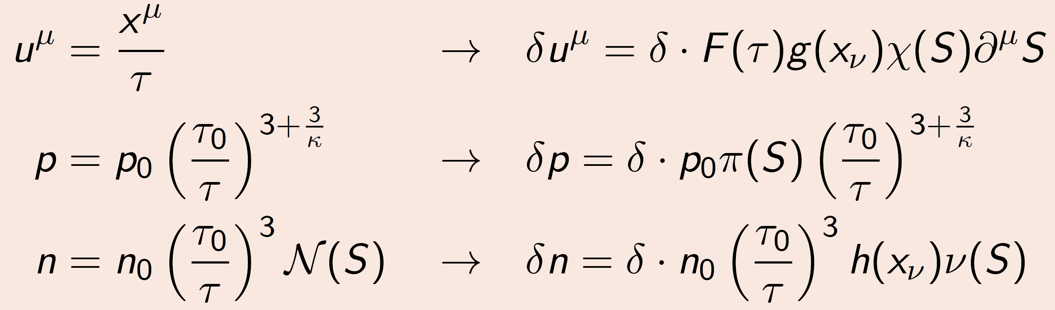
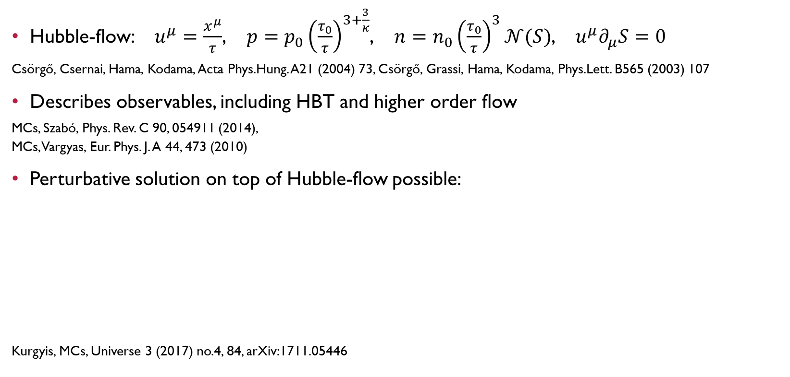
A new class of perturbative solutions
Hubble-flow: $u^{μ}=\frac{x^{μ}}{τ}$, $p=p_{0}{\left(\frac{τ_{0}}{τ}\right)}^{3+\frac{3}{κ}}$, $n=n_{0}{\left(\frac{τ_{0}}{τ}\right)}^{3}𝒩(S)$, $u^{μ}∂_{μ}S=0$
Csörgő, Csernai, Hama, Kodama, Acta Phys.Hung. A21 (2004) 73, Csörgő, Grassi, Hama, Kodama, Phys.Lett. B565 (2003) 107
Describes observables, including HBT and higher order flow
MCs, Szabó, Phys. Rev. C 90, 054911 (2014),
MCs, Vargyas, Eur. Phys. J. A 44, 473 (2010)
Perturbative solution on top of Hubble-flow possible:
Kurgyis, MCs, Universe 3 (2017) no.4, 84, arXiv:1711.05446
ENERGY DENSITY NEW SOLUTIONS VISCOSITY PERTURBATIONS VORTICITY

Slide 20
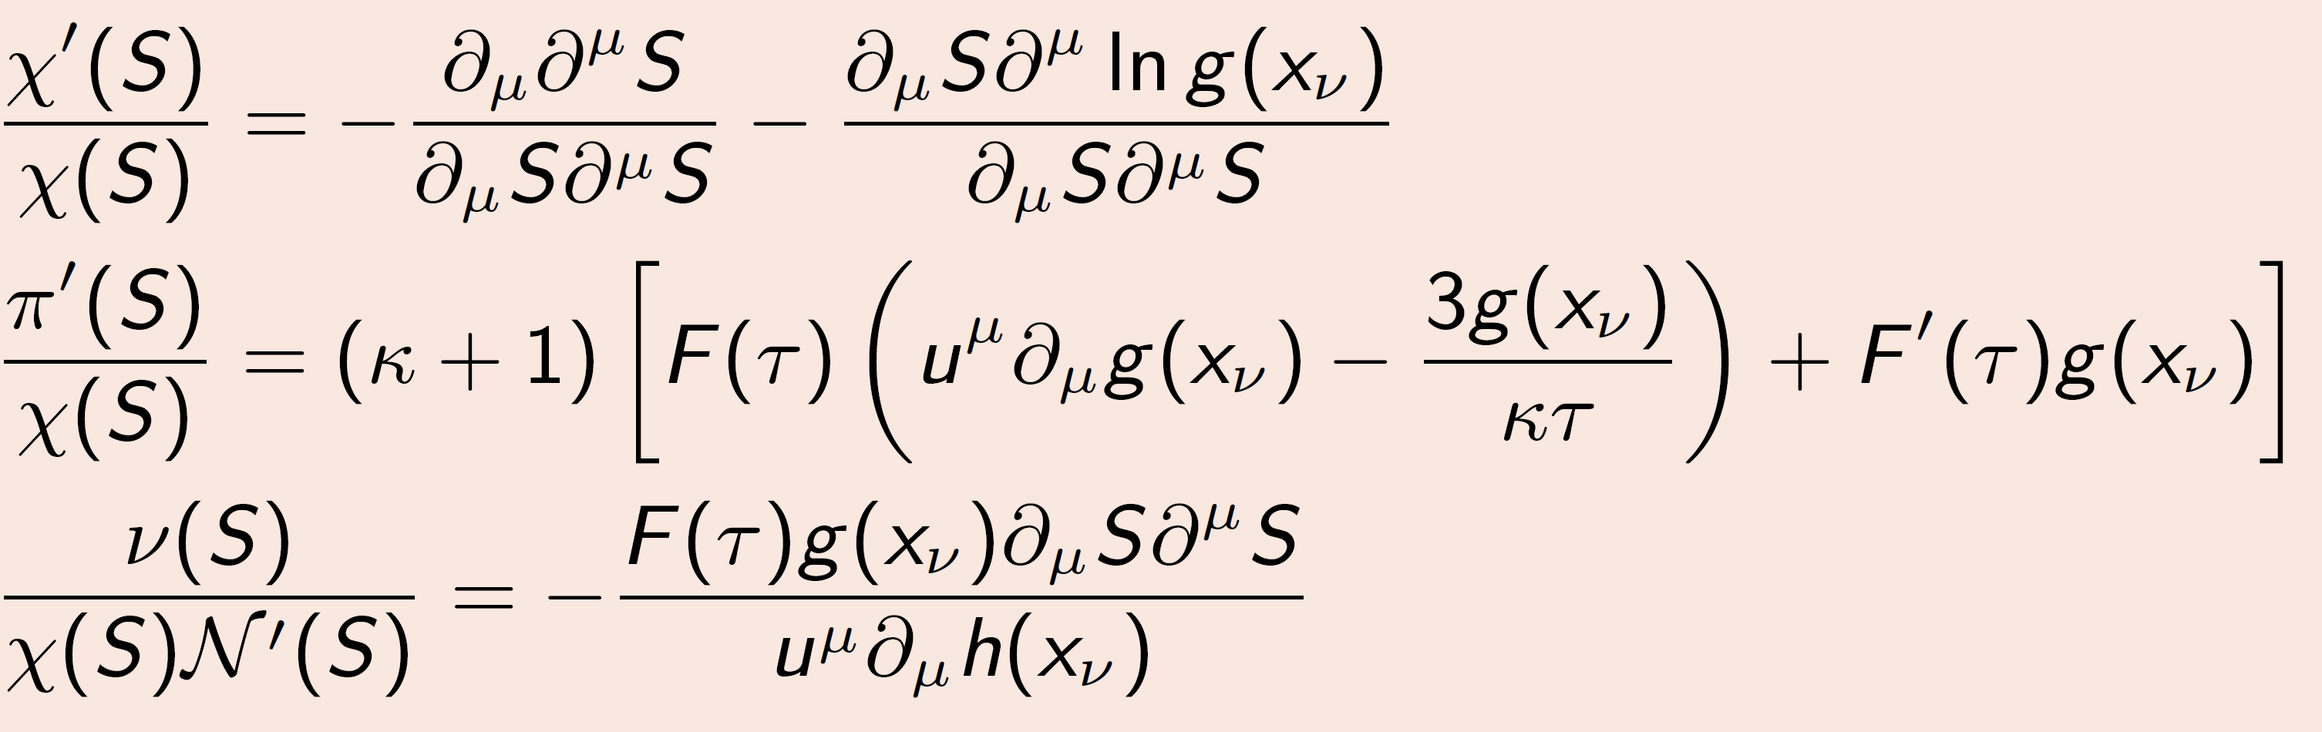

Rescritions for perturbative solutions
Flow profile $χ(S)$, pressure profile $π(S)$, density profile $ν(S)$
Auxiliary functions $F\left(τ\right),g\left(x^{ν}\right),h\left(x^{ν}\right)$
These are related to each other as:
Left side: only depends on scale variable $S$!
Many solutions possible, various scaling variables and profiles
ENERGY DENSITY NEW SOLUTIONS VISCOSITY PERTURBATIONS VORTICITY

Slide 21
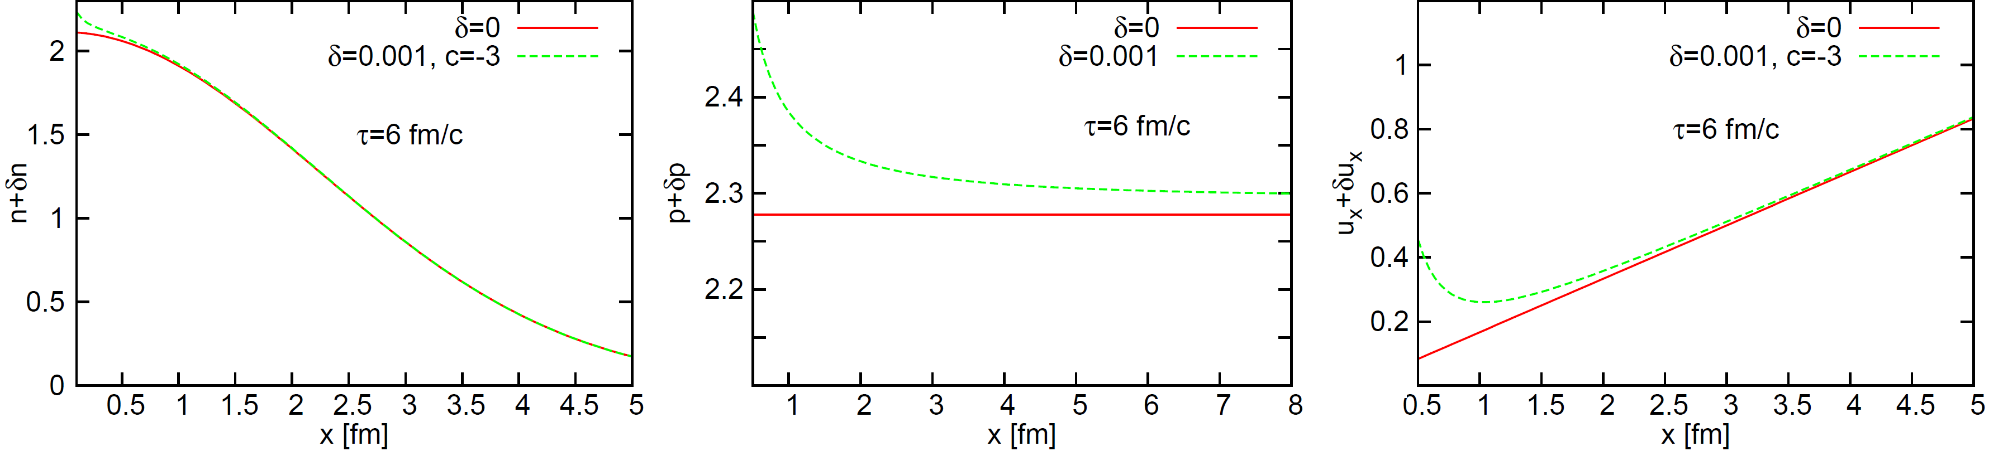
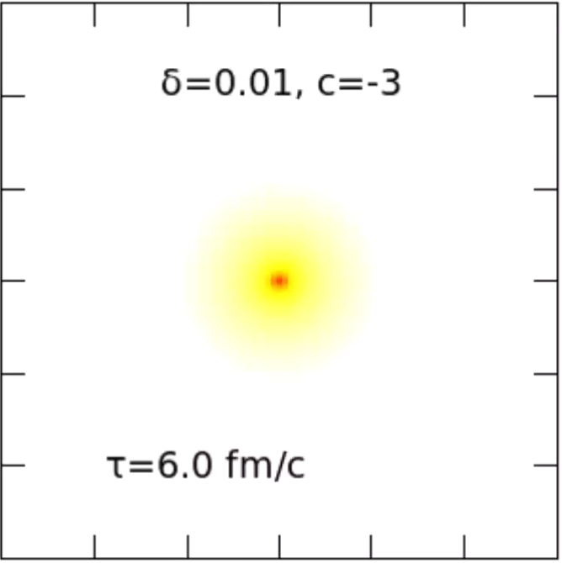
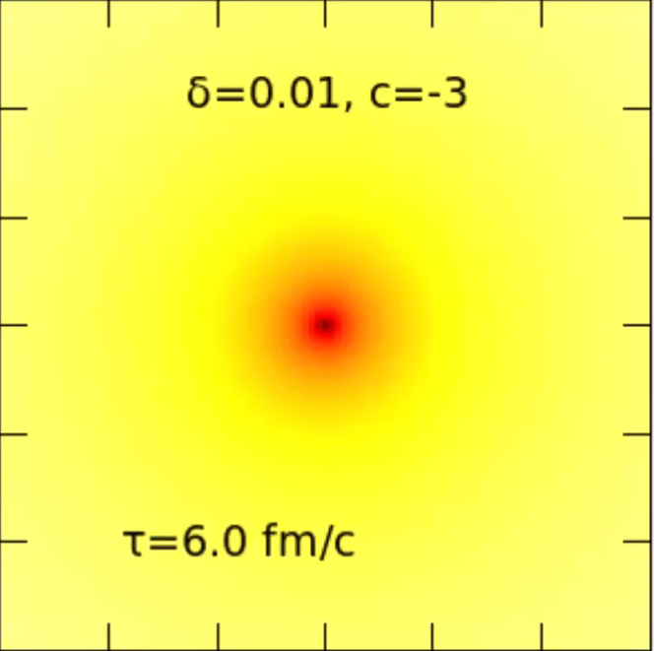
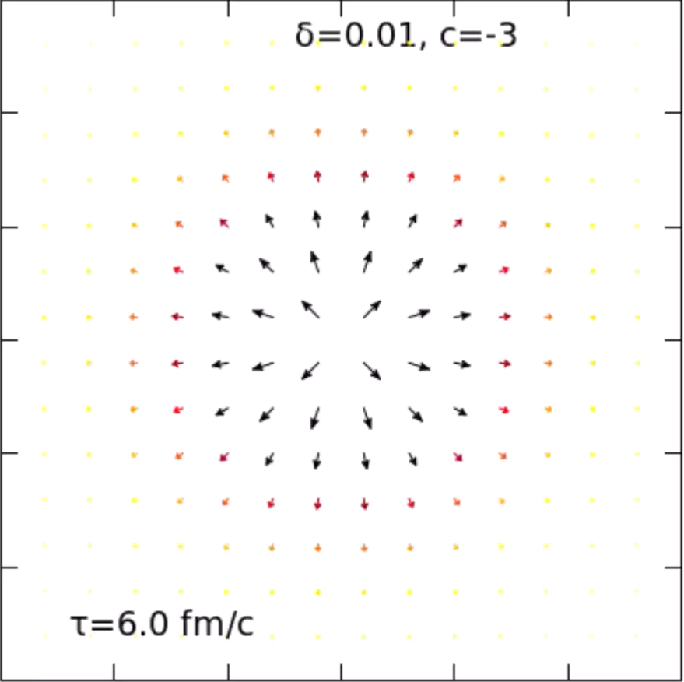
Time evolution of perturbations
An example perturbation from the class of solutions:
Kurgyis, MCs, Universe 3 (2017) no.4, 84, arXiv:1711.05446
density n(x)
pressure p(x)
flow u(x)
ENERGY DENSITY NEW SOLUTIONS VISCOSITY PERTURBATIONS VORTICITY

Slide 22
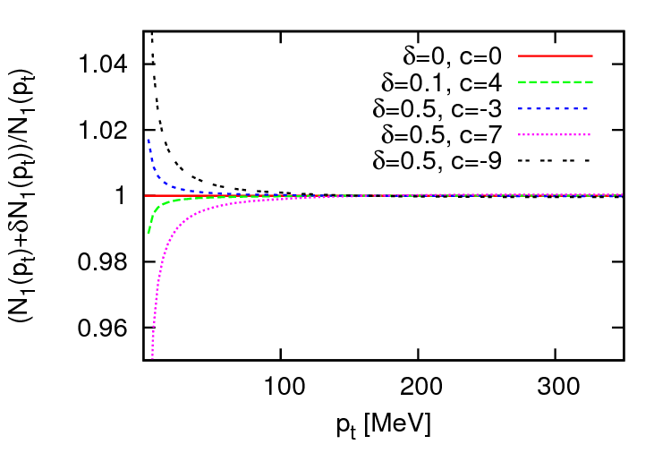
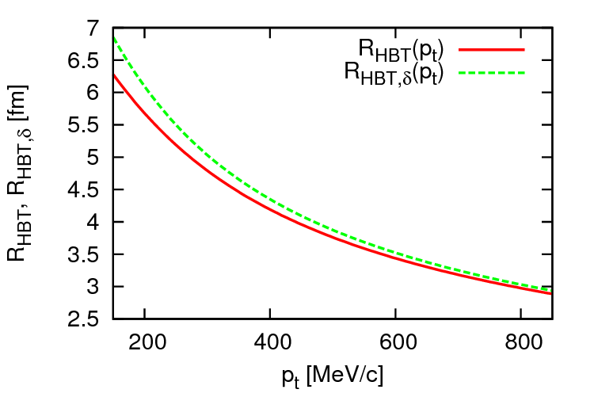
Perturbations of the observables
Observables calculable via usual Jüttner-Boltzmann source w/ Cooper-Fry
Spectra and correlations obtain a perturbative component
Hubble-flow observables stable against small perturbations
Kurgyis, MCs, Universe 3 (2017) no.4, 84, arXiv:1711.05446
ENERGY DENSITY NEW SOLUTIONS VISCOSITY PERTURBATIONS VORTICITY

Slide 23
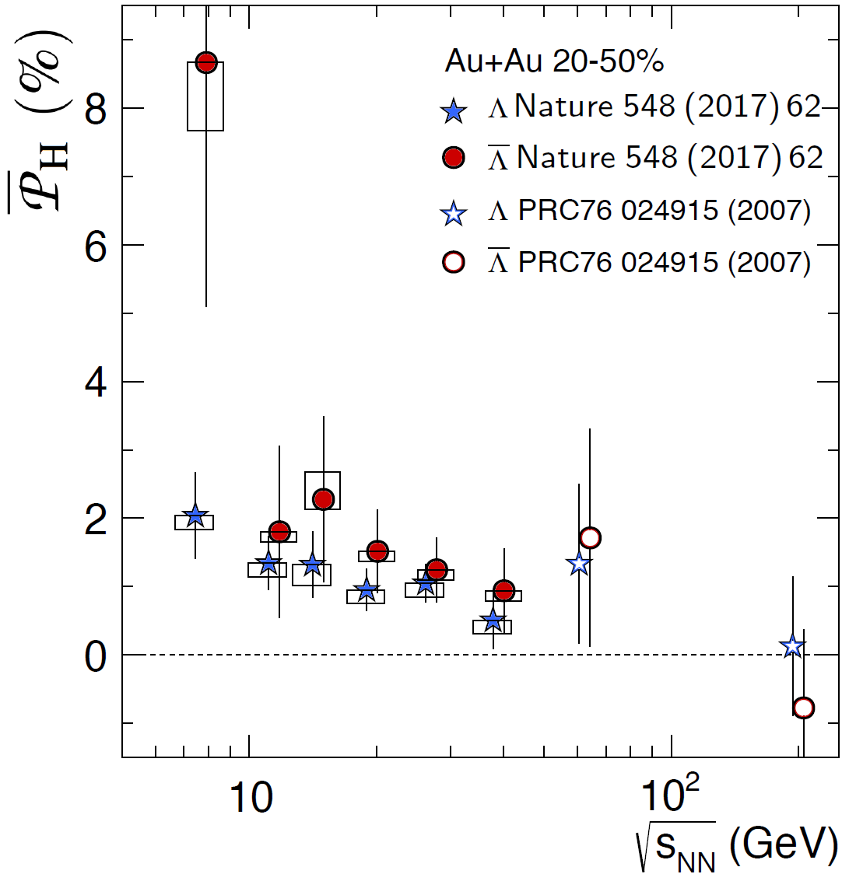
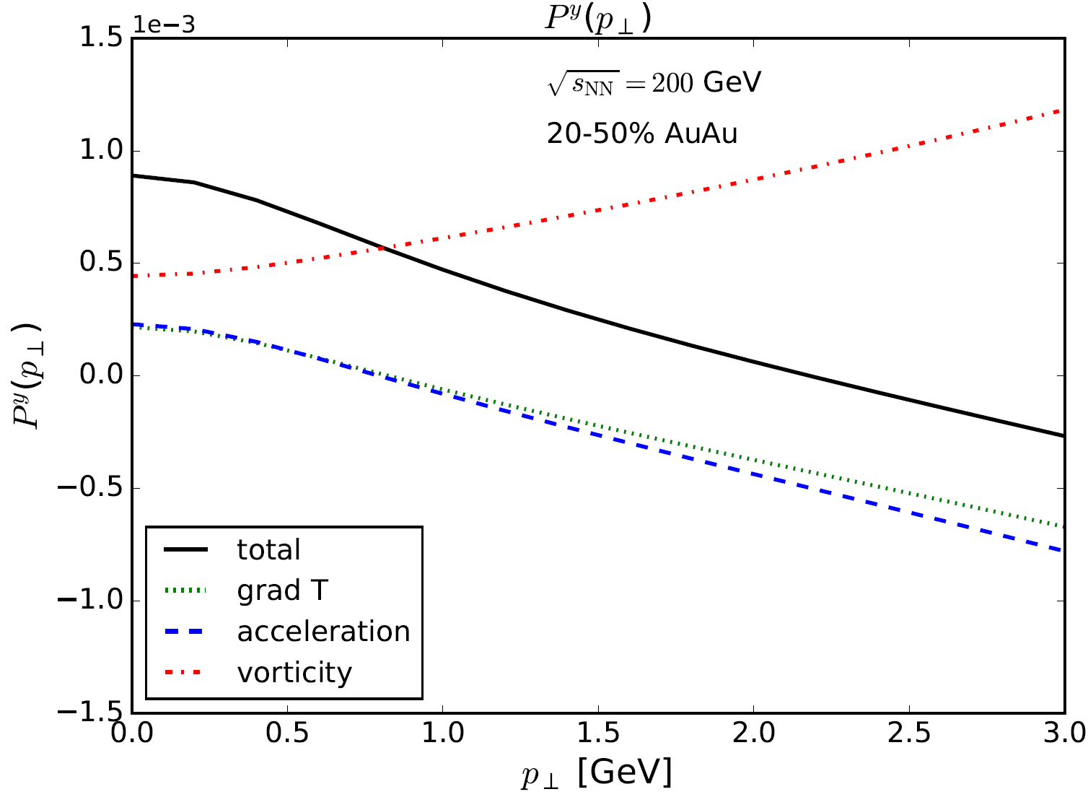

Vorticity of the quark gluon plasma
Residual angular momentum: rotating fluid?
Vorticity can be (and is) measured via Λ polarization
Calculation: $S^{μ}\left(p\right)=\frac{1}{8m}\left(1−f\left(x,p\right)\right)ε^{μνρσ}p_{σ}∂_{ν}β_{ρ}$
F. Becattini, V. Chandra, L. Del Zanna, E. Grossi, Ann. Phys. 338 (2013) 32
Described in numerical
hydro calculations
Becattini, Csernai, Wang, Xie, PRC88
Becattini, Inghirami, et al, EPJC75
Pang, Petersen, Wang, Wang, PRL117
Karpenko, Becattini, QM18
Many features mixing in →
How about analytic hydro?
STAR
ENERGY DENSITY NEW SOLUTIONS VISCOSITY PERTURBATIONS VORTICITY

Slide 24
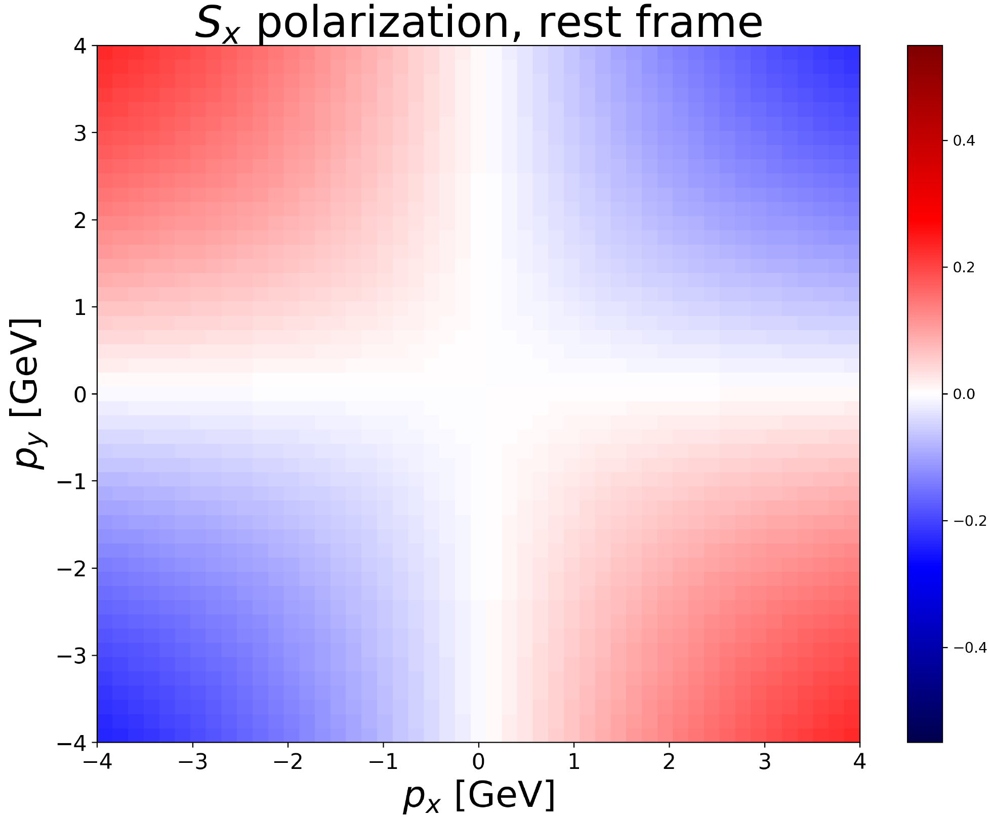
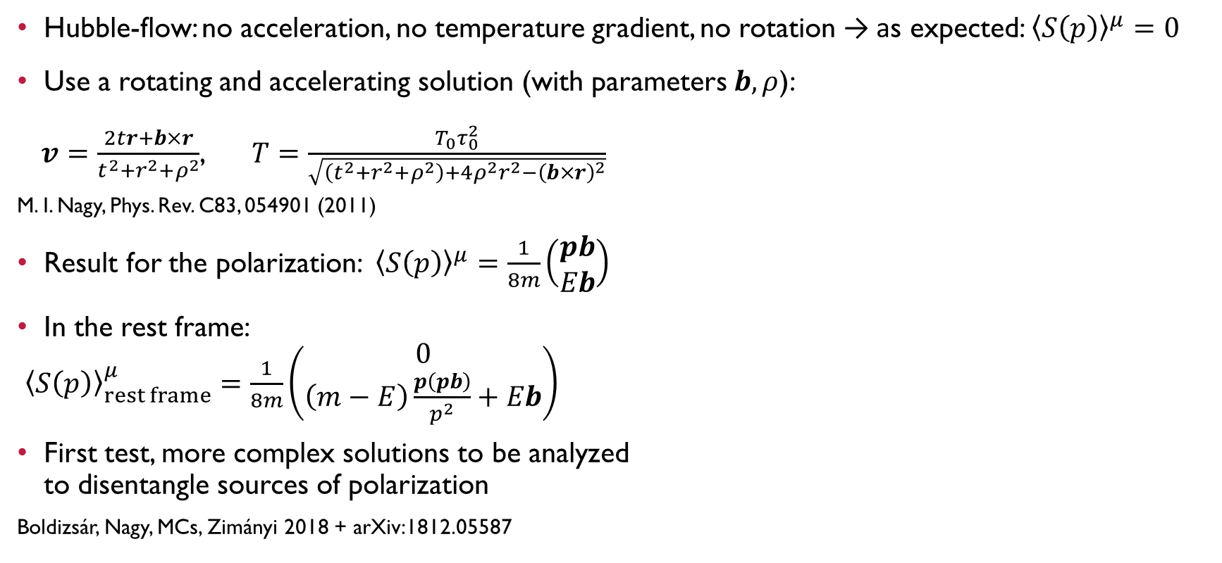
Polarization in analytic hydro
Hubble-flow: no acceleration, no temperature gradient, no rotation → as expected: ${\left\langle S\left(p\right)\right\rangle }^{μ}=0$
Use a rotating and accelerating solution (with parameters $b,ρ$):
$v=\frac{2tr+b×r}{t^{2}+r^{2}+ρ^{2}}$, $T=\frac{T_{0}τ_{0}^{2}}{\sqrt{\left(t^{2}+r^{2}+ρ^{2}\right)+4ρ^{2}r^{2}−{\left(b×r\right)}^{2}}}$
M. I. Nagy, Phys. Rev. C83, 054901 (2011)
Result for the polarization: ${\left\langle S\left(p\right)\right\rangle }^{μ}=\frac{1}{8m}\left(\begin{matrix}pb \\ Eb\end{matrix}\right)$
In the rest frame:
${\left\langle S\left(p\right)\right\rangle }_{rest frame}^{μ}=\frac{1}{8m}\left(\begin{matrix}0 \\ \left(m−E\right)\frac{p\left(pb\right)}{p^{2}}+Eb\end{matrix}\right)$
First test, more complex solutions to be analyzed
to disentangle sources of polarization
Boldizsár, Nagy, MCs, Zimányi 2018 + arXiv:1812.05587
ENERGY DENSITY NEW SOLUTIONS VISCOSITY PERTURBATIONS VORTICITY

Slide 25

Summary
Many new results in exact/analytic hydro
Perturbations on top of Hubble-flow
  Allows to introduce complicated anisotropies
  To be expanded to other solutions
Advanced energy density estimates
  Björken estimate: no acceleration, no pressure
  Advanced estimates based on exact solutions
  High energy densities reached in LHC p+p
New accelerating families of solutions
  Arbitrary acceleration, arbitrary EoS
  EoS dependent energy density estimate
New exact viscous solutions found
Vorticity calculated in exact hydro
THANK YOU FOR
YOUR ATTENTION!
Ceterum censeo
Carthaginem esse delendam
… if you are interested in these subjects, come to:
http://zimanyischool.kfki.hu/19
ENERGY DENSITY NEW SOLUTIONS VISCOSITY PERTURBATIONS VORTICITY

Slide 26
BACKUP

Slide 27


The pseudorapidity density from CNC
$\frac{dN}{dy}≅N_{0}\cosh^{−\frac{α}{2}−1}\left(\frac{y}{α}\right)\exp\left[−\frac{m}{T_{f}}\cosh^{α}{\frac{y}{α}}\right]$
Main parameter: $α=\frac{2λ−1}{λ−1}$
Particle mass $m$,
Freeze-out temp. $T_{f}$
Measure acceleration
from rapidity distributions
Extension to more
complex flows?

Slide 28



Initial energy density at RHIC
Bjorken estimate from BRAHMS: $ε_{Bj}=\frac{\left\langle E\right\rangle }{R^{2}πτ_{0}}\frac{dN}{dη}≅5$ GeV/fm3
Advanced estimate: $ε=ε_{Bj}\left(2λ−1\right){\left(τ_{f}/τ_{i}\right)}^{\left(λ−1\right)}$
Correction: 2-3x, result ~15 GeV/fm³, QCD agreement
Corresponds to T_{ini} ≅ 2T_{c} ≅ 340 MeV, confirmed by γ spectra
BRAHMS
dN/dη

Slide 29
Pseudorapity densities in A+A
Describes data well from RHIC to LHC
Jiang, Yang, MCs, Csörgő,
Phys. Rev. C 97, 064906, 2018

Slide 30

Energy densities in AA, RHIC to LHC
Effect of acceleration and conjectured effect of Equation of State
Jiang, Yang, MCs, Csörgő, Phys. Rev. C 97, 064906, 2018
Effect of EoS: important to understand analytically!
What about p+p?

Slide 31


Polarization in exact hydro
In this very simple solution, results different from full numerical simulations
More complex solutions to be tested to disentangle sources of polarization

