Slide 1
areaDetector Workshop(?)
EPICS Collaboration Meeting
ITER, June. 2019
Ulrik Pedersen, Gary Yendell
Diamond Light Source

Slide 2
Mark couldn’t make it…
So who are we?
Ulrik:
  Working with areaDetector since around 2008
  Rolling out the areaDetector framework on Diamond
  Implemented the HDF5 plugin
  Closely involved with moving source to github in 2013
Gary:
  Working with HDF5 plugin fixes and new features
  Development and commissioning of ADEiger at Diamond
    Collaboration with Bruno

Slide 3
Mark couldn’t make it…
Fortunately his slides could…
Introduction
  Collaboration
  Workflow
areaDetector overview
  Architecture, goals
  Drivers
  Plugins
  Viewers
Changes, new features and future
  Version 3.x news
  PVAccess
  Codec/compression
  Future

Slide 4
How to pitch these talks?
Who has worked with areaDetector at all?
With areaDetector 2.x?
  i.e. on github
With areaDetector 3.x?
  Latest, bleeding edge…

Slide 5
areaDetector Collaboration
areaDetector Working Group established in 2013
  WG co-chaired by Mark Rivers and Ulrik Pedersen
  Regular video conference meetings every 1,2,3 months for a couple of years
  Workshops such as this one!
Source code moved to github
  Drivers and framework split up into separate repos
    ADCore
    ADSupport
    ADSimDetector
    Etc

Slide 6
areaDetector Collaboration
Collaborative workflow: Github Pull Request
  Developer: Fork repo, clone, branch, code, test, push, issue Pull Request
  Collaborators: review, discuss
  Maintainers (typically Mark): merge
Discuss fixes and features: raise issue on ADCore or other relevant repo
Ask for help: Tech-talk mailing list
  Mark does an amazing job there!!!

Slide 7
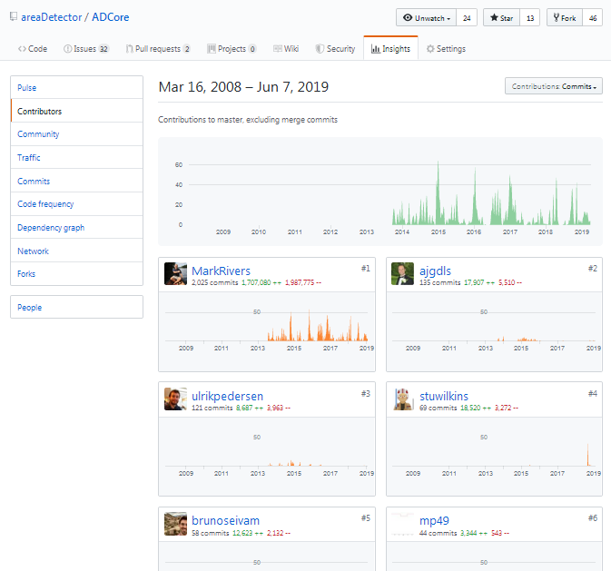
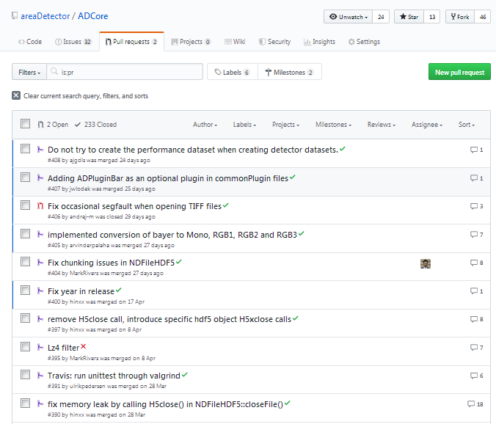
areaDetector Collaboration

Slide 8
areaDetectors at DLS
Firewire IEEE1397 using firewireDCAM
  Now mostly decommissioned
GigE cameras using aravisGigE
Pilatus
Eiger
PCO
Andor
XMAP
electronAnalysers
dtaq ADCs

Slide 9
We have an Eiger!
New VMXi beamline: Eiger 4M
  750fps, 40gbps NIC
  Status: beamline commissioning
Control: NSLS-II NDEiger areaDetector driver
  Thanks Brunon and Gary!
DAQ: DLS scalable DAQ software
  ZeroMQ stream from Eiger server
  4 x file writer processes + 1 meta-data writer process
  HDF5 files
    SWMR
    Direct Chunk Write (pre-compressed data)
    VDS
Proposal: adopt ADEiger into areaDetector?

