Slide 1
Update on high intensity studies in SPS part II
H. Bartosik, M. Beck, T. Bohl, M. Carla’, L. Carver, H. Damerau, V. Kain, G. Kotzian, A. Lasheen, K. Li, G. Papotti, J. Repond, M. Schwarz, E. Shaposhnikova, C. Zannini
SPS & PS operators
LIU beam performance meeting, 1 November 2018

Slide 2
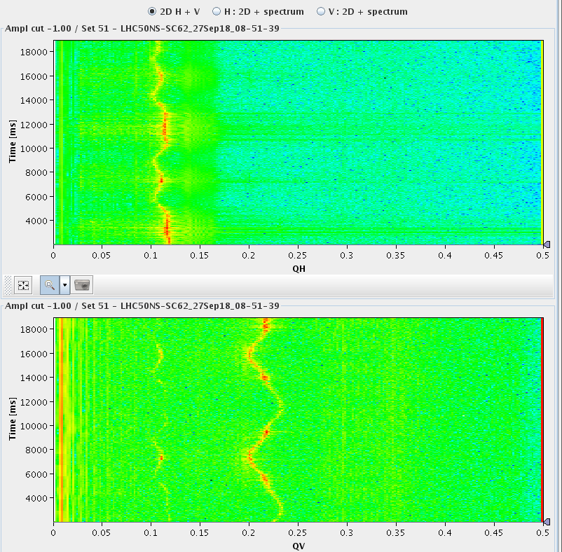
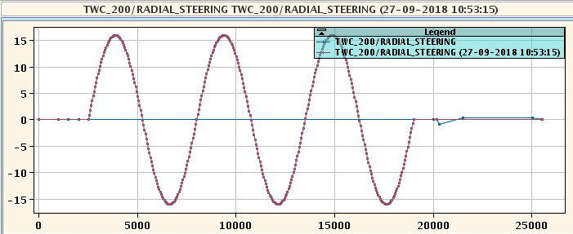
Preparation of flat bottom cycle
Corrected amplitude detuning
  KLOF = -0.2 gives roughly zero horizontal amplitude detuning
Measurement of chromaticity
  Sinusoidal trim of radial steering allows
  chromaticity measurement within a cycle
  Calibration of chroma knobs shows QPH = 0.05
  corresponds roughly to zero chromaticity

Slide 3
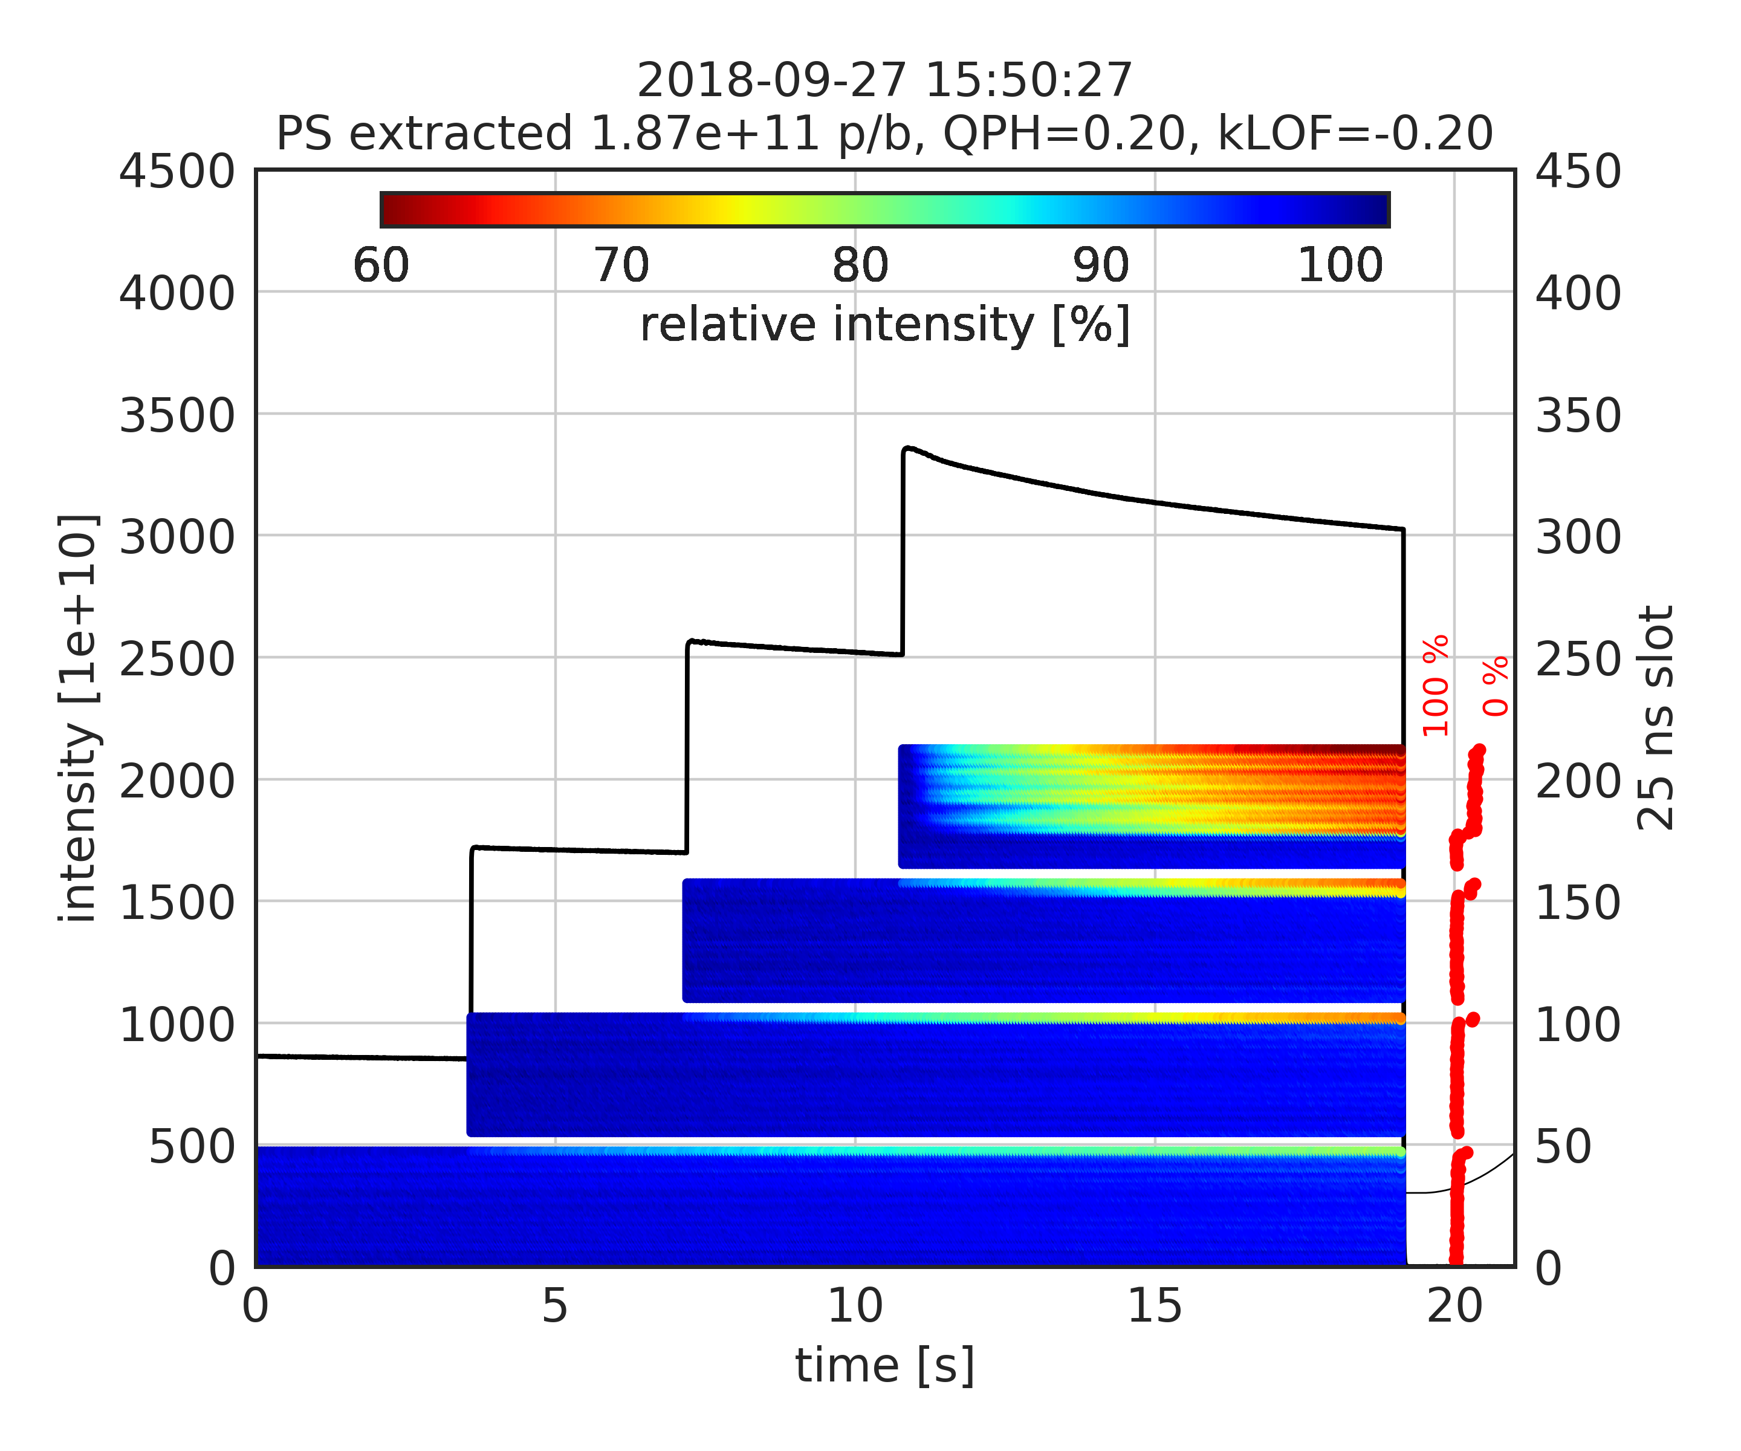
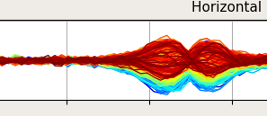
Instability depending on chromaticity
QPH=0.2 and no amplitude detuning
  Mode 1 instability on last bunches of the batch for intensity >1.8e11 p/b
  Last bunches of last circulating batch excited by injection kicker (MKP delay not optimal)
Losses correlated with instability
FF OFF

Slide 4
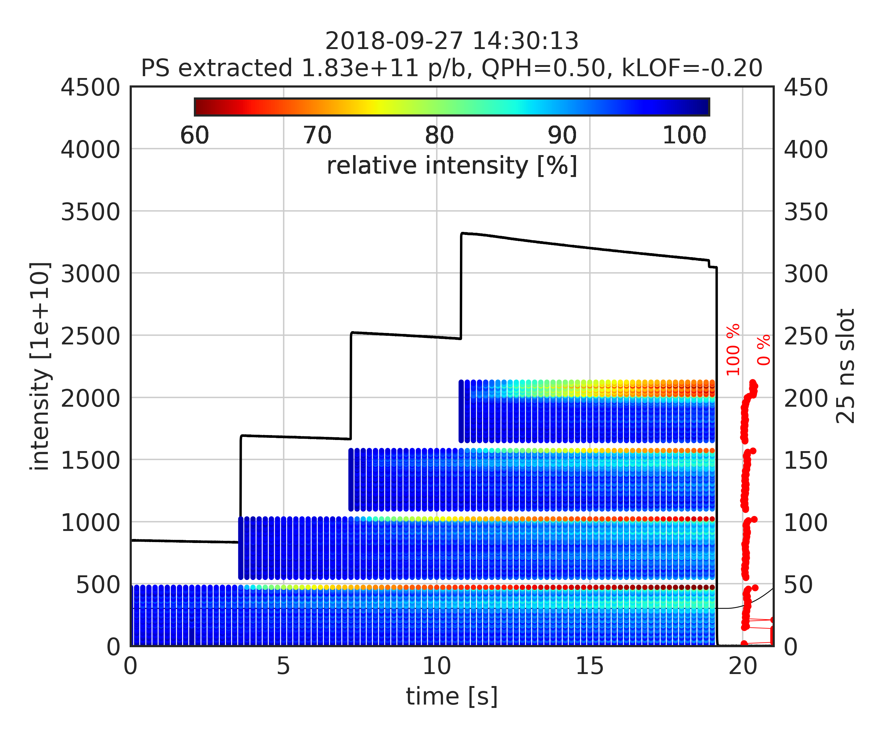
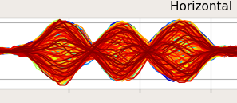
Instability depending on chromaticity
QPH=0.2 and no amplitude detuning
  Mode 1 instability on last bunches of the batch for intensity >1.8e11 p/b
  Last bunches of last circulating batch excited by injection kicker (MKP delay not optimal)
QPH=0.5 and no amplitude detuning
  Mode 2 instability on last bunches of the batch for intensity >1.8e11 p/b
Note: losses on first batch enhanced with feed-forward ON – see later
FF ON

Slide 5
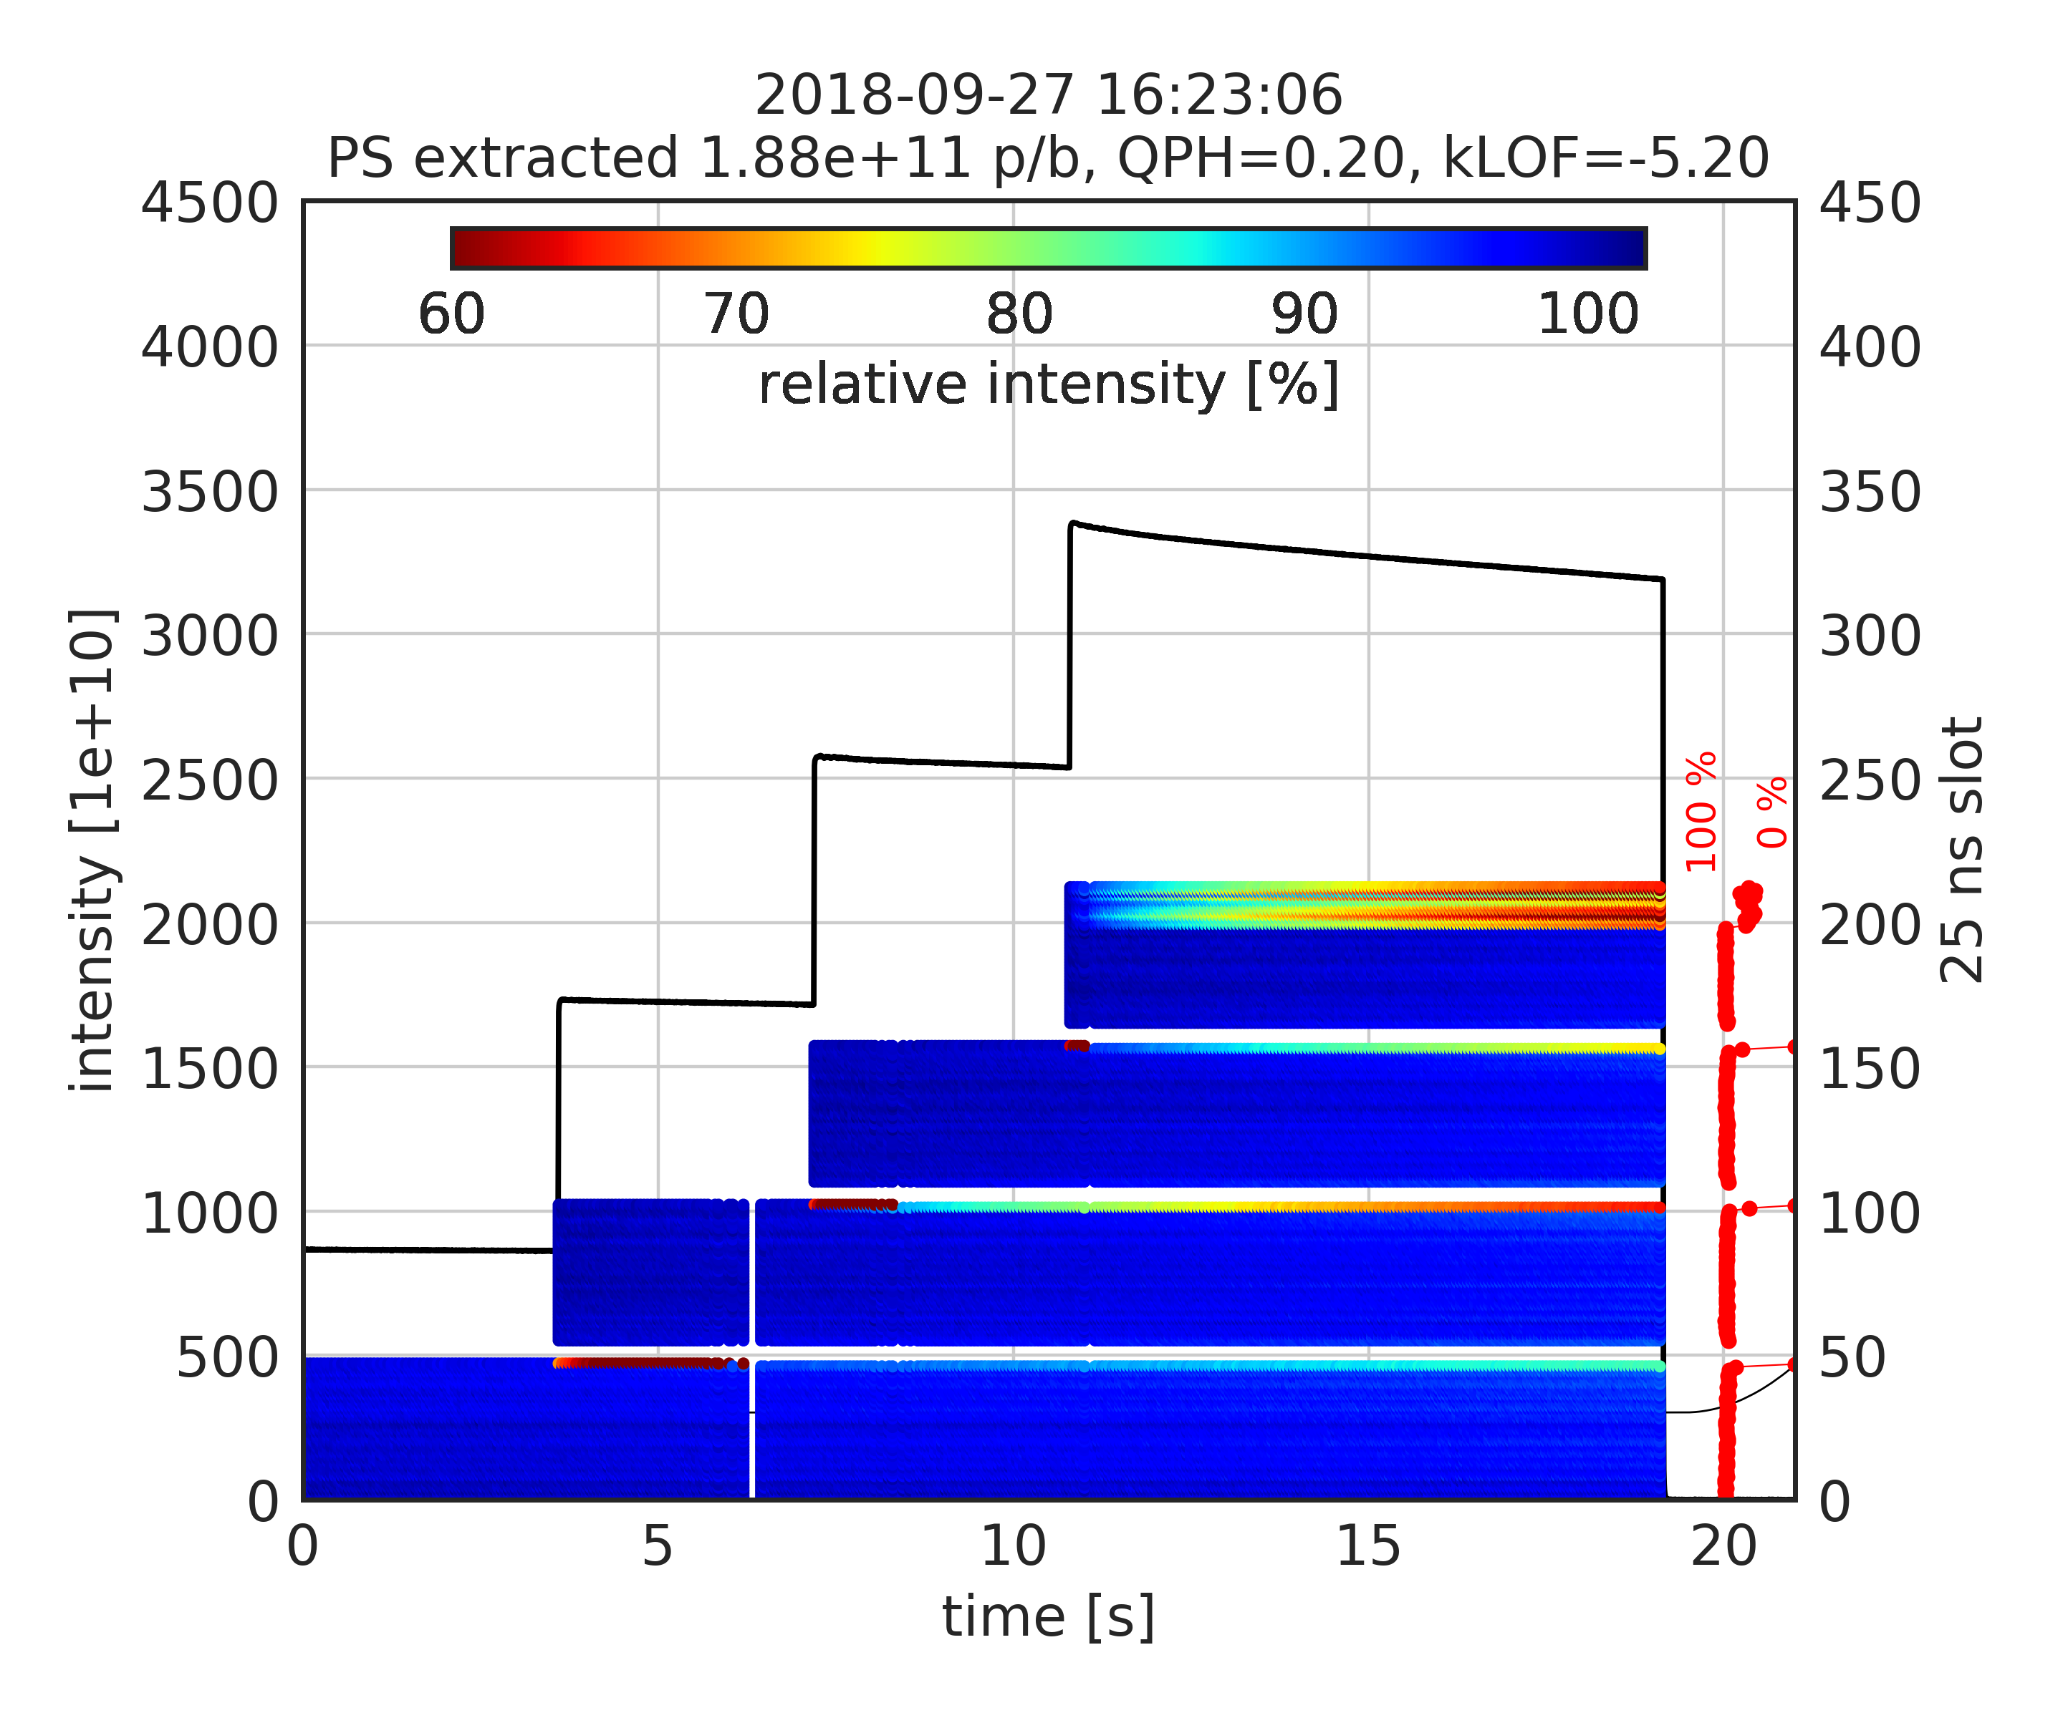
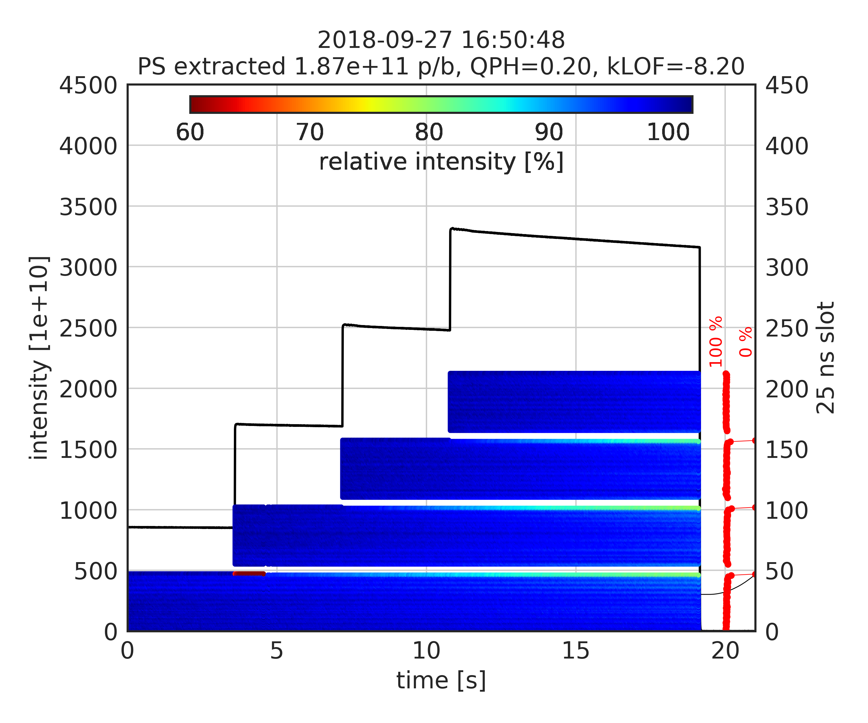
Stabilization with octupoles
Strong Landau octupoles now accessible after reconfiguration to minimize Q’’
  Took data in various configurations of octupole and chroma settings
  Only negative KLOF settings observed to help stabilizing
  Still the last bunches of the last circulating batches were affected (MKP delay not optimal)
QPH=0.2 / KLOF=-5.2
most shots unstable
QPH=0.2 / KLOF=-8.2
3 out of 3 shots stable

Slide 6

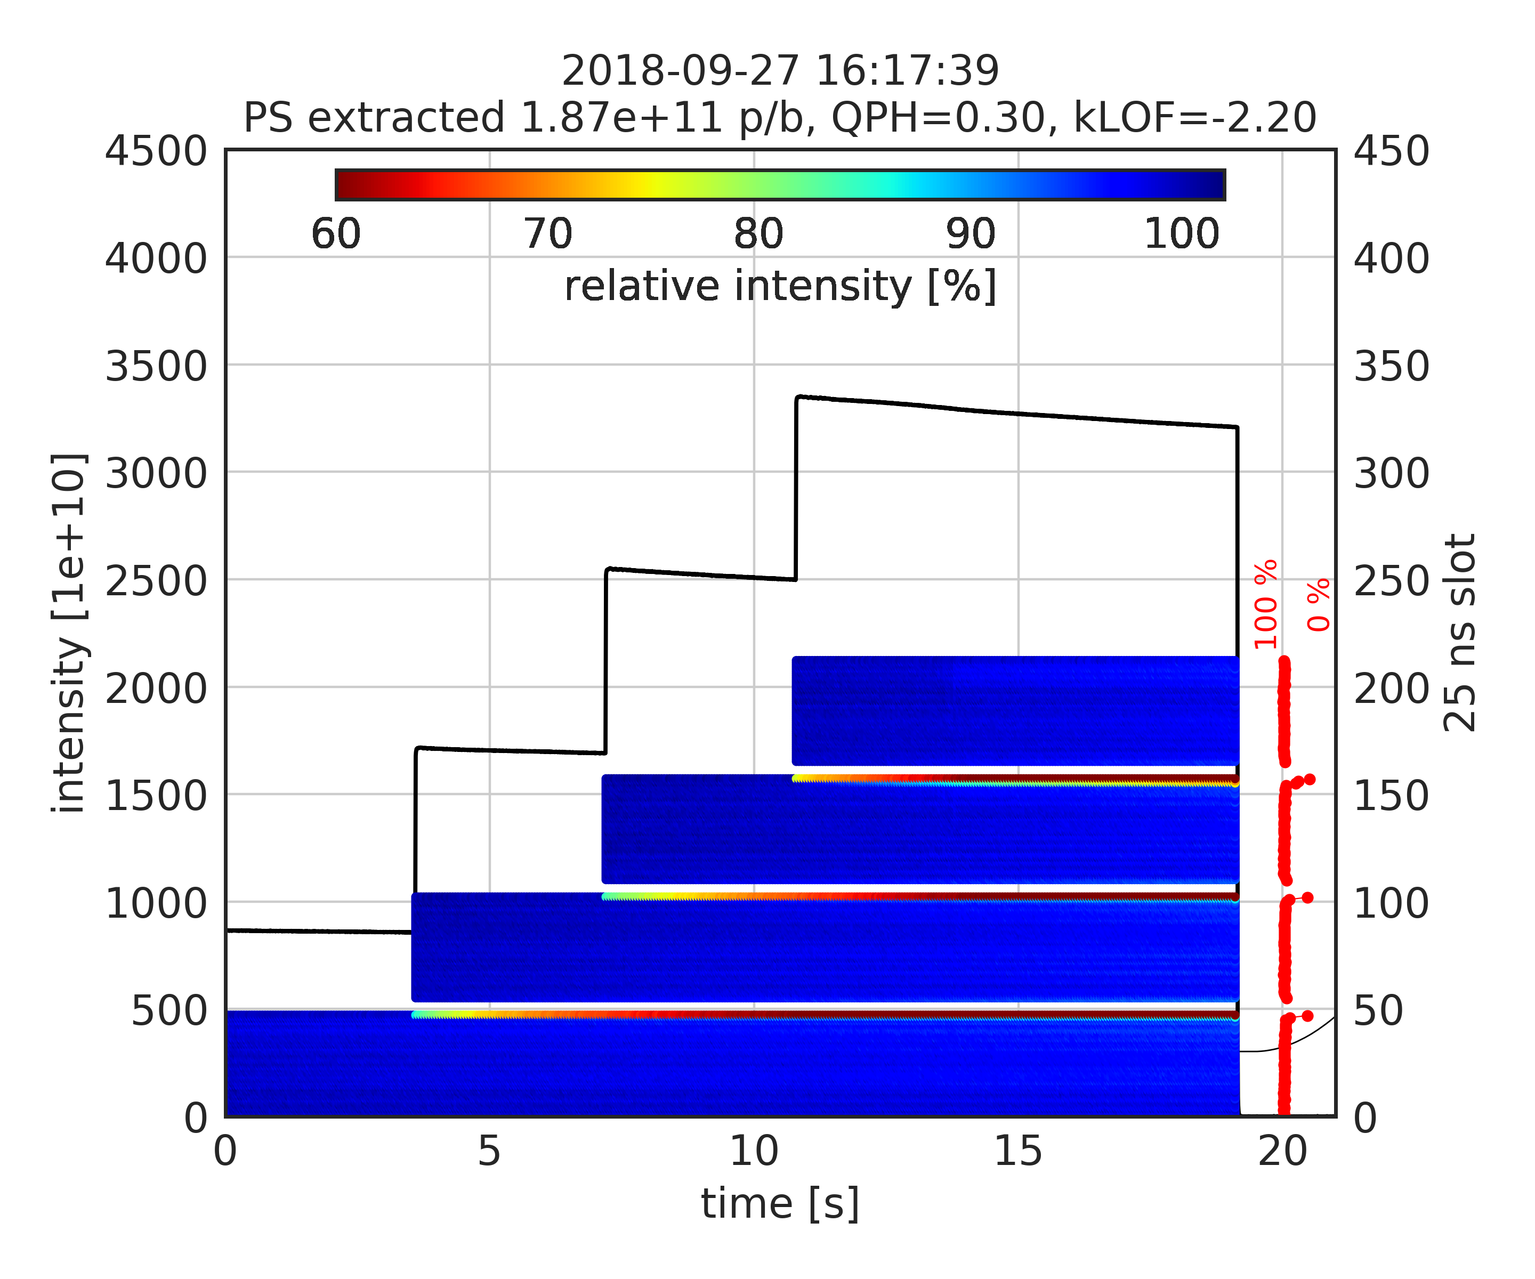
Stabilization with octupoles
Strong Landau octupoles now accessible after reconfiguration to minimize Q’’
  Took data in various configurations of octupole and chroma settings
  Only negative KLOF settings observed to help stabilizing
  Still the last bunches of the last circulating batches were affected (MKP delay not optimal)
QPH=0.3 / KLOF=-0.2
sometimes unstable
QPH=0.3 / KLOF=-2.2
6 out of 6 shots stable

Slide 7
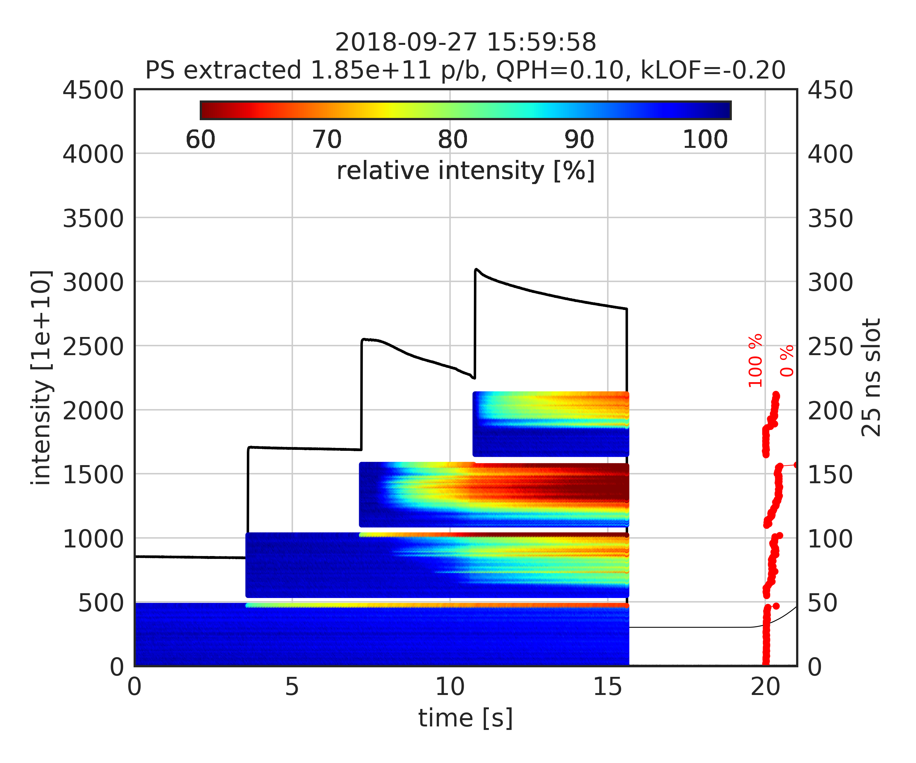
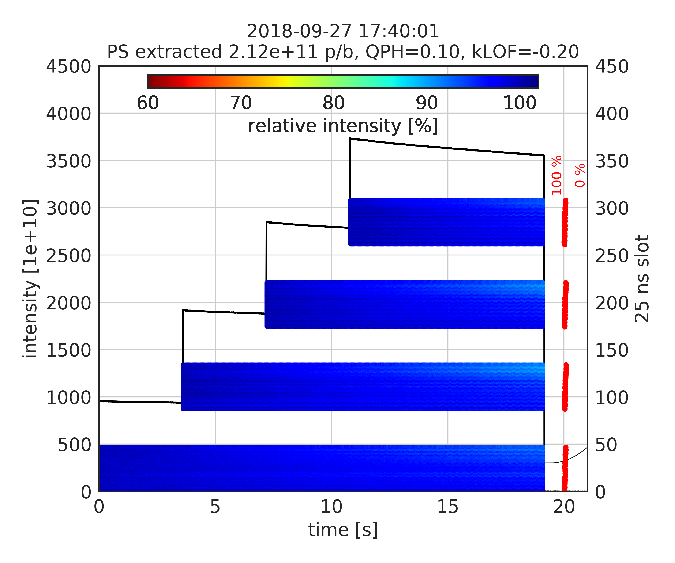
Impact of batch spacing
Instability not observed for large batch spacing
  Even for low chromaticity and higher intensity
200 ns batch spacing
1000 ns batch spacing

Slide 8
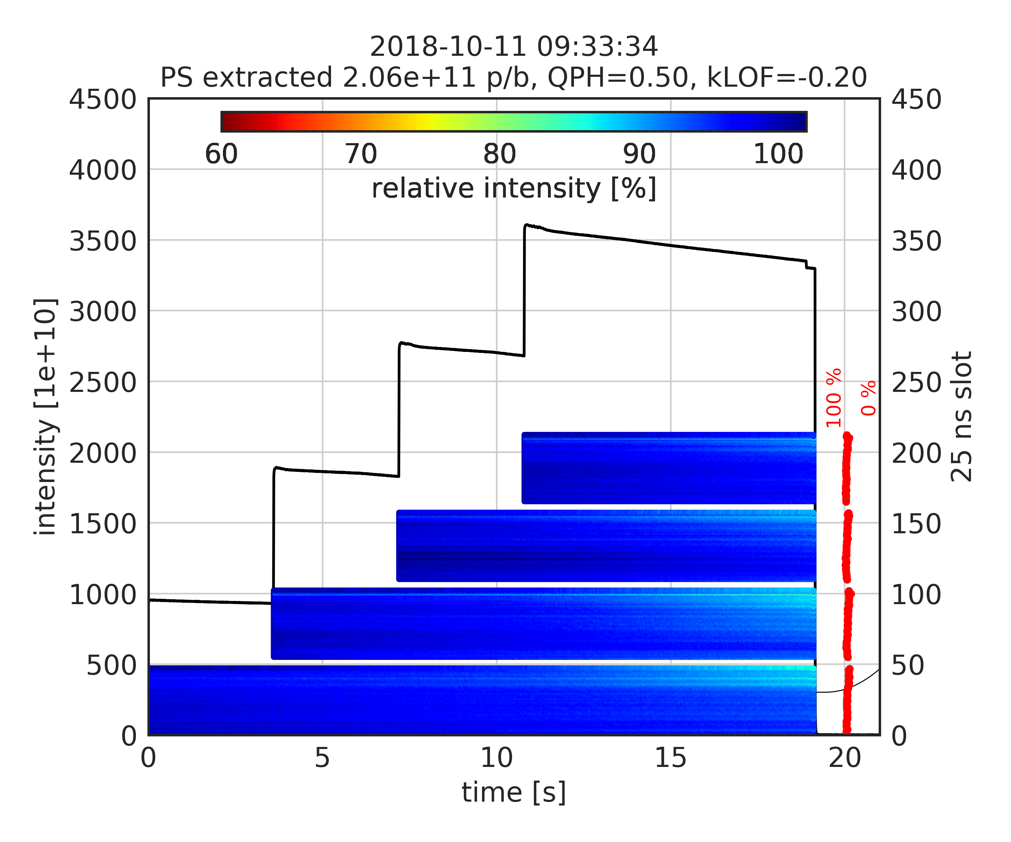
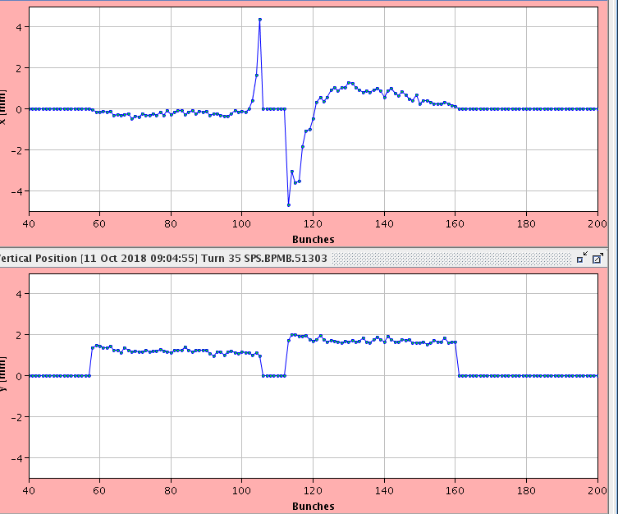
Optimization of MKP delay
Optimum delay settings
  Still the last bunch of circulating batch is kicked by about 4 mm …
  But clear improvement on transmission of last bunches

Slide 9
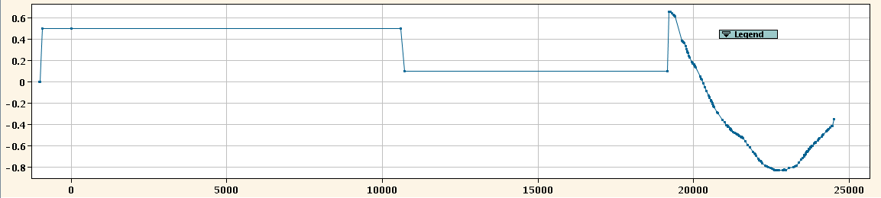
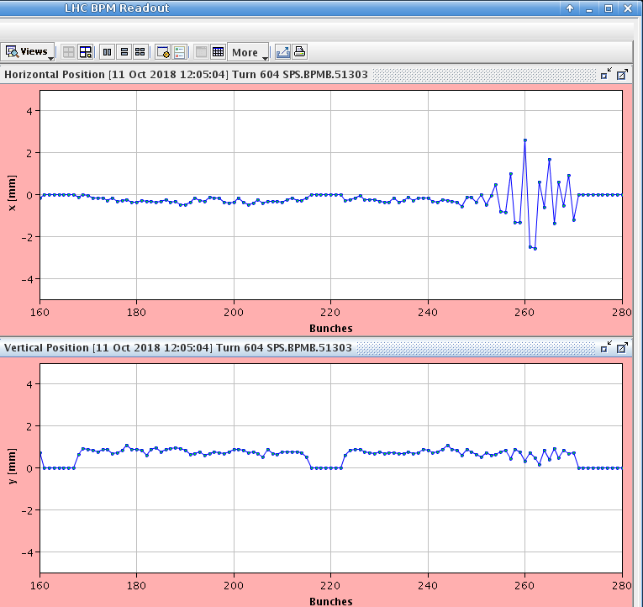
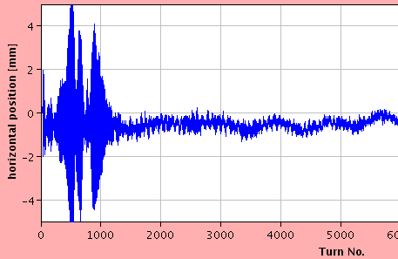
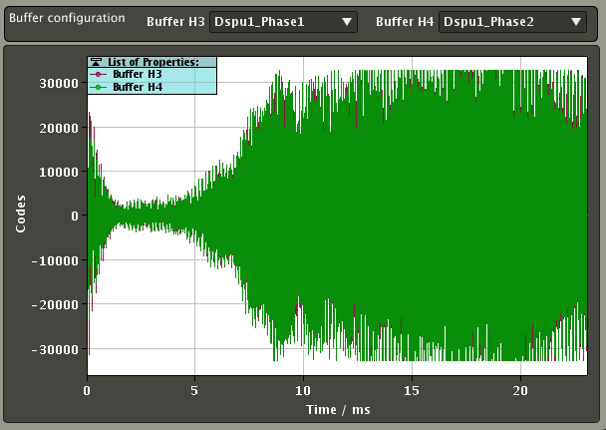
Studies with chromaticity step
Lots of data taken to characterize instability – to be analyzed in detail
  First 3 batches with high chromaticity to maintain stability, then reduced just before last injection
  Clear observation of instability with LHC BPMs, headtail monitor, wirescanners
  Optimized damper settings (tune acceptance, delay at 20 MHz)
  Managed to stabilize up to about 2e11 p/b, above this also coupled bunch pattern visible
Chroma step
LHC BPM
ADT
3rd batch
4th batch
rise time of a
few hundred turns

Slide 10
Summary
Detailed measurements of horizontal instability at SPS flat bottom
  With multiple closely spaced batches of 25 ns beam above 1.8e11 p/b
  “Mild” losses observed on BCT, but unstable bunches have important losses and huge emittance
  Optimization of MKP delay critical to avoid exciting last circulating bunches
  Stabilization by chromaticity alone results in too high (incoherent) losses
  Octupoles (with negative KLOF) help to stabilize the beam up to about 2e11 p/b
  Still a big step to 2.6e11 p/b
Next steps
  Gerd will try to commision the horizontal wideband feedback (exponential pickup used as kicker)
  Try to perform measurements with horizontal WBFB in one of upcoming MD slots
  Work on simulations and impedance studies to identify the source of the instability

