Slide 1
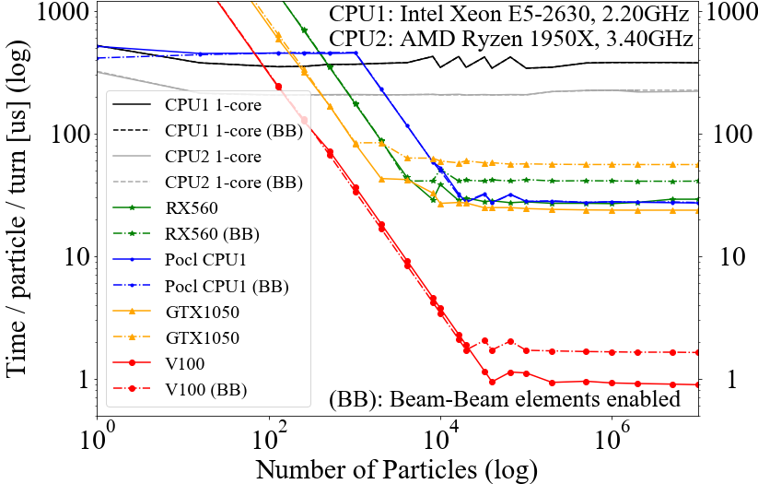
SixTrackLib
Github.com/SixTrack/SixTrackLib
Library to track many particles through accelerators for many turns.
Pseudo code:
for n in range(turns):
for type, params in beamline_elements:
for p in particles: // Parallel
if not_lost(p):
p=map[type](params, p)
LHC simulation
Figures:
turns : 10⁴-10⁷
particles (6-10 coordinates/particles): 10⁴-10⁷
beamline elements (1-50 parameters): 10³-10⁵
element types (10-20 types): 20-10⁵ arithmetic operations
20x
20 ms/turn
Current implementation single kernel with case-switch in OpenCL.
Goal:
maximum speed in both gaming (LHC@home) and server GPU, CUDA implementation.
tradeoffs: single large kernels vs multiple small kernels, storing redundant coordinates vs re-computing, no code duplication

Slide 2
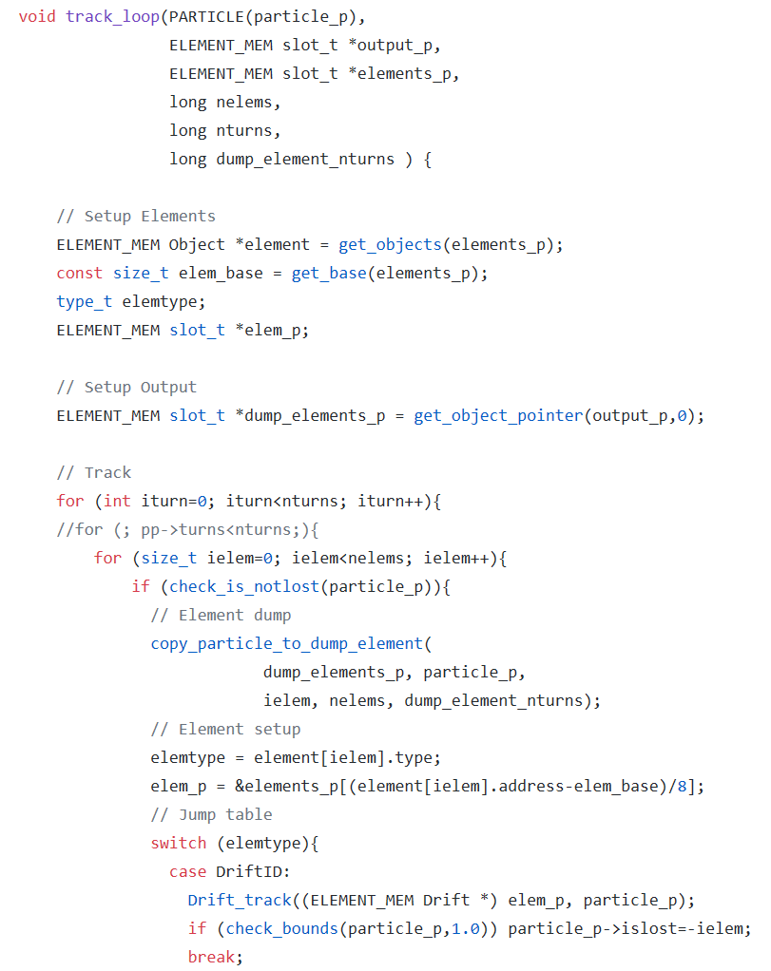
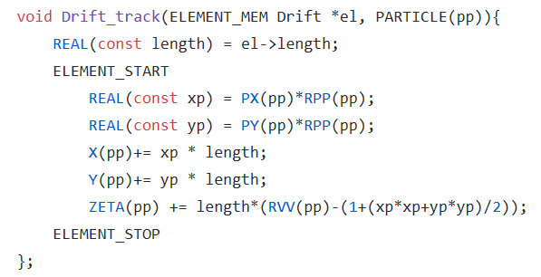
Code samples
Status:
Macros specialized for OpenCL.
Program:
Specialize macros for
  Monday: CPU (autovectorization)
  Tuesday: GPU (Cuda)

Slide 3
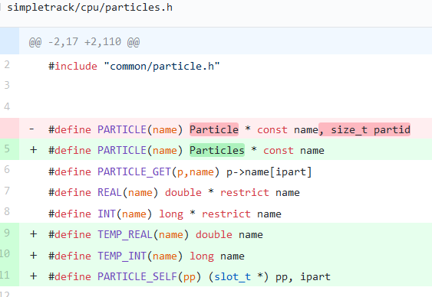
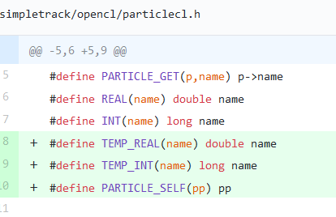
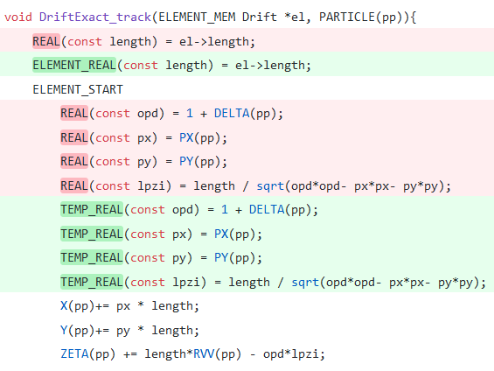
Day 1: Done
CPU Particles: SOA
GPU Particles: Global memory (SOA),
Computation on private/local memory (single structure)
Adapted CPU specific code: needed some restructuring of the GPU code and add some abstraction
It compiles now without warning, testing needed.

Slide 4
Day 2: To Do
Test code CPU and measure
Implement first CUDA kernel: should be similar to OpenCL besides cosmetics
Try to use dynamic parallisism to launch micro-kernels

