Slide 1
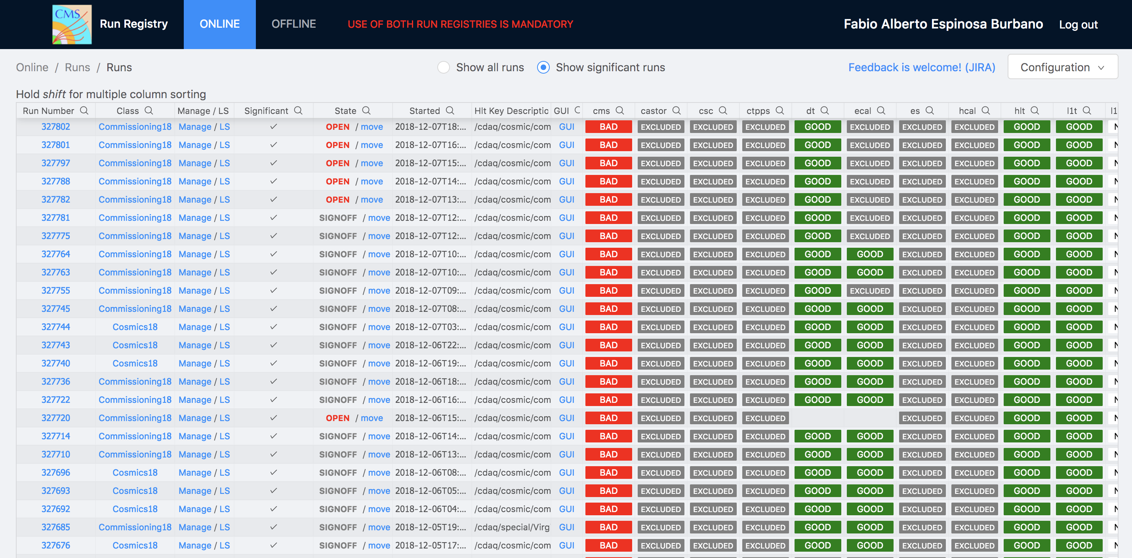
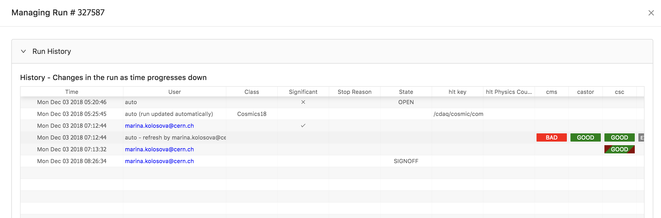
Run Registry
- Marcel, Fabio
New Run Registry:
https://cmsrunregistry.web.cern.ch

Slide 2
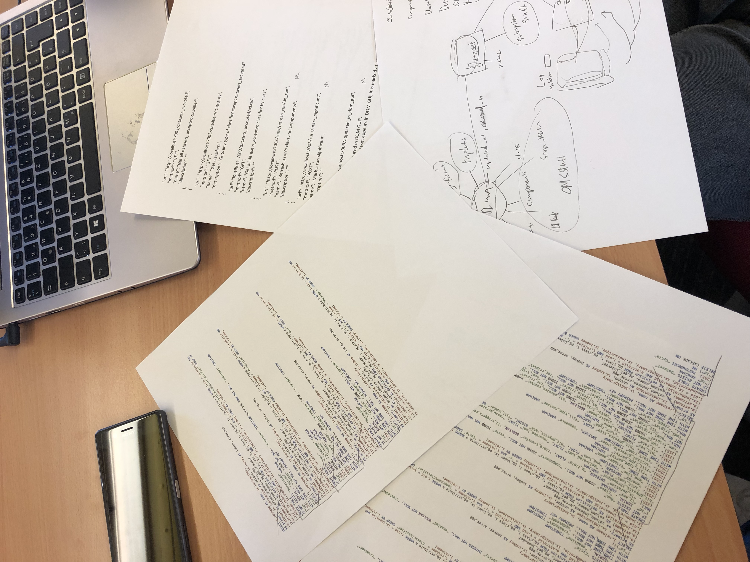
What did we do this morning
Analyzed SQL statements
Discussed DB Schema
Listed HTTP API requests
Try to setup postgres and node.js on CC7

Slide 3
What we want to do
Design db Schema
Test environment running

