Slide 1
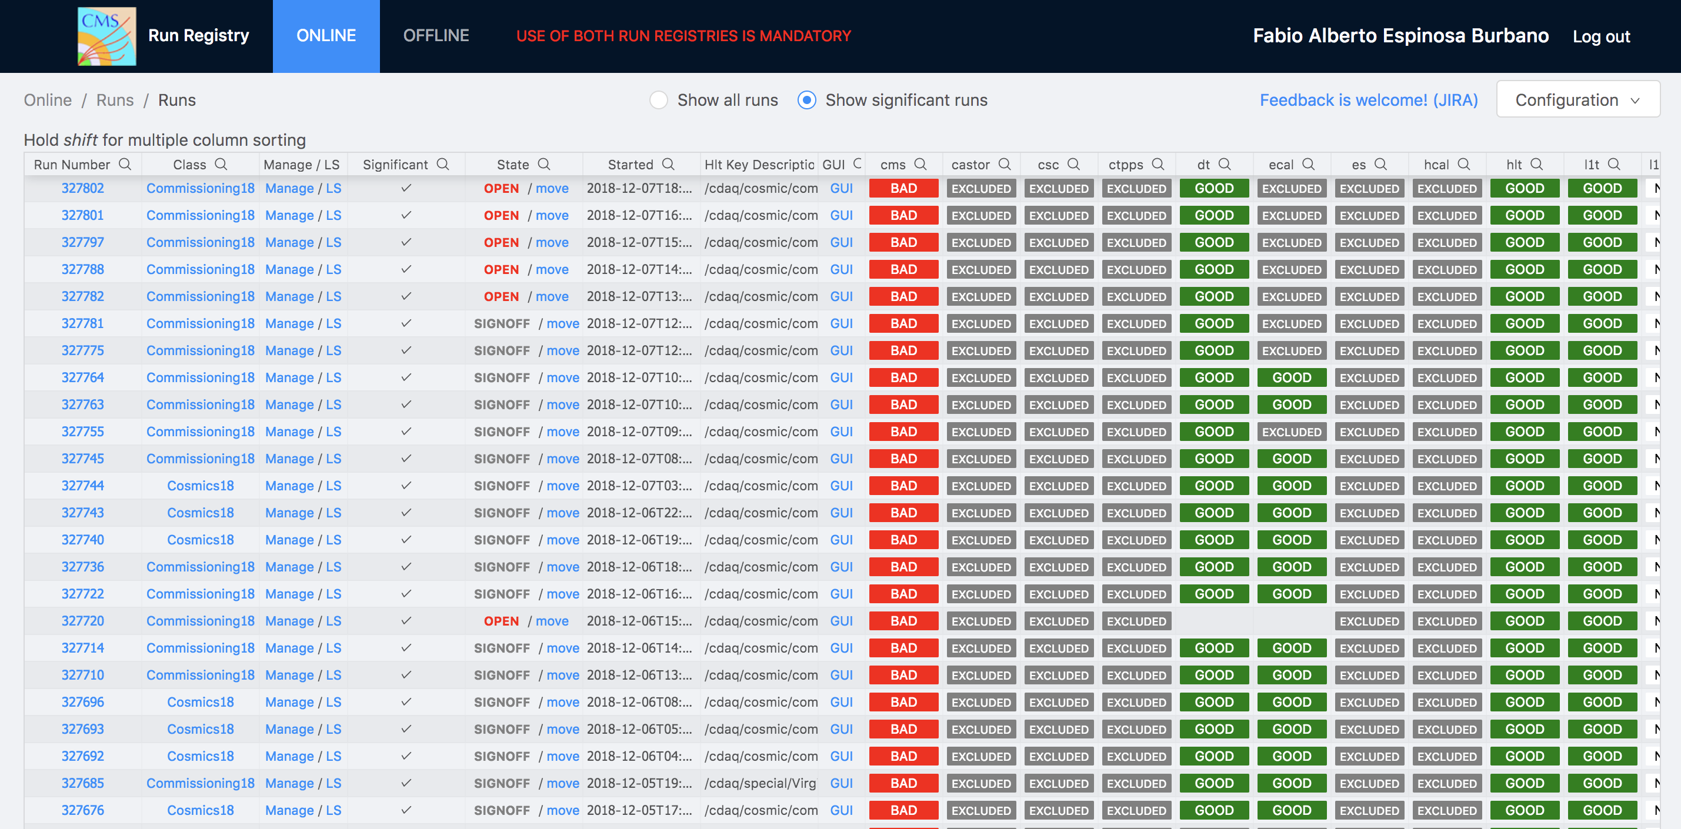
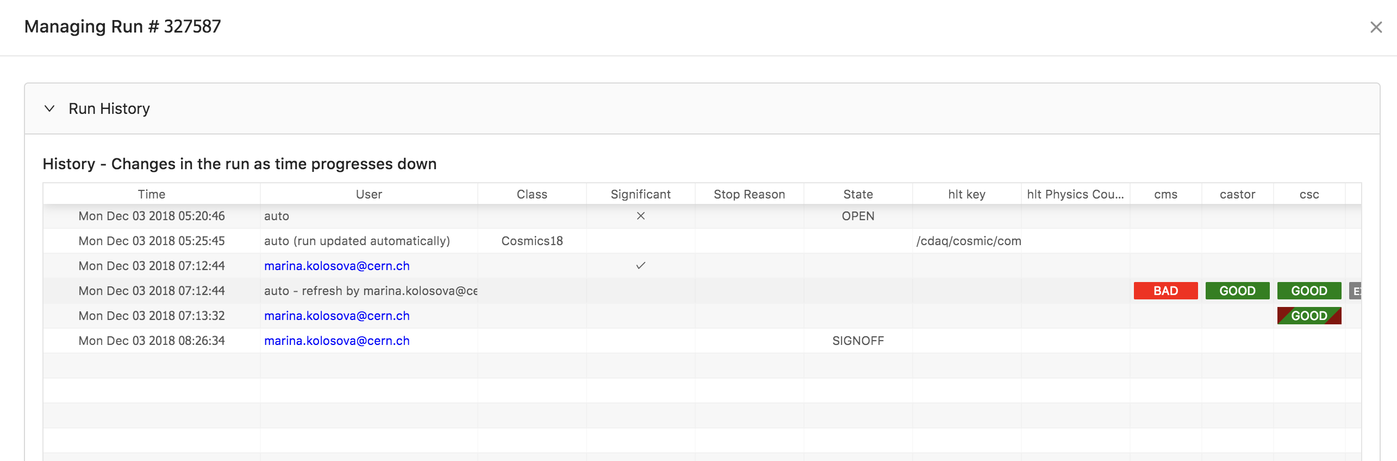
Run Registry
“Blockchain without Crypto”
- Marcel, Fabio
New Run Registry:
https://cmsrunregistry.web.cern.ch

Slide 2
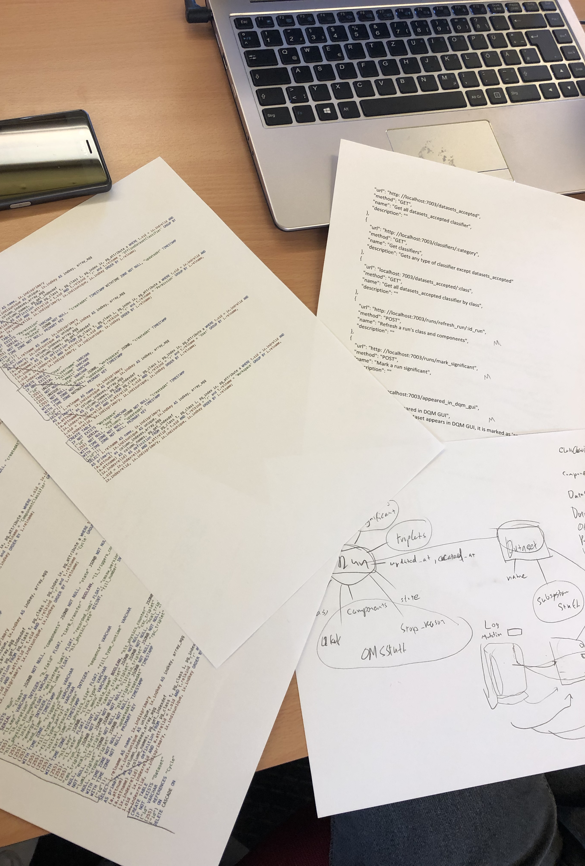
After a careful revision of what the real DB schema of RR should be…

Slide 3
We came to the conclusion…
That an immutable DB structure would make run registry maintainable, debugger-friendly, data-certification friendly and in short, just what DQM needs for such a tool.
Everything can be traced, nothing is ever deleted.
The ability that someone references a ”golden json” in a paper, and Run Registry can show you how the application looked like at that exact point is now possible.

Slide 4
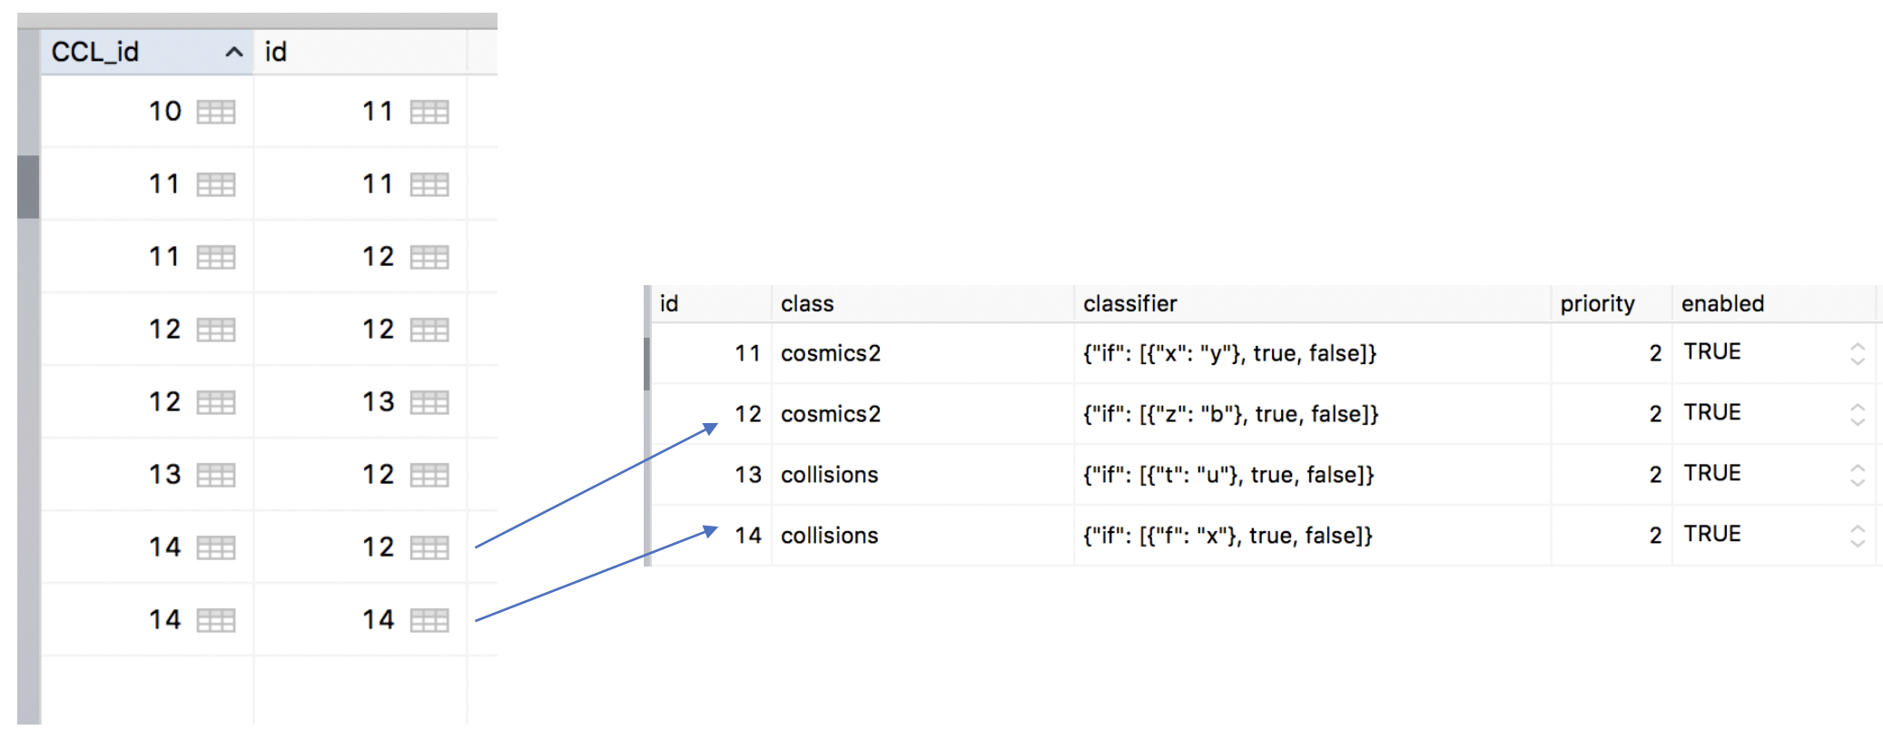
Two Immutable SQL Data structures were designed and implemented
One for settings, which was Git-like:

Slide 5
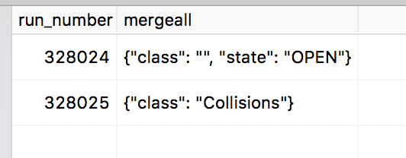
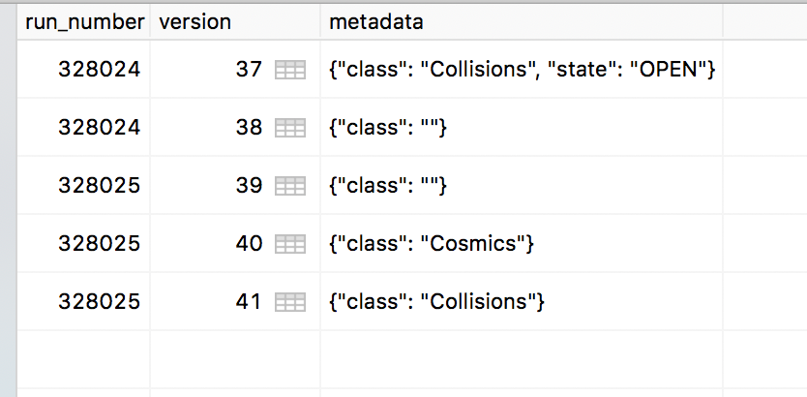
Two Immutable SQL Data structures were designed and implemented
One for Runs, Datasets and Lumisections, which Chain-like
View
Reconstruction
Reconstruction

Slide 6

Tradeoffs
Performance wise it will be just a bit slower
  Marcel beta tested with 1 million modifications and the result was in the order of a few seconds (when filtering runs).
  Although some optimizations are in the way and we are aiming towards the milliseconds.

Slide 7
Result
Settings configuration was integrated with current front end
DB Design was made
DQM Meeting today approved the benefits from hackathon’s design and the prototype will be demo’d next week.

