Slide 2

Experimental assessment of heat transport mechanisms in a superfluid helium-cooled Nb₃Sn 11 T Dipole coil segment
Mário David Grosso Xavier
Fellow
TE-CRG-CI (Cryolab and Instrumentation)

Slide 3
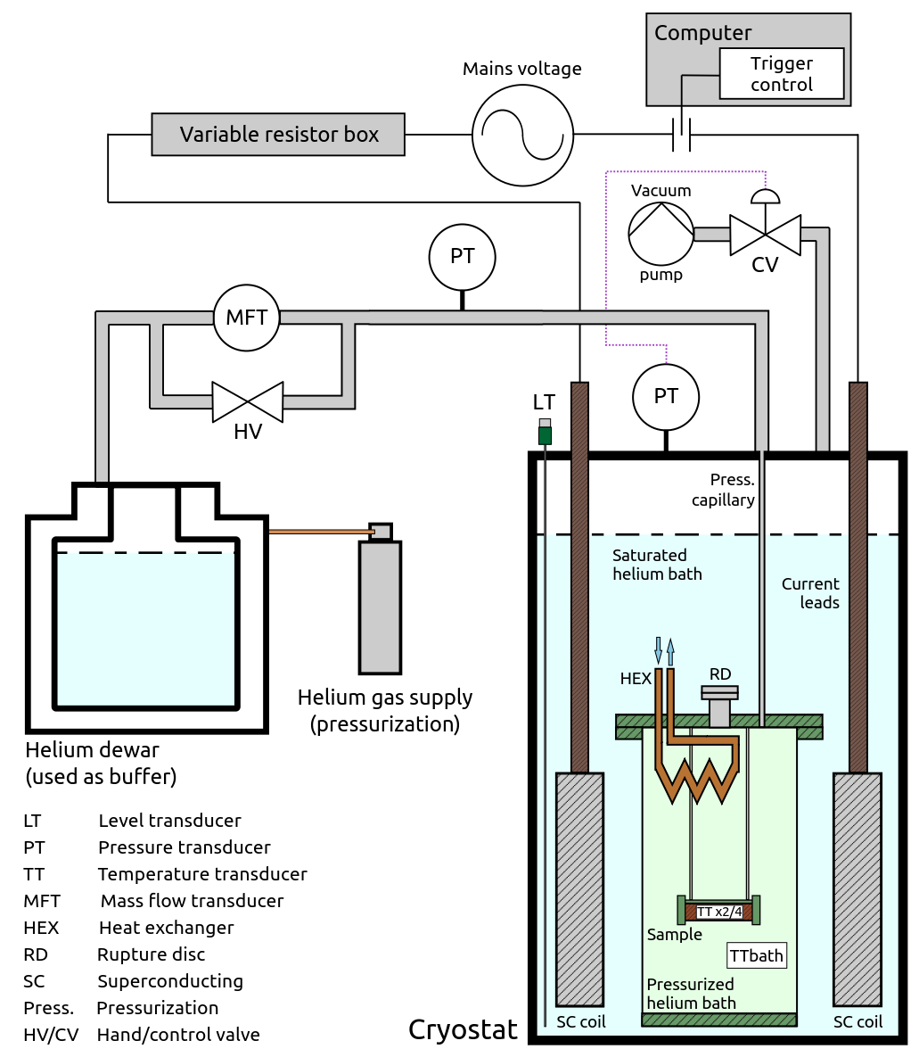
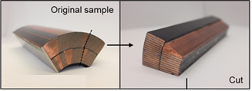
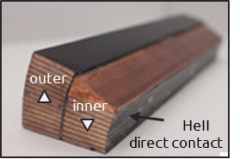
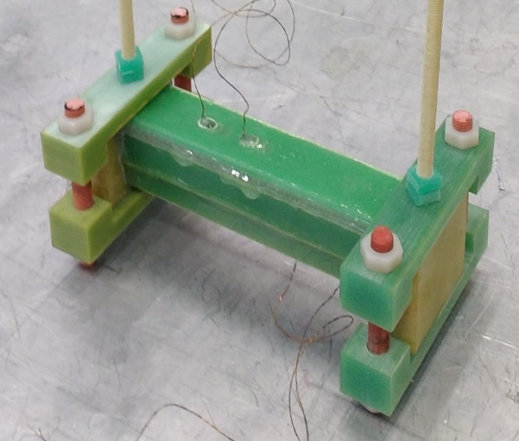
Experimental setup
Exploiting different AC loss mechanisms the sample is heated and the temperature evolution in sample and bath is measured.
The generated power can be varied by changing the combination of the resistor box.
Important parameters:
T_{eq} : equilibrium temperature
τ : time constant (time to reach 63.2 % of peak temperature)
HeII direct contact

Slide 4
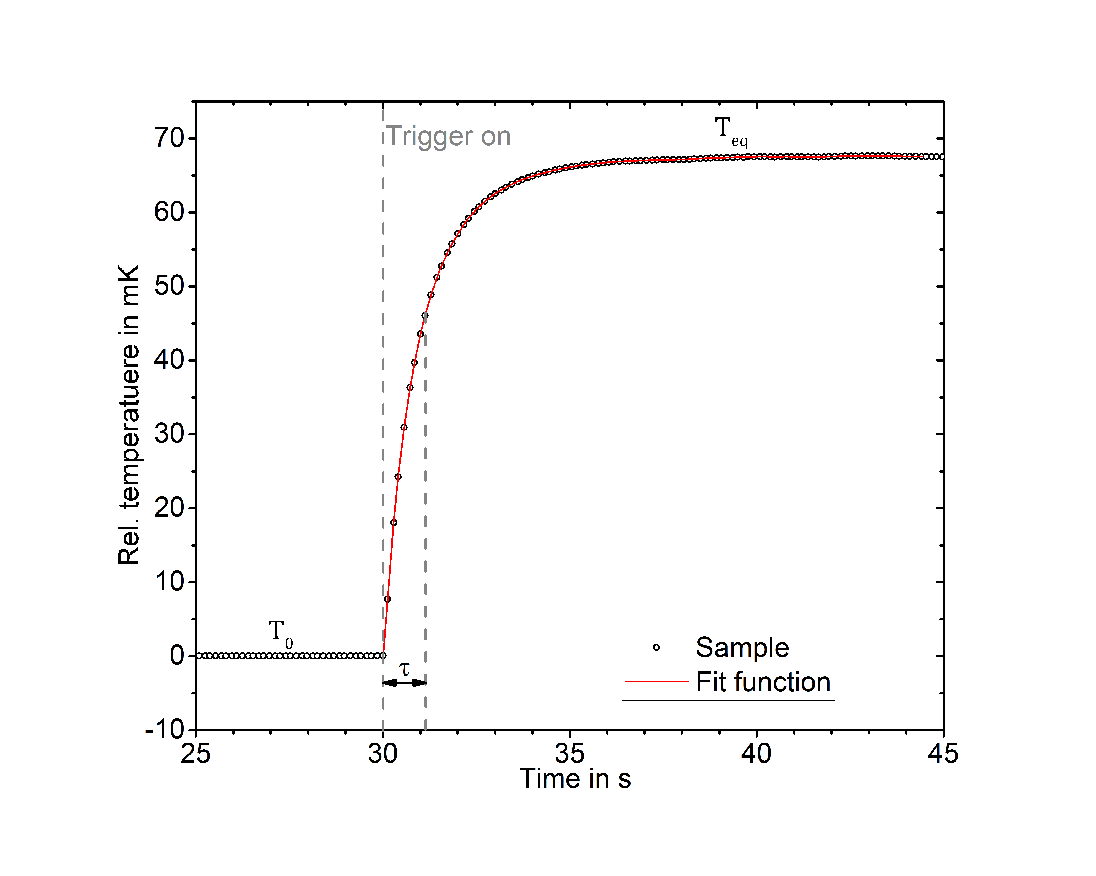
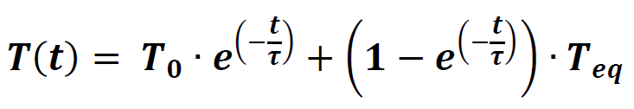
Typical measurement
Relative temperature in mK
Time in s

Slide 5
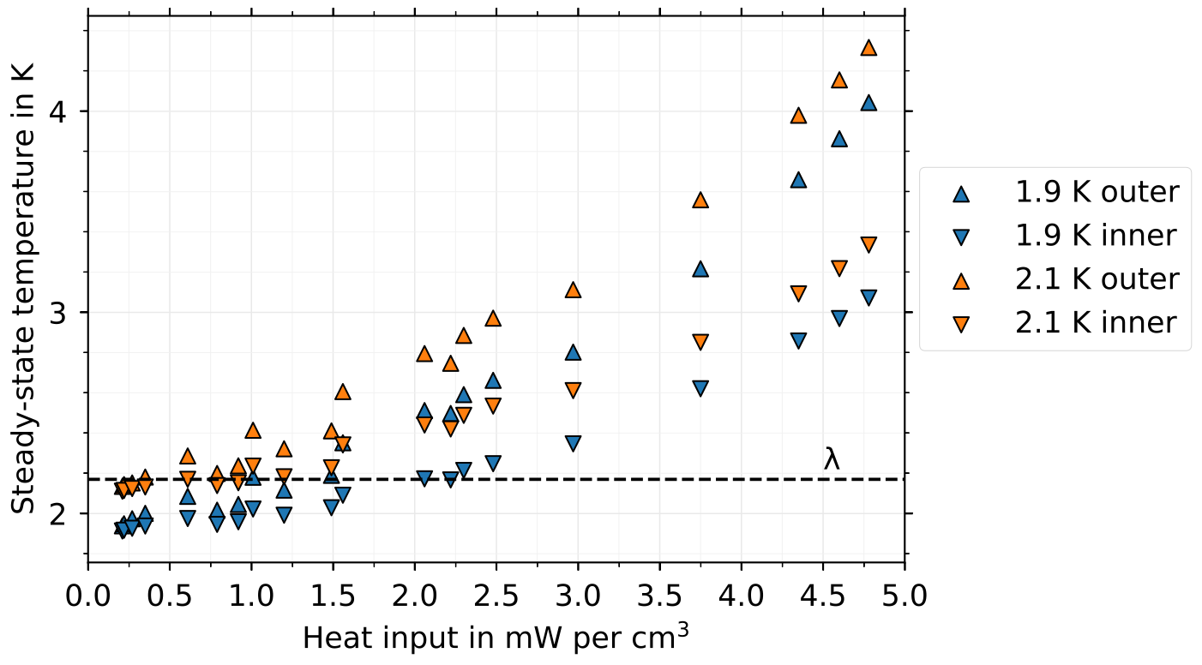
WARNING: Uniform power deposition results CANNOT be simply translated to 11 T Dipole loss profile

Slide 6
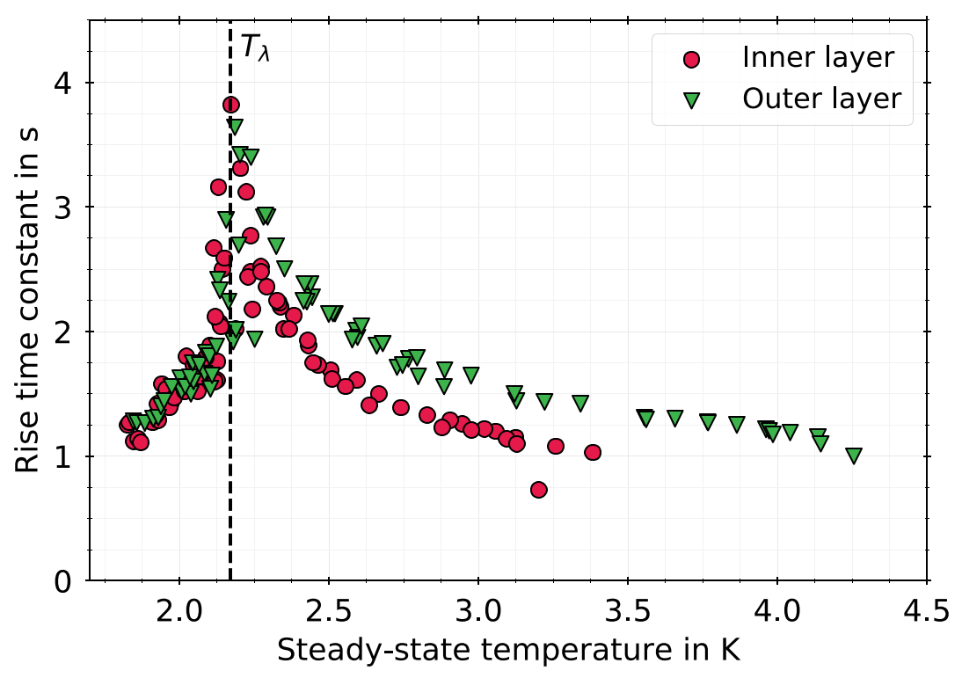
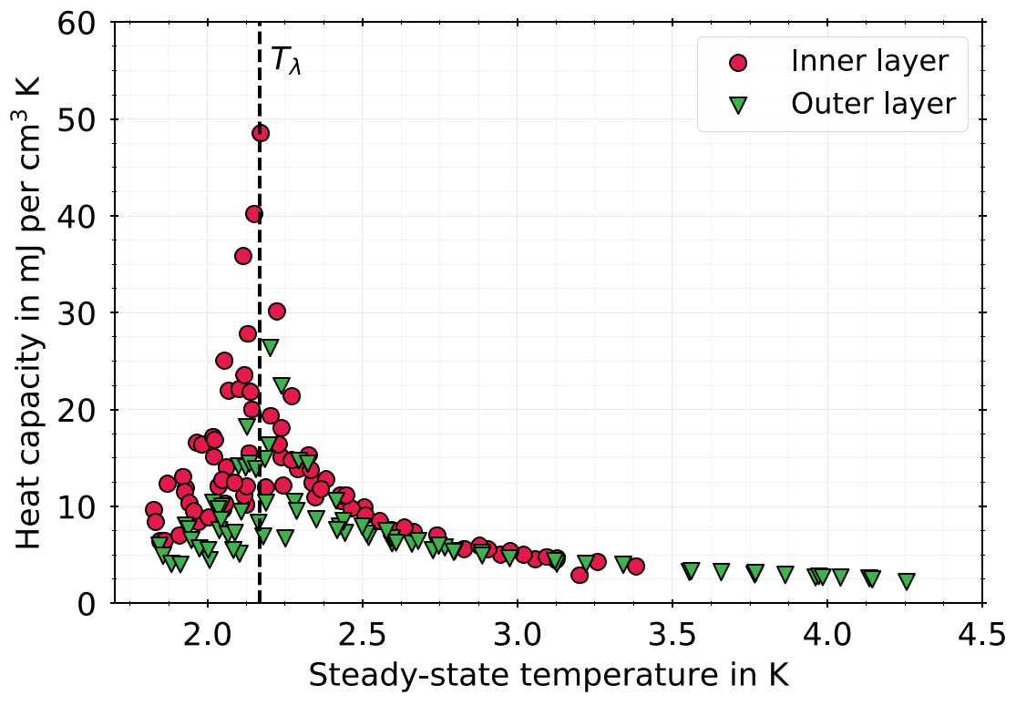
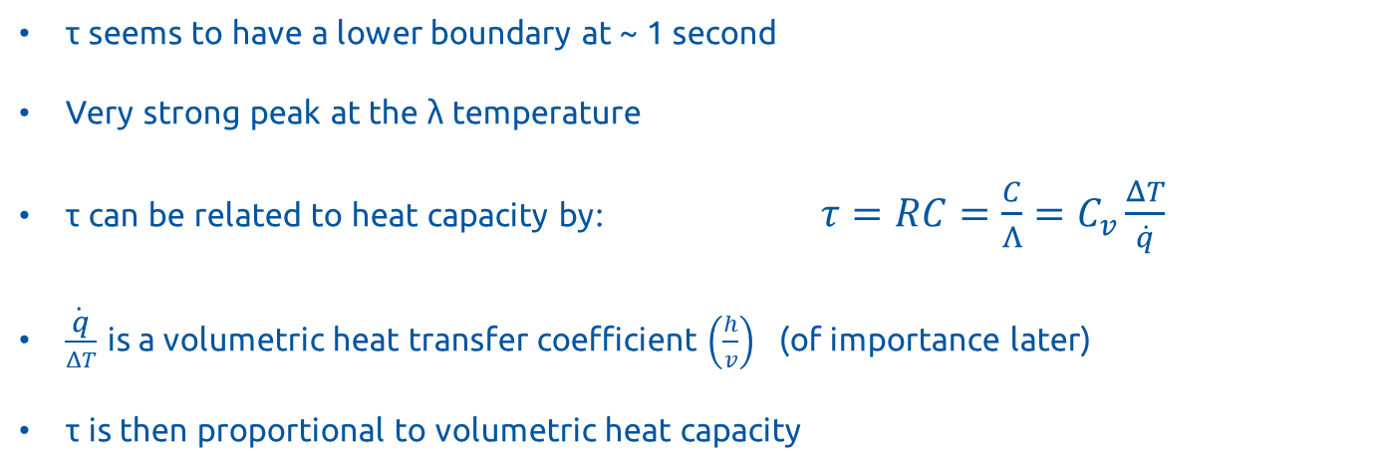
τ seems to have a lower boundary at ~ 1 second
Very strong peak at the λ temperature
τ can be related to heat capacity by: $τ=RC=\frac{C}{Λ}=C_{v}\frac{ΔT}{\dot{q}}$
$\frac{\dot{q}}{ΔT}$ is a volumetric heat transfer coefficient $\left(\frac{h}{v}\right)$ (of importance later)
τ is then proportional to volumetric heat capacity

Slide 7
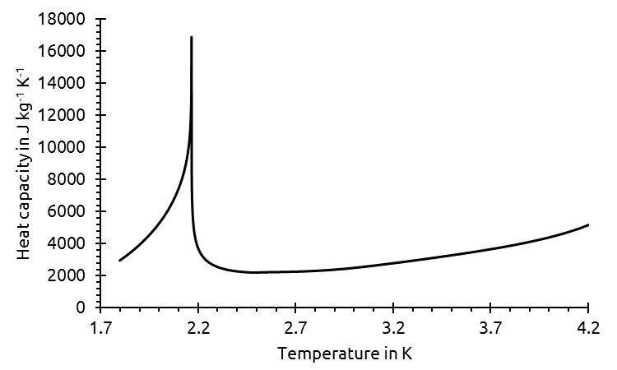
This volumetric heat capacity seems to then show a peak at T_{λ}, like in LHe
The order of magnitude is much larger than the usual range of material heat capacities, so any small presence of LHe is very sensitively measured
Implies a small presence of LHe in the cable sample, with clear influence in the time constant, and thus the heat capacity
(Data from HePak)

Slide 8
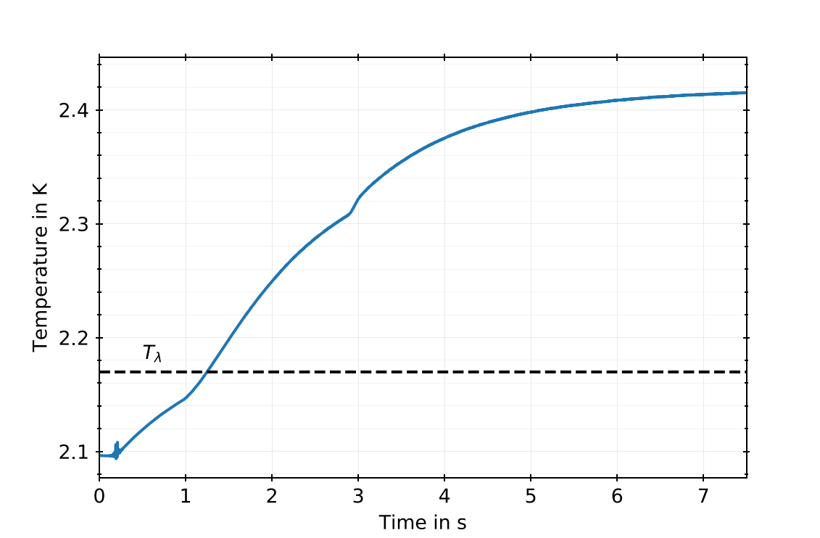
Measurement at 2.1 K starting temperature and heat input of 1 mW cm⁻³, one of the outer layer temperature sensors

Slide 9
Concluding remarks
Very clear indication of small LHe presence in the cable
Absolute values shown cannot simply be translated to the 11 T collimation loss profile use case:
Steady-state temperatures, as well as response times, are measured up to a UNIFORM power deposition of 5 mW per cm³, whereas collimation-induced power distribution is a narrow cone, within a limited area – see diagram in next slide
Reaction times τ measured (1 s to 4 s) also include the adiabatic G10 walls added to the sample for insulation, which delay with an approximate factor 2 to 3 the reaction times. The reaction time is also affected by the power distribution
Experiment currently being used to validate details of the 11 T Dipole magnet simulation model (Kirtana Puthran, ongoing work)

Slide 10
Rough generalization of system response
Uniform heating with adiabatic walls
Inner-layer quench heater in bath
Simulation of 11 T Dipole
collimation loss profile
Helium contact
Adiabatic wall
Heat deposition
Heat transfer direction
Comparison of experimental results (uniform heating with adiabatic walls) with other cases is not immediate: power distribution and heat transfer paths rather different
Uniform heating with adiabatic walls is likely the worst cooled of the 3 options, as generated heat must be transferred on average over a longer path:
Highest time constant, lowest volumetric heat transfer coefficient?

Slide 11


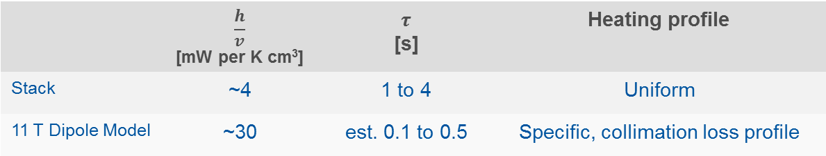
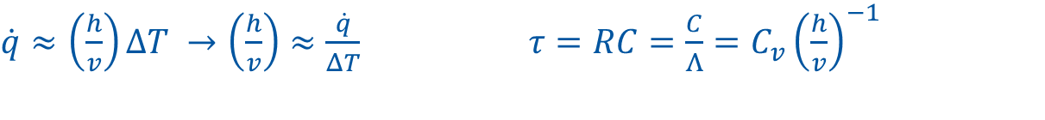
Rough generalization of system response
$$\dot{q}(t)$$
$$T(t)$$
$\dot{q}≈\left(\frac{h}{v}\right)ΔT →\left(\frac{h}{v}\right)≈\frac{\dot{q}}{ΔT}$ $τ=RC=\frac{C}{Λ}=C_{v}{\left(\frac{h}{v}\right)}^{−1}$
Volumetric heat transfer coefficient
Volumetric heat capacity
Volumetric heat input
 | $$\frac{h}{v}$$ [mW per K cm³] | $$τ$$ [s] | Heating profile
Stack | ~4 | 1 to 4 | Uniform
11 T Dipole Model | ~30 | est. 0.1 to 0.5 | Specific, collimation loss profile
Measured
Simulated

Slide 13
