Slide 1
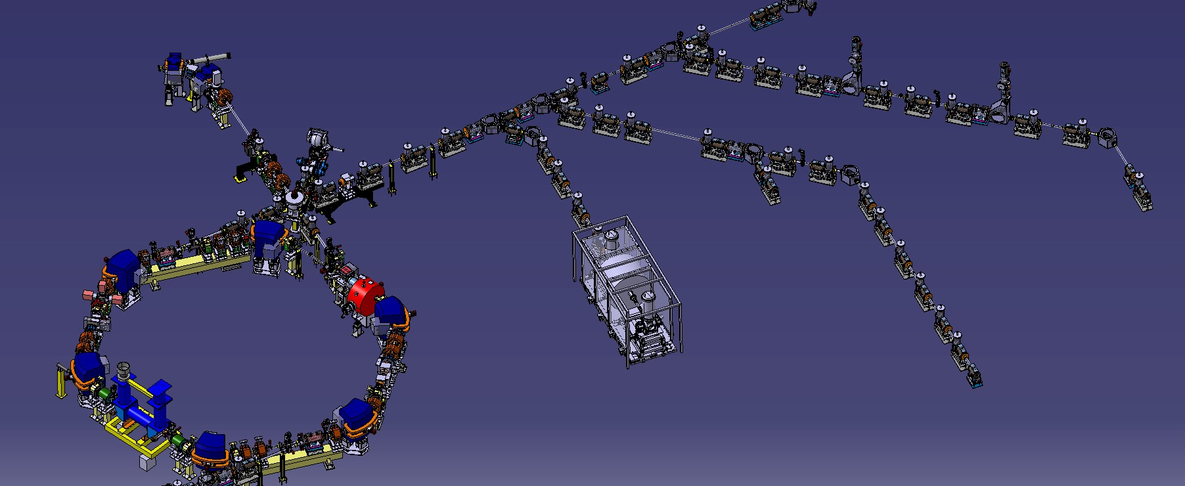
Status of ELENA
C. Carli on behalf of the AD/ELENA team(s) ADUC, 30th October 2018
Recent Results from Commissioning (selection of a few highlights)
ELENA Commissioning Status
Summary and Outlook

Slide 2
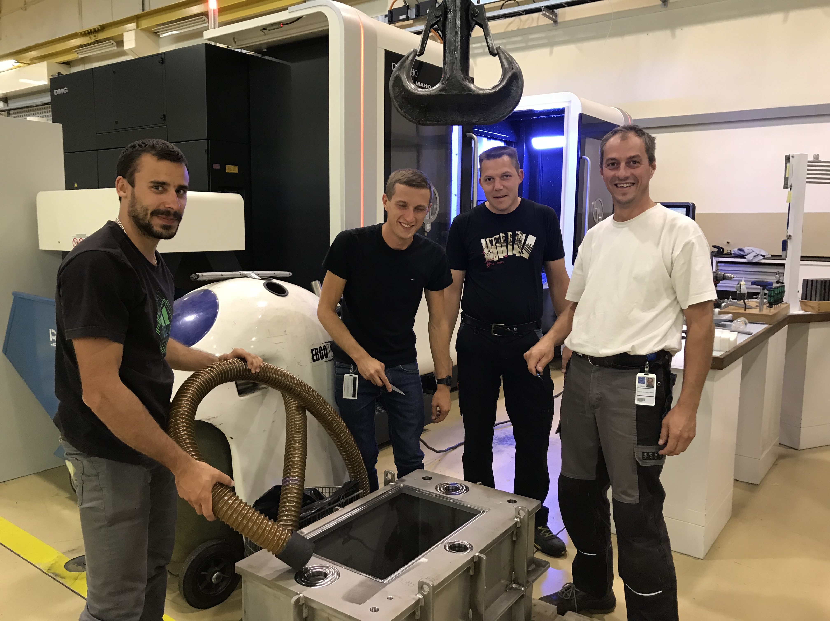
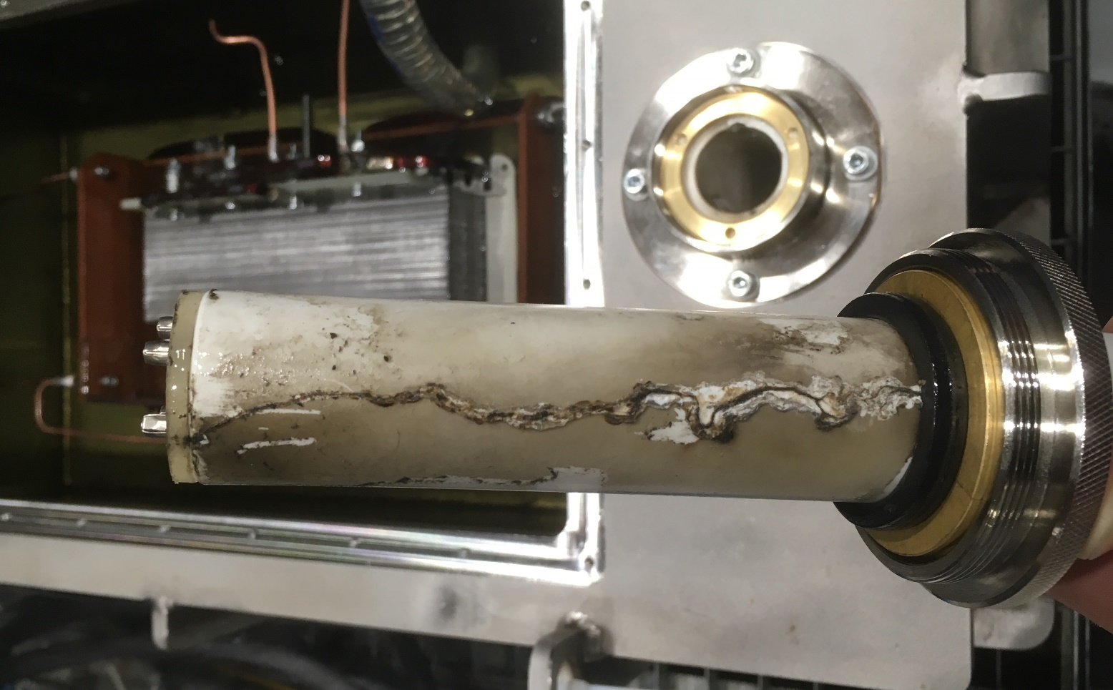
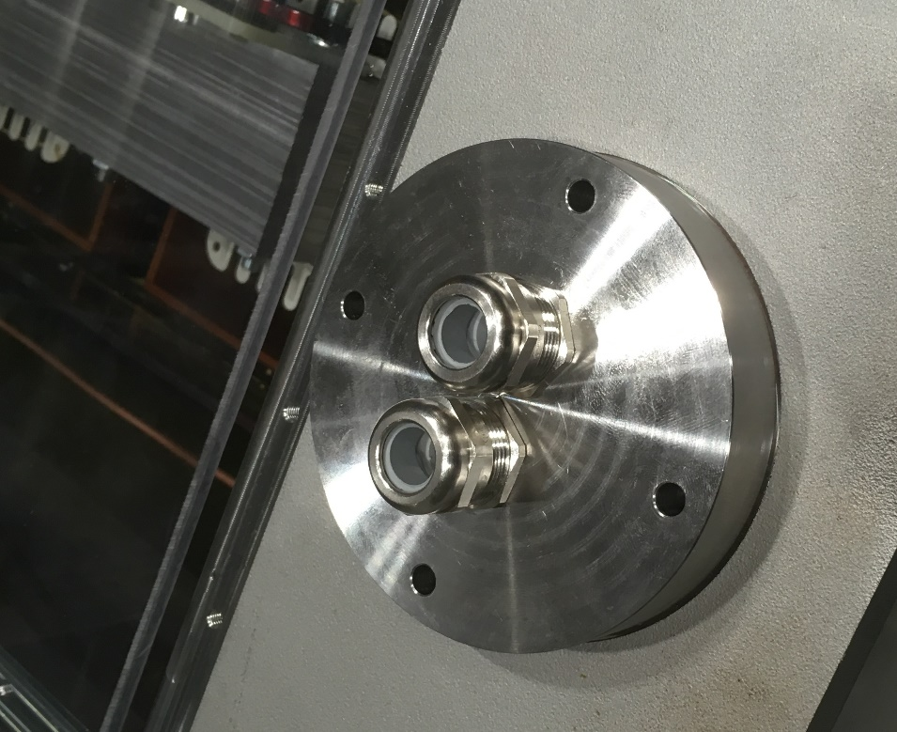
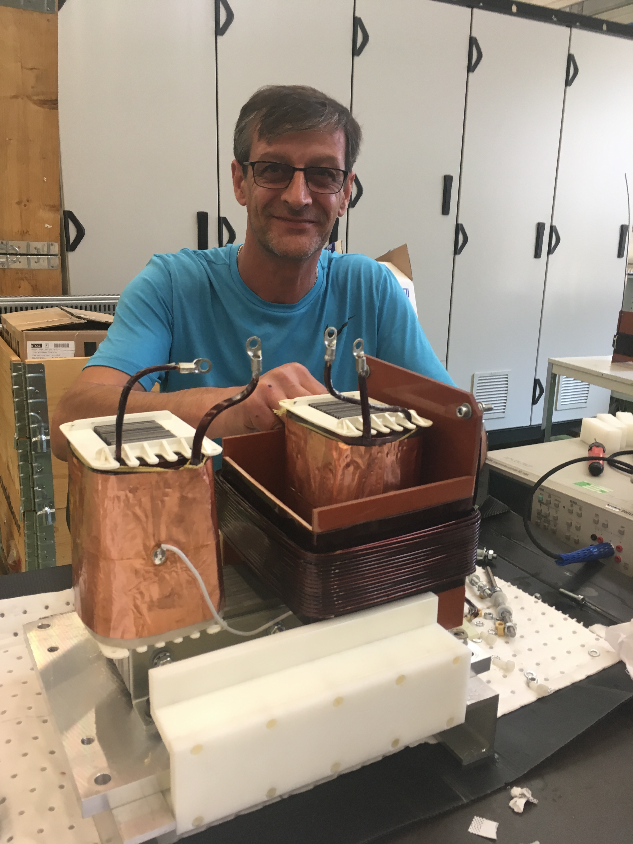
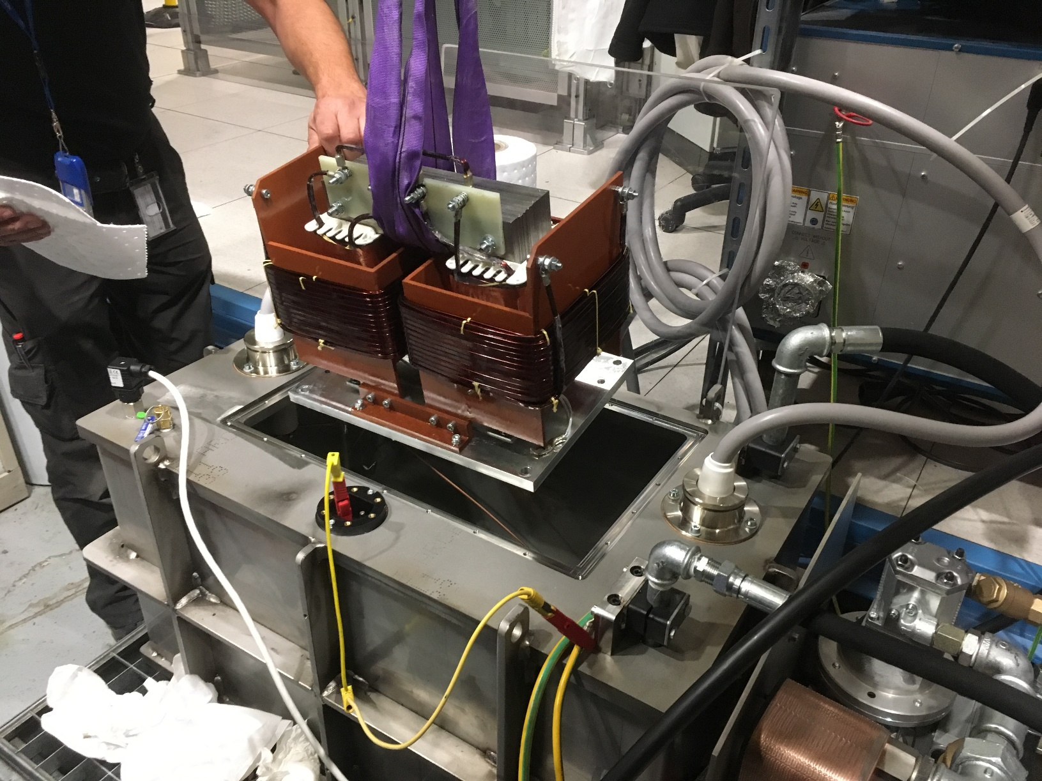
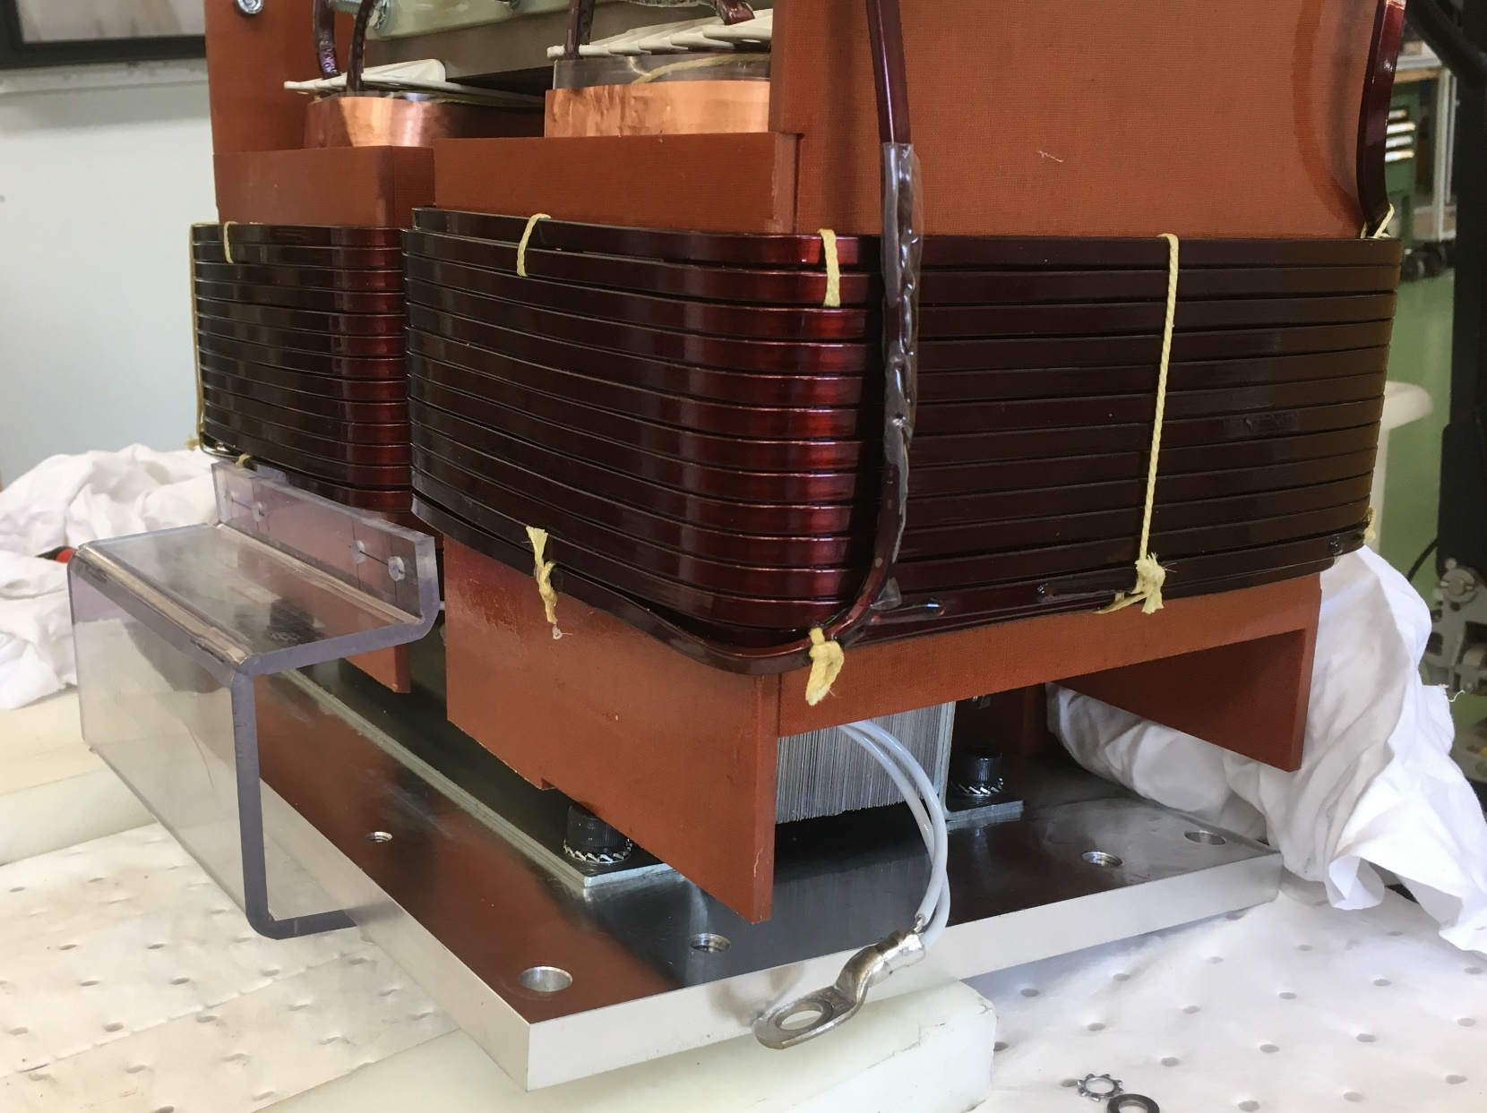
Recent Results from Commissioning
Efforts for a new isolation transformer using oil as insulator
Last (repaired) isolation transfo using solid insulator and operated at 85 kV failed on Friday 21st September
Despite high priority by CERN groups for a transformer using oil, beam available only a few hours since
Broken connector and new HV connection without connector
Oil tank for isolation transformer
completed already on 26th September
Thanks a lot for the high priority
and efforts by several groups
and many people
1st mounting of transformer
New support for secondary coils
Winding new secondary coil

Slide 3
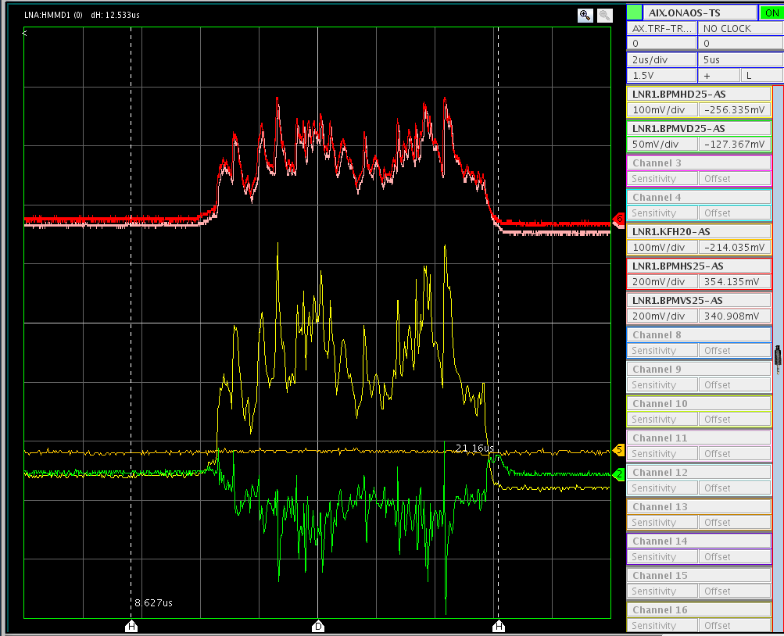
Recent Results from Commissioning
Observation of the beam from the source on a ring pick-up
Observation of beam from source on first pick-up in ring
  Steering without kicker (flat-top shorter than beam
  pulse from source) up to first ring pick-up
  Higher deflection from septum
  and steering upstream
  No beam must hit pick-up plates
  (delicate!)
  Intensity fluctuations depend on
  source settings:
  probably caused by plasma fluctuations
  and may explain poor reproducibility
  observed
  Source optimisation easier with these observations
  Possibly, fluctuations may be reduced with longer rise times of the pulse
Investigations by
D. Gamba
Pick-up sum signals showing (very likely
intensity fluctuations, sometimes saturated)
Pick-up
difference signals

Slide 4
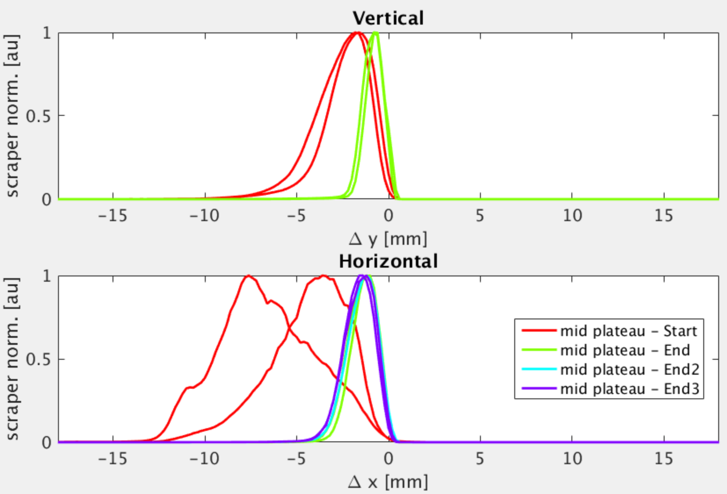
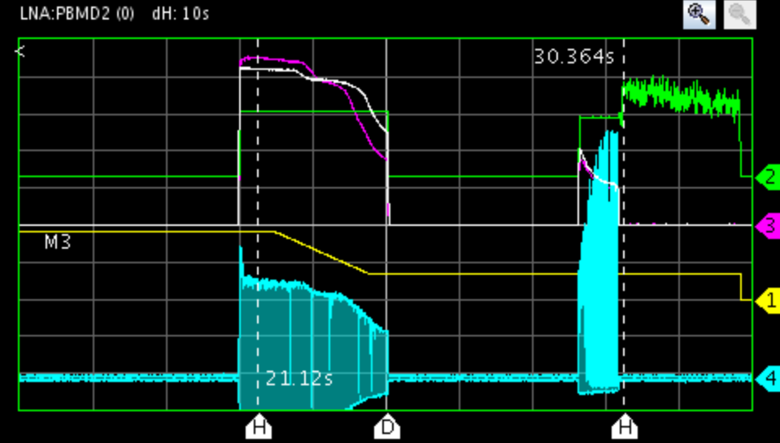
Recent Results from Commissioning
Observation along the cycle
Intensity estimate from RF electronics
RF voltage
Peak signal of
pick-up sum signal
2 s/div
Real loss
Bunched beam
electron cooling
Probably no loss, but systematic error with short bunches
- Measurements with a “scraper” at different
times on the 35 MeV/c plateau
Clear emittance reduction observed
- Only limited amount of time spent on
systematic optimization of electron cooling
(lack of time)
=> Margin for further improvements?
- Some signals along 2nd ramp and
on the 100 keV plateau
- Typical situation during the last weeks
- Significant efforts to reduce the loss
and situation improving slowly

Slide 5
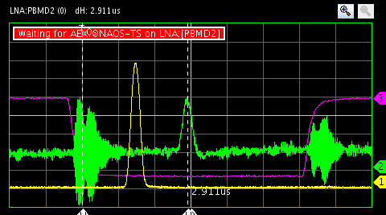
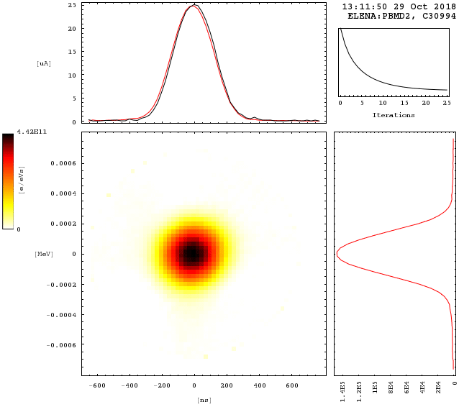
Recent Results from Commissioning
Observation of antiproton beams at extraction
Transformer
in LNE 50 line
Last time on a
ring pick-up
Fast deflector
1 us/div
-0.6 0 0.6 keV
Bunches around extraction
  More than .5 10⁷ antiprotons seen
  very reproducibly in ring prior to
  ejection and in line
  Possibly improved with better steering
  thanks to profile acquistions
  Bunch lengths a bit long with U_{RF} = 32 V
  programmed on harmonics h = 1
  Rms relative momentum spread of 0.68 10⁻³ from reconstruction about nominal
  (and possibly overestimated due to lower than expected RF voltage)
-0.6 0 0.6 ns
Reconstruction (“Tomography”) of longitudinal
phase space density distribution from bunch shapes
acquired during about one synchrotron oscillation

Slide 6
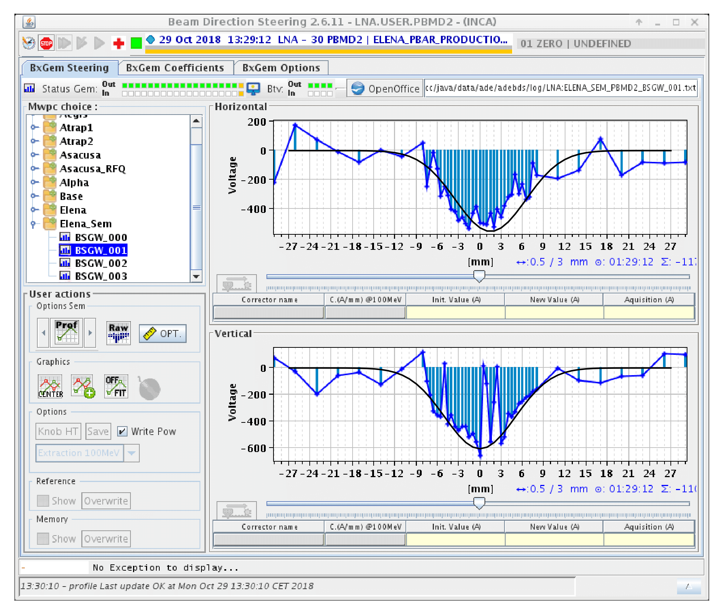
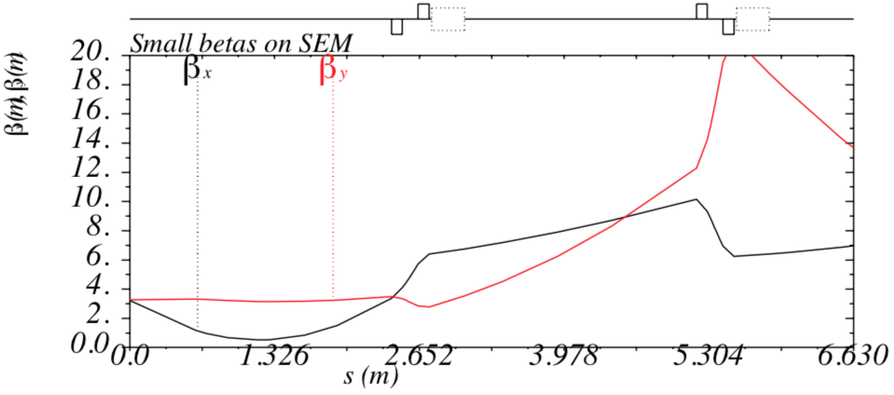
Recent Results from Commissioning
Observation of antiproton beams at extraction
Profiles in the GBAR line
  Acquisitions with second monitor LNE.BSGWA.5060 in GBAR line
  Beam sizes with voltages of first two
  quads of line set to zero
    β_{H} =6 m gives rms emittance
    ε_{H} = 3.3 um (slightly overestimated without
    taking dispersion into account)
    β_{V} = 20 m gives rms emittance
    ε_{V} = 1.25 um
Gaussian fit by hand with σ_{H} = 4.5 mm
Gaussian fit by hand with σ_{V} = 5 mm
Betatron functions along LNE50 line with settings
to provide beam to GBAR and ring optics updated
to quad settings used in practice

Slide 7
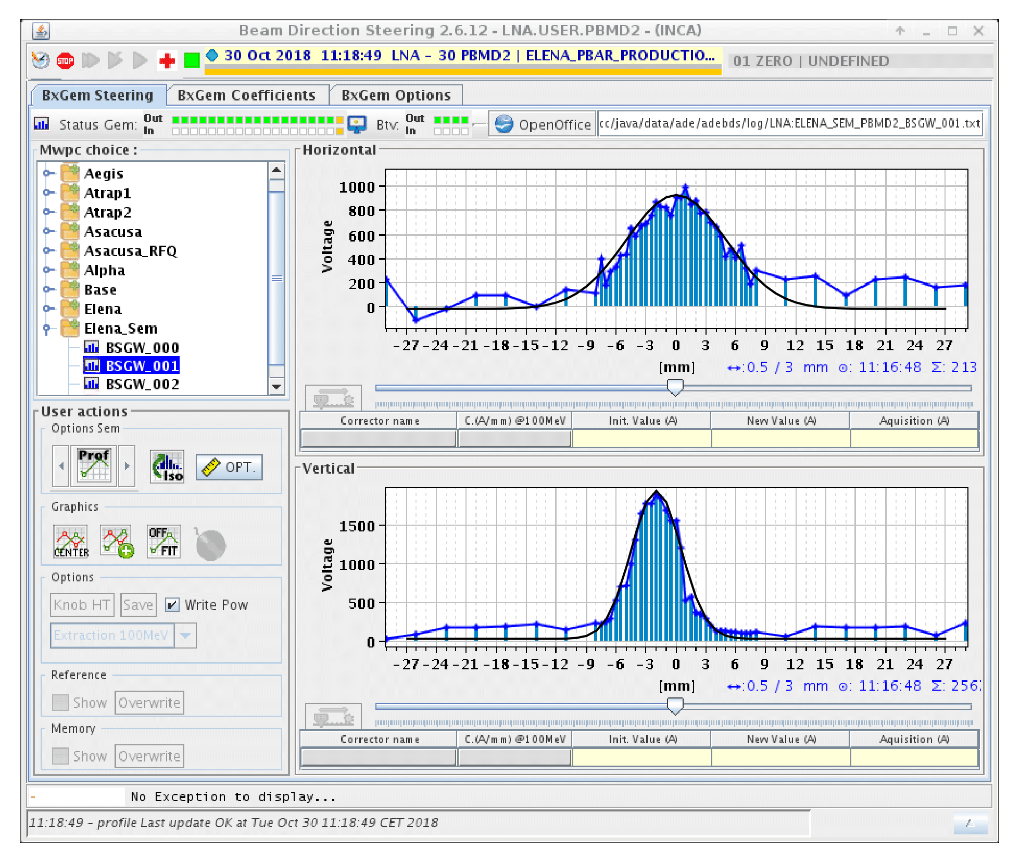
Recent Results from Commissioning
Observation of antiproton beams at extraction
Profiles in the GBAR line
  Acquisitions with second monitor LNE.BSGWA.5020 in GBAR line
  Beam sizes with voltages of first two
  quads of line set to zero
    β_{H} = 6 m gives rms emittance
    ε_{H} = 4.1 um (slightly overestimated without
    taking dispersion into account)
    β_{V} = 4 m gives rms emittance
    ε_{V} = 1.5 um
Gaussian fit by hand with σ_{H} = 5 mm
Gaussian fit by hand with σ_{V} = 2.5 mm

Slide 8
ELENA Commissioning Status
Aims defined at the beginning of 2018:
  Continuation of Commissioning with electron cooler from April on
  Get Confidence that machine works properly
    Ideally demonstration of operational cycle to deliver 100 keV antiprotons
  First beams for GBAR
Achieved by and-October 2018:
  Deceleration of antiprotons to 100 keV so far with modest efficiency (very reproducible)
    Loss along 2nd ramp to 100 keV
    >20 % of injected beam extracted
  Clear emittance reduction in all three planes due to electron cooling (beneficial for deceleration)
  Operation for GBAR
    H⁻ and antiproton bunches with about nominal intensities
    Emittance of antiproton bunches probably somewhat above nominal (factor <2 in transverse beam size)
Status, issues, plans:
  Less progress than expected at the beginning of
  the year, but evidence that conditions for experiments are improved
  Progress slowed down by unavailability of beam from the AD and from the source
  Open issues, studies to be done
    Estimate Injection matching, loss along second ramp, blow-up due to RF noise, still very limited observations with prototype profile monitor for transfer lines

Slide 9
Summary and Outlook
Significant ELENA Commissioning progress over the year despite various delays
  Delay of restart due a vacuum leak of the cooler, unavailability of AD, issues with the ion source
  In practice, most progress made with antiprotons, only during dedicated AD shifts
  (change of commissioning strategy)
  Nominal antiproton cycle not (yet) available, single bunches (one per cycle) with characters “similar” to nominal bunches regularly sent to GBAR
Plans for LS2
  Installation of the transfer lines to the “old” experimental zone
  Upgrades of the ion source for reliable generation of 100 keV proton and H⁻ beams
  Review of status and possible improvements (ring optics, applications, instrumentation …)
  Resume commissioning activities with beam from source in early summer 2020
    Test of ring and electron cooling with protons
    Commissioning of lines with H⁻ (beam intensity and quality of measured profiles?)
Position of ELENA team on installation of lines to old experimental area
  Enough observations to be confident that ELENA can improve the conditions for the experiments despite a fully operational antiproton cycle not (yet) available
  Confidence in profile monitor availability thanks to a collaboration between Masaki Hori and BE/BI
  => Go on with the installation of the new lines (LS2 is the perfect moment for this activity)
  => Have 100 keV antiprotons for all experiments from 2021 on

