Slide 1


ELENA Project
TRANFER LINES INSTALLATION LS2
ADUC 30 Oct 2018

Slide 2
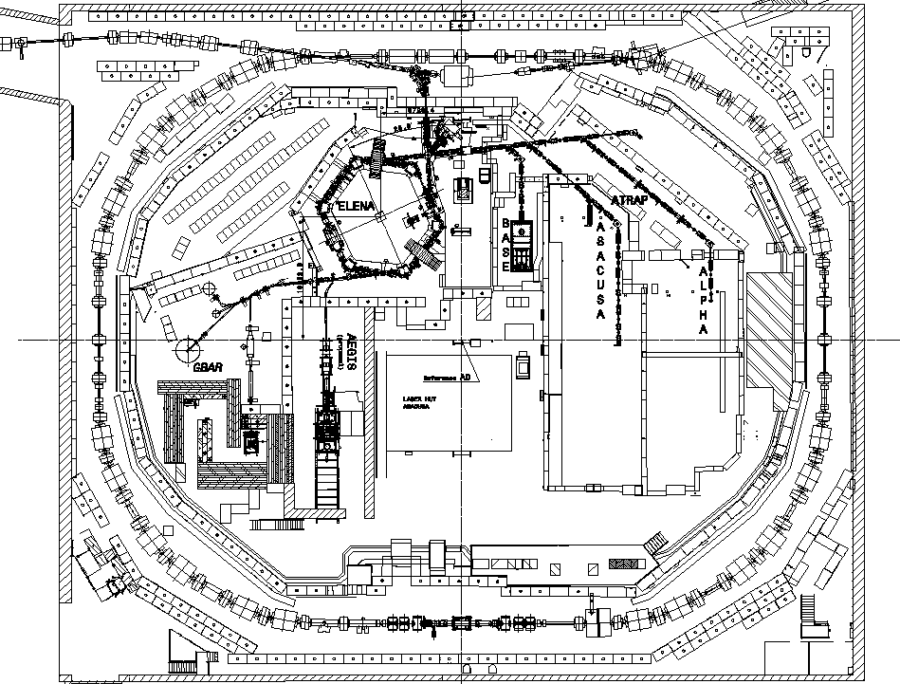
ELENA in AD hall
AEGIS
ELENA
ATRAP
BASE
ASACUSA
ALPHA
GBAR
AEGIS 2
AD machine

Slide 3
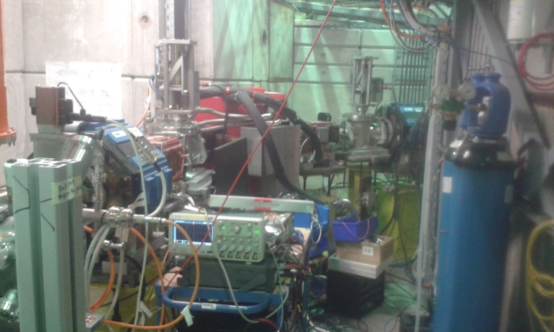
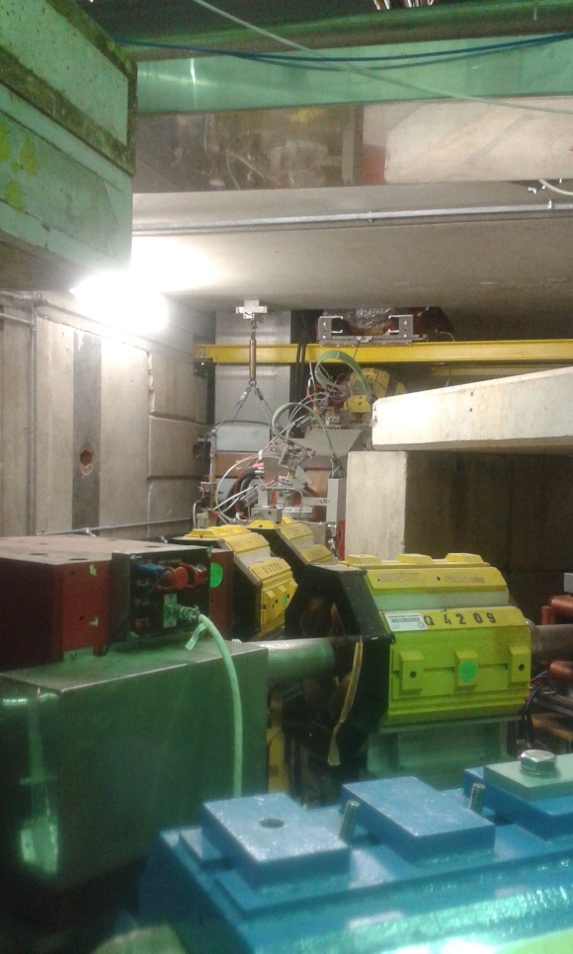
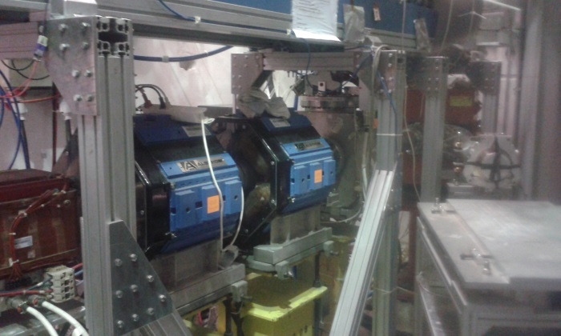
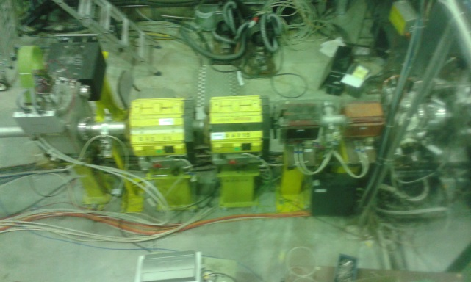
LS2 : 12 Nov 2018 – March 2021
Existing magnetic
TLs to be replaced by electrostatic TLs

Slide 4
Transfer lines works
Lock-out, cables disconnection, flexible cooling pipes disconnection
Remove all magnetic transfer lines plus corresponding supports
Remove all corresponding cables
Re-organize part of the shielding walls
Re-route cable trays and water pipes
Install electrostatic transfer lines, instrumentation, vacuum and services
Commission new transfer lines
TIME

Slide 5
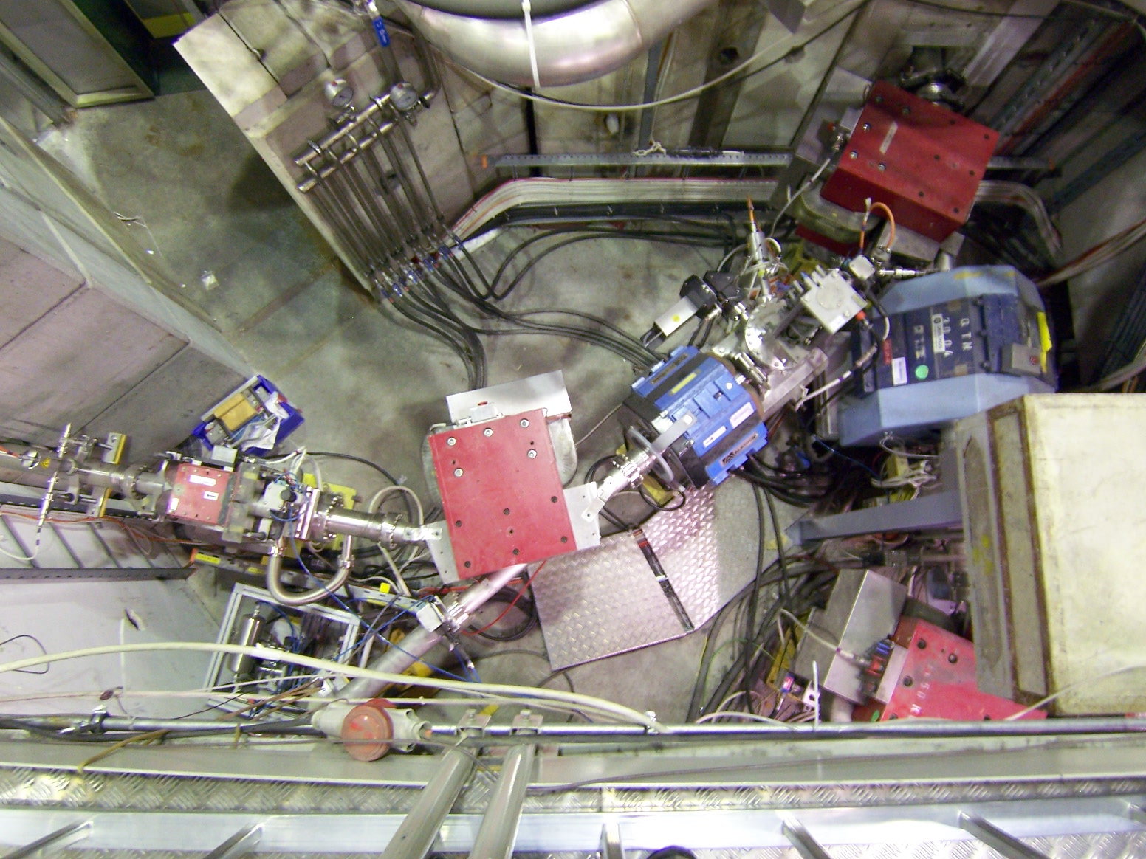
Central region (DE0 – DE5)
Lock-out / disconnect cables/pipes from equipment
TE/MSC
BE/BI
EN/STI
12 Nov 2018 – 16 Nov 2018
Vacuum disconnection central part (DE0 / DE5)
VSC
16 Nov 2018 – 19 Nov 2018
Remove equipment central part
(Vac, BTV, STP, GEM, Magnets, cooling pipies, supports)
MSC
VSC
BI, STI
CV, HE
20 Nov 2018 – 23 Nov 2018
Remove cables and cable trays
EL
26 Nov 2018 – 21 Dec 2018
TIME
DE0 / DE5
2 shield blocks,
5 magnets,
1 GEM, 1 BTV, 1 STP
DE5.BHZ10, DE5QN20, DE5BHZ25,
DE5DVT28 DE0.QN40 DE0XGEM42
DE5BTV15 DE5STP27

Slide 6
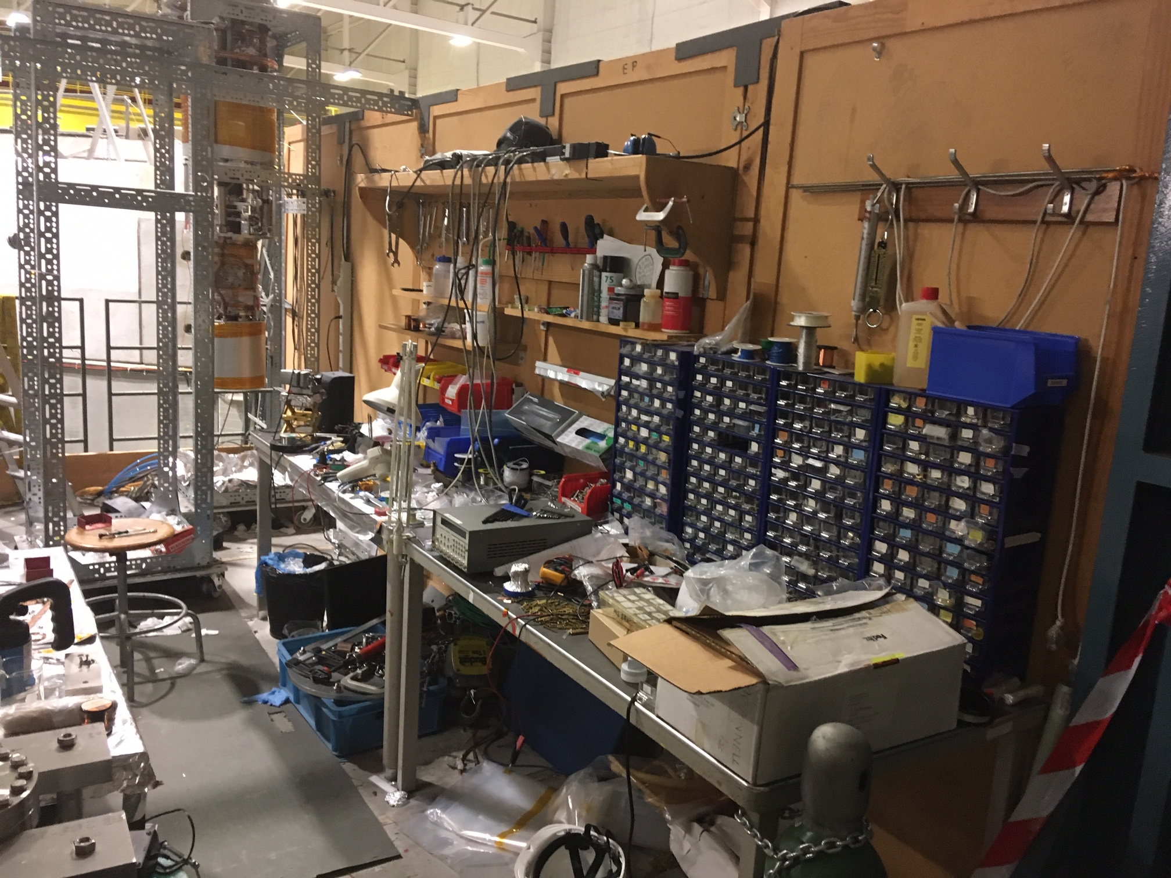
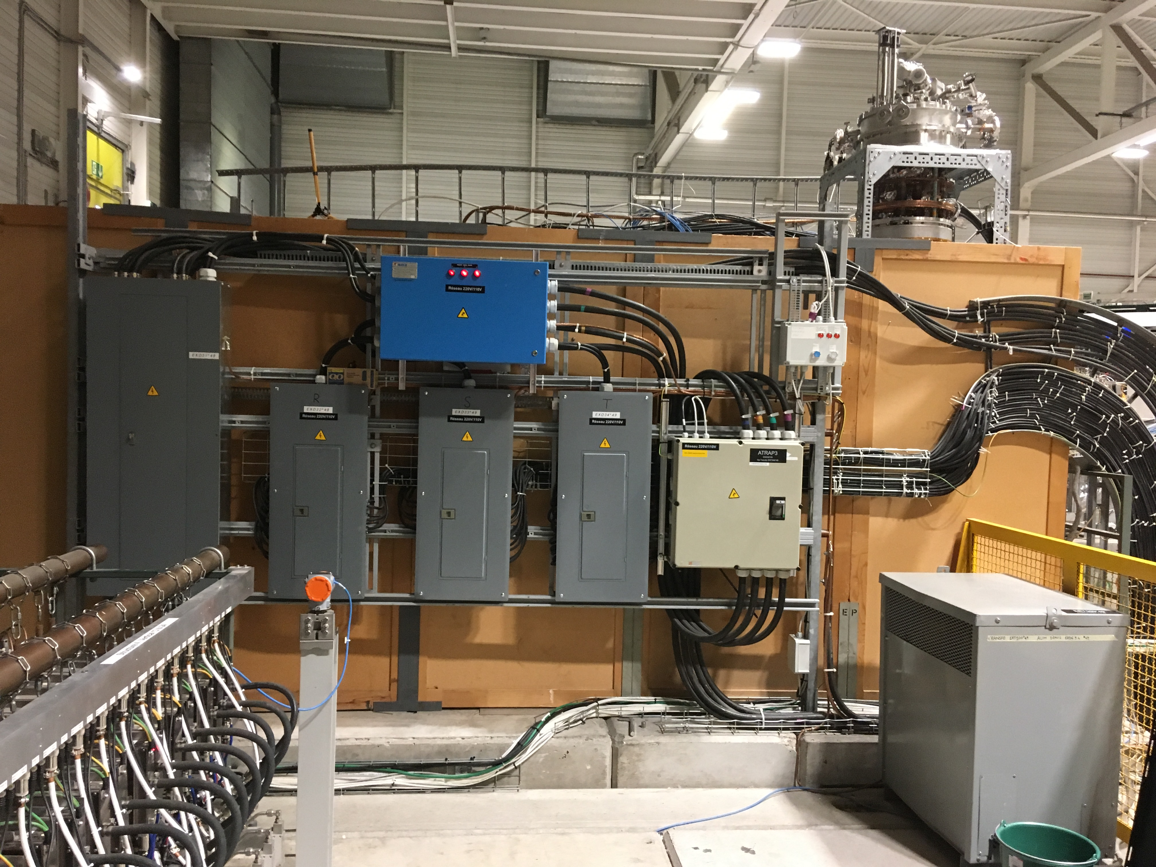
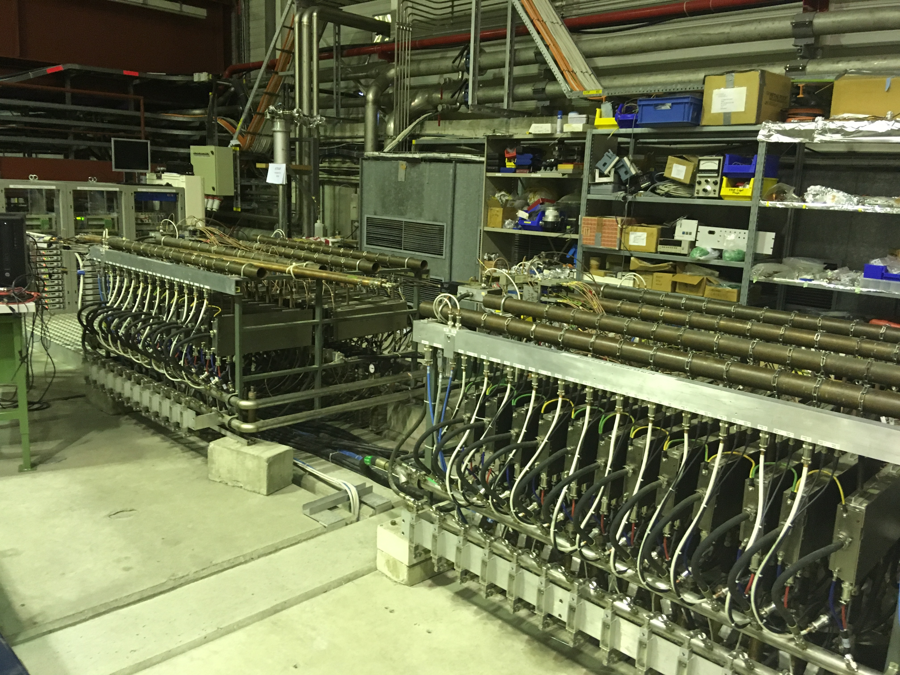
In parallel: Stoch cooling + RFQD dismantling
RFQD racks, power supplies removal
EPC, EA
RF, HE
12 Nov 2018 – 21 Nov 2018
ATRAP workshop+ stuff removal, move EL cabinets
ATRAP, HE, EL
12 Nov 2018 – 23 Nov 2018
Stochastic cooling equipment measure, drain, remove
RF, HE, CV
13 Nov 2018 – 26 Nov 2018
RFQD faraday cage + RF amplifier removal
RF, HE
22 Nov 2018 – 28 Nov 2018
ATRAP
TIME
EL cabinets
Transfo
Stoch cooling
RFQD
RFQD

Slide 7
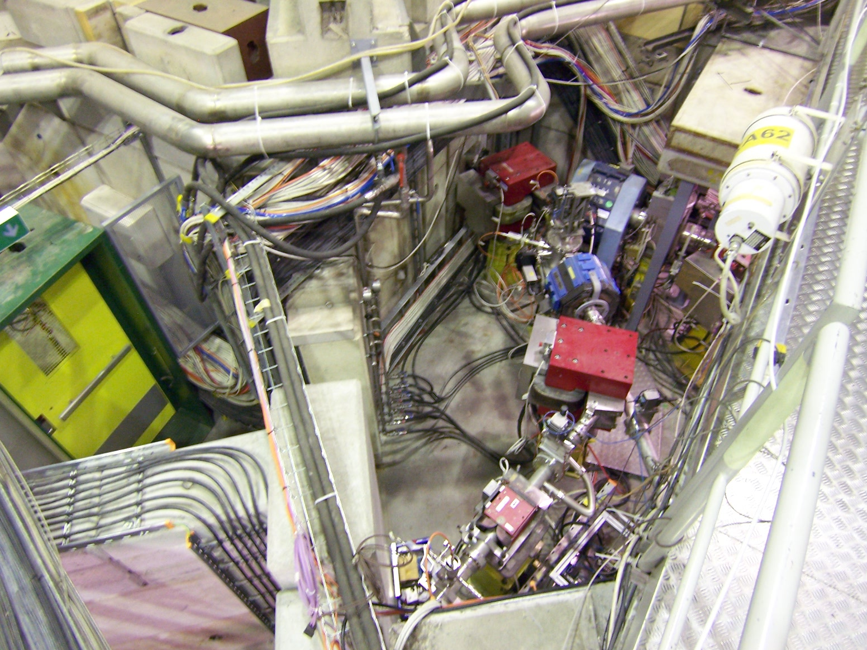
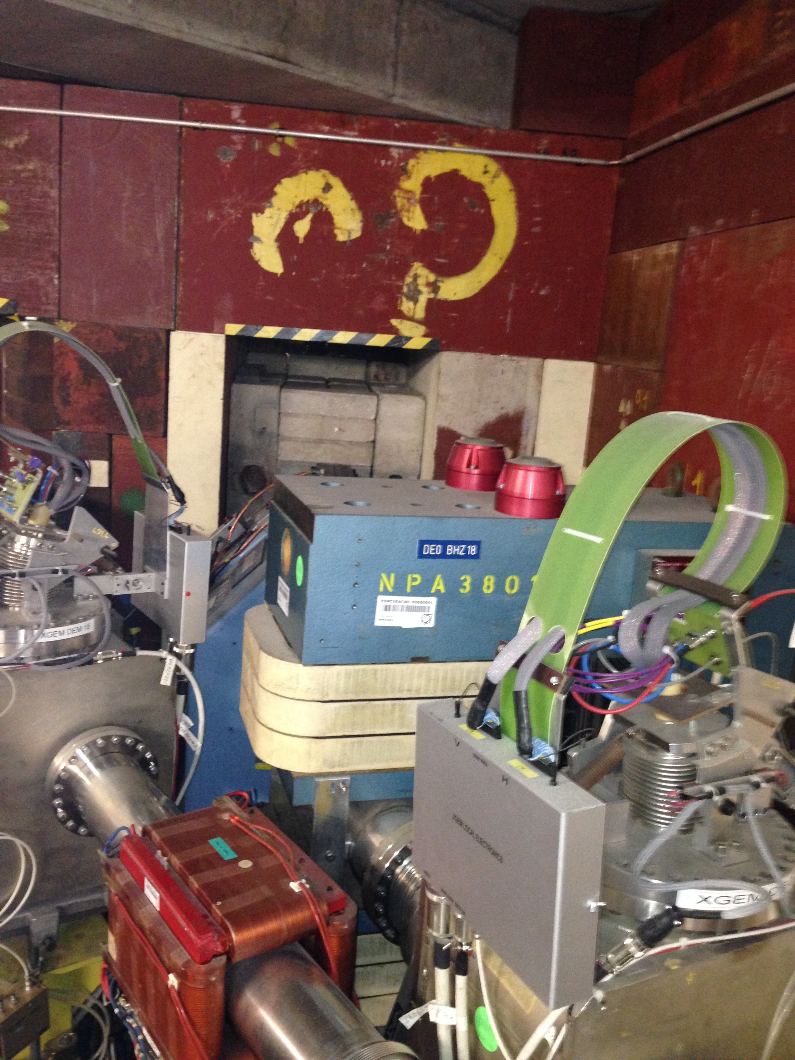
DE0 line inside shielding
Open shielding, remove DE0 line
(Vac, 1 GEM, 1 STP, 4 Magnets)
BI
CV HE MSC
17 Dec 2018 – 08 Jan 2019
Magnets to be removed: DE0.BHZ18, DE0QN20, DE0QN30, DE0DHV35
GEM to be removed: DE0MWPC15
Stopper: DE0STP16
Remove CV pipe, Shielding wall modifs
CV, HE
07 Jan 2019 – 04 Feb 2019
TIME
DE0
Shield wall

Slide 8
DE1 –DE5 removal
Remove BASE TL (DE5): 5 Magnets, 2 BTV
BI, CV, HE, MSC, VSC
04 Feb 2019 – 18 Feb 2019
DE5QN30, DE5DVT33, DE5BHZ35, DE5DHV38, DE5QN40
DE5BTV32, DE5BTV37
Remove ASACUSA TL (DE1):
10 magnets, 3 GEM, 1 buncher, 1STP, 1 RFQD
BI, STI, RF
CV, HE, MSC, VSC
19 Feb 2019 – 07 Mar 2019
DE0 BHZ10, DE1QN20, DE1DHV25, DE1DHV28, DE1QN30,
DE1QN40, DE1QN50, DE1DN60, DE1DHV65, DE1DHV67
DE1XGEM27, DE1XGEM45. DE1XGEM47
DE1STP26
DE1BUNCHER; RFQD
TIME
Remove ATRAP/ALPHA TL (DE2, DE3, DE4)
20 magnets, 7 GEM, 3 stopper
STI, BI, VSC
CV, HE, MSC
08 Mar 2019 – 03 Apr 2019
DE0DHV45, DE0QN50, DE0QN60, DE0QN70, DE0QN80, DE0DHV85,
DE0DHZ87, DE0QN90, DE0QN100, DE2BHZ10
DE0STP105
DE0XGEM65, DE0XGEM82, DE0XGEM107
Vertical lines:
DE3BVT10, DE3QN20, DE3BVT25, DE4DHV10, DE4QN20, DE4BVT25
DE3STP15, DE4STP15
DE3XGEM17, DE4XGEM17
Dans Zone ALPHA:
DE2DHV15, DE2QN20, DE2QN30, DE2DHV35
DE2XGEM12, DE2XGEM40

Slide 9
Infrastructure modifs
Removal of DE0 access control gate | BE/ICS, EN/HE | 1 day | Mon 12/11/18 | Mon 12/11/18
Long concrete beam cut | SMB-CE | 3 days | Mon 17/12/18 | Wed 19/12/18
Remove big demi water piping | EN-CV | 1 wk | Mon 07/01/19 | Fri 11/01/19
AD shielding wall dismantle | EN-HE | 2 wks | Mon 14/01/19 | Fri 25/01/19
New AD shielding wall re-install | EN-HE | 1 wk | Mon 28/01/19 | Fri 01/02/19
New demi water piping install | EN-CV | 1 wk | Mon 04/02/19 | Fri 08/02/19
Install steel barriers ATRAP zone | EN-EA | 2 days | Wed 15/05/19 | Thu 16/05/19
Remove steel cross bracing on BASE shielding | EN-EA | 2 days | Fri 10/01/20 | Mon 13/01/20
Modify BASE exp area shielding | EN-HE | 1 wk | Tue 14/01/20 | Mon 20/01/20
Disconnect / reconnect BASE access door | BE-ICS | 2 days | Tue 21/01/20 | Wed 22/01/20

Slide 10
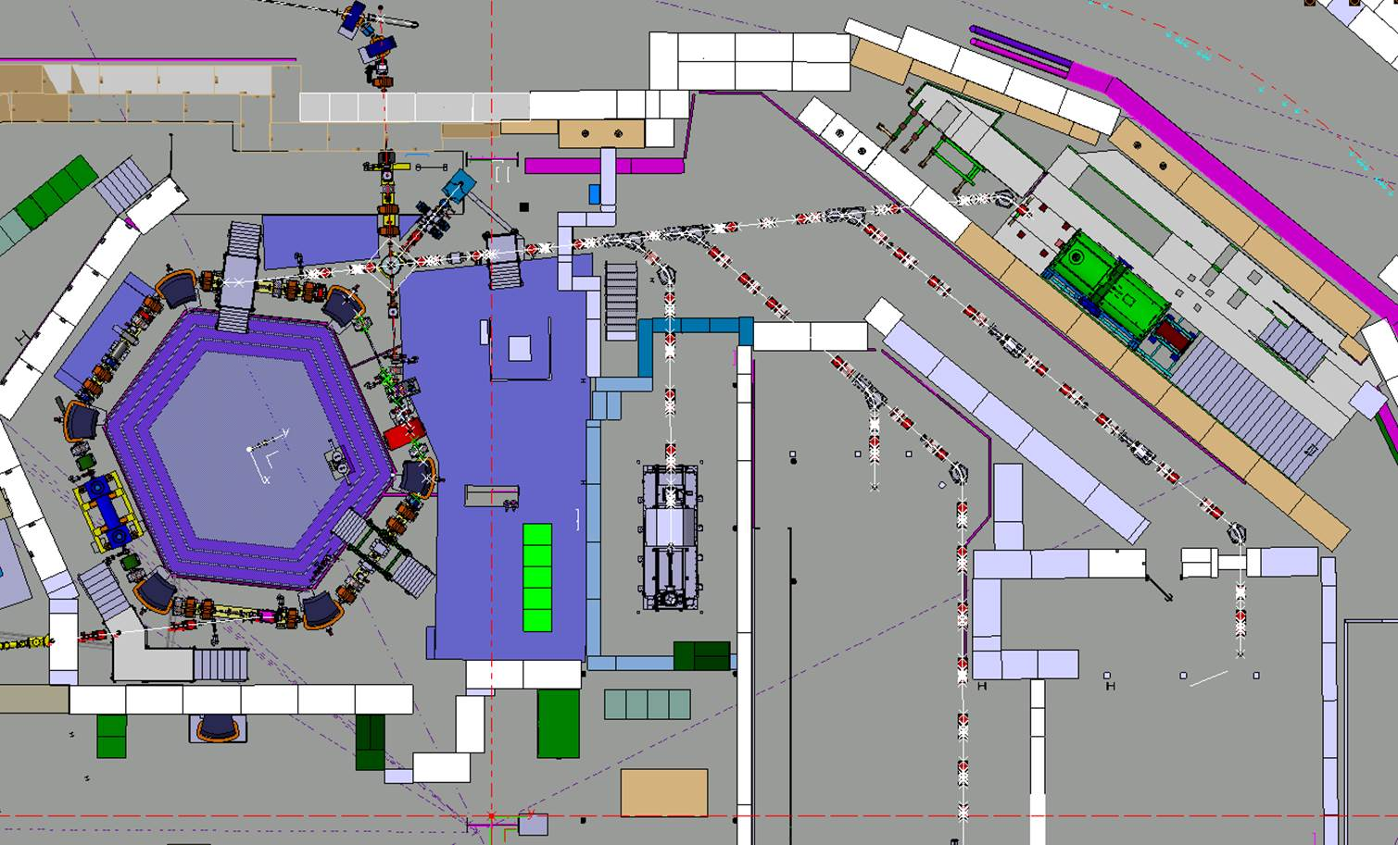
Electrostatic lines to be installed
LNE02
LNE00
LNE01
LNE03
LNE07
LNE06
LNE04
LNE50
LNE05
LNE51

Slide 11
Installation of the new lines
Survey Marking
SMM
05 April 2019– 8 May 2019
Floor drilling
MME
23 May 2019– 05 June 2019
Install mechanical supports
MME
06 June 2019– 26 June 2019
Install Equipment (Electrostatic + vacuum + SEM)
ABT, VSC
HE
27 June 2019– 31 July 2019
Survey /Align Equipment
SMM
01 August 2019– 29 Aug 2019
TIME
Vacuum connections + pump + leak check + bake out
VSC
30 Aug 2019– 15 Nov 2019
Lissage, SEM measurement
SMM
18 Nov 2019– 06 Dec 2019
Cabling campaign (signal, AC, optical fibres)
EL
06 Jan 2020 – 03 Apr 2020
HW tests / Global commissionning
ABT EPC VSC + OP
06 April 2020 – AD restart 2021

Slide 12
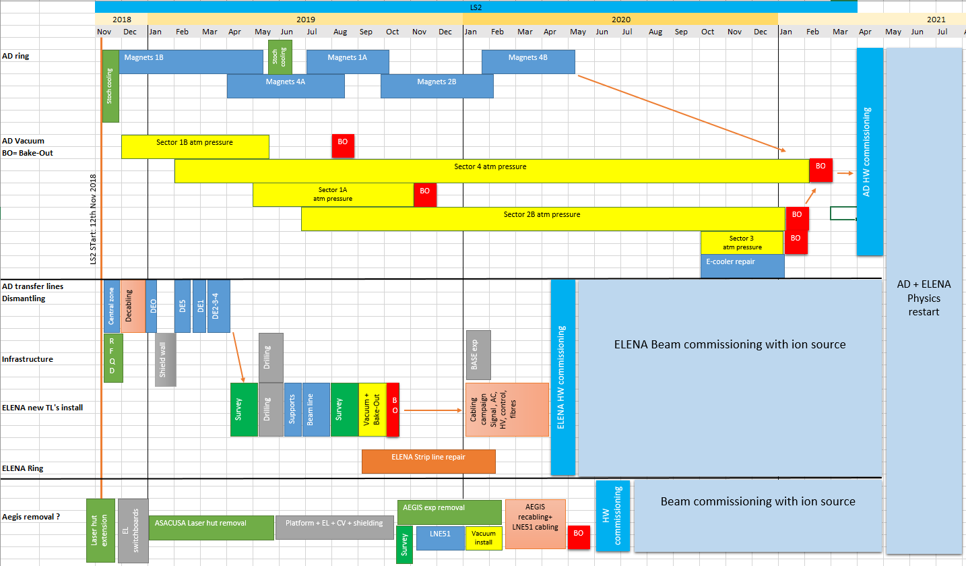
In the context of AD consolidation…

Slide 13
Readiness status
All the teams are aware and accepted the work to be perfomed through PLAN and in regular ADTC + ELENA IIC meetings
Production of all components either complete (electrostatic elements, pumps) or on time for installation (vac pipes, mechanical supports)
Remaining worries: SEM electronics availability, vac tests of SEM, possible need for magnetic shielding near Aegis/ATRAP
Schedule available at
https://espace.cern.ch/en-ea-planning/SitePages/Plannings.aspx?RootFolder=%2Fen%2Dea%2Dplanning%2FShared%20Documents%2FLS2%20Plannings&FolderCTID=0x0120005F33F2ECA6929F4FB4BE25060D74BD71&View=%7B7615CB2E%2D344A%2D4AE5%2DA726%2D8B89A68DFB8A%7D

