Slide 1


AD machine status
Tommy Eriksson CERN/BE/OP

Slide 2
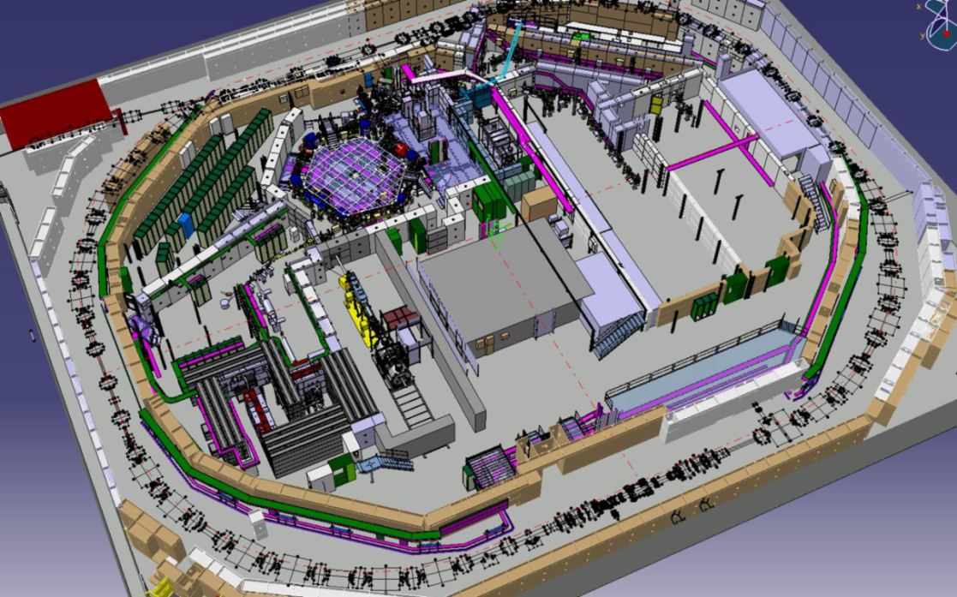
Outline
2018 AD start-up and performance
Machine issues
Run statistics
Plans for LS2

Slide 3
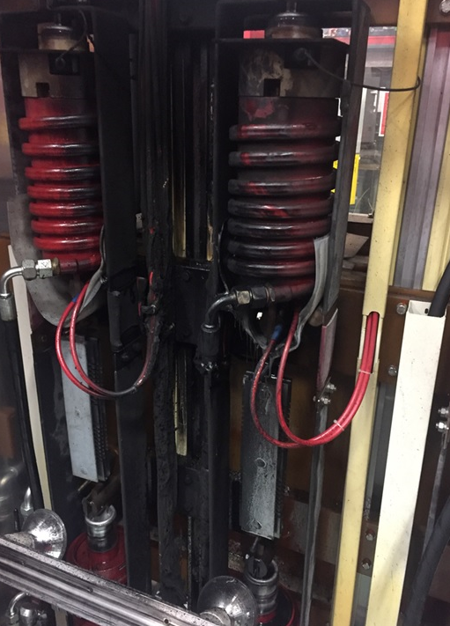
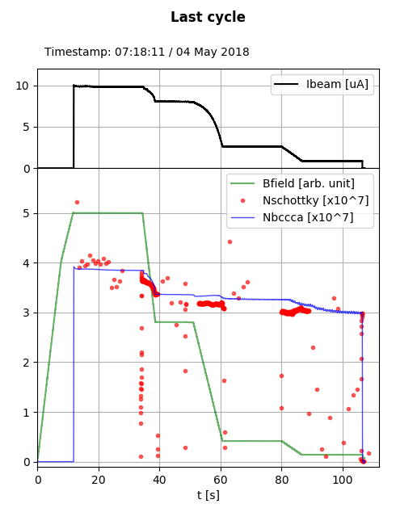
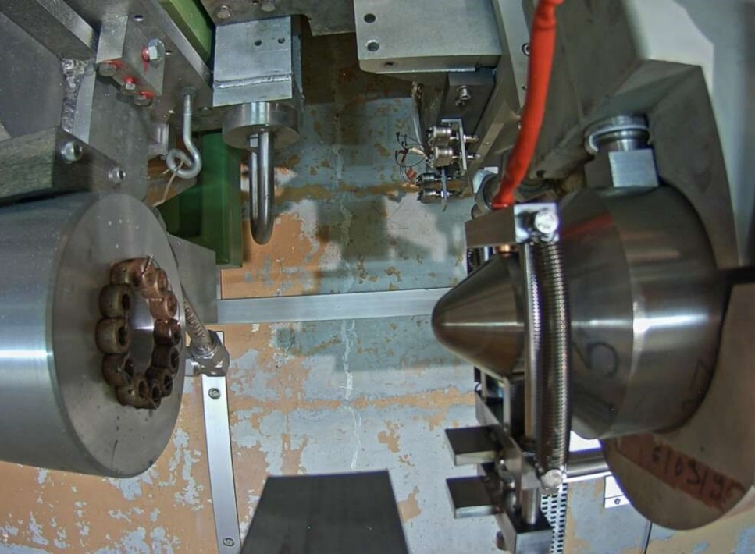
2018 AD start-up
Physics start delayed from 9/4 to 30/4 due to fire in the Horn power supply…
Very short AD start-up:
  First Pbars produced 19/4
  Issues with Power converter controls upgrade (FGC3) and other minor problems
  First signs of target cooling water leak

Slide 4
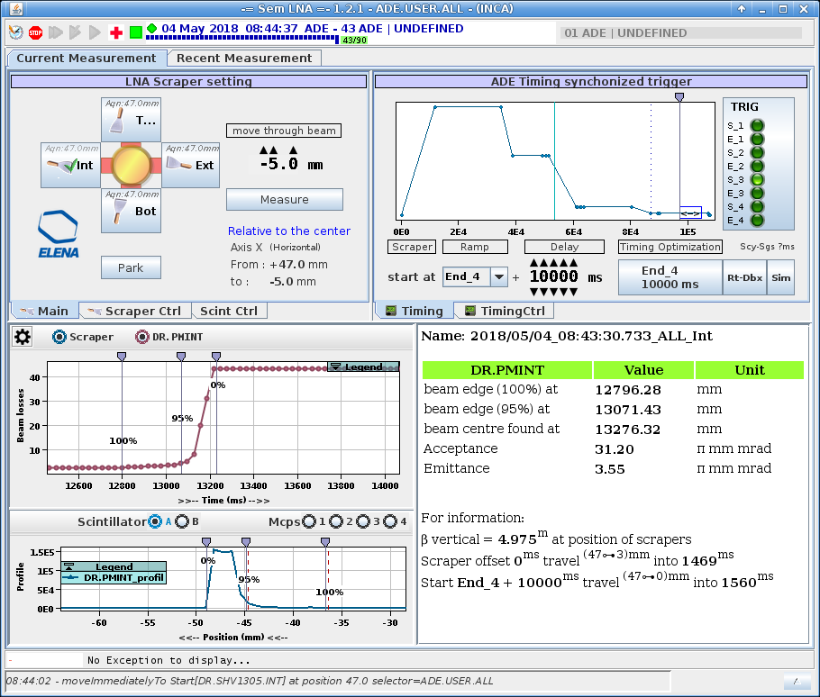
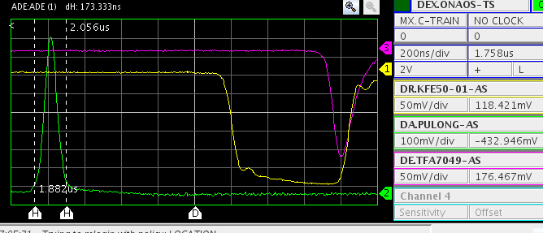
2018 AD start-up
Good deceleration efficiency and beam quality at 100Mev/c: absence of “halo”, lbunch<200ns
Physics start on 30/4 as (re-) planned

Slide 5
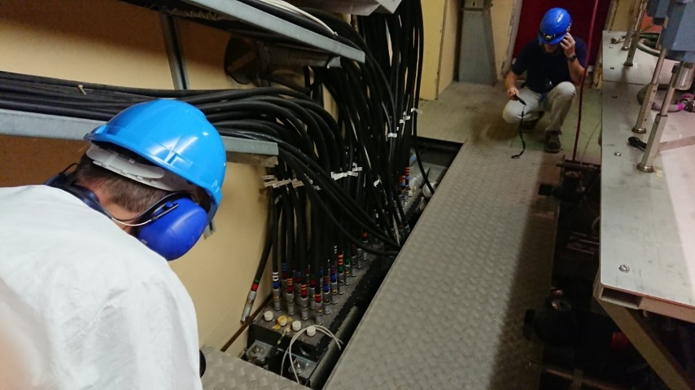
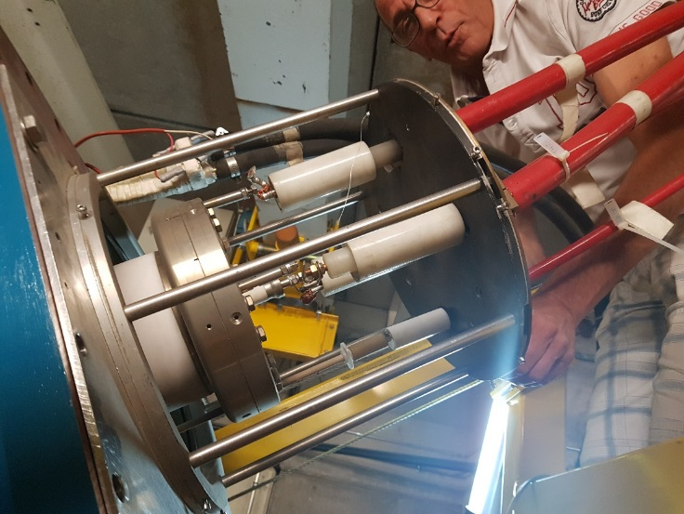
Major machine issues (physics run)
15/6 – 22/6: HV flashover in Horn junction box/stripline (in Target Area). Replaced with spare unit.
23/7 – 17/8: Electron cooler cooling water leak inside collector vacuum chamber. Replaced with spare collector.
6/9 – 12/10: Spare collector also develops (smaller) leak….this time no spare is available:
  A: Isolate and vacuum pump leaking circuit. HV tests ok but HV breakdowns when starting electron beam
  B: Repair leak with liquid epoxy. HV tests ok and some cooling observed at 300 MeV/c but vacuum pressure builds up…
  C: Install (recently) repaired original collector. Some HV issues at restart.
  (D: Design and build new collector to fit both existing and future e-cooler)
Until 12/10: Target cooling water leak:
  Varying leak rate at first believed to be linked to proton beam intensity
  System modified to air-cooled, works well with full beam intensity

Slide 6
AD statistics
Running for physics since 2000, > 60000 physics hours realized, (no machine runs in 2005 & 2013):
run time (h) | 2000 | 2001 | 2002 | 2003 | 2004 | 2006 | 2007 | 2008 | 2009 | 2010 | 2011 | 2012 | 2014 | 2015 | 2016 | 2017 | 2018 <30/10
Total | 3600 | 3050 | 2800 | 2800 | 3400 | 2925 | 3800 | 3340 | 4600 | 4610 | 4680 | 5480 | 2185 | 3300 | 5440 | 5400 | 4400
Beam available for physics (%) | 86 | 89 | 90 | 90 | 71 | 65 | 76 | 81 | 78 | 87 | 84 | 90 | 85 | 89 | 86 | 95 | 62
Uptime AD machine (%) |  |  |  |  | 89 | 74 | 81 | 93 | 92 | 91 | 90 | 95 | 90 | 92 | 93 | 98 | 65

Slide 7
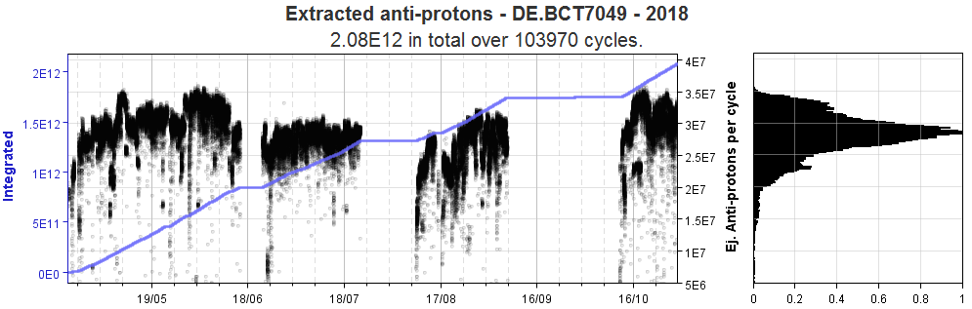
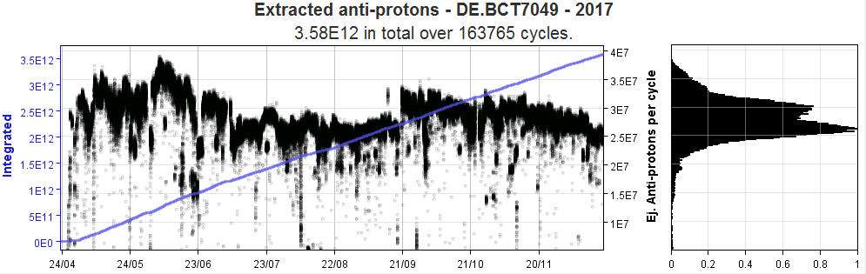
Ejected beam intensity 2018
For comparison – 2017:

Slide 8
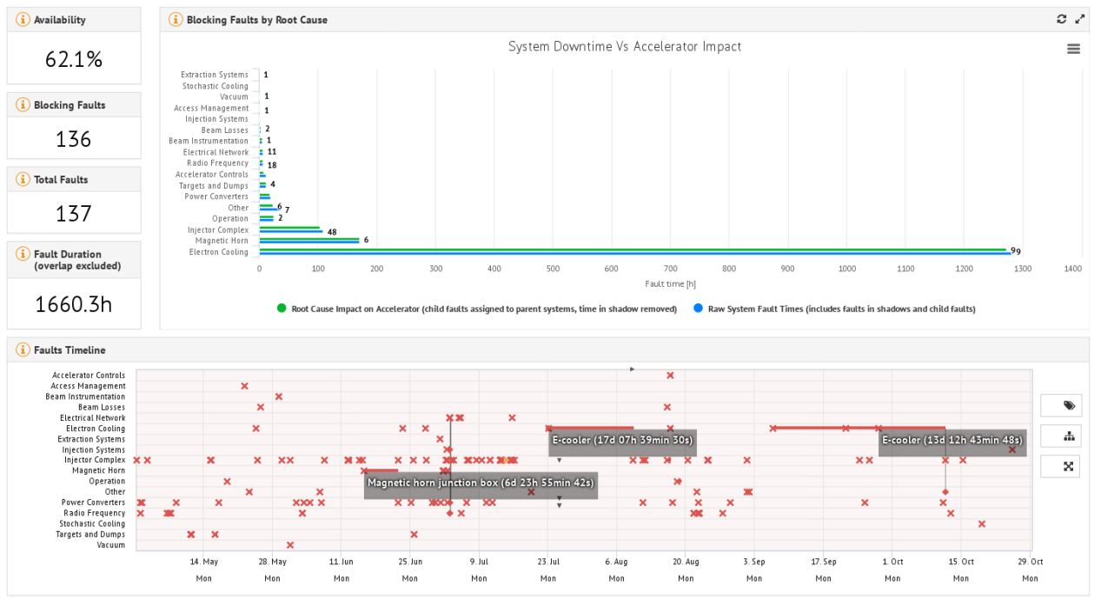
Fault statistics

Slide 9
Outlook for LS2
LS2 - heavy activities in AD machine & target area:
  Major Target Area refurbishment after 30 years w/o major interventions: new target design & new horns including new re-designed trolleys, new ventilation building B196, new ventilation/cooling systems, magnet consolidation, infrastructure, decontamination etc.
  Finalise most of AD machine consolidation:
    Magnets: 70/50% of Ring Bendings/Quads will be completed in LS2
    Power converters: Capacitor discharge elements to be gradually renewed
    RF C10: Fabrication of new final stage triodes, “small” Low-level upgrade
    RF C02: new cavity (PSB finemet prototype), new Low-level DSP system
    Stochastic cooling: Transmission lines/amplifiers etc. needs removal and re-installation to access magnets below shirlding
    Electron cooling: Design/build new collector
    BI: Consolidation of BCCCA Cryo system
  And let’s not forget the experimental area...ELENA transfer lines (see F.Butins talk)

