Slide 1
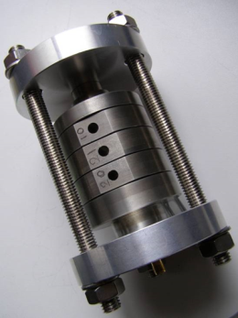
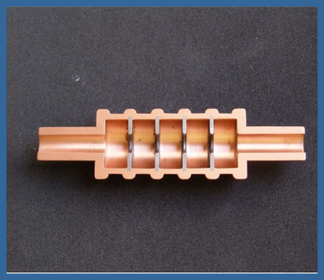
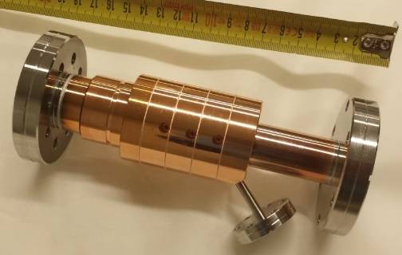
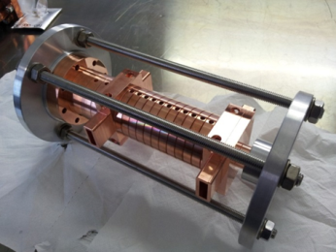
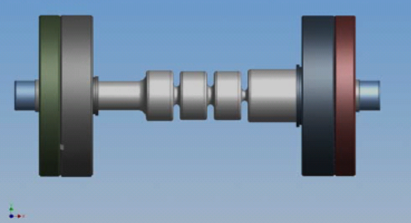
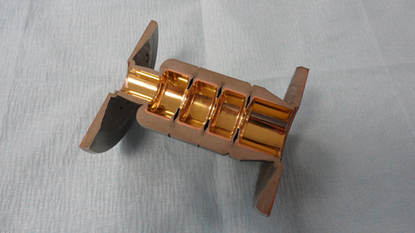
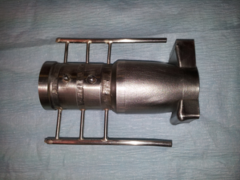
Achievements on the X Band technological activity at INFN-LNF
presented by Bruno Spataro
on behalf of DEMETRA experiment at INFN-LNF
HG2019 – June 10 -14 2019 - Chamonix (France)

Slide 2

Contributors
This work is made possible by the efforts :
DEMETRA , INFN – LNF experiment
SLAC(USA)
KEK (JAPAN)
DEMETRA stands for DiElectric and METallic Radiofrequency Accelerator experiment
HG2019 – June 10 -14 2019 - Chamonix (France)

Slide 3
Summary
Hints on the Mo structure issues
Hints on the Electroforming and Elecroplating structures issues
Tungsten inert gas (TIG) and Electron Beam Welding (EBW) welded structures
Status on Structure made out of two halves
Status on the S and X band TM₀₁ mode launchers with four symmetric ports
S band cryogenic structure
Collaborations : SLAC, KEK
HG2019 – June 10 -14 2019 - Chamonix (France)

Slide 4


Demetra (DiElectric and METallic Radiofrequency Accelerator) is the INFN R&D program on ‘multicell resonant structures’ operating at S, X and W Band frequencies
the MOTIVATION …….
The research project is devoted to the R&D of key components for existing accelerators and for the next generation of accelerators. New technologies are necessary to achieve the multi-TeV energies of future linear colliders, x-ray FELs, etc.
To use in high brilliance photo-injectors to compensate the beam longitudinal phase-space distorsion, enhanced by the bunch compression of the acceleration process
To gain know-how in vacuum microwave technologies
Approach :
To study new materials and manufacturing techniques including single and multi-layer surfaces with precision-controlled properties
HG2019 – June 10 -14 2019 - Chamonix (France)

Slide 5


X-band device realization issue: guidelines
How to improve the high power perfomance (e.g. discharge rate) ?
Avoiding the device heating at high temperature as done in conventional brazing (or hard structures)
Using material with a higher fusion temperature
R&D on fabrication techniques
R&D on material
Electroplating and Electroforming
EBW and TIG welding
Open structures
Sintered Molybdenum (Bulk)
Molybdenum coatings
All above techniques can be transfered from X-band to W band
[ SLAC : M. Dal Forno, E. Nanni, V. Dolgashev and so on]
HG2019 – June 10 -14 2019 - Chamonix (France)

Slide 6
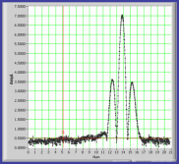
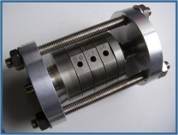

Achievements……..
Three cells π mode Mo bulk structure
The model was designed at SLAC in order to concentrate
the RF field in the mid-cell for breakdown studies
3 cells Sintered Molybdenum bulk brazed structure issue
Sintered Mo bulk
Brazed structure
Field profile – π mode
[NIM-A-657 (2011) 114-121]
Higher power tests of the brazed model have been carried out at SLAC (V. Dolgashev et al.). As a result:
long time for machining
the cavity (Mo bulk is a
hard material)
~300 nm roughness using ‘tungsten carbide’ tools (3 tools for machining the structure)
It is not easy to braze. It is likely to have a gas contamination and an uneven loading stress in the braze region (joints are not completely filled with alloy)
HG2019 – June 10 -14 2019 - Chamonix (France)

Slide 7
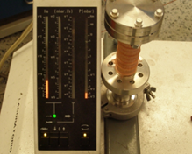
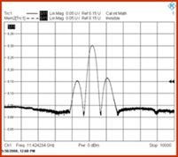
Three cells π mode X band electroplated structure
The electroplating approach is a manufacturing method in order to avoid heat treatment of the metal
Cu electroplated structure
[NIM-A-657 (2011) 114-121]
A three cells Cu structure encapsulated by galvanoplastic procedure under vacuum leak test
Field profile – π mode
Cu encapsulated (electroplating) structure: measured π-mode field profiles by bead-pull technique.Q₀ = 7700 (measured)
The Cu cells are already machined
to make the electroplating structure
High power test have been carried out at SLAC by giving very promising results. Most likely this structure was improving during 150 ns experiment [V. Dolgashev et al.]
HG2019 – June 10 -14 2019 - Chamonix (France)

Slide 8
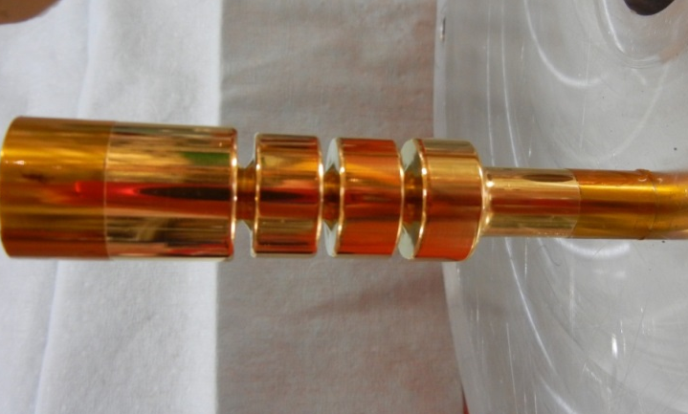
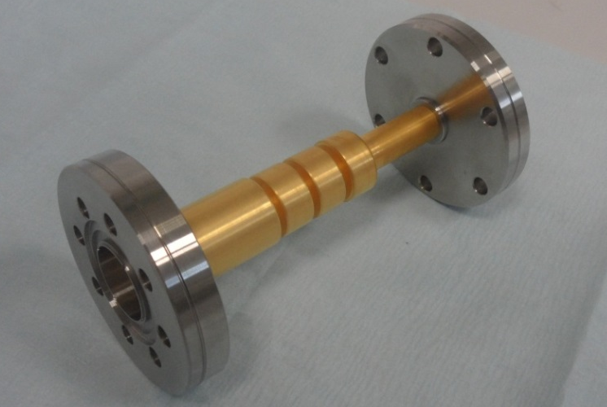
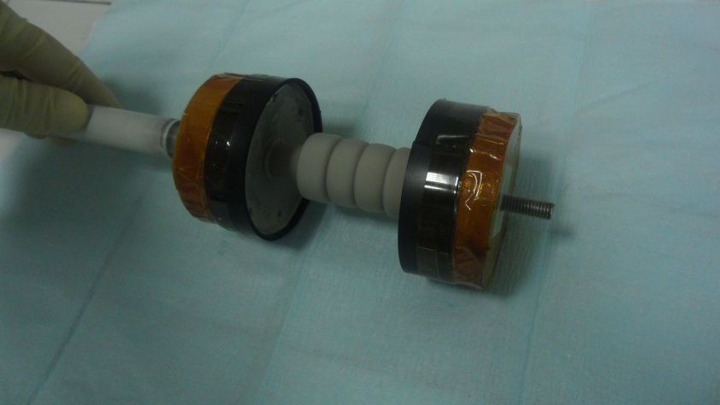
Electroformed Demetra’s prototype of the 3-cells X-Band structure
The electroforming approach is another manufacturing method
in order to avoid heat treatment of the metal
The electroforming mandrel model made of Al
3 µm Au coating thickness mandrel model
JINST September, 19 2018
Fitting tests between mandrel and CF flanges
Final structure after coating of Ni with a 4 mm thickness
(COMEB and MLT Companies)
HG2019 – June 10 -14 2019 - Chamonix (France)

Slide 9
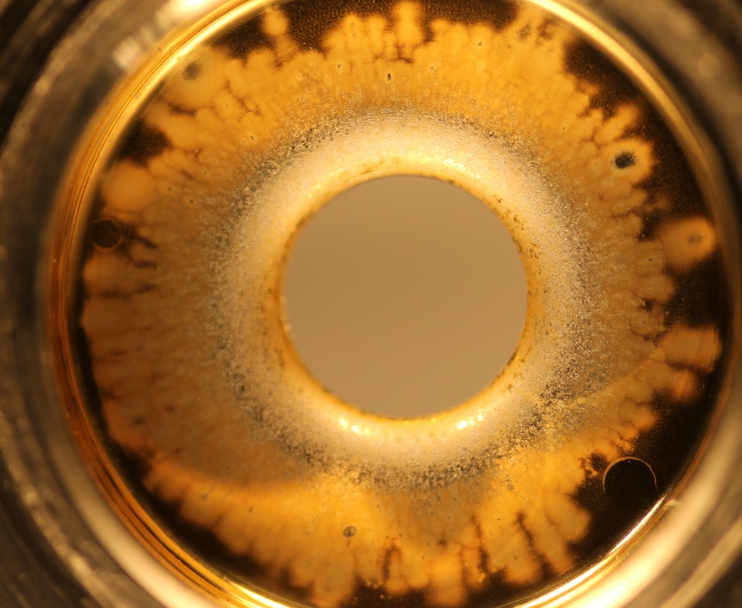
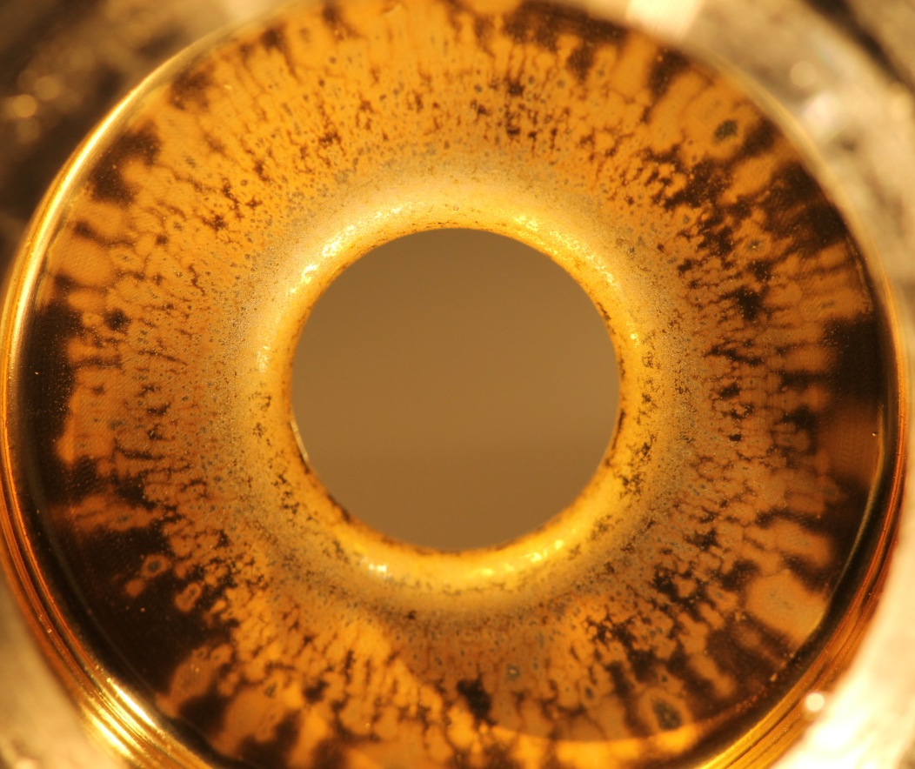
Autopsy of electroformed made of Gold – Nickel (Au-Ni) alloy
High power test have been carried out at SLAC [V. Dolgashev et al.]
  Magnification of the images taken from the high gradient side
JINST September, 19 2018
High gradient side of
Center cell
High gradient side of
End cell
Gold coating has been almost completely removed in the region of the high-electric field by multiple breakdowns
HG2019 – June 10 -14 2019 - Chamonix (France)

Slide 10
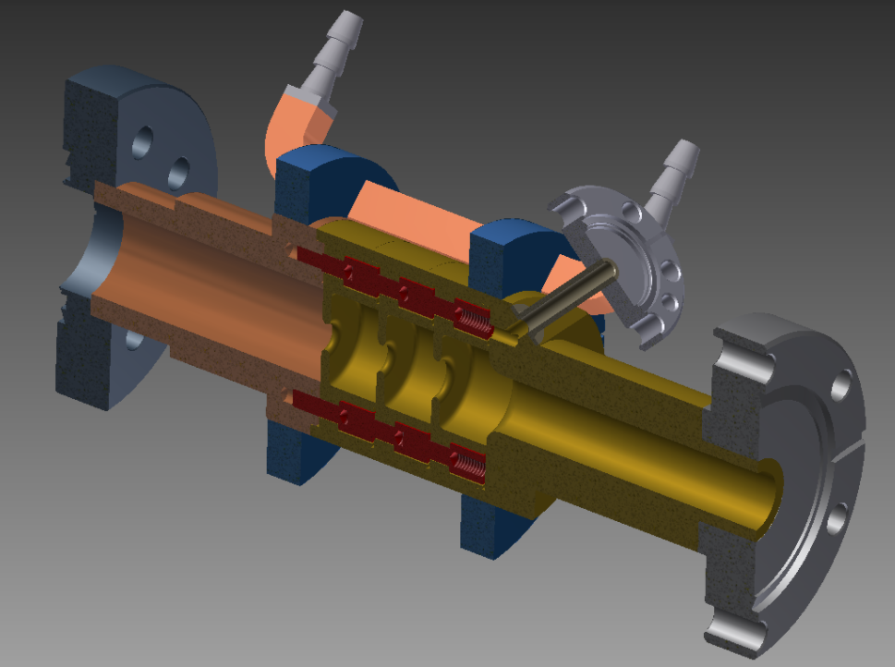
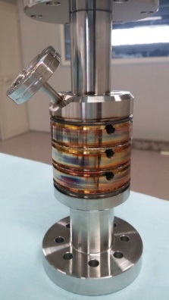
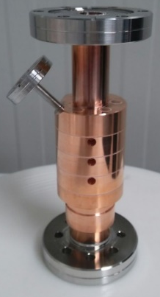
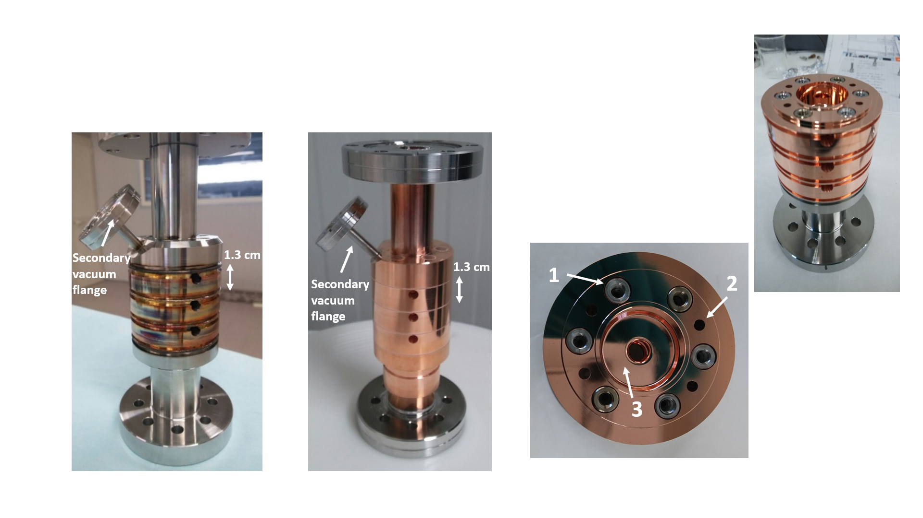
Achievements…..
Innovative compact braze-free joints accelerating structure at X band (SLAC/INFN-LNF)
Motivations for future innovative accelerators:
Avoids high temperature processes
Cells joined together by means of specifically designed and proprietary screws which ensure good vacuum and RF contacts
Use the Electron beam welding (EBW) and Tungsten Inert gas (TIG) processes
Remarkable improvements of the RF perfomance
Strong costs reductions
Strong increase of the accelerating field Eacc > 100 MV/m
3D model
TIG
EBW
Side-view of the two structures
1. Special hollow screws
2. Channel for pumping the secondary vacuum chamber
Secondary
pumping
Secondary
pumping
3. Primary RF chamber
Both structures have been tested at high power tests at SLAC (V. Dolgachev’s talk)
HG2019 – June 10 -14 2019 - Chamonix (France)

Slide 11

Additional details on the Tungsten Inert Gas welding (TIG)
Structure welded with the T.I.G. process (Tungsten Inert Gas).
The structure was welded inside an inert Argon atmosphere.
Teeth are machined in the welding joints to allow the quickly expulsion of the high heat accumulated in the welding region while avoiding thermal expansion of the whole structure since the heat is absorbed by the teeth themselves.
No heat gradient is generated through the cavity (thanks to the teeth) therefore avoiding any sort of tilting/bending of the structure.
Tooth
HG2019 – June 10 -14 2019 - Chamonix (France)

Slide 12
Preliminary: Comparison of performance of TIG welded hard copper structure with soft and hard copper clamped structures, shaped pulse with 150 ns flat part, all breakdowns
TIG Cu
TIG Cu
Soft Cu
Soft Cu
Hard Cu
Hard Cu
Soft Cu
At breakdown rate 10^-3/pulse/meter hard copper TIG welded structure has gradient about 145 MV/m vs. 190 MV/m for both soft and clamped hard copper structures, but slope of the breakdown rate vs. gradient is steeper than both.
TIG Cu
Hard Cu
V. Dolgashev (SLAC)

Slide 13
Preliminary: Comparison of performance of TIG welded hard copper structure with soft and hard copper clamped structures, shaped pulse with 400 ns flat part, all breakdowns
TIG Cu
TIG Cu
Soft Cu
Soft Cu
Hard Cu
Hard Cu
At breakdown rate 10^-3/pulse/meter hard copper TIG welded structure has gradient about 130 MV/m vs. 160 MV/m for both soft and clamped hard copper structures, again slope of the breakdown rate vs. gradient is steeper then other two structures.
Soft Cu
TIG Cu
Hard Cu
V. Dolgashev (SLAC)

Slide 14
Preliminary: Pulse length dependence of breakdowns probability of TIG welded hard copper (1C-SW-A2.75-T2.0-TIG-Cu-Frascati-#1_6May2019) structure, shaped pulse
with 100 ns, 150 ns, 400 and 600 ns flat part, all breakdowns
400 ns
400 ns
600 ns
600 ns
100 ns
100 ns
150 ns
150 ns
100 ns
Neither peak surface fields of peak pulse heating are good predictors of the breakdowns performance. Likely at short pulses the breakdown rate more depend on peak fields and at longer pulses by peak pulse heating.
400 ns
600 ns
150 ns
V. Dolgashev (SLAC)

Slide 15
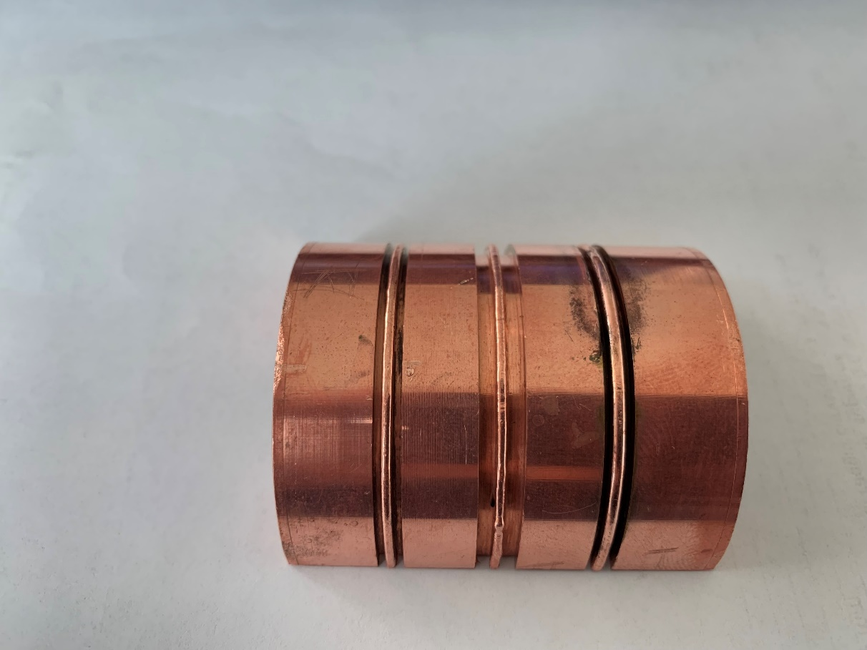
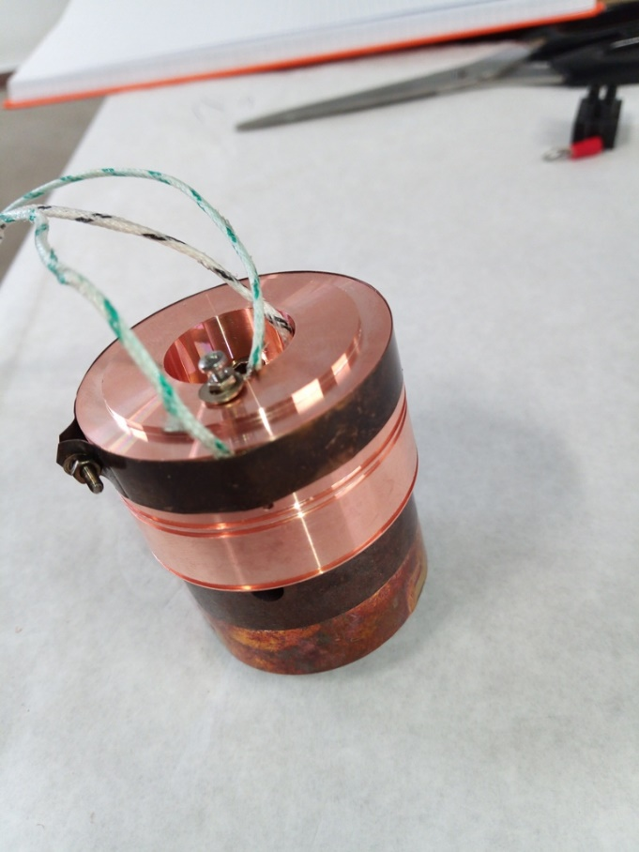

Achievements…..
Setup prototype for Temperature Monitoring during TIG Welding
Welding teeth
Cell iris
Cell outer
radius
width = 2.9 mm
Tooth
Tooth thickness = 0.9 mm
Tooth depth = 1 mm
Thermocouples wiring
Tooth thickness is proportional to welding current: lower current, smaller tooth
Ideal compromise: lowest current, mechanically more stable welding (robustness) and vacuum tightness
HG2019 – June 10 -14 2019 - Chamonix (France)

Slide 16
Achievements…..
TIG Welding current set up 140 A [welder readout, effective value 117 A]
Max Temperature
Iris: 265 °C
Tooth: 298 °C
Cell Face: 249 °C
Welding : about 2 minutes
Temperature (deg C)
Iris
Tooth
Cell face
Working at 160 A (effective 133 A)
the max temperature on tooth: 321 °C
Time (sec)
HG2019 – June 10 -14 2019 - Chamonix (France)

Slide 17
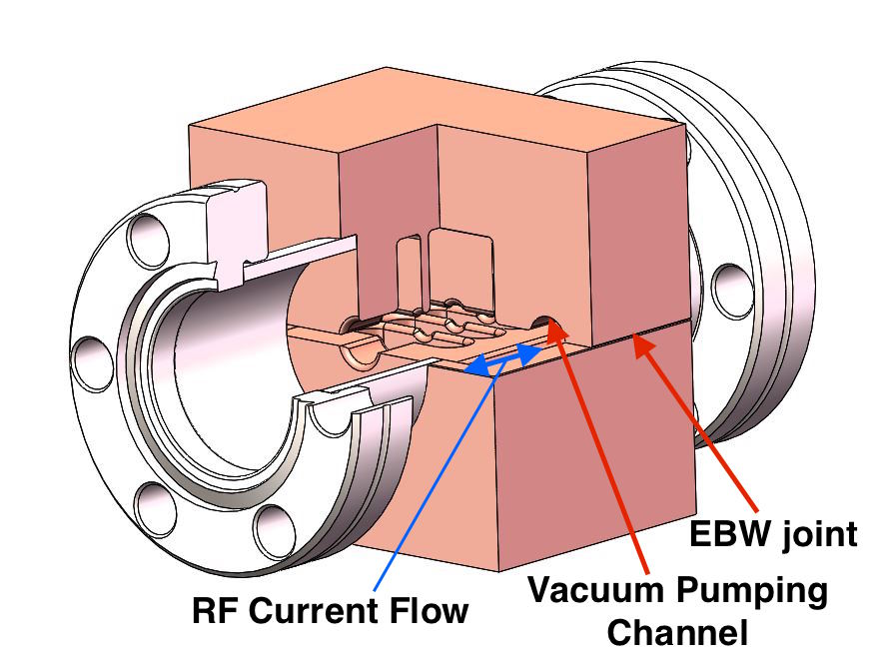
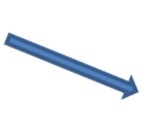

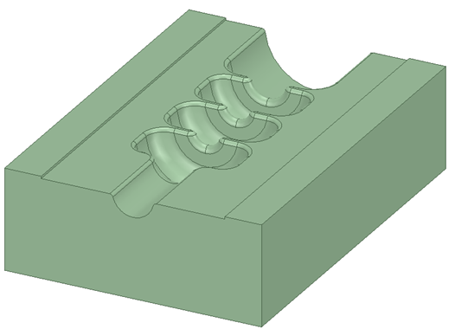



Perspectives …..
Split structure ( A. Grudiev, V. Dolgashev, H. Zha)
The authors propose a structure made out of two halves bonded together (as an example with Electron Beam Welding (EBW) or TIG (Tungsten Inert Gas) performed along the outside edges
Welded surface
Beam axis
Cavity
Gap
Gap
Welded surface
One half piece of the model
A sketch of a three-cell model
The main motivations for this work is to study the high gradient performance of accelerating structures made with novel manufacturing methods
At Frascati (INFN-LNF ) we scheduled to fabricate an accelerating structure milled out of two halves and welded together
HG2019 – June 10 -14 2019 - Chamonix (France)

Slide 18

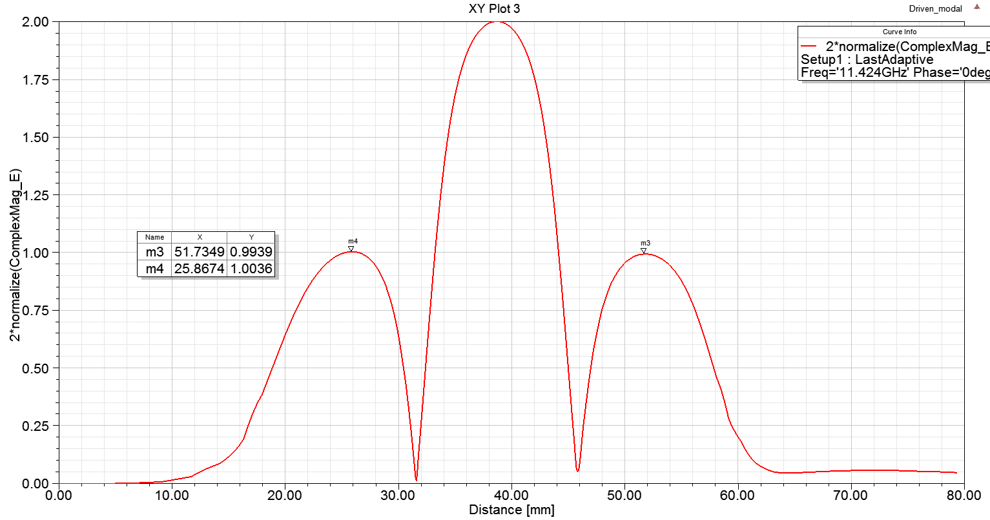
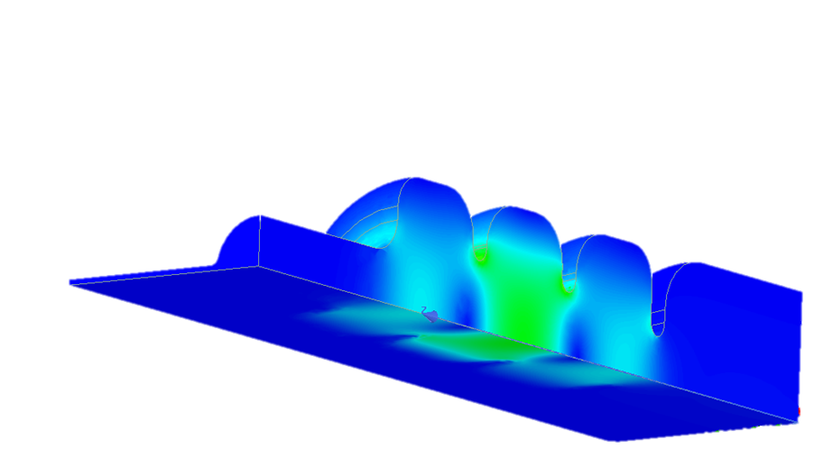
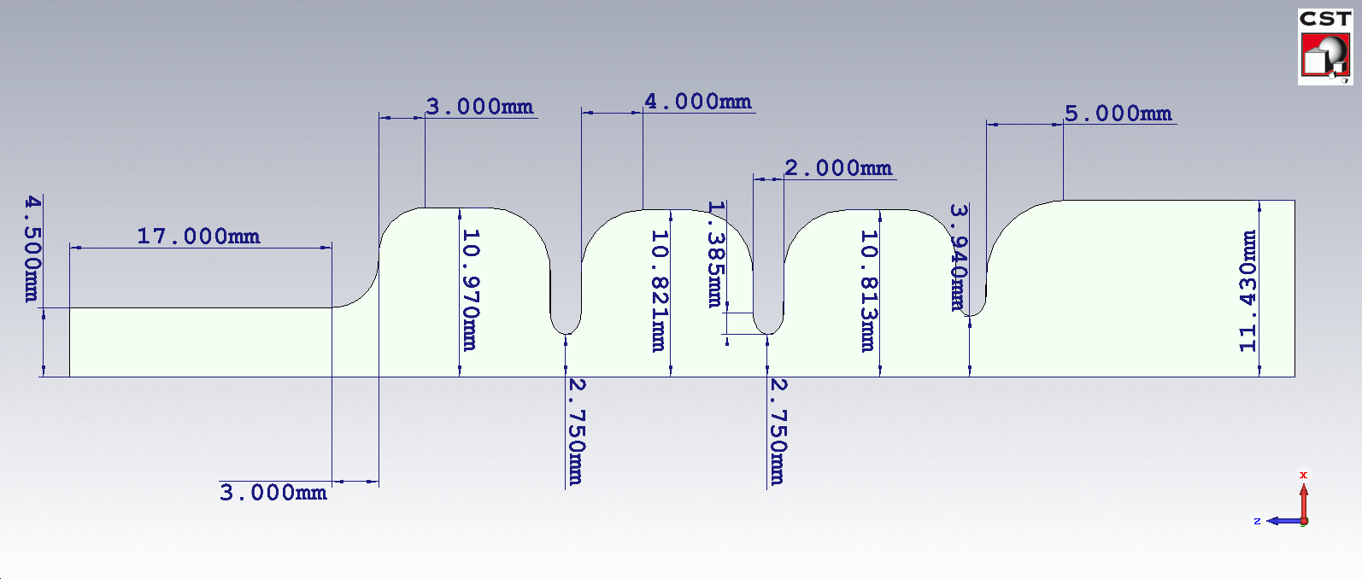
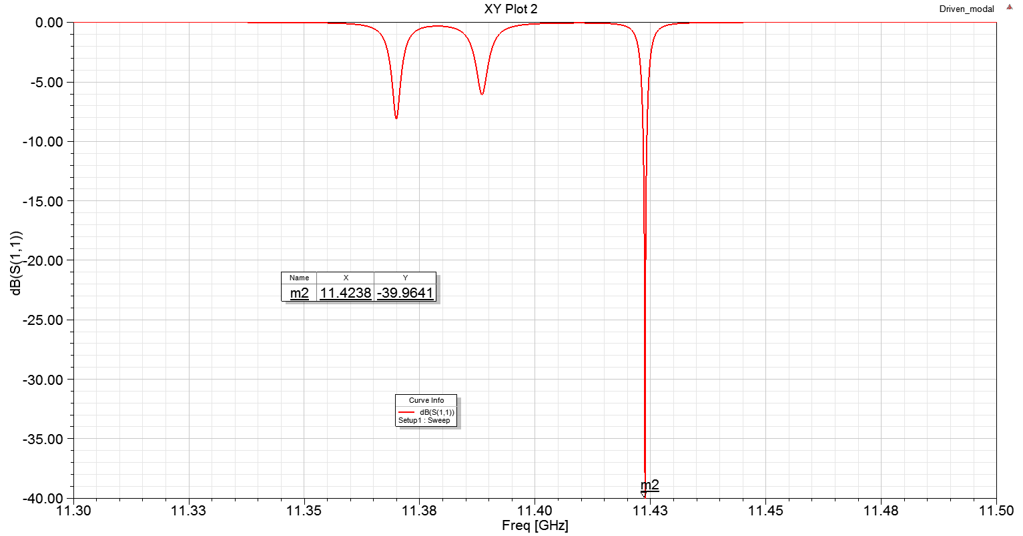
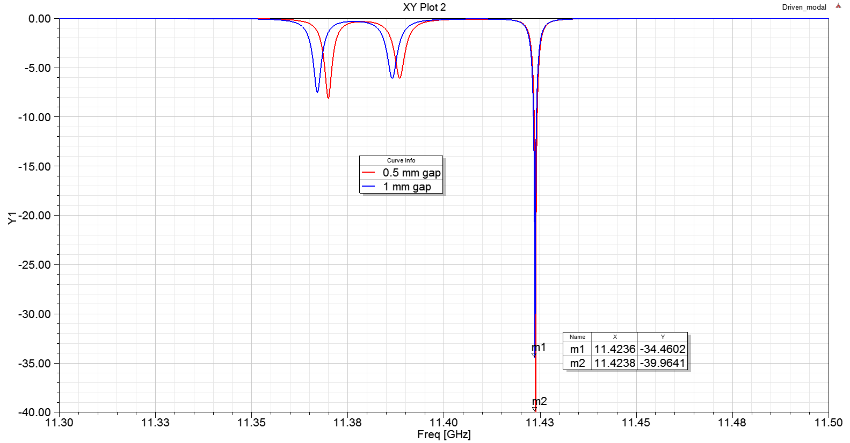
Perspectives on X band structures…..
Split structure : dimensions and results of the preliminary design
3D model
1 mm gap
Longitudinal field profile of the operating π mode – SW structure
Simulations have been carried with a 1 and 0.5 mm gap
Blue 1 mm gap
0.5 mm gap
Red 0.5 mm gap
Frequencies spectrum
Frequencies spectrum
HG2019 – June 10 -14 2019 - Chamonix (France)

Slide 19
Future work for two halves structures
Next step is to fabricate 24 regular cells by using the TIG process. The order has been approved by INFN
Study are in progress for scaling to 100 GHz by using the braze-free technique is undergoing
[SLAC - E. Nanni et al.]
HG2019 – June 10 -14 2019 - Chamonix (France)

Slide 20
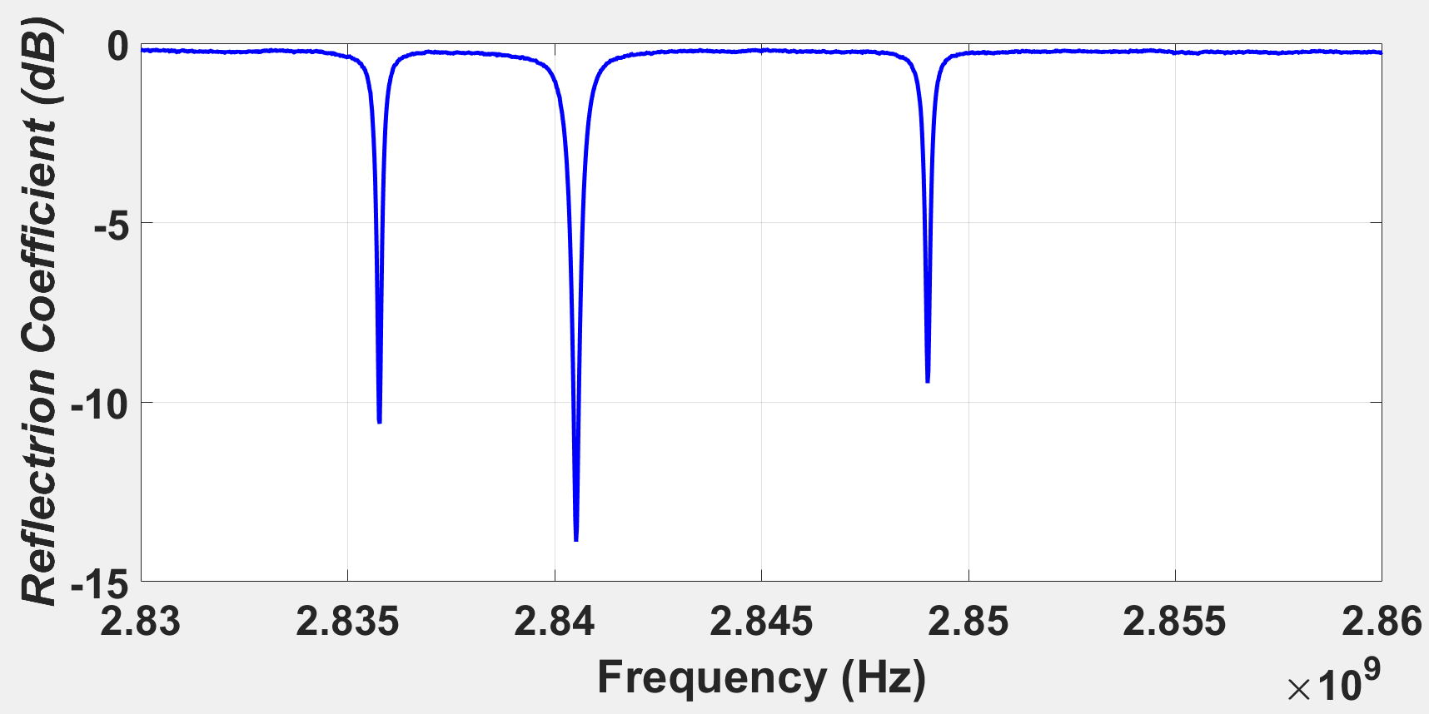
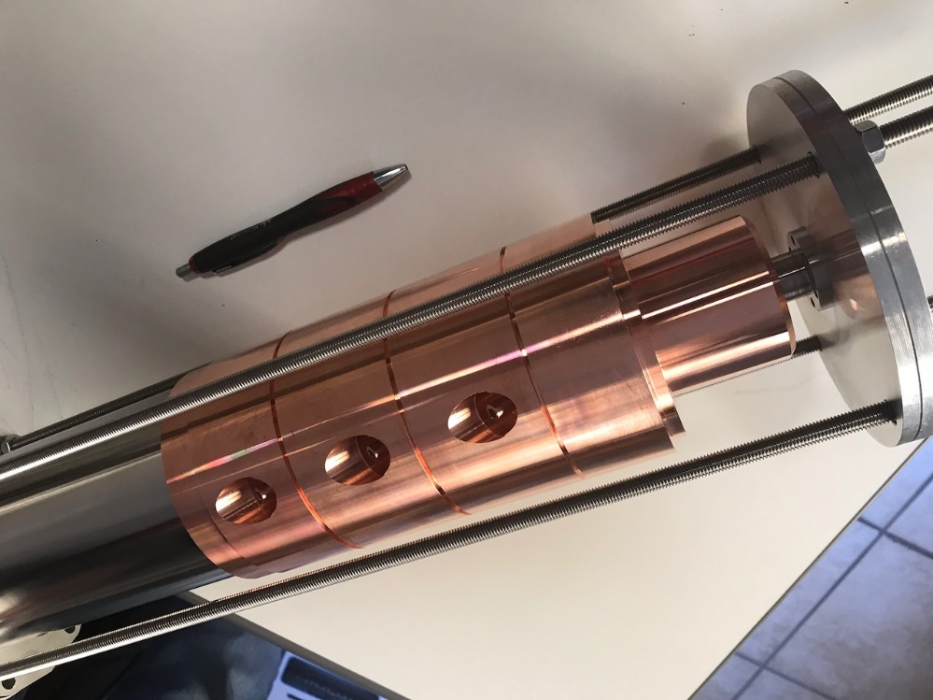
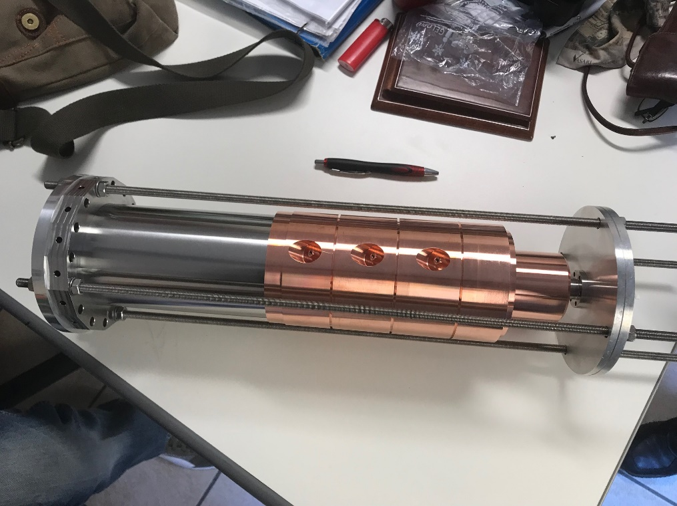
3-cell S band accelerating cavity for cryogenic high-power tests at SLAC
Perspectives on S band structures…..
Low-power RF tests in good agreement with design simulations;
The structure has been shipped to SLAC for the RF cryogenic
high-power tests.
Reflection coefficient from low-power RF tests before brazing and in air.
Input RF
waveguide
3-cell cavity
tuners
HG2019 – June 10 -14 2019 - Chamonix (France)

Slide 21
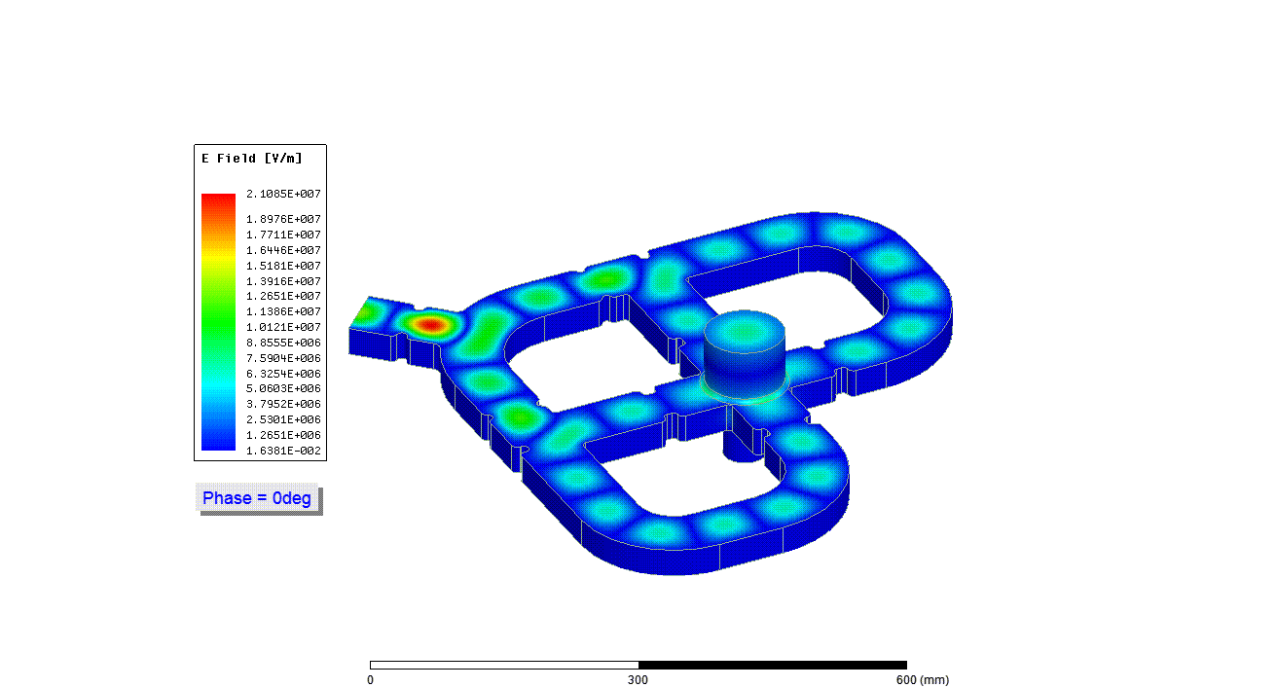
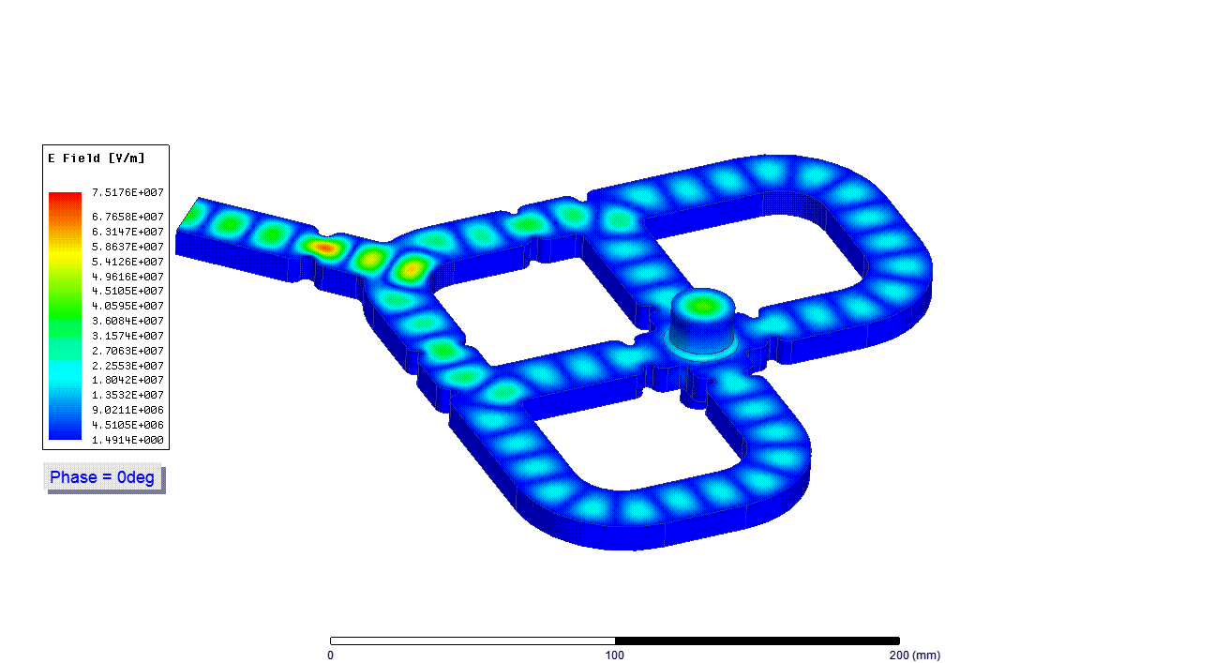
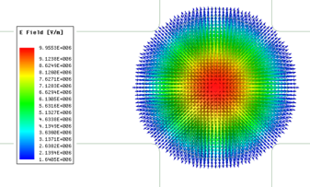
Perspectives on X band structures…..
Compact mode launchers with no dipole and quadrupole EM fields (SLAC collaboration) – Power couplers for next generation of RF photoguns
S - Band
X - Band
RF input
RF input
RF output
RF output
H-plane symmetry
H-plane symmetry
dimensions 600 mm x 600 mm
dimensions 200 mm x 200 mm
0
300
600 (mm)
0
100
200 (mm)
Fields normalized to 200 MW input power
Peak Electric field: 21 MV/m
Peak Magnetic field: 80 kA/m
Fields normalized to 200 MW input power
Peak Electric field: 75 MV/m
Peak Magnetic field: 240 kA/m
S Band : S11 = - 51.4 dB – Power Trasmission - 0.022 dB at F = 2856 MHz
Vector plot of electric field to cavity
X Band : S11 = -75.9 dB – Power Trasmission - 0.045 dB at F = 11.424 GHz
HG2019 – June 10 -14 2019 - Chamonix (France)

Slide 22
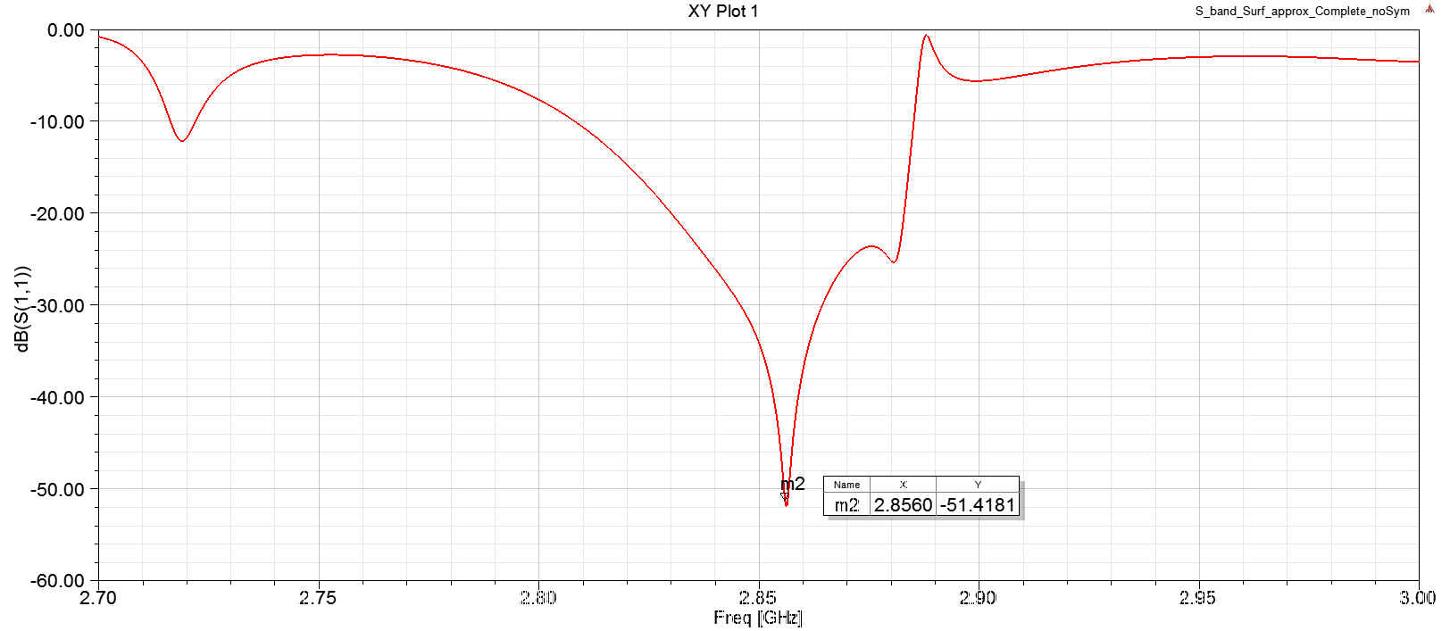
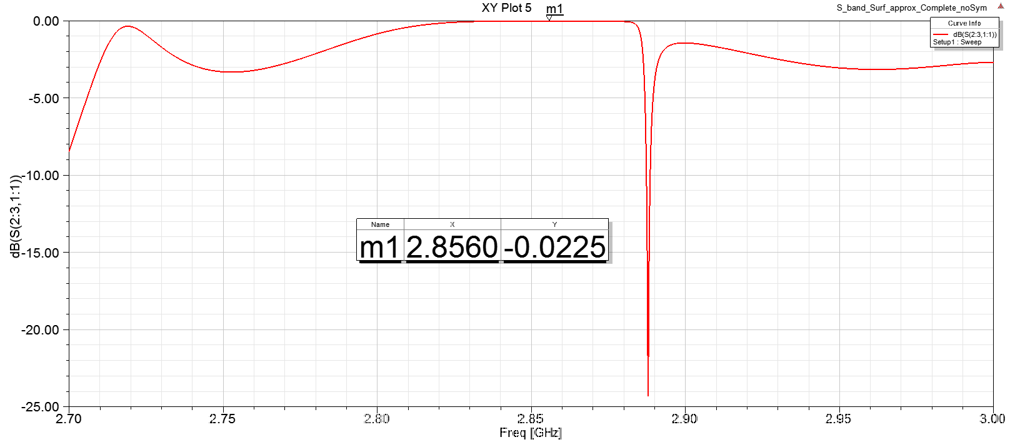
S band TM₀₁ mode launcher - S₁₁ Parameter
Power transmission
HG2019 – June 10 -14 2019 - Chamonix (France)

Slide 23
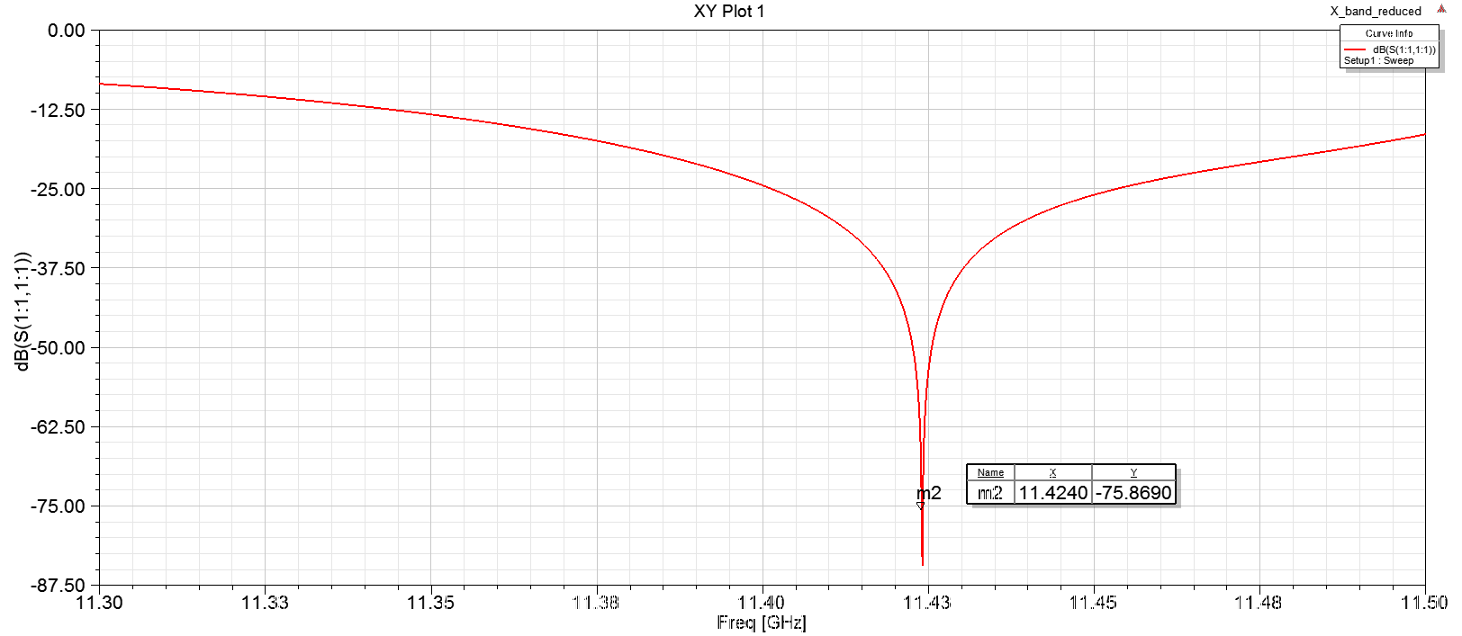
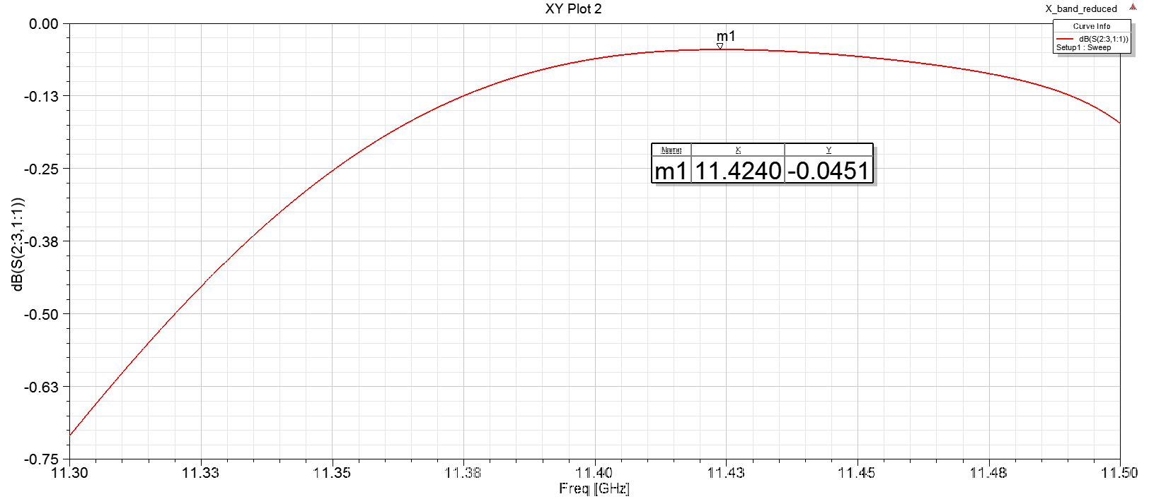
X band design reduced dimension - S₁₁ Parameter
Power transmission
HG2019 – June 10 -14 2019 - Chamonix (France)

Slide 24

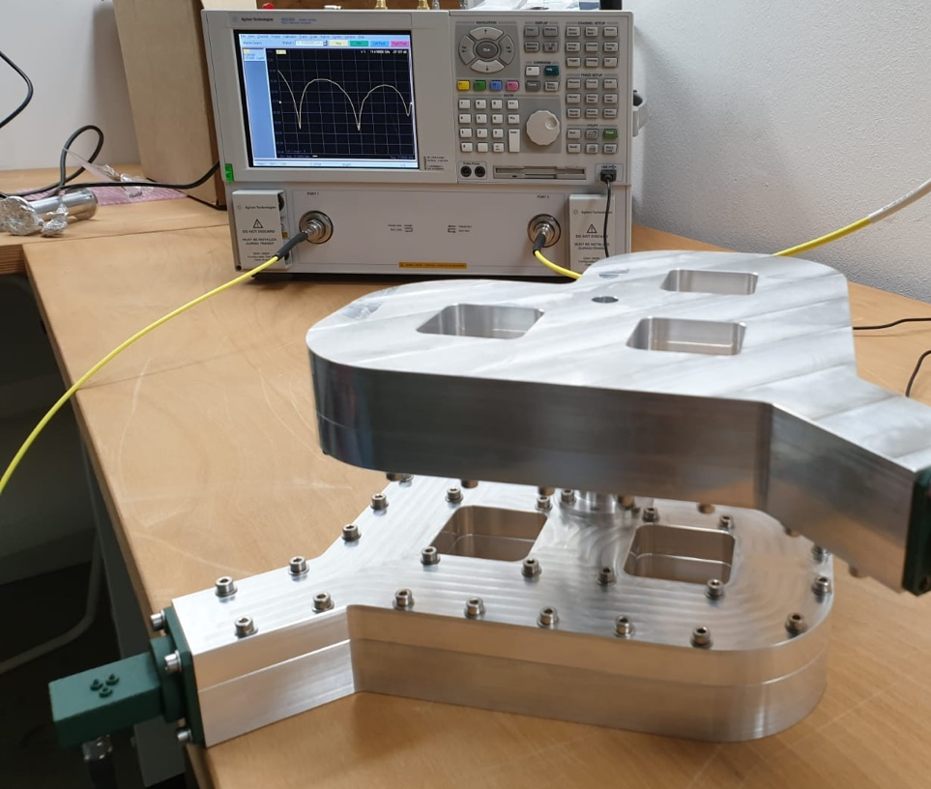
LOW POWER RF TEST OF A DIPOLE - QUADRUPOLE-FREE X-BAND
MODE LAUNCHER FOR HIGH BRIGHTNESS APPLICATIONS
[INFN-LNS_LNF_SLAC collaboration]
NEXT : construction of the X Band mode launcher for RF high power tests to be carried out at SLAC
The two mode-launchers jointed back to back for S-parameters measurements (paper IPAC19 – G. Torrisi et al. ) in the frame of the INFN-LNS_LNF_SLAC collaboration
HG2019 – June 10 -14 2019 - Chamonix (France)

Slide 25
Future Work
Construction of the X band structure made of two halves (3 cells)
Fabrication of X Band structure made of 24 regular cells by using the TIG process. The order has been approved by INFN-LNF
X Band TM₀₁ mode launcher for high power test at SLAC
S band cryogenic structure for high power tests at SLAC
Techonological studies are in progress for the 100 GHz structure by using the braze-free technique [SLAC - E. Nanni et al.]
A lot of thanks to SLAC’s people for their big help !!
Thank you very much for your attention !

