Slide 1
Status of CERN electron lenses test stand

Slide 2
Plan:
To check if current design fits requirements for SCC gun
To provide parameters for already existing equipment
To clarify unknown parameters (diagnostics and vacuum)

Slide 3
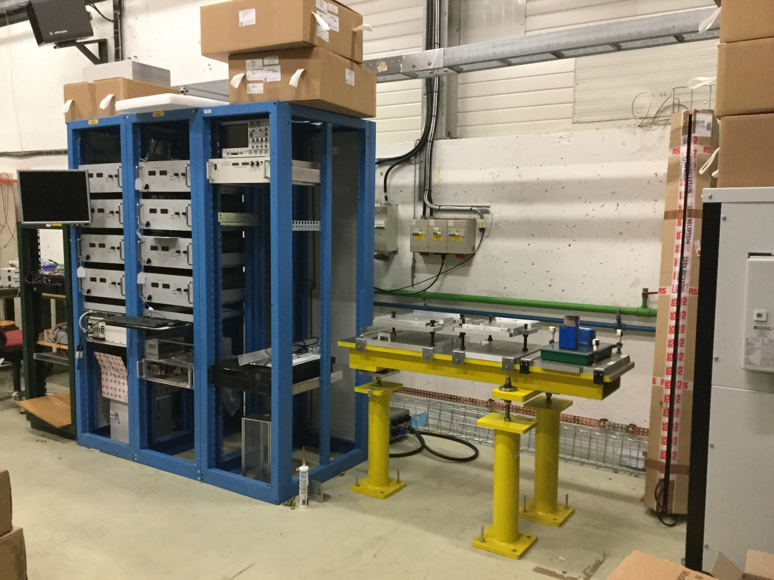
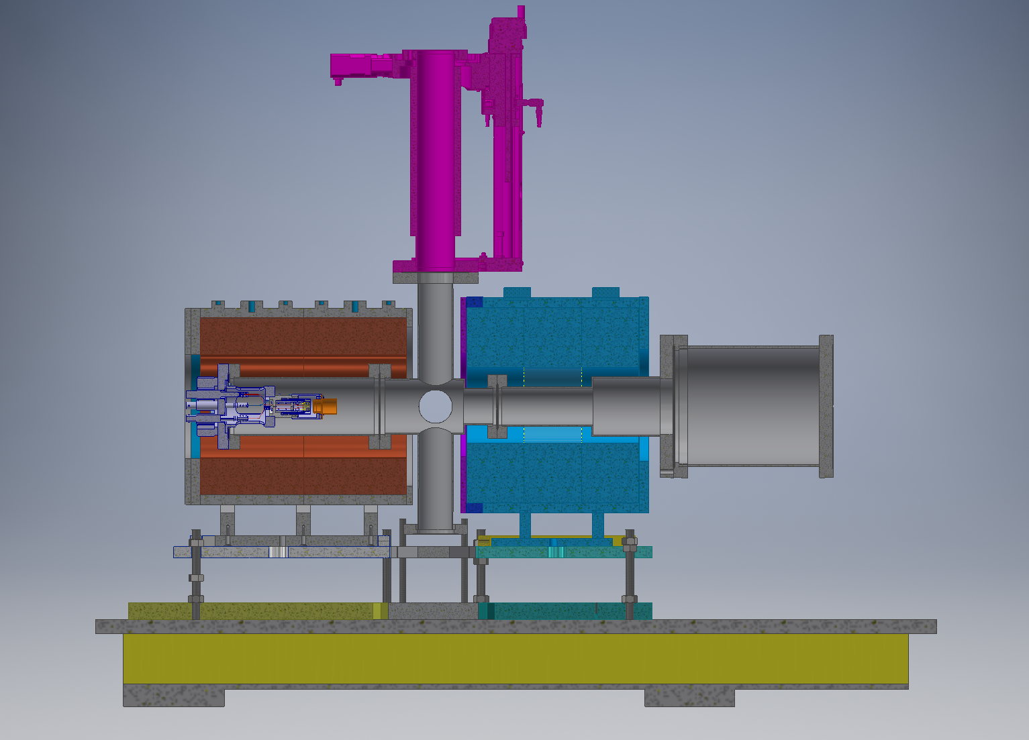
Lab
07/11/2013

Slide 4
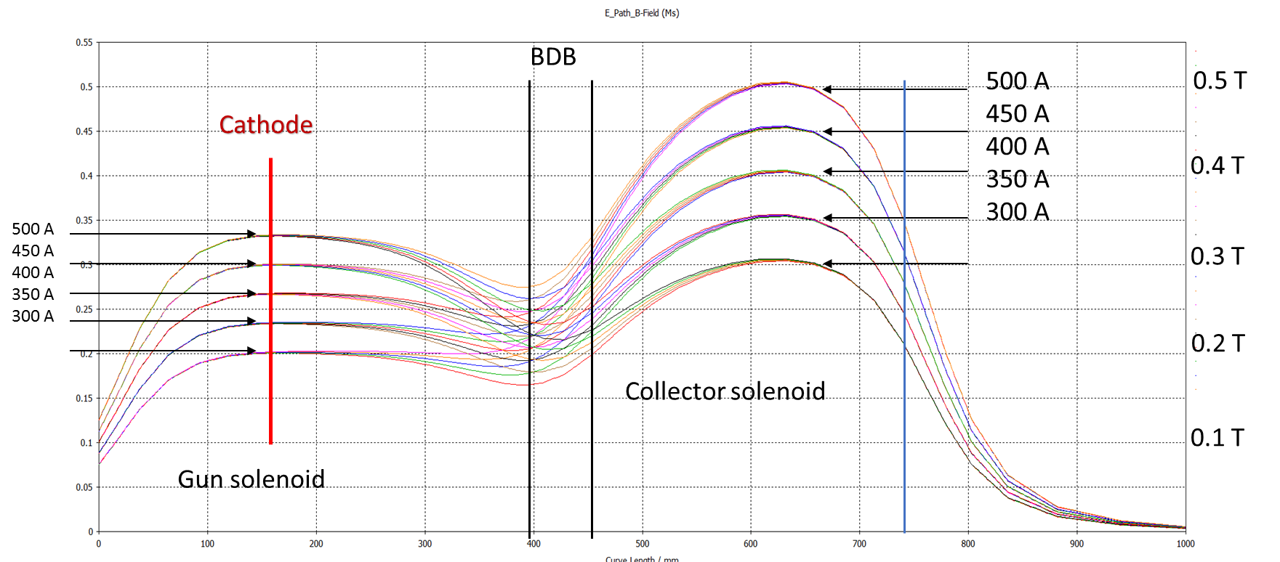
Solenoids and power converters
Power converters are installed
8 units 45V-140A
45V-560A Collector Solenoid
45V-560A Gun Solenoid
Solenoids are available
Up to 0.35 T in the gun solenoid
Up to 0.50 T in the collector solenoid
Installation of water cooling system is under preparation

Slide 5
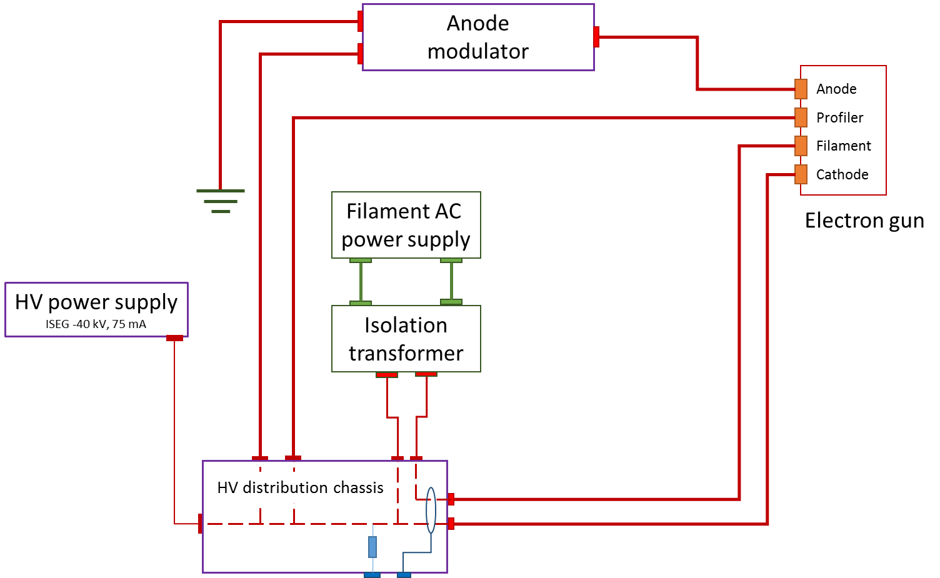
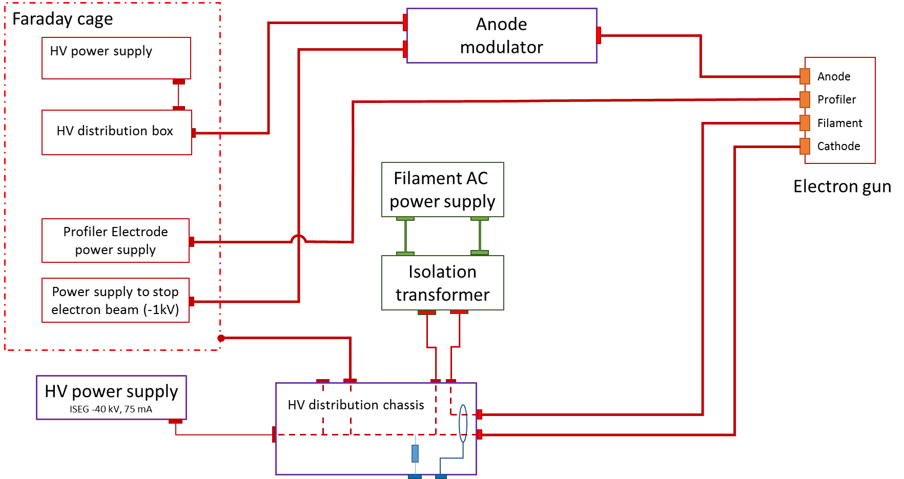
HV circuits
Extraction voltage is up to 40 kV
Filament power supply 20A 40V
Items in the Faraday Cage are not ordered

Slide 6
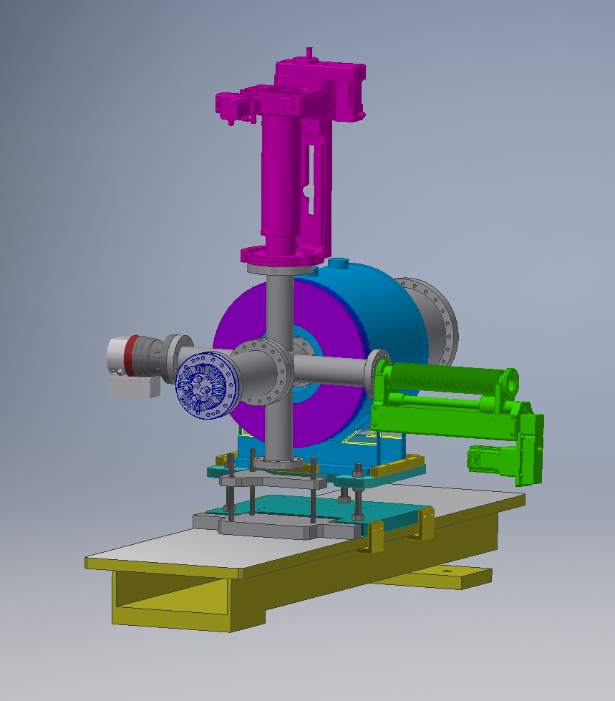
Beam diagnostics
Requirements for SCC gun:
profile measurement (resolution, precision)
Faraday Cup vs YAG screen
Longitudinal measurements (resolution, precision)
Minimum length of the pulse for SCC gun
(maximum energy to dissipate – collector, FC, HV circuit, etc.)

Slide 7
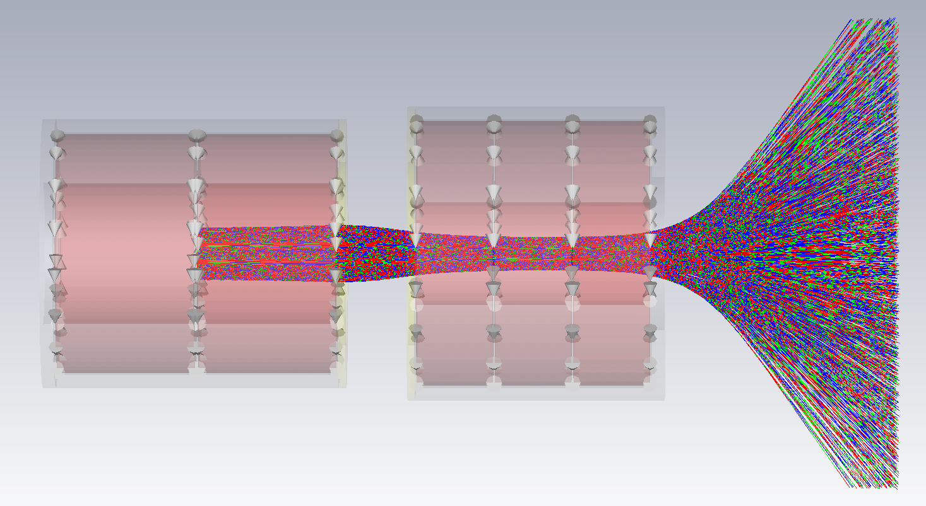
Beam dynamics
0.2 T
0.5 T

Slide 8
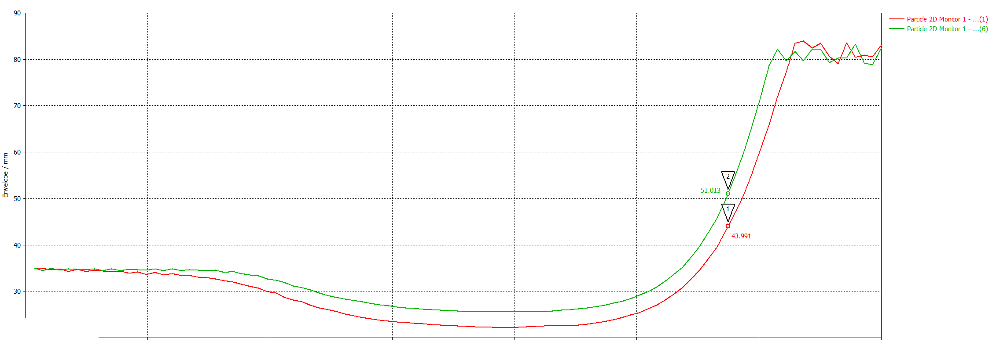
Beam dynamics - 2
0.2 T vs 0.3 T

Slide 9
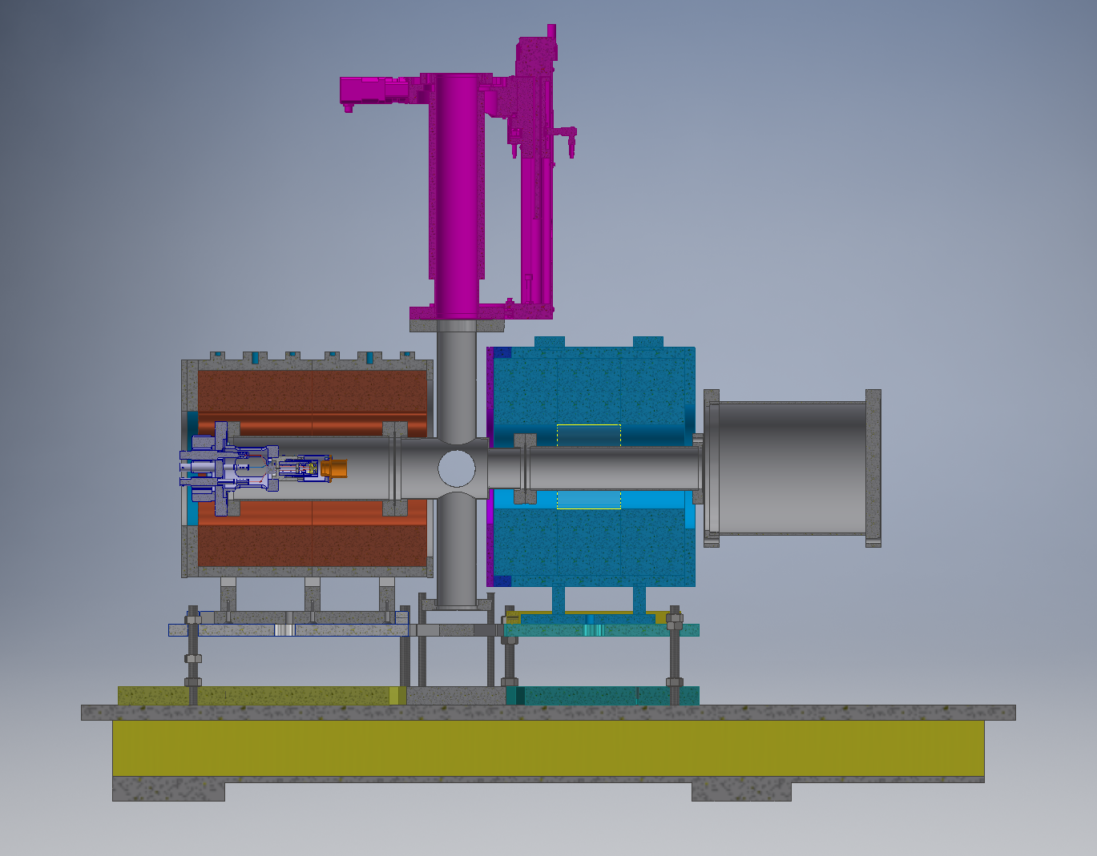
Vacuum system
Aperture restriction:
Gun Solenoid: 185 mm
Collector Solenoid: 130 mm
Minimum field in the gun solenoid required?

