Slide 1
IMC19 Report
Uta Bilow + Ken Cecire
IPPOG meeting, GSI
23.05.2019

Slide 2
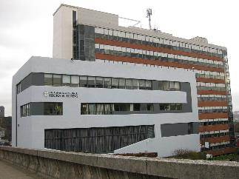
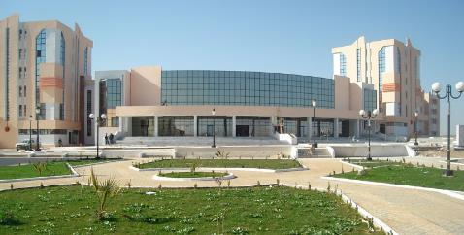
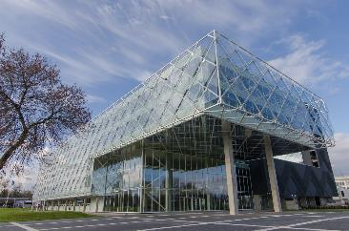
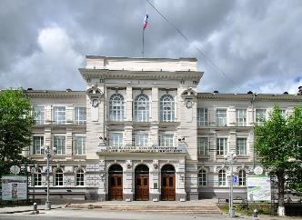
New physics institutes in IMC19
ATLAS
U. of Sheffield, UK
U. of M´Sila, Algeria
CMS
Kaunas, U. of Technology, Lithuania
Tomsk, Polytechnic University, Russia

Slide 3
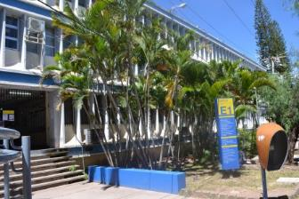
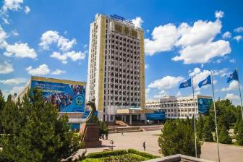
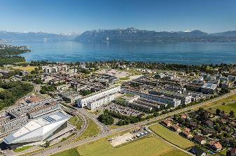
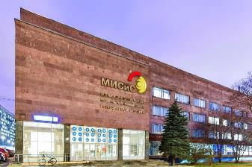
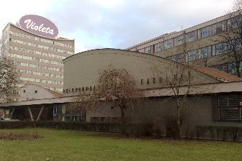
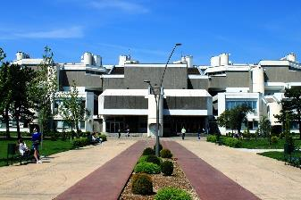
More new physics institutes in IMC19
LHCb
UNAH, Tegucigalpa, Honduras
KazNU, Almaty, Kazakhstan
EPFL, Lausanne, Switzerland
MISIS, Moscow, Russia
ALICE
U. of Sarajevo, Bosnia and Herzegovina
U. of Montenegro, Podgorica

Slide 4
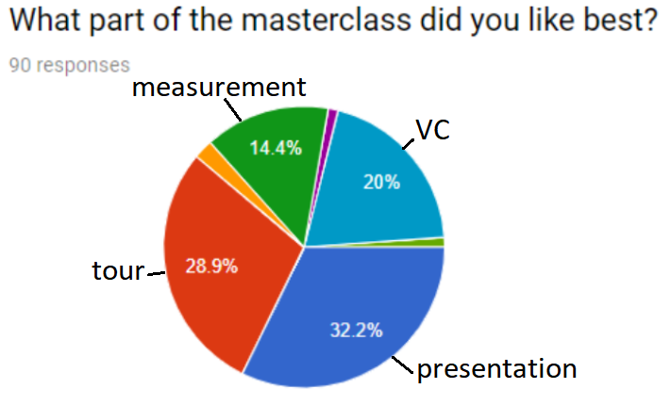
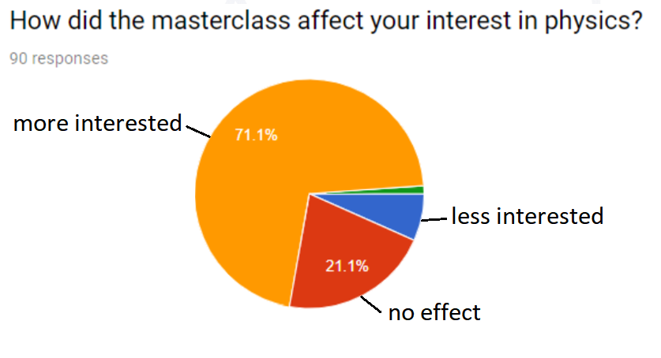
New: Neutrino Masterclasses
MINERvA Masterclass – passed tests and part of IMC2019
MicroBooNE – expected for IMC2020
Plans and inquiries for more
More at http://tiny.cc/y7d16y.

Slide 5
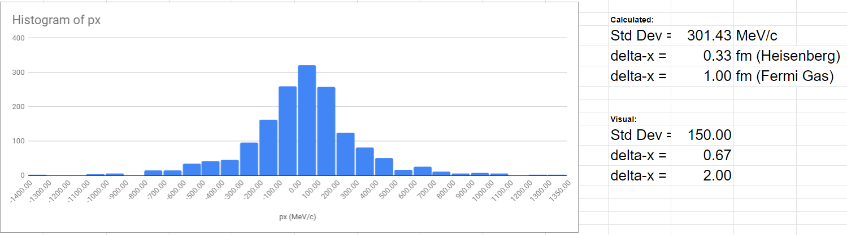
MINERvA success
Students made good analyses
Videocons in ROC West went well
Students, teachers, tutors generally satisfied
May need to add to measurement

Slide 6
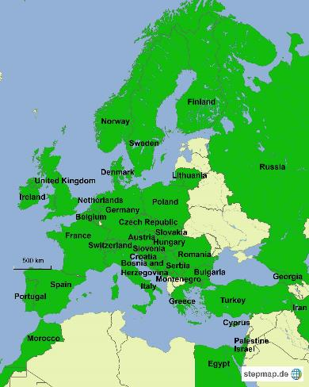
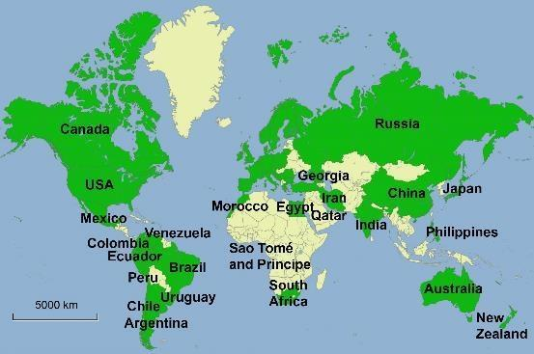
IMC19 – the whole picture
7.3. - 16.4.2019
+ satellite dates
+ Spanish VCs
(to accomodate all needs)
54 countries involved
Coord.: QuarkNet / TU Dresden
188 institutes (177)
266 LHC Masterclasses (257)
  30 ATLAS W (35)
  101 ATLAS Z (104)
  64 CMS (58)
  41 LHCb (39)
  27 ALICE SP (18)
  3 ALICE R_AA (3)
51 institutes (48)
54 LHC Masterclasses (50)
  22 ATLAS (19)
  32 CMS (31)
(Incl. TRIUMF program)
12 MINERvA Masterclasses

Slide 7
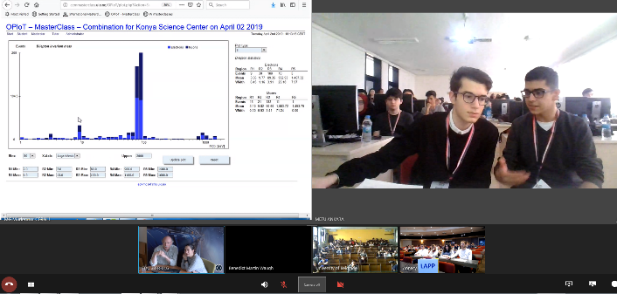
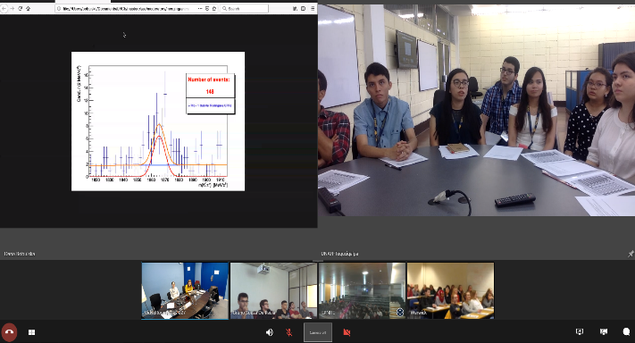
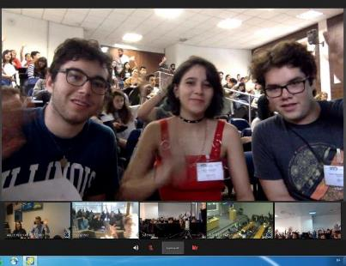
Video conference
59 video conf. with CERN (61), 50 moderators
18 with Fermilab (18), 28 moderators
1 with TRIUMF (1)
Spanish language VCs:
add 1.5 to CERN, 0.5 to FNAL,
2 moderators

Slide 8
Key factors for success
Stable measurements (no changes)
Not too many special requests from institutes
Comprehensive preparation for institutes
  23 circulars http://physicsmasterclasses.org/index.php?cat=local_organisation&page=organisation
  Manual for videoconference https://physicsmasterclasses.org/downloads/manual_local_organizers_2019_01_24.pdf
  „Question time“
  Orientation for Fermilab institutes
WG videoconference (Ina Carli, Katharine Leney, Uta)
  Training for moderators (2 h) https://indico.cern.ch/event/796348/
  twiki, manual
  Prepared rooms at CERN
Vidyo team / Ruben Aparicio + videoconference team at Fermilab
  Room 31-S-27
  Vidyo support for every session + preliminary Vidyo tests
Maureen
  Room 33-R-16
  Shirts for moderators
Notes:
Link zu circulars + manual

Slide 9
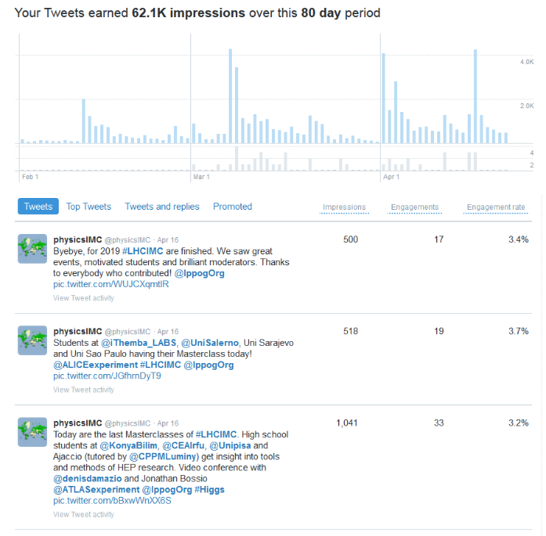


External Communication
Twitter @physicsIMC
  #LHCIMC
  Team: Kate, Ken, Uta
  Schedule (Feb – April)
April 2018:
May 2019:

Slide 10
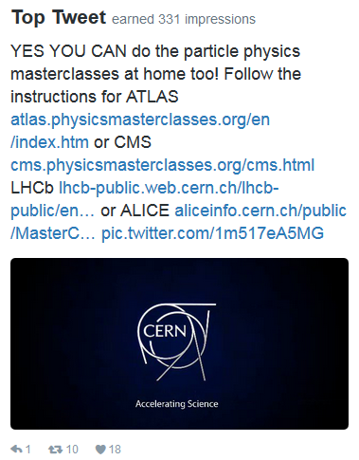
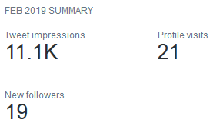
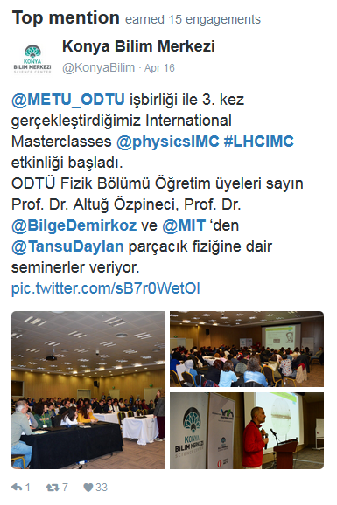
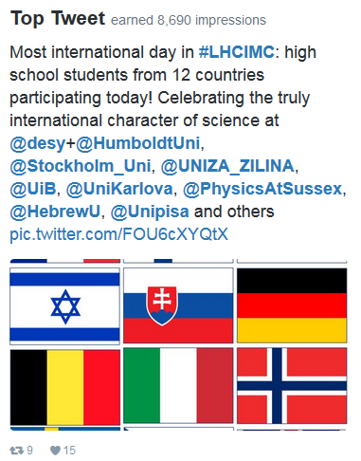
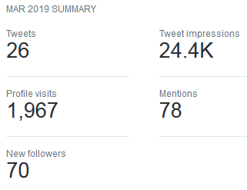
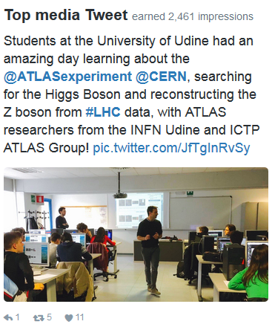
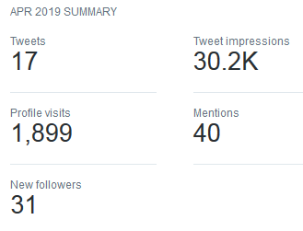
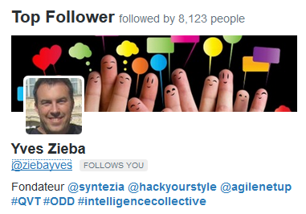
Twitter impressions

Slide 11
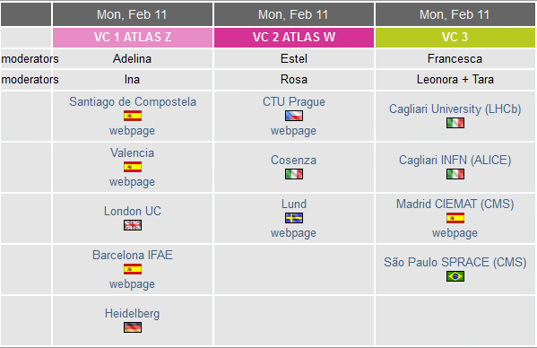
Int. Day of Women and Girls in Science
Proclaimed by the UN in 2016 (Feb 11th)
www.un.org/en/events/women-and-girls-in-science-day/
To support and promote the access of women and girls to science education and research activities
MCs for girls on Feb 11th http://physicsmasterclasses.org/index.php?cat=women_in_science
  11 institutes participating (8)
  600 students (250)
  Female lecturers and tutors (as much as possible)
  3 videoconferences at CERN with female moderators, incl. presentation on situation of women in physics

Slide 12
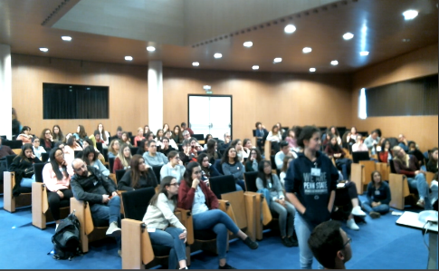
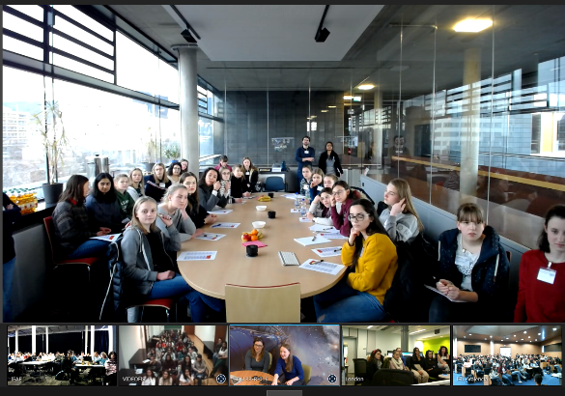
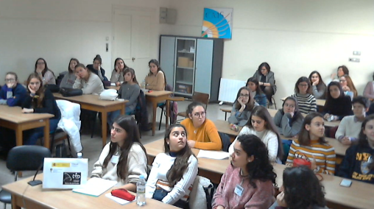
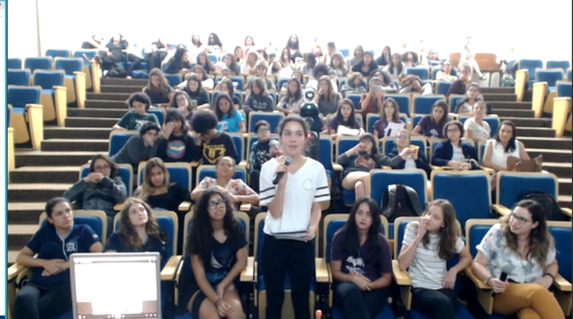
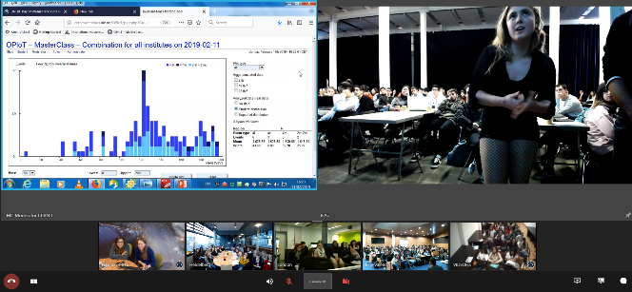
Int. Day of Women and Girls in Science

Slide 13

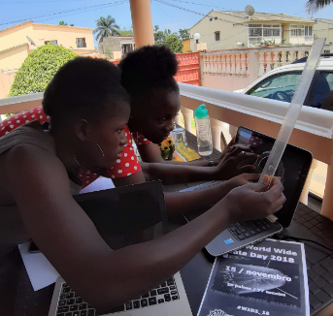
World Wide Data Day
15 Nov 2018 (14 Nov 2017) (2 Dec 2016)
The numbers:
  Participating groups – 66 (34) (21)
  Students – 1064 (445) (354)
  Moderators – 24 (14) (8)
http://tiny.cc/w2d2-18
Students measure theta and phi for dimuon events
Data analysis at school, physics discussion in VC
Measurement used in Chile, Mexico, Namibia workshops in 2018
Great growth in Mexico: 9 groups
Measurement stable

Slide 14
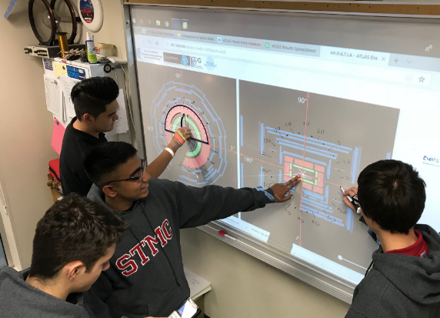
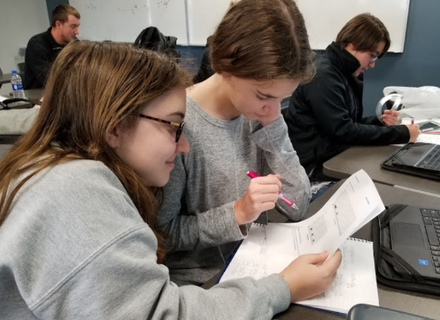
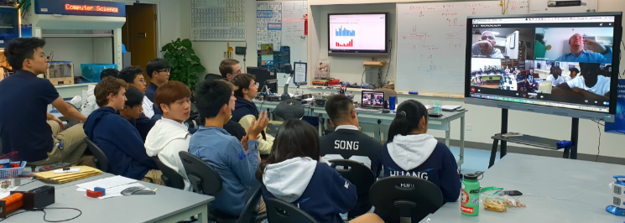
World Wide Data Day
Clockwise, from top-left:
Burnaby, BC, Canada
Ottawa, KS, USA
Shanghai, China

Slide 15
News from SG meeting
New J/Psi Masterclass developed at GSI/Uni Münster
Masterclass mini-training at CERN (half day, in connection with IPPOG)

Slide 16
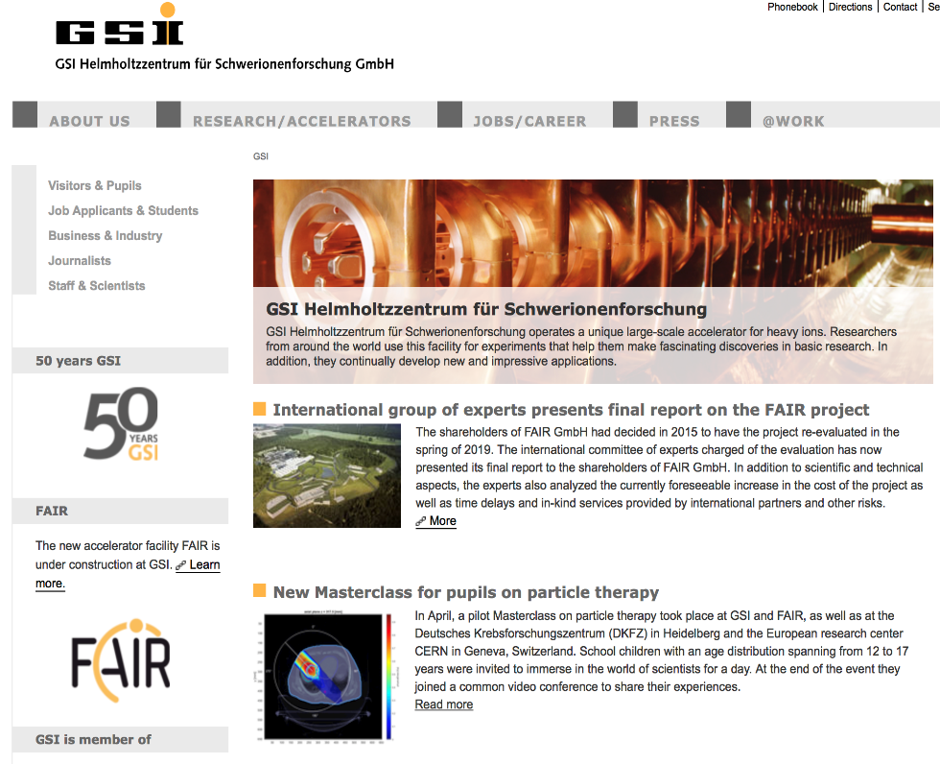
New Particle Therapy MasterClass
News at GSI Home Page
gsi.de
Coming: ENLIGHT, ARIES….

Slide 17
Executive Summary
First test: locally at GSI early 7th February 2019
First pilot: GSI, Heidelberg DKFZ, CERN 5th April 2019
Very well received
IMC Steering Group: Presentation and Feedback
Material ready for IMC web: during summer
In the IMC program for 2020: end march
Several institutes interested
  Announcement at Biophysics Meeting at GSI

Slide 18
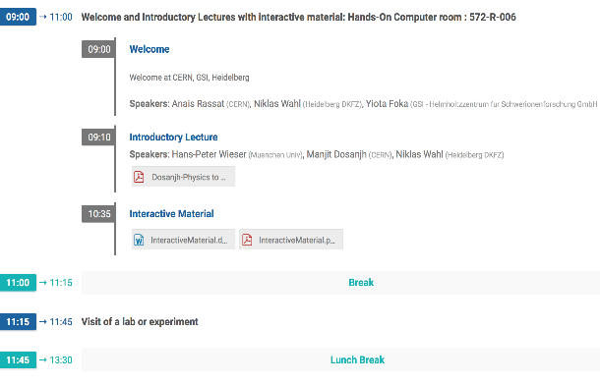
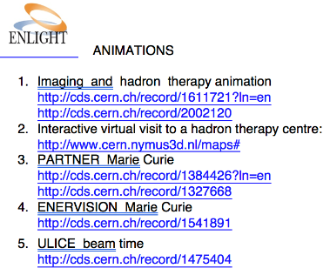
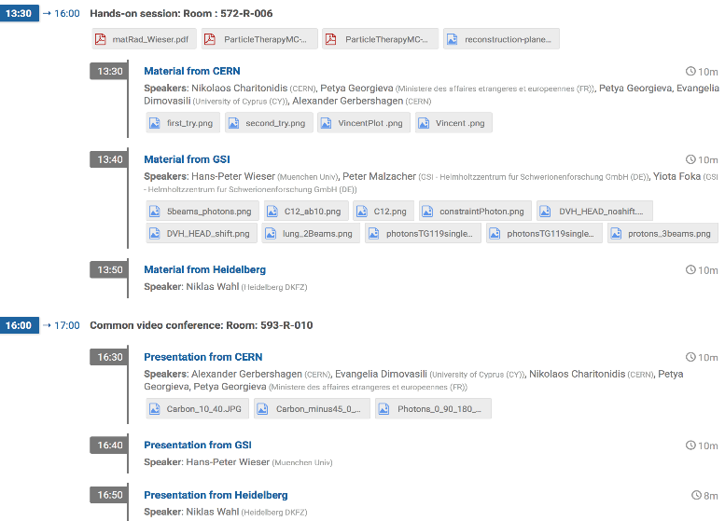
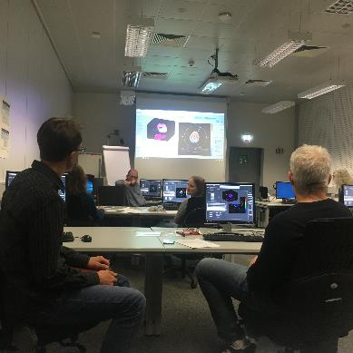
Typical MasterClass Day Agenda
https://indico.cern.ch/event/808272/
CERN: 12-17 years old
HD DKFZ: 17 years old
GSI: 15 to NN years old

Slide 19
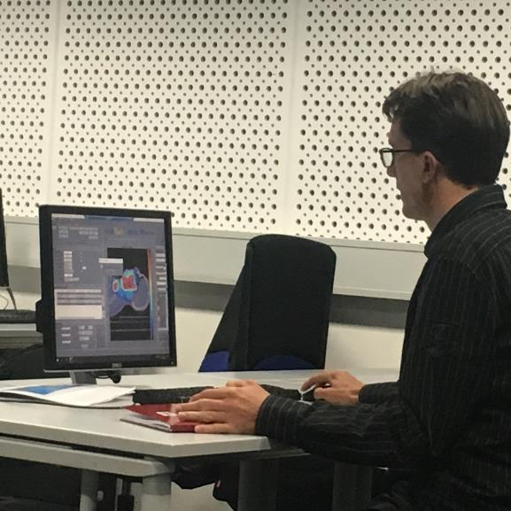
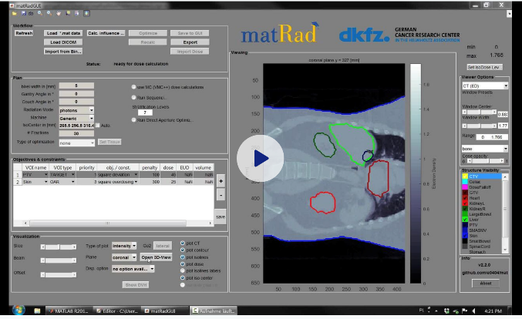
Treatment Planning
Based on professional open source treatment planning: matRad
developed by Heidelberg DKFZ www.matrad.org
First contact proposed by C.G.
Simplified version by HD DKFZ
https://www.dropbox.com/s/m75u80ev3a5clvp/AAPM_matRad_screenGrab_take3.wmv?dl=0

Slide 20
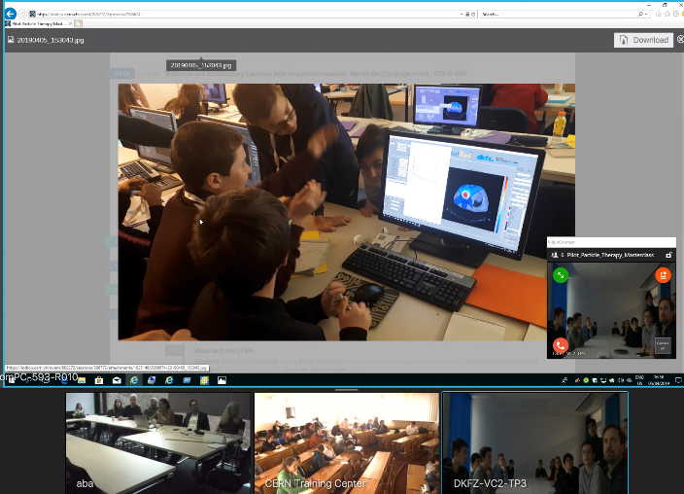
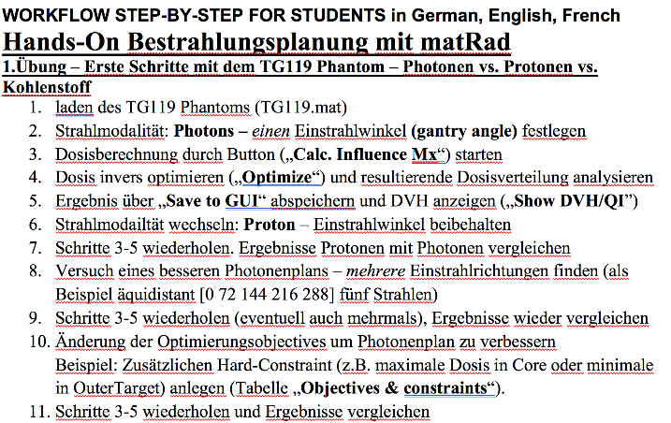
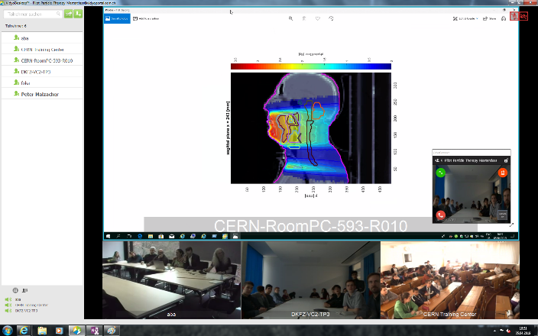
Common vidyoconference
Common discussion: intuitive, visual
comparisons of photos, protons, ions
Survey: positive results from students
Feedback from observers
(different disciplines)

Slide 21
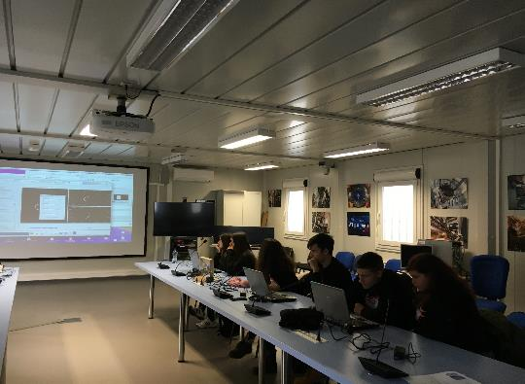
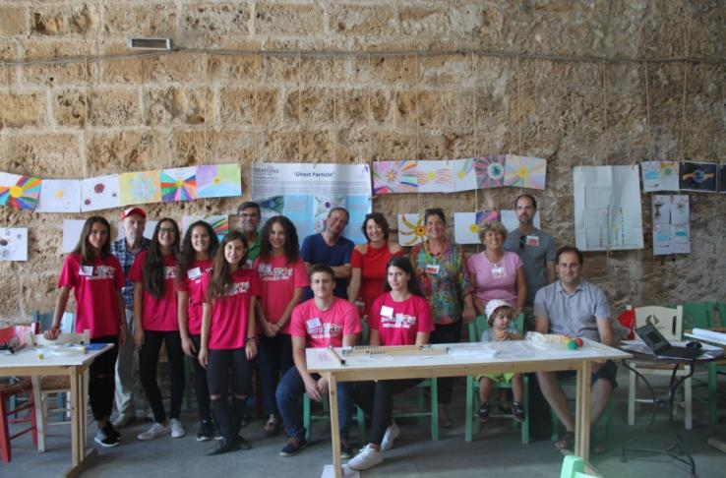
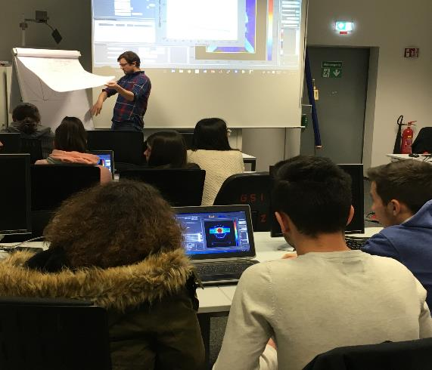

Tests: CURIEocity team
… to CERN
From Crete
… to GSI
Yiota Foka
8

Slide 22





Ions for cancer therapy
Acknowledgements
BIOMAT and BIOPHYSICS
Focus on medical applications
Ideas and technologies for a next-generation facility
for medical research and therapy with ions
Yiota Foka
Archamps, 19 June 2018
6
Theme: benefits for society

Slide 23
Acknowledgements
DKFZ Heidelberg
Bangert, Mark" m.bangert@dkfz-heidelberg.de
Wahl, Niklas <n.wahl@dkfz-heidelberg.de>
Katrin Platzer
Malte Ellerbrock
Noa Homolka
Amit Ben
Antony Bennan
Hans-Peter Wieser <h.wieser@lmu.de>
Currently LMU Garching (Catia Parodi group)
GSI
GSI Biophysics:
Graeff, Christian Dr." <C.Graeff@gsi.de>
Pleskac, Radek Dr." <R.Pleskac@gsi.de>
GSI ALICE, EMMI :
Ralf Averbeck <R.Averbeck@gsi.de>
Malzacher, Peter" <P.Malzacher@GSI.DE>
GSI IT :
Thorsten Kollegger <t.kollegger@gsi.de>
Behnert, Katharina" <K.Behnert@gsi.de>
Osdoba, Sascha" <S.Osdoba@gsi.de>
CERN (staff and users)
CERN: tutors
Nikolaos Charitonidis nikolaos.charitonidis@cern.ch
Alexander Gerbershagen <a.ge@cern.ch>
Evangelia Dimovasili Evangelia.Dimovasili@cern.ch
Elena Benedetto Elena.Benedetto@cern.ch
CERN/ARIES: Maurizio Vretenar Maurizio.Vretenar@cern.ch
Valerie Brunner <Valerie.Brunner@cern.ch>
CERN/ENLIGHT: Manjit Dosanjh Manjit.Dosanjh@cern.ch
Petya Georgieva <petya.georgieva@cern.ch>
CERN/KT: Manuela Cirilli <Manuela.Cirilli@cern.ch>
Anais Rassat <anais.rassat@cern.ch>
Rita Ferreira <rita.ferreira@cern.ch>
Giovanni Porcellana giovanni.porcellana@cern.ch
CERN: Visits Service Visits.Service@cern.ch
Erwan Harrouch erwan.harrouch@cern.ch
Francois Butin Francois.Butin@cern.ch
CERN: Training Centre: Technical.Training@cern.ch
Eric Bonnefoy Eric.Bonnefoy@cern.ch
Marie-Laure LECOQ

