Slide 1
Tumor Therapy @ GSI
Gerhard Kraft
Biophysics Dep. GSI Darmstadt Germany
Motivation
Realisation

Slide 2
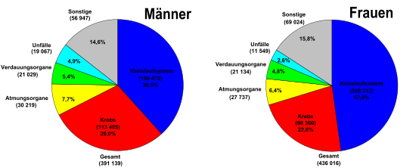
Death in Germany (2007)
Motivation for ion beam therapy
Statistisches Bundesamt (2012/14)
live expectance : Men : 78 years / women: 83 Jahre
cancer
cancer
Cancer is the second most cause for death
https://de.wikipedia.org/wiki/Todesursache

Slide 3
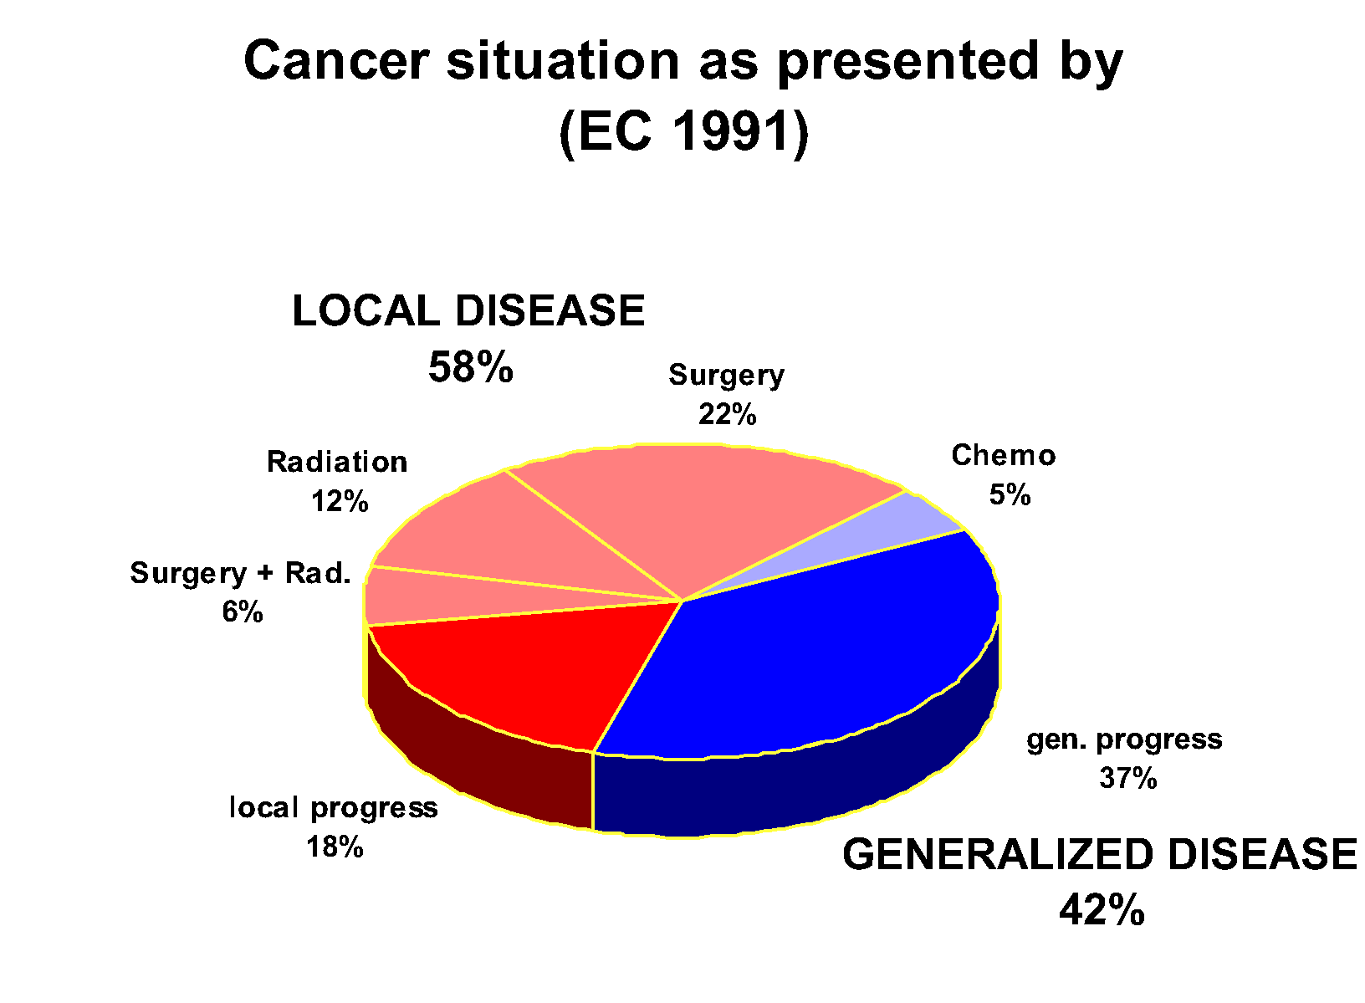
Motivation
Higher precision = better cure +less side effects ?

Slide 4
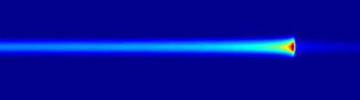
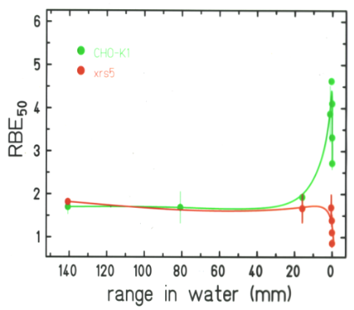
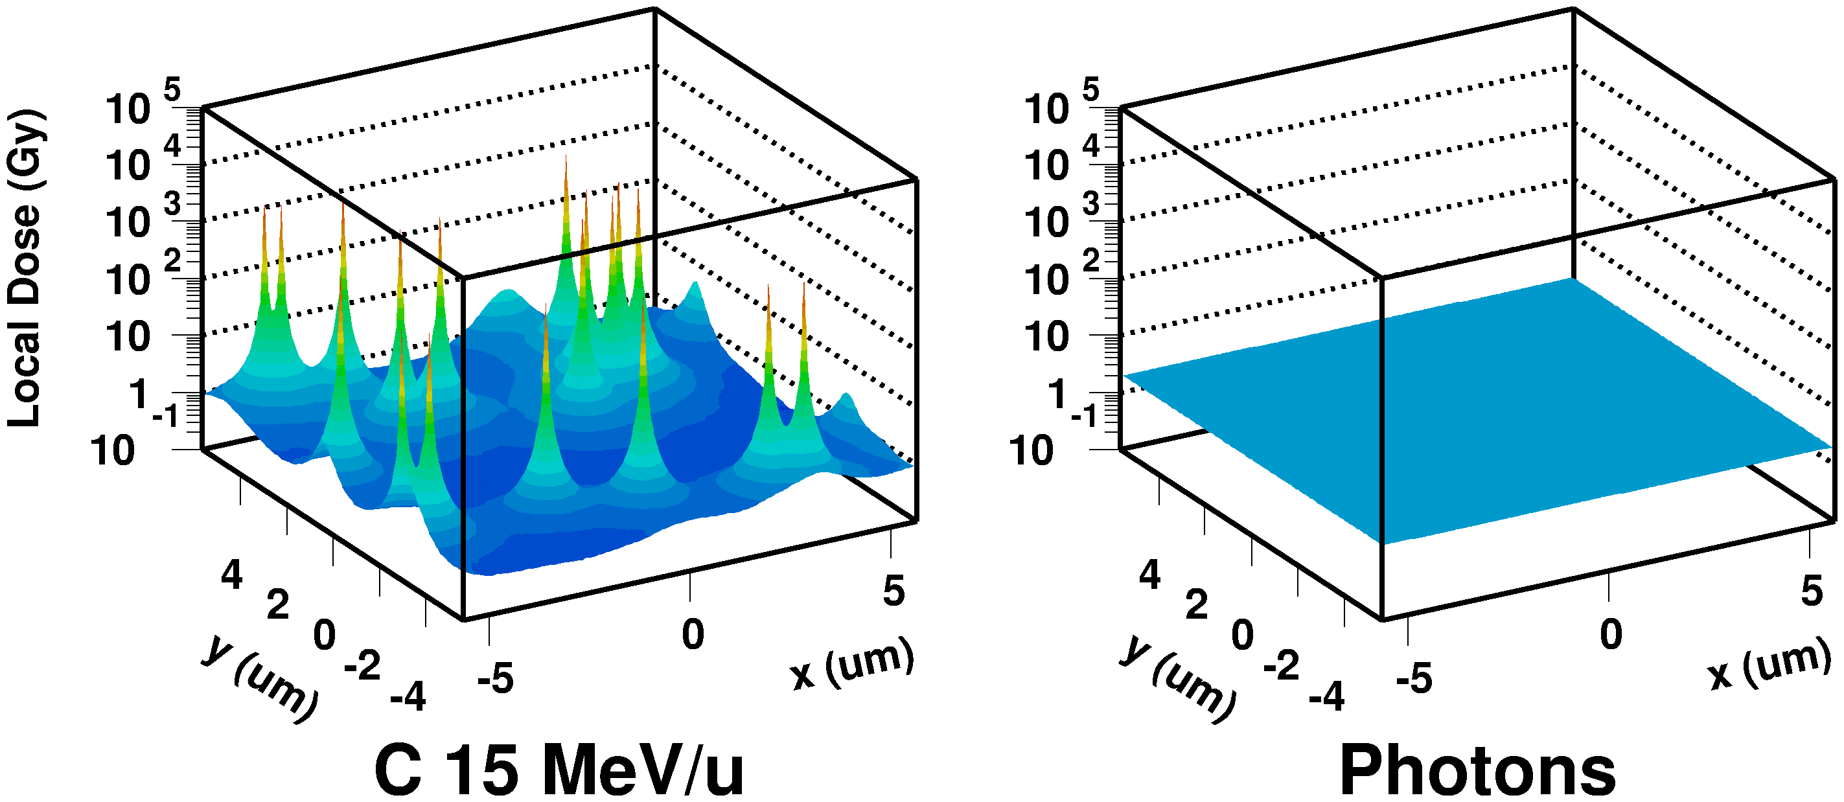
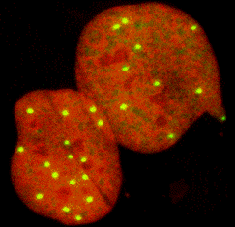
Rational for particle therapy:
Physical advantages:
High dose at the end of range
small lateral scattering
Biological advantages
elevated relative biological effectiveness RBE in the tumor

Slide 5
Technical problems
From a 1-dimensional monoenergetic beam
to a tumorconform treatment volume
possibilities for particle
beam shaping
Passive methods
absorber , collimators
Active methods:
Scanning , energy variation
Particles
IMRT

Slide 6
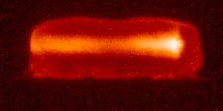



Principle of beam scanning
Intense ion beam
Phatom of solid mater

Slide 7
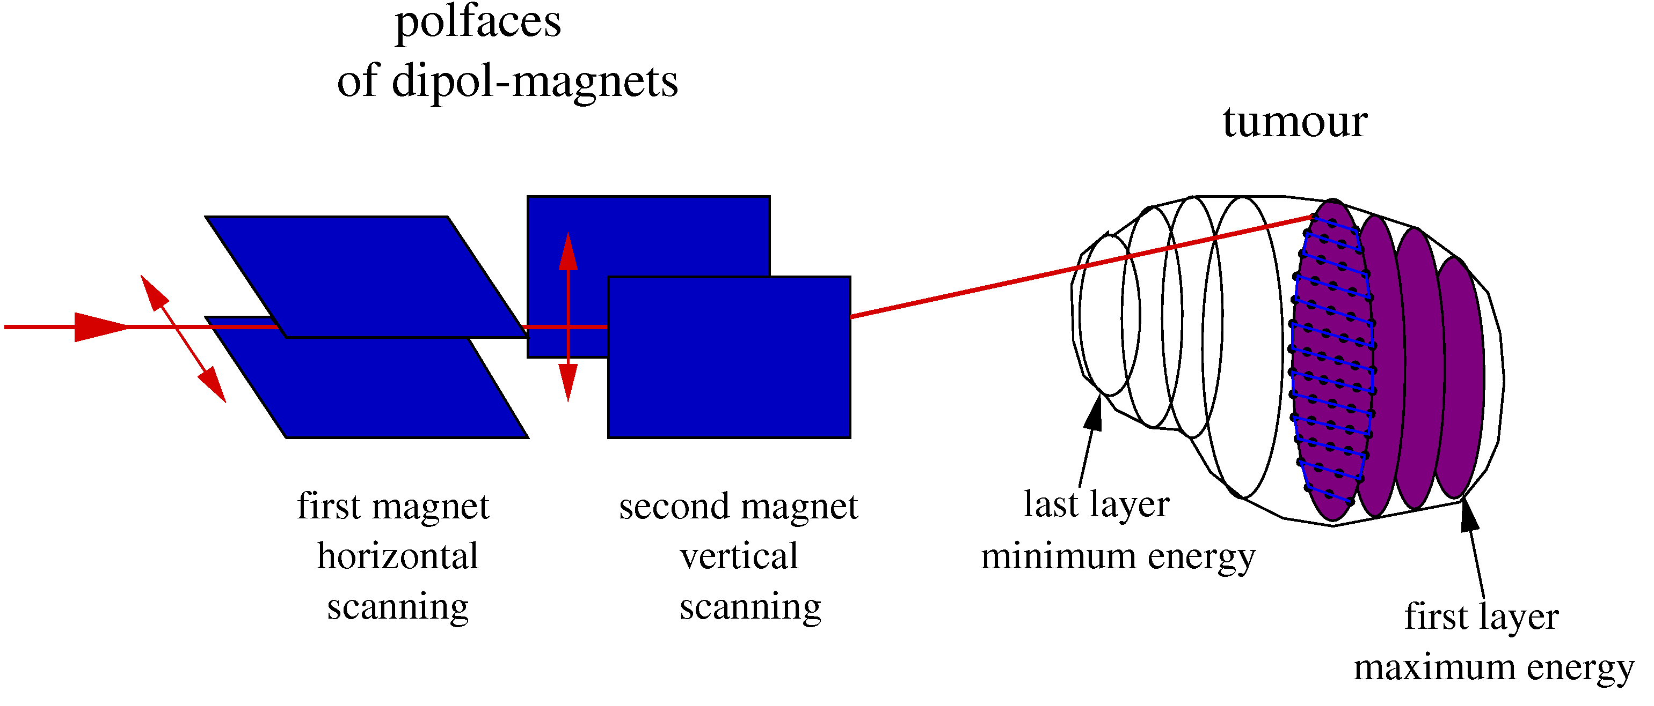
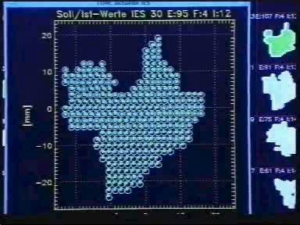
Active beam delivery: Principles of Beam scanning
O.Jaekel DKFZ
Notes:
Evtl Animation

Slide 8
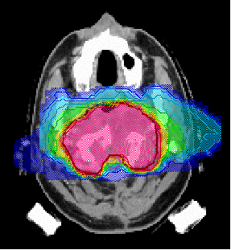
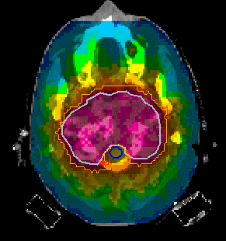
Comparison of Treatment Plans
Heavy Ions (2 Fields)
IMRT (9 Fields)

Slide 9
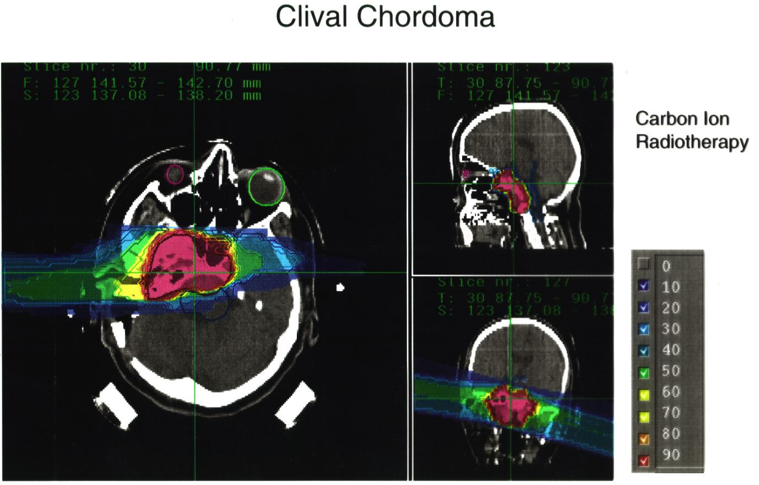

Slide 10
Advantages of Carbon
Higher precision => greater dose to tumor
=> smaller dose to normal tissue
Greater biological effectiveness
but restricted to the target volume
staying low in the normal tissue

Slide 11
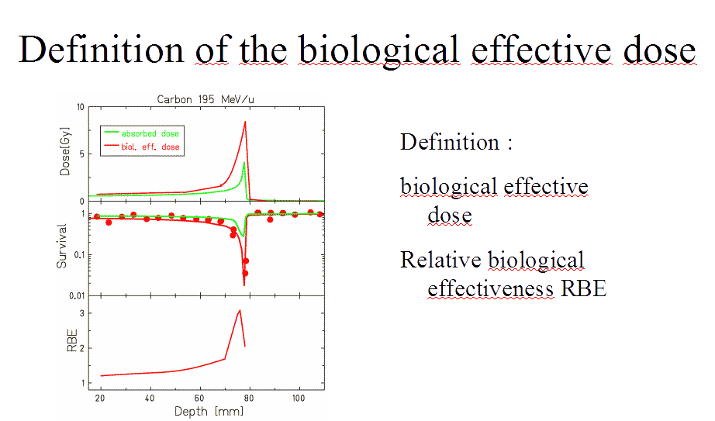

Slide 12
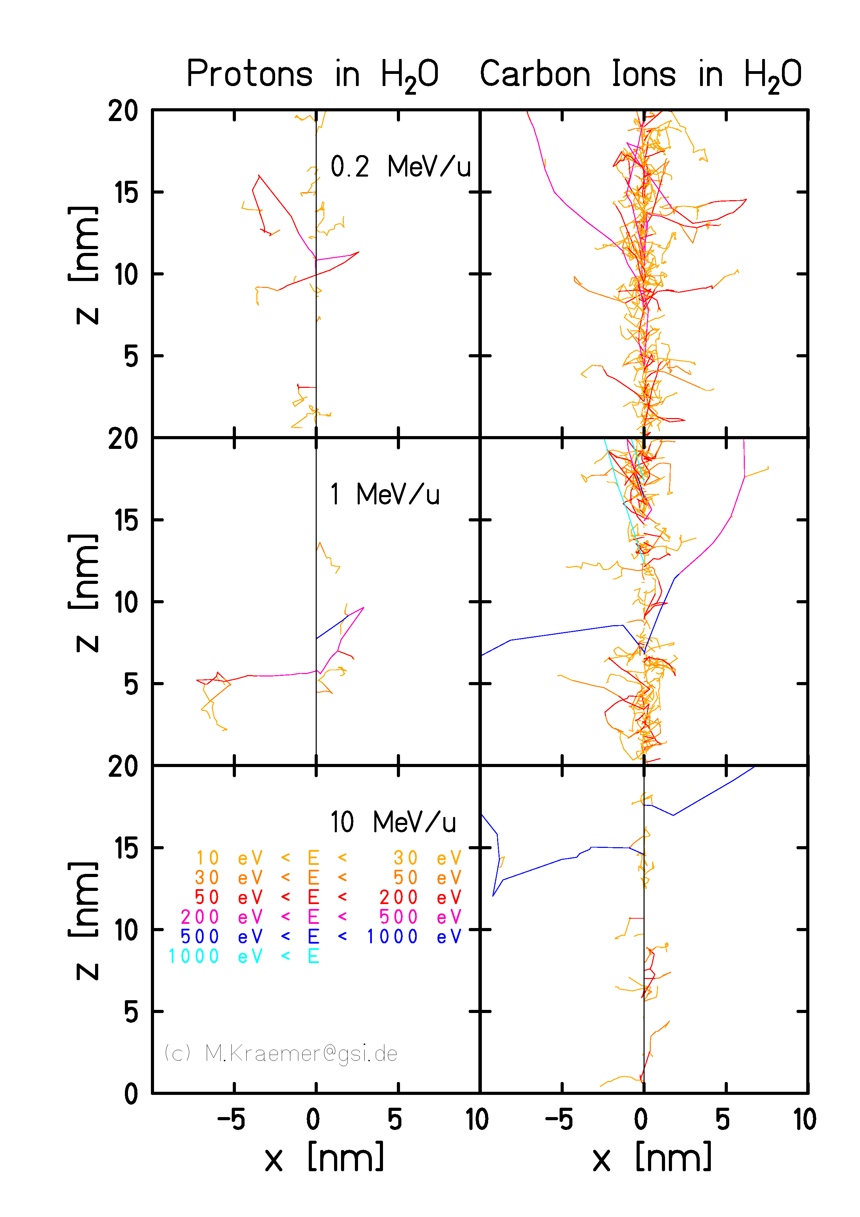
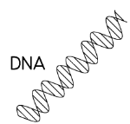
Dose distribution
in
nanometer scale

Slide 13
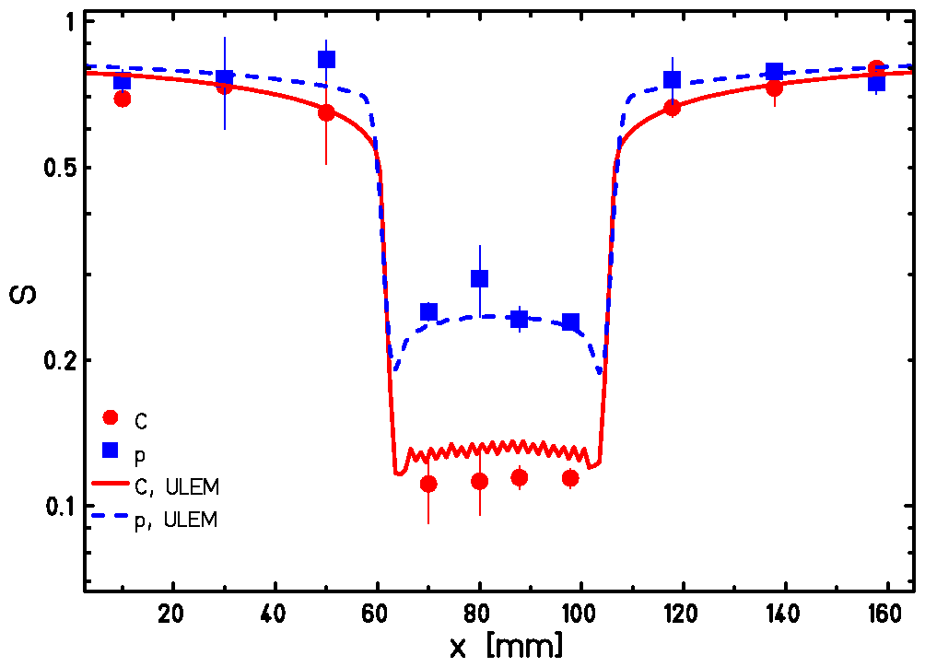
Protons versus Carbon:
Calculations : LEM IV Model
Experiment at HIT : same parameters
Protons and Carbon beams alternating
CHO cells
Normalized : same effect in the entrance
Survival
Proton
Carbon
W.K.Weyrather et al.@ GSI

Slide 14
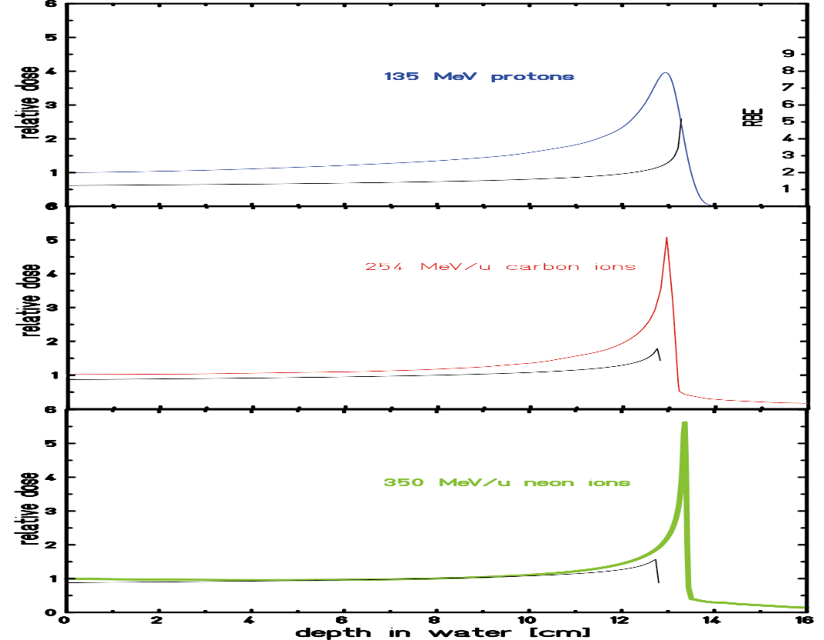
Dose & RBE for protons, carbon, neon
RBE maximum
in color: dose

Slide 15
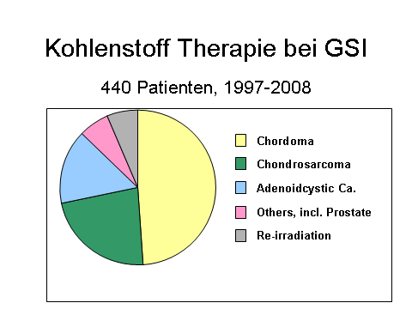
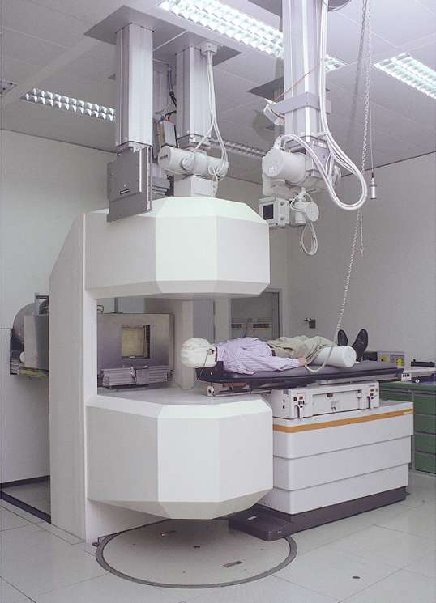
Röntgenröhre
Bildverstärker
Patientenmaske
Strahlaustrittsfenster
Patientenmonitor
Patient
PET-Kamera
Patiententisch

Slide 16

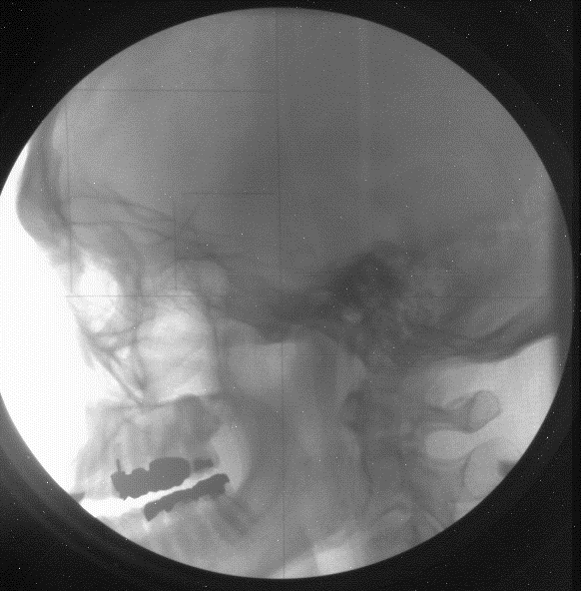
X-ray Imaging in Treatment Position

Slide 17
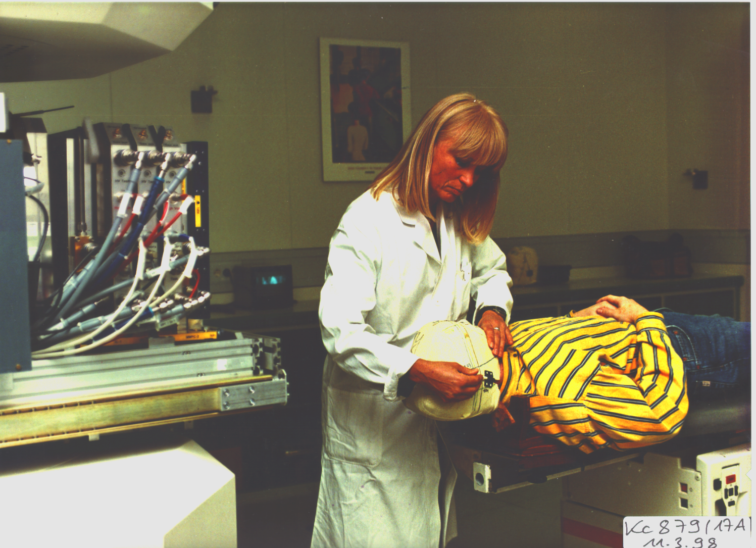
Quality& beam control:
Ionisation- / multiwire Chambers
>10 000 measurements / sec
Patient fixation
In vivo beamcontrol with PET

Slide 18
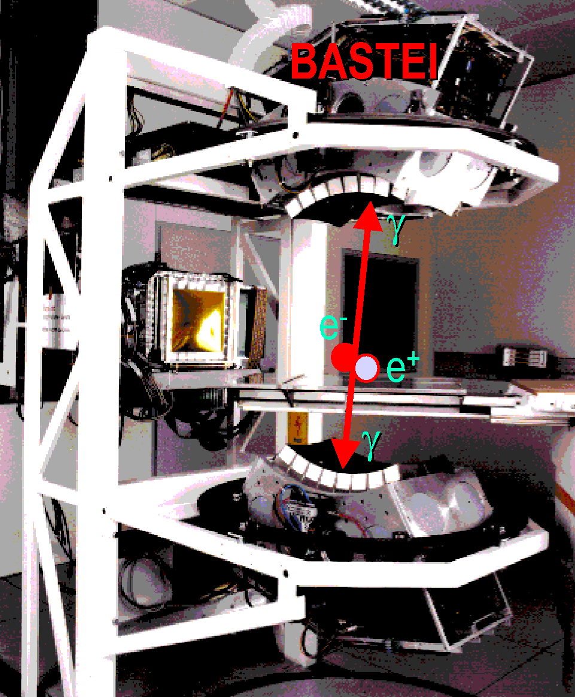
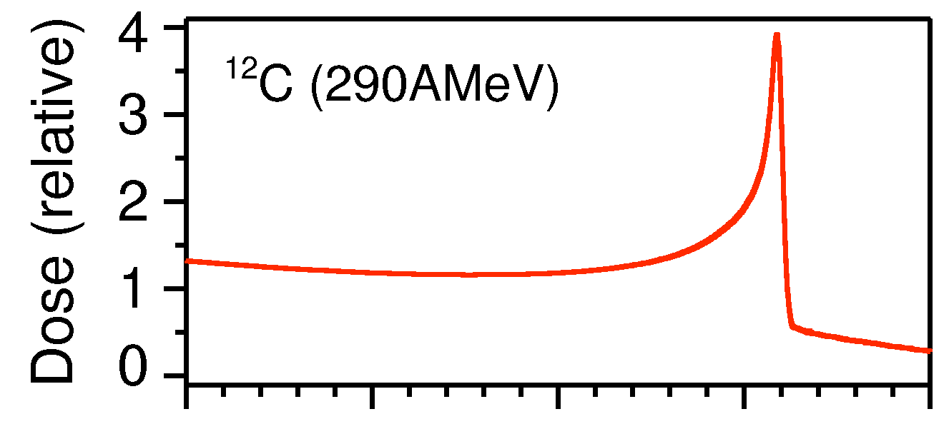
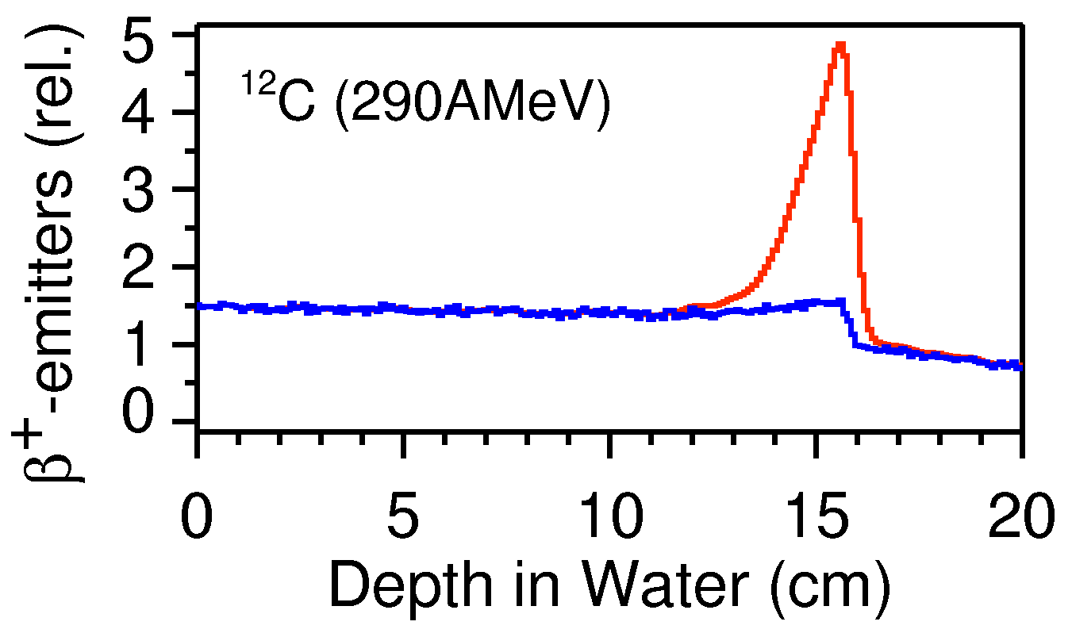
PET-control of treatment
projectile
target
[Enghardt et al. Rossendorf]

Slide 19
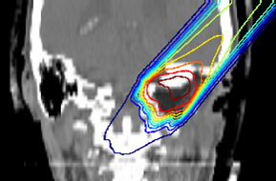
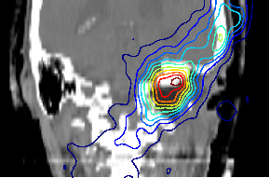
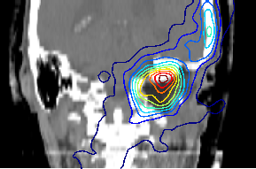
Dose verification with PET
3D reconstruction by back projection
Positron emitter distribution neither proportional nor equivalent to the dose distribution
Comparison with expected positrion emitter distribution
Treatment plan
Predicted β⁺-activity
Measured β⁺-activity
[Enghardt et al. Rossendorf]

Slide 20
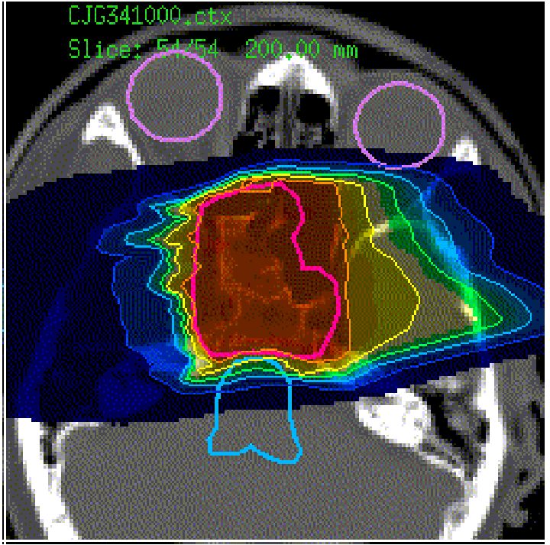
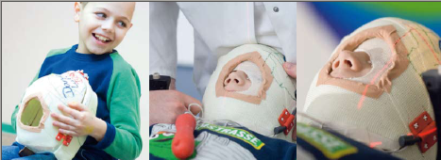
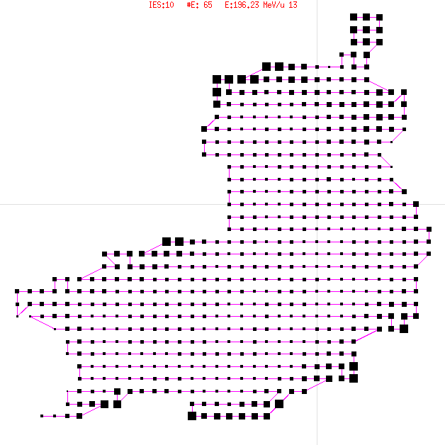
Treatment of tumors close to the eye
39 patients
  High precision treatment using rasterscan
  precission spares critical structures
  Push button experiment
  correlates flashes with scan position
Patient signal
Patient signal
taking into account
reaction time
Light flashes are associated with
radiation effects in the retina
no evidence for direct stimulation of the optic nerves

Slide 21
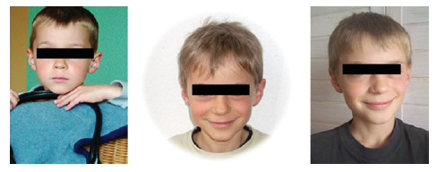
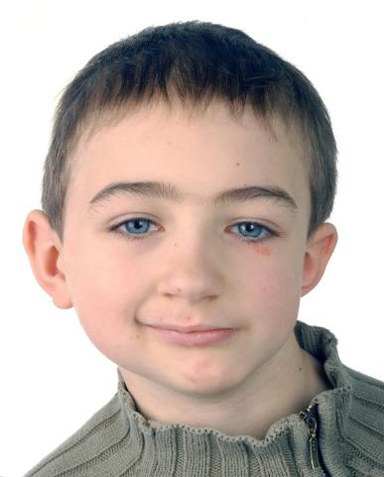
Carbon treatment of a recurrent chordoma in a 5 year old child
After 5 years 8 years 12 years
Sparing of bone sutures in children
No asymetric growth after particle RT
J.Debus et al.
For comparison : IMRT treatment after 5 years

Slide 22
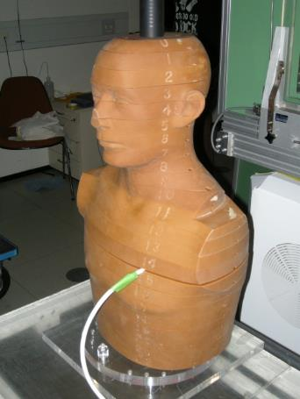
Absorbed dose along the spinal cord in a human phantom
Measurement direction
Beam
direction
La Tessa ,Kaderka et al., Radiother Oncol , 2012
Notes:
22

Slide 23
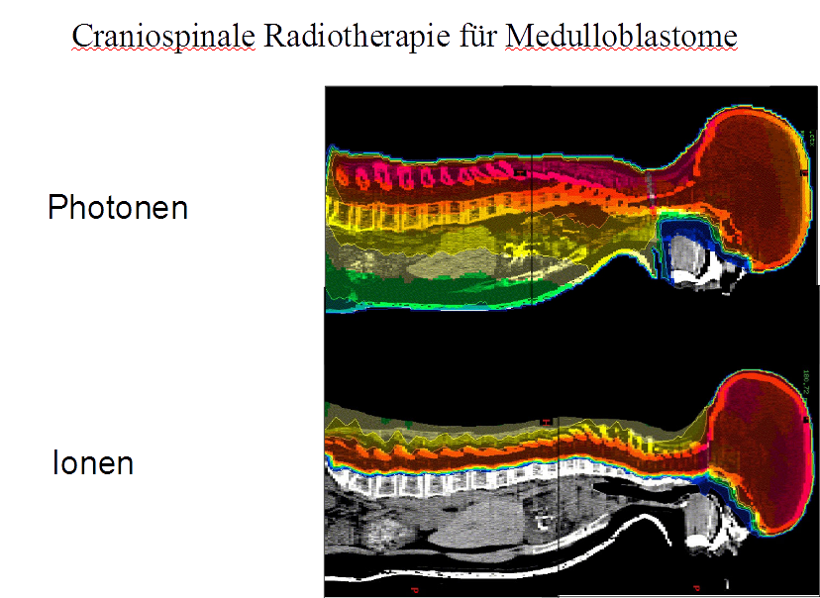
Treatment plan: medulloblastoma
Intention to treat spinal cord and brain only

Slide 24
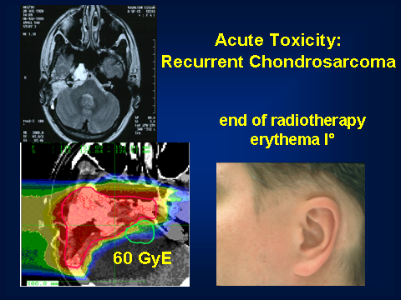
Differential RBE in patients
High RBE in the tumor, low RBE for the skin

Slide 25
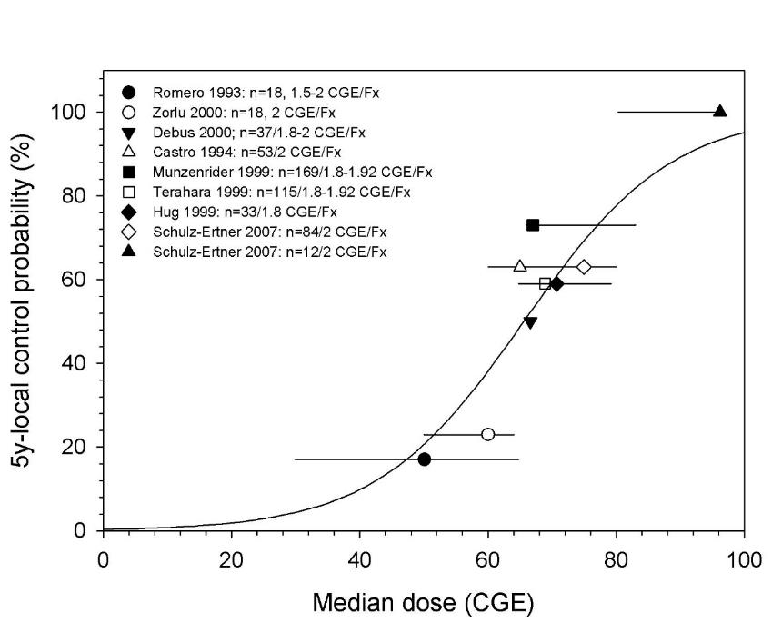
Tumor Control Rates: Chordomas
Schulz-Ertner, IJROBP 2007
C-Ions
Protons
Conventional RT
Better control because of:
higher target dose and better sparing of normal tissue : physical selectivity
greater biological effectiveness in the tumor : biological selectivity

Slide 26
Summary Rational for Particle RT
Higher conformity to the target volume
Smaller scattering to normal tissue
Increased effectivenes for radioresitant tumors
But :
More complex beam delivery
sensitive to target motion

Slide 27
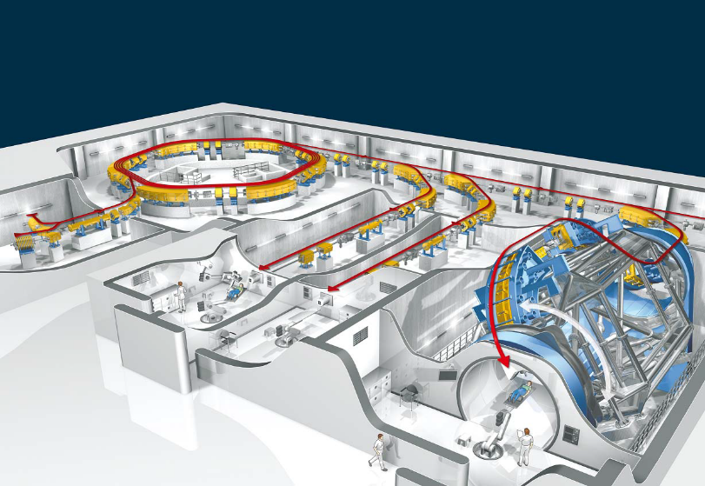
Heidelberg Ion Beam Therapy (HIT)
Proposal 1998 – start 2003 – first patient 2009
Proton, Carbon, (Helium, Oxygen) @ 100 – 400 MeV/u
  GSI: hardware, Siemens: software, medical product
2 horizontal beams,
1 gantry,
1 research beam
>3500 patients treated
  ~700 / year
  up to 16h per day
  >300 days / year

Slide 28
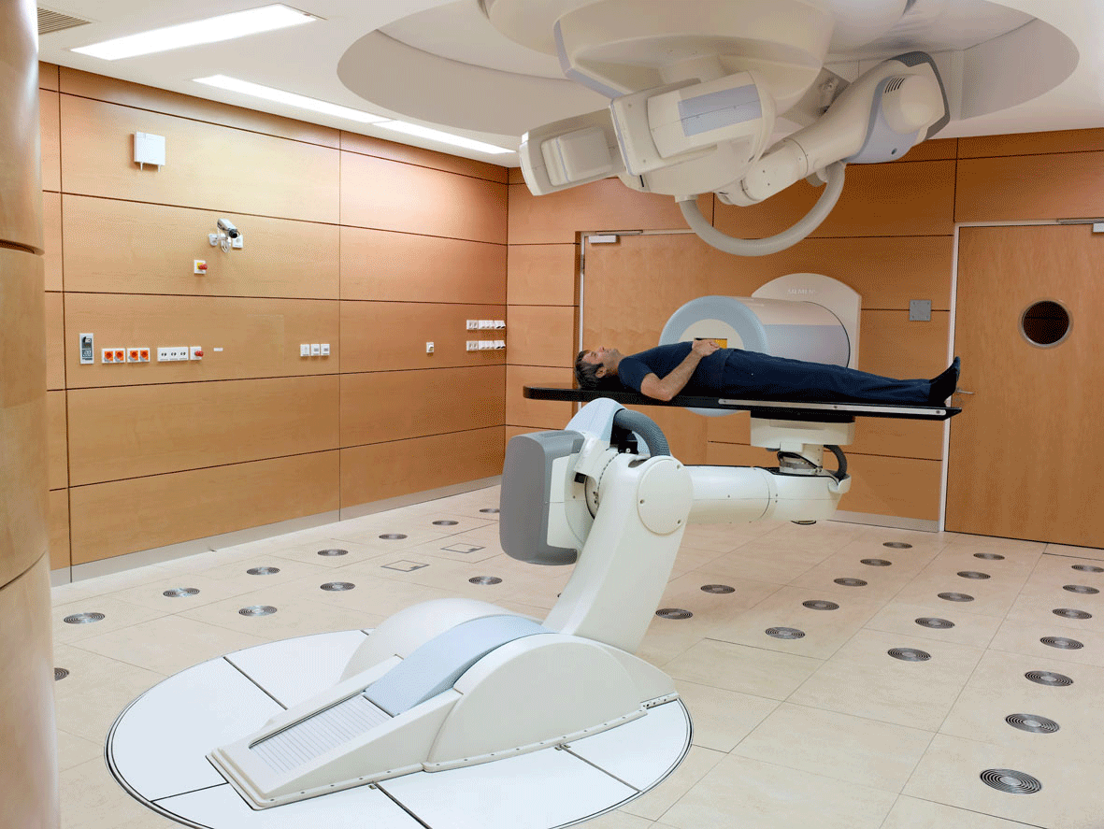
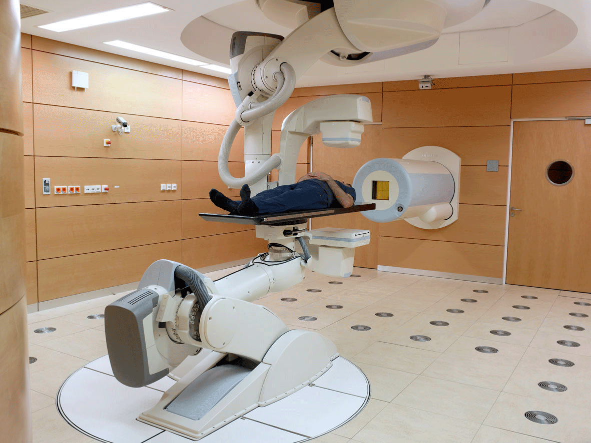
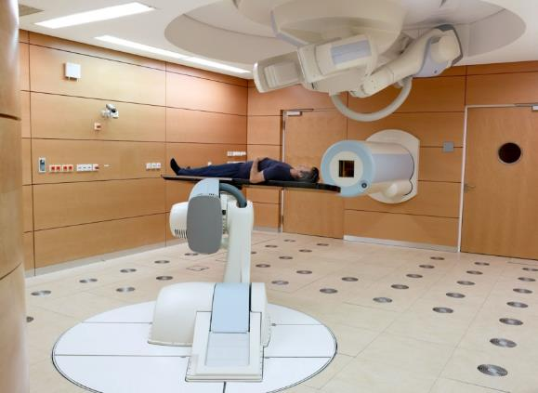

IGRT in der Partikeltherapie
Roboter zur
- Positionierung
- Bildsteuerung
Isocentric Rotation +/-100°
Roll max. +/-15°

Slide 29
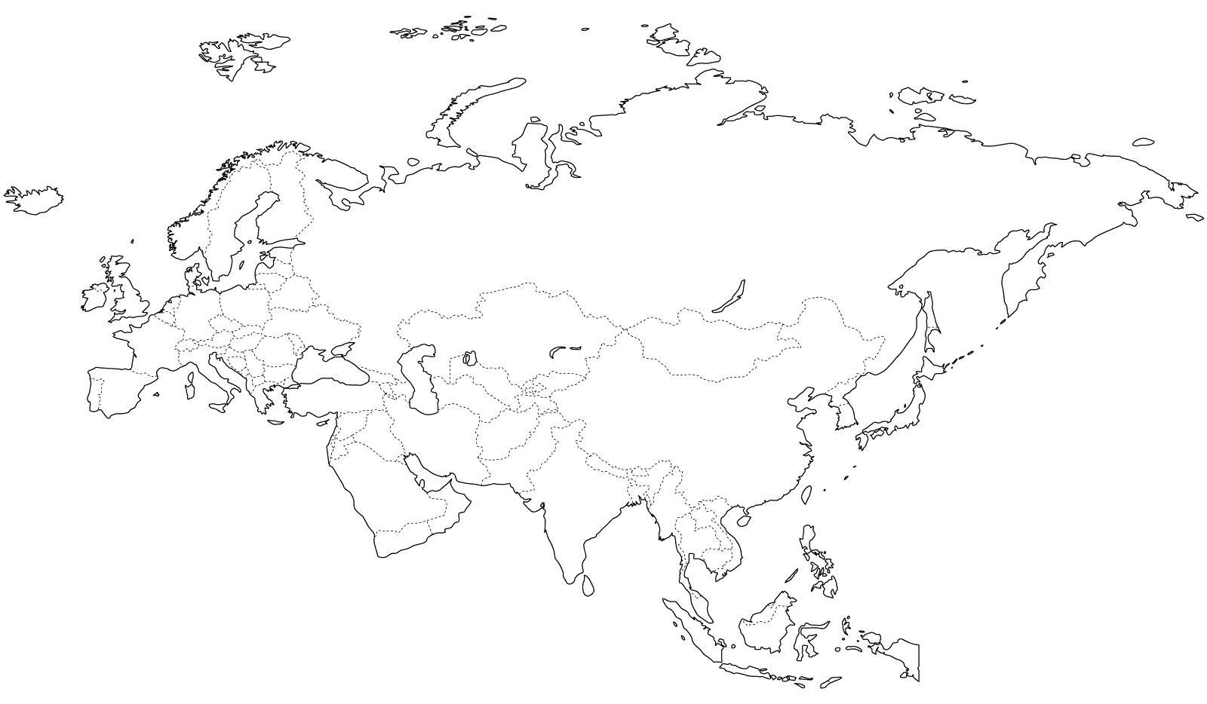
Ion beam therapies worldwide
MIT (2015)
KHIMA
(2018 geplant)
Med. Austron
(2016 )
HIT
(2009)
GHMC
(2010)
CNAO
(2012)
IMP-CAS
(2012)
HIMAC
(1994)
SPHIC
(2012)
i-ROCK
(2015)
SAGA-HIMAT
(2013)
HIBMC
(2002)
> 60 proton centers not shown, ~25 in the US
2 carbon centers in the US in planning stage

Slide 30
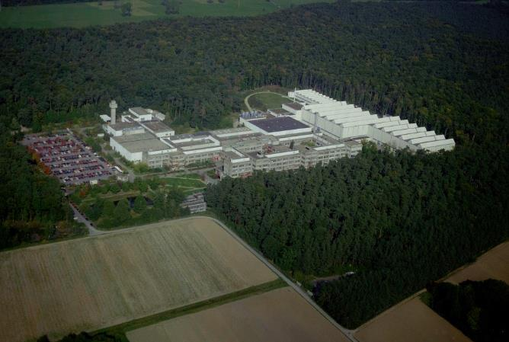
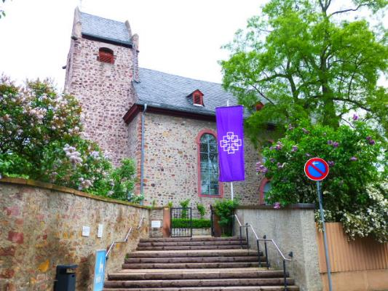
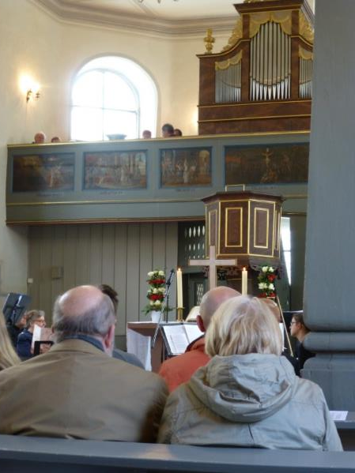
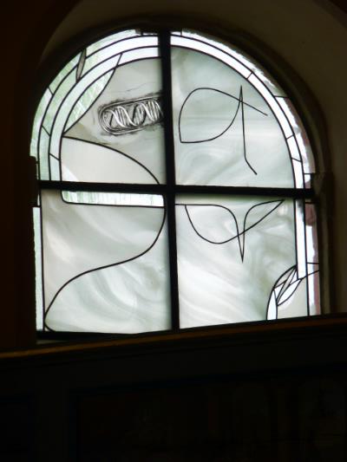
oldest building at Darmstadt
900 years
GSI Darmstadt
2 km
DNA, dose and cell survival
Ion beam therapy
window

Slide 31
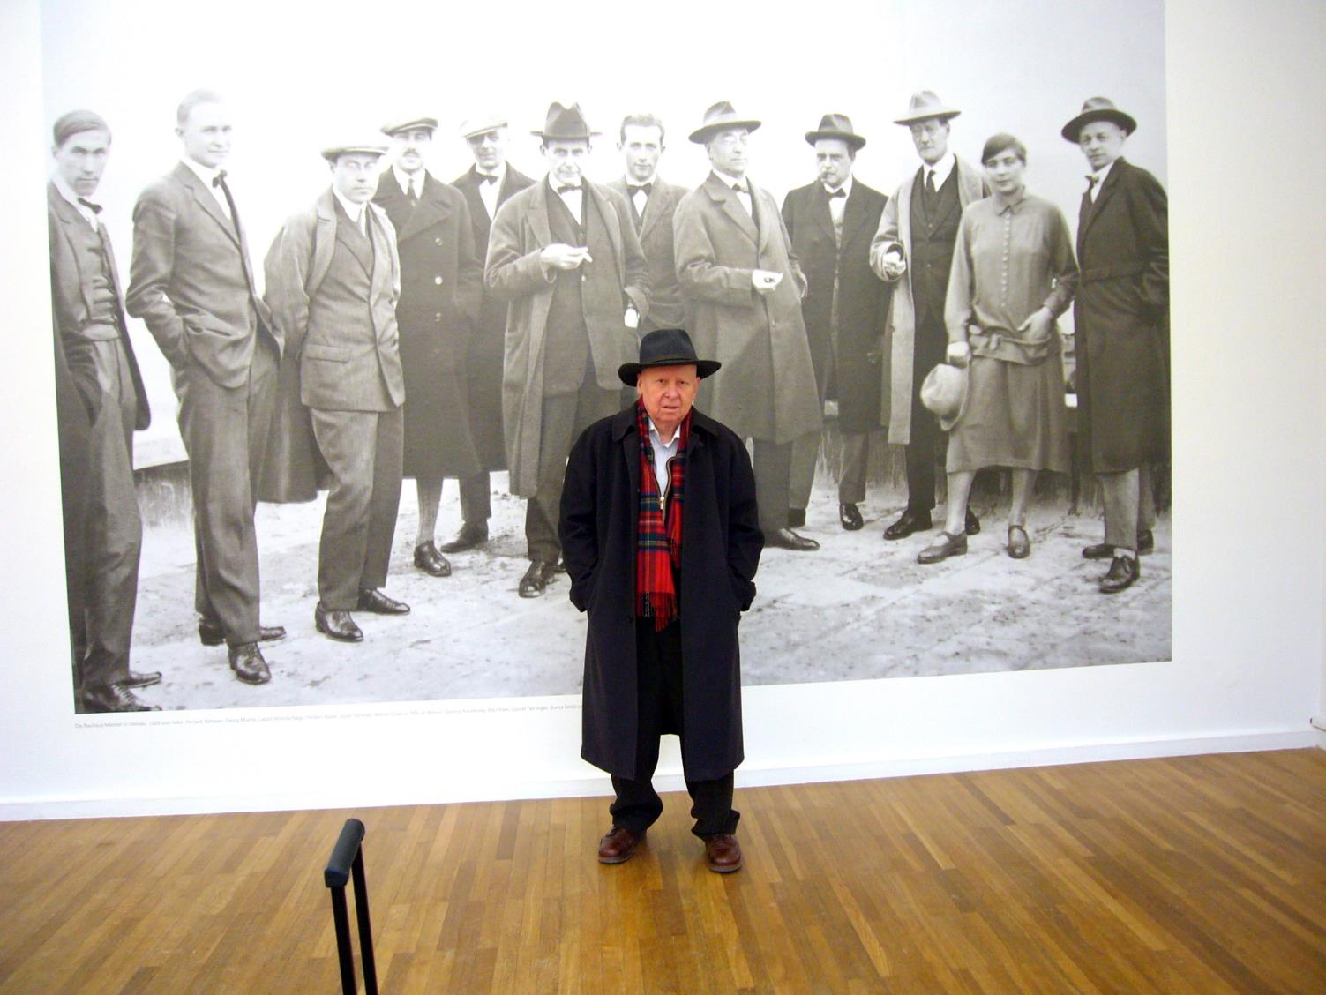
Danke fürs
Zuhören

Slide 33
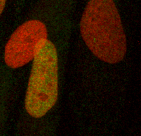
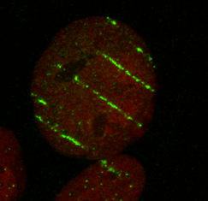
Energy-Deposition in Micrometer-Scale
Zellkerne

Slide 34
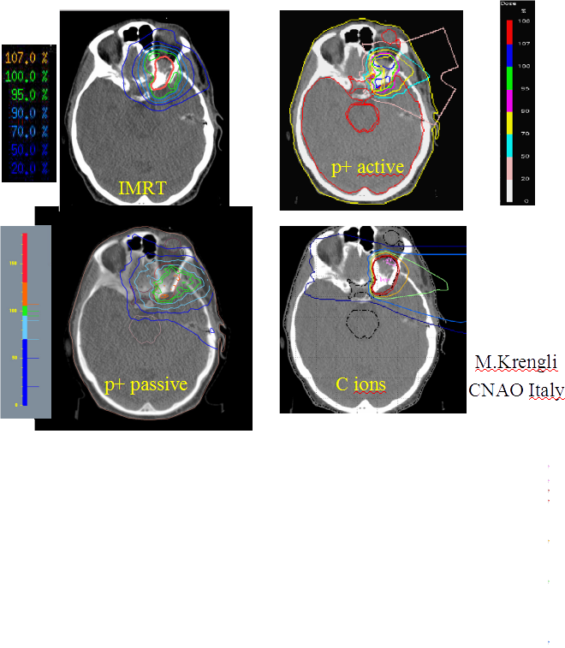
Comparison of treatment plans

