Slide 2
Archival Storage WG Activities
Oliver Keeble on behalf of the WG

Slide 3
Archival WG - overview
Experiments have been asked to exploit archival storage as much as possible
  Cost advantages
WLCG Archival Storage Group created to follow up
  Launched with two main topics
    Optimal exploitation of archival systems by experiments
    Metric identification and reporting
  Since added
    Atlas Carousel tests
    Cost modelling

Slide 4
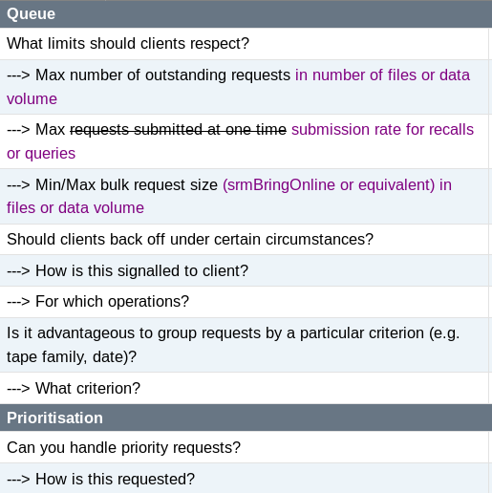
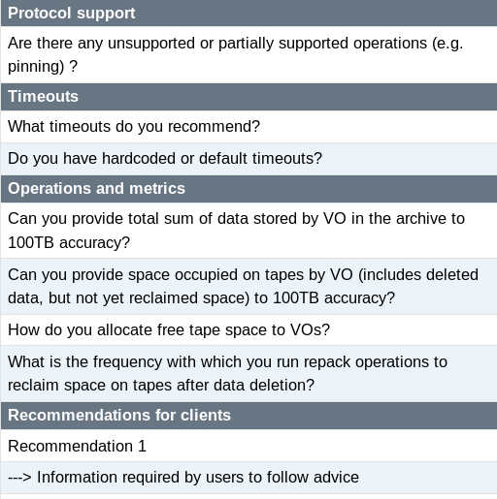
Archival site survey

Slide 5
Archival site survey - conclusions
Results for each question have been summarised on the twiki
  Discussed at June GDB - https://indico.cern.ch/event/651354/
Advice can be classified under
  Campaign planning
    Planning, grouping, sync with processing, managing priorities
  Client behaviour
    Fill up queues and use bulk submission
  Write operations
    Write the way you want to read.
    Investigating dataset awareness.
https://twiki.cern.ch/twiki/bin/view/HEPTape/Survey_Conclusions
  Archival sites are diverse and universal advice is hard to identify
Actions
  FTS
    fts3-pilot.cern.ch has been reconfigured to use larger bulks (1000)
      Trying to quantify the effect
    Optimisations are planned to allow better filling of queues
      Updating logic on queue state detection

Slide 6
Monitoring and metrics
Capacity and pledges
  all sites contributing
Remounts
  a number of sites contributing
Read and write volumes
  very few sites contributing
http://cern.ch/go/8bNm

Slide 7
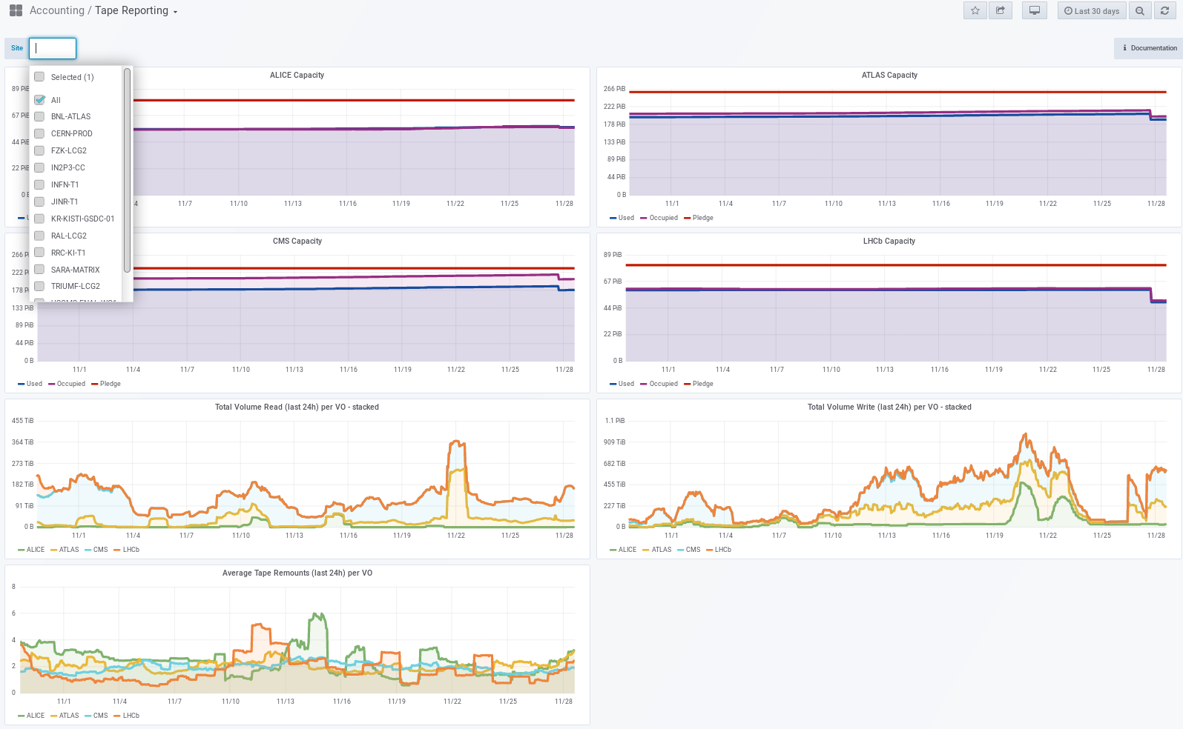

Slide 8
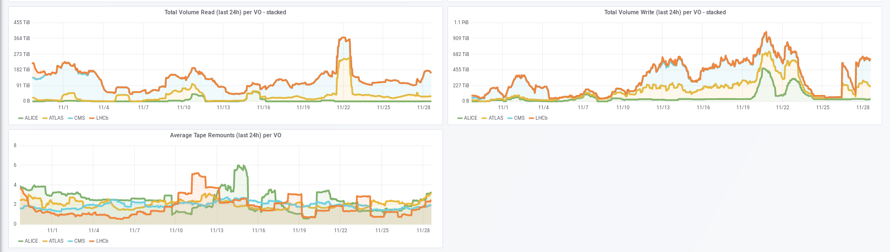
Remounts, reads, writes

Slide 9
Atlas Carousel R&D
The WG has acted as a forum for discussion on the ongoing Atlas R&D on Carousels
  A “Carousel” is a moving window of disk residency for a large tape archive
    Atlas has tested this workflow on all 10 of their T1s
    Xin Zhao presented results at WG meetings
  Focused discussions between sites, Atlas and storage devs (dCache in particular)
    Comparison of site performance, configuration, disk buffers, tape families, hardware etc
      Understanding bottlenecks, improving metrics
  WG will follow up on further tests and try to track performance improvements

Slide 10
System performance and cost modelling
Established a connection to the “SPACM” WG.
The “make the most of tape” story is motivated by its lower cost.
  The advantage must be demonstrated before sites will make significant further investments
Have started to discuss how to model the costs of tape systems
  Driven by IN2P3 (Renaud Vernet)
  Many questions about what to take into account and what timescales to amortise over
  All T1s will be asked for a report
    Discussion will be scheduled with the WG
WG will evaluate the Carousel model in this context and collaborate with “SPACMWG”.

Slide 11
Topic status
Client optimisation and survey – closed
  FTS modifications are on their way
Metrics – finalising
  Summarised in Vlado’s contribution
  More metrics will be added as required
Carousel R&D – ongoing
  New rounds of testing scheduled
Cost modelling – starting up
Open for other topics and contact with DOMA activities where required
  Post-SRM data management interfaces?
  Input to QoS WG
    Use of non-tape archival storage?

Slide 12
More Information
https://twiki.cern.ch/HEPTape
Join the group –
  https://e-groups.cern.ch/e-groups/EgroupsSubscription.do?egroupName=wlcg-data-archival-storage
Contact Oliver Keeble (CERN) or Vlado Bahyl (CERN)

