Slide 1
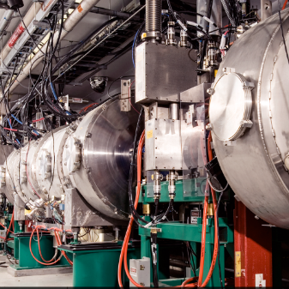
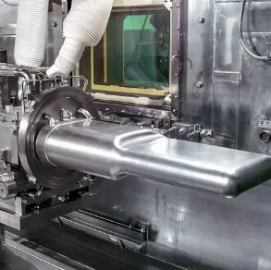
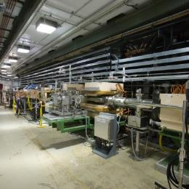

Why In-Beam Testing and Development Is Important – The SNS Target Example
Bernie Riemer
SNS Upgrades Office
International HiRadMat Workshop
CERN
July 10 – 12, 2019
Notes:
30 minutes total including Q&A

Slide 2
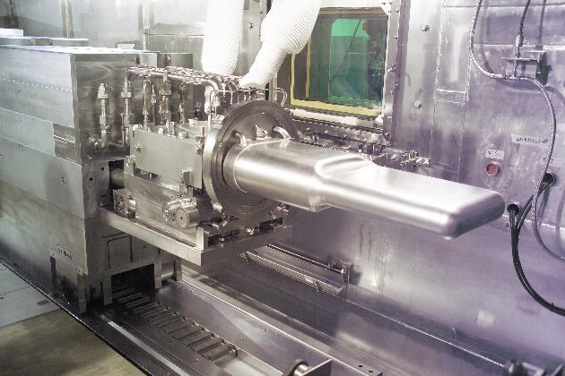
The SNS mercury target is a first-of-a-kind design:
MW-class, short-pulse, liquid-metal
Target R&D during the design & construction phase – and into early SNS operations – obtained critical findings from in-beam experiments with mercury test targets
In-beam experiments were generally aimed at understanding:
  ‘thermal-shock’ response of the target vessel
    needed for fatigue life evaluation
    target lifetime pulses 10⁸ ~10⁹
  cavitation damage – an issue which became real at an awkward project time
SNS Mercury Target Module
1.4 MW, 1.0 GeV p, 60 Hz, 0.7 μs
Notes:
Groundbreaking in late 1999. First beam on target: 2006.
SNS Cost: $1.4B
Now operating T22 at 1.4 MW
Major offline R&D / experimentation was also performed, including 3 purpose-built test loops for thermal-hydraulic.

Slide 3
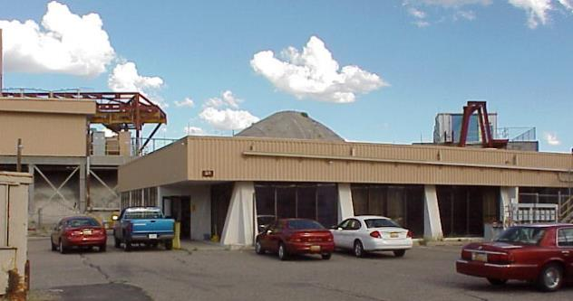
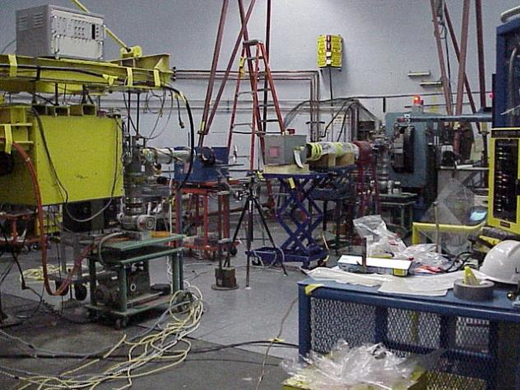
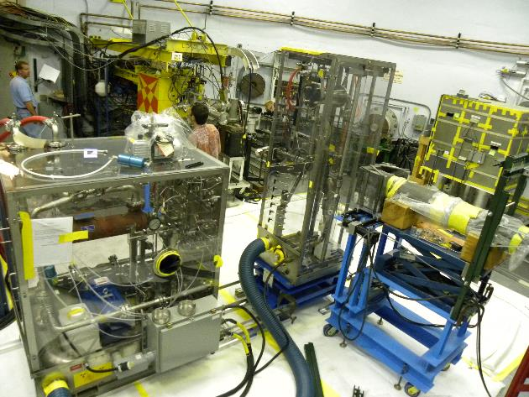
SNS in-beam target experiments started in the late 1990s and continued into 2011
LANSCE - WNR
Most of these tests were performed at LANSCE – WNR in the ‘Blue Room’
  (Los Alamos Neutron Science Center - Weapons Neutron Research)
Typical beam parameters:
  800 MeV protons; 0.3 μs pulse length
  0.5 to 3.5 x10¹³ protons / pulse
  Beam size:
    Circular σ_{r} ~ 10 mm, or
    Elliptical up to ~ 10 mm x 30 mm
  Max. energy density similar to SNS @ 3+ MW
  Max. pulse repetition rate: 2 per minute
  Typical pulses on target: 100 (max. 1000)
WNR ‘Blue Room’
Notes:
10 in-beam experiment campaigns at LANSCE – 9 at WNR, 1 at pRad
WNR 1997, 1999, 2000, 2001 x2, 2002, 2005, 2006 (pRad), 2008, 2011
These were ‘hands-on’ experiments. Dose management a key limitation factor.
Targets scaled to ca. 1/3rd that of SNS were similar wrt beam – target size

Slide 4
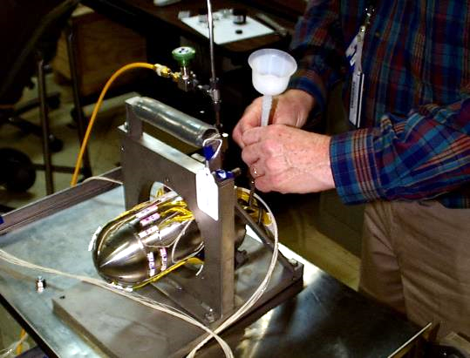
WNR experiments in late 1990s attempted high-speed strain and pressure measurements of pulse response
1st Test Target - 1997
Small, cylindrical mercury test targets
Conventional strain gauges went numb after pulse for a few ms
  All the important response finished by then
Fiber optic sensors were the best option, but needed development
Hg pressure measurement was unsuccessful
Key outcome:
  Commercial fiber sensors / signal processor from FISO Technologies were most promising for dynamic strain measurement needs
Target ‘A’- 1999

Slide 5
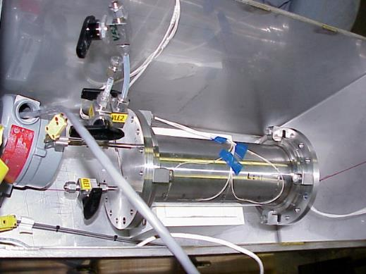
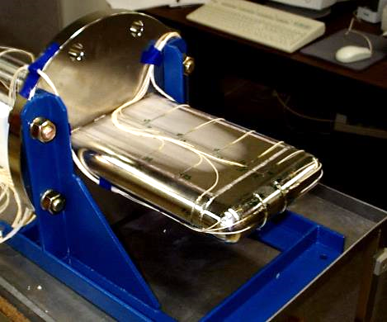
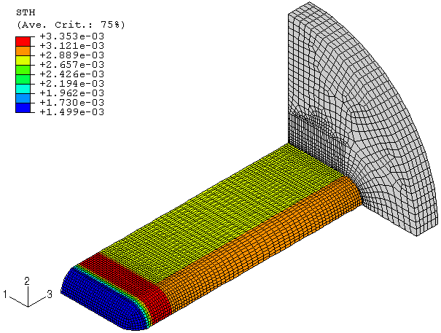
Experiment campaign in August 2000 produced credible sets of dynamic strain data on mercury and solid targets
Four mercury targets were tested for pulse response behavior
  Two cylindrical ‘Large Effects’ targets
  Two ‘Prototypic Shape’ targets
Parallel modeling work now had data to benchmark simulation results against
Large Effects
Prototypic Shape
B.W. Riemer / Journal of Nuclear Materials 343 (2005) 81–91
Notes:
We had clues that cavitation was occurring from the pulse.
A bit of gas phase changes the mercury sound speed a lot, which affects modeling estimates
Large effects’ responses looked slow vs. simulation. Strains were large – reaching yield
Developed simulation method became basis for SNS (and JSNS) target fatigue stress estimation

Slide 6
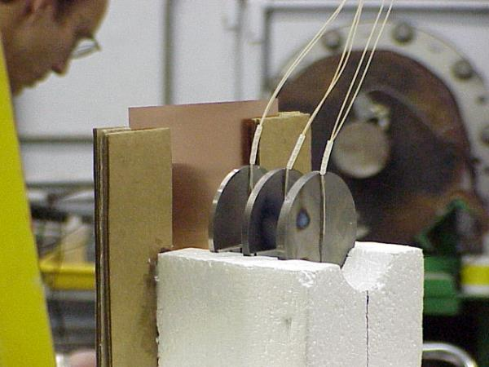
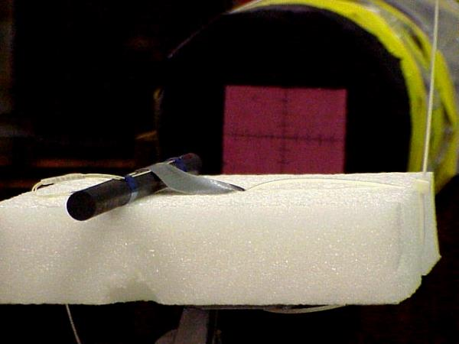
WNR 2000 test campaign also examined pulse response of solid targets
Simpler to model, but FISO system was pushed to limits to produce useful data
Graphite rod simulated response match data well when offset beam condition was included
Tungsten, tantalum and zirconium disks
Graphite rod
Graphite rod measured strain

Slide 7
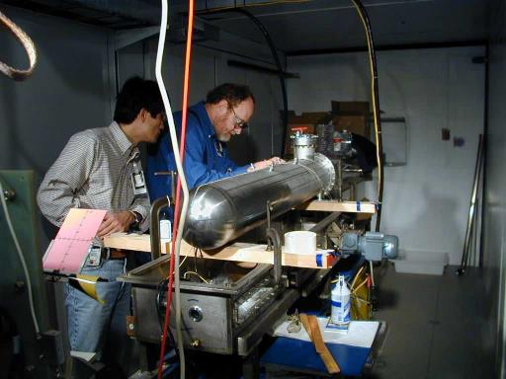
ASTE – AGS Spallation Target Experiments 1997 & 2001
A collaboration formed around mercury spallation target projects at the time
  The SNS in Oak Ridge, Tennessee
  The JSNS (J-Parc) in Tokai, Japan
  The ESS in Jülich, Germany
A single, large mercury target
  φ = 20 cm, L = 130 cm
Alternating Gradient Synchrotron (AGS) at Brookhaven National Laboratory
  23 GeV protons
  ~1 to 3 x10¹² ppp
  Beam size: circular σ_{r} ~ 15 mm
ASTE mercury target
Thermal shock tests
  Strain sensors & LDV
Shielding / neutronics tests

Slide 8
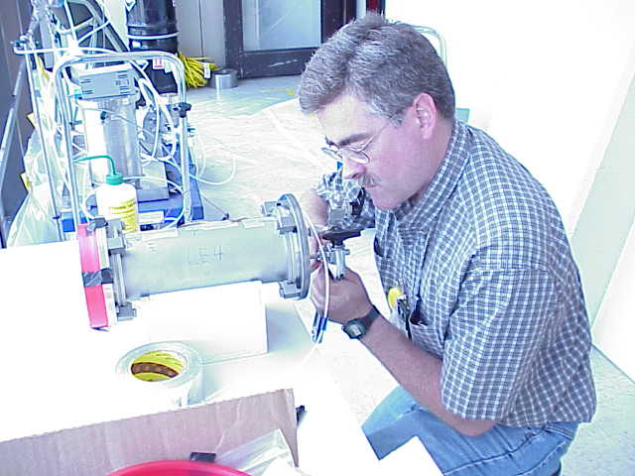
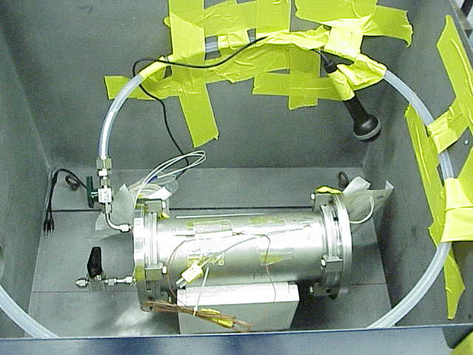
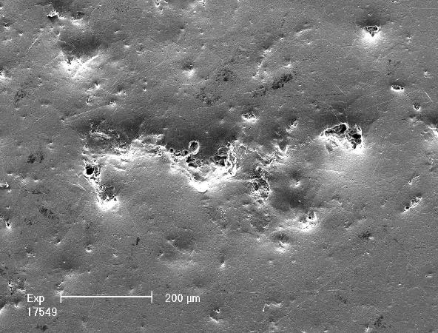

Beam induced cavitation damage and its mitigation became topic of mercury target R&D in late 2000
J-PARC offline investigations of wave propagation through mercury produced disturbing result with pressure and rise time similar to spallation target (M. Futakawa et al. / International Journal of Impact Engineering 28 (2003) 123–135)
July 2001 WNR experiment confirmed damage cause by beam pulse using Large Effects targets
July 2001:
A summary of the major findings of the July tests can
be made:
• All flange surfaces had large, visible pit clusters.
These clusters were located near, but a few mm below
the geometric centers.
• It was determined that the beam entered above center
on both targets at roughly half this distance.
• The sizes of the damage clusters on the rear flanges
were less than on the front, but the smaller sizes were
not in proportion to the proton beam intensity. In
fact, beam intensity at the rear flange surface was less
than 10% of its value at the front.
• Evidence of damage could be found generally over all
of the annealed surfaces using optical microscopes
and SEM. Although the size and density of pits varied
over these surfaces, they could be found far from
the center.
• The hardened surface did notably better as very little
damage could be found aside from the 2 mm pit cluster.
Damage within the cluster was more comparable
to the annealed surface damage clusters.
Damage after 200 pulses
B.W. Riemer et al. / Journal of Nuclear Materials 318 (2003) 92–101
Notes:
JAERI finding shared at Nov. 2000 workshop
July 2001 WNR test after inspection of 2000 target flanges failed to reveal damage – surfaces were machine rough

Slide 9
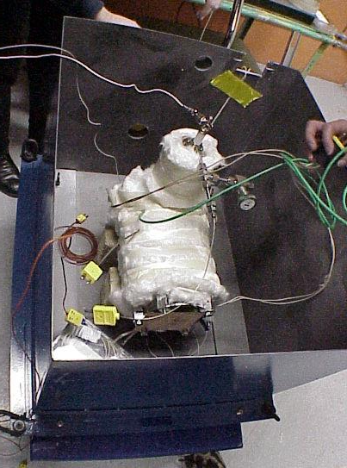
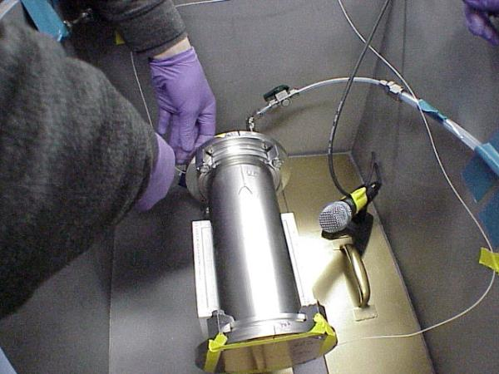
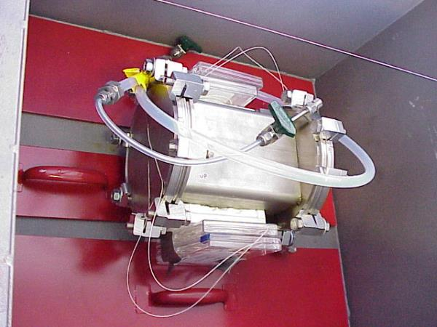
A 2nd WNR experiment in December 2001 investigated damage dependence on:
Target geometry
Damage resistant materials & surface treatments
100 & 20 test pulses vs. 200
A lead-bismuth eutectic target was also tested for LANL
LBE
Key outcomes:
Materials & treatments alone helped but did not stop damage
Geometry mattered
100 pulses enough
  20 too few
Cylindrical
Rectangular
B. Riemer, Journal of Nuclear Materials 318 (2003) 92–101
Notes:
Local energy deposition was not necessarily the driving cause of local damage
Clues that the global target vessel – fluid interaction response had to be considered

Slide 10
In 2001 SNS was 5 years away from first beam on target
Change from a mercury based design was barely possible
Project leadership established October 2002 deadline for deciding whether to keep mercury or pursue alternative design
Simulation / modeling alone was far from being able to capture all relevant physics of the pulsed mercury target to predict if it can survive desired lifetime
  Fluid-structure interaction
  Thermal-shock loading
  Multiphase fluid (cavitation vapor, injected gas), flow
Six months after the 2nd 2001 WNR test … another in-beam test campaign

Slide 11
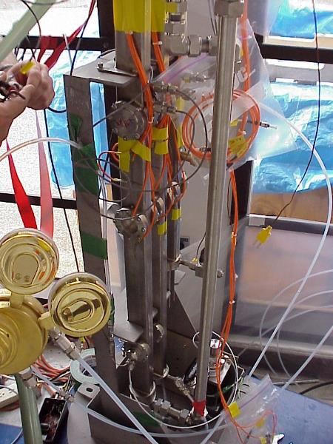
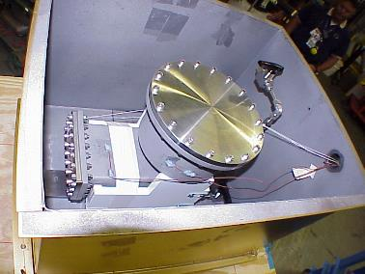
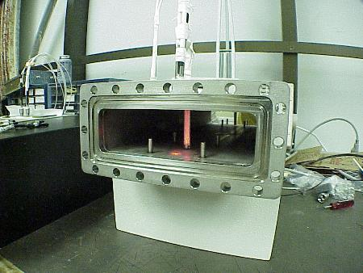
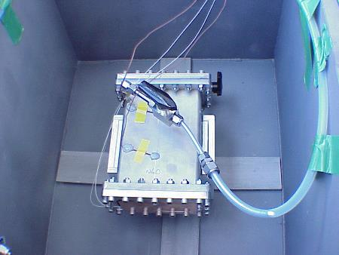
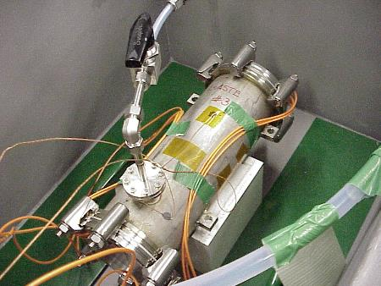
WNR 2002 experiment investigated damage dependence on:
Small gas bubbles
(H. Soltner - FzJ)
Target geometry
Intensity (ppp)
Damage resistant materials and surface treatments
Gas bubble injection
Gas layer injection
Total of 19 target tests
  100 pulses/test
  1 test @ 1000 pulses
Wave deflection target
Bubble diagnostic target
Key outcomes:
Damage strongly non-linear with intensity
Materials & treatments can help but not stop damage
Gas injection promising, but
R&D must continue
RECT target
J.R. Haines et al. / Journal of Nuclear Materials 343 (2005) 58–69
ASTE2 target (FzJ)
Notes:
June 2002

Slide 12
In-beam tests contributed to decision to keep mercury for the SNS target design, with caveat that R&D continue
Collaboration with J-Parc strengthened (ESS – FzJ halted)
Emphasis on injection of small gas bubbles
J-Parc contributed greatly with MIMTM experiments
  (Magnetic Impact Test Machine)
  Offline device for generating pulsed cavitation in mercury
  High cycles, many materials, gas injection, diagnostic correlation to damage (aka, cavitation damage potential)
SNS repurposed the Target Test Facility (TTF) for offline gas injection development
  Full scale, SNS prototypic mercury test loop

Slide 13
Next round of in-beam testing pursued effects of mercury flow, gas injection and energy density
2005 WNR campaign we introduced a small flowing mercury loop with a bubbler: the In-Beam Bubble Test Loop IBBTL
  Rectangular flow channel, exchangeable damage specimens at beam spot, flow speed of 0.4 m/s
  Compared stagnant vs. flow vs. flow + bubbles
Rectangular targets used for energy density investigations
  Protons/pulse fixed, spot size changed
B. Riemer et al. / Journal of Nuclear Materials 377 (2008) 162–173

Slide 14
Key 2005 in-beam test results
Flow reduced damage vs. stagnant mercury
Injection of small bubbles w/flow reduced damage vs. flow
Bubble injection reduced vessel strain, especially at measuring points at distance from the beam spot
  Less reduction near / at the beam spot
  We did not understand the bubble population we created
LDV vibration response was attenuated with gas
LDV derived data correlated with observed damage
Acoustic measures of wave propagation in bubbly mercury indicated scattering vs. attenuation of sound
  Suggesting bubbles were somewhat large
Beam flux intensity tests results were confusing

Slide 15
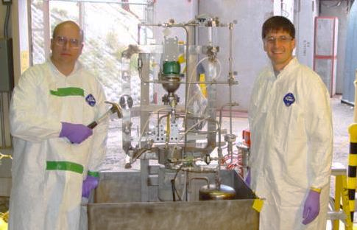
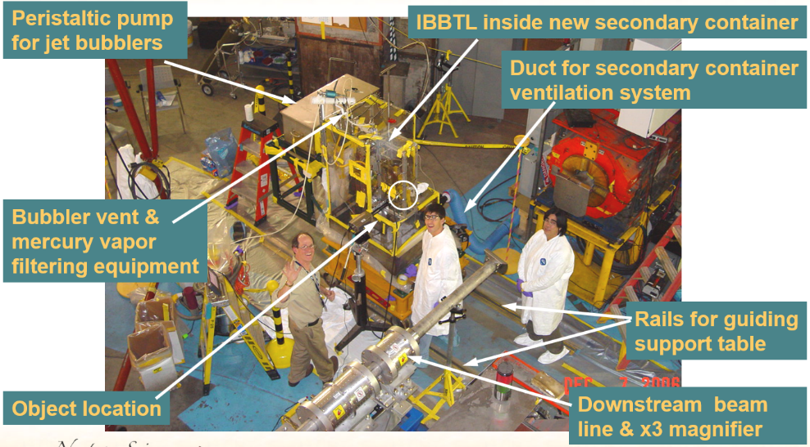
Proton radiography 2006 at LANSCE attempted to measure bubbles population in flowing mercury
Repurposed the IBBTL for this experiment

Slide 16
Proton radiography 2006 at LANSCE imaged bubbles injected into mercury
Visualized through either 22 mm or 6 mm of Hg
Mercury stagnant or flowing at 0.4 m/s
Three bubblers tested; three gases: He, Ar, Xe
Acoustic measures
Key findings:
Jet bubblers
  Credible bubble size distribution data
  Smallest visible bubble size: R~ 0.24 mm
  Total volume of small bubbles determined ~0.1%
  Good agreement between acoustic measures & theory
  No value added in using Argon or Xenon
Needle bubbler
B. Riemer, et al., Proc. ICANS-XVIII, Dongguan, China, 2007
B. Riemer, et al., Proc. AccApp'07, Pocatello, Idaho, 2007
Notes:
Central region has a diameter of 25 mm

Slide 17
We returned to the WNR in 2008 to further investigate cavitation
Damage in mercury cooling channel feature of SNS target
  Water (stagnant) also tried in channel
Damage dependence on proton flux intensity in rectangular targets
Damage on a target with a gas layer enhanced by surface texture
LDV vibration data to estimate ‘Cavitation Damage Potential’ (CDP) and correlation to observed damage
Acoustic sensing of cavitation
Beam fluorescence of chromium-doped alumina sprayed onto steel
A long-pulse test for cavitation damage
12 test targets in all, 72 hours of beam time

Slide 18
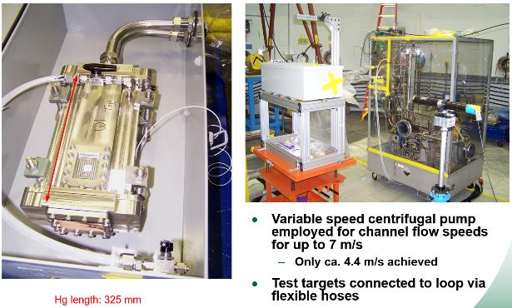
Tests on SNS flow channel used several targets
Test target design and setup Stage 1 PIE Stage 2 PIE
Channel damage less than bulk side
Flow speed helps … to a point
B. Riemer, et al., Proc. ICANS-XIX, Grindelwald, Switzerland, 2010
B. Riemer, et al., Jnl. of Nucl. Mat. 398 (2010) 207
Notes:
Targets were exchanged … connection to pump module was remade each case
Damaged area fraction
Maximum pit depth
Mean depth of erosion

Slide 19
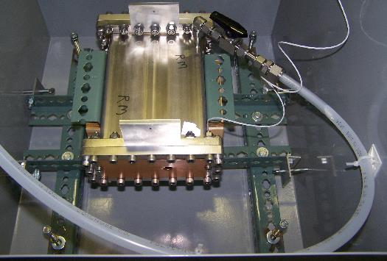
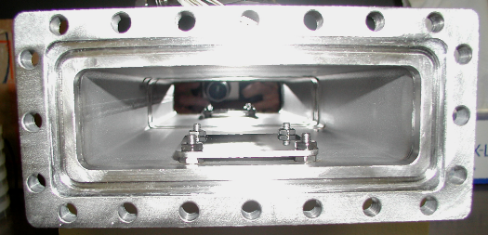
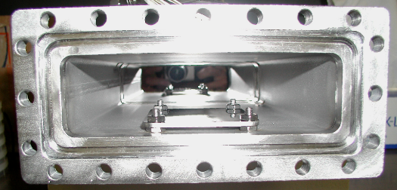
Beam flux test fixed total energy deposited in each rectangular target
Flux varied by changing beam spot size
Maximum pit depth scaled by about the square of peak proton flux
Gas layer target:
  No damage observed
Long-pulse
  No clear damage evidence
Gas layer with acrylic textured wall in pretest

Slide 20
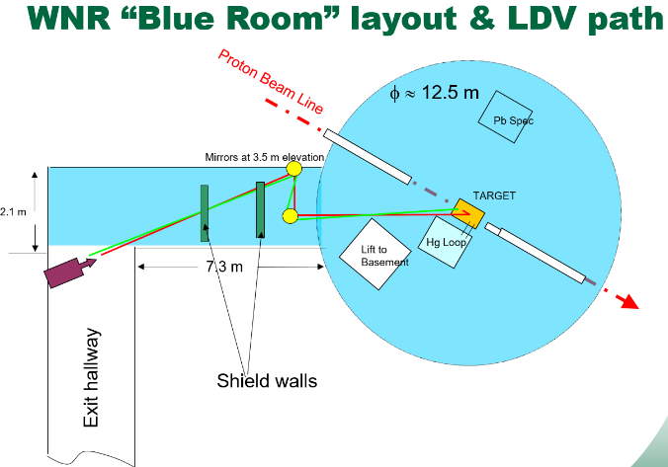
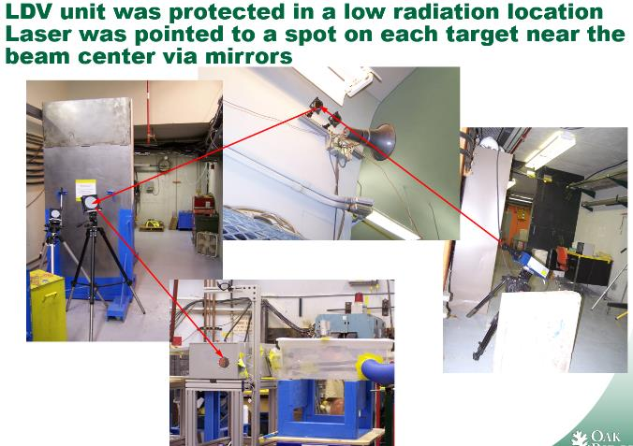
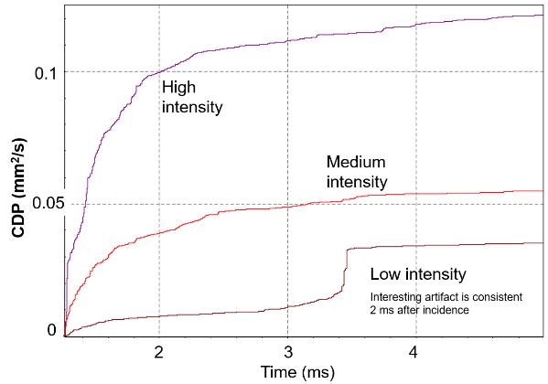
Laser Doppler Vibrometer detection of cavitation
Remote optical sensing of vibrations associated with cavity collapse gave indications of cavitation intensity
  Technique pioneered by J-Parc
Band pass 15 kHz – 300 kHz
Time integrate filtered velocity

Slide 21
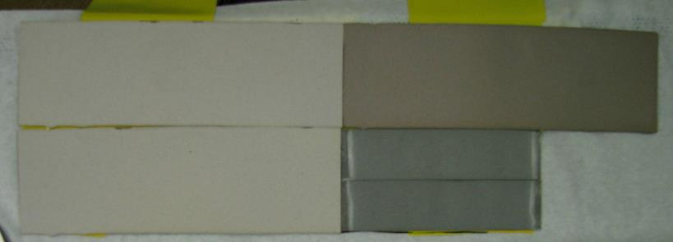
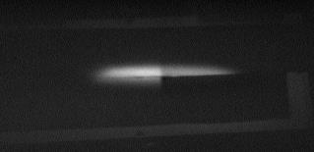
Successful demonstration test of flame-sprayed Cr-doped alumina on steel
Process used on SNS targets, aka ‘Target Imaging System’
1% Chromia, flame spray
5% Chromia, flame spray
0.5% Chromia, flame spray
2.5% Chromia D-gun
10 mm
2.5% Chromia D-gun

Slide 22
Final SNS in-beam experiment in 2011 investigated gas bubble injection for reducing pulse damage and fatigue
New flowing mercury test loop used exchangeable damage test specimens (beam windows) and 3 types of bubblers
Variable mercury flow speed and gas injection rates
Small bubble populations were assessed by novel offline method prior to beam testing
Online measurements for strain, vibration (LDV), cavitation acoustic emission, pressure, sound
PIE of damage test specimens: 19 cases x 2 specimens
  Automated scanning optical microscopy (1800 images / case)
  3D laser profiling microscopy
B.W. Riemer et al. / Journal of Nuclear Materials 450 (2014) 192–203
M. Wendel eat al. / Measurements of Gas Bubble Size Distributions in Flowing Liquid Mercury, FEDSM2012-72015

Slide 23
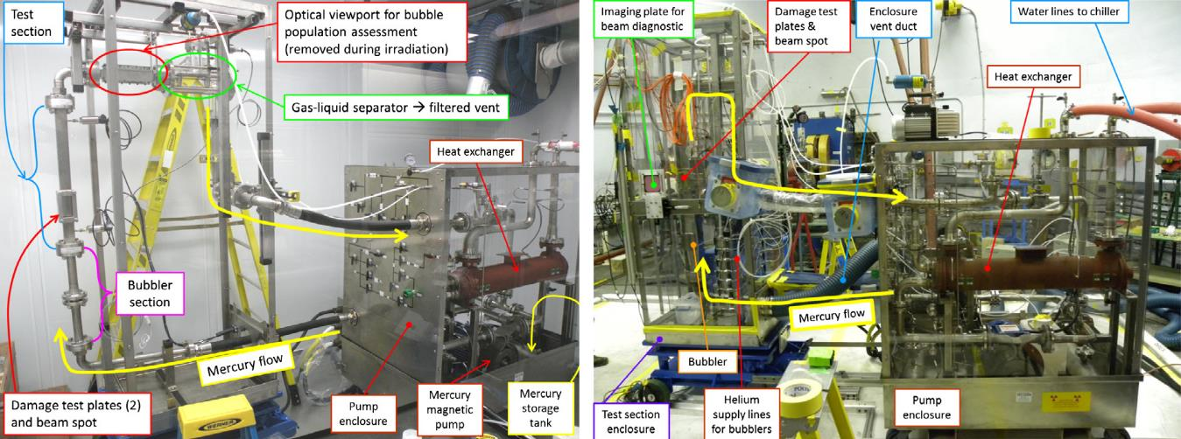
Multi Bubbler Test Loop was assembled and tested at ORNL
Flow cross-section of 47.8 x 22.4 mm
Mercury flow speeds from 0 to 1.7 m/s
Helium gas injection rates from 0 to 0.8 SLPM
Pule intensities from 1.45 to 3.40 x10¹³ /pulse; 100 pulses per case
  Beam profile: σ_{X} = 7 mm, σ_{Y} = 17 mm
  Flux intensities comparable to SNS, JSNS
MBTL pre-beam testing
MBTL in WNR Blue Room

Slide 24
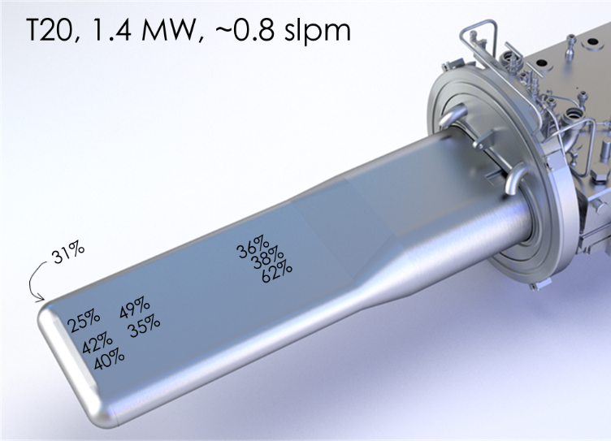
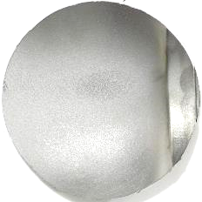
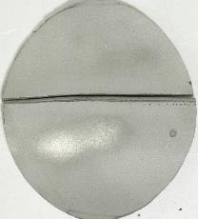
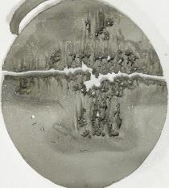
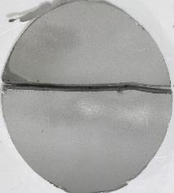
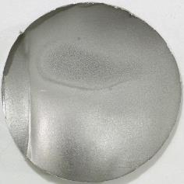
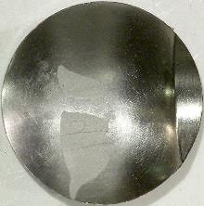
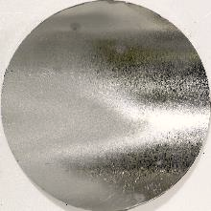
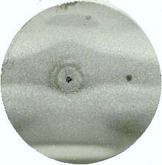
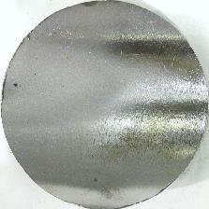
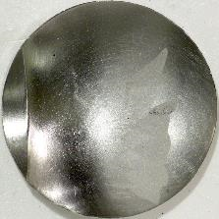
Key findings from in-beam experiments illuminated path forward for high power SNS operation, with gas injection
Fatigue life enhancement
& cavitation damage reduction
PIE specimens cut from SNS inner beam window
SNS Target T20
Reduction in measured strain with gas injection from 1.4 MW pulses
Target 16 – no gas injection
Target 20 – with gas injection
SNS targets have been reliable at 1.4 MW with gas injection
2MW operation of the SNS mercury target coming in 2024
Notes:
Both Jet-flow designs
Target 16: P_{avg} = 968 kW ; E_{total} = 1780 MWh
Target 20: P_{avg} = 1287 kW; E_{total} = 2231 MWh; Q_{avg} = 0.57 SLPM (Q_{max} = 0.8 SLPM)

Slide 25
In-beam experiments were a major part of SNS target development & solving challenges in meeting power goals
New target / beam intercepting device technologies – tasked with unprecedented operating requirements – need relevant in-beam test data
  Determine behavior of materials and designs when simulations cannot
  Develop and verify simulation techniques
Facilities like HiRadMat are vital to the Target / BID community
  New performance challenges are persistent
  Failure to meet reliability requirements has bigger consequences with growing costs of new & upgraded science facilities

