Slide 1

Beam Instrumentation developments at HiRadMat
T. Lefevre on behalf of the BI Team involved
Thanks to the contributions of J. Albertone, M. Bergamaschi, C. Boccard, T. Bogey, S. Burger, A. Curcio, L. Jensen, R. Kieffer, M. Krupa, S. Mazzoni, A. Sounas, A. Topaloudis, E. Senes, M. Turner and M. Wendt
International HiRadMat Workshop, 10-12 July 2019, CERN

Slide 2
Outline
Existing beam instrumentation
Beam instrumentation R&D
  Test-stand
  Example of future developments
Conclusions

Slide 3
BI close to experiments
In October 2014, a request came to improve the Beam monitoring at experiment
Motivation :
  Measure the Beam position w.r.t experiments better than 0.1mm
  Measure shot-to-shot beam position fluctuations
  Measure transverse beam size on target
Decided to built a combined BTV/BPM station
  3 ensembles built and mounted on HiRadMat experiments

Slide 4
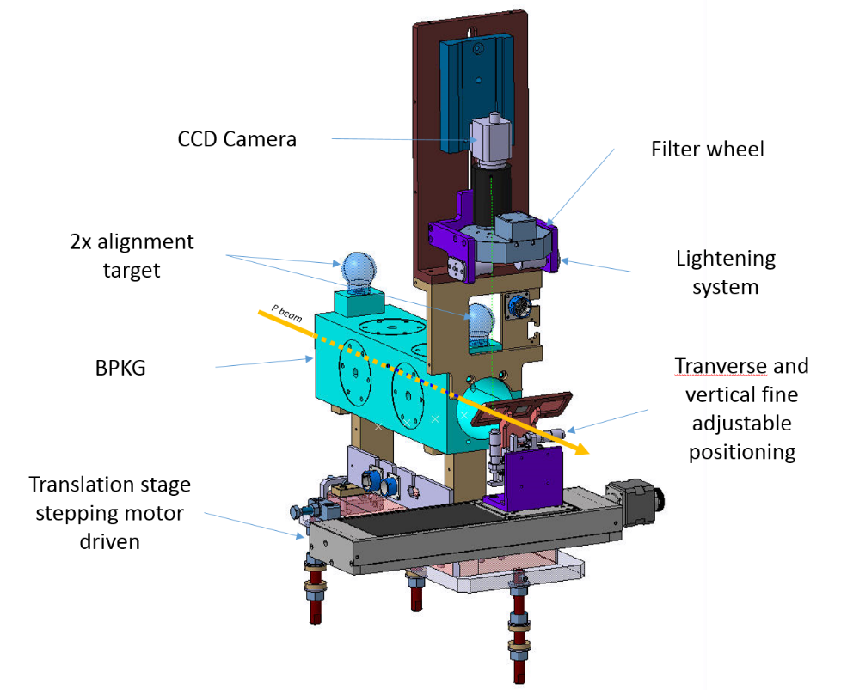
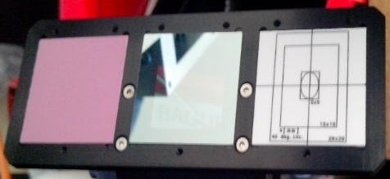
BTV/BPM assembly
Al₂O₃:CrO₂, SiC and Al2O3 (target) screens

Slide 5
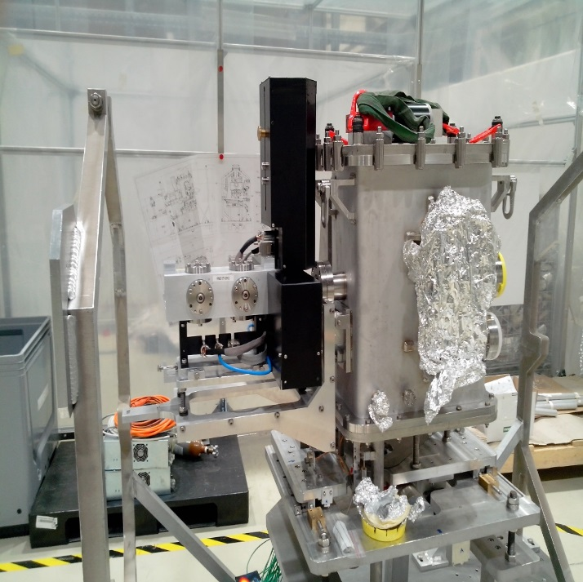
BTV/BPM assembly
BTV is used for setting up and absolute calibration
  Calibration Screen pre-aligned to the experiments on surface – Used for reference
  Offset between BTV and BPKG measured using low beam intensities
BPM providing bunch-by-bunch on-line measurements up to highest beam intensities
No beam profile for high intensity beams

Slide 6
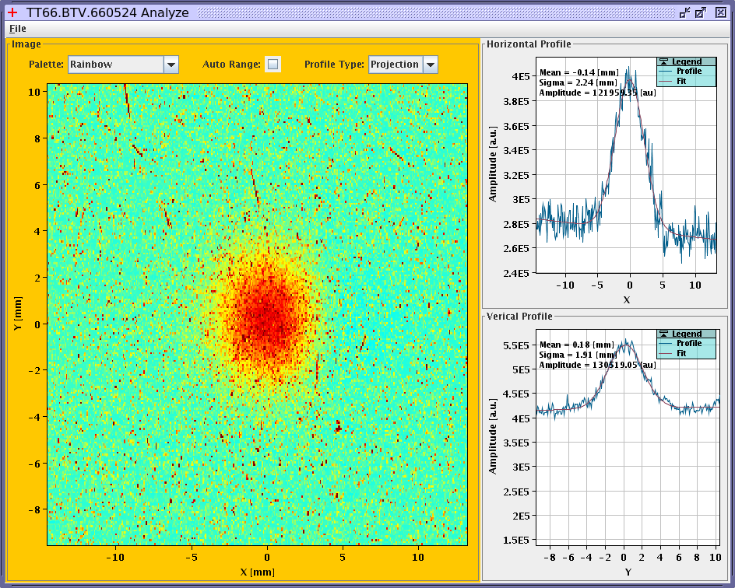
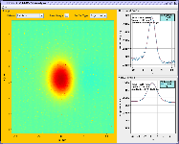
Particle showers affecting BTV
Scintillating screen - Image acquired synchronously with beam
Scintillating screen - Image acquired with 100ms delay after beam passage
back-scatterred shower from the target
No noise on the image
Observing the light emitted during the decay time of the screen
Scintillating screen - Al₂O₃:CrO₂
  Non linearity above 1E12 p/mm²
  Damage above 1E13 p/mm²

Slide 7
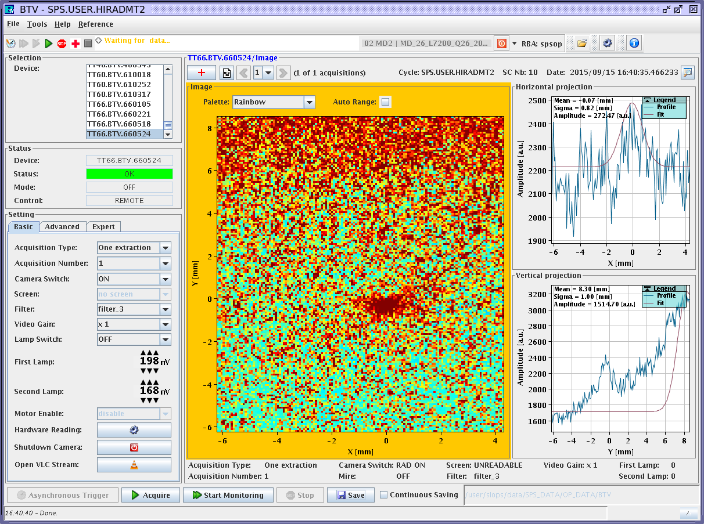
Particle showers affecting BTV
Use of OTR screens is limited as acquisition must be synchronized with beam (backscattering particles gives high background on camera !)
12 bunches (1.2E12p)
SiC screen
T 0.001%

Slide 8
Cherenkov background in -air
Strong background from Cherenkov light emitted in air
Cherenkov emission
Energy threshold in air: 37.4GeV
OTR Light
Vacuum
Air
OTR screen
Proton Beam

Slide 9
Cherenkov background in -air
Strong background from Cherenkov light emitted in air
Cherenkov emission
Energy threshold in air: 37.4GeV
OTR Light
Vacuum
Air
OTR screen
Proton Beam
‘Blocking foil’

Slide 10
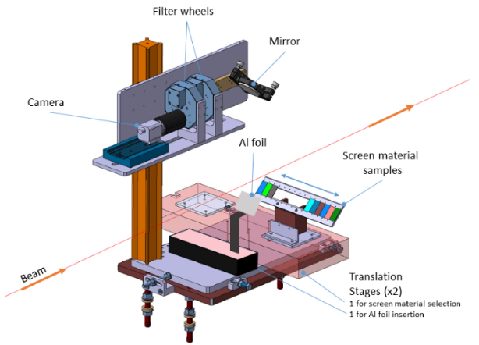
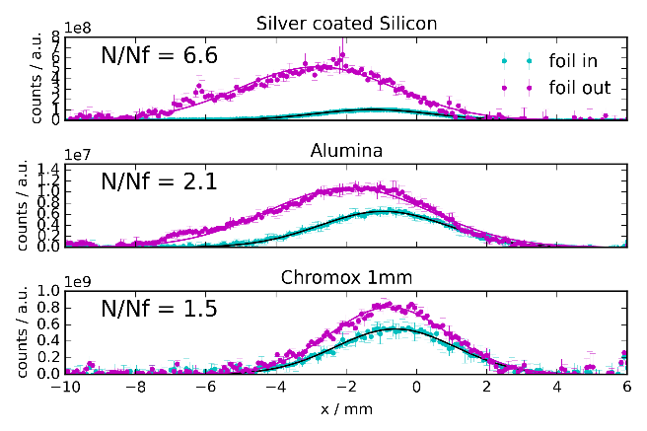
Cherenkov background in -air
Strong background from Cherenkov light emitted in air
Oct 2015 – HRMT30
* Scintillation and Otr Screen Characterization with a 440 GeV/c Proton Beam in air at the Cern HiRadMat Facility
S. Burger†, M.Turner², B. Biskup¹, S.Mazzoni, CERN, Geneva, Switzerland
¹also at Czech Technical University, Prague, Czech Republic
²also at Graz University of Technology Theoretical Physics Institute, Vienna, Austria
June 2016 – HRMT32

Slide 11
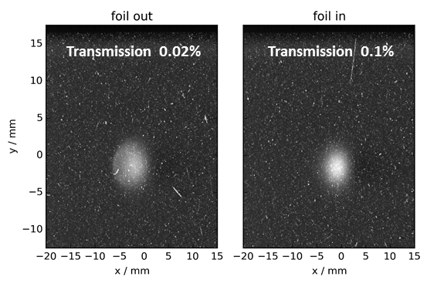
Cherenkov background in -air
Strong background from Cherenkov light emitted in air
OTR
Oct 2015 – HRMT30
* Scintillation and Otr Screen Characterization with a 440 GeV/c Proton Beam in air at the Cern HiRadMat Facility
S. Burger†, M.Turner², B. Biskup¹, S.Mazzoni, CERN, Geneva, Switzerland
¹also at Czech Technical University, Prague, Czech Republic
²also at Graz University of Technology Theoretical Physics Institute, Vienna, Austria
June 2016 – HRMT32

Slide 12
BPM Performance
Some issues observed in fall 2015 when testing high-Z targets
  Traced to be due to backscattered particles affecting the electronic
  Mitigation found by relocating the electronic in a radiation safe zone during YETS 2015-2016
Still some perturbations observed on the beam position signal resulting in large fluctuations in the BPM readings (±mm)

Slide 13
BPM Performance
Some issues observed in 2015 when testing high-Z target
  Traced to be due to backscattered particles affecting the electronic
  Mitigation found by relocating the electronic in a radiation safe zone
Still some perturbations observed on the beam position signal resulting in large fluctuations in the BPM readings
Development of a BTV system capable of measuring in all beam conditions
Small beam size at high intensities

Slide 14
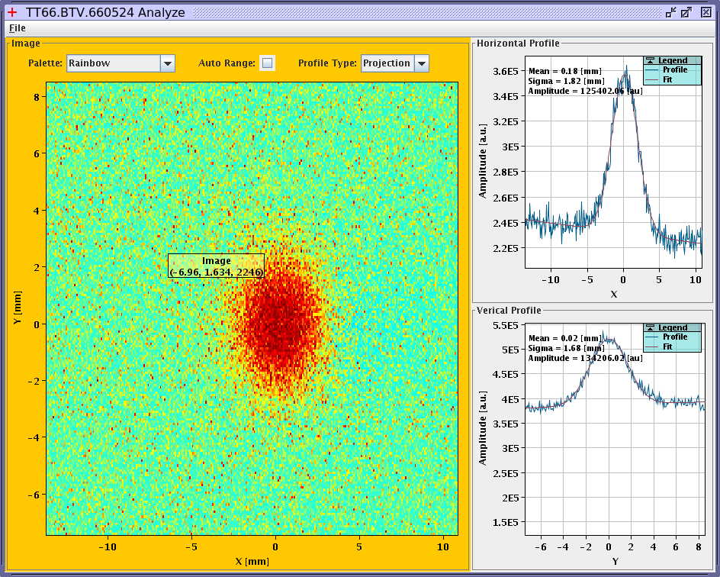
BTV for all beam conditions
Long optical line to install the camera in a radiation-friendly location (showers and ageing)
Thermal resistant OTR screen in primary vacuum to suppress Cherenkov background light (<10⁻³ Torr)
Aging of the Camera damaged by radiation by the end of HRMT27

Slide 15
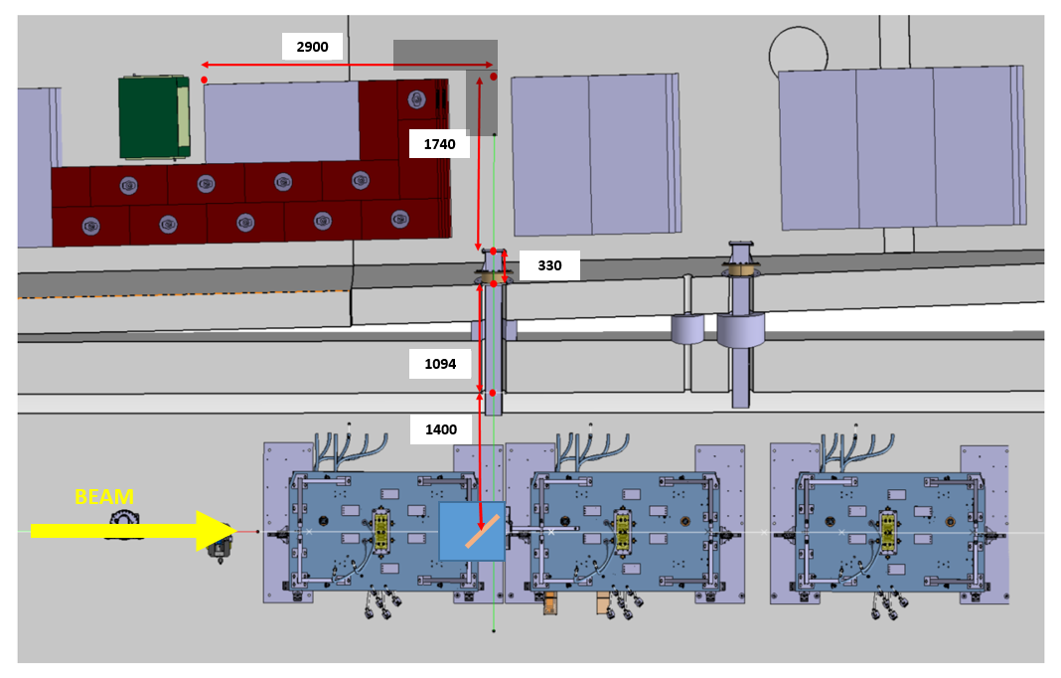
BTV for all beam conditions
Camera installed in TT61 parallel tunnel
Camera
TT61
Shielding
TNC
New BTV installed on Table A

Slide 16
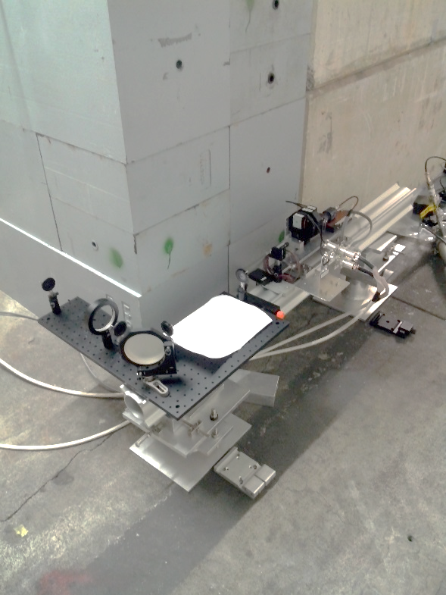
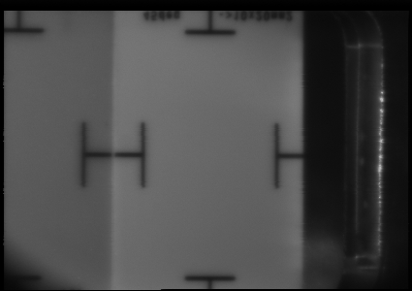
BTV for all beam conditions
> 5m long optical line
Optical magnification 0.2
Resolution [um/px]
Horizontal | 72
Vertical | 79
Camera
WATEC ULT902H3
Achromatic Lens
Focal 1m, Diam: 80mm
Screen position IN
Mirror
Diameter 4”
~5m
~0.3m
~0.9m
Beam

Slide 17
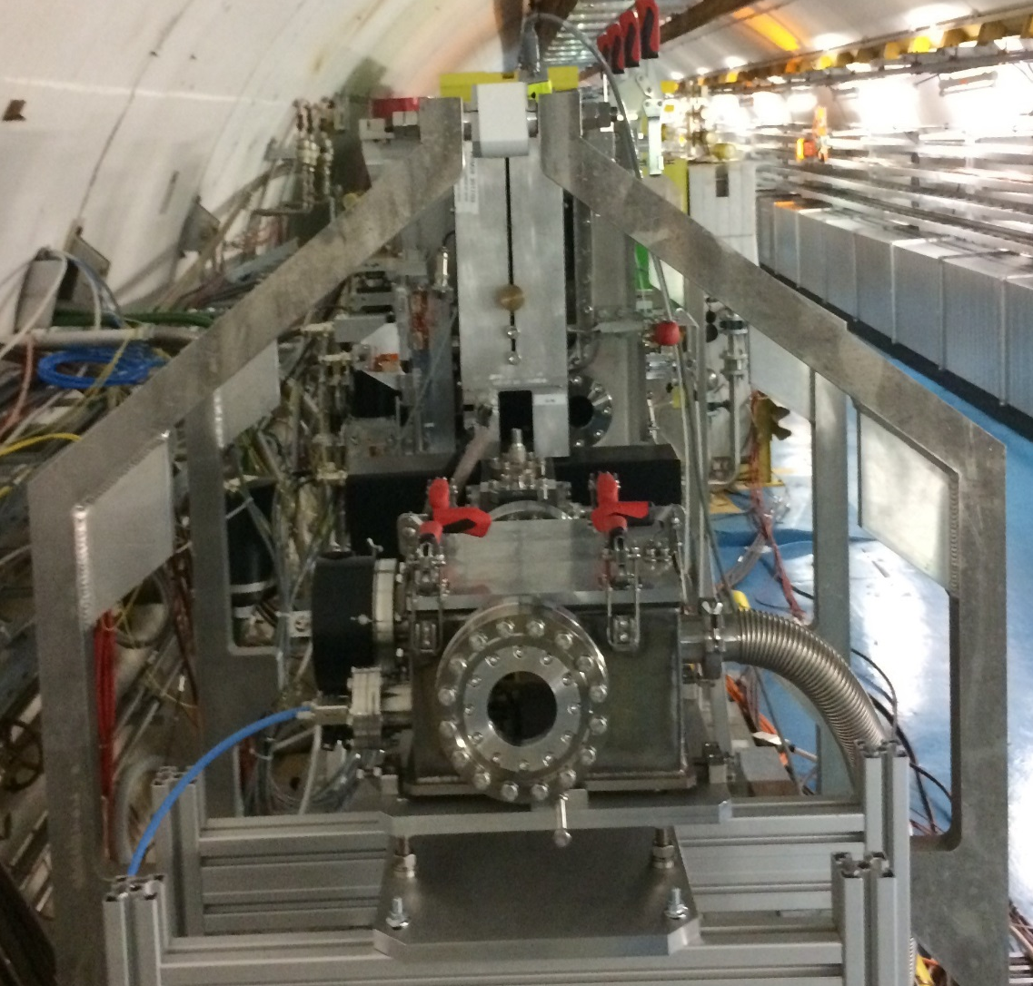
BTV for all beam conditions
Image from V. Clerc
Photons
Beam
Photons
p BEAM
CATIA 3D drawing of the new BTV for HRM
Installation of the new BTV HRM from 2017
Located end of experimental table A

Slide 18
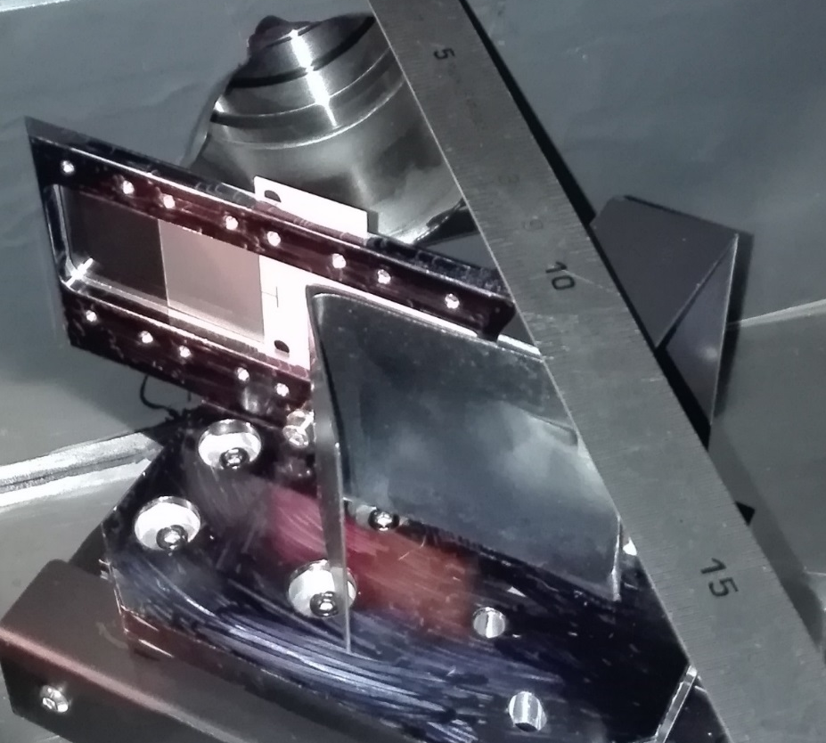
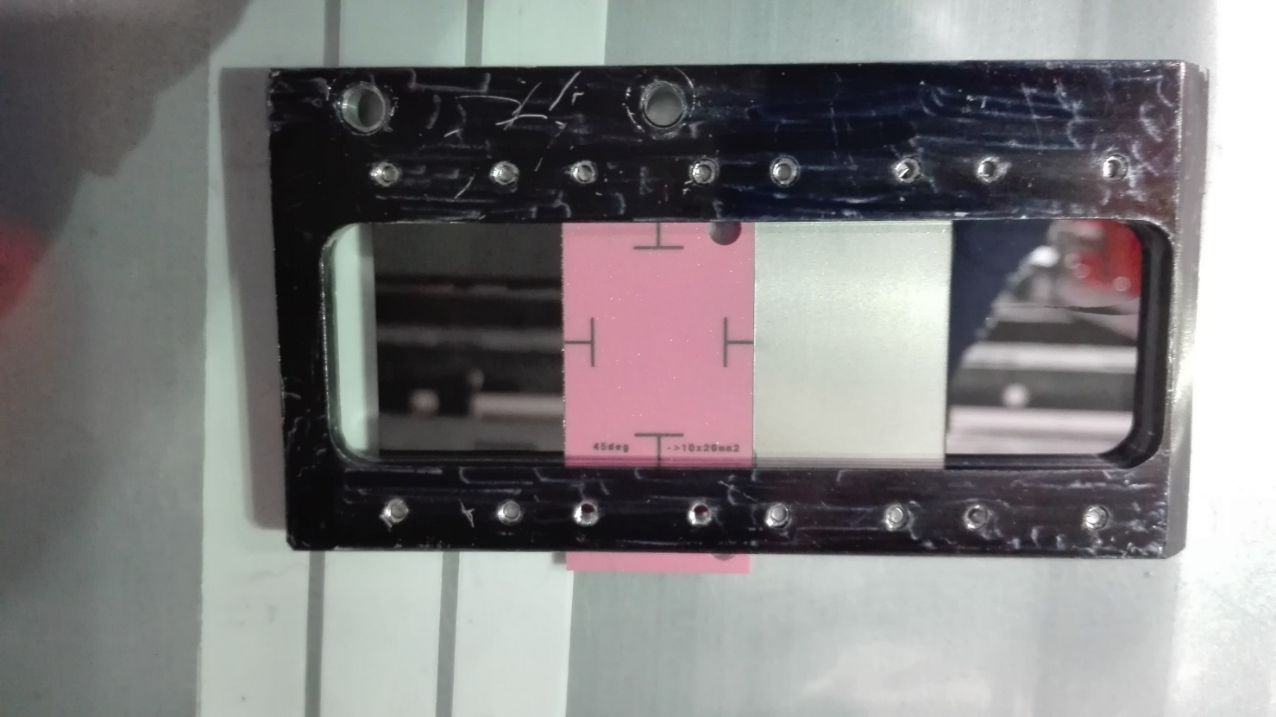
BTV for all beam conditions
SiC
0.5mm
Ti
0.1mm
Chromox
0.5mm
Sigradur G Glassy C
0.5mm
Beam
Fixed 75um Carbon foil

Slide 19
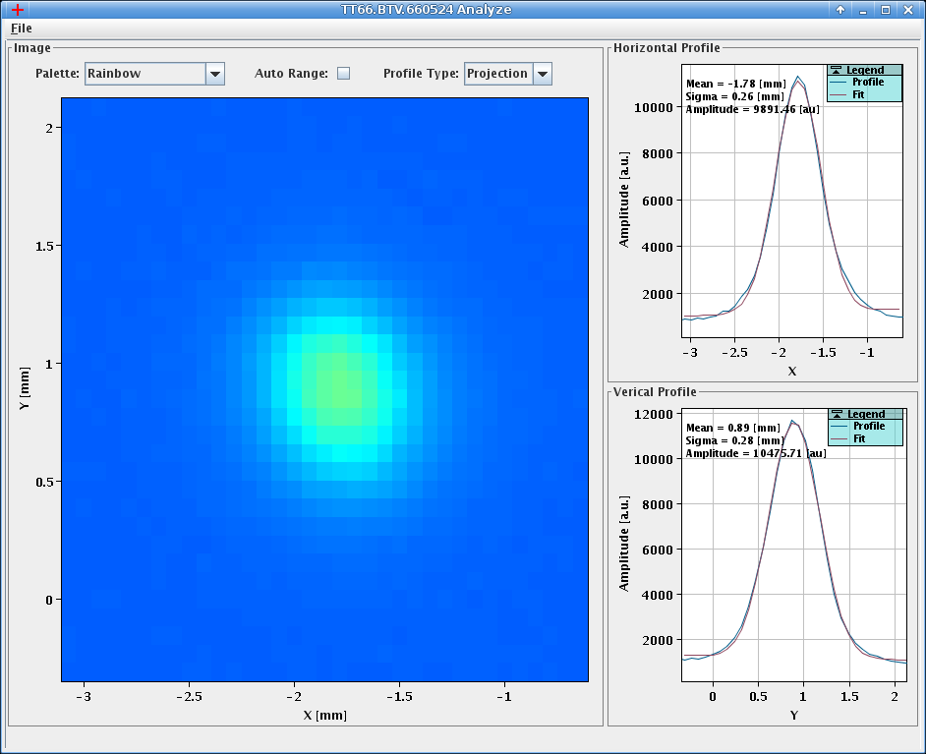
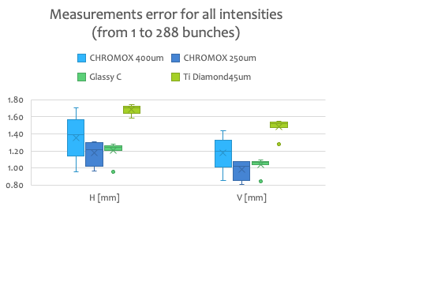
BTV for all beam conditions
SiC broken after 3 impacts at full beam power density
288 bunches at 1E11 with σ_{H} = 0.26mm and σ_{V} = 0.28mm

Slide 20
BTV for all beam conditions
SiC broken after 3 impacts at full beam power density
Glassy C has shown reliable measurements down to smallest beam sizes of 0.25mm
  Systematic over-estimation due to Forward OTR from blocking foil simulated using ZEMAX to be less than 10%
288 bunches at 1E11 with σ_{H} = 0.26mm and σ_{V} = 0.28mm

Slide 21
BI developments at HiRadMat

Slide 22
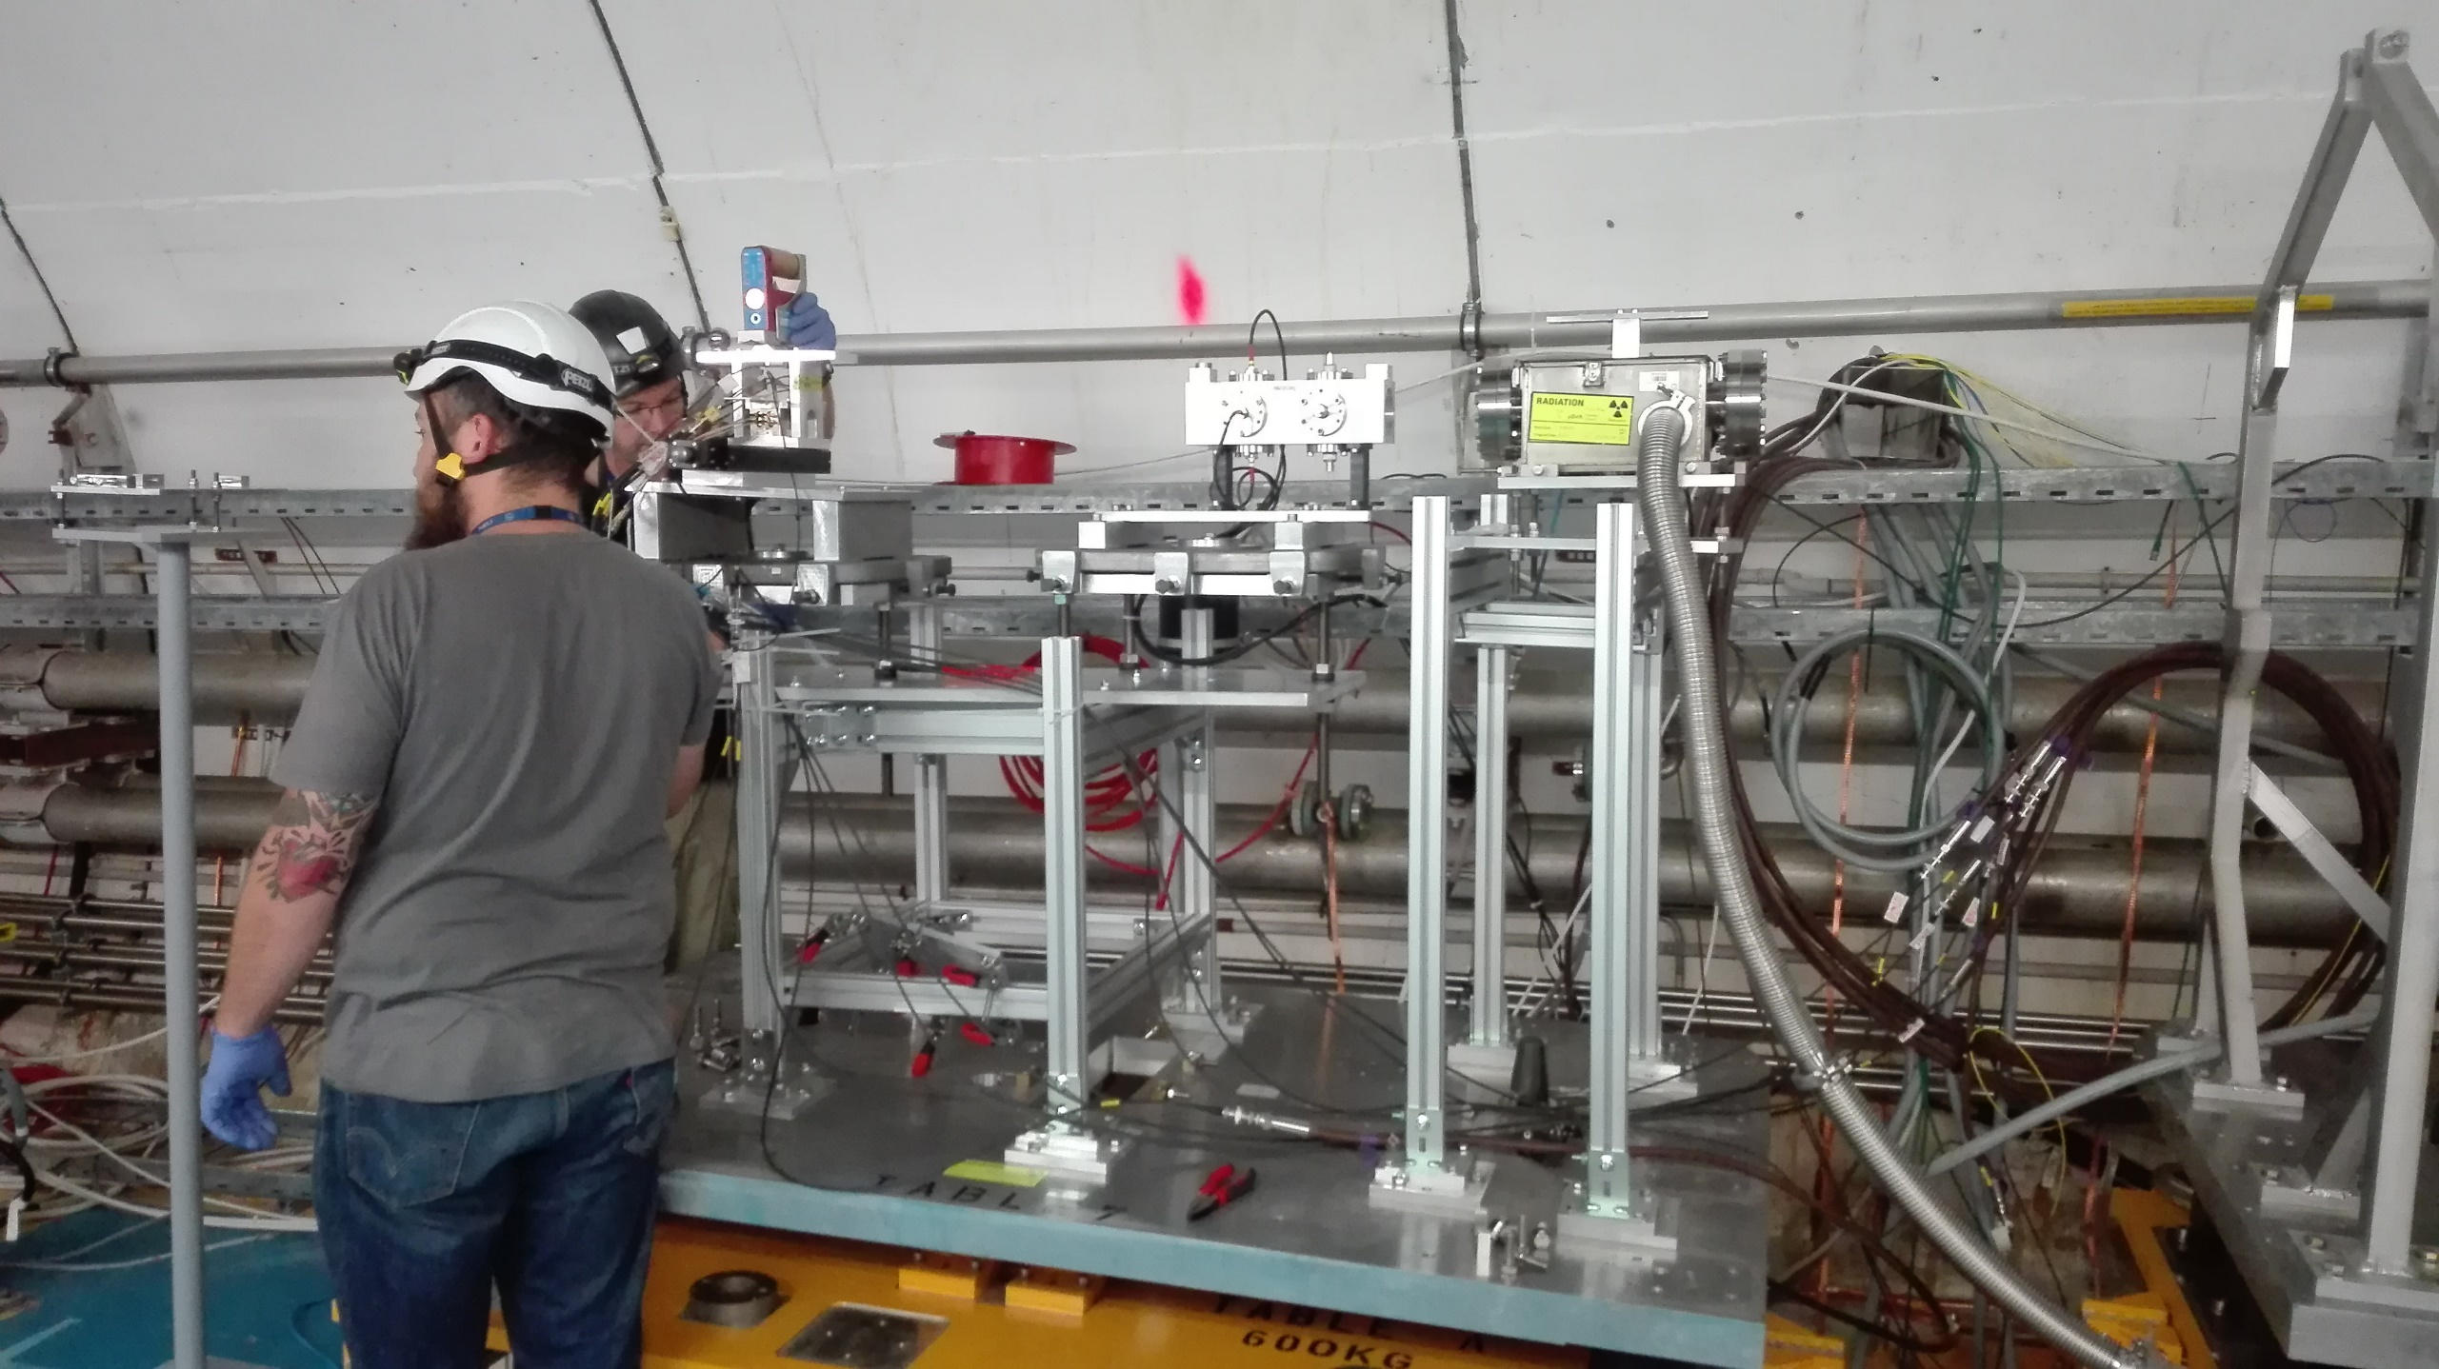
BI developments at HiRadMat
Using Table a as an in-air BI test-stand

Slide 23
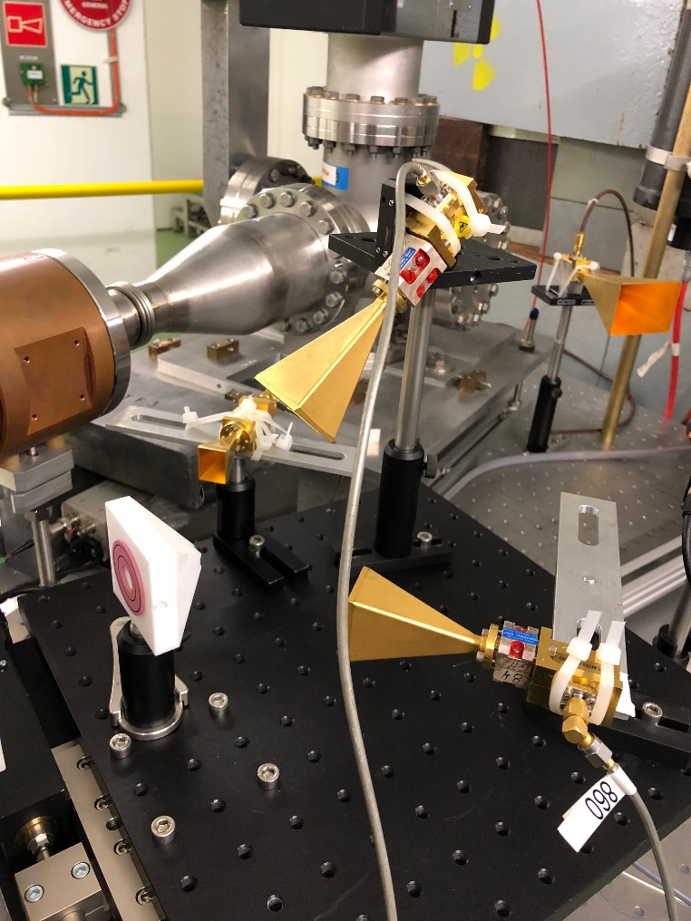
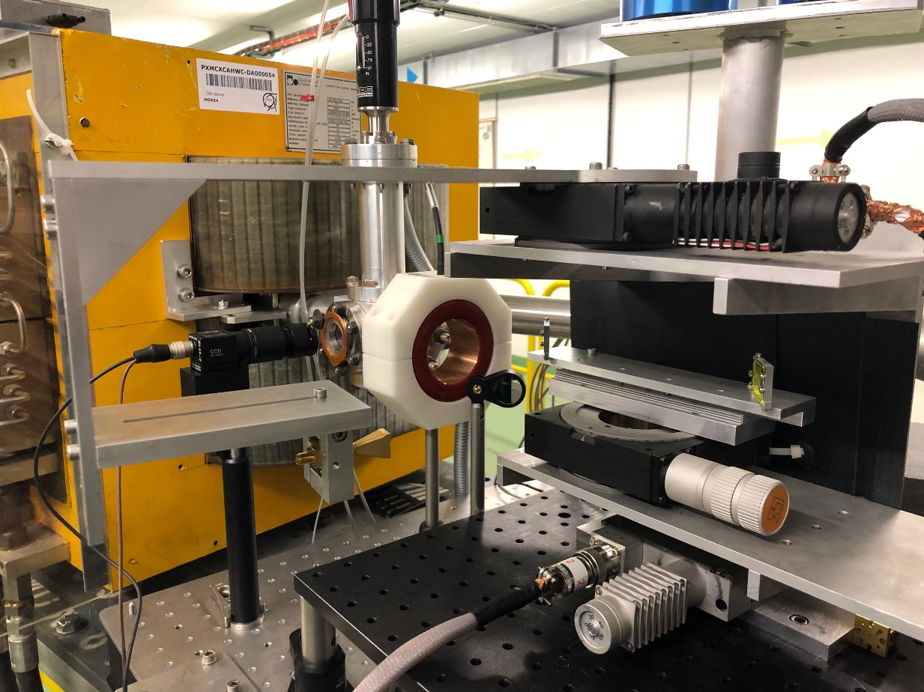
BI developments at HiRadMat
1m long in-air testing area on CLEAR/CERN (200MeV electrons – low charge)
  Equipped with beam position monitor and Screen/camera
  Equipped with movers and motor controller

Slide 24
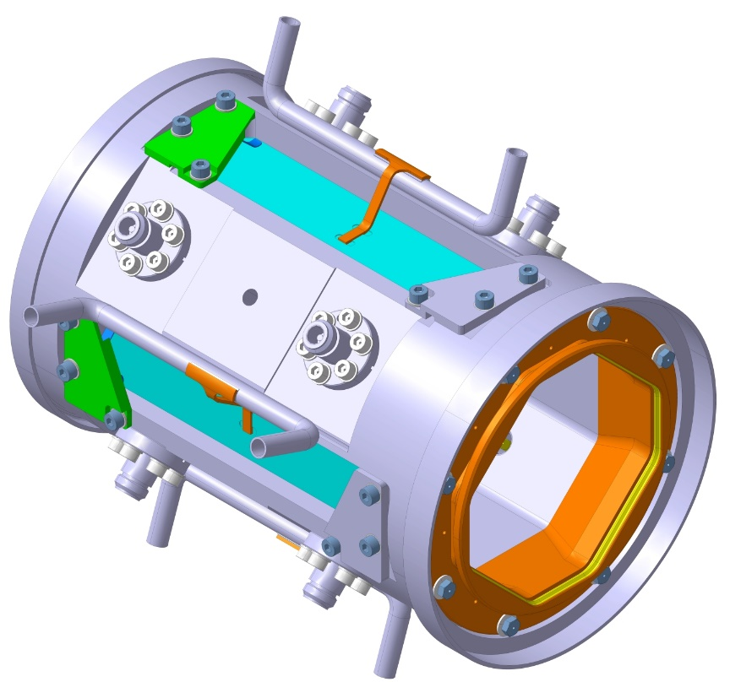
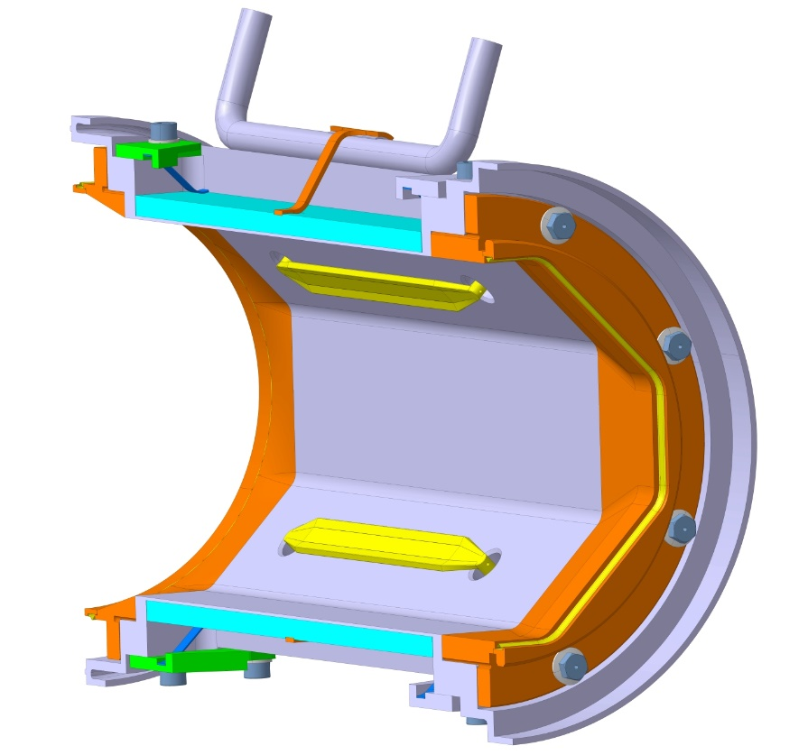
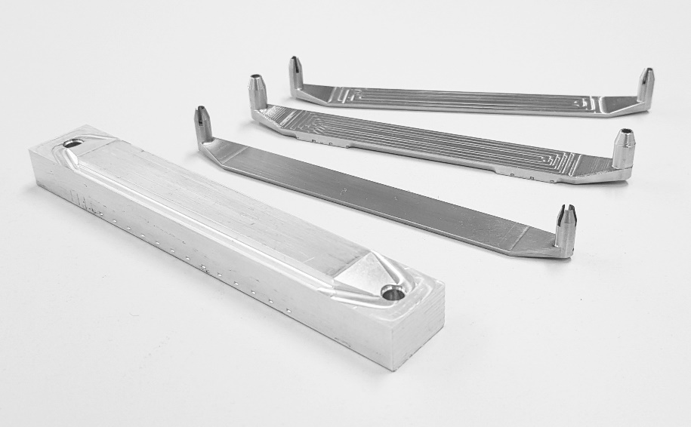
BI developments at HiRadMat
Testing Directivity of Hilumi new cold Stripline BPM
  Expected directivity better than > 25dB
  Prototype under fabrication

Slide 25
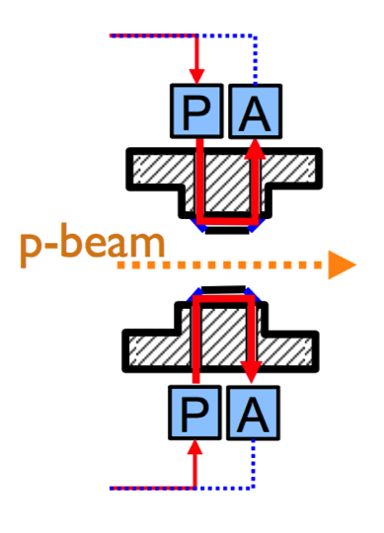
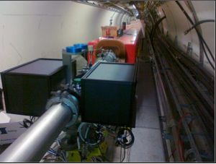
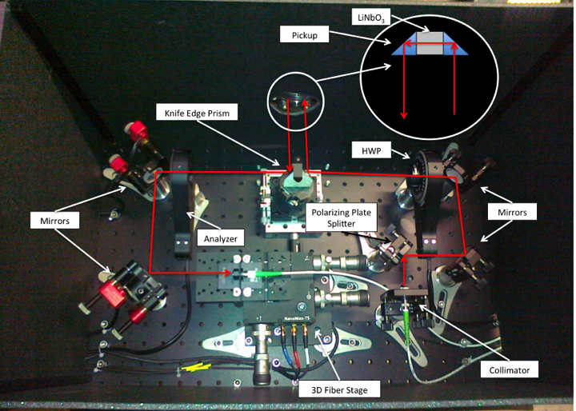
BI developments at HiRadMat
Testing Electro-optical BPM for Hilumi
  Prototype tested in SPS for measuring intrabunch instability
  New compact design underway – prototype expected in 2020
SPS protoype
25

Slide 26
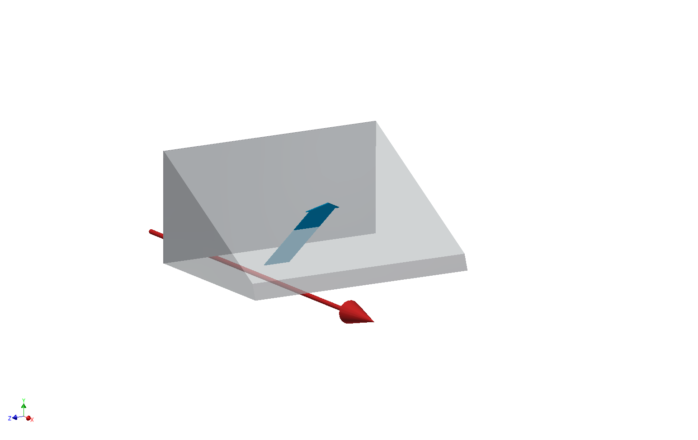
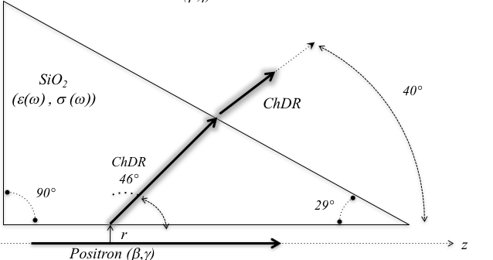
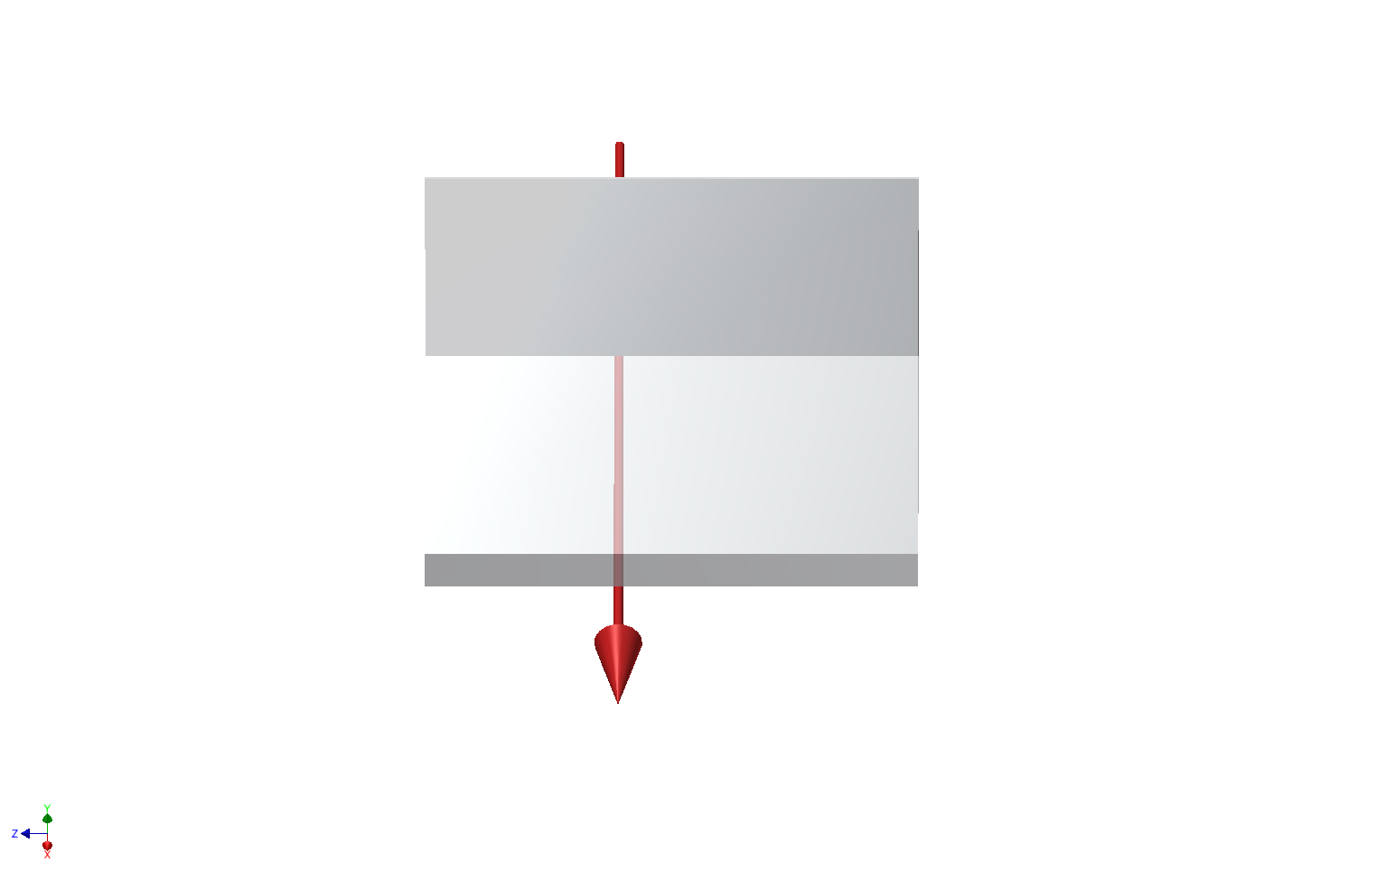
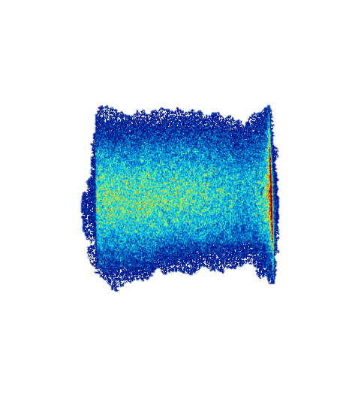
BI developments at HiRadMat
R&D on Incoherent Cherenkov-Diffraction Radiation
  Beam profile monitoring for highly relativistic particles
5.3GeV Positrons at CESR propagating at 3mm from the surface of a 2cm long fused silica prism
Cherenkov
Diffraction
Radiation
Positron Beam
Positron Beam
R. Kieffer et al., “Direct Observation of Incoherent Cherenkov Diffraction Radiation in the Visible Range”, PRL 121 (2018) 054802

Slide 27
BI developments at HiRadMat
R&D on Incoherent Cherenkov-Diffraction Radiation
  Beam position monitoring in long(er) dielectrics
Dielectric
Incoherent Cherenkov DR
photons
Motivation
Increasing the photon yield to detect particles sitting at larger distances (h > 1cm)
Investigating measuring ChDR in longer wavelength (NIR) for low(er) beam energies (e⁻@200MeV or H⁺@400GeV)
E Field
h
Vacuum
$$θ_{Ch}$$
L ????

Slide 28
BI developments at HiRadMat
R&D on Incoherent Cherenkov-Diffraction Radiation
  Beam position monitoring in long(er) dielectrics
20cm long stripline in Fused Silica

Slide 29
BI developments at HiRadMat
R&D on Incoherent Cherenkov-Diffraction Radiation
  Beam position monitoring in long(er) dielectrics
First test in dec. 2018 at CLEAR using a train of 50pC electron bunches (1nC total)
0 charge)

Slide 30
BI developments at HiRadMat
R&D on Incoherent Cherenkov-Diffraction Radiation
  Beam position monitoring in long(er) dielectrics
R&D for high energy collider studies (LC or FCC)
But also instrumentation for crystal collimator @ LHC
First test using train of 50pC electron bunch (1nC total charge)

Slide 31
Conclusions
Since 2014, significant improvements in measuring high intensity beam properties in HiRadMat
Very useful R&D performed already on screen and imaging systems (Many thanks to the HiRadMat team for help and support)
Instrumenting Table A with an in-air test-stand is an efficient and unique opportunity for beam instrumentation developments !
Most of the testing can be run almost parasitically to other HiRadMat experiments.
LoI under preparation

Slide 32
Thanks for your attention
Many Thanks to all colleagues involved !

Slide 33
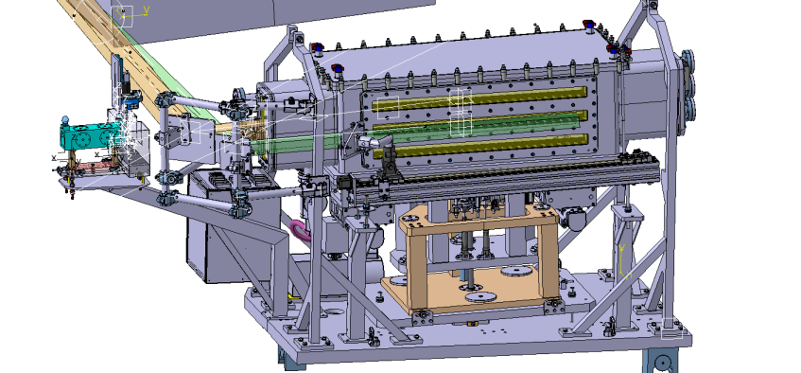
BTV/BPKG assembly

Slide 34
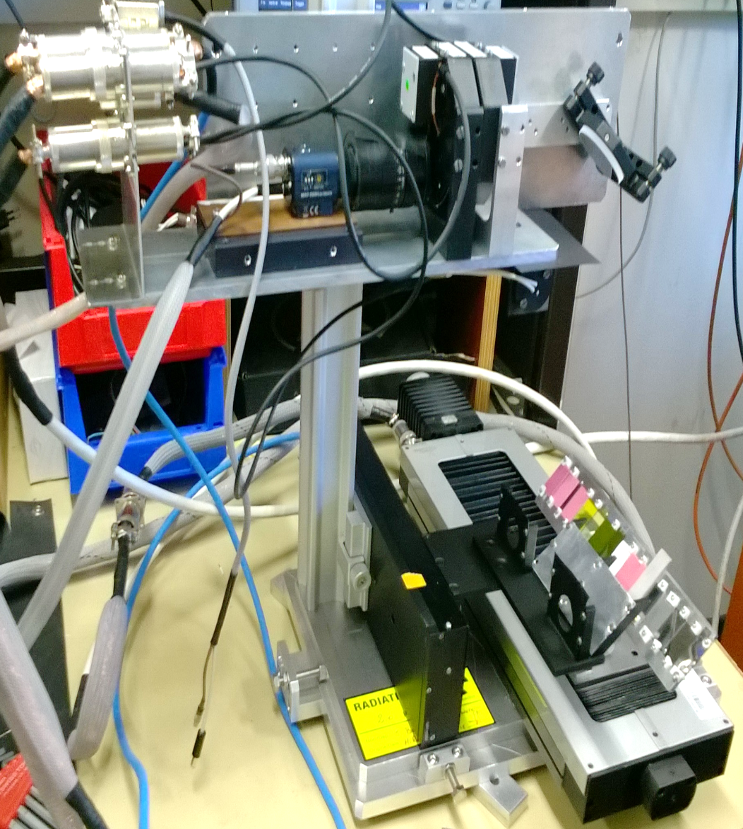
Measurement setup
Oct 2015 – HRMT30
June 2016 – HRMT32
beam
Diaphragm
Al foils

Slide 35
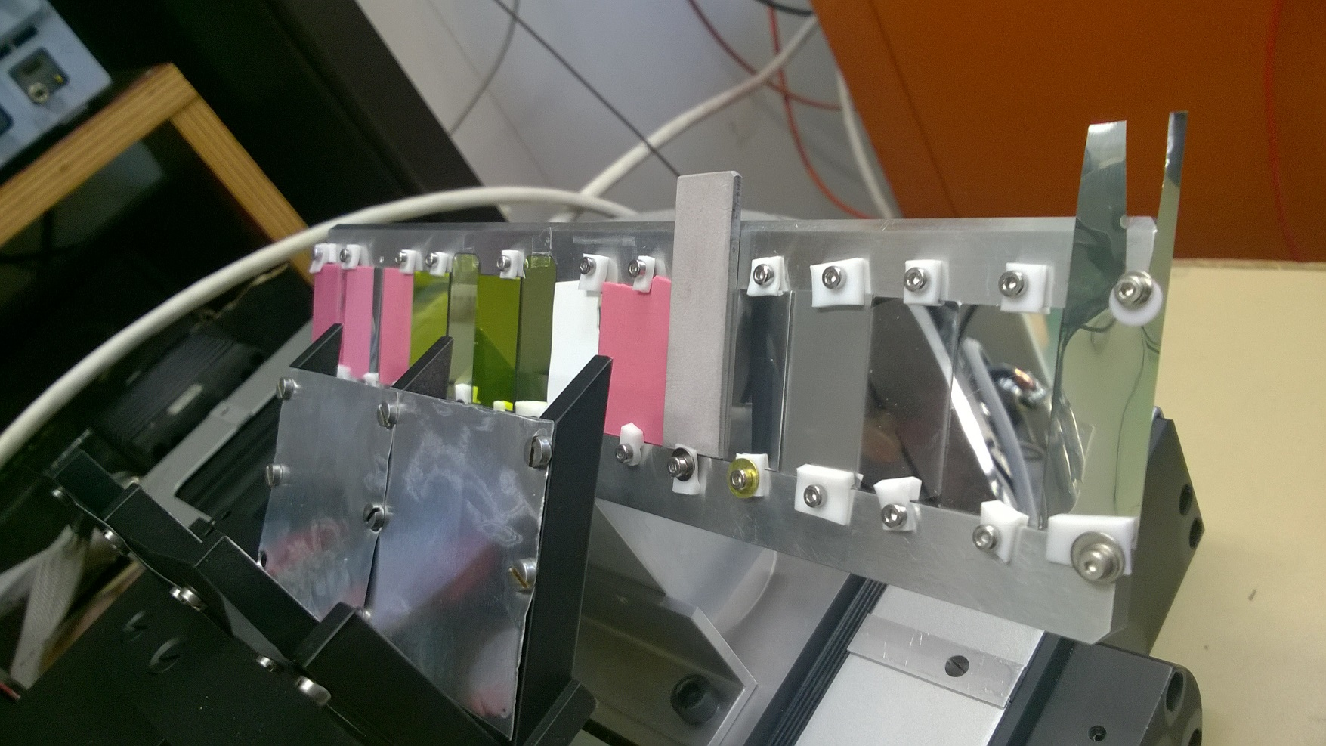
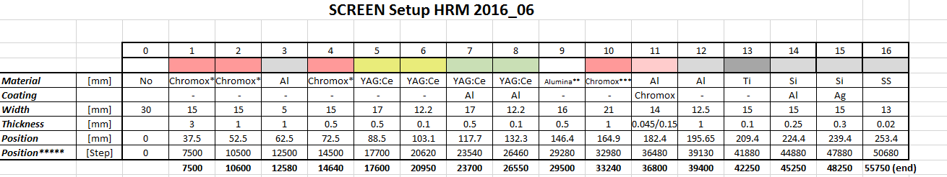
Screens tested
Scintillator:
  Alumina (Al₂O₃) – Purity: 96% & 99%
  Chromox (Al₂O₃:Cr₂O₃)
  thicknesses: 3 mm, 1 mm, 0.5 mm
  YAG – thicknesses: 0.1 mm, 0.5 mm
  both coated and uncoated
OTR
  Titanium, Aluminium, Silicon coated by aluminium & silver

Slide 36
Results (Nov. 15-HRMT30)
Different luminescent/scintillating screens
Chromox 1 mm thick screen was chosen to be used for the AWAKE halo measurement (as the best compromise between a high light yield and sufficient resolution)
For reflective OTR screens, measurements limited by some parasitic light of unknown origin (cherenkov in air ?)

Slide 37
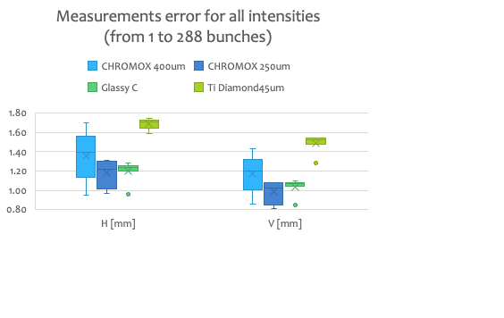
BTV for all beam conditions

Slide 38
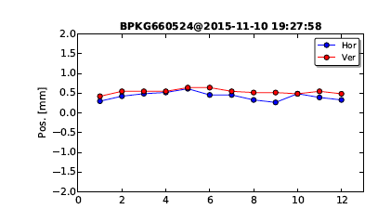
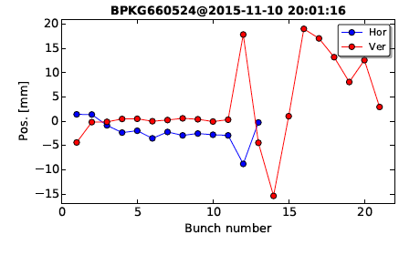
Issues with BPKG (1/4)
Cross-calibration between BTV ad BPKG went well
But we then discovered an issue while using long(er) bunch trains with large
unreal beam offsets measured
Published BPM data is the average of the beam position of all bunches
Target out
Target in
12 bunches
12 bunches

Slide 39
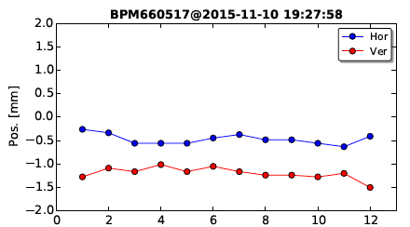
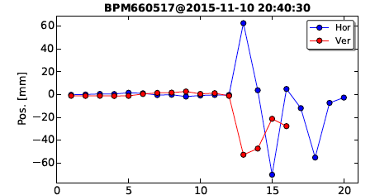
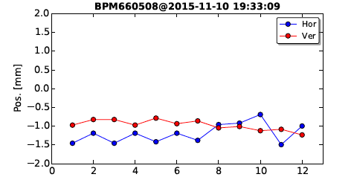
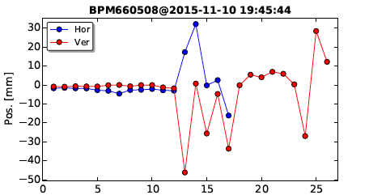
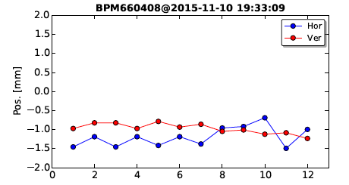
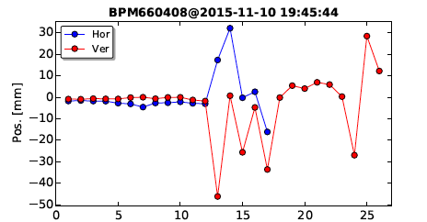
Issues with BPKG (2/4)
Target out
Target in
BPM517
Strong perturbations coming after the first 9 bunches
Seen on all BPMs down to the BPM408 in TJ7
BPM508
BPM408

Slide 40
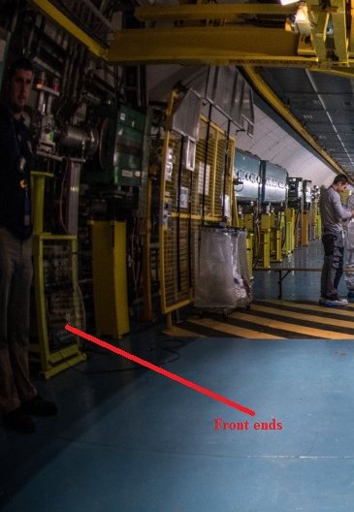
Issues with BPKG (3/4)
The electronics of all these BPMs sit in TJ7 underneath the BPM408
Perturbations compatible with backscattered shower affecting the electronic. Confirmed by time of flight
Relocation of BPM electronic in less exposed area
  Tunnel access to TJ7
  Done during EYETS 15-16

Slide 41
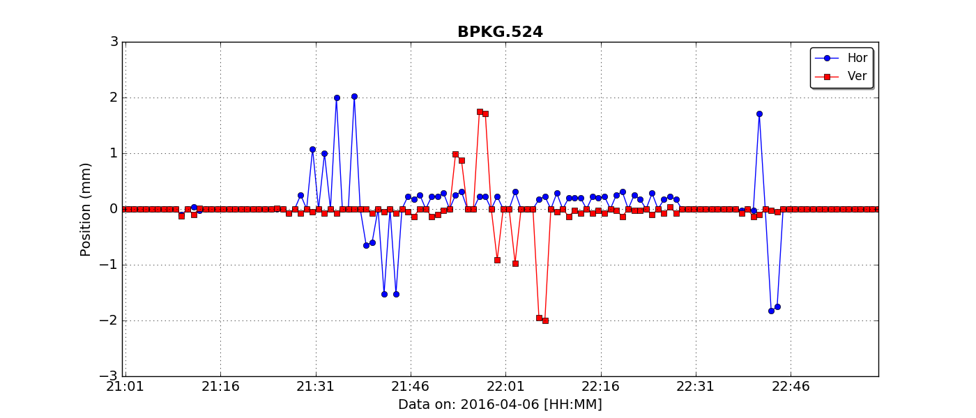
BTV/BPKG cross-calibration @HRMT28
Cross-alignment between BPKG.524 & BTV.524
Bumps ±1,2 mm
Identifying central offsets and scaling issues
Intensity ~ 1e11 p

Slide 42
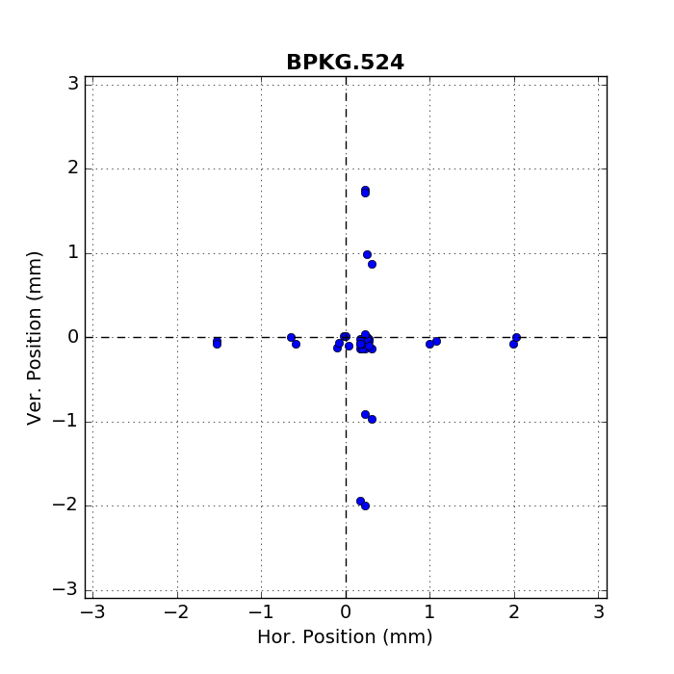
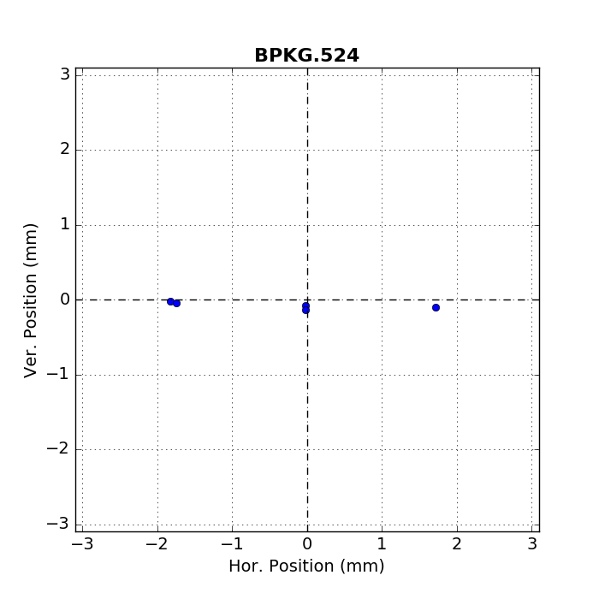
Correcting BPM geometrical offsets
First shots before changing offsets
Offset on the horizontal position
Shots after changing offsets

Slide 43
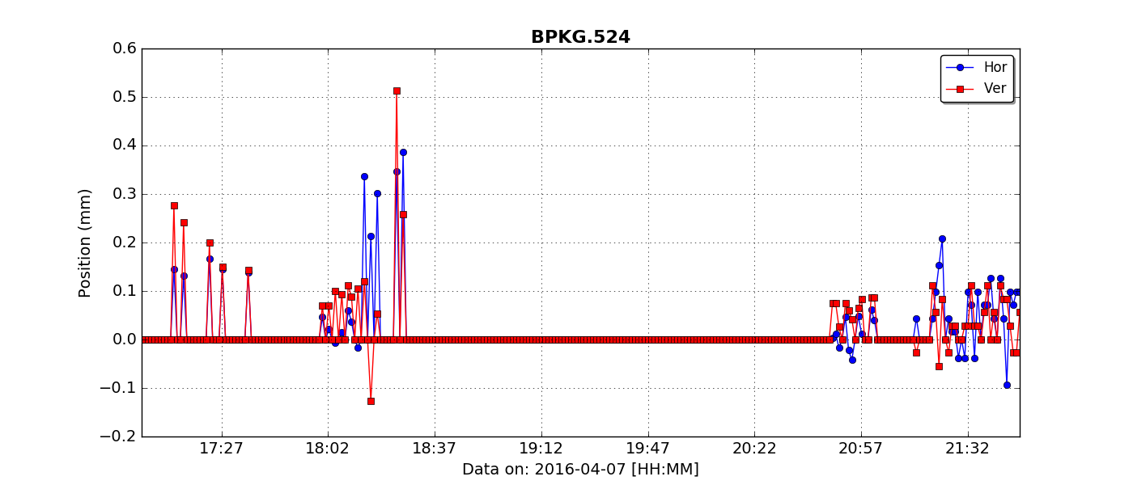
Reproducibility study
One nominal bunch

Slide 44
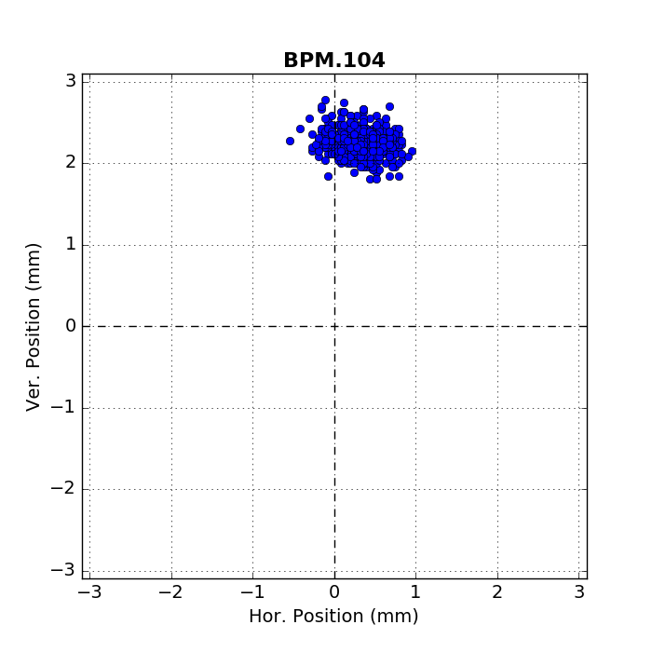







Steering along the line
Beam Direction

Slide 45


Reproducibility study – longer trains
288 -bunches
72 -bunches

Slide 46


Steering along the line
72 -bunches
288 -bunches

Slide 47



Test with Collimator in – long trains
No wrong reading anymore due to radiation effects
BPKG.524
BPM.517
BPM.408

Slide 48


BLM test @ HRMT19-BLM2
LHC ionization chamber (IC) : 1.5l active vol.@ 1.1bar
Little Ionization Chamber (LIC) : 0.05l active vol.@ 1.1bar
for LHC in high losses region
Flat Ionization Chamber (FIC) : 0.05l active vol.@ 1.1bar
new detector for Booster
Tested with 3-5 shots using respectively
1, 36, 72, 144, 216, 288 nominal bunches
Measuring linearity and dynamic range

Slide 49

BLM test @ HRMT19-BLM2
IC
FIC
LIC
FIC
LIC

Slide 50




Diamond Detector (1/2)
Requirements:
Position, and size precision of 0.1mm
Simple real-time acquisition of beam parameters
Single bunch resolution
intensity range 1E9 to 5E13 p⁺/pulse
Based on Beam halo measurement

Slide 51



Diamond Detector (2/2)
Measuring BEAM POSITION
Comparing with BTV
± 1σ standard deviation is plotted
1σ = 0.12mm
Working as well with W-target inserted with reduced resolution (temporal signal distorted by showers)
Beam Size
Measuring BEAM SIZE
Assuming circular spot
Measurements for beam sizes of 1mm and 2mm
  2 mm data taken with W-target in beam
Standard deviation 0.07 mm for 1 mm optics, 0.36 mm for 2 mm optics

Slide 52
R&D performed in 2017-18
Development of non-invasive beam instruments using incoherent Cherenkov Diffraction Radiation in long(er) dielectrics
L = 1m & h = 2mm
Dielectric
Incoherent Cherenkov DR
photons
LHC 7TeV
FCC
E Field
N_{ph}
per protorn
LHC 450GeV
h
Vacuum
$$θ_{Ch}$$
Beam Energy (MeV)
For comparison N_{ph} from OTR is 10⁻² -10⁻³

Slide 53
R&D performed in 2017-18
Development of non-invasive beam instruments using incoherent Cherenkov Diffraction Radiation in long(er) dielectrics
L = 1m & h = 2mm
Dielectric
FCC
Incoherent Cherenkov DR
photons
LHC 7TeV
E Field
Photon
Spectrum (a.u)
Detection
in the IR
h
Vacuum
LHC 450GeV
$$θ_{Ch}$$
Wavelength (m)

Slide 54




BI developments at HiRadMat
R&D on Coherent Cherenkov-Diffraction Radiation
  BPM for Electrons which should be insensitive to Protons
Simulations by E. Senes
Current system
not working !!

Slide 55


BI developments at HiRadMat
R&D on Coherent Cherenkov-Diffraction Radiation
  Bunch length and Beam position monitor for short bunches (sub-ns)
Bunch spectrum
Bunch position monitor using coherent Cherenkov-Diffraction radiation at >20GHz (in 2018)
E. Senes , A. Curcio, M. Bergamaschi

Slide 56

Developing Beam diagnostics at CERN
Testing directly on the Operational Machines themselves
  It works..but may lead to unpleasant surprises
    e.g. Beam position dependency of CERN Fast Beam Current Transformer on LHC
  Limited time for hardware installation/modification in the tunnel (i.e. Technical stops)
  Limited beam time available for tests during MDs
  R&D is rarely compatible with the strict requirements for Operational Machines
  e.g. Testing gas jet monitor and their performance
  as function of gas pressure would conflict with
  vacuum requirements

