Slide 1
Beam impact response of irradiated materials
M. Tomut*
P. Simon, P. Bolz, P. Drechsel, A. Prosvetov, C. Trautmann, A. Schlüter,
Ch. Kuhn, R. Müller, R. Knöbel, H. Weick, M. Guinchard, A. Bouvard,
F.Harden, Y. Kadi
* GSI, Darmstadt, Germany,
Institute for Materials Physics, University of Münster,
University of Kaiserslautern, Germany
CERN

Slide 2
Outline
Role of microstructure in materials response to beam impact
Radiation- induced target material degradation:
                swelling
                thermal diffusivity
                hardening- new stress-concentrators
                microimpact studies
                - dynamic hardness, damping, fatigue
                damage recovery at high temperature
Dynamic response in context of radiation damage
Simulations of dynamic thermal fracture of targets in the context of radiation damage

Slide 3
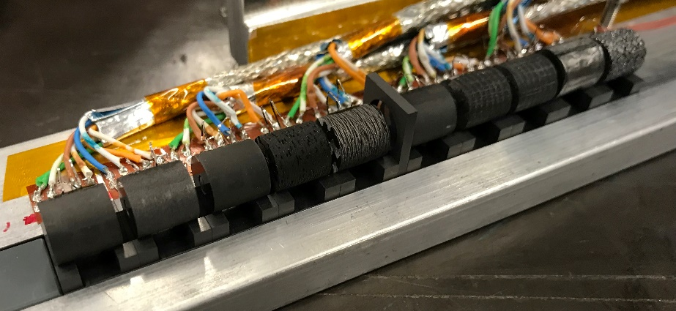
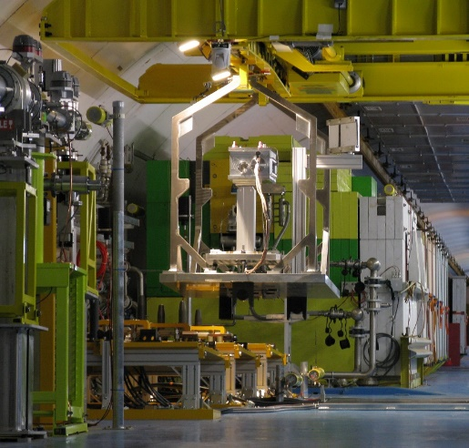
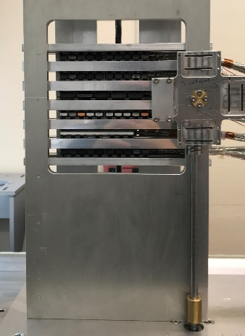
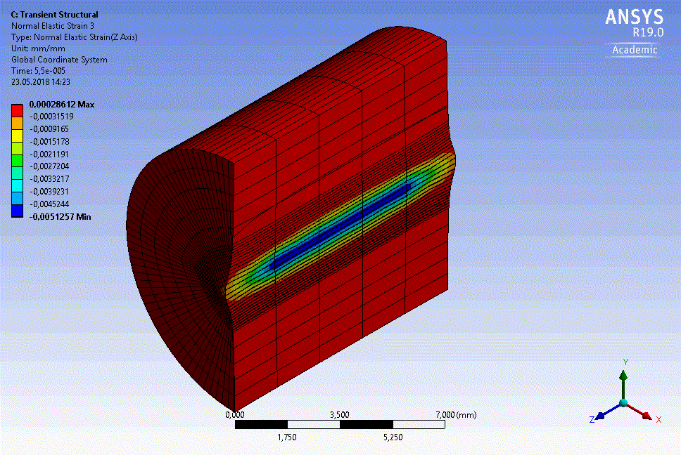
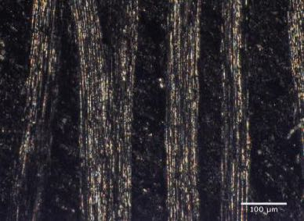
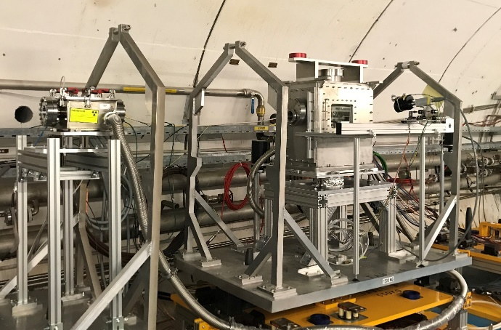
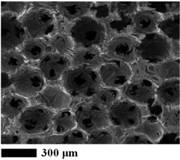
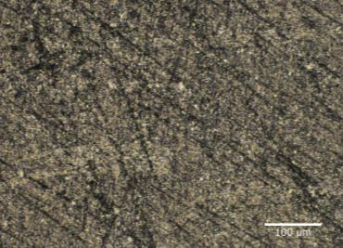

Role of microstructure
in materials response to beam impact
FlexMat experiment at HiRadMat-
- Graphitic materials response to beam impact
- applications for high power targets and beam dumps
FlexMat - June 2018
HiRadMat@SPS, CERN
283 beam pulses
total of 1.24E15 pot
up to 1.3E11 ppb
FlexMat mounting in SPS tunnel at CERN

Slide 4
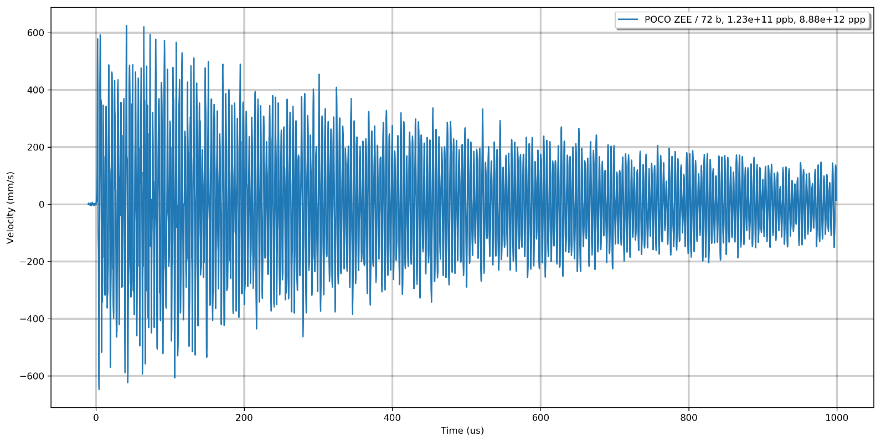
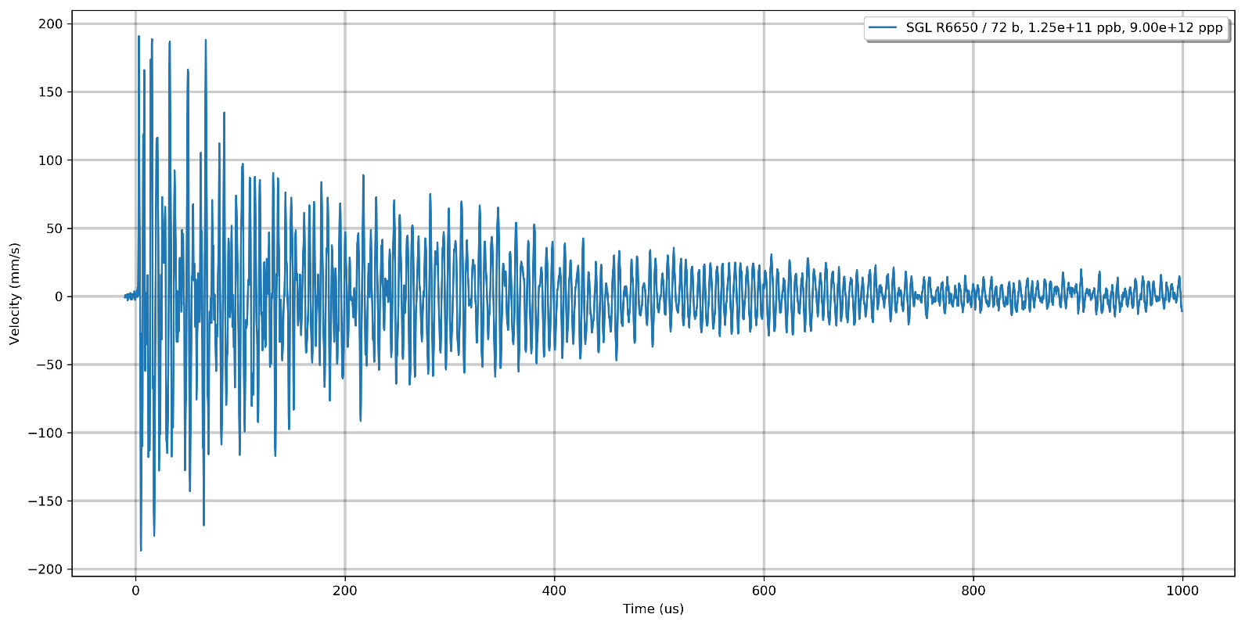
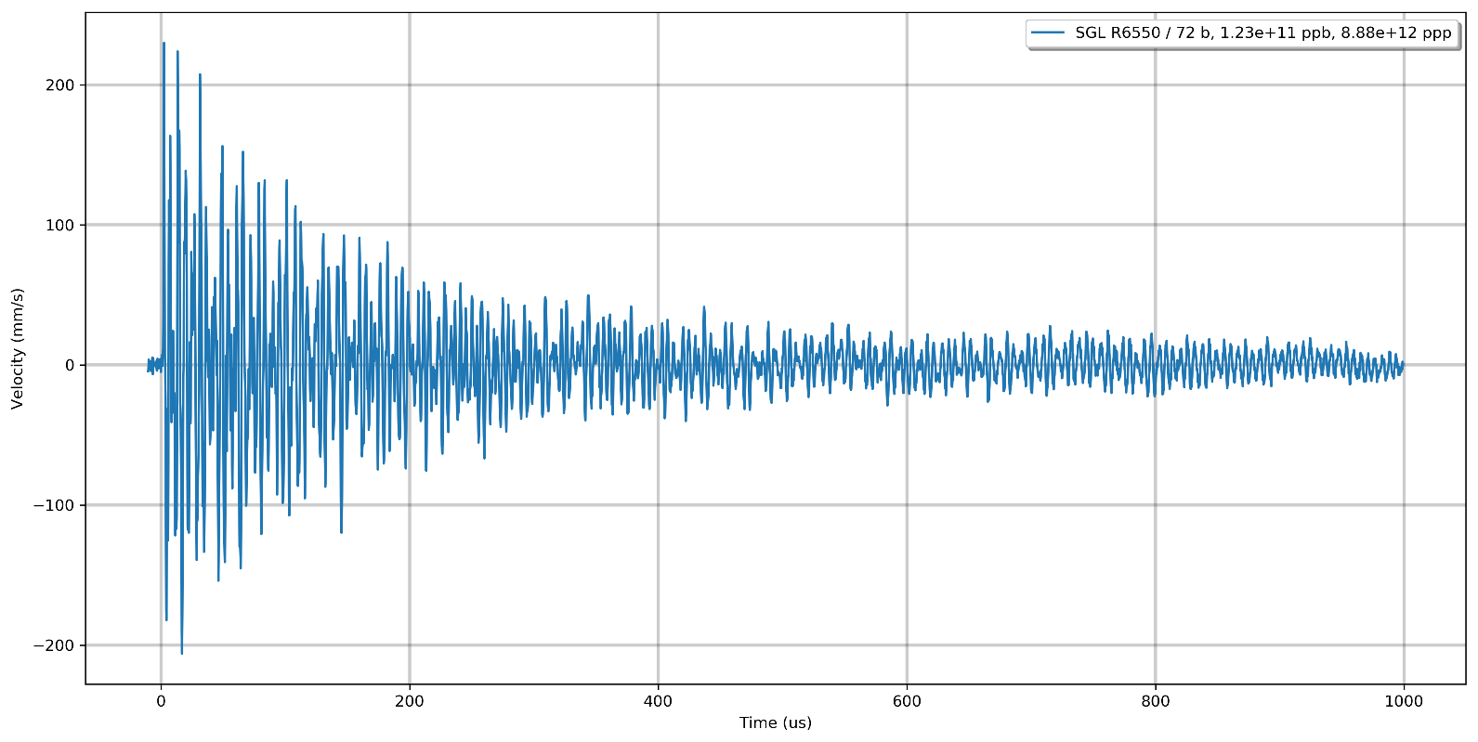
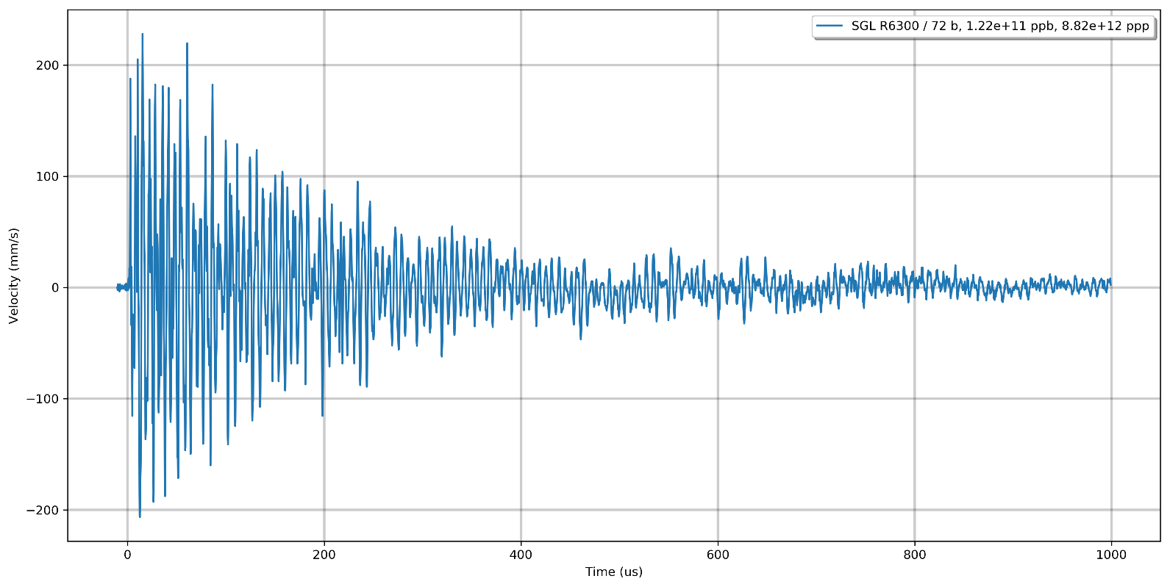
Beam impact response of graphite
- microstructure influence
1 μm
7 μm
10 μm
20 μm
Polycrystalline graphites with different grain sizes
LDV signal- velocities

Slide 5
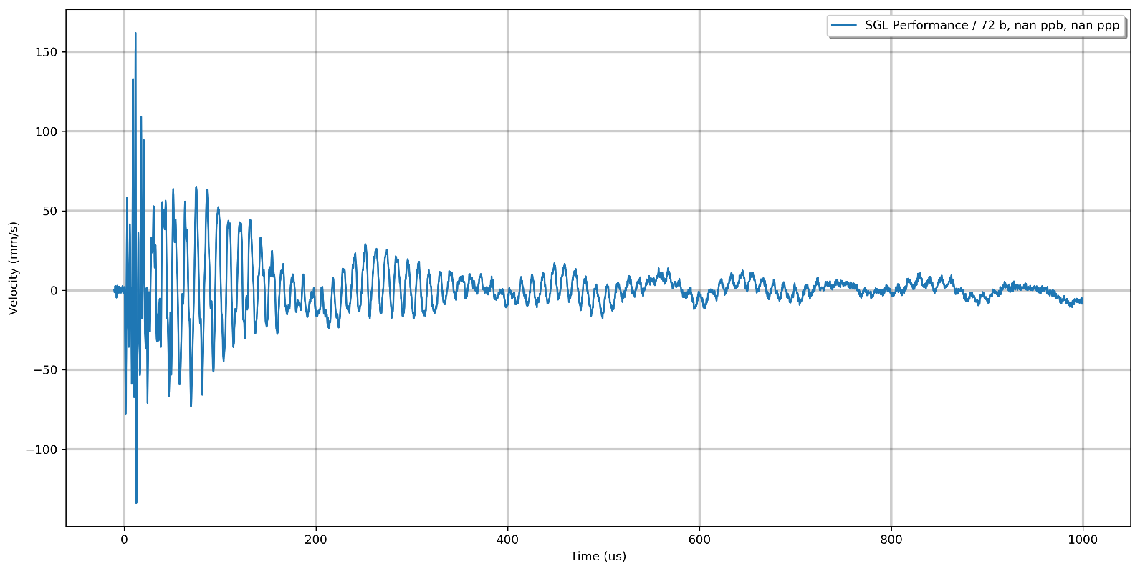
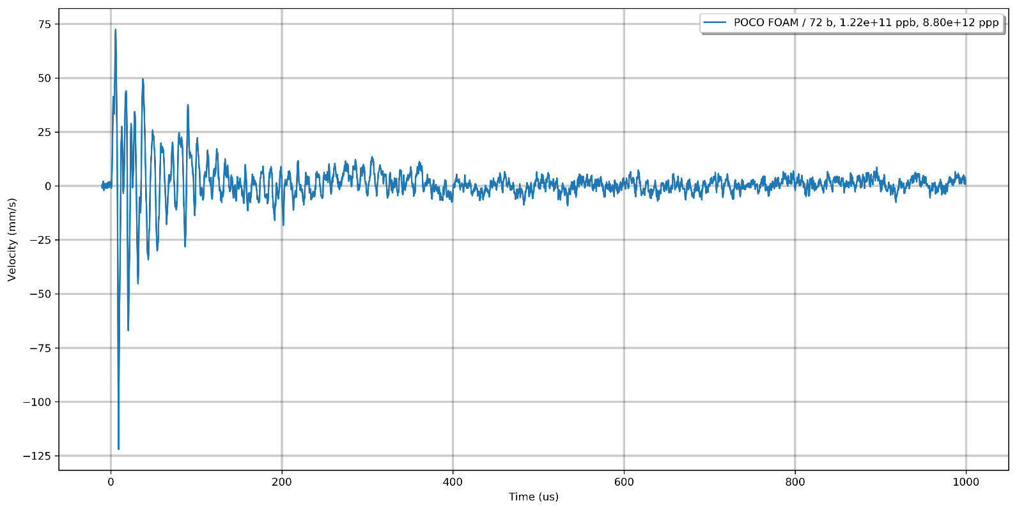
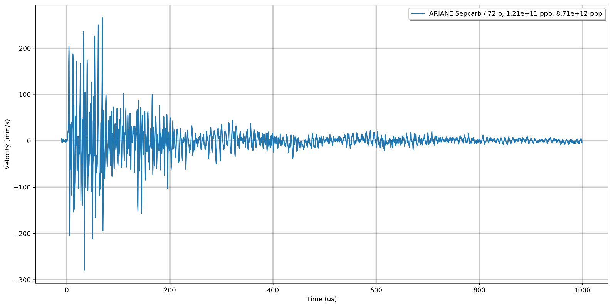
Beam impact response of other graphitic materials
PG / 1 μm
2D CFC
POCO Foam
3D CFC

Slide 6
Radiation- induced thermo-mechanical
properties degradation

Slide 7
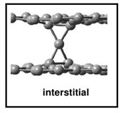


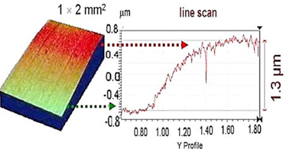
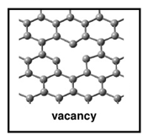


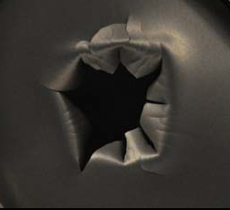
Beam- induced swelling in graphite
Swelling mechanism in irradiated graphite;
defect creation
Swelling measurements-profilometry
Leads to additional stress at the edge of the beam spot on target

Slide 8
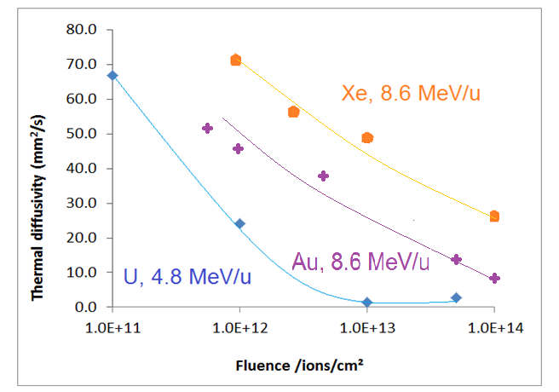
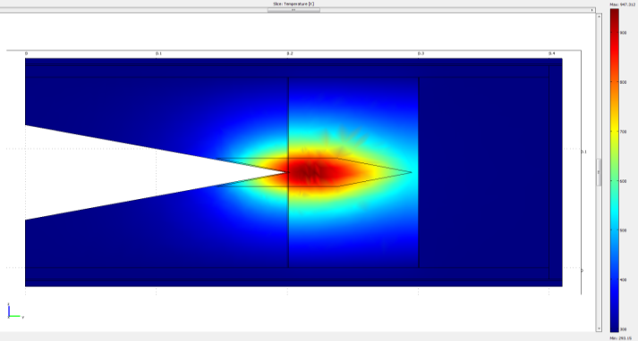
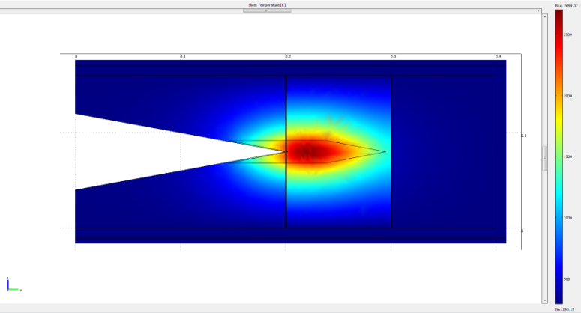
Effects of beam- induced degradation of thermal diffusivity of graphite
Super-FRS Beam Catchers
pristine graphite
T_{max -} 900 K
beam
radiation-damaged graphite
T_{max -} 2500 K
beam
(Ronja Knöbel, Helmut Weick, Super-FRS)
Thermal simulation shows cooling problem with radiation-damaged graphite:
- degradation of thermal diffusivity: 70-40 W/(m K) -> 15 W/(m K)

Slide 9
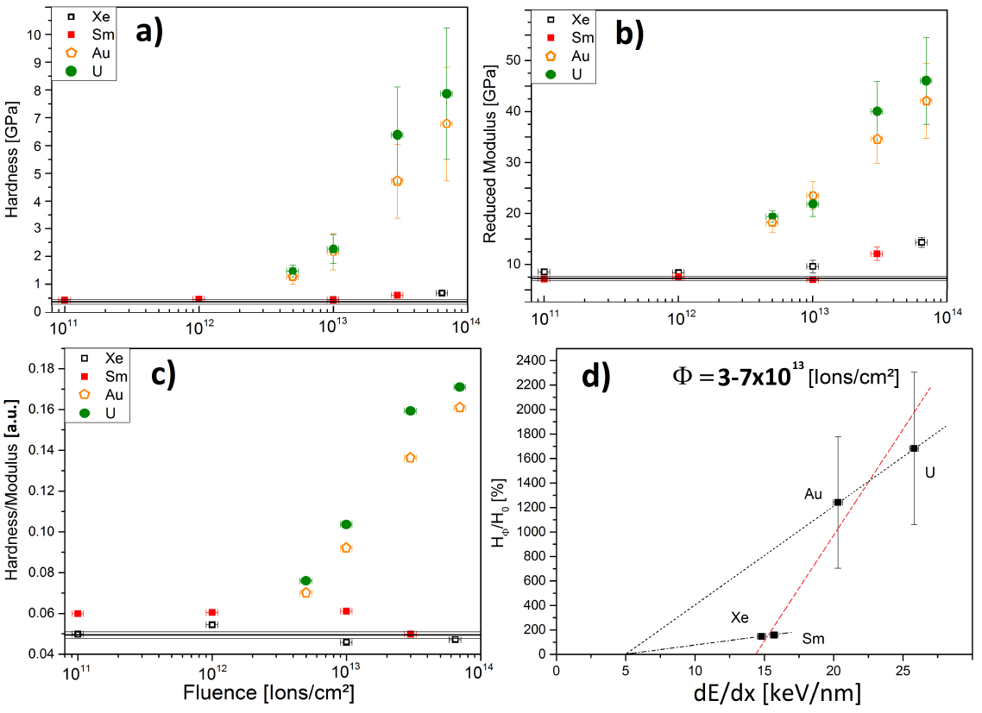
Ion beam induced hardening in graphite
4.8 MeV/u
Xe → U
Hardness
E modulus
Hardness / E modulus
Dependence
on dE/dx

Slide 10
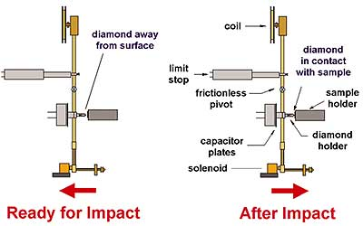

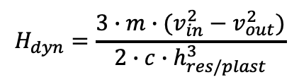
Microimpact tests– derived parameters
$$H_{dyn}=\frac{3∙m∙(v_{in}^{2}−v_{out}^{2})}{2{∙c∙h}_{res/plast}^{3}}$$
$$h=A∙e^{−DC∙t}+h_{plast}$$

Slide 11
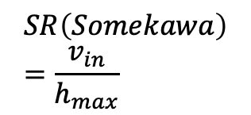

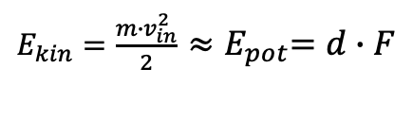
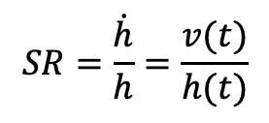

Microimpact tests- achieved strain rates
$$SR=\frac{\dot{h}}{h}=\frac{v(t)}{h(t)}$$
$E_{kin}=\frac{{m∙v}_{in}^{2}}{2}$ ${≈E}_{pot}=d∙F$
$$d=distance$$
$$SR\left(Somekawa\right)=\frac{v_{in}}{h_{max}}$$
$$F=acceleration force$$

Slide 12
Microimpact – dynamic hardness and damping evolution with fluence
Dynamic hardness
Damping constant
 | Strain rate [s⁻¹]
Quasi static indentation | 10⁻² to 10⁻¹
Nanoimpact | 10⁴
Ion beam impact | 10³ to 10⁵

Slide 13
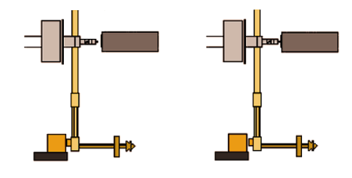
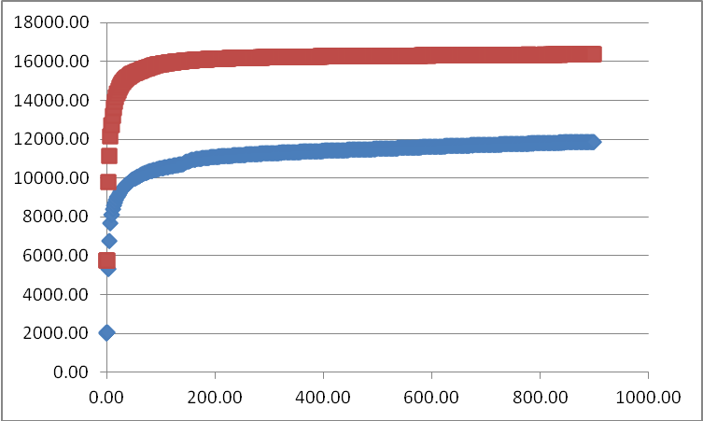

Multiple microimpact on irradiated graphite- fatigue
Cube Corner 20 mN max load; comparison pristine and irradiated samples
Fatigue period
Embrittlement
Fracture
pristine
Depth [nm]
Irradiated, 7E13 Au i/ cm²
Time [s]

Slide 14
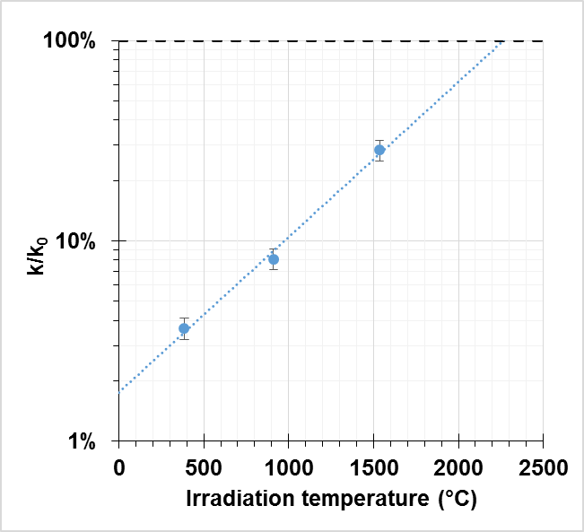
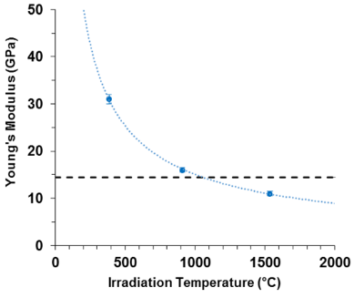
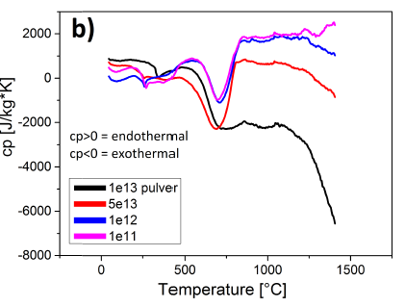
How to mitigate radiation damage effects in graphite
(production targets and beam catchers materials)
Damage recovery by - operation at high temperatures (> 900 ºC)
- post-irradiation annealing
thermal diffusivity
Young modulus
DSC – defect annealing
F. Pellemoine et al., Nucl.Inst.Meth.B, (2015) DOI:10.1016/j.nimb.2015.09.007
C.Hubert et al., Nucl.Inst.Meth.B, (2015) DOI:10.1016/ j.nimb.2015.08.056
    at T> 900 ºC → beneficial effect on recovery of thermo-mechanical properties
      thermal diffusivity reaches 30 % of the pristine value (1500 ºC)
      Young modulus reaches pristine value

Slide 15
Dynamic response in context of radiation damage
-experiments with 4.8 MeV/u U at UNILAC, GSI

Slide 16
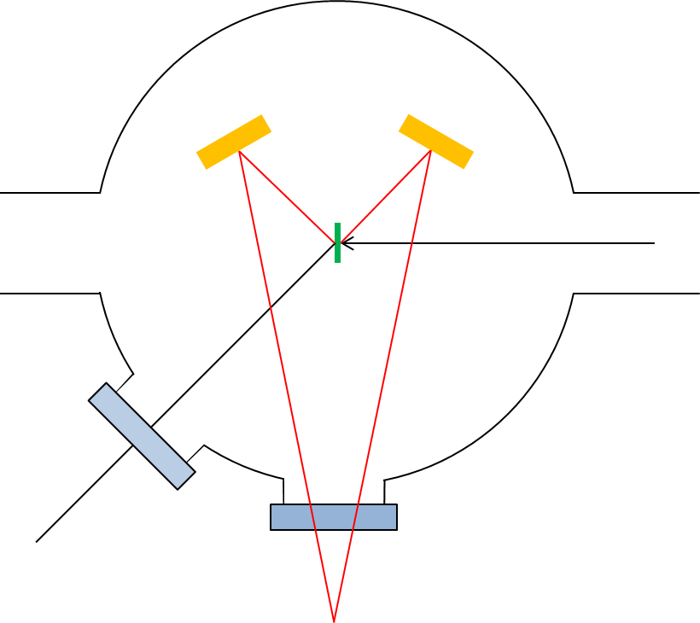
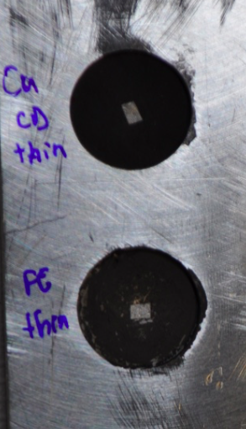
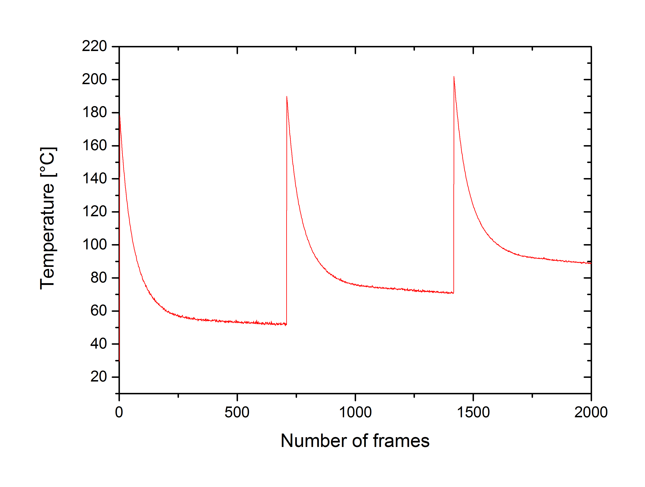
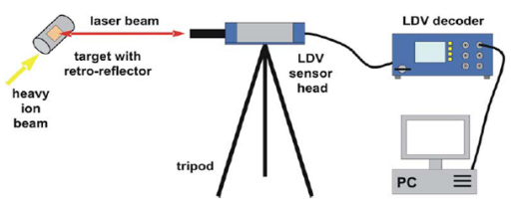
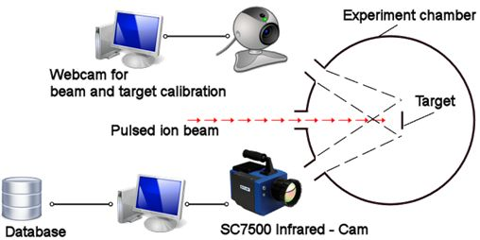
Experimental details
Irradiation parameters & set-up
Beam parameters
  4.8 MeV/u U²⁸⁺
  Up to 1.5×10¹⁰ i/cm² per pulse
  Up to fluences of 1×10¹⁴ i/cm²
high-current mode (MEVVA source)
1-2 Hz
100-200 µm length of macropulse
100 µs
1 s
LDV
IR camera

Slide 17
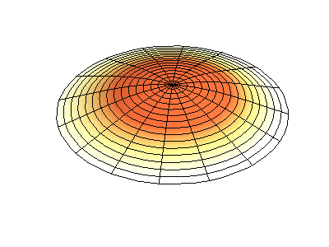
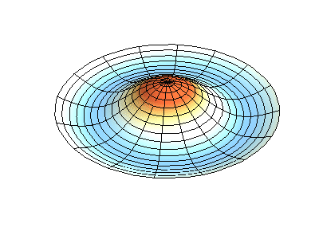
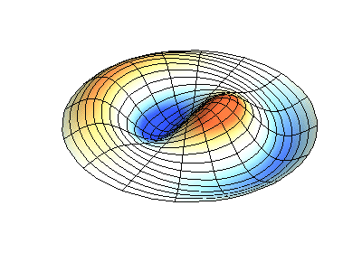
Vibration of a disc – beam modified material in the central beam spot
vibration with one circular node
pristine sample
vibration with two circular nodes
modified material in the beam spot
vibration with one circular node
and one diameter node – beam hits eccentric
Animation - Dr. Dan Russell, Grad. Prog. Acoustics, Penn State

Slide 18
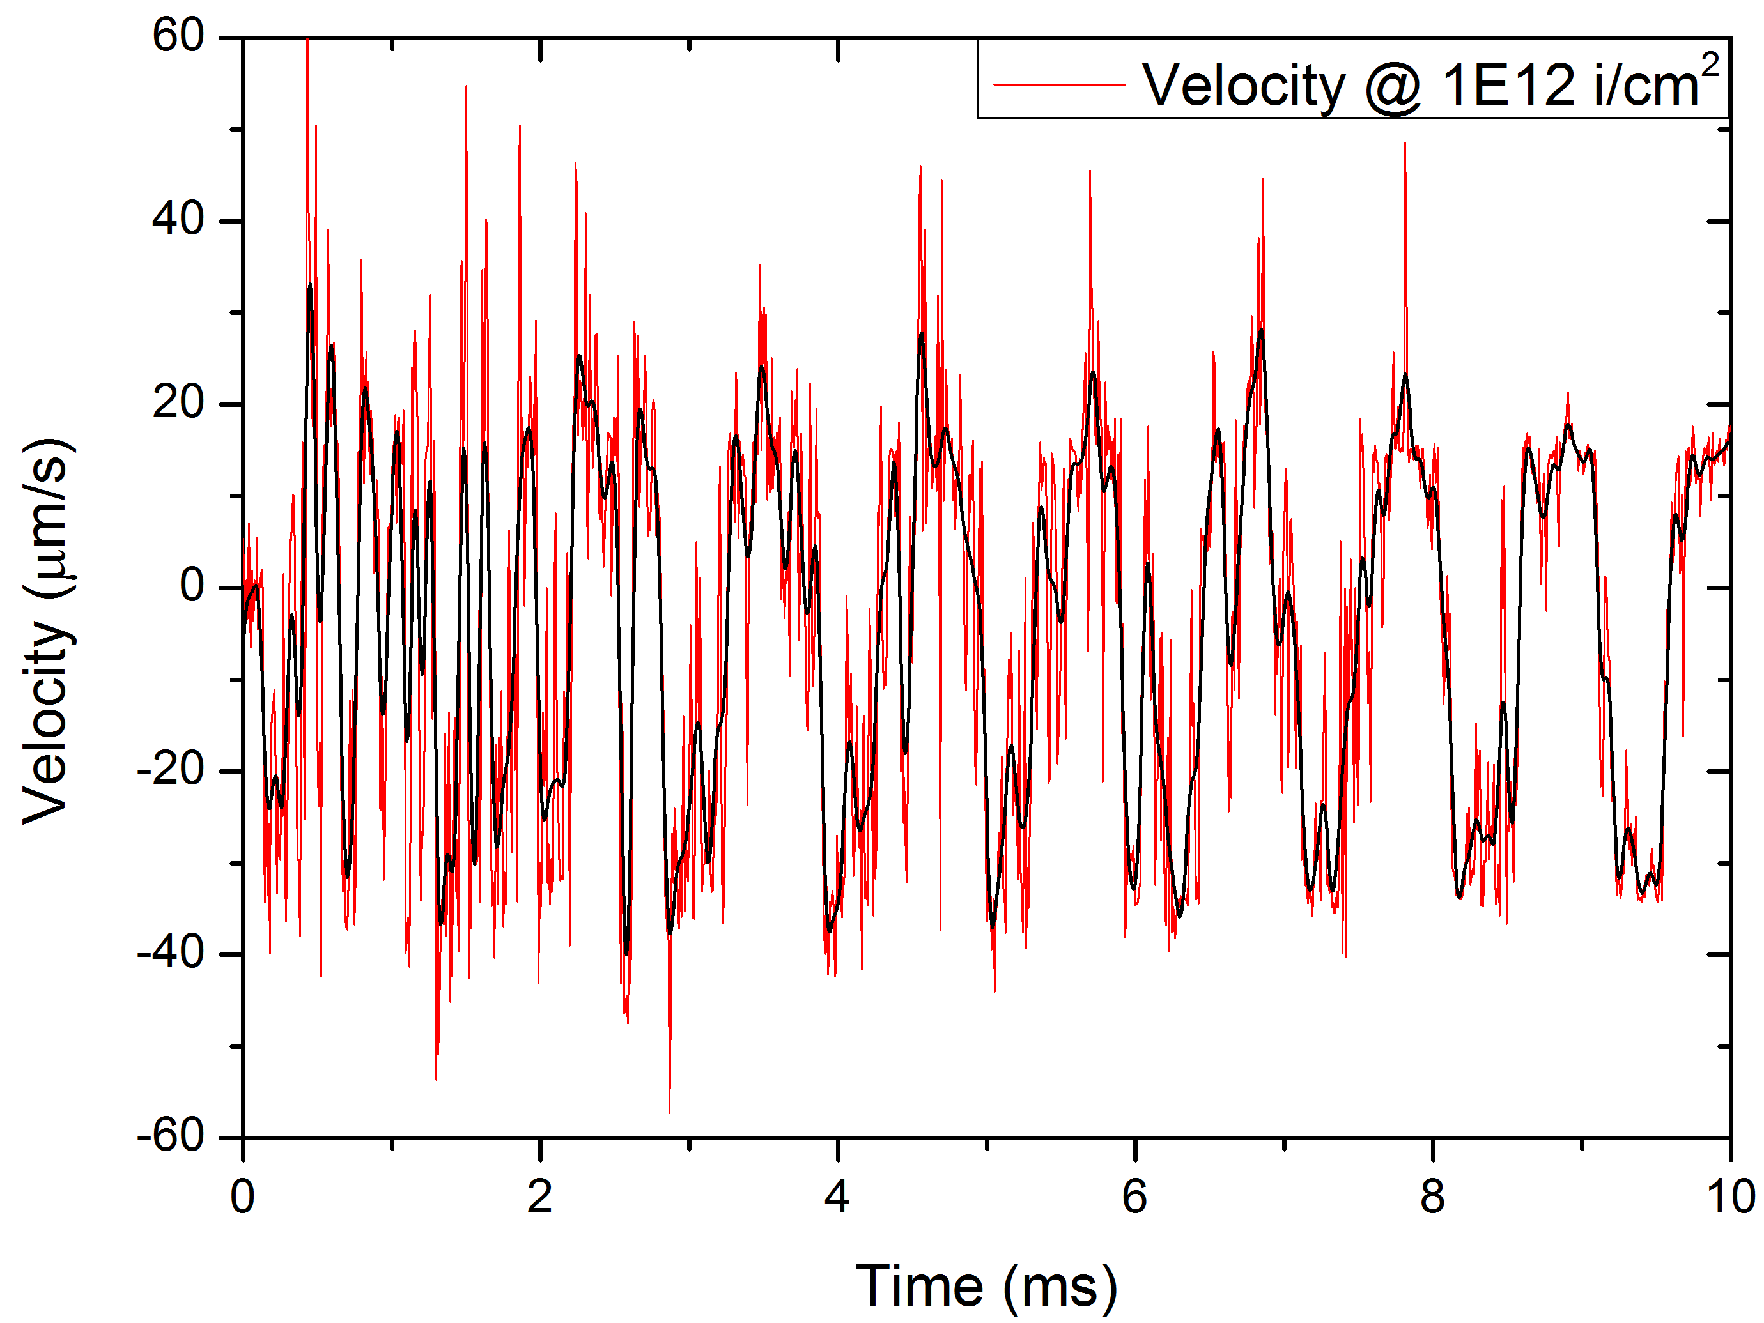
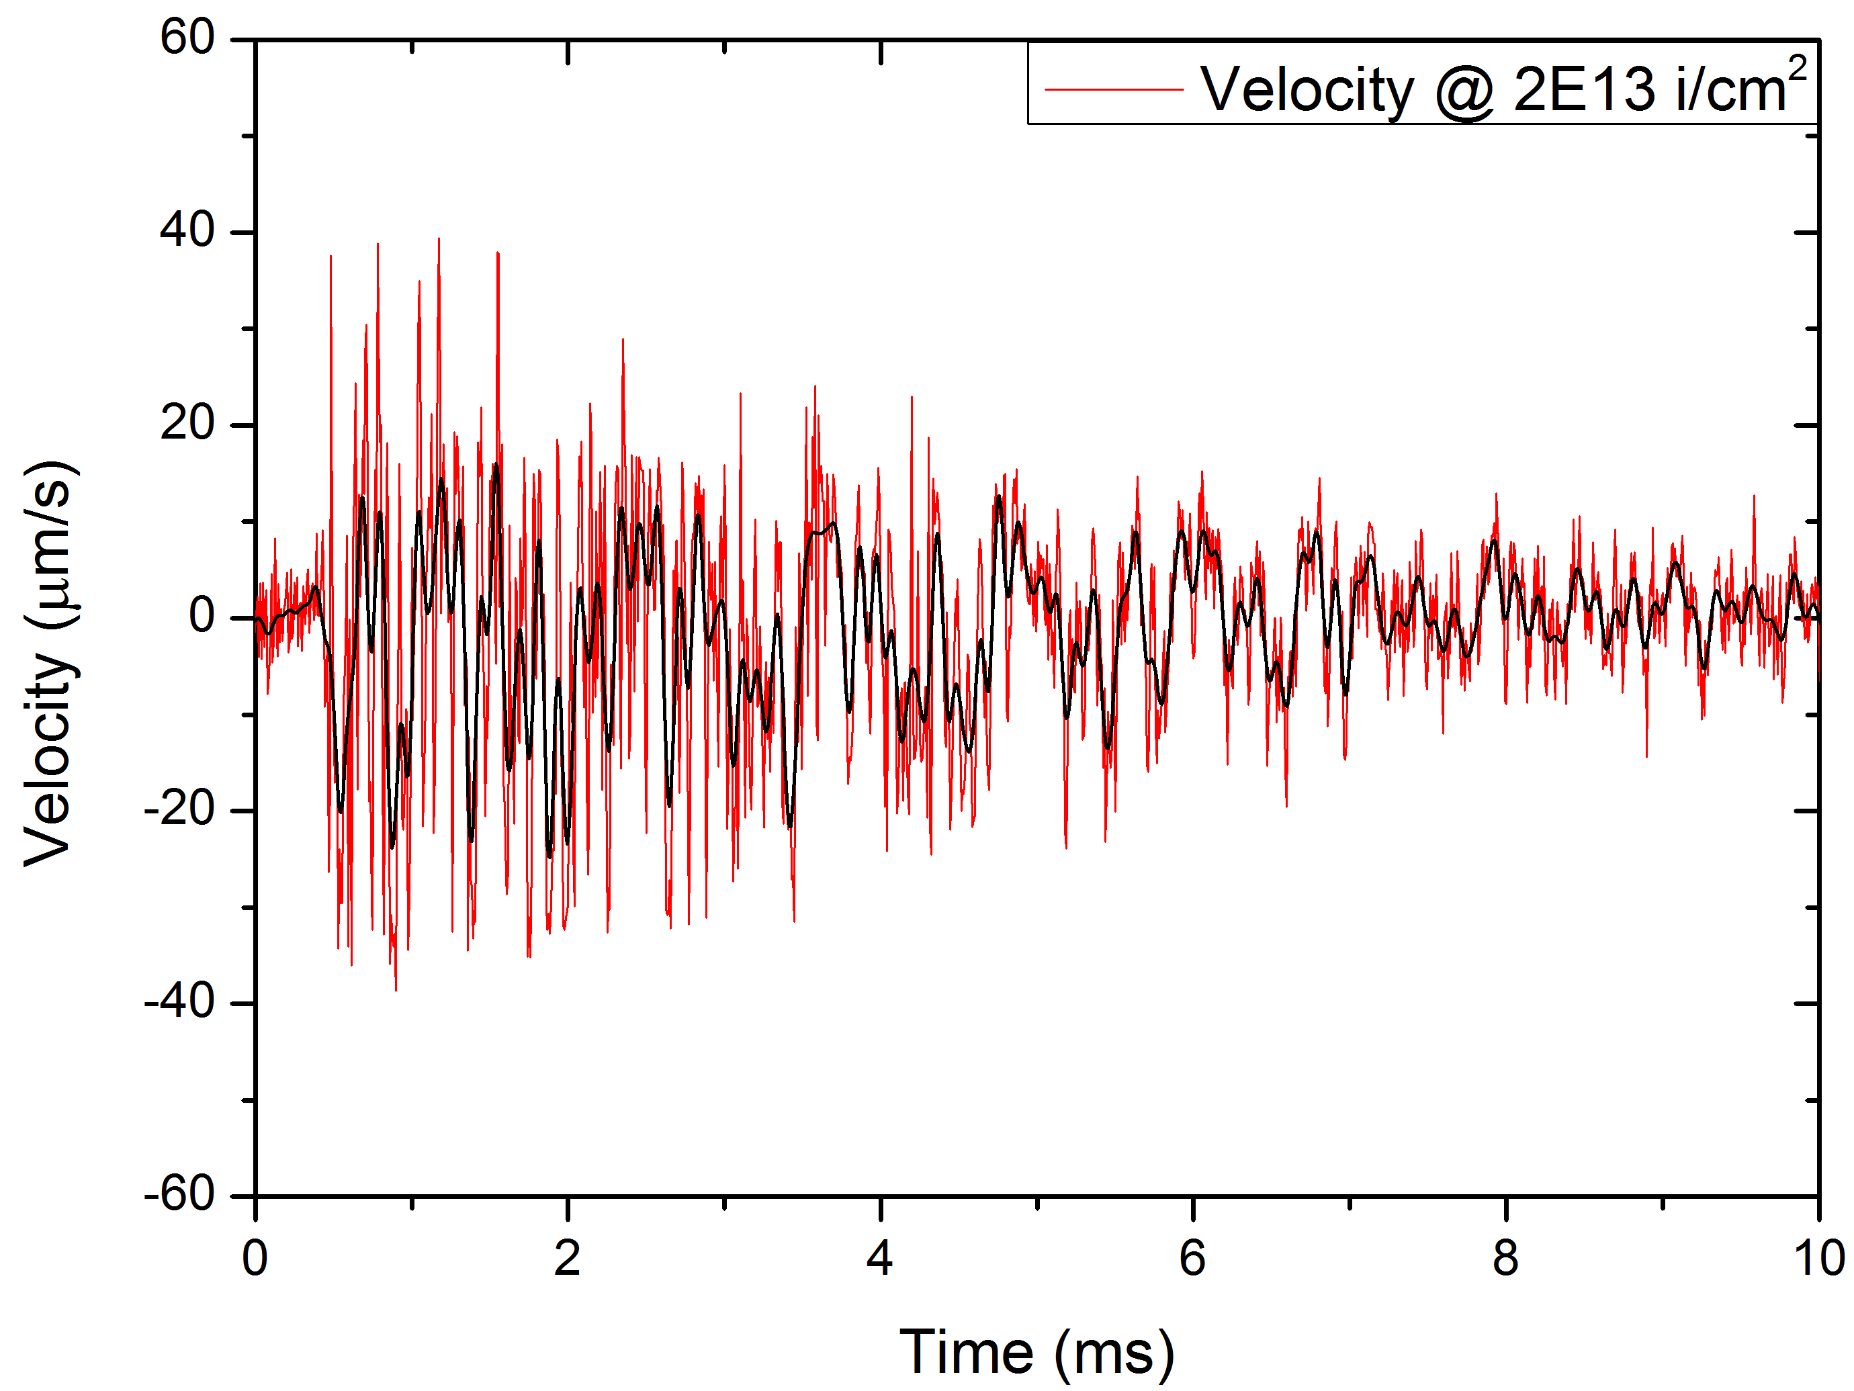
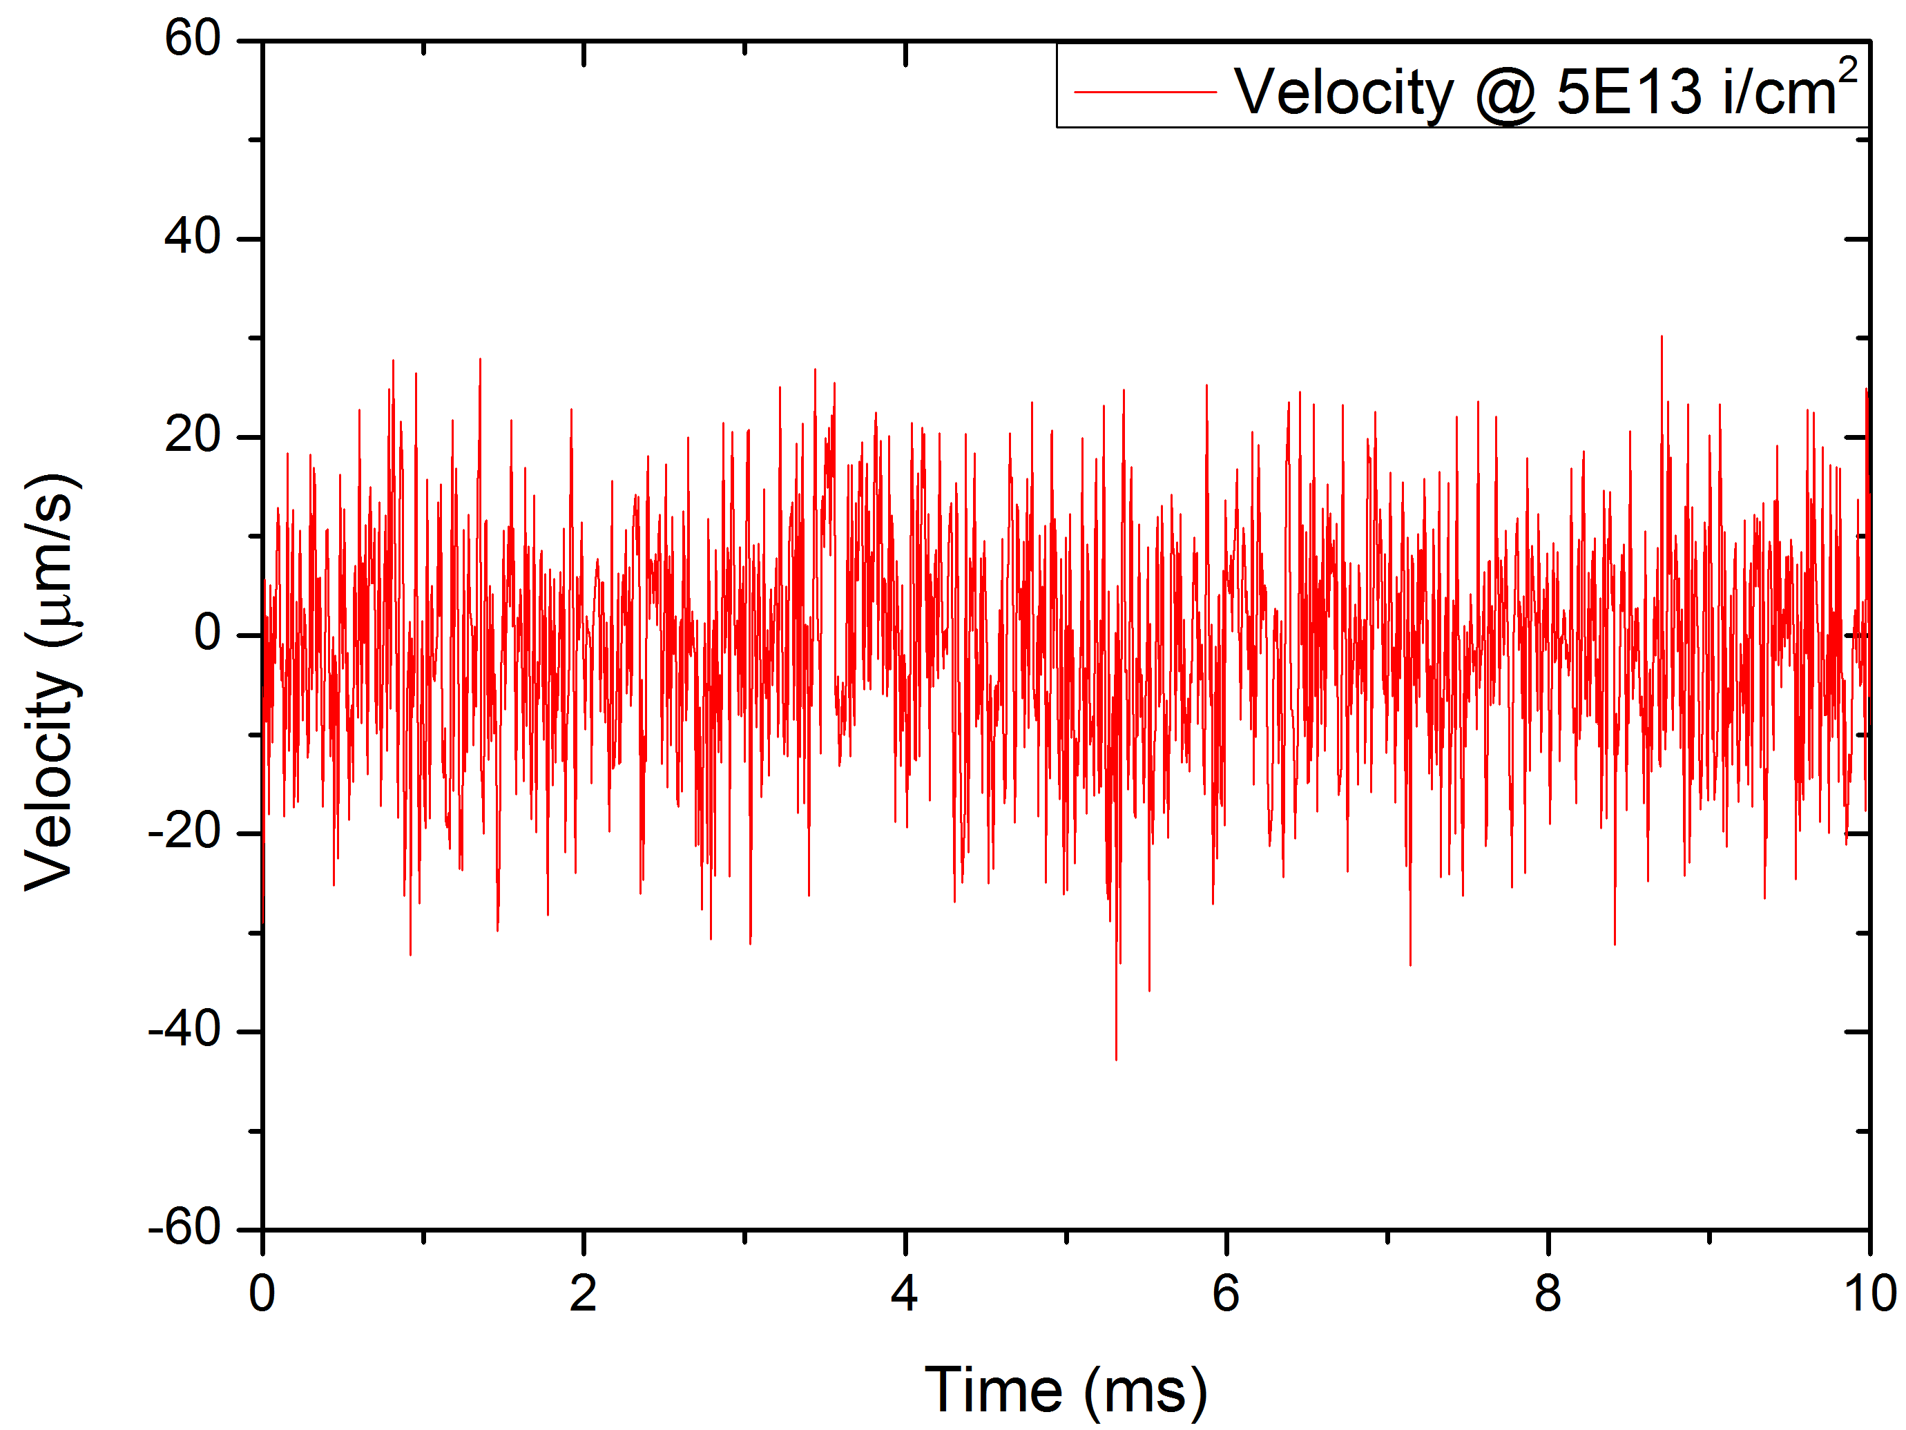
Oscillation monitoring as a function of fluence
Polycrystalline isotropic graphite 140 μm
Target failure
With radiation damage accumulation:
  Additional reflection at irradiated / non-irradiated interface
increase of frecquency
increase of damping
decrease of velocity

Slide 19
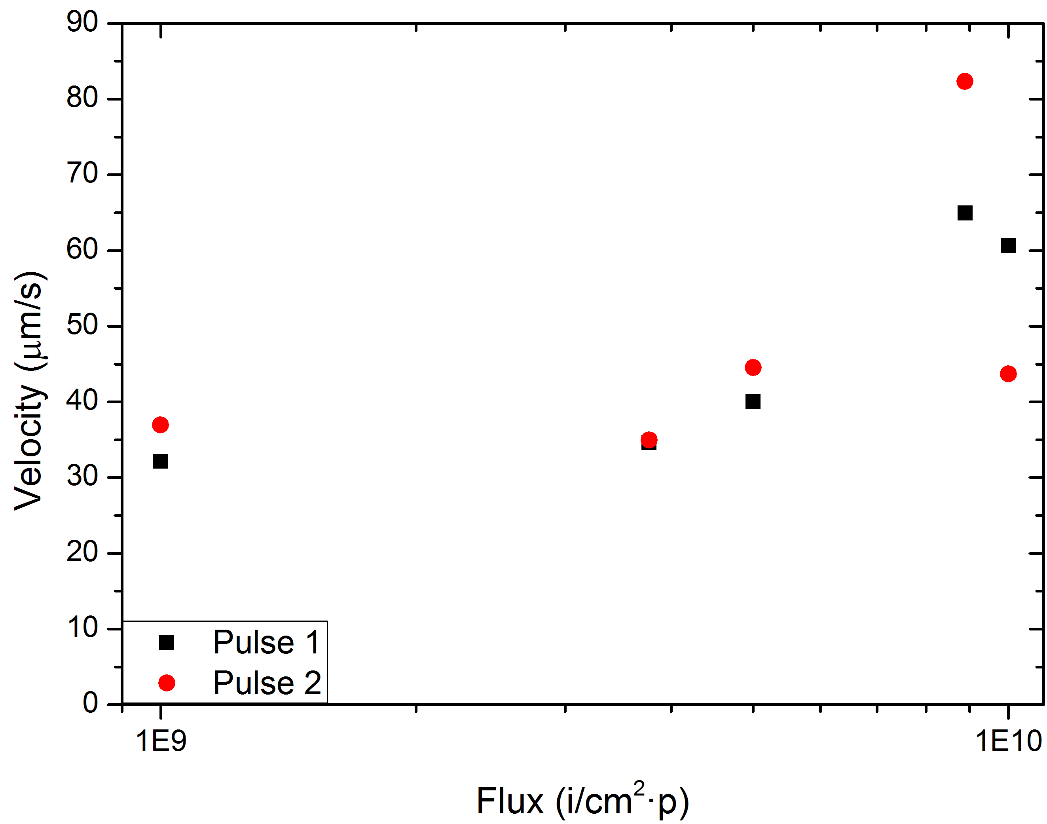
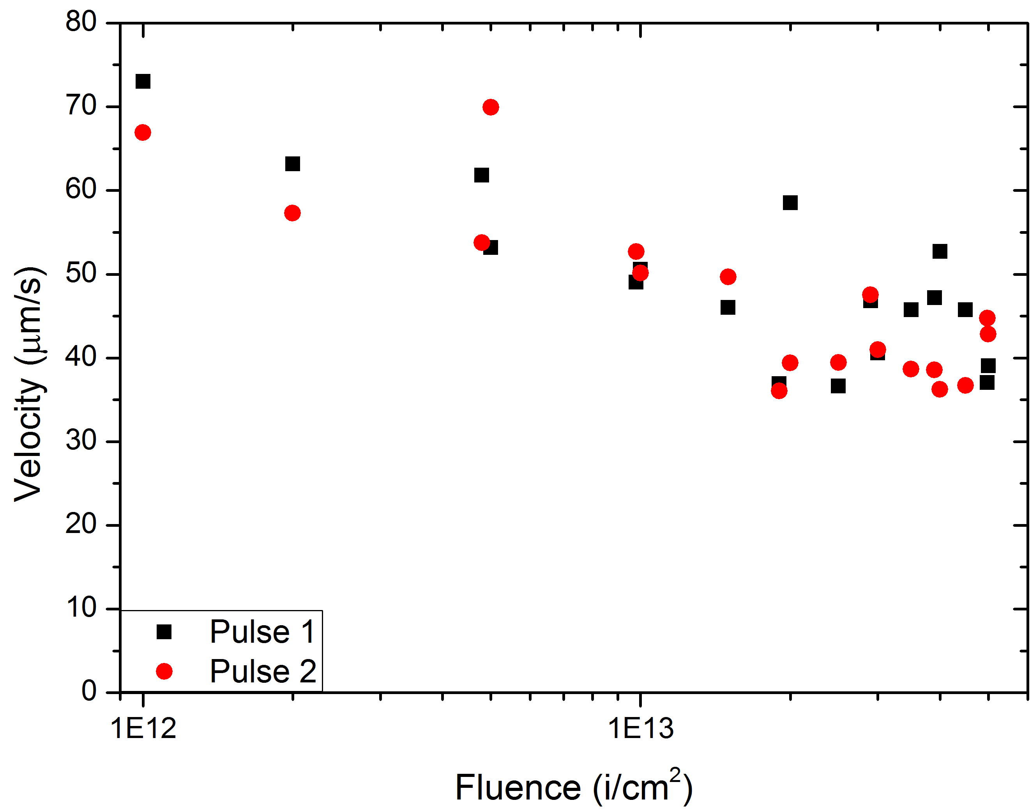
Measured maximum velocities - LDV
Decrease of maximum velocity with accumulated dose:
  Radiation damage:
  density reduction in beam spot
  internal friction
  plastic deformation processes

Slide 20
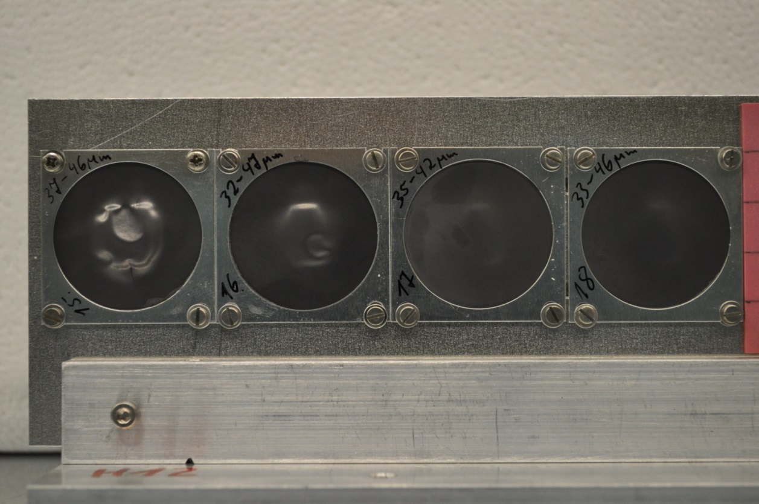
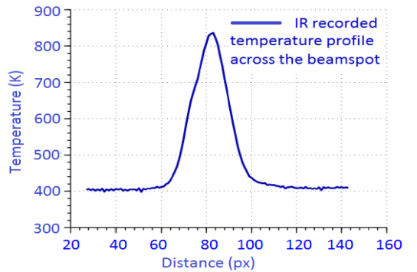
Failure of graphite exposed to pulsed GeV ²³⁸U beam
- accelerated radiation damage
²³⁸U, 1.14 GeV; 1.5 x10¹⁰ i/pulse ; 150 µs, 1 Hz
5x10¹⁴ i/cm² 10¹⁴ i/cm² 10¹³ i/cm² 5x10¹² i/cm²
radiation damage
⇨ swelling
creep
stress concentrators + fatigue ⇨ crack

Slide 21
Simulations of dynamic thermal fracture of targets in the context of radiation damage

Slide 22
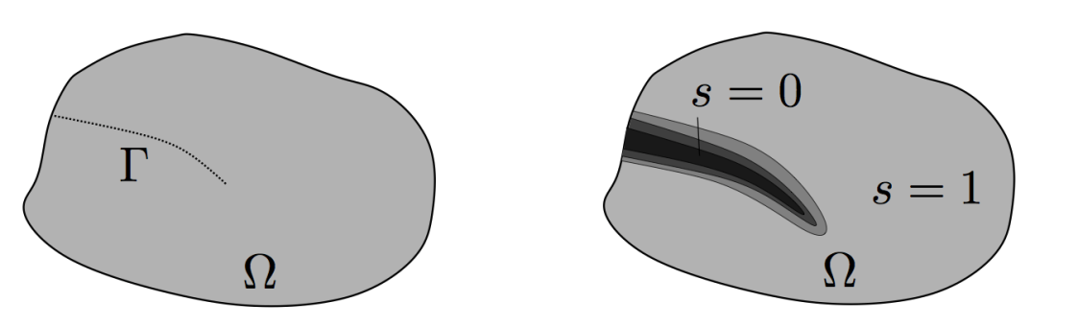
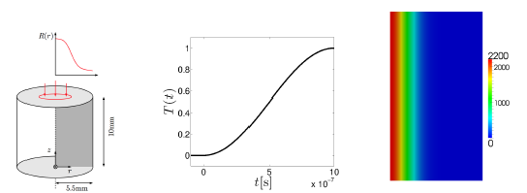

Phase field modelling of brittle fracture induced by pulsed beams
Smooth field s approximates cracks
Set of coupled PDEs determines deformation, heat transfer and fracturing

Slide 23

Fracturing of irradiated graphite cylinders at different beam-spot temperatures – Hoop stress

Slide 24


Fracturing of irradiated graphite cylinders at different beam-spot temperatures

Slide 25


Conclusions and Outlook
Dynamic response of irradiated materials to intense, short-pulse beam show in general earlier failure in the material that accumulated radiation damage
A complex puzzle has to be assembled as not all effects of accumulated dose and high beam intensity have a detrimental effect on the target lifetime
A concerted campaign, bringing together facilities for materials irradiation, materials characterization and those providing high-intensity pulsed beams, such as HiRadMat is needed
Mitigation of earlier failure by using functionally graded materials and components

Slide 26

Thank you for your attention!
Too much stress ?

