Slide 1



An Introduction to the Mechanics of Materials Interacting with Energetic Particle Beams and Their Testing
Alessandro Bertarelli
CERN, EN/MME
with contributions by F. Carra, M. Pasquali
International HiRadMat Workshop
CERN, Geneva – 10-12 July 2019

Slide 2
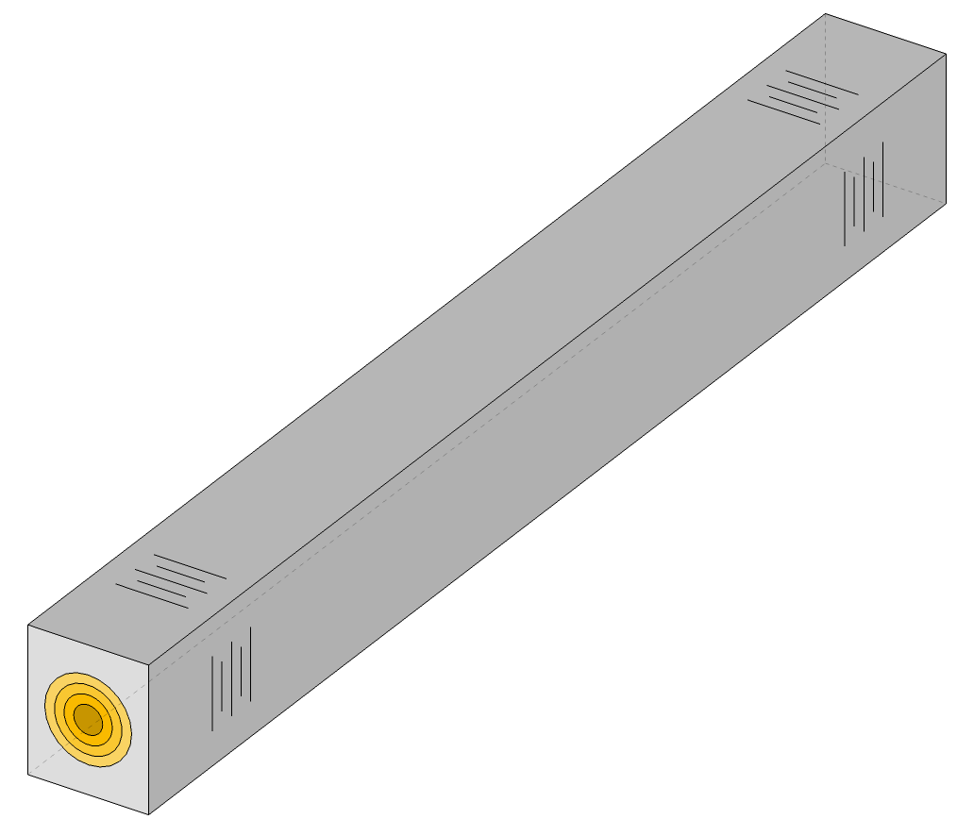
Dynamic Phenomena Induced by Rapid Heating
Thermally-Induced Dynamic Effects
Interaction of high energy, high intensity particle pulses with matter leads to sudden temperature rises (with possible changes of phase) and large thermal deformations in very short times (initially prevented by mass inertia), with propagation of intense pressure waves, possibly leading to extensive mechanical damage.
Spallation, fragmentation
Reflected waves
Liquid, gas, plasma
Longitudinal waves
Solid
(B)
Liquid, gas, plasma
Plastic deformation
p
BEAM
r
Micro-spallation, micro-jetting
A. Bertarelli, et al (2008). Dynamic Response of Rapidly Heated Cylindrical Rods: Longitudinal and Flexural Behavior, J. Appl. Mech., Vol. 75, issue 3, 031010.
A. Dallocchio (2008). Study of thermomechanical effects induced in solids by high-energy particle beams: analytical and numerical methods. CERN-THESIS-2008-140.
M. Scapin (2013). Shock-wave and high strain-rate phenomena in matter: modeling and applications. PhD thesis, 10.6092/polito/porto/2507944.
F. Carra (2017). Thermomechanical Response of Advanced Materials under Quasi Instantaneous Heating. PhD thesis, https://zenodo.org/record/1414090.
Cylindrical waves
attenuation
L. Peroni et al
(Politecnico di Torino)

Slide 3
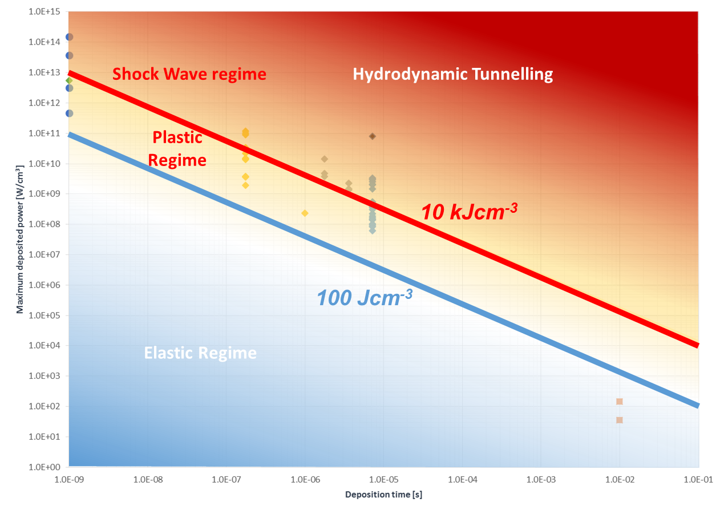
Dynamic Regimes Induced by Rapid Heating
Thermally-Induced Dynamic Effects
Structure responses depend on the intensity and duration of the energy deposition ⇒ Elastic, Plastic, Shockwave, hydrodynamic tunneling regimes…
In spite of variety in conditions and materials, threshold for energy density with (some) general validity (at least locally) can be indicatively derived …
A. Bertarelli (2016). Beam-induced damage mechanisms and their calculation. CERN Yellow Reports, v. 2, p. 159, Jan. 2016. ISSN 00078328.
< ~100 J cm-3 Elastic behavior
~100 J cm-3 to ~10 kJ cm-3 Plastic behavior
> ~10 kJ cm-3 hydrodynamic regime

Slide 4
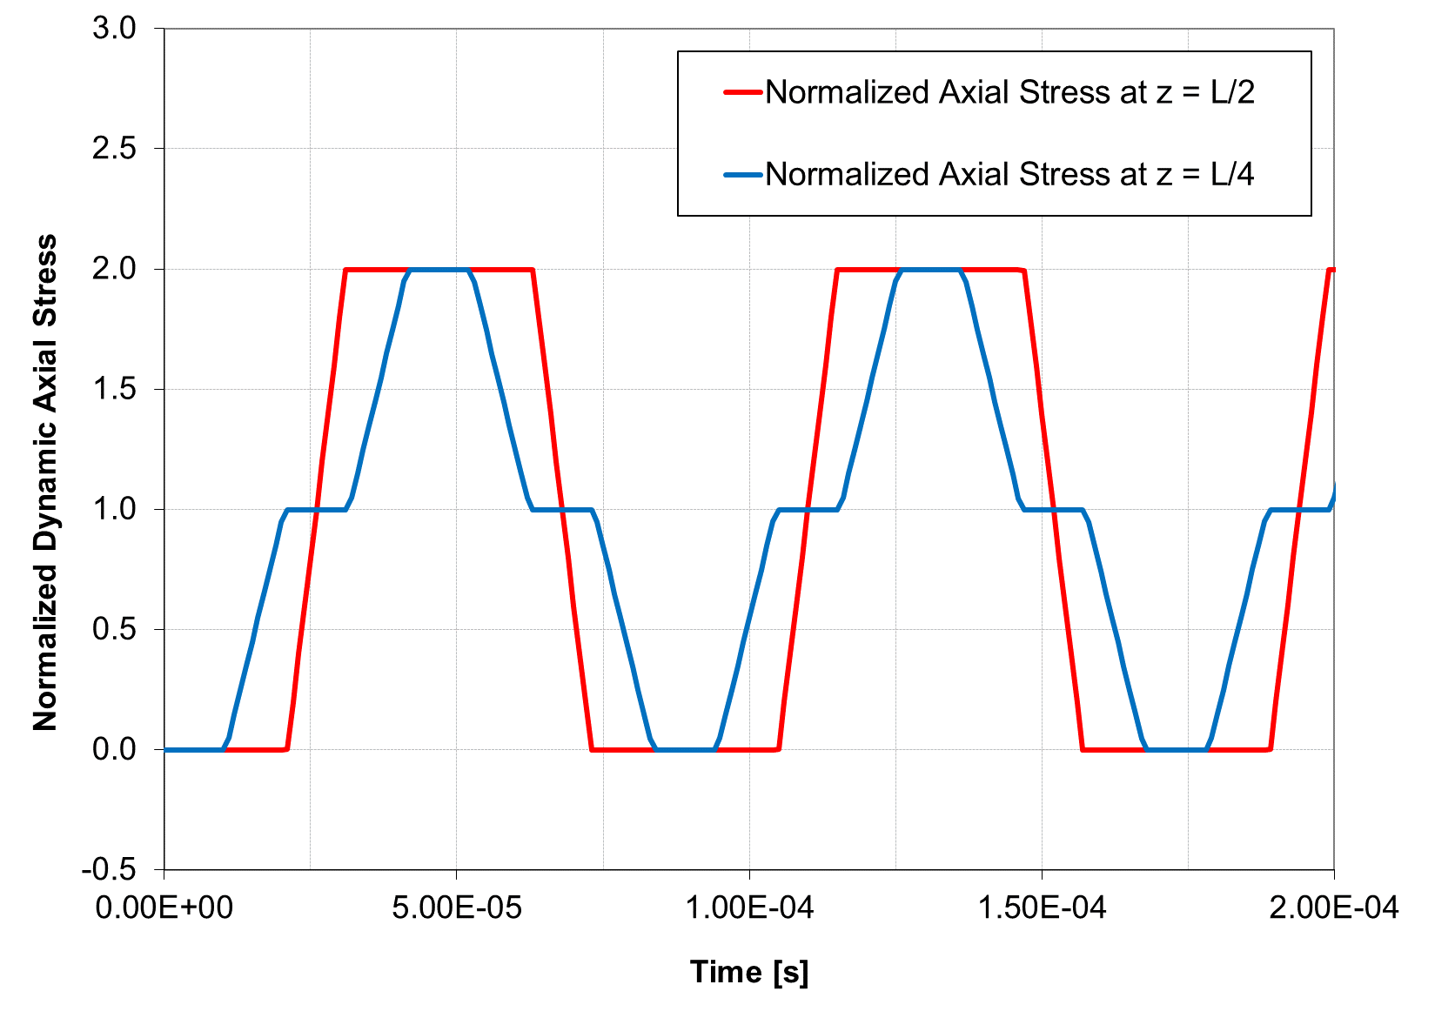
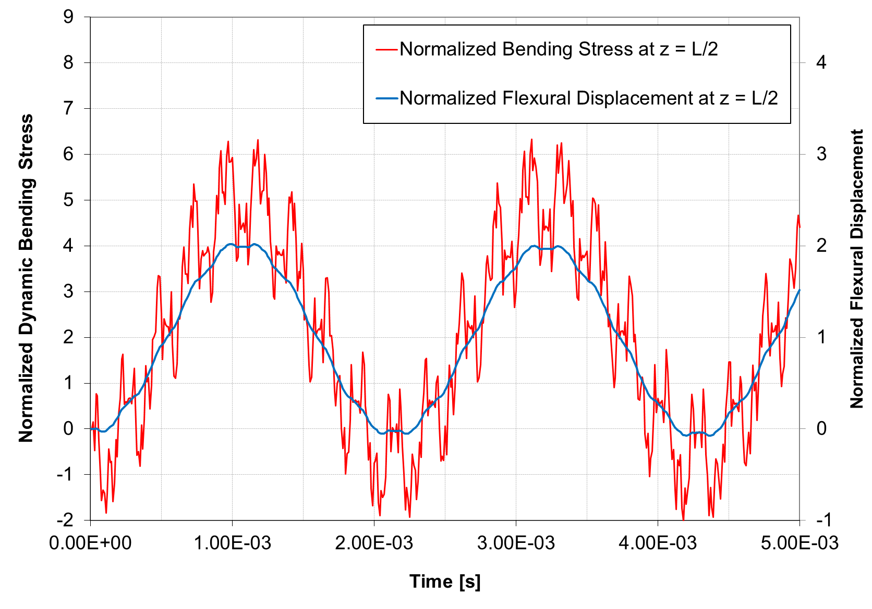

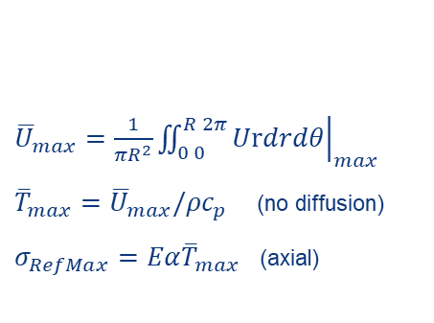


Thermally-induced Dynamics: Elastic Regime
Thermally-Induced Dynamic Effects
The elastic response can in some simple cases (slender rods) be computed analytically …
Thermal expansion of the impacted material is initially prevented by its mass inertia ⇒ purely compressive state
Dynamic response induced with stress waves departing from free rod ends
L
Offset Gaussian energy distribution $U(r,θ)$
Simply Supported Rod
$$θ$$
Beam Pulse
$$r$$
Uniform energy deposition over the length (z)
Global dynamic response of the target is governed by the total energy deposited averaged on its cross-section:
Even in elastic regime, some properties as internal damping can only be assessed experimentally …
${\overline{U}}_{max}={\left.\frac{1}{πR^{2}}\iint_{0 0}^{R 2π}{Urdrdθ}\right|}_{max}$
${\overline{T}}_{max}={\overline{U}}_{max}/{ρc}_{p}$ (no diffusion)
$σ_{RefMax}=Eα{\overline{T}}_{max}$ (axial)
A. Bertarelli, et al (2008). Dynamic response of rapidly heated cylindrical rods: longitudinal and flexural behavior. J. Appl. Mech. 75:1-13.
M. Pasquali et al. (2019). Dynamic response of advanced materials impacted by particle beams: the MultiMat experiment. Submitted to the DYMAT2019 Workshop.

Slide 5
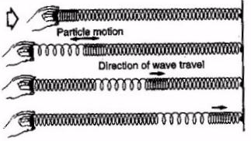
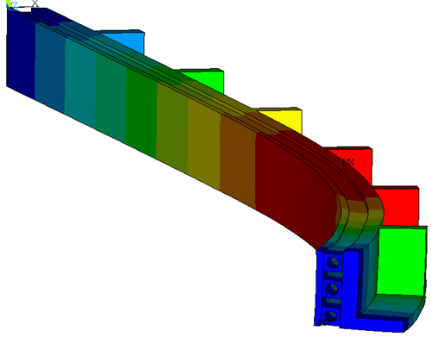
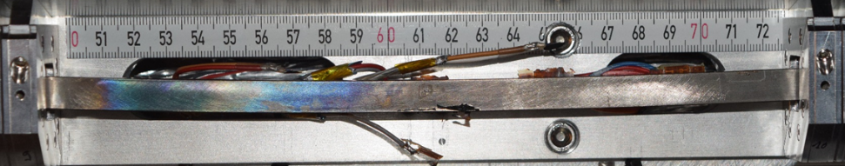

Thermally-induced Dynamics: Plastic Regime
Thermally-Induced Dynamic Effects
High-energy accelerator components are usually designed to work in the Elastic Regime …
Plane strain approximation for the propagation of stress waves
HOWEVER
Beam impact accidents can provoke permanent deformations of the component…⇨
Plastic Regime
    Small (negligible) changes in material density
    Irreversible plastic deformations
    Stress waves slower than speed of sound
In plastic regime, an implicit FEA code (e.g. ANSYS) is usually adopted to simulate structure response …
Shock
Wave
σ_{c}
Plastic Wave
Wave velocity lower than speed of sound
Stress / Pressure
Elastic
Wave
Wave travels at the speed of sound
ε_{c}
$$δmax ≅ \\ 350 μm$$
Strain / Volume Change

Slide 6
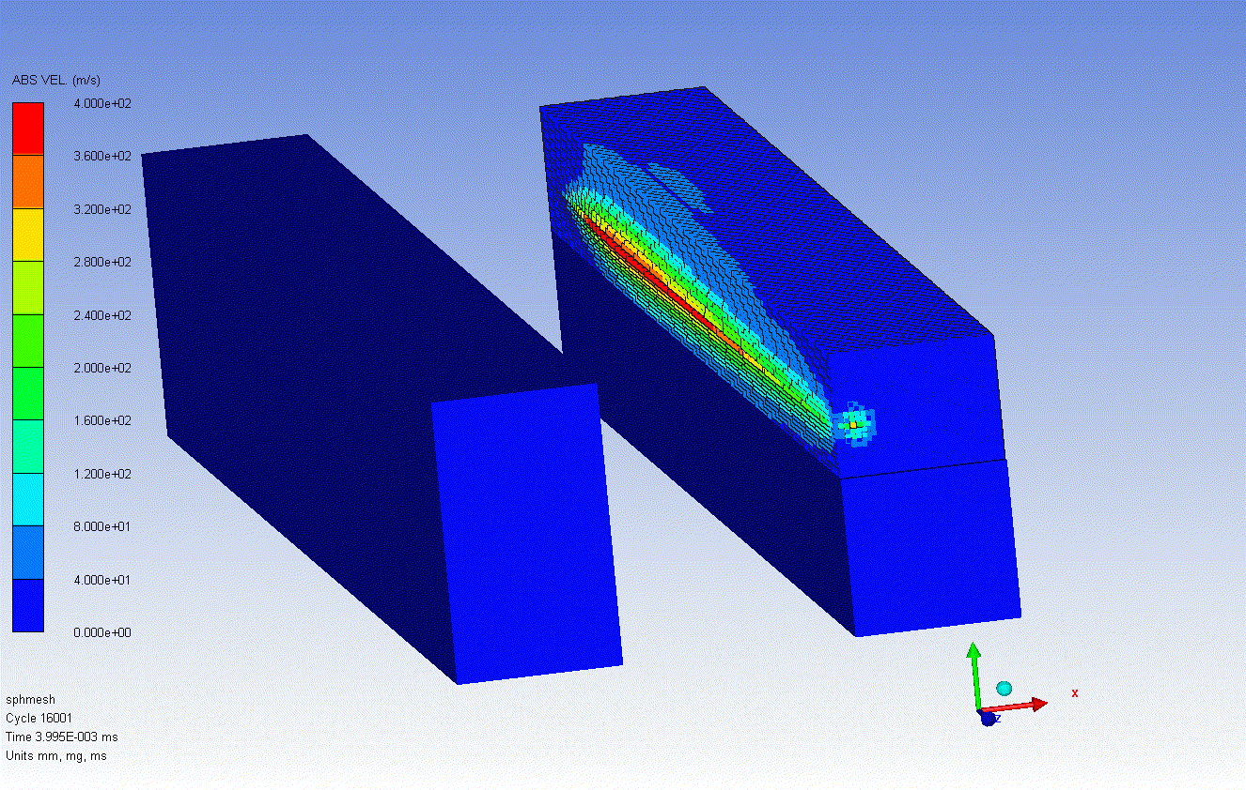
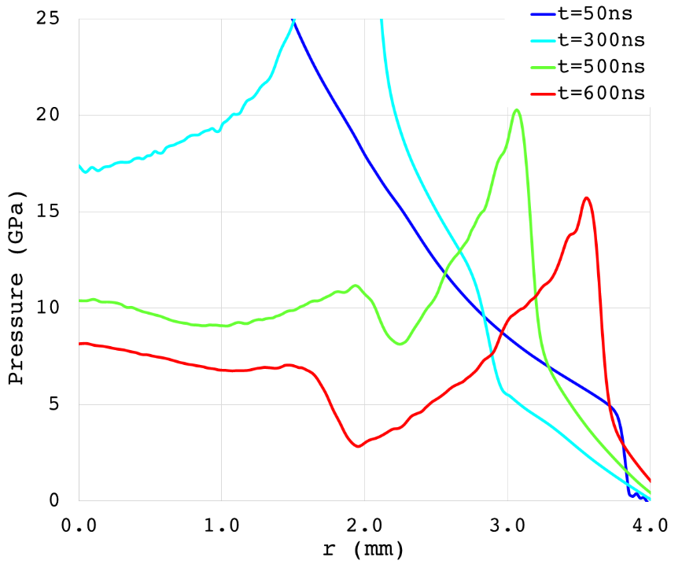
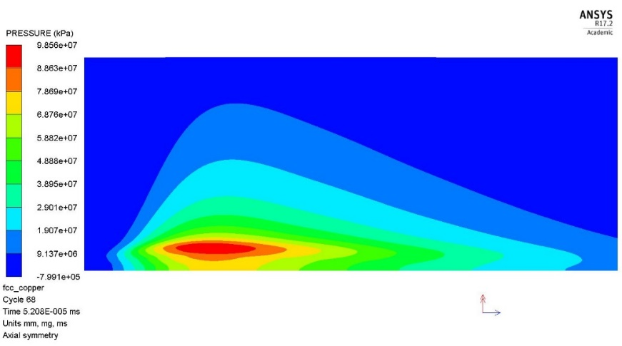
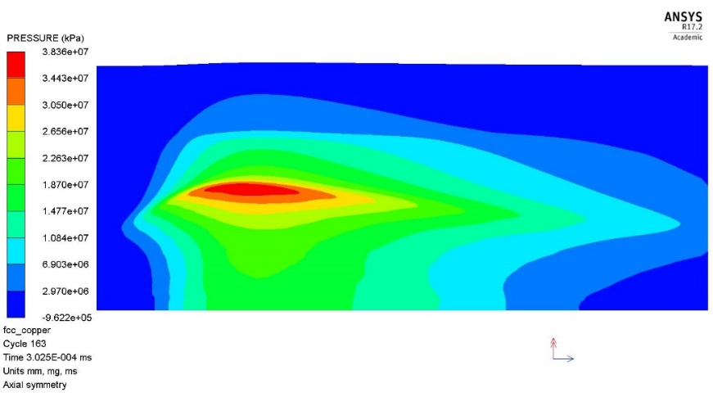
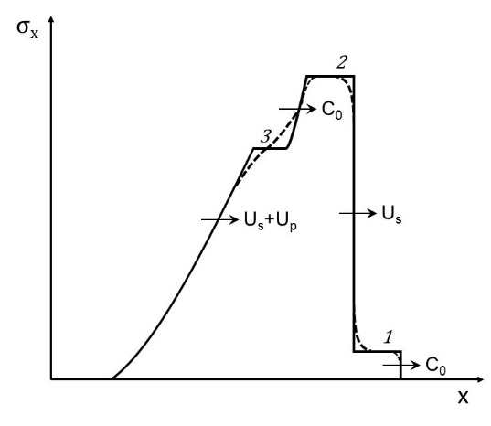
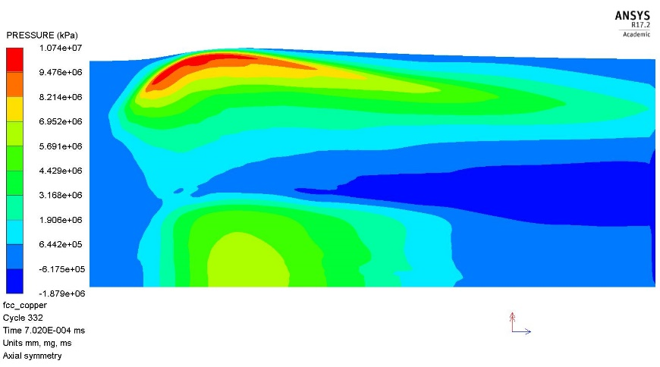
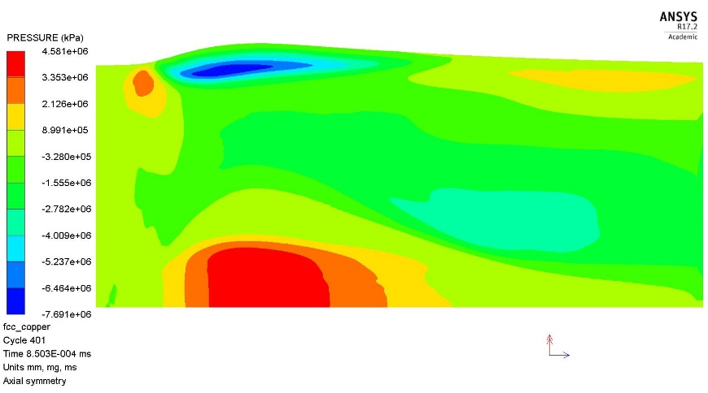
Thermally-induced Dynamics: Shockwave Regime
Thermally-Induced Dynamic Effects
When the impact induces large density and phase changes (U >> 100 kJ cm⁻³), classical Structure Dynamics approach is no longer viable.
In these regimes, materials tend to behave like fluids ⇨ Hydrodynamic approach ⇨ Hydrocodes (e.g. Autodyn, LS-Dyna …), highly nonlinear wave propagation tools
Complex material Constitutive Models are required, i.e. Equations of State, Strength Model and Failure Model which are often unavailable …
7TeV, 2e10 p impact on LHC Tertiary Collimator
Mixed Lagragian / SPH mesh
Shock front creation
1 FCC proton bunch impacting on a Cu cylinder (L = 1 m; D = 8 mm)
Pressure at t = 50ns
Pressure at t = 300ns
Pressure at t = 700ns
Pressure at t = 850ns

Slide 7
Why Experimental Tests?
Experimental Testing and Validation
Why is experimental validation important?
With accidental beam impacts, one enters a relatively unknown territory, that of high power impacts and ballistics.
When large density changes, phase transitions, fragmentations are involved, one has to resort to special advanced highly nonlinear tools (Hydrocodes).
These state-of-the-art wave propagation codes can be very reliable, provided the complex material models required are available and precise.
Material constitutive models at extreme conditions are scarce and mostly drawn from military research (classified). They are often unavailable for specific alloys and composites
Advanced and/or novel materials are required in high energy accelerators, for which characterization is incomplete or non-existing.
Even for less extreme cases, a number of time-dependent properties relevant to dynamic structural response are hardly available (e.g. high strain-rate mechanical behaviour, internal damping, viscoelastic properties …)
Additional consequences on UHV, electronics, bellows cannot be easily anticipated by numerical simulations.
Only ad-hoc in-beam material tests can provide the correct inputs for numerical analyses benchmarking simulation results on simple specimens and validate the design of complex structures.
HiRadMat (High Radiation to Materials) is the ideal facility to test materials and systems under high intensity pulsed particle beams.

Slide 8
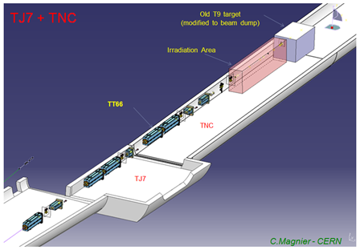
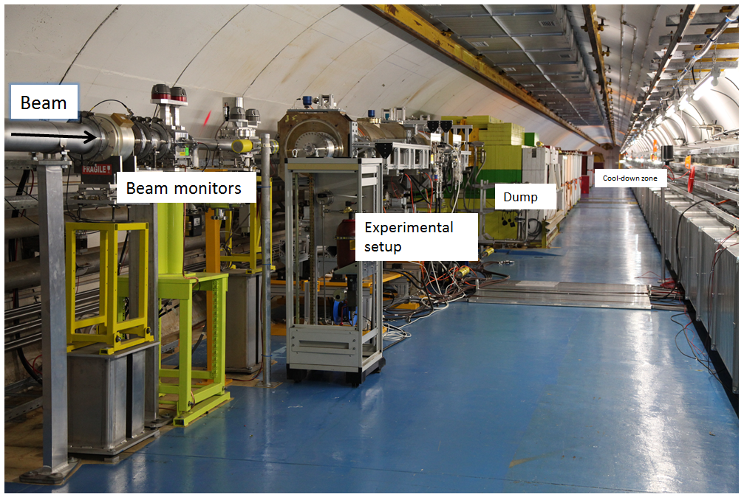

HiRadMat (High Radiation to Materials) Facility
Experimental Testing and Validation
HiRadMat offers in particular great flexibility as to pulse intensity, duration and brightness and to the type of experimental setups it can host …
This permits testing both full, complex structures, to qualify designs and small, simple specimens to benchmark simulations and disentangle various phenomena …
HiRadMat flexibility can be exploited to reach conditions exceeding those imposed by the SPS by:
  Reducing beam transverse size down to 0.25 mm (σ) to increase peak energy density $U_{max}$ which governs local damage (spallation, fragmentation, local melting …)
  Reducing sample cross-section to increase average energy density ${\overline{U}}_{max}$, hence amplifying global elastic (plastic) stress waves (which depend upon average temperature)
Y. Kadi, F. Harden, I. Efthymiopoulos (CERN)

Slide 9
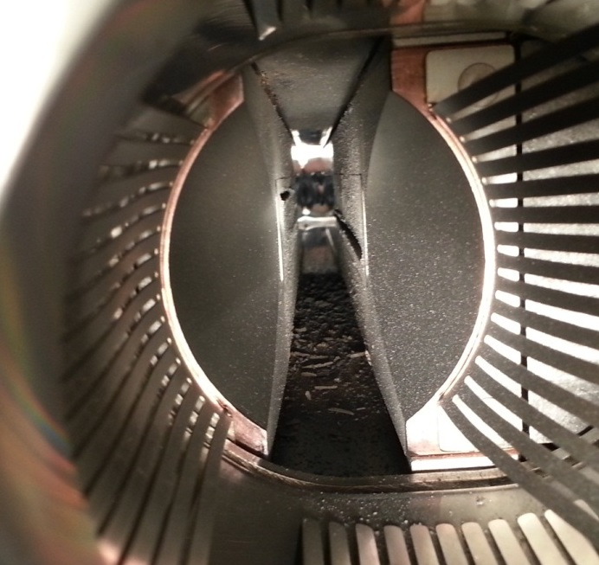
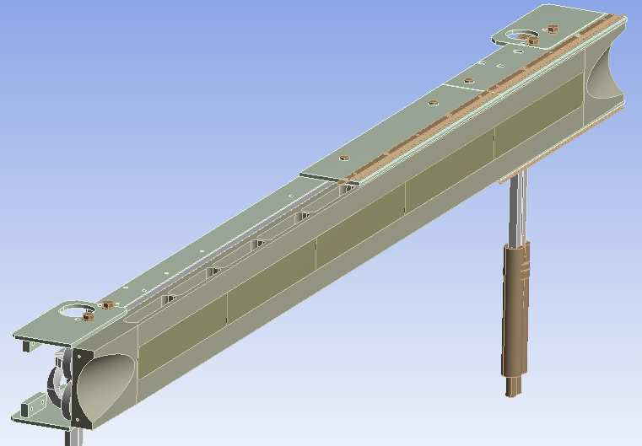
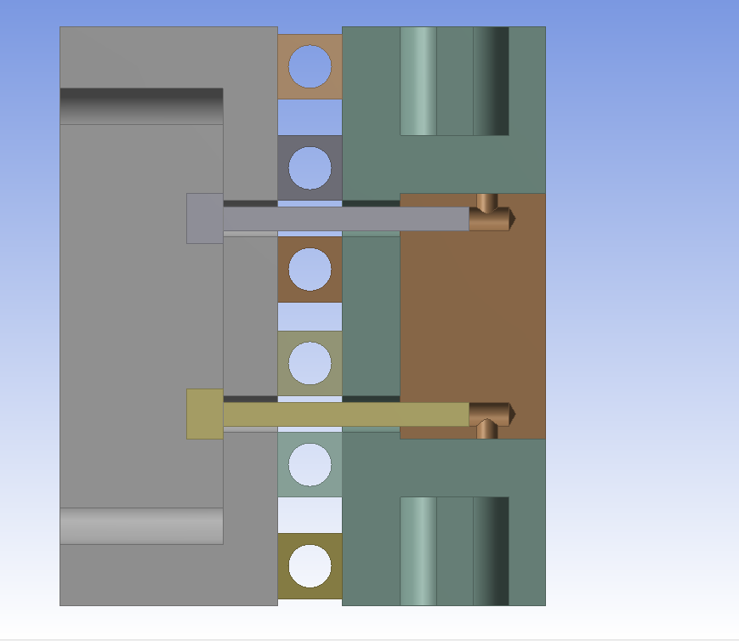

Example of Full Structure Test: HRMT09
Experimental Testing and Validation
2012 test on full LHC Tertiary Collimator (Inermet180 - Tungsten alloy as active material)
Beam size (σ_{x/y}) 0.53 × 0.36 mm²
Impact depth: 2 mm
3 impact tests (24, 6, 72 bunches)
Goal: determine damage limits for collimator
materials
Simulated with Autodyn SPH (Smooth Particle Hydrodynamics) for W core; Lagrangian
for outer parts …
Groove height
~ 1 cm
Test 1
(equivalent ~1 LHC bunch @ 7TeV)
Test 2
(Onset of Damage)
Test 3
(72 SPS bunches equivalent to ~3 LHC bunches)
Stiffener
(Glidcop
modeled as OFE-Cu)
Water
±10 mm through 5th axis
Bloc Support
(OFE-Copper)
Cooling Pipes
(Cu(89%)-Ni(10%)-Fe(1%) modeled as OFE-Cu)
Jaw bloc (x5)
(W(95%)-Ni(3.5%)-Cu(1.5%)
partly modelled as pure W)
Screw (x40)
(Stainless Steel)

Slide 10
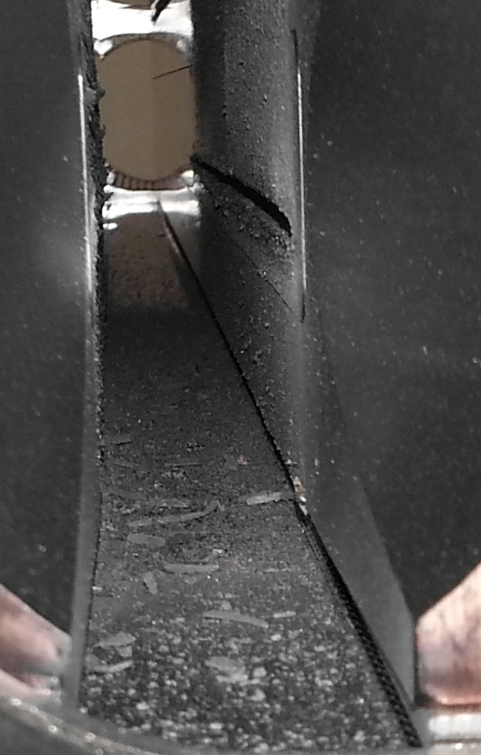
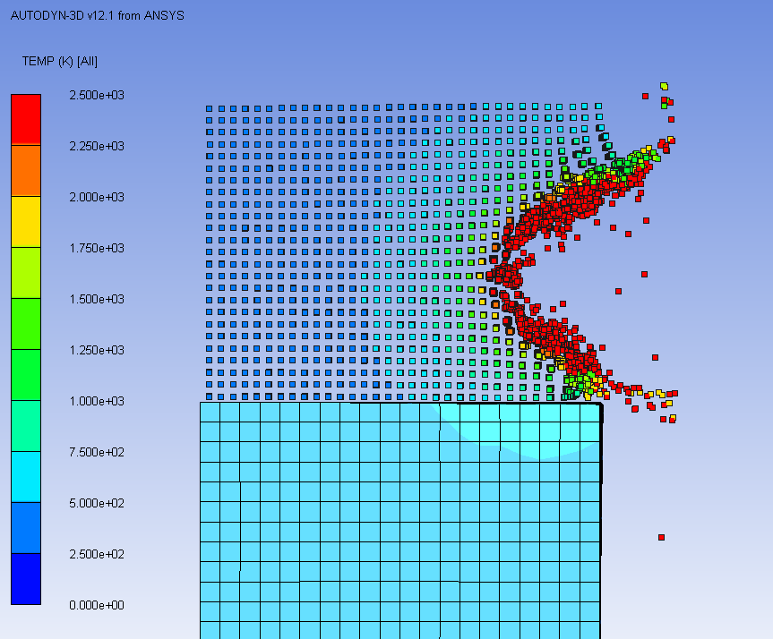
Example of Full Structure Test: HRMT09
Experimental Testing and Validation
Analysis of Test 3
Impressive quantity of tungsten alloy ejected (partly bonded to the
opposite jaw, partly fallen on tank bottom or towards entrance and
exit flanges)
Vacuum degraded. Tank contaminated
Groove height ~ 1 cm (consistent with numerical
simulations)
Groove height
~ 1 cm
Ejected W fragments
SPH scheme allowing to simulate fragmentation and droplet motion
72 bunches 440 GeV
~12 mm
Lagrangian mesh

Slide 11
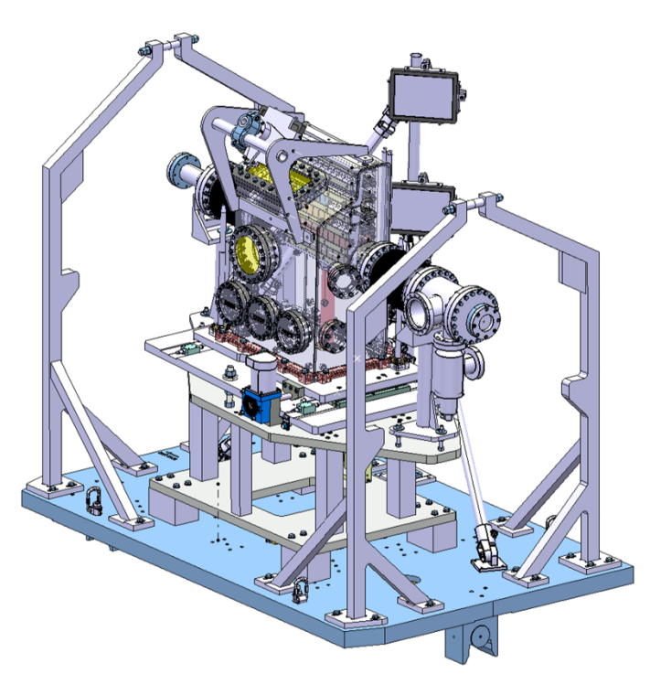
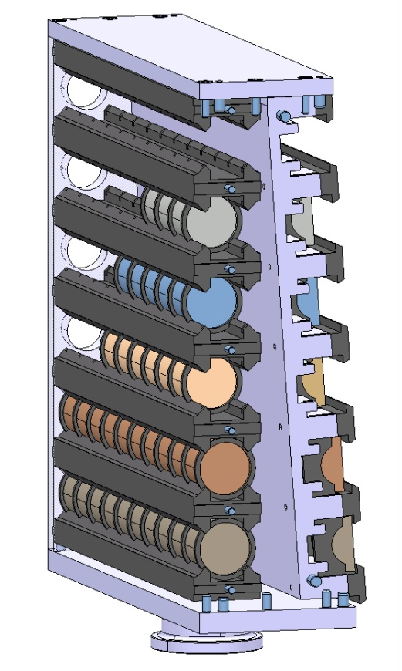
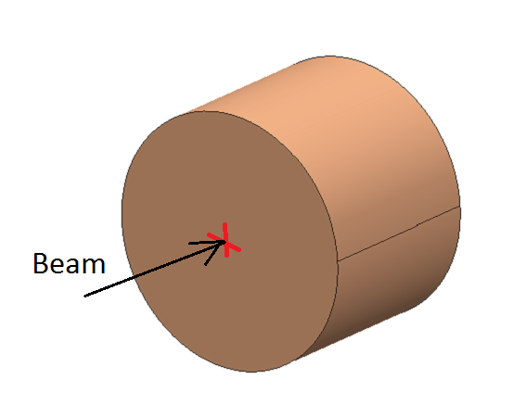
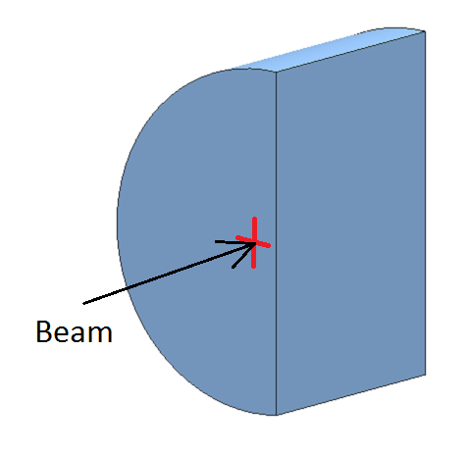
Example of test on simple specimens: HRMT14
Experimental Testing and Validation
2014 experiment featuring a movable sample holder equipped with 6 + 6 stations each hosting up to 10 specimens of two different shape for medium intensity and high intensity pulses. Main goals
Benchmark advanced numerical simulations and material constitutive models through extensive acquisition system
Characterize six existing and novel materials under development for HL-LHC Collimators: Inermet180, Molybdenum, Glidcop, MoCuCD, CuCD, MoGr
Collect, mostly in real time, experimental data from different acquisition systems (Strain Gauges, Laser Doppler Vibrometer, High Speed video Camera, Temperature and Vacuum probes)
Beam Parameters
Beam energy | 440 GeV
Number of protons per bunch | 1.1e11
Bunch Spacing | 25 ns
Medium Intensity Tests:
Sample: Ø 40 mm , L30 mm
High Intensity Tests:
Sample: half-moon;
Beam Offset 2 mm
Beam

Slide 12
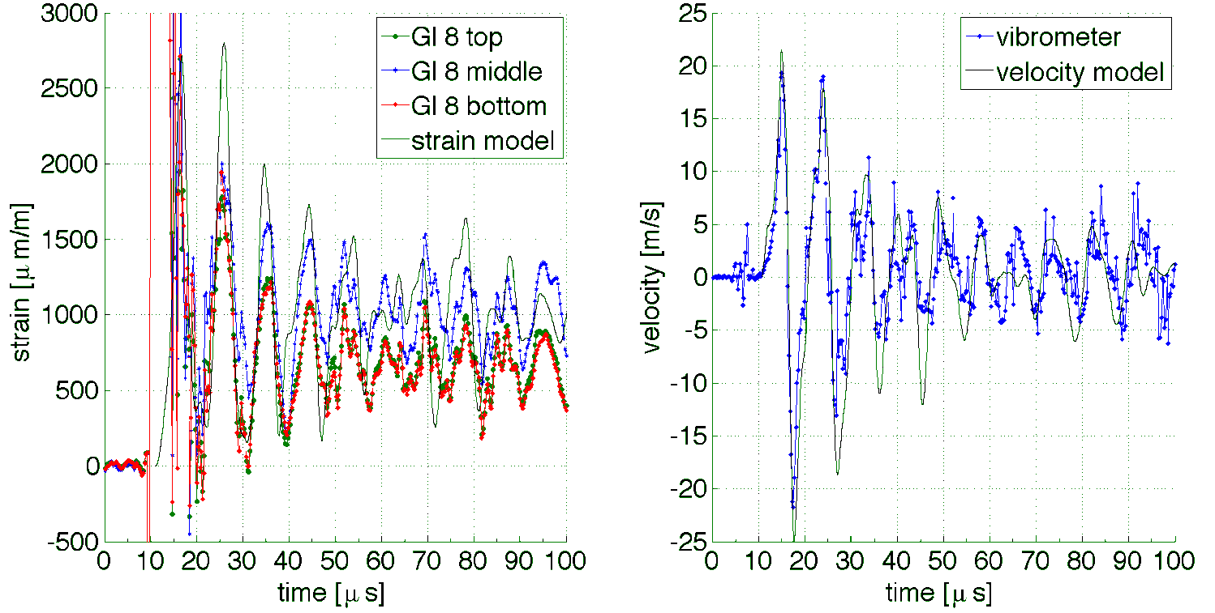
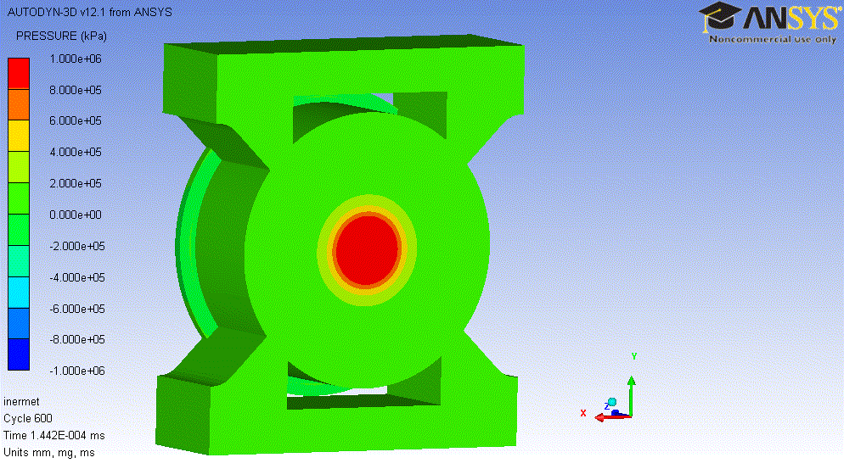
Example of test on simple specimens: HRMT14
Experimental Testing and Validation
Medium Intensity Tests
Extensive hydrocode numerical analysis (Autodyn).
Comparison of simulated circumferential strains and radial velocity with measured values on sample outer surface.
Strain Gauges
LDV
Inermet180
24 b (scraped)
Total intensity: 2.7e12 p
σ ≅ 1.4 mm

Slide 13
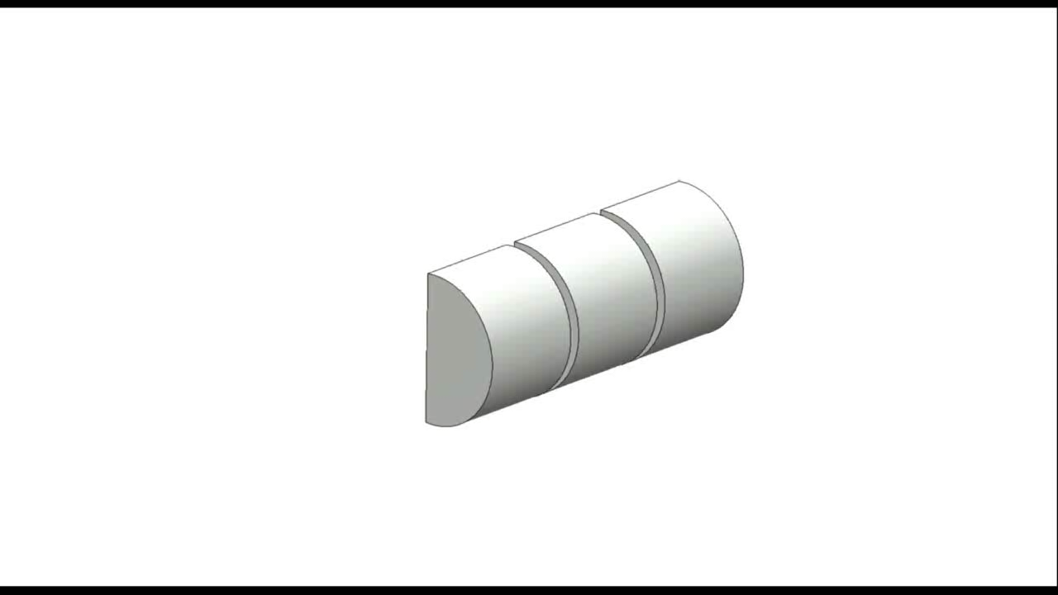
Example of test on simple specimens: HRMT14
Experimental Testing and Validation
High Intensity Tests
  Tungsten alloy samples as seen from test-bench viewport and remote fast-speed camera

Slide 14
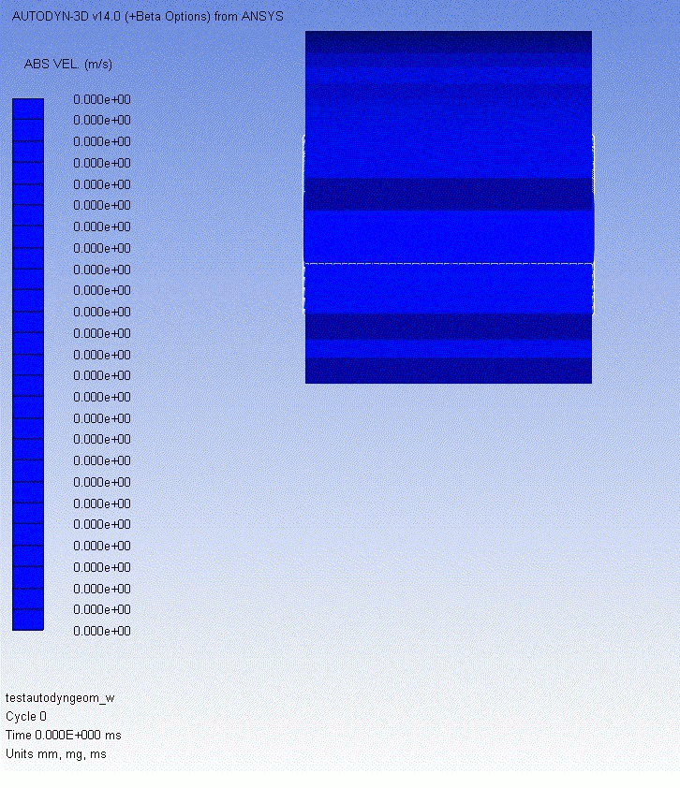
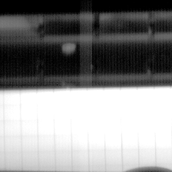
Example of test on simple specimens: HRMT14
Experimental Testing and Validation
  High Intensity Tests: Comparison between numerical simulation (SPH) and experiment
Beam
Case | Bunches | p/bunch | Total Intensity | Beam Sigma | Specimen Slot | Velocity
Simulation | 60 | 1.5e11 | 9.0e12 p | 2.5 mm | 9 | 316 m/s
Experiment | 72 | 1.26e11 | 9.0e12 p | 1.9 mm | 8 (partly 9) | ~275 m/s

Slide 15
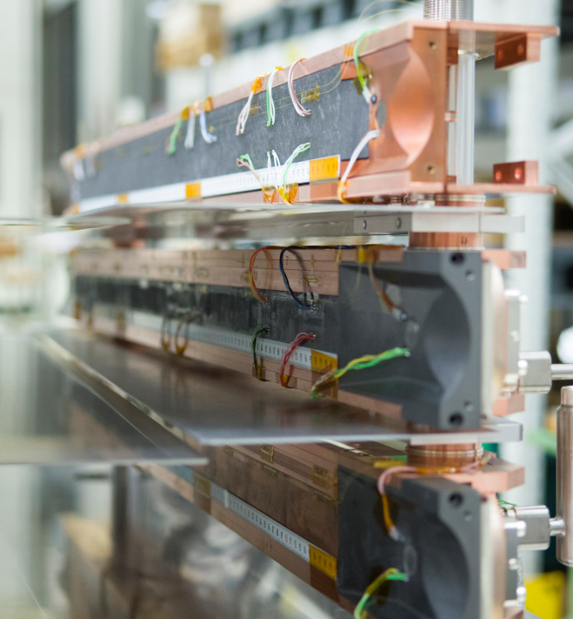
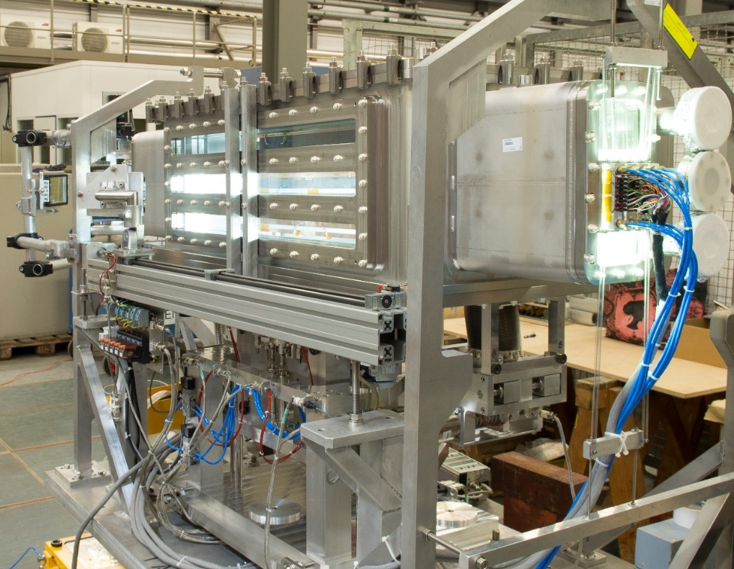
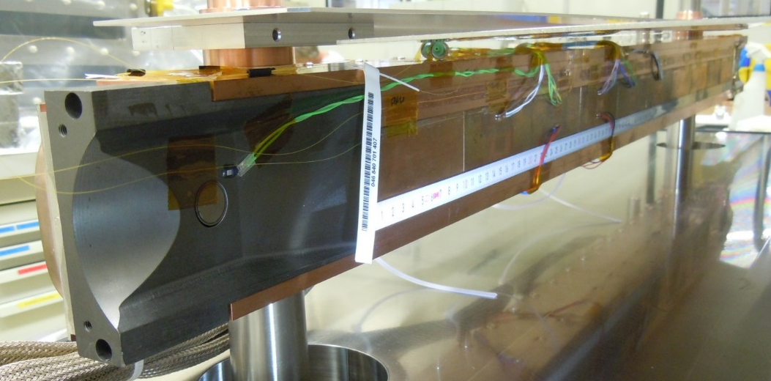

Example of Full Structure Test: HRMT23
Experimental Testing and Validation
Experiment performed in 2015 to simultaneously test 3 complete jaws (in CFC, MoGr, CuCD) of 2 different designs (LHC and HL-LHC); system equipped with comprehensive set of online sensors, viewports for optical acquisition and fast dismounting system, permitting reuse.
Allowed validation of absorber jaw materials, as well as integral HL design (taperings, BPM, housing, cooling circuit, brazing)
Achieved $U_{max}$of HL-LHC accidental cases, by squeezing the beam
For CuCD, exceeded ${\overline{U}}_{max}$ of the HL-LHC accidental case; for MoGr and CFC LIU beam is needed!

Slide 16
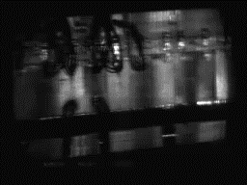
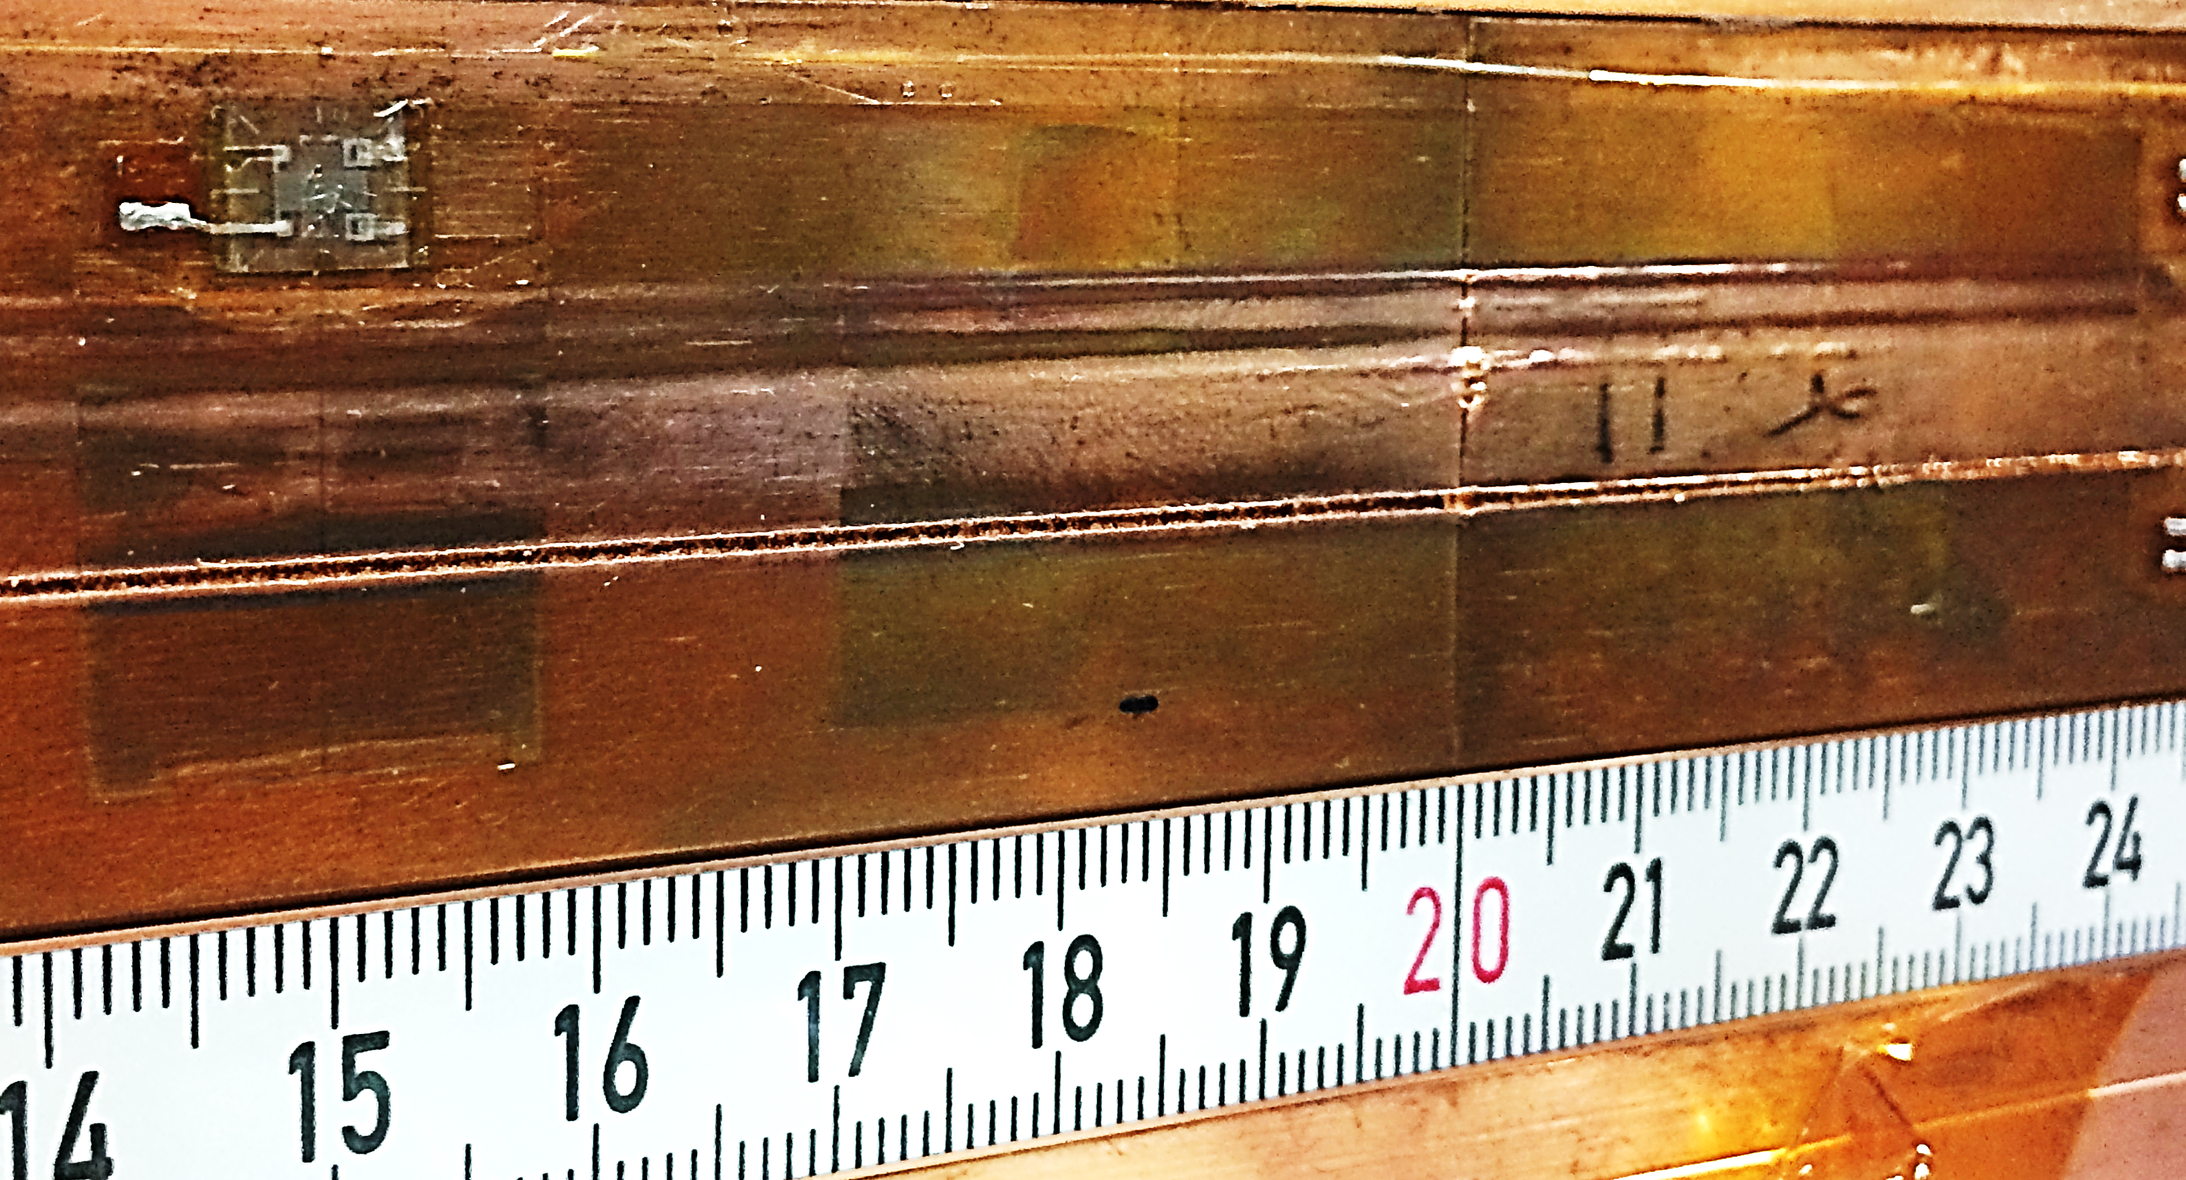


Example of Full Structure Test: HRMT23
Experimental Testing and Validation
CuCD on HL-LHC jaw survived (with a limited surface scratch on the Cu coating) the impact of 24 b, σ 0.35 mm at 440 GeV, with peak energy density ($U_{max}$) equivalent to 1 LHC bunch at 7 TeV
At 48 b (~2 LHC 7 TeV bunches) the scratch is more severe, but the jaw appears globally undeformed
This qualifies CuCD as an alternative material for TCT jaws (presently in Tungsten alloy). Local damage could be compensated by jaw shift with 5th axis.
CuCD jaw
60b, η=0.18mm
σ=0.61mm
144b, η=3.05mm
σ=0.61mm
48b, η=0.18mm
σ=0.35mm
F. Carra (2017). Thermomechanical Response of Advanced Materials under Quasi Instantaneous Heating. PhD thesis, https://zenodo.org/record/1414090.
G. Gobbi et al. (2019). Novel LHC collimator materials: High-energy Hadron beam impact tests and non-destructive post-irradiation examination. Journal of Mechanics of Advanced Materials and Structures.
F. Carra et al. (2019). Mechanical robustness of HL-LHC collimator designs. Accepted in IPAC19, Melbourne, Australia.
48 bunches on CuCD $σ=0.35mm$, $η_{x}=0.18mm$

Slide 17
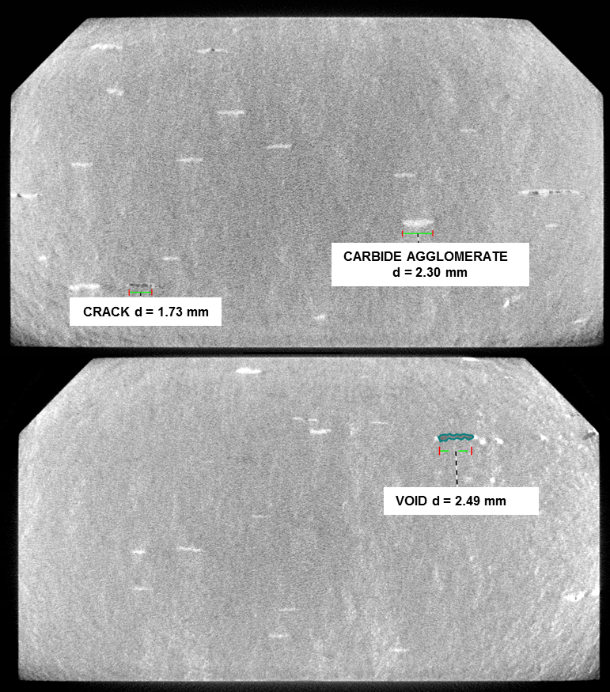
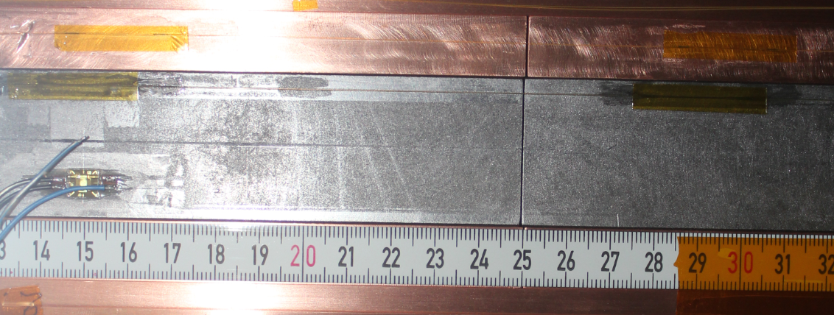
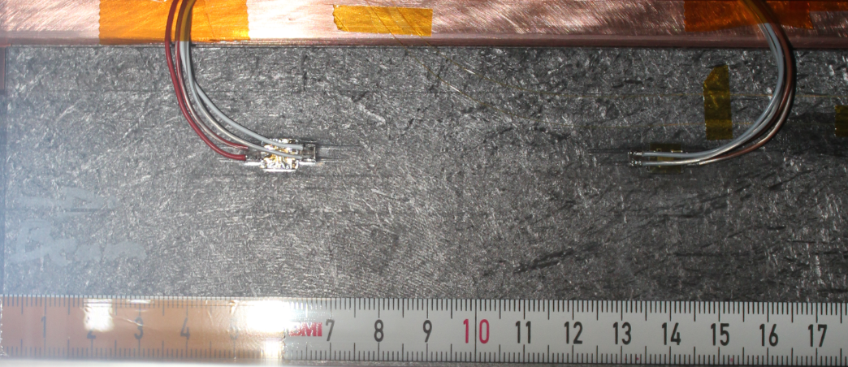
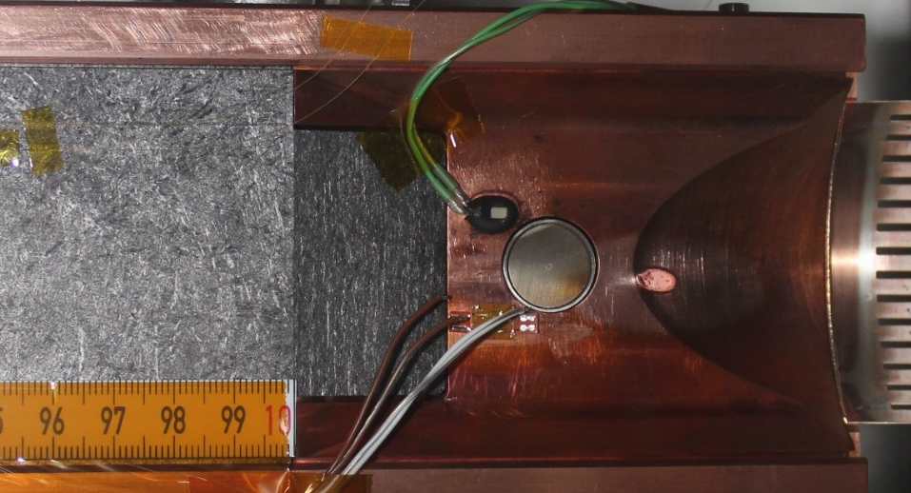

Example of Full Structure Test: HRMT23
Experimental Testing and Validation
In the case of CFC and MoGr, minor traces visible after the grazing impacts at 144 b and 288 b
Deeper impacts (even at 288b) → no damage (smaller tensile wave at surface)
No ${\overline{U}}_{max}$- induced damage on downstream blocks
Downstream Glidcop tapering locally melted, BPM button lost functionality → For HL-LHC, change to MoGr tapering and to Ti BPM
MoGr after multiple impacts
CT scan: block 2 and 1
CFC after multiple impacts

Slide 18
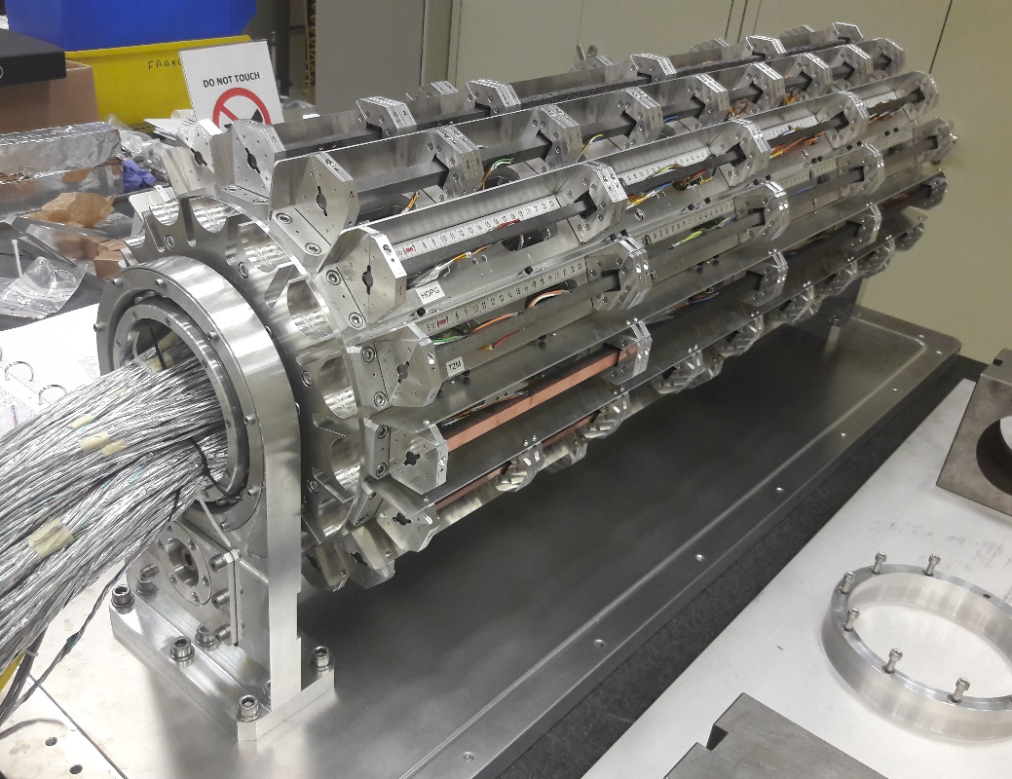
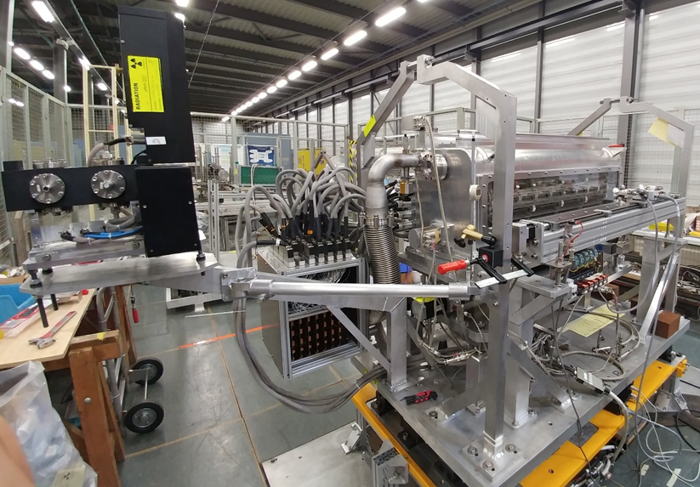
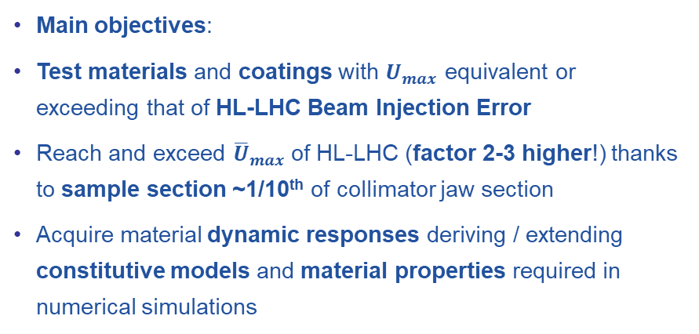
Example of test on simple specimens: HRMT36
Experimental Testing and Validation
Experiment performed in October 2017
Al vessel hosting under inert gas a rotatable barrel equipped with 16 target stations, each one embarking up to 8 slender specimens, with rectangular cross-section
18 different materials tested, ranging from ultra light C foams to W heavy alloys
MoGr, CFC and graphite coated with Mo, Cu, TiN
Platform reusable in future HRMT tests
Main objectives:
Test materials and coatings with $U_{max}$ equivalent or exceeding that of HL-LHC Beam Injection Error
Reach and exceed ${\overline{U}}_{max}$of HL-LHC (factor 2-3 higher!) thanks to sample section ~1/10th of collimator jaw section
Acquire material dynamic responses deriving / extending constitutive models and material properties required in numerical simulations

Slide 19
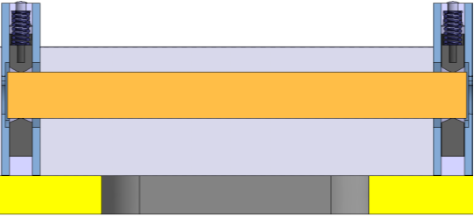
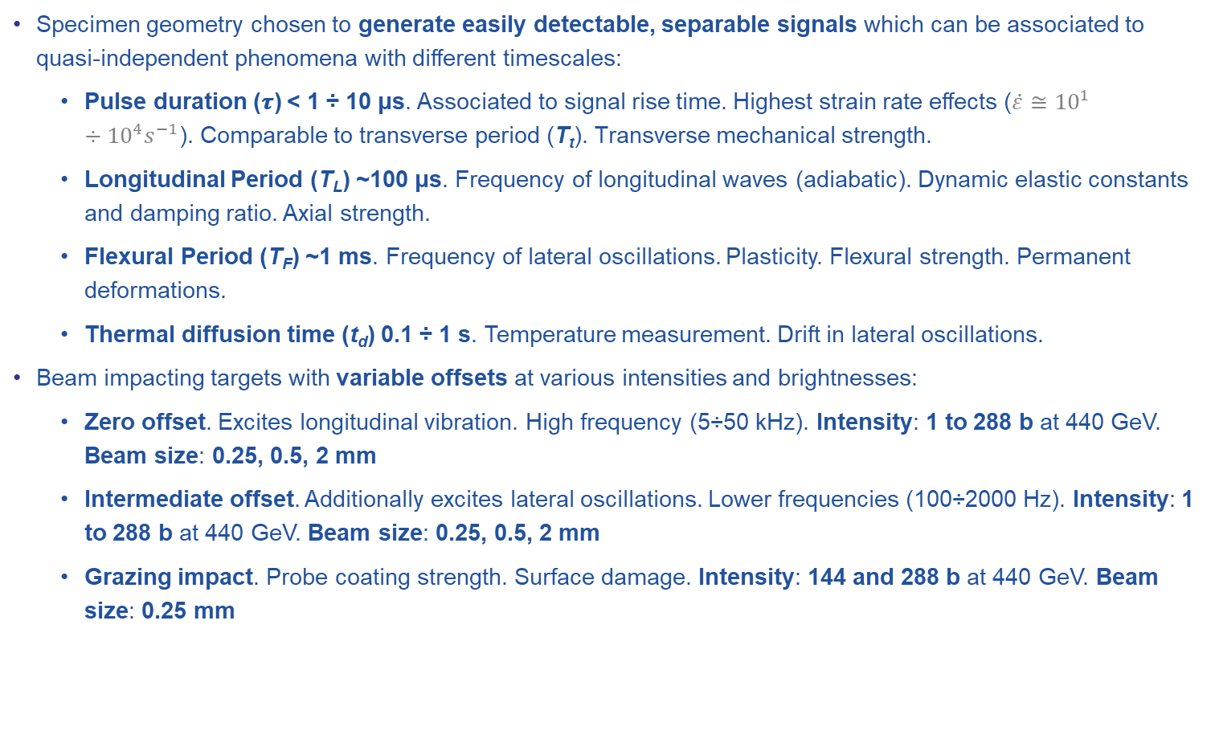
Example of test on simple specimens: HRMT36
Experimental Testing and Validation
Specimen geometry chosen to generate easily detectable, separable signals which can be associated to quasi-independent phenomena with different timescales:
  Pulse duration (𝝉) < 1 ÷ 10 μs. Associated to signal rise time. Highest strain rate effects ($\dot{ε}≅{10}^{1}÷{10}^{4}s^{−1}$). Comparable to transverse period (T_{t}). Transverse mechanical strength.
  Longitudinal Period (T_{L}) ~100 μs. Frequency of longitudinal waves (adiabatic). Dynamic elastic constants and damping ratio. Axial strength.
  Flexural Period (T_{F}) ~1 ms. Frequency of lateral oscillations. Plasticity. Flexural strength. Permanent deformations.
  Thermal diffusion time (t_{d}) 0.1 ÷ 1 s. Temperature measurement. Drift in lateral oscillations.
Beam impacting targets with variable offsets at various intensities and brightnesses:
  Zero offset. Excites longitudinal vibration. High frequency (5÷50 kHz). Intensity: 1 to 288 b at 440 GeV. Beam size: 0.25, 0.5, 2 mm
  Intermediate offset. Additionally excites lateral oscillations. Lower frequencies (100÷2000 Hz). Intensity: 1 to 288 b at 440 GeV. Beam size: 0.25, 0.5, 2 mm
  Grazing impact. Probe coating strength. Surface damage. Intensity: 144 and 288 b at 440 GeV. Beam size: 0.25 mm

Slide 20
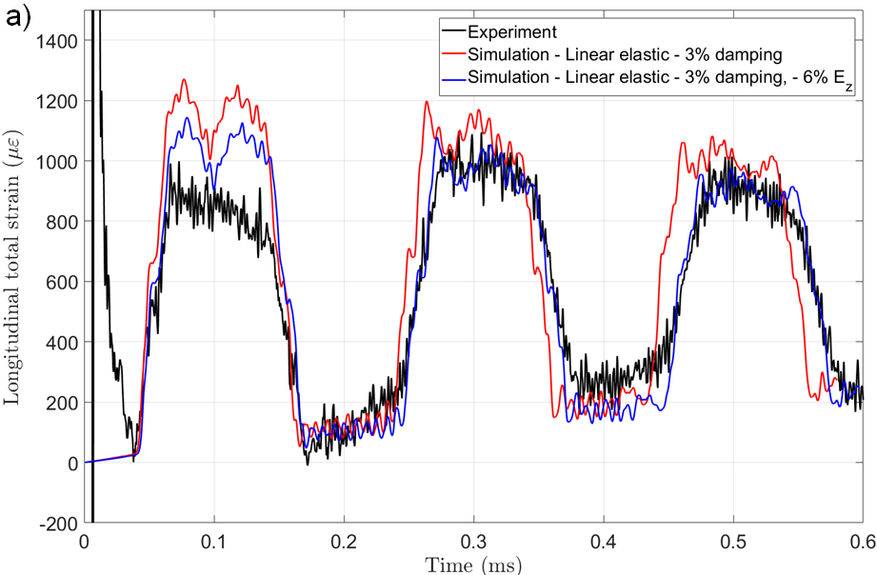
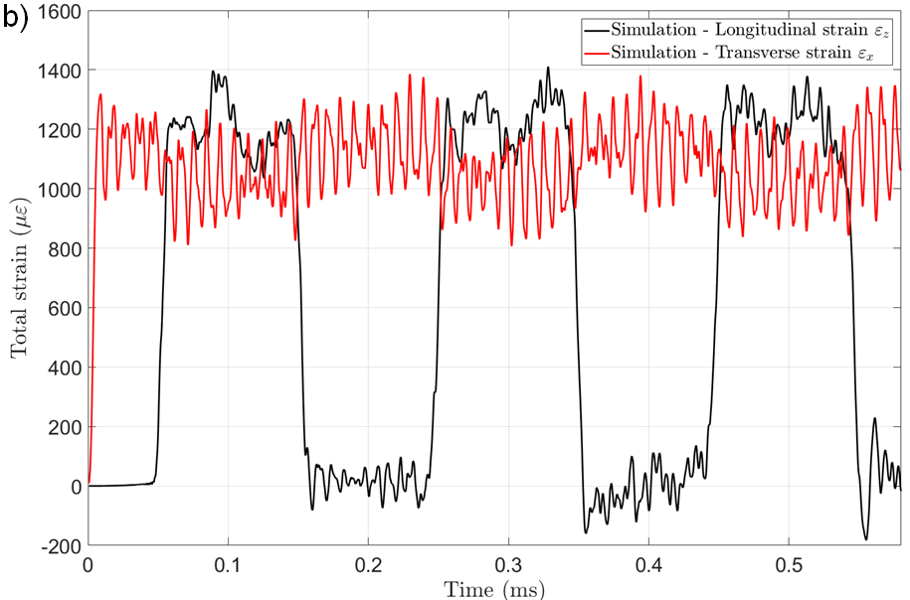




Example of test on simple specimens: HRMT36
Experimental Testing and Validation
Analysis of results:
Good agreement with simulations
Elastic constants of several materials updated
Role and extent of internal damping assessed
All carbon-based materials survived impacts at HL-LHC ${\overline{U}}_{max}$
Surface damage induced on coatings at $U_{max}$ exceeding HL-LHC: larger in Cu coatings (lower melting point), smaller in Mo and TiN. Damaged stripes ~ 1÷3 mm wide
Plastic permanent deflections induced in some high-Z
materials
Some unexpected failures (SiC and TZM) recorded

Slide 21



Example of test on simple specimens: HRMT36
Experimental Testing and Validation
On top of observing the onset of damage related to $U_{max}$(upstream samples), onset of damage related to ${\overline{U}}_{max}$ (downstream) was also determined
Sample section ~1/10 of collimator block section → increased ${\overline{U}}_{max}$
Appearing on samples with ${\overline{U}}_{max}$ 2.5 higher than HL-LHC accidents
Samples with ${\overline{U}}_{max}$ equal to HL-LHC → below onset of damage
F. Carra et al. (2017). The “Multimat” experiment at CERN HiRadMat facility: advanced testing of novel materials and instrumentation for HL LHC collimators. J. Phys.: Conf. Ser., Vol 874, Issue 1.
A. Bertarelli et al. (2018). Dynamic testing and characterization of advanced materials in a new experiment at CERN HiRadMat facility. J. Phys.: Conf. Ser.1067 082021.
M. Pasquali et al. (2019). Dynamic response of advanced materials impacted by particle beams: the MultiMat experiment. Submitted to the DYMAT2019 Workshop.
F. Carra et al. (2019). Mechanical robustness of HL-LHC collimator designs. Accepted in IPAC19, Melbourne, Australia.
MoGr sample n. 8
(highest average energy density per section)

Slide 22




Example of test on simple specimens: HRMT36
Experimental Testing and Validation
Grazing impact. Probe coating strength (Cu, Mo, TiN) and surface damage.
Smallest available beam size (0.25×0.25 mm²) at max bunch intensity (1.4e11 p/b) Impacts at 144 (on Cu) and 288 b (all) at different depth (150 µm and 500 µm)
U_{MAX}=6.11 kJ/cm³ (bulk)
U_{MAX}=13.9 kJ/cm³ (coat.)
σ_{real} =0.29x0.31 mm
288 b, σ_{nom} 0.25 mm, impact -500 µm
288 b, σ_{nom} 0.25 mm, impact -150 µm
U_{MAX}=3.72 kJ/cm³ (bulk)
U_{MAX}=14.3 kJ/cm³ (coat.)
σ_{real} =0.38x0.23 mm
288 b, σ_{nom} 0.25 mm, impact -150 µm
288 b, σ_{nom} 0.25 mm, impact -500 µm

Slide 23
Summary
Conclusion
High energy particle accelerators handle beams with extremely high destructive potential in case of interaction with matter
The analysis of beam-matter interaction involves several disciplines and requires a multiphysics approach
When interaction phenomena do not lead to extensive changes of density or phase transitions, material response can be analysed with a good degree of approximation by classical thermoelasticity principles
Otherwise, advanced nonlinear tools (hydrocodes) must be invoked: these numerical codes rely on complex material constitutive models encompassing the full range of states of matter
Only dedicated, carefully designed experiments in ad-hoc facilities such as HiRadMat can benchmark advanced numerical simulations and provide the final validation for systems potentially exposed to interaction with highly energetic beams
The flexibility of HiRadMat allows to perform tests on full, large structures as well as on small, simple specimens, providing results of interest well beyond the High Energy Physics community
It is possible, playing with beam brightness and sample cross sections, to reach peak energy densities and average energy densities exceeding those expected in HL_LHC …
… however, only an upgrade of the facility operating with full LIU beams can allow to test full equipment to be operated in HL-LHC, further enhancing this key asset for the Particle Accelerator community and beyond …

Slide 24

The research leading to these results has received funding from the European Commission under the FP7 Research Infrastructures project EuCARD-2, Grant Agreement 312453 and HiLumi LHC Design Study, Grant Agreement 284404.
alessandro.bertarelli@cern.ch

Slide 25






High Energy Particle Accelerators Challenges
Introduction
Particle beams have reached unprecedented energy and energy density (363 MJ for the LHC, 690 MJ for its High Luminosity upgrade (HL-LHC)).
Beam-induced accidents and beam losses among the most relevant issues in the design and operation of high power particle accelerators!
This is particularly relevant for components intrinsically exposed to such events (Beam Intercepting Devices) …
What is HL-LHC Energy equivalent to?
v = 7 knots
This trend is set to become even more compelling for future super-accelerators, e.g. 8500 MJ for future 100 km FCC-hh proposal
30 kg Milk Chocolate
USS Harry S. Truman
v = 210 km/h
TGV
J. Wenninger
(CERN)
160 kg TNT

Slide 26

LHC (Secondary) Collimator Main subsystems
LHC Collimators General Design
Jaw Assembly (1.2 m long)
TCS version
Jaw Block
(2D Carbon Reinforced Carbon – C/C)
Vacuum Vessel (AISI 304L)
Particle Beam
Jaw Cooling system
Actuation system (2 DoF per jaw)
Notes:
26

Slide 27





Dynamic Plastic Regime: Example
Non-Linear Thermomechanical Analysis
In plastic regime, an implicit FEA code (e.g. ANSYS) is usually adopted to simulate structure response.
Example: LHC Secondary Collimator submitted to robustness test in 2004 (288 x 1.15x10¹¹ p, 450 GeV)
3D coupled analysis to assess temperature, stresses and strains
Priority given to critical carbon-based jaw blocks ⇨ post-mortem analysis confirmed survival of both blocks.
Carbon/ carbon jaw
5 mm
Graphite jaw
A moderate T increase (~70°C) on OFE-Cu back-plate was initially ignored …
A simple analytical check anticipated what numerical simulation then confirmed…
Area of residual plastic strains
$$δmax ≅ \\ 350 μm$$

Slide 28



Numerical Codes: Hybrid mesh (Hydrocodes)
Non-Linear Thermomechanical Analysis
Hydrocodes are highly nonlinear wave propagation tools, initially developed for high speed mechanical impacts, where solids can be approximated as fluids (deviatoric stresses neglected).
Simulations can be performed using two different meshing schemes, Lagrangian and SPH:
Lagrangian mesh moves and distorts with the material it models as a result of forces from neighboring elements.
  Most efficient solution for structures.
  Very slow when element incur in large deformations.
SPH (Smooth Particle Hydrodynamic): mesh-free method, with single node elements, ideally suited for problems with extensive material damage and separation.
  Possibility to study crack propagation inside a body and motion of ejected fragments/liquid droplets.
  SPH elements must be generally very small to accurately model the material.
  Compromise to be found between accuracy and computation time.
7TeV, 1.3E11 protons impact on LHC Tertiary Collimator
  Interaction SPH - Lagrangian mesh:
  When an SPH particle approaches a Lagrangian part the interaction matrix must take into account the non penetration of solids and turn kinetic energy into deformation.

Slide 29


Slide 30


Example of test on simple specimens: HRMT14
HiRadMat Experiments
High Intensity Tests
Smooth-Particle-Hydrodynamics (SPH) calculations allowed determining damage extension, particle fragment velocity and trajectories.
Assessment of potential damages to tank, windows and viewports.
Material density changes.
Inermet180
70 b
s = 2.5 mm
V_{max} ≅ 365 m/s
Inermet180
60 b
s = 0.25 mm
V_{max} ≅ 870m/s

Slide 31

Example of test on simple specimens: HRMT14
Examples of Beam-induced Accidents
Post-irradiation observations
    Inermet 180 0.65 MJ
    Molybdenum 0.65 MJ and
    1.3 MJ
    Glidcop
    0.65 MJ (twice)
    MoCuCD
    1.3 MJ
    CuCD
    1.3 MJ
    MoGr
    (3 old grades)
    1.3 MJ

Slide 32



18 materials/grades to be tested.
4 grades of MoGr from 2 manufacturers (BB and Nanoker)
3 coatings, Cu, Mo (CERN) and TiN (DTI)
Different combination of surface and thermal treatments (48h firing, CO2 blasting, US cleaning);
2 grades of CuCD from 2 suppliers (RHP and IFAM)
Novel carbon-based materials as HOPG (Highly-Ordered Pyrolitic Graphite) and Titanium-Graphite (TG-1100)
Additively Manufactured Titanium samples (Ti6Al4V);
Actively controlled (via piezoelectric transducers) Al samples (UoH)
# | Material | Density [g/cm³] | Coated | Coating Material
1 | IT180 | 18.0 | ✗
2 | Ta10W | 16.9 | ✗
3 | Ta2.5W | 16.7 | ✗
4 | TZM | 10.0 | ✗
5 | CuCD IFAM | 5.40 | ✗
6 | CuCD RHP | 5.40 | ✗
7 | SiC | 3.21 | ✗
8 | MG-6403Fc | 2.54 | ✓ | TiN
9 | ND-7401-Sr | 2.52 | ✗
10 | MG-6530Aa | 2.50 | ✓ | Cu
11 | MG-6541Fc | 2.49 | ✓ | Mo
12 | HOPG | 2.26 | ✗
13 | TG-1100 | 2.19 | ✗
14 | R4550 | 1.90 | ✓ | Cu
15 | CFC AC150K | 1.88 | ✓ | Mo
16 | Ti6Al4V (AM) | 1.62 | ✗
17 | CFOAM | 0.40 | ✗
18 | Al 6082-T651 (UoHud) | 2.70 | ✗
high
density
medium
density
low
density
Dedicated setup

Slide 33




MultiMat Design Overview
HRMT-36 Experiment (MultiMat)
Specimens of simple geometry (slender bars, length 120 or 248 mm) to generate simple wave signals, relatively easy to acquire and benchmark. Some low-Z samples coated (Mo, Cu, TiN)
Simply supported bars, axially free to expand.
Mainly square cross section (8×8 to 12×11.5 mm²) to disentangle anisotropy and simplify PIE

Slide 34



Experiment Runs
Installed 2 October
Experimental runs from 3 October to 17 October
478 pulses (including BBA and parking position). 2.25x10¹⁵ POT (in line with initial request)
Intensity ranging from 1 b to 288 b, typically 1.3x10¹¹ p/b
Beam rms size (nominal): 0.25×0.25, 0.5×0.5, 2×2 mm²
Good beam stability and repeatability, particularly important for grazing impacts (all data available on logbook)

Slide 35



No Offset Impact
Preliminary Results
Excites longitudinal vibration.
High frequency (5÷50 kHz).
Shock. Strain rate effects. Internal damping.
Weaker signals for low-Z materials → Small cross-section
Larger beam size (2 mm) to prevent excessive radial and azimuthal stresses in high-Z materials
Radial waves (ignored in analytical approximation) depending on Poisson’s ratio and target geometry
Few μs…

Slide 36

No Offset Impact: Ta10W (1b 1.49e11)
Preliminary Results
❶
Longitudinal Waves @ 6.2kHz
Poisson ratio effect
Transversal Waves @ 60kHz

Slide 37

No Offset Impact: TZM (Strain Gauge vs Simulation)
Preliminary Results
Experimental data: Pulse 348. Axial impact 12 b, rms beam size 2 mm, 1.12e11 p/b
Axial strain gauge at specimen centre
FLUKA data: 12 b, rms beam size 0.5 mm, 1.3e11 p/b, circular cross section R 7.5 mm
FLUKA scaling factor 1/1.8

Slide 38



Offset Impact
Preliminary Results
Intermediate offset. Additionally excites lateral oscillations.
Lower frequencies (100÷2000 Hz).
Material strength. Delamination. Internal damping.
Larger signal intensity

Slide 39

Preliminary results (Copper Diamond material)
LDV signal from CuCd 1bunch 3mm Offset
Preliminary Results
Flexural waves measured by the LDV
Axial waves

Slide 40


Offset Impact: Permanent Deformation
Preliminary Results
Permanent Deformation induced on high-Z materials
IT180 after 24 b,
2 mm offset
TZM after 36 b,
2 mm offset
Ta10W after 24 b,
2 mm offset

Slide 41


Grazing Impact: effects on Mo Coatings
Preliminary Results
288 b, σ 0.25 mm, impact 150 µm
288 b, σ 0.25 mm, impact 500 µm
CFC (AC150K) with
8 µm Mo coating – CO₂ blasting
288 b, σ 0.25 mm, impact 150 µm
288 b, σ 0.25 mm, impact 500 µm
MoGr (MG6541Fc) with 8 µm Mo Coating –
US cleaning

Slide 42


Grazing Impact: effects on Cu Coatings
Preliminary Results
144 b, σ 0.25 mm, impact 150 µm
288 b, σ 0.25 mm, impact 150 µm
Graphite (R4550) with
2 µm Cu + 0.5 µm Ti coating – CO₂ blasting
144 b, σ 0.25 mm, impact 150 µm
288 b, σ 0.25 mm, impact 150 µm
MoGr (MG6530Aa) with
2 µm Cu + 0.5 µm Ti coating – US cleaning

Slide 43


Grazing Impact: effects pm TiN coating
Preliminary Results
288 b, σ 0.25 mm, impact 150 µm
288 b, σ 0.25 mm, impact 500 µm
MoGr (MG6403Fc) with
5 µm TiN coating
– US cleaning

