Slide 1

Displacement cross section measurements at HiRadMat
International HiRadMat Workshop at CERN 10 Jul 2019
(JAEA/J-PARC) Shin-ichiro. Meigo,
H. Matsuda, Y. Iwamoto,
S. Hasegawa, F. Maekawa,
H. Iwamoto
(KEK/J-PARC) M. Yoshida, T. Nakamoto, T. Ishida,
and S. Makimura
Present study includes the results of “Measurement of displacement cross section at J-PARC for structural material utilized at ADS” entrusted to JAEA by MEXT

Slide 2
Contents
Introduction
  Present and future plan of J-PARC
Displacement cross section experiment at J-PARC
Experiment at HiRadMat
Summary

Slide 3
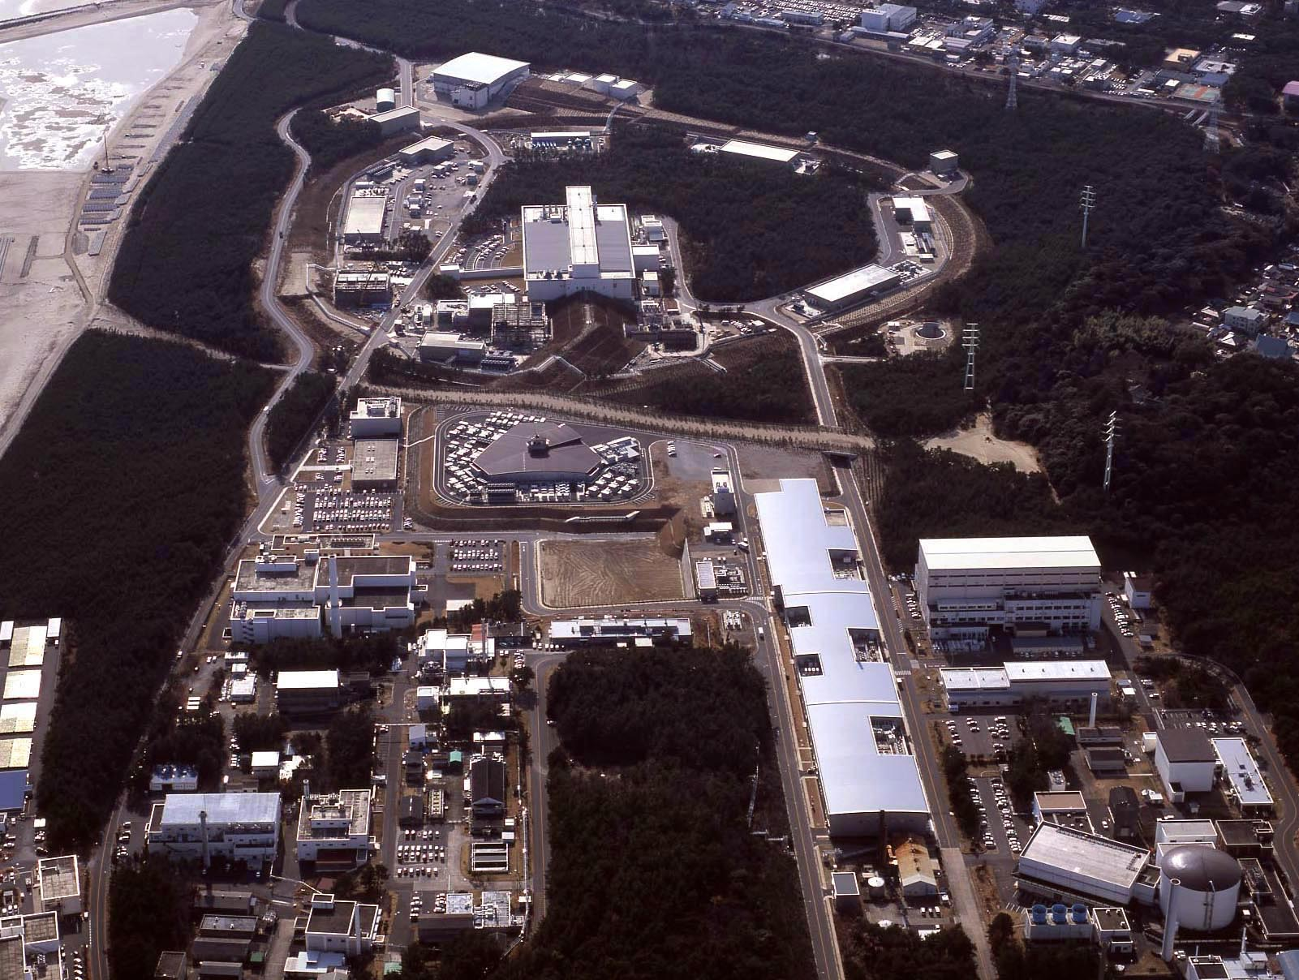
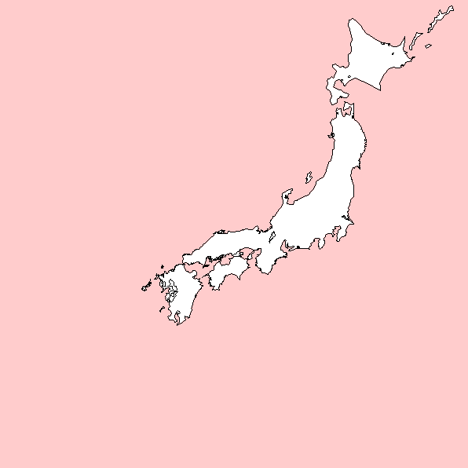
Hadron Experiment Facility
30GeV Synchrotron
MR (0.75MW)
Materials & Life Science Facility (MLF)
Bird’s eye photo
3GeV Synchrotron
RCS (25Hz,1MW)
Neutrino Exp. Facility
(294km to Super KAMIOKANDE)
Transmutation
Facility (TEF)
(Phase II）
Linac
400MeV(50mA)
JFY2007 Beam
JFY2008 Beam
JFY2009 Beam
JRR-3M
800m to MLF
Neutron beam lines (23)
J-PARC = Japan Proton Accelerator Research Complex

Slide 4
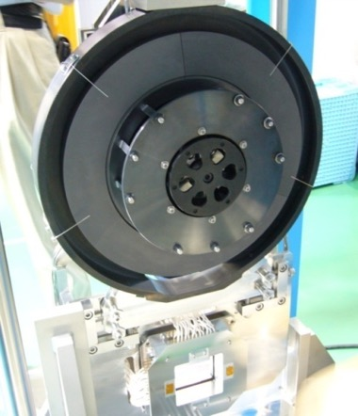
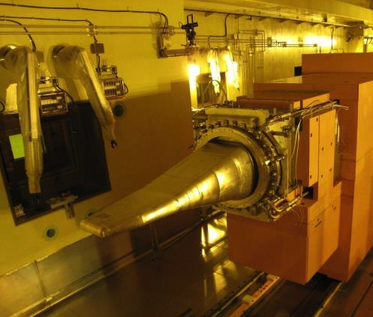
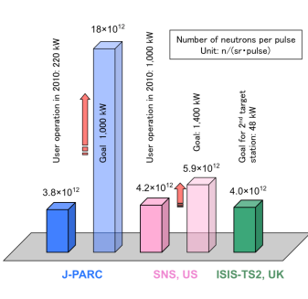
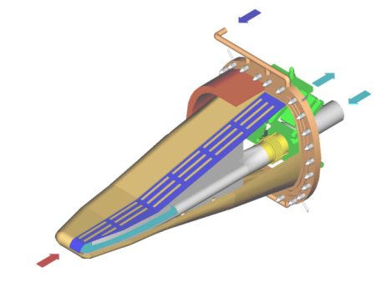
Targets in Material Life Experimental Facility (MLF)
Muon production target
  Carbon graphite
  Highest μ⁻ intensity
Neutron production target
  Mercury (Hg)
Highest pulse intensity in the world
SS container
Thick. 2cm
Diam. Φ33cm
L 2m
W 34cm
Light water
Safety hull
Double wall: Helium layer observed radiation
Hg
8% beam loss
Ptron

Slide 5
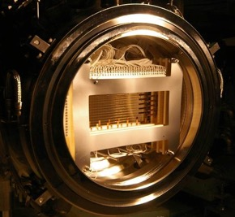
Target for high-intensity hadron accelerator and superconductor in high radiation area
Proton beam window in J-PARC spallation neutron source: Aluminum alloy (φ 0.6 m)
T2K beam window
Titanium alloy (Ti-6Al-4V)
For damage estimation of beam intercepting material, DPA is utilized based on displacement cross section.
High accuracy of the displacement cross-section is required.
Proton
3 GeV
Proton 30 GeV
Resistivity change due to radiation is crucial for Superconductor(SC) magnet sustaining damage.
SC magnet system in beam line of COMET (J-PARC)

Slide 6
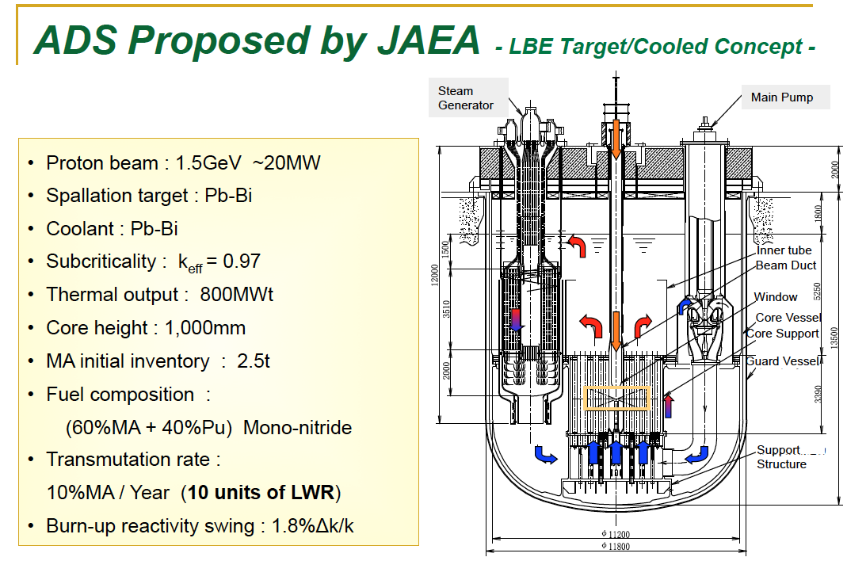
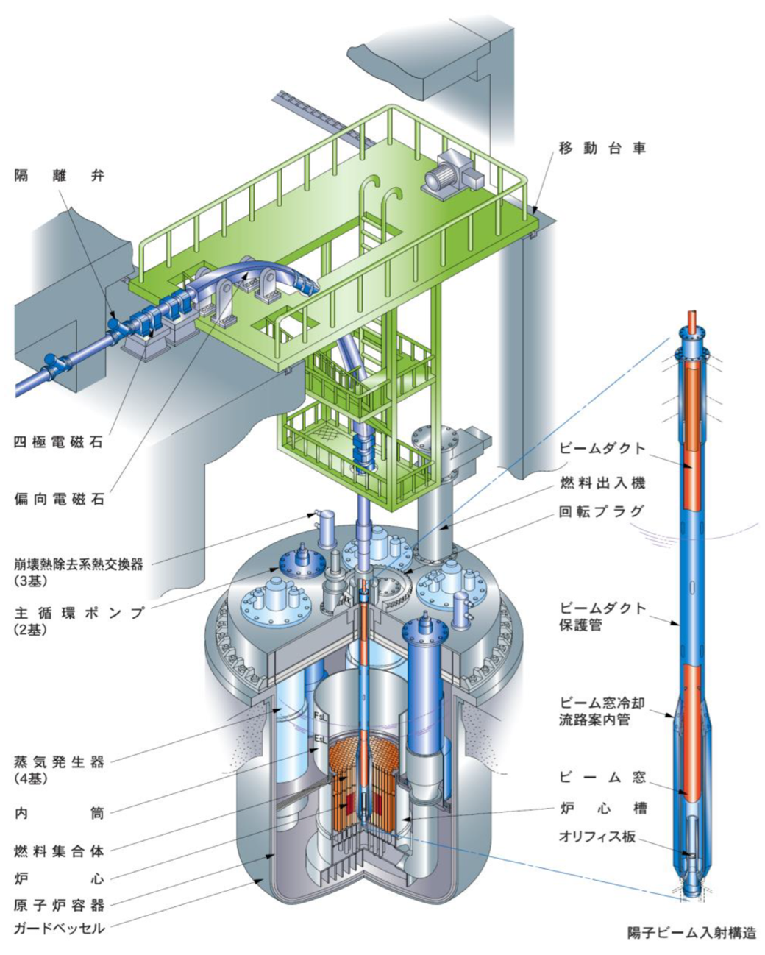
ADS proposed by JAEA
Belgium ADS program MYRRHA at SCK・CEN (Mol) approved 558 M€
~ 30 MW
Beam window
Beam window: 20 dpa/year. Accuracy of dpa is required for damage estimation.

Slide 7
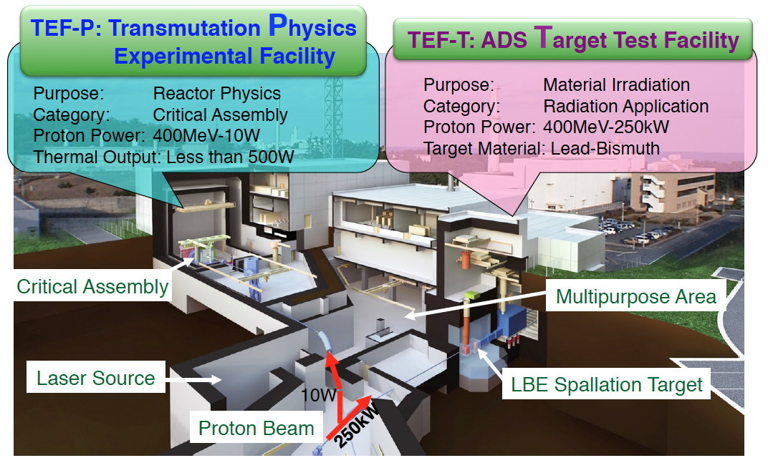
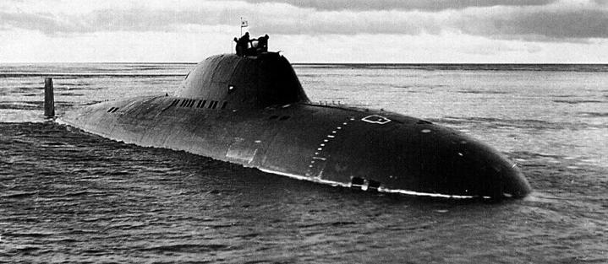
Transmutation Experimental Facility (TEF)
Soviet submarine (LBE)
For R&D of ADS, 0.4 GeV beam by LINAC will be delivered to TEF.

Slide 8
Beam transport from RCS to MLF
600ns
Ep: 3GeV
Power: 1MW
Already demonstrated
Rep.: 25Hz
600ns
Length of 3NBT: 314m
Partial beam goes to MR
FX: 2.48 s, SX: 5.5 s
50-GeV MR
FWHM ~150ns
road to
coast
Material and Life Science Experimental Facility (MLF)
Dump
Neutrino line
3NBT
MUSE
JSNS
3-GeV
RCS
3-50BT
Muon target
Neutron target

Slide 9
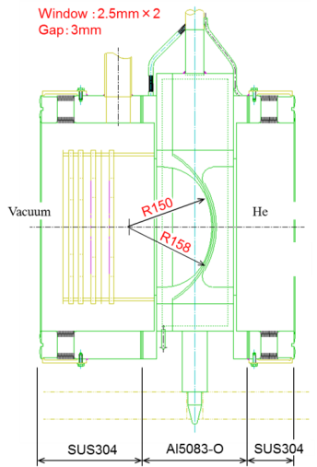
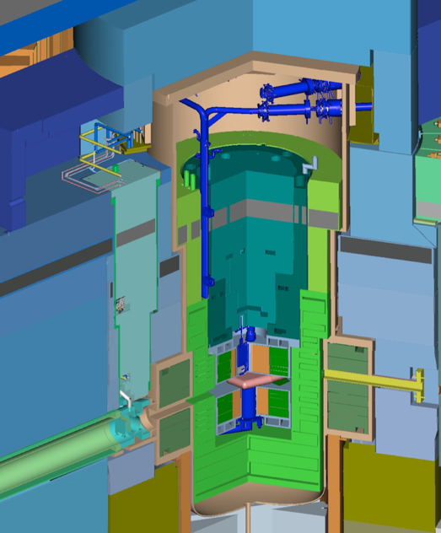
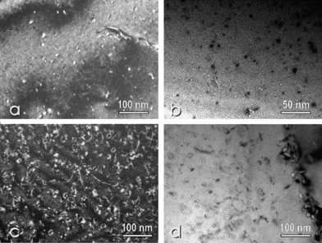
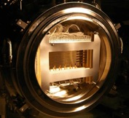
Proton Beam Window at MLF (A5083)
Lifetime estimation based on Post Irradiation Examination (PIE) for safety shroud (AlMg3) at SINQ in PSI
Considering difference of proton energy, to predict lifetime of the PBW with high accuracy for validation of calculation
Result at SINQ/PSI for 0.6GeV
Y. Dai, et al, J. Nucl Mat. 343 184 (2005)
Lifetime of PBW: Determined by He gas production (1200 appm) 2 years*
By recent PIE result of the SINQ (2400 apmm), lifetime may be applicable to 3 years.
Height: 3.8m
Weight：10t
* S. Meigo, et al, J. Nucl Mat. 450 141 (2012)

Slide 10
1 MW beam operation at MLF
Last year memorial snap shot at 1MW for 1 h test (2018/7/3)
1 MW
Result of this year
Beam intensity trend at 1MW for 10.5 h test (2019/7/3)
Availability ~ 99%

Slide 11
PKA and DPA
DPA (Displacement per Atom) is estimated by calculation based on PKA.

Slide 12
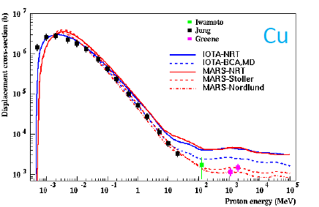
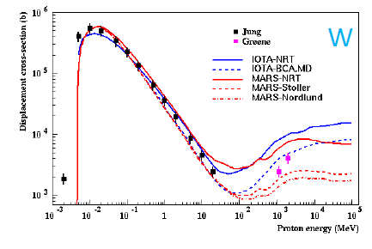
DPA and displacement cross section
Although DPA is widely utilized for estimation of damage, displacement cross section has not been enough validated.
    DPA = flux x Displacement cross section
  Displacement cross section has been measured only Cu and W for a few energies of protons less than 3 GeV
  Among calculations models, showing large discrepancies
N. Mokhov HPTW2016

Slide 13
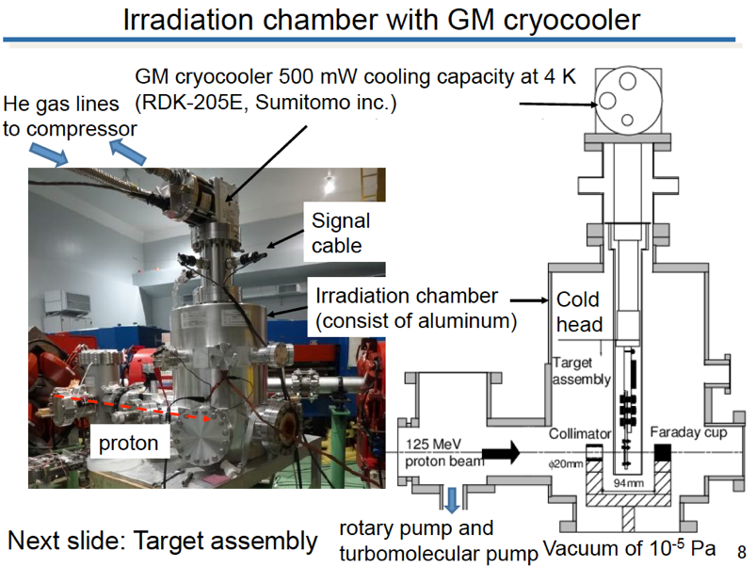
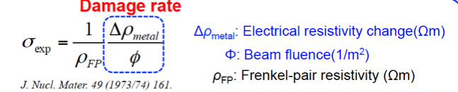
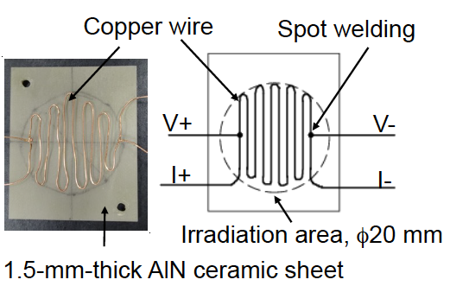
Measurement of DPA cross section at Kyoto univ.
Irradiation on metal at cryogenic temperature with GM cryocooler
By observing increase of electrical resistance, the cross section can be observed.
Experiment at J-PARC
Samples and GM placed at exit of 3-GeV synchrotron for various energy of proton 0.4 to 3 GeV
Other experiment performed at other sites for energy < 400 MeV
Measurement for Cu already performed at Kyoto university for 125 MeV proton

Slide 14
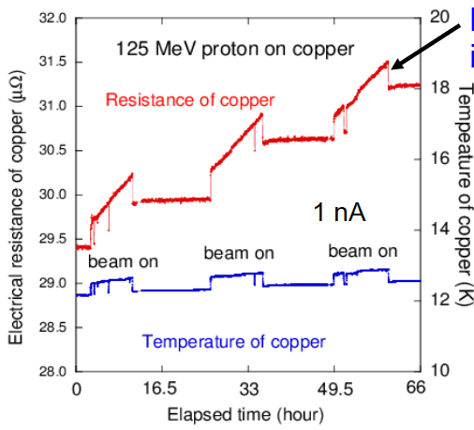
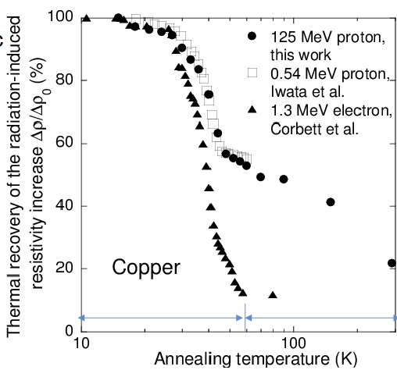
Experimental condition
Resist. and Temp. during beam irrad.
Recovering Resist. by annealing
1 nA x 12h = 3x10¹⁴ protons
Several shots of beam at MLF
Temp rising ~20 K will be acceptable.
Lower beam intensity with accurate beam shape is preferable.
(1x10¹⁰ – 2x10¹³ protons/shot)
Y. Iwamoto et al.

Slide 15
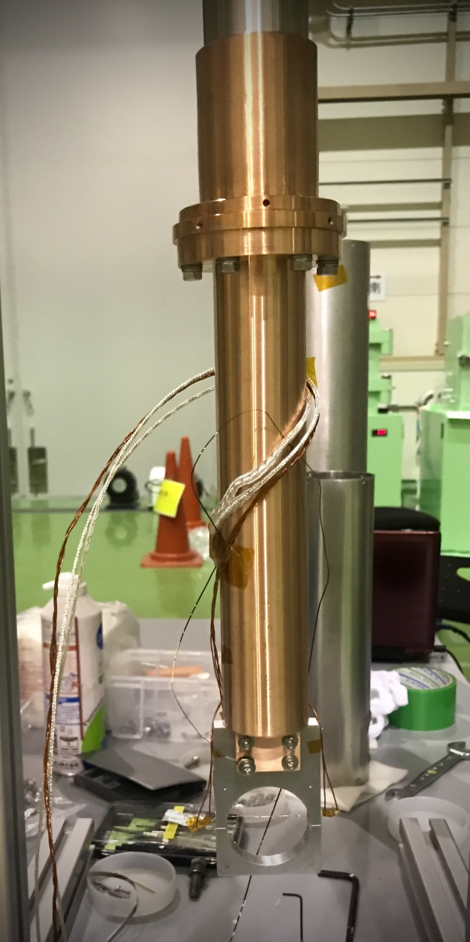
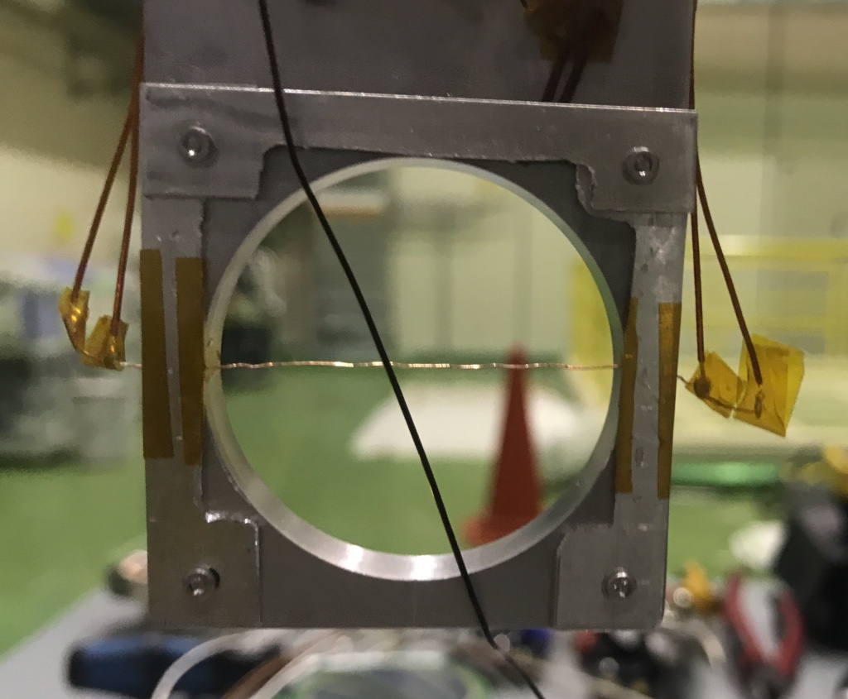
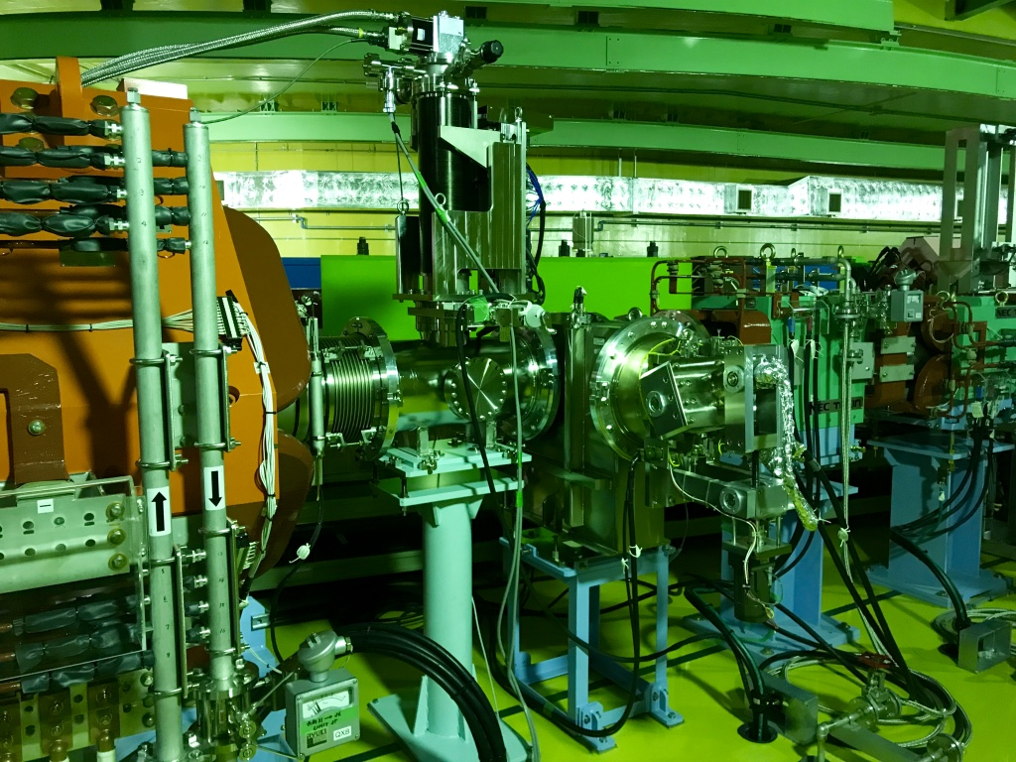
Measurement of cross section for 0.4～3 GeV proton
Experiment at the RCS with change of radiation license
With changing extraction timing of RCS, kinetic energy of proton can vary from 0.4 to 3 GeV.
Cold head and sample
Under cryotemperature (~ 20 K), displacement cross section(σ) was obtained by increase of resistivity (Δρ_{cu}) due to proton irradiation with average flux (φ(E))
Cu wire (φ 0.25 mm) with purity 99.999%
annealed 1,350 K
ρ_{FP}: Resistivity change by a Frankel pair (2.2x10⁻⁶ Ωm)
Vacuum chamber with 4-K GM cooler
40 mm
To MLF
Beam
From RCS
Beam dump
Vertical view
1 m

Slide 16
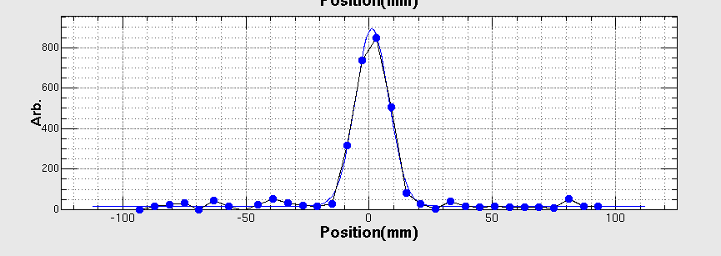
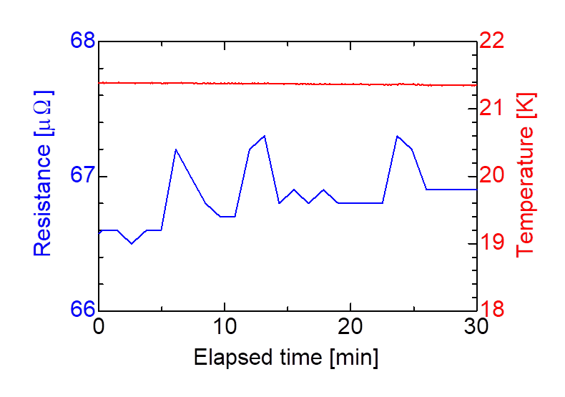
Experimental result
Resistance and temperature during irradiation
Vertical beam profile
50 shots
50 shots
50 shots
Ep (GeV) | Resistivity change (ΔΩm³X10⁻³¹) | σ_{dpa} (b)
0.8 | 2.35±0.31 | 1070±284
1.3 | 2.32±0.26 | 1053±270
2.2 | 2.49±0.21 | 1133±277
3.0 | 2.49±0.16 | 1010±244
0.4μΩ
150 shots x 3.3x10¹² = 5x10¹⁴protons
Experiment was carried out for protons with 0.8, 1.3, 2.2 and 3.0 GeV
To obtain resistance with high accuracy, 4 wire with delta mode with averaging was applied.
Beam width on the sample was obtained with the beam profile monitor.
Error is dominated with resistivity change by creation of the Frankel pair (23%).

Slide 17
Cascade sample holder
RCNP (Osaka univ.) experiment by Iwamoto
Experiment at 3NBT in J-PARC
To obtain Cu and Al data, cascade scheme applied.
Achieved ~5 K
Cascade target of 4 pieces (Al, Fe, Cu, W) applied
Temp ~19 K
In future improved to achieve ~5K

Slide 18
Calculation with PHITS code
Displacement cross section with PHITS implemented following models
  Norgett-Robinson-Torrens (NRT) model
  Athermal recombination corrected (arc) model (Nordlund model)
    Nature comm. 9, 1084, 2018
NRT (Cu Ed 33 eV):
Nordlund (Cu Ed 33 eV):
N_{d}: Number of displacement
T_{d}: Displ. energy
N_{d} different for T_{d}>83 eV
ー NRT
ー Nordlund

Slide 19
Comparison with models calculation
NRT model
overestimates ~ x3
arc model of Nordlund
good agreement
Present data imply that the DPA should be calculated with Nordlund model.
Ratio of NRT/Nord is constant above ~200 MeV.
NRT/Nordlund

Slide 20
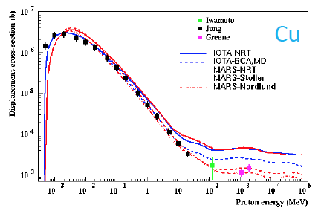
Comparison with MARS

Slide 21
Displacement cross section for Al and W

Slide 22
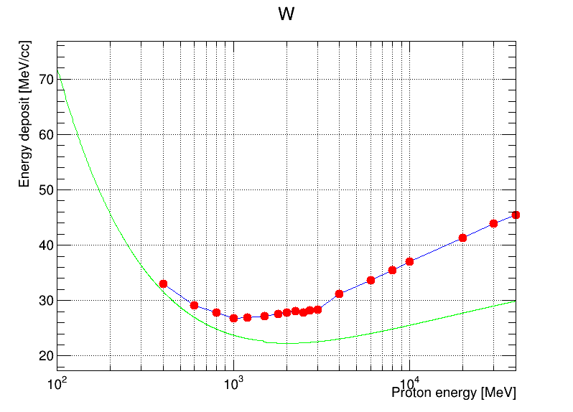
Displacement cross section above 30 GeV
Regardless of the kinematic energy for Ep>30 GeV, displacement cross-section sustains almost constant
As increase proton kinematic energy, heat density on material (W) increase
● Heat density
ー Bethe-Bloch
30 GeV
To solve the curious puzzle, the experiment should be carried out for high energy region.

Slide 23
Disp. cross-section experiment at HiRadMat
Relatively easy experiment
Equipment
  GM cryo-cooler
  Vacuum chamber
    Those had be utilized at previous exepeiment at HiRad
  Instruments to observe sample resistance
Instruments can be placed at near the sample with low radiation (TT61)
Requirement of experiment
  Beam monitor and properties
  Beam scan procedure
Almost instruments are prepared. All we need is sample, sample holder and budget of travel.

Slide 24
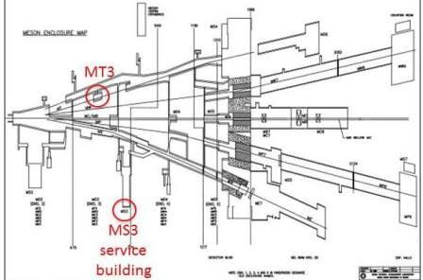
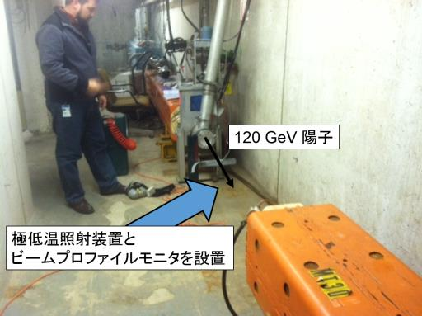
Experiment at FNAL
Budget already approved by MEXT for some of our collaborators
On 2021, the experiment will start for 120 GeV proton.
MT3
120 GeV proton
Cryo chamber and beam instruments will be placed

Slide 25
Summary
Displacement cross section, measurement for 0.4〜30 GeV protons has conducted in J-PARC.
At FNAL, displacement cross section experiment for 120 GeV will be carried out.
To obtain the displacement cross section at 400 GeV, which is important for HL-LHC, the experiment should be performed at HiRadMat.

Slide 27
Contribution for displacement
Fission and spallation fragment dominating

