Slide 1
Irradiation and Structural Analysis Capabilities at Brookhaven National Laboratory:
A synergistic model of beam irradiation and synchrotron light source characterization to bridge the micro-macro characterization gap of radiation effects and damage
C. Cutler, D.Kim, D. Medvedev, M. Palmer*, N. Simos

Slide 2
Nuclear (and other) Material Studies at BNL
At a glance:
Intense proton beam effects on target materials and beam windows
  24 GeV protons at AGS
Radiation damage effects on particle accelerator materials and systems
  Targets, beam windows and collimators
Radiation damage effects on reactor materials
  Graphites, Carbon-fiber and SiC/SiC composites, Be, W, Ta, Mo
  Super-alloys (super-Invar, Gum metal, Ti₆Al₄V)
  Dispersion strengthened Cu (fusion, LHC)
  Nano-precipitated steels
  Nano-structured coatings on reactor steels
  Molten-salt/material interfaces (Inconel, Steels)
Radiation effects on detectors and exotic systems
  Rare earth magnets (synchrotron undulators)
  CZT crystals
  SiO₂ fibers
  Ferrofluids

Slide 3
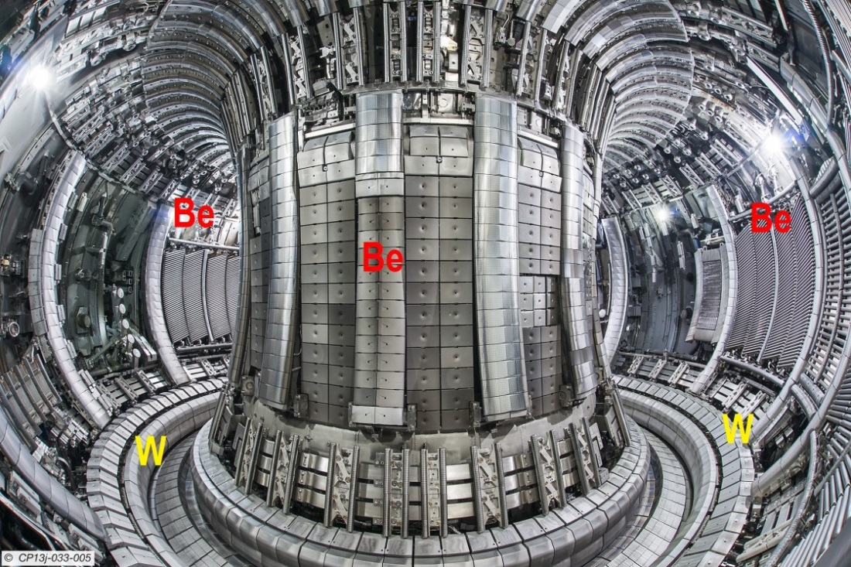
Nuclear Materials and Synchrotron Radiation Relationship
Advanced Reactor Concepts
N. Simos, “Composite Materials under Extreme Radiation and Temperature Environments of the Next Generation Nuclear Reactors", Composite Materials, Intech Publishers, ISBN 978-953-307-1098-3, 2011

Slide 4
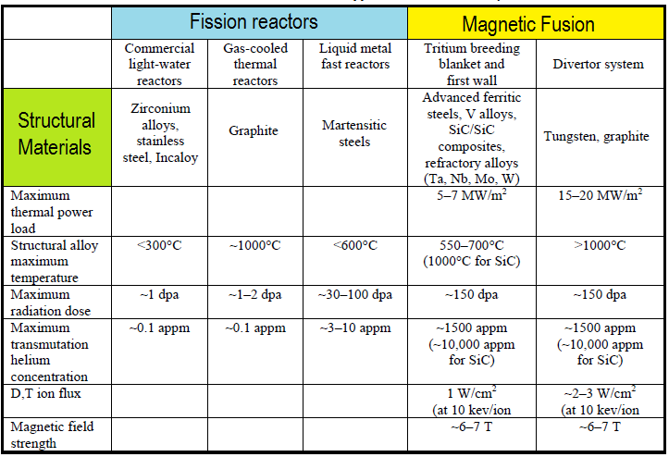
Extreme Environments for Structural Materials: Fission Reactors and Magnetic Fusion Systems

Slide 5
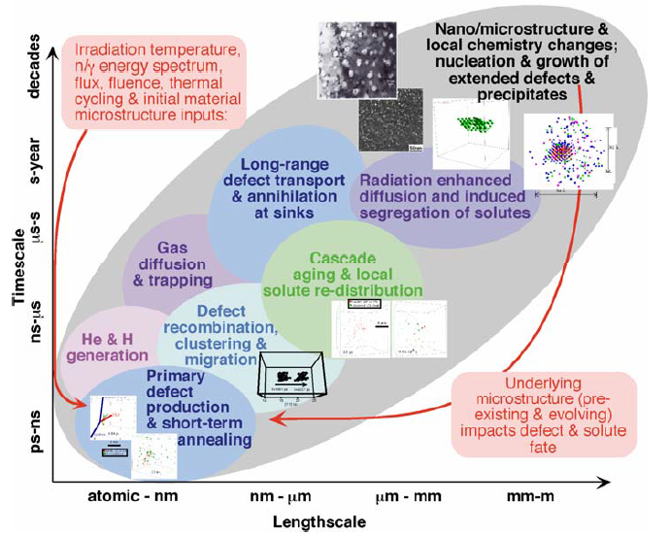
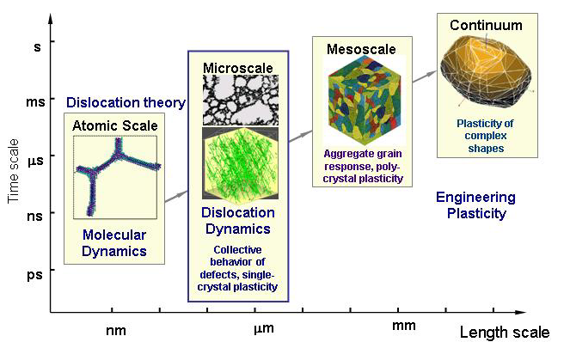
Challenges of Connecting Scales: Materials in Extreme Conditions
a The unique position of HiRadMat to help advance the field

Slide 6
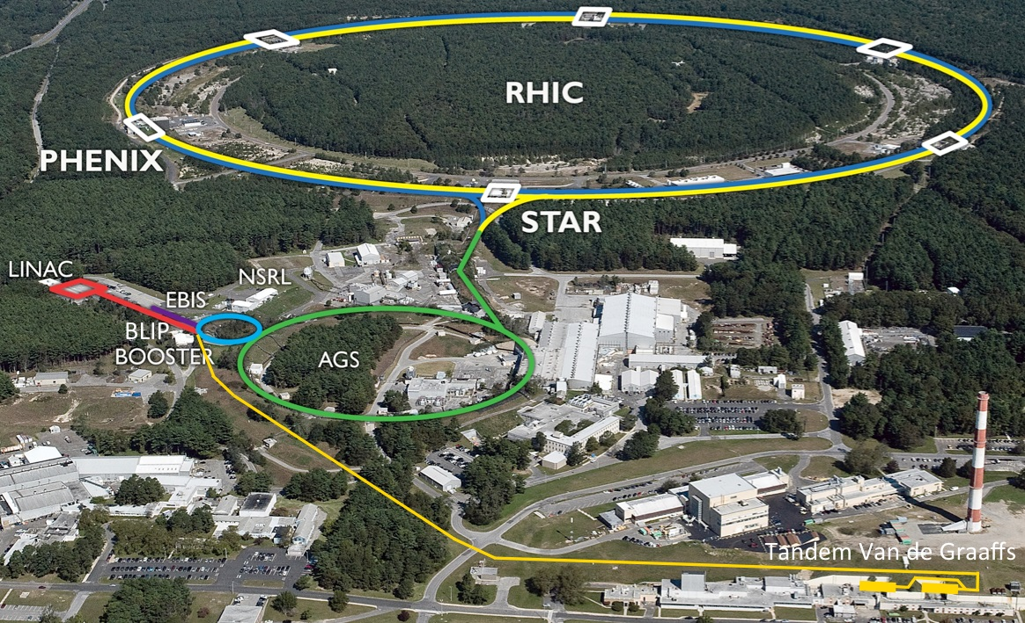

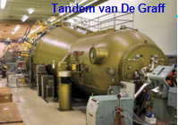
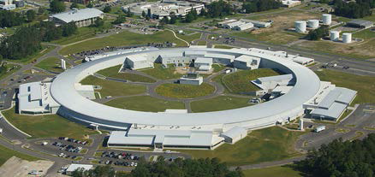
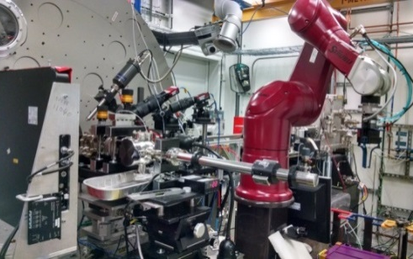
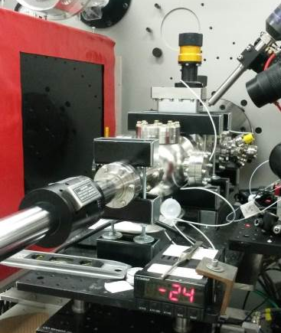
Synergies with the BNL Accelerator Complex
Collider Complex
NSLS II Synergy
ID 28 (XPD) Beamline

Slide 7
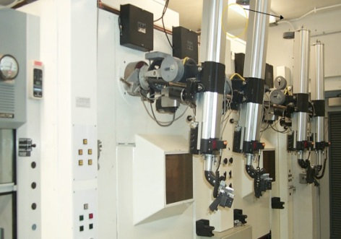
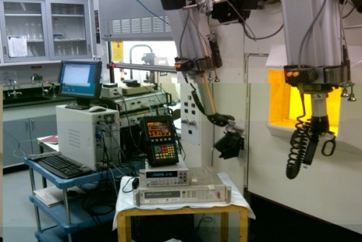
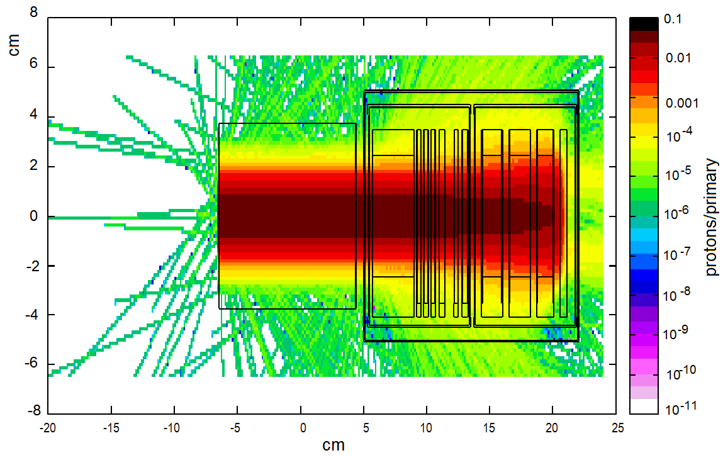
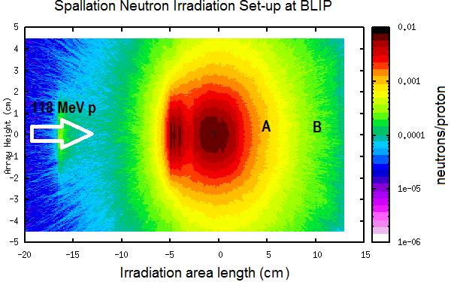
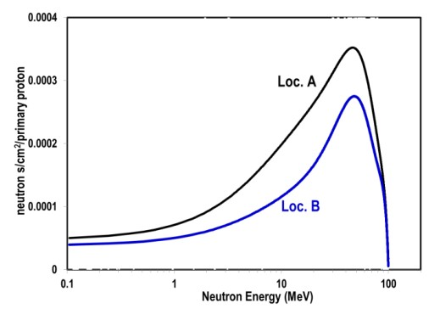
BLIP Irradiation Capabilities
Multiple proton energies 66-200 MeV
Good beam current (165µA +) Beam rastering
RUN cycle (Dec. – July)
Operates in-tandem with Isotope production and RHIC
(no dedicated beam time needed)
Fully operational hot cell laboratory & infrastructure Availability of nuclear instruments/technical expertise Can operate as neutron spallation source
Mode I: Irradiation with BNL Linac protons (up to 200 MeV)
Mode II: Target endstation as a Neutron Source
Fusion spectrum similarities
Position A
Position B
Beam

Slide 8
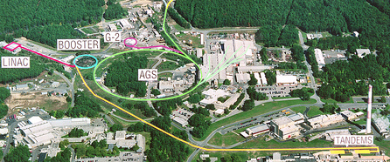
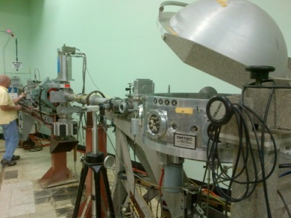
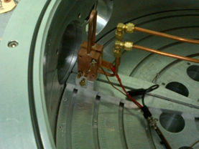
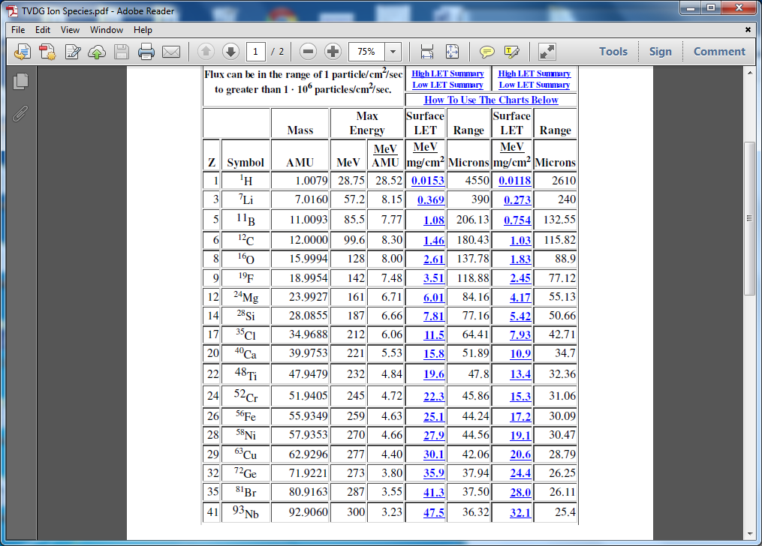
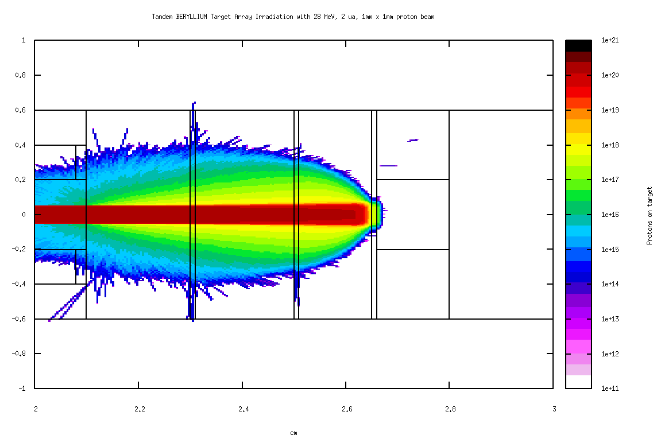
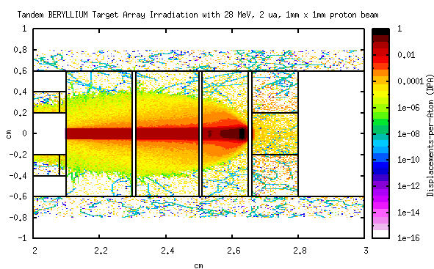
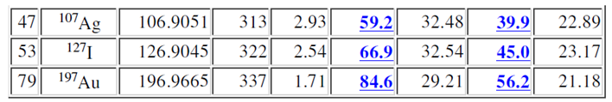
Tandem van de Graaff Capabilities
Target Irradiation Beamline
Ions Available at Tandem

Slide 9
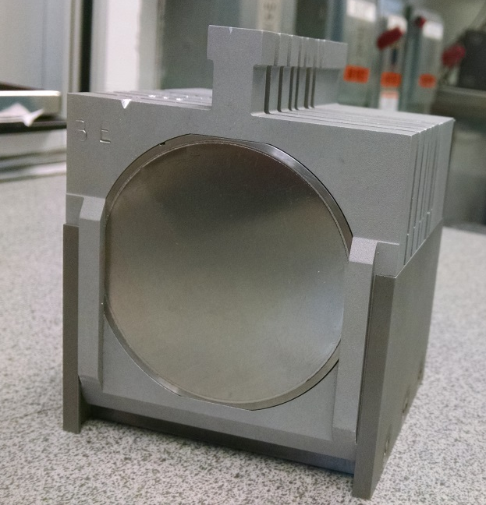
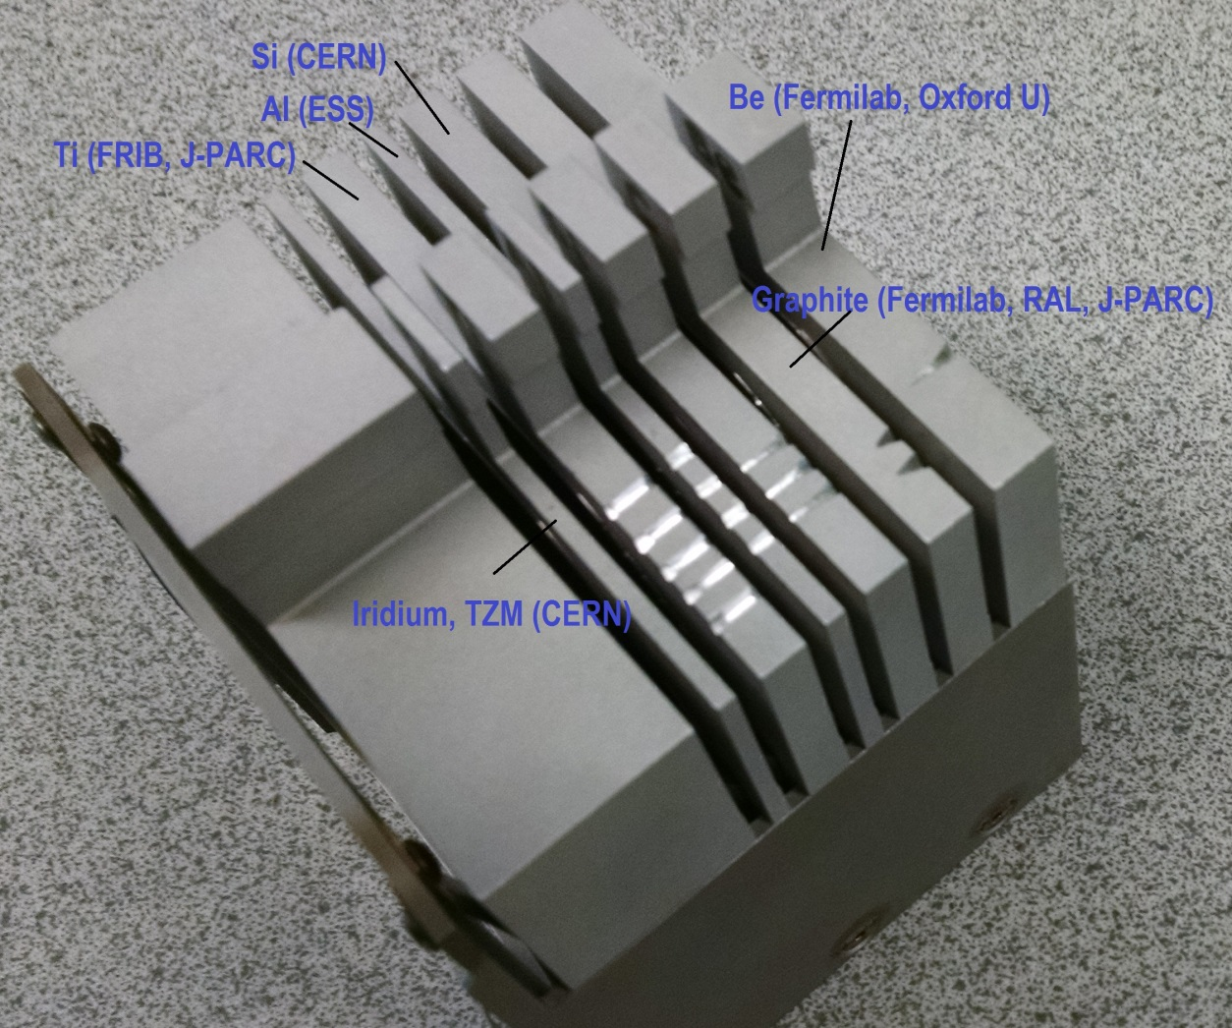
Irradiation Damage Experiments
Aim: reach proton fluence levels that approach threshold or operational goal
Target Array in Beam

Slide 10
Nuclear Material Studies at BNL
Radiation damage effects
Linking macrostructure to radiation-induced lattice defects
Focus on:
Gr, h-BN, Be
Super-alloys
Dispersion strengthened Cu (fusion, LHC)
Nano-precipitated steels

Slide 11
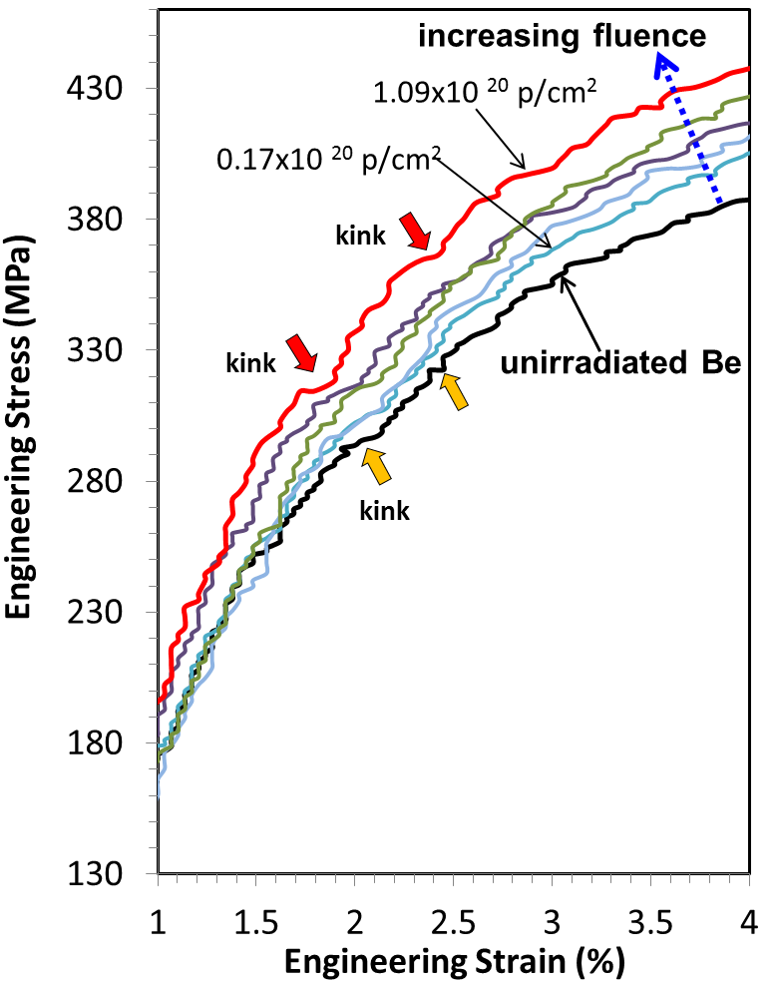
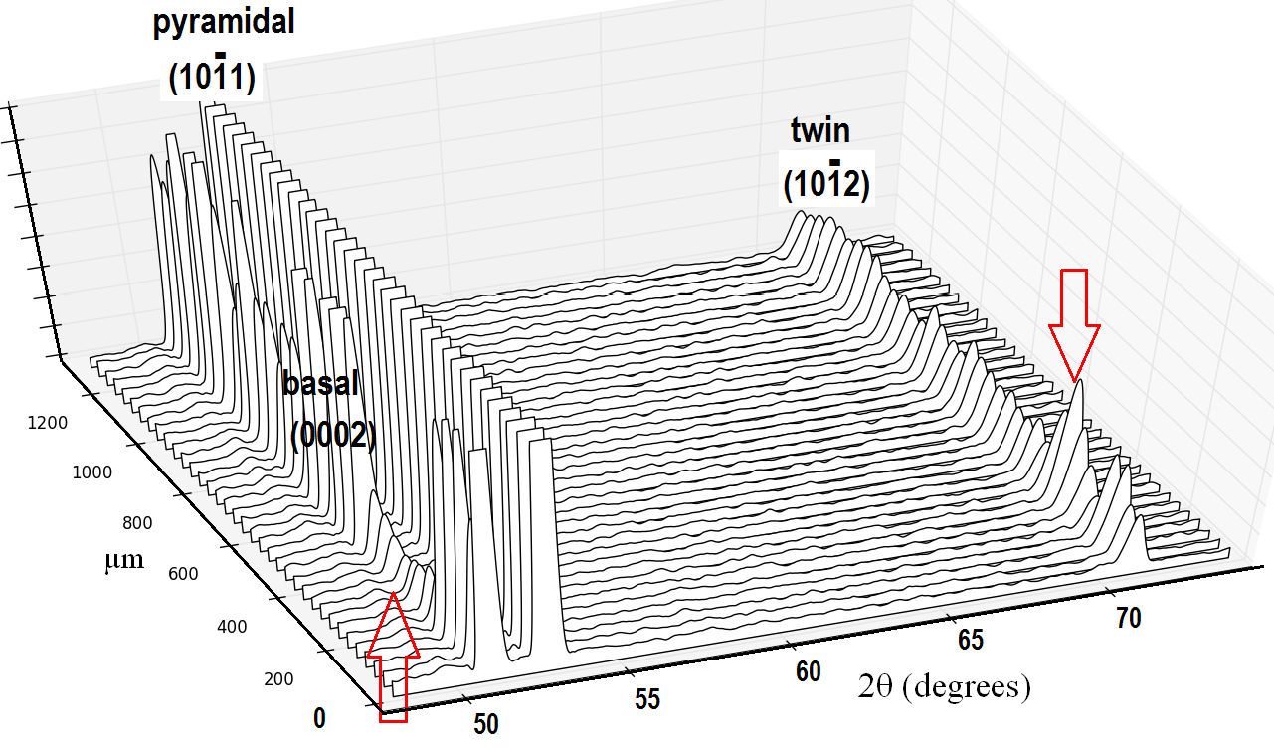
Beryllium Deformation – Correlating Macroscopic with Lattice Strain
N. Simos, et al, “Proton irradiation effects on beryllium - A macroscopic assessment,” Journal of Nuclear Materials, Vol. 479, 489-503, 2016
N. Simos, et al, “High-temperature annealing of proton irradiated beryllium – A dilatometry-based study,” Journal of Nuclear Materials 477, 2016
N. Simos, M. Elbakhshwan, et al, “X-ray diffraction studies of 145 MeV proton-irradiated AlBeMet 162,” Nuclear Materials and Energy, Vol. 8, 8-17, 2016
N. Simos, M. Elbakhshwan, et al, “X-ray Diffraction, Annealing and Oxidation studies of Proton-irradiated Beryllium,” Transactions of the American Nuclear Society, 2017

Slide 12
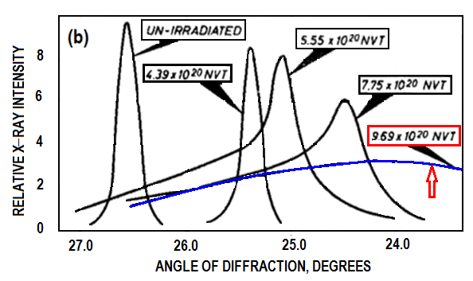
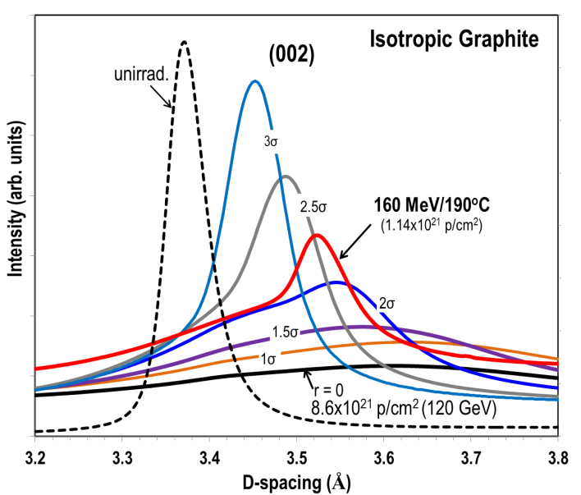
Graphite Irradiation Damage Studies
Proton-neutron damage correlation with the help of NSLS-II
Neutron Damage
Proton Damage
N. Simos, et al., “Proton Irradiated Graphite Grades for a Long Baseline Neutrino Facility Experiment,” Ph. Review Accelerators and Beams 20, 071002 2017

Slide 13
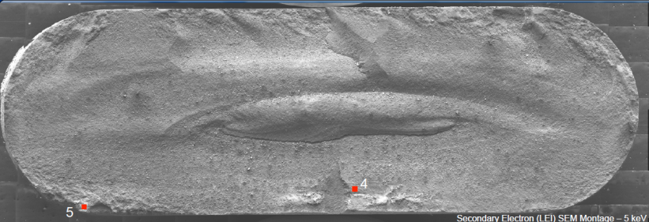
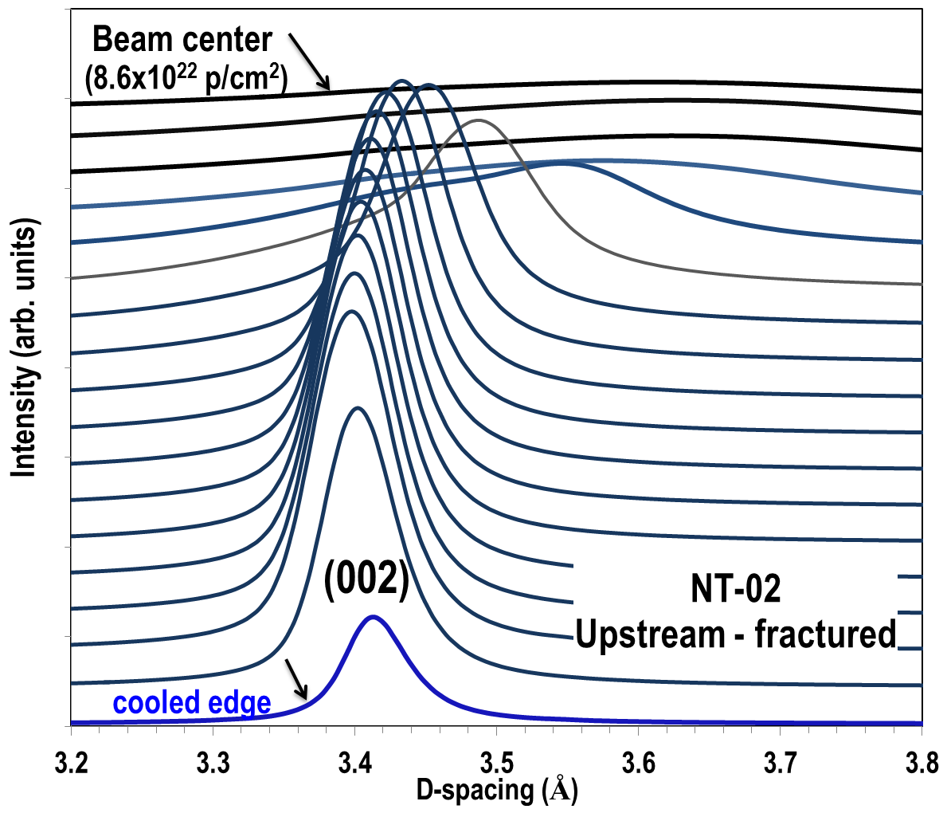
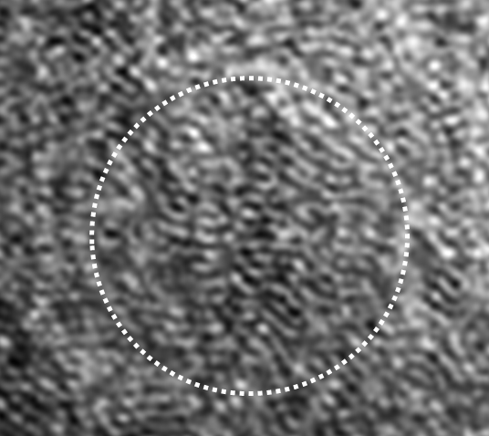
120 GeV NuMI Target Meets World’s Brightest X-ray beam at NSLS-II
6.1 x10²⁰ protons delivered to NT-02 target resulting in a peak fluence of 8.6x10²¹ protons/cm²
Fracture surface
Graphite fragmentation into nano-crystallites
Correlation of X-ray and electron microscopy
in IDENTIFYING the state of NuMI target at FAILURE
N. Simos, et al., “120 GeV neutrino physics graphite target damage assessment using electron microscopy and high-energy X-ray diffraction,” Phys.Rev.Accel.Beams 22, 041001, 2019

Slide 14
Using the BNL Accelerator Complex to Study Super-alloys & Novel Materials
  The (α + β) Ti-6Al-4V alloy
  Super-Invar
  The β-titanium alloy Gum metal
  (Ti-21Nb-0.7Ta-2.Zr-1.2O)
Simos et al., Multi-MW accelerator target material properties under proton irradiation at Brookhaven National Laboratory linear isotope producer, PHYSICAL REVIEW ACCELERATORS AND BEAMS 21, 053001 (2018)

Slide 15
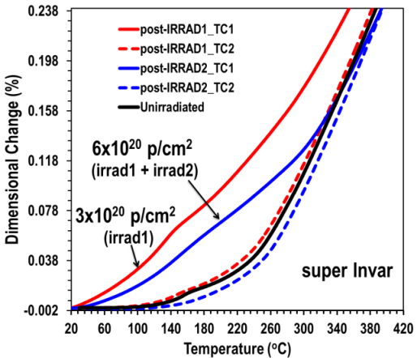
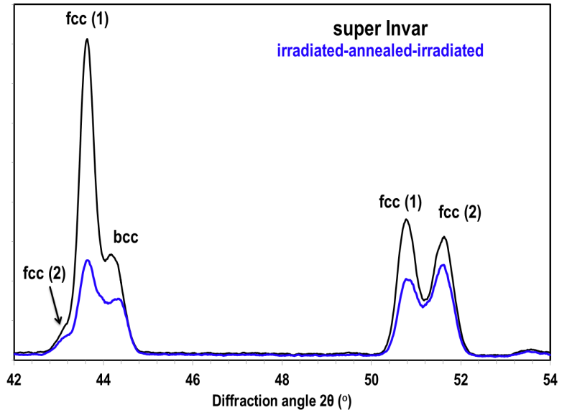
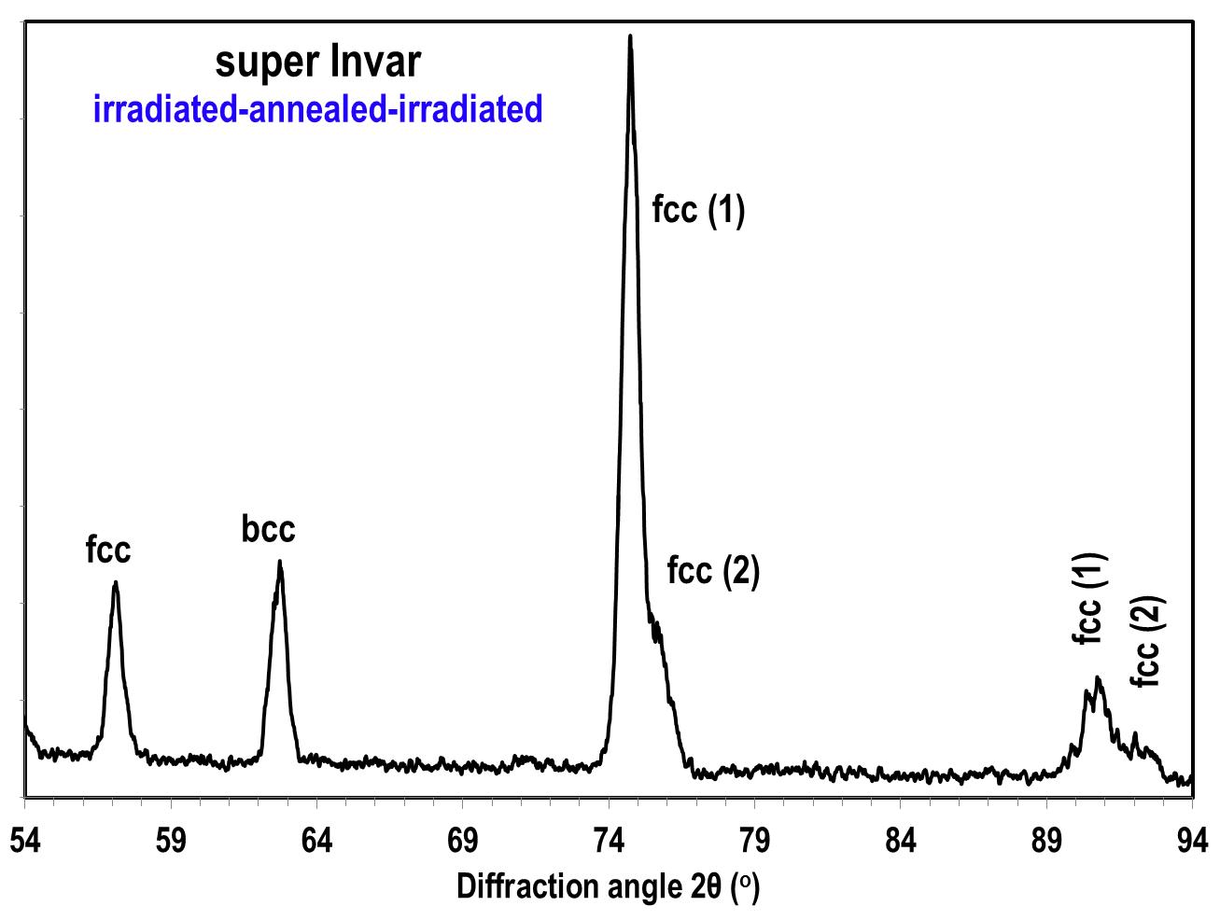
Magnetostriction, Annealing and fcc Phases in Super-Invar
CC phases (Ni-rich and Fe-rich) stable following irradiation and annealing !!
X-ray beam, at NSLS II to reveal presence of 2nd fcc (paramagnetic) phase

Slide 16
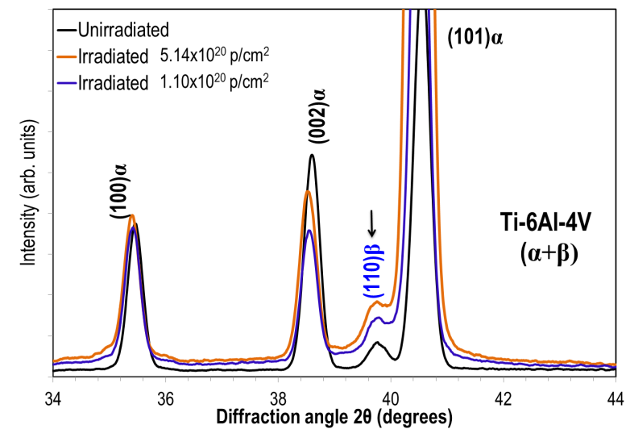
Radiation Effects on Microstructure and Phase Stability in Ti-6Al-4V
Phase evolution in Ti-6Al-4V ➔ appearance of ω-phase
Tension-compression asymmetry
Simos et al.

Slide 17
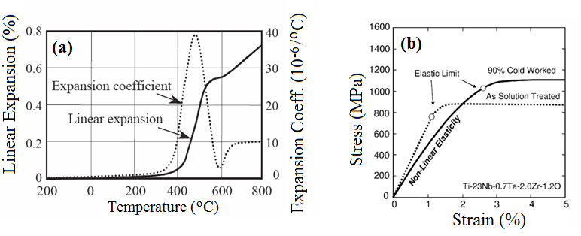
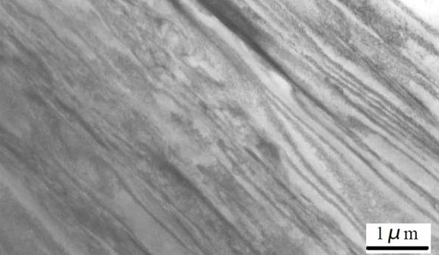
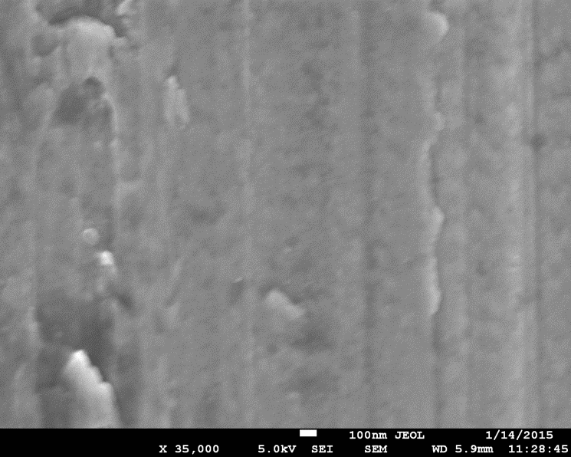
β-type MULTIFUNCTIONAL alloys Ti-21Nb-2Ta-3Zr-1.2O (Gum Metals)
Gum metals, exhibit extraordinary properties
  Super-elasticity
  Super-plasticity
  Low elastic modulus
  High strength
Debate as to mechanism responsible for its deformation:
  Martensitic transformations ?
  or
  Unconventional localized lattice distortions
  (dislocation-free plastic deformation)
Stress & thermally-induced martensite transformations
and their role in super-elasticity and super-plasticity of the
multifunctional Ti-21Nb-2Ta-3Zr-1.2O have been explored
Radiation-induced phase evolution
Saito et al.
Simos, Camino, et al.

Slide 18
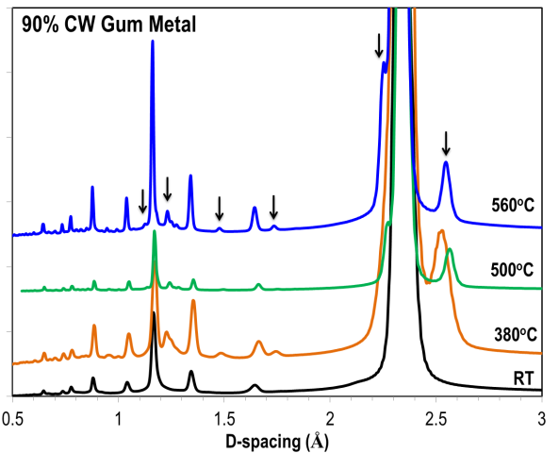
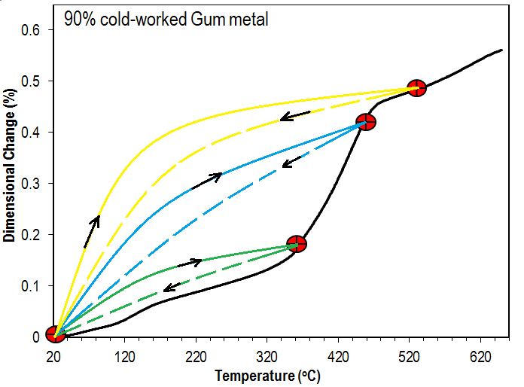
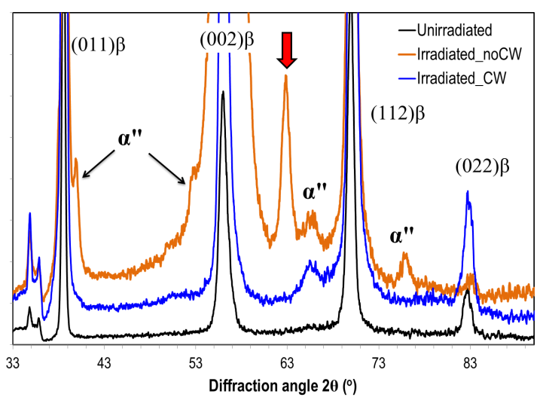
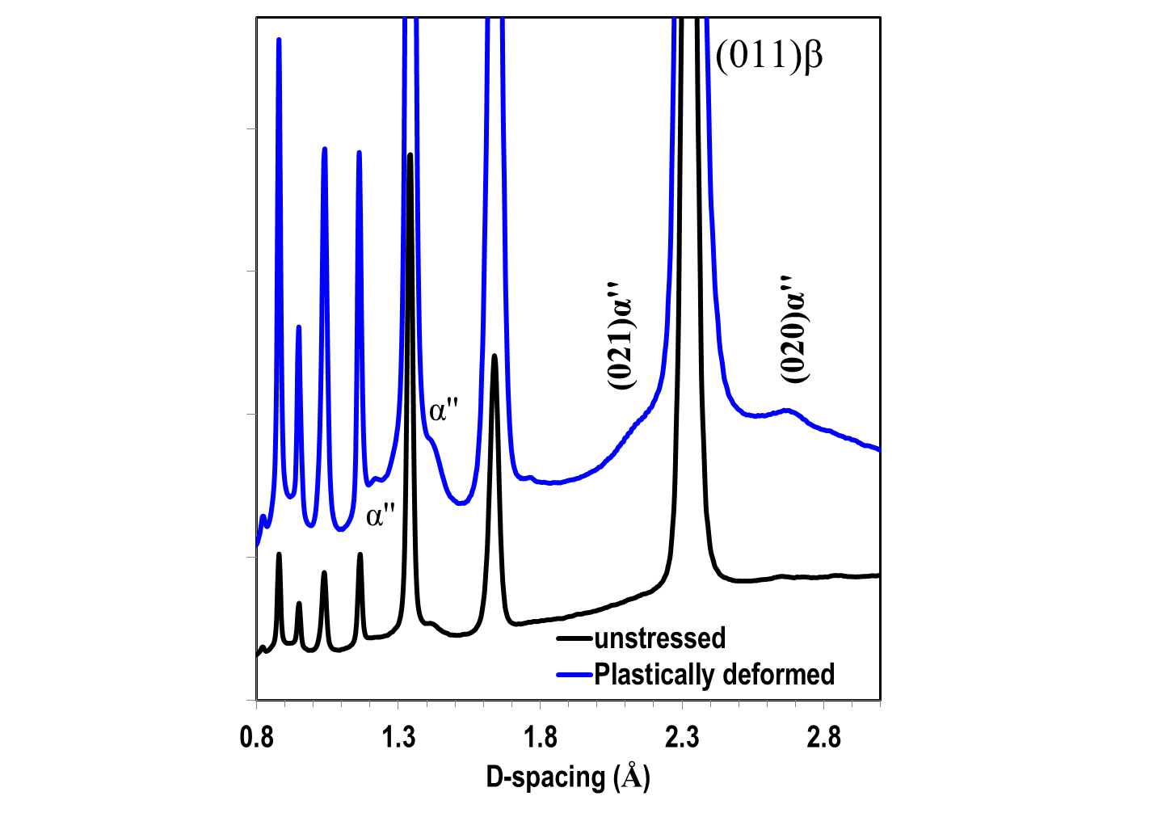
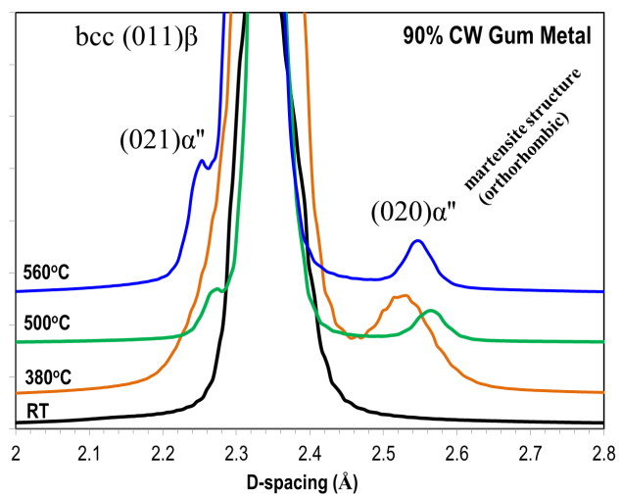
Ti-21Nb-2Ta-3Zr-1.2O: Temperature, Strain and Radiation-induced Phase Transitions
Phase evolution following irradiation
Phase transformation with temperature
Phase transformation during plastic deformation

Slide 19
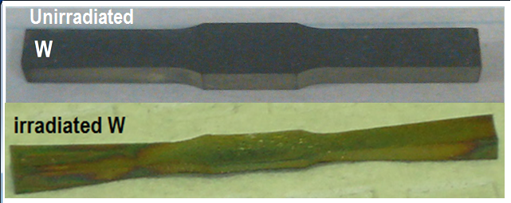
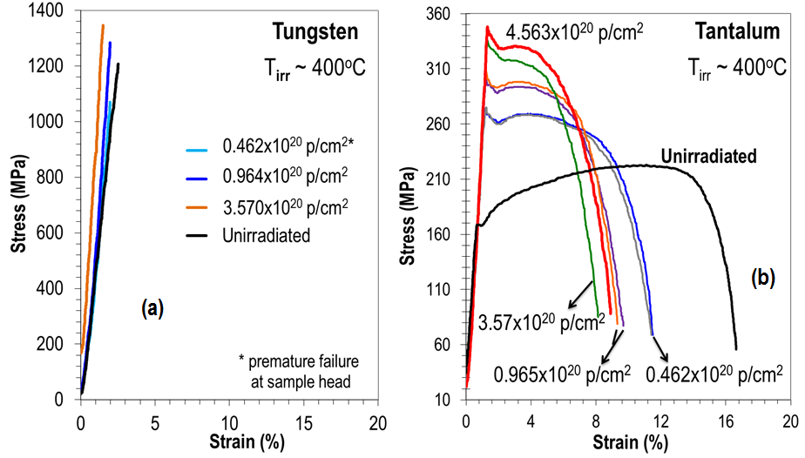
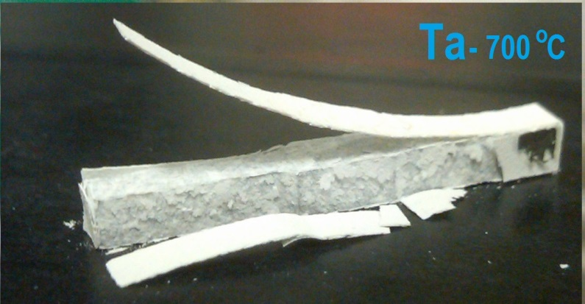
Studies of Refractory Metals (W; Ta: Mo)
Fusion applications
Spallation target
Simos et al., Multi-MW accelerator target material properties under proton irradiation at Brookhaven National Laboratory linear isotope producer, PHYSICAL REVIEW ACCELERATORS AND BEAMS 21, 053001 (2018)

Slide 20
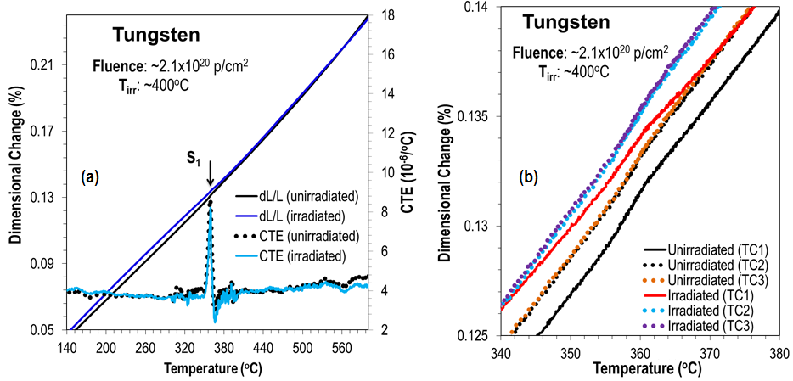
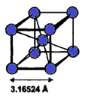
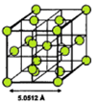
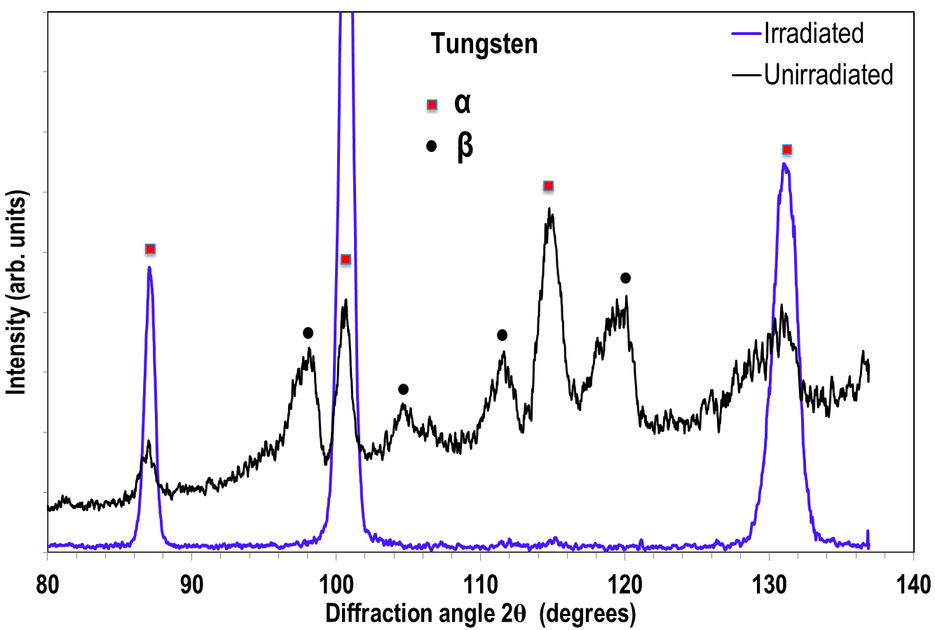
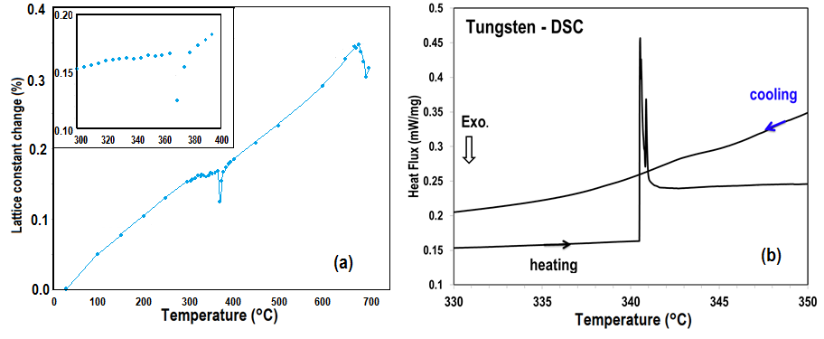
Observed “anomalies” – W or WO3 ?

Slide 21



Nuclear Steels: Dispersion Strengthened, Nano-structured Coatings
Precipitates in steel and their kinetics
  CRP = copper-rich precipitates (more Cu than other solutes: Mn, Ni, P, Si)
  MNP = manganese-nickel-rich precipitates (more Mn-Ni than Cu)
  LBPs = late blooming phases (Great Fear)
  LBPs: Phases that give rise to sudden an unexpected increase in embrittlement
      long incubation period
      rapid growth thereafter
560 ºC
730 ºC

Slide 22



Addressing the “Great Fear” in Pressure Vessel Reactor Steels
Precipitates in steel and their kinetics:
Under higher energy particle (fast neutron/proton) is “Great Fear” realized much earlier and these phases are not late blooming but rather early blooming?

Slide 23




Nano-structured Fe-based Coatings on Steel
BNL studies demonstrated the remarkable ability of nano-structured coatings to remain amorphous under intense proton irradiation.

Slide 24






Oxide-dispersion-strengthened Copper Alloys (GlidCop Al15)
From LHC applications (collimators) to Fusion reactor considerations
Wrought
Cold-worked

Slide 25
Using BNL accelerator complex to study detector materials, etc.
  Rare earth magnets
  CZT crystals
  SiO2 fibers
  Ferrofluidics

Slide 26










  CZT crystals
SiO₂: LHC
0-degree calorimeter
  Rare-earth magnets
  Ferrofluidics
  Performance Degradation of Ferrofluidic Feedthroughs in a Mixed Irradiation Field
FF static torque vs. the inverse of displacement time
(1/t_{d}) following rotational speed cycles up to 5,000 rpm

Slide 27
Summary
The novel materials, alloys and composites required for next generation reactors and accelerator applications require evaluation under extreme conditions
  The suite of tools available with the BNL accelerator complex enable such assessments
Predicting material lifetimes in likely future environments remains a formidable challenge
  Detailed studies of the structural evolution of materials under a range of conditions can substantially improve our ability to anticipate material performance
The availability of fast neutron sources with high fluence for materials tests is very limited
  Our knowledge of how materials evolve and damage under thermal neutrons cannot be extrapolated to their response to fast neutrons for fast reactors
  Using protons or heavy ions as surrogates to emulate the damaging effects of fast neutrons is an ongoing debate and research
  BNL’s combination of irradiation and x-ray characterization tools provides a powerful route to studying relationship between proton and fast neutron damage through detailed study of the evolution of materials at the microstructural level

Slide 28
The BNL Team looks forward to continued collaboration with the HiRadMat effort to provide the next-generation materials our future facilities require
Thank you for your attention!

