Slide 1








“Beam steering performance of bent silicon crystal irradiated with high-intensity and high-energy protons”
International HiRadMat Workshop
CERN, Switzerland, 10 July 2019
Marco Garattini
CERN / Imperial College London
UA9 Collaboration

Slide 2
Outline
Crystal beam steering
Crystal applications
Reasons to irradiate crystals
Crystal HRMT test
Crystal hi-dose irradiation with neutron
LoI: HRMT test on hi-dose irradiated crystals
Conclusions

Slide 3
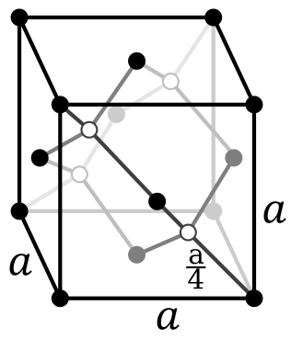
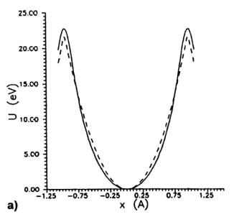
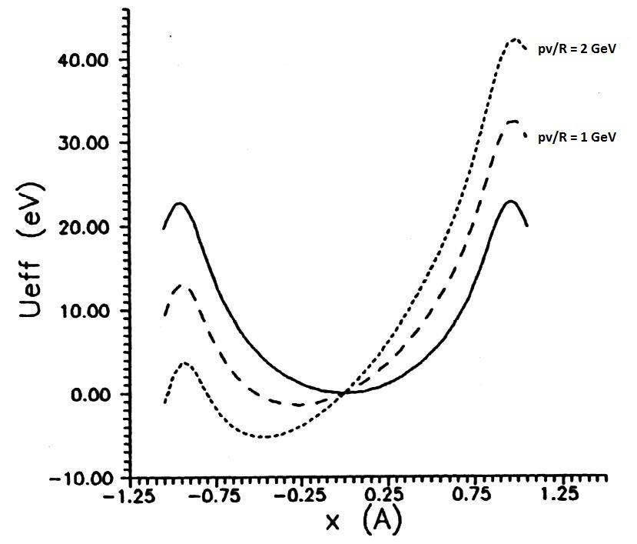

Crystal physics_{[1]}
Channeling only if
the protons have
p_{T} < U_{max}
Silicon diamond lattice
Potential well between two planes:
Straight crystal
Bent crystal
Typical values at energies
of our interest:
Channeling
[1]

Slide 4
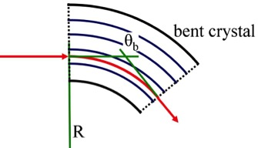
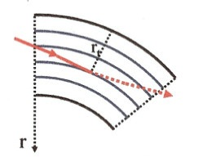
Coherent processes in bent crystals_{[1]}
From test beam on the CERN-SPS extraction line H8:
(in the framework of the UA9 experiment)
Dechanneling
3
CH
VC
DC
DC
AM
Volume capture
5
AM
VR
Θ_{c}
VC
Channeling
Volume reflection
2
4
Θ_{in}
Θ_{out}
ΔΘ
CH
VR

Slide 5
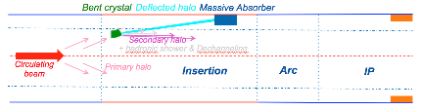
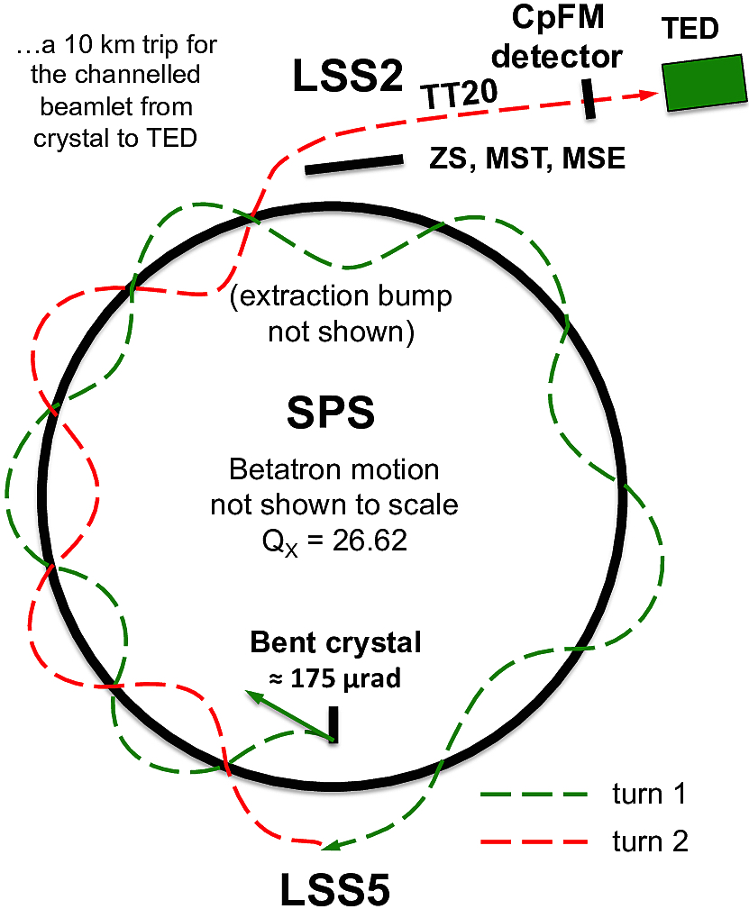
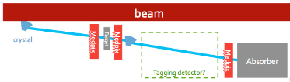
Crystal applications
LHC Crystal Collimation for Hi-Lumi [2]: use of a bent crystal to deflect beam halo particles instead of 3 stages of standard collimators (successfully proved in the LHC)
  Reduced off-momentum losses in DS
  Impedance reduction
  Simpler and cheaper solution
SPS extraction [3,4]: use of a crystal to extract (or support the extraction) from the SPS to the North area (successfully proved in the SPS)
  Reduction of losses at the extraction septum
  Simpler and cheaper solution
Beam splitting for LHC: use of two crystal in a raw to split the halo beam and send it on a fixed target (preliminary proved in SPS)
  At now the only way to split the LHC beam
  inside the LHC itself

Slide 6
Reasons to irradiate crystals
No systematic study of irradiated crystals has ever been carried out until now
High-intensity and energy particles could produce thermo mechanical stresses on the crystal system: deformations, evaporations, vetrification, craks, etc…
HiRadMat test at CERN to study consequences of unwanted fast irradiations during injection or dump procedures
------------------------------------------------------------------------------------------------------
High fluxes particles produce crystal lattice damages that affects the channeling performance (the channeling efficiency)
Efficiency test before and after irradiation to test their robustness

Slide 7
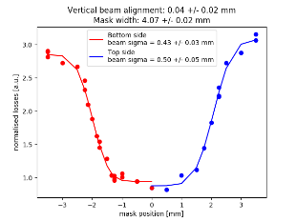
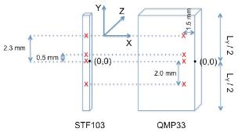
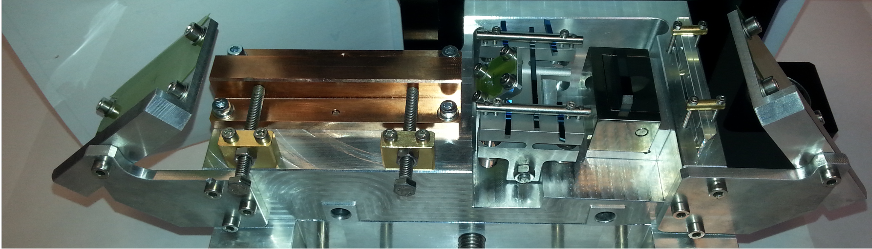
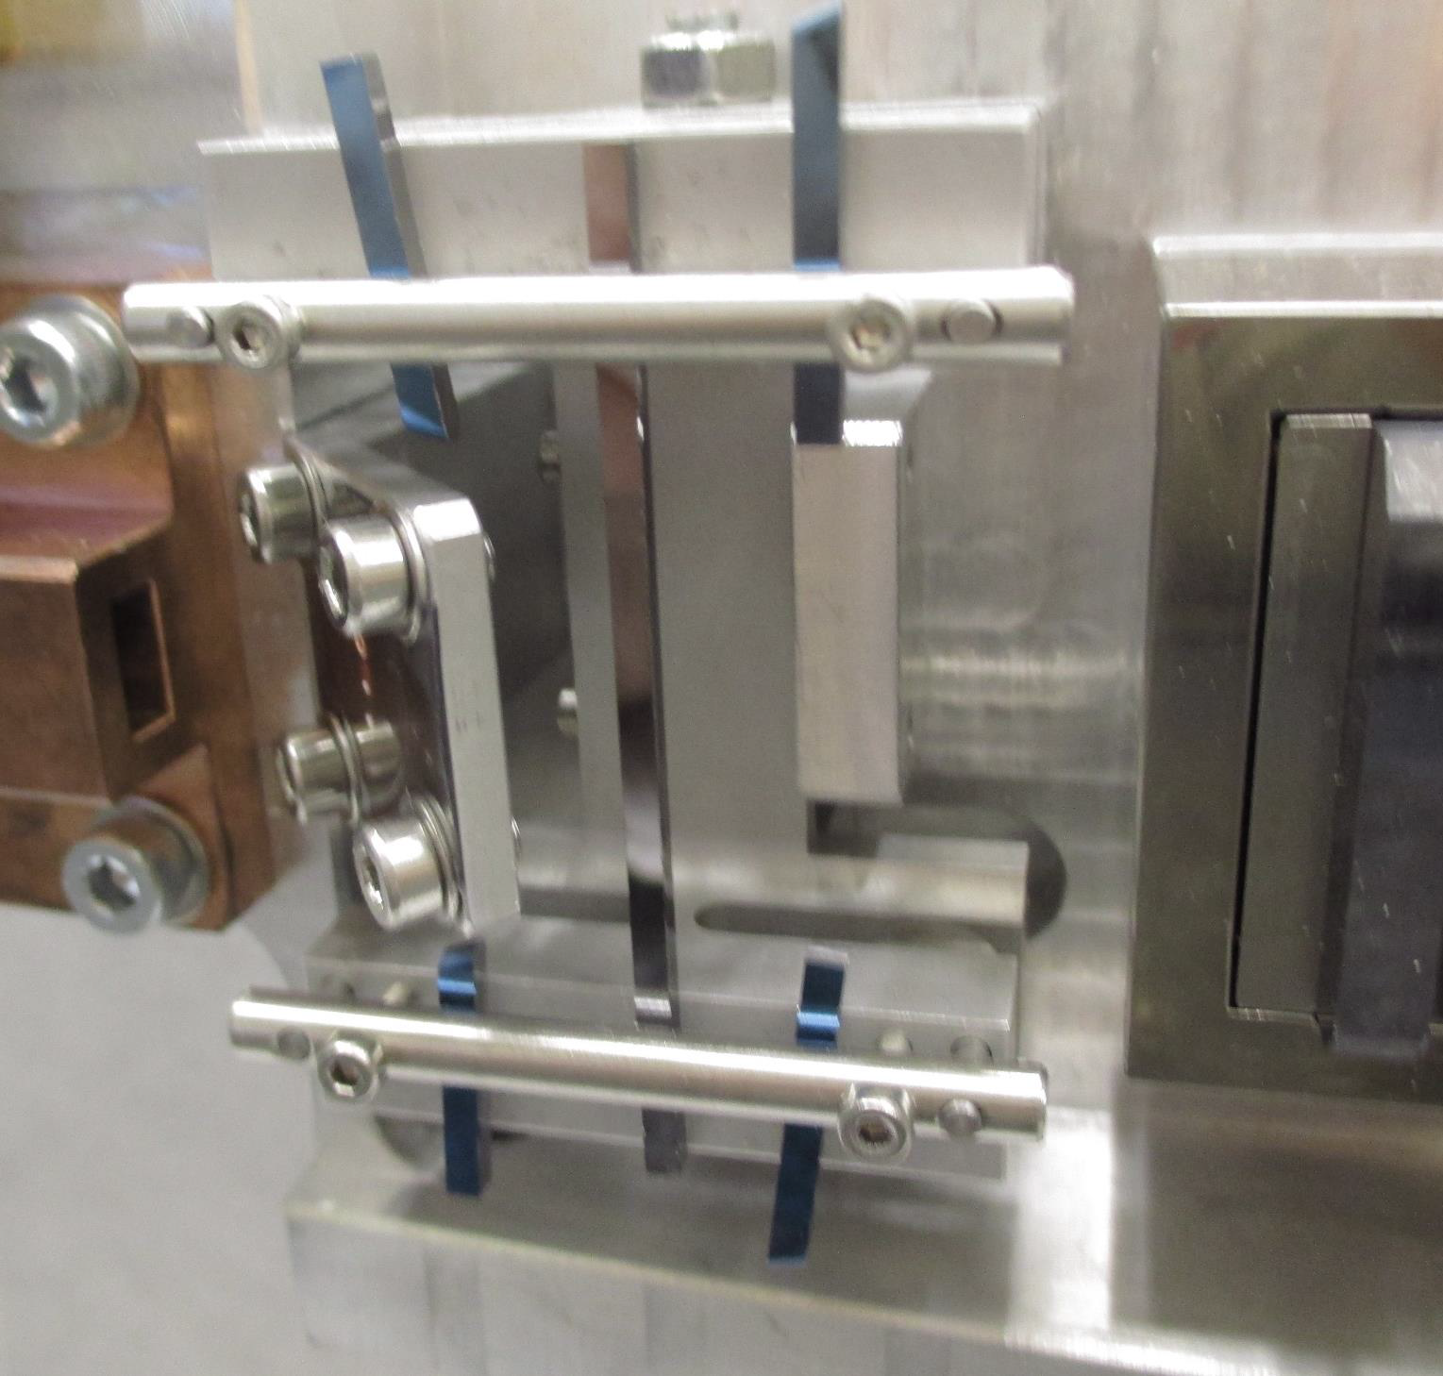
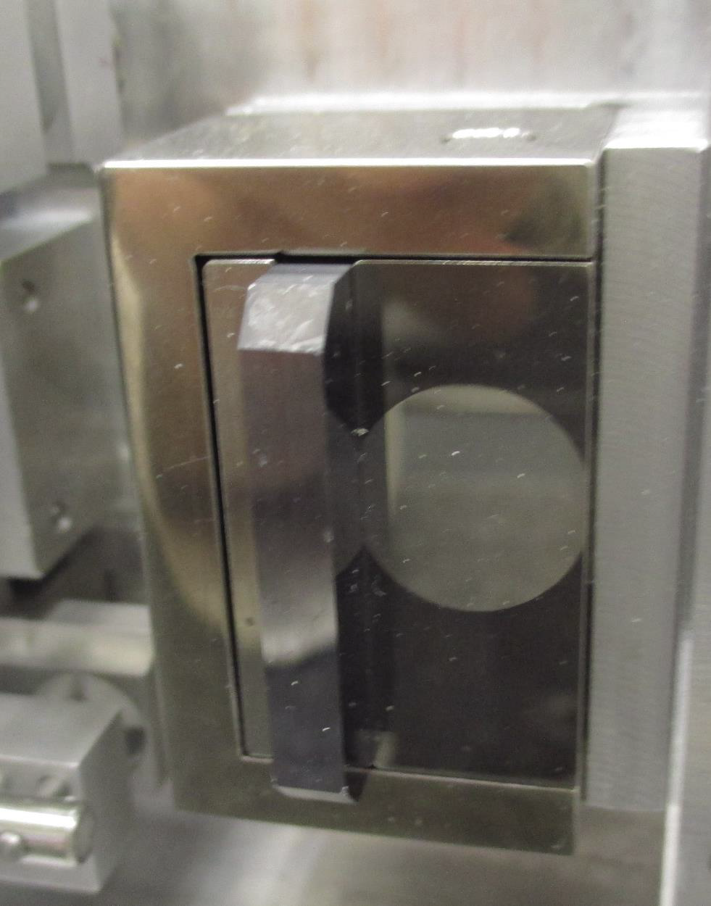
HiRadMat irradiation (2017)
A special thanks to the STI and SMM groups!!!
- E = 440 GeV
- 3 shots with 216 bunches
(~2.5e13 ppp)
- 1 shot with 288 bunches
(~ 3.2e13 ppp)
- ~ 0.3 x 0.3 mm size at 1σ
Alignment using losses read by BLM’s
The Setup
CuCrZr Mask for beam based alignment
2 different types of LHC crystals
No macroscopic damages after irradiation
Beam
STF103
QMP33
C. Torregrosa
Gafchromic foils for beam impact crosscheck

Slide 8
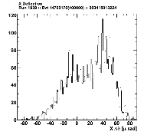
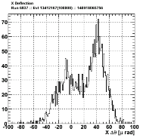
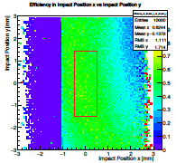
HiRadMat Crystals H8 results
2 LHC crystals irradiated in HiRadMat and tested before and after in H8
- 1st crystal fully analysed: tested with different beams: 400 GeV p & 180 GeV h⁺
Crystal | Θ_{CH} (before) (±1 µrad) | Eff. (before) (±2 %) | Θ (after) (±1 µrad) | Eff. (after) (±2 %)
STF103 | 55 (400 GeV p+) | 75 (400 GeV p+) | 54 (180 GeV π+) | 69 (180 GeV π+)
Crystal of the same kind of the STF103, tested with different beams but not irradiated
Crystal | Θ_{CH} (400 GeV p⁺) (±1 µrad) | Eff. (400 GeV p⁺) (±2 %) | Θ_{CH} (180 GeV h⁺) (±1 µrad) | Eff. (180 GeV h⁺) (±2 %)
STF105 | 51 | 74 | 52 | 64
- 2nd crystal under analysis: tested both times with 180 GeV h⁺
Very promising preliminary results…
Arbitrary units
On-line plots
Arbitrary units
Out of the crystal
In the crystal
Crystal before HiRadMat
Crystal after HiRadMat
CH efficiency 2D map

Slide 9
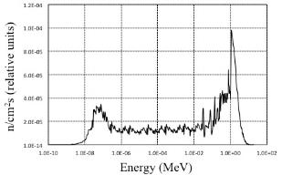
Crystal hi-dose neutron irradiation
A special thanks to the STI group !!!
Neutron energy spectrum
9 crystal samples have been irradiated at the SCK-CEN BR2 reactor
with 2.5 x 10²¹ neutrons/cm²
0 < E < 10 MeV
Two crystals samples ready to be measured in H8
19.89 x 10²⁰ n/cm²
5.01 x 10²⁰ n/cm²
- All the 9 crystal samples has been tested in H8 before and after the irradiation in the same conditions
- In particular, their channeling efficiency has been measured
- A mean channeling efficiency reduction of ~ 8 % after the irradiation has been registered

Slide 10
Crystal operational lifetime estimations
- To estimate the real crystal robustness in a hi-energy and intensity particle accelerator, we have to rescale the neutron effect to the proton and heavy ions ones, at different energies
- The parameter used for this rescaling is the number of Displacements Per Atom (DPA) produced during the irradiation
- Using FLUKA it was possible to compute the DPAs produced by the neutron spectrum of the BR2 reactor, by proton and Pb ions at different energies, computing the equivalent doses that produce ~ 8% of channeling efficiency decrease
- LHC collimation:
considering the LHC operational range in 2018, the crystal will lose ~ 8 % in efficiency in a time between ~ 5 and ~27 years
- SPS extraction (shadowing):
considering the machine parameters of the successful test performed in 2018, the crystal will lose ~ 8 % in efficiency in ~ 82 years
These results are a crystal reliability proof in terms of radiation hardiness,
also in hi-intensity hadron accelerator applications

Slide 11
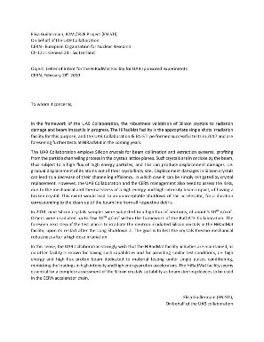
LoI: Crystal HiRadMat test on high-fluxes irradiated crystals
New HiRadMat test on high-flux irradiated crystals: to test crystal robustness to fast irradiation during injection or dump procedures at the end of their operational lifetime
The new HiRadMat test will be almost the same of 2017:
  Same beam features
  Same supports, tank, etc…
  Same alignment procedure
  only the crystals will be different: irradiated instead
  of not irradiated
Quite simple and standard test, but extremely important to
verify the reliability of the crystal technology
2019: Letter of Interest
from UA9 and STI group

Slide 12
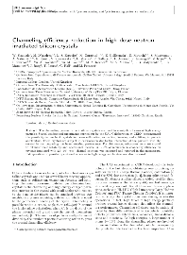
References
The studies about neutron irradiation have produced a paper recently submitted to the “European Physics Journal C”
The paper about the HiRadMat test are almost ready and will be submitted soon to the
“European Physics Journal C”
References
[1] M. Biryukov, Y. A. Chesnokov, and V. I. Kotov, “Crystal channeling and its application at high-energy accelerators”. Springer Science & Business Media, 2013
[2] W. Scandale et al., “Observation of channeling for 6500 GeV/c protons in the crystal assisted collimation setup for LHC”, Phys. Lett. B, 2016
[3] Fraser, M. A., et al. “Experimental results of crystal-assisted slow extraction at the SPS.” arXiv preprint arXiv:1707.05151 (2017).
[4] F. Addesa et al., “The SE-CpFM Detector for the Crystal-Assisted Extraction at CERN-SPS”, 6th Int. Beam Instrumentation Conf.(IBIC’17, Grand Rapids, MI, USA, 20-24 August 2017. JACOW, Geneva, Switzerand, 2018

Slide 13
Conclusions
The HiRadMat test proves the crystal robustness also in case of a machine accident
Crystal robustness test with hi-fluxes of neutrons is a proof of the crystal radiation hardiness also in hi-intensity hadron accelerator applications
The same test will be performed with hi-fluxes of protons
Future HiRadMat tests on hi-dose irradiated crystals (both with neutron & protons) are fundamental to definitely prove the reliability of the crystal technology

Slide 14
Thank you for your attention !
&
thanks a lot to all the UA9, EN and HRMT colleagues
strongly involved !!!

Slide 15
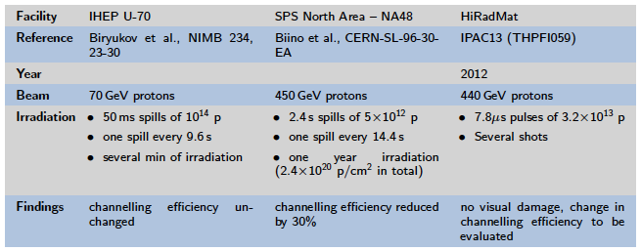
Crystal irradiation history
Moreover…
UA9 tested several bent silicon crystals for collimation MDs in SPS and LHC
Crystals have been irradiated for years during MD operations
Crystals suffered some accidental beam impacts
Crystals have shown always the same performances (angle and efficiency)
Crystals did not show macroscopic damages

Slide 16
LHC Crystal Collimation
[2]
Bent crystal
Deflected halo
Massive Absorber
Secondary halo
+ hadronic shower & Dechanneling
Circulating
beam
Primary halo
Insertion
Arc
IP
Main gains:
LHC design parameters for Silicon ST Crystals
Reduction of inelastic nuclear interactions
  Reduced off-momentum losses in DS
4 mm
1 mm
50 mm
Less collimators and with larger gaps
Impedance reduction
Beam
Similar performance with both p and Pb
  Significant improvement of w.r.t. present
Bending 50μrad B ≈ 300 T @ 7 TeV!

Slide 17
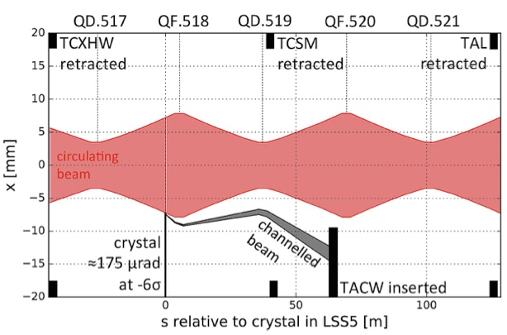
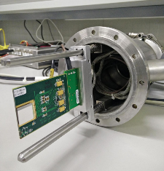
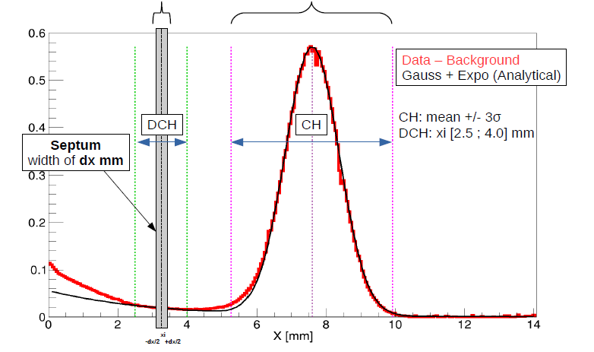
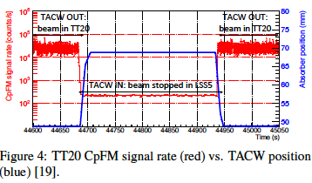
SPS crystal extraction
Joint activity with TE/ABT and EN/STI
2016 - slow non-local extraction of 270 GeV p⁺ in channeling mode [6] [7]
beam into the TT20 extraction line towards the North Experimental Area of the SPS was demonstrated using the extraction septa and a bent crystal
2018 - “Virtual” non-resonant local beam extraction of 270 GeV p⁺ in channeling mode
Timepix
Circulating beam
270 GeV p⁺
Extraction in 2 turns
Edge of the circulating beam core
NDCH(xi)/dx
NCH
Halo density in channeling mode along the horizontal axis
(self-normalized to the total No of impinging particles)
UA9 CpFM
(“Cherenkov for proton Flux Measurements”)
detector for SPS and LHC has seen the extracted beam
0.2 mm thick virtual septum
Extracted beam
loss ratio R ≈ N_{DCH} / N_{CH}= ~6 ‰

Slide 18
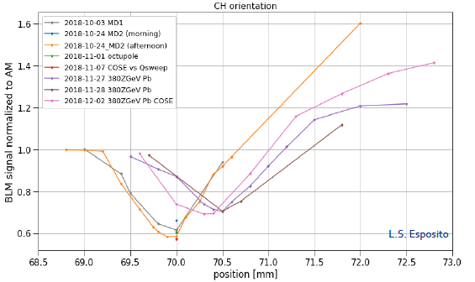
SPS slow extraction with crystal shadowing
This technique is developed to reduce the number of particles on the SPS
extraction septum (ZS wires) and consequently the extraction losses
A crystal is used upstream to shadow the ZS wires deflecting the particles that would hit him
In 2018, a feasibility test has been performed and a reduction of 40 % of losses with protons and 30 % with lead ions was observed

Slide 19
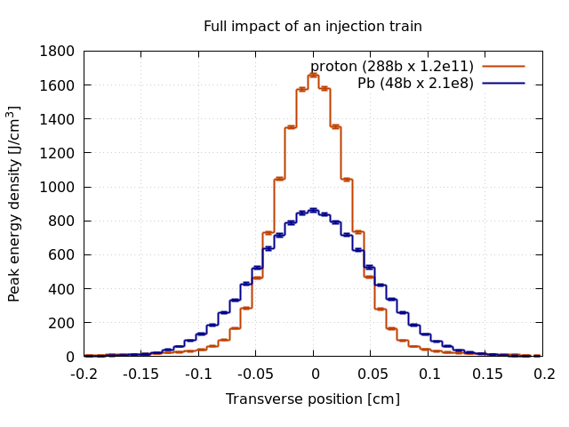
FLUKA simulations
Accidental impact on crystal at injection
 | Protons | Pb
Energy [GeV] | 450 | 450 Z
#bunches | 288 | 48
#particles/bunch | 1.2E11 | 2.1E8
Norm. emit. [μm] | 1.3 | 1.5
- Impact of a full injection
train on TCPCV.A6R7.B2
(smaller β_{x}·β_{y})
- Crystal assumed as
amorphous
- Same optics for the
injection of proton and Pb
L. Esposito
Remark on induced energy densities:
Due to small dimensions of the crystal (4 mm thick) peak energy density dominated by ionising energy loss of impacting protons
Electronic stopping power of protons in silicon only varies by 10% between 440 GeV and 7 TeV → a test in HiRadMat with 288 bunches at 440 GeV allows also for conclusion valid at higher energies
For an asynchronous beam dump at top energy few bunches are expected to be lost on the crystal

Slide 20
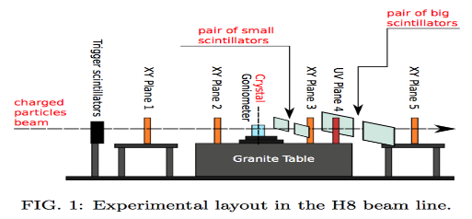
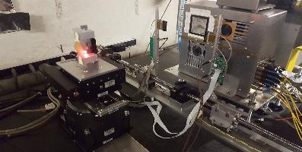

UA9 Experimental apparatus at the H8 SPS extraction line
High rate and high angular resolution beam telescope based on CMS Tracker HW&SW
M. Pesaresi, T. James, J. Borg
10 m
10 m
Main steps in the characterization of bent crystals:
- Systematic error < 1µrad
- Statistical error negligible
Alignment run: only the tracking stations are in the beam line
Linear scan: the crystal is placed on the beam line
3. Angular scan: ~10⁵ events/step are acquired around the channeling orientation looking for CH
4. High statistics runs:
- the crystal is left in the optimal channeling position for hi-stat. of ~16 M events

Slide 21

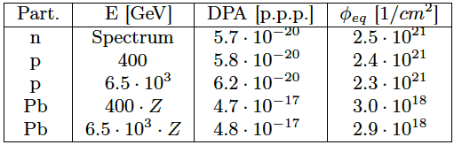
Rescaling to different particle and energy
- To estimate the real crystal robustness in a hi-energy and intensity particle accelerator, we have to rescale the neutron effect to the proton and heavy ions ones, at different energies
- The parameter used for this rescaling is the number of Displacements Per Atom (DPA) produced during the irradiation
ρ = atomic density
Ni = number of particles per interaction channel
N_{i}^{F} = number of Frenkel pairs (dislocations)
- Using FLUKA it was possible to compute the DPAs produced by the neutron spectrum of the BR2 reactor and by proton and Pb ions at different energies

