Slide 1
HiRadMat tests on collimator elements
F. Carra
with contributions from O. Aberle, C. Accettura, A. Bertarelli, G. Gobbi, I. Lamas, M. Pasquali, J. Guardia-Valenzuela, T. Lefevre, M. Guinchard, A. Masi, E. Skordis, S. Redaelli and many others
International HiRadMat Workshop
CERN, Geneva
July 12th, 2019

Slide 2
Outline
LHC collimators
Beam impact tests on collimators
  Categories of tests
  Before HiRadMat
  With HiRadMat
What tests do we need for HL-LHC?
Conclusions

Slide 3
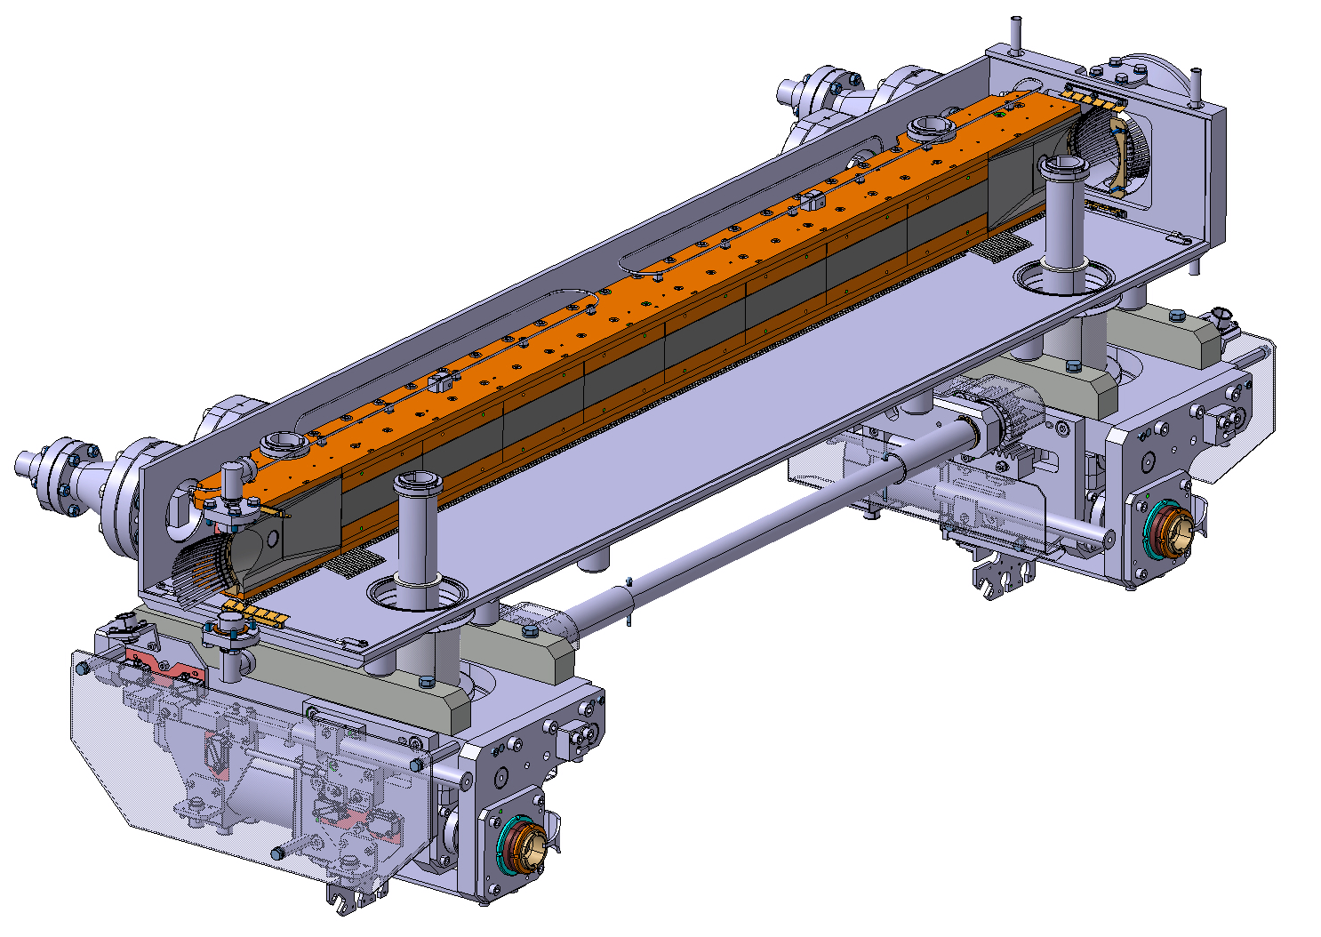
LHC collimators
Two main functions:
  Beam cleaning
  SC magnet protection
Design quite similar between collimator families, main changes are in the jaw
Potentially impacted by the beam in accidental scenarios
Lighter materials for jaws closer to the beam, heavier for jaws more opened
Vacuum tank
Jaw
Actuation system

Slide 4
Beam impact tests
Advanced numerical analysis in the design phase must be complemented by experimental tests
Necessary to assess consequences of an impact to the structure unpredictable with numerical codes (e.g. consequences to vacuum, contamination, etc.)
Also, need of deriving material models for the thermomechanical calculations
Three main test categories:
  Material samples
  Collimator sub-assemblies
  Full collimators

Slide 5
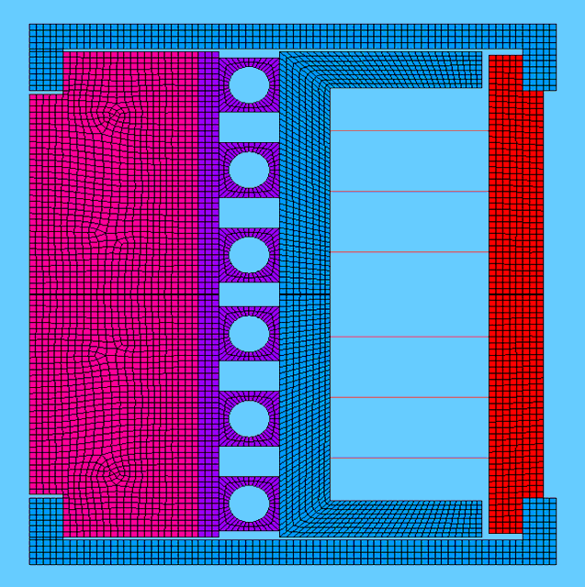
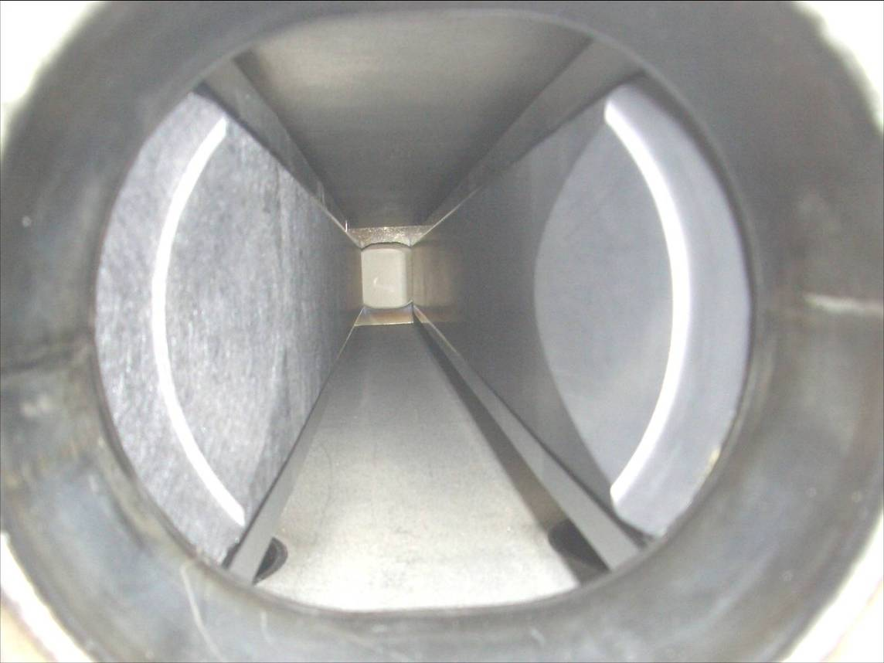
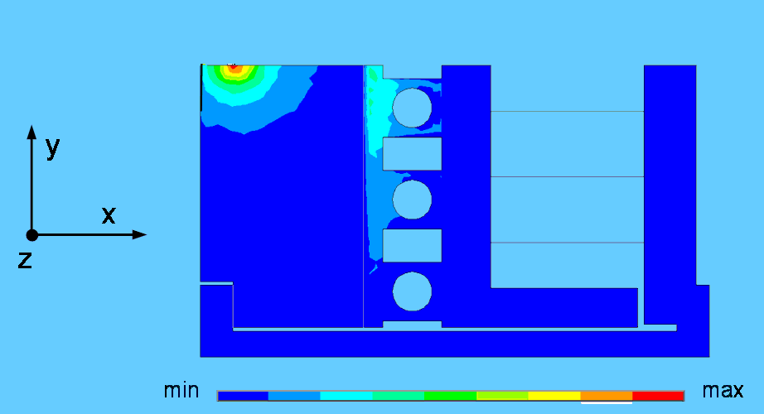
Before HiRadMat
Before availability of the HiRadMat facility, tests on collimator sub-assemblies (B) (CFC and graphite jaws, with copper and Glidcop housing) in TT40 and TT60 (2004 and 2006)
Impacts of 288 b, 450 GeV, σ = 1 mm² → design accidental scenario (beam injection error)
Very important to assess the robustness of graphitic materials
Allowed to choose Glidcop over copper for the metallic structure
Typical collimator cross-section
5 mm
Power Density distribution [W/m³] from FLUKA team
Carbon/Carbon jaw block
Graphite jaw block

Slide 6
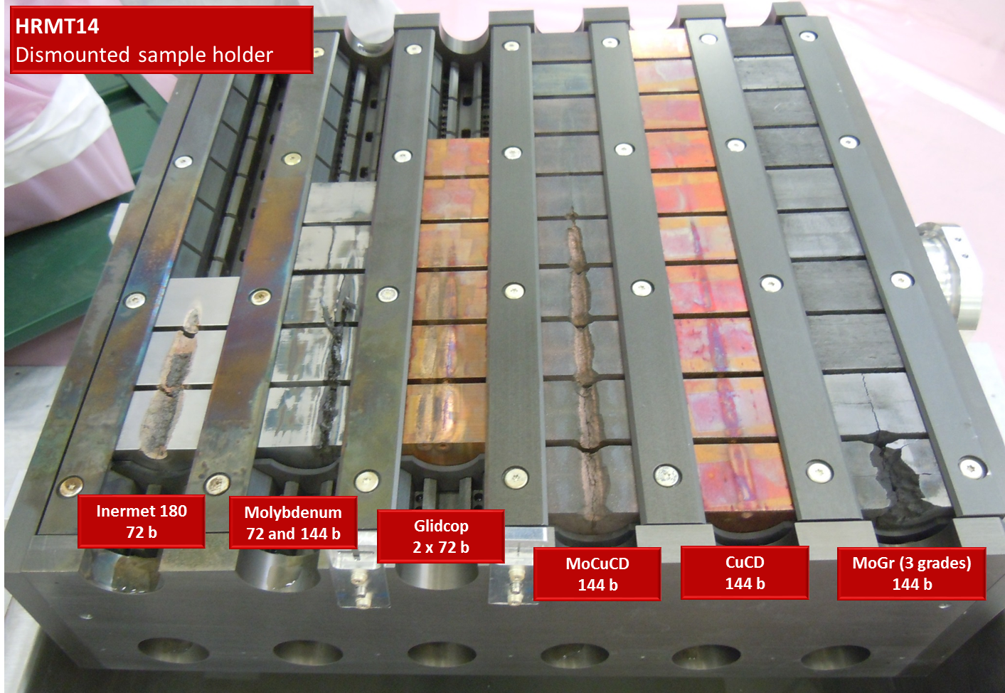
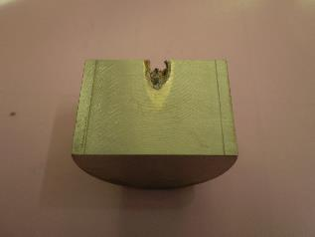
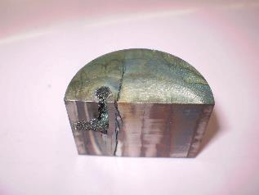
With HiRadMat: tests on material samples (A) – HRMT14 (2012)
Test of specimens from 6 different materials: Inermet180, Mo, Glidcop, MoCuCD CuCD, and MoGr (very old grade with high density, 5.4 g/cm3)
Allowed characterization of materials of interest for collimators
Tuning of numerical models, with very good benchmarking between measurements and simulations
Inermet specimen
Molybdenum specimen
A. Bertarelli et al. (2013). An experiment to test advanced materials impacted by intense proton pulses at CERN HiRadMat facility. Nucl. Instr. Meth. Phys. Res. B 308:88–99.

Slide 7
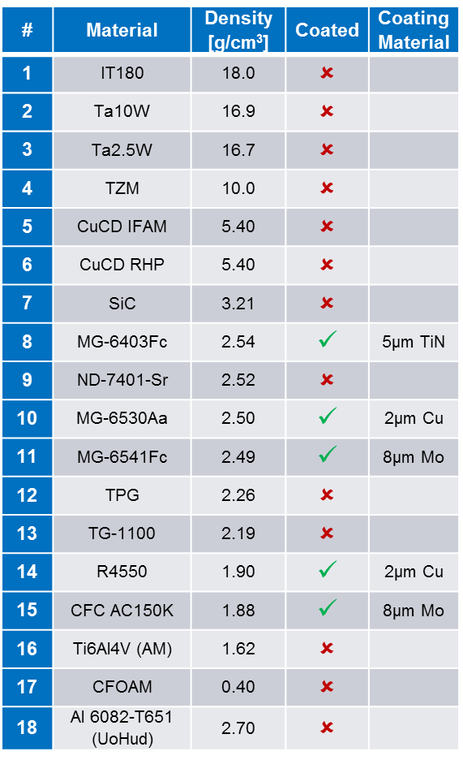
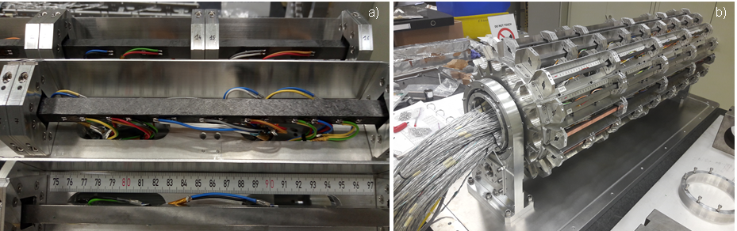
With HiRadMat: tests on material samples (A) – HRMT36 (2017)
Test on 16 target stations, including coated and uncoated material targets (rods) and electronic devices
Specimen geometry chosen to:
  Generate easily detectable uniaxial signals
  Enhance maximum energy per section (factor 2-3 above HL-LHC!) thanks to sample section ~1/10 of collimator jaw section
  Energy density peak enhanced by squeezing the beam (30-50% above HL-LHC)
high
density
medium
density
low
density
Dedicated setup

Slide 8
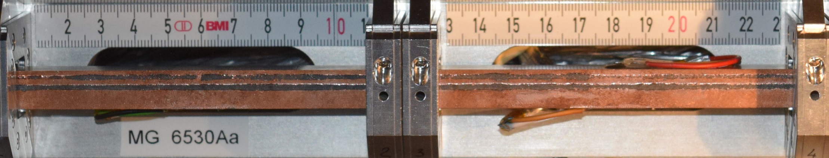
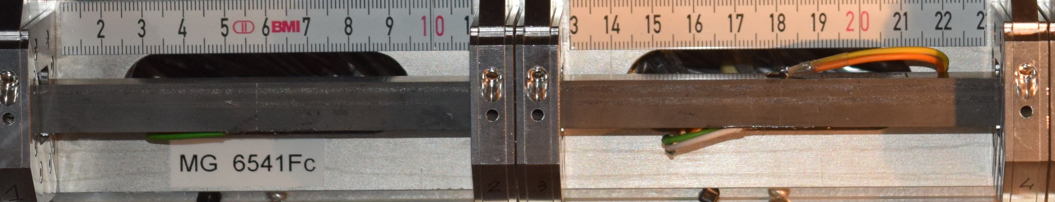
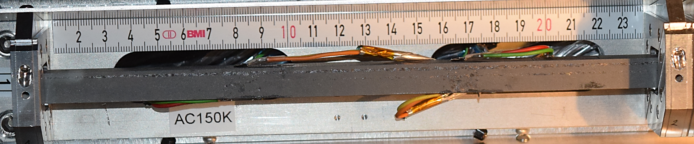
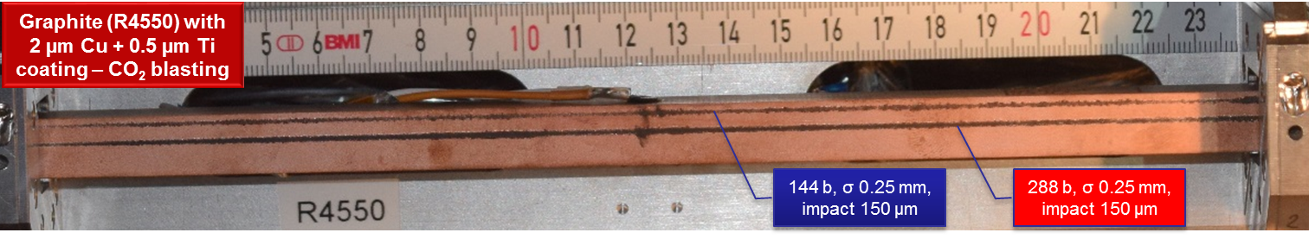
With HiRadMat: tests on material samples (A) – HRMT36 (2017)
E_{MAX}=7.68 kJ/cm³ (bulk)
E_{MAX}=15.3 kJ/cm³ (coat.)
σ_{real} =0.29x0.26 mm
144 b, σ_{nom} 0.25 mm, impact -150 µm
288 b, σ_{nom} 0.25 mm, impact -500 µm
E_{MAX}=6.11 kJ/cm³ (bulk)
E_{MAX}=13.9 kJ/cm³ (coat.)
σ_{real} =0.29x0.31 mm
288 b, σ_{nom} 0.25 mm, impact -500 µm
288 b, σ_{nom} 0.25 mm, impact -150 µm
E_{MAX}=3.72 kJ/cm³ (bulk)
E_{MAX}=14.3 kJ/cm³ (coat.)
σ_{real} =0.38x0.23 mm
288 b, σ_{nom} 0.25 mm, impact -150 µm
288 b, σ_{nom} 0.25 mm, impact -500 µm

Slide 9
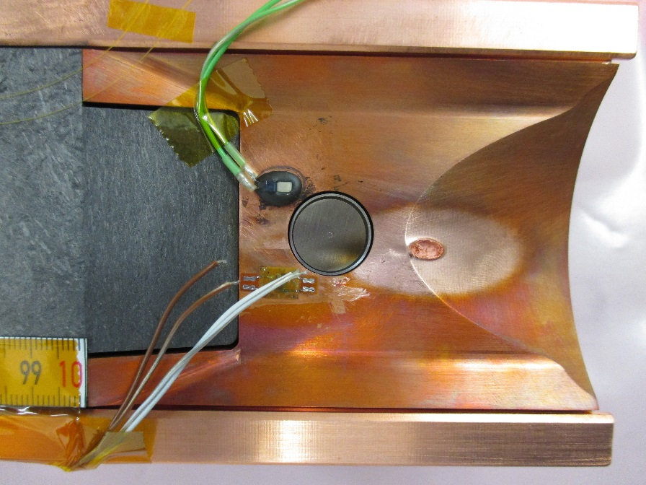
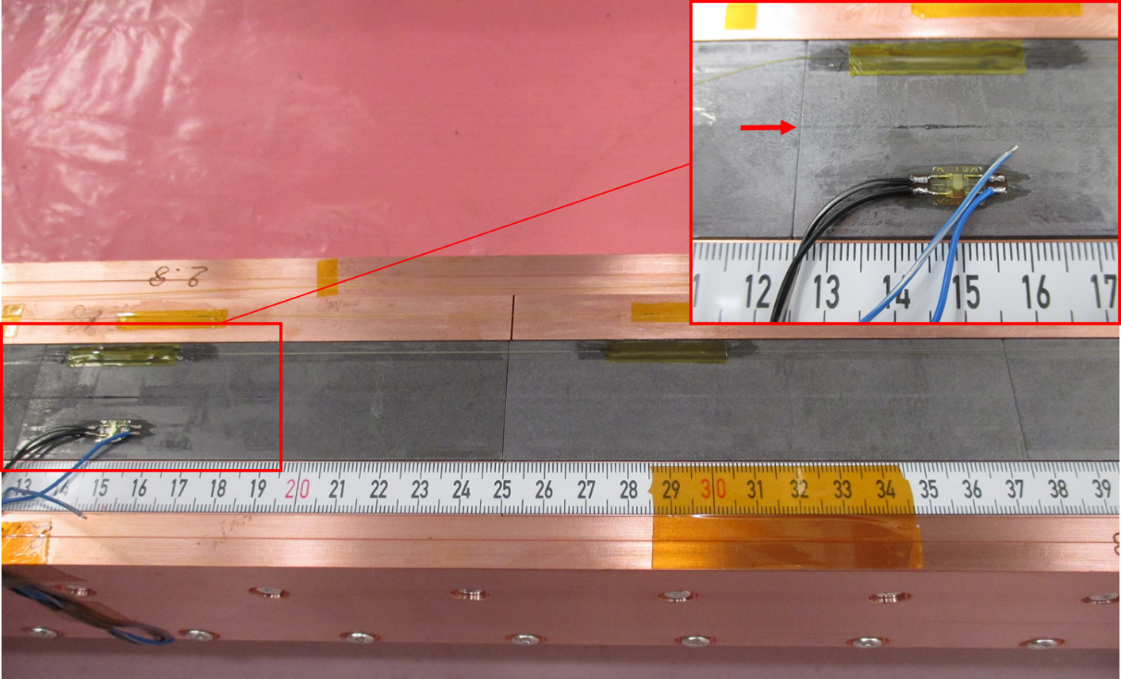
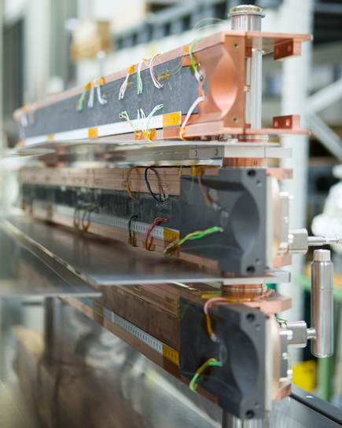
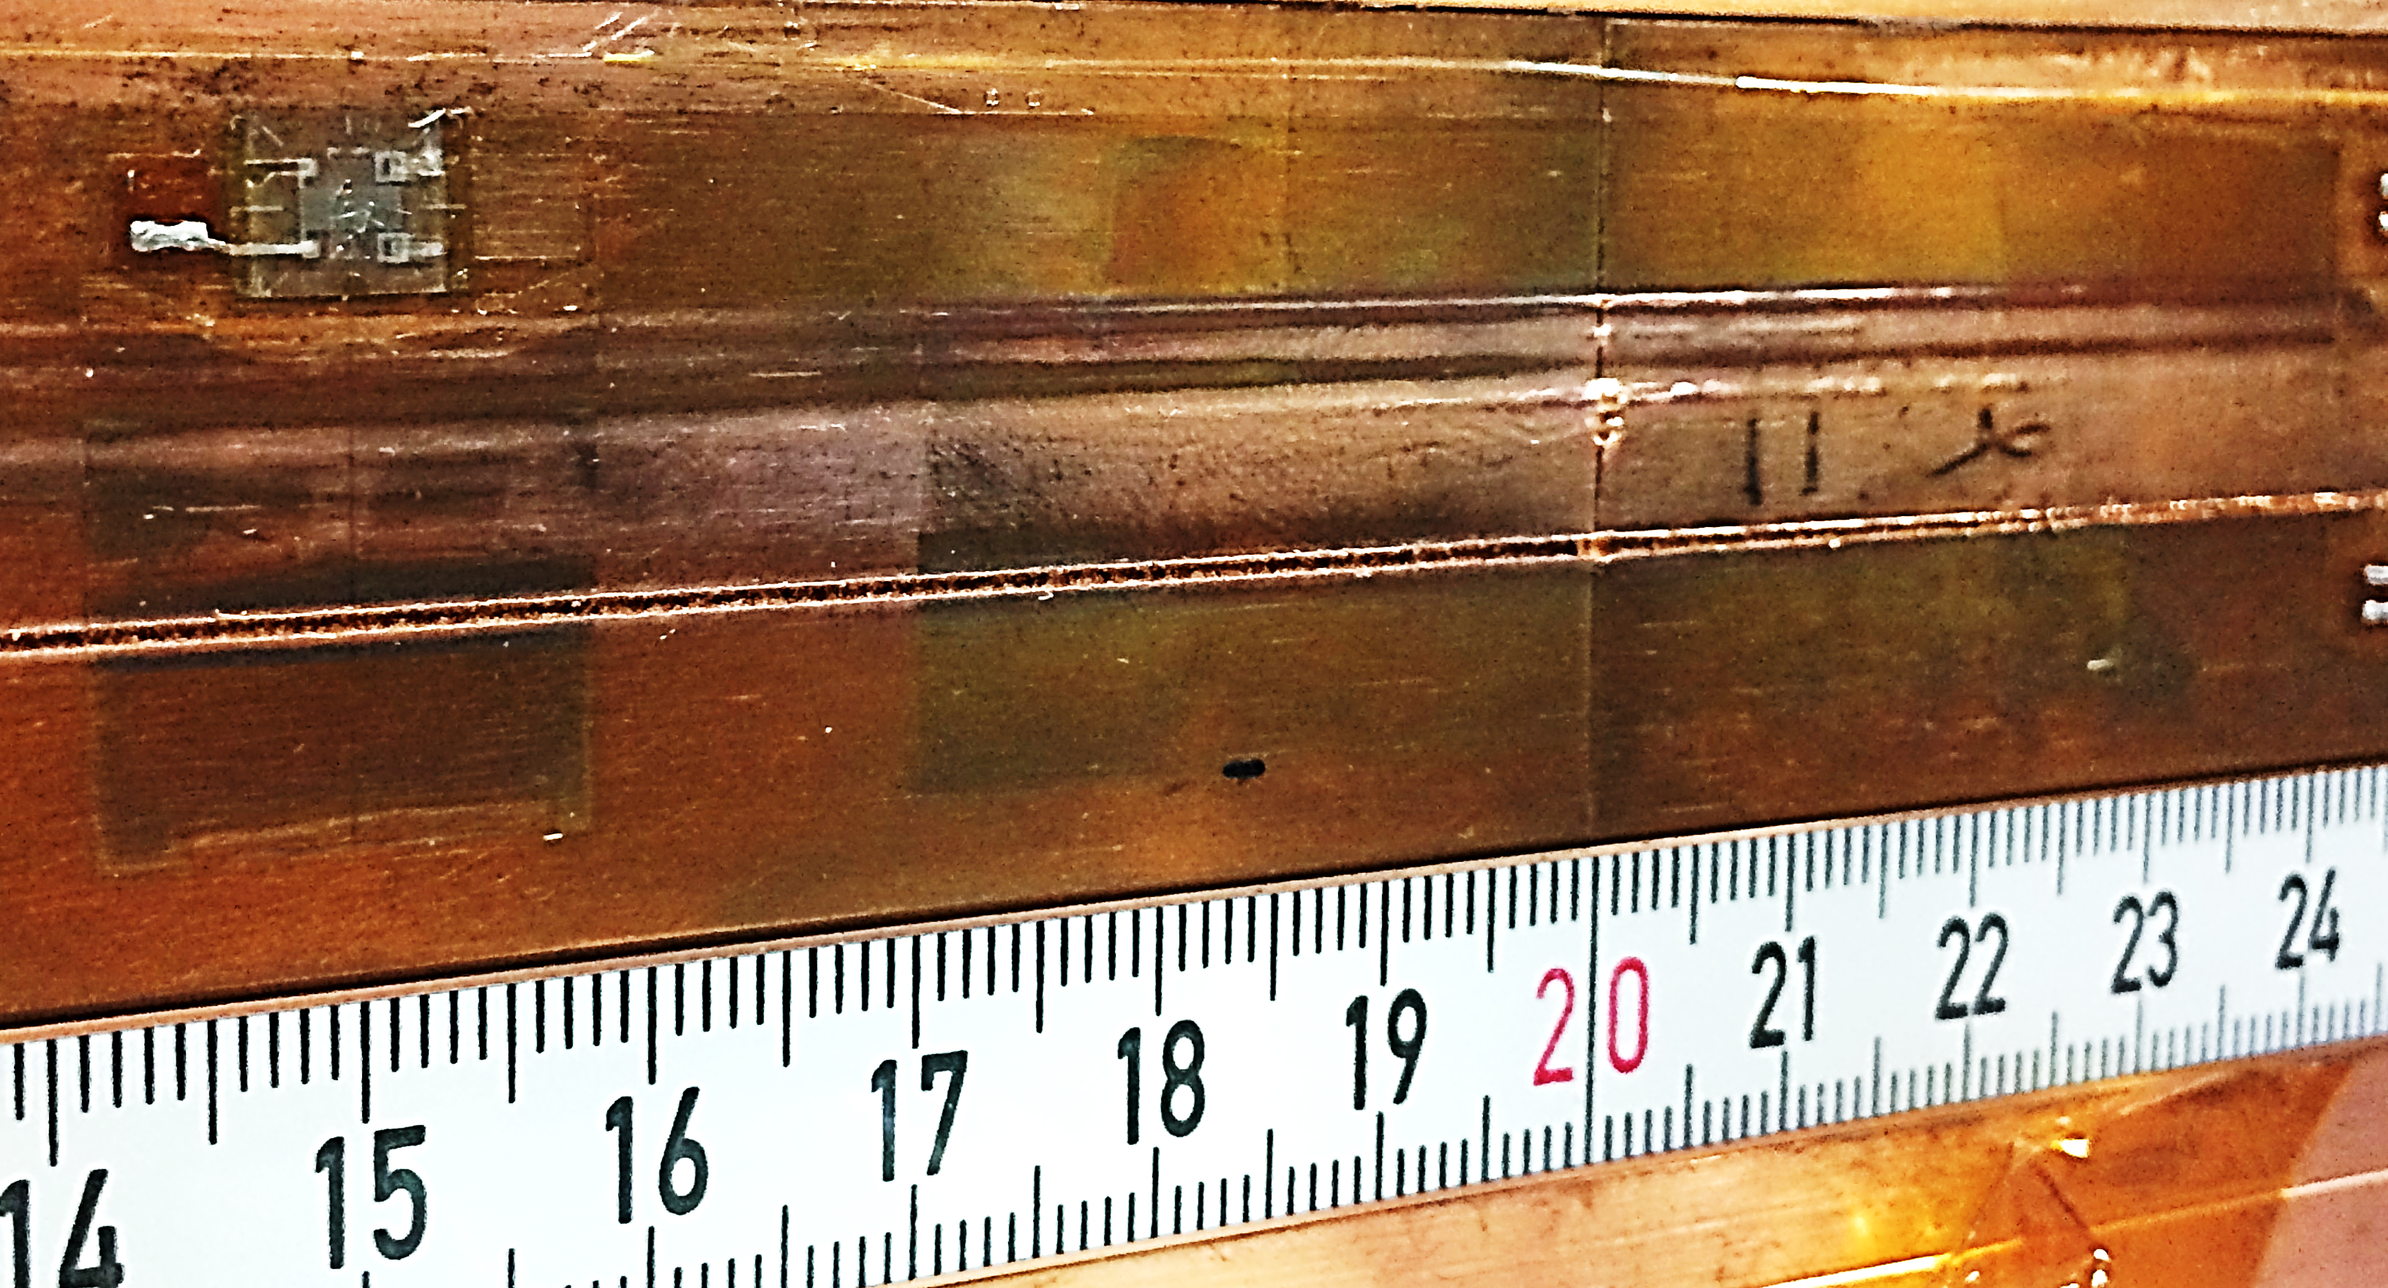
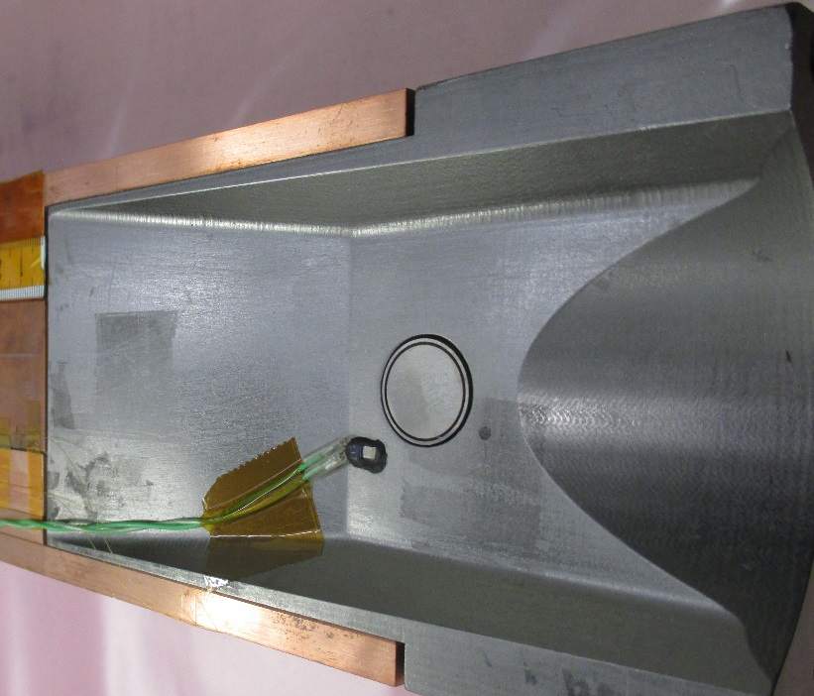
With HiRadMat: tests on collimator sub-assemblies (B) – HRMT23 (2015)
Test on three collimator jaws: CFC (LHC design), MoGr and CuCD (HL-LHC design)
Allowed validation of absorber jaw materials, as well as additional elements (taperings, BPM, housing, cooling circuit, brazing)
MoGr jaw
CuCD jaw

Slide 10
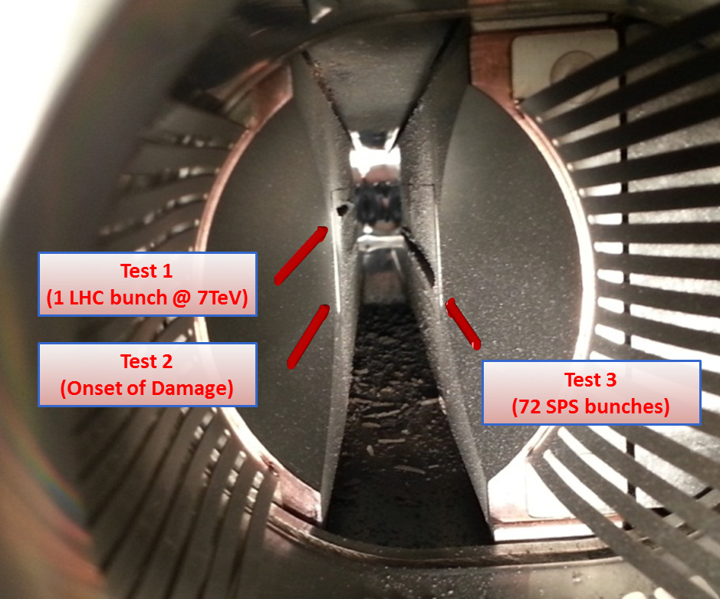
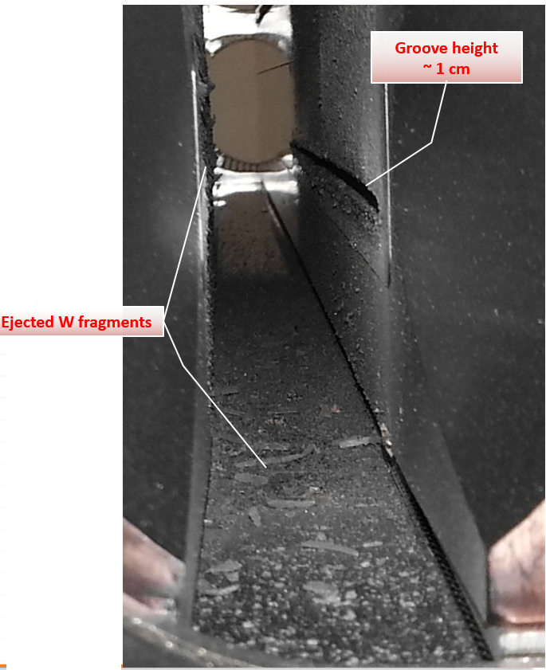
With HiRadMat: tests on full collimators (C) – HRMT09 (2012)
Testing of a spare TCT full collimator
Allowed to derive damage limits for tertiary collimator jaws (Inermet180)
Highlighted additional potential machine protection issues on top of mechanical damage, due to projection of fragments and dust (UHV degradation, contamination of vacuum chambers, complication of dismounting procedure)

Slide 11
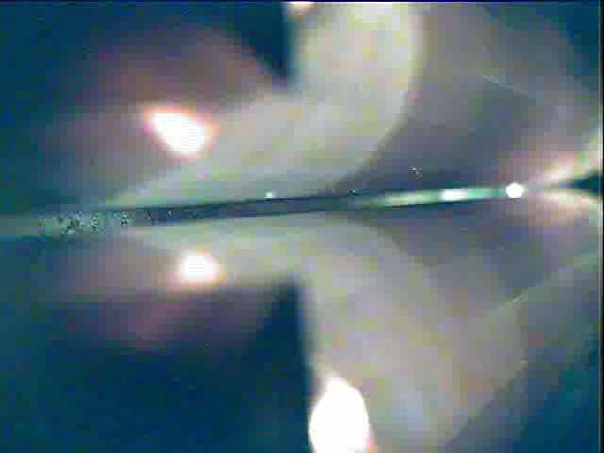
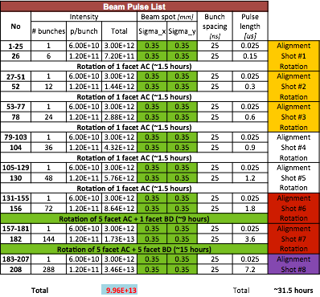
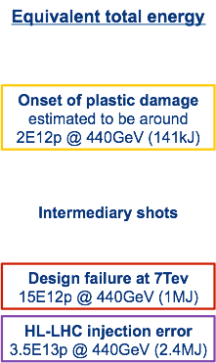
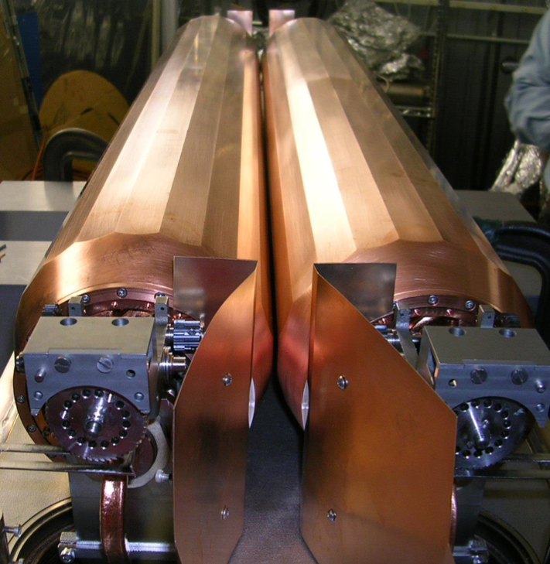
With HiRadMat: tests on full collimators (C) – HRMT21 (2017)
Test on SLAC rotatable collimator (Glidcop)
Low-impedance secondary collimator capable of withstanding 7 TeV failures
Shot 7 – 288b

Slide 12
Future tests for HL-LHC
With LIU and HL-LHC, the bunch intensity will go up by almost a factor of 2 (1.3E11 p → 2.2E11 p)
So far, the HL-LHC energy density peak has been mimicked by squeezing the beam
However, HL-LHC equivalent energies per section could be achieved only on samples (reducing the section)
The maximum energy per section is the relevant parameter in case of extensive failure (production of debris, UHV contamination, etc.), as well as for the onset of damage in graphitic materials
Also, it is the only way to reproduce the energy shower on collimator elements not directly impacted by the primary protons (housing, taperings, BPM, pipes, etc.)
Future tests (categories A, B, C) in HiRadMat with the HL-LHC ultimate bunch intensity are of paramount importance for the Collimation Project, and of strong interest for the scientific community for extending the validity of material models

Slide 13
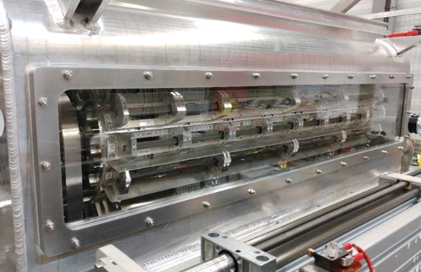
Future tests for HL-LHC
Aim is re-using as much as possible the expensive elements of previous test benches (mirrors, windows, feedthrough, pumps, supports, etc.)
For experiments of category A (material samples), multi-purpose tank with rotatable barrel to host up to 16 samples of desired geometry
For experiments of category B (sub-assemblies), we will see if we can re-use a tank adopted for past experiments
For the tests of category C (full collimators), prototypes at the end of their qualification lifetime will be adopted

Slide 14
Conclusions
HiRadMat allowed to push tests on collimator elements with respect to previous experiments in the SPS transfer lines (more extensive instrumentation, cameras, online diagnostics, controlled beam size and parameters)
In the time period 2012-2017, important experiments were run in HiRadMat, providing key elements for the design of new collimators, and for the improvements of the understanding of the beam/matter interaction and simulations
In view of the increase of beam stored energy in HL-LHC, as well as in future accelerators under design (FCC, CEPC-SPPC, etc.), we believe that continuing the experimental studies in a future HiRadMat run is of paramount importance for the Collimation project, as well as for similar beam intercepting devices
The material models that could be extended are of relevant scientific interest in all applications were dynamic loads are involved

Slide 15

Thanks for your attention!

