Slide 1

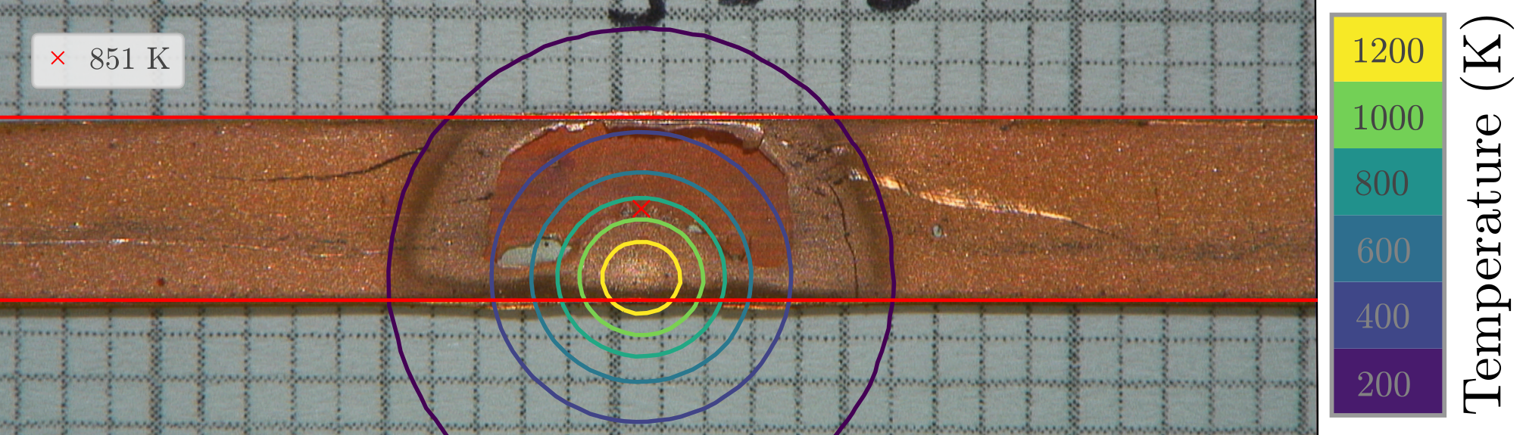
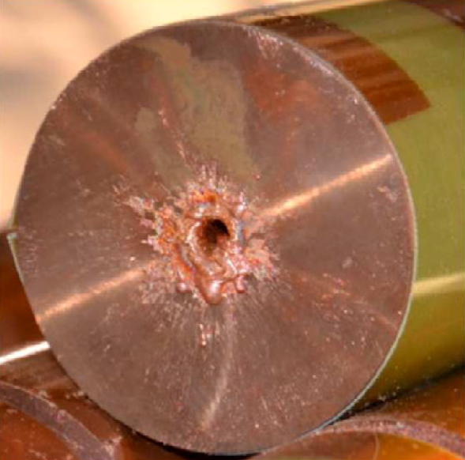
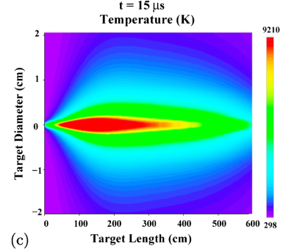
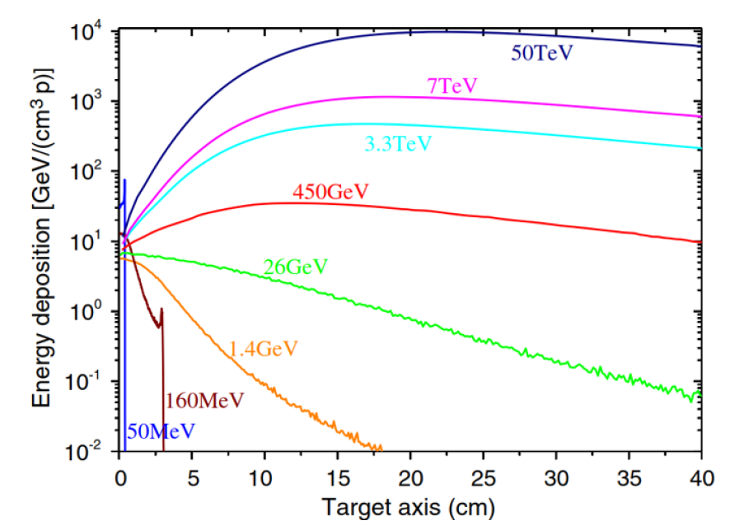
Experiments for machine protection: from consequences of beyond-design failures to damage limits of sc. magnets
C. Wiesner, D. Wollmann, CERN, Geneva, Switzerland
with input from: F. Burkart, A. Oslandsbotn, R. Schmidt, V. Raginel, J. Schubert, A. Siemko, A. Verweij,
A. Will, M. Zerlauth

Slide 2
Outline
Motivation: Experiments for Machine Protection (MP)
Letter of Interest 1: Damage limits of superconducting materials
  Performed experiments: Damage tests of Nb-Ti and Nb₃Sn strands at room temperature and at 4.5 K
  Proposed experiments: Damage limits of superconducting coils
Letter of Interest 2: Beyond-design failures and hydrodynamic tunnelling
  Performed experiment: First proof of hydrodynamic tunnelling
  Proposed experiments: Investigation of hydrodynamic-tunnelling effects and tests of new absorber materials and mechanisms
Conclusions

Slide 3
Motivation: Experiments for MP
Stored beam energy
 | LHC nominal | HL-LHC standard | FCC-hh
Stored energy per beam | 0.36 GJ | 0.68 GJ | 8.3 GJ
Typical* beam-energy density | 1.6 GJ/mm² | 4.4 GJ/mm² | 220 GJ/mm²
*Assuming: β = 100 m for (HL-)LHC and β = 200 m for FCC.
The stored beam energy at LHC, HL-LHC and future machines is a major machine-protection (MP) challenge.
Accidental release of this energy would lead to high energy deposition in short time scales.
Fast (~milliseconds) and ultra-fast (<hundreds of µs) failures can be caused by existing and new equipment in the LHC and HL-LHC.
Experimental beam-impact studies are required to estimate the failure consequences and define the reliability requirements for the protection elements, whilst optimizing the machine’s physics output.

Slide 4
Letter of Interest 1: Study the damage limits of superconducting coils

Slide 5
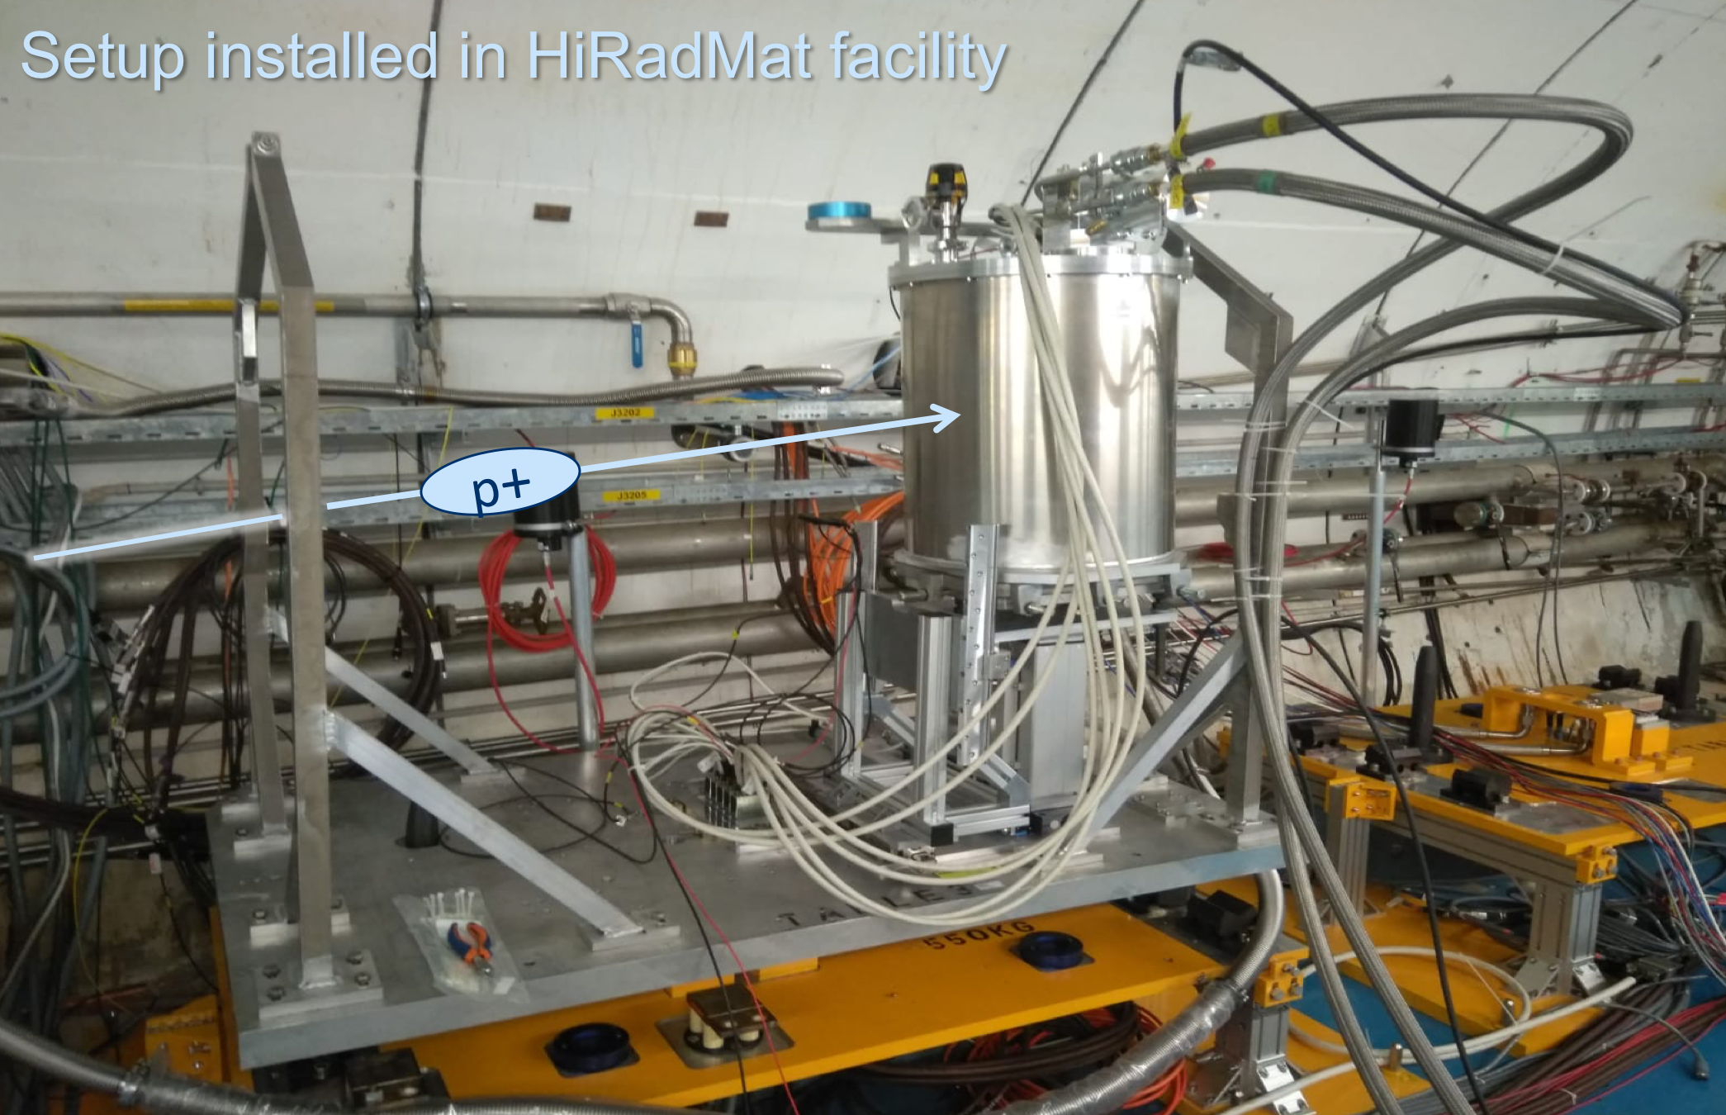
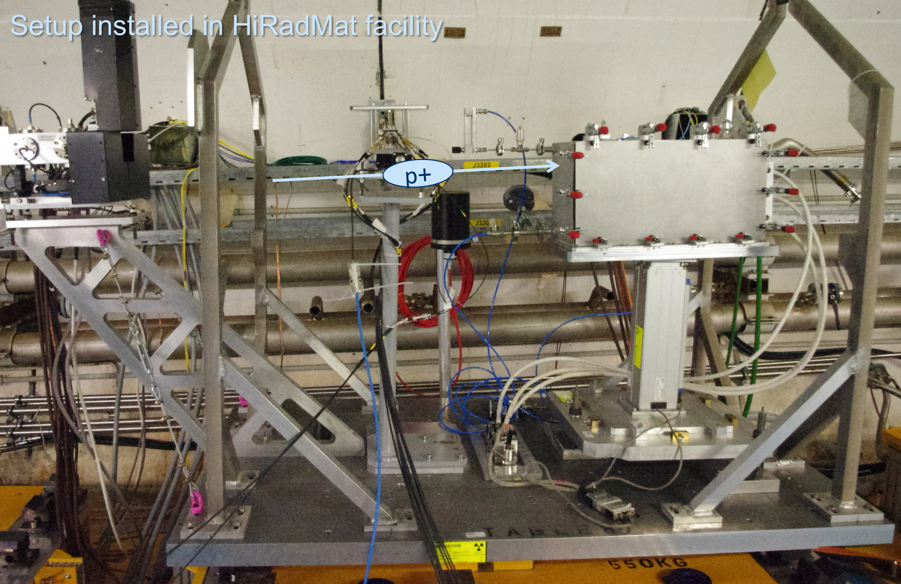
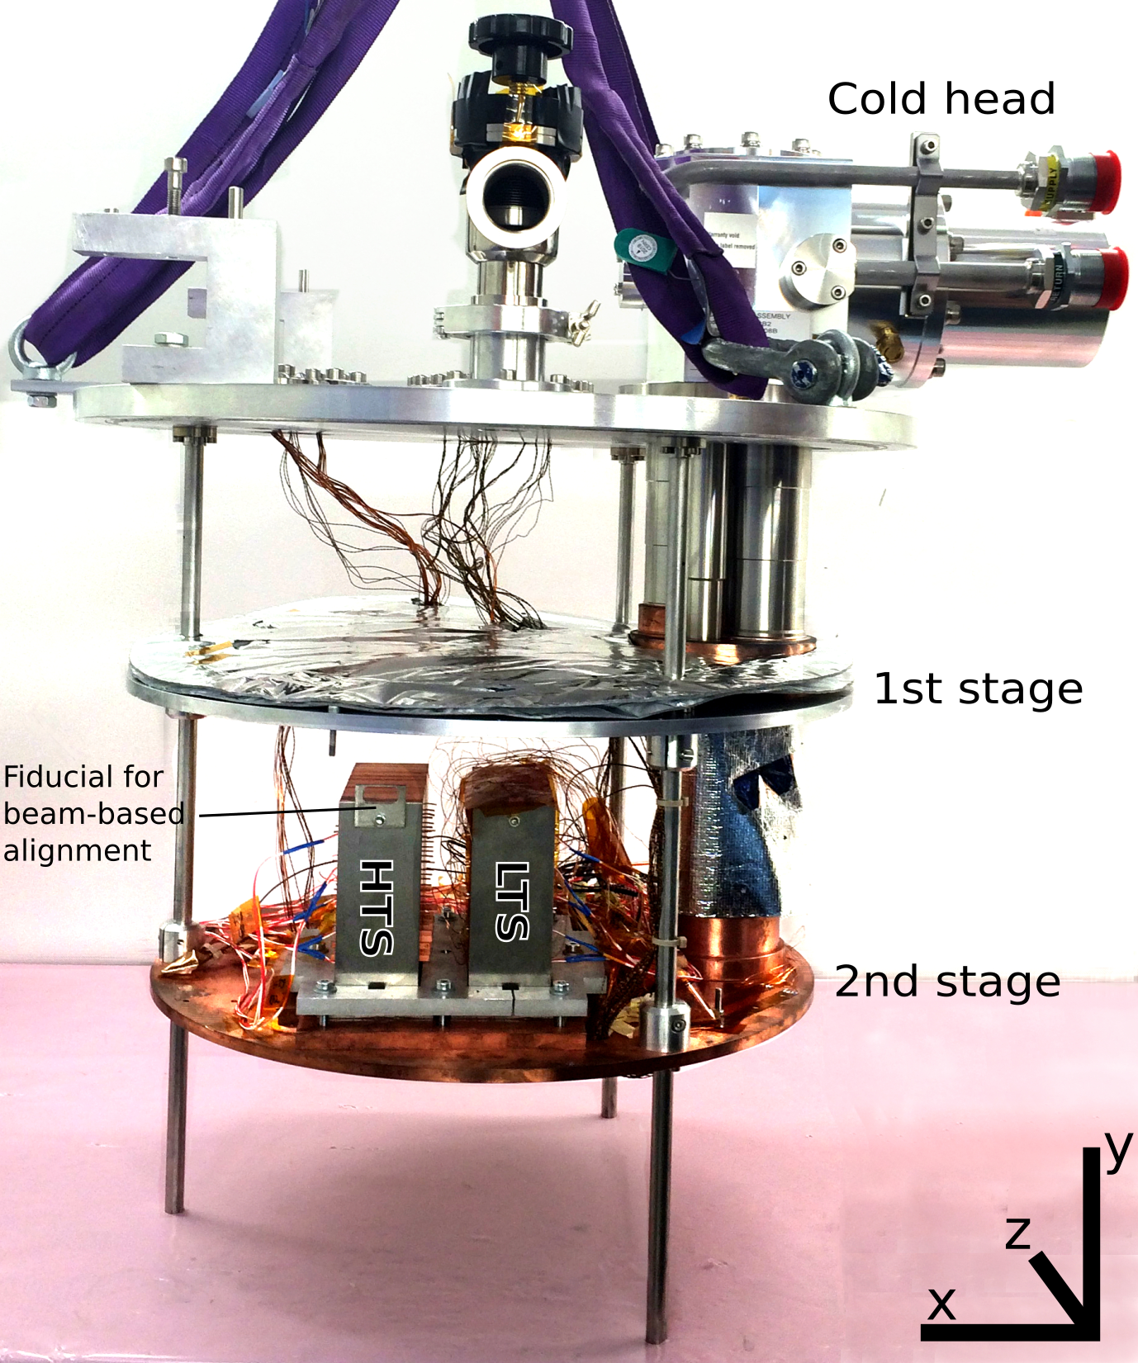
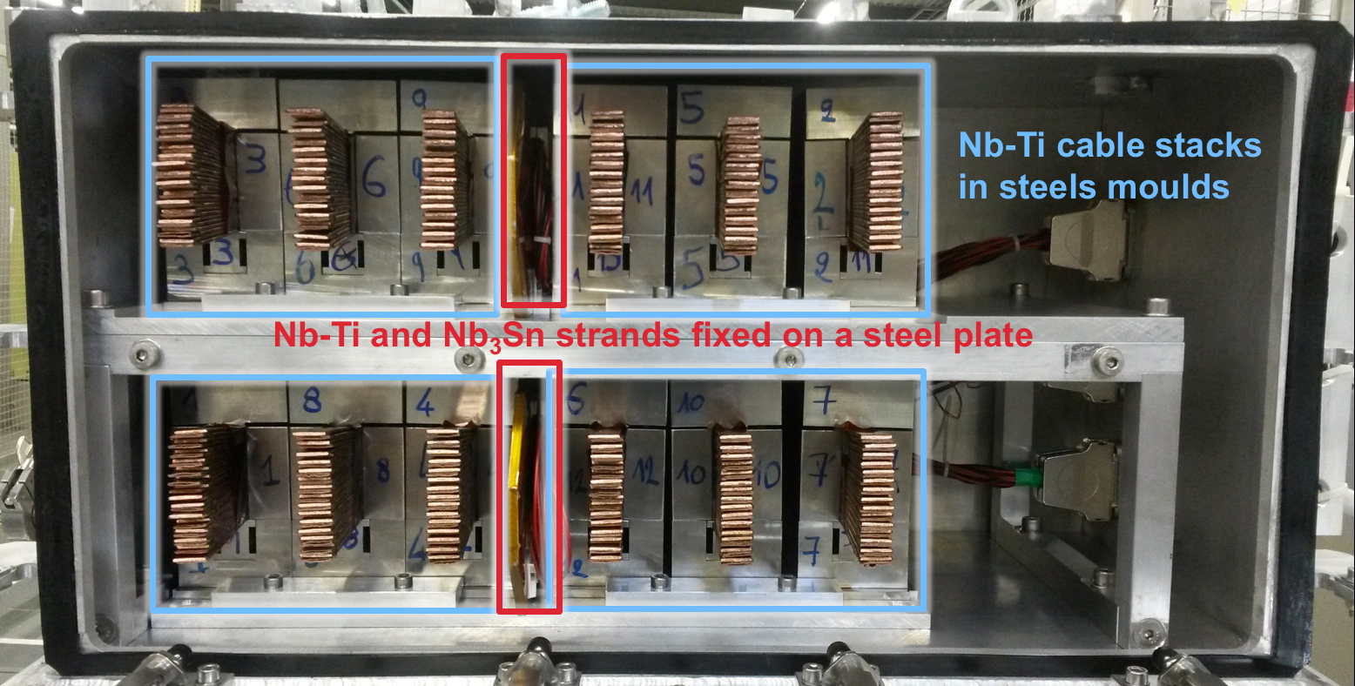
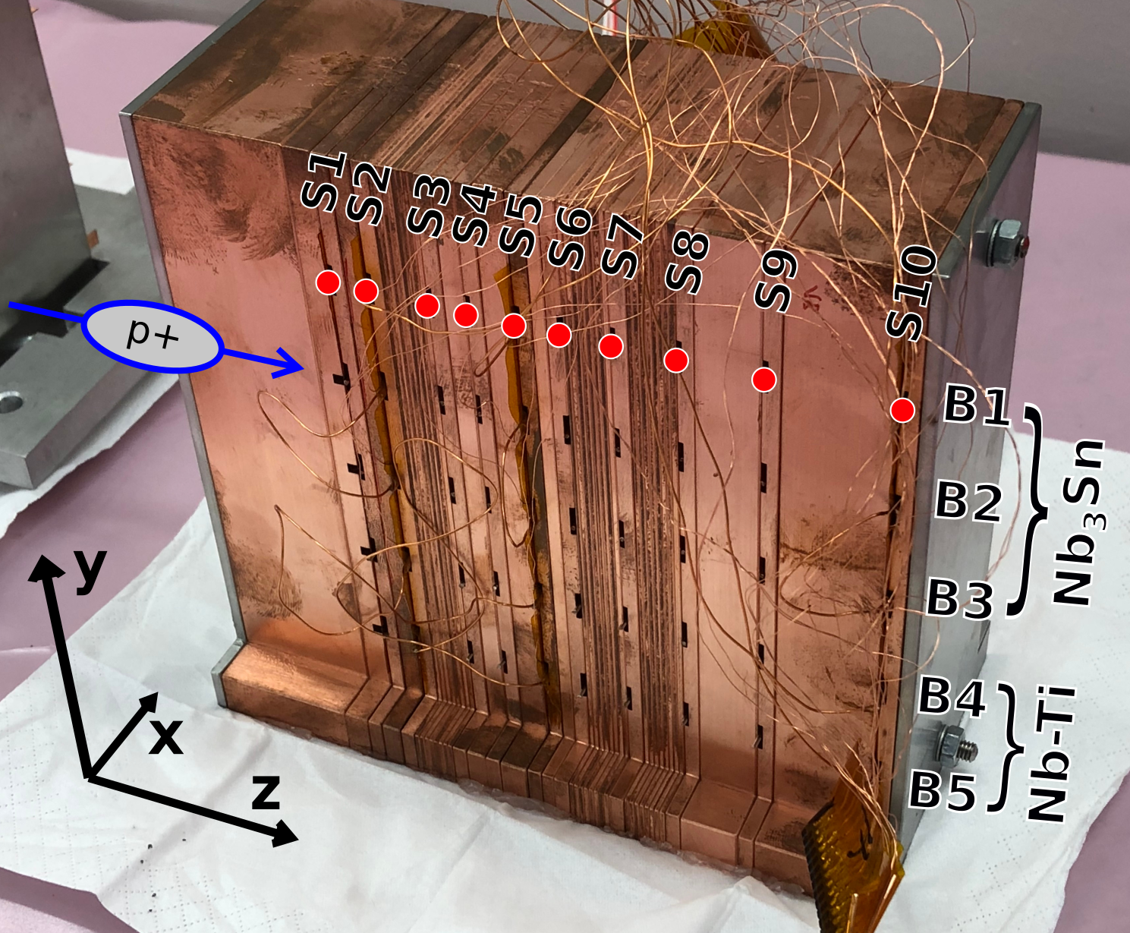
Damage limits of superconducting strands
Previous experiments: Beam-induced degradation of superconducting strands has been measured at CERN’s HiRadMat facility (2016 and 2018).
Room-temperature experiment (09/2016):
Nb-Ti & Nb₃Sn strands
Up to 2.6e12 p⁺ per shot at 440 GeV
Hotspots up to ~1150 K reached in strands
Cryogenic experiment at 4.5 K (08/2018):
Nb-Ti, Nb₃Sn strands & YBCO tapes
3e12 p⁺ per shot at 440 GeV
Hotspots up to ~1250 K reached in strands
Copper sample holders
Daniel Wollmann
12/07/2019

Slide 6
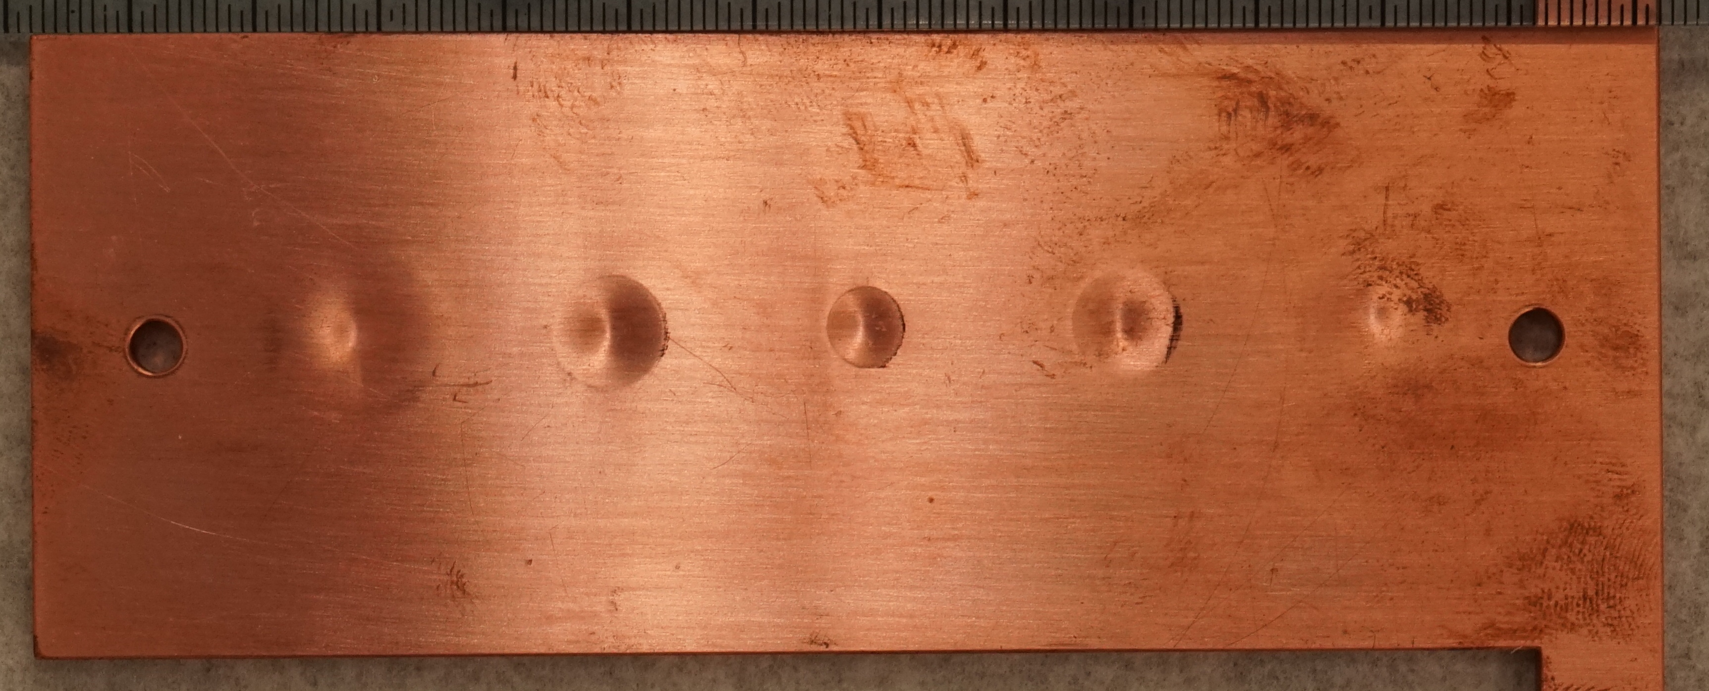
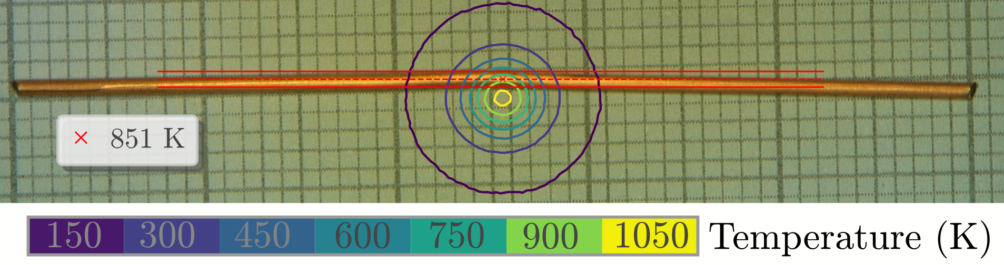
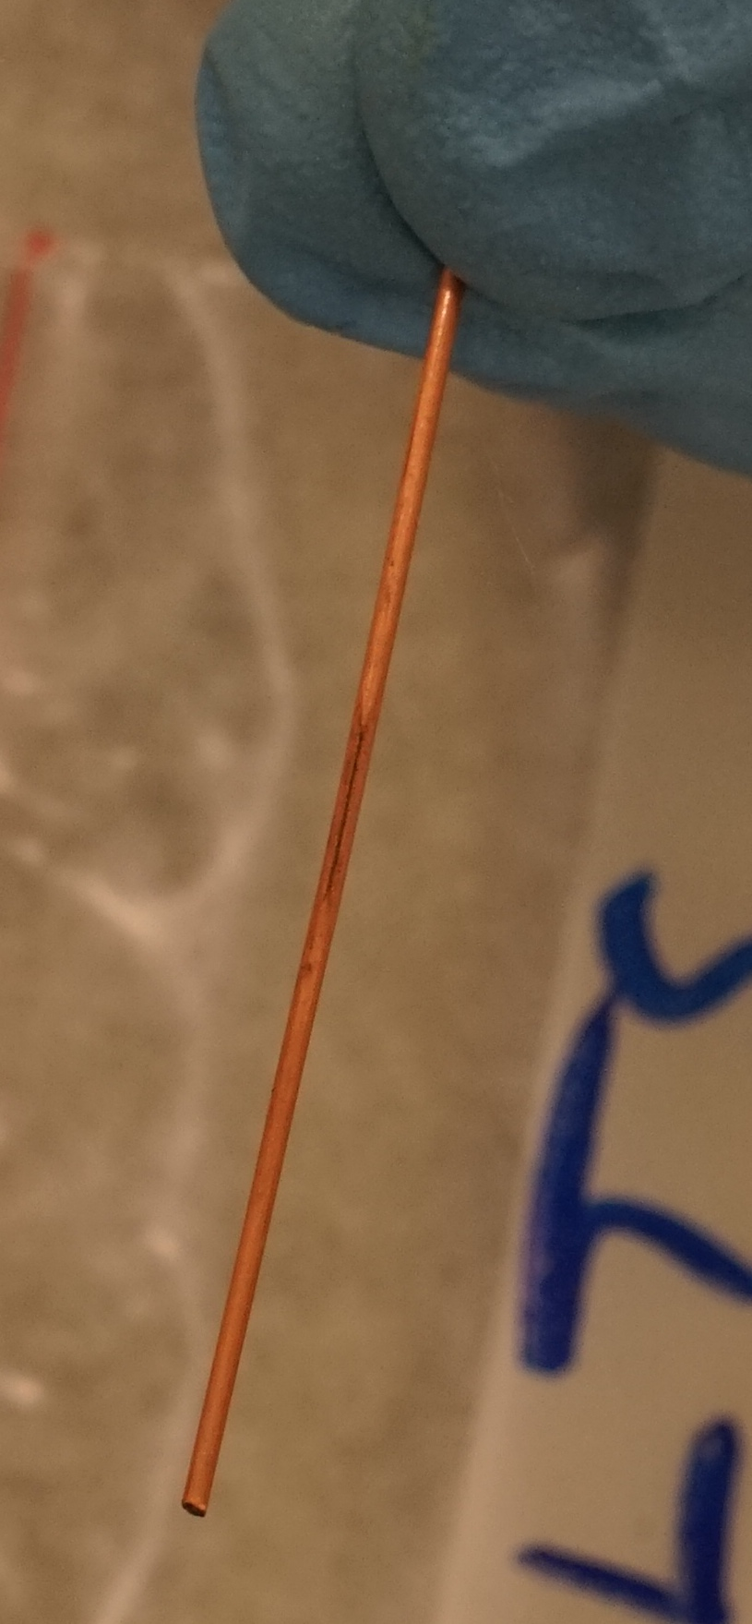
Experimental Results: RT & Cryogenic
Nb-Ti strands:
J_{c} degradation for hotspot temperatures > 880 K (2.2 kJ/cm³)
Nb₃Sn strands:
J_{c} degradation observed in all impacted samples
(T ≥ 700 K, 1.4 kJ/cm³)
Nb-Ti strands: no visible deformation up to 1100 K.
Nb₃Sn strands: plastic deformation from T_{hotspot} ≥ 640 K.
YBCO tapes: decolourisation for T_{hotspot} ≥ 720 K.
Detailed analysis and critical transport current (I_{c}) measurements ongoing in collaboration with University of Geneva.
Nb₃Sn
Beam impact marks on sample holder
Nb₃Sn, hot spot ~ 1150 K
YBCO
V. Raginel, et al., First Experimental Results on Damage Limits of Superconducting Accelerator Magnet Components Due to Instantaneous Beam Impact, IEEE Trans. Appl. SC, Vol 28(4), June 2018
V. Raginel, Study of the Damage Mechanisms and Limits of Superconducting Magnet Components due to Beam Impact, CERN-THESIS-2018-090
A. Oslandsbotn, A. Will, D. Wollmann, Beam Impact on Superconductor short samples of Nb3Sn, Nb-Ti and YBCO, 2018, EDMS 2068064
A. Will, et al., Beam impact experiment of 440GeV/p Protons on superconducting wires and tapes in a cryogenic environment, IPAC2019

Slide 7
Proposed Experiments at HiRadMat I
Study the damage limit of dedicated superconducting sample coils (Nb-Ti, Nb₃Sn) at cryogenic temperatures.
Study the damage limit of HL-LHC Nb₃Sn triplet short prototype coils at cryogenic temperatures.
Experimental wish-list:
  Use of liquid helium (4.2 K) to allow in-situ measurement of degradation of critical current.
  Shot intensities from 10¹⁰ to ~3x10¹² protons, allowing to verify the models for quench and damage limits in case of transient beam losses and reaching peak hot-spot temperatures in the coils of up to 1200 K.
Better knowledge of quench/damage limits will allow to optimize machine-protection settings (e.g. beam-loss limits) and design choices for passive absorbers.

Slide 8
Letter of Interest 2: Beyond-Design Failures and Hydrodynamic Tunnelling

Slide 9
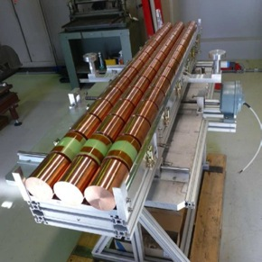
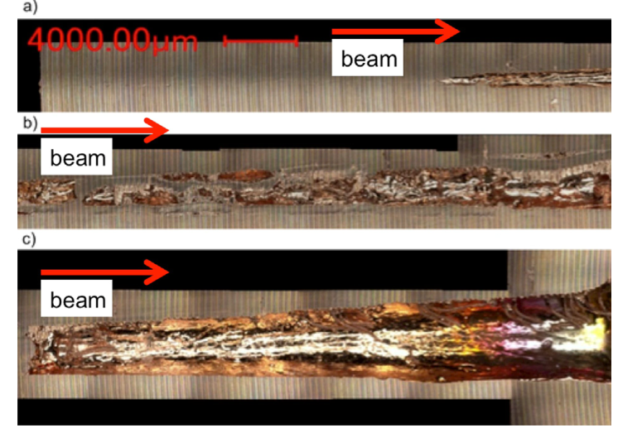
Beyond-Design Failures
Beyond-design failure cases at (HL-)LHC and future machines can lead to localized impact of numerous bunches → hydrodynamic-tunnelling effect has to be considered to estimate the failure consequences.
Hydrodynamic tunnelling: Material density is reduced by first impacting bunches → penetration depth of subsequent bunches is (significantly) increased.
Simulation requires coupling of energy-deposition codes and hydro codes.
Simulated point impact of LHC beam
Segmented Cu target
Experiment at HiRadMat, CERN
7 TeV, 2808b, 1.15e11 ppb, σ = 0.2 mm
440 GeV, 144b, σ = 0.2 mm, 1.5e11 p⁺, 1.5 MJ beam energy
N.A. Tahir, F. Burkart, et al., NIM B 427 (2018) 70–86
[N. A. Tahir et al., PRSTAB 15, 051003 (2012)]
→ Full LHC beam would penetrate ~25 m into a carbon target
→ First experimental proof of hydrodynamic tunnelling

Slide 10
Proposed Experiments at HiRadMat II
Continue the numerical and experimental study of hydrodynamic-tunneling effects for copper or other machine-relevant materials, such as graphite or tungsten.
  → Benchmark the numerical models and study the Equation of State for these materials.
Study new absorber materials and mechanisms
  Future high-energy machines will pose demanding requirements to the different kinds of beam-intercepting devices.
  Traditional materials or mechanisms might reach their limits, while non-standard approaches, such as using foams, powders, non-solid materials, still present numerous challenges.
  → long-term machine-protection interest to assess the feasibility and limitations of these approaches.
Experimental wish-list:
  288 bunches per pulse.
  1.2e11 protons/bunch (ideally LIU bunch intensities).
  Variable beam sigma, e.g. between 0.25 mm (or smaller) and 2.0 mm, to adjust the energy density.

Slide 11
Conclusions
Beam-impact studies are essential for machine protection
  to estimate the failure consequences,
  and define the reliability requirements for the protection elements,
  whilst optimizing the machine’s physics output.
HiRadMat is a unique facility for experimental beam-impact studies.
CERN’s TE-MPE group has conducted 3 beam damage experiments at HiRadMat in recent years and the continuation of these tests has high priority.
Future experiments are proposed to
  study the damage limits of superconducting sample and prototype coils,
  study the consequences of beyond-design failures, including the effect of hydrodynamic tunnelling, and test new absorber materials and mechanisms.

Slide 12
Thank you for your attention!

Slide 13
LHC Risk Matrix
HL-LHC/ LHC risk matrix |  | Recovery
 |  | ∞ | year | month | week | day | hours | minutes
 |  | S7 | S6 | S5 | S4 | S3 | S2 | S1
Frequency | 1 / hour
 | 1 / day
 | 1 / week
 | 1 / month
 | 1 / year
 | 1 / 10 years
 | 1 / 100 years
 | 1 / 1000 years
Risk matrix: J. Uythoven/M. Blumenschein

Slide 14
LBDS failure cases
“Acceptable (Design) Fault Cases” | “Unacceptable (Beyond Design) Fault Cases”
Asynchronous beam dump | MKDs not firing upon request
One missing extraction kicker (MKD) | Wrong energy information in BETS → beam can impact on machine/TCDQ
Missing dilution kicker | Complete dilution failure with high-intensity beam
… | …
[See LHC Design Report, Chap. 17]

