Slide 1
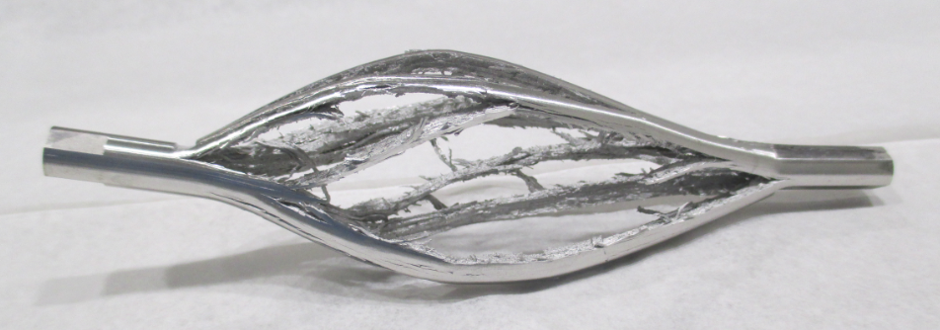





Expression of Interests on the Future HiRadMat Experiments from
Taku Ishida^{*1}
Shunshuke Makimura¹ ,Takeshi Nakadaira¹
Hajime Nishiguchi¹, Yoshinori Hashimoto¹
Shin-Ichiro Meigo², Masatoshi Futakawa²
J-PARC Center
¹: High Energy Accelerator
Research Organization, KEK
²: Japan Atomic Energy
Agency, JAEA
RaDIATE
Collaboration
Radiation Damage In Accelerator Target Environments

Slide 2
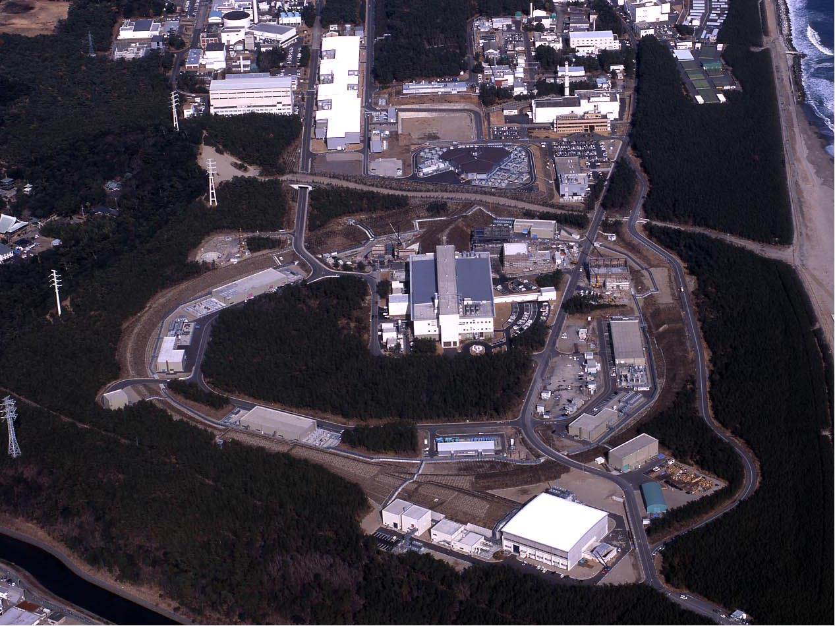
Japan Proton Accelerator Research
Complex
400 MeV H⁻ Linac
Material Irradiation Facility for ADS R&D
Neutrino Experimental Facility (ν)
3GeV Rapid Cycling Synchrotron (RCS) 25Hz, 1MW
295 km to
Kamioka
MLF 2nd Target Station
Materials & Life Science Facility (MLF, muon)
A round: 1,568m
Hadron Experimental Facility (HEF)
30 GeV Main Ring Synchrotron (MR)
Design beam power :
Fast Extraction to ν: 750kW → 1.3MW
Slow Extraction to HEF: > 100 kW
COMET: search for μ-e conversion

Slide 3
Overview
J-PARC consists of a series of the world’s most intense accelerators and experimental facilities producing and utilizing high-intensity proton beams
Future experiments at HiRadMat facility will provide great opportunities to J-PARC for its undergoing researches and developments on accelerator, beamline & detector components
3 Letter-Of-Interests being submitted
  Thermal shock experiments of advanced target / window / dump materials with high energy proton beam at HiRadMat Facility [ S.Makimura/T.Nakadaira/TI/M.Futakawa et al]
  Displacement cross section of target and beam window materials for 440 GeV/c protons [ S.Meigo et al]
  Development of the Next Generation High Radiation Tolerant Detector with the High Intensity Proton Beam at HiRadMat Facility [ H.Nishiguchi, Y.Hashimoto et al]

Slide 4
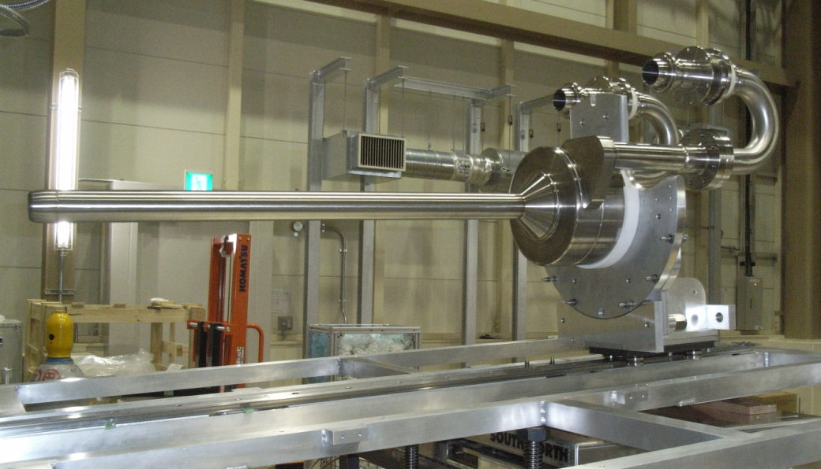
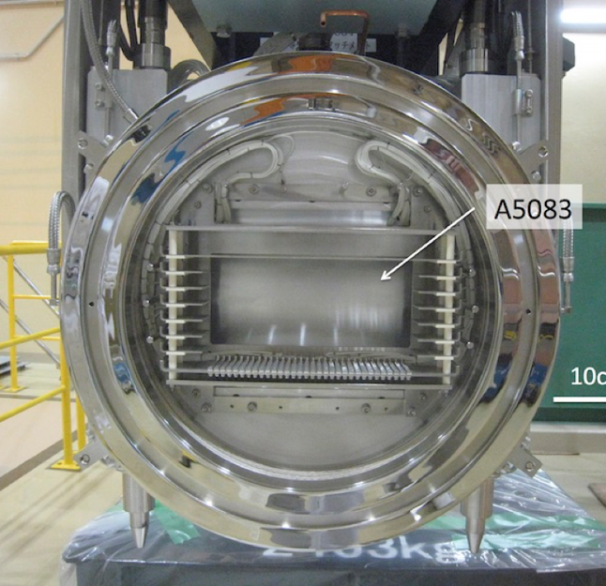
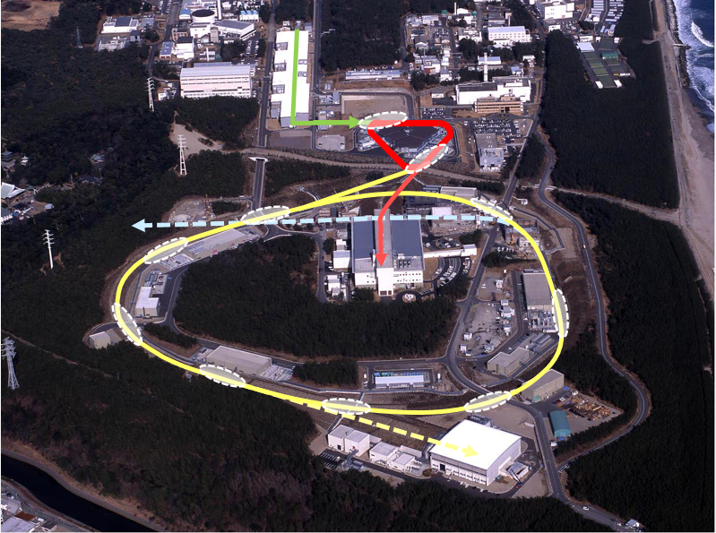
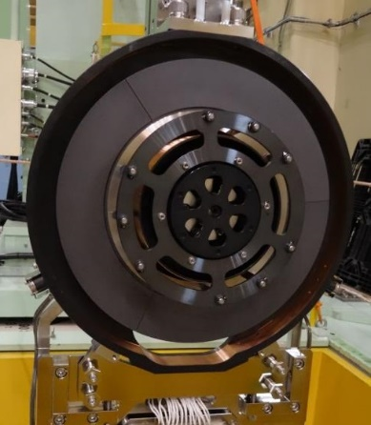
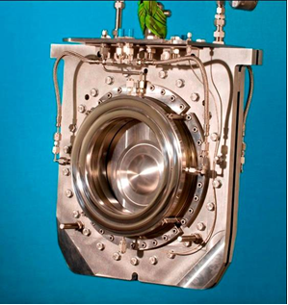
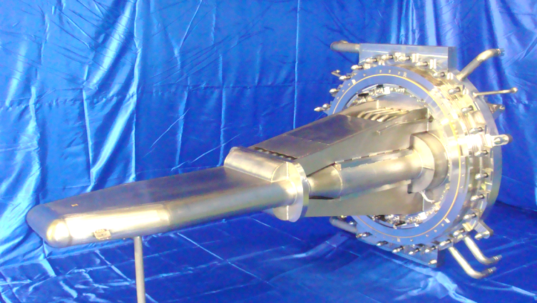
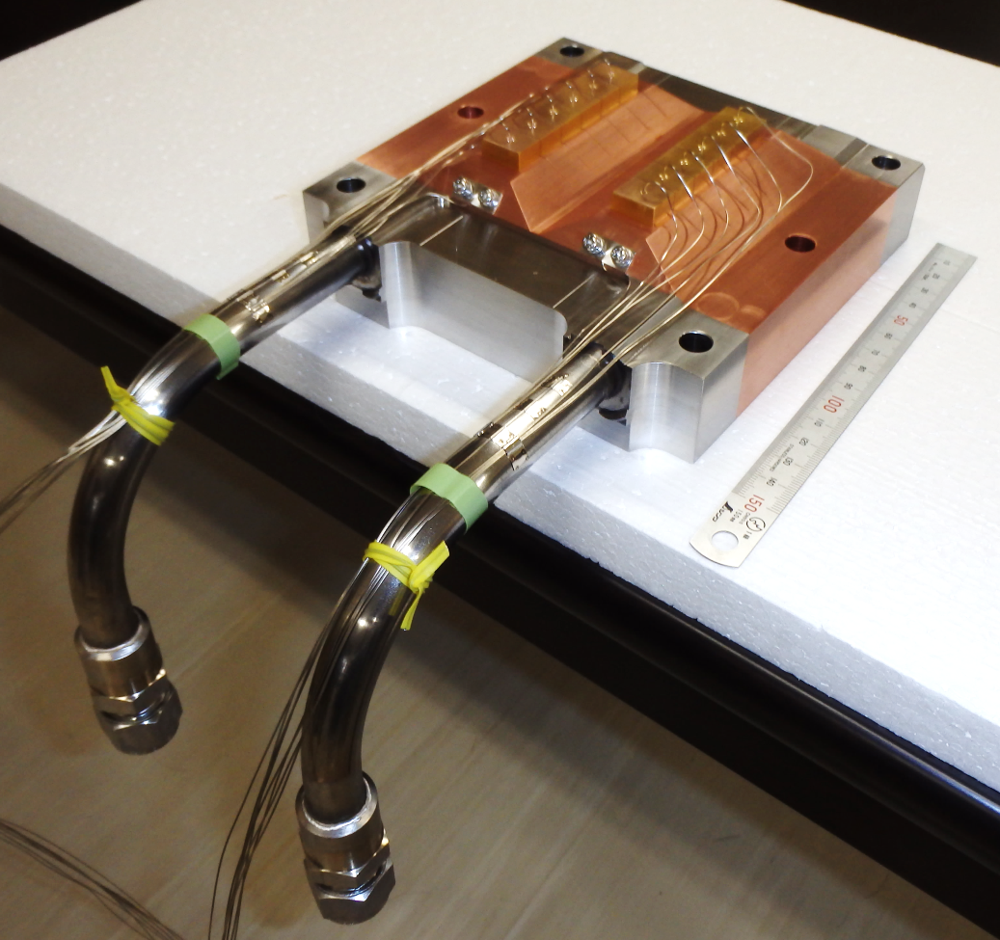
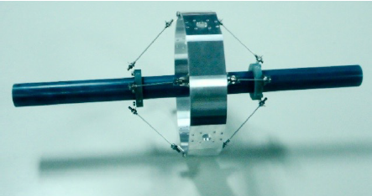
Targets & Windows at J-PARC
Neutrino [ν]
He-cooled graphite
Al A5083 BW
Muon [MLF-MUSE]
Rotating Graphite
Ti-6Al-4V BW
Neutron [MLF]
Liquid Mercury
Hadron [HEF]
Water cooled gold
Graphite [COMET]

Slide 5
1. Advanced Targetry Material Studies
For power upgrade aiming several hundred kW to MW, upgrade of each target and beam window system should be completed in a timely manner:
  Nickel (or Platinum) rotating target at HEF
  Light material (SiC composite, SiC-coated graphite) in place of (or combined with) the graphite target for ν, MLF muon, COMET at HEF
  Highly-ductile Tungsten target for COMET second phase, MLF second target station
  Syst. studies on Ti-alloy grades as beam window material
  Graphite, copper alloy, stainless steel for MR abort beam dump, with reference to CERN’s beam dump design
  Lead Bismuth Eutectic (LBE) target at proposed Material Irradiation Facility for ADS

Slide 6
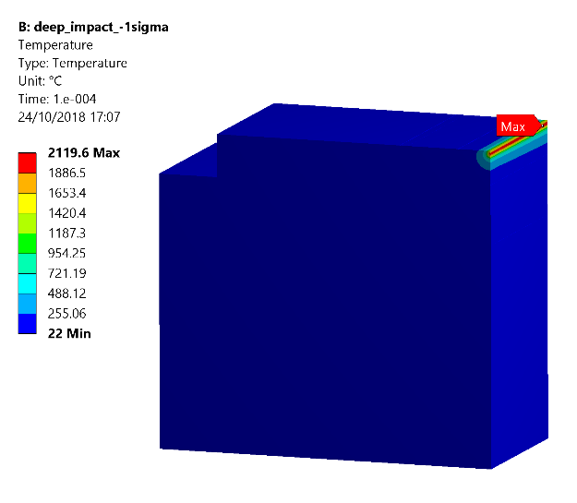
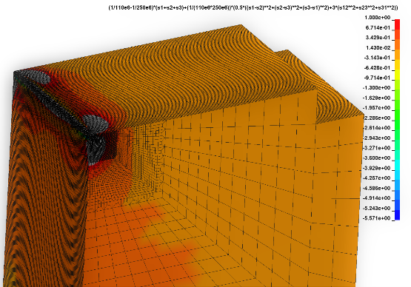
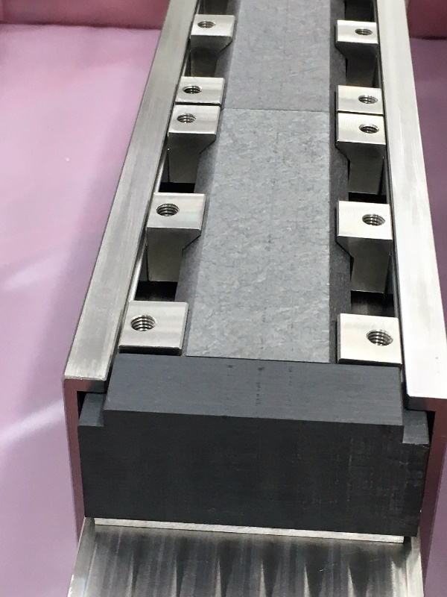
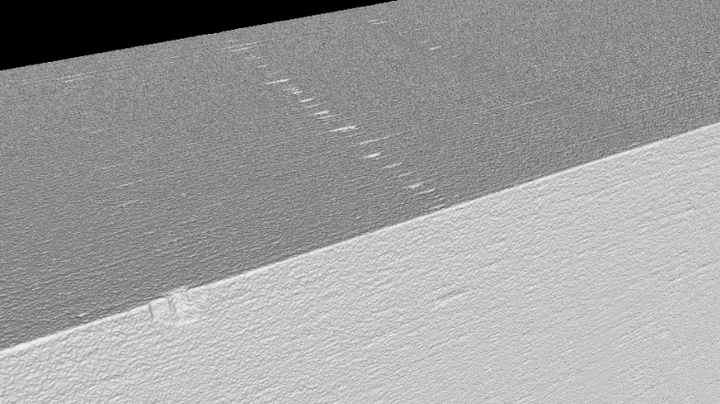
Study of Solid Materials with Thermal Shock(1)
NITE-SiC/SiC
  Density 3.2 g/cc (SiC) → more secondary emission than graphite
  SiC fibers + matrix, control mechanical properties / to replicate ductility
J. Maestre et al RaDIATE2018
2100°C
(Gray) →Failure
HiRadMat35
TDICoat
Blocking
Crack
Propagation
failure
DOWNSTREAM
grazing impact
Deep impact
tilted impact
DOWNSTREAM
To continue the studies with various impact parameters, especially to compare behavior between cold and irradiated specimen at next BLIP run

Slide 7
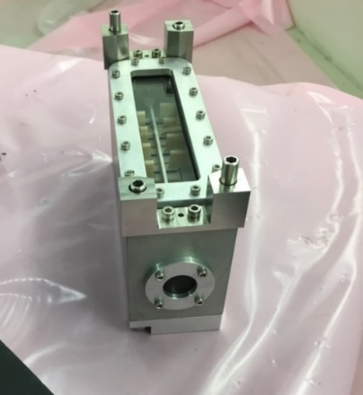
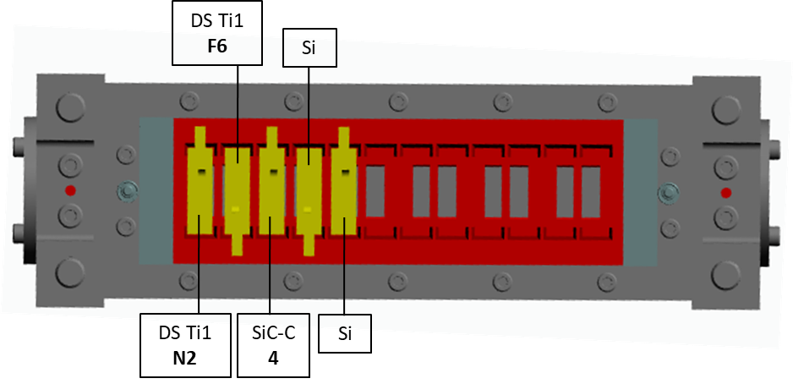
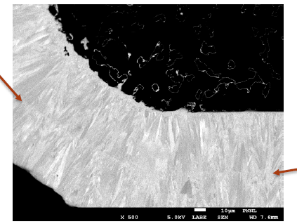
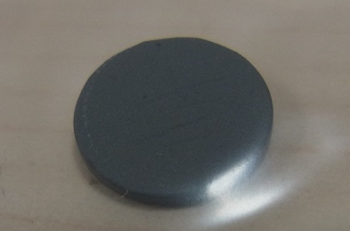
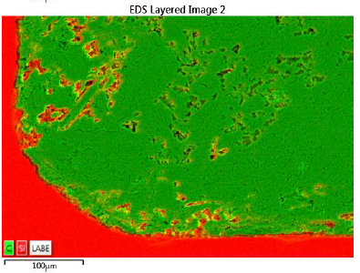

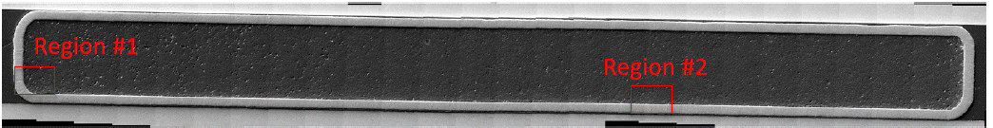
Study of Solid Materials with Thermal Shock(2)
SiC-coated graphite / Titanium Alloy (cold & irradiated at BLIP) exposed to thermal shock at HiRadMat in autumn JFY2018
HRMT43 BeGrid2
BOX-3
Ti-6Al-4V Gr5
Ti-3Al-2.5V Gr9
SiC-coated Graphite IG-630U
10mm-φ
CVD-SiC
0.1 mm
For Si
1 mm
Graphite
How did the SiC-coating on graphite behave with beam impact?
How different between Ti-6Al-4V(α+β) and Ti-3Al-2.5V(nearly α) ?
How different between irradiated at BLIP / un-irradiated ?

Slide 8
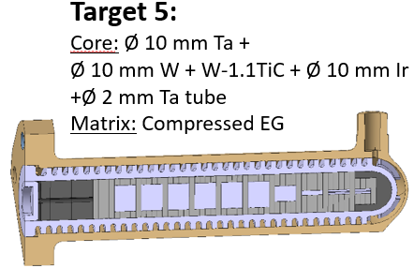
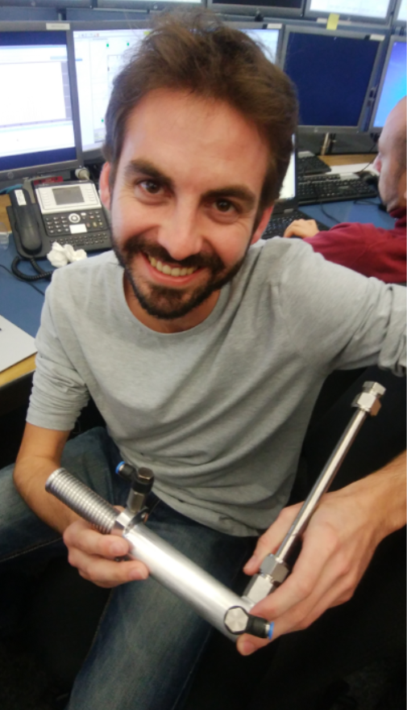
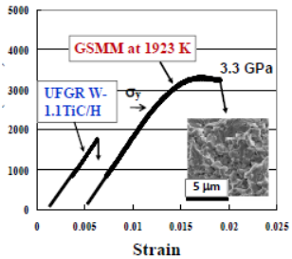
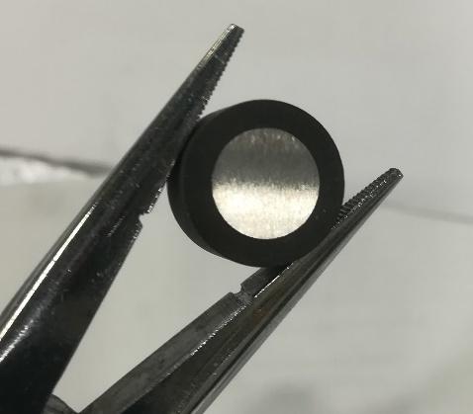
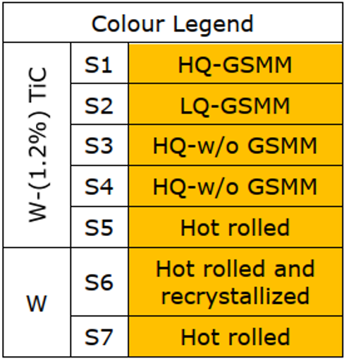
Study of Solid Materials with Thermal Shock(3)
HRMT48
PROTAD
Highly-Ductile W (TFGR W-1.1TiC)
  Tungsten: high density/melting point, but become brittle by recrystalization at 1200’C
  3D MA (FineGrain) → HIP → recrystallization under grain boundary sliding (GSMM): segregation / precipitation of TiC at grain boundary 13：
3PB at RT
The fabrication process is improving. Need to continue studies, especially irradiation run at BLIP, and thermal shock studies (w-w/o irrad?)

Slide 9
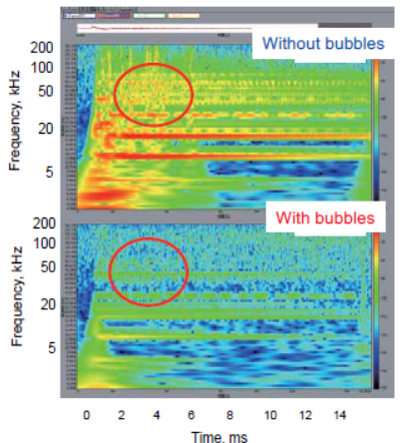
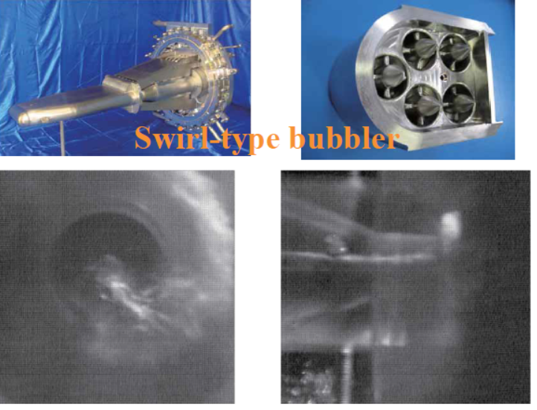
Study of Shock Wave on Liquid Metal Target
Liq-Mercury target
Liquid metal, or substituting liquid, are contained in a confined vessel w-w/o flow and gas bubbling.
Effects of various flow paths and flow rates are to be investigated.
LBE target for material irradiation facility
400 MeV, 0.625 mA,
250 kW,
25 Hz
Stainless Steel-T91
LBE inlet : 400 ℃ outlet 500 ℃

Slide 10
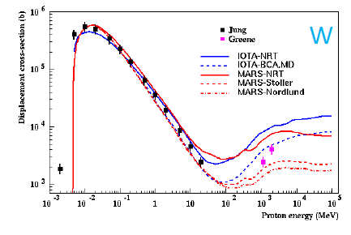
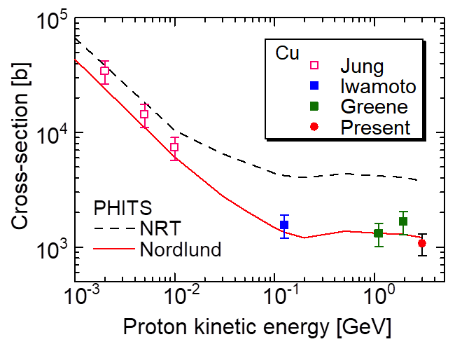
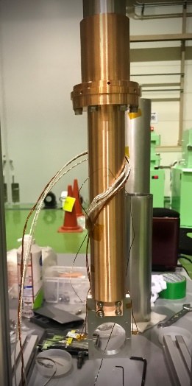
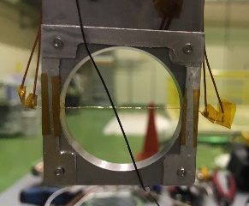
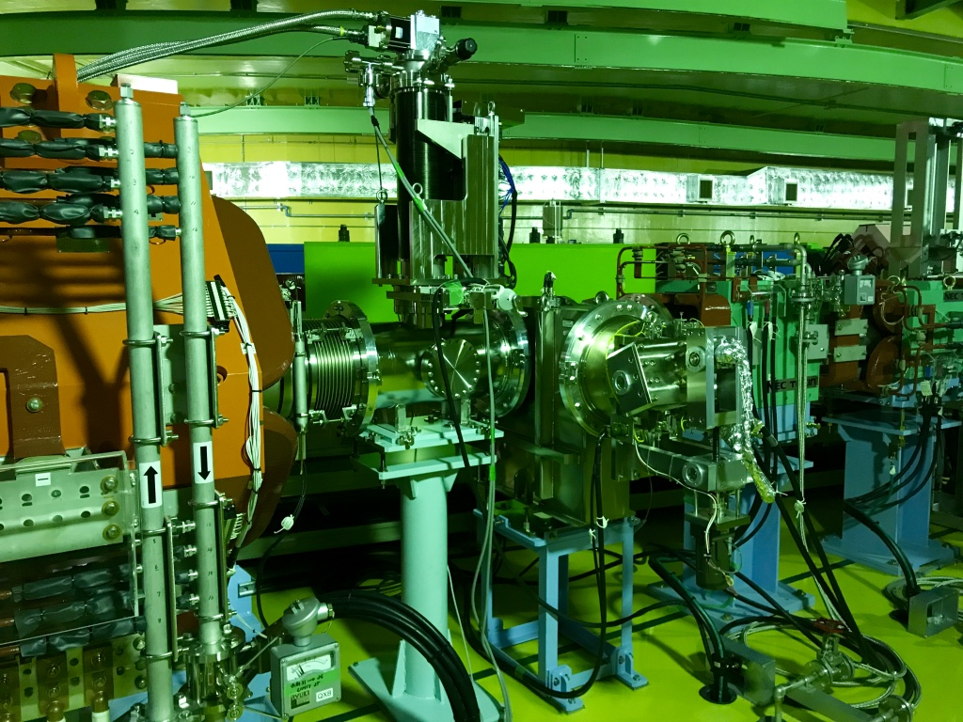
2. Displacement Cross-section Measurement
N. Mokhov, HPTW2016
Experiment at 3-GeV Rapid Cycling Synchrotron (RCS)
Under cryotemperature (~ 20 K), displacement cross section(σ) was obtained by increase of resistivity (Δρ_{cu}) due to proton irradiation with average flux (φ(E))
x 8
Vacuum chamber with 4-K GM cooler
40 mm
Beam
Ｄpa is vitary important parameter to represent target/window lifetime evaluation. To improve errors for high energy proton, measurements at J-PARC, FNAL and CERN are to be envisaged.
1 m

Slide 11
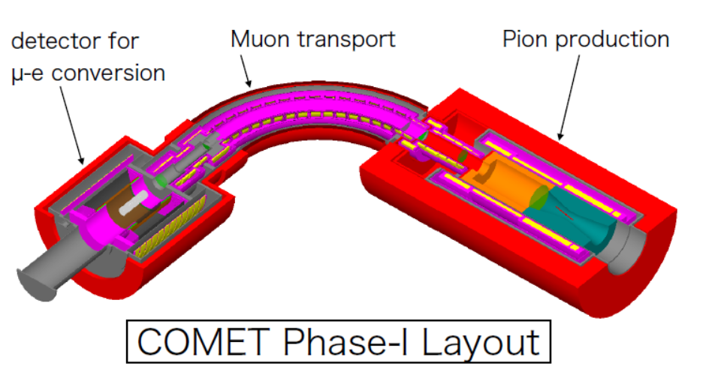



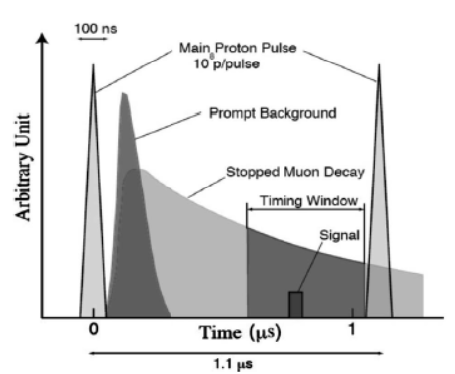
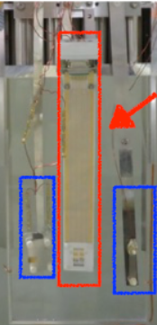
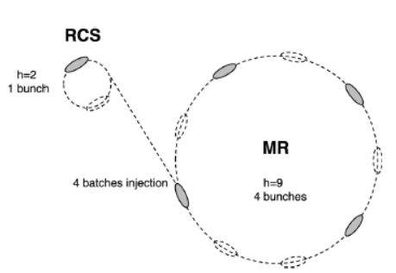
3. High Radiation Tolerant Detector
COMET: Coherent Muon-to-Electron Transition
In-beam
Extinction
Monitor
B(μ→e+γ) = 10⁻¹¹~10⁻¹⁴(SUSY-GUT)
< 4.2x10⁻¹³ (MEG 2016)
8GeV, 3kW
(56kW for phase-II)
for Al
Extinction Factor =
#of residual protons btw. 2 bunches
#of protons in a bunch
< 10⁻¹⁰
Single crystal CVD
Diamond
(4mmx4mm,0.5mmt)
Charge collection ~10ns
down to single MIP level
Vias Voltage to be off during main bunches

Slide 12
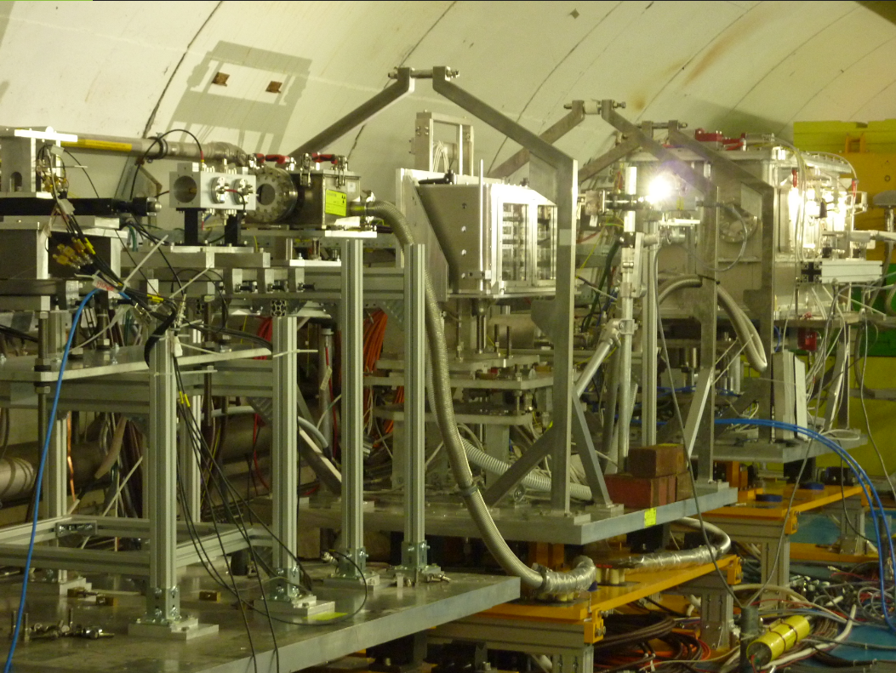
Multipurpose
Assembly
Beam Profile Monitors
BeGrid2
(HRMT43)
nTOF(46)
PROTARD(48)
SiBlock(49)

Slide 13
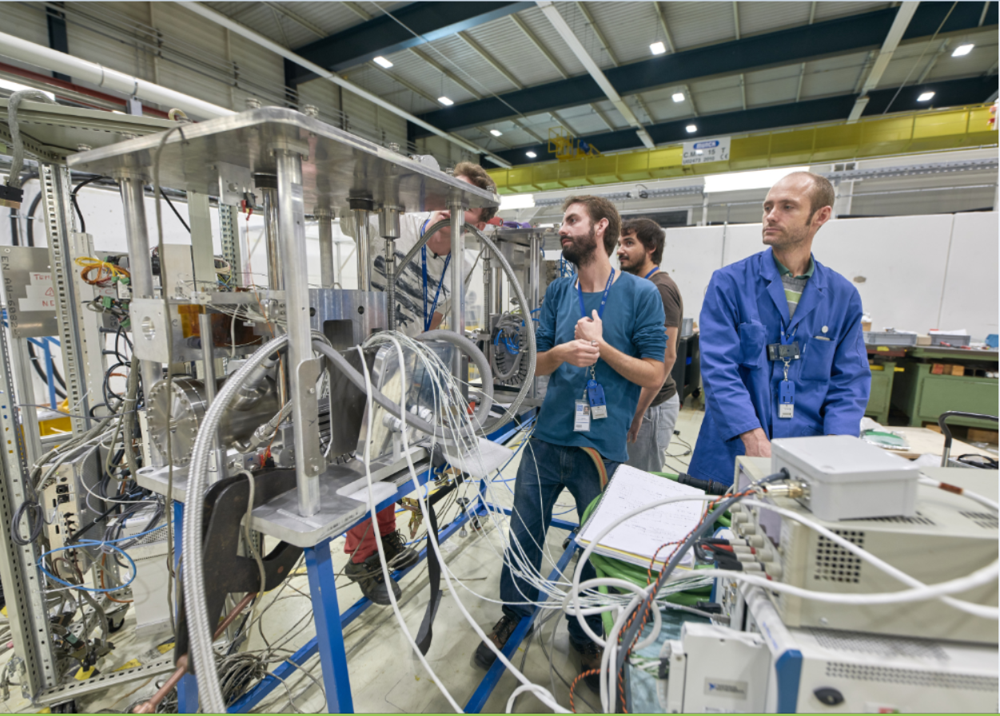
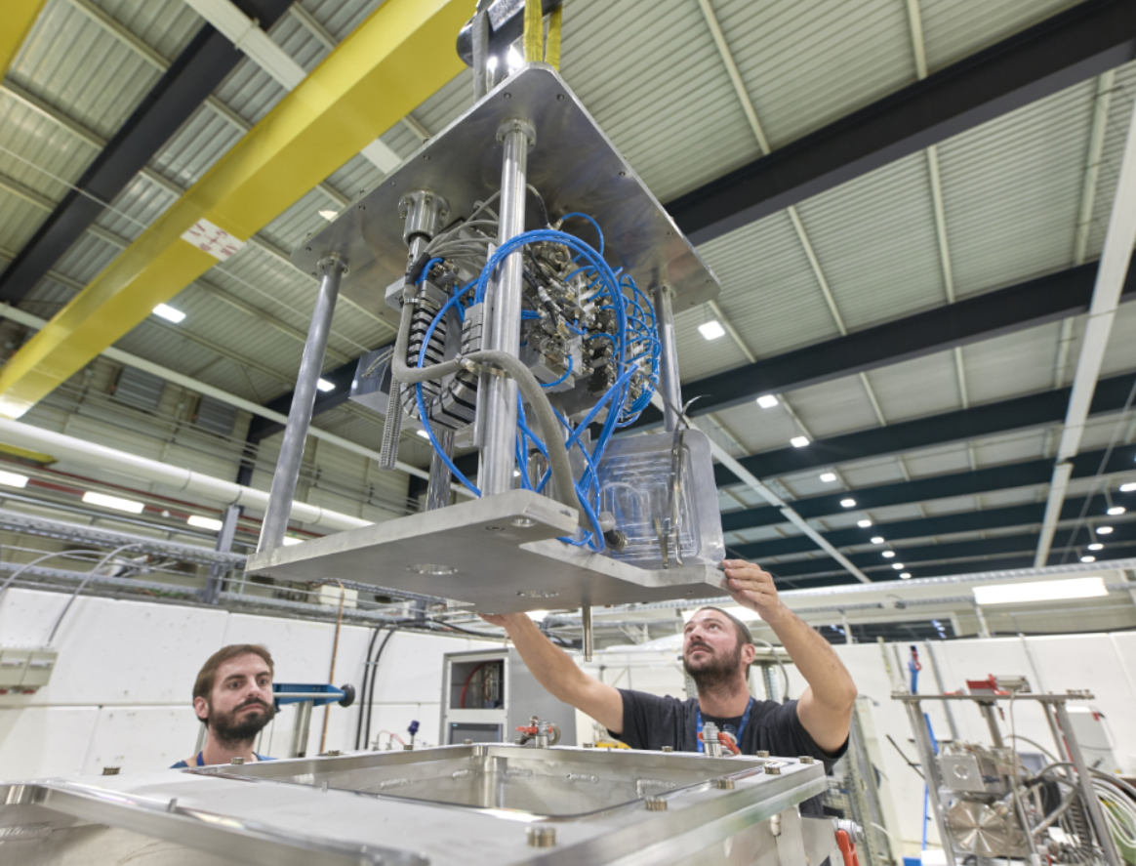
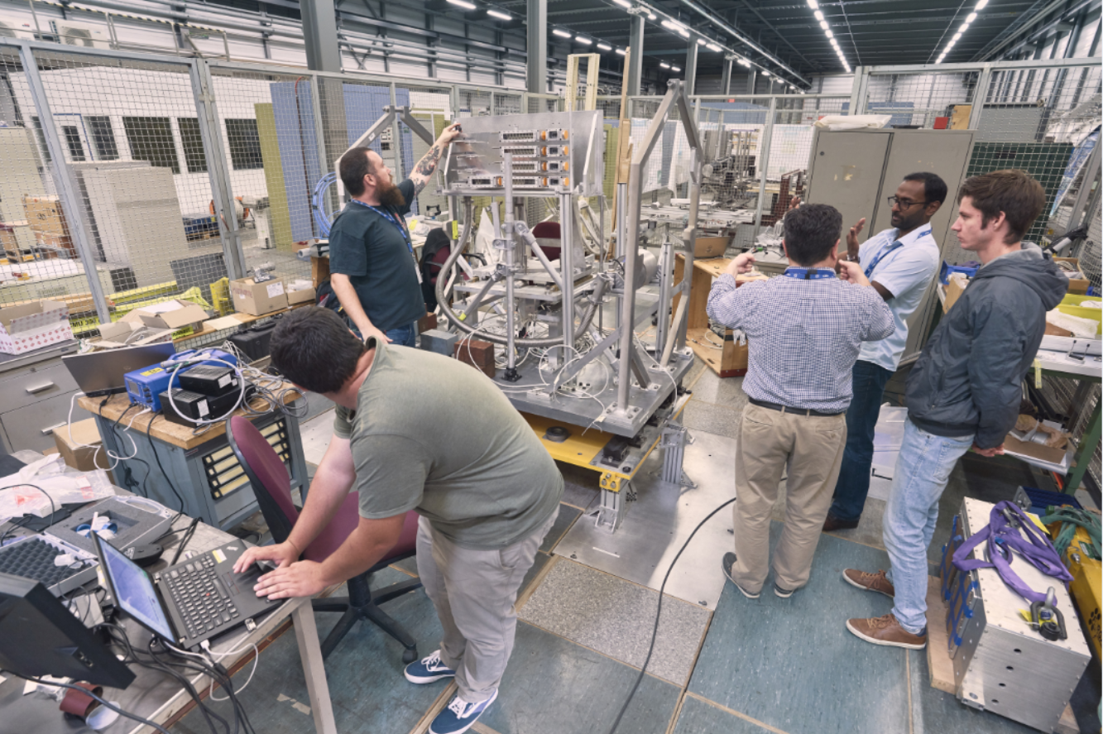
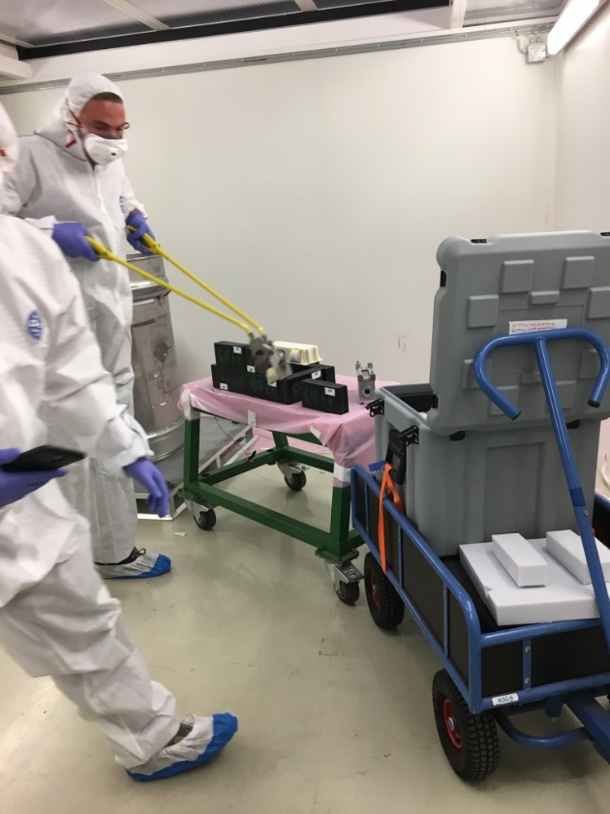
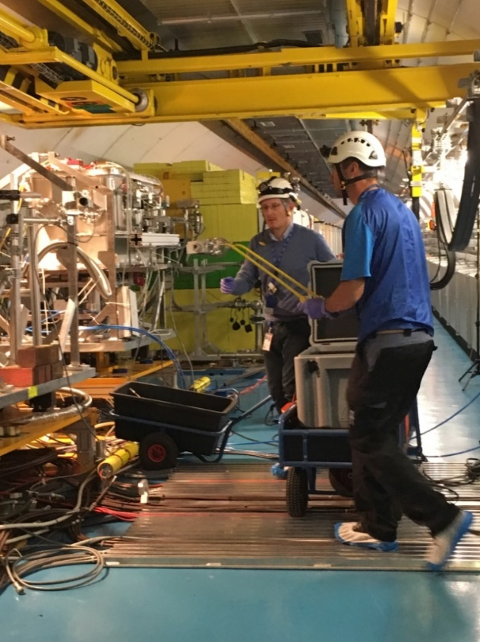

Slide 14
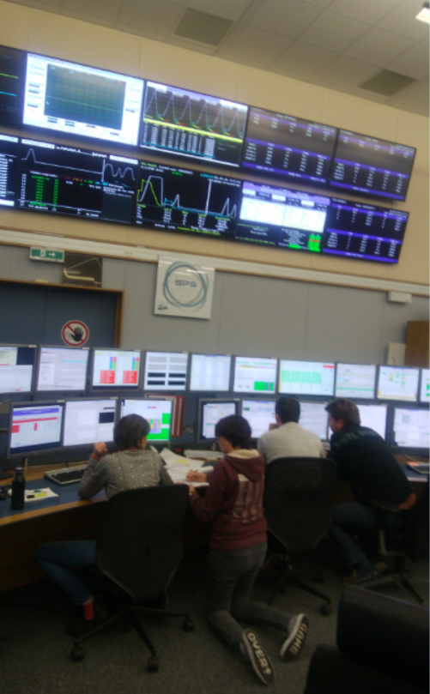
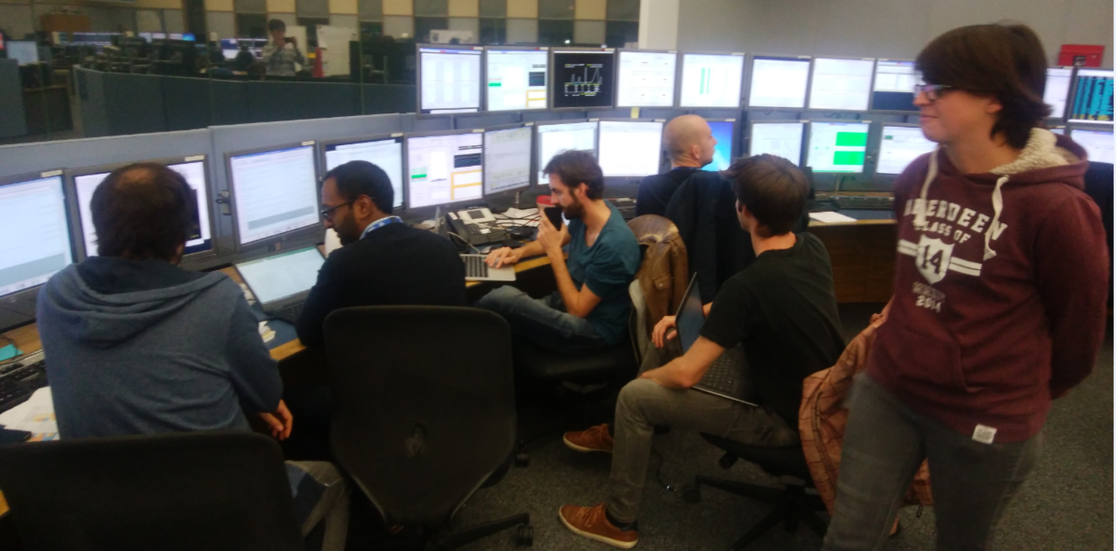
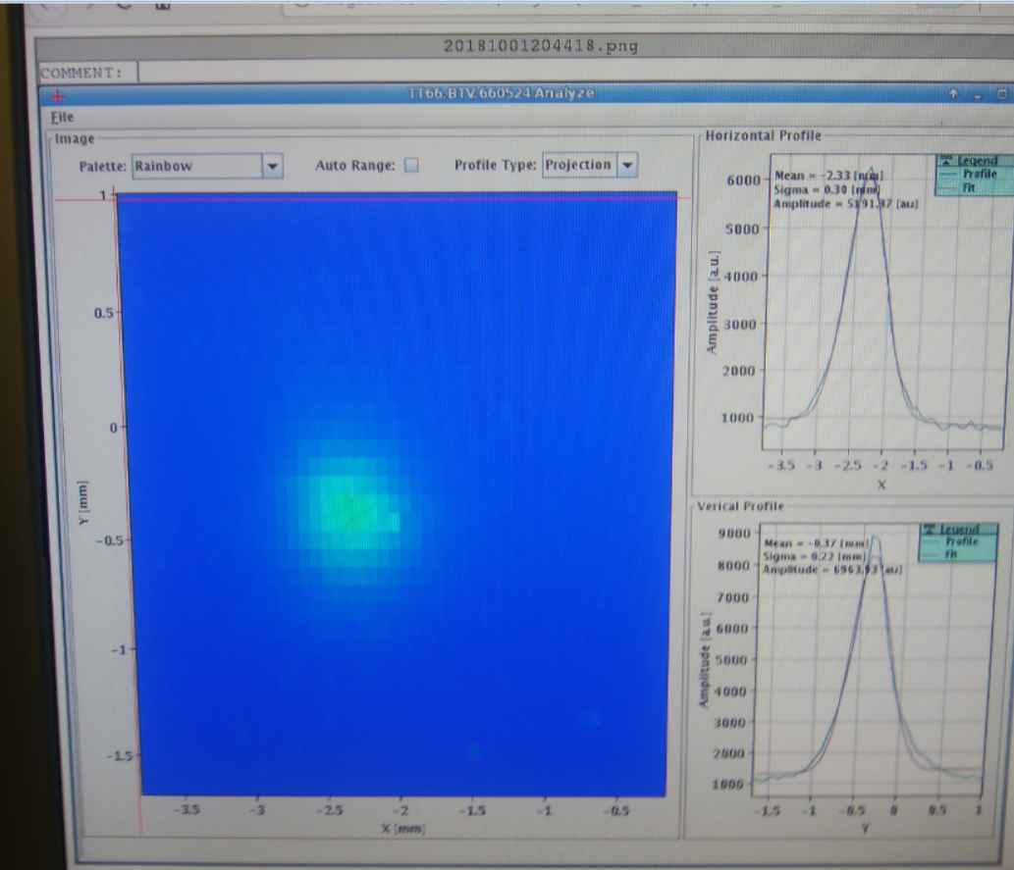
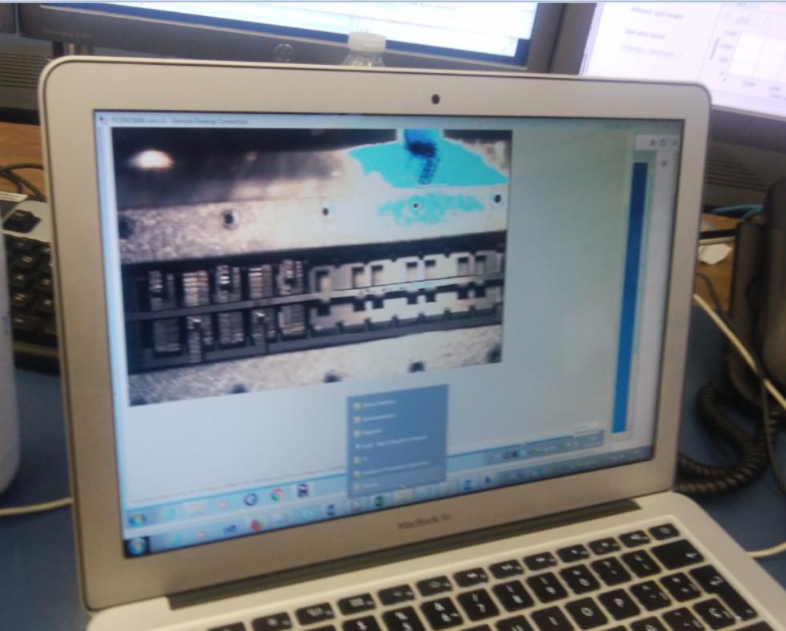
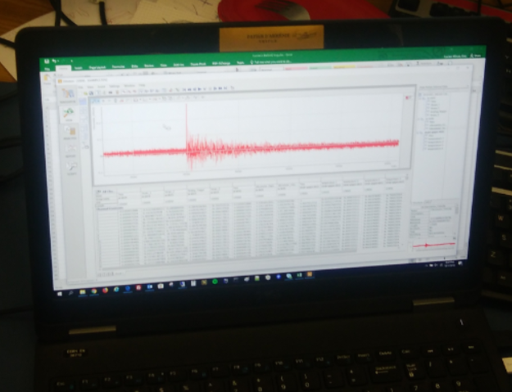
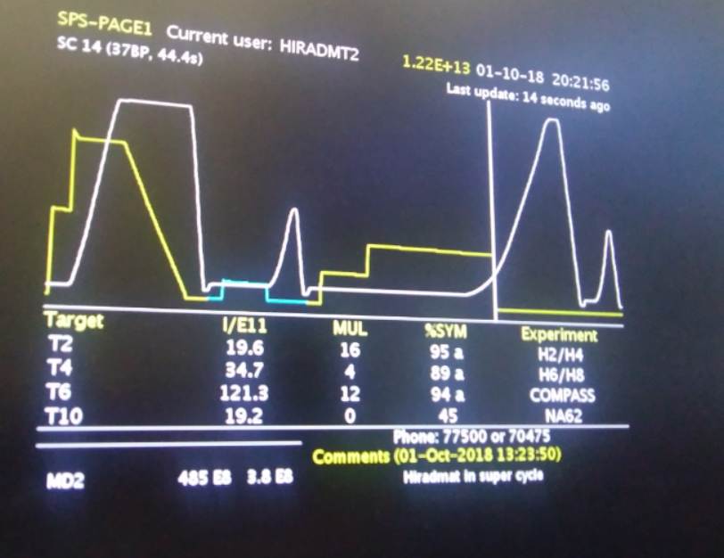
Sep.28: PROTARD, SiBlock Completed ☺
Sep.29: PROTARD Completed ☺
Oct.1~2: BeGrid2 Completed on 4am ☺
Sturm und Drang !

Slide 15
Summary
  HiRadMat is the only facility dedicated to thermal shock studies
    Remarkable achievements to research and developments on high power targets, beam windows, collimators, beam dumps and other accelerator assemblies.
    The facility has no equivalent and is indispensable for the world-wide high power accelerator communities.
    The facility provides indispensable opportunities for young enthusiastic and talented engineers to design forefront accelerator materials and hardware
  J-PARC express strong interest on the future experiments to be managed at HiRadMat facility
    Advanced target/window/dump material developments
    Displacement Cross-Section Measurement
    In-beam rad.-tolerant detector to count intra-bunch MIPs

Slide 16
J-PARC-CERN Cooperation AMENDMENT No.2
COOPERATION IN THE DEVELOPMENT OF PROTON LINEAR ACCELERATORS (2011~)
Amendment No.1: COOPERATION IN THE DEVELOPMENT OF PROTON ACCELERATORS (2016~)
No.2: Expand the co-operation to the fields of high-intensity accelerator target facilities and relevant technologies, to fully realize and accomplish the benefits of the high intensity proton accelerators:
The Parties intend to co-operate in the following areas of activities:
  Research and development of beam intercepting devices, such as targets, beam windows, collimators and beam dumps, including mechanical engineering and material expertise utilized in such devices;
  Research and development of technologies and engineering techniques applied to the design, operation, and maintenance of high intensity accelerator target facilities, including target containment vessels and supporting infrastructure systems
To be in effect soon, + 5years (until 8 April, 2026)

Slide 17


HiRadMat

