Slide 1
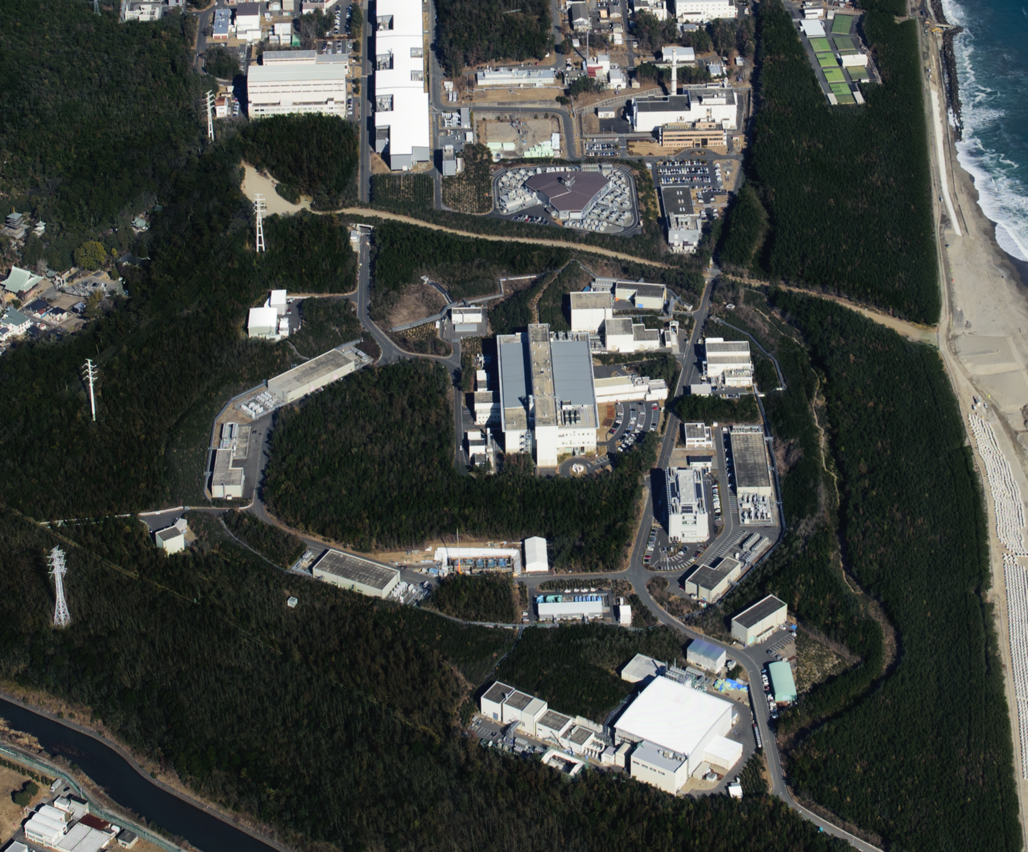

Target development activity in J-PARC
and
related expectation to HiRadMat irradiation facility
J-PARC center
Deputy Director
Masatoshi Futakawa

Slide 2

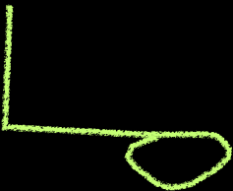
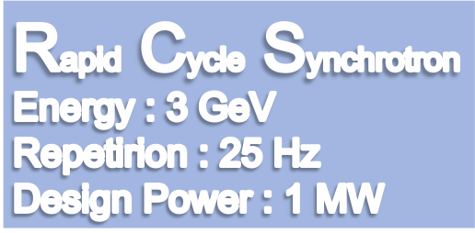
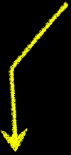

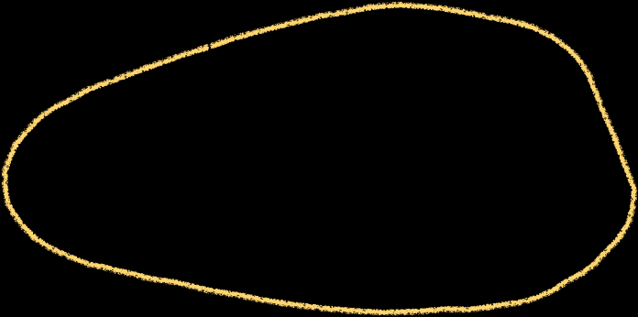
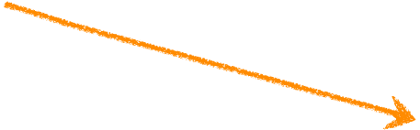
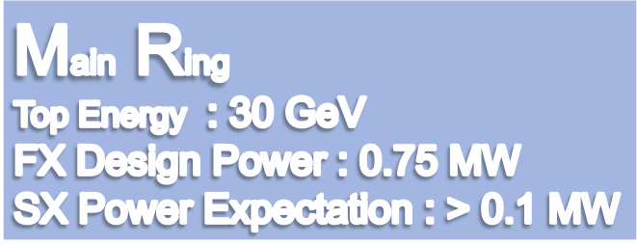
LINAC
400 MeV
Neutrino Beam to Kamioka
Currently 0.4 MW
Materials and Life Science Experimental Facility
Currently 0.48 MW(FX) and 0.05 MW (SX)
Hadron Hall
Notes:
まず、こちらが、J-PARCの加速器複合施設です。陽子ビームを１８１MeVまで加速する（来年度以降４００ MeVになる）線形加速器ライナックがあり、その後、ビームは、40 msという短い時間の間に3 GeVまで加速されます。そのビームのほとんどは、この物質生命科学実験施設で中性子やミュオンを使った実験の為に使われています。

Slide 3
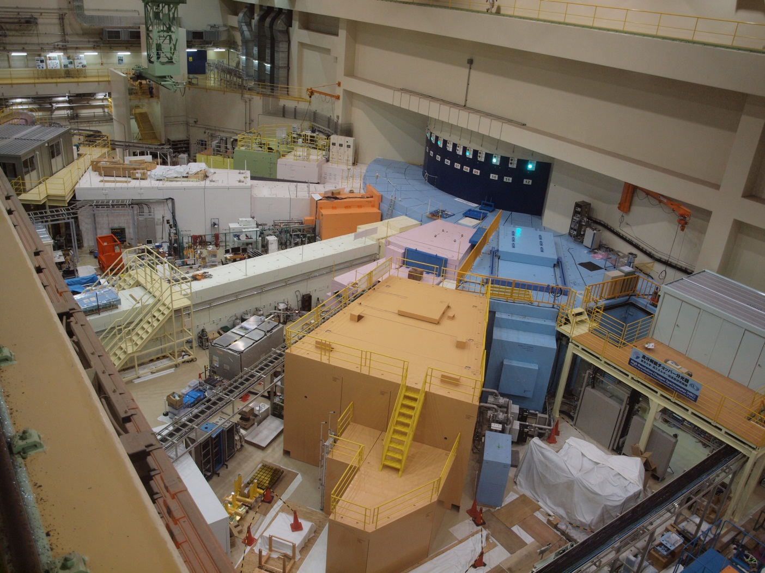
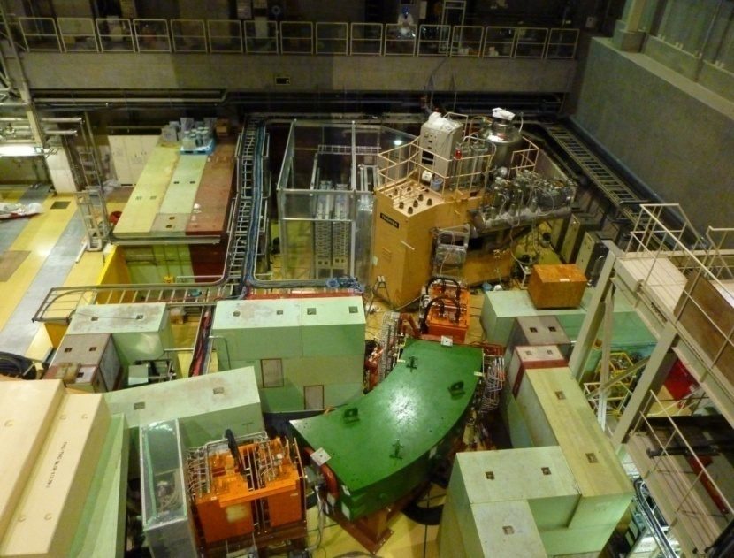
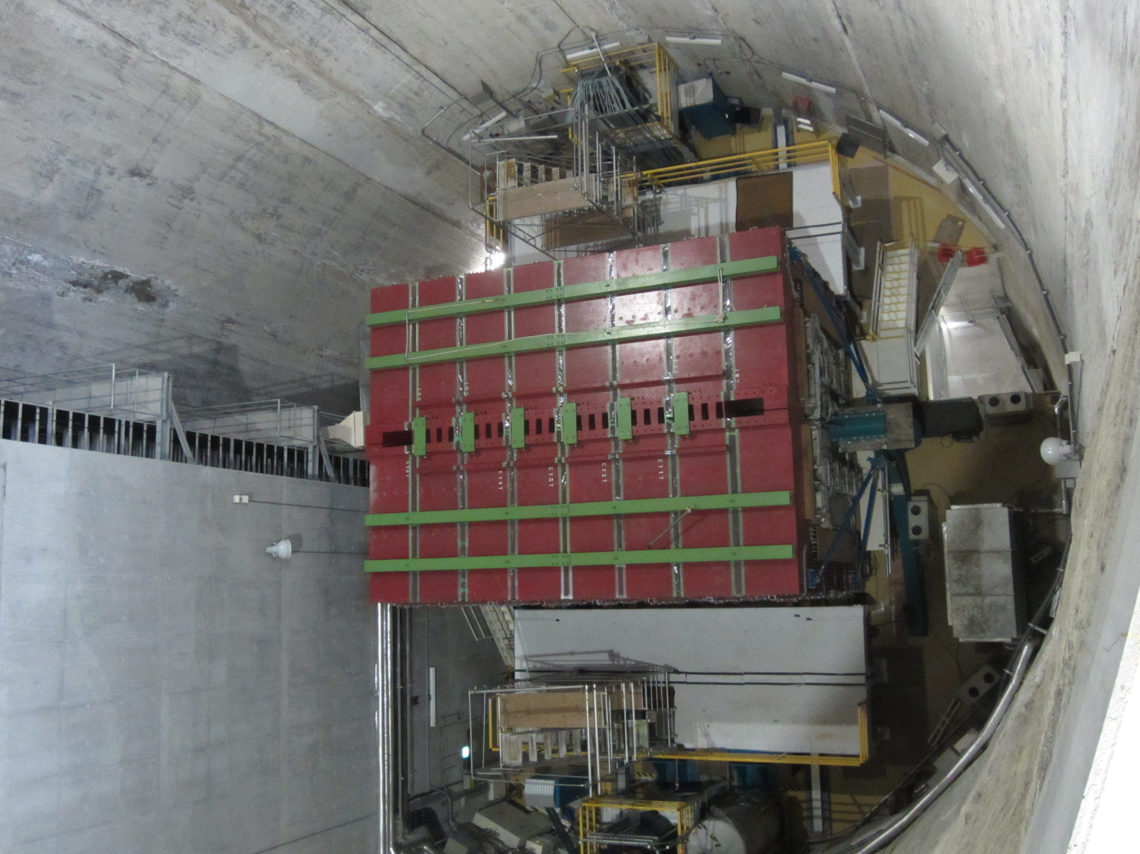
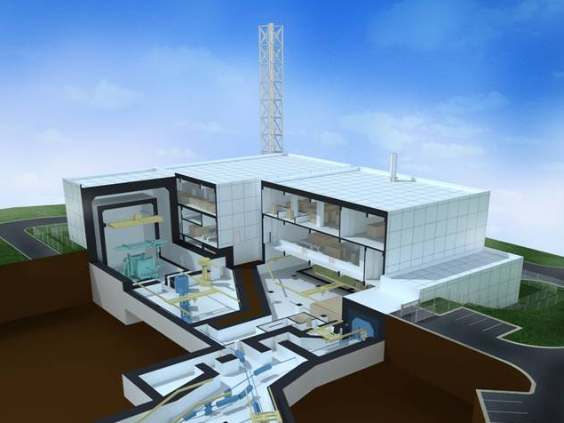
J-PARC Experimental Facilities
Wide range of research fields
Materials & Life Science Experimental Facility
  neutron and muon beams
  materials science, life science, industrial applications
Hadron Experimental Facility
  K mesons, π mesons, muons ····
  nuclear physics and particle physics
Neutrino Experimental Facility
  muon neutrino beams
  neutrino oscillation search with Super-Kamiokande
Transmutation Experimental Facility (Phase II)
  R&D for accelerator-driven nuclear transmutation
  with neutrons

Slide 4
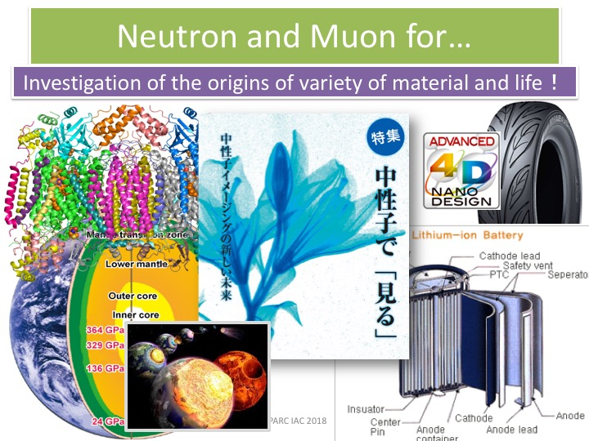
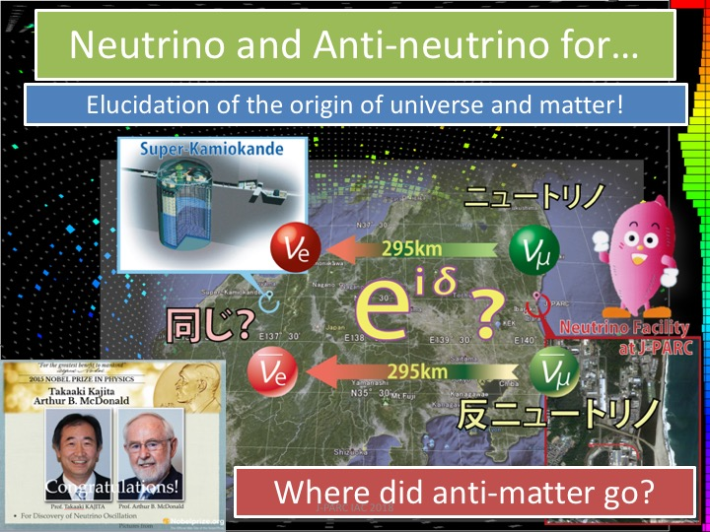
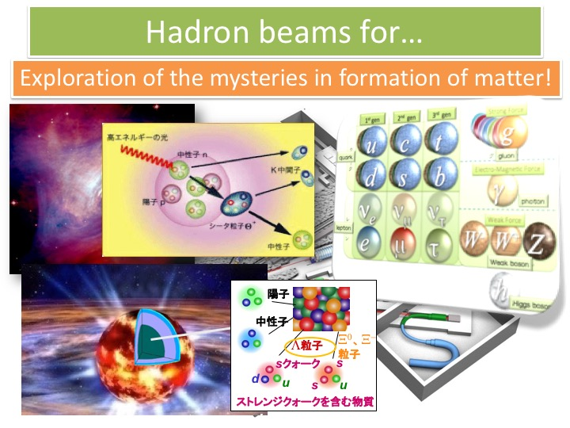
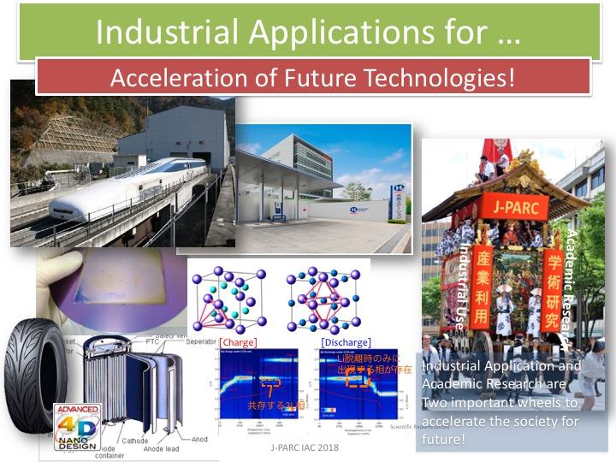

Slide 5
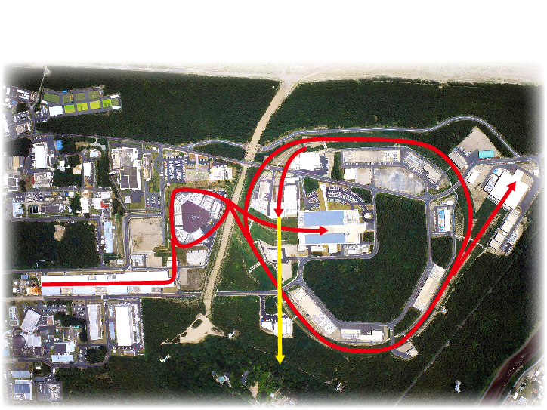
Neutron Source
at Materials & Life science experimental Facility
International User Facility
Hadron Exp. Facility
(SX mode)
3 GeV synchrotron RCS (25 Hz, 1MW)
Materials & Life Facility (MLF)
neutron・muon
Linac
(400MeV)
Neutrino Exp. Facility （T2K）
(FX mode)
30 GeV synchrotron MR(0.75 MW)
3 Accelerators for 3 User facilities +…

Slide 6
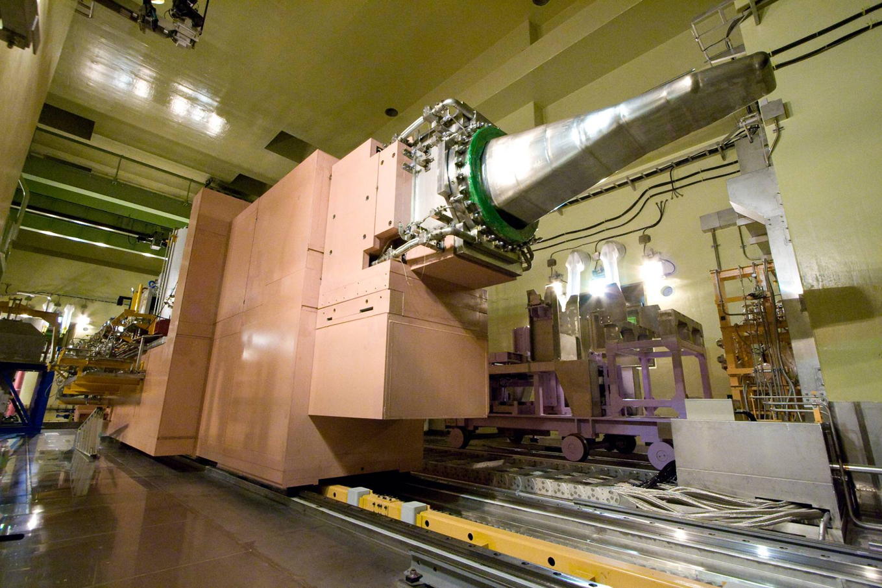
Proton
W
W/O
W
W/O
High power operation (1MW)
Stable operation
Higher freq. components, related with cavitation phenomena, were sufficiently mitigated.
Notes:
This is the liquid mercury target station of J-PARC MLF.
The beam power is 300 kW.
Due to the bubble injection, the velocity of vessel wall dramatically reduced and the high frequency components also almost disappeared. The high frequency components are considered to be induced by the cavitation bubble collapsing.
So that, this means the cavitation inception is mitigated.

Slide 7
Beam Power History at MLF

Slide 8
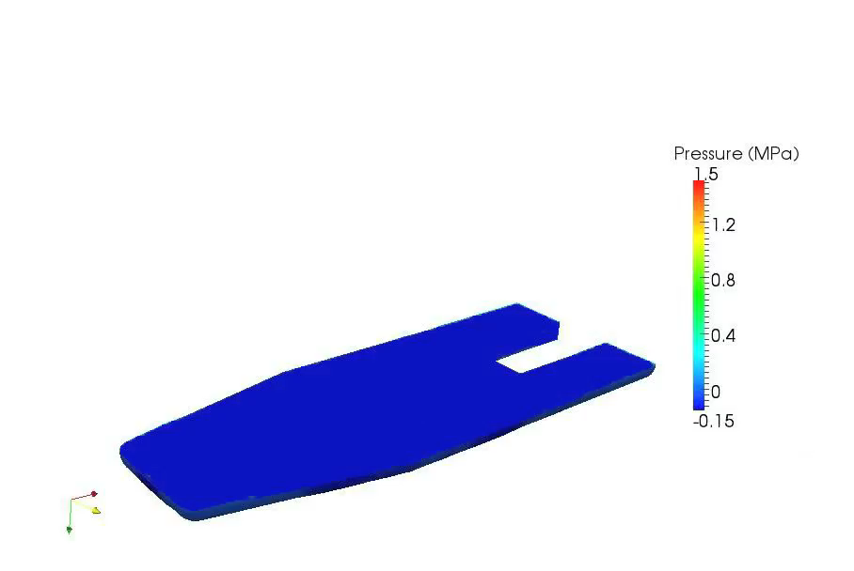
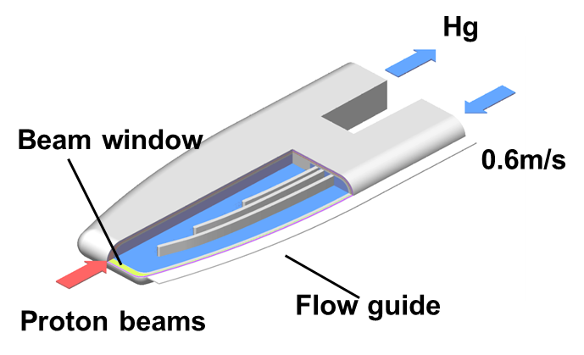
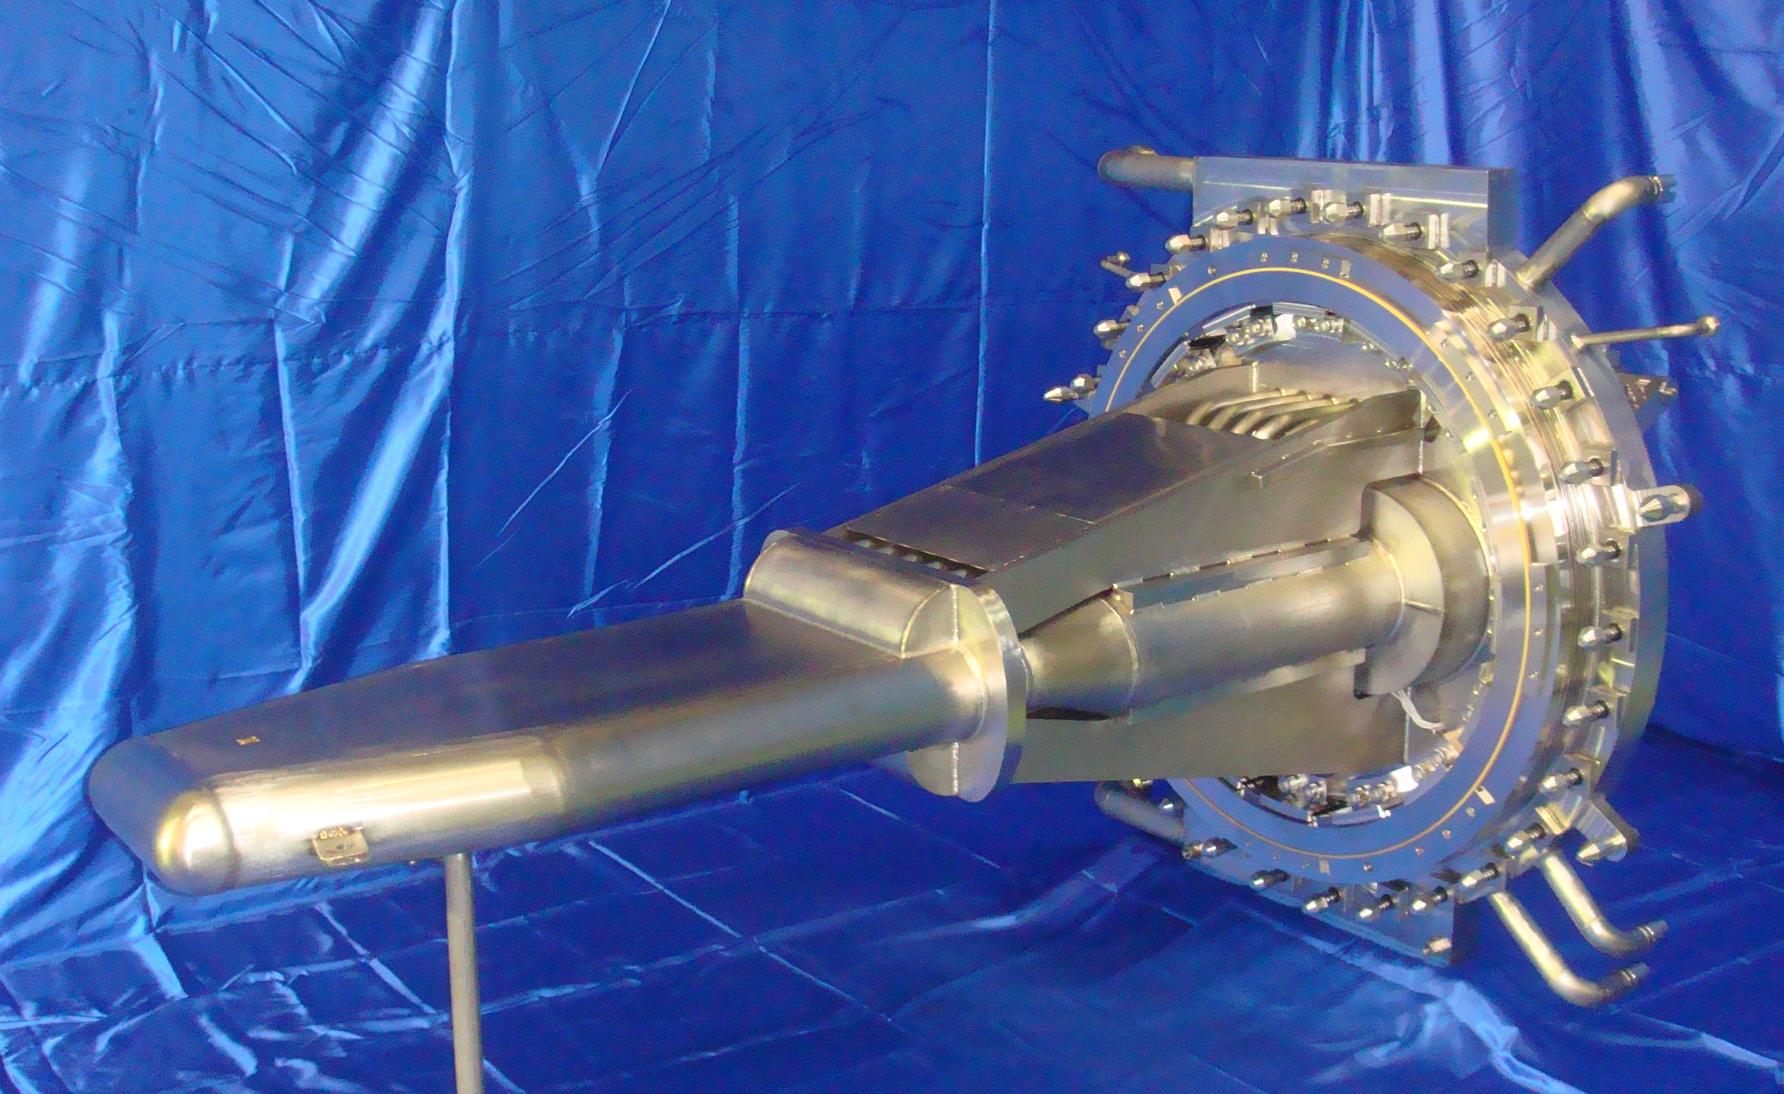
Background on Spallation Neutron Source
Pressure waves
by thermal shock
Neutrons
Proton injection
Mercury target vessel at JSNS (Made of 316L SS)
High Intensive impulsive pressure induced by proton injection into mercury.
Repeated proton injection freq. is 25 Hz. The lifetime is estimated to be 5000 h.
Giga-cycle fatigue (～10⁹ cycles） combined with pitting damage
Irradiation by intense fluxes of neutrons; accumulated dislocations

Slide 9
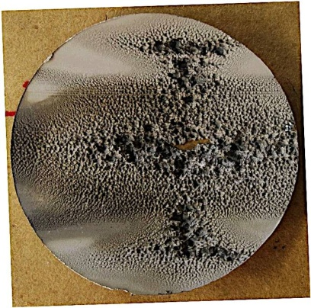
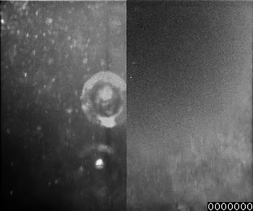
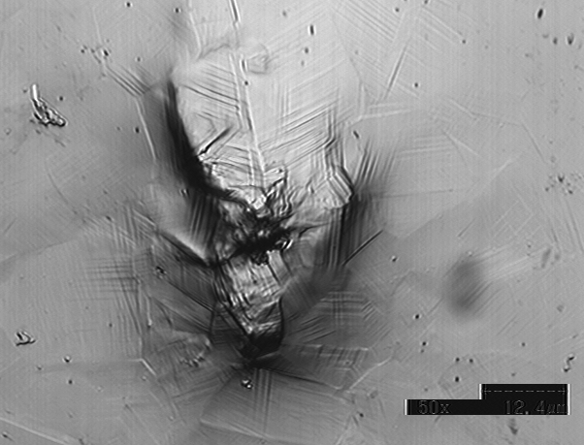
Shock generates at bubble collapse
Notes:
One million frame rate, after completely collapse, the galaxy is spread, which is sub-nanobubbles generated by passing the shockwaves.

Slide 10
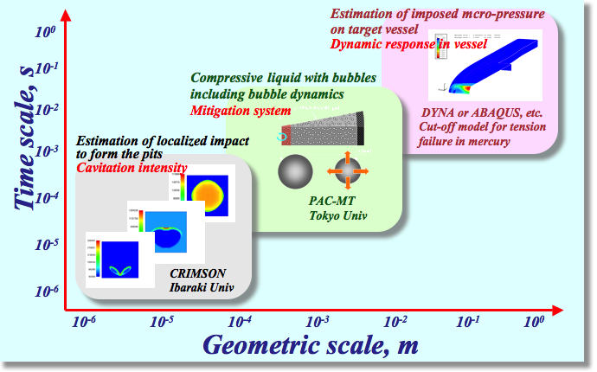
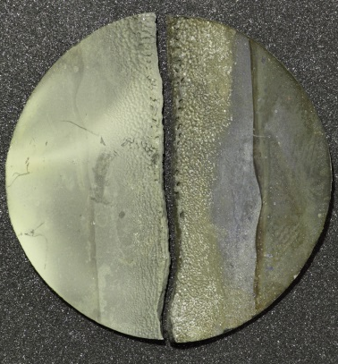
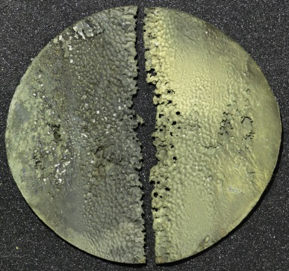
Micro, Mezo, Macroscopic Approaches
Interface damage between Liquid and Solid Metals
Micropits
Dynamic response
Fatigue crack
Notes:
In order to solve these issues,
We did micro, mezo, macroscopic approache, in particular the interface damage between liquid and solid metals.
This is the approaches from the liquid side.
Isolated bubble dynamics.
Bubble cloud behaviors.
Liquid-solid structure vibration.
And the approaches from the solid side .
Mico-pits generation due to cavitation erosion.
Fatigue crack propagation initiated at the pits.
Dynamic responses the structure including mercury.

Slide 11
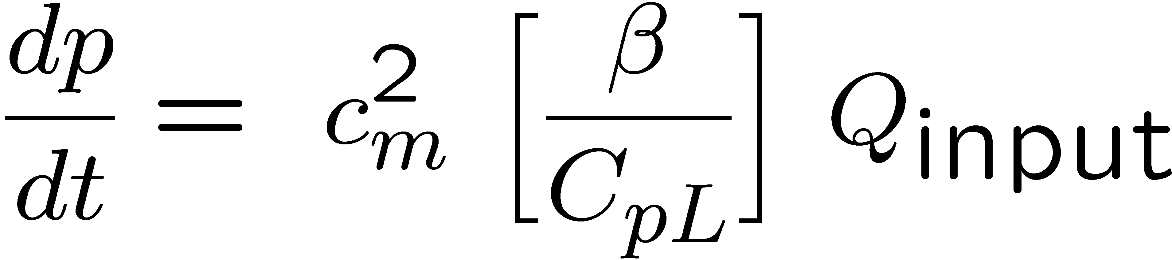
What is expected by introducing
micro bubbles?
Decrease of pressure rise
Attenuation of pressure waves
Absorption of thermal expansion
Thermal, Viscous and Acoustic damping
Thermal diffusion
Kinetic
energy
Thermal
energy
Thermal
expansion
Pressure
wave
Dispersion of pressure waves
Notes:
11
Micro-bubble is expected to decrease pressure rise and attenuate pressure waves.
Thermal expansion due to proton beam injection was absorbed by the contract of small bubbles.
The pressure wave will be attenuated by thermal, viscous and acoustic damping and dispersion.

Slide 12
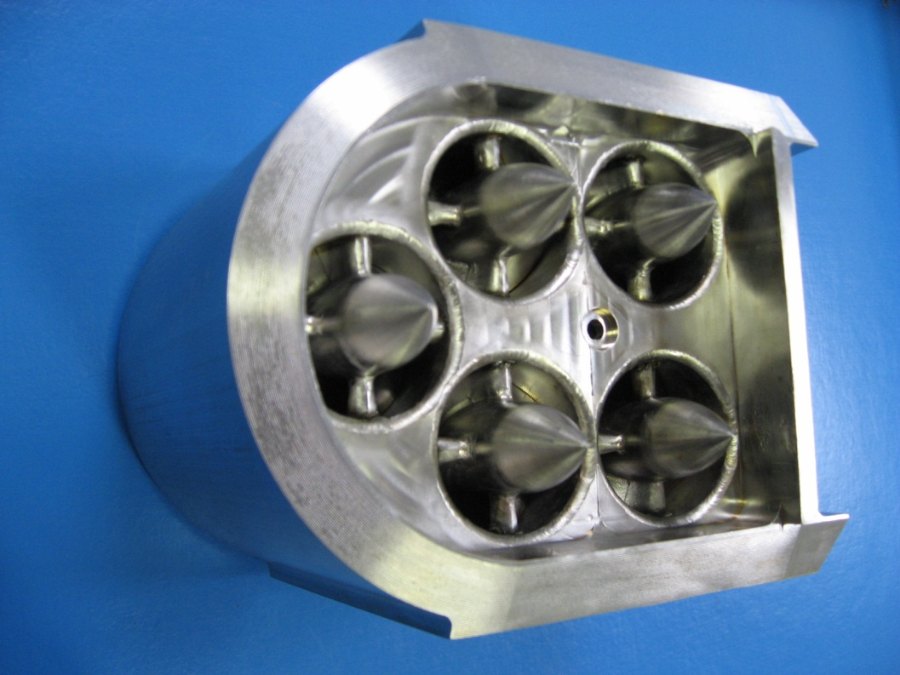
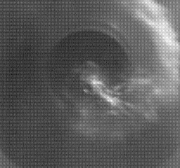
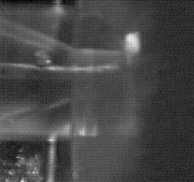
Microbubble generator for JSNS
Swirl-type bubbler

Slide 13
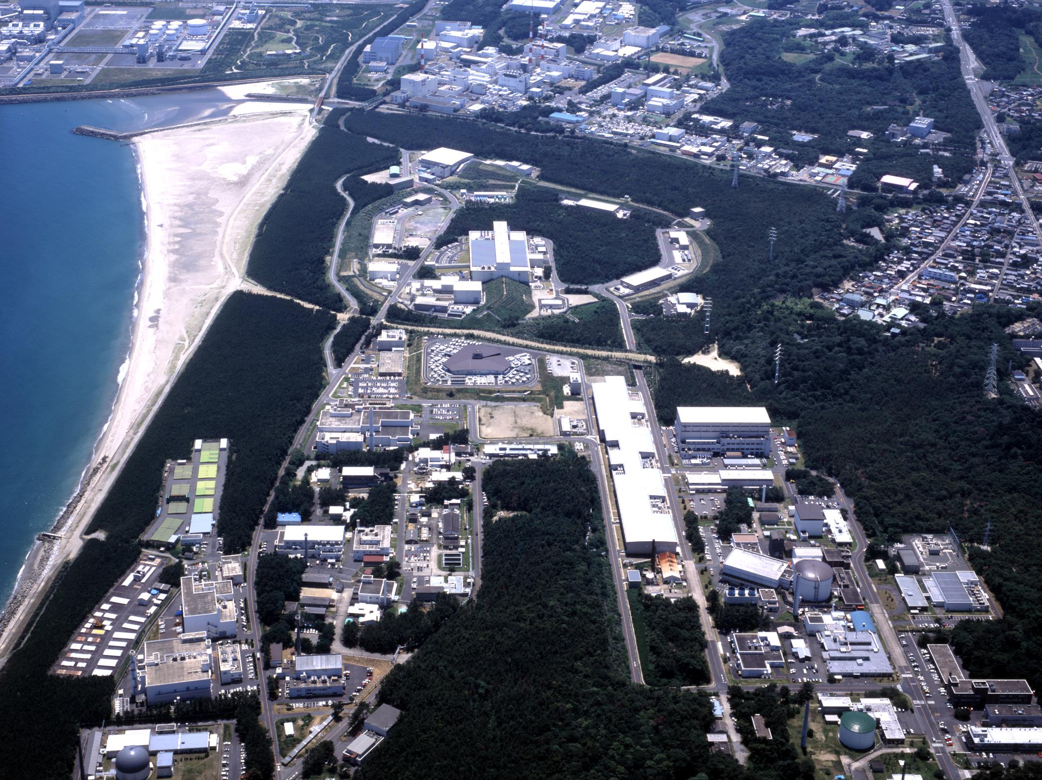
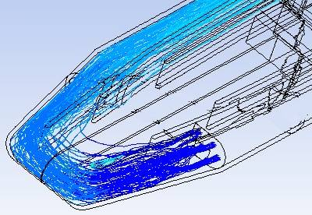
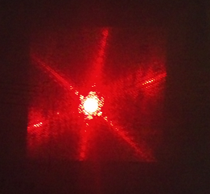
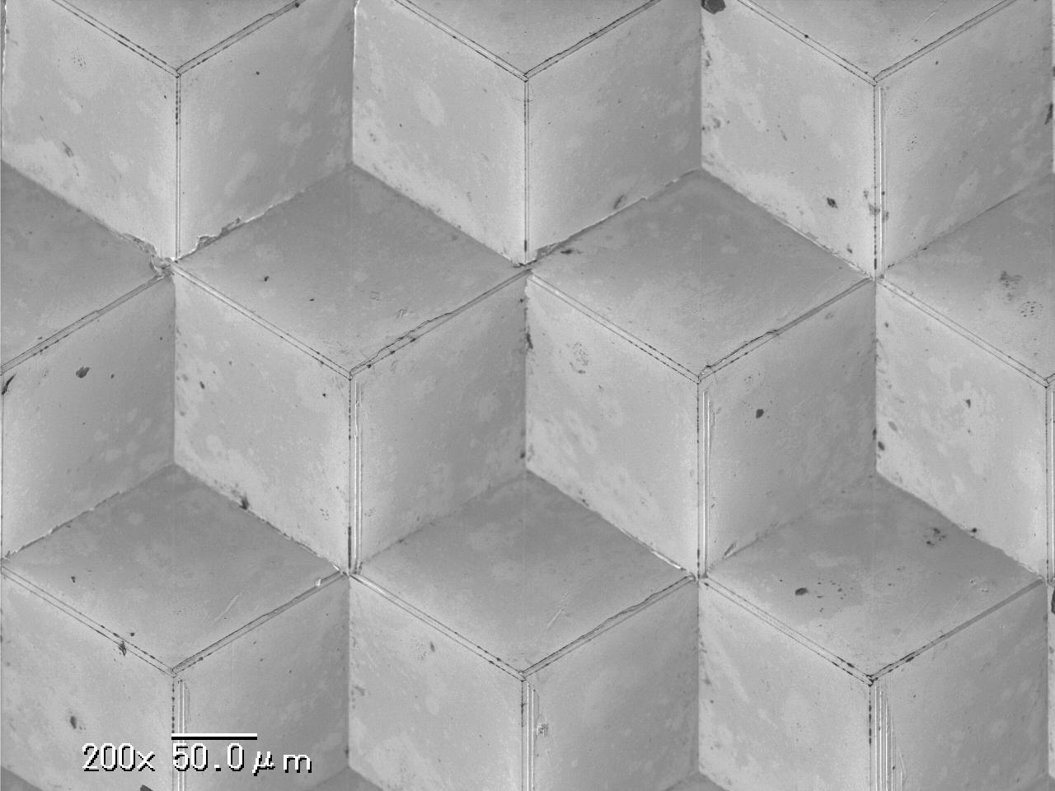
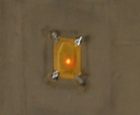
Mercury Target at MLF/J-PARC
25 Hz, short-pulse, 3 GeV H⁺
  Power in design : 1MW more
  Pressure mitigation system : Microbubbling
  Lase doppler in-situ-diagnostic system
J-PARC
Cross-flow mercury target
High intensive light
100 μm
Micro-machining tech was applied to the mirror.
Swirl bubbler
Micromirror
Laser reflector
Notes:
In the mercury target at MLF/J-PARC, in order to solve this issue, the micro-bubble
injection and in-situ diagnostic system are installed. In the JSNS, the beam pulse repetition rate is 25 Hz. That is, as compared SNS, the heat deposition of ISNS is 2.4 times higher than that of SNS.
The fine microbubbles are generated by using the multi swirl type bubbler. The appropriate bubble distribution was achieved by controlling mercury flow.
The vessel wall displacement velocity is being measured by using Laser Doppler vibrometer like that.

Slide 14
Bubbling mitigation effect
on pressure wave responses
W
W/O
Without bubbles
With bubbles
W
W/O
The peaks of spectrum were reduced clearly by bubbles injection regardless of frequency.
Higher freq. components, related with cavitation phenomena, were sufficiently mitigated.

Slide 15
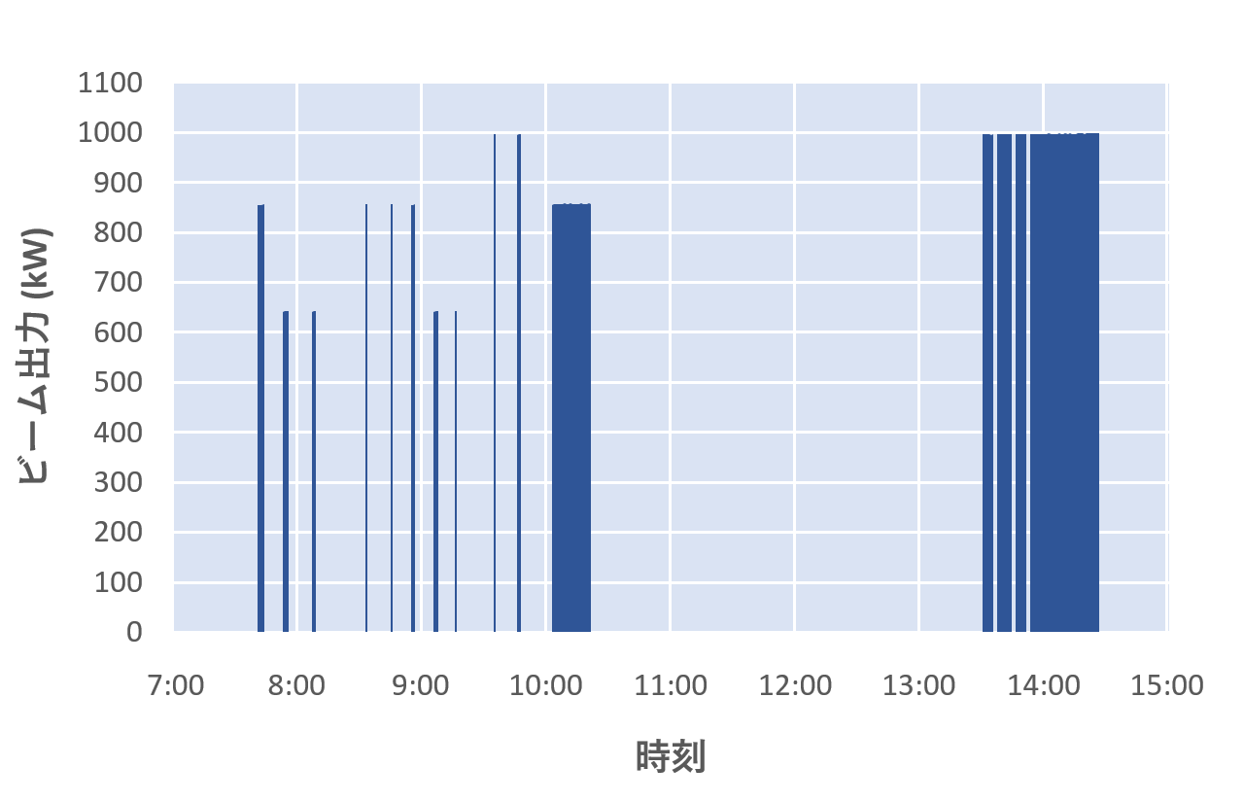
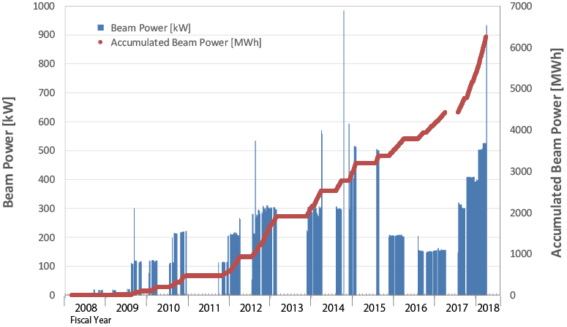
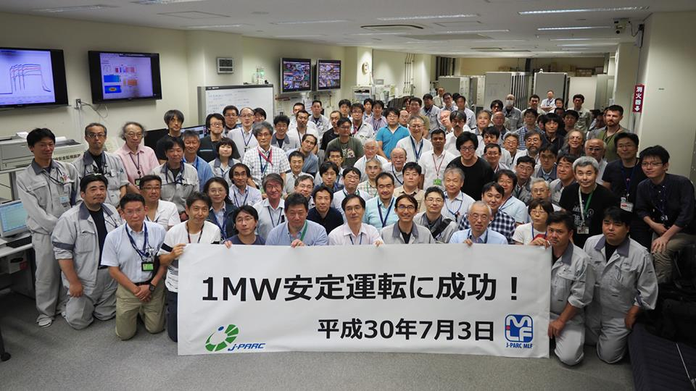
Beam Power History at MLF
1MW Operation
for 1 hr
1 MW eq. pulse
1 MW Test
500 kW
Accident at
Hadron Facility
Beam Power (kW)
300 kW
Earthquake
On July 3, 2018
～10 months interruption
due to the earthquake
～1 month interruption
due to the fire in MLF
Interruption due to troubles of Hg-target
Time
as of July 3, 2018

Slide 16
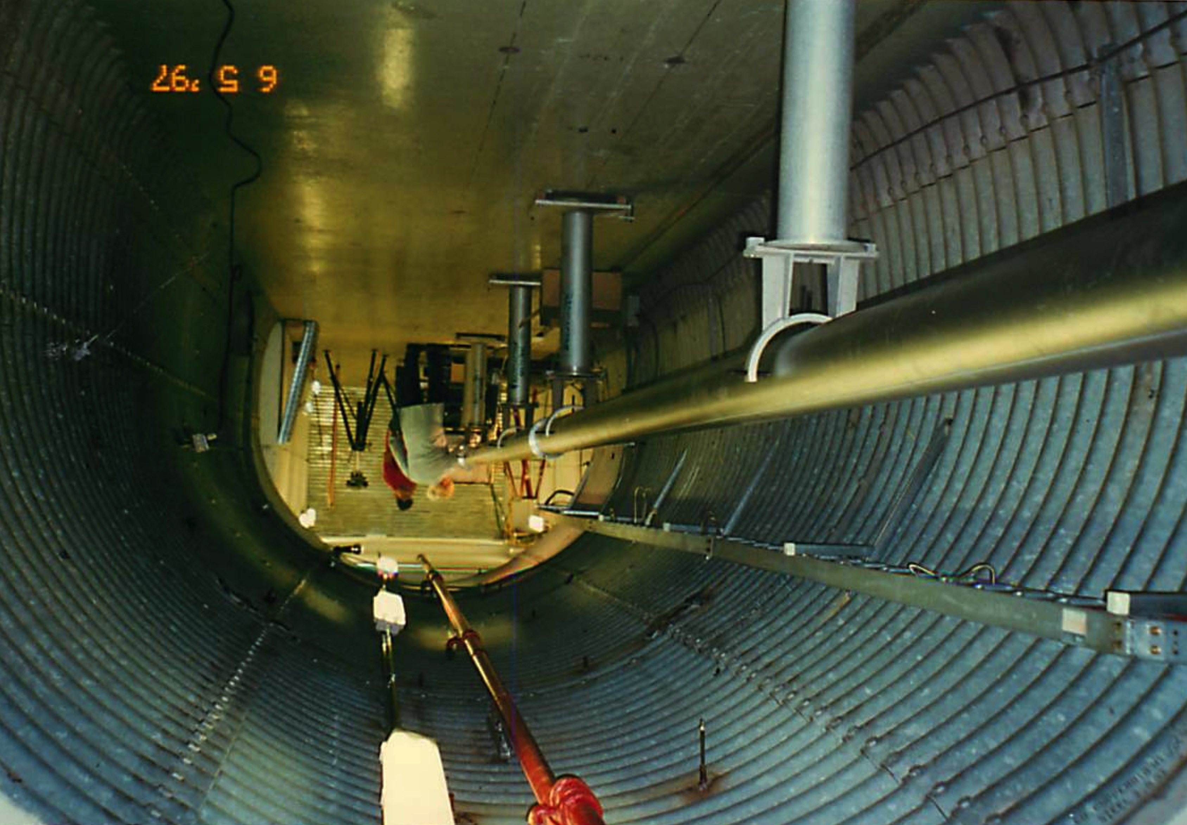
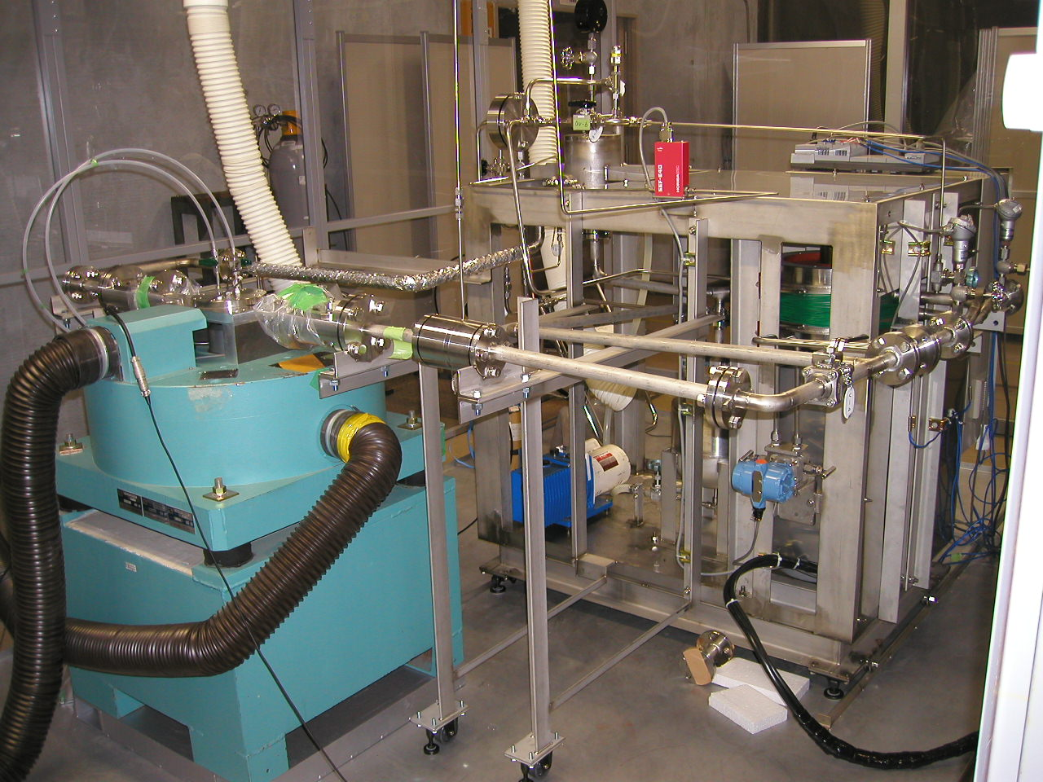
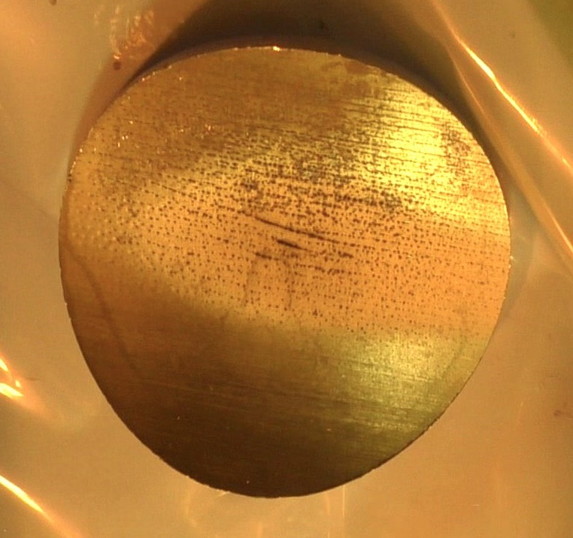
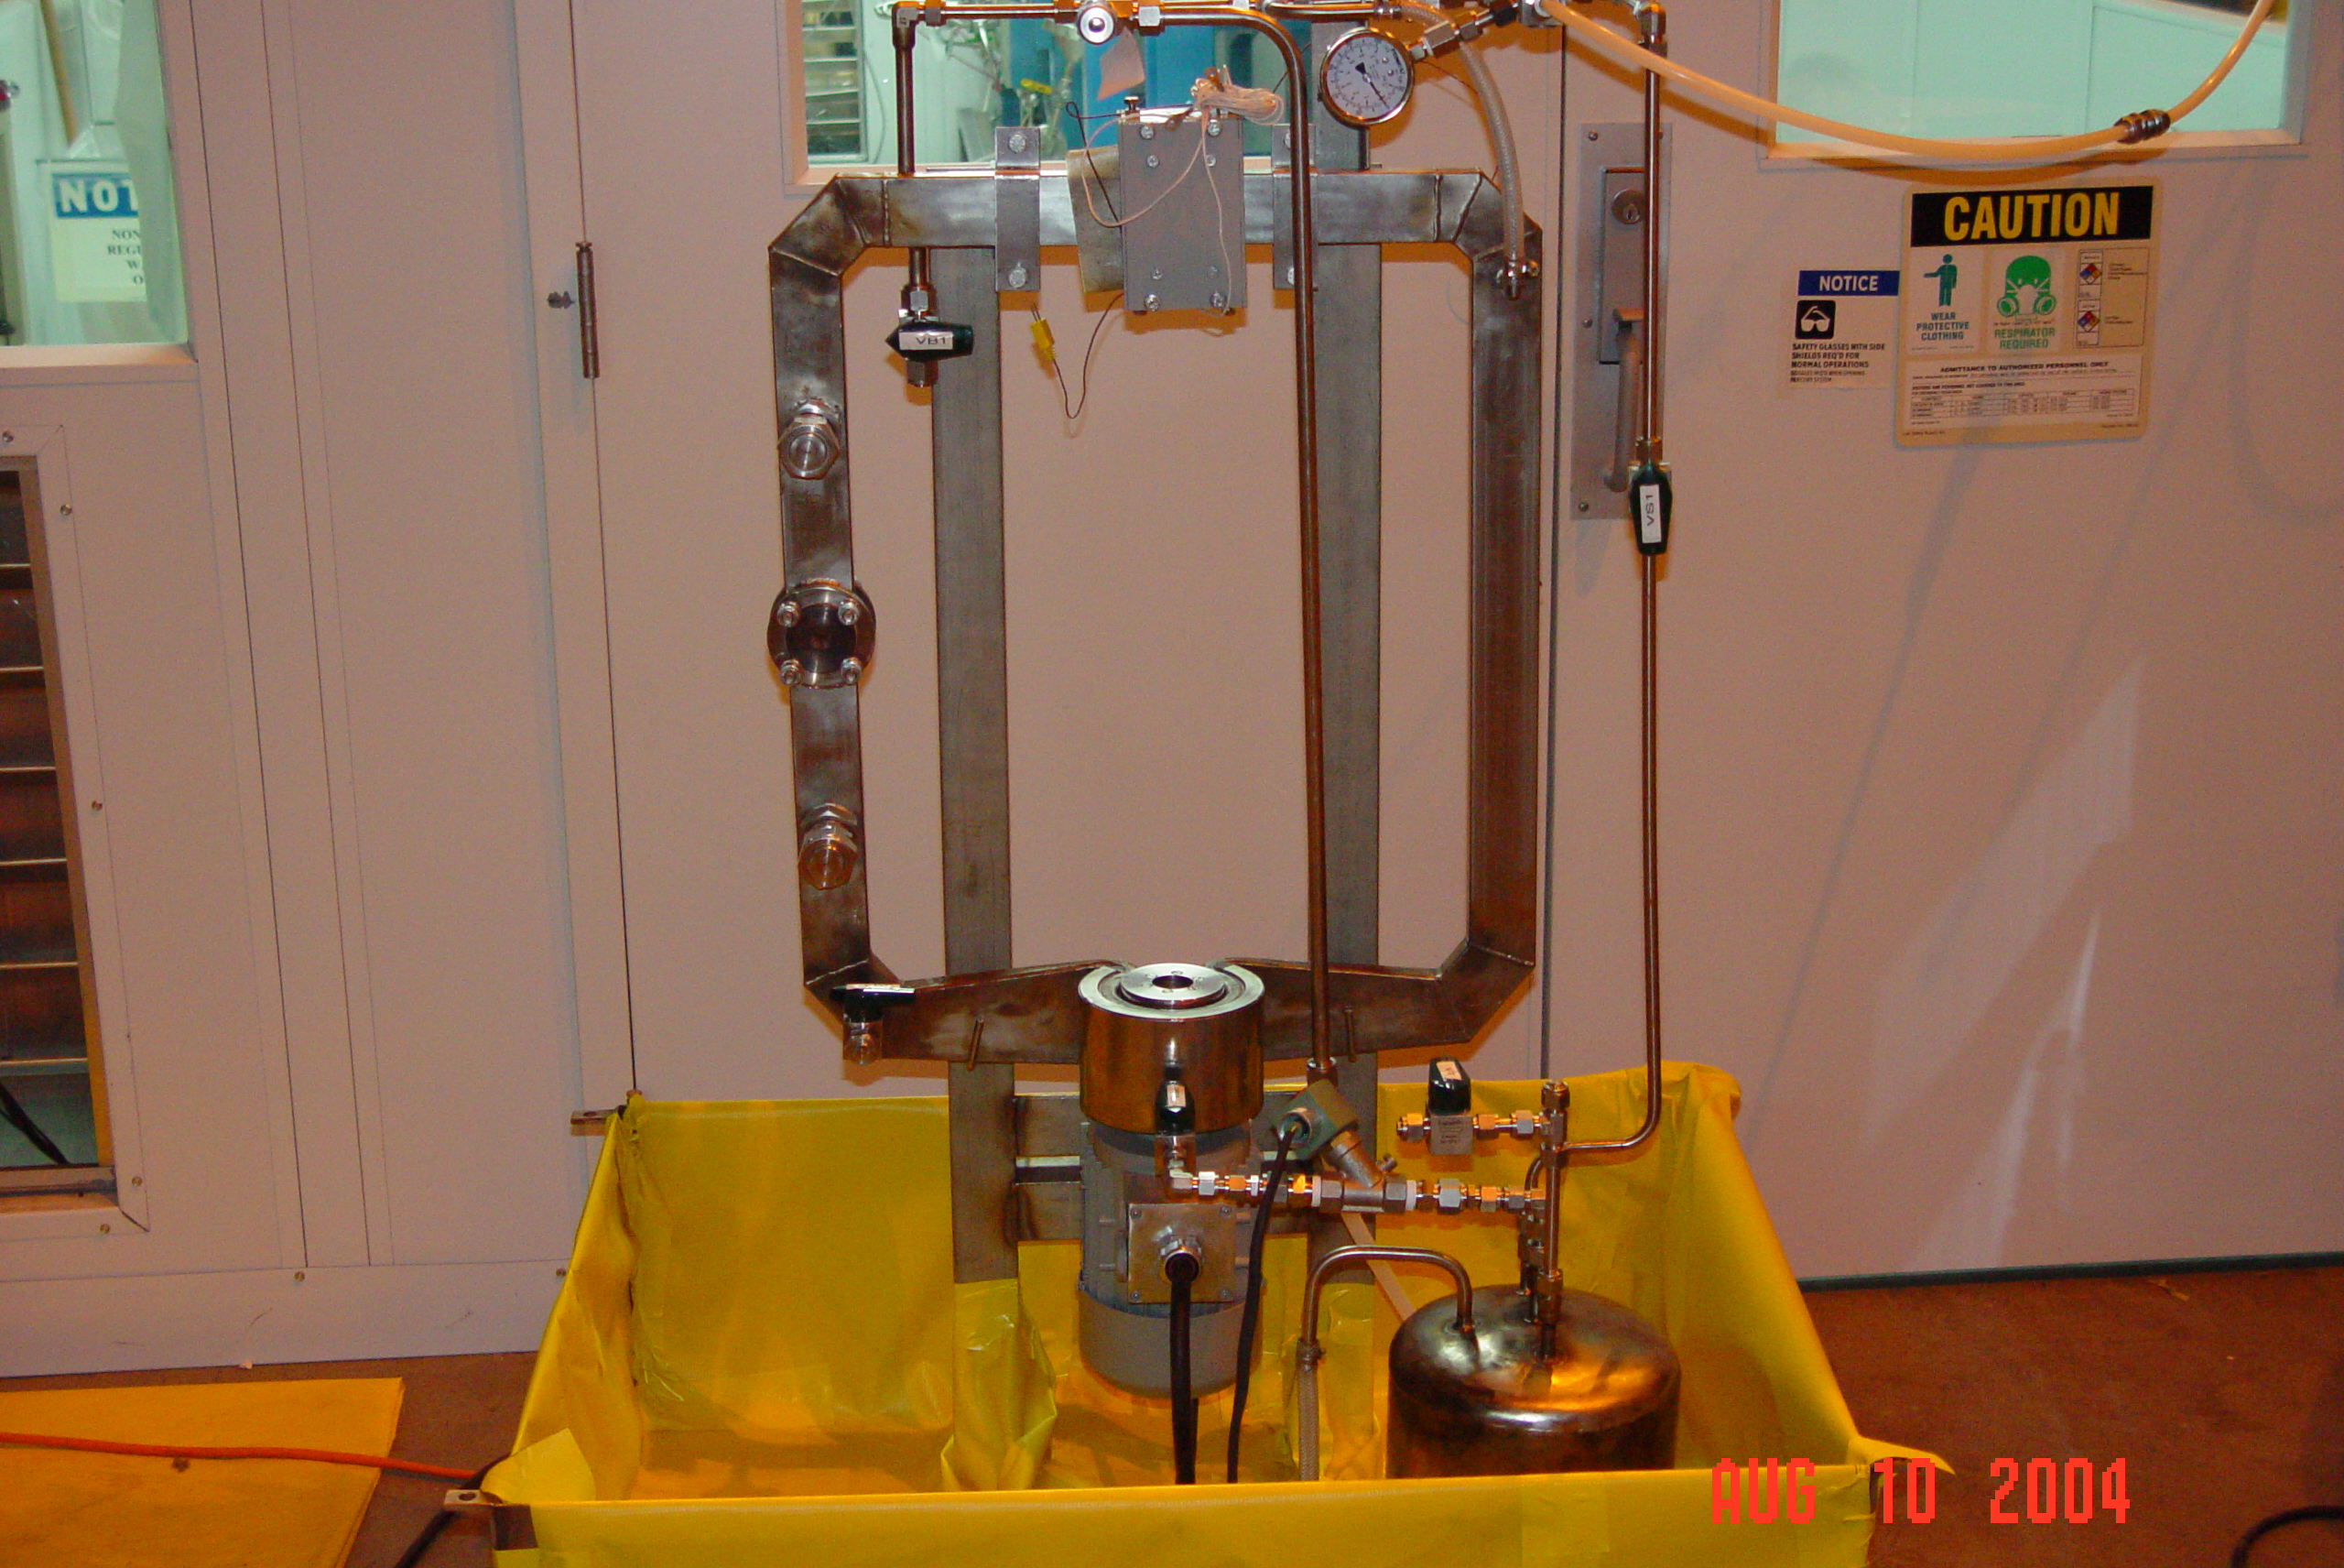
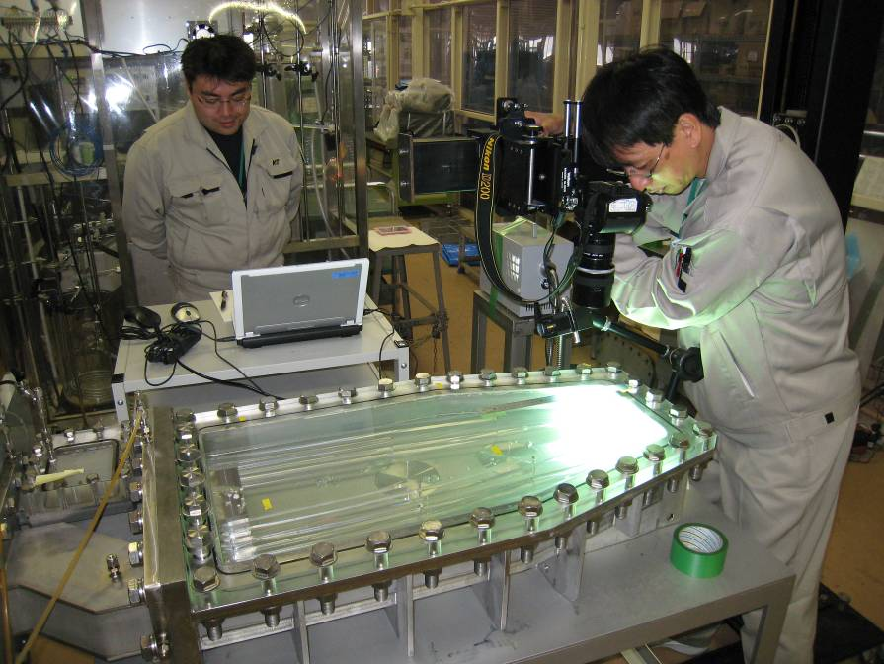
What we have done
for High Power Mercury Target Development
Notes:
16
Pressure wave problem and cavitation problem were predicted by G. Baure and J. Carpenter in 95 and 96.
Relating to the pressure waves, ASTE was carried out under the international collaboration.
2000, the pitting was observed by mechanical impact pressure test at JAERI.
This is the first observed pitting monster.

Slide 17
In-beam and Off-beam tests
for High Power Mercury Target Development
1995 Pressure wave problem (K. Skala & G. Bauer)
1996 Prediction on cavitation due to pressure wave (J Carpenter)
1997 ASTE pressure wave measurement (JAERI, ORNL, ESS/FZJ)
2000 Pitting damage was found experimentally through SHPB tests(JAERI)
2001 Pitting damage was confirmed in-beam tests (ORNL)
Design of mercury target was suspended in SNS(ORNL)
2002 Pitting damage formation over 10 million pulses was
evaluated by MIMTM (JAERI)
Design of MT was resumed in SNS (ORNL)
R&Ds on mitigation system (ORNL & FZJ)
Detail analysis regarding with the bubbling effect
on pressure wave mitigation (The Univ. Tokyo)
Struggle to find suitable bubbler in mercury
WNR test on bubbling effect (ORNL & JAERI, ESS)
Swirl bubbler to form fine bubbles in flowing mercury (Tsukuba Univ.)
2009 SNS target reached 1MW operation & PIE of real target.
Notes:
17
Pressure wave problem and cavitation problem were predicted by G. Baure and J. Carpenter in 95 and 96.
Relating to the pressure waves, ASTE was carried out under the international collaboration.
2000, the pitting was observed by mechanical impact pressure test at JAERI.
This is the first observed pitting monster.

Slide 18
2009 TTF experiment to measure
bubble distribution in flowing mercury (J-PARC & SNS)
2011 WNR test on bubbling effect with
swirl bubbler and Inlet Orifice Bubbler (IOB) (J-PARC & SNS)
1st PIE of real target (J-PARC)
2012 Bubbling operation with swirl bubbler in real target (J-PARC)
Bubbling effect on reduction of pressure waves was
demonstrated in real target (J-PARC)
Narrow channel experiment on pitting damage (J-PARC)
2013 Swirl bubbler was improved to have a function that
bubbles are able to be generated without compressor (J-PARC)
2014 The target with swirl bubbler and narrow channel was operated (J-PARC)
2015 PIE on narrow channel wall
(failure for the wall facing to bubbling mercury) (J-PARC)
2017 Bubbling operation without compressor (J-PARC)
2018 Bubbling operation with IOB (SNS)
Scheduled operation with 500 kW at 25 Hz was accomplished. (J-PARC)
1 MW - 1 hour operation was succeeded (J-PARC)
PIE on both of narrow channel wall and
the wall facing to bubbling mercury (J-PARC)
2019 1 MW - 12 hour operation will be conducted (J-PARC)
In-beam and Off-beam tests
for High Power Mercury Target Development
TTF experiment to measure bubble distribution in flowing mercury
(J-PARC & SNS)
WNR test on bubbling effect with swirl bubbler and Inlet Orifice Bubbler (IOB)
(J-PARC & SNS) 1st PIE of real target (J-PARC)
Bubbling operation with swirl bubbler in real target (J-PARC),
Confirmed bubbling pressure wave mitigation effect in target (J-PARC)
2013 Swirl bubbler was improved for bubble generation without compressor (J-PARC)
Target with swirl bubbler and double flow channel (J-PARC), 2nd PIE
3rd PIE
Bubbling operation without compressor (J-PARC), 4th PIE
Bubbling operation with IOB (SNS)
1 MW - 1 hour operation was succeeded (J-PARC) , 5th PIE
1 MW - 12 hour operation will be conducted (J-PARC)
Notes:
18
Pressure wave problem and cavitation problem were predicted by G. Baure and J. Carpenter in 95 and 96.
Relating to the pressure waves, ASTE was carried out under the international collaboration.
2000, the pitting was observed by mechanical impact pressure test at JAERI.
This is the first observed pitting monster.

Slide 19
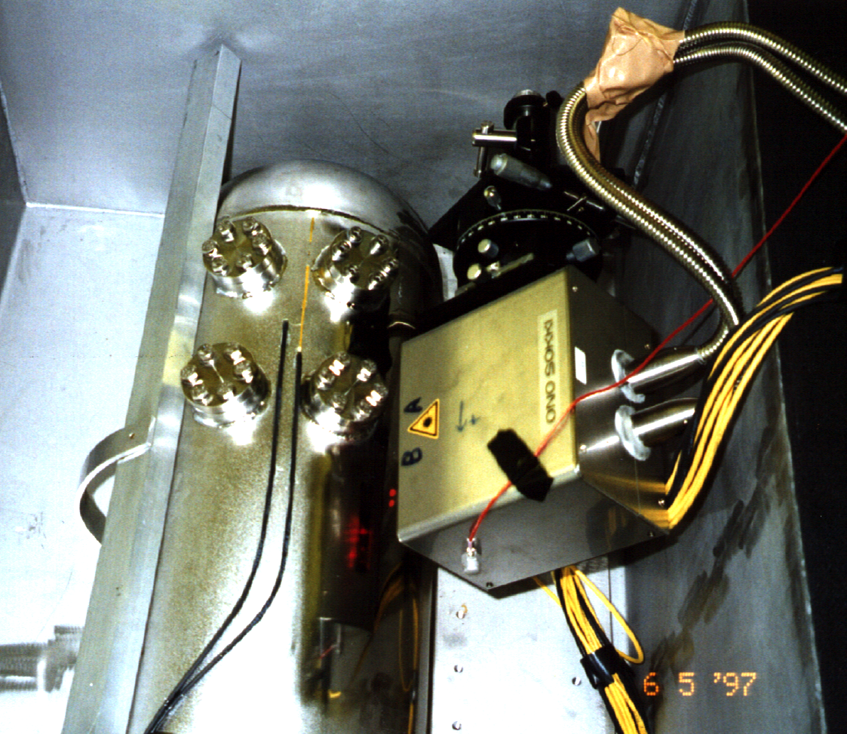
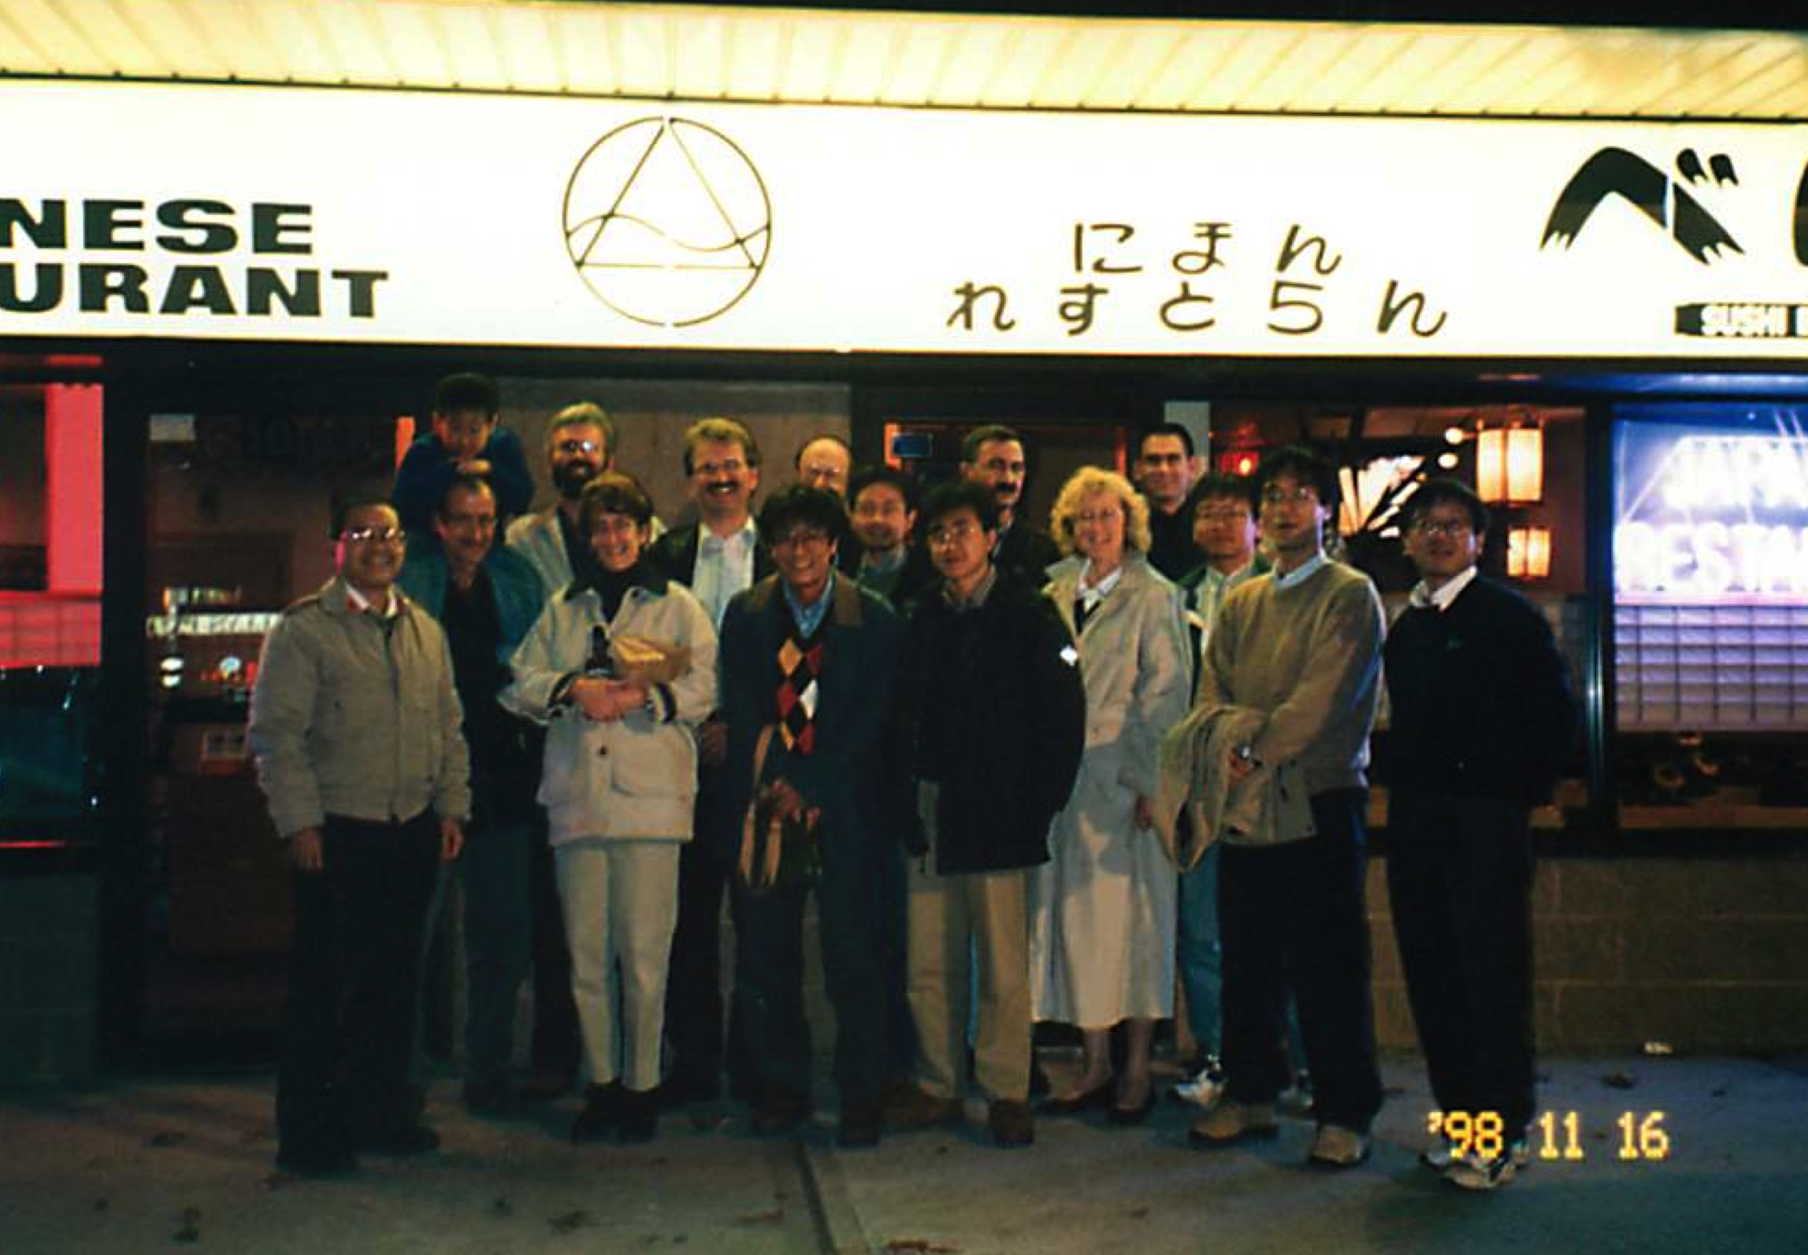
International collaboration of AGS experiment to measure dynamic response of mercury target in １９９７

Slide 20
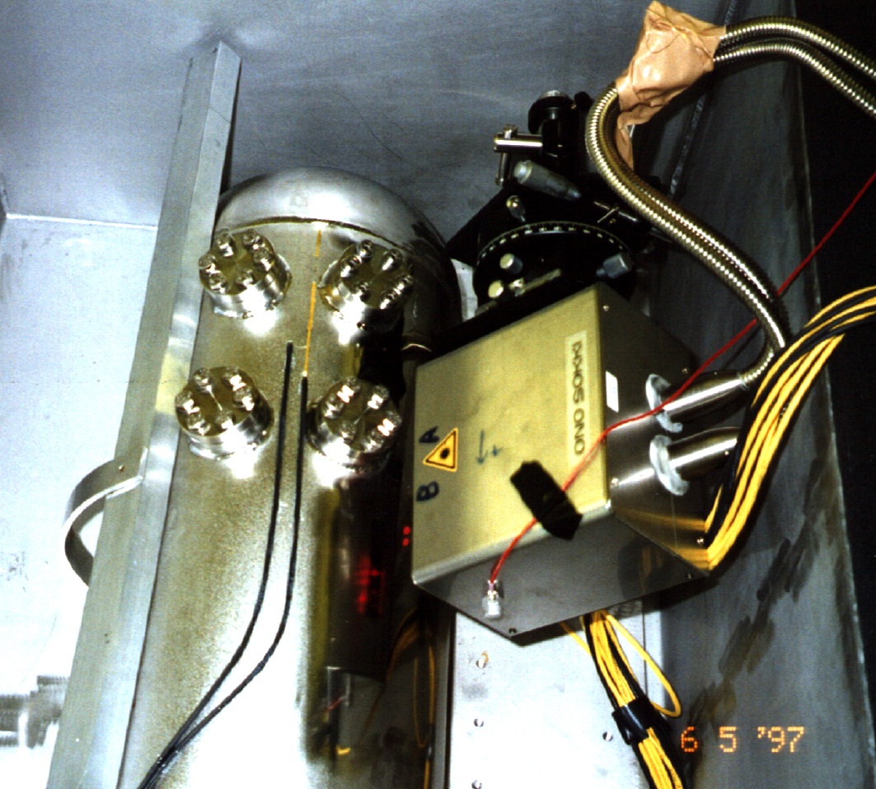
4
Impact problem on mercury target
Proton beam (5MW)
Stress waves
Materials
compatibility
1μs
Irradiation
Mercury
Target container
AGS experiment
Injected proton beam : 24 GeV, 10¹² n, 40 ns
Laser Doppler technique
The stress propagation up to 100 ms is adequately described by the calculation. After 100 ms, in the calculation the velocity rapidly increases with superimposed high frequencies components, and in the experiment the velocity fluctuates comparatively slowly.
Notes:
But, to reach 1MW–class we have to solve the pressure waves problem and mercury cavitation damage.
This is the picture of target and the length is about 2 m and the weight is 2 ton.
The image of pressure wave is lie that.
The thermal energy is applied the proton beam injection and the thermal shock is induced in mercury and compressive pressure waves generated and by the interaction between the vessel wall and the pressure waves, the negative pressure occurs and cavitation phenomenon caused as results.

Slide 21
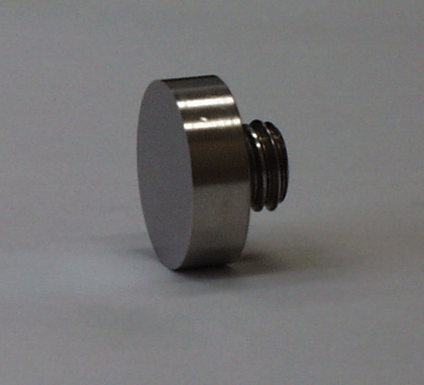
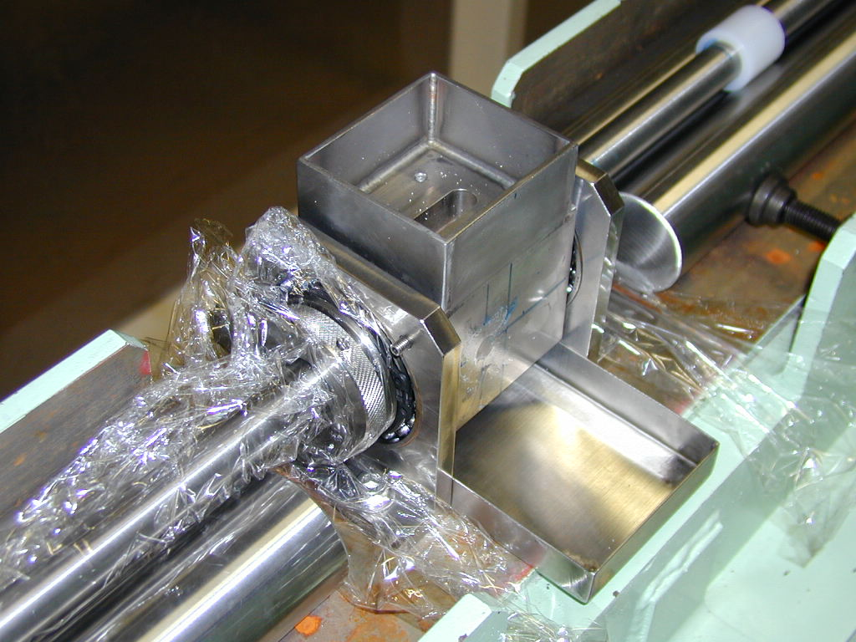
Experiment by using SHPB tech.
to evaluate dynamic behavior of mercury
Modified split Hopkinson pressure bar apparatus
10 mm
Specimen for impact erosion fixed to the both end of bars
Chamber for mercury
Notes:
But, to reach 1MW–class we have to solve the pressure waves problem and mercury cavitation damage.
This is the picture of target and the length is about 2 m and the weight is 2 ton.
The image of pressure wave is lie that.
The thermal energy is applied the proton beam injection and the thermal shock is induced in mercury and compressive pressure waves generated and by the interaction between the vessel wall and the pressure waves, the negative pressure occurs and cavitation phenomenon caused as results.

Slide 22
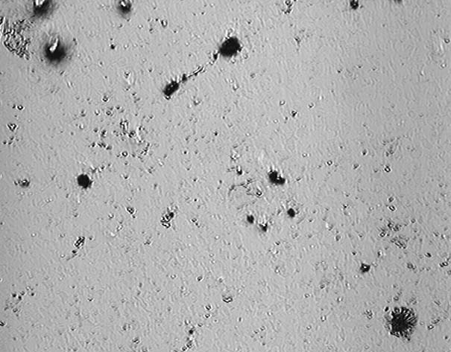
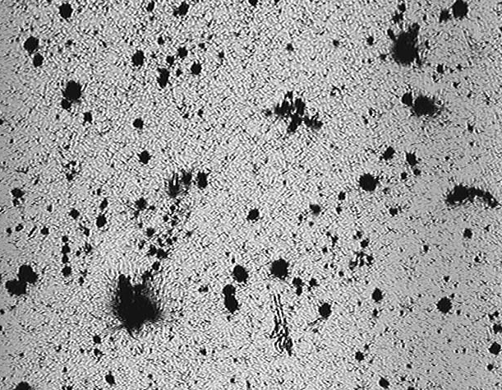


Materials dependency of impact erosion
Open : Input
Close : Output
Inconel600
A6061
A6061
Inconel600
316SS
Maraging Steel
316SS
Maraging Steel
Surface degradation after 10 impacts imposed
The collapse of the cavitation bubble imposes high compressive stress on the surface microarea due to the microjet injection and the cumulative cavitation damage causes the erosion pits.
The degradation due to the impact erosion, A6061>Inconel 600>Maraging Steel>316SS.
Notes:
But, to reach 1MW–class we have to solve the pressure waves problem and mercury cavitation damage.
This is the picture of target and the length is about 2 m and the weight is 2 ton.
The image of pressure wave is lie that.
The thermal energy is applied the proton beam injection and the thermal shock is induced in mercury and compressive pressure waves generated and by the interaction between the vessel wall and the pressure waves, the negative pressure occurs and cavitation phenomenon caused as results.

Slide 23






Pitting formation by MIMTIM
10³
10⁴
Cracks
Isolated pits
10⁵
Combined pits
10⁶
20μm
Erosion by pitting
10⁷
Pitting damage data are accumulated up to over 10 million
Notes:
It was found that the damage was distinguished over 1 million impacts and cracks was recognized on the surface, and so on.

Slide 24


Experiment on the effect of micro-bubble
on cavitation damage
Stagnant
250μm
Microbubble injection
under flowing
Flow : 0.3m/s+Bubble ca.0.1%
Futakawa et al; J. Nucl. Sci. Tech. 453(2008)1041-1048
Notes:
This is experimental results to show how much the damage is mitigated by using the micro-bubbles.
This case is the void fraction of 10-3. Clearly the damage was reduced.

Slide 25


Flowing effect
on bubble collapsing behavior
Flowing velocity (1m/s)
Stagnant

Slide 26


Pressure wave mitigation by bubbles
A lot of efforts have been made to realize MW-class mercury target.
Bubbling is most effective tech. to reduce pressure waves !
Prospective bubbler ( simple & robust) was found finally after several years research.
Experimentally and theoretically understood mitigation phenomena more deeply.
Noticed similarity of bubble-cloud dynamics in Hg and H₂O
Effectiveness was demonstrated under water test with high pressure rising rate.
Reduction
Electric
spark
Very rapid
pressure rise

Slide 27


Pressure wave mitigation
confirmed in–beam tests
Proton
beam
Hg loop
with bubbler
On-beam test was carried out by using WNR facility to investigate the bubbling effect on the pressure waves caused by proton beam injection. The displacement velocity measured by a Laser Doppler Vibrometer L.D.V. was reduced by bubbling.

Slide 28



Pitting damage mitigation by bubbles
Proton radiography
to observe bubbles in mercury
Evaluated bubble population
Stagnant
With bubbling
Okita, et al.
Damaged surfaces
By ORNL
Expected pressure reduction
by bubbling

Slide 29
What we have learned through the high power mercury target development
In-beam tests are indispensable !
Have to learn what happens !
Sensing with visualization is Key technology to understand phenomena.
Off-beam tests and Physical modeling to explore the mechanisms are important, as well.

Slide 30



Future facilities at J-PARC
As usage of neutron,
ADS experiment & Secondary target facilities

Slide 31





R&D for ADS Plants (under discussion)
High-power target technology
  LBE technology
    thermal-hydraulics
    materials corrosion
    Instrumentation
    remote-handling
  Materials irradiation study with using existing facilities, such as STIP/PSI and MLF/J-PARC
    Contracted with PSI for STIP-8
Experimental
data for V&V
Computer simulation
Thermal-hydraulics
Corrosion in LBE
Simulation models
to predict stress-strain
properties for irradiated materials
IMMORTAL
J-PARC’s experimental devices
OLLOCHI
Experimental
data for V&V
Time scale
SINQ target
  Behavior of spallation products
    Started collaborative research with Fukui Univ., “Physicochemical form of SP in LBE”
    J-PARC’s experience for MLF Hg-target
Size scale

Slide 32








Future improvement on
Targets & Windows at J-PARC
Neutrino [ν]
He-cooled graphite
Al A5083 BW
Muon [MLF-MUSE]
Rotating Graphite
Ti-6Al-4V BW
Neutron [MLF]
Liquid Mercury
Hadron [HEF]
Water cooled gold
Graphite [COMET]

Slide 33
    Expectation to HRM Facility
    1) Developments of Advanced target/window/dump materials
    2) Research on Displacement Cross-Section dependency on
    proton energy
    3) Development of In-beam radiation-tolerant detector
    ……etc.
COOPERATION between CERN and J-PARC
In effect on 8 April 2011 , 5 years (8 April 2016)
In effect on 30 March 2016, + 5years (until 8 April, 2021)
To be in effect soon, + 5years (until 8 April, 2026)
Expand the co-operation to the fields of high-intensity accelerator target facilities and relevant technologies, to fully realize and accomplish the benefits of the high intensity proton accelerators

Slide 34






R a D I A T E Collaboration
Radiation Damage In Accelerator Target Environments
Founded in 2012 by 5 institutions led by FNAL and STFC to bring together the HEP/BES accelerator target and nuclear fusion/fission materials communities
In 2017, 2nd MoU revision has counted J-PARC (KEK+JAEA) & CERN as official participants
Collaboration has now grown to
13(14) Institutions, 70 members
http://radiate.fnal.gov
34
J-PARC MoU signing & workshop in 2017

Slide 35
Summary
In-beam tests are indispensable to learn what happens
J-PARC (KEK and JAEA) express interests in the future experiments at HiRadMat facility
Expand COOPERATION between CERN and J-PARC

