Slide 1
Fast Transient Beam-Matter Interactions at the
European Spallation Source
Yong Joong LEE
European Spallation Source ERIC
International HiRadMat Workshop, July 11, 2019, CERN

Slide 2
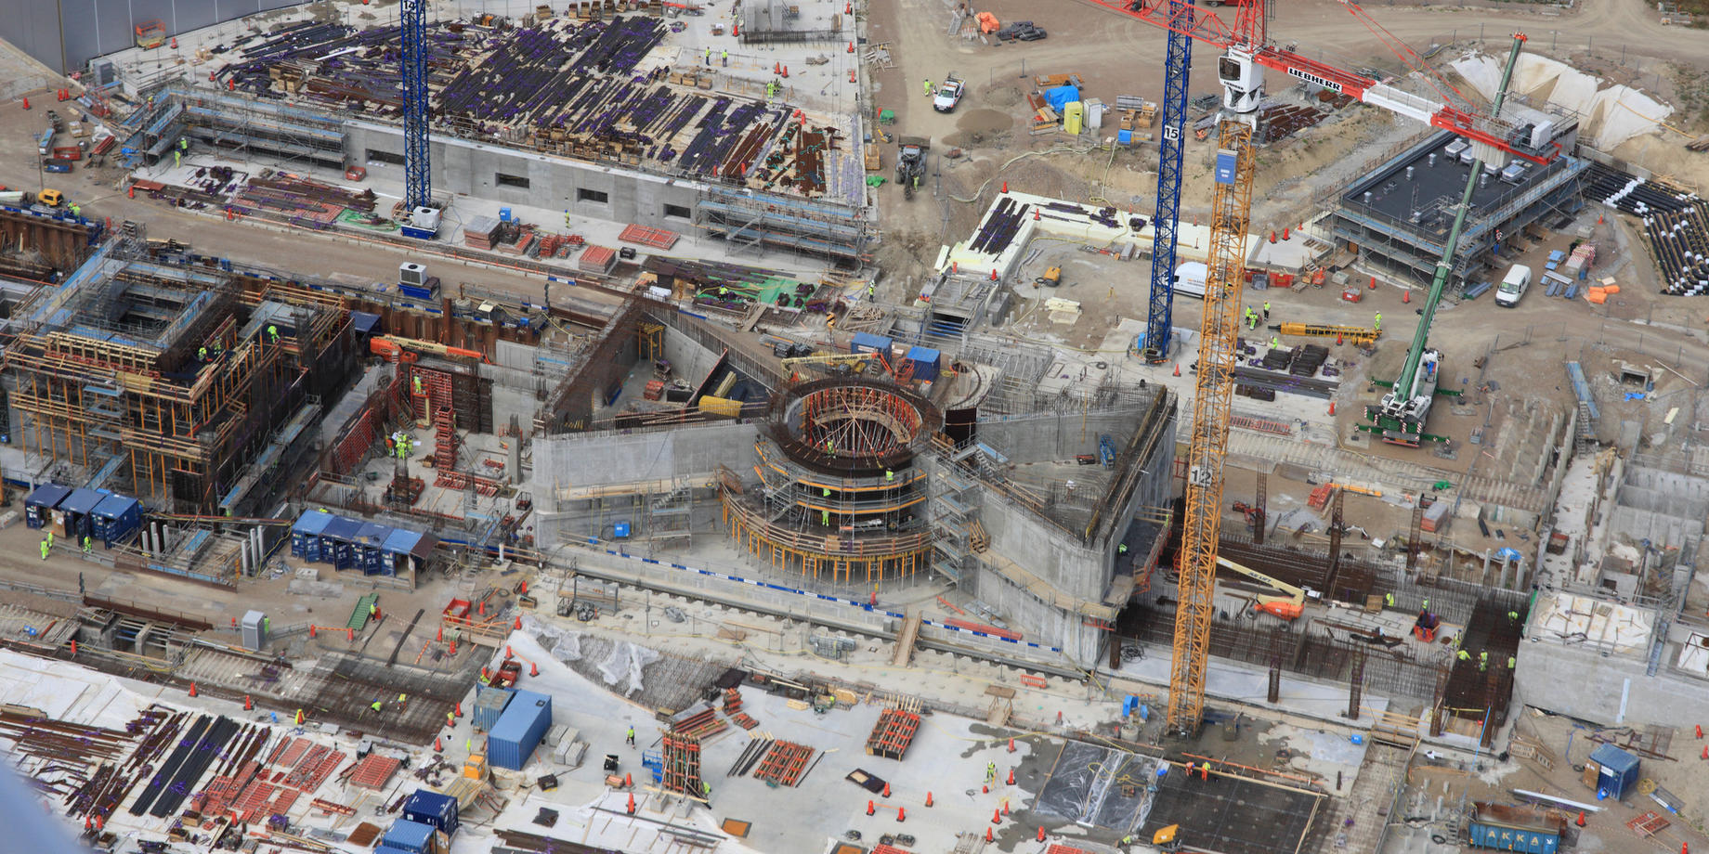
Progress as of June 2019
ESS Project: 60% Completion
Target Sub-Project: 46% Completion

Slide 3
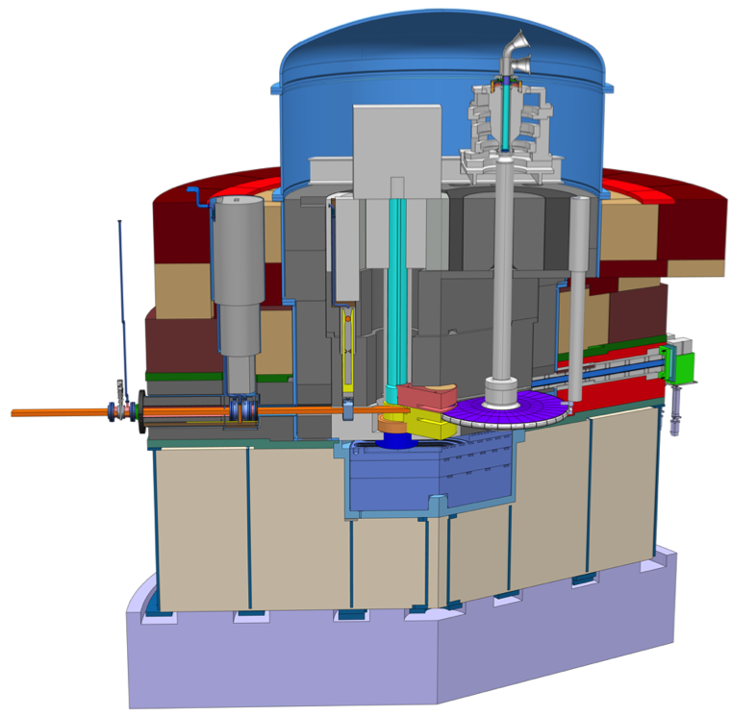
ESS Target Environment
Proton Beam Instrumentation
Target Wheel Drive Unit
Proton Beam Window (PBW)
Proton beam (2 GeV/5 MW)
Beam Extraction Unit
Moderator Reflector
Target Wheel

Slide 4
High Level Beam Parameters: ESS vs HiRadMat
Parameter | Units | Value@ESS | Value@HiRadMat
Energy | GeV | 2.0 | 440
Current during pulse | mA | 62.5 | 696.4
Protons per pulse | - | 1.1∙10¹⁵ | 3.46∙10¹³
Average current | mA | 2.5 | -
Macro-pulse length | ms | 2.86 | 7.95∙10⁻³
Bunching frequency | MHz | 352.21 | 36.23
Pulse repetition rate | Hz | 14 | -
Average power | MW | 5 | -
Power during pulse | MW | 125 | 3.1∙10⁵
Energy per pulse | kJ | 357 | 2436
Long pulse vs Short pulse:
What are the cases where fast transient
beam-matter interaction is of a concern at ESS?

Slide 5
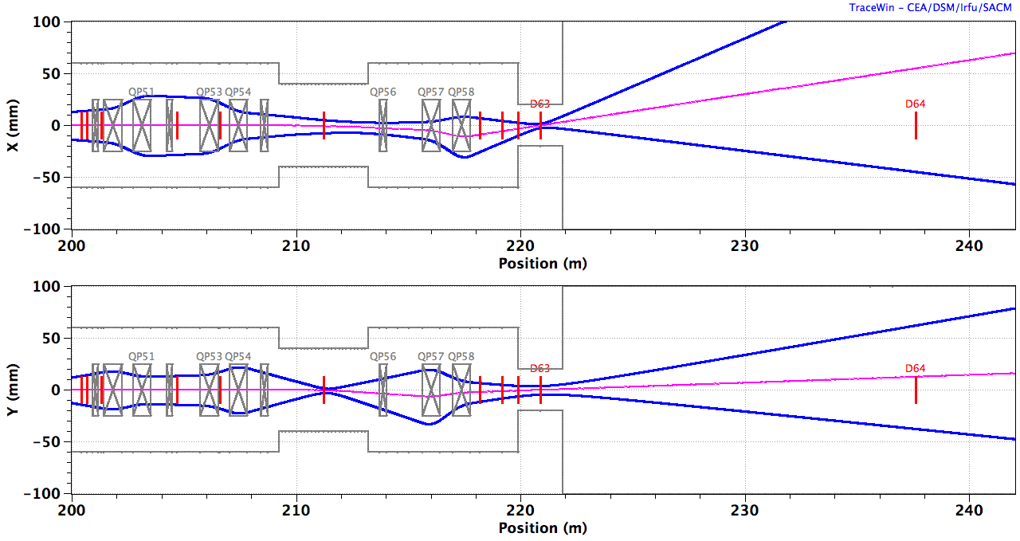
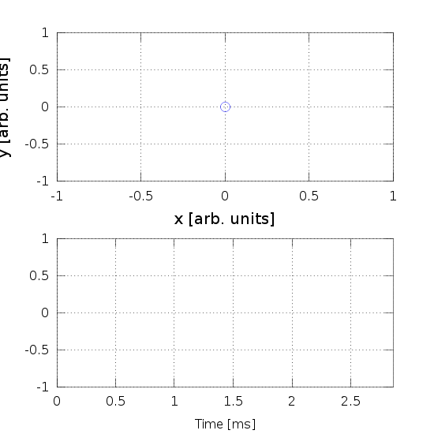
ESS Beam Raster
Parameter | Value
Sweep frequency - horizontal | 39.55 kHz
Sweep frequency - vertical | 29.05 kHz
Animation courtesy by H. D. Thomsen

Slide 6
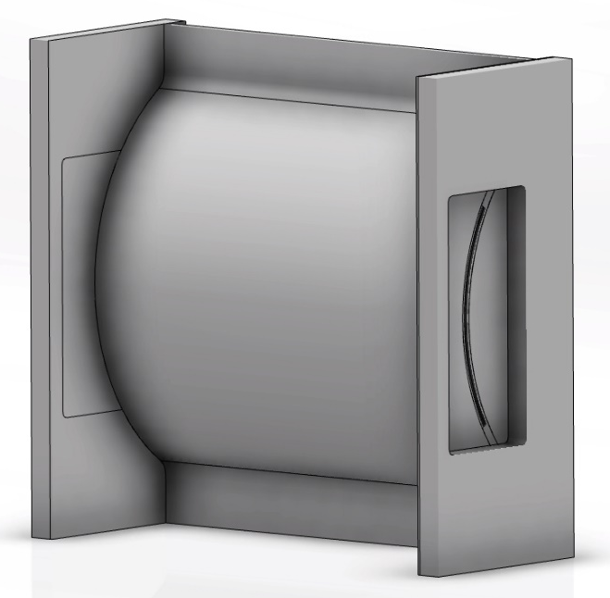
Beam on Proton Beam Window (PBW)
Peak charge density per pulse at PBW
Parameter | Unit | Value
Material | Al6061-T651
Raster deflection, horizontal | mm | 47.4
Raster deflection, vertical | mm | 15.8
Beam RMS, horizontal | mm | 10.67
Beam RMS, vertical | mm | 3.99
Peak current density (Rastered) | mA/cm² | 1.66
Peak current density (Unrastered) | mA/cm² | 23.36
Peak charge density per pulse (Rastered) | µC/cm² | 4.7
Peak charge density per pulse (Unrastered) | µC/cm² | 66.7
Reference peak charge density per pulse at HiRadMat
Parameter | Reference RMS | Unit | Value
Peak charge density per pulse | 0.5 mm | µC/cm² | 352.5
 | 2.0 mm | µC/cm² | 22.0

Slide 7
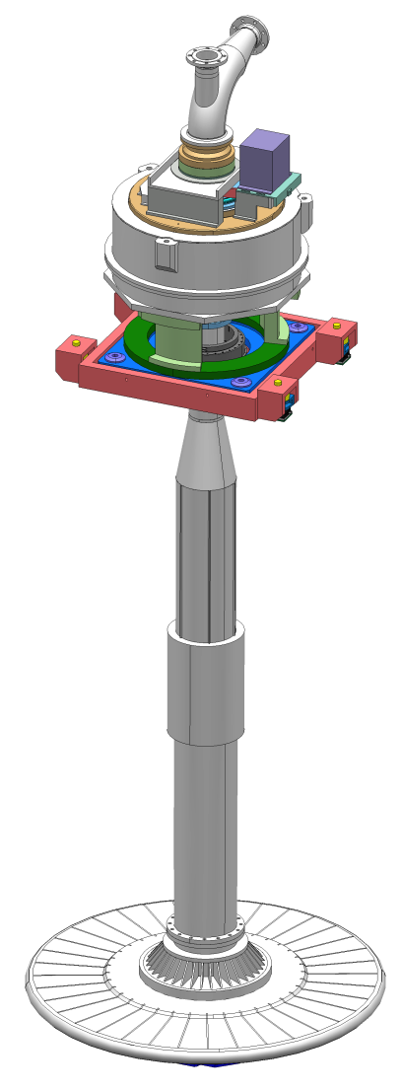
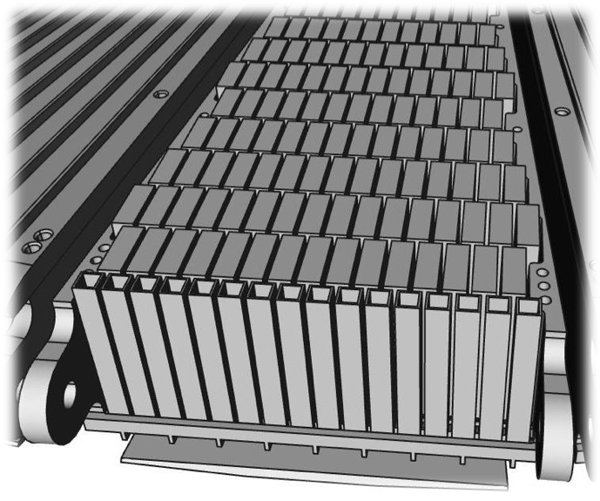
Beam on Target: Beam Entrance Window (BEW)
Peak charge density per pulse at BEW
Parameter | Unit | Value
Raster deflection, horizontal | mm | 60.0
Raster deflection, vertical | mm | 20.0
Beamlet RMS, horizontal | mm | 13.5
Beamlet RMS, vertical | mm | 5.05
Peak current density (Rastered) | mA/cm² | 1.16
Peak current density (Unrastered) | mA/cm² | 14.6
Peak charge density per pulse (Rastered) | µC/cm² | 3.3
Peak charge density per pulse (Unrastered) | µC/cm² | 41.7
Reference peak charge density per pulse at HiRadMat
Parameter | Reference RMS | Unit | Value
Peak charge density per pulse | 0.5 mm | µC/cm² | 352.5
 | 2.0 mm | µC/cm² | 22.0

Slide 8
Potential HiRadMat Application:
Raster Failure Study
The BEW and PBW shall not lose its mechanical properties during a full pulse in case of a total failure of beam raster.
Pressure vessel design codes in general recommend:
  SA SS-316L: Precipitation of chromium-rich carbides at grain boundaries at above 550 ºC.
  Al6061-T6: Thermal aging becomes an issue at the temperatures above 250 ºC
Component | Max. temperature operation | Temperature limit during pulse | Max. dE/dz [MeV/cm] | Min. allowed RMSx * RMSy
BEW | 160 ºC | 550 ºC (?) | 18.5 | 33.5 mm² (?)
PBW | 60 ºC | 250 ºC (?) | 5.3 | 32.6 mm² (?)
The materials property change for short beam impulse is not within the scope of design codes.
HiRadMat could be used to identify the minimum allowed RMS size of unrastered beam, considering that high temperature is reached only for several milliseconds.

Slide 9
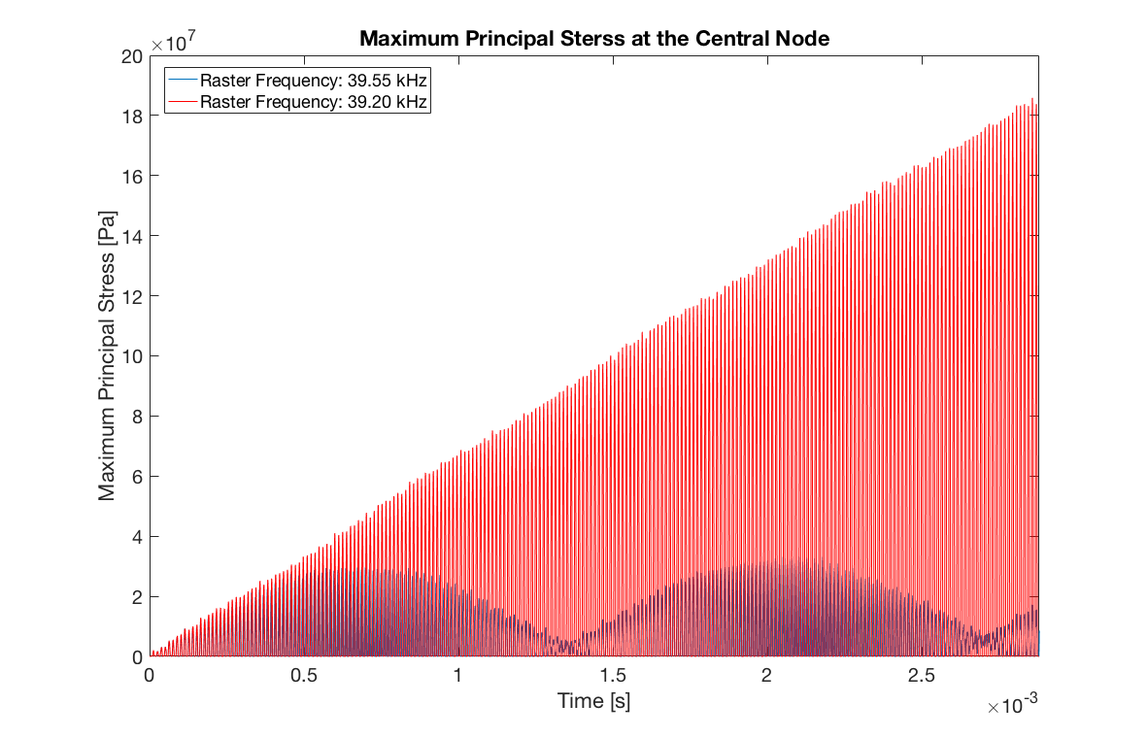
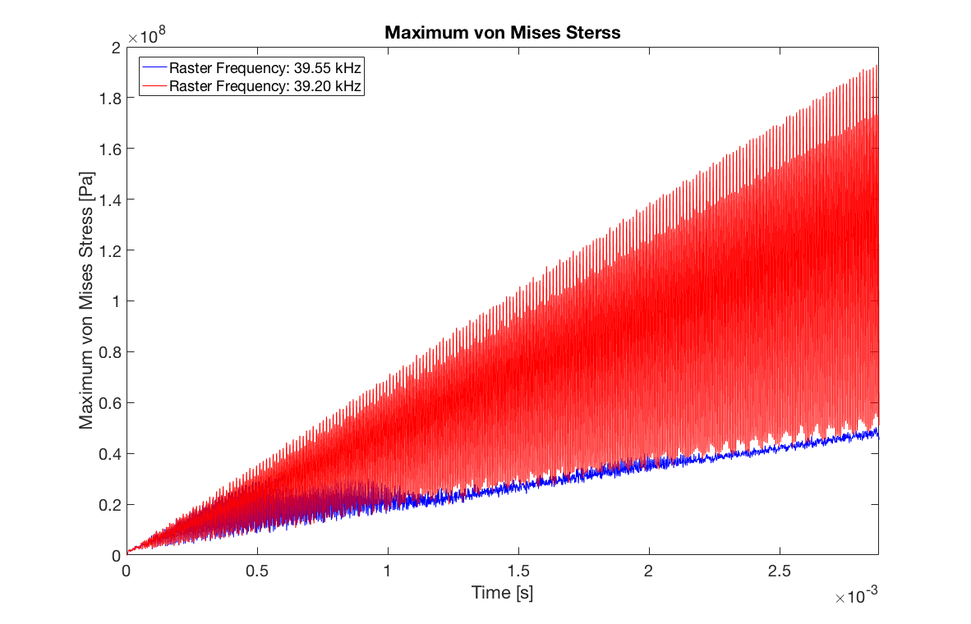
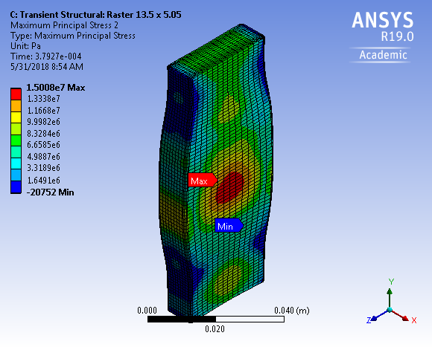
Potential HiRadMat Application:
Study of Dynamic Stress Wave in Tungsten
High frequency beam raster induces short pulse effect on individual tungsten brick
Resonance mode identified at 41.2 kHz which is only 4% off from the horizontal raster frequency (39.55 kHz)
The dynamics of rastered beam with a short pulse character could be studied at HiRadMat

Slide 10
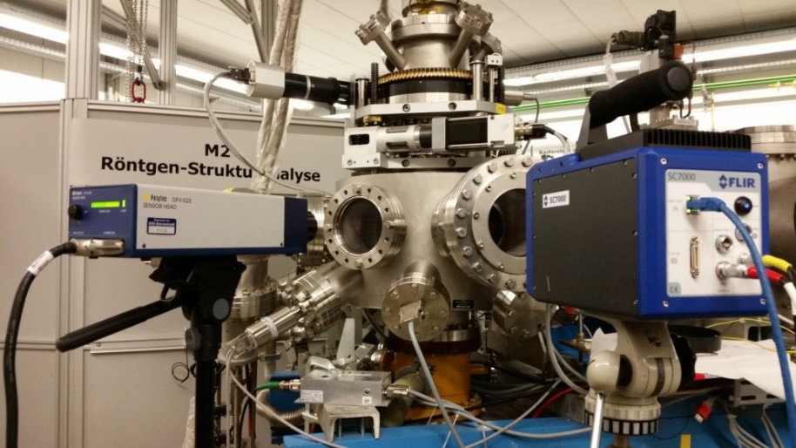
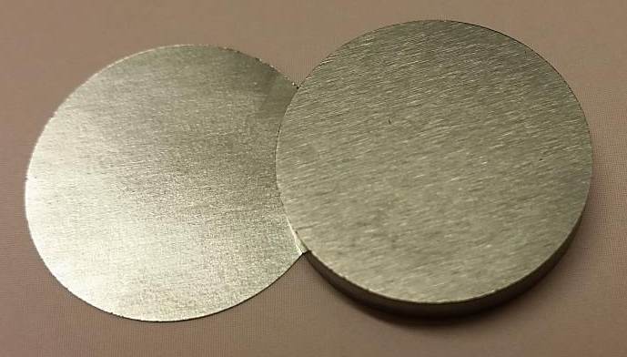
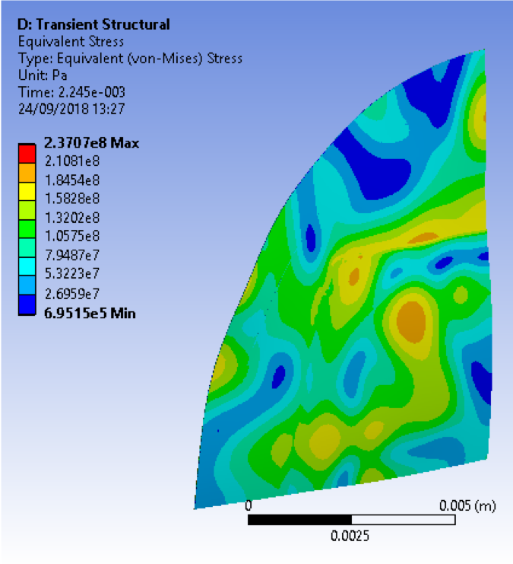
Potential HiRadMat Application
In Beam Fatigue Tests
Uranium beam irradiation at M3-beamline of GSI-UNILAC on tungsten coins
  Beam energy: 4.8 MeV/u
  Ion flux: Max. 1e10 ions/cm²/pulse
  Pulse length: 100 us
  Repetition rate: 1 Hz
Beam pulse created stress waves with lose boundary fixture
  Virtual ~100 fatigue cycles per pulse, with a stress amplitude of 50 MPa
  The maximum design stress amplitude of tungsten brick in ESS target is 50 MPa
HiRadMat could simulate in situ fatigue loads by smartly design a target
  Progressive radiation damage in W: 10⁻⁵ – 10⁻⁴ dpa/Pulse

Slide 11
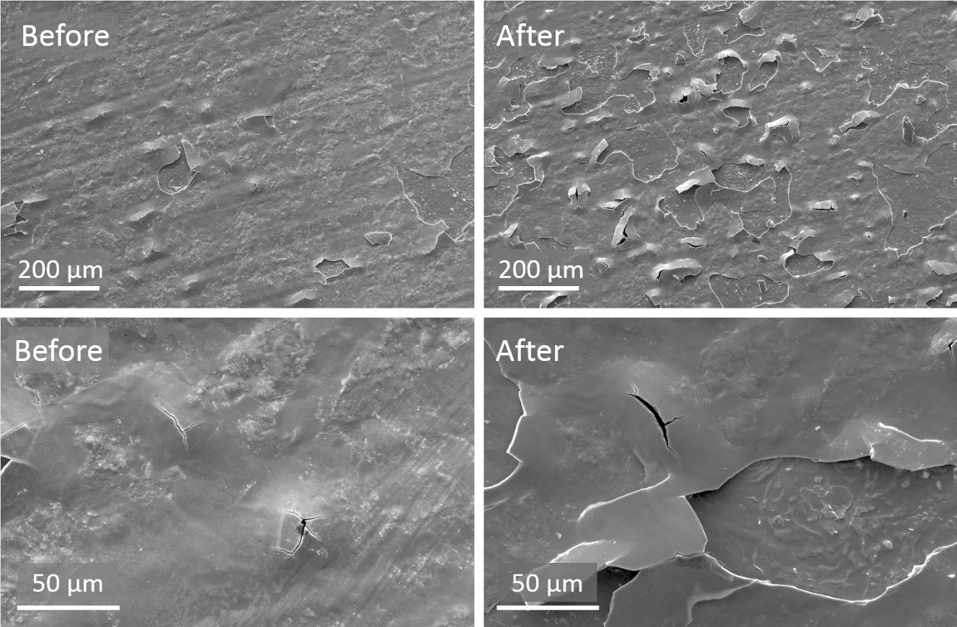
Potential HiRadMat Application
Tungsten Coating Characterisation
During operation, oxidation of unprotected tungsten surface could cause problems of corrosion and erosion
  Study on corrosion resistant coating of tungsten could be in need
As tungsten becomes brittle with increasing radiation damage, beam induced thermal stress could induce surface cracks and disintegration in tungsten
  Study on coating solutions which provide ductile surface layer on tungsten could be in need
HiRadMat could be applied to create volumetric stress impulse to study the adhesion of coating layer during beam pulse

Slide 12
Potential HiRadMat Application
Study of elemental ejection of radioactive isotopes
There are two physical mechanisms by which spallation products can reach the helium.
  Direct ejection from the tungsten of the recoiling nucleus at the end of the spallation reaction that created it.
  Spallation products can be released is via diffusion of the trace element atoms through the tungsten matrix.
Calculations show that release fractions for the great majority of elements are based solely on the ejection fraction (E. Pitcher).
HiRadMat could be used to study the mechanism of spallation products release induced by beam driven direct ejection.

Slide 13

Potential HiRadMat Application
Study of Muon Radiography of Target Internal Structure
Muon Radiography:
  A potential way to monitor the soundness of tungsten bricks inside the target wheel
  HiRadMat could be used to study muon radiography using secondary muons.

Slide 14
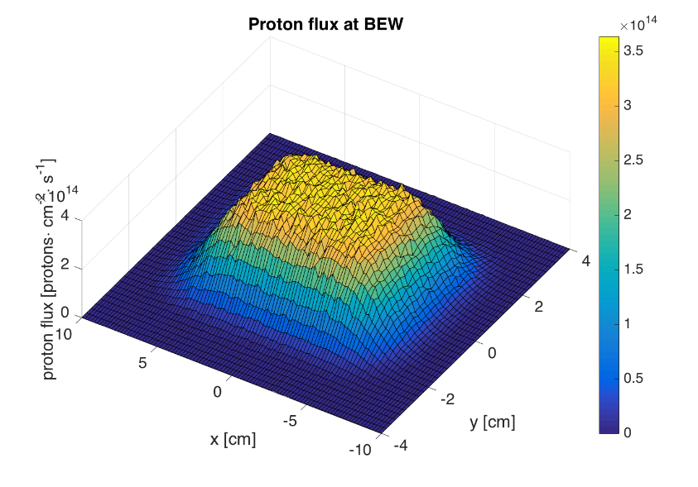
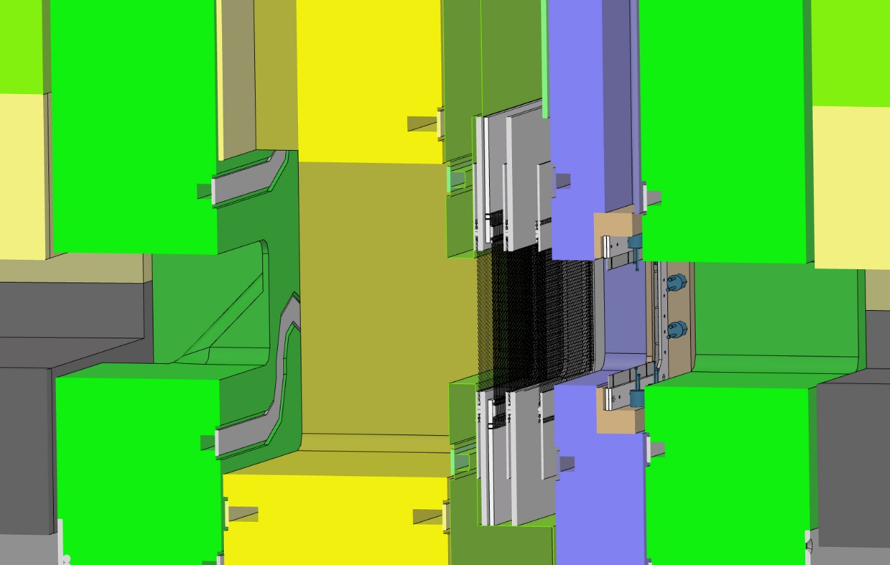
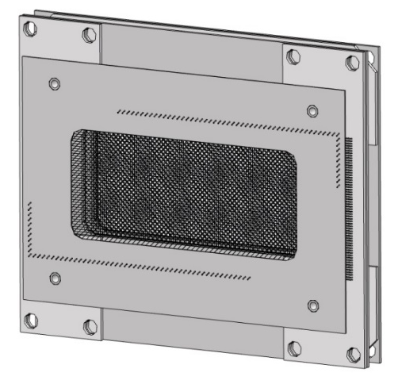
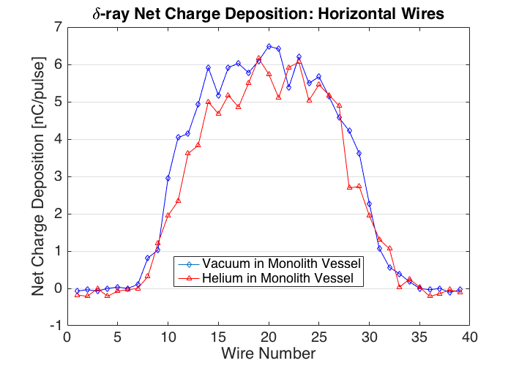
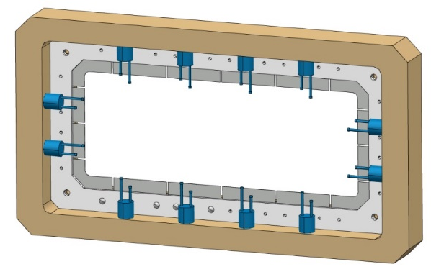
Potential HiRadMat Application
Characterisation of beam monitoring devices
Elena Donegani (ESS), “Challenges for the beam instrumentation of the ESS target and the role of the HiRadMat facility”, Remote Sensing & Beam Instrumentation (10:50 MON)
14

Slide 15
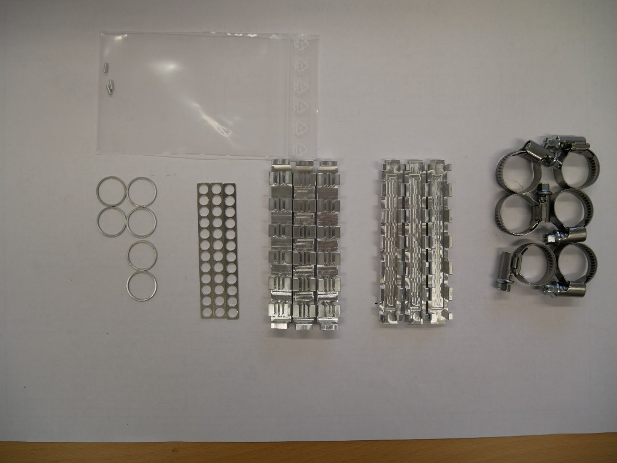
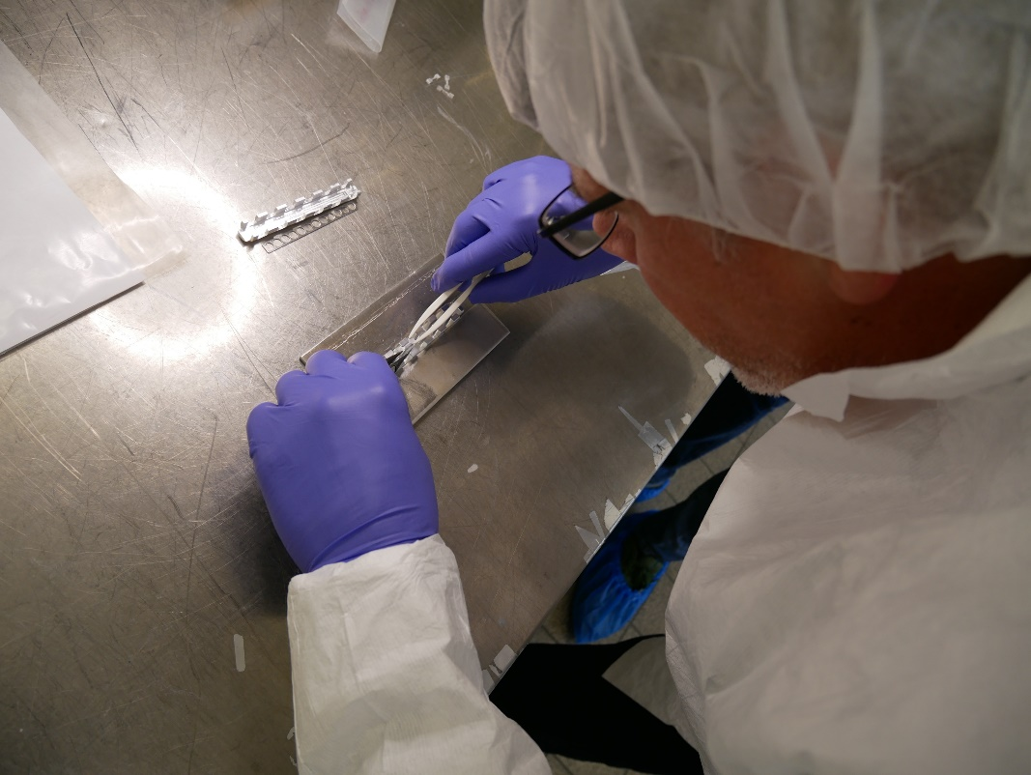
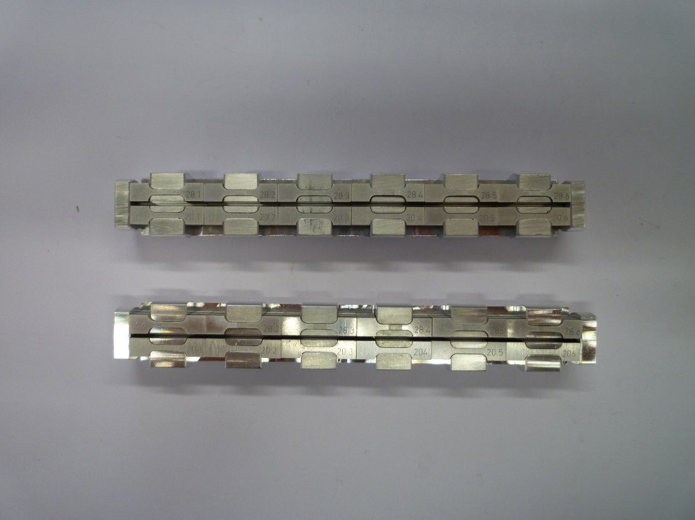
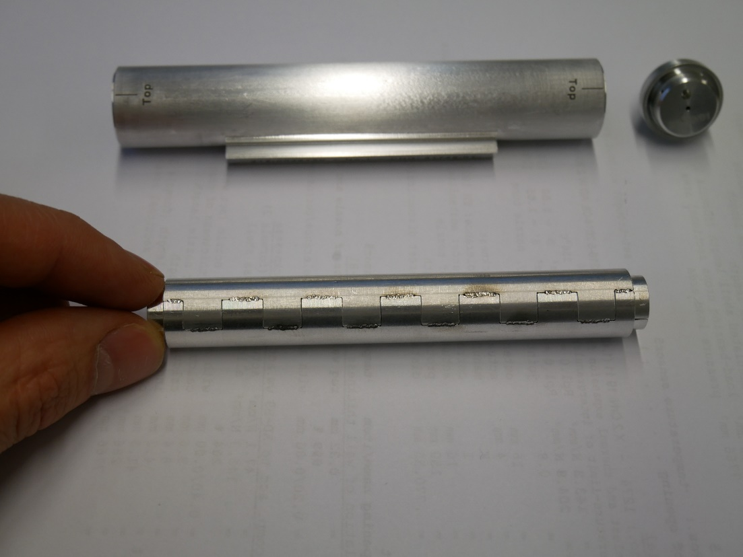
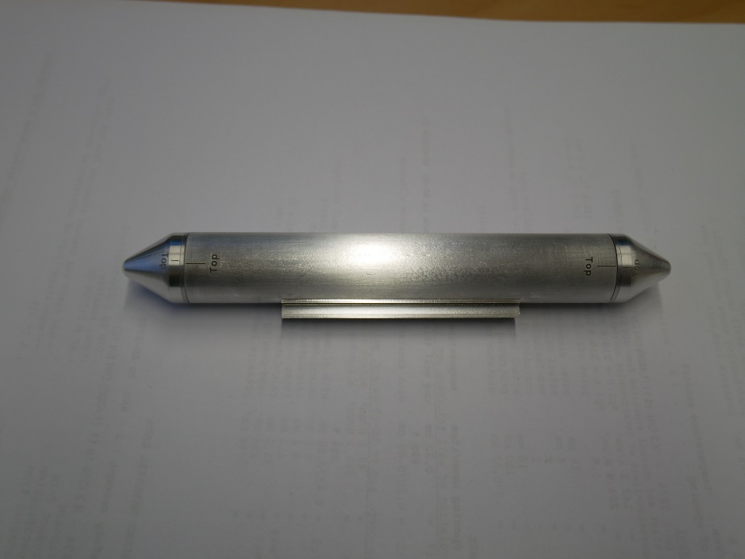
Proposals for Future HiRadMat Facility
Capability of handling and testing pre-irradiated material
Irradiation Module for Spallation and Fusion Materials Study

Slide 16
Summary
Potential research area using HiRadMat for beam intercepting devices at ESS :
  Beam raster failure and its structural impact on beam intercepting devices
  Study of dynamic stress wave in beam intercepting devices
  In beam fatigue tests of materials with mild and extensive radiation damages
  Development of coating for beam intercepting devices
  Study of elemental ejection of radioactive isotopes from BIDs
  Study of muon/gamma radiography of target internal structure
  Characterisation of beam monitoring devices
  ...
As ESS gradually moves into initial operation, proposals for research projects utilising HiRadMat facility will be consolidated.
It would be desirable if pre-irradiated materials to a high dose could be handled and tested at future HiRadMat facility.

Slide 17

Thank you for your attention
Any Suggestions and Advices?

